Slide 1



Slide 2

EXODUS STRUCTURE/OUTLINE
Redemption (1–18)
  Redemption (1:1–12:30)
  Liberation (12:31–15:21)
  Preservation (15:22–18:27)
Mosaic Covenant (19–40)
  Law (19–24)
  Tabernacle instructions (25–31)
  Apostasy (32–34)
  Tabernacle building (35–40)

Slide 3
REDEMPTION
(1:1–12:30)
Why redemption is necessary (Exod 1)
Development of the deliverer (Exod 2–4)
First confrontation with Pharaoh (Exod 5)
God reassures Moses (Exod 6:1–7:7)
Second confrontation with Pharaoh (Exod 7:8-13)
Plagues (Exod 7:14–12:30)

Slide 4
The Plagues of Egypt
NO. | DESCRIPTION | SCRIPTURE | Egyptian Deity
1. | Water to Blood | Exod. 7:14-25 | Hapi, Khnum
2. | Frogs | Exod. 8:1-15 | Heqt
3. | Gnats | Exod. 8:16-19 | Set
4. | Flies | Exod. 8:20-32 | Uatchit
5. | Disease on Cattle | Exod. 9:1-7 | Hathor, Apis
6. | Boils | Exod. 9:8-12 | Sekhmet, Serapis
7. | Hail | Exod. 9:13-35 | Seth, Nut
8. | Locusts | Exod. 10:1-20 | Seth, Nut, Osiris
9. | Darkness | Exod. 10:21-29 | Re, Horus, Atum
10. | Death of the First Born | Exod. 12:29-36 | Min, Osiris, Heqt, Isis

Slide 5
TEN PLAGUES REDEMPTION (7:14–12:30)
Nile to blood
Frogs
Gnats
Flies
Death of livestock
Boils
Hail
Locusts
Darkness
Death of 1st born

Slide 6
DEATH OF FIRST BORN
Exodus 12:1-51
  God’s instructions to Moses (1-20)
  Moses instructions to Israel (21-28)
  Death of the 1st born (29-32)
  Exodus from Egypt (33-42)
  Passover instituted (43-51)

Slide 7
III. Exodus 12:429-32
Death of 1st Born
    Comprehensive judgment (29)
    Emotional response (30)
    Command to leave (31-32)

Slide 8
III. Exodus 12:429-32
Death of 1st Born
    Comprehensive judgment (29)
    Emotional response (30)
    Command to leave (31-32)

Slide 9
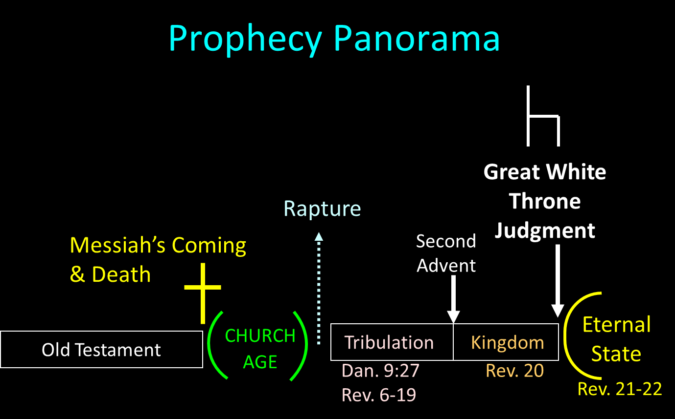

Slide 10
Scripture’s Four Judgments
NAME | SHEEP AND GOAT | JUDGMENT OF THE JEWS | BEMA SEAT | GREAT WHITE THRONE
SCRIPTURE | Matt 25:31-46 | Ezek 20:33-44 | 1 Cor 3:10-15 | Rev 20:11-15
PLACE | Earth, Jerusalem | Earth, wilderness | Heaven | Earth
AUDIENCE | Gentile Tribulation survivors | Jewish Tribulation survivors | Church Age believers | All unsaved
WHEN | After Tribulation | After Tribulation | After rapture | After Millennium
PURPOSE | Saved Gentiles enter kingdom | Saved Jews enter kingdom | Reward believers | Degree of punishment in hell
EVALUATION | Treatment of Christ’s brethren | Passing under shepherd’s rod | Works taken through fire | Not in the book; judged by books

Slide 11
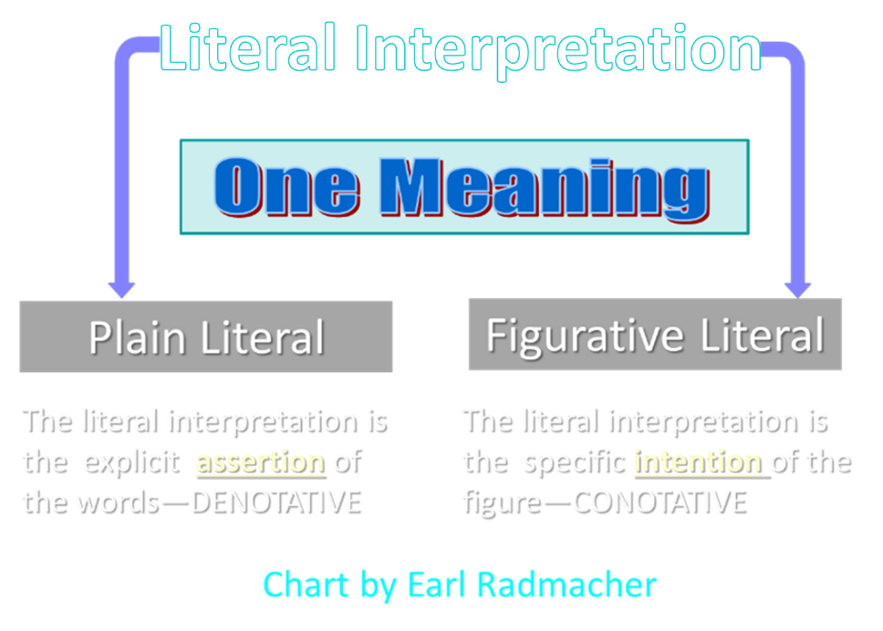

Slide 12
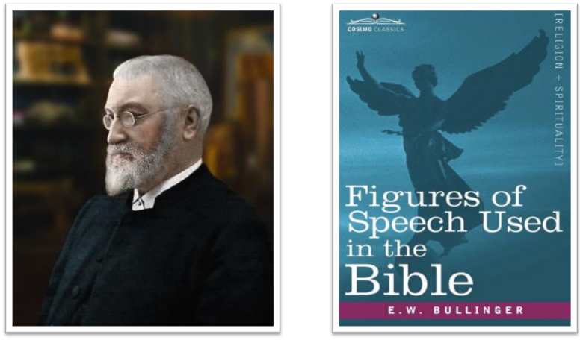
E.W. Bullinger (1837‒1913)

Slide 13
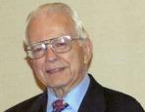

Dr. Roy B. Zuck
Basic Bible Interpretation, p. 151.
“Merism. A merism is a form of synecdoche in which the totality or whole is substituted by two contrasting or opposite parts. When the psalmist wrote, ‘You know when I sit and when I rise’ (Ps. 139:2), he was not limiting the Lord’s knowledge to times when he sat down and when he got up. Instead he was saying the Lord knew all his actions.”

Slide 14
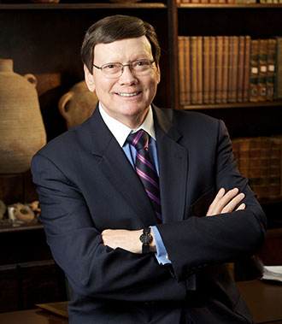
Dr. Ed Hindson
Hindson, E. E., & Mitchell, D. R., eds. (2010). KJV Bible Commentary for Today: The Most Up-to-Date Commentary on the Time-Honored Text of the KJV (p. 101). Thomas Nelson.
“12:29. Those holding to the miraculous intensification of natural events theory of the plagues cannot in any fashion explain the origin of a virus intelligent enough to select only firstborn males. The hand of the Lord is the only satisfactory explanation for this disaster. His promised judgment (4:23) had been rendered.”

Slide 15

PLAGUES’ MIRACULOUS NATURE
Moses knew about them beforehand (8:10; 9:5, 29)
Instantaneous appearance and termination
Description as “signs and wonders” (7:3)
Intensification
Timing
Accomplishment of a moral purpose (11:1)
Response they invoked from the Egyptian sorcerers (7:22; 8:18-19)
Last seven plagues did not effect the Jews living in Goshen (9:6)
Nile into blood affected all rivers, streams, pools, reservoirs, and vessels holding waters
Hill and Walton, A Survey of the Old Testament, 114-15

Slide 16
DATE OF THE EXODUS
1446 b.c.
  Oppression – Thutmose III
  Exodus – Amenhotep II
  Post – Exodus – Thutmose IV

Slide 17

Charles Ryrie
Ryrie Study Bible, page 109
Exodus 12:29 “the firstborn of Pharaoh. We know Thutmose IV succeeded Amenhotep II, the Pharaoh of the Exodus, but Thutmose IV was not his firstborn.”

Slide 18
III. Exodus 12:429-32
Death of 1st Born
    Comprehensive judgment (29)
    Emotional response (30)
    Command to leave (31-32)

Slide 19
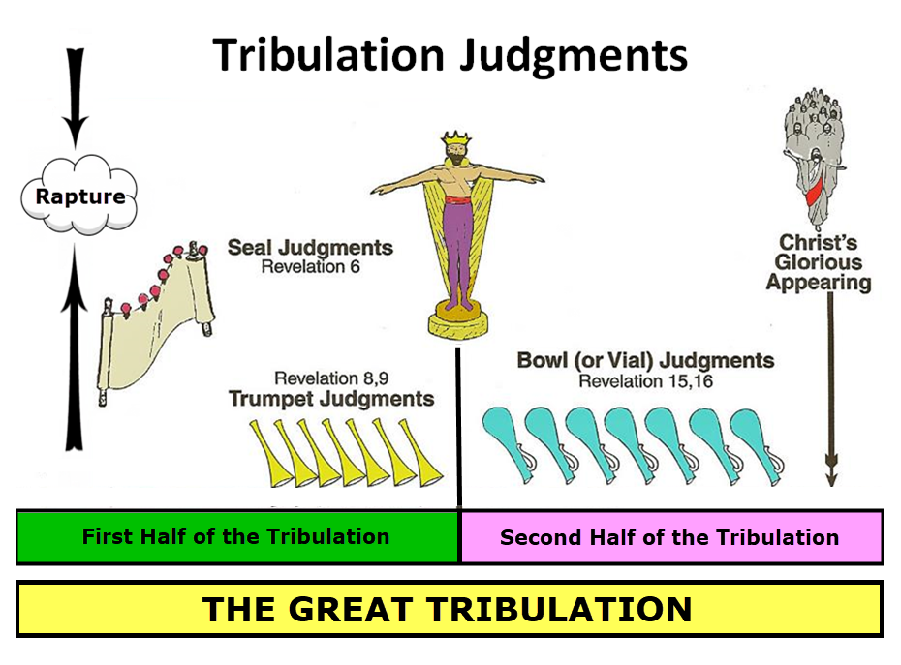

Slide 20
1st Six Seals (Revelation 6)
6:1-2 – Advent of antichrist
6:3-4 – War
6:5-6 – Famine
6:7-8 – Death
6:9-11 – Martyrdoms
6:12-17 – Cosmic disturbances

Slide 21


Revelation 6:16-17
^{“16} and they said to the mountains and the rocks, ‘Fall on us and hide us from the sight of Him who sits on the throne, and from the wrath [orgḗ] of the Lamb; ¹⁷ for the great day of Their wrath [orgḗ] has come, and who is able to stand?’”

Slide 22


Slide 23


John 13:19; 14:29
“¹⁹ From now on I am telling you before it comes to pass, so that when it does occur, you may believe that I am He… ^{14:29} Now I have told you before it happens, so that when it happens, you may believe.”

Slide 24

1 Thessalonians 4:13-18
. . . those who have fallen asleep. ¹⁶ For the Lord Himself descend from heaven with a shout, with the voice of the archangel and with the trumpet of God, and the dead in Christ will rise first. ¹⁷ Then we who are alive and remain will be caught up together with them in the clouds to meet the Lord in the air, and so we shall always be with the Lord. ¹⁸ Therefore comfort one another with these words."

Slide 25
1 Thessalonians 4:13-18
¹³ "But we do not want you to be uninformed, brethren, about those who are asleep, so that you will not grieve as do the rest who have no hope. ¹⁴ For if we believe that Jesus died and rose again, even so God will bring with Him those who have fallen asleep in Jesus. ¹⁵ For this we say to you by the word of the Lord, that we who are alive and remain until the coming of the Lord, will not precede. . .

Slide 26
III. Exodus 12:429-32
Death of 1st Born
    Comprehensive judgment (29)
    Emotional response (30)
    Command to leave (31-32)

Slide 27
Exodus 12:31-32
Command to Leave
      People (31)
      Flocks (32)

Slide 28
Exodus 12:31-32
Command to Leave
      People (31)
      Flocks (32)

Slide 29
Charles Ryrie
Ryrie Study Bible, page 109
Exodus 12:31 “Though Pharaoh manufactured rationalizations for the other plagues, he could not reason away the trauma of the death of his own son. He called for Moses and Aaron that night and gave them permission to go, this time without insisting on any concessions.”

Slide 30

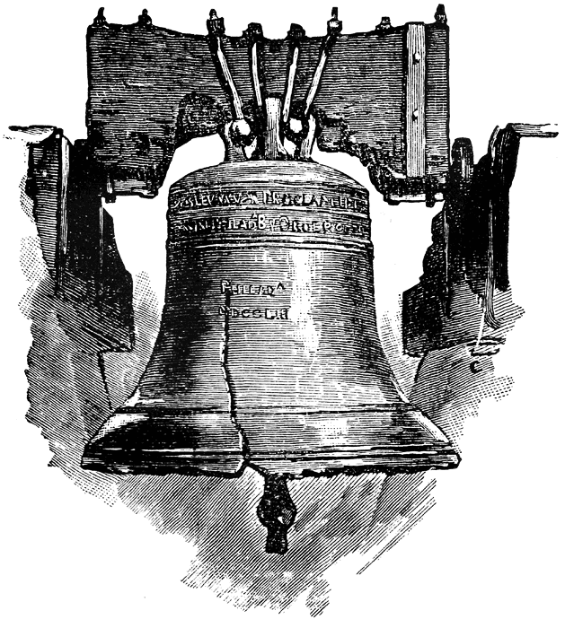
Leviticus 25:10
“And you shall consecrate the fiftieth year, and proclaim liberty throughout [all] the land to all its inhabitants. It shall be a Jubilee for you; and each of you shall return to his possession, and each of you shall return to his family.”

Slide 31
Exodus 12:31-32
Command to Leave
      People (31)
      Flocks (32)

Slide 32
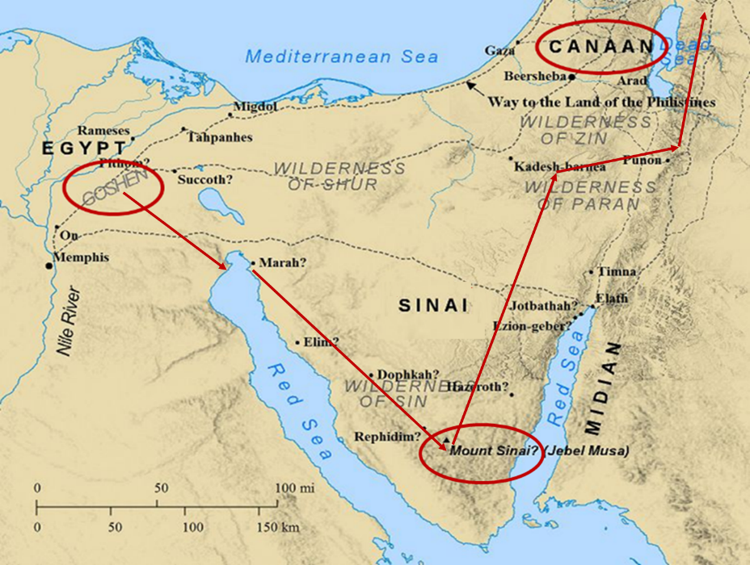

Slide 33
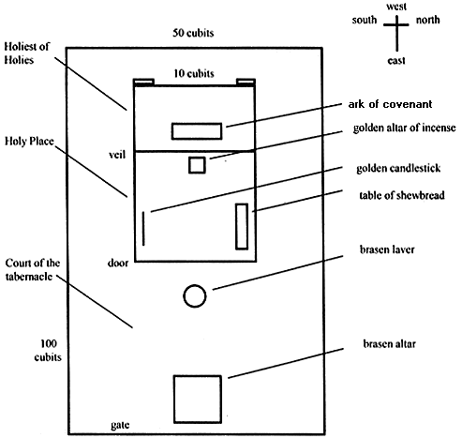
Tabernacle Diagram

Slide 34
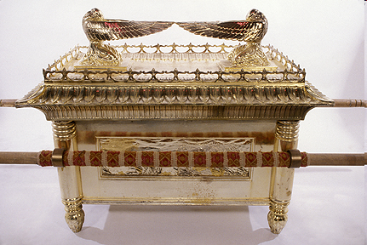
Ark of the Covenant

Slide 35
The Plagues of Egypt
NO. | DESCRIPTION | SCRIPTURE | Egyptian Deity
1. | Water to Blood | Exod. 7:14-25 | Hapi, Khnum
2. | Frogs | Exod. 8:1-15 | Heqt
3. | Gnats | Exod. 8:16-19 | Set
4. | Flies | Exod. 8:20-32 | Uatchit
5. | Disease on Cattle | Exod. 9:1-7 | Hathor, Apis
6. | Boils | Exod. 9:8-12 | Sekhmet, Serapis
7. | Hail | Exod. 9:13-35 | Seth, Nut
8. | Locusts | Exod. 10:1-20 | Seth, Nut, Osiris
9. | Darkness | Exod. 10:21-29 | Re, Horus, Atum
10. | Death of the First Born | Exod. 12:29-36 | Min, Osiris, Heqt, Isis

Slide 36
DEATH OF FIRST BORN
Exodus 12:1-51
  God’s instructions to Moses (1-20)
  Moses instructions to Israel (21-28)
  Death of the 1st born (29-32)
  Exodus from Egypt (33-42)
  Passover instituted (43-51)

Slide 37
IV. Exodus 12:33-42
Exodus from Egypt
    Urgency (33)
    Unleavened dough taken (34)
    Egyptians plundered (35-36)
    Direction (37a)
    Number (37b)
    Mixed multitude (38)
    Unleavened bread baked (39)
    Duration of bondage (40-41)
    Ritual established (42)

Slide 38
IV. Exodus 12:33-42
Exodus from Egypt
    Urgency (33)
    Unleavened dough taken (34)
    Egyptians plundered (35-36)
    Direction (37a)
    Number (37b)
    Mixed multitude (38)
    Unleavened bread baked (39)
    Duration of bondage (40-41)
    Ritual established (42)

Slide 39
IV. Exodus 12:33-42
Exodus from Egypt
    Urgency (33)
    Unleavened dough taken (34)
    Egyptians plundered (35-36)
    Direction (37a)
    Number (37b)
    Mixed multitude (38)
    Unleavened bread baked (39)
    Duration of bondage (40-41)
    Ritual established (42)

Slide 40
Dr. Ed Hindson
Hindson, E. E., & Mitchell, D. R., eds. (2010). KJV Bible Commentary for Today: The Most Up-to-Date Commentary on the Time-Honored Text of the KJV (p. 101). Thomas Nelson.
“12:34. …in the Hebrews’ haste to leave (on what was the first day of the seven-day festival), they grabbed the only food that was on hand: their as yet unleavened bread dough. They formed the dough into cakes and hoisted the pans onto their shoulders. The sun then baked the cakes into matzos, unleavened bread.”

Slide 41
IV. Exodus 12:33-42
Exodus from Egypt
    Urgency (33)
    Unleavened dough taken (34)
    Egyptians plundered (35-36)
    Direction (37a)
    Number (37b)
    Mixed multitude (38)
    Unleavened bread baked (39)
    Duration of bondage (40-41)
    Ritual established (42)

Slide 42
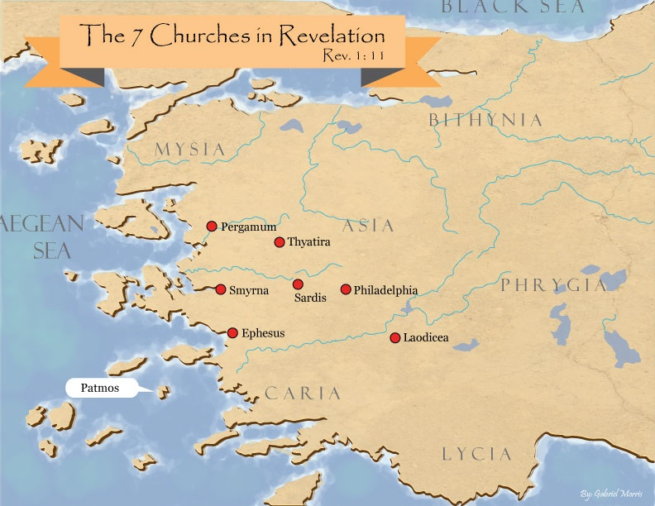
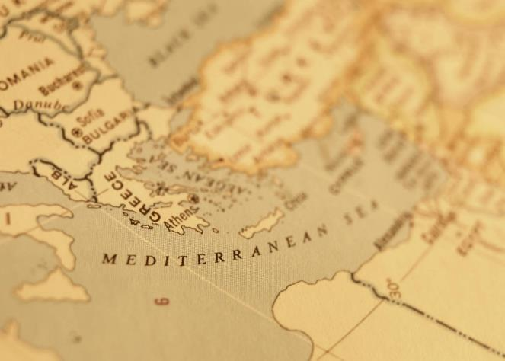

Slide 43

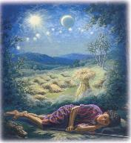
Genesis 37:9
“Now he had still another dream, and related it to his brothers, and said, ‘Lo, I have had still another dream; and behold, the sun and the moon and eleven stars were bowing down to me.’”

Slide 44
Genesis 37:10
“He related it to his father and to his brothers; and his father rebuked him and said to him, ‘What is this dream that you have had? Shall I and your mother and your brothers actually come to bow ourselves down before you to the ground?’”

Slide 46
John 13:19; 14:29
“¹⁹ From now on I am telling you before it comes to pass, so that when it does occur, you may believe that I am He… ^{14:29} Now I have told you before it happens, so that when it happens, you may believe.”

Slide 47


Slide 48
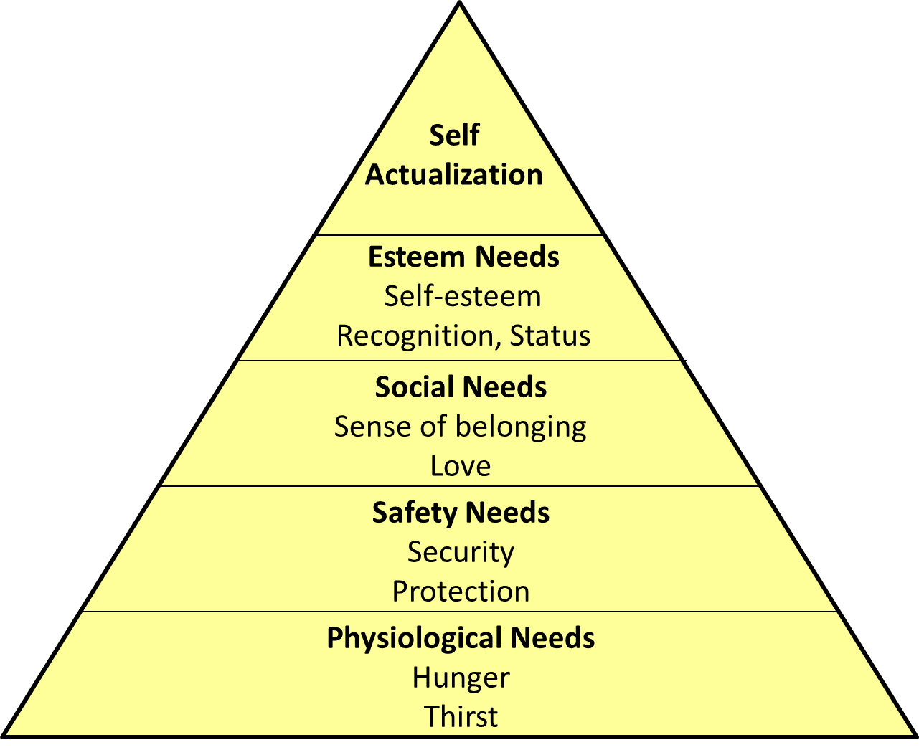
Maslow’s Hierarchy of Needs

Slide 49


2 Timothy 3:16-17
“¹⁶ All Scripture is inspired by God [theopneustos] and profitable for teaching, for reproof, for correction, for training in righteousness; ¹⁷ so that the man of God may be adequate, equipped for every good work.”

Slide 50

2 Peter 1:3-4
“³ Seeing that His divine power has granted to us everything pertaining to life and godliness, through the true knowledge of Him who called us by His own glory and excellence. ⁴For by these He has granted to us His precious and magnificent promises, so that by them you may become partakers of the divine nature, having escaped the corruption that is in the world by lust.”

Slide 51
1 Peter 2:2
“like newborn babies, long for the pure [adolos] milk of the word, so that by it you may grow in respect to salvation, ³ if you have tasted the kindness of the Lord.”

Slide 52

Chafer Theological Seminary Distinctives:
sufficiency of the scriptures
"We believe in the complete adequacy of Scripture, for in it God has given us all things that pertain to life and godliness. We hold, therefore, that the Word of God by itself is sufficient to prepare a person for a lifetime of effective ministry.”
https://www.chafer.edu/distinctives

Slide 53
IV. Exodus 12:33-42
Exodus from Egypt
    Urgency (33)
    Unleavened dough taken (34)
    Egyptians plundered (35-36)
    Direction (37a)
    Number (37b)
    Mixed multitude (38)
    Unleavened bread baked (39)
    Duration of bondage (40-41)
    Ritual established (42)

Slide 55
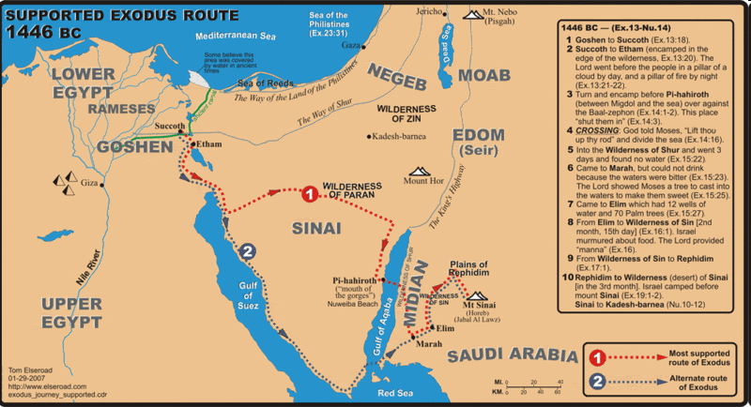

Slide 56
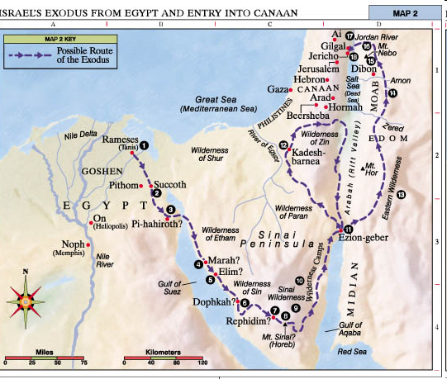

Slide 57
IV. Exodus 12:33-42
Exodus from Egypt
    Urgency (33)
    Unleavened dough taken (34)
    Egyptians plundered (35-36)
    Direction (37a)
    Number (37b)
    Mixed multitude (38)
    Unleavened bread baked (39)
    Duration of bondage (40-41)
    Ritual established (42)

Slide 58
Dr. Ed Hindson
Hindson, E. E., & Mitchell, D. R., eds. (2010). KJV Bible Commentary for Today: The Most Up-to-Date Commentary on the Time-Honored Text of the KJV (p. 101). Thomas Nelson.
“12:37. Six hundred thousand … men. This is a round figure; the total number of men aged twenty and older was 603,550 (38:26). Extrapolating from that number, assuming one wife and two children per man, one arrives at an exodus population of roughly two million people. Objections have been commonly raised over the possibility of such an extraordinary population. While enormous energy and scholarly creativity has gone into the development of alternative theories to explain why the population numbers should not be taken at their face value, none has proven definitively convincing.”

Slide 59
IV. Exodus 12:33-42
Exodus from Egypt
    Urgency (33)
    Unleavened dough taken (34)
    Egyptians plundered (35-36)
    Direction (37a)
    Number (37b)
    Mixed multitude (38)
    Unleavened bread baked (39)
    Duration of bondage (40-41)
    Ritual established (42)

Slide 60
Dr. Ed Hindson
Hindson, E. E., & Mitchell, D. R., eds. (2010). KJV Bible Commentary for Today: The Most Up-to-Date Commentary on the Time-Honored Text of the KJV (p. 101). Thomas Nelson.
“12:38. A mixed multitude went with them. These were likely other, non-Hebrew, slaves and perhaps a few God-fearing Egyptians. This Gentile group would stir up trouble in the camp during the wilderness journey (Num. 11:4).”

Slide 61
IV. Exodus 12:33-42
Exodus from Egypt
    Urgency (33)
    Unleavened dough taken (34)
    Egyptians plundered (35-36)
    Direction (37a)
    Number (37b)
    Mixed multitude (38)
    Unleavened bread baked (39)
    Duration of bondage (40-41)
    Ritual established (42)

Slide 62
IV. Exodus 12:33-42
Exodus from Egypt
    Urgency (33)
    Unleavened dough taken (34)
    Egyptians plundered (35-36)
    Direction (37a)
    Number (37b)
    Mixed multitude (38)
    Unleavened bread baked (39)
    Duration of bondage (40-41)
    Ritual established (42)

Slide 63

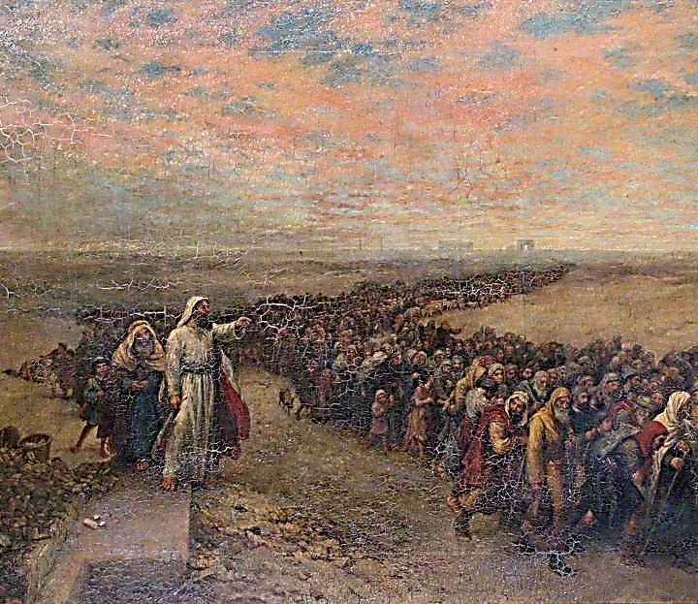
Exodus 12:40-41
“⁴⁰ Now the time that the sons of Israel lived in Egypt was four hundred and thirty years. ⁴¹ And at the end of four hundred and thirty years, to the very day, all the hosts of the Lord went out from the land of Egypt.”

Slide 64
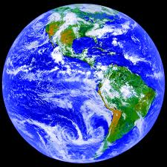
AGE OF THE EARTH?
971-931 BC=Solomonic reign
966=Solomon rebuilds temple (1 Kgs 6:1b)
- 480 years for the Exodus’ date (1 Kgs 6:1a)
= 1446 BC for Exodus’ date
- 430 years for Jacob’s migration to Egypt (Exod 12:40)
= 1876 BC for Jacob’s migration to Egypt (Gen 46)
Genealogies of Gen 5; 11
= 4000 BC for the earth’s age

Slide 65
AGE OF THE EARTH?
971-931 BC=Solomonic reign
966=Solomon rebuilds temple (1 Kgs 6:1b)
- 480 years for the Exodus’ date (1 Kgs 6:1a)
= 1446 BC for Exodus’ date
- 430 years for Jacob’s migration to Egypt (Exod 12:40)
= 1876 BC for Jacob’s migration to Egypt (Gen 46)
Genealogies of Gen 5; 11
= 4000 BC for the earth’s age

Slide 66
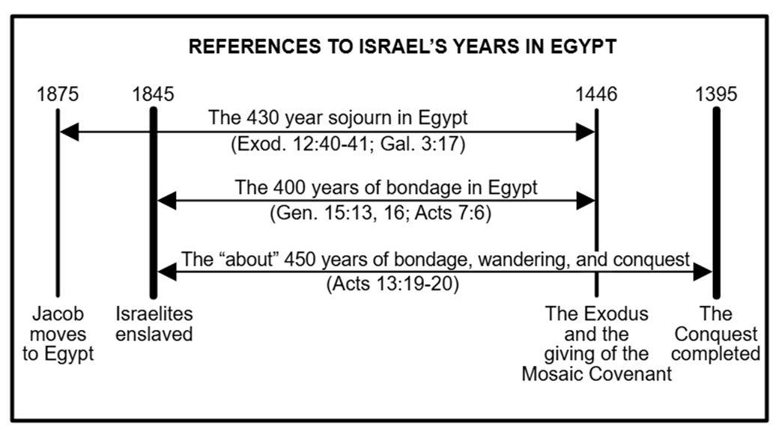

Slide 67
IV. Exodus 12:33-42
Exodus from Egypt
    Urgency (33)
    Unleavened dough taken (34)
    Egyptians plundered (35-36)
    Direction (37a)
    Number (37b)
    Mixed multitude (38)
    Unleavened bread baked (39)
    Duration of bondage (40-41)
    Ritual established (42)

Slide 69
John 13:19; 14:29
“¹⁹ From now on I am telling you before it comes to pass, so that when it does occur, you may believe that I am He… ^{14:29} Now I have told you before it happens, so that when it happens, you may believe.”

Slide 70
DEATH OF FIRST BORN
Exodus 12:1-51
  God’s instructions to Moses (1-20)
  Moses instructions to Israel (21-28)
  Death of the 1st born (29-32)
  Exodus from Egypt (33-42)
  Passover instituted (43-51)

Slide 71
V. Exodus 112:43-51
Passover Instituted
    Foreigners excluded (43-45)
    Lamb’s bones unbroken (46)
    Foreigner circumcision (47-49)
    Israel’s obedience (50)
    Exodus date (51)

Slide 72
V. Exodus 112:43-51
Passover Instituted
    Foreigners excluded (43-45)
    Lamb’s bones unbroken (46)
    Foreigner circumcision (47-49)
    Israel’s obedience (50)
    Exodus date (51)

Slide 73
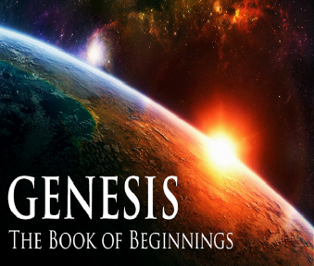
Genesis 12‒25
Abraham’s Early Journeys
Unconditional promises (Gen. 12:1-3) From Haran to Canaan (Gen. 12:4-5) In Canaan (Gen. 12:6-9) In Egypt (Gen. 12:10-20) Abram and Lot Separate (Gen. 13:1-13) Reaffirmation of Abram’s promises (Gen. 13:14-18) Abram Rescues Lot (14:1-24) Abrahamic Covenant (15:1-21) Hagar & Ishmael (16:1-16) Circumcision (Gen. 17:1-27) | Sodom & Gomorrah (Gen. 18‒19) Abraham & Abimelech (Gen. 20) Isaac’s birth (Gen. 21:1-7) Ishmael’s expulsion (21:8-21) Abraham & Abimelech’s covenant (21:22-34) Abraham sacrifices Isaac (22) Sarah’s death (23) Isaac’s marriage (24) Abraham & Keturah (25:1-6) Abraham’s death (25:7-11)

Slide 74
V. Exodus 112:43-51
Passover Instituted
    Foreigners excluded (43-45)
    Lamb’s bones unbroken (46)
    Foreigner circumcision (47-49)
    Israel’s obedience (50)
    Exodus date (51)

Slide 75

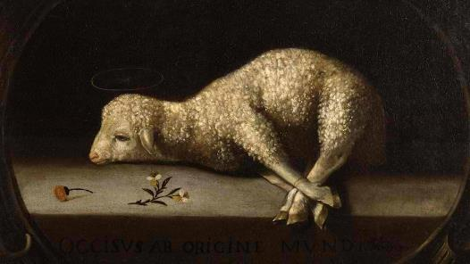
Exodus 12:5, 46
“Your lamb shall be an unblemished male a year old; you may take it from the sheep or from the goats…nor are you to break any bone of it.”

Slide 76
V. Exodus 112:43-51
Passover Instituted
    Foreigners excluded (43-45)
    Lamb’s bones unbroken (46)
    Foreigner circumcision (47-49)
    Israel’s obedience (50)
    Exodus date (51)

Slide 77
Genesis 12‒25
Abraham’s Early Journeys
Unconditional promises (Gen. 12:1-3) From Haran to Canaan (Gen. 12:4-5) In Canaan (Gen. 12:6-9) In Egypt (Gen. 12:10-20) Abram and Lot Separate (Gen. 13:1-13) Reaffirmation of Abram’s promises (Gen. 13:14-18) Abram Rescues Lot (14:1-24) Abrahamic Covenant (15:1-21) Hagar & Ishmael (16:1-16) Circumcision (Gen. 17:1-27) | Sodom & Gomorrah (Gen. 18‒19) Abraham & Abimelech (Gen. 20) Isaac’s birth (Gen. 21:1-7) Ishmael’s expulsion (21:8-21) Abraham & Abimelech’s covenant (21:22-34) Abraham sacrifices Isaac (22) Sarah’s death (23) Isaac’s marriage (24) Abraham & Keturah (25:1-6) Abraham’s death (25:7-11)

Slide 78
V. Exodus 112:43-51
Passover Instituted
    Foreigners excluded (43-45)
    Lamb’s bones unbroken (46)
    Foreigner circumcision (47-49)
    Israel’s obedience (50)
    Exodus date (51)

Slide 79
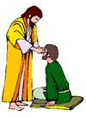
“SEVEN SIGNS” in Gospel of John
1. Changing Water into Wine | 2:11
2. Healing official’s son | 4:46-54
3. Healing an invalid at the Pool of Bethesda | 5:1-18
4. Feeding the 5,000 | 6:5-14
5. Walking on water | 6:16-21
6. Healing a blind man | 9:1-7
7. Raising dead Lazarus | 11:1-45

Slide 80
V. Exodus 112:43-51
Passover Instituted
    Foreigners excluded (43-45)
    Lamb’s bones unbroken (46)
    Foreigner circumcision (47-49)
    Israel’s obedience (50)
    Exodus date (51)

Slide 81

Genesis 15:13;16
¹³ God said to Abram, “Know for certain that your descendants will be strangers in a land that is not theirs, where they will be enslaved and oppressed four hundred years…¹⁶ “Then in the fourth generation they will return here, for the iniquity of the Amorite is not yet complete.”

Slide 82
Conclusion

Slide 83
DEATH OF FIRST BORN
Exodus 12:1-51
  God’s instructions to Moses (1-20)
  Moses instructions to Israel (21-28)
  Death of the 1st born (29-32)
  Exodus from Egypt (33-42)
  Passover instituted (43-51)

Slide 84
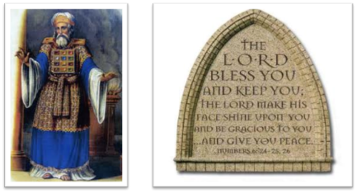
²⁴ The Lord bless you, and keep you; ²⁵ The Lord make His face shine on you, And be gracious to you; ²⁶ The Lord lift up His countenance on you, And give you peace.
Numbers 6:24–26 (NASB95)

