Slide 1
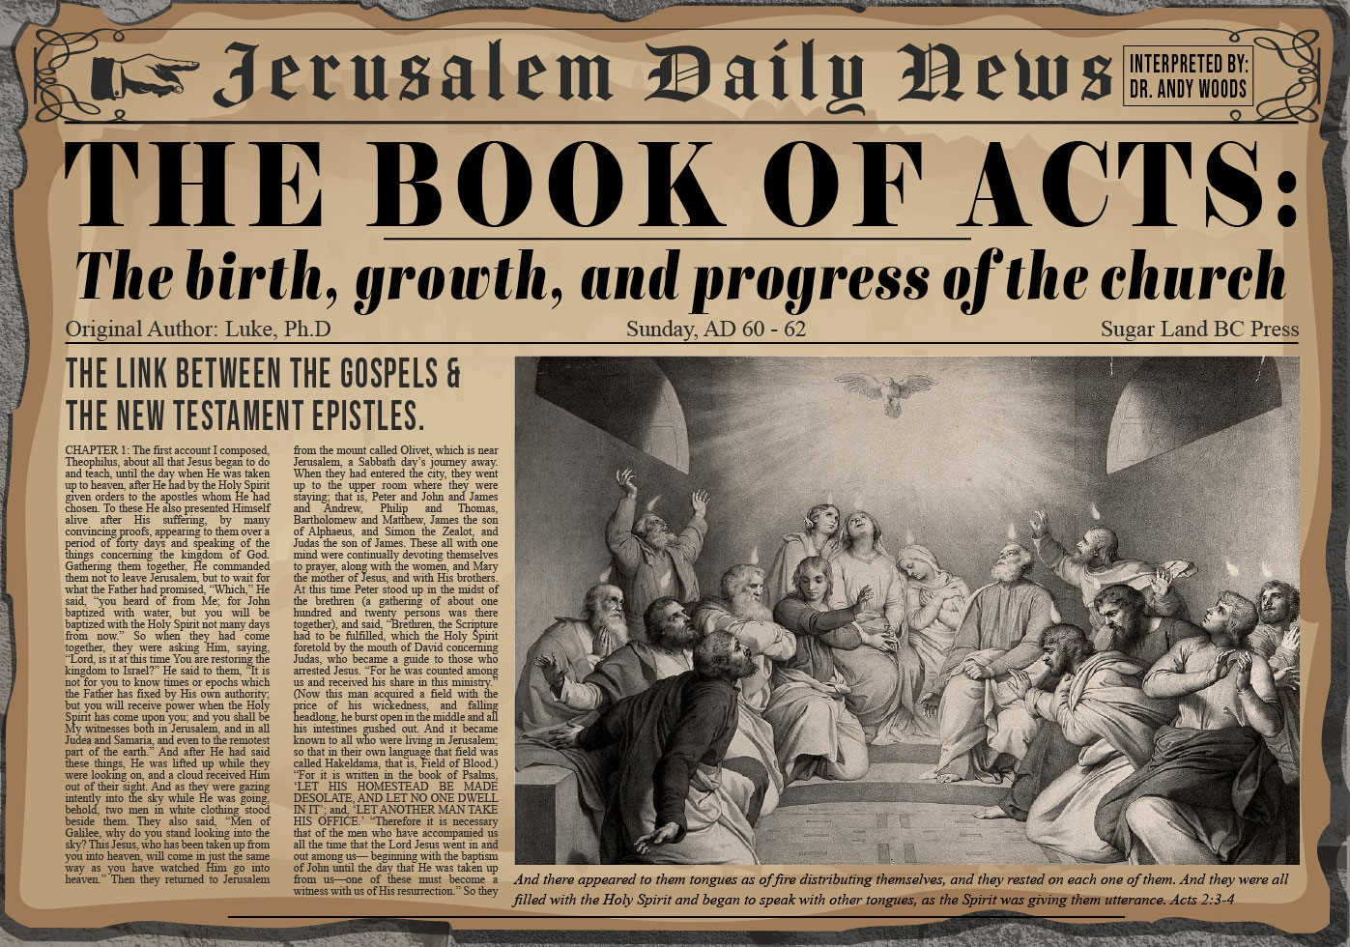


Slide 2
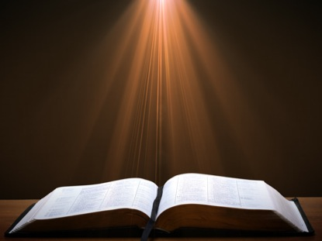
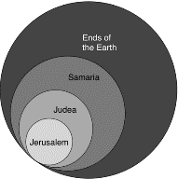
Acts 1:8
“but you will receive power when the Holy Spirit has come upon you; and you shall be My witnesses both in Jerusalem (Acts 1-7), and in all Judea and Samaria (Acts 8-12), and even to the remotest part of the earth (Acts 13-28).”

Slide 3
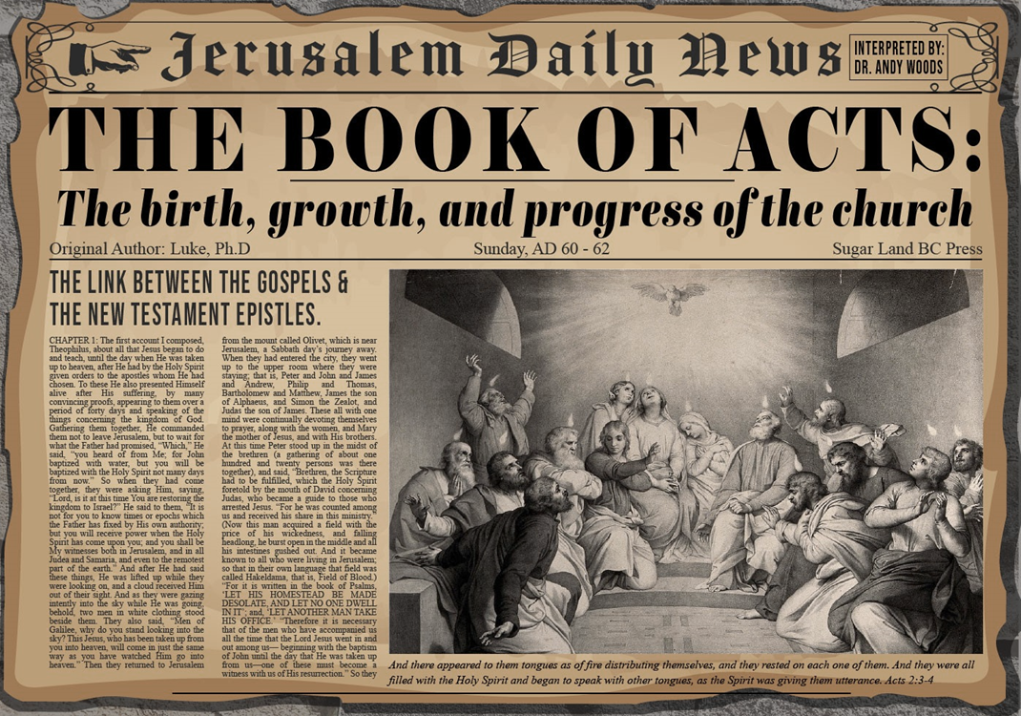
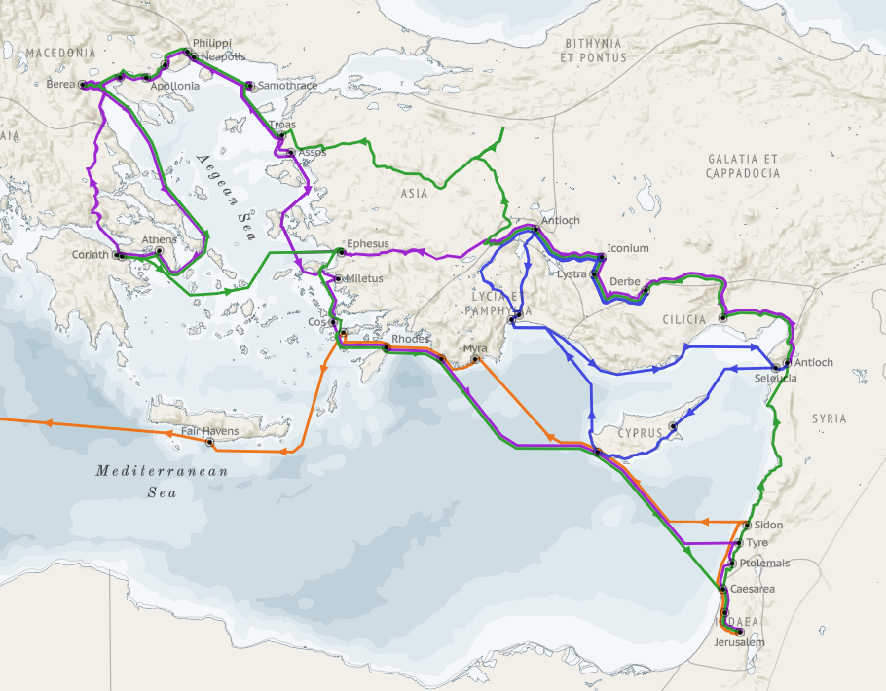
Structure (Acts 1:8)
  Jerusalem (Acts 1–7)
  Judea and Samaria (Acts 8–12)
  Remotest part of the earth (Acts 13–28)
  1st missionary journey (Acts 13–14)
  Jerusalem council (Acts 15:1-35)
  2nd missionary journey (Acts 15:36 –18:22)
  3rd missionary journey (Acts 18:23–21:17)
  Trip to Rome (Acts 21:18–28:31)

Slide 4
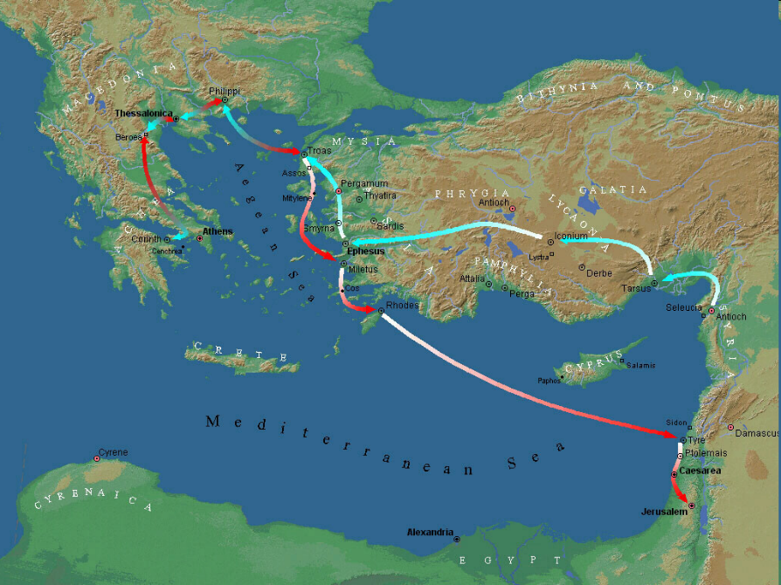

Slide 5
Acts 18:23‒21:17
3rd Missionary Journey
  Galatia & Phrygia ministry (18:23)
  Ephesus ministry (18:24‒19:41)
  Macedonian & Greece ministry (20:1-4)
  Troas ministry (20:5-12)
  Miletus ministry (20:13-38)
  Journey to Jerusalem (21:1-17)

Slide 6
Acts 18:23‒21:17
3rd Missionary Journey
  Galatia & Phrygia ministry (18:23)
  Ephesus ministry (18:24‒19:41)
  Macedonian & Greece ministry (20:1-4)
  Troas ministry (20:5-12)
  Miletus ministry (20:13-38)
  Journey to Jerusalem (21:1-17)

Slide 7
I. Galatia & Phrygia Ministry
Acts 18:23
  Time in Antioch (23a)
  Areas covered (23b)
  Discipleship emphasis (23c)

Slide 8
I. Galatia & Phrygia Ministry
Acts 18:23
  Time in Antioch (23a)
  Areas covered (23b)
  Discipleship emphasis (23c)

Slide 9
I. Galatia & Phrygia Ministry
Acts 18:23
  Time in Antioch (23a)
  Areas covered (23b)
  Discipleship emphasis (23c)

Slide 11
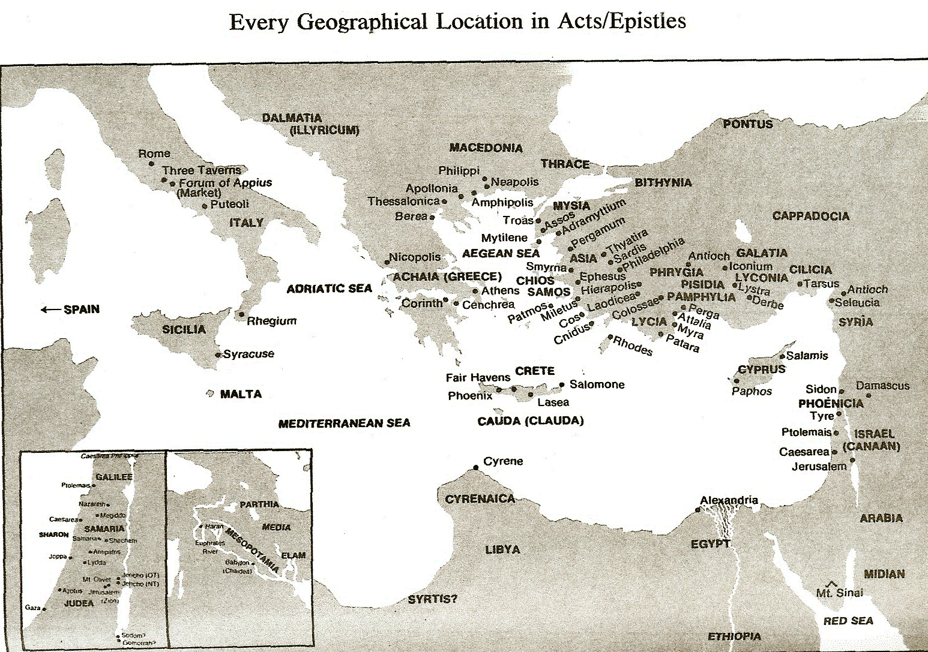

Slide 12
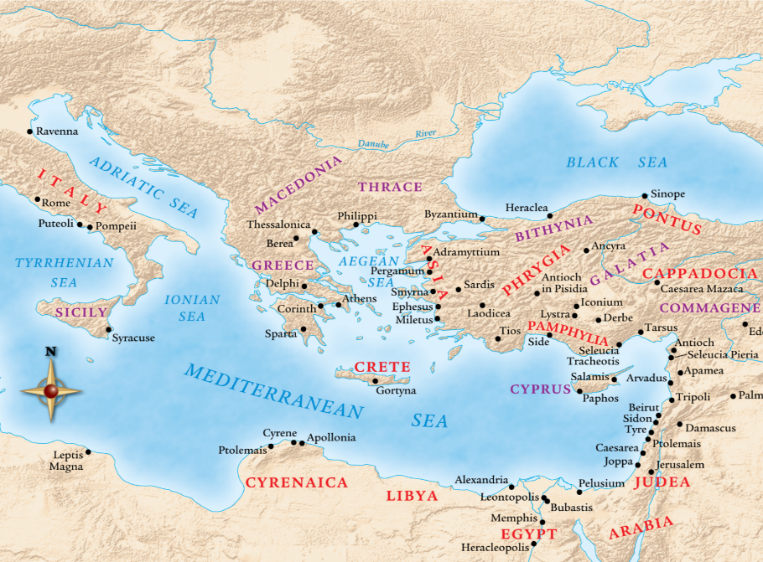

Slide 13
I. Galatia & Phrygia Ministry
Acts 18:23
  Time in Antioch (23a)
  Areas covered (23b)
  Discipleship emphasis (23c)

Slide 14
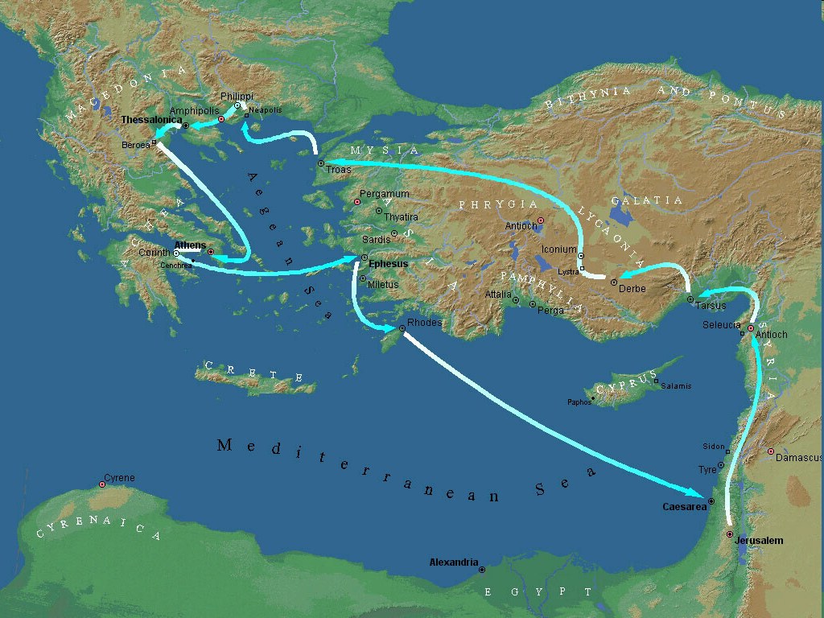
Second Missionary Journey

Slide 15

Ephesians 4:11-16
“¹¹ And He gave some as apostles, and some as prophets, and some as evangelists, and some as pastors and teachers, ¹² for the equipping of the saints for the work of service, to the building up of the body of Christ;”

Slide 16
Ephesians 4:11-16
“¹³ until we all attain to the unity of the faith, and of the knowledge of the Son of God, to a mature man, to the measure of the stature which belongs to the fullness of Christ. ¹⁴ As a result, we are no longer to be children, tossed here and there by waves and carried about by every wind of doctrine, by the trickery of men, by craftiness in deceitful scheming;”

Slide 17
Ephesians 4:11-16
“¹⁵ but speaking the truth in love, we are to grow up in all aspects into Him who is the head, even Christ, ¹⁶ from whom the whole body, being fitted and held together by what every joint supplies, according to the proper working of each individual part, causes the growth of the body for the building up of itself in love.”

Slide 18
Acts 18:23‒21:17
3rd Missionary Journey
  Galatia & Phrygia ministry (18:23)
  Ephesus ministry (18:24‒19:41)
  Macedonian & Greece ministry (20:1-4)
  Troas ministry (20:5-12)
  Miletus ministry (20:13-38)
  Journey to Jerusalem (21:1-17)

Slide 21
II. Ephesus Ministry
Acts 18:24‒19:41
  Apollos (18:24-28)
  John’s disciples (19:1-7)
  Ephesus witness (19:8-12)
  Imitators’ failure (19:13-20)
  Future plans (19:21-22)
  Silversmiths’ riot (19:23-41)

Slide 22
II. Ephesus Ministry
Acts 18:24‒19:41
  Apollos (18:24-28)
  John’s disciples (19:1-7)
  Ephesus witness (19:8-12)
  Imitators’ failure (19:13-20)
  Future plans (19:21-22)
  Silversmiths’ riot (19:23-41)

Slide 23

Message
  Birth and growth of the church numerically, geographically, ethnically.
  Components
  Numerically (progress reports)
  Geographically (From Jerusalem to Rome)
  Ethnically (From Judaism to Gentile domination)

Slide 24
Acts 18:24-28
Apollos
      His introduction (24)
      His limited understanding (25)
      His synagogue ministry (26a)
      His further education (26b)
      His transition to Corinth (27a-c)
      His Corinthian ministry (27d-28)

Slide 25
Acts 18:24-28
Apollos
      His introduction (24)
      His limited understanding (25)
      His synagogue ministry (26a)
      His further education (26b)
      His transition to Corinth (27a-c)
      His Corinthian ministry (27d-28)

Slide 26
Acts 18:24
His Introduction
      Jew (24a)
      Alexandrian (24b)
      Eloquence (24c)
      Mighty in the Scriptures (24d)

Slide 27
Acts 18:24
His Introduction
      Jew (24a)
      Alexandrian (24b)
      Eloquence (24c)
      Mighty in the Scriptures (24d)

Slide 28
Acts 18:24
His Introduction
      Jew (24a)
      Alexandrian (24b)
      Eloquence (24c)
      Mighty in the Scriptures (24d)

Slide 30
Acts 18:24
His Introduction
      Jew (24a)
      Alexandrian (24b)
      Eloquence (24c)
      Mighty in the Scriptures (24d)

Slide 32
Acts 18:24
His Introduction
      Jew (24a)
      Alexandrian (24b)
      Eloquence (24c)
      Mighty in the Scriptures (24d)

Slide 33
Acts 18:24-28
Apollos
      His introduction (24)
      His limited understanding (25)
      His synagogue ministry (26a)
      His further education (26b)
      His transition to Corinth (27a-c)
      His Corinthian ministry (27d-28)

Slide 34


John 1:29
“The next day he saw Jesus coming to him, and said, ‘Behold, the Lamb of God who takes away the sin of the world!’”

Slide 35

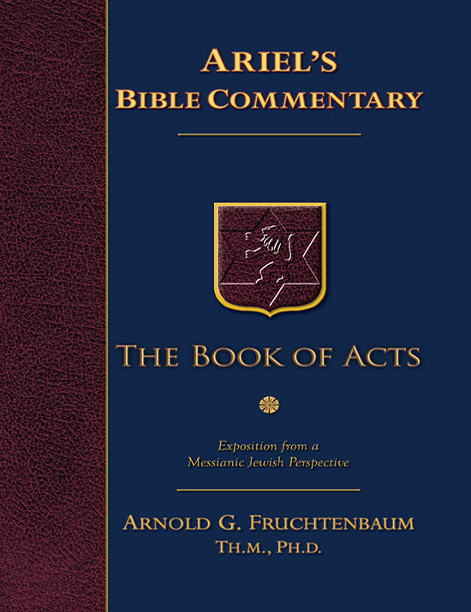
Dr. Arnold G. Fruchtenbaum
The Book of Acts, 392
“His basic message was that John was the forerunner of the Messiah, that he had pointed out Yeshua as the Lamb of God, that takes away the sin of the world (Jn. 1:29), and that Yeshua was the Messiah (Acts 18:28). That was as much as Apollos knew, because he knew only the baptism of John. His knowledge was incomplete in that he did not know about the death, burial, and resurrection of Yeshua, and for that reason, he did not have believer’s baptism, only John’s baptism. Those who were baptized by John committed themselves to accept whomever he pointed out to be the Messiah (Acts 19:4). Apollos had done this; however, he probably left the land of Israel to go back to Alexandria without ever finding out how the rest of the story developed.”

Slide 36
Acts 18:24-28
Apollos
      His introduction (24)
      His limited understanding (25)
      His synagogue ministry (26a)
      His further education (26b)
      His transition to Corinth (27a-c)
      His Corinthian ministry (27d-28)

Slide 37
Second Missionary Journey

Slide 38
IX. Ephesus Ministry
Acts 18:19-21
  Arrival (19a)
  Leaving Priscilla & Aquila behind (19b)
  Synagogue ministry (19c)
  Synagogue invitation (20a)
  Invitation declined (20b)
  Promise (21a)
  Departure (21b)

Slide 39
Acts 18:24-28
Apollos
      His introduction (24)
      His limited understanding (25)
      His synagogue ministry (26a)
      His further education (26b)
      His transition to Corinth (27a-c)
      His Corinthian ministry (27d-28)

Slide 40
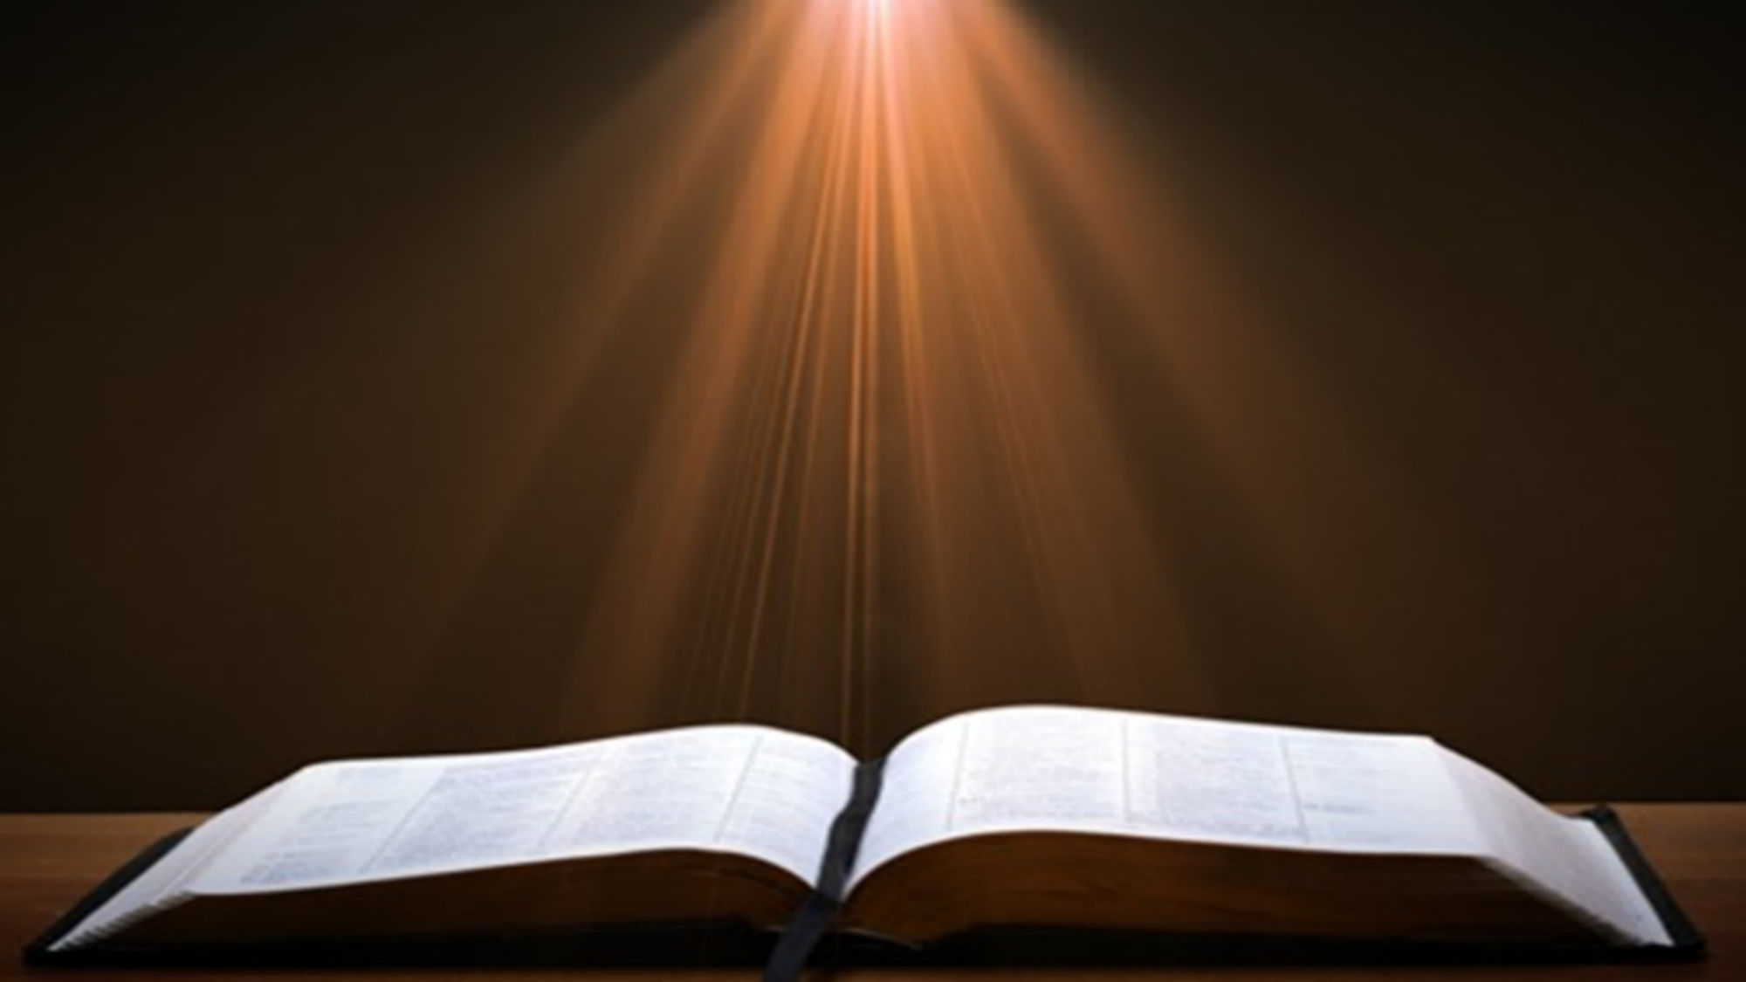
2 Timothy 3:15-17
“¹⁵ and that from childhood you have known the sacred writings which are able to give you the wisdom that leads to salvation through faith which is in Christ Jesus. ¹⁶ All Scripture is inspired by God [theopneustos] and profitable for teaching, for reproof, for correction, for training in righteousness; ¹⁷ so that the man of God may be adequate, equipped for every good work.”
Notes:
hapaxlegomena

Slide 41
Acts 18:24-28
Apollos
      His introduction (24)
      His limited understanding (25)
      His synagogue ministry (26a)
      His further education (26b)
      His transition to Corinth (27a-c)
      His Corinthian ministry (27d-28)

Slide 42
Acts 18:27a-c
His Transition to Corinth
      Journey to Achaia (27a)
      Encouragement from the brethren (27b)
      Commendation (27c)

Slide 43
Acts 18:27a-c
His Transition to Corinth
      Journey to Achaia (27a)
      Encouragement from the brethren (27b)
      Commendation (27c)

Slide 45
Second Missionary Journey

Slide 46
Acts 18:27a-c
His Transition to Corinth
      Journey to Achaia (27a)
      Encouragement from the brethren (27b)
      Commendation (27c)

Slide 47
Acts 18:27a-c
His Transition to Corinth
      Journey to Achaia (27a)
      Encouragement from the brethren (27b)
      Commendation (27c)

Slide 48
ORDER OF PAUL’S LETTERS | ORDER OF PAUL’S LETTERS
1. | Galatians | A.D. 49
2. | 1‒2 Thessalonians | A.D. 51
3. | 1‒2 Corinthians | A.D. 56
4. | Romans | A.D. 57
5. | Ephesians, Colossians, Philemon, Philippians | A.D. 60‒62
6. | 1 Timothy, Titus | A.D. 62‒66
7. | 2 Timothy | A.D. 67

Slide 49
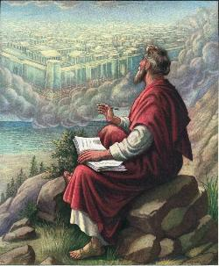
John 20:30-31
“Therefore many other signs Jesus also performed in the presence of the disciples, which are not written in this book; but these have been written so that you may believe that Jesus is the Christ, the Son of God; and that believing you may have life in His name.”

Slide 50
2 Timothy 3:15-17
“¹⁵ and that from childhood you have known the sacred writings which are able to give you the wisdom that leads to salvation through faith which is in Christ Jesus. ¹⁶ All Scripture is inspired by God [theopneustos] and profitable for teaching, for reproof, for correction, for training in righteousness; ¹⁷ so that the man of God may be adequate, equipped for every good work.”
Notes:
hapaxlegomena

Slide 51
Acts 18:24-28
Apollos
      His introduction (24)
      His limited understanding (25)
      His synagogue ministry (26a)
      His further education (26b)
      His transition to Corinth (27a-c)
      His Corinthian ministry (27d-28)

Slide 52
Acts 18:27d-28
His Corinthian Ministry
      Ministry to believers (27d)
      Jewish evangelism (28)

Slide 53
Acts 18:27d-28
His Corinthian Ministry
      Ministry to believers (27d)
      Jewish evangelism (28)

Slide 54
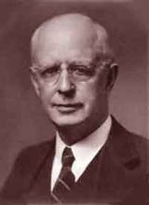
Lewis Sperry Chafer, vol. 7, Systematic Theology
(Grand Rapids, MI: Kregel Publications, 1993), 265-66.
Belief-God’s One Condition for Justification
“…because upwards of 150 passages of Scripture condition salvation upon believing only (cf. John 3:16; Acts 16:31).”

Slide 55
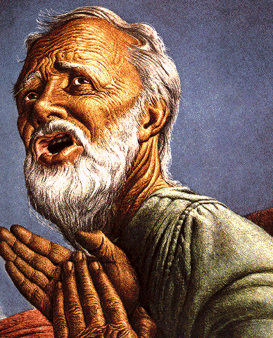
Belief – God’s One Condition for Justification
Gen 15:6
Then he believed in the LORD; and He reckoned it to him as righteousness.
John 3:16
For God so loved the world, that He gave His only begotten Son, that whoever believes in Him shall not perish, but have eternal life.
Acts 16:30-31
"Sirs, what must I do to be saved?" They said, "Believe in the Lord Jesus, and you will be saved..."

Slide 56

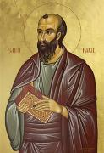
Romans 4:4-5
⁴ “Now to the one who works, his wage is not credited as a favor, but as what is due. ⁵ But to the one who does not work, but believes in Him who justifies the ungodly, his faith is credited as righteousness.”

Slide 57
John 16:7–11
⁷ “But I tell you the truth, it is to your advantage that I go away; for if I do not go away, the Helper will not come to you; but if I go, I will send Him to you. ⁸ And He, when He comes, will convict the world concerning sin and righteousness and judgment; ⁹ concerning sin, because they do not believe in Me; ¹⁰ and concerning righteousness, because I go to the Father and you no longer see Me; ¹¹ and concerning judgment, because the ruler of this world has been judged.”

Slide 58
Acts 18:27d-28
His Corinthian Ministry
      Ministry to believers (27d)
      Jewish evangelism (28)

Slide 59
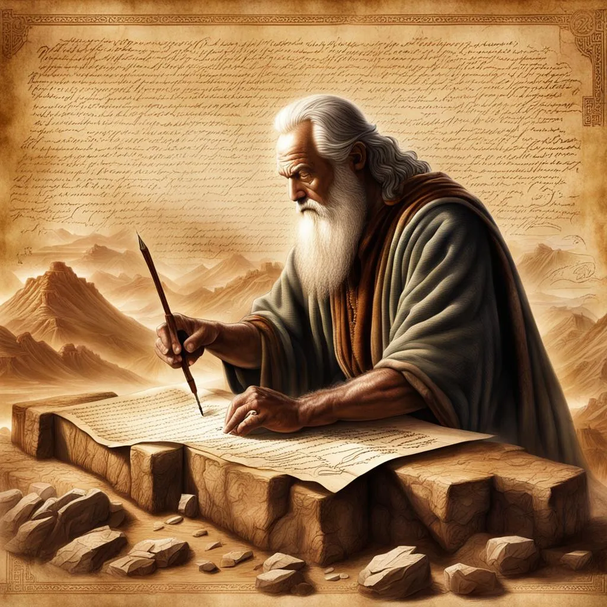
John 5:39, 46
“³⁹ You search the Scriptures because you think that in them you have eternal life; it is these that testify about Me…⁴⁶ For if you believed Moses, you would believe Me, for he wrote about Me.”

Slide 60
Luke 24:27, 44
“²⁷ Then beginning with Moses and with all the prophets, He explained to them the things concerning Himself in all the Scriptures…⁴⁴ Now He said to them, ‘These are My words which I spoke to you while I was still with you, that all things which are written about Me in the Law of Moses and the Prophets and the Psalms must be fulfilled.’”

Slide 61

Acts 17:1-3
“¹ Now when they had traveled through Amphipolis and Apollonia, they came to Thessalonica, where there was a synagogue of the Jews. ² And according to Paul’s custom, he visited them, and for three Sabbaths reasoned with them from the Scriptures, ³ explaining and giving evidence that the Christ had to suffer and rise from the dead, and saying, “This Jesus whom I am proclaiming to you is the Christ.”

Slide 62

1 Corinthians 15:3-4
“³ For I handed down to you as of first importance what I also received, that Christ died for our sins according to the Scriptures, ⁴ and that He was buried, and that He was raised on the third day according to the Scriptures.”

Slide 63
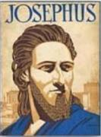
Josephus
Antiquities 18.3.3
“About this time there lived Jesus, a wise man, if indeed one ought to call him a man. For he was one who performed surprising deeds and was a teacher of such people as accept the truth gladly. He won over many Jews and many of the Greeks. He was the Christ. And when, upon the accusation of the principal men among us, Pilate had condemned him to a cross, those who had first come to love him did not cease. He appeared to them spending a third day restored to life, for the prophets of God had foretold these things and a thousand other marvels about him. And the tribe of the Christians, so called after him, has still to this day not disappeared.”

Slide 64
OT Prophecies About Christ
Prophecy | Scripture | Years in Advance
Manner of Birth | Isaiah 7:14 | 700 years
Place of Birth | Micah 5:2 | 700 years
Nationality | Numbers 24:17 | 1400 years
Tribe | Genesis 49:10 | 1800 years
Time of and Response to His Messiahship | Dan. 9:25-26 | 600 years

Slide 65
OT Prophecies About Christ
Prophecy | Scripture | Years in Advance
Crucified Between Thieves | Isaiah 53:9 | 700 years
Pierced | Isaiah 53:5 | 700 years
No Broken Bones | Psalm 22:17 | 1000 years
Gamble for His Clothing | Psalm 22:18 | 1000 years
Buried in Rich Man’s Tomb | Isaiah 53:9 | 700 years
Notes:
109 prophecies…
Peter Stoner – SCIENCE SPEAKS, An Evaluation of Certain Christian Evidences
To fulfill just 8 prophecies =1 X 10 to the twenty-eighth power!
Can we visualize this with an illustration? Suppose we took an atheistic professor, blindfolded him and covered the state of Texas two feet deep with silver dollars. Then we put a check on one of those silver dollars and mixed them up. The odds of one person fulfilling just these eight prophecies would be the same as this atheistic professor selecting the silver dollar upon which we have placed a check, in his first try.
https://www.bereanpublishers.com/the-odds-of-eight-messianic-prophecies-coming-true/

Slide 66
II. Ephesus Ministry
Acts 18:24‒19:41
  Apollos (18:24-28)
  John’s disciples (19:1-7)
  Ephesus witness (19:8-12)
  Imitators’ failure (19:13-20)
  Future plans (19:21-22)
  Silversmiths’ riot (19:23-41)

Slide 67
Acts 19:1-7
John’s Disciples
      Journey (1a)
      Interaction (1b-7)

Slide 68
Acts 19:1-7
John’s Disciples
      Journey (1a)
      Interaction (1b-7)

Slide 70
Second Missionary Journey

Slide 71
Acts 19:1-7
John’s Disciples
      Journey (1a)
      Interaction (1b-7)

Slide 72
Acts 19:1b-7
Interaction
      Encounter (1b)
      Initial question (2a)
      Answer (2b)
      Second question (3a)
      Answer (3b)
      Explanation (4)
      Salvation (5)
      Spirit reception (6)
      Number (7)

Slide 73
Acts 19:1b-7
Interaction
      Encounter (1b)
      Initial question (2a)
      Answer (2b)
      Second question (3a)
      Answer (3b)
      Explanation (4)
      Salvation (5)
      Spirit reception (6)
      Number (7)

Slide 74
John 1:29
“The next day he saw Jesus coming to him, and said, ‘Behold, the Lamb of God who takes away the sin of the world!’”

Slide 75
Acts 19:1b-7
Interaction
      Encounter (1b)
      Initial question (2a)
      Answer (2b)
      Second question (3a)
      Answer (3b)
      Explanation (4)
      Salvation (5)
      Spirit reception (6)
      Number (7)

Slide 76
WORK OF THE SPIRIT IN THE OT
 | OT/GOSPELS/ACTS 1 | ACTS 2/TODAY
External vs. Internal | Upon (1 Sam. 16:13) | Within (John 14:17)
Reception of all of the Spirit at the moment of salvation? | Subsequent to salvation (Exod 31:3) | At moment of salvation (Rom 8:9)
How long is the indwelling? | Temporary indwelling (1 Sam 16:14; Ps 51:11) | Permanent indwelling (John 14:16)
Who is indwelt? | Selective indwelling (Joel 2:28) | Universal indwelling (1 Cor 12:13)

Slide 77


1 Corinthians 12:13
“For by one Spirit we were all baptized into one body, whether Jews or Greeks, whether slaves or free, and we were all made to drink of one Spirit.”

Slide 78
Dr. Arnold G. Fruchtenbaum
The Book of Acts, 394
“Paul recognized that these men were believers of some sort, but he also realized that there was something lacking in the content of their faith. So, he raised a question in verse 2a: Did ye receive the Holy Spirit when ye believed? By the time of Acts 19, everyone received the Spirit when they believed. So, it is unfortunate that the Authorized King James Version, unlike all other translations, rendered the question as ‘Have ye received the Holy Ghost since ye believed?’ As Ger points out, this translation ‘has been the basis of a great deal of otherwise avoidable doctrinal confusion.’ The Greek verb Paul used for ‘believed’ is the aorist participle form of pisteuó, ‘to believe.’ Greek grammar and the context of this verse support the ASV rendering ‘when you believed’ to express a simultaneous, not a subsequent action. Paul did not ask whether John’s disciples received the Holy Spirit after they had believed. He knew that if these people had not been baptized by the Spirit, it would indicate that they were not yet believers in Yeshua.”

Slide 79
Acts 19:1b-7
Interaction
      Encounter (1b)
      Initial question (2a)
      Answer (2b)
      Second question (3a)
      Answer (3b)
      Explanation (4)
      Salvation (5)
      Spirit reception (6)
      Number (7)

Slide 80
Acts 19:1b-7
Interaction
      Encounter (1b)
      Initial question (2a)
      Answer (2b)
      Second question (3a)
      Answer (3b)
      Explanation (4)
      Salvation (5)
      Spirit reception (6)
      Number (7)

Slide 81
Acts 19:1b-7
Interaction
      Encounter (1b)
      Initial question (2a)
      Answer (2b)
      Second question (3a)
      Answer (3b)
      Explanation (4)
      Salvation (5)
      Spirit reception (6)
      Number (7)

Slide 82
Messengers of the Kingdom In Matthew
John the Baptist – 3:2
Jesus Christ – 4:17
12 Apostles – 10:5-7
Seventy – Luke 10:1, 9
Toussaint, Behold the King, 18-20

Slide 83

Matthew 3:1-2
“Now in those days John the Baptist came, preaching in the wilderness of Judea, saying, ‘Repent, for the kingdom of heaven is at hand.”

Slide 84
Acts 19:1b-7
Interaction
      Encounter (1b)
      Initial question (2a)
      Answer (2b)
      Second question (3a)
      Answer (3b)
      Explanation (4)
      Salvation (5)
      Spirit reception (6)
      Number (7)

Slide 85
John 1:29
“The next day he saw Jesus coming to him, and said, ‘Behold, the Lamb of God who takes away the sin of the world!’”

Slide 86
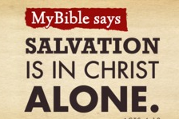
Acts 4:12
“And there is salvation in no one else; for there is no other name under heaven that has been given among men by which we must [dei] be saved.”

Slide 87
Acts 19:1b-7
Interaction
      Encounter (1b)
      Initial question (2a)
      Answer (2b)
      Second question (3a)
      Answer (3b)
      Explanation (4)
      Salvation (5)
      Spirit reception (6)
      Number (7)

Slide 88
Acts 19:1b-7
Interaction
      Encounter (1b)
      Initial question (2a)
      Answer (2b)
      Second question (3a)
      Answer (3b)
      Explanation (4)
      Salvation (5)
      Spirit reception (6)
      Number (7)

Slide 89
Dr. Arnold G. Fruchtenbaum
The Book of Acts, 398
“The following four conclusions can be drawn from the comparison of Acts 2, 8, 10, and 19. First, in the Book of Acts, the gift of tongues was given to certain people and not in a general way. They were given to a select group of Jews, Samaritans, Gentiles, and Jewish disciples of John the Baptist, and only once to each group. Second, in Acts, the gift was given as an opener to each of these groups, and it was never repeated to another selection within these groups. In Acts 2, the Jewish group consisted of the apostles, and no other Jewish group is recorded to have received the gift of tongues. In Acts 8, a group of Samaritans received the gift by the laying on of hands of Peter. No other Samaritan group received it this way. In Acts 10, the household of Cornelius and other Gentiles opened the Gentile group. Yet, with the many conversions of Gentiles under Paul’s ministry, not once is it recorded that his Gentile converts spoke in tongues.”

Slide 90
Dr. Arnold G. Fruchtenbaum
The Book of Acts, 398
“In Acts 19, the twelve disciples of John the Baptist became the opening in that group, and no one else in this group is said to have received it. Tongues only appear in the initial reception of the Spirit in each of the four groups, and there is no repetition in any of these groups. Third, the purpose of tongues in the book of Acts is authentication, especially in relation to a new group being initiated into the body of the Messiah. Fourth, Acts is an historical account of the appearance of tongues. However, the doctrine of tongues cannot be developed from the historical sections of Acts, but only from the doctrinal sections of the epistles. Acts and the historical segments tell what happened, but the account is not a basis for teaching that it must always happen this way. History states what happened, but doctrine states what is and what will happen.”

Slide 91
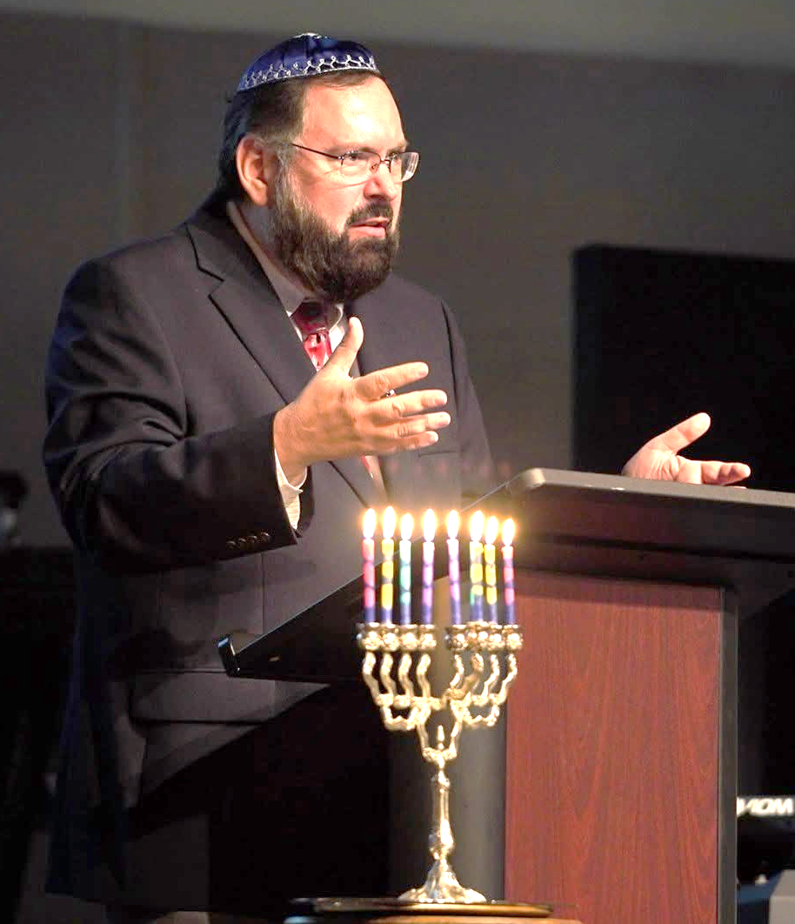
Steven Ger
The Book of Acts, 254
“The book of Acts cannot be used as a guide to establish a timeless doctrine, practice or formula for the receipt of Spirit baptism. It is simply not possible to discern which one of these four examples should serve as a prototypical model for church observance. The task Luke set out to accomplish in Acts was to describe historical fact without necessarily prescribing universal doctrinal practice. Luke’s purpose, as articulated in his prologue, is to report on what happened in a particular place and time, not what must universally happen thereafter in every place and time. The unambiguous propositional instructions found in Paul’s epistles are the only Scripture by which we can develop an accurate and consistent theology of Spirit baptism.”

Slide 92
Acts 19:1b-7
Interaction
      Encounter (1b)
      Initial question (2a)
      Answer (2b)
      Second question (3a)
      Answer (3b)
      Explanation (4)
      Salvation (5)
      Spirit reception (6)
      Number (7)

Slide 93
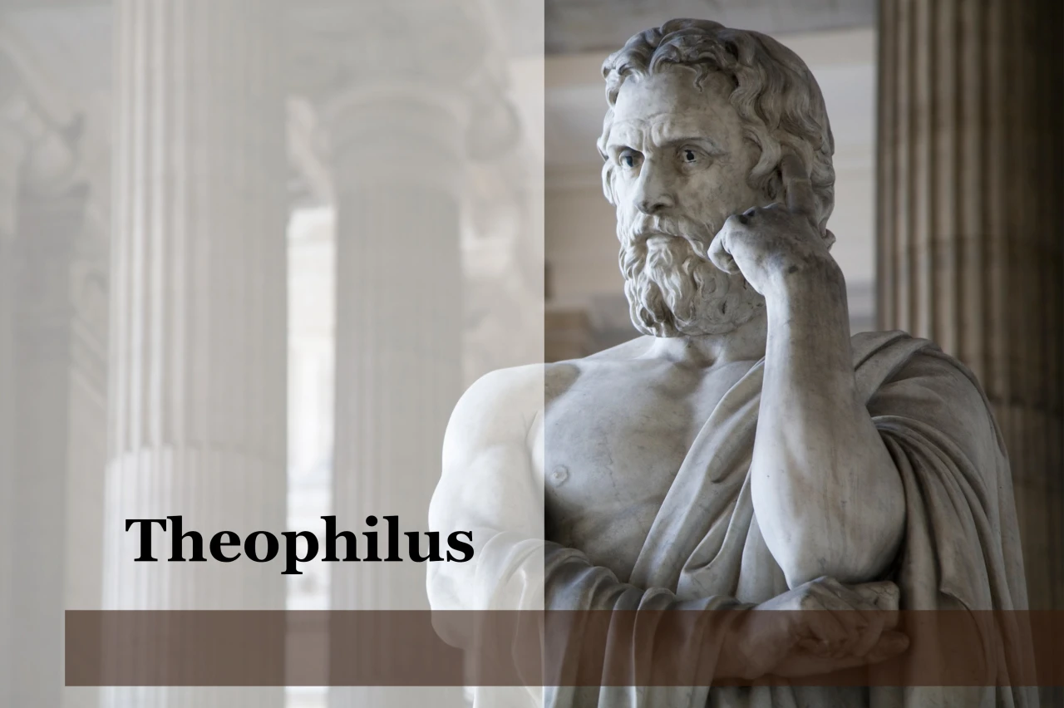
Purpose
  To present Theophilus with an orderly account of the birth and growth of the church so as to affirm him in what he has believed.

Slide 94
Message
  Birth and growth of the church numerically, geographically, ethnically.
  Components
  Numerically (progress reports)
  Geographically (From Jerusalem to Rome)
  Ethnically (From Judaism to Gentile domination)

Slide 95
Progress Reports
  Clearest:
    Acts 2:47; 4:4; 6:7; 9:31; 12:24; 16:5; 19:20; 28:30-31
  Less clear:
    Acts 1:13, 15; 2:41; 4:4:31; 5:14, 42; 8:25, 40; 11:21; 13:49; 17:6

Slide 96
II. Ephesus Ministry
Acts 18:24‒19:41
  Apollos (18:24-28)
  John’s disciples (19:1-7)
  Ephesus witness (19:8-12)
  Imitators’ failure (19:13-20)
  Future plans (19:21-22)
  Silversmiths’ riot (19:23-41)

Slide 97
Acts 19:8-12
Ephesus Witness
      Synagogue ministry (8-9a)
      School of Tyrannus (9b-10)
      Signs (11-12)

Slide 98
Acts 19:8-12
Ephesus Witness
      Synagogue ministry (8-9a)
      School of Tyrannus (9b-10)
      Signs (11-12)

Slide 99
Acts 19:8-9a
Synagogue Ministry
      Ministry (8)
      Departure (9a)

Slide 100
Acts 19:8-9a
Synagogue Ministry
      Ministry (8)
      Departure (9a)

Slide 101
Acts 17:1-3
“¹ Now when they had traveled through Amphipolis and Apollonia, they came to Thessalonica, where there was a synagogue of the Jews. ² And according to Paul’s custom, he visited them, and for three Sabbaths reasoned with them from the Scriptures, ³ explaining and giving evidence that the Christ had to suffer and rise from the dead, and saying, ‘This Jesus whom I am proclaiming to you is the Christ.’”

Slide 102
Steven Ger
The Book of Acts, 254
“Luke provides yet another example of Paul’s unwavering commitment to Jewish witness. For three months, the Ephesian synagogue, which had so warmly received him on his previous visit, became the center of Paul’s ministry. The Jewish community, having subsequently engaged in vigorous debate over the gospel with Apollos, continued to do so with Paul. The Jewish community’s commitment to this dialogue resulted in Paul’s longest recorded synagogue ministry. As befits an extended teaching ministry, the content of Paul’s preaching is described as having advanced beyond a basic argument that Jesus was the Messiah to emphasizing the kingdom of God. It is possible that the Jewish listeners were . . .

Slide 103
Steven Ger
The Book of Acts, 254
. . . prepared to grant the possibility that Jesus was the Messiah as a result of the combination of both Apollos and Paul’s persuasive and unassailable arguments. However, the sticking point seems to have been the non-commencement of the messianic kingdom which, in Jewish expectation, was to be launched by the Messiah, the very same expectation voiced by the apostles just prior to Jesus’ ascension (Acts 1:6).”

Slide 104

Alva J. McClain
Alva J. McClain, The Greatness of the Kingdom: An Inductive Study of the Kingdom of God as Set Forth in the Scriptures (Grand Rapids: Zondervan, 1959), 424-26.
“The term ‘kingdom’ (Grk. basileia) occurs eight times in Acts as referring to the divine rule. . . . In the Book of Acts this ‘kingdom of God’ appears as something future, the term being used, as James Orr has observed, ‘in an almost exclusively eschatological sense.’ The Old Testament prophecies of the Messianic Kingdom, occasionally quoted by the apostles (cf. Acts 2:25–36; 3:22–36; 13:22–39) are used to show the regal rights of Jesus the Messiah. But nowhere do they ever assert that the Kingdom has been established. In passages about which there can be no dispute, this is a matter which belongs to the future when the King returns from heaven (cf. 1:6–11; 3:19–21; 15:13–16).”

Slide 105
Alva J. McClain
Alva J. McClain, The Greatness of the Kingdom: An Inductive Study of the Kingdom of God as Set Forth in the Scriptures (Grand Rapids: Zondervan, 1959), 424-26.
“The passage in 14:22, ‘we must through much tribulation enter into the kingdom of God,’ is sometimes used to prove a present Messianic Kingdom established on earth in the church. But such a use would prove too much. . . . But in the Old Testament prophetic picture of the coming Messianic Kingdom, as every intelligent Jew understood, a period of terrible tribulation always precedes its establishment on earth. . . . Therefore the passage in 14:22 is in complete harmony with the historical situation and the progress of revelation. . . .”

Slide 106
Alva J. McClain
Alva J. McClain, The Greatness of the Kingdom: An Inductive Study of the Kingdom of God as Set Forth in the Scriptures (Grand Rapids: Zondervan, 1959), 424-26.
“The argument advanced by some, that since the apostles throughout the Acts period preached ‘the things concerning the kingdom of God’ (19:8), therefore the Kingdom must have already been established, is not very good logic. Most of us preach and teach many things in the Christian faith which are not yet realized in experience. No sensible person would argue that because the apostles continually preached the resurrection of the dead, therefore, it must have already taken place.”

Slide 107
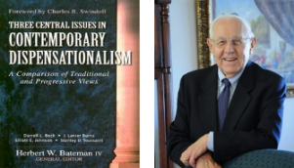
Stanley D. Toussaint
“Israel and the Church of a Traditional Dispensationalist,” in Three Central Issues in Contemporary Dispensationalism, ed. Herbert W. Bateman (Grand Rapids: Kregel, 1999), 242.
“It is difficult to explain why Luke does not use the term if the kingdom is being inaugurated. He employs it forty-five times in the gospel. . . . [O]ne would expect Luke to use the word if such a startling thing as the inauguration of the kingdom had taken place. The fact that Luke uses kingdom only eight times in Acts after such heavy usage in his gospel implies that the kingdom had not begun but was in fact, postponed.”

Slide 108
Acts 19:8-9a
Synagogue Ministry
      Ministry (8)
      Departure (9a)

Slide 109
Purpose
  To present Theophilus with an orderly account of the birth and growth of the church so as to affirm him in what he has believed.

Slide 110
Message
  Birth and growth of the church numerically, geographically, ethnically.
  Components
  Numerically (progress reports)
  Geographically (From Jerusalem to Rome)
  Ethnically (From Judaism to Gentile domination)

Slide 111


2 Thessalonians 2:3
“Let no one in any way deceive you, for it will not come unless the apostasy [apostasia] comes first, and the man of lawlessness is revealed, the son of destruction.”

Slide 112
Dr. Arnold G. Fruchtenbaum
The Book of Acts, 400-01
“The English word ‘apostasy’ comes from the Greek term for ‘departed,’ apostas. As is seen in this context, the term can also be used for physical departure. For that reason, some believe that the ‘falling away’ or ‘departure’ of II Thessalonians 2:3 refers to the rapture of the church. And, indeed, the Greek word can refer to physical departure, although most of the time it refers to moral departure. Not only did Paul separate himself physically from the synagogue, he also pulled the Jewish believers out and planted a new church.”

Slide 113
Acts 19:8-12
Ephesus Witness
      Synagogue ministry (8-9a)
      School of Tyrannus (9b-10)
      Signs (11-12)

Slide 114
Acts 19:9b-10
School of Tyrannus
      Location (9b)
      Duration (10a)
      Effectiveness (10b)

Slide 115
Acts 19:9b-10
School of Tyrannus
      Location (9b)
      Duration (10a)
      Effectiveness (10b)

Slide 116
Dr. Arnold G. Fruchtenbaum
The Book of Acts, 401
“Paul also established a new base for his ministry; he reasoned daily in the school of Tyrannus. This was a Greek lecture hall or school building, where intellectual pursuits and instruction were followed. But now, this school was to attain its finest use because Paul taught there on the Messiah, who is the wisdom of God (I Cor. 1:30). Tyrannus was probably a Greek rhetorician who taught rhetoric. From historical records, it is known that the people of Ephesus worked into the wee hours of the morning. They rested from 11:00 a.m. until 4:00 p.m. Thus, Tyrannus would have worked in the morning and Paul would have used this lecture hall in the afternoons to proclaim his own message.”

Slide 117
Acts 19:9b-10
School of Tyrannus
      Location (9b)
      Duration (10a)
      Effectiveness (10b)

Slide 118
Paul’s Ministry Chronology
# OF BOOKS | JOURNEY | ACTS | DATE | BOOKS
1 | 1 | 13–14 | 48–49 | Gal
2 | 2 | 15:36–18:22 | 50–52 | 1–2 Thess
3 | 3 | 18:23–21:17 | 53–57 | 1–2 Cor, Rom
4 | 4 | 28:16-31 | 60–62 | Eph, Col, Phlm, Phlp
2 | Between Imprisonments | Post Acts | 62–66 | 1 Tim, Titus
1 | 2nd Imprisonment | Post Acts | 67 | 2 Tim

Slide 119
ORDER OF PAUL’S LETTERS | ORDER OF PAUL’S LETTERS
1. | Galatians | A.D. 49
2. | 1‒2 Thessalonians | A.D. 51
3. | 1‒2 Corinthians | A.D. 56
4. | Romans | A.D. 57
5. | Ephesians, Colossians, Philemon, Philippians | A.D. 60‒62
6. | 1 Timothy, Titus | A.D. 62‒66
7. | 2 Timothy | A.D. 67

Slide 120
Acts 19:9b-10
School of Tyrannus
      Location (9b)
      Duration (10a)
      Effectiveness (10b)

Slide 121
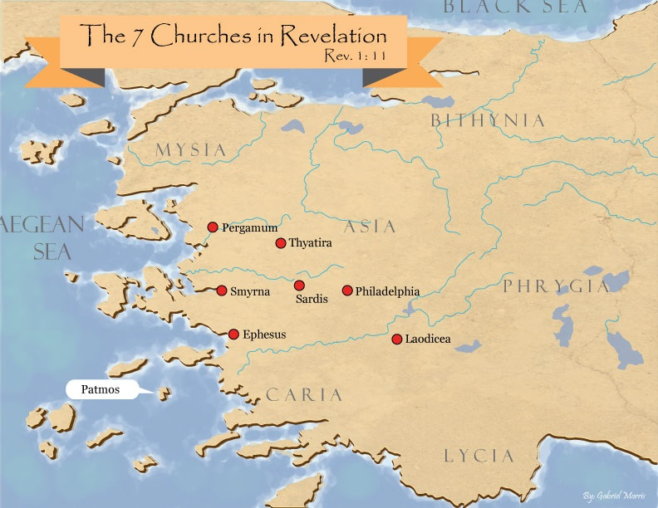
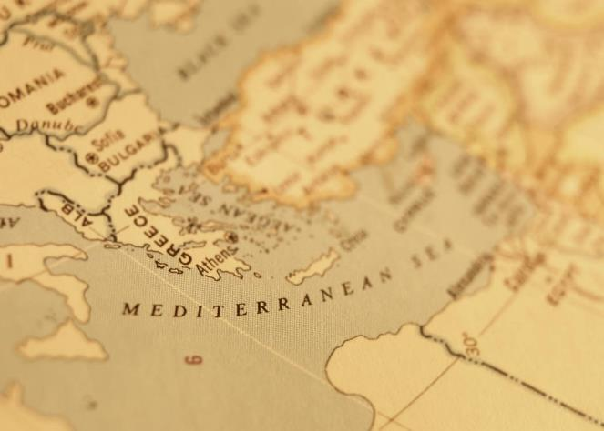

Slide 122
Acts 19:8-12
Ephesus Witness
      Synagogue ministry (8-9a)
      School of Tyrannus (9b-10)
      Signs (11-12)

Slide 123
Acts 19:11-12
Signs
      Source (11)
      Specifics (12)

Slide 124
Acts 19:11-12
Signs
      Source (11)
      Specifics (12)

Slide 125

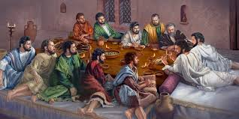
Ephesians 2:20
“having been built on the foundation of the apostles and prophets, Christ Jesus Himself being the corner stone.”

Slide 126
Miracle Clusters In Scripture
NUM. | ERA | AUTHENTICATION
1. | Moses | Law
2. | Joshua | Conquest
3. | Elijah-Elisha | Prophet
4. | Christ | Kingdom offer
5. | Apostles | Church
6. | Tribulation & Millennium | Kingdom establishment

Slide 127
Dr. Arnold G. Fruchtenbaum
The Book of Acts, 402
“These miracles were not ones that happened by chance, they were not ordinary. Rather, they were uniquely performed by the Apostle Paul, as was the case with Peter and his shadow in Acts 5:15. These special miracles went beyond those familiar to the disciples and were wrought by the hands of Paul, as part of his apostolic authority. This verse again shows that such powers were limited to the apostles and their legates in the book of Acts. Miracles were not performed by believers in general. Even Paul did not always have this power (II Cor. 12:8-10; Phil. 2:25-27; I Tim. 5:23; II Tim. 4:20).”

Slide 128
Acts 19:11-12
Signs
      Source (11)
      Specifics (12)

Slide 129

Galatians 2:7-8
“⁷ But on the contrary, seeing that I had been entrusted with the gospel to the uncircumcised, just as Peter had been to the circumcised ⁸ (for He who effectually worked for Peter in his apostleship to the circumcised effectually worked for me also to the Gentiles).”

Slide 130
From Peter to Paul
Reference | Center | Person | Place | Outreach
Acts 1–12 | Jerusalem | Peter | Jerusalem, Judea, Samaria | Jewish
Acts 13–28 | Antioch | Paul | Uttermost parts | Gentiles

Slide 131
From Peter to Paul
Peter | Paul
Heals a man lame from birth (3:1-11) | Heals a man lame from birth (14:8-18)
Heals by shadow (5:15-16) | Heals by handkerchief (19:11-12)
Success is a cause of jealousy (5:17) | Success is a cause of jealousy (13:45)
Confronts a sorcerer (8:9-24) | Confronts a sorcerer (13:6-11)
Raises Dorcas (9:36-41) | Raises Eutychus (20:9-12)
Jailed and miraculously freed (12:3-19) | Jailed and miraculously freed (16:25-34)

Slide 132
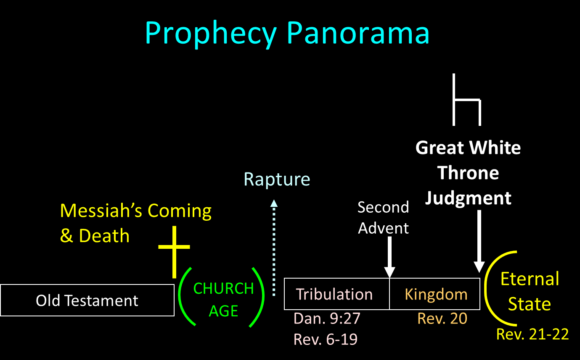

Slide 133

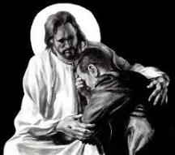
Revelation 21:4
“and He will wipe away every tear from their eyes; and there will no longer be any death; there will no longer be any mourning, or crying, or pain; the first things have passed away.”

Slide 134
II. Ephesus Ministry
Acts 18:24‒19:41
  Apollos (18:24-28)
  John’s disciples (19:1-7)
  Ephesus witness (19:8-12)
  Imitators’ failure (19:13-20)
  Future plans (19:21-22)
  Silversmiths’ riot (19:23-41)

Slide 135
Acts 19:13-20
Imitators’ Failure
      Imitators (13-14)
      Demonic response (15)
      Demonic overpowering (16)
      Results (17-19)
      Progress report (20)

Slide 136
Acts 19:13-20
Imitators’ Failure
      Imitators (13-14)
      Demonic response (15)
      Demonic overpowering (16)
      Results (17-19)
      Progress report (20)

Slide 137
Acts 19:13-14
Imitators
      General (13)
      Specific (14)

Slide 138
Acts 19:13-14
Imitators
      General (13)
      Specific (14)

Slide 139
Acts 19:13-14
Imitators
      General (13)
      Specific (14)

Slide 140
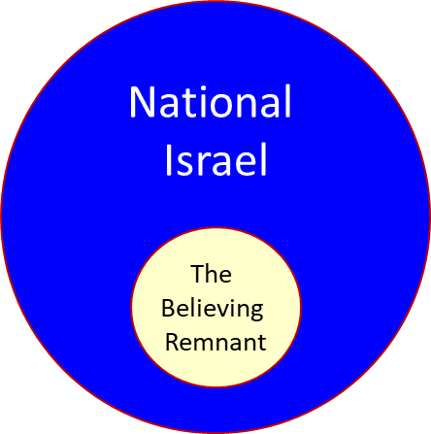

Slide 141
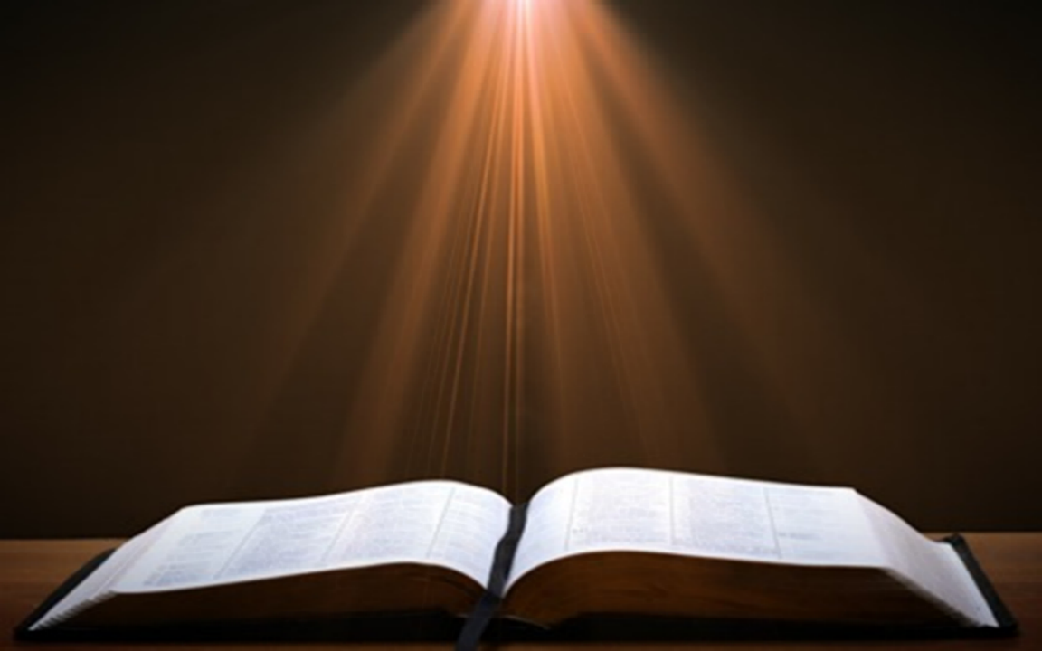
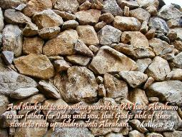
Matthew 3:9
“and do not suppose that you can say to yourselves, ‘We have Abraham for our father’; for I say to you that from these stones God is able to raise up children to Abraham.”

Slide 142

Romans 2:28-29
“²⁸ For he is not a Jew who is one outwardly, nor is circumcision that which is outward in the flesh. ²⁹ But he is a Jew who is one inwardly; and circumcision is that which is of the heart, by the Spirit, not by the letter; and his praise is not from men, but from God.”

Slide 143
Romans 9:6
“But it is not as though the word of God has failed. For they are not all Israel who are descended from Israel.”

Slide 145

Revelation 2:9
“I know your tribulation and your poverty (but you are rich), and the blasphemy by those who say they are Jews and are not, but are a synagogue of Satan.”

Slide 147
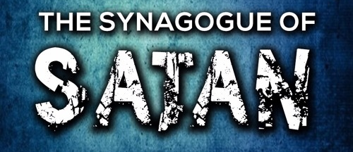
Revelation 3:9
“Behold, I will cause those of the synagogue of Satan, who say that they are Jews and are not, but lie—I will make them come and bow down at your feet, and make them know that I have loved you.”

Slide 148

Zechariah 13:8-9
⁸“It will come about in all the land,” Declares the Lord, “That two parts in it will be cut off and perish; But the third will be left in it. ⁹“And I will bring the third part through the fire, Refine them as silver is refined, And test them as gold is tested. They will call on My name, And I will answer them; I will say, ‘They are My people,’ And they will say, ‘The Lord is my God.’ ”

Slide 149

Ezekiel 20:33-38
³³ “As I live,” declares the Lord God, “surely with a mighty hand and with an outstretched arm and with wrath poured out, I shall be king over you. ³⁴ I will bring you out from the peoples and gather you from the lands where you are scattered, with a mighty hand and with an outstretched arm and with wrath poured out; ³⁵ and I will bring you into the wilderness of the peoples, and there I will enter into judgment with you face to face. ³⁶ As I entered into . . .

Slide 150
Ezekiel 20:33-38
. . . judgment with your fathers in the in the wilderness of the land of Egypt, so I will enter into judgment with you,” declares the Lord God. ³⁷ “I will make you pass under the rod, and I will bring you into the bond of the covenant; ³⁸ and I will purge from you the rebels and those who transgress against Me; I will bring them out of the land where they sojourn, but they will not enter the land of Israel. Thus you will know that I am the Lord.

Slide 151
Acts 19:13-20
Imitators’ Failure
      Imitators (13-14)
      Demonic response (15)
      Demonic overpowering (16)
      Results (17-19)
      Progress report (20)

Slide 152
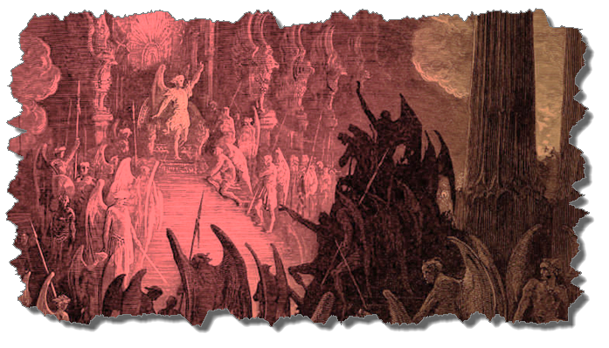
Demonic Personhood
Attributes of personhood
  Intellect – Acts 19:15
  Emotions – Luke 8:28; Jas 2:19
  Will – Luke 8:32
  Personal pronouns – Mark 1:24-25

Slide 153
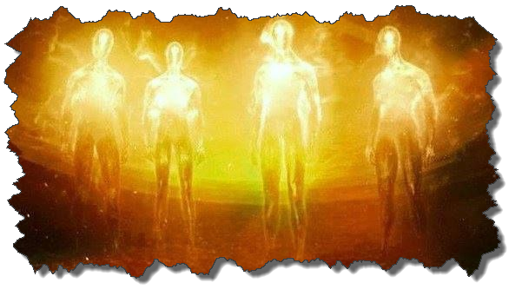
Demonic Powers
Great strength (Mark 5:3-4; Acts 19:16) but not omnipotent (Dan 10:13)
Superhuman intelligence (2 Sam. 14:20; Luke 8:28; 20:35-36) but not omniscient (Acts 19:15)
Not confined by physical space or barriers (Mark 5:9) but not omnipresent (Mark 5:12)

Slide 154
Acts 19:13-20
Imitators’ Failure
      Imitators (13-14)
      Demonic response (15)
      Demonic overpowering (16)
      Results (17-19)
      Progress report (20)

Slide 155
Demonic Powers
Great strength (Mark 5:3-4; Acts 19:16) but not omnipotent (Dan 10:13)
Superhuman intelligence (2 Sam. 14:20; Luke 8:28; 20:35-36) but not omniscient (Acts 19:15)
Not confined by physical space or barriers (Mark 5:9) but not omnipresent (Mark 5:12)

Slide 156
Acts 19:13-20
Imitators’ Failure
      Imitators (13-14)
      Demonic response (15)
      Demonic overpowering (16)
      Results (17-19)
      Progress report (20)

Slide 157
Acts 19:17-19
Results
      Jesus glorified (17)
      Confession (18)
      Destruction of occult items (19)

Slide 158
Acts 19:17-19
Results
      Jesus glorified (17)
      Confession (18)
      Destruction of occult items (19)

Slide 159
Dispensational Theology is a System of Theology
Traditional-normative dispensational theology is a system that embodies three essential, fundamental concepts called the sine qua non (lit. “without which is not”):
The consistent use of a plain, normal, literal, grammatical-historical method of interpretation;
Which reveals that the Church is distinct from Israel;
God’s overall purpose is to bring glory to Himself (Eph. 1:6, 12, 14).
Dr. Charles Ryrie, Dispensationalism, pp. 38-41

Slide 160
Doxological Purpose
God’s ultimate purpose for the ages is to glorify Himself. Scripture is not human-centered, as though salvation were the principle point, but God-centered, because His glory is at the center.
The glory of God is the primary principle that unifies all dispensations, the program of salvation being just one of the means by which God glorifies Himself. Each successive revelation of God’s plan for the ages, as well as His dealing with the elect, non-elect, angels, and nations all manifest His glory.
Dictionary of Premillennial Theology, Charles Ryrie, p. 94

Slide 161
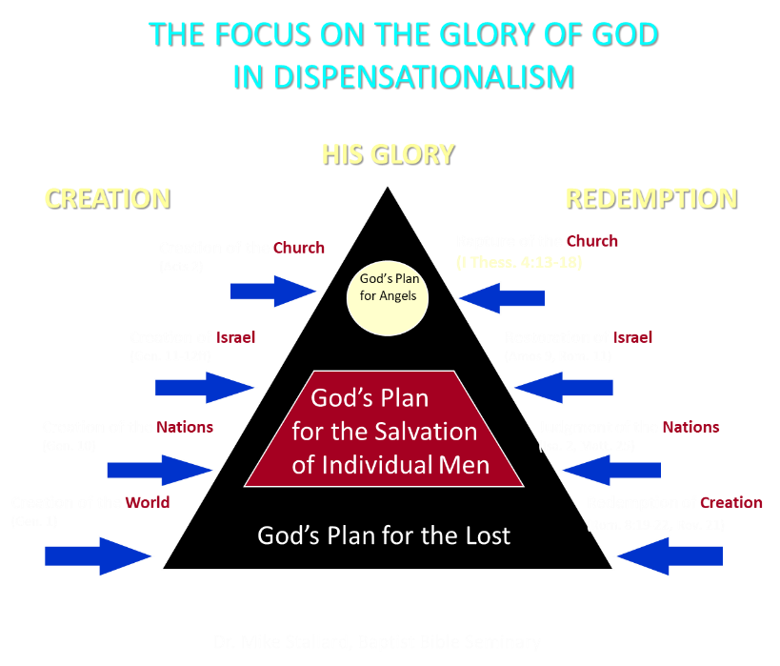

Slide 162
Acts 19:17-19
Results
      Jesus glorified (17)
      Confession (18)
      Destruction of occult items (19)

Slide 163
Lewis Sperry Chafer, vol. 7, Systematic Theology
(Grand Rapids, MI: Kregel Publications, 1993), 265-66.
Belief-God’s One Condition for Justification
“…because upwards of 150 passages of Scripture condition salvation upon believing only (cf. John 3:16; Acts 16:31).”

Slide 164
Belief – God’s One Condition for Justification
Gen 15:6
Then he believed in the LORD; and He reckoned it to him as righteousness.
John 3:16
For God so loved the world, that He gave His only begotten Son, that whoever believes in Him shall not perish, but have eternal life.
Acts 16:30-31
"Sirs, what must I do to be saved?" They said, "Believe in the Lord Jesus, and you will be saved..."

Slide 165

Charles Ryrie
Ryrie, C. C. (1997). So Great Salvation: What It Means to Believe in Jesus Christ (pp. 102–103). Moody Press.
“Think about the condition of the believers at Ephesus (Acts 19:1–20). Paul ministered in that city more than two years. Some believed at the beginning of his ministry; others, later on. They were converted from a lifestyle that included devotion to magical arts based on the gibberish that was written on the statue of Diana in the great temple at Ephesus. But even after believing in the Lord, many, perhaps most, of those believers (and Acts 19:18 clearly states that they were believers) still continued their superstitious practices. It would be wishful thinking to imagine that they did not know such practices were wrong when they accepted Christ and during those two ensuing years when they continued to do them. The books of magical arts were directly linked to the idol in the temple.”

Slide 166
Charles Ryrie
Ryrie, C. C. (1997). So Great Salvation: What It Means to Believe in Jesus Christ (pp. 102–103). Moody Press.
“But not until the end of Paul’s ministry in Ephesus did the believers finally become convicted about these sinful practices, confess their sins, and burn the books. Clearly, there were people at Ephesus who became believers in Christ knowing full well that they should give up their use of superstitious magical arts but who were unwilling to do so (some for two or more years), but who nevertheless were born again. Their salvation did not depend on faith plus submission to the mastery of Christ in relation to their sinful use of magic. Even their unwillingness to give up those books did not prevent their becoming new creations in Christ. Their salvation did not depend on faith plus giving up or being willing to give up their belief in superstitious practices.”

Slide 167
Charles Ryrie
Ryrie, C. C. (1997). So Great Salvation: What It Means to Believe in Jesus Christ (pp. 102–103). Moody Press.
“At any time during those few years, lordship advocates (had they lived back in those days and visited in the homes of some of those believers) might have looked at the lives of such Ephesians and concluded they were not saved. But the Bible says they were. So who are we to impose conditions on them (to at least be willing to give up their books of magical arts) or on anyone? God does not; we must not. There are many commands to be obeyed by Christians, but to become a Christian only requires receiving the gift of eternal life from our Lord.”

Slide 168
Acts 19:17-19
Results
      Jesus glorified (17)
      Confession (18)
      Destruction of occult items (19)

Slide 169


Acts 19:19
“And many of those who practiced magic brought their books together and began burning them in the sight of everyone; and they counted up the price of them and found it fifty thousand pieces of silver.”

Slide 170

Charles Ryrie
The Ryrie Study Bible
“19:19 Magic. Magical spells written on scrolls. Fifty thousand pieces of silver. If the silver drachma is meant, the value would have been the equivalent of about 138 years’ pay for a rural worker.”

Slide 171
Occult Works
NAME | DEFINITION | SCRIPTURE
Divination | Fortune telling | Deut 18:10; Acts 16:16
Spiritism | Contacting the dead | Deut 18:11
Magic | Performance of miraculous powers | Deut 18:11
Pharamkeia | Illicit drug use | Rev 9:20-21; 18:2, 23

Slide 172
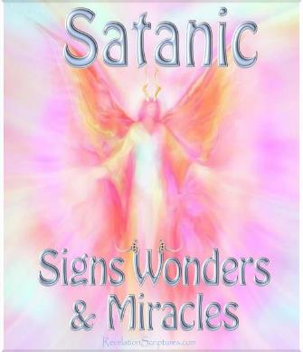
Bible Verses Against Necromancy
Lev. 19:31
Deut. 18:9-14
1 Sam. 28:7-8
2 Kgs. 21:6
1 Chron. 10:13
Isa. 8:19-20

Slide 173
Acts 19:13-20
Imitators’ Failure
      Imitators (13-14)
      Demonic response (15)
      Demonic overpowering (16)
      Results (17-19)
      Progress report (20)

Slide 174
Purpose
  To present Theophilus with an orderly account of the birth and growth of the church so as to affirm him in what he has believed.

Slide 175
Message
  Birth and growth of the church numerically, geographically, ethnically.
  Components
  Numerically (progress reports)
  Geographically (From Jerusalem to Rome)
  Ethnically (From Judaism to Gentile domination)

Slide 176
Progress Reports
  Clearest:
    Acts 2:47; 4:4; 6:7; 9:31; 12:24; 16:5; 19:20; 28:30-31
  Less clear:
    Acts 1:13, 15; 2:41; 4:4:31; 5:14, 42; 8:25, 40; 11:21; 13:49; 17:6

Slide 177
II. Ephesus Ministry
Acts 18:24‒19:41
  Apollos (18:24-28)
  John’s disciples (19:1-7)
  Ephesus witness (19:8-12)
  Imitators’ failure (19:13-20)
  Future plans (19:21-22)
  Silversmiths’ riot (19:23-41)

Slide 178
Acts 19:21-22
Future Plans
      Purpose (21)
      Preparation (22)

Slide 179
Acts 19:21-22
Future Plans
      Purpose (21)
      Preparation (22)

Slide 180
Acts 19:21
Purpose
      Motivation (21a)
      Jerusalem (21b)
      Macedonia & Achaia (21c)
      Rome (21d)

Slide 181
Acts 19:21
Purpose
      Motivation (21a)
      Jerusalem (21b)
      Macedonia & Achaia (21c)
      Rome (21d)

Slide 182
Acts 19:21
Purpose
      Motivation (21a)
      Jerusalem (21b)
      Macedonia & Achaia (21c)
      Rome (21d)

Slide 184
Acts 19:21
Purpose
      Motivation (21a)
      Jerusalem (21b)
      Macedonia & Achaia (21c)
      Rome (21d)

Slide 186
Acts 19:21
Purpose
      Motivation (21a)
      Jerusalem (21b)
      Macedonia & Achaia (21c)
      Rome (21d)

Slide 187
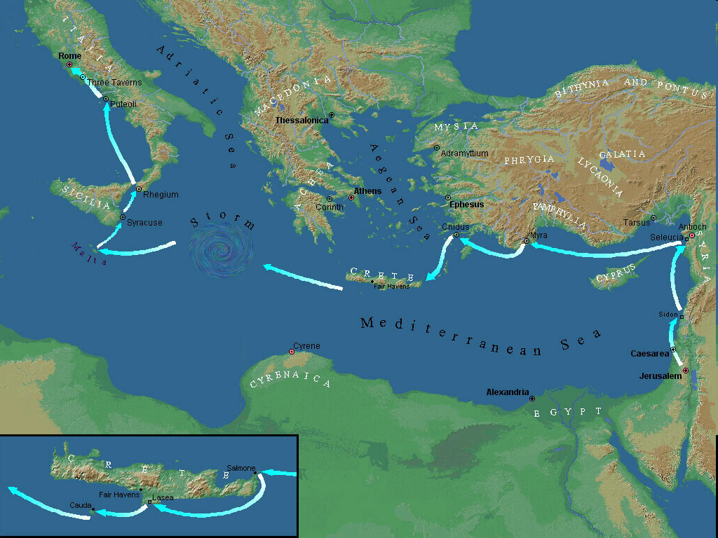

Slide 189
Purpose
  To present Theophilus with an orderly account of the birth and growth of the church so as to affirm him in what he has believed.

Slide 190
Progress Reports
  Clearest:
    Acts 2:47; 4:4; 6:7; 9:31; 12:24; 16:5; 19:20; 28:30-31
  Less clear:
    Acts 1:13, 15; 2:41; 4:4:31; 5:14, 42; 8:25, 40; 11:21; 13:49; 17:6

Slide 191
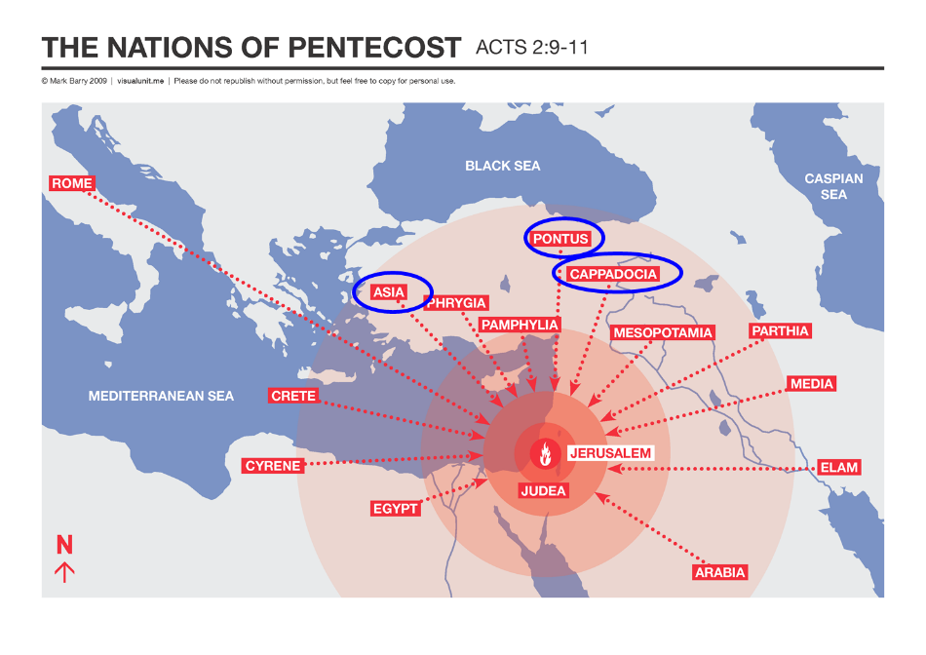

Slide 192
Acts 19:21-22
Future Plans
      Purpose (21)
      Preparation (22)

Slide 193
Acts 19:22
Preparation
      Timothy & Erastus to Macedonia (22a)
      Paul stays in Asia (22b)

Slide 194
Acts 19:22
Preparation
      Timothy & Erastus to Macedonia (22a)
      Paul stays in Asia (22b)

Slide 196
Acts 19:22
Preparation
      Timothy & Erastus to Macedonia (22a)
      Paul stays in Asia (22b)

Slide 198
II. Ephesus Ministry
Acts 18:24‒19:41
  Apollos (18:24-28)
  John’s disciples (19:1-7)
  Ephesus witness (19:8-12)
  Imitators’ failure (19:13-20)
  Future plans (19:21-22)
  Silversmiths’ riot (19:23-41)

Slide 199
Acts 19:23-41
Silversmiths’ Riot
      Riot (23)
      Organizer (24)
      Demetrius’ speech (25-27)
      Reaction (28-32)
      Alexander seeks to silence the mob (33)
      Opposite effect (34)
      Town clerk’s intervention (35-41)

Slide 200
Acts 19:23-41
Silversmiths’ Riot
      Riot (23)
      Organizer (24)
      Demetrius’ speech (25-27)
      Reaction (28-32)
      Alexander seeks to silence the mob (33)
      Opposite effect (34)
      Town clerk’s intervention (35-41)

Slide 201
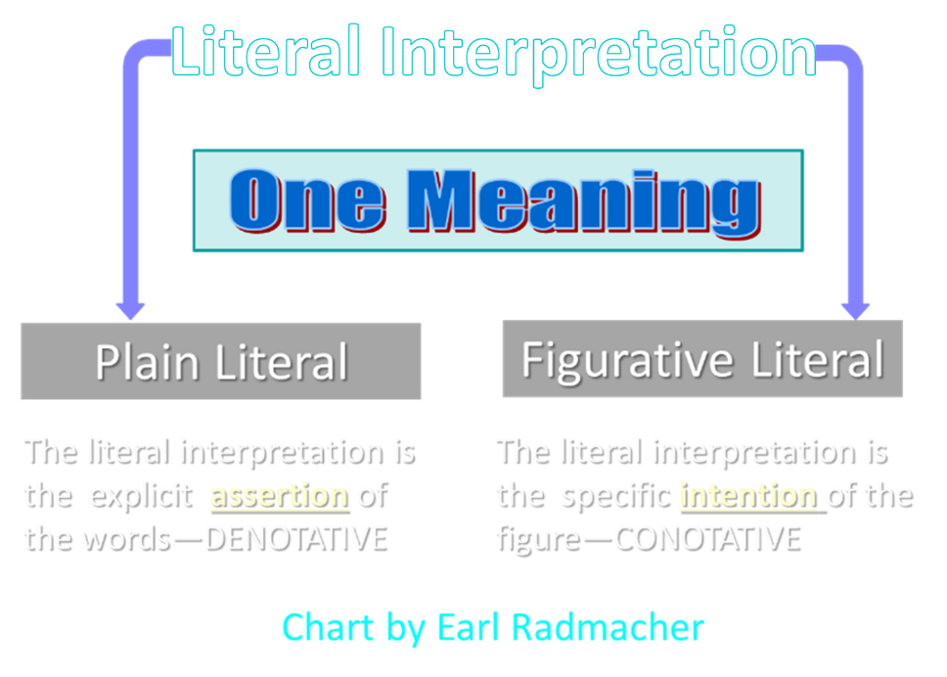

Slide 202
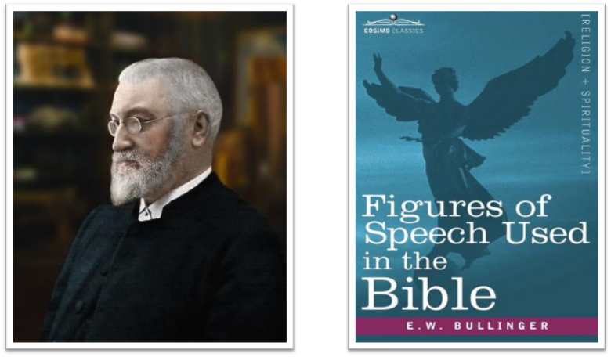
E.W. Bullinger (1837‒1913)

Slide 203
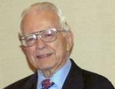

Dr. Roy B. Zuck
Basic Bible Interpretation, p. 156-57.
“﻿Litotes. A litotes is an understatement or a negative statement to express an affirmation. This is the opposite of hyperbole. When we say, ‘He is not a bad preacher,’ we mean he is a very good preacher. The understatement is made for emphasis. When Paul wrote, ‘I am a Jew … a citizen of no insignificant city’ (Acts 21:39, nasb), he meant that Tarsus was in fact a rather significant city. A litotes is at times a belittling statement, as in Numbers 13:33, ‘We seemed like grasshoppers in our own eyes, and we looked the same to them.’ Luke used a number of litotes.”

Slide 204
Dr. Roy B. Zuck
Basic Bible Interpretation, p. 156-57.
“﻿He spoke of ‘no small disturbance among the soldiers’ (Acts 12:18, nasb), ‘no little business’ (19:24), and ‘no small storm’ (27:20, nasb). When Luke wrote that Paul and Barnabas stayed in Antioch ‘a long time’ (14:28), the Greek has a litotes. It is literally, ‘they stayed there not a little time.’ Paul belittled himself with a litotes in 1 Corinthians 15:9, ‘For I am the least of the apostles.’ This statement of genuine humility was written to highlight God’s grace in his life as an undeserving sinner (see v. 10).”

Slide 205
Purpose
  To present Theophilus with an orderly account of the birth and growth of the church so as to affirm him in what he has believed.

Slide 206
Message
  Birth and growth of the church numerically, geographically, ethnically.
  Components
  Numerically (progress reports)
  Geographically (From Jerusalem to Rome)
  Ethnically (From Judaism to Gentile domination)

Slide 207
Acts 19:23-41
Silversmiths’ Riot
      Riot (23)
      Organizer (24)
      Demetrius’ speech (25-27)
      Reaction (28-32)
      Alexander seeks to silence the mob (33)
      Opposite effect (34)
      Town clerk’s intervention (35-41)

Slide 208
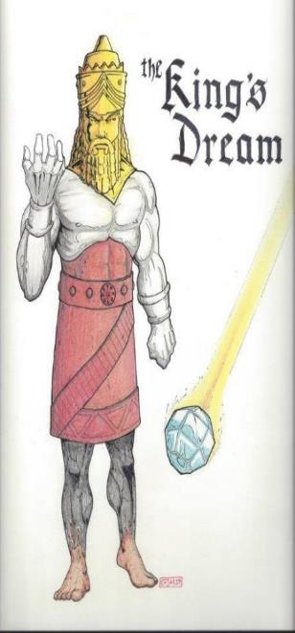
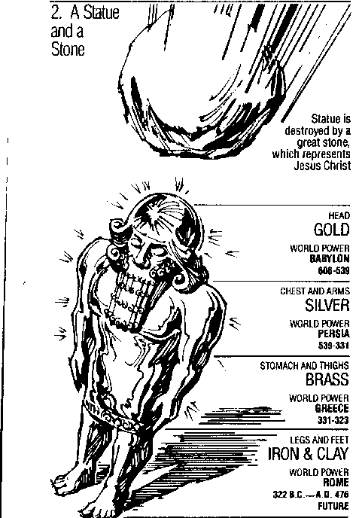
Statue
&
Stone

Slide 209
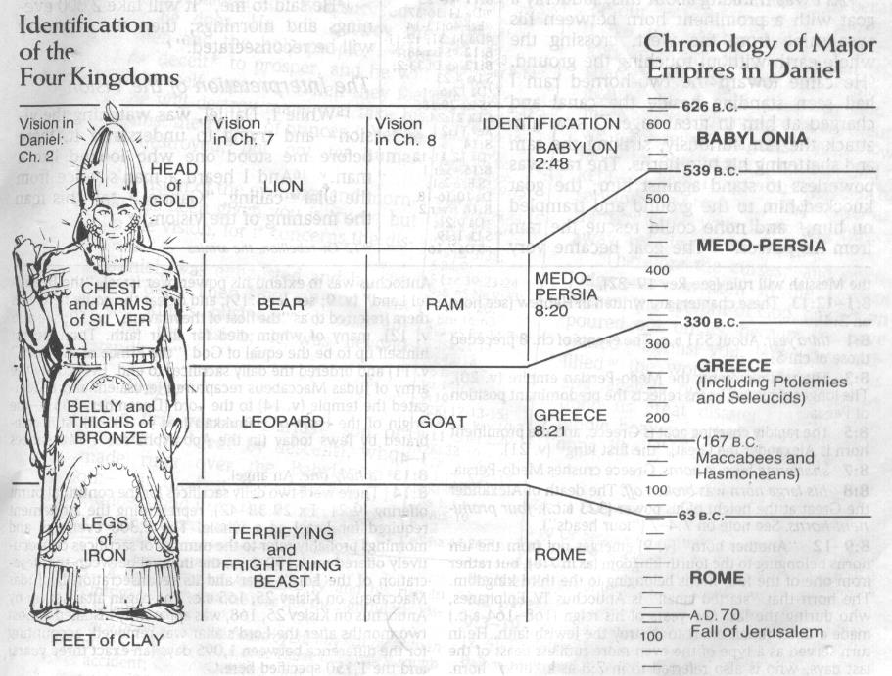

Slide 211
E.W. Bullinger (1837‒1913)

Slide 212
Dr. Roy B. Zuck
Basic Bible Interpretation, p. 156-57.
“﻿Litotes. A litotes is an understatement or a negative statement to express an affirmation. This is the opposite of hyperbole. When we say, ‘He is not a bad preacher,’ we mean he is a very good preacher. The understatement is made for emphasis. When Paul wrote, ‘I am a Jew … a citizen of no insignificant city’ (Acts 21:39, nasb), he meant that Tarsus was in fact a rather significant city. A litotes is at times a belittling statement, as in Numbers 13:33, ‘We seemed like grasshoppers in our own eyes, and we looked the same to them.’ Luke used a number of litotes.”

Slide 213
Dr. Roy B. Zuck
Basic Bible Interpretation, p. 156-57.
“﻿He spoke of ‘no small disturbance among the soldiers’ (Acts 12:18, nasb), ‘no little business’ (19:24), and ‘no small storm’ (27:20, nasb). When Luke wrote that Paul and Barnabas stayed in Antioch ‘a long time’ (14:28), the Greek has a litotes. It is literally, ‘they stayed there not a little time.’ Paul belittled himself with a litotes in 1 Corinthians 15:9, ‘For I am the least of the apostles.’ This statement of genuine humility was written to highlight God’s grace in his life as an undeserving sinner (see v. 10).”

Slide 214
Acts 19:23-41
Silversmiths’ Riot
      Riot (23)
      Organizer (24)
      Demetrius’ speech (25-27)
      Reaction (28-32)
      Alexander seeks to silence the mob (33)
      Opposite effect (34)
      Town clerk’s intervention (35-41)

Slide 215
Acts 19:25-27
Demetrius’ Speech
      Gathering of idol makers (25)
      Paul as opposition (26)
      Paul as threat (27)

Slide 216
Acts 19:25-27
Demetrius’ Speech
      Gathering of idol makers (25)
      Paul as opposition (26)
      Paul as threat (27)

Slide 217
Acts 19:25-27
Demetrius’ Speech
      Gathering of idol makers (25)
      Paul as opposition (26)
      Paul as threat (27)

Slide 218
Acts 19:25-27
Demetrius’ Speech
      Gathering of idol makers (25)
      Paul as opposition (26)
      Paul as threat (27)

Slide 219
Acts 19:27
Pauline Threat
      Trade (27a)
      Religion (27b)

Slide 220
Acts 19:27
Pauline Threat
      Trade (27a)
      Religion (27b)

Slide 221
Acts 19:27
Pauline Threat
      Trade (27a)
      Religion (27b)

Slide 222
Acts 19:23-41
Silversmiths’ Riot
      Riot (23)
      Organizer (24)
      Demetrius’ speech (25-27)
      Reaction (28-32)
      Alexander seeks to silence the mob (33)
      Opposite effect (34)
      Town clerk’s intervention (35-41)

Slide 223
Acts 19:28-32
Reaction to the Speech
      Crowd (28-29)
      Paul’s response (30a)
      Paul’s dissuaders (30b-31)
      Confusion (32)

Slide 224
Acts 19:28-32
Reaction to the Speech
      Crowd (28-29)
      Paul’s response (30a)
      Paul’s dissuaders (30b-31)
      Confusion (32)

Slide 225
Acts 19:28-29
Crowd
      Artisans (28)
      Population (29)

Slide 226
Acts 19:28-29
Crowd
      Artisans (28)
      Population (29)

Slide 227
Acts 19:28-29
Crowd
      Artisans (28)
      Population (29)

Slide 228
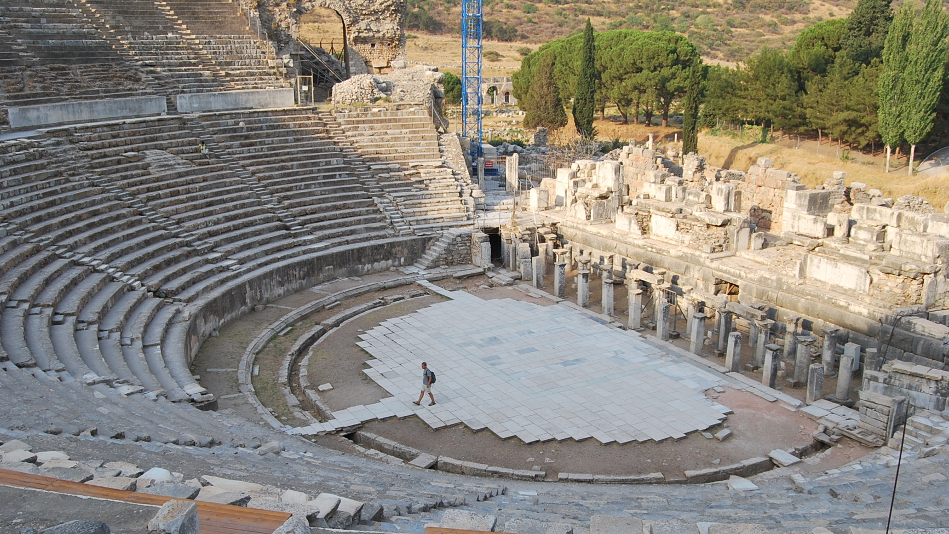

Slide 229
Acts 19:28-32
Reaction to the Speech
      Crowd (28-29)
      Paul’s response (30a)
      Paul’s dissuaders (30b-31)
      Confusion (32)

Slide 230
Acts 19:28-32
Reaction to the Speech
      Crowd (28-29)
      Paul’s response (30a)
      Paul’s dissuaders (30b-31)
      Confusion (32)

Slide 231
Acts 19:30b-31
Paul’s Dissuaders
      Disciples (30b)
      Friends (31)

Slide 232
Acts 19:30b-31
Paul’s Dissuaders
      Disciples (30b)
      Friends (31)

Slide 233
Acts 19:30b-31
Paul’s Dissuaders
      Disciples (30b)
      Friends (31)

Slide 235
Dr. Arnold G. Fruchtenbaum
The Book of Acts, 412
“The Asiarchs were ten officers elected by the cities of the Roman province of Asia. Their key responsibility was twofold: first, to supervise funds collected in connection with the worship of the emperor; and second, to preside at the games in the festivals. They had to fulfill these responsibilities at their own expense, and so the job was given only to those who were wealthy enough to afford it. Yet, wealthy people eagerly sought this opportunity for involvement because of the prestige it gave them. According to The Jewish Annotated New Testament, ‘local officials and other elite persons often assist Paul or become believers (13.12,50; 16.35; 17.12,34; 18.15-16).’ In this case, it was some of these Asiarchs who had befriended the apostle. This does not mean that they had become believers, but at least they respected him. Since they were not present to physically restrain him, they sent a message, urging him not to venture into the theater.”

Slide 236
Acts 19:28-32
Reaction to the Speech
      Crowd (28-29)
      Paul’s response (30a)
      Paul’s dissuaders (30b-31)
      Confusion (32)

Slide 237


Matthew 16:18
“I also say to you that you are Peter, and upon this rock I WILL build [oikodomeō] My church; and the gates of Hades WILL NOT overpower it.”

Slide 238

Ephesians 2:14
“For He Himself is our peace, who made both groups into one and broke down the barrier of the dividing wall.”

Slide 239
Ephesians 3:3-6
“³ that by revelation there was made known to me the mystery, as I wrote before in brief. ⁴ By referring to this, when you read you can understand my insight into the mystery of Christ, ⁵ which in other generations was not made known to the sons of men, as it has now been revealed to His holy apostles and prophets in the Spirit; ⁶ to be specific, that the Gentiles are fellow heirs and fellow members of the body, and fellow partakers of the promise in Christ Jesus through the gospel.”

Slide 240


Ephesians 3:9
“and to bring to light what is the administration of the mystery which for ages has been hidden in God who created all things.”

Slide 241
Acts 19:23-41
Silversmiths’ Riot
      Riot (23)
      Organizer (24)
      Demetrius’ speech (25-27)
      Reaction (28-32)
      Alexander seeks to silence the mob (33)
      Opposite effect (34)
      Town clerk’s intervention (35-41)

Slide 242
Acts 19:23-41
Silversmiths’ Riot
      Riot (23)
      Organizer (24)
      Demetrius’ speech (25-27)
      Reaction (28-32)
      Alexander seeks to silence the mob (33)
      Opposite effect (34)
      Town clerk’s intervention (35-41)

Slide 243
Acts 19:23-41
Silversmiths’ Riot
      Riot (23)
      Organizer (24)
      Demetrius’ speech (25-27)
      Reaction (28-32)
      Alexander seeks to silence the mob (33)
      Opposite effect (34)
      Town clerk’s intervention (35-41)

Slide 244
Acts 19:35-41
Town Clerk’s Intervention
      Quiets crowd (35a)
      Speech (35b-41)

Slide 245
Acts 19:35-41
Town Clerk’s Intervention
      Quiets crowd (35a)
      Speech (35b-41)

Slide 246
Acts 19:35-41
Town Clerk’s Intervention
      Quiets crowd (35a)
      Speech (35b-41)

Slide 247
Acts 19:35b-41
Speech
      City’s status (35b)
      Warning against rashness (36)
      Innocence of Gaius & Aristarchus (37)
      Proper course of action (38-40)
      Dismissal (41)

Slide 248
Acts 19:35b-41
Speech
      City’s status (35b)
      Warning against rashness (36)
      Innocence of Gaius & Aristarchus (37)
      Proper course of action (38-40)
      Dismissal (41)

Slide 249
Acts 19:35b-41
Speech
      City’s status (35b)
      Warning against rashness (36)
      Innocence of Gaius & Aristarchus (37)
      Proper course of action (38-40)
      Dismissal (41)

Slide 250
Acts 19:35b-41
Speech
      City’s status (35b)
      Warning against rashness (36)
      Innocence of Gaius & Aristarchus (37)
      Proper course of action (38-40)
      Dismissal (41)

Slide 251
Acts 19:35b-41
Speech
      City’s status (35b)
      Warning against rashness (36)
      Innocence of Gaius & Aristarchus (37)
      Proper course of action (38-40)
      Dismissal (41)

Slide 252
Acts 19:38-40
Proper Course
      Use the courts (38)
      No violence (39)
      Loss of Roman standing (40)

Slide 253
Acts 19:38-40
Proper Course
      Use the courts (38)
      No violence (39)
      Loss of Roman standing (40)

Slide 254
Acts 19:38-40
Proper Course
      Use the courts (38)
      No violence (39)
      Loss of Roman standing (40)

Slide 255
Acts 19:38-40
Proper Course
      Use the courts (38)
      No violence (39)
      Loss of Roman standing (40)

Slide 256
Dr. Arnold G. Fruchtenbaum
The Book of Acts, 415
“The Ephesians might have to give an account to the Roman authorities to guarantee that there was nothing anti-Roman about the commotion. Quoting Seneca, Robertson notes that ‘there was nothing on which the Romans looked with such jealousy as a tumultuous meeting.’”

Slide 257
Acts 19:35b-41
Speech
      City’s status (35b)
      Warning against rashness (36)
      Innocence of Gaius & Aristarchus (37)
      Proper course of action (38-40)
      Dismissal (41)

Slide 258
Conclusion

Slide 259
Acts 18:23‒21:17
3rd Missionary Journey
  Galatia & Phrygia ministry (18:23)
  Ephesus ministry (18:24‒19:41)
  Macedonian & Greece ministry (20:1-4)
  Troas ministry (20:5-12)
  Miletus ministry (20:13-38)
  Journey to Jerusalem (21:1-17)

Slide 260
II. Ephesus Ministry
Acts 18:24‒19:41
  Apollos (18:24-28)
  John’s disciples (19:1-7)
  Ephesus witness (19:8-12)
  Imitators’ failure (19:13-20)
  Future plans (19:21-22)
  Silversmiths’ riot (19:23-41)

