Slide 1



Slide 2


Slide 3
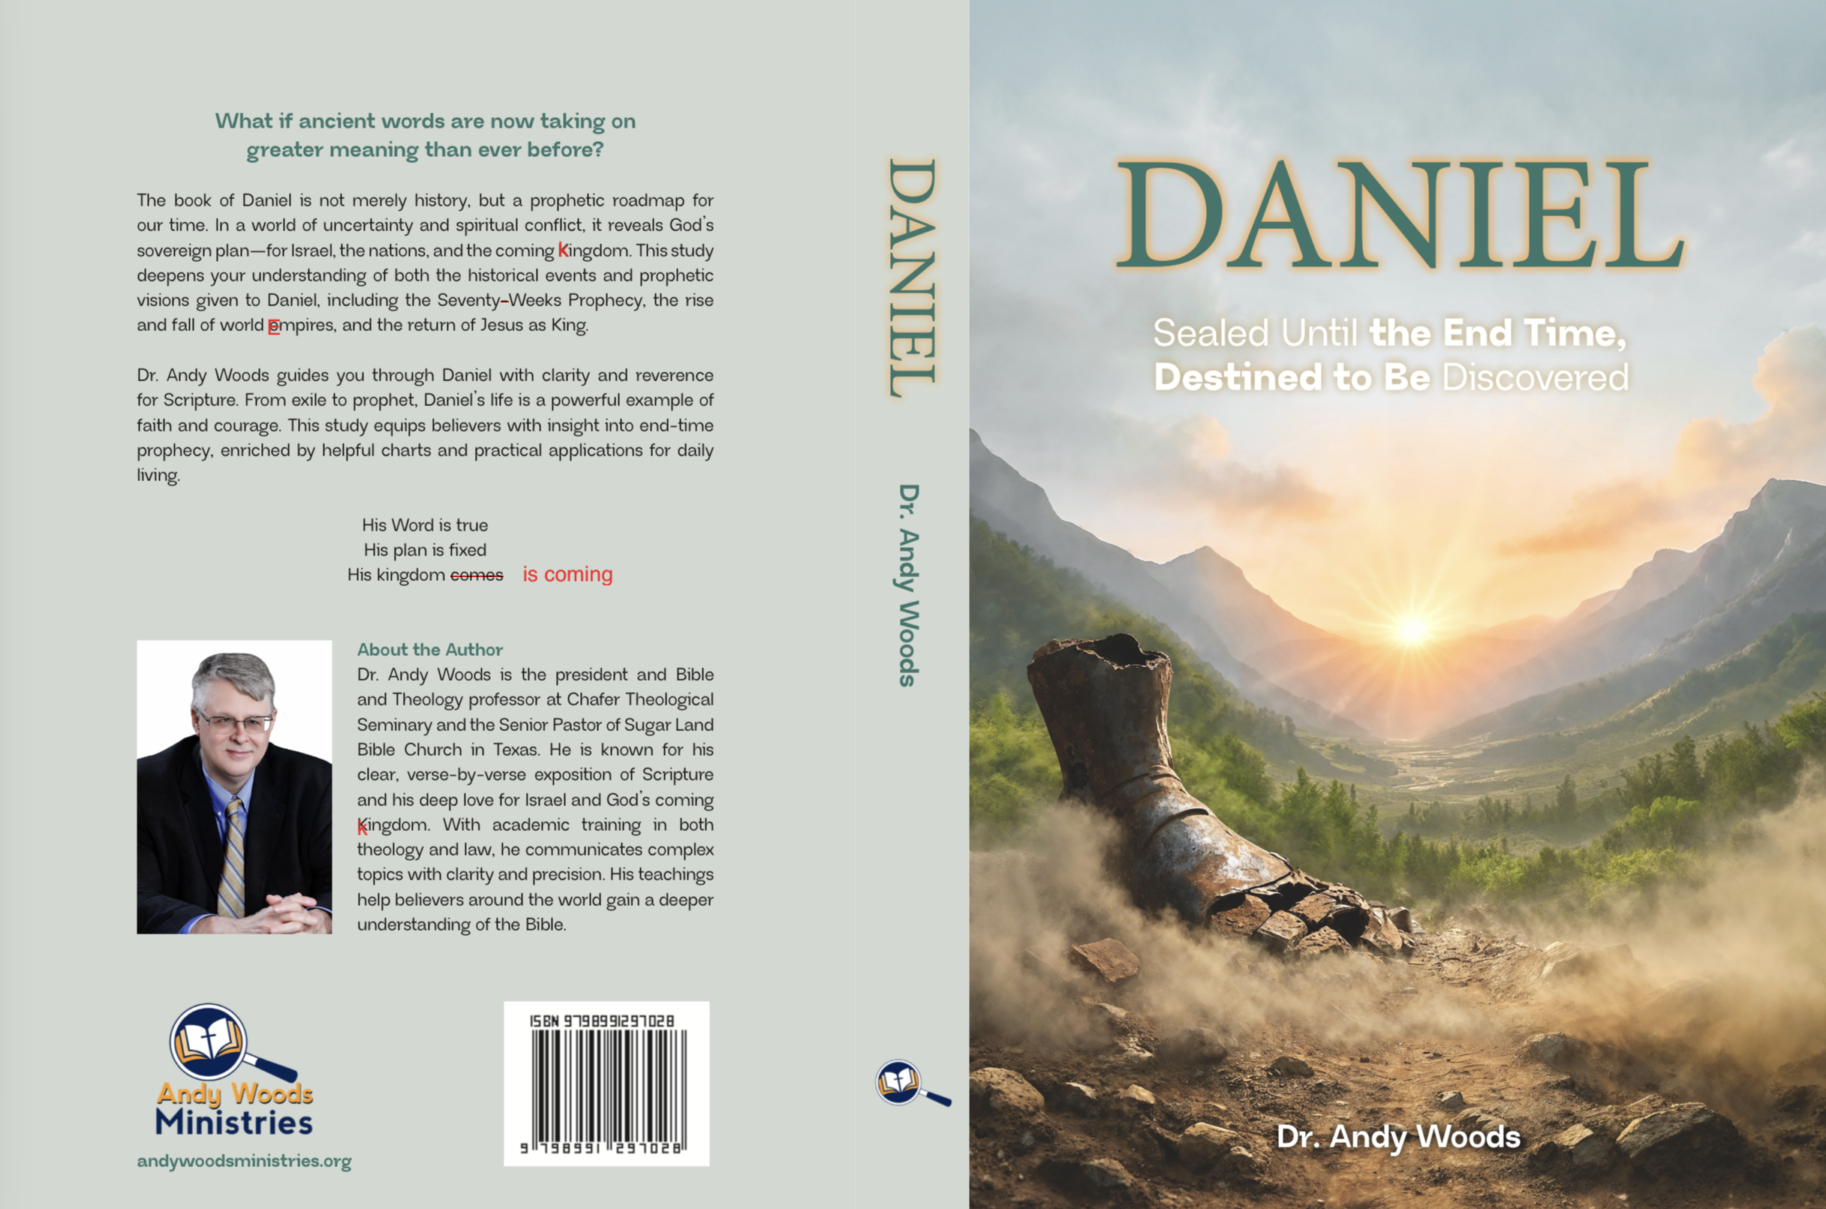

Slide 4

EXODUS STRUCTURE/OUTLINE
Redemption (1–18)
  Redemption (1:1–12:30)
  Liberation (12:31–15:21)
  Preservation (15:22–18:27)
Mosaic Covenant (19–40)
  Law (19–24)
  Tabernacle instructions (25–31)
  Apostasy (32–34)
  Tabernacle building (35–40)

Slide 5
REDEMPTION
(1:1–12:30)
Why redemption is necessary (Exod 1)
Development of the deliverer (Exod 2–4)
First confrontation with Pharaoh (Exod 5)
God reassures Moses (Exod 6:1–7:7)
Second confrontation with Pharaoh (Exod 7:8-13)
Plagues (Exod 7:14–12:30)

Slide 6
The Plagues of Egypt
NO. | DESCRIPTION | SCRIPTURE | Egyptian Deity
1. | Water to Blood | Exod. 7:14-25 | Hapi, Khnum
2. | Frogs | Exod. 8:1-15 | Heqt
3. | Gnats | Exod. 8:16-19 | Set
4. | Flies | Exod. 8:20-32 | Uatchit
5. | Disease on Cattle | Exod. 9:1-7 | Hathor, Apis
6. | Boils | Exod. 9:8-12 | Sekhmet, Serapis
7. | Hail | Exod. 9:13-35 | Seth, Nut
8. | Locusts | Exod. 10:1-20 | Seth, Nut, Osiris
9. | Darkness | Exod. 10:21-29 | Re, Horus, Atum
10. | Death of the First Born | Exod. 12:29-36 | Min, Osiris, Heqt, Isis

Slide 7
TEN PLAGUES REDEMPTION (7:14–12:30)
Nile to blood
Frogs
Gnats
Flies
Death of livestock
Boils
Hail
Locusts
Darkness
Death of 1st born

Slide 8
DEATH OF FIRST BORN
Exodus 12:1-51
  God’s instructions to Moses (1-20)
  Moses instructions to Israel (21-28)
  Death of the 1st born (29-32)
  Exodus from Egypt (33-42)
  Passover instituted (43-51)

Slide 9
II. Exodus 12:21-28
Moses’ Instructions to Israel
    Lamb’s death (21)
    Blood applied (22)
    Passover described (23)
    Ritual established (24-27a)
    Israel’s response (27b-28)

Slide 10
II. Exodus 12:21-28
Moses’ Instructions to Israel
    Lamb’s death (21)
    Blood applied (22)
    Passover described (23)
    Ritual established (24-27a)
    Israel’s response (27b-28)

Slide 11
II. Exodus 12:21-28
Moses’ Instructions to Israel
    Lamb’s death (21)
    Blood applied (22)
    Passover described (23)
    Ritual established (24-27a)
    Israel’s response (27b-28)

Slide 12
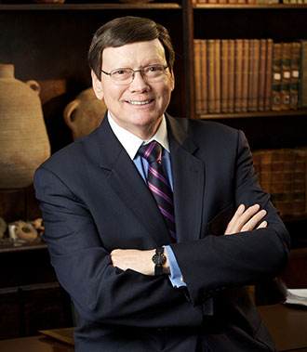
Dr. Ed Hindson
Hindson, E. E., & Mitchell, D. R., eds. (2010). KJV Bible Commentary for Today: The Most Up-to-Date Commentary on the Time-Honored Text of the KJV (p. 99). Thomas Nelson.
“12:7. The blood of the sacrificed lamb was to be stained on the two side posts and … upper door post of the home in which the lamb would be eaten that evening. At either corner where the side posts met the lintel, the bloody stain would have formed a cross.”

Slide 13
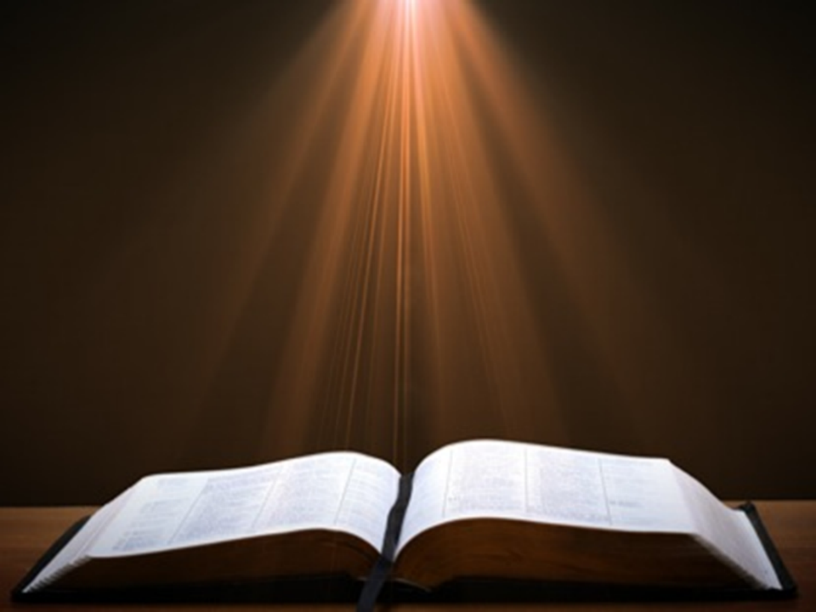
Luke 24:27, 44
“²⁷ Then beginning with Moses and with all the prophets, He explained to them the things concerning Himself in all the Scriptures…⁴⁴ Now He said to them, ‘These are My words which I spoke to you while I was still with you, that all things which are written about Me in the Law of Moses and the Prophets and the Psalms must be fulfilled.’”

Slide 14
II. Exodus 12:21-28
Moses’ Instructions to Israel
    Lamb’s death (21)
    Blood applied (22)
    Passover described (23)
    Ritual established (24-27a)
    Israel’s response (27b-28)

Slide 15

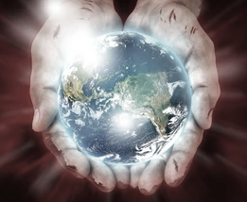
John 1:29
“The next day he saw Jesus coming to him, and said, ‘Behold, the Lamb of God who takes away the sin of the world!’”

Slide 16
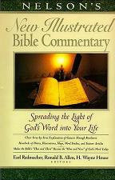
Exodus 12:23
“The term ‘the destroyer’ in Ex. 12:23 (a Heb. participle from shahat, in the Hiphil theme) seems to suggest that the agent of destruction is someone other than the Lord (but compare Ex. 12:12, 13). Who then, or what, is ‘the destroyer?’…It seems that only with the NT revelation may this conundrum be solved. The ‘Destroyer’ (the term should be spelled with a capital letter) appears to be another reference to the pre-incarnate Jesus! (This is also, we believe, the better solution to the meaning of the term ‘the Angel of Yahweh’; 23:20.)”
Nelson's New Illustrated Bible Commentary, 108.

Slide 17
Exodus 12:23
“Certainly many will cringe at the notion of Jesus being described with this dark title; but they cringe as well at the picture of the Savior in Rev. 19:11–21. (Perhaps the same image is intended in the account of the Angel of the Lord with a drawn sword in His hand standing over the infamous Balaam; Num. 22:31.) Scriptural categories should not be established by ‘cringe-quotients’! There are many and varied portraits of the Savior-King in Scripture. Here is a neglected one, ‘the Destroyer!’”
Nelson's New Illustrated Bible Commentary, 108.

Slide 18
II. Exodus 12:21-28
Moses’ Instructions to Israel
    Lamb’s death (21)
    Blood applied (22)
    Passover described (23)
    Ritual established (24-27a)
    Israel’s response (27b-28)

Slide 19
Exodus 12:24-27a
Ritual Established
      Practiced forever (24)
      In the land (25)
      Taught in the family (26-27a)

Slide 20
Exodus 12:24-27a
Ritual Established
      Practiced forever (24)
      In the land (25)
      Taught in the family (26-27a)

Slide 21

John 13:19; 14:29
“¹⁹ From now on I am telling you before it comes to pass, so that when it does occur, you may believe that I am He… ^{14:29} Now I have told you before it happens, so that when it happens, you may believe.”

Slide 22
Exodus 12:24-27a
Ritual Established
      Practiced forever (24)
      In the land (25)
      Taught in the family (26-27a)

Slide 23

Genesis 15:18-21
¹⁸ On that day the Lord made a covenant with Abram, saying, “To your descendants I have given this land, From the river of Egypt as far as the great river, the river Euphrates: ¹⁹ the Kenite and the Kenizzite and the Kadmonite ²⁰ and the Hittite and the Perizzite and the Rephaim ²¹ and the Amorite and the Canaanite and the Girgashite and the Jebusite.”

Slide 24
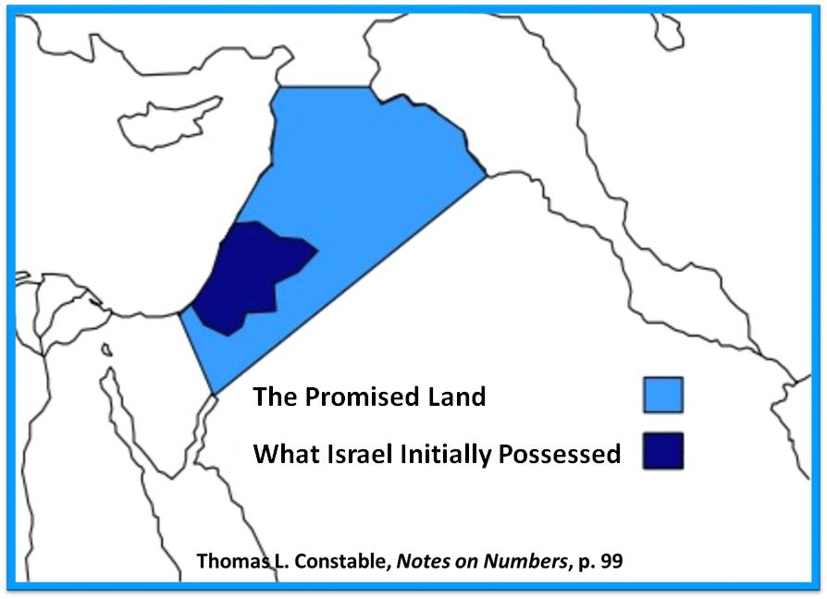

Slide 25
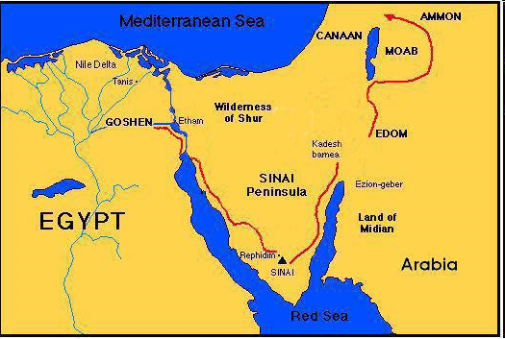

Slide 26
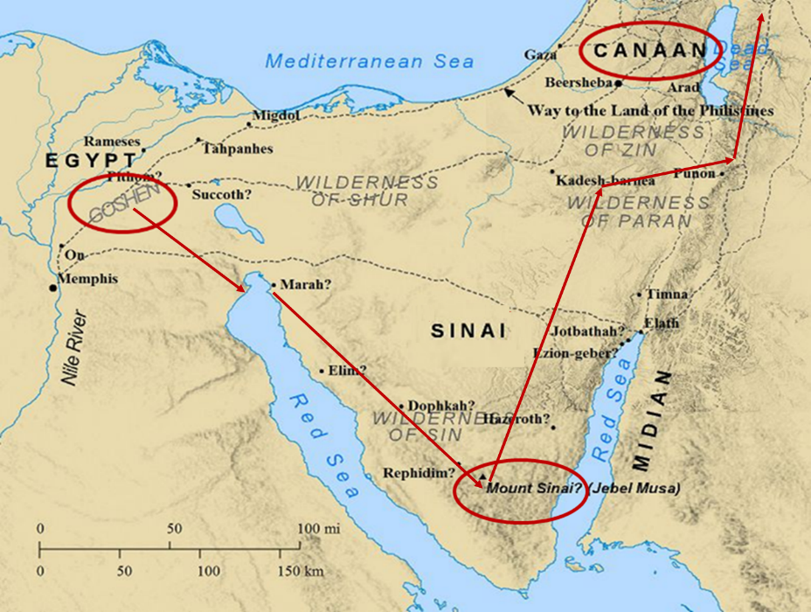

Slide 27
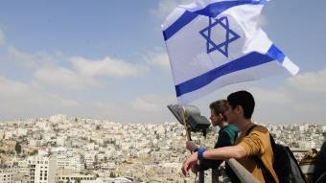
Reliability of the “Divine Regathering” Predictions
 | RETURN | PREDICTED | FULFILLED
1st | From Egypt to Canaan | Gen. 15:13-14 | Joshua 1‒12
2nd | From Babylon to Israel | Jer. 25:11; 29:10 | Ezra & Nehemiah
3rd | From the Diaspora to Israel’s restoration | Ezekiel 36:24-28 | Millennial Kingdom

Slide 28
Exodus 12:24-27a
Ritual Established
      Practiced forever (24)
      In the land (25)
      Taught in the family (26-27a)

Slide 29
Exodus 12:26-27a
Taught in the Family
      Children's question (26)
      Parent’s answer (27a)

Slide 30
Exodus 12:26-27a
Taught in the Family
      Children's question (26)
      Parent’s answer (27a)

Slide 31
Exodus 12:26-27a
Taught in the Family
      Children's question (26)
      Parent’s answer (27a)

Slide 32

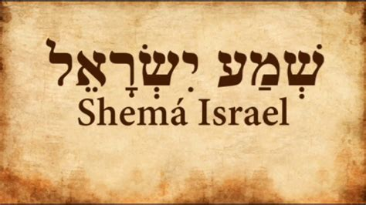
Deuteronomy 6:4-7
“⁴ Hear, Israel! The Lord is our God, the Lord is one!... ⁶ These words, which I am commanding you today, shall be on your heart. ⁷ You shall teach them diligently to your sons and shall talk of them when you sit in your house and when you walk by the way and when you lie down and when you rise up.”

Slide 33
II. Exodus 12:21-28
Moses’ Instructions to Israel
    Lamb’s death (21)
    Blood applied (22)
    Passover described (23)
    Ritual established (24-27a)
    Israel’s response (27b-28)

Slide 34
Exodus 12:27b-28
Israel’s Response
      Worship (27b)
      Obedience (28)

Slide 35
Exodus 12:27b-28
Israel’s Response
      Worship (27b)
      Obedience (28)

Slide 36
Exodus 12:27b-28
Israel’s Response
      Worship (27b)
      Obedience (28)

Slide 37
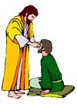
“SEVEN SIGNS” in Gospel of John
1. Changing Water into Wine | 2:11
2. Healing official’s son | 4:46-54
3. Healing an invalid at the Pool of Bethesda | 5:1-18
4. Feeding the 5,000 | 6:5-14
5. Walking on water | 6:16-21
6. Healing a blind man | 9:1-7
7. Raising dead Lazarus | 11:1-45

Slide 38
DEATH OF FIRST BORN
Exodus 12:1-51
  God’s instructions to Moses (1-20)
  Moses instructions to Israel (21-28)
  Death of the 1st born (29-32)
  Exodus from Egypt (33-42)
  Passover instituted (43-51)

Slide 39
III. Exodus 12:429-32
Death of 1st Born
    Comprehensive judgment (29)
    Emotional response (30)
    Command to leave (31-32)

Slide 40
III. Exodus 12:429-32
Death of 1st Born
    Comprehensive judgment (29)
    Emotional response (30)
    Command to leave (31-32)

Slide 41
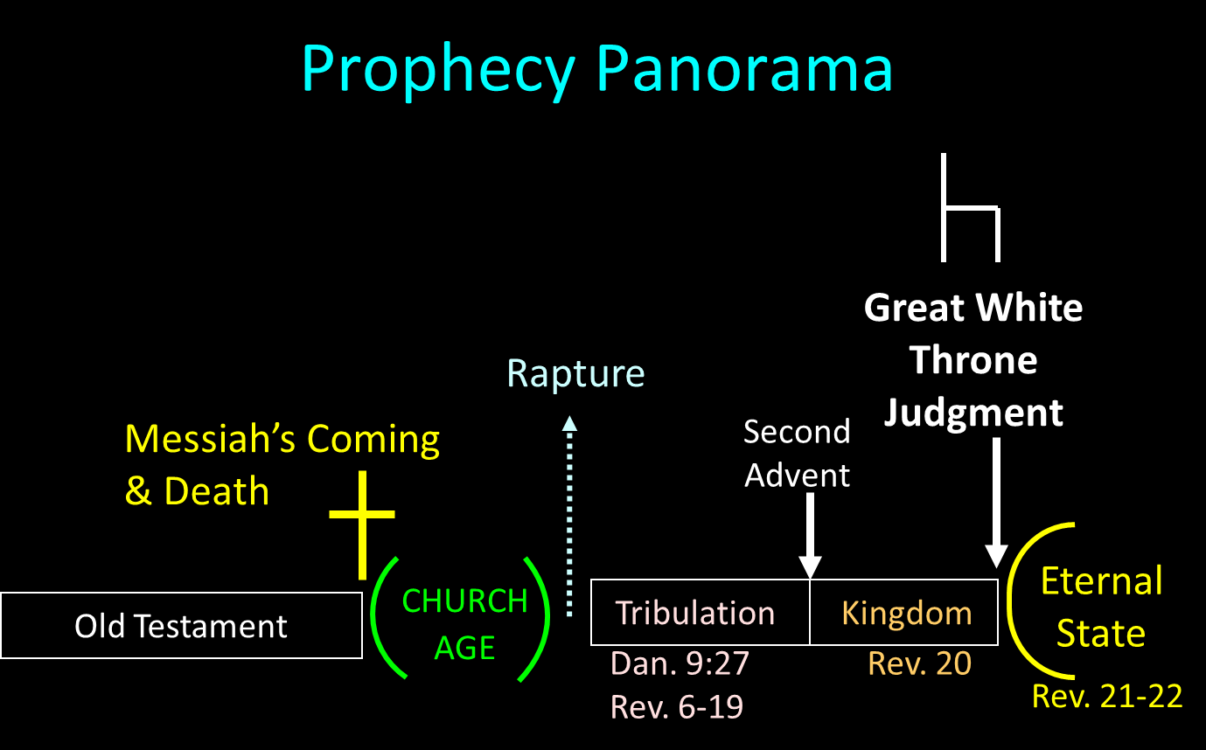

Slide 42
Scripture’s Four Judgments
NAME | SHEEP AND GOAT | JUDGMENT OF THE JEWS | BEMA SEAT | GREAT WHITE THRONE
SCRIPTURE | Matt 25:31-46 | Ezek 20:33-44 | 1 Cor 3:10-15 | Rev 20:11-15
PLACE | Earth, Jerusalem | Earth, wilderness | Heaven | Earth
AUDIENCE | Gentile Tribulation survivors | Jewish Tribulation survivors | Church Age believers | All unsaved
WHEN | After Tribulation | After Tribulation | After rapture | After Millennium
PURPOSE | Saved Gentiles enter kingdom | Saved Jews enter kingdom | Reward believers | Degree of punishment in hell
EVALUATION | Treatment of Christ’s brethren | Passing under shepherd’s rod | Works taken through fire | Not in the book; judged by books

Slide 43
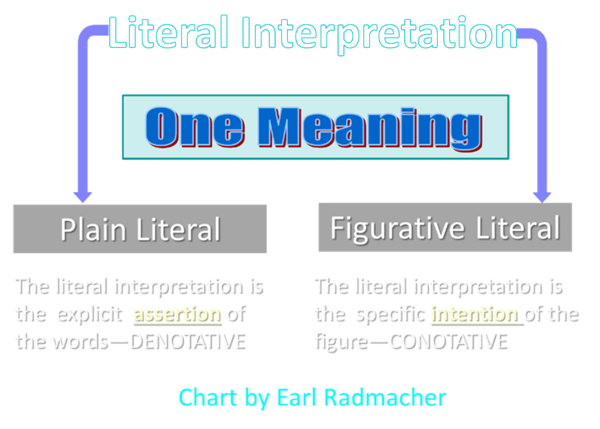

Slide 44
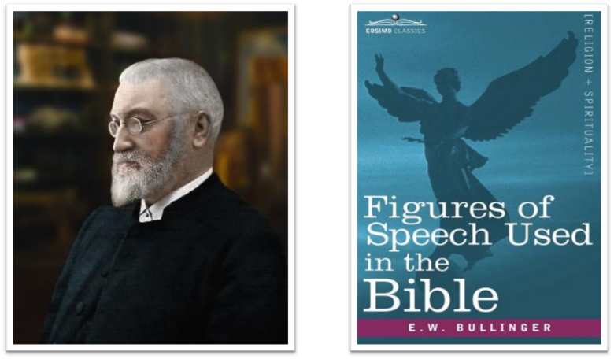
E.W. Bullinger (1837‒1913)

Slide 45
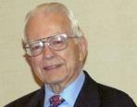

Dr. Roy B. Zuck
Basic Bible Interpretation, p. 151.
“Merism. A merism is a form of synecdoche in which the totality or whole is substituted by two contrasting or opposite parts. When the psalmist wrote, ‘You know when I sit and when I rise’ (Ps. 139:2), he was not limiting the Lord’s knowledge to times when he sat down and when he got up. Instead he was saying the Lord knew all his actions.”

Slide 46
Dr. Ed Hindson
Hindson, E. E., & Mitchell, D. R., eds. (2010). KJV Bible Commentary for Today: The Most Up-to-Date Commentary on the Time-Honored Text of the KJV (p. 101). Thomas Nelson.
“12:29. Those holding to the miraculous intensification of natural events theory of the plagues cannot in any fashion explain the origin of a virus intelligent enough to select only firstborn males. The hand of the Lord is the only satisfactory explanation for this disaster. His promised judgment (4:23) had been rendered.”

Slide 47

PLAGUES’ MIRACULOUS NATURE
Moses knew about them beforehand (8:10; 9:5, 29)
Instantaneous appearance and termination
Description as “signs and wonders” (7:3)
Intensification
Timing
Accomplishment of a moral purpose (11:1)
Response they invoked from the Egyptian sorcerers (7:22; 8:18-19)
Last seven plagues did not effect the Jews living in Goshen (9:6)
Nile into blood affected all rivers, streams, pools, reservoirs, and vessels holding waters
Hill and Walton, A Survey of the Old Testament, 114-15

Slide 48

Charles Ryrie
Ryrie Study Bible, page 109
Exodus 12:29 “the firstborn of Pharaoh. We know Thutmose IV succeeded Amenhotep II, the Pharaoh of the Exodus, but Thutmose IV was not his firstborn.”

Slide 49
DATE OF THE EXODUS
1446 b.c.
  Literal numbers
  Oppression – Thutmose III
  Exodus – Amenhotep II

Slide 50
III. Exodus 12:429-32
Death of 1st Born
    Comprehensive judgment (29)
    Emotional response (30)
    Command to leave (31-32)

Slide 51

1 Thessalonians 4:13-18
¹³ "But we do not want you to be uninformed, brethren, about those who are asleep, so that you will not grieve as do the rest who have no hope. ¹⁴ For if we believe that Jesus died and rose again, even so God will bring with Him those who have fallen asleep in Jesus. ¹⁵ For this we say to you by the word of the Lord, that we who are alive and remain until the coming of the Lord, will not precede. . .

Slide 52
1 Thessalonians 4:13-18
. . . those who have fallen asleep. ¹⁶ For the Lord Himself descend from heaven with a shout, with the voice of the archangel and with the trumpet of God, and the dead in Christ will rise first. ¹⁷ Then we who are alive and remain will be caught up together with them in the clouds to meet the Lord in the air, and so we shall always be with the Lord. ¹⁸ Therefore comfort one another with these words."

Slide 53
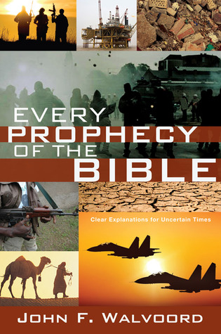

Slide 54
John 13:19; 14:29
“¹⁹ From now on I am telling you before it comes to pass, so that when it does occur, you may believe that I am He… ^{14:29} Now I have told you before it happens, so that when it happens, you may believe.”

Slide 55
III. Exodus 12:429-32
Death of 1st Born
    Comprehensive judgment (29)
    Emotional response (30)
    Command to leave (31-32)

Slide 56
Exodus 12:31-32
Command to Leave
      People (31)
      Flocks (32)

Slide 57
Exodus 12:31-32
Command to Leave
      People (31)
      Flocks (32)

Slide 58
Charles Ryrie
Ryrie Study Bible, page 109
Exodus 12:31 “Though Pharaoh manufactured rationalizations for the other plagues, he could not reason away the trauma of the death of his own son. He called for Moses and Aaron that night and gave them permission to go, this time without insisting on any concessions.”

Slide 59
Exodus 12:31-32
Command to Leave
      People (31)
      Flocks (32)

Slide 61
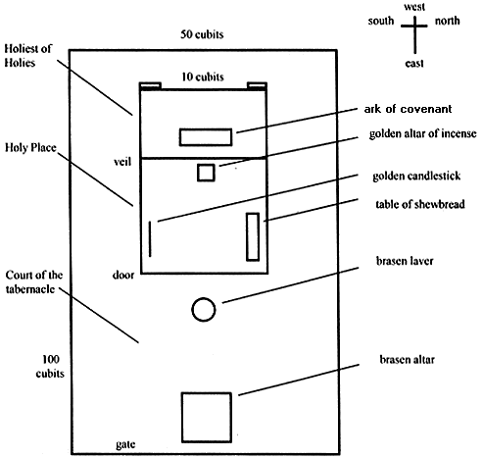
Tabernacle Diagram

Slide 62
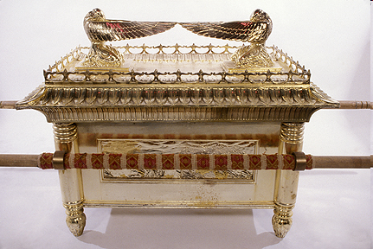
Ark of the Covenant

Slide 63
DEATH OF FIRST BORN
Exodus 12:1-51
  God’s instructions to Moses (1-20)
  Moses instructions to Israel (21-28)
  Death of the 1st born (29-32)
  Exodus from Egypt (33-42)
  Passover instituted (43-51)

Slide 64
IV. Exodus 12:33-42
Exodus from Egypt
    Urgency (33)
    Unleavened dough taken (34)
    Egyptians plundered (35-36)
    Direction (37a)
    Number (37b)
    Mixed multitude (38)
    Unleavened bread baked (39)
    Duration of bondage (40-41)
    Ritual established (42)

Slide 65
IV. Exodus 12:33-42
Exodus from Egypt
    Urgency (33)
    Unleavened dough taken (34)
    Egyptians plundered (35-36)
    Direction (37a)
    Number (37b)
    Mixed multitude (38)
    Unleavened bread baked (39)
    Duration of bondage (40-41)
    Ritual established (42)

Slide 66
IV. Exodus 12:33-42
Exodus from Egypt
    Urgency (33)
    Unleavened dough taken (34)
    Egyptians plundered (35-36)
    Direction (37a)
    Number (37b)
    Mixed multitude (38)
    Unleavened bread baked (39)
    Duration of bondage (40-41)
    Ritual established (42)

Slide 67
Dr. Ed Hindson
Hindson, E. E., & Mitchell, D. R., eds. (2010). KJV Bible Commentary for Today: The Most Up-to-Date Commentary on the Time-Honored Text of the KJV (p. 101). Thomas Nelson.
“12:34. …in the Hebrews’ haste to leave (on what was the first day of the seven-day festival), they grabbed the only food that was on hand: their as yet unleavened bread dough. They formed the dough into cakes and hoisted the pans onto their shoulders. The sun then baked the cakes into matzos, unleavened bread.”

Slide 68
IV. Exodus 12:33-42
Exodus from Egypt
    Urgency (33)
    Unleavened dough taken (34)
    Egyptians plundered (35-36)
    Direction (37a)
    Number (37b)
    Mixed multitude (38)
    Unleavened bread baked (39)
    Duration of bondage (40-41)
    Ritual established (42)

Slide 69
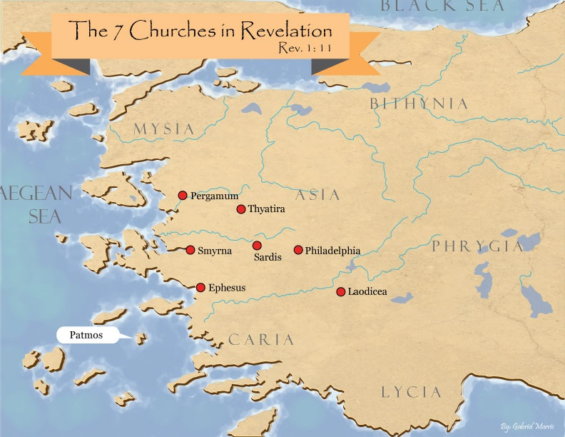
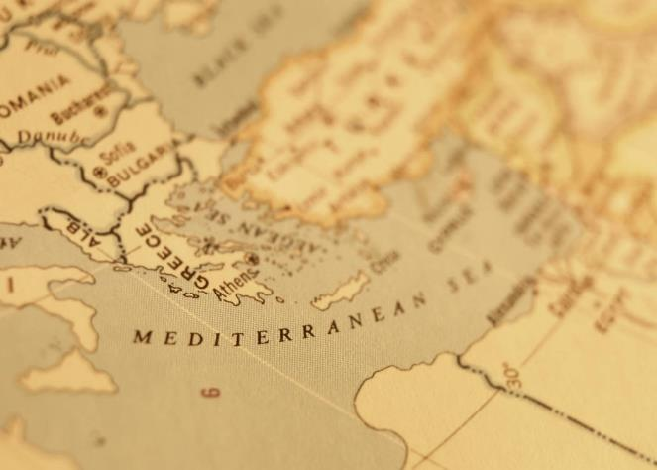

Slide 70

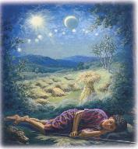
Genesis 37:9
“Now he had still another dream, and related it to his brothers, and said, ‘Lo, I have had still another dream; and behold, the sun and the moon and eleven stars were bowing down to me.’”

Slide 71
Genesis 37:10
“He related it to his father and to his brothers; and his father rebuked him and said to him, ‘What is this dream that you have had? Shall I and your mother and your brothers actually come to bow ourselves down before you to the ground?’”

Slide 73
John 13:19; 14:29
“¹⁹ From now on I am telling you before it comes to pass, so that when it does occur, you may believe that I am He… ^{14:29} Now I have told you before it happens, so that when it happens, you may believe.”

Slide 74


Slide 75
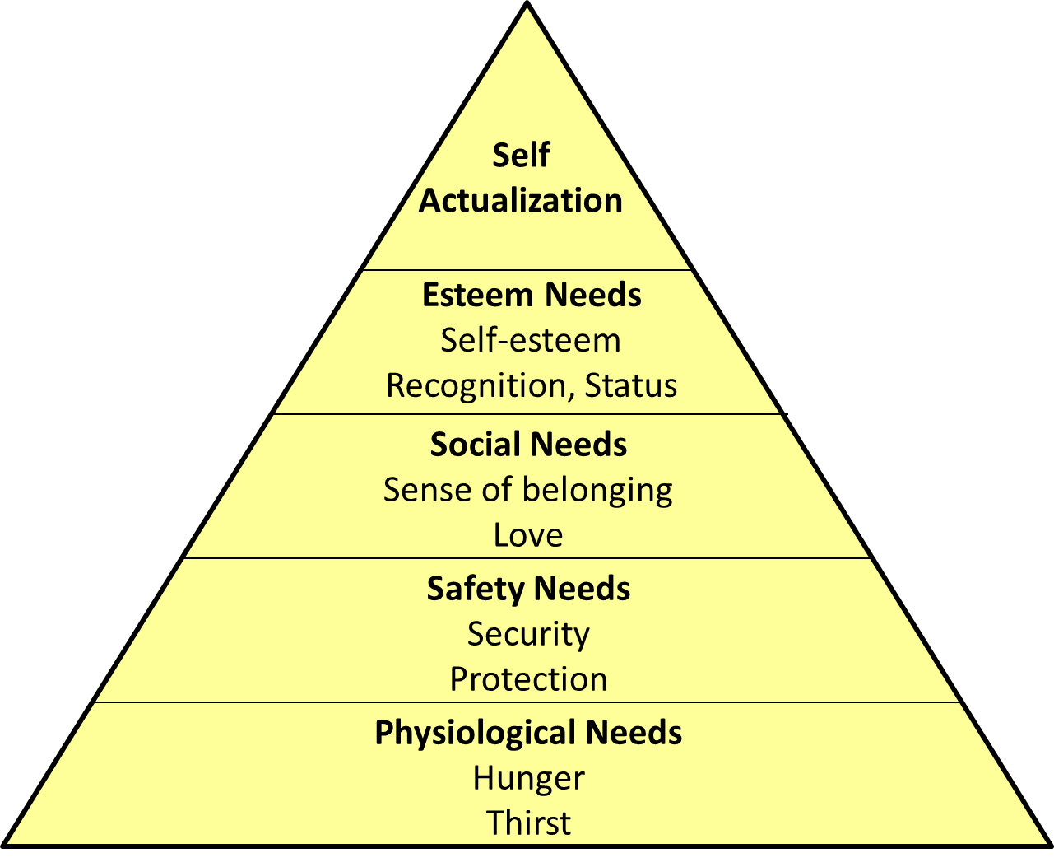
Maslow’s Hierarchy of Needs

Slide 76

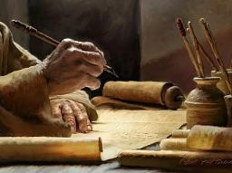
2 Timothy 3:16-17
“¹⁶ All Scripture is inspired by God [theopneustos] and profitable for teaching, for reproof, for correction, for training in righteousness; ¹⁷ so that the man of God may be adequate, equipped for every good work.”

Slide 77

2 Peter 1:3-4
“³ Seeing that His divine power has granted to us everything pertaining to life and godliness, through the true knowledge of Him who called us by His own glory and excellence. ⁴For by these He has granted to us His precious and magnificent promises, so that by them you may become partakers of the divine nature, having escaped the corruption that is in the world by lust.”

Slide 78
1 Peter 2:2
“like newborn babies, long for the pure [adolos] milk of the word, so that by it you may grow in respect to salvation, ³ if you have tasted the kindness of the Lord.”

Slide 79

Chafer Theological Seminary Distinctives:
sufficiency of the scriptures
"We believe in the complete adequacy of Scripture, for in it God has given us all things that pertain to life and godliness. We hold, therefore, that the Word of God by itself is sufficient to prepare a person for a lifetime of effective ministry.”
https://www.chafer.edu/distinctives

Slide 80
IV. Exodus 12:33-42
Exodus from Egypt
    Urgency (33)
    Unleavened dough taken (34)
    Egyptians plundered (35-36)
    Direction (37a)
    Number (37b)
    Mixed multitude (38)
    Unleavened bread baked (39)
    Duration of bondage (40-41)
    Ritual established (42)

Slide 82
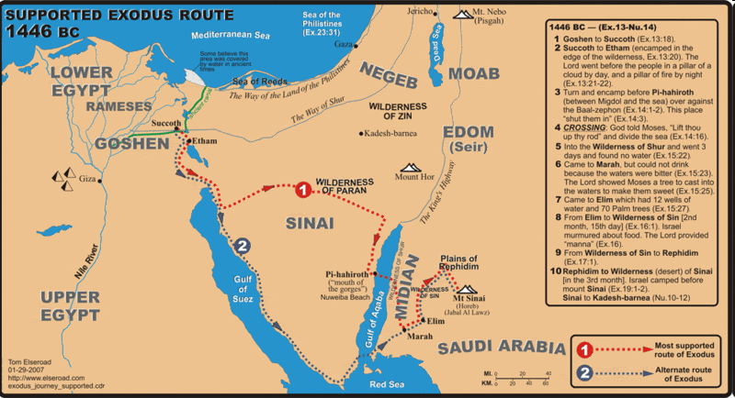

Slide 83
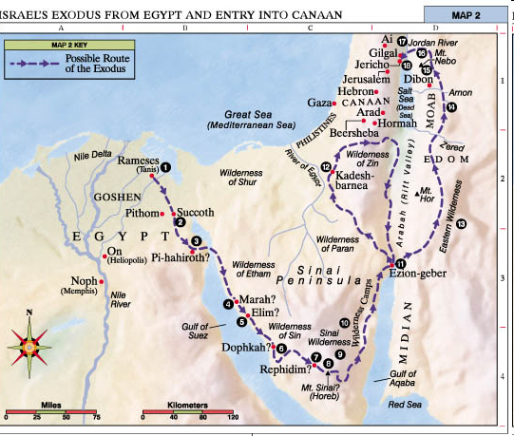

Slide 84
IV. Exodus 12:33-42
Exodus from Egypt
    Urgency (33)
    Unleavened dough taken (34)
    Egyptians plundered (35-36)
    Direction (37a)
    Number (37b)
    Mixed multitude (38)
    Unleavened bread baked (39)
    Duration of bondage (40-41)
    Ritual established (42)

Slide 85
Dr. Ed Hindson
Hindson, E. E., & Mitchell, D. R., eds. (2010). KJV Bible Commentary for Today: The Most Up-to-Date Commentary on the Time-Honored Text of the KJV (p. 101). Thomas Nelson.
“12:37. Six hundred thousand … men. This is a round figure; the total number of men aged twenty and older was 603,550 (38:26). Extrapolating from that number, assuming one wife and two children per man, one arrives at an exodus population of roughly two million people. Objections have been commonly raised over the possibility of such an extraordinary population. While enormous energy and scholarly creativity has gone into the development of alternative theories to explain why the population numbers should not be taken at their face value, none has proven definitively convincing.”

Slide 86
IV. Exodus 12:33-42
Exodus from Egypt
    Urgency (33)
    Unleavened dough taken (34)
    Egyptians plundered (35-36)
    Direction (37a)
    Number (37b)
    Mixed multitude (38)
    Unleavened bread baked (39)
    Duration of bondage (40-41)
    Ritual established (42)

Slide 87
Dr. Ed Hindson
Hindson, E. E., & Mitchell, D. R., eds. (2010). KJV Bible Commentary for Today: The Most Up-to-Date Commentary on the Time-Honored Text of the KJV (p. 101). Thomas Nelson.
“12:38. A mixed multitude went with them. These were likely other, non-Hebrew, slaves and perhaps a few God-fearing Egyptians. This Gentile group would stir up trouble in the camp during the wilderness journey (Num. 11:4).”

Slide 88
IV. Exodus 12:33-42
Exodus from Egypt
    Urgency (33)
    Unleavened dough taken (34)
    Egyptians plundered (35-36)
    Direction (37a)
    Number (37b)
    Mixed multitude (38)
    Unleavened bread baked (39)
    Duration of bondage (40-41)
    Ritual established (42)

Slide 89
IV. Exodus 12:33-42
Exodus from Egypt
    Urgency (33)
    Unleavened dough taken (34)
    Egyptians plundered (35-36)
    Direction (37a)
    Number (37b)
    Mixed multitude (38)
    Unleavened bread baked (39)
    Duration of bondage (40-41)
    Ritual established (42)

Slide 90

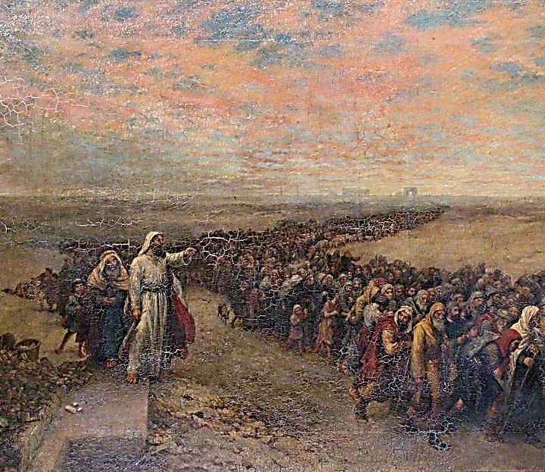
Exodus 12:40-41
“⁴⁰ Now the time that the sons of Israel lived in Egypt was four hundred and thirty years. ⁴¹ And at the end of four hundred and thirty years, to the very day, all the hosts of the Lord went out from the land of Egypt.”

Slide 91
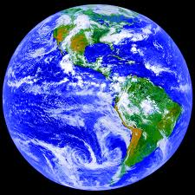
AGE OF THE EARTH?
971-931 BC=Solomonic reign
966=Solomon rebuilds temple (1 Kgs 6:1b)
- 480 years for the Exodus’ date (1 Kgs 6:1a)
= 1446 BC for Exodus’ date
- 430 years for Jacob’s migration to Egypt (Exod 12:40)
= 1876 BC for Jacob’s migration to Egypt (Gen 46)
Genealogies of Gen 5; 11
= 4000 BC for the earth’s age

Slide 92
AGE OF THE EARTH?
971-931 BC=Solomonic reign
966=Solomon rebuilds temple (1 Kgs 6:1b)
- 480 years for the Exodus’ date (1 Kgs 6:1a)
= 1446 BC for Exodus’ date
- 430 years for Jacob’s migration to Egypt (Exod 12:40)
= 1876 BC for Jacob’s migration to Egypt (Gen 46)
Genealogies of Gen 5; 11
= 4000 BC for the earth’s age

Slide 93
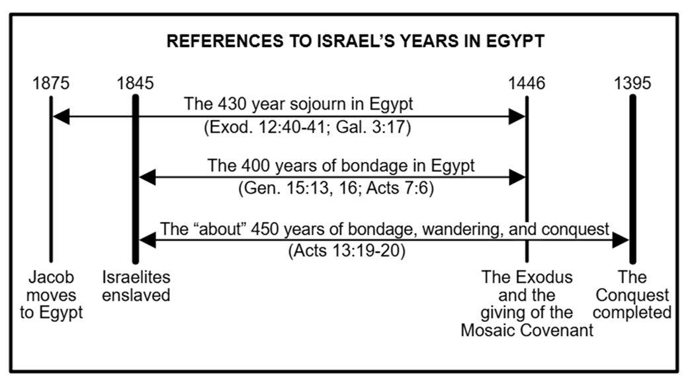

Slide 94
IV. Exodus 12:33-42
Exodus from Egypt
    Urgency (33)
    Unleavened dough taken (34)
    Egyptians plundered (35-36)
    Direction (37a)
    Number (37b)
    Mixed multitude (38)
    Unleavened bread baked (39)
    Duration of bondage (40-41)
    Ritual established (42)

Slide 96
John 13:19; 14:29
“¹⁹ From now on I am telling you before it comes to pass, so that when it does occur, you may believe that I am He… ^{14:29} Now I have told you before it happens, so that when it happens, you may believe.”

Slide 97
DEATH OF FIRST BORN
Exodus 12:1-51
  God’s instructions to Moses (1-20)
  Moses instructions to Israel (21-28)
  Death of the 1st born (29-32)
  Exodus from Egypt (33-42)
  Passover instituted (43-51)

Slide 98
V. Exodus 112:43-51
Passover Instituted
    Foreigners excluded (43-45)
    Lamb’s bones unbroken (46)
    Foreigner circumcision (47-49)
    Israel’s obedience (50)
    Exodus date (51)

Slide 99
V. Exodus 112:43-51
Passover Instituted
    Foreigners excluded (43-45)
    Lamb’s bones unbroken (46)
    Foreigner circumcision (47-49)
    Israel’s obedience (50)
    Exodus date (51)

Slide 100
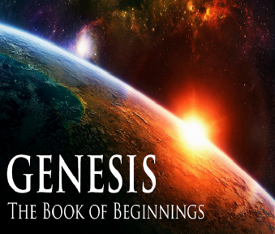
Genesis 12‒25
Abraham’s Early Journeys
Unconditional promises (Gen. 12:1-3) From Haran to Canaan (Gen. 12:4-5) In Canaan (Gen. 12:6-9) In Egypt (Gen. 12:10-20) Abram and Lot Separate (Gen. 13:1-13) Reaffirmation of Abram’s promises (Gen. 13:14-18) Abram Rescues Lot (14:1-24) Abrahamic Covenant (15:1-21) Hagar & Ishmael (16:1-16) Circumcision (Gen. 17:1-27) | Sodom & Gomorrah (Gen. 18‒19) Abraham & Abimelech (Gen. 20) Isaac’s birth (Gen. 21:1-7) Ishmael’s expulsion (21:8-21) Abraham & Abimelech’s covenant (21:22-34) Abraham sacrifices Isaac (22) Sarah’s death (23) Isaac’s marriage (24) Abraham & Keturah (25:1-6) Abraham’s death (25:7-11)

Slide 101
V. Exodus 112:43-51
Passover Instituted
    Foreigners excluded (43-45)
    Lamb’s bones unbroken (46)
    Foreigner circumcision (47-49)
    Israel’s obedience (50)
    Exodus date (51)

Slide 102
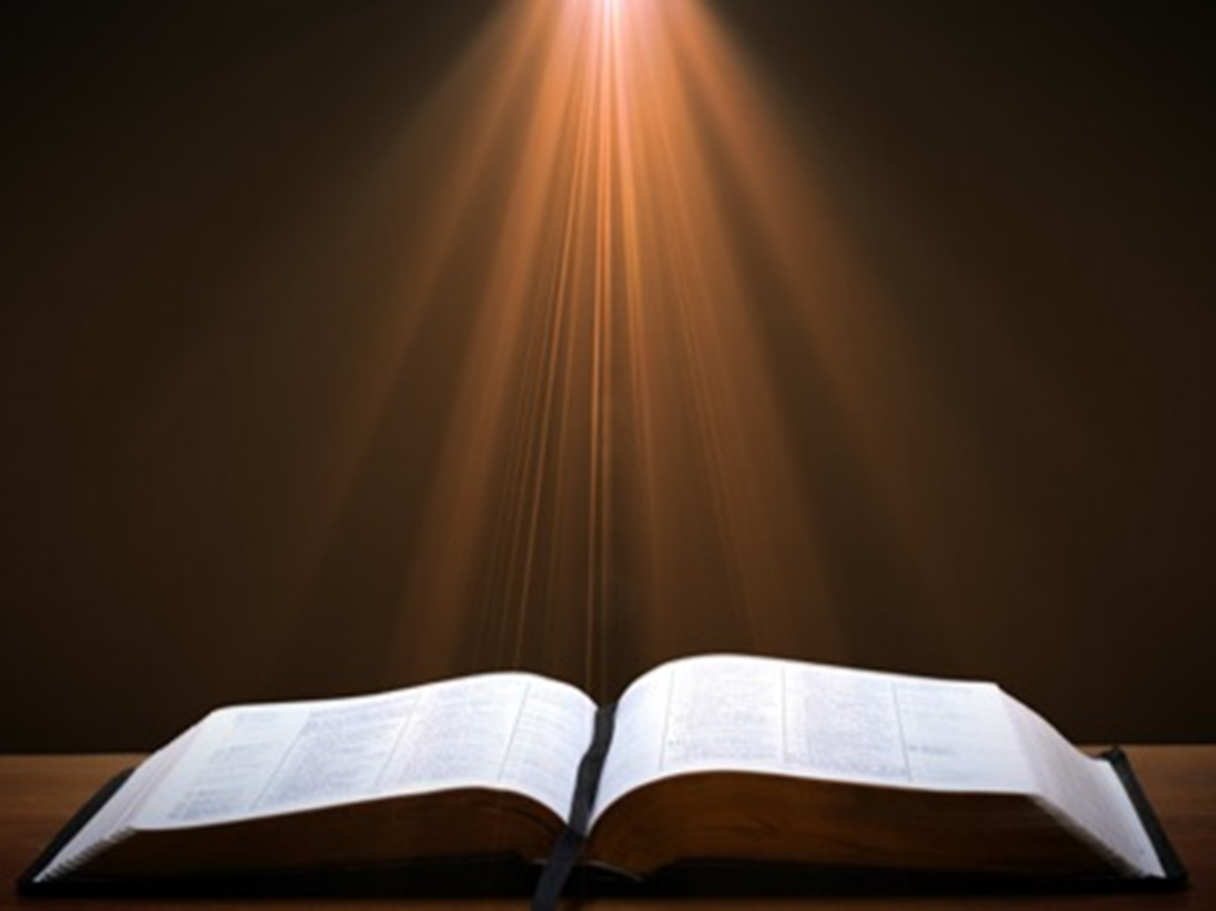
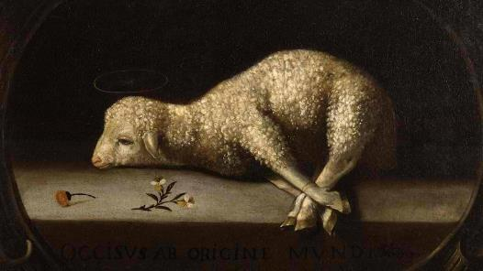
Exodus 12:5, 46
“Your lamb shall be an unblemished male a year old; you may take it from the sheep or from the goats…nor are you to break any bone of it.”

Slide 103
V. Exodus 112:43-51
Passover Instituted
    Foreigners excluded (43-45)
    Lamb’s bones unbroken (46)
    Foreigner circumcision (47-49)
    Israel’s obedience (50)
    Exodus date (51)

Slide 104
Genesis 12‒25
Abraham’s Early Journeys
Unconditional promises (Gen. 12:1-3) From Haran to Canaan (Gen. 12:4-5) In Canaan (Gen. 12:6-9) In Egypt (Gen. 12:10-20) Abram and Lot Separate (Gen. 13:1-13) Reaffirmation of Abram’s promises (Gen. 13:14-18) Abram Rescues Lot (14:1-24) Abrahamic Covenant (15:1-21) Hagar & Ishmael (16:1-16) Circumcision (Gen. 17:1-27) | Sodom & Gomorrah (Gen. 18‒19) Abraham & Abimelech (Gen. 20) Isaac’s birth (Gen. 21:1-7) Ishmael’s expulsion (21:8-21) Abraham & Abimelech’s covenant (21:22-34) Abraham sacrifices Isaac (22) Sarah’s death (23) Isaac’s marriage (24) Abraham & Keturah (25:1-6) Abraham’s death (25:7-11)

Slide 105
V. Exodus 112:43-51
Passover Instituted
    Foreigners excluded (43-45)
    Lamb’s bones unbroken (46)
    Foreigner circumcision (47-49)
    Israel’s obedience (50)
    Exodus date (51)

Slide 106
“SEVEN SIGNS” in Gospel of John
1. Changing Water into Wine | 2:11
2. Healing official’s son | 4:46-54
3. Healing an invalid at the Pool of Bethesda | 5:1-18
4. Feeding the 5,000 | 6:5-14
5. Walking on water | 6:16-21
6. Healing a blind man | 9:1-7
7. Raising dead Lazarus | 11:1-45

Slide 107
V. Exodus 112:43-51
Passover Instituted
    Foreigners excluded (43-45)
    Lamb’s bones unbroken (46)
    Foreigner circumcision (47-49)
    Israel’s obedience (50)
    Exodus date (51)

Slide 108

Genesis 15:13;16
¹³ God said to Abram, “Know for certain that your descendants will be strangers in a land that is not theirs, where they will be enslaved and oppressed four hundred years…¹⁶ “Then in the fourth generation they will return here, for the iniquity of the Amorite is not yet complete.”

Slide 109
Conclusion

Slide 110
DEATH OF FIRST BORN
Exodus 12:1-51
  God’s instructions to Moses (1-20)
  Moses instructions to Israel (21-28)
  Death of the 1st born (29-32)
  Exodus from Egypt (33-42)
  Passover instituted (43-51)

Slide 111
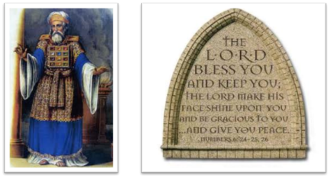
²⁴ The Lord bless you, and keep you; ²⁵ The Lord make His face shine on you, And be gracious to you; ²⁶ The Lord lift up His countenance on you, And give you peace.
Numbers 6:24–26 (NASB95)

