Slide 1
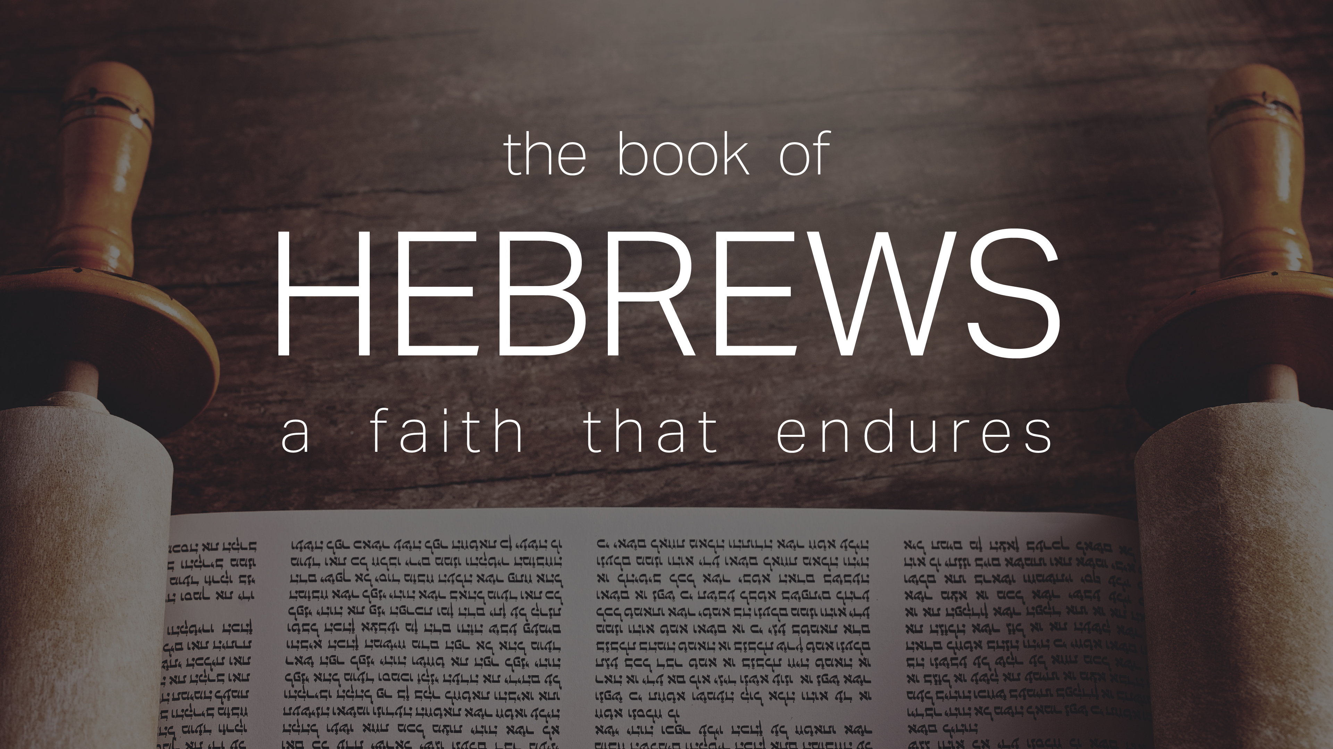


Slide 2
INTRODUCTORY MATTERS
Authorship
Audience
Date
Occasion
Purpose
Message
Outline

Slide 3
OUTLINE
Doctrinal section (1:1–10:18)
  Christ’s attributes (1:1-3)
  Christ is superior to the angels (1:4–2:18)
  Christ is superior to Moses (3:1–4:13)
  Christ is superior to Aaron (4:14–10:18)
Practical section (10:19–13:25)
  Exhortations and pastoral reminders (10, 12, 13)
  Hall of faith (11)
  Benediction (13:20-25)

Slide 4
CHRIST IS SUPERIOR TO PREVIOUS REVELATION (1:1-2A)
OT – Indirect, incomplete, temporary
Christ – Direct, complete, permanent
Notes:
Preparation / manifestation / propagation / explanation / consumation

Slide 5
CHRIST’S 7 ATTRIBUTES SHOWING HIS FINALITY (1:2B-3)
Heir of all things
Maker of all things
Brightness of the Father’s glory
Express image of the Father
Upholds all things
Made complete purification for sins
Sat down at the Father’s right hand

Slide 6
OUTLINE
Doctrinal section (1:1–10:18)
  Christ’s attributes (1:1-3)
  Christ is superior to the angels (1:4–2:18)
  Christ is superior to Moses (3:1–4:13)
  Christ is superior to Aaron (4:14–10:18)
Practical section (10:19–13:25)
  Exhortations and pastoral reminders (10, 12, 13)
  Hall of faith (11)
  Benediction (13:20-25)

Slide 7
Hebrews 1:4‒2:18
Christ is Superior to the Angels
      Seven OT Citations (1:4-14)
      Warning Against Drifting (2:1-4)
      Why God Became Man (2:5-18)

Slide 8
7 OT CITATIONS DEMONSTRATING CHRIST’S
SUPERIORITY TO THE ANGELS (1:4-14)
      vs. 5a – Ps 2:7
      vs. 5b – 2 Sam 7:14
      vs. 6 – Ps 97:7
      vs. 7 – Ps 104:4
      vs. 8-9 – Ps 45:6-7
      vs. 10-12 – Ps 102:25-7
      vs. 13 – Ps 110:1

Slide 9
Hebrews 1:4‒2:18
Christ is Superior to the Angels
      Seven OT Citations (1:4-14)
      Warning Against Drifting (2:1-4)
      Why God Became Man (2:5-18)

Slide 10
FIVE WARNINGS
2:1-4 – Warning against drifting
3:7–4:13 – Warning against disobedience
5:10–6:20 – Warning against immaturity
10:26-39 – Warning against despising the truth
12:25-29 – Warning against denying the truth

Slide 11
WARNING AGAINST DRIFTING (2:1-4)
Parenthesis in argument about angels
From the lesser to the greater (a fortiori)

Slide 12
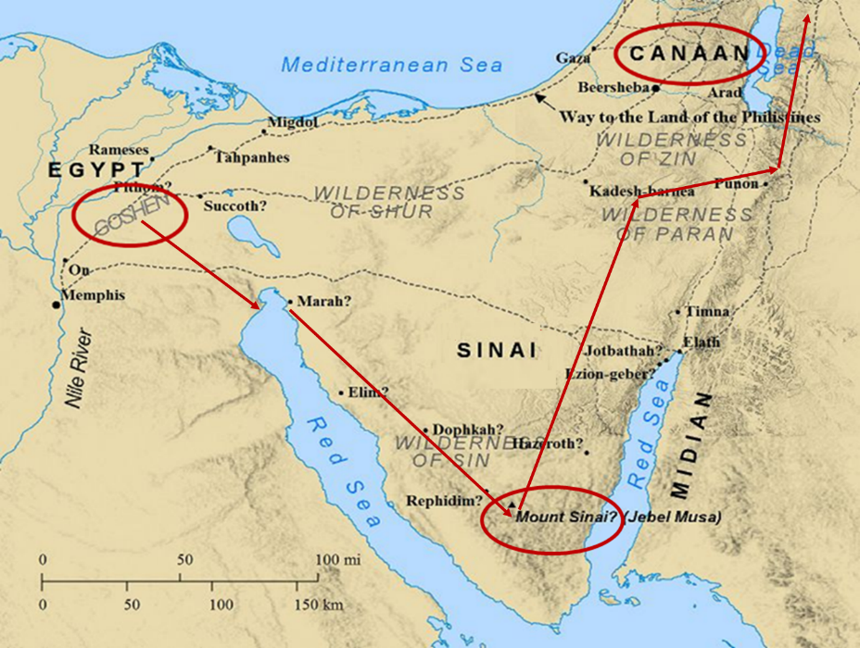

Slide 13
Six Parts of a Suzerain-Vassal Treaty in Deuteronomy
Preamble (1:1-5)
Prologue (1:6–4:40)
Covenant obligations (5–26)
Storage and reading instructions (27:2-3; 31:9, 24, 26)
Witnesses (32:1)
Blessings and curses (28)

Slide 14
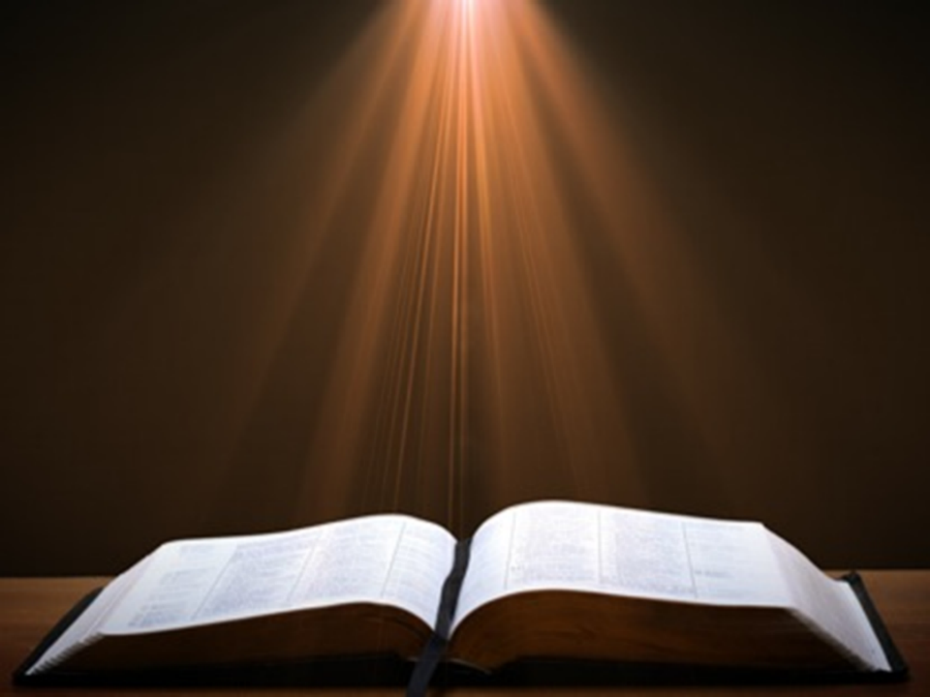

Deuteronomy 28:49-50
⁴⁹ “The Lord will bring a nation against you from afar, from the end of the earth, as the eagle swoops down, a nation whose language you shall not understand, ⁵⁰ a nation of fierce countenance who will have no respect for the old, nor show favor to the young.”

Slide 15
ISRAEL'S JUDGMENTS
Division of the kingdom in 931 B.C. (1 Kgs. 12)
Assyrian judgment in 722 B.C. (2 Kgs. 17)
Babylonian captivity in 586 B.C. (2 Kgs. 25)
Rome Diaspora in A.D. 70 (Luke 19:41-44)

Slide 16
4 VIEWS ON WARNING PASSAGES
Hypothetical
Arminianism
Calvinism/Reformed
Loss of blessings

Slide 17
Hebrews 1:4‒2:18
Christ is Superior to the Angels
      Seven OT Citations (1:4-14)
      Warning Against Drifting (2:1-4)
      Why God Became Man (2:5-18)

Slide 18
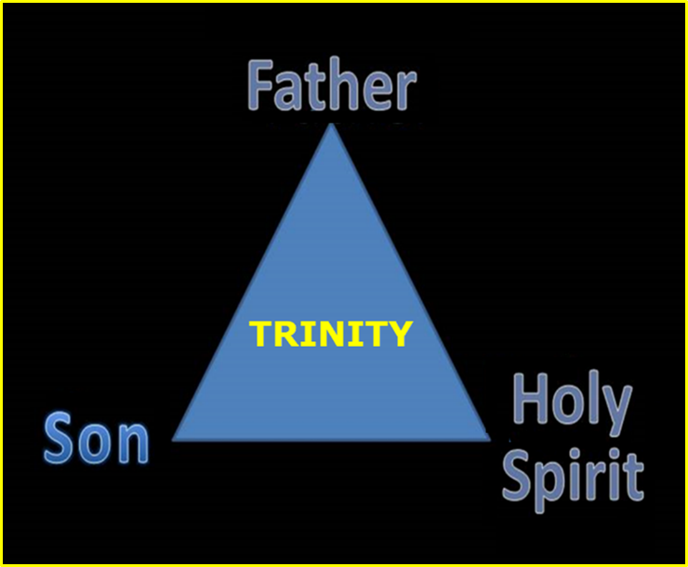

Slide 19
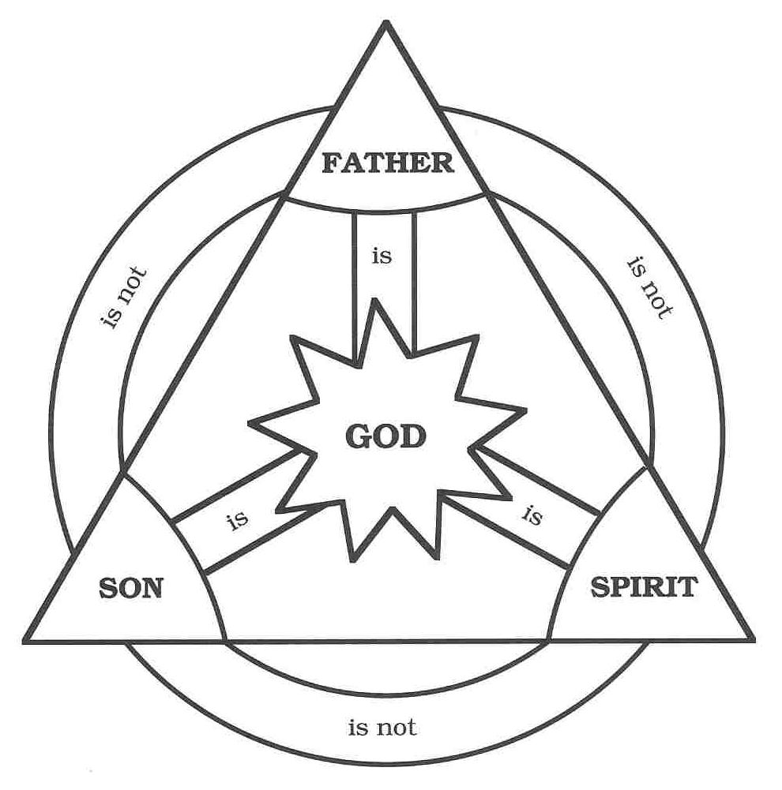

Slide 20
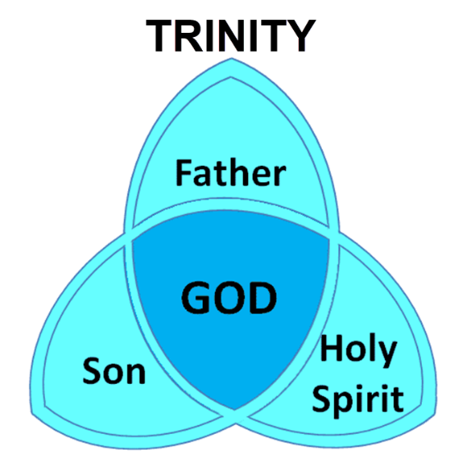

Slide 21
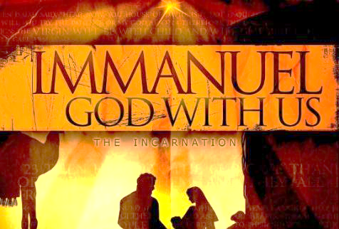
An Important Doctrine
Incarnation
Hypostatic Union
100% God
100 % Man
Unique God-Man

Slide 22

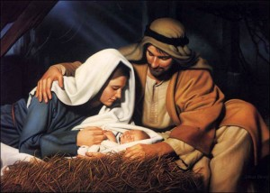
John 1:14
“And the Word became flesh, and dwelt among us, and we saw His glory, glory as of the only begotten [monogenēs] from the Father, full of grace and truth.”

Slide 23
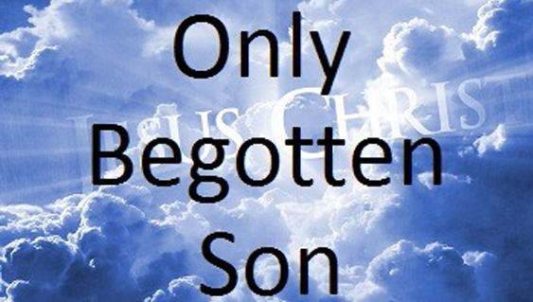
John 1:18
“No one has seen God at any time; the only begotten [monogenēs] God who is in the bosom of the Father, He has explained [exēgeomai] Him.”

Slide 24
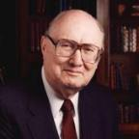
Dr. John Walvoord
Jesus Christ Our Lord, 143-44
“The act of kenosis [emptying] as stated in Philippians 2:5-8 may therefore be properly understood to mean that Christ surrendered no attribute of deity, but that He did voluntarily restrict their independent use in keeping with His purpose of living among men and their limitations.”

Slide 25
Why God Became Man
(Heb. 2:5-18)
To restore God’s original purpose for man (5-8)
To taste death for every man (9)
To bring many to glory (10-13)
To break Satan’s rule over humanity (14)
To remove the fear of death (15)
To become our merciful high priest (16-17a)
To make a complete purification for sin (17b)
To sympathize with those tested (18)
Adapted from J. Dwight Pentecost, Faith that Endures (Grand Rapids, MI: Kregel, 2000), 60-71.

Slide 26
Why God Became Man
(Heb. 2:5-18)
To restore God’s original purpose for man (5-8)
To taste death for every man (9)
To bring many to glory (10-13)
To break Satan’s rule over humanity (14)
To remove the fear of death (15)
To become our merciful high priest (16-17a)
To make a complete purification for sin (17b)
To sympathize with those tested (18)
Adapted from J. Dwight Pentecost, Faith that Endures (Grand Rapids, MI: Kregel, 2000), 60-71.

Slide 27
Genesis 1:26-28
²⁶ Then God said, “Let Us make man in Our image, according to Our likeness; and let them rule over the fish of the sea and over the birds of the sky and over the cattle and over all the earth, and over every creeping thing that creeps on the earth.” ²⁷ God created man in His own image, in the image of God He created him; male and female He created them. ²⁸ God blessed them; and God said to them, “Be fruitful and multiply, and fill the earth, and subdue it; and rule over the fish of the sea and over the birds of the sky and over every living thing that moves on the earth.”

Slide 28
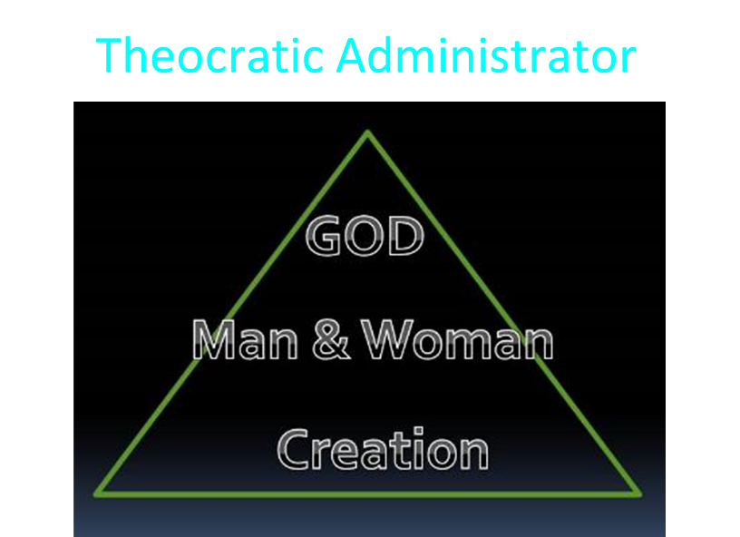

Slide 29
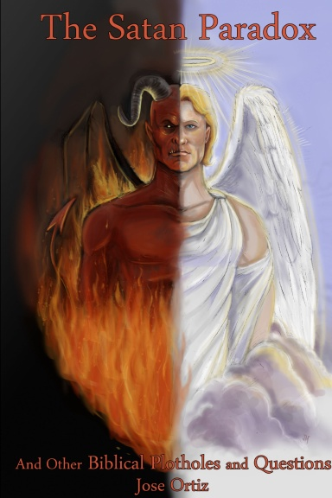
Names & Titles Demonstrating Satan’s Post-Fall, Earthly Authority
(Job 1:7; 2:2; Luke 4:5-8; Rom. 8:19-22)
Prince of this world (John 12:31; 14:30; 16:11)
God of this world (2 Cor. 4:4)
Prince and power of the air (Eph. 2:2)
Who the believer wrestles with (Eph. 6:12)
Roaring lion (1 Pet. 5:8)
Whole world lies in his power (1 John 5:19)

Slide 30
To Reverse Man’s Sinful Condition
Adam’s disobedience affected all
Christ’s obedience blessed all
Christ is the last Adam
  Rom. 5:18-19; 1 Cor. 15:45

Slide 31
The Two Most Influential Men in World History
 | ADAM | JESUS
Single action | Disobedience | Obedience
Tree | Knowledge | Cross
Universal impact | Curse | Blessing
Birth | Physical | Spiritual
Adam | First | Last

Slide 32
Romans 8:19-23
¹⁹ “For the anxious longing of the creation waits eagerly for the revealing of the sons of God. ²⁰ For the creation was subjected to futility, not willingly, but because of Him who subjected it, in hope ²¹ that the creation itself also will be set free from its slavery to corruption into the freedom of the glory of the children of God. ²² For we know that the whole creation groans and suffers the pains of childbirth together until now. ²³ And not only this, but also we ourselves, having the first fruits of the Spirit, even we ourselves groan within ourselves, waiting eagerly for our adoption as sons, the redemption of our body.”

Slide 33
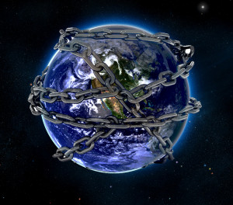

Slide 34
Ultimate Exodus
(Rev 11:15)
Sores: 6th plague (Ex 9:8-12), 1st bowl (Rev 16:1-2)
Rivers to blood: 1st plague (Ex 7:19-21), 3rd bowl (Rev 16:4-7)
Darkness: 9th plague (Ex 10:21-23), 5th bowl (Rev 16:10-11)
Frogs: 2nd plague (Ex 7:25‒8:15), 6th bowl (Rev 16:13)
Hail: 7th plague (Ex 9:22-26), 7th bowl (Rev 16:17-21)

Slide 35

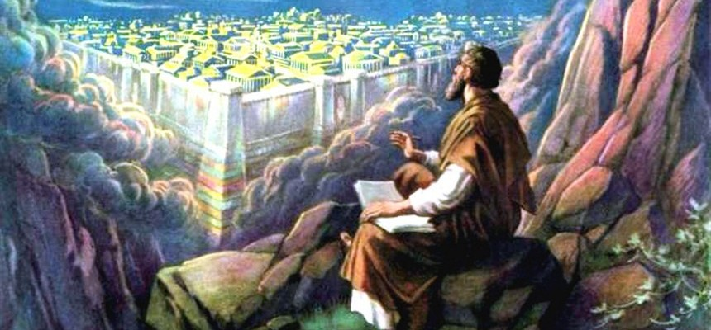
Revelation 11:15
¹⁵ “Then the seventh angel sounded; and there were loud voices in heaven, saying, ‘The kingdom of the world has become the kingdom of our Lord and of His Christ; and He will reign forever and ever.’”

Slide 36
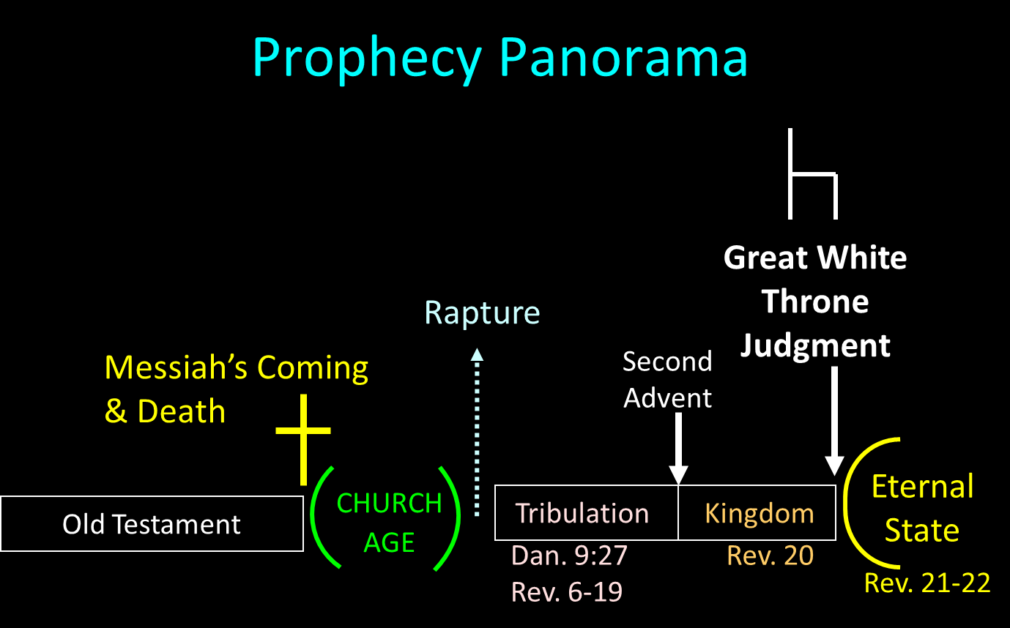

Slide 37
Why God Became Man
(Heb. 2:5-18)
To restore God’s original purpose for man (5-8)
To taste death for every man (9)
To bring many to glory (10-13)
To break Satan’s rule over humanity (14)
To remove the fear of death (15)
To become our merciful high priest (16-17a)
To make a complete purification for sin (17b)
To sympathize with those tested (18)
Adapted from J. Dwight Pentecost, Faith that Endures (Grand Rapids, MI: Kregel, 2000), 60-71.

Slide 38

Hebrews 2:9
“But we do see Him who was made for a little while lower than the angels, namely, Jesus, because of the suffering of death crowned with glory and honor, so that by the grace of God He might taste death for everyone.”

Slide 39
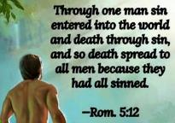
Genesis 2:16-17
“¹⁶ The Lord God commanded the man, saying, ‘From any tree of the garden you may eat freely; ¹⁷ but from the tree of the knowledge of good and evil you shall not eat, for in the day that you eat from it you will surely die (muwth).’”

Slide 40
To Pay the Penalty for Man’s Sin
Gen. 2:17
Gen. 3:21
Ezek. 18:20
Rom. 6:23
Hebrews 2:9

Slide 41
Hebrews 2:9
“But we do see Him who was made for a little while lower than the angels, namely, Jesus, because of the suffering of death crowned with glory and honor, so that by the grace of God He might taste death for everyone.”

Slide 42
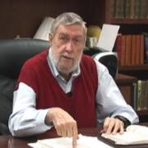
Jay Adams
Competent to Counsel, 70.
“But counselors, as Christians, are obligated to present the claims of Christ. They must present the good news that Christ Jesus died on the cross in the place of His own, that He bore the guilt and suffered the penalty for their sins. He died that all whom the Father had given to Him might come unto Him and have life everlasting. As a reformed Christian, the writer believes that counselors must not tell any unsaved counselee that Christ died for him, FOR THEY CANNOT SAY THAT. No man knows except Christ Himself who are His elect for whom He died." [emphasis mine]

Slide 43
Why God Became Man
(Heb. 2:5-18)
To restore God’s original purpose for man (5-8)
To taste death for every man (9)
To bring many to glory (10-13)
To break Satan’s rule over humanity (14)
To remove the fear of death (15)
To become our merciful high priest (16-17a)
To make a complete purification for sin (17b)
To sympathize with those tested (18)
Adapted from J. Dwight Pentecost, Faith that Endures (Grand Rapids, MI: Kregel, 2000), 60-71.

Slide 44


Galatians 4:7
“Therefore you are no longer a slave, but a son; and if a son, then an heir through God.”

Slide 45
Romans 8:29–30
²⁹ “For those whom He foreknew, He also predestined to become conformed to the image of His Son, so that He would be the firstborn among many brethren; ³⁰ and these whom He predestined, He also called; and these whom He called, He also justified; and these whom He justified, He also glorified.”

Slide 46
Romans 8:29–30
²⁹ “For those whom He foreknew, He also predestined to become conformed to the image of His Son, so that He would be the firstborn among many brethren; ³⁰ and these whom He predestined, He also called; and these whom He called, He also justified; and these whom He justified, He also glorified.”

Slide 47
Why God Became Man
(Heb. 2:5-18)
To restore God’s original purpose for man (5-8)
To taste death for every man (9)
To bring many to glory (10-13)
To break Satan’s rule over humanity (14)
To remove the fear of death (15)
To become our merciful high priest (16-17a)
To make a complete purification for sin (17b)
To sympathize with those tested (18)
Adapted from J. Dwight Pentecost, Faith that Endures (Grand Rapids, MI: Kregel, 2000), 60-71.

Slide 48

Hebrews 2:14
“Therefore, since the children share in flesh and blood, He Himself likewise also partook of the same, that through death He might render powerless him who had the power of death, that is, the devil.”

Slide 49
Names & Titles Demonstrating Satan’s Post-Fall, Earthly Authority
(Job 1:7; 2:2; Luke 4:5-8; Rom. 8:19-22)
Prince of this world (John 12:31; 14:30; 16:11)
God of this world (2 Cor. 4:4)
Prince and power of the air (Eph. 2:2)
Who the believer wrestles with (Eph. 6:12)
Roaring lion (1 Pet. 5:8)
Whole world lies in his power (1 John 5:19)

Slide 50
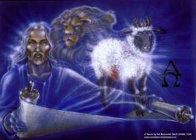
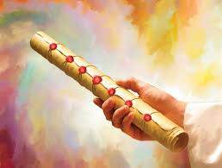
God’s Role in Redemption (Rev 5)
Seven sealed scroll (5:1)
John weeps (5:2-4)
Christ is qualified to open the scroll (5:5-6)
Christ takes the scroll (5:7)
Christ praised by various entities (5:8-14)

Slide 51
God’s Role in Redemption (Rev 5)
Seven sealed scroll (5:1)
John weeps (5:2-4)
Christ is qualified to open the scroll (5:5-6)
Christ takes the scroll (5:7)
Christ praised by various entities (5:8-14)

Slide 53
God’s Role in Redemption (Rev 5)
Seven sealed scroll (5:1)
John weeps (5:2-4)
Christ is qualified to open the scroll (5:5-6)
Christ takes the scroll (5:7)
Christ praised by various entities (5:8-14)

Slide 54
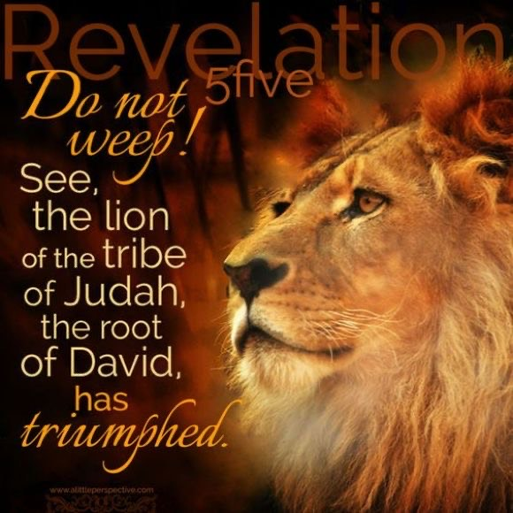
Revelation 5:5
and one of the elders said to me, “Stop weeping; behold, the Lion that is from the tribe of Judah, the Root of David, has overcome so as to open the book and its seven seals.”

Slide 55
Revelation 5:5
and one of the elders said to me, “Stop weeping; behold, the Lion that is from the tribe of Judah, the Root of David, has overcome so as to open the book and its seven seals.”

Slide 56
Revelation 5:5
and one of the elders said to me, “Stop weeping; behold, the Lion that is from the tribe of Judah, the Root of David, has overcome so as to open the book and its seven seals.”

Slide 57
God’s Role in Redemption (Rev 5)
Seven sealed scroll (5:1)
John weeps (5:2-4)
Christ is qualified to open the scroll (5:5-6)
Christ takes the scroll (5:7)
Christ praised by various entities (5:8-14)

Slide 58
God’s Role in Redemption (Rev 5)
Seven sealed scroll (5:1)
John weeps (5:2-4)
Christ is qualified to open the scroll (5:5-6)
Christ takes the scroll (5:7)
Christ praised by various entities (5:8-14)

Slide 60
Ultimate Exodus
(Rev 11:15)
Sores: 6th plague (Ex 9:8-12), 1st bowl (Rev 16:1-2)
Rivers to blood: 1st plague (Ex 7:19-21), 3rd bowl (Rev 16:4-7)
Darkness: 9th plague (Ex 10:21-23), 5th bowl (Rev 16:10-11)
Frogs: 2nd plague (Ex 7:25‒8:15), 6th bowl (Rev 16:13)
Hail: 7th plague (Ex 9:22-26), 7th bowl (Rev 16:17-21)

Slide 61

John 16:33
“These things I have spoken to you, so that in Me you may have peace. In the world you have tribulation, but take courage; I have overcome [nikaō; perfect tense] the world.”

Slide 62
1 John 4:4
“You are from God, little children, and have overcome [nikaō; perfect tense] them; because greater is He who is in you than he who is in the world.”

Slide 63

1 John 5:4-5
^{“4} For whatever is born of God overcomes the world; and this is the victory that has overcome the world—our faith. ⁵ Who is the one who overcomes the world, but he who believes that Jesus is the Son of God?”

Slide 64

Romans 8:37
“But in all these things we overwhelmingly conquer [hypernikaō , present tense] through Him who loved us.”

Slide 65
Why God Became Man
(Heb. 2:5-18)
To restore God’s original purpose for man (5-8)
To taste death for every man (9)
To bring many to glory (10-13)
To break Satan’s rule over humanity (14)
To remove the fear of death (15)
To become our merciful high priest (16-17a)
To make a complete purification for sin (17b)
To sympathize with those tested (18)
Adapted from J. Dwight Pentecost, Faith that Endures (Grand Rapids, MI: Kregel, 2000), 60-71.

Slide 66

Hebrews 2:15
“and release those who through fear of death were all their lifetime subject to bondage.”

Slide 67
Romans 8:29–30
²⁹ “For those whom He foreknew, He also predestined to become conformed to the image of His Son, so that He would be the firstborn among many brethren; ³⁰ and these whom He predestined, He also called; and these whom He called, He also justified; and these whom He justified, He also glorified.”

Slide 68
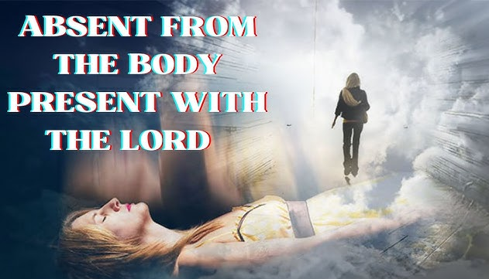
2 Corinthians 5:8
“we are of good courage, I say, and prefer rather to be absent from the body and to be at home with the Lord.”

Slide 69
Philippians 1:21-24
^{21 “}For to me, to live is Christ and to die is gain. ²² But if I am to live on in the flesh, this will mean fruitful labor for me; and I do not know which to choose. ²³ But I am hard-pressed from both directions, having the desire to depart and be with Christ, for that is very much better; ²⁴ yet to remain on in the flesh is more necessary for your sake.”

Slide 70
Why God Became Man
(Heb. 2:5-18)
To restore God’s original purpose for man (5-8)
To taste death for every man (9)
To bring many to glory (10-13)
To break Satan’s rule over humanity (14)
To remove the fear of death (15)
To become our merciful high priest (16-17a)
To make a complete purification for sin (17b)
To sympathize with those tested (18)
Adapted from J. Dwight Pentecost, Faith that Endures (Grand Rapids, MI: Kregel, 2000), 60-71.

Slide 71
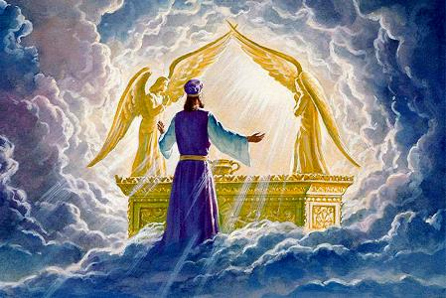
Hebrews 2:17
“Therefore, in all things He had to be made like His brethren, that He might be a merciful and faithful High Priest in things pertaining to God, to make propitiation for the sins of the people.”

Slide 72
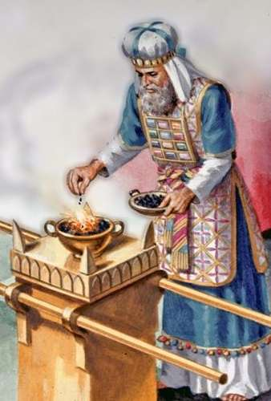
To Become Man’s Merciful High Priest
Definition of a priest
Job’s cry (Job 9:32-33)
One mediator (1 Timothy 2:5)

Slide 73
To Become Man’s Merciful High Priest
Definition of a priest
Job’s cry (Job 9:32-33)
One mediator (1 Timothy 2:5)

Slide 74
To Become Man’s Merciful High Priest
Definition of a priest
Job’s cry (Job 9:32-33)
One mediator (1 Timothy 2:5)

Slide 75
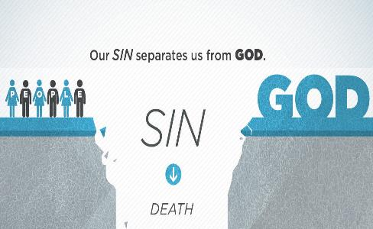
Job 9:32-33
³² “For He is not a man as I am that I may answer Him, That we may go to court together. ³³ There is no umpire between us, Who may lay his hand upon us both.”

Slide 76
To Become Man’s Merciful High Priest
Definition of a priest
Job’s cry (Job 9:32-33)
One mediator (1 Timothy 2:5)

Slide 77
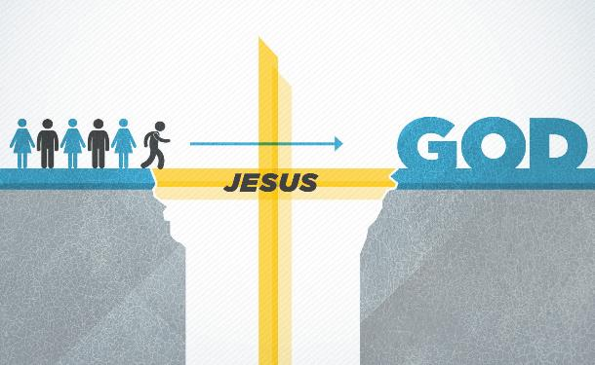
1 Timothy 2:5
“For there is one God, and one mediator also between God and men, the man Christ Jesus.”

Slide 78
Why God Became Man
(Heb. 2:5-18)
To restore God’s original purpose for man (5-8)
To taste death for every man (9)
To bring many to glory (10-13)
To break Satan’s rule over humanity (14)
To remove the fear of death (15)
To become our merciful high priest (16-17a)
To make a complete purification for sin (17b)
To sympathize with those tested (18)
Adapted from J. Dwight Pentecost, Faith that Endures (Grand Rapids, MI: Kregel, 2000), 60-71.

Slide 79
Hebrews 2:17
“Therefore, in all things He had to be made like His brethren, that He might be a merciful and faithful High Priest in things pertaining to God, to make propitiation [hilasmos; hilaskomai] for the sins of the people.”

Slide 80
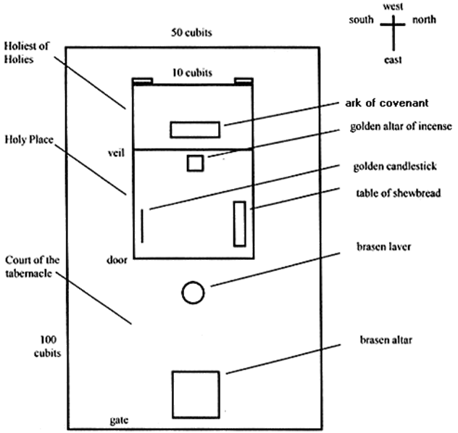
Tabernacle Diagram

Slide 81
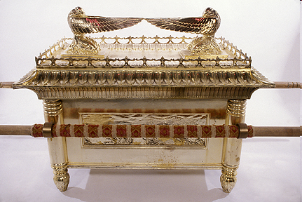
Ark of the Covenant

Slide 82
Hebrews 10:5-7
⁵ Therefore, when He comes into the world, He says, “Sacrifice and offering You have not desired, But a body You have prepared for Me;⁶ In whole burnt offerings and sacrifices for sin You have taken no pleasure.⁷ “Then I said, ‘Behold, I have come (In the scroll of the book it is written of Me) To do Your will, O God.’”

Slide 83

John 19:30
Therefore when Jesus had received the sour wine, He said, “It is finished!” [tetelestai] And He bowed His head and gave up His spirit.

Slide 84
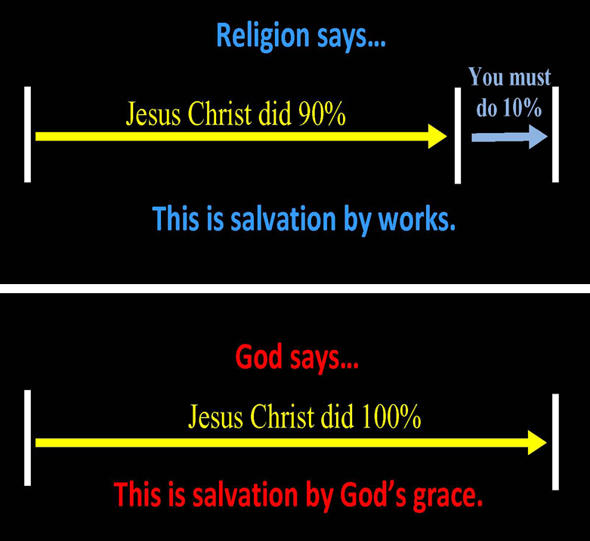
Chart courtesy of Thomas Stegall
Notes:
Pay, pray, and obey!

Slide 85
Why God Became Man
(Heb. 2:5-18)
To restore God’s original purpose for man (5-8)
To taste death for every man (9)
To bring many to glory (10-13)
To break Satan’s rule over humanity (14)
To remove the fear of death (15)
To become our merciful high priest (16-17a)
To make a complete purification for sin (17b)
To sympathize with those tested (18)
Adapted from J. Dwight Pentecost, Faith that Endures (Grand Rapids, MI: Kregel, 2000), 60-71.

Slide 86

Hebrews 2:18
“For since He Himself was tempted in that which He has suffered, He is able to come to the aid of those who are tempted.”

Slide 87
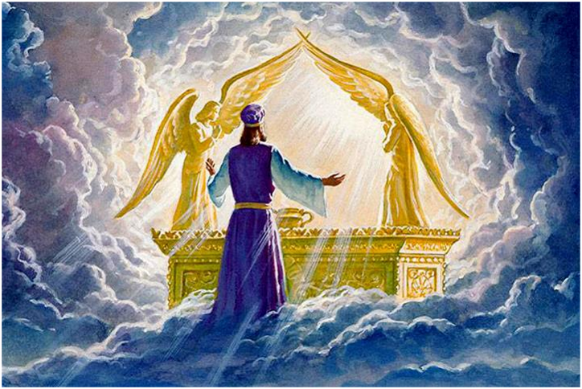
To Become Man’s Merciful High Priest
Definition of a priest
Job’s cry (Job 9:32-33)
One mediator (1 Timothy 2:5)

Slide 88
Hebrews 4:15-16
^{15 “}For we do not have a high priest who cannot sympathize with our weaknesses, but One who has been tempted in all things as we are, yet without sin. ¹⁶ Therefore let us draw near with confidence to the throne of grace, so that we may receive mercy and find grace to help in time of need.”

Slide 89
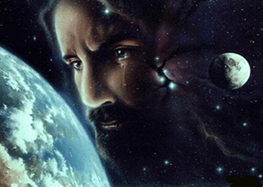
Christ’s Human Experiences
Labor (Mark 6:3)
Distress (Luke 22:44)
Being troubled (John 12:27)
Thirst (John 19:28)
Hunger (Matt 4:2)
Fatigue (John 4:6)
Sadness (John 11:35)
Lack of understanding (Matt 24:36)
Temptation (Luke 4:1-13; Heb. 4:15)

Slide 90
Conclusion

Slide 91
Why God Became Man
(Heb. 2:5-18)
To restore God’s original purpose for man (5-8)
To taste death for every man (9)
To bring many to glory (10-13)
To break Satan’s rule over humanity (14)
To remove the fear of death (15)
To become our merciful high priest (16-17a)
To make a complete purification for sin (17b)
To sympathize with those tested (18)
Adapted from J. Dwight Pentecost, Faith that Endures (Grand Rapids, MI: Kregel, 2000), 60-71.

Slide 92
Hebrews 1:4‒2:18
Christ is Superior to the Angels
      Seven OT Citations (1:4-14)
      Warning Against Drifting (2:1-4)
      Why God Became Man (2:5-18)

