Slide 1



Slide 2

EXODUS STRUCTURE/OUTLINE
Redemption (1–18)
Redemption (1:1–12:30)
Liberation (12:31–15:21)
Preservation (15:22–18:27)
Mosaic Covenant (19–40)
Law (19–24)
Tabernacle instructions (25–31)
Apostasy (32–34)
Tabernacle building (35–40)

Slide 3
REDEMPTION (1:1–12:30)
Why redemption is necessary (Exod 1)
Development of the deliverer (Exod 2–4)
First confrontation with Pharaoh (Exod 5)
God reassures Moses (Exod 6:1–7:7)
Second confrontation with Pharaoh (Exod 7:8-13)
Plagues (Exod 7:14–12:30)

Slide 4
The Plagues of Egypt
NO. | DESCRIPTION | SCRIPTURE | Egyptian Deity
1. | Water to Blood | Exod. 7:14-25 | Hapi, Khnum
2. | Frogs | Exod. 8:1-15 | Heqt
3. | Gnats | Exod. 8:16-19 | Set
4. | Flies | Exod. 8:20-32 | Uatchit
5. | Disease on Cattle | Exod. 9:1-7 | Hathor, Apis
6. | Boils | Exod. 9:8-12 | Sekhmet, Serapis
7. | Hail | Exod. 9:13-35 | Seth, Nut
8. | Locusts | Exod. 10:1-20 | Seth, Nut, Osiris
9. | Darkness | Exod. 10:21-29 | Re, Horus, Atum
10. | Death of the First Born | Exod. 12:29-36 | Min, Osiris, Heqt, Isis

Slide 5
TEN PLAGUES REDEMPTION (7:14–12:30)
Nile to blood
Frogs
Gnats
Flies
Death of livestock
Boils
Hail
Locusts
Darkness
Death of 1st born

Slide 6
DEATH OF FIRST BORN Exodus 12:1-51
God’s instructions to Moses (1-20)
Moses instructions to Israel (21-28)
Death of the 1st born (29-32)
Exodus from Egypt (33-42)
Passover instituted (43-51)

Slide 7
I. Exodus 12:1-20 God’s Instructions to Moses
Passover (1-13)
Unleavened bread (14-20)

Slide 8
Exodus 12:14-20 Unleavened Bread
Memorial (14)
Instructions (15-20)

Slide 9
Exodus 12:14-20 Unleavened Bread
Memorial (14)
Instructions (15-20)

Slide 10
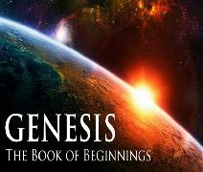
Covenant Signs
Noahic Covenant: Rainbow (Gen 9)
Abrahamic Covenant: Circumcision (Gen 17)
Mosaic Covenant: Sabbath (Exod 20; Lev 25: Jer 25:11; 29:10; 2 Chron 36:21)
New Covenant: Communion (Luke 22)

Slide 11
7 Levitical Feasts (Leviticus 23)
Feast | Season | Purpose | Type
Passover | Spring | Redemption | 1 Cor 5:7
Unleavened Bread | Spring | Separation | John 6:35
1st fruits | Spring | Praise for initial crop | 1 Cor. 15:20
Pentecost | Spring | Praise for full crop | Acts 2:1-4
Trumpets | Fall | New Year | Matt. 24:31
Atonement | Fall | Lev. 16 | Zech. 12:10
Booths | Fall | Wilderness provision | Zech. 14:16-18

Slide 12
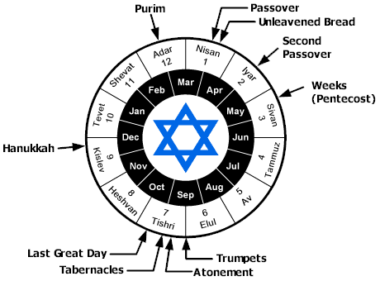

Slide 13
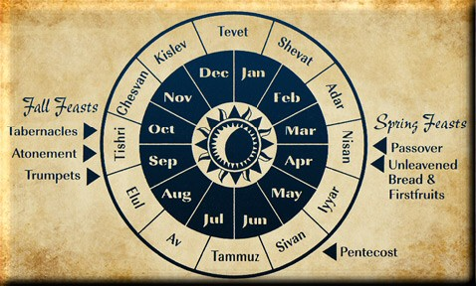

Slide 14
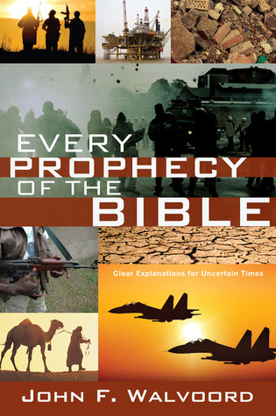

Slide 15
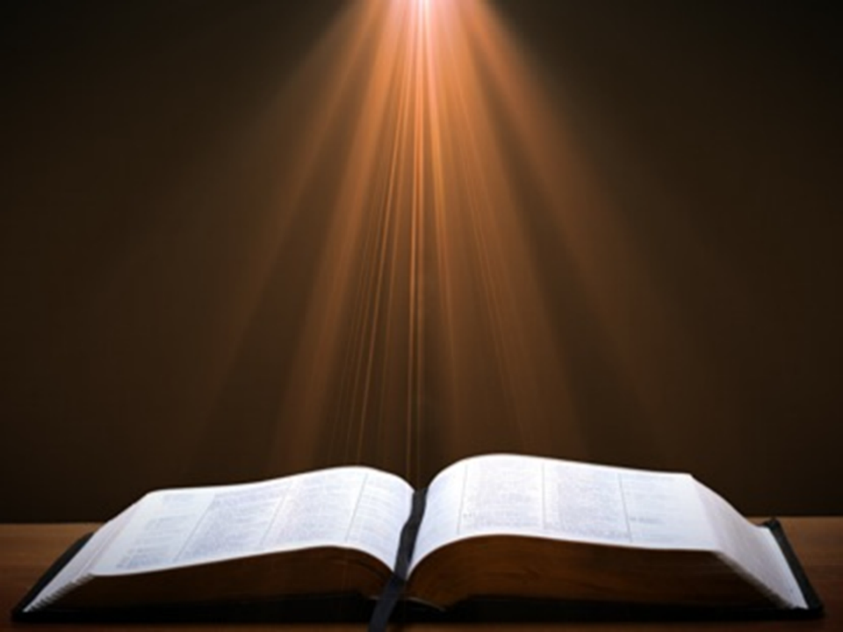

John 13:19; 14:29
“¹⁹ From now on I am telling you before it comes to pass, so that when it does occur, you may believe that I am He… ^{14:29} Now I have told you before it happens, so that when it happens, you may believe.”

Slide 16
Exodus 12:14-20 Unleavened Bread
Memorial (14)
Instructions (15-20)

Slide 17
Exodus 12:14-20 Instructions
Removal (15)
Assembly (16)
Observance (17)
Timing (18-19)
Conclusion (20)

Slide 18
Exodus 12:14-20 Instructions
Removal (15)
Assembly (16)
Observance (17)
Timing (18-19)
Conclusion (20)

Slide 19
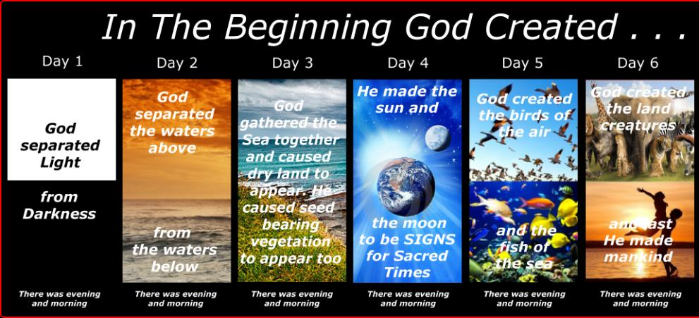
SHAPING AND POPULATING (GEN 1:1)
Day 1: | Light | Day 4: | Luminaries
Day 2: | Water, sky | Day 5: | Sea animals, birds
Day 3: | Land, vegetation | Day 6: | Land animals, man

Slide 20
Exodus 12:14-20 Instructions
Removal (15)
Assembly (16)
Observance (17)
Timing (18-19)
Conclusion (20)

Slide 21
SHAPING AND POPULATING (GEN 1:1)
Day 1: | Light | Day 4: | Luminaries
Day 2: | Water, sky | Day 5: | Sea animals, birds
Day 3: | Land, vegetation | Day 6: | Land animals, man

Slide 22
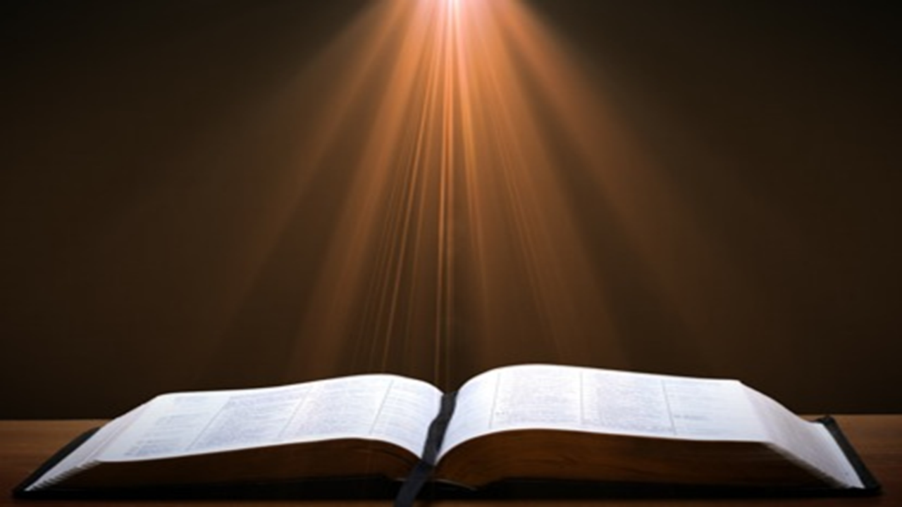
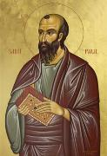
Romans 4:4-5
⁴ “Now to the one who works, his wage is not credited as a favor, but as what is due. ⁵ But to the one who does not work, but believes in Him who justifies the ungodly, his faith is credited as righteousness.”

Slide 23
7 Discourses
Discourse | Verses
New birth Water of life Equality with the Father Bread of life Life giving Spirit Light of the world Good shepherd | 3:1-36 4:1-42 5:19-47 6:22-26 7:1-52 8:12-59 10:1-42

Slide 24

Exodus 20:8-11
⁸ “Remember the sabbath day, to keep it holy. ⁹ Six days you shall labor and do all your work, ¹⁰ but the seventh day is a sabbath of the Lord your God; in it you shall not do any work, you or your son or your daughter, your male or your female servant or your cattle or your sojourner who stays with you. ¹¹ For in six days the Lord made the heavens and the earth, the sea and all that is in them, and rested on the seventh day; therefore the Lord blessed the sabbath day and made it holy.”

Slide 25
Exodus 31:15-17
¹⁵ ‘For six days work may be done, but on the seventh day there is a sabbath of complete rest, holy to the Lord; whoever does any work on the sabbath day shall surely be put to death. ¹⁶ ‘So the sons of Israel shall observe the sabbath, to celebrate the sabbath throughout their generations as a perpetual covenant.’ ¹⁷ “It is a sign between Me and the sons of Israel forever; for in six days the Lord made heaven and earth, but on the seventh day He ceased from labor, and was refreshed.”

Slide 26
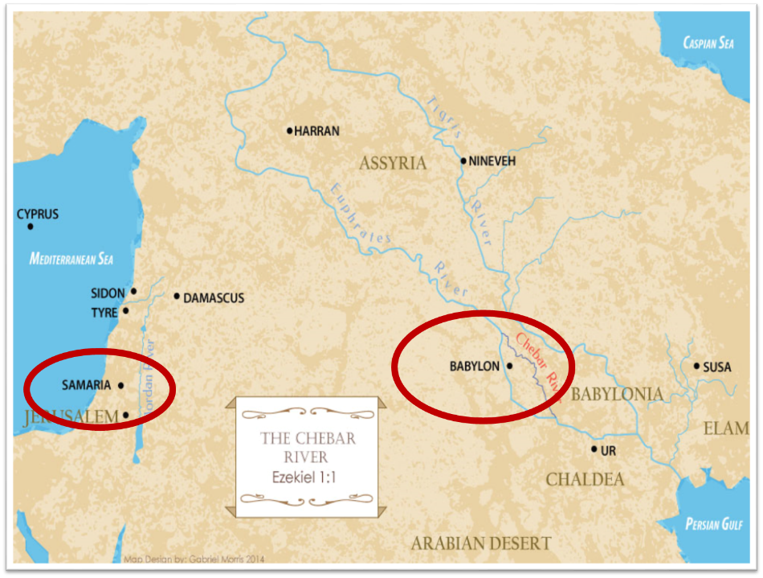

Slide 27
Exodus 12:14-20 Instructions
Removal (15)
Assembly (16)
Observance (17)
Timing (18-19)
Conclusion (20)

Slide 29
John 13:19; 14:29
“¹⁹ From now on I am telling you before it comes to pass, so that when it does occur, you may believe that I am He… ^{14:29} Now I have told you before it happens, so that when it happens, you may believe.”

Slide 30
Exodus 12:14-20 Instructions
Removal (15)
Assembly (16)
Observance (17)
Timing (18-19)
Conclusion (20)

Slide 31
SHAPING AND POPULATING (GEN 1:1)
Day 1: | Light | Day 4: | Luminaries
Day 2: | Water, sky | Day 5: | Sea animals, birds
Day 3: | Land, vegetation | Day 6: | Land animals, man

Slide 32

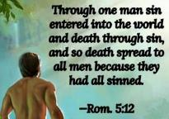
Genesis 2:16-17
“¹⁶ The Lord God commanded the man, saying, ‘From any tree of the garden you may eat freely; ¹⁷ but from the tree of the knowledge of good and evil you shall not eat, for in the day that you eat from it you will surely die (muwth).’”

Slide 33
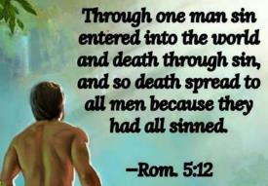
Genesis 3:19
“By the sweat of your face You will eat bread, Till you return to the ground, Because from it you were taken; For you are dust, And to dust you shall return.”

Slide 34


Romans 5:12
“Therefore, just as through one man sin entered into the world, and death through sin, and so death spread to all men, because all sinned—.”

Slide 35
Exodus 12:14-20 Instructions
Removal (15)
Assembly (16)
Observance (17)
Timing (18-19)
Conclusion (20)

Slide 36
7 Levitical Feasts (Leviticus 23)
Feast | Season | Purpose | Type
Passover | Spring | Redemption | 1 Cor 5:7
Unleavened Bread | Spring | Separation | John 6:35
1st fruits | Spring | Praise for initial crop | 1 Cor. 15:20
Pentecost | Spring | Praise for full crop | Acts 2:1-4
Trumpets | Fall | New Year | Matt. 24:31
Atonement | Fall | Lev. 16 | Zech. 12:10
Booths | Fall | Wilderness provision | Zech. 14:16-18

Slide 37
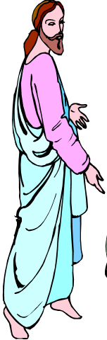
7 “I AM” statements in John
I am the Bread of Life | 6:35
I am the Light of the world | 8:12
I am the Gate for the sheep | 10:7; cf. v.9
I am the Good Shepherd | 10:11,14
I am the Resurrection and the Life | 11:25
I am the Way and the Truth and the Life | 14:6
I am the true Vine | 15:1; cf. v.5

Slide 38
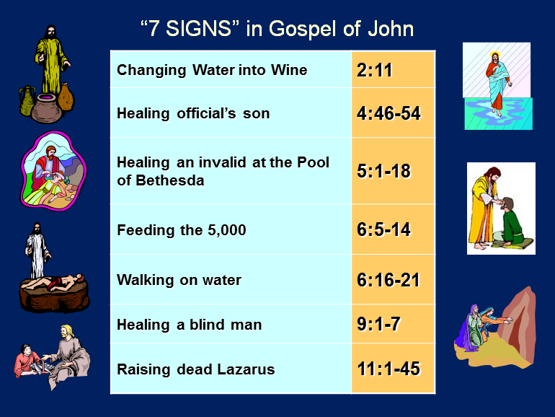

Slide 39
7 Discourses
Discourse | Verses
New birth Water of life Equality with the Father Bread of life Life giving Spirit Light of the world Good shepherd | 3:1-36 4:1-42 5:19-47 6:22-26 7:1-52 8:12-59 10:1-42

Slide 40
DEATH OF FIRST BORN Exodus 12:1-51
God’s instructions to Moses (1-20)
Moses instructions to Israel (21-28)
Death of the 1st born (29-32)
Exodus from Egypt (33-42)
Passover instituted (43-51)

Slide 41
II. Exodus 12:21-28 Moses’ Instructions to Israel
Lamb’s death (21)
Blood applied (22)
Passover described (23)
Ritual established (24-27a)
Israel’s response (27b-28)

Slide 42
II. Exodus 12:21-28 Moses’ Instructions to Israel
Lamb’s death (21)
Blood applied (22)
Passover described (23)
Ritual established (24-27a)
Israel’s response (27b-28)

Slide 43
II. Exodus 12:21-28 Moses’ Instructions to Israel
Lamb’s death (21)
Blood applied (22)
Passover described (23)
Ritual established (24-27a)
Israel’s response (27b-28)

Slide 44
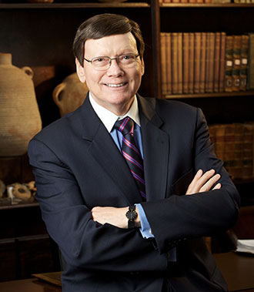
Dr. Ed Hindson
Hindson, E. E., & Mitchell, D. R., eds. (2010). KJV Bible Commentary for Today: The Most Up-to-Date Commentary on the Time-Honored Text of the KJV (p. 99). Thomas Nelson.
“12:7. The blood of the sacrificed lamb was to be stained on the two side posts and … upper door post of the home in which the lamb would be eaten that evening. At either corner where the side posts met the lintel, the bloody stain would have formed a cross.”

Slide 45
II. Exodus 12:21-28 Moses’ Instructions to Israel
Lamb’s death (21)
Blood applied (22)
Passover described (23)
Ritual established (24-27a)
Israel’s response (27b-28)

Slide 46

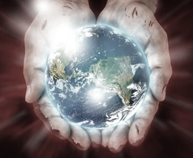
John 1:29
“The next day he saw Jesus coming to him, and said, ‘Behold, the Lamb of God who takes away the sin of the world!’”

Slide 47
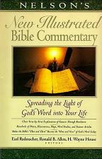
Exodus 12:23
“The term ‘the destroyer’ in Ex. 12:23 (a Heb. participle from shahat, in the Hiphil theme) seems to suggest that the agent of destruction is someone other than the Lord (but compare Ex. 12:12, 13). Who then, or what, is ‘the destroyer?’…It seems that only with the NT revelation may this conundrum be solved. The ‘Destroyer’ (the term should be spelled with a capital letter) appears to be another reference to the pre-incarnate Jesus! (This is also, we believe, the better solution to the meaning of the term ‘the Angel of Yahweh’; 23:20.)”
Nelson's New Illustrated Bible Commentary, 108.

Slide 48
Exodus 12:23
“Certainly many will cringe at the notion of Jesus being described with this dark title; but they cringe as well at the picture of the Savior in Rev. 19:11–21. (Perhaps the same image is intended in the account of the Angel of the Lord with a drawn sword in His hand standing over the infamous Balaam; Num. 22:31.) Scriptural categories should not be established by ‘cringe-quotients’! There are many and varied portraits of the Savior-King in Scripture. Here is a neglected one, ‘the Destroyer!’”
Nelson's New Illustrated Bible Commentary, 108.

Slide 49
II. Exodus 12:21-28 Moses’ Instructions to Israel
Lamb’s death (21)
Blood applied (22)
Passover described (23)
Ritual established (24-27a)
Israel’s response (27b-28)

Slide 50
Exodus 12:24-27a Ritual Established
Practiced forever (24)
In the land (25)
Taught in the family (26-27a)

Slide 51
Exodus 12:24-27a Ritual Established
Practiced forever (24)
In the land (25)
Taught in the family (26-27a)

Slide 52
Exodus 12:24-27a Ritual Established
Practiced forever (24)
In the land (25)
Taught in the family (26-27a)

Slide 53

Genesis 15:18-21
¹⁸ On that day the Lord made a covenant with Abram, saying, “To your descendants I have given this land, From the river of Egypt as far as the great river, the river Euphrates: ¹⁹ the Kenite and the Kenizzite and the Kadmonite ²⁰ and the Hittite and the Perizzite and the Rephaim ²¹ and the Amorite and the Canaanite and the Girgashite and the Jebusite.”

Slide 54
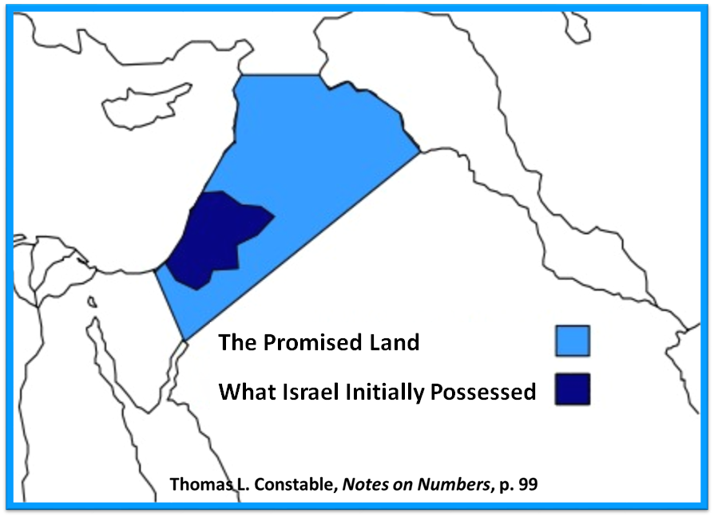

Slide 55
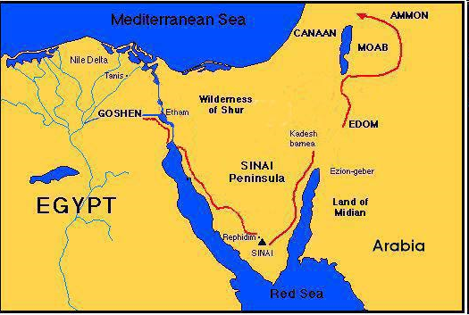

Slide 56
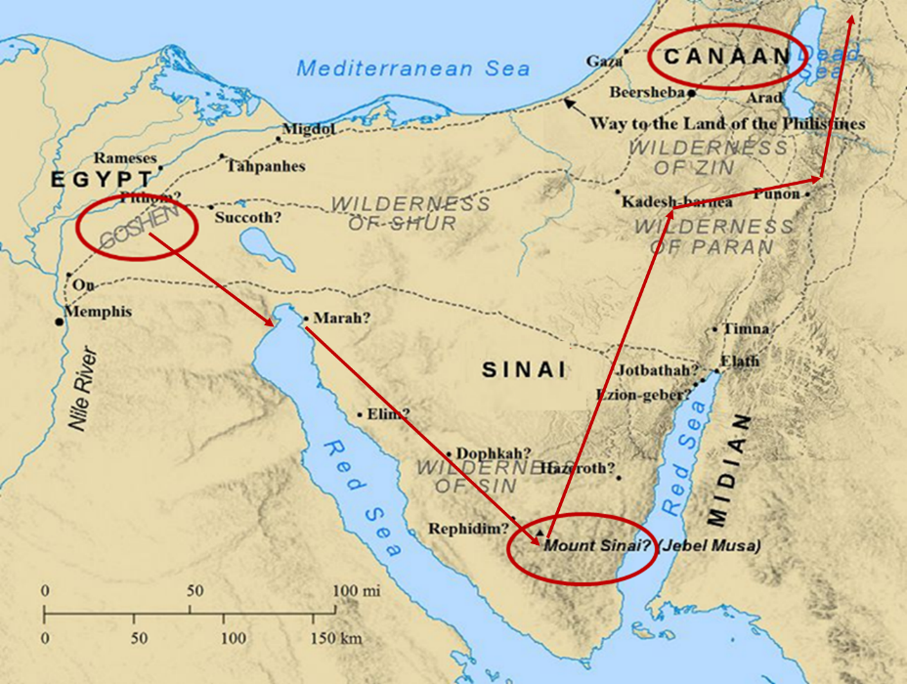

Slide 57
Exodus 12:24-27a Ritual Established
Practiced forever (24)
In the land (25)
Taught in the family (26-27a)

Slide 58
Exodus 12:26-27a Taught in the Family
Children's question (26)
Parent’s answer (27a)

Slide 59
Exodus 12:26-27a Taught in the Family
Children's question (26)
Parent’s answer (27a)

Slide 60
Exodus 12:26-27a Taught in the Family
Children's question (26)
Parent’s answer (27a)

Slide 61

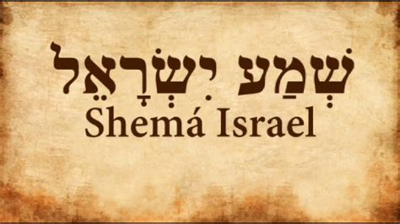
Deuteronomy 6:4-7
“⁴ Hear, Israel! The Lord is our God, the Lord is one!... ⁶ These words, which I am commanding you today, shall be on your heart. ⁷ You shall teach them diligently to your sons and shall talk of them when you sit in your house and when you walk by the way and when you lie down and when you rise up.”

Slide 62
II. Exodus 12:21-28 Moses’ Instructions to Israel
Lamb’s death (21)
Blood applied (22)
Passover described (23)
Ritual established (24-27a)
Israel’s response (27b-28)

Slide 63
Exodus 12:27b-28 Israel’s Response
Worship (27a)
Obedience (28)

Slide 64
Exodus 12:27b-28 Israel’s Response
Worship (27a)
Obedience (28)

Slide 65
Exodus 12:27b-28 Israel’s Response
Worship (27a)
Obedience (28)

Slide 66
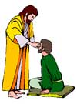
“SEVEN SIGNS” in Gospel of John
1. Changing Water into Wine | 2:11
2. Healing official’s son | 4:46-54
3. Healing an invalid at the Pool of Bethesda | 5:1-18
4. Feeding the 5,000 | 6:5-14
5. Walking on water | 6:16-21
6. Healing a blind man | 9:1-7
7. Raising dead Lazarus | 11:1-45

Slide 67
DEATH OF FIRST BORN Exodus 12:1-51
God’s instructions to Moses (1-20)
Moses instructions to Israel (21-28)
Death of the 1st born (29-32)
Exodus from Egypt (33-42)
Passover instituted (43-51)

Slide 68
III. Exodus 12:429-32 Death of 1st Born
Comprehensive judgment (29)
Emotional response (30)
Command to leave (31-32)

Slide 69
III. Exodus 12:429-32 Death of 1st Born
Comprehensive judgment (29)
Emotional response (30)
Command to leave (31-32)

Slide 70
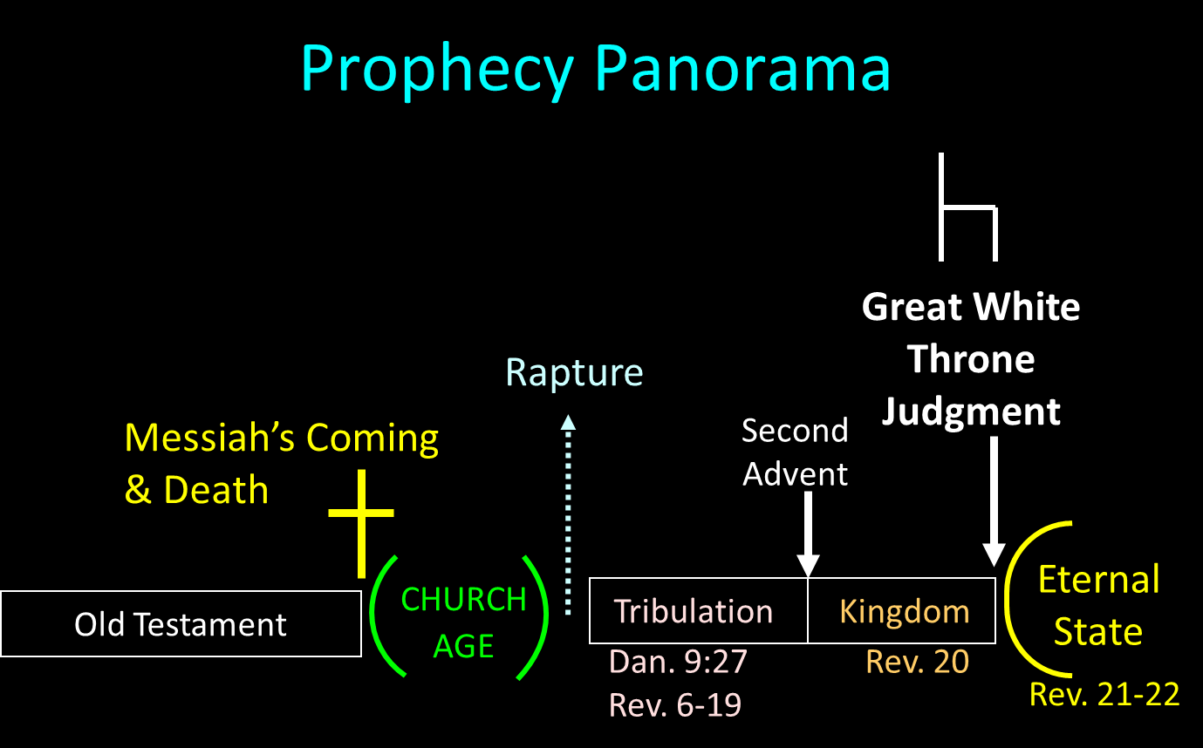

Slide 71
Scripture’s Four Judgments
NAME | SHEEP AND GOAT | JUDGMENT OF THE JEWS | BEMA SEAT | GREAT WHITE THRONE
SCRIPTURE | Matt 25:31-46 | Ezek 20:33-44 | 1 Cor 3:10-15 | Rev 20:11-15
PLACE | Earth, Jerusalem | Earth, wilderness | Heaven | Earth
AUDIENCE | Gentile Tribulation survivors | Jewish Tribulation survivors | Church Age believers | All unsaved
WHEN | After Tribulation | After Tribulation | After rapture | After Millennium
PURPOSE | Saved Gentiles enter kingdom | Saved Jews enter kingdom | Reward believers | Degree of punishment in hell
EVALUATION | Treatment of Christ’s brethren | Passing under shepherd’s rod | Works taken through fire | Not in the book; judged by books

Slide 72
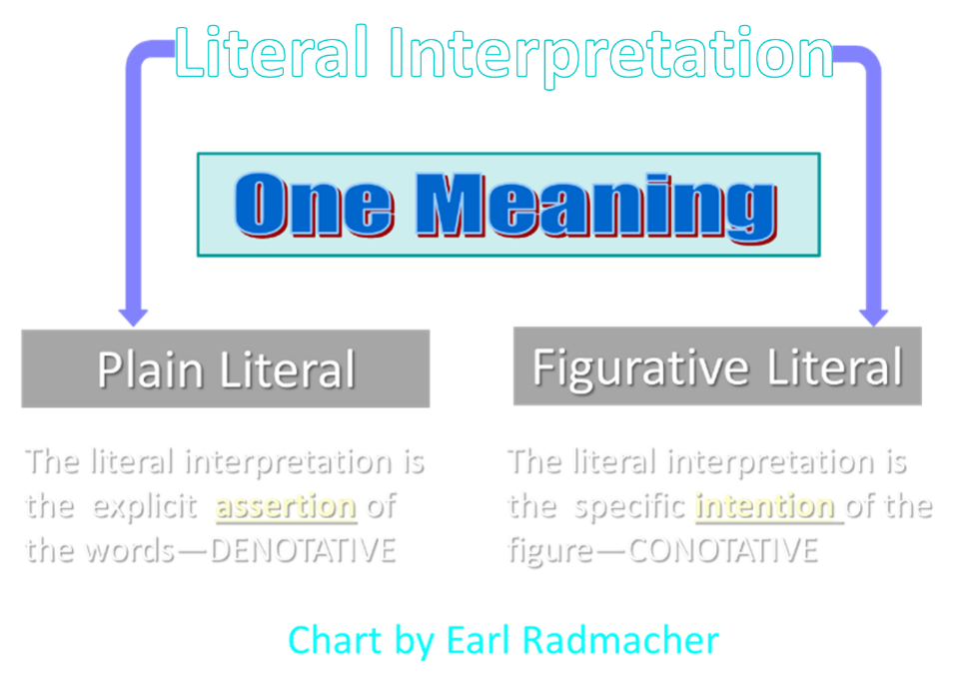

Slide 73
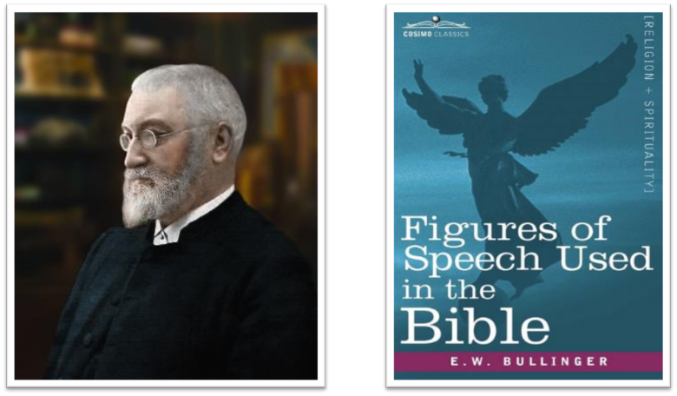
E.W. Bullinger (1837‒1913)

Slide 74
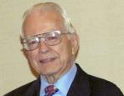

Dr. Roy B. Zuck
Basic Bible Interpretation, p. 151.
“Merism. A merism is a form of synecdoche in which the totality or whole is substituted by two contrasting or opposite parts. When the psalmist wrote, ‘You know when I sit and when I rise’ (Ps. 139:2), he was not limiting the Lord’s knowledge to times when he sat down and when he got up. Instead he was saying the Lord knew all his actions.”

Slide 75
Dr. Ed Hindson
Hindson, E. E., & Mitchell, D. R., eds. (2010). KJV Bible Commentary for Today: The Most Up-to-Date Commentary on the Time-Honored Text of the KJV (p. 101). Thomas Nelson.
“12:29. Those holding to the miraculous intensification of natural events theory of the plagues cannot in any fashion explain the origin of a virus intelligent enough to select only firstborn males. The hand of the Lord is the only satisfactory explanation for this disaster. His promised judgment (4:23) had been rendered.”

Slide 76

PLAGUES’ MIRACULOUS NATURE
Moses knew about them beforehand (8:10; 9:5, 29)
Instantaneous appearance and termination
Description as “signs and wonders” (7:3)
Intensification
Timing
Accomplishment of a moral purpose (11:1)
Response they invoked from the Egyptian sorcerers (7:22; 8:18-19)
Last seven plagues did not effect the Jews living in Goshen (9:6)
Nile into blood affected all rivers, streams, pools, reservoirs, and vessels holding waters
Hill and Walton, A Survey of the Old Testament, 114-15

Slide 77

Charles Ryrie Ryrie Study Bible, page 109
Exodus 12:29 “the firstborn of Pharaoh. We know Thutmose IV succeeded Amenhotep II, the Pharaoh of the Exodus, but Thutmose IV was not his firstborn.”

Slide 78
DATE OF THE EXODUS
1446 b.c.
Literal numbers
Oppression – Thutmose III
Exodus – Amenhotep II

Slide 79
III. Exodus 12:429-32 Death of 1st Born
Comprehensive judgment (29)
Emotional response (30)
Command to leave (31-32)

Slide 80

1 Thessalonians 4:13-18
¹³ "But we do not want you to be uninformed, brethren, about those who are asleep, so that you will not grieve as do the rest who have no hope. ¹⁴ For if we believe that Jesus died and rose again, even so God will bring with Him those who have fallen asleep in Jesus. ¹⁵ For this we say to you by the word of the Lord, that we who are alive and remain until the coming of the Lord, will not precede. . .

Slide 81
1 Thessalonians 4:13-18
. . . those who have fallen asleep. ¹⁶ For the Lord Himself descend from heaven with a shout, with the voice of the archangel and with the trumpet of God, and the dead in Christ will rise first. ¹⁷ Then we who are alive and remain will be caught up together with them in the clouds to meet the Lord in the air, and so we shall always be with the Lord. ¹⁸ Therefore comfort one another with these words."

Slide 83
John 13:19; 14:29
“¹⁹ From now on I am telling you before it comes to pass, so that when it does occur, you may believe that I am He… ^{14:29} Now I have told you before it happens, so that when it happens, you may believe.”

Slide 84
III. Exodus 12:429-32 Death of 1st Born
Comprehensive judgment (29)
Emotional response (30)
Command to leave (31-32)

Slide 85
Exodus 12:31-32 Command to Leave
People (31)
Flocks (32)

Slide 86
Exodus 12:31-32 Command to Leave
People (31)
Flocks (32)

Slide 87
Charles Ryrie Ryrie Study Bible, page 109
Exodus 12:31 “Though Pharaoh manufactured rationalizations for the other plagues, he could not reason away the trauma of the death of his own son. He called for Moses and Aaron that night and gave them permission to go, this time without insisting on any concessions.”

Slide 88
Exodus 12:31-32 Command to Leave
People (31)
Flocks (32)

Slide 90
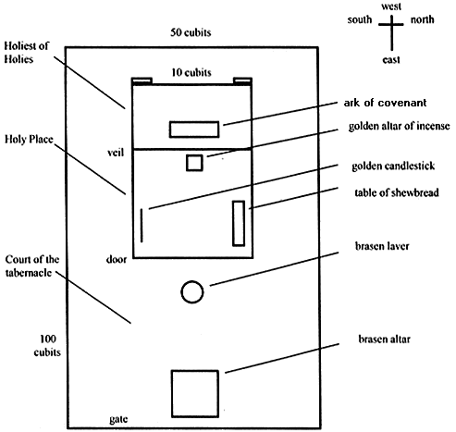
Tabernacle Diagram

Slide 91
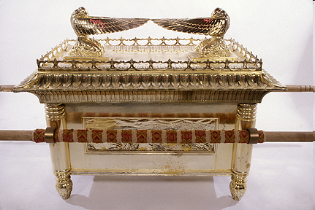
Ark of the Covenant

Slide 92
DEATH OF FIRST BORN Exodus 12:1-51
God’s instructions to Moses (1-20)
Moses instructions to Israel (21-28)
Death of the 1st born (29-32)
Exodus from Egypt (33-42)
Passover instituted (43-51)

Slide 93
IV. Exodus 12:33-42 Exodus from Egypt
Urgency (33)
Unleavened dough taken (34)
Egyptians plundered (35-36)
Direction (37a)
Number (37b)
Mixed multitude (38)
Unleavened bread baked (39)
Duration of bondage (40-41)
Ritual established (42)

Slide 94
IV. Exodus 12:33-42 Exodus from Egypt
Urgency (33)
Unleavened dough taken (34)
Egyptians plundered (35-36)
Direction (37a)
Number (37b)
Mixed multitude (38)
Unleavened bread baked (39)
Duration of bondage (40-41)
Ritual established (42)

Slide 95
IV. Exodus 12:33-42 Exodus from Egypt
Urgency (33)
Unleavened dough taken (34)
Egyptians plundered (35-36)
Direction (37a)
Number (37b)
Mixed multitude (38)
Unleavened bread baked (39)
Duration of bondage (40-41)
Ritual established (42)

Slide 96
Dr. Ed Hindson
Hindson, E. E., & Mitchell, D. R., eds. (2010). KJV Bible Commentary for Today: The Most Up-to-Date Commentary on the Time-Honored Text of the KJV (p. 101). Thomas Nelson.
“12:34. …in the Hebrews’ haste to leave (on what was the first day of the seven-day festival), they grabbed the only food that was on hand: their as yet unleavened bread dough. They formed the dough into cakes and hoisted the pans onto their shoulders. The sun then baked the cakes into matzos, unleavened bread.”

Slide 97
IV. Exodus 12:33-42 Exodus from Egypt
Urgency (33)
Unleavened dough taken (34)
Egyptians plundered (35-36)
Direction (37a)
Number (37b)
Mixed multitude (38)
Unleavened bread baked (39)
Duration of bondage (40-41)
Ritual established (42)

Slide 98
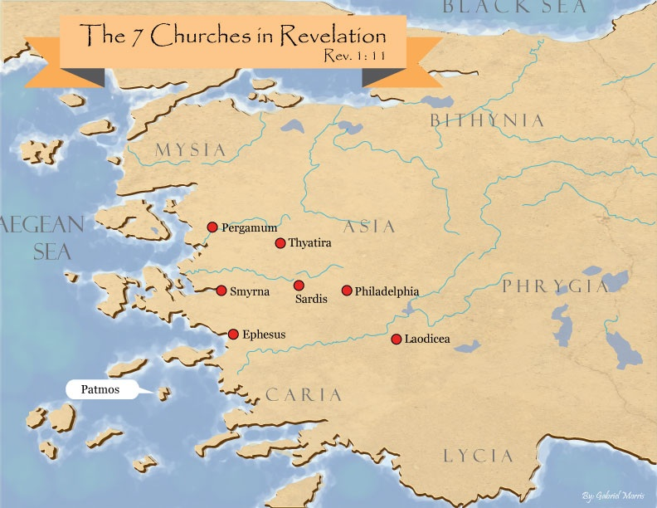
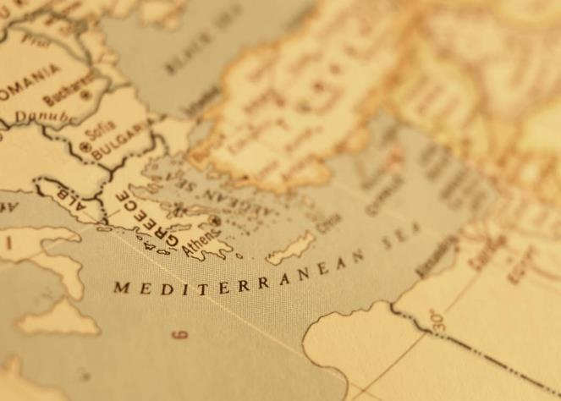

Slide 99

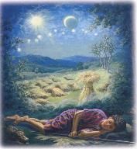
Genesis 37:9
“Now he had still another dream, and related it to his brothers, and said, ‘Lo, I have had still another dream; and behold, the sun and the moon and eleven stars were bowing down to me.’”

Slide 100
Genesis 37:10
“He related it to his father and to his brothers; and his father rebuked him and said to him, ‘What is this dream that you have had? Shall I and your mother and your brothers actually come to bow ourselves down before you to the ground?’”

Slide 102
John 13:19; 14:29
“¹⁹ From now on I am telling you before it comes to pass, so that when it does occur, you may believe that I am He… ^{14:29} Now I have told you before it happens, so that when it happens, you may believe.”

Slide 103
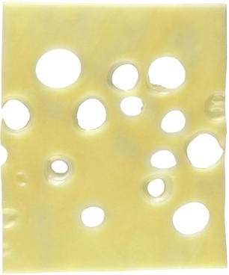

Slide 104
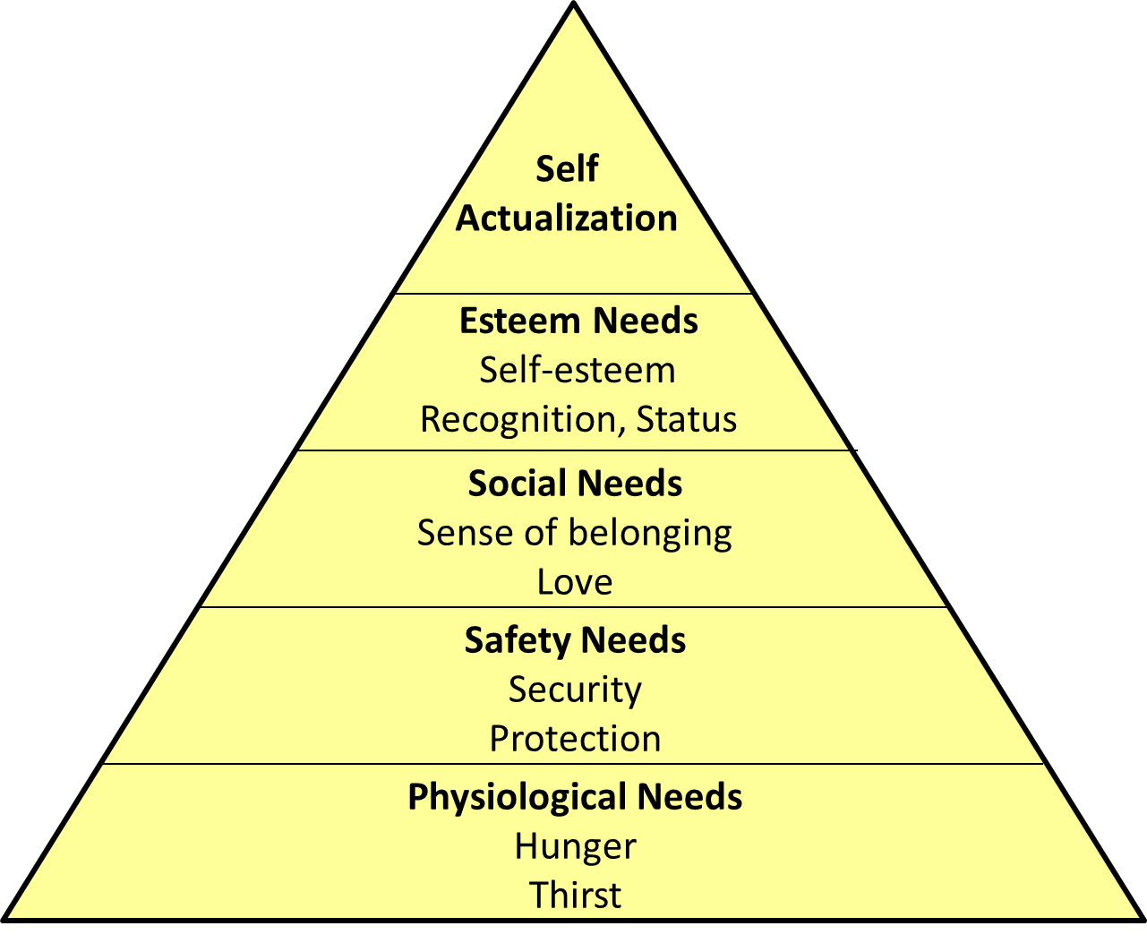
Maslow’s Hierarchy of Needs

Slide 105

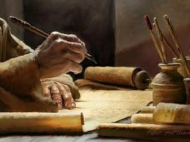
2 Timothy 3:16-17
“¹⁶ All Scripture is inspired by God [theopneustos] and profitable for teaching, for reproof, for correction, for training in righteousness; ¹⁷ so that the man of God may be adequate, equipped for every good work.”

Slide 106

2 Peter 1:3-4
“³ Seeing that His divine power has granted to us everything pertaining to life and godliness, through the true knowledge of Him who called us by His own glory and excellence. ⁴For by these He has granted to us His precious and magnificent promises, so that by them you may become partakers of the divine nature, having escaped the corruption that is in the world by lust.”

Slide 107
1 Peter 2:2
“like newborn babies, long for the pure [adolos] milk of the word, so that by it you may grow in respect to salvation, ³ if you have tasted the kindness of the Lord.”

Slide 108

Chafer Theological Seminary Distinctives:
sufficiency of the scriptures
"We believe in the complete adequacy of Scripture, for in it God has given us all things that pertain to life and godliness. We hold, therefore, that the Word of God by itself is sufficient to prepare a person for a lifetime of effective ministry.”
https://www.chafer.edu/distinctives

Slide 109
IV. Exodus 12:33-42 Exodus from Egypt
Urgency (33)
Unleavened dough taken (34)
Egyptians plundered (35-36)
Direction (37a)
Number (37b)
Mixed multitude (38)
Unleavened bread baked (39)
Duration of bondage (40-41)
Ritual established (42)

Slide 111
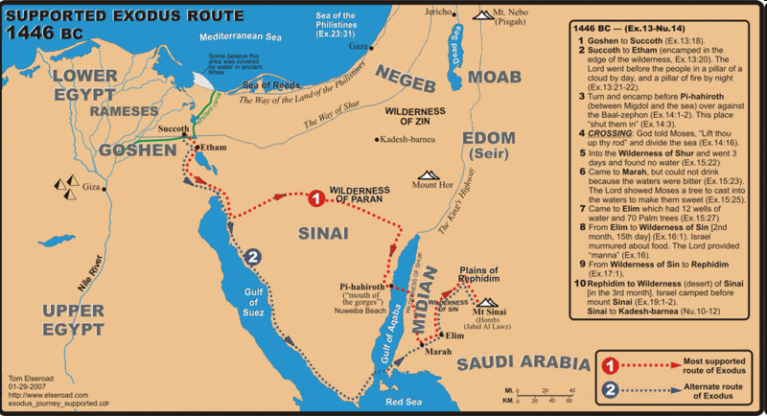

Slide 112
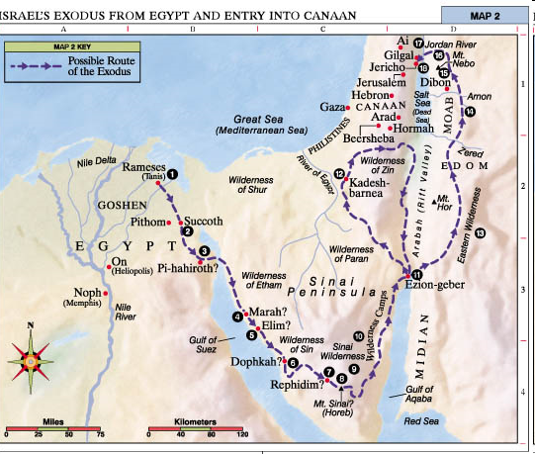

Slide 113
IV. Exodus 12:33-42 Exodus from Egypt
Urgency (33)
Unleavened dough taken (34)
Egyptians plundered (35-36)
Direction (37a)
Number (37b)
Mixed multitude (38)
Unleavened bread baked (39)
Duration of bondage (40-41)
Ritual established (42)

Slide 114
Dr. Ed Hindson
Hindson, E. E., & Mitchell, D. R., eds. (2010). KJV Bible Commentary for Today: The Most Up-to-Date Commentary on the Time-Honored Text of the KJV (p. 101). Thomas Nelson.
“12:37. Six hundred thousand … men. This is a round figure; the total number of men aged twenty and older was 603,550 (38:26). Extrapolating from that number, assuming one wife and two children per man, one arrives at an exodus population of roughly two million people. Objections have been commonly raised over the possibility of such an extraordinary population. While enormous energy and scholarly creativity has gone into the development of alternative theories to explain why the population numbers should not be taken at their face value, none has proven definitively convincing.”

Slide 115
IV. Exodus 12:33-42 Exodus from Egypt
Urgency (33)
Unleavened dough taken (34)
Egyptians plundered (35-36)
Direction (37a)
Number (37b)
Mixed multitude (38)
Unleavened bread baked (39)
Duration of bondage (40-41)
Ritual established (42)

Slide 116
Dr. Ed Hindson
Hindson, E. E., & Mitchell, D. R., eds. (2010). KJV Bible Commentary for Today: The Most Up-to-Date Commentary on the Time-Honored Text of the KJV (p. 101). Thomas Nelson.
“12:38. A mixed multitude went with them. These were likely other, non-Hebrew, slaves and perhaps a few God-fearing Egyptians. This Gentile group would stir up trouble in the camp during the wilderness journey (Num. 11:4).”

Slide 117
IV. Exodus 12:33-42 Exodus from Egypt
Urgency (33)
Unleavened dough taken (34)
Egyptians plundered (35-36)
Direction (37a)
Number (37b)
Mixed multitude (38)
Unleavened bread baked (39)
Duration of bondage (40-41)
Ritual established (42)

Slide 118
IV. Exodus 12:33-42 Exodus from Egypt
Urgency (33)
Unleavened dough taken (34)
Egyptians plundered (35-36)
Direction (37a)
Number (37b)
Mixed multitude (38)
Unleavened bread baked (39)
Duration of bondage (40-41)
Ritual established (42)

Slide 119

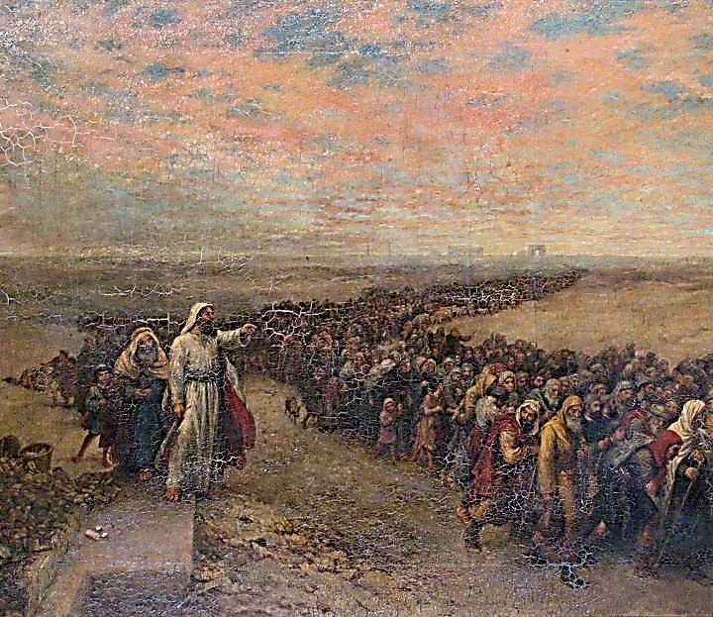
Exodus 12:40-41
“⁴⁰ Now the time that the sons of Israel lived in Egypt was four hundred and thirty years. ⁴¹ And at the end of four hundred and thirty years, to the very day, all the hosts of the Lord went out from the land of Egypt.”

Slide 120
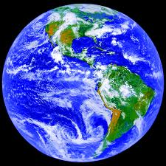
AGE OF THE EARTH?
971-931 BC=Solomonic reign
966=Solomon rebuilds temple (1 Kgs 6:1b)
- 480 years for the Exodus’ date (1 Kgs 6:1a)
= 1446 BC for Exodus’ date
- 430 years for Jacob’s migration to Egypt (Exod 12:40)
= 1876 BC for Jacob’s migration to Egypt (Gen 46)
Genealogies of Gen 5; 11
= 4000 BC for the earth’s age

Slide 121
AGE OF THE EARTH?
971-931 BC=Solomonic reign
966=Solomon rebuilds temple (1 Kgs 6:1b)
- 480 years for the Exodus’ date (1 Kgs 6:1a)
= 1446 BC for Exodus’ date
- 430 years for Jacob’s migration to Egypt (Exod 12:40)
= 1876 BC for Jacob’s migration to Egypt (Gen 46)
Genealogies of Gen 5; 11
= 4000 BC for the earth’s age

Slide 122
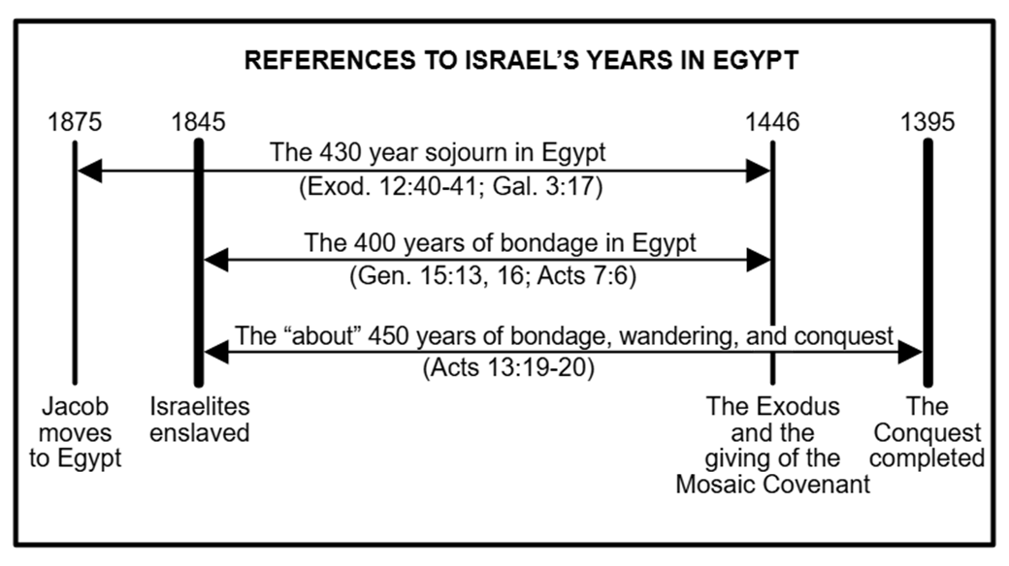

Slide 123
IV. Exodus 12:33-42 Exodus from Egypt
Urgency (33)
Unleavened dough taken (34)
Egyptians plundered (35-36)
Direction (37a)
Number (37b)
Mixed multitude (38)
Unleavened bread baked (39)
Duration of bondage (40-41)
Ritual established (42)

Slide 125
John 13:19; 14:29
“¹⁹ From now on I am telling you before it comes to pass, so that when it does occur, you may believe that I am He… ^{14:29} Now I have told you before it happens, so that when it happens, you may believe.”

Slide 126
DEATH OF FIRST BORN Exodus 12:1-51
God’s instructions to Moses (1-20)
Moses instructions to Israel (21-28)
Death of the 1st born (29-32)
Exodus from Egypt (33-42)
Passover instituted (43-51)

Slide 127
V. Exodus 112:43-51 Passover Instituted
Foreigners excluded (43-45)
Lamb’s bones unbroken (46)
Foreigner circumcision (47-49)
Israel’s obedience (50)
Exodus date (51)

Slide 128
V. Exodus 112:43-51 Passover Instituted
Foreigners excluded (43-45)
Lamb’s bones unbroken (46)
Foreigner circumcision (47-49)
Israel’s obedience (50)
Exodus date (51)

Slide 129

Genesis 12‒25 Abraham’s Early Journeys
Unconditional promises (Gen. 12:1-3) From Haran to Canaan (Gen. 12:4-5) In Canaan (Gen. 12:6-9) In Egypt (Gen. 12:10-20) Abram and Lot Separate (Gen. 13:1-13) Reaffirmation of Abram’s promises (Gen. 13:14-18) Abram Rescues Lot (14:1-24) Abrahamic Covenant (15:1-21) Hagar & Ishmael (16:1-16) Circumcision (Gen. 17:1-27) | Sodom & Gomorrah (Gen. 18‒19) Abraham & Abimelech (Gen. 20) Isaac’s birth (Gen. 21:1-7) Ishmael’s expulsion (21:8-21) Abraham & Abimelech’s covenant (21:22-34) Abraham sacrifices Isaac (22) Sarah’s death (23) Isaac’s marriage (24) Abraham & Keturah (25:1-6) Abraham’s death (25:7-11)

Slide 130
V. Exodus 112:43-51 Passover Instituted
Foreigners excluded (43-45)
Lamb’s bones unbroken (46)
Foreigner circumcision (47-49)
Israel’s obedience (50)
Exodus date (51)

Slide 131

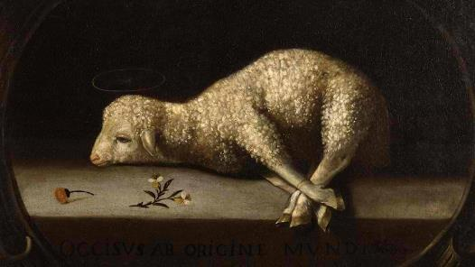
Exodus 12:5, 46
“Your lamb shall be an unblemished male a year old; you may take it from the sheep or from the goats…nor are you to break any bone of it.”

Slide 132
V. Exodus 112:43-51 Passover Instituted
Foreigners excluded (43-45)
Lamb’s bones unbroken (46)
Foreigner circumcision (47-49)
Israel’s obedience (50)
Exodus date (51)

Slide 133
Genesis 12‒25 Abraham’s Early Journeys
Unconditional promises (Gen. 12:1-3) From Haran to Canaan (Gen. 12:4-5) In Canaan (Gen. 12:6-9) In Egypt (Gen. 12:10-20) Abram and Lot Separate (Gen. 13:1-13) Reaffirmation of Abram’s promises (Gen. 13:14-18) Abram Rescues Lot (14:1-24) Abrahamic Covenant (15:1-21) Hagar & Ishmael (16:1-16) Circumcision (Gen. 17:1-27) | Sodom & Gomorrah (Gen. 18‒19) Abraham & Abimelech (Gen. 20) Isaac’s birth (Gen. 21:1-7) Ishmael’s expulsion (21:8-21) Abraham & Abimelech’s covenant (21:22-34) Abraham sacrifices Isaac (22) Sarah’s death (23) Isaac’s marriage (24) Abraham & Keturah (25:1-6) Abraham’s death (25:7-11)

Slide 134
V. Exodus 112:43-51 Passover Instituted
Foreigners excluded (43-45)
Lamb’s bones unbroken (46)
Foreigner circumcision (47-49)
Israel’s obedience (50)
Exodus date (51)

Slide 135
“SEVEN SIGNS” in Gospel of John
1. Changing Water into Wine | 2:11
2. Healing official’s son | 4:46-54
3. Healing an invalid at the Pool of Bethesda | 5:1-18
4. Feeding the 5,000 | 6:5-14
5. Walking on water | 6:16-21
6. Healing a blind man | 9:1-7
7. Raising dead Lazarus | 11:1-45

Slide 136
V. Exodus 112:43-51 Passover Instituted
Foreigners excluded (43-45)
Lamb’s bones unbroken (46)
Foreigner circumcision (47-49)
Israel’s obedience (50)
Exodus date (51)

Slide 137

Genesis 15:13;16
¹³ God said to Abram, “Know for certain that your descendants will be strangers in a land that is not theirs, where they will be enslaved and oppressed four hundred years…¹⁶ “Then in the fourth generation they will return here, for the iniquity of the Amorite is not yet complete.”

Slide 138
Conclusion

Slide 139
DEATH OF FIRST BORN Exodus 12:1-51
God’s instructions to Moses (1-20)
Moses instructions to Israel (21-28)
Death of the 1st born (29-32)
Exodus from Egypt (33-42)
Passover instituted (43-51)

Slide 140
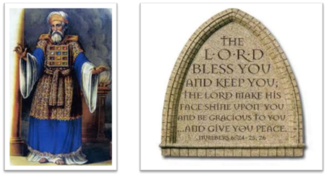
²⁴ The Lord bless you, and keep you; ²⁵ The Lord make His face shine on you, And be gracious to you; ²⁶ The Lord lift up His countenance on you, And give you peace.
Numbers 6:24–26 (NASB95)

