Slide 1



Slide 2

EXODUS STRUCTURE/OUTLINE
Redemption (1–18)
  Redemption (1:1–12:30)
  Liberation (12:31–15:21)
  Preservation (15:22–18:27)
Mosaic Covenant (19–40)
  Law (19–24)
  Tabernacle instructions (25–31)
  Apostasy (32–34)
  Tabernacle building (35–40)

Slide 3
REDEMPTION
(1:1–12:30)
Why redemption is necessary (Exod 1)
Development of the deliverer (Exod 2–4)
First confrontation with Pharaoh (Exod 5)
God reassures Moses (Exod 6:1–7:7)
Second confrontation with Pharaoh (Exod 7:8-13)
Plagues (Exod 7:14–12:30)

Slide 4
The Plagues of Egypt
NO. | DESCRIPTION | SCRIPTURE | Egyptian Deity
1. | Water to Blood | Exod. 7:14-25 | Hapi, Khnum
2. | Frogs | Exod. 8:1-15 | Heqt
3. | Gnats | Exod. 8:16-19 | Set
4. | Flies | Exod. 8:20-32 | Uatchit
5. | Disease on Cattle | Exod. 9:1-7 | Hathor, Apis
6. | Boils | Exod. 9:8-12 | Sekhmet, Serapis
7. | Hail | Exod. 9:13-35 | Seth, Nut
8. | Locusts | Exod. 10:1-20 | Seth, Nut, Osiris
9. | Darkness | Exod. 10:21-29 | Re, Horus, Atum
10. | Death of the First Born | Exod. 12:29-36 | Min, Osiris, Heqt, Isis

Slide 5
TEN PLAGUES REDEMPTION (7:14–12:30)
Nile to blood
Frogs
Gnats
Flies
Death of livestock
Boils
Hail
Locusts
Darkness
Death of 1st born

Slide 6
DEATH OF FIRST BORN
Exodus 12:1-51
  God’s instructions to Moses (1-20)
  Moses instructions to Israel (21-28)
  Death of the 1st born (29-32)
  Exodus from Egypt (33-42)
  Passover instituted (43-51)

Slide 7
DEATH OF FIRST BORN
Exodus 12:1-51
  God’s instructions to Moses (1-20)
  Moses instructions to Israel (21-28)
  Death of the 1st born (29-32)
  Exodus from Egypt (33-42)
  Passover instituted (43-51)

Slide 8
I. Exodus 12:1-20
God’s Instructions to Moses
    Passover (1-13)
    Unleavened bread (14-20)

Slide 9
I. Exodus 12:1-20
God’s Instructions to Moses
    Passover (1-13)
    Unleavened bread (14-20)

Slide 10
Exodus 12:1-13
Passover
      Instructions (1)
      Calendar (2)
      Lamb (3-11)
      Death of 1st born (12-13)

Slide 11
Exodus 12:1-13
Passover
      Instructions (1)
      Calendar (2)
      Lamb (3-11)
      Death of 1st born (12-13)

Slide 12
Exodus 12:1-13
Passover
      Instructions (1)
      Calendar (2)
      Lamb (3-11)
      Death of 1st born (12-13)

Slide 13
7 Levitical Feasts (Leviticus 23)
Feast | Season | Purpose | Type
Passover | Spring | Redemption | 1 Cor 5:7
Unleavened Bread | Spring | Separation | John 6:35
1st fruits | Spring | Praise for initial crop | 1 Cor. 15:20
Pentecost | Spring | Praise for full crop | Acts 2:1-4
Trumpets | Fall | New Year | Matt. 24:31
Atonement | Fall | Lev. 16 | Zech. 12:10
Booths | Fall | Wilderness provision | Zech. 14:16-18

Slide 14
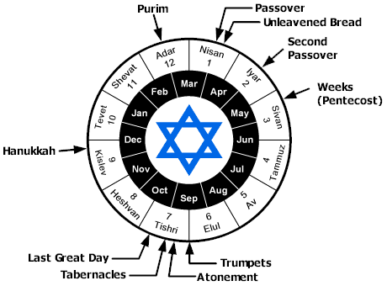

Slide 15
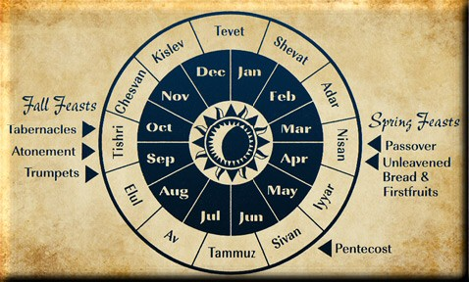

Slide 16
Exodus 12:1-13
Passover
      Instructions (1)
      Calendar (2)
      Lamb (3-11)
      Death of 1st born (12-13)

Slide 17
Exodus 12:3-11
Lamb
      One per household (3-4)
      Lamb’s qualifications (5)
      Lamb’s death (6)
      Lamb’s blood applied (7)
      Lamb’s flesh consumed (8-11)

Slide 18
Exodus 12:3-11
Lamb
      One per household (3-4)
      Lamb’s qualifications (5)
      Lamb’s death (6)
      Lamb’s blood applied (7)
      Lamb’s flesh consumed (8-11)

Slide 19
Exodus 12:3-11
Lamb
      One per household (3-4)
      Lamb’s qualifications (5)
      Lamb’s death (6)
      Lamb’s blood applied (7)
      Lamb’s flesh consumed (8-11)

Slide 20

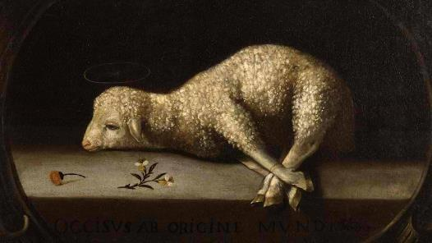
Exodus 12:5
“Your lamb shall be an unblemished male a year old; you may take it from the sheep or from the goats.”

Slide 21


John 1:29
“The next day he saw Jesus coming to him, and said, ‘Behold, the Lamb of God who takes away the sin of the world!’”

Slide 22
Exodus 12:3-11
Lamb
      One per household (3-4)
      Lamb’s qualifications (5)
      Lamb’s death (6)
      Lamb’s blood applied (7)
      Lamb’s flesh consumed (8-11)

Slide 23
Exodus 12:3-11
Lamb
      One per household (3-4)
      Lamb’s qualifications (5)
      Lamb’s death (6)
      Lamb’s blood applied (7)
      Lamb’s flesh consumed (8-11)

Slide 24
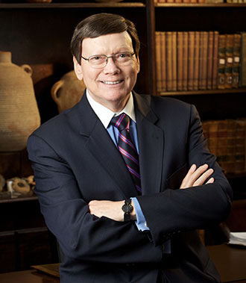
Dr. Ed Hindson
Hindson, E. E., & Mitchell, D. R., eds. (2010). KJV Bible Commentary for Today: The Most Up-to-Date Commentary on the Time-Honored Text of the KJV (p. 99). Thomas Nelson.
“12:7. The blood of the sacrificed lamb was to be stained on the two side posts and … upper door post of the home in which the lamb would be eaten that evening. At either corner where the side posts met the lintel, the bloody stain would have formed a cross.”

Slide 25
Exodus 12:3-11
Lamb
      One per household (3-4)
      Lamb’s qualifications (5)
      Lamb’s death (6)
      Lamb’s blood applied (7)
      Lamb’s flesh consumed (8-11)

Slide 26
Dr. Ed Hindson
Hindson, E. E., & Mitchell, D. R., eds. (2010). KJV Bible Commentary for Today: The Most Up-to-Date Commentary on the Time-Honored Text of the KJV (p. 99). Thomas Nelson.
“12:11. Eat it in haste. This is by no means a divine command or sanction for the Hebrews to rapidly wolf down their food. The term translated as ‘haste’ simply means ‘with an attitude of trembling expectancy or trepidation.’”

Slide 27
Exodus 12:1-13
Passover
      Instructions (1)
      Calendar (2)
      Lamb (3-11)
      Death of 1st born (12-13)

Slide 28
Exodus 12:12-13
Instructions
      Plague (12)
      Passover (13)

Slide 29
Exodus 12:12-13
Instructions
      Plague (12)
      Passover (13)

Slide 30
The Plagues of Egypt
NO. | DESCRIPTION | SCRIPTURE | Egyptian Deity
1. | Water to Blood | Exod. 7:14-25 | Hapi, Khnum
2. | Frogs | Exod. 8:1-15 | Heqt
3. | Gnats | Exod. 8:16-19 | Set
4. | Flies | Exod. 8:20-32 | Uatchit
5. | Disease on Cattle | Exod. 9:1-7 | Hathor, Apis
6. | Boils | Exod. 9:8-12 | Sekhmet, Serapis
7. | Hail | Exod. 9:13-35 | Seth, Nut
8. | Locusts | Exod. 10:1-20 | Seth, Nut, Osiris
9. | Darkness | Exod. 10:21-29 | Re, Horus, Atum
10. | Death of the First Born | Exod. 12:29-36 | Min, Osiris, Heqt, Isis

Slide 31
Exodus 12:12-13
Instructions
      Plague (12)
      Passover (13)

Slide 32
Dr. Ed Hindson
Hindson, E. E., & Mitchell, D. R., eds. (2010). KJV Bible Commentary for Today: The Most Up-to-Date Commentary on the Time-Honored Text of the KJV (p. 99-100). Thomas Nelson.
“12:13. The origin of the term Passover is a stark reminder that the Hebrews were not automatically exempt from the Lord’s judgment simply because of their racial status. Although the Lord had chosen to automatically discriminate between the Egyptians and Hebrews in plagues four through nine, He changed that pattern here.

Slide 33
I. Exodus 12:1-20
God’s Instructions to Moses
    Passover (1-13)
    Unleavened bread (14-20)

Slide 34
Exodus 12:14-20
Unleavened Bread
      Memorial (14)
      Instructions (15-20)

Slide 35
Exodus 12:14-20
Unleavened Bread
      Memorial (14)
      Instructions (15-20)

Slide 36
7 Levitical Feasts (Leviticus 23)
Feast | Season | Purpose | Type
Passover | Spring | Redemption | 1 Cor 5:7
Unleavened Bread | Spring | Separation | John 6:35
1st fruits | Spring | Praise for initial crop | 1 Cor. 15:20
Pentecost | Spring | Praise for full crop | Acts 2:1-4
Trumpets | Fall | New Year | Matt. 24:31
Atonement | Fall | Lev. 16 | Zech. 12:10
Booths | Fall | Wilderness provision | Zech. 14:16-18

Slide 39
Exodus 12:14-20
Unleavened Bread
      Memorial (14)
      Instructions (15-20)

Slide 40
Exodus 12:14-20
Instructions
      Removal (15)
      Assembly (16)
      Observance (17)
      Timing (18-19)
      Conclusion (20)

Slide 41
Exodus 12:14-20
Instructions
      Removal (15)
      Assembly (16)
      Observance (17)
      Timing (18-19)
      Conclusion (20)

Slide 42
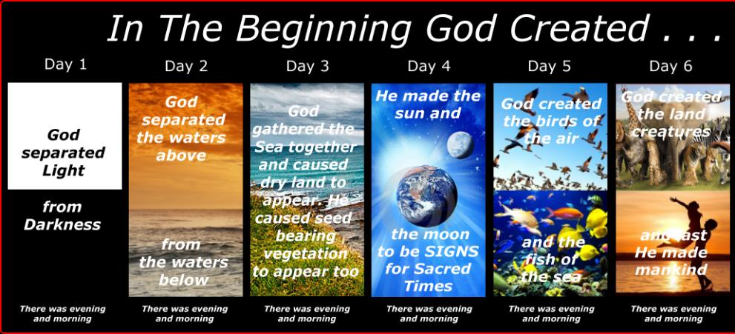
SHAPING AND POPULATING (GEN 1:1)
Day 1: | Light | Day 4: | Luminaries
Day 2: | Water, sky | Day 5: | Sea animals, birds
Day 3: | Land, vegetation | Day 6: | Land animals, man

Slide 43
Exodus 12:14-20
Instructions
      Removal (15)
      Assembly (16)
      Observance (17)
      Timing (18-19)
      Conclusion (20)

Slide 44
SHAPING AND POPULATING (GEN 1:1)
Day 1: | Light | Day 4: | Luminaries
Day 2: | Water, sky | Day 5: | Sea animals, birds
Day 3: | Land, vegetation | Day 6: | Land animals, man

Slide 45
Exodus 12:14-20
Instructions
      Removal (15)
      Assembly (16)
      Observance (17)
      Timing (18-19)
      Conclusion (20)

Slide 46
Exodus 12:14-20
Instructions
      Removal (15)
      Assembly (16)
      Observance (17)
      Timing (18-19)
      Conclusion (20)

Slide 47
Exodus 12:14-20
Instructions
      Removal (15)
      Assembly (16)
      Observance (17)
      Timing (18-19)
      Conclusion (20)

Slide 48
DEATH OF FIRST BORN
Exodus 12:1-51
  God’s instructions to Moses (1-20)
  Moses instructions to Israel (21-28)
  Death of the 1st born (29-32)
  Exodus from Egypt (33-42)
  Passover instituted (43-51)

Slide 49
II. Exodus 12:21-28
Moses’ Instructions to Israel
    Lamb’s death (21)
    Blood applied (22)
    Passover described (23)
    Ritual established (24-27a)
    Israel’s response (27b-28)

Slide 50
II. Exodus 12:21-28
Moses’ Instructions to Israel
    Lamb’s death (21)
    Blood applied (22)
    Passover described (23)
    Ritual established (24-27a)
    Israel’s response (27b-28)

Slide 51
II. Exodus 12:21-28
Moses’ Instructions to Israel
    Lamb’s death (21)
    Blood applied (22)
    Passover described (23)
    Ritual established (24-27a)
    Israel’s response (27b-28)

Slide 52
Dr. Ed Hindson
Hindson, E. E., & Mitchell, D. R., eds. (2010). KJV Bible Commentary for Today: The Most Up-to-Date Commentary on the Time-Honored Text of the KJV (p. 99). Thomas Nelson.
“12:7. The blood of the sacrificed lamb was to be stained on the two side posts and … upper door post of the home in which the lamb would be eaten that evening. At either corner where the side posts met the lintel, the bloody stain would have formed a cross.”

Slide 53
II. Exodus 12:21-28
Moses’ Instructions to Israel
    Lamb’s death (21)
    Blood applied (22)
    Passover described (23)
    Ritual established (24-27a)
    Israel’s response (27b-28)

Slide 54
John 1:29
“The next day he saw Jesus coming to him, and said, ‘Behold, the Lamb of God who takes away the sin of the world!’”

Slide 55
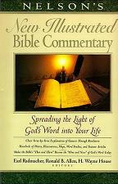
Exodus 12:23
“The term ‘the destroyer’ in Ex. 12:23 (a Heb. participle from shahat, in the Hiphil theme) seems to suggest that the agent of destruction is someone other than the Lord (but compare Ex. 12:12, 13). Who then, or what, is ‘the destroyer?’…It seems that only with the NT revelation may this conundrum be solved. The ‘Destroyer’ (the term should be spelled with a capital letter) appears to be another reference to the pre-incarnate Jesus! (This is also, we believe, the better solution to the meaning of the term ‘the Angel of Yahweh’; 23:20.)”
Nelson's New Illustrated Bible Commentary, 108.

Slide 56
Exodus 12:23
“Certainly many will cringe at the notion of Jesus being described with this dark title; but they cringe as well at the picture of the Savior in Rev. 19:11–21. (Perhaps the same image is intended in the account of the Angel of the Lord with a drawn sword in His hand standing over the infamous Balaam; Num. 22:31.) Scriptural categories should not be established by ‘cringe-quotients’! There are many and varied portraits of the Savior-King in Scripture. Here is a neglected one, ‘the Destroyer!’”
Nelson's New Illustrated Bible Commentary, 108.

Slide 57
II. Exodus 12:21-28
Moses’ Instructions to Israel
    Lamb’s death (21)
    Blood applied (22)
    Passover described (23)
    Ritual established (24-27a)
    Israel’s response (27b-28)

Slide 58
Exodus 12:24-27a
Ritual Established
      Practiced forever (24)
      In the land (25)
      Taught in the family (26-27a)

Slide 59
Exodus 12:24-27a
Ritual Established
      Practiced forever (24)
      In the land (25)
      Taught in the family (26-27a)

Slide 60
Exodus 12:24-27a
Ritual Established
      Practiced forever (24)
      In the land (25)
      Taught in the family (26-27a)

Slide 61

Genesis 15:18-21
¹⁸ On that day the Lord made a covenant with Abram, saying, “To your descendants I have given this land, From the river of Egypt as far as the great river, the river Euphrates: ¹⁹ the Kenite and the Kenizzite and the Kadmonite ²⁰ and the Hittite and the Perizzite and the Rephaim ²¹ and the Amorite and the Canaanite and the Girgashite and the Jebusite.”

Slide 62
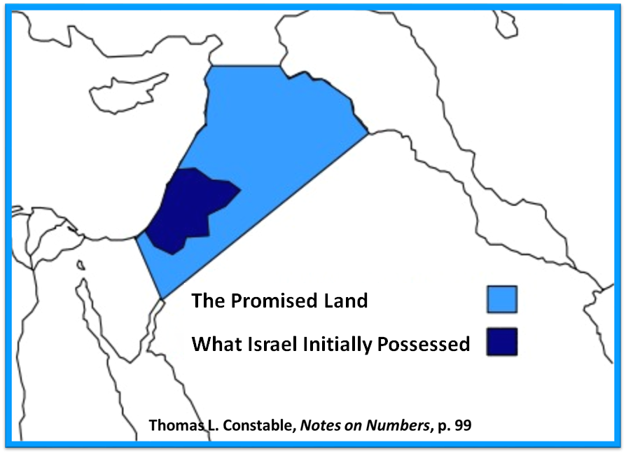

Slide 63
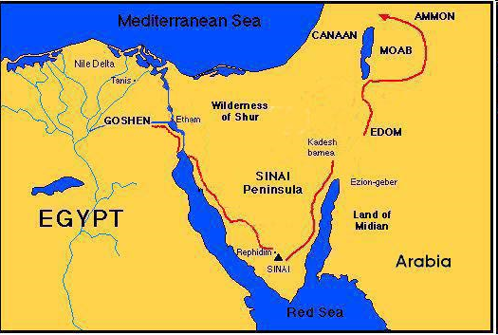

Slide 64
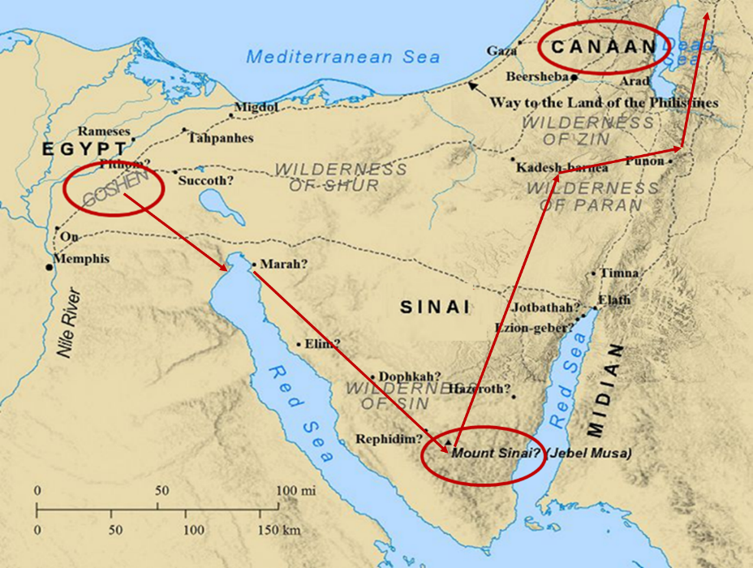

Slide 65
Exodus 12:24-27a
Ritual Established
      Practiced forever (24)
      In the land (25)
      Taught in the family (26-27a)

Slide 66
Exodus 12:26-27a
Taught in the Family
      Children's question (26)
      Parent’s answer (27a)

Slide 67
Exodus 12:26-27a
Taught in the Family
      Children's question (26)
      Parent’s answer (27a)

Slide 68
Exodus 12:26-27a
Taught in the Family
      Children's question (26)
      Parent’s answer (27a)

Slide 69

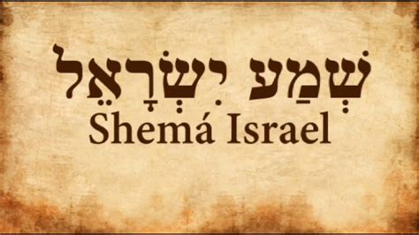
Deuteronomy 6:4-7
“⁴ Hear, Israel! The Lord is our God, the Lord is one!... ⁶ These words, which I am commanding you today, shall be on your heart. ⁷ You shall teach them diligently to your sons and shall talk of them when you sit in your house and when you walk by the way and when you lie down and when you rise up.”

Slide 70
II. Exodus 12:21-28
Moses’ Instructions to Israel
    Lamb’s death (21)
    Blood applied (22)
    Passover described (23)
    Ritual established (24-27a)
    Israel’s response (27b-28)

Slide 71
Exodus 12:27b-28
Israel’s Response
      Worship (27a)
      Obedience (28)

Slide 72
Exodus 12:27b-28
Israel’s Response
      Worship (27a)
      Obedience (28)

Slide 73
Exodus 12:27b-28
Israel’s Response
      Worship (27a)
      Obedience (28)

Slide 74
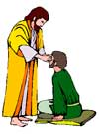
“SEVEN SIGNS” in Gospel of John
1. Changing Water into Wine | 2:11
2. Healing official’s son | 4:46-54
3. Healing an invalid at the Pool of Bethesda | 5:1-18
4. Feeding the 5,000 | 6:5-14
5. Walking on water | 6:16-21
6. Healing a blind man | 9:1-7
7. Raising dead Lazarus | 11:1-45

Slide 75
DEATH OF FIRST BORN
Exodus 12:1-51
  God’s instructions to Moses (1-20)
  Moses instructions to Israel (21-28)
  Death of the 1st born (29-32)
  Exodus from Egypt (33-42)
  Passover instituted (43-51)

Slide 76
III. Exodus 12:429-32
Death of 1st Born
    Comprehensive judgment (29)
    Emotional response (30)
    Command to leave (31-32)

Slide 77
III. Exodus 12:429-32
Death of 1st Born
    Comprehensive judgment (29)
    Emotional response (30)
    Command to leave (31-32)

Slide 78
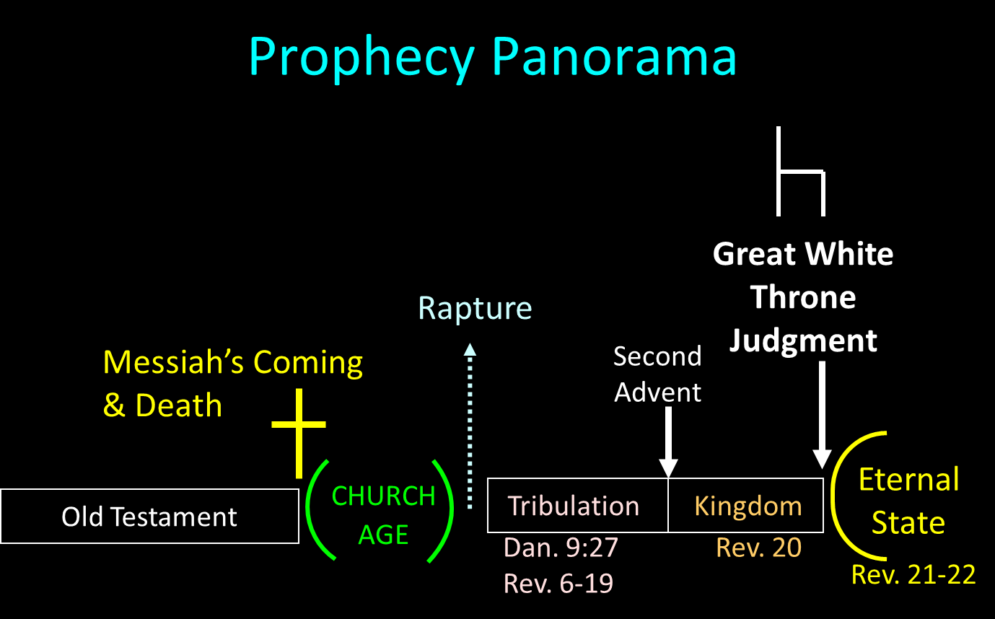

Slide 79
Scripture’s Four Judgments
NAME | SHEEP AND GOAT | JUDGMENT OF THE JEWS | BEMA SEAT | GREAT WHITE THRONE
SCRIPTURE | Matt 25:31-46 | Ezek 20:33-44 | 1 Cor 3:10-15 | Rev 20:11-15
PLACE | Earth, Jerusalem | Earth, wilderness | Heaven | Earth
AUDIENCE | Gentile Tribulation survivors | Jewish Tribulation survivors | Church Age believers | All unsaved
WHEN | After Tribulation | After Tribulation | After rapture | After Millennium
PURPOSE | Saved Gentiles enter kingdom | Saved Jews enter kingdom | Reward believers | Degree of punishment in hell
EVALUATION | Treatment of Christ’s brethren | Passing under shepherd’s rod | Works taken through fire | Not in the book; judged by books

Slide 80
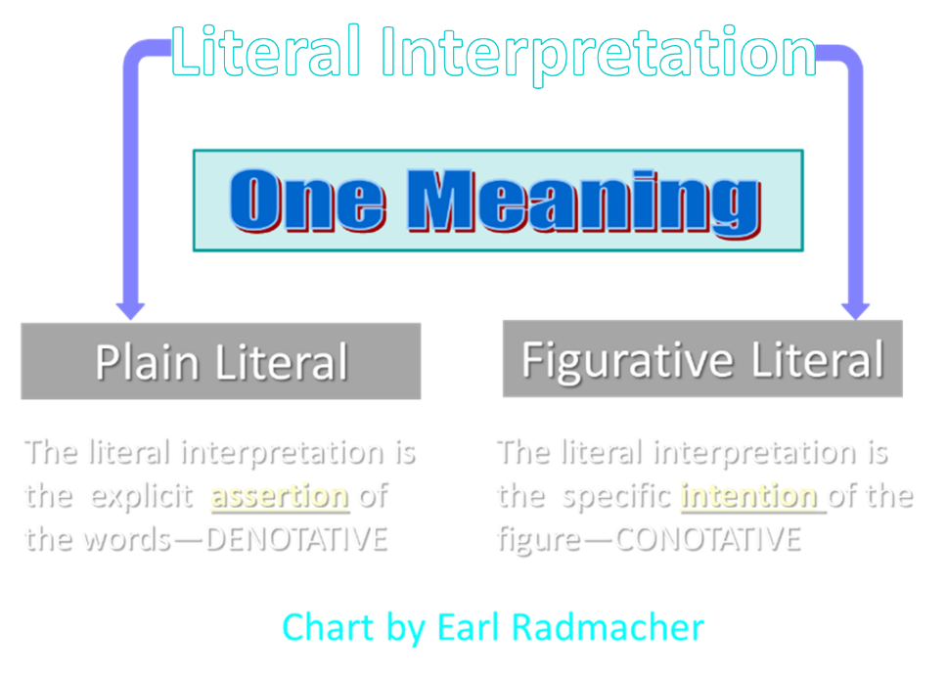

Slide 81
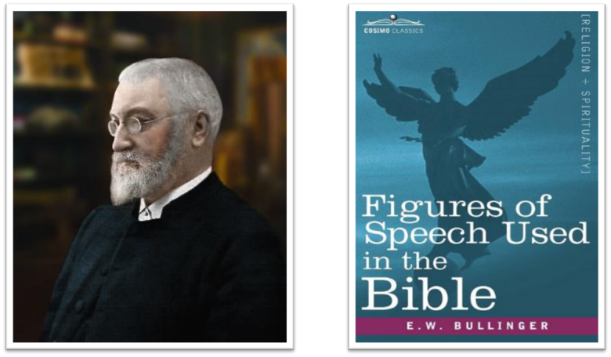
E.W. Bullinger (1837‒1913)

Slide 82
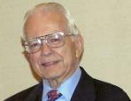

Dr. Roy B. Zuck
Basic Bible Interpretation, p. 151.
“Merism. A merism is a form of synecdoche in which the totality or whole is substituted by two contrasting or opposite parts. When the psalmist wrote, ‘You know when I sit and when I rise’ (Ps. 139:2), he was not limiting the Lord’s knowledge to times when he sat down and when he got up. Instead he was saying the Lord knew all his actions.”

Slide 83
Dr. Ed Hindson
Hindson, E. E., & Mitchell, D. R., eds. (2010). KJV Bible Commentary for Today: The Most Up-to-Date Commentary on the Time-Honored Text of the KJV (p. 101). Thomas Nelson.
“12:29. Those holding to the miraculous intensification of natural events theory of the plagues cannot in any fashion explain the origin of a virus intelligent enough to select only firstborn males. The hand of the Lord is the only satisfactory explanation for this disaster. His promised judgment (4:23) had been rendered.”

Slide 84

PLAGUES’ MIRACULOUS NATURE
Moses knew about them beforehand (8:10; 9:5, 29)
Instantaneous appearance and termination
Description as “signs and wonders” (7:3)
Intensification
Timing
Accomplishment of a moral purpose (11:1)
Response they invoked from the Egyptian sorcerers (7:22; 8:18-19)
Last seven plagues did not effect the Jews living in Goshen (9:6)
Nile into blood affected all rivers, streams, pools, reservoirs, and vessels holding waters
Hill and Walton, A Survey of the Old Testament, 114-15

Slide 85

Charles Ryrie
Ryrie Study Bible, page 109
Exodus 12:29 “the firstborn of Pharaoh. We know Thutmose IV succeeded Amenhotep II, the Pharaoh of the Exodus, but Thutmose IV was not his firstborn.”

Slide 86
DATE OF THE EXODUS
1446 b.c.
  Literal numbers
  Oppression – Thutmose III
  Exodus – Amenhotep II

Slide 87
III. Exodus 12:429-32
Death of 1st Born
    Comprehensive judgment (29)
    Emotional response (30)
    Command to leave (31-32)

Slide 88

1 Thessalonians 4:13-18
¹³ "But we do not want you to be uninformed, brethren, about those who are asleep, so that you will not grieve as do the rest who have no hope. ¹⁴ For if we believe that Jesus died and rose again, even so God will bring with Him those who have fallen asleep in Jesus. ¹⁵ For this we say to you by the word of the Lord, that we who are alive and remain until the coming of the Lord, will not precede. . .

Slide 89
1 Thessalonians 4:13-18
. . . those who have fallen asleep. ¹⁶ For the Lord Himself descend from heaven with a shout, with the voice of the archangel and with the trumpet of God, and the dead in Christ will rise first. ¹⁷ Then we who are alive and remain will be caught up together with them in the clouds to meet the Lord in the air, and so we shall always be with the Lord. ¹⁸ Therefore comfort one another with these words."

Slide 90


Slide 91


John 13:19; 14:29
“¹⁹ From now on I am telling you before it comes to pass, so that when it does occur, you may believe that I am He… ^{14:29} Now I have told you before it happens, so that when it happens, you may believe.”

Slide 92
III. Exodus 12:429-32
Death of 1st Born
    Comprehensive judgment (29)
    Emotional response (30)
    Command to leave (31-32)

Slide 93
Exodus 12:31-32
Command to Leave
      People (31)
      Flocks (32)

Slide 94
Exodus 12:31-32
Command to Leave
      People (31)
      Flocks (32)

Slide 95
Charles Ryrie
Ryrie Study Bible, page 109
Exodus 12:31 “Though Pharaoh manufactured rationalizations for the other plagues, he could not reason away the trauma of the death of his own son. He called for Moses and Aaron that night and gave them permission to go, this time without insisting on any concessions.”

Slide 96
Exodus 12:31-32
Command to Leave
      People (31)
      Flocks (32)

Slide 98
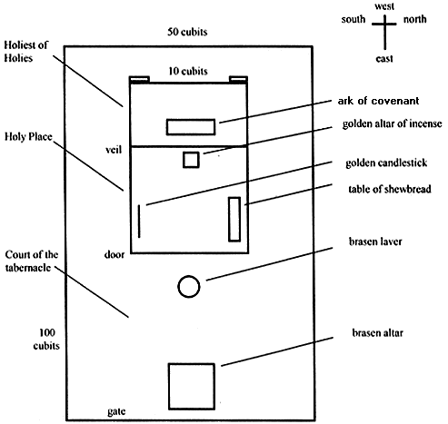
Tabernacle Diagram

Slide 99
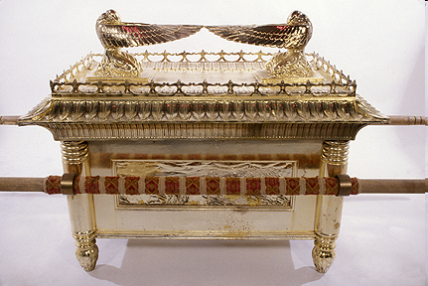
Ark of the Covenant

Slide 100
DEATH OF FIRST BORN
Exodus 12:1-51
  God’s instructions to Moses (1-20)
  Moses instructions to Israel (21-28)
  Death of the 1st born (29-32)
  Exodus from Egypt (33-42)
  Passover instituted (43-51)

Slide 101
IV. Exodus 12:33-42
Exodus from Egypt
    Urgency (33)
    Unleavened dough taken (34)
    Egyptians plundered (35-36)
    Direction (37a)
    Number (37b)
    Mixed multitude (38)
    Unleavened bread baked (39)
    Duration of bondage (40-41)
    Ritual established (42)

Slide 102
IV. Exodus 12:33-42
Exodus from Egypt
    Urgency (33)
    Unleavened dough taken (34)
    Egyptians plundered (35-36)
    Direction (37a)
    Number (37b)
    Mixed multitude (38)
    Unleavened bread baked (39)
    Duration of bondage (40-41)
    Ritual established (42)

Slide 103
IV. Exodus 12:33-42
Exodus from Egypt
    Urgency (33)
    Unleavened dough taken (34)
    Egyptians plundered (35-36)
    Direction (37a)
    Number (37b)
    Mixed multitude (38)
    Unleavened bread baked (39)
    Duration of bondage (40-41)
    Ritual established (42)

Slide 104
Dr. Ed Hindson
Hindson, E. E., & Mitchell, D. R., eds. (2010). KJV Bible Commentary for Today: The Most Up-to-Date Commentary on the Time-Honored Text of the KJV (p. 101). Thomas Nelson.
“12:34. …in the Hebrews’ haste to leave (on what was the first day of the seven-day festival), they grabbed the only food that was on hand: their as yet unleavened bread dough. They formed the dough into cakes and hoisted the pans onto their shoulders. The sun then baked the cakes into matzos, unleavened bread.”

Slide 105
IV. Exodus 12:33-42
Exodus from Egypt
    Urgency (33)
    Unleavened dough taken (34)
    Egyptians plundered (35-36)
    Direction (37a)
    Number (37b)
    Mixed multitude (38)
    Unleavened bread baked (39)
    Duration of bondage (40-41)
    Ritual established (42)

Slide 106
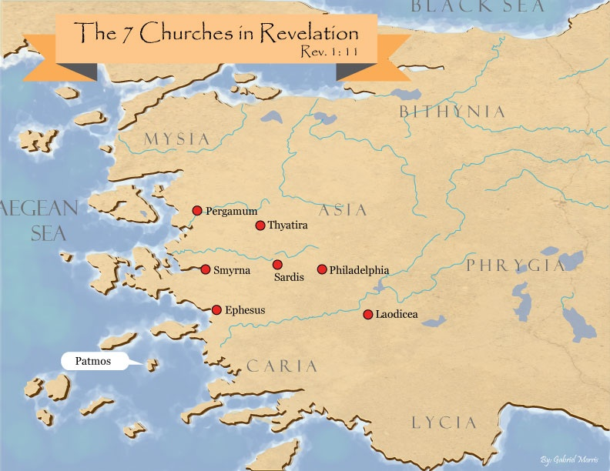
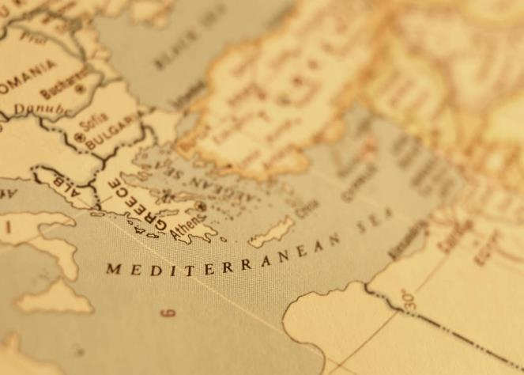

Slide 107

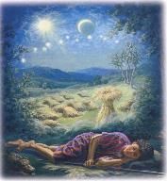
Genesis 37:9
“Now he had still another dream, and related it to his brothers, and said, ‘Lo, I have had still another dream; and behold, the sun and the moon and eleven stars were bowing down to me.’”

Slide 108
Genesis 37:10
“He related it to his father and to his brothers; and his father rebuked him and said to him, ‘What is this dream that you have had? Shall I and your mother and your brothers actually come to bow ourselves down before you to the ground?’”

Slide 110
John 13:19; 14:29
“¹⁹ From now on I am telling you before it comes to pass, so that when it does occur, you may believe that I am He… ^{14:29} Now I have told you before it happens, so that when it happens, you may believe.”

Slide 111


Slide 112
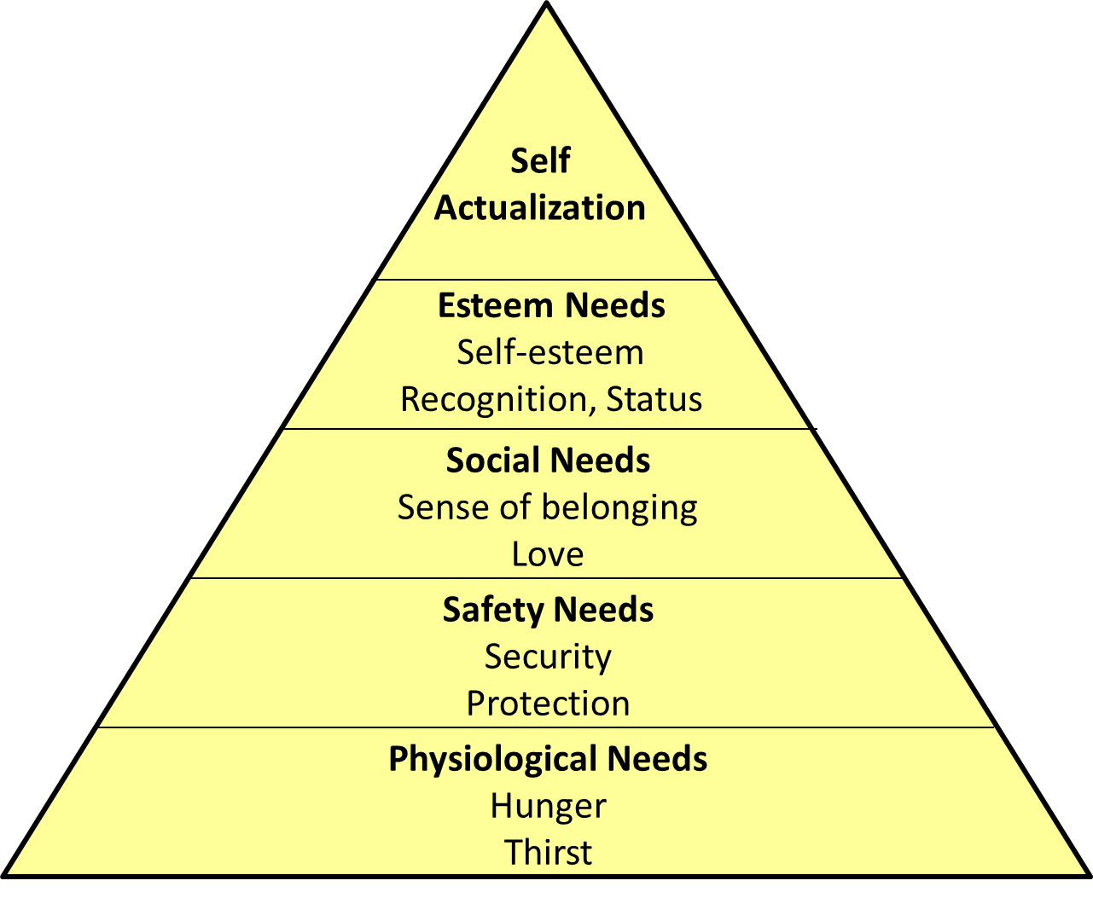
Maslow’s Hierarchy of Needs

Slide 113

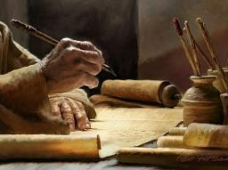
2 Timothy 3:16-17
“¹⁶ All Scripture is inspired by God [theopneustos] and profitable for teaching, for reproof, for correction, for training in righteousness; ¹⁷ so that the man of God may be adequate, equipped for every good work.”

Slide 114

2 Peter 1:3-4
“³ Seeing that His divine power has granted to us everything pertaining to life and godliness, through the true knowledge of Him who called us by His own glory and excellence. ⁴For by these He has granted to us His precious and magnificent promises, so that by them you may become partakers of the divine nature, having escaped the corruption that is in the world by lust.”

Slide 115
1 Peter 2:2
“like newborn babies, long for the pure [adolos] milk of the word, so that by it you may grow in respect to salvation, ³ if you have tasted the kindness of the Lord.”

Slide 116

Chafer Theological Seminary Distinctives:
sufficiency of the scriptures
"We believe in the complete adequacy of Scripture, for in it God has given us all things that pertain to life and godliness. We hold, therefore, that the Word of God by itself is sufficient to prepare a person for a lifetime of effective ministry.”
https://www.chafer.edu/distinctives

Slide 117
IV. Exodus 12:33-42
Exodus from Egypt
    Urgency (33)
    Unleavened dough taken (34)
    Egyptians plundered (35-36)
    Direction (37a)
    Number (37b)
    Mixed multitude (38)
    Unleavened bread baked (39)
    Duration of bondage (40-41)
    Ritual established (42)

Slide 119
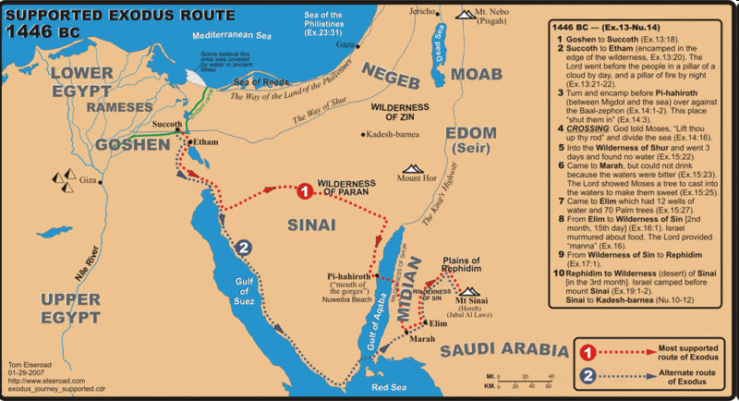

Slide 120
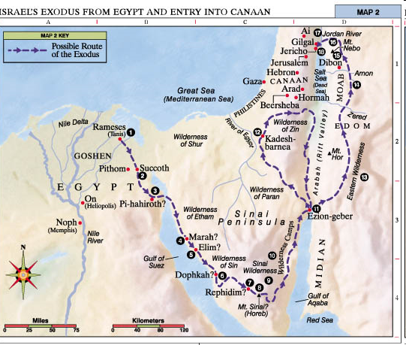

Slide 121
IV. Exodus 12:33-42
Exodus from Egypt
    Urgency (33)
    Unleavened dough taken (34)
    Egyptians plundered (35-36)
    Direction (37a)
    Number (37b)
    Mixed multitude (38)
    Unleavened bread baked (39)
    Duration of bondage (40-41)
    Ritual established (42)

Slide 122
Dr. Ed Hindson
Hindson, E. E., & Mitchell, D. R., eds. (2010). KJV Bible Commentary for Today: The Most Up-to-Date Commentary on the Time-Honored Text of the KJV (p. 101). Thomas Nelson.
“12:37. Six hundred thousand … men. This is a round figure; the total number of men aged twenty and older was 603,550 (38:26). Extrapolating from that number, assuming one wife and two children per man, one arrives at an exodus population of roughly two million people. Objections have been commonly raised over the possibility of such an extraordinary population. While enormous energy and scholarly creativity has gone into the development of alternative theories to explain why the population numbers should not be taken at their face value, none has proven definitively convincing.”

Slide 123
IV. Exodus 12:33-42
Exodus from Egypt
    Urgency (33)
    Unleavened dough taken (34)
    Egyptians plundered (35-36)
    Direction (37a)
    Number (37b)
    Mixed multitude (38)
    Unleavened bread baked (39)
    Duration of bondage (40-41)
    Ritual established (42)

Slide 124
Dr. Ed Hindson
Hindson, E. E., & Mitchell, D. R., eds. (2010). KJV Bible Commentary for Today: The Most Up-to-Date Commentary on the Time-Honored Text of the KJV (p. 101). Thomas Nelson.
“12:38. A mixed multitude went with them. These were likely other, non-Hebrew, slaves and perhaps a few God-fearing Egyptians. This Gentile group would stir up trouble in the camp during the wilderness journey (Num. 11:4).”

Slide 125
IV. Exodus 12:33-42
Exodus from Egypt
    Urgency (33)
    Unleavened dough taken (34)
    Egyptians plundered (35-36)
    Direction (37a)
    Number (37b)
    Mixed multitude (38)
    Unleavened bread baked (39)
    Duration of bondage (40-41)
    Ritual established (42)

Slide 126
IV. Exodus 12:33-42
Exodus from Egypt
    Urgency (33)
    Unleavened dough taken (34)
    Egyptians plundered (35-36)
    Direction (37a)
    Number (37b)
    Mixed multitude (38)
    Unleavened bread baked (39)
    Duration of bondage (40-41)
    Ritual established (42)

Slide 127

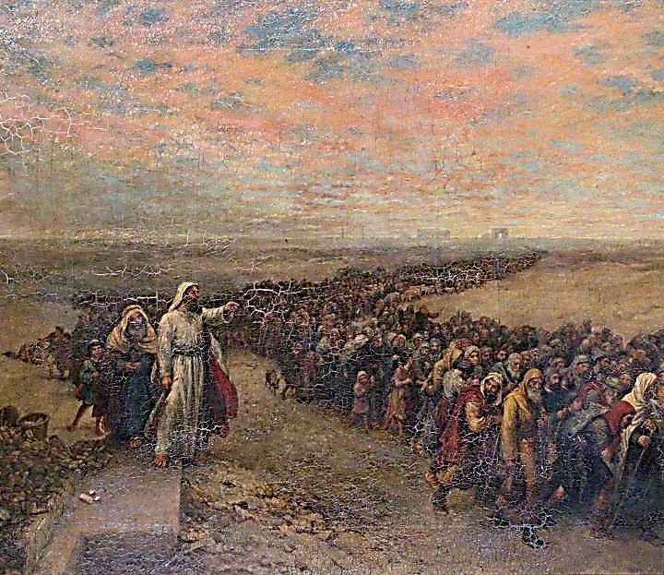
Exodus 12:40-41
“⁴⁰ Now the time that the sons of Israel lived in Egypt was four hundred and thirty years. ⁴¹ And at the end of four hundred and thirty years, to the very day, all the hosts of the Lord went out from the land of Egypt.”

Slide 128
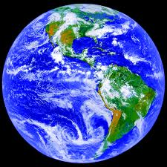
AGE OF THE EARTH?
971-931 BC=Solomonic reign
966=Solomon rebuilds temple (1 Kgs 6:1b)
- 480 years for the Exodus’ date (1 Kgs 6:1a)
= 1446 BC for Exodus’ date
- 430 years for Jacob’s migration to Egypt (Exod 12:40)
= 1876 BC for Jacob’s migration to Egypt (Gen 46)
Genealogies of Gen 5; 11
= 4000 BC for the earth’s age

Slide 129
AGE OF THE EARTH?
971-931 BC=Solomonic reign
966=Solomon rebuilds temple (1 Kgs 6:1b)
- 480 years for the Exodus’ date (1 Kgs 6:1a)
= 1446 BC for Exodus’ date
- 430 years for Jacob’s migration to Egypt (Exod 12:40)
= 1876 BC for Jacob’s migration to Egypt (Gen 46)
Genealogies of Gen 5; 11
= 4000 BC for the earth’s age

Slide 130
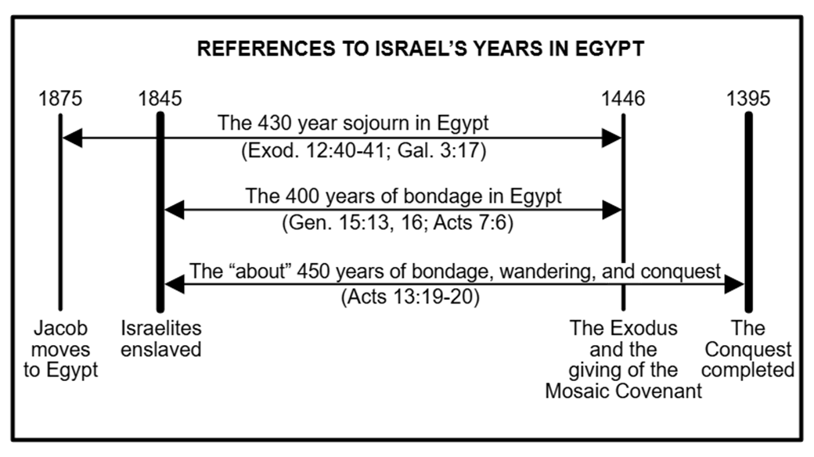

Slide 131
IV. Exodus 12:33-42
Exodus from Egypt
    Urgency (33)
    Unleavened dough taken (34)
    Egyptians plundered (35-36)
    Direction (37a)
    Number (37b)
    Mixed multitude (38)
    Unleavened bread baked (39)
    Duration of bondage (40-41)
    Ritual established (42)

Slide 133
John 13:19; 14:29
“¹⁹ From now on I am telling you before it comes to pass, so that when it does occur, you may believe that I am He… ^{14:29} Now I have told you before it happens, so that when it happens, you may believe.”

Slide 134
DEATH OF FIRST BORN
Exodus 12:1-51
  God’s instructions to Moses (1-20)
  Moses instructions to Israel (21-28)
  Death of the 1st born (29-32)
  Exodus from Egypt (33-42)
  Passover instituted (43-51)

Slide 135
V. Exodus 112:43-51
Passover Instituted
    Foreigners excluded (43-45)
    Lamb’s bones unbroken (46)
    Foreigner circumcision (47-49)
    Israel’s obedience (50)
    Exodus date (51)

Slide 136
V. Exodus 112:43-51
Passover Instituted
    Foreigners excluded (43-45)
    Lamb’s bones unbroken (46)
    Foreigner circumcision (47-49)
    Israel’s obedience (50)
    Exodus date (51)

Slide 137
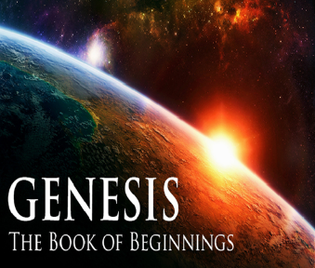
Genesis 12‒25
Abraham’s Early Journeys
Unconditional promises (Gen. 12:1-3) From Haran to Canaan (Gen. 12:4-5) In Canaan (Gen. 12:6-9) In Egypt (Gen. 12:10-20) Abram and Lot Separate (Gen. 13:1-13) Reaffirmation of Abram’s promises (Gen. 13:14-18) Abram Rescues Lot (14:1-24) Abrahamic Covenant (15:1-21) Hagar & Ishmael (16:1-16) Circumcision (Gen. 17:1-27) | Sodom & Gomorrah (Gen. 18‒19) Abraham & Abimelech (Gen. 20) Isaac’s birth (Gen. 21:1-7) Ishmael’s expulsion (21:8-21) Abraham & Abimelech’s covenant (21:22-34) Abraham sacrifices Isaac (22) Sarah’s death (23) Isaac’s marriage (24) Abraham & Keturah (25:1-6) Abraham’s death (25:7-11)

Slide 138
V. Exodus 112:43-51
Passover Instituted
    Foreigners excluded (43-45)
    Lamb’s bones unbroken (46)
    Foreigner circumcision (47-49)
    Israel’s obedience (50)
    Exodus date (51)

Slide 139
Exodus 12:5, 46
“Your lamb shall be an unblemished male a year old; you may take it from the sheep or from the goats…nor are you to break any bone of it.”

Slide 140
V. Exodus 112:43-51
Passover Instituted
    Foreigners excluded (43-45)
    Lamb’s bones unbroken (46)
    Foreigner circumcision (47-49)
    Israel’s obedience (50)
    Exodus date (51)

Slide 141
Genesis 12‒25
Abraham’s Early Journeys
Unconditional promises (Gen. 12:1-3) From Haran to Canaan (Gen. 12:4-5) In Canaan (Gen. 12:6-9) In Egypt (Gen. 12:10-20) Abram and Lot Separate (Gen. 13:1-13) Reaffirmation of Abram’s promises (Gen. 13:14-18) Abram Rescues Lot (14:1-24) Abrahamic Covenant (15:1-21) Hagar & Ishmael (16:1-16) Circumcision (Gen. 17:1-27) | Sodom & Gomorrah (Gen. 18‒19) Abraham & Abimelech (Gen. 20) Isaac’s birth (Gen. 21:1-7) Ishmael’s expulsion (21:8-21) Abraham & Abimelech’s covenant (21:22-34) Abraham sacrifices Isaac (22) Sarah’s death (23) Isaac’s marriage (24) Abraham & Keturah (25:1-6) Abraham’s death (25:7-11)

Slide 142
V. Exodus 112:43-51
Passover Instituted
    Foreigners excluded (43-45)
    Lamb’s bones unbroken (46)
    Foreigner circumcision (47-49)
    Israel’s obedience (50)
    Exodus date (51)

Slide 143
“SEVEN SIGNS” in Gospel of John
1. Changing Water into Wine | 2:11
2. Healing official’s son | 4:46-54
3. Healing an invalid at the Pool of Bethesda | 5:1-18
4. Feeding the 5,000 | 6:5-14
5. Walking on water | 6:16-21
6. Healing a blind man | 9:1-7
7. Raising dead Lazarus | 11:1-45

Slide 144
V. Exodus 112:43-51
Passover Instituted
    Foreigners excluded (43-45)
    Lamb’s bones unbroken (46)
    Foreigner circumcision (47-49)
    Israel’s obedience (50)
    Exodus date (51)

Slide 145

Genesis 15:13;16
¹³ God said to Abram, “Know for certain that your descendants will be strangers in a land that is not theirs, where they will be enslaved and oppressed four hundred years…¹⁶ “Then in the fourth generation they will return here, for the iniquity of the Amorite is not yet complete.”

Slide 146
Conclusion

Slide 147
DEATH OF FIRST BORN
Exodus 12:1-51
  God’s instructions to Moses (1-20)
  Moses instructions to Israel (21-28)
  Death of the 1st born (29-32)
  Exodus from Egypt (33-42)
  Passover instituted (43-51)

Slide 148
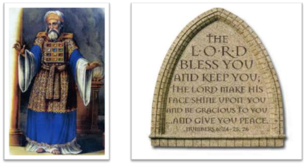
²⁴ The Lord bless you, and keep you; ²⁵ The Lord make His face shine on you, And be gracious to you; ²⁶ The Lord lift up His countenance on you, And give you peace.
Numbers 6:24–26 (NASB95)

