Slide 1



Slide 2
INTRODUCTORY MATTERS
Authorship
Audience
Date
Occasion
Purpose
Message
Outline

Slide 3
OUTLINE
Doctrinal section (1:1–10:18)
  Christ’s attributes (1:1-3)
  Christ is superior to the angels (1:4–2:18)
  Christ is superior to Moses (3:1–4:13)
  Christ is superior to Aaron (4:14–10:18)
Practical section (10:19–13:25)
  Exhortations and pastoral reminders (10, 12, 13)
  Hall of faith (11)
  Benediction (13:20-25)

Slide 4
CHRIST IS SUPERIOR TO PREVIOUS REVELATION (1:1-2A)
OT – Indirect, incomplete, temporary
Christ – Direct, complete, permanent
Notes:
Preparation / manifestation / propagation / explanation / consumation

Slide 5
CHRIST’S 7 ATTRIBUTES SHOWING HIS FINALITY (1:2B-3)
Heir of all things
Maker of all things
Brightness of the Father’s glory
Express image of the Father
Upholds all things
Made complete purification for sins
Sat down at the Father’s right hand

Slide 6
OUTLINE
Doctrinal section (1:1–10:18)
  Christ’s attributes (1:1-3)
  Christ is superior to the angels (1:4–2:18)
  Christ is superior to Moses (3:1–4:13)
  Christ is superior to Aaron (4:14–10:18)
Practical section (10:19–13:25)
  Exhortations and pastoral reminders (10, 12, 13)
  Hall of faith (11)
  Benediction (13:20-25)

Slide 7

Daniel 9 Outline
The Setting (1-2)
Daniel’s prayer (3-19)
Gabriel’s arrival (20-23)
The Seventy Weeks Prophecy (24-27)

Slide 8
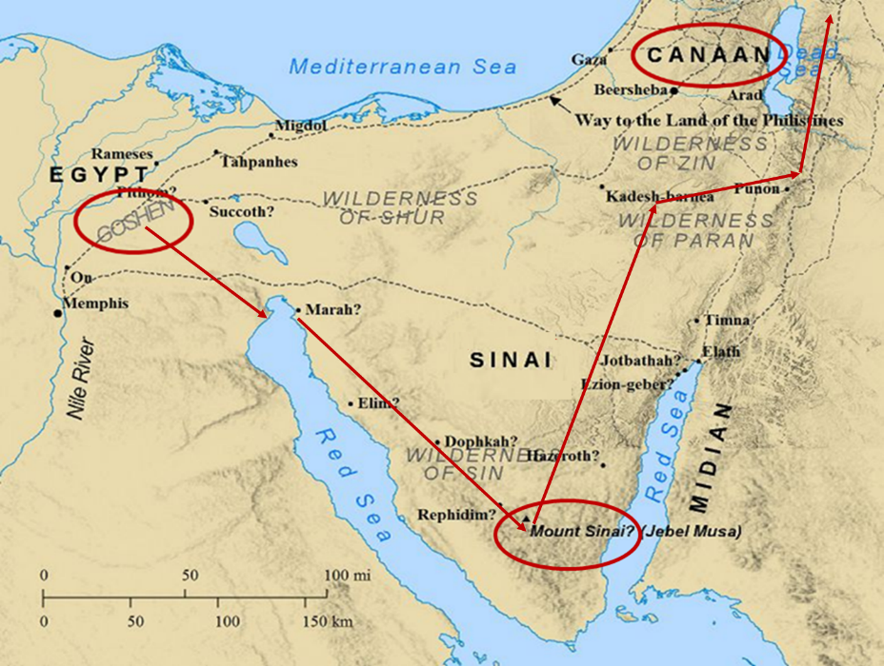

Slide 9
Hebrews 1:4‒2:18
Christ is Superior to the Angels
      Seven OT Citations (1:4-14)
      Warning Against Drifting (2:1-4)
      Why God Became Man (2:5-18)

Slide 10
Hebrews 1:4‒2:18
Christ is Superior to the Angels
      Seven OT Citations (1:4-14)
      Warning Against Drifting (2:1-4)
      Why God Became Man (2:5-18)

Slide 11
7 OT CITATIONS DEMONSTRATING CHRIST’S
SUPERIORITY TO THE ANGELS (1:4-14)
      vs. 5a – Ps 2:7
      vs. 5b – 2 Sam 7:14
      vs. 6 – Ps 97:7
      vs. 7 – Ps 104:4
      vs. 8-9 – Ps 45:6-7
      vs. 10-12 – Ps 102:25-7
      vs. 13 – Ps 110:1

Slide 12
7 OT CITATIONS DEMONSTRATING CHRIST’S
SUPERIORITY TO THE ANGELS (1:4-14)
      vs. 5a – Ps 2:7
      vs. 5b – 2 Sam 7:14
      vs. 6 – Ps 97:7
      vs. 7 – Ps 104:4
      vs. 8-9 – Ps 45:6-7
      vs. 10-12 – Ps 102:25-7
      vs. 13 – Ps 110:1

Slide 13
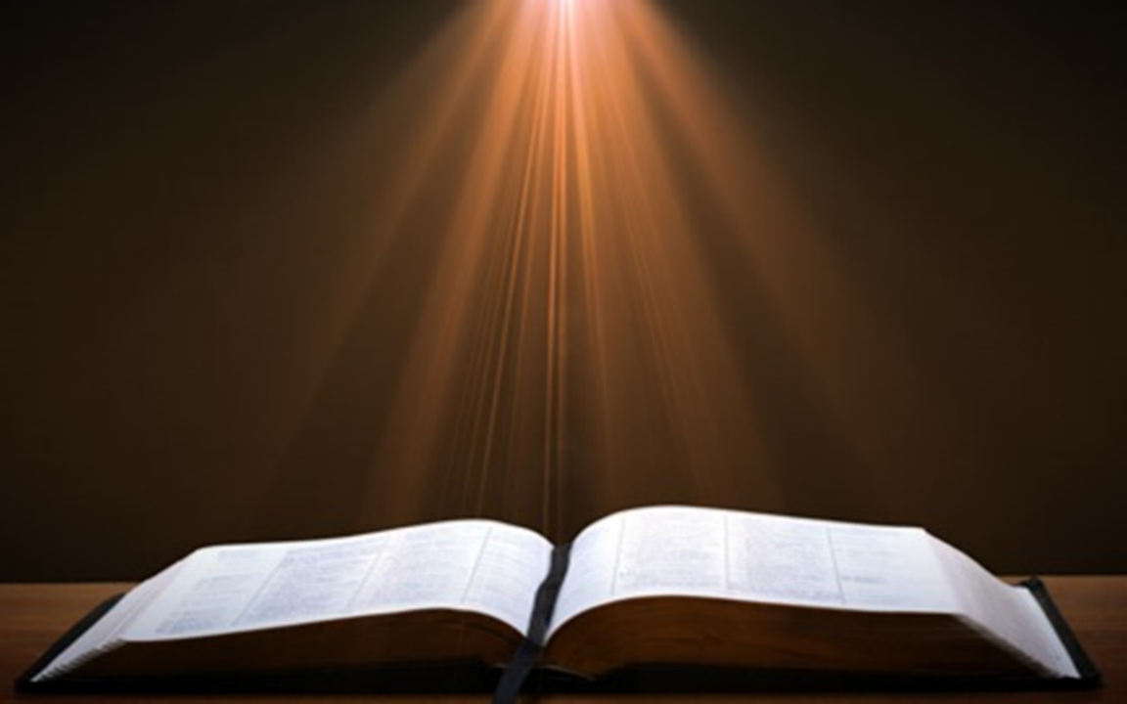

Galatians 4:7
“Therefore you are no longer a slave, but a son; and if a son, then an heir through God.”

Slide 14
Nicene Creed (AD 325)
“I believe in one God, the Father Almighty, Maker of heaven and earth, and of all things visible and invisible. And in one Lord Jesus Christ, the only-begotten Son of God, begotten of the Father before all worlds; God of God, Light of Light, very God of very God; BEGOTTEN, NOT MADE, being of one substance with the Father, by whom all things were made. Who, for us men and for our salvation, came down from heaven, and was incarnate by the Holy Spirit of the virgin Mary, and was made man; and was crucified also for us under Pontius Pilate; He suffered and was buried; and the third day He rose again, according to the Scriptures; and ascended into heaven, and sits on the right hand of the Father; and He shall come again, with glory, to judge the quick and the dead; whose kingdom shall have no end. And I believe in the Holy Ghost, the Lord and Giver of Life; who proceeds from the Father and the Son; who with the Father and the Son together is worshipped and glorified; who spoke by the prophets. And I believe in one holy catholic and apostolic Church. I acknowledge one baptism for the remission of sins; and I look for the resurrection of the dead, and the life of the world to come. Amen.”
Notes:
Arianism’s error

Slide 15


John 1:14
“And the Word became flesh, and dwelt among us, and we saw His glory, glory as of the only begotten [monogenēs] from the Father, full of grace and truth.”

Slide 16
John 1:18
“No one has seen God at any time; the only begotten [monogenēs] God who is in the bosom of the Father, He has explained [exēgeomai] Him.”

Slide 17
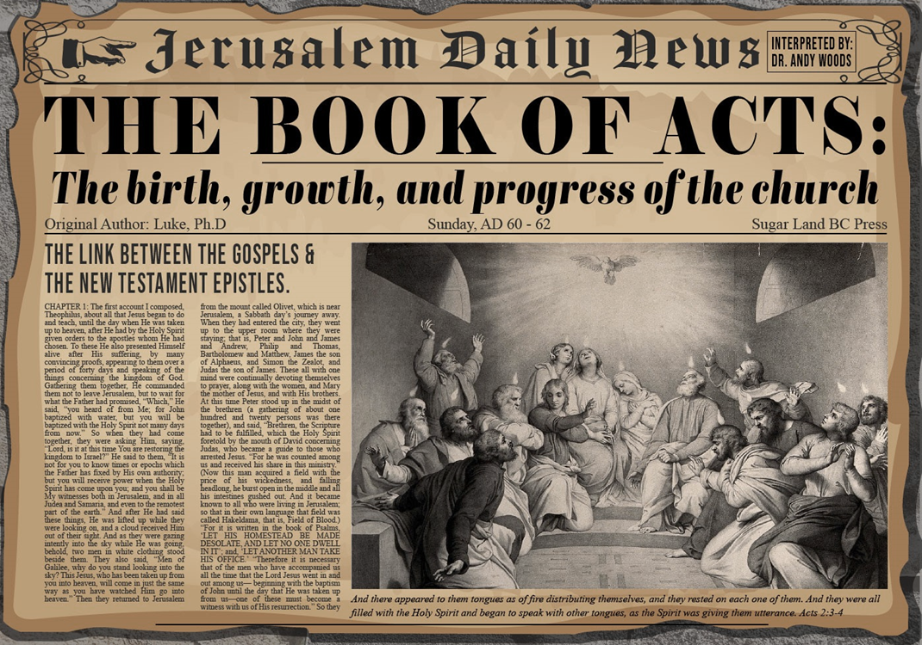
Acts 13:16-41
Paul’s Message
      Introduction (16)
      Historical background (17-22)
      Messiah (23-25)
      Gospel (26-29)
      Resurrection (30-37)
      Application to Paul’s audience (38-39)
      Warning (40-41)

Slide 18
7 OT CITATIONS DEMONSTRATING CHRIST’S
SUPERIORITY TO THE ANGELS (1:4-14)
      vs. 5a – Ps 2:7
      vs. 5b – 2 Sam 7:14
      vs. 6 – Ps 97:7
      vs. 7 – Ps 104:4
      vs. 8-9 – Ps 45:6-7
      vs. 10-12 – Ps 102:25-7
      vs. 13 – Ps 110:1

Slide 19
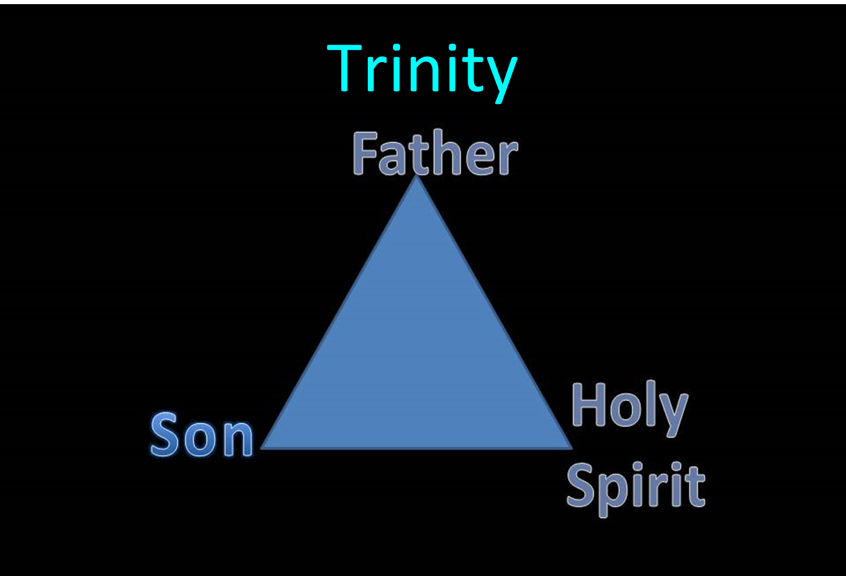

Slide 20
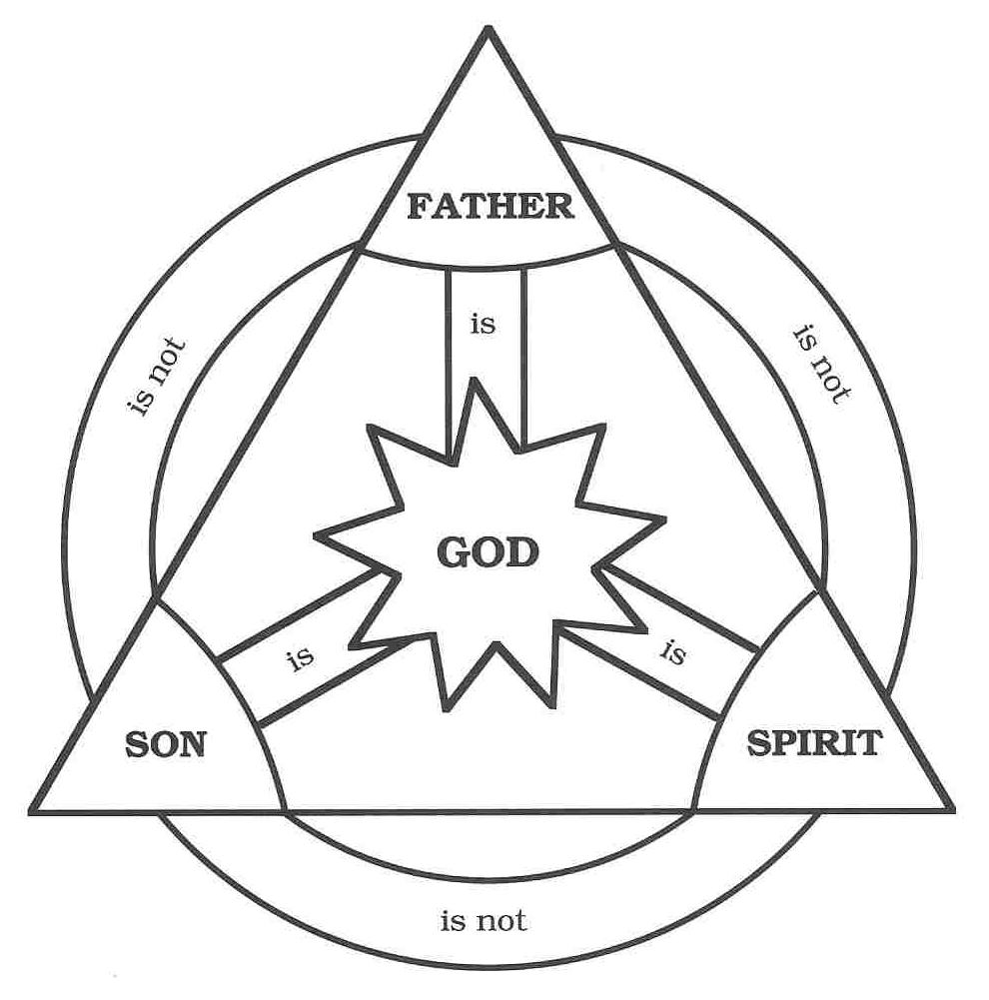

Slide 21
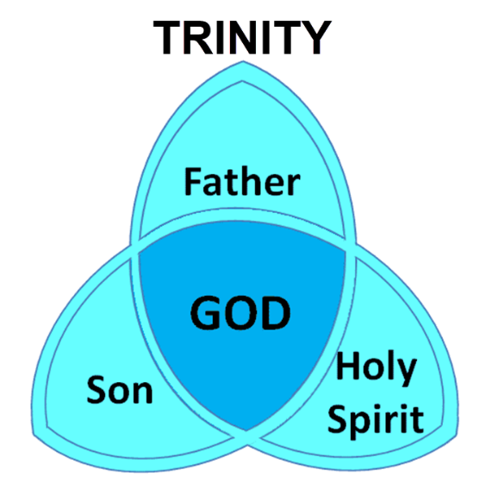

Slide 22
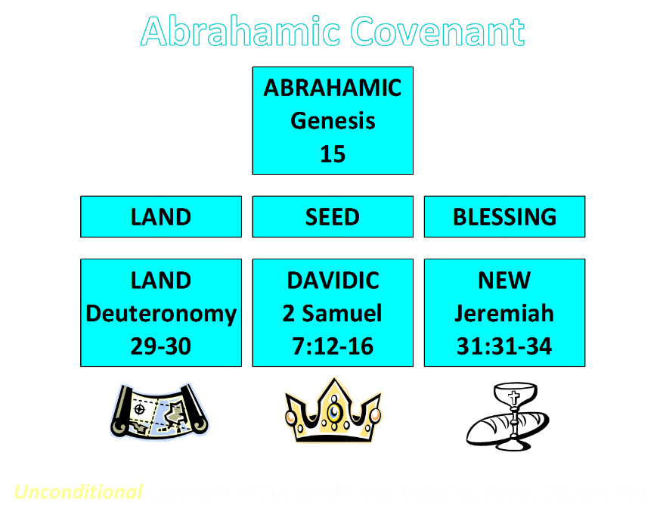

Slide 23
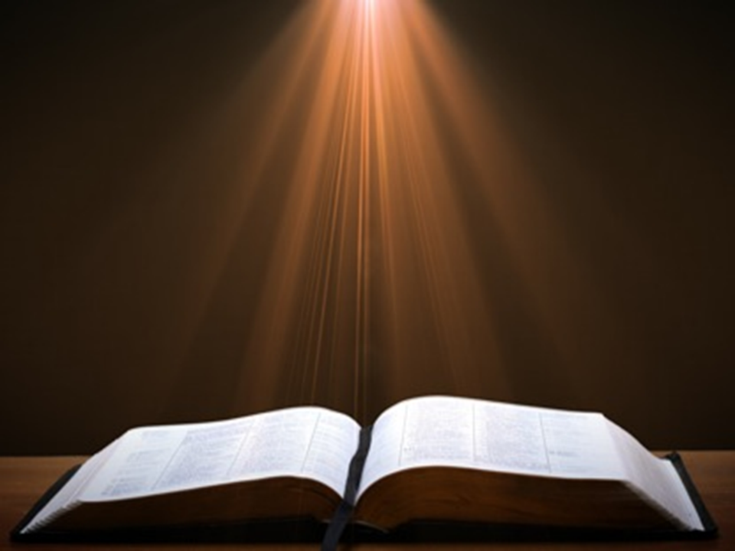
2 Samuel 7:8, 16
“⁸ Now therefore, thus you shall say to My servant David, ‘Thus says the Lord of hosts, “I took you from the pasture, from following the sheep, to be ruler over My people Israel… ¹⁶ Your house and your kingdom shall endure before Me forever; your throne shall be established forever.”

Slide 24
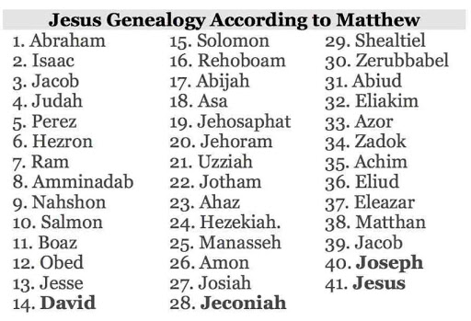

Slide 25
7 OT CITATIONS DEMONSTRATING CHRIST’S
SUPERIORITY TO THE ANGELS (1:4-14)
      vs. 5a – Ps 2:7
      vs. 5b – 2 Sam 7:14
      vs. 6 – Ps 97:7
      vs. 7 – Ps 104:4
      vs. 8-9 – Ps 45:6-7
      vs. 10-12 – Ps 102:25-7
      vs. 13 – Ps 110:1

Slide 26
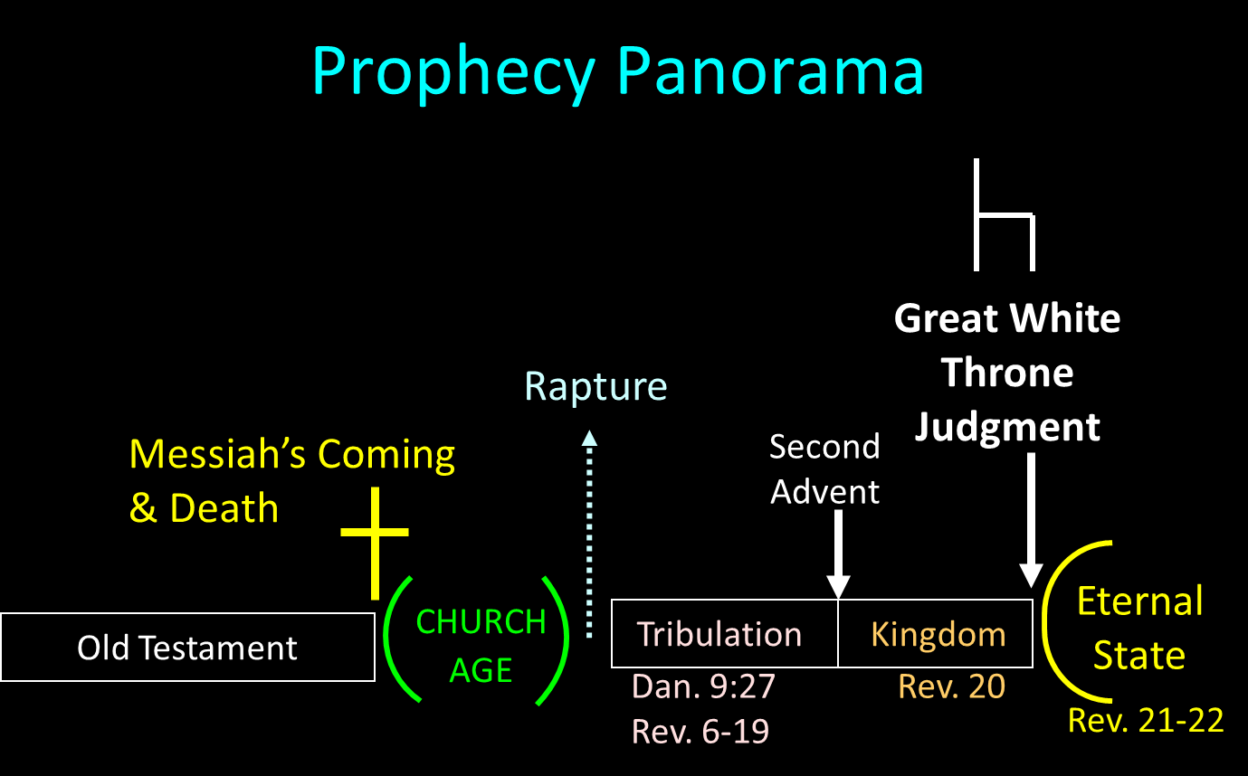

Slide 27
7 OT CITATIONS DEMONSTRATING CHRIST’S
SUPERIORITY TO THE ANGELS (1:4-14)
      vs. 5a – Ps 2:7
      vs. 5b – 2 Sam 7:14
      vs. 6 – Ps 97:7
      vs. 7 – Ps 104:4
      vs. 8-9 – Ps 45:6-7
      vs. 10-12 – Ps 102:25-7
      vs. 13 – Ps 110:1

Slide 28
John 1:14
“And the Word became flesh, and dwelt among us, and we saw His glory, glory as of the only begotten [monogenēs] from the Father, full of grace and truth.”

Slide 29
John 1:18
“No one has seen God at any time; the only begotten [monogenēs] God who is in the bosom of the Father, He has explained [exēgeomai] Him.”

Slide 30
7 OT CITATIONS DEMONSTRATING CHRIST’S
SUPERIORITY TO THE ANGELS (1:4-14)
      vs. 5a – Ps 2:7
      vs. 5b – 2 Sam 7:14
      vs. 6 – Ps 97:7
      vs. 7 – Ps 104:4
      vs. 8-9 – Ps 45:6-7
      vs. 10-12 – Ps 102:25-7
      vs. 13 – Ps 110:1

Slide 31

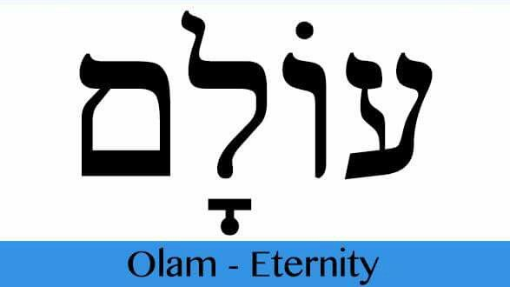
Psalm 90:2
“Before the mountains were born Or You gave birth to the earth and the world, Even from everlasting (olam) to everlasting (olam), You are God.”

Slide 32

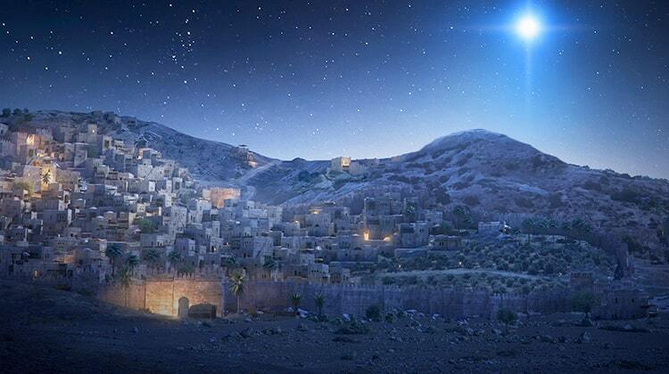
Micah 5:2
“But as for you, Bethlehem Ephrathah, Too little to be among the clans of Judah, From you One will go forth for Me to be ruler in Israel. His goings forth are from long ago, From the days of eternity (olam).”

Slide 33
7 OT CITATIONS DEMONSTRATING CHRIST’S
SUPERIORITY TO THE ANGELS (1:4-14)
      vs. 5a – Ps 2:7
      vs. 5b – 2 Sam 7:14
      vs. 6 – Ps 97:7
      vs. 7 – Ps 104:4
      vs. 8-9 – Ps 45:6-7
      vs. 10-12 – Ps 102:25-7
      vs. 13 – Ps 110:1

Slide 34
CHRIST’S 7 ATTRIBUTES SHOWING HIS FINALITY (1:2B-3)
Heir of all things
Maker of all things
Brightness of the Father’s glory
Express image of the Father
Upholds all things
Made complete purification for sins
Sat down at the Father’s right hand

Slide 35

Hebrews 1:2-3
“² in these last days has spoken to us in His Son, whom He appointed heir of all things, through whom also He made the world. ³ And He is the radiance of His glory and the exact representation of His nature, and upholds all things by the word of His power. When He had made purification of sins, He sat down at the right hand of the Majesty on high.”

Slide 36

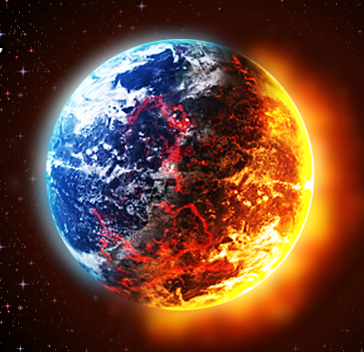
Matthew 5:18; 24:35
“^{5:18} For truly I say to you, until heaven and earth pass away, not the smallest letter or stroke shall pass from the Law until all is accomplished. . . .^{24:35} Heaven and earth will pass away, but My words will not pass away.”

Slide 37
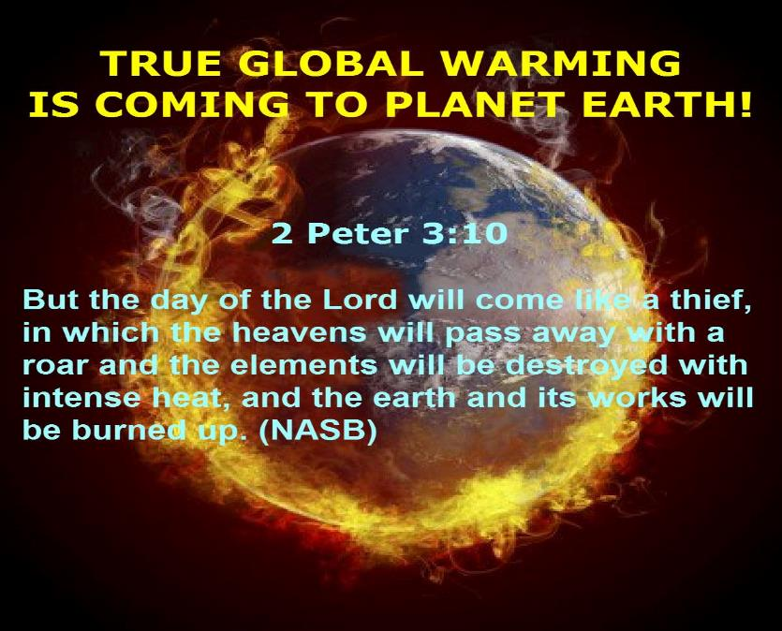

Slide 38
Revelation 21:1, 4
¹ Then I saw a new heaven and a new earth; for the first heaven and the first earth passed away [apérchomai], and there is no longer any sea…⁴ and He will wipe away every tear from their eyes; and there will no longer be any death; there will no longer be any mourning, or crying, or pain; the first things have passed away [apérchomai].

Slide 39
7 OT CITATIONS DEMONSTRATING CHRIST’S
SUPERIORITY TO THE ANGELS (1:4-14)
      vs. 5a – Ps 2:7
      vs. 5b – 2 Sam 7:14
      vs. 6 – Ps 97:7
      vs. 7 – Ps 104:4
      vs. 8-9 – Ps 45:6-7
      vs. 10-12 – Ps 102:25-7
      vs. 13 – Ps 110:1

Slide 40
CHRIST’S 7 ATTRIBUTES SHOWING HIS FINALITY (1:2B-3)
Heir of all things
Maker of all things
Brightness of the Father’s glory
Express image of the Father
Upholds all things
Made complete purification for sins
Sat down at the Father’s right hand

Slide 41
Hebrews 1:2-3
“² in these last days has spoken to us in His Son, whom He appointed heir of all things, through whom also He made the world. ³ And He is the radiance of His glory and the exact representation of His nature, and upholds all things by the word of His power. When He had made purification of sins, He sat down at the right hand of the Majesty on high.”

Slide 42
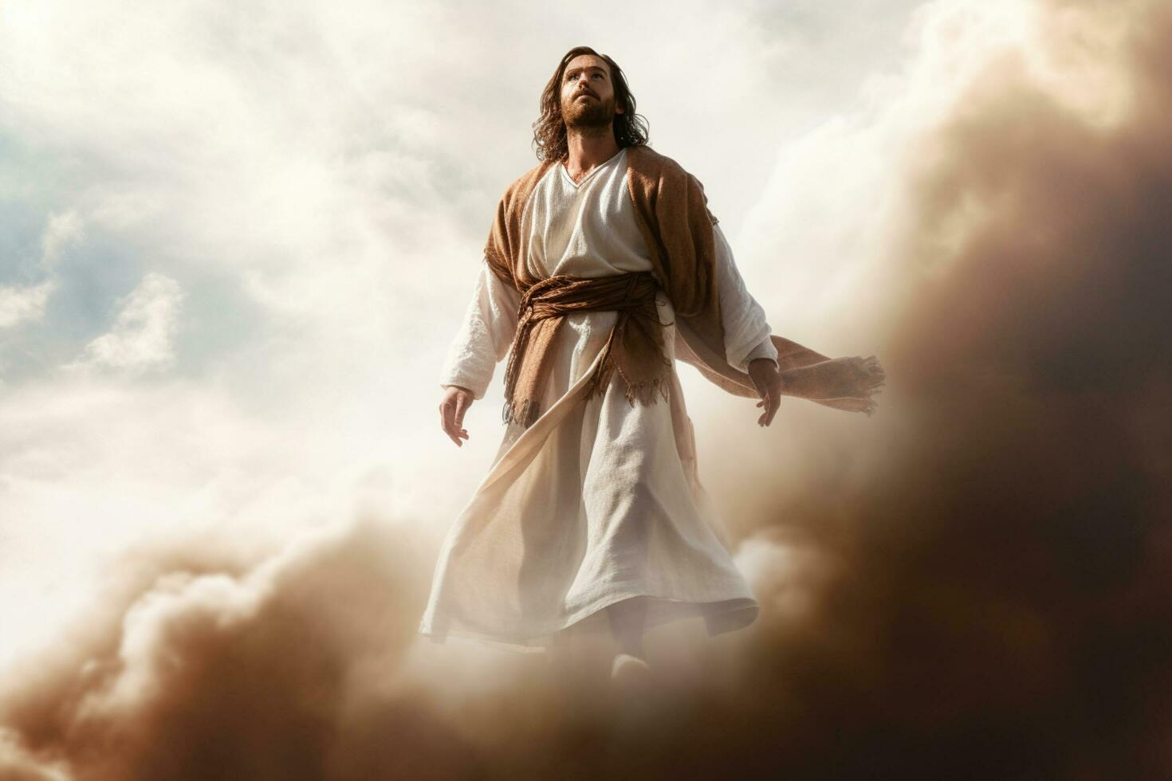
John 17:5
“Now, Father, glorify Me together with Yourself, with the glory which I had with You before the world was.”

Slide 43
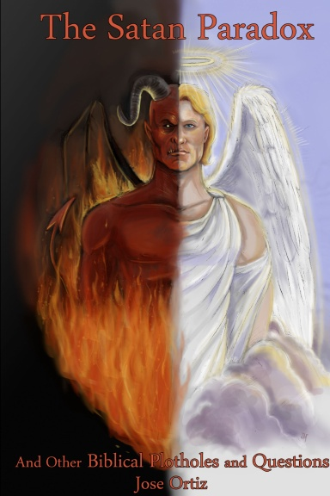
Names & Titles Demonstrating Satan’s Post-Fall, Earthly Authority
(Job 1:7; 2:2; Luke 4:5-8; Rom. 8:19-22)
Prince of this world (John 12:31; 14:30; 16:11)
God of this world (2 Cor. 4:4)
Prince and power of the air (Eph. 2:2)
Who the believer wrestles with (Eph. 6:12)
Roaring lion (1 Pet. 5:8)
Whole world lies in his power (1 John 5:19)

Slide 44
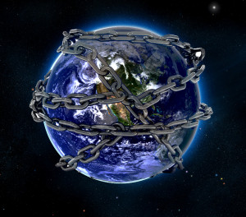

Slide 45
Ultimate Exodus
(Rev 11:15)
Sores: 6th plague (Ex 9:8-12), 1st bowl (Rev 16:1-2)
Rivers to blood: 1st plague (Ex 7:19-21), 3rd bowl (Rev 16:4-7)
Darkness: 9th plague (Ex 10:21-23), 5th bowl (Rev 16:10-11)
Frogs: 2nd plague (Ex 7:25‒8:15), 6th bowl (Rev 16:13)
Hail: 7th plague (Ex 9:22-26), 7th bowl (Rev 16:17-21)

Slide 46

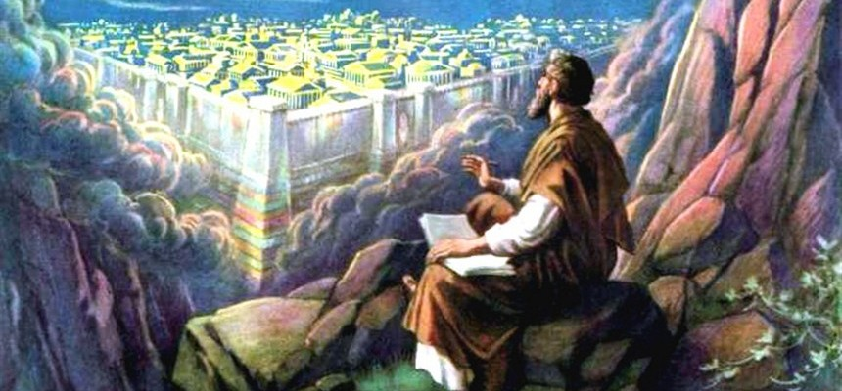
Revelation 11:15
¹⁵ “Then the seventh angel sounded; and there were loud voices in heaven, saying, ‘The kingdom of the world has become the kingdom of our Lord and of His Christ; and He will reign forever and ever.’”

Slide 47
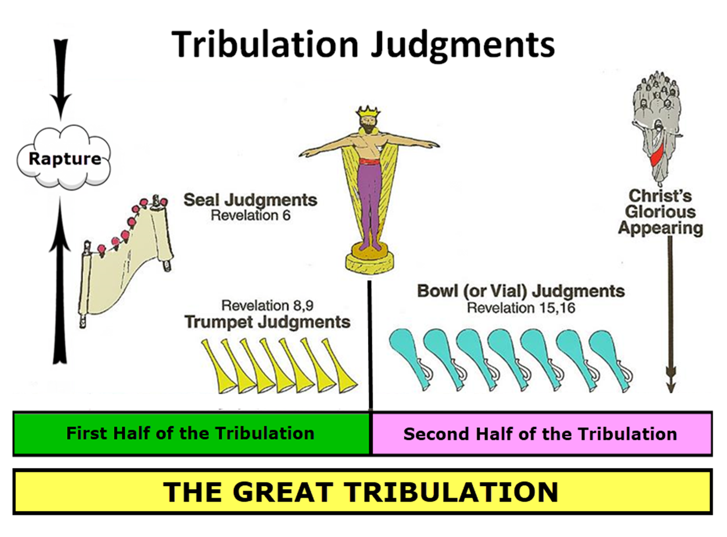

Slide 49
Conclusion

Slide 50
7 OT CITATIONS DEMONSTRATING CHRIST’S
SUPERIORITY TO THE ANGELS (1:4-14)
      vs. 5a – Ps 2:7
      vs. 5b – 2 Sam 7:14
      vs. 6 – Ps 97:7
      vs. 7 – Ps 104:4
      vs. 8-9 – Ps 45:6-7
      vs. 10-12 – Ps 102:25-7
      vs. 13 – Ps 110:1

Slide 51
Hebrews 1:4‒2:18
Christ is Superior to the Angels
      Seven OT Citations (1:4-14)
      Warning Against Drifting (2:1-4)
      Why God Became Man (2:5-18)

Slide 52
Hebrews 1:4‒2:18
Christ is Superior to the Angels
      Seven OT Citations (1:4-14)
      Warning Against Drifting (2:1-4)
      Why God Became Man (2:5-18)

