Slide 1
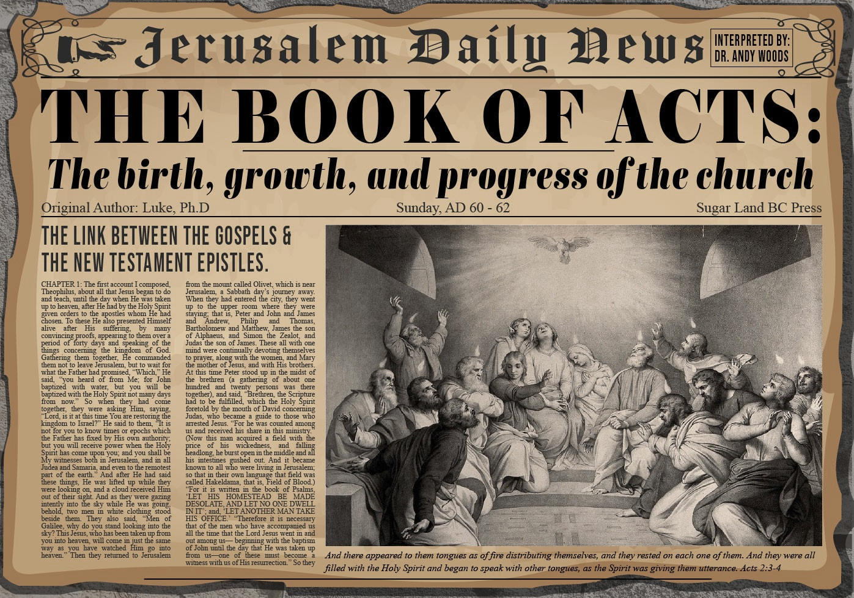


Slide 2
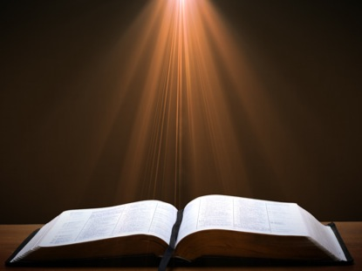
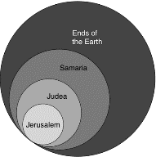
Acts 1:8
“but you will receive power when the Holy Spirit has come upon you; and you shall be My witnesses both in Jerusalem (Acts 1-7), and in all Judea and Samaria (Acts 8-12), and even to the remotest part of the earth (Acts 13-28).”

Slide 3
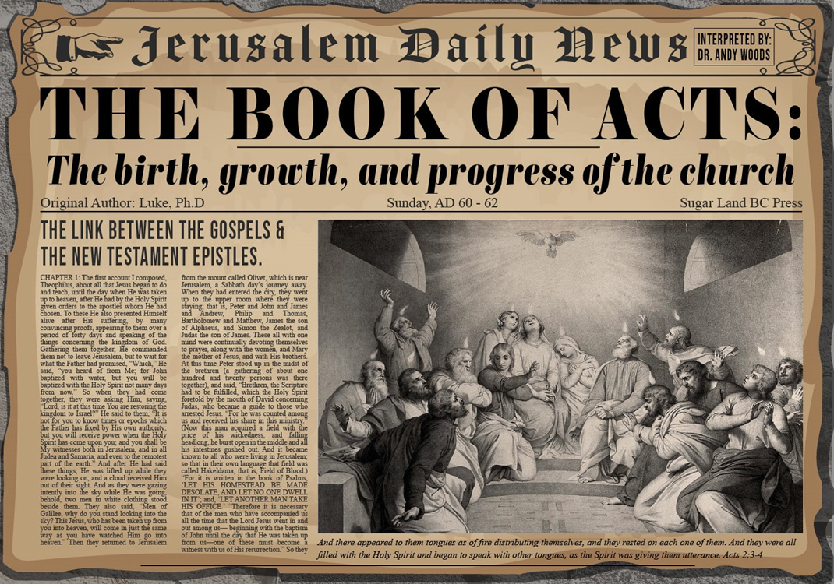
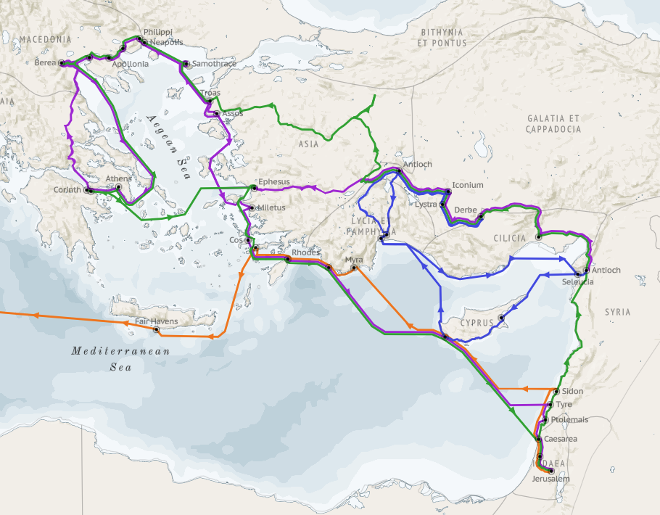
Structure (Acts 1:8)
Jerusalem (Acts 1–7)
Judea and Samaria (Acts 8–12)
Remotest part of the earth (Acts 13–28)
1st missionary journey (Acts 13–14)
Jerusalem council (Acts 15:1-35)
2nd missionary journey (Acts 15:36 –18:22)
3rd missionary journey (Acts 18:23–21:17)
Trip to Rome (Acts 21:18–28:31)

Slide 4
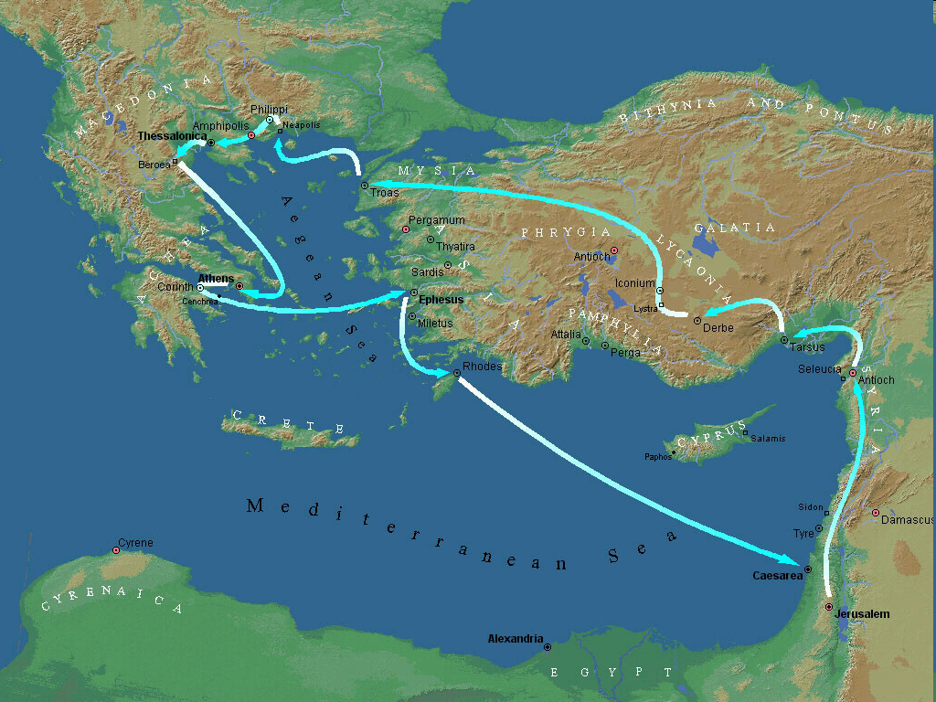
Second Missionary Journey

Slide 5
Acts 15:36‒18:22 2nd Missionary Journey
Schism between Paul & Barnabas (15:36-41)
Syria & Cilicia ministry (16:1-5)
Macedonian call (16:6-10)
Philippian ministry (16:11-40)
Thessalonica ministry (17:1-9)
Berean ministry (17:10-15)
Athens’ ministry (17:16-34)
Corinthian ministry (18:1-18)
Ephesus’ ministry (18:19-21)
Return to Antioch (18:22)

Slide 6
IX. Ephesus Ministry Acts 18:19-21
Arrival (19a)
Leaving Priscilla & Aquila behind (19b)
Synagogue ministry (19c)
Synagogue invitation (20a)
Invitation declined (20b)
Promise (21a)
Departure (21b)

Slide 7
IX. Ephesus Ministry Acts 18:19-21
Arrival (19a)
Leaving Priscilla & Aquila behind (19b)
Synagogue ministry (19c)
Synagogue invitation (20a)
Invitation declined (20b)
Promise (21a)
Departure (21b)

Slide 8
Second Missionary Journey

Slide 9
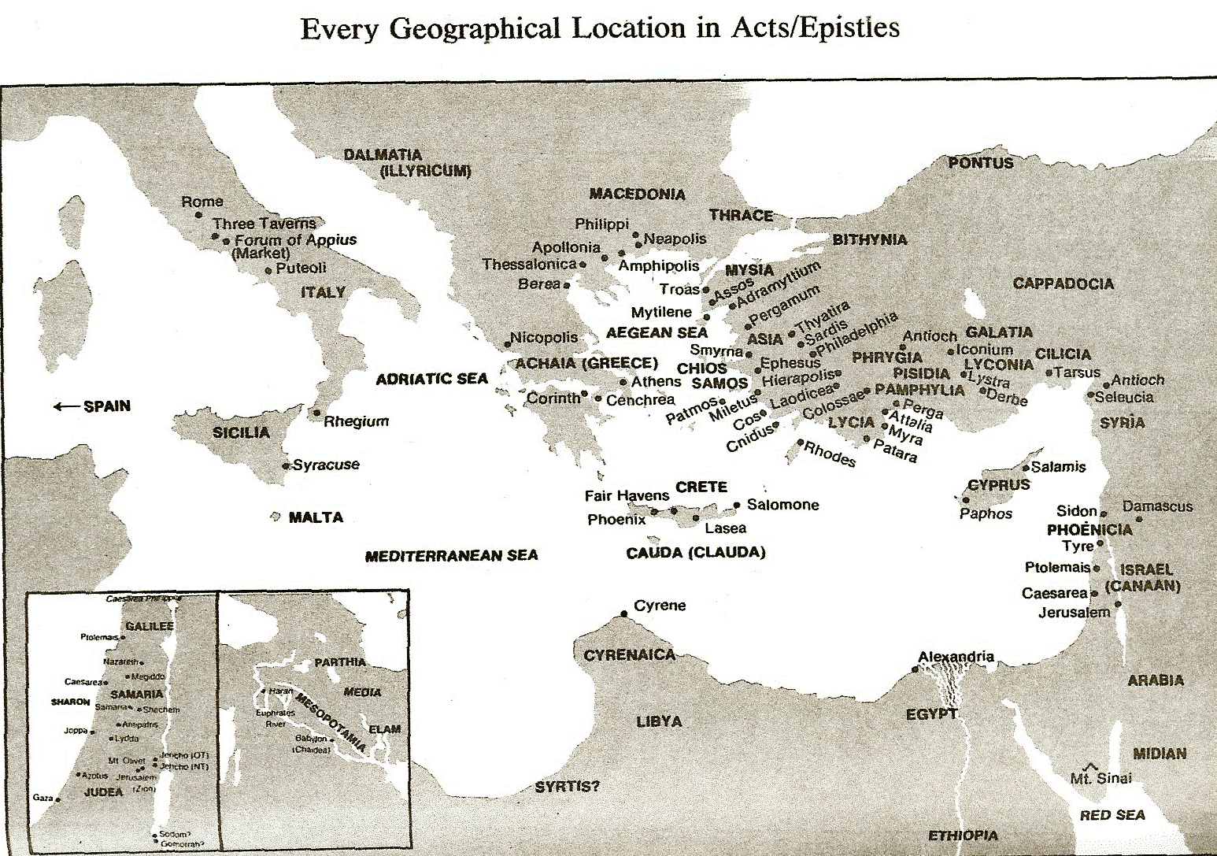

Slide 10
Paul’s Ministry Chronology
# OF BOOKS | JOURNEY | ACTS | DATE | BOOKS
1 | 1 | 13–14 | 48–49 | Gal
2 | 2 | 15:36–18:22 | 50–52 | 1–2 Thess
3 | 3 | 18:23–21:17 | 53–57 | 1–2 Cor, Rom
4 | 4 | 28:16-31 | 60–62 | Eph, Col, Phlm, Phlp
2 | Between Imprisonments | Post Acts | 62–66 | 1 Tim, Titus
1 | 2nd Imprisonment | Post Acts | 67 | 2 Tim

Slide 11
ORDER OF PAUL’S LETTERS | ORDER OF PAUL’S LETTERS
1. | Galatians | A.D. 49
2. | 1‒2 Thessalonians | A.D. 51
3. | 1‒2 Corinthians | A.D. 56
4. | Romans | A.D. 57
5. | Ephesians, Colossians, Philemon, Philippians | A.D. 60‒62
6. | 1 Timothy, Titus | A.D. 62‒66
7. | 2 Timothy | A.D. 67

Slide 12
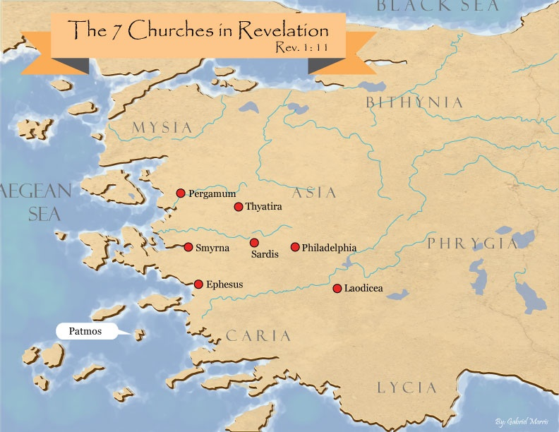
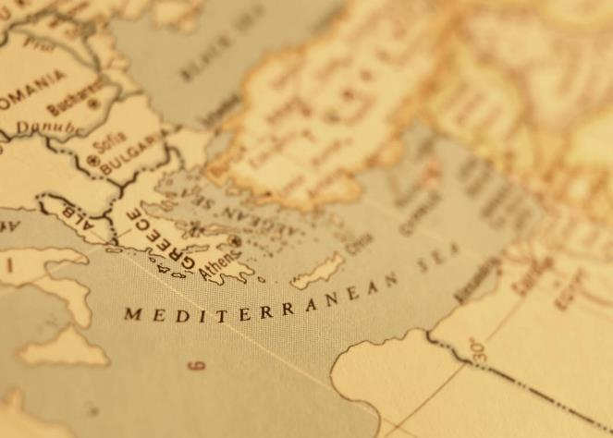

Slide 13

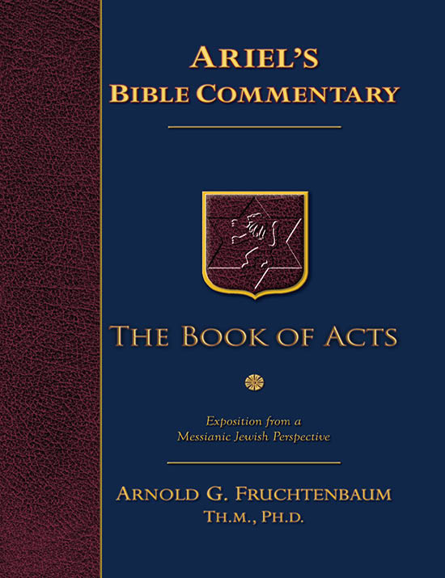
Dr. Arnold G. Fruchtenbaum
The Book of Acts, 385
“At the time of Paul, ‘it was the greatest commercial city of Asia Minor,’ with a population of about 250,000, making it probably the fourth largest city of the Roman Empire after Rome, Alexandria in Egypt, and Antioch of Syria. Throughout Roman history, Ephesus was known as ‘the Gateway to Asia’ because it was a port city.”

Slide 14
Dr. Arnold G. Fruchtenbaum
The Book of Acts, 386
“It was the center of sorcery and the practice of the black arts. The city was also known as ‘the Warden of the Temple of Artemis,’ which will play a role in Acts 19. Artemis, also known as Diana, was the multi-breasted goddess of fertility and hunting. The Artemision, or temple to Artemis, was one of the seven wonders of the ancient world. Built on a plain between the hills of Ayasoluk (Selçuk) and Pion, it was destroyed at least three times. The last version is said to have contained 127 columns, four to six feet in diameter and 60 feet high. The temple was about 425 feet in length and 225 feet wide, making it nearly double the size of the Parthenon in Athens. It became the center of pagan worship, with sacrifices and religious prostitution. According to the historian Strabo (64/63 B.C.-ca. A.D. 24), the Artemision also served as a refuge for fugitives from justice and as a bank for treasures.”

Slide 15
IX. Ephesus Ministry Acts 18:19-21
Arrival (19a)
Leaving Priscilla & Aquila behind (19b)
Synagogue ministry (19c)
Synagogue invitation (20a)
Invitation declined (20b)
Promise (21a)
Departure (21b)

Slide 16
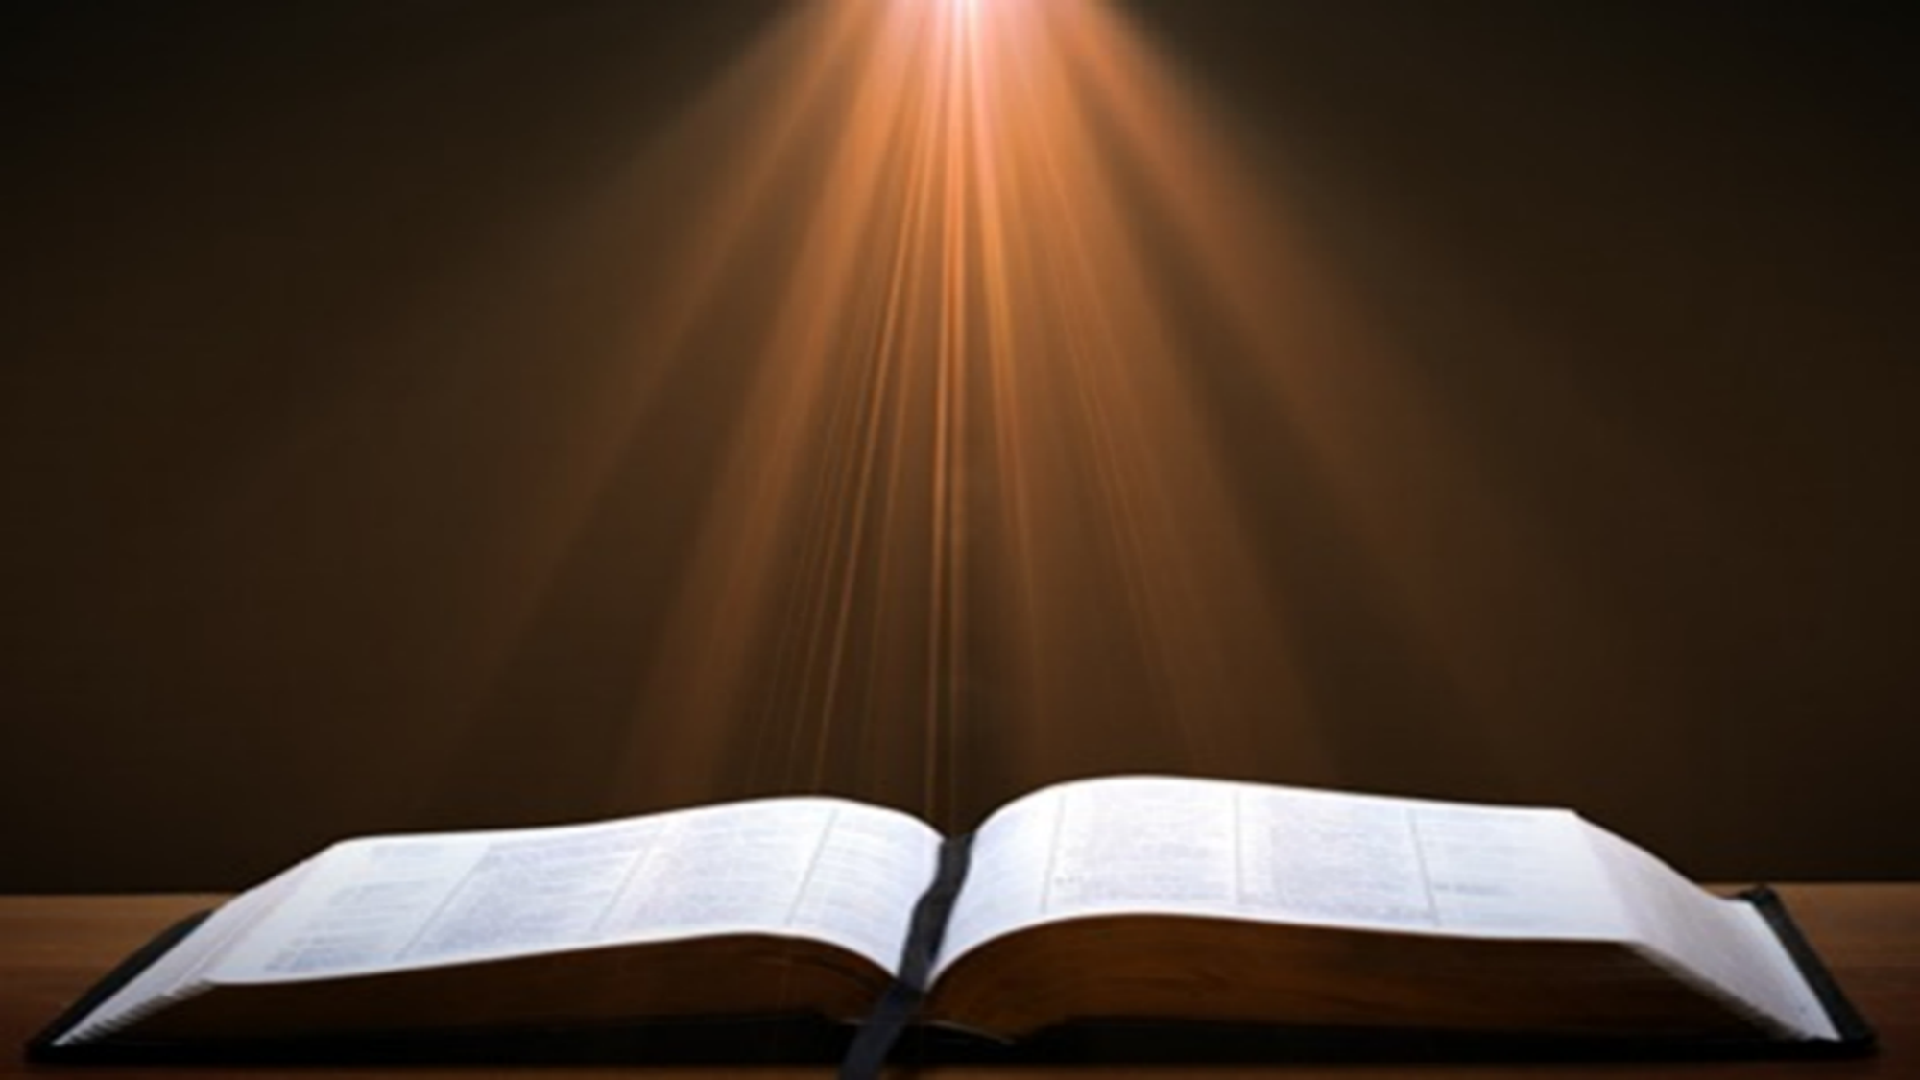
2 Timothy 3:15-17
“¹⁵ and that from childhood you have known the sacred writings which are able to give you the wisdom that leads to salvation through faith which is in Christ Jesus. ¹⁶ All Scripture is inspired by God [theopneustos] and profitable for teaching, for reproof, for correction, for training in righteousness; ¹⁷ so that the man of God may be adequate, equipped for every good work.”
Notes:
hapaxlegomena

Slide 17
IX. Ephesus Ministry Acts 18:19-21
Arrival (19a)
Leaving Priscilla & Aquila behind (19b)
Synagogue ministry (19c)
Synagogue invitation (20a)
Invitation declined (20b)
Promise (21a)
Departure (21b)

Slide 18

Acts 17:1-3
“¹ Now when they had traveled through Amphipolis and Apollonia, they came to Thessalonica, where there was a synagogue of the Jews. ² And according to Paul’s custom, he visited them, and for three Sabbaths reasoned with them from the Scriptures, ³ explaining and giving evidence that the Christ had to suffer and rise from the dead, and saying, ‘This Jesus whom I am proclaiming to you is the Christ.’”

Slide 19
IX. Ephesus Ministry Acts 18:19-21
Arrival (19a)
Leaving Priscilla & Aquila behind (19b)
Synagogue ministry (19c)
Synagogue invitation (20a)
Invitation declined (20b)
Promise (21a)
Departure (21b)

Slide 20
IX. Ephesus Ministry Acts 18:19-21
Arrival (19a)
Leaving Priscilla & Aquila behind (19b)
Synagogue ministry (19c)
Synagogue invitation (20a)
Invitation declined (20b)
Promise (21a)
Departure (21b)

Slide 21
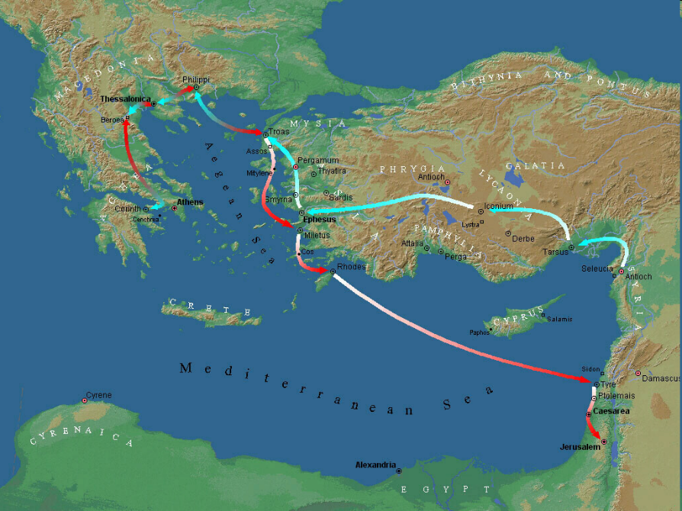

Slide 23
Second Missionary Journey

Slide 24
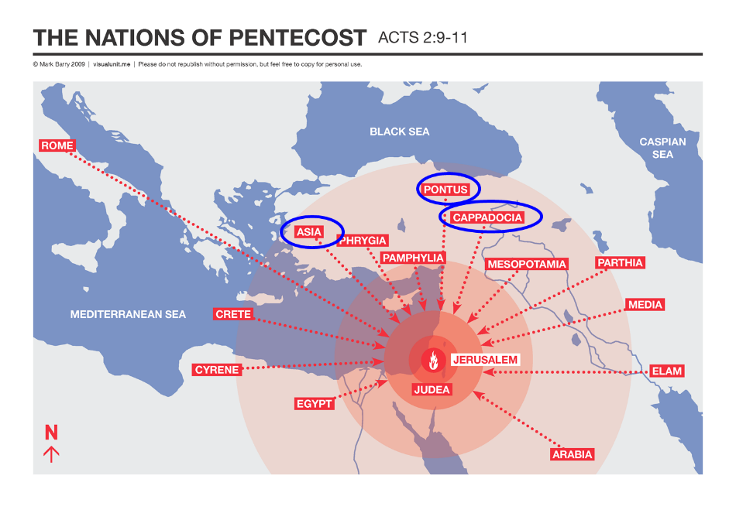

Slide 25
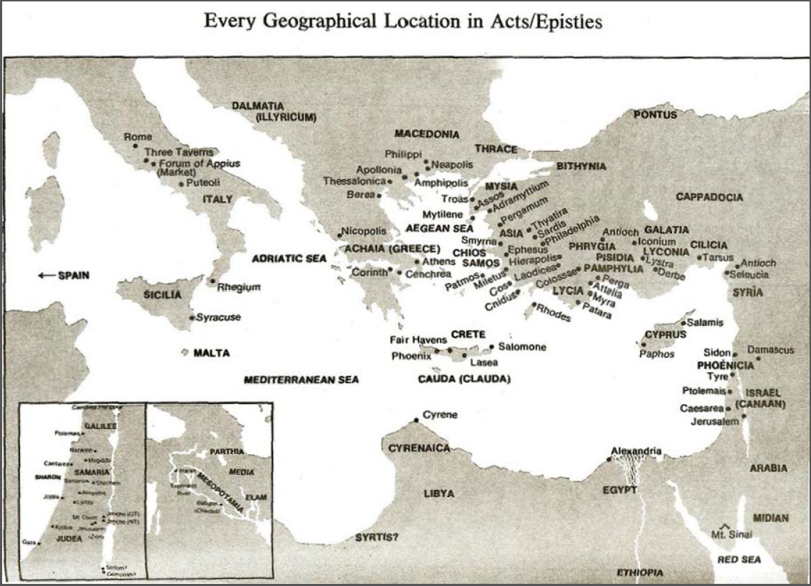

Slide 26

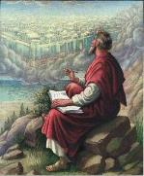
1 Peter 1:1
“To those who reside as aliens, scattered throughout Pontus, Galatia, Cappadocia, Asia, and Bithynia, who are chosen.”

Slide 27
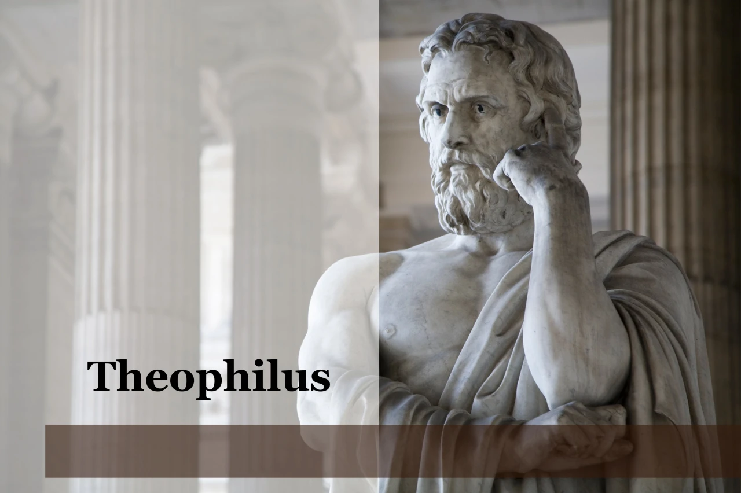
Purpose
To present Theophilus with an orderly account of the birth and growth of the church so as to affirm him in what he has believed.

Slide 28

Message
Birth and growth of the church numerically, geographically, ethnically.
Components
Numerically (progress reports)
Geographically (From Jerusalem to Rome)
Ethnically (From Judaism to Gentile domination)

Slide 29
IX. Ephesus Ministry Acts 18:19-21
Arrival (19a)
Leaving Priscilla & Aquila behind (19b)
Synagogue ministry (19c)
Synagogue invitation (20a)
Invitation declined (20b)
Promise (21a)
Departure (21b)

Slide 31
IX. Ephesus Ministry Acts 18:19-21
Arrival (19a)
Leaving Priscilla & Aquila behind (19b)
Synagogue ministry (19c)
Synagogue invitation (20a)
Invitation declined (20b)
Promise (21a)
Departure (21b)

Slide 32
Second Missionary Journey

Slide 33
Acts 15:36‒18:22 2nd Missionary Journey
Schism between Paul & Barnabas (15:36-41)
Syria & Cilicia ministry (16:1-5)
Macedonian call (16:6-10)
Philippian ministry (16:11-40)
Thessalonica ministry (17:1-9)
Berean ministry (17:10-15)
Athens’ ministry (17:16-34)
Corinthian ministry (18:1-18)
Ephesus’ ministry (18:19-21)
Return to Antioch (18:22)

Slide 34
X. Return to Antioch Acts 18:22
Caesarea landing (22a)
Visit to Jerusalem Church (22b)
Journey to Antioch (22c)

Slide 35
X. Return to Antioch Acts 18:22
Caesarea landing (22a)
Visit to Jerusalem Church (22b)
Journey to Antioch (22c)

Slide 36
Second Missionary Journey

Slide 37
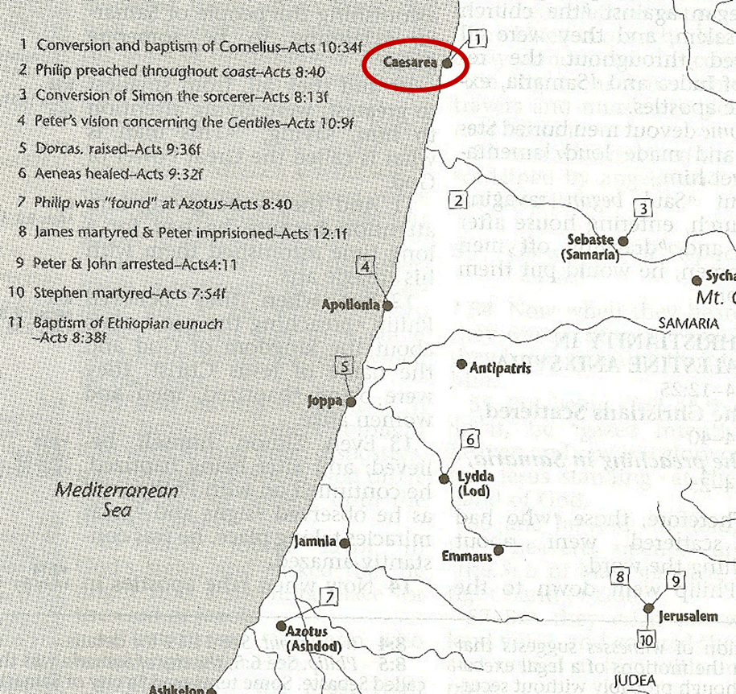

Slide 38
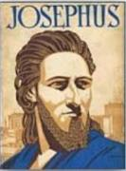
Josephus
Antiquities 18.3.3
“About this time there lived Jesus, a wise man, if indeed one ought to call him a man. For he was one who performed surprising deeds and was a teacher of such people as accept the truth gladly. He won over many Jews and many of the Greeks. He was the Christ. And when, upon the accusation of the principal men among us, Pilate had condemned him to a cross, those who had first come to love him did not cease. He appeared to them spending a third day restored to life, for the prophets of God had foretold these things and a thousand other marvels about him. And the tribe of the Christians, so called after him, has still to this day not disappeared.”

Slide 39
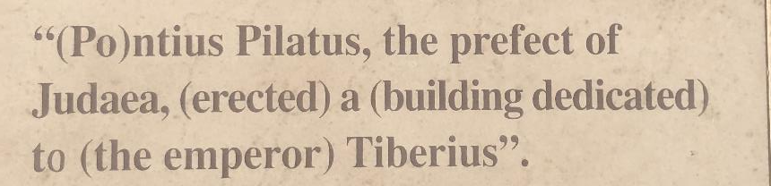
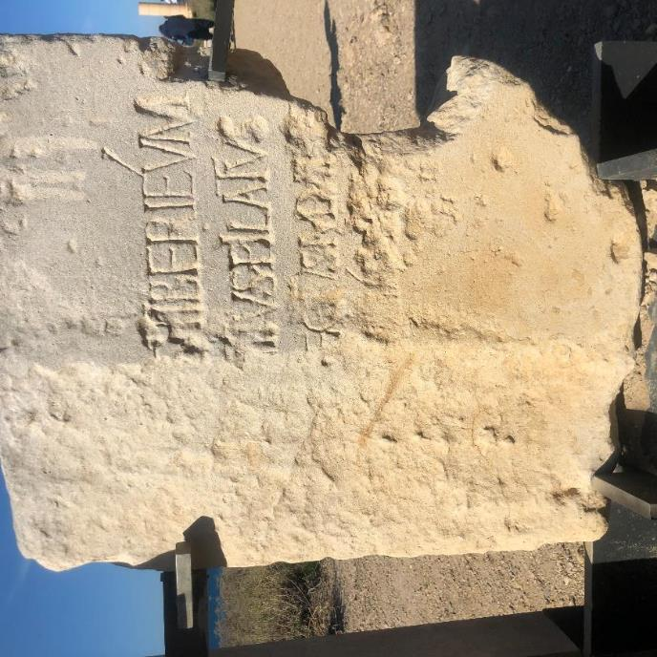
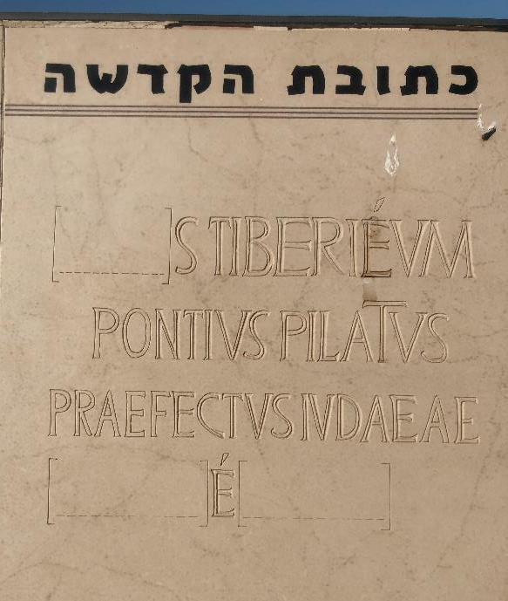

Slide 40
X. Return to Antioch Acts 18:22
Caesarea landing (22a)
Visit to Jerusalem Church (22b)
Journey to Antioch (22c)

Slide 41
Second Missionary Journey

Slide 42
Levitical Feasts (Leviticus 23)
Feast | Season | Purpose | Type
Passover | Spring | Redemption | 1 Cor 5:7
Unleavened Bread | Spring | Separation | John 6:35
1st Fruits | Spring | Praise | 1 Cor 15:20
Pentecost | Spring | Praise | Acts 2:1-4
Trumpets | Fall | New Year | Matt 24:31
Atonement | Fall | Lev 16 | Zech 12:10
Booths | Fall | Wilderness provision | Zech 14:16-18

Slide 43
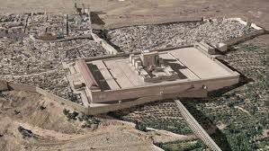
Christ’s Five Trips to Jerusalem
Feast | Verse
Passover | 2:23
Unnamed | 5:1
Tabernacles | 7:2
Dedication | 10:22
Passover | 13:1

Slide 44
X. Return to Antioch Acts 18:22
Caesarea landing (22a)
Visit to Jerusalem Church (22b)
Journey to Antioch (22c)

Slide 45
Conclusion

Slide 46
Acts 15:36‒18:22 2nd Missionary Journey
Schism between Paul & Barnabas (15:36-41)
Syria & Cilicia ministry (16:1-5)
Macedonian call (16:6-10)
Philippian ministry (16:11-40)
Thessalonica ministry (17:1-9)
Berean ministry (17:10-15)
Athens’ ministry (17:16-34)
Corinthian ministry (18:1-18)
Ephesus’ ministry (18:19-21)
Return to Antioch (18:22)

Slide 47
IX. Ephesus Ministry Acts 18:19-21
Arrival (19a)
Leaving Priscilla & Aquila behind (19b)
Synagogue ministry (19c)
Synagogue invitation (20a)
Invitation declined (20b)
Promise (21a)
Departure (21b)

Slide 48
Acts 15:36‒18:22 2nd Missionary Journey
Schism between Paul & Barnabas (15:36-41)
Syria & Cilicia ministry (16:1-5)
Macedonian call (16:6-10)
Philippian ministry (16:11-40)
Thessalonica ministry (17:1-9)
Berean ministry (17:10-15)
Athens’ ministry (17:16-34)
Corinthian ministry (18:1-18)
Ephesus’ ministry (18:19-21)
Return to Antioch (18:22)

Slide 49
X. Return to Antioch Acts 18:22
Caesarea landing (22a)
Visit to Jerusalem Church (22b)
Journey to Antioch (22c)

Slide 50
Structure (Acts 1:8)
Jerusalem (Acts 1–7)
Judea and Samaria (Acts 8–12)
Remotest part of the earth (Acts 13–28)
1st missionary journey (Acts 13–14)
Jerusalem council (Acts 15:1-35)
2nd missionary journey (Acts 15:36 –18:22)
3rd missionary journey (Acts 18:23–21:17)
Trip to Rome (Acts 21:18–28:31)

