Slide 1


Slide 2
“The Lord’s Mercy Meets Genuine Repentance”

Slide 3
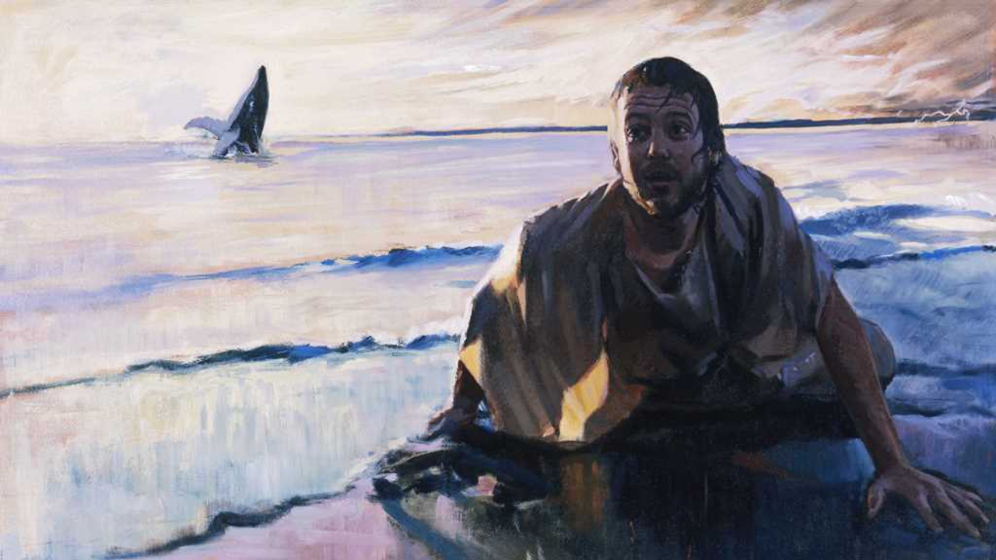

Slide 4
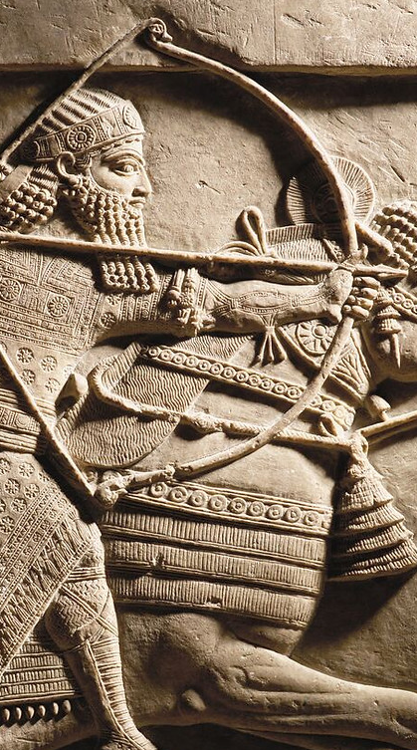
“With their blood I dyed the mountain red like red wool, [and] the rest of them the ravines [and] torrents of the mountain swallowed. I carried off captives [and] possessions from them. I cut off the heads of their fighters [and] built [therewith] a tower before their city. I burnt their adolescent boys [and] girls.”
I captured many troops alive: I cut off of some their arms [and] hands; I cut off of others their noses, ears, [and] extremities. I gouged out the eyes of many troops. I made one pile of the living [and] one of heads. I hung their heads on trees around the city.”

Slide 5
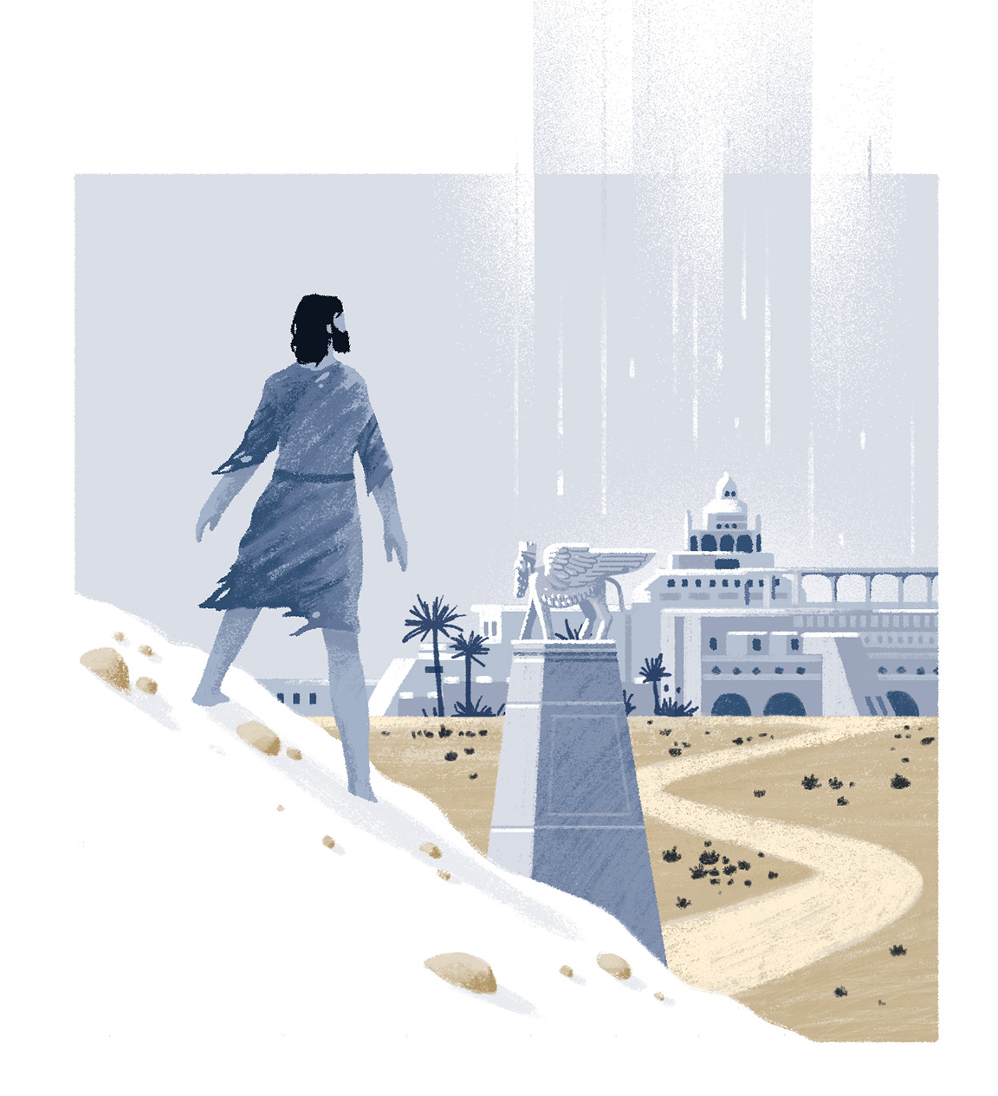
“Yet forty days and Nineveh will be overthrown.”
Jonah 3:4

Slide 6
Without a biblical perspective on repentance and mercy, we either despair over hardened sinners, or we trivialize sin and cheapen grace.

Slide 7
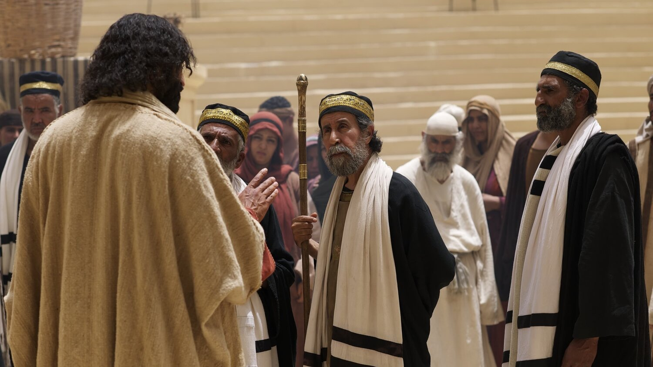
Matthew 12:39-41
39 “But He answered and said to them, ‘An evil and adulterous generation craves for a sign; and yet no sign will be given to it but the sign of Jonah the prophet; 40 for just as JONAH WAS THREE DAYS AND THREE NIGHTS IN THE BELLY OF THE SEA MONSTER, so will the Son of Man be three days and three nights in the heart of the earth. 41 The men of Nineveh will stand up with this generation at the judgment and will condemn it because they repented at the preaching of Jonah; and behold, something greater than Jonah is here.’”

Slide 8
“The Lord’s mercy meets genuine repentance… ”
when sinners humble themselves before His warning (vv.6–7).
when sinners look to Him and turn from their evil ways (v.8–9).
as He sees their turning and withholds calamity (v.10).

Slide 9
“The Lord’s mercy meets genuine repentance… ”
when sinners humble themselves before His warning (vv.6–7).
when sinners look to Him and turn from their evil ways (v.8–9).
as He sees their turning and withholds calamity (v.10).

Slide 10
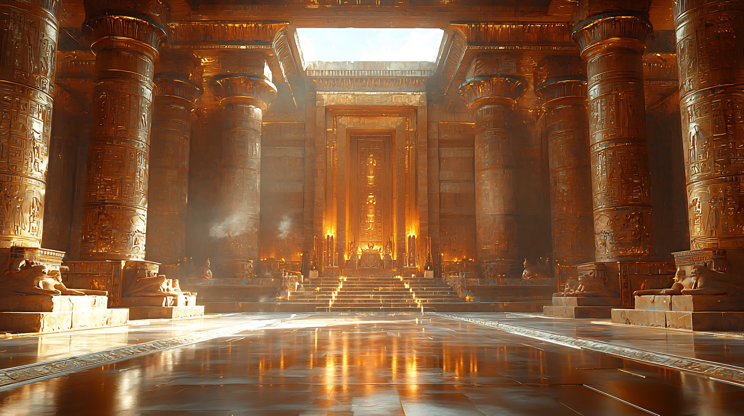
Jonah 3:6
“When the word reached the king of Nineveh, he arose from his throne, laid aside his robe from him, covered himself with sackcloth and sat on the ashes.”

Slide 11
Jonah 3:6
“When the word reached the king of Nineveh, he arose from his throne, laid aside his robe from him, covered himself with sackcloth and sat on the ashes.”

Slide 12
A.R. Fausett
“The language implies that it was after the appointment of a fast by general acclamation of the people that the whole of what had occurred reached the king; and, instead of being jealous at the initiative having been taken by the people, he at once humbled himself after his people’s example.”

Slide 13
Jonah 3:6
“When the word reached the king of Nineveh, he arose from his throne, laid aside his robe from him, covered himself with sackcloth and sat on the ashes.”

Slide 14
R.A. Nixon
“There is a beautiful symmetry in the way the actions of the king are set out. The action begins with him rising from his throne and ends with him sitting in ashes. Between these two resting places he has taken off his royal robe and covered, or ‘hidden’, himself in sackcloth. Not even David’s repentance, after he had heard the words of Nathan the prophet, is so lucidly portrayed… The pagan king of Nineveh…knew that fasting and the usual outward signs of repentance alone were insufficient.”

Slide 15
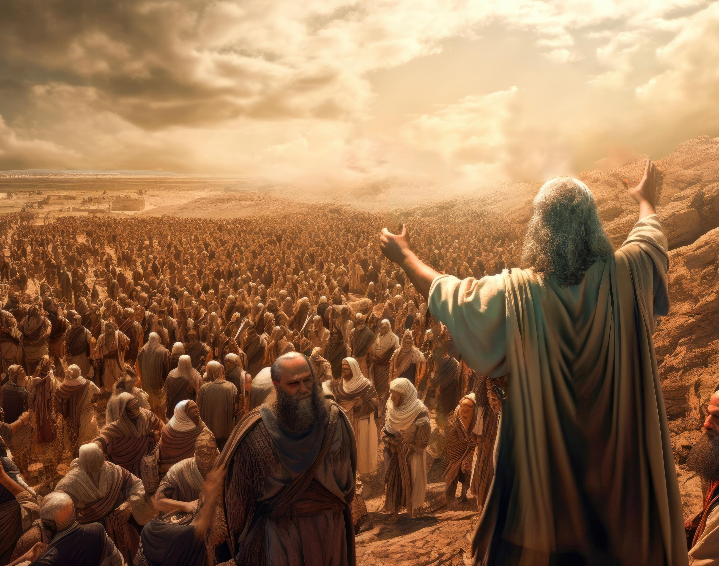
2 Chronicles 33:12-13
“When he was in distress, he entreated the LORD his God and humbled himself greatly before the God of his fathers. When he prayed to Him, He was moved by his entreaty and heard his supplication, and brought him again to Jerusalem to his kingdom. Then Manasseh knew that the LORD was God.”

Slide 16
“The Lord’s mercy meets genuine repentance… ”
when sinners humble themselves before His warning (vv.6–7).
when sinners look to Him and turn from their evil ways (v.8–9).
as He sees their turning and withholds calamity (v.10).

Slide 17
Jonah 3:8
“But both man and beast must be covered with sackcloth; and let men call on God earnestly that each may turn from his wicked way and from the violence which is in his hands.”

Slide 18
“But both man and beast must be covered with sackcloth…(3:8a)
Visible sorrow
Earnest prayer
Moral turning

Slide 19
Jonah 3:8
“But both man and beast must be covered with sackcloth; and let men call on God earnestly that each may turn from his wicked way and from the violence which is in his hands.”

Slide 20
Smith and Page
“The inclusion even of animals in this royally mandated fast is the act of a desperate monarch and a desperate people. Fasting and uncomfortable dress represented self-denial. By eschewing normal comforts and making themselves physically miserable, they sought to show the genuineness of their prayers for mercy. This action was an attempt to impress forcibly upon the Lord the sincerity of Nineveh’s repentance. It was an attempt to move the heart of God and lead him to relent.”

Slide 21
Jonah 3:8
“But both man and beast must be covered with sackcloth; and let men call on God earnestly that each may turn from his wicked way and from the violence which is in his hands.”

Slide 22
Jonah 3:8
“But both man and beast must be covered with sackcloth; and let men call on God earnestly that each may turn from his wicked way and from the violence which is in his hands.”

Slide 23
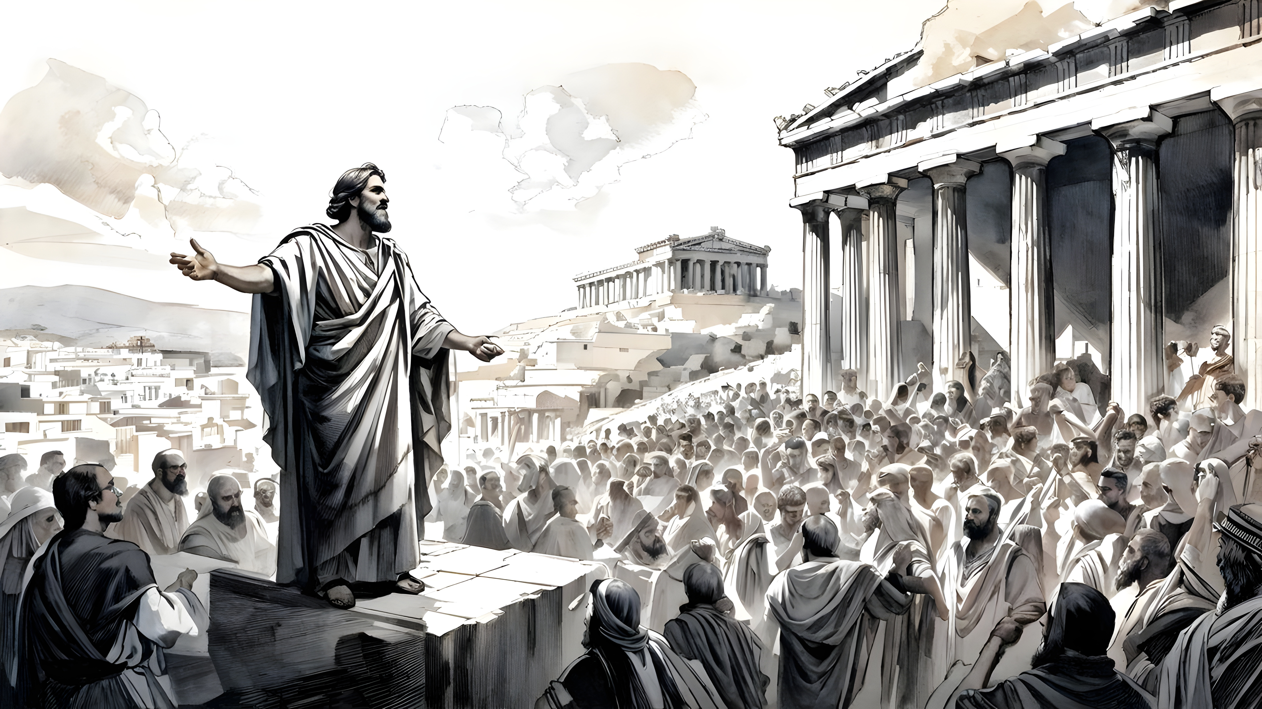
Romans 6:1-2
  What shall we say then? Are we to continue in sin so that grace may increase? May it never be! How shall we who died to sin still live in it?

Slide 24
“The Lord’s mercy meets genuine repentance… ”
when sinners humble themselves before His warning (vv.6–7).
when sinners look to Him and turn from their evil ways (v.8–9).
as He sees their turning and withholds calamity (v.10).

Slide 25
Jonah 3:10
“When God saw their deeds, that they turned from their wicked way, then God relented concerning the calamity which He had declared He would bring upon them. And He did not do it.”

Slide 26
Jonah 3:10
“When God saw their deeds, that they turned from their wicked way, then God relented concerning the calamity which He had declared He would bring upon them. And He did not do it.”

Slide 27
Jonah 3:10
“When God saw their deeds, that they turned from their wicked way, then God relented concerning the calamity which He had declared He would bring upon them. And He did not do it.”

Slide 28
Jonah 3:10
“When God saw their deeds, that they turned from their wicked way, then God relented concerning the calamity which He had declared He would bring upon them. And He did not do it.”

Slide 29
Jonah 3:10
“When God saw their deeds, that they turned from their wicked way, then God relented concerning the calamity which He had declared He would bring upon them. And He did not do it.”

Slide 30
Conclusion

Slide 31
“The Lord’s mercy meets genuine repentance… ”
when sinners humble themselves before His warning (vv.6–7).
when sinners look to Him and turn from their evil ways (v.8–9).
as He sees their turning and withholds calamity (v.10).

Slide 32
channun חַנּוּן – gracious, kind, merciful
  Root – hen חַן – grace, favor freely given
rachum רַחוּם – compassionate, merciful
  Root – rehem רחם – womb, bowels

Slide 33
INTRODUCTORY MATTERS OF JONAH
Who wrote it? Jonah
When was it written? 770-750 BC
Who was it written to? Israel
Historicity of the book? Fact!
Genre of the book? Historical Narrative
What is it all about? (Message) To showcase God’s universal love and plan of redemption which extends beyond Israel to include all nations

