Slide 1
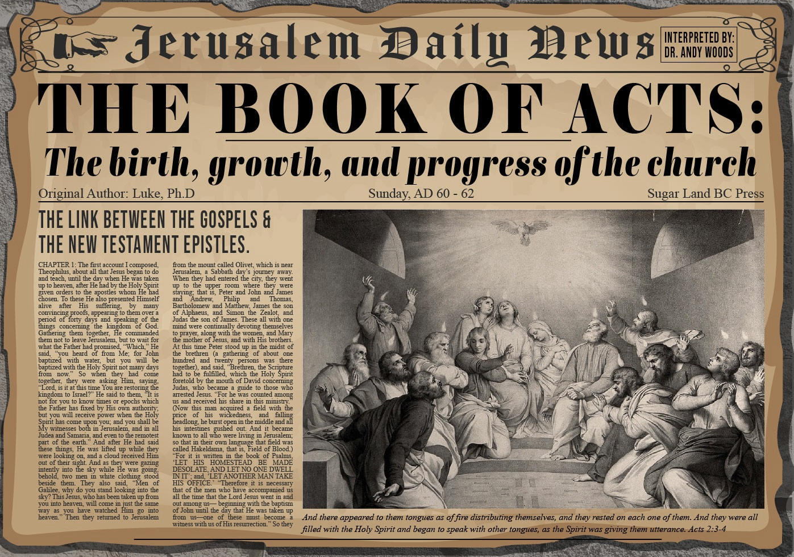


Slide 2

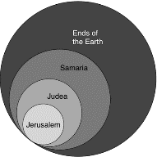
Acts 1:8
“but you will receive power when the Holy Spirit has come upon you; and you shall be My witnesses both in Jerusalem (Acts 1-7), and in all Judea and Samaria (Acts 8-12), and even to the remotest part of the earth (Acts 13-28).”

Slide 3
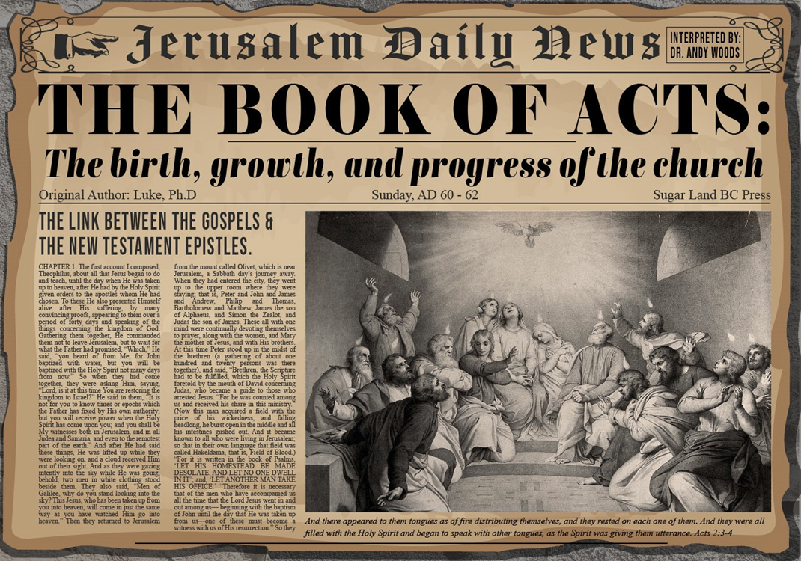
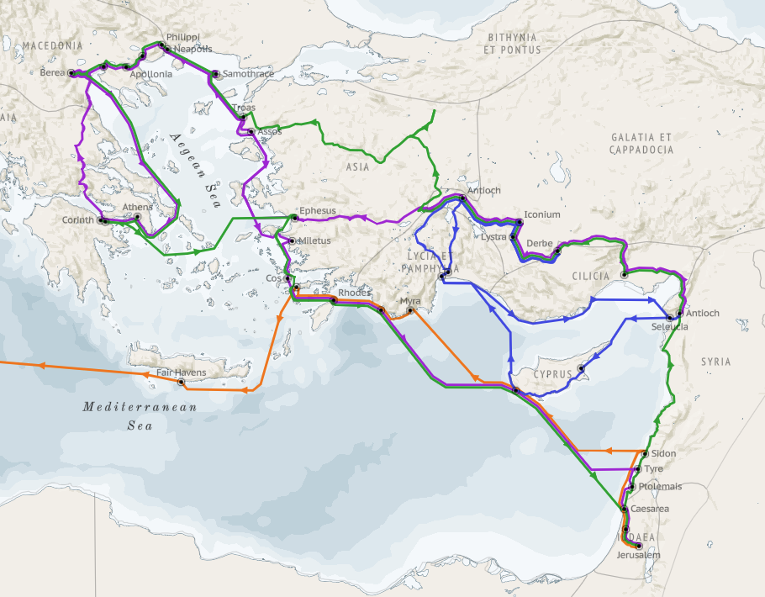
Structure (Acts 1:8)
Jerusalem (Acts 1–7)
Judea and Samaria (Acts 8–12)
Remotest part of the earth (Acts 13–28)
1st missionary journey (Acts 13–14)
Jerusalem council (Acts 15:1-35)
2nd missionary journey (Acts 15:36 –18:22)
3rd missionary journey (Acts 18:23–21:17)
Trip to Rome (Acts 21:18–28:31)

Slide 4
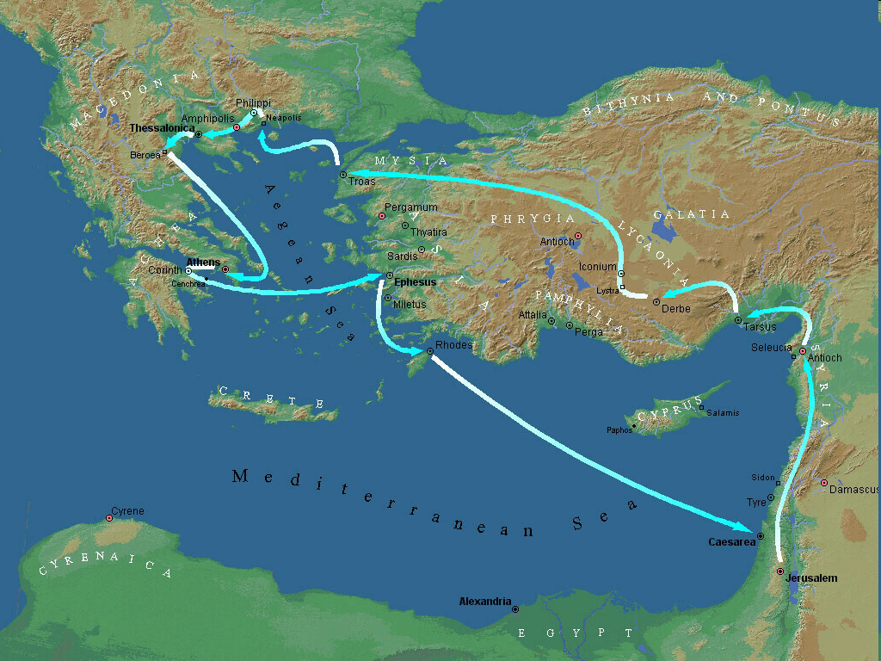
Second Missionary Journey

Slide 5
Acts 15:36‒18:22 2nd Missionary Journey
Schism between Paul & Barnabas (15:36-41)
Syria & Cilicia ministry (16:1-5)
Macedonian call (16:6-10)
Philippian ministry (16:11-40)
Thessalonica ministry (17:1-9)
Berean ministry (17:10-15)
Athens’ ministry (17:16-34)
Corinthian ministry (18:1-18)
Ephesus’ ministry (18:19-21)
Return to Antioch (18:22)

Slide 6
VIII. Corinthian Ministry Acts 18:1-18
Arrival (1-4)
Ministry (5-11)
Paul Before Gallio (12-17)
Paul’s Departure (18)

Slide 7
Acts 18:12-17 Paul Before Gallio
Opposition (12-13)
Gallio’s decision (14-15)
Judgment’s results (16-17)

Slide 8
Acts 18:12-13 Opposition
Circumstances (12)
Charge (13)

Slide 9
Acts 18:12-13 Opposition
Circumstances (12)
Charge (13)

Slide 10

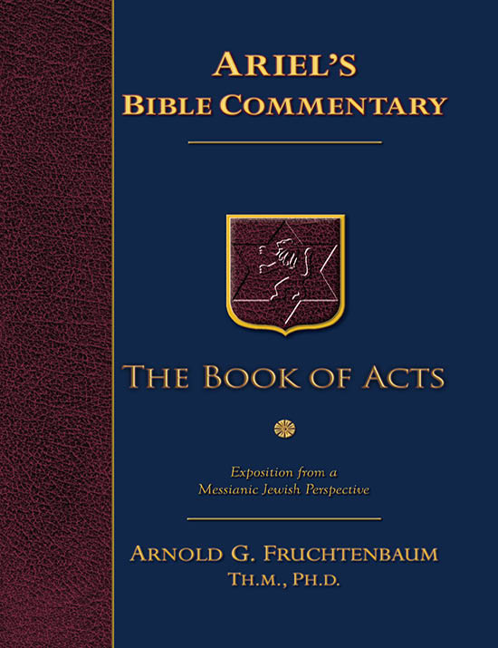
Dr. Arnold G. Fruchtenbaum
The Book of Acts, 381
“The existence of this proconsul is well documented outside the Scriptures. Gallio’s father was Seneca the Elder (ca. 50 B.C. – ca. A.D. 40), a famous Roman rhetorician from the Iberian Peninsula. Gallio had two brothers, one of whom was Lucius Annaeus Seneca (ca. 4 B.C. – A.D. 65). Better known as Seneca the Younger, this brother was the Stoic philosopher, statesman, orator, and writer, who tutored Emperor Nero. Gallio was born in Cordova (Cordoba) around the year 5 B.C. He was originally named Lucius Annaeus Novatus, but assumed the name Gallio after his adoption by the senator L. Junius Gallio.”

Slide 11
Dr. Arnold G. Fruchtenbaum
The Book of Acts, 381
“He served as proconsul of Achaia, as mentioned in this verse, for only two years, in A.D. 51–52. Seneca the Younger said of him: ‘No mortal is so pleasant to any one person as Gallio is to everybody.’ Emperor Claudius referred to Gallio as ‘my friend and proconsul’ in the Delphi Inscription, a collection of nine fragments of a letter written by Claudius in ca. A.D. 52. Hence, this man’s name and the fact that he was proconsul in Achaia is recorded elsewhere. In the year A.D. 65, Emperor Nero, in one of his fits of madness, forced Seneca the Younger to commit suicide. It seems that Gallio followed suit shortly after. It was this man before whom Paul was now brought by the opposition.”

Slide 12
Acts 18:12-13 Opposition
Circumstances (12)
Charge (13)

Slide 13
Acts 18:12-17 Paul Before Gallio
Opposition (12-13)
Gallio’s decision (14-15)
Judgment’s results (16-17)

Slide 14
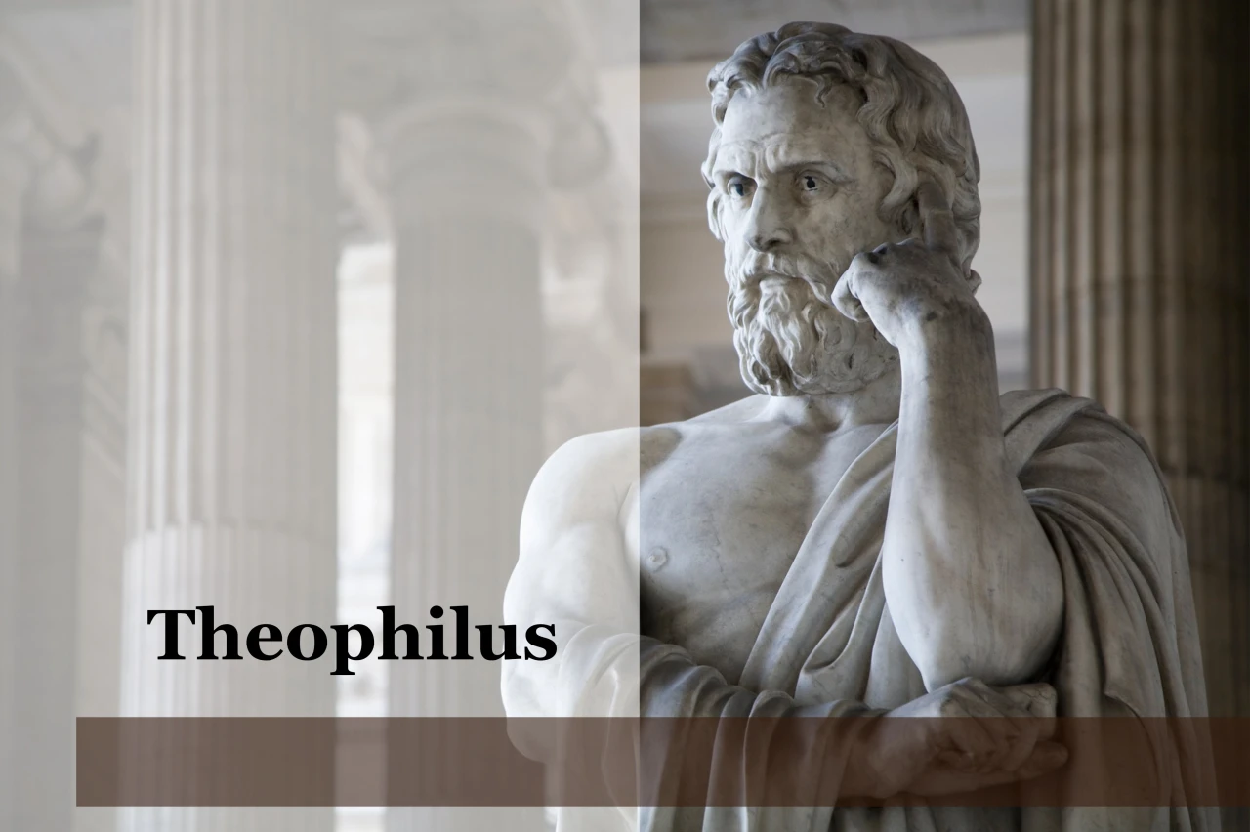
Purpose
To present Theophilus with an orderly account of the birth and growth of the church so as to affirm him in what he has believed.

Slide 15

Message
Birth and growth of the church numerically, geographically, ethnically.
Components
Numerically (progress reports)
Geographically (From Jerusalem to Rome)
Ethnically (From Judaism to Gentile domination)

Slide 16

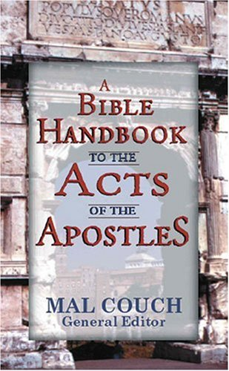
Dr. Mal Couch
Couch, A Bible Handbook to the Acts of the Apostles, 348
“Gallio’s actions in the book of Acts will have profound effect on the growth of Christianity in the Roman world by postponing official persecution... [His] refusal to indict Paul has ramifications throughout the Empire. Had he sided with the Jewish leaders and proclaimed Christianity a new religion, it would be illegal under Roman law. A precedent would have been set that could outlaw the church at a time it is still weak and vulnerable. His refusal to indict Paul protects the preaching of Christianity for a time.”

Slide 17
Acts 18:12-17 Paul Before Gallio
Opposition (12-13)
Gallio’s decision (14-15)
Judgment’s results (16-17)

Slide 18
Acts 18:16-17 Judgment’s Results
Case dismissed (16)
Attack on the Jews (17a)
Gallio’s indifference (17b)

Slide 19
Acts 18:16-17 Judgment’s Results
Case dismissed (16)
Attack on the Jews (17a)
Gallio’s indifference (17b)

Slide 20
Acts 18:16-17 Judgment’s Results
Case dismissed (16)
Attack on the Jews (17a)
Gallio’s indifference (17b)

Slide 21
Acts 18:16-17 Judgment’s Results
Case dismissed (16)
Attack on the Jews (17a)
Gallio’s indifference (17b)

Slide 22
VIII. Corinthian Ministry Acts 18:1-18
Arrival (1-4)
Ministry (5-11)
Paul Before Gallio (12-17)
Paul’s Departure (18)

Slide 23
Acts 18:18 Paul’s Departure
Additional ministry (18a)
Return to Jerusalem (18b)
Nazirite vow (18c)

Slide 24
Acts 18:18 Paul’s Departure
Additional ministry (18a)
Return to Jerusalem (18b)
Nazirite vow (18c)

Slide 25
Acts 18:18 Paul’s Departure
Additional ministry (18a)
Return to Jerusalem (18b)
Nazirite vow (18c)

Slide 26
Second Missionary Journey

Slide 27
Acts 18:18 Paul’s Departure
Additional ministry (18a)
Return to Jerusalem (18b)
Nazirite vow (18c)

Slide 28
Second Missionary Journey

Slide 29
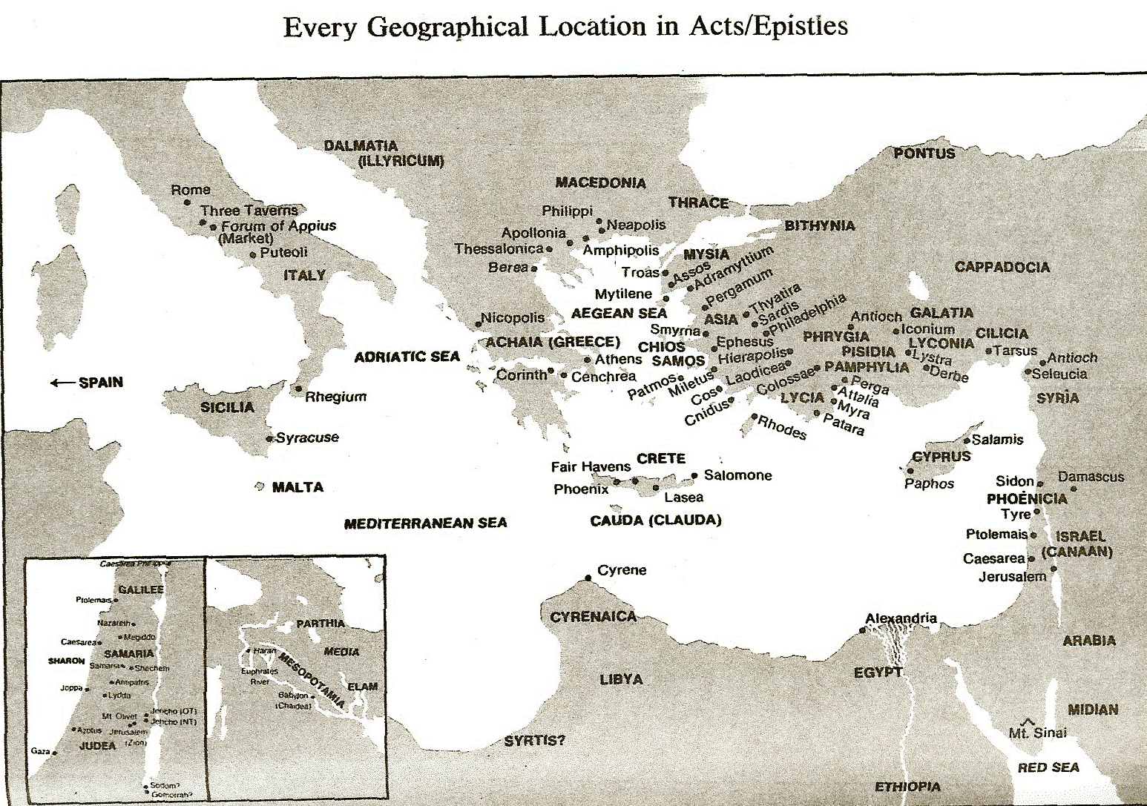

Slide 30
Dr. Arnold G. Fruchtenbaum
The Book of Acts, 374-75
“Freedom from the Mosaic Law means two things: First, it means believers are free from the obligation to obey any of the 613 commandments; but second, freedom from the law also means that they are free to observe those things that they choose to observe as long as they do not contradict the laws of Messiah. Paul saw no contradiction between keeping Jewish customs and living his new faith…The difference between Paul and the Judaizers was that the Judaizers tried to impose these things upon the Gentile believers. While choosing to practice many Jewish customs, Paul refused to impose them on the Gentiles.”

Slide 31
Conclusion

Slide 32
VIII. Corinthian Ministry Acts 18:1-18
Arrival (1-4)
Ministry (5-11)
Paul Before Gallio (12-17)
Paul’s Departure (18)

Slide 33
Acts 15:36‒18:22 2nd Missionary Journey
Schism between Paul & Barnabas (15:36-41)
Syria & Cilicia ministry (16:1-5)
Macedonian call (16:6-10)
Philippian ministry (16:11-40)
Thessalonica ministry (17:1-9)
Berean ministry (17:10-15)
Athens’ ministry (17:16-34)
Corinthian ministry (18:1-18)
Ephesus’ ministry (18:19-21)
Return to Antioch (18:22)

