Slide 1



Slide 2

EXODUS STRUCTURE/OUTLINE
Redemption (1–18)
Redemption (1:1–12:30)
Liberation (12:31–15:21)
Preservation (15:22–18:27)
Mosaic Covenant (19–40)
Law (19–24)
Tabernacle instructions (25–31)
Apostasy (32–34)
Tabernacle building (35–40)

Slide 3
REDEMPTION (1:1–12:30)
Why redemption is necessary (Exod 1)
Development of the deliverer (Exod 2–4)
First confrontation with Pharaoh (Exod 5)
God reassures Moses (Exod 6:1–7:7)
Second confrontation with Pharaoh (Exod 7:8-13)
Plagues (Exod 7:14–12:30)

Slide 4
The Plagues of Egypt
NO. | DESCRIPTION | SCRIPTURE | Egyptian Deity
1. | Water to Blood | Exod. 7:14-25 | Hapi, Khnum
2. | Frogs | Exod. 8:1-15 | Heqt
3. | Gnats | Exod. 8:16-19 | Set
4. | Flies | Exod. 8:20-32 | Uatchit
5. | Disease on Cattle | Exod. 9:1-7 | Hathor, Apis
6. | Boils | Exod. 9:8-12 | Sekhmet, Serapis
7. | Hail | Exod. 9:13-35 | Seth, Nut
8. | Locusts | Exod. 10:1-20 | Seth, Nut, Osiris
9. | Darkness | Exod. 10:21-29 | Re, Horus, Atum
10. | Death of the First Born | Exod. 12:29-36 | Min, Osiris, Heqt, Isis

Slide 5
TEN PLAGUES REDEMPTION (7:14–12:30)
Nile to blood
Frogs
Gnats
Flies
Death of livestock
Boils
Hail
Locusts
Darkness
Death of 1st born

Slide 6
DEATH OF FIRST BORN Exodus 11:1-10
Conversation Interrupted (1-3)
Conversation Continued (4-8)
Conversation Aftermath (9-10)

Slide 7
II. Exodus 11:4-8 Conversation Continued
Plague predicted (4-8c)
Conversation terminated (8d)

Slide 8
Exodus 11:4-8c Plague Predicted
God’s direct involvement (4)
Comprehensive death of first born (5)
Emotional anguish (6)
Israel exempted (7)
Servants’ reaction (8a-b)
Moses’ exit (8c)

Slide 9
Exodus 11:8a-b Servants’ Reaction
What they will do (8a)
What they will say (8b)

Slide 10
Exodus 11:8a-b Servants’ Reaction
What they will do (8a)
What they will say (8b)

Slide 11
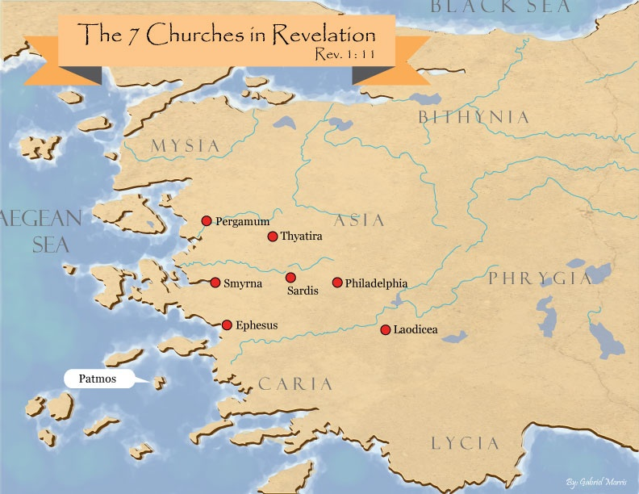
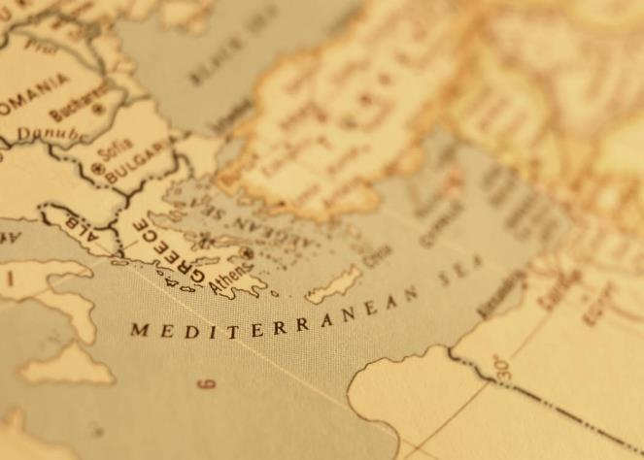

Slide 12
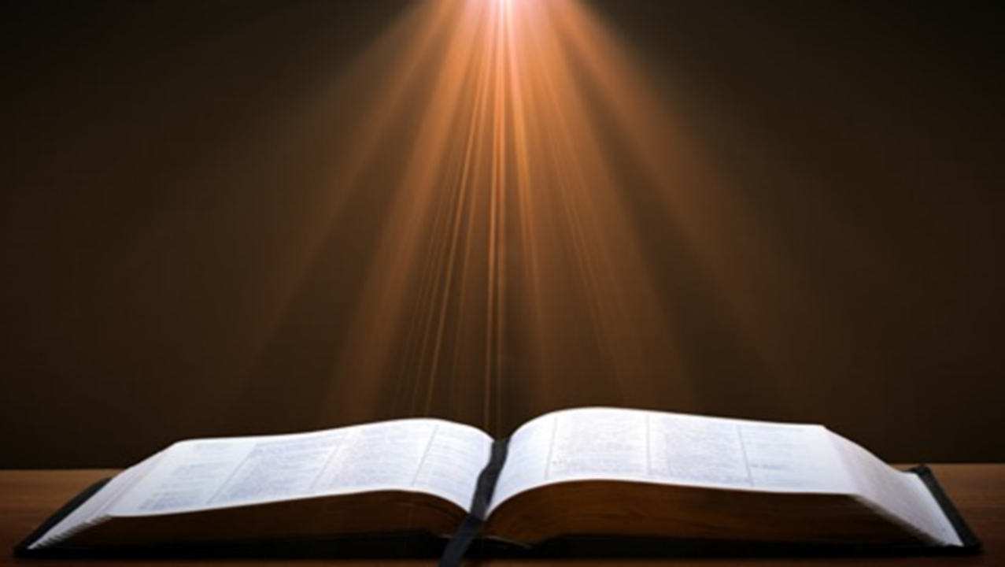
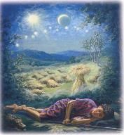
Genesis 37:9
“Now he had still another dream, and related it to his brothers, and said, ‘Lo, I have had still another dream; and behold, the sun and the moon and eleven stars were bowing down to me.’”

Slide 13
Genesis 37:10
“He related it to his father and to his brothers; and his father rebuked him and said to him, ‘What is this dream that you have had? Shall I and your mother and your brothers actually come to bow ourselves down before you to the ground?’”

Slide 14
Exodus 11:8a-b Servants’ Reaction
What they will do (8a)
What they will say (8b)

Slide 15
Exodus 11:4-8c Plague Predicted
God’s direct involvement (4)
Comprehensive death of first born (5)
Emotional anguish (6)
Israel exempted (7)
Servants’ reaction (8a-b)
Moses’ exit (8c)

Slide 16
II. Exodus 11:4-8 Conversation Continued
Plague predicted (4-8c)
Conversation terminated (8d)

Slide 17
DEATH OF FIRST BORN Exodus 11:1-10
Conversation Interrupted (1-3)
Conversation Continued (4-8)
Conversation Aftermath (9-10)

Slide 18
III. Exodus 11:9-10 Conversation Aftermath
God’s prediction (9a)
God’s purpose (9b)
Summary (10a)
Pharaoh’s hardening (10b)

Slide 19
III. Exodus 11:9-10 Conversation Aftermath
God’s prediction (9a)
God’s purpose (9b)
Summary (10a)
Pharaoh’s hardening (10b)

Slide 20
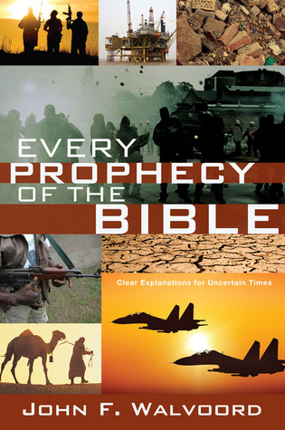

Slide 21
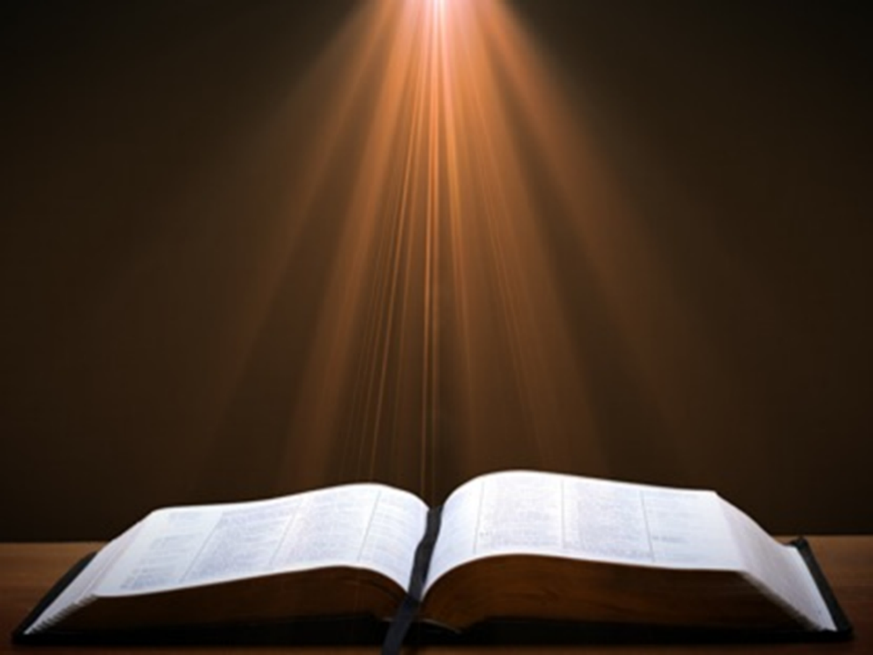

John 13:19; 14:29
“¹⁹ From now on I am telling you before it comes to pass, so that when it does occur, you may believe that I am He… ^{14:29} Now I have told you before it happens, so that when it happens, you may believe.”

Slide 22
III. Exodus 11:9-10 Conversation Aftermath
God’s prediction (9a)
God’s purpose (9b)
Summary (10a)
Pharaoh’s hardening (10b)

Slide 23
Dispensational Theology is a System of Theology
Traditional-normative dispensational theology is a system that embodies three essential, fundamental concepts called the sine qua non (lit. “without which is not”):
The consistent use of a plain, normal, literal, grammatical-historical method of interpretation;
Which reveals that the Church is distinct from Israel;
God’s overall purpose is to bring glory to Himself (Eph. 1:6, 12, 14).
Dr. Charles Ryrie, Dispensationalism, pp. 38-41

Slide 24
Doxological Purpose
God’s ultimate purpose for the ages is to glorify Himself. Scripture is not human-centered, as though salvation were the principle point, but God-centered, because His glory is at the center.
The glory of God is the primary principle that unifies all dispensations, the program of salvation being just one of the means by which God glorifies Himself. Each successive revelation of God’s plan for the ages, as well as His dealing with the elect, non-elect, angels, and nations all manifest His glory.
Dictionary of Premillennial Theology, Charles Ryrie, p. 94

Slide 25
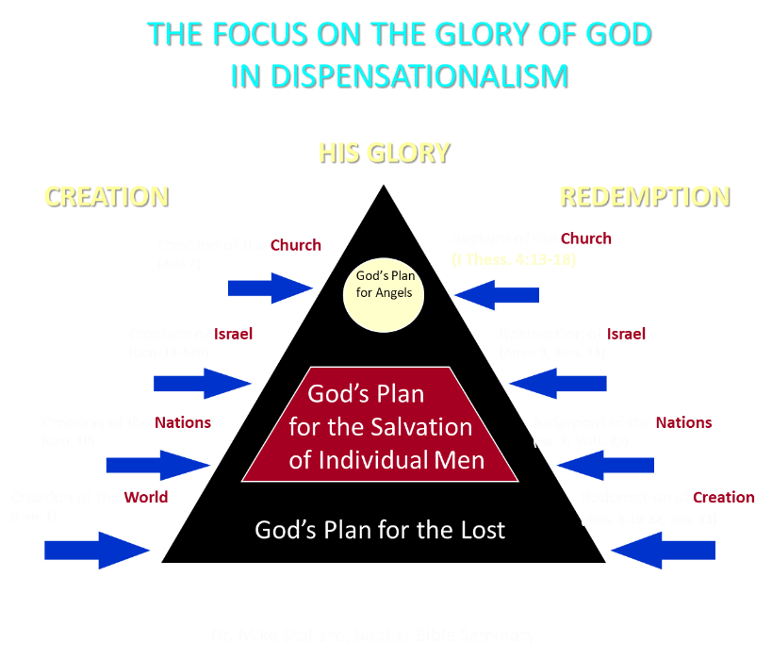

Slide 26
III. Exodus 11:9-10 Conversation Aftermath
God’s prediction (9a)
God’s purpose (9b)
Summary (10a)
Pharaoh’s hardening (10b)

Slide 27
TEN PLAGUES REDEMPTION (7:14–12:30)
Nile to blood
Frogs
Gnats
Flies
Death of livestock
Boils
Hail
Locusts
Darkness
Death of 1st born

Slide 28
The Plagues of Egypt
NO. | DESCRIPTION | SCRIPTURE | Egyptian Deity
1. | Water to Blood | Exod. 7:14-25 | Hapi, Khnum
2. | Frogs | Exod. 8:1-15 | Heqt
3. | Gnats | Exod. 8:16-19 | Set
4. | Flies | Exod. 8:20-32 | Uatchit
5. | Disease on Cattle | Exod. 9:1-7 | Hathor, Apis
6. | Boils | Exod. 9:8-12 | Sekhmet, Serapis
7. | Hail | Exod. 9:13-35 | Seth, Nut
8. | Locusts | Exod. 10:1-20 | Seth, Nut, Osiris
9. | Darkness | Exod. 10:21-29 | Re, Horus, Atum
10. | Death of the First Born | Exod. 12:29-36 | Min, Osiris, Heqt, Isis

Slide 29
III. Exodus 11:9-10 Conversation Aftermath
God’s prediction (9a)
God’s purpose (9b)
Summary (10a)
Pharaoh’s hardening (10b)

Slide 30
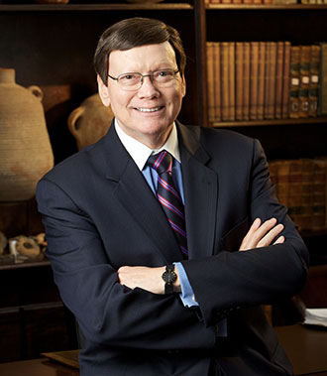
Dr. Ed Hindson
Hindson, E. E., & Mitchell, D. R., eds. (2010). KJV Bible Commentary for Today: The Most Up-to-Date Commentary on the Time-Honored Text of the KJV (p. 86). Thomas Nelson.
“4:21. I will harden his heart. An expression meaning ‘to strengthen his will.’ The text identifies the heart as the location of the volition, man’s decision-making ability. On seven occasions in the narrative, God hardens Pharaoh’s heart (9:12; 10:1, 20, 27; 11:10; 14:4, 8) or foretells that He will harden Pharaoh’s heart (4:21; 7:3), and nine times in the text, Pharaoh hardens his own heart (7:13, 14, 22; 8:15, 19, 32; 9:7, 34–35). For the initial five plagues, the text registers Pharaoh as the agent of hardening. Not until the sixth plague does God participate in the confirmation of Pharaoh’s own volitional choices.”

Slide 31

Charles Ryrie Ryrie Study Bible, page 96
Exodus 4:21 - “harden his heart. Ten times it is said that Pharaoh hardened his own heart (7:13, 14, 22; 8:15, 19, 32; 9:7, 34, 35; 13:15), and 10 times that God hardened Pharaoh’s heart (4:21; 7:3; 9:12; 10:1, 20, 27; 11:10; 14:4, 8, 17). Paul uses this as an example of the inscrutable will of God and of His mercy toward men (Rom. 9:14–18). Seven times Pharaoh hardened his own heart before God first hardened it, though the prediction that God would do it preceded all.”

Slide 32
GOD HARDENING PHARAOH'S HEART
The prediction of God hardening of Pharaoh (4:21)
Pharaoh repeatedly hardening his own heart (7:13, 22; 8:15, 19, 32; 9:7)
Not until the sixth plague did God harden Pharaoh’s heart (Exod 9:12)

Slide 33
Conclusion

Slide 34
DEATH OF FIRST BORN Exodus 11:1-10
Conversation Interrupted (1-3)
Conversation Continued (4-8)
Conversation Aftermath (9-10)

Slide 35
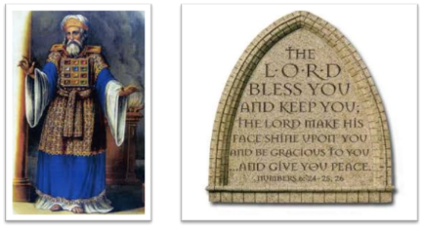
²⁴ The Lord bless you, and keep you; ²⁵ The Lord make His face shine on you, And be gracious to you; ²⁶ The Lord lift up His countenance on you, And give you peace.
Numbers 6:24–26 (NASB95)

