Slide 1
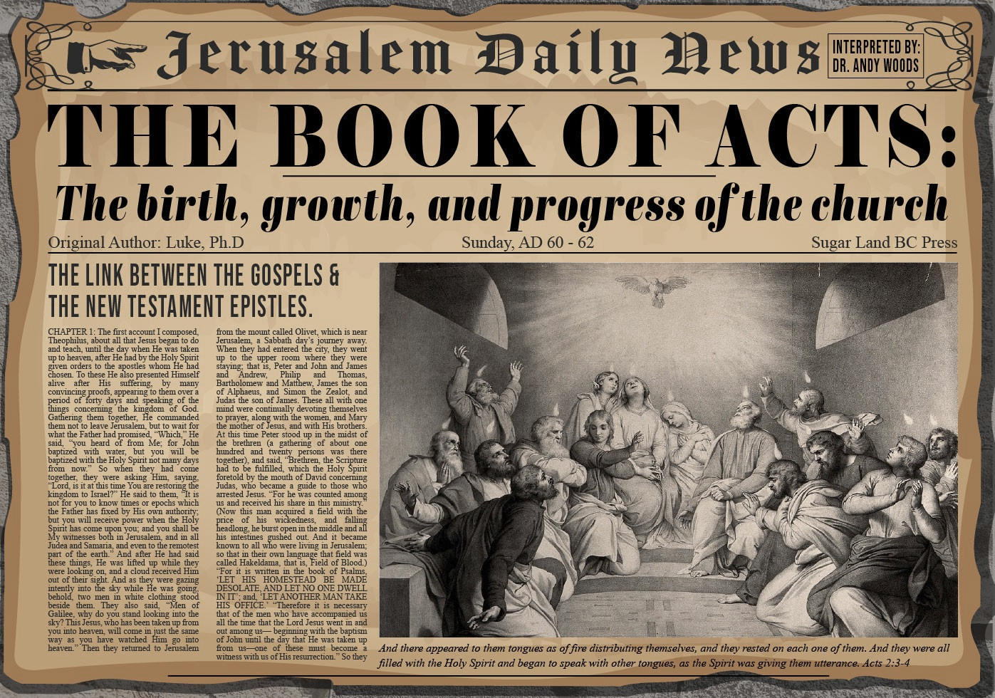


Slide 2
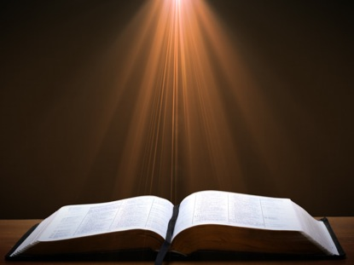
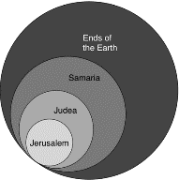
Acts 1:8
“but you will receive power when the Holy Spirit has come upon you; and you shall be My witnesses both in Jerusalem (Acts 1-7), and in all Judea and Samaria (Acts 8-12), and even to the remotest part of the earth (Acts 13-28).”

Slide 3
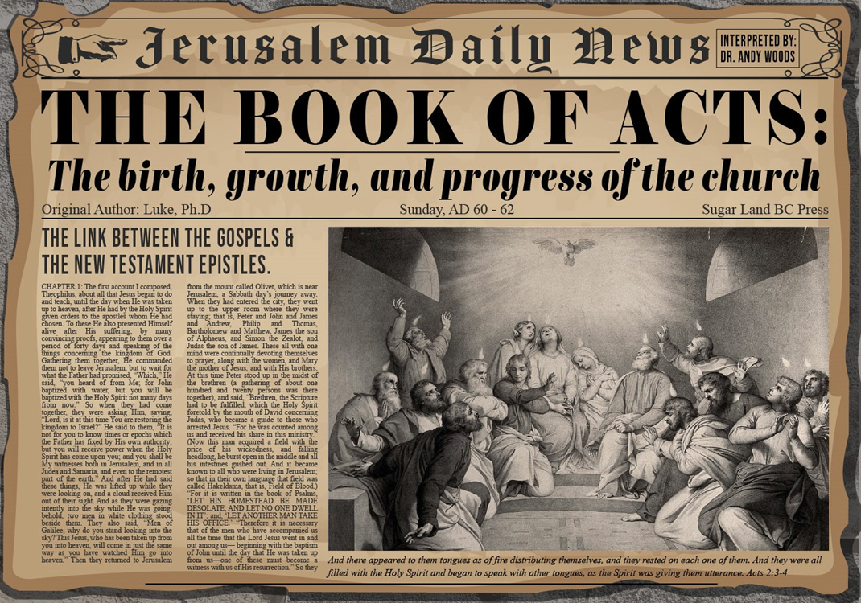
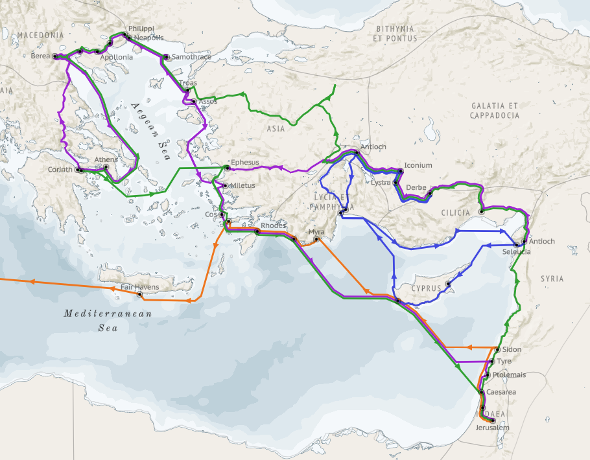
Structure (Acts 1:8)
Jerusalem (Acts 1–7)
Judea and Samaria (Acts 8–12)
Remotest part of the earth (Acts 13–28)
1st missionary journey (Acts 13–14)
Jerusalem council (Acts 15:1-35)
2nd missionary journey (Acts 15:36 –18:22)
3rd missionary journey (Acts 18:23–21:17)
Trip to Rome (Acts 21:18–28:31)

Slide 4
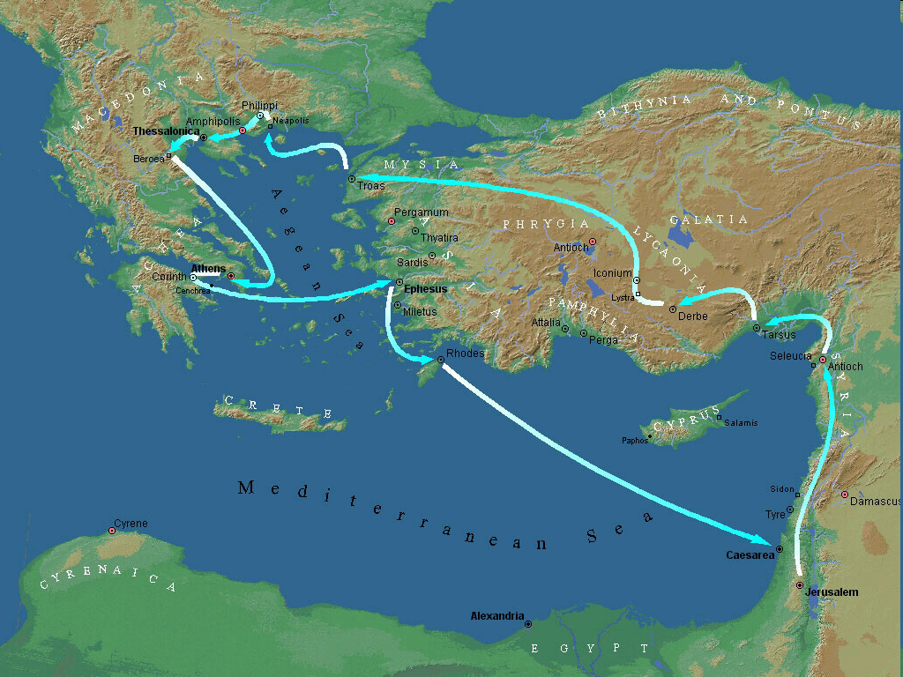
Second Missionary Journey

Slide 5
Acts 15:36‒18:22 2nd Missionary Journey
Schism between Paul & Barnabas (15:36-41)
Syria & Cilicia ministry (16:1-5)
Macedonian call (16:6-10)
Philippian ministry (16:11-40)
Thessalonica ministry (17:1-9)
Berean ministry (17:10-15)
Athens’ ministry (17:16-34)
Corinthian ministry (18:1-18)
Ephesus’ ministry (18:19-21)
Return to Antioch (18:22)

Slide 6
VIII. Corinthian Ministry Acts 18:1-18
Arrival (1-4)
Ministry (5-11)
Paul Before Gallio (12-17)
Paul’s Departure (18)

Slide 7
Acts 18:5-11 Ministry
Silas & Timothy’s report (5a)
Jewish evangelism (5b)
Jewish opposition (6)
Ministry results (7-8)
Divine revelation (9-10)
Ministry duration (11)

Slide 8
Acts 18:9-10 Divine Revelation
Timing (9a)
Content (9b)
Reason (10)

Slide 9
Acts 18:9-10 Divine Revelation
Timing (9a)
Content (9b)
Reason (10)

Slide 10
Acts 18:9-10 Divine Revelation
Timing (9a)
Content (9b)
Reason (10)

Slide 11
Acts 18:9-10 Divine Revelation
Timing (9a)
Content (9b)
Reason (10)

Slide 12
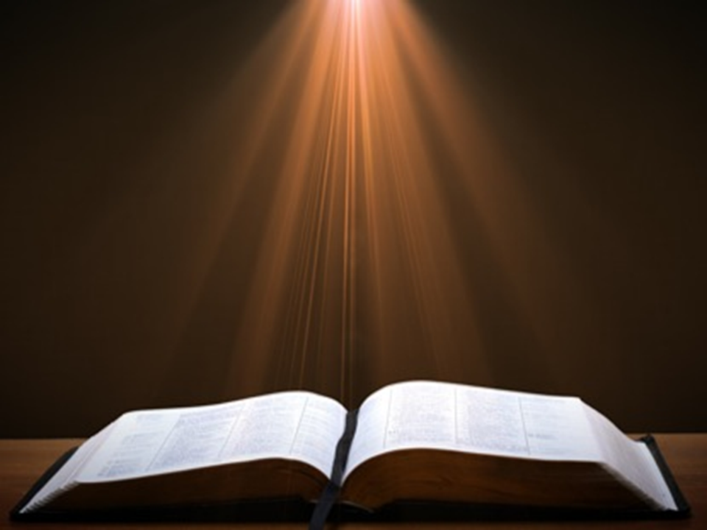

2 Peter 3:9
“The Lord is not slow about His promise, as some count slowness, but is patient toward you, not wishing for any to perish but for all to come to repentance.”

Slide 13
Romans 11:25-26
“²⁵ For I do not want you, brethren, to be uninformed of this mystery—so that you will not be wise in your own estimation—that a partial hardening has happened to Israel until the fullness of the Gentiles has come in; ²⁶ and so all Israel will be saved; just as it is written, ‘The Deliverer will come from Zion, He will remove ungodliness from Jacob.’”

Slide 14
Acts 18:5-11 Ministry
Silas & Timothy’s report (5a)
Jewish evangelism (5b)
Jewish opposition (6)
Ministry results (7-8)
Divine revelation (9-10)
Ministry duration (11)

Slide 15
Reasons for Understanding 1000 Literally
John’s use of indefinite concepts elsewhere
Revelation 20:8, 20:3
Exception to the “# of years” examples?
Other numbers are taken literally
Two witnesses (11:3), 7000 people (11:13), 4 Angels (7:1) 7 Angels (8:6),144,000 Jews (7:4), 42 months (11:2), 1260 days (11:3)
Not always a symbolic interpretation
(Rev. 17:18)

Slide 16


Acts 2:42
“They were continually devoting themselves to the apostles’ teaching and to fellowship, to the breaking of bread and to prayer.”

Slide 17

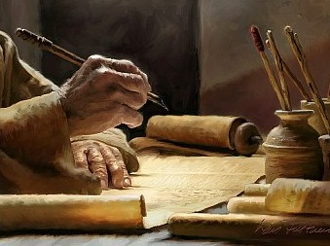
1 Timothy 4:13
“Until I come, give your attention to the public reading, to exhortation, and teaching.”

Slide 18

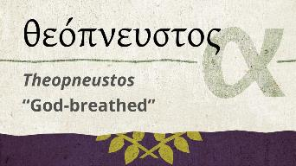
2 Timothy 3:16-17
“All Scripture is inspired by God [theopneustos] and profitable for teaching, for reproof, for correction, for training in righteousness; so that the man of God may be adequate, equipped for every good work.”
Notes:
hapaxlegomena

Slide 19

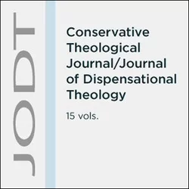
Emphasis of 2 Timothy
“By my count, there are twenty-seven explicit commands given in the body of this letter. In 27 words Paul tells pastors what to focus on. You have to be blind to miss the thrust of Paul's instructions here, because eighteen of those commands--fully two-thirds--have to do with the ministry of the Word.”
Daniel Wallace, “Crisis of the Word: A Message to Pastors or Would-be Pastors,”
Conservative Theological Journal 1, no. 2 (August 1997): 108.

Slide 20
VIII. Corinthian Ministry Acts 18:1-18
Arrival (1-4)
Ministry (5-11)
Paul Before Gallio (12-17)
Paul’s Departure (18)

Slide 21
Acts 18:12-17 Paul Before Gallio
Opposition (12-13)
Gallio’s decision (14-15)
Judgment’s results (16-17)

Slide 22
Acts 18:12-17 Paul Before Gallio
Opposition (12-13)
Gallio’s decision (14-15)
Judgment’s results (16-17)

Slide 23
Acts 18:12-13 Opposition
Circumstances (12)
Charge (13)

Slide 24
Acts 18:12-13 Opposition
Circumstances (12)
Charge (13)

Slide 25
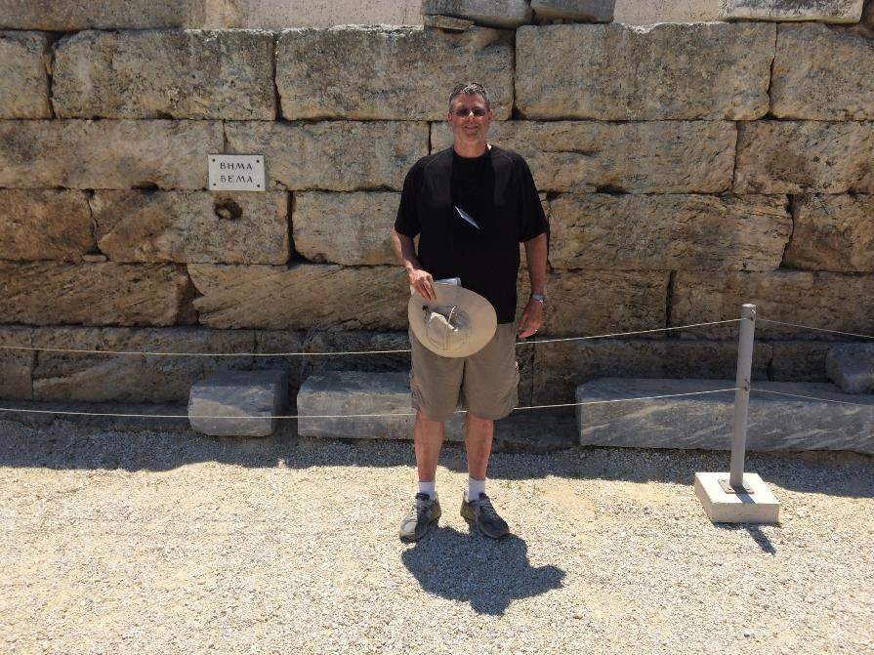

Slide 26
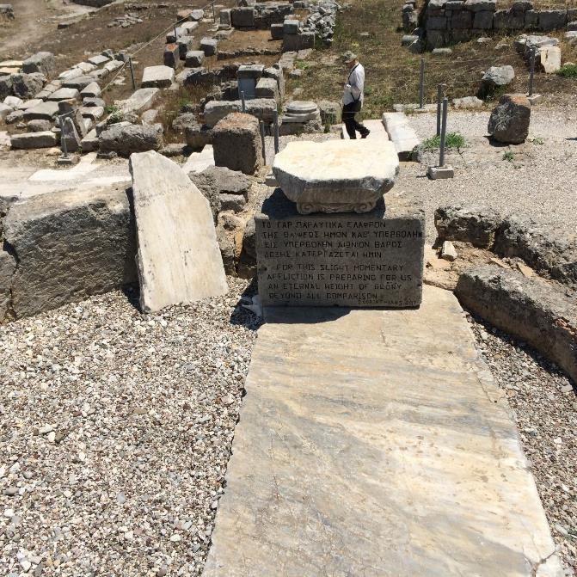

Slide 27

1 Corinthians 3:10-15
“¹⁰ According to the grace of God which was given to me, like a wise master builder I laid a foundation, and another is building on it. But each person must be careful how he builds on it. ¹¹ For no one can lay a foundation other than the one which is laid, which is Jesus Christ. ¹² Now if anyone builds on the foundation with gold, silver, precious stones, wood, hay, or straw. ¹³ each one’s work will become evident; for the day will show it because it is to be revealed with fire, and the fire itself will test the . . .

Slide 28
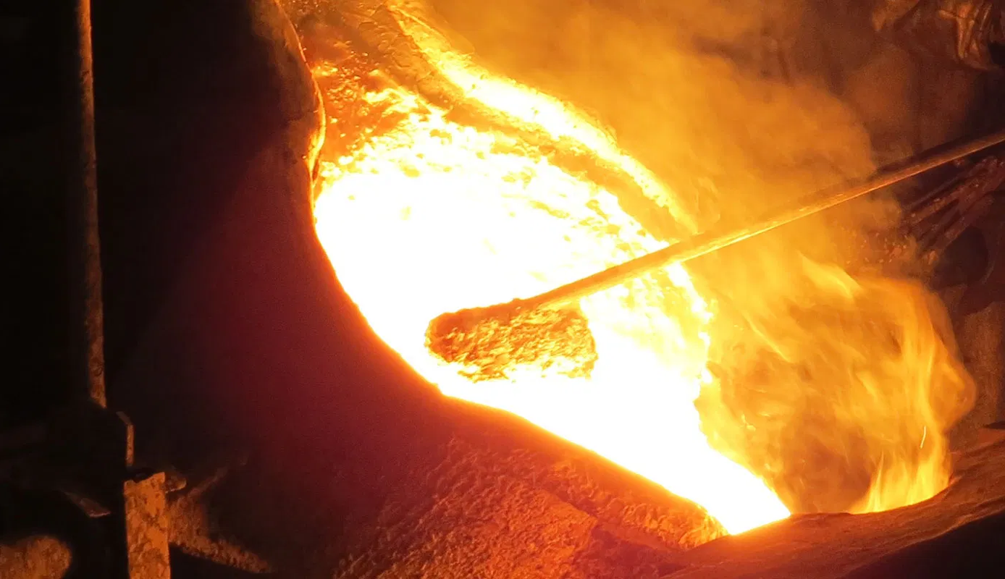
1 Corinthians 3:10-15
…quality of each one’s work. ¹⁴ If anyone’s work which he has built on it remains, he will receive a reward. ¹⁵ If anyone’s work is burned up, he will suffer loss; but he himself will be saved, yet only so as through fire.”

Slide 29
1 Corinthians 4:5
“Therefore do not go on passing judgment before the time, but wait until the Lord comes who will both bring to light the things hidden in the darkness and disclose the motives of men’s hearts; and then each man’s praise will come to him from God.”

Slide 30

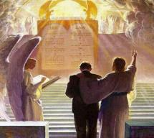
2 Corinthians 5:10
“For we must all appear before the judgment seat of Christ, so that each one may be recompensed for his deeds in the body, according to what he has done, whether good or bad.”

Slide 31

1 Corinthians 9:24-27
“²⁴ Do you not know that those who run in a race all run, but only one receives the prize? Run in such a way that you may win. ²⁵ Everyone who competes in the games exercises self-control in all things. They then do it to receive a perishable wreath, but we an imperishable. ²⁶ Therefore I run in such a way, as not without aim; I box in such a way, as not beating the air; ²⁷ but I discipline my body and make it my slave, so that, after I have preached to others, I myself will not be disqualified.”

Slide 32
Scripture’s Five Crowns (Rev 4:10: 3:11; 2 John 8)
SCRIPTURE | CROWN | PURPOSE
1 Cor. 9:24-27 | Incorruptible | Gaining mastery over the flesh
1 Thess. 2:19-20 | Rejoicing | Soul winning
Jas. 1:12; Rev. 2:10 | Life | Enduring trials
1 Pet. 5:2-4 | Glory | Shepherding God’s people
2 Tim. 4:8 | Righteousness | Longing for His appearing

Slide 33
SCRIPTURE’S FOUR JUDGMENTS
NAME | SHEEP AND GOAT | JUDGMENT OF THE JEWS | BEMA SEAT | GREAT WHITE THRONE
SCRIPTURE | Matt 25:31-46 | Ezek 20:33-44 | 1 Cor 3:10-15 | Rev 20:11-15
PLACE | Earth, Jerusalem | Earth, wilderness | Heaven | Earth
AUDIENCE | Gentile Tribulation survivors | Jewish Tribulation survivors | Church Age believers | All unsaved
WHEN | After Tribulation | After Tribulation | After rapture | After Millennium
PURPOSE | Saved Gentiles enter kingdom | Saved Jews enter kingdom | Reward believers | Degree of punishment in hell
EVALUATION | Treatment of Christ’s brethren | Passing under shepherd’s rod | Works taken through fire | Not in the book; judged by books

Slide 34
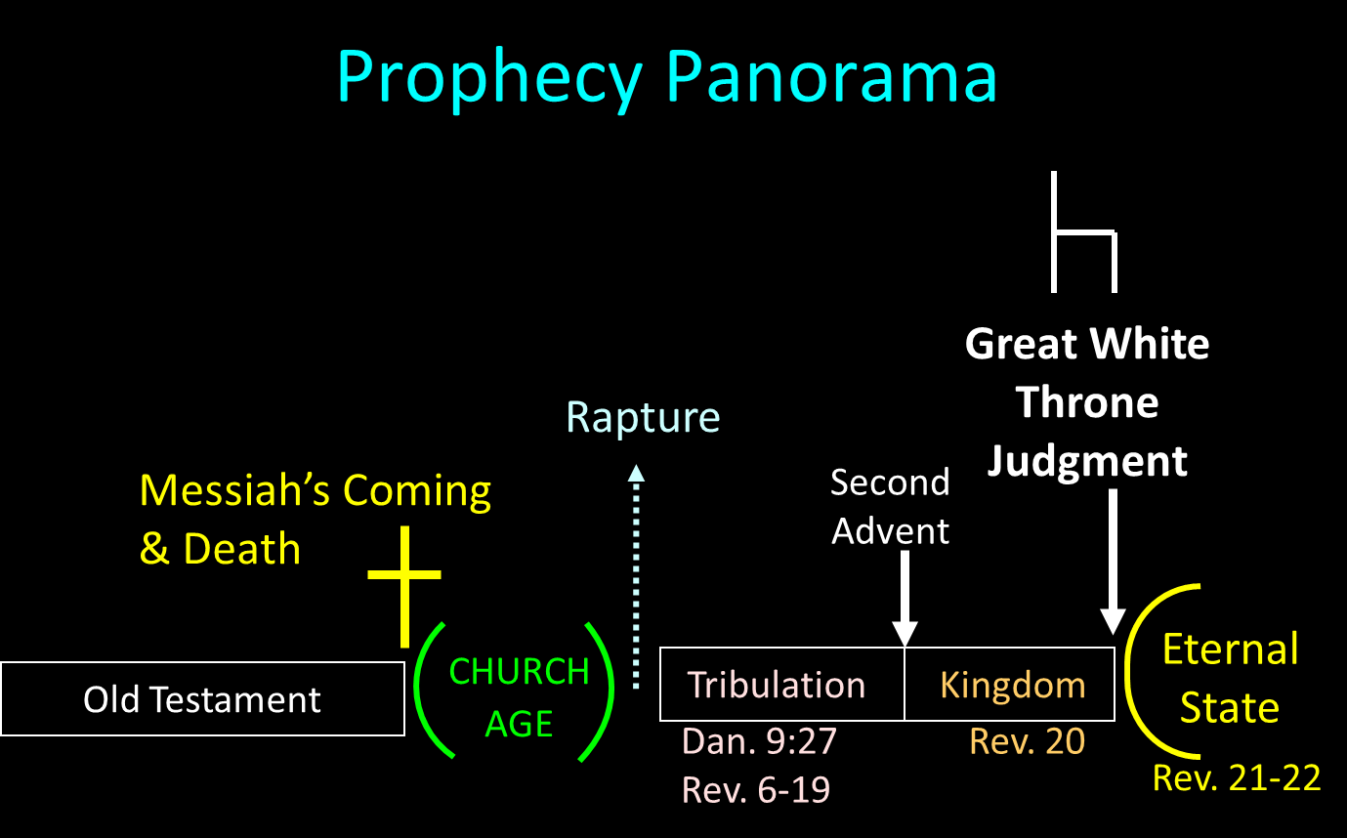

Slide 35

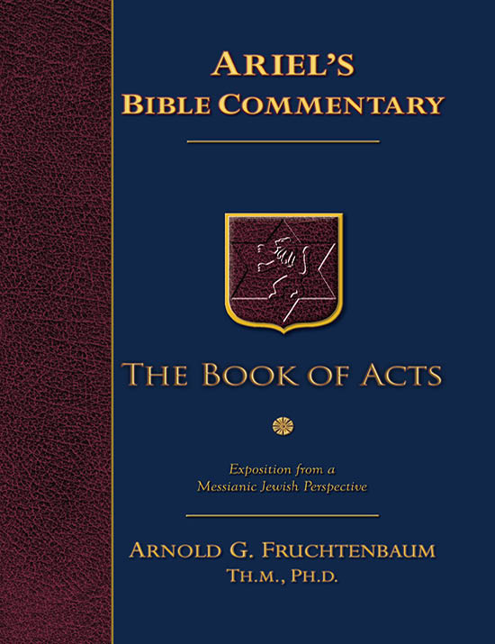
Dr. Arnold G. Fruchtenbaum
The Book of Acts, 381
“The existence of this proconsul is well documented outside the Scriptures. Gallio’s father was Seneca the Elder (ca. 50 B.C. – ca. A.D. 40), a famous Roman rhetorician from the Iberian Peninsula. Gallio had two brothers, one of whom was Lucius Annaeus Seneca (ca. 4 B.C. – A.D. 65). Better known as Seneca the Younger, this brother was the Stoic philosopher, statesman, orator, and writer, who tutored Emperor Nero. Gallio was born in Cordova (Cordoba) around the year 5 B.C. He was originally named Lucius Annaeus Novatus, but assumed the name Gallio after his adoption by the senator L. Junius Gallio.”

Slide 36
Dr. Arnold G. Fruchtenbaum
The Book of Acts, 381
“He served as proconsul of Achaia, as mentioned in this verse, for only two years, in A.D. 51–52. Seneca the Younger said of him: ‘No mortal is so pleasant to any one person as Gallio is to everybody.’ Emperor Claudius referred to Gallio as ‘my friend and proconsul’ in the Delphi Inscription, a collection of nine fragments of a letter written by Claudius in ca. A.D. 52. Hence, this man’s name and the fact that he was proconsul in Achaia is recorded elsewhere. In the year A.D. 65, Emperor Nero, in one of his fits of madness, forced Seneca the Younger to commit suicide. It seems that Gallio followed suit shortly after. It was this man before whom Paul was now brought by the opposition.”

Slide 37
Acts 18:12-13 Opposition
Circumstances (12)
Charge (13)

Slide 38
Acts 18:12-17 Paul Before Gallio
Opposition (12-13)
Gallio’s decision (14-15)
Judgment’s results (16-17)

Slide 39
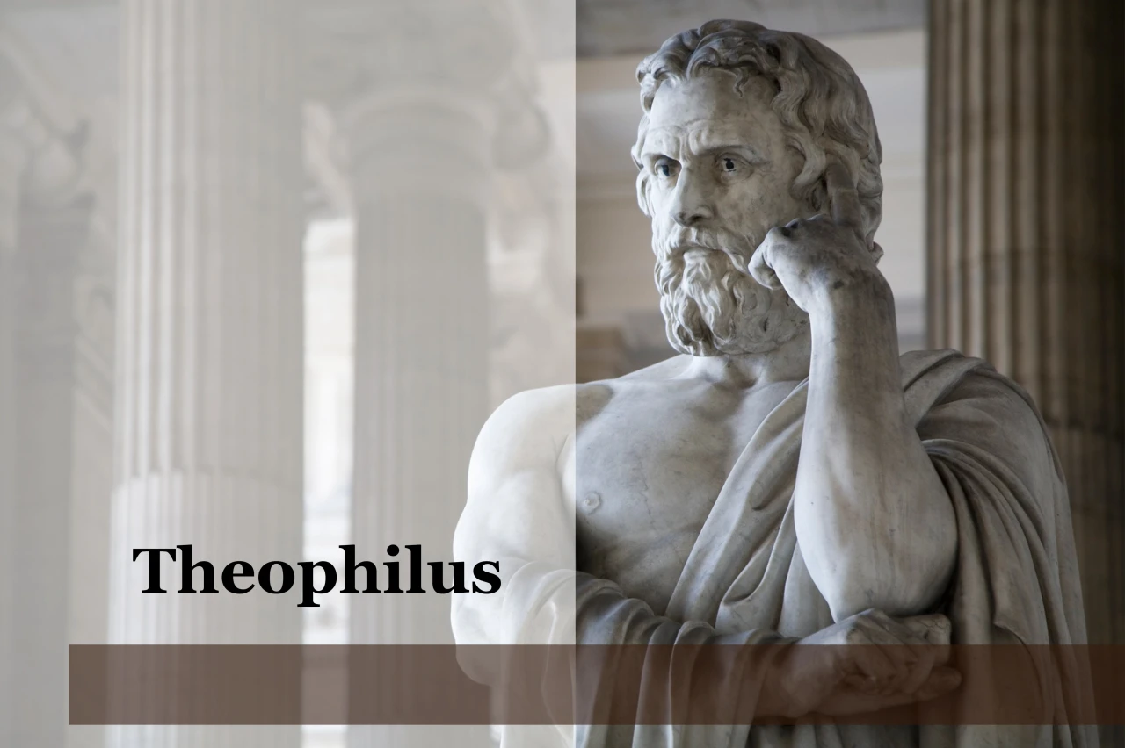
Purpose
To present Theophilus with an orderly account of the birth and growth of the church so as to affirm him in what he has believed.

Slide 40

Message
Birth and growth of the church numerically, geographically, ethnically.
Components
Numerically (progress reports)
Geographically (From Jerusalem to Rome)
Ethnically (From Judaism to Gentile domination)

Slide 41

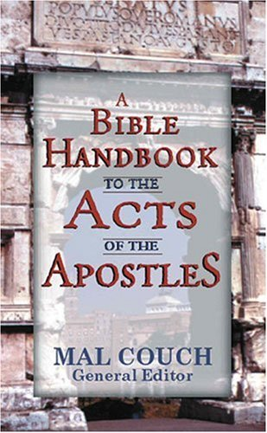
Dr. Mal Couch
Couch, A Bible Handbook to the Acts of the Apostles, 348
“Gallio’s actions in the book of Acts will have profound effect on the growth of Christianity in the Roman world by postponing official persecution... [His] refusal to indict Paul has ramifications throughout the Empire. Had he sided with the Jewish leaders and proclaimed Christianity a new religion, it would be illegal under Roman law. A precedent would have been set that could outlaw the church at a time it is still weak and vulnerable. His refusal to indict Paul protects the preaching of Christianity for a time.”

Slide 42
Acts 18:12-17 Paul Before Gallio
Opposition (12-13)
Gallio’s decision (14-15)
Judgment’s results (16-17)

Slide 43
Acts 18:16-17 Judgment’s Results
Case dismissed (16)
Attack on the Jews (17a)
Gallio’s indifference (17b)

Slide 44
Acts 18:16-17 Judgment’s Results
Case dismissed (16)
Attack on the Jews (17a)
Gallio’s indifference (17b)

Slide 45
Acts 18:16-17 Judgment’s Results
Case dismissed (16)
Attack on the Jews (17a)
Gallio’s indifference (17b)

Slide 46
Acts 18:16-17 Judgment’s Results
Case dismissed (16)
Attack on the Jews (17a)
Gallio’s indifference (17b)

Slide 47
VIII. Corinthian Ministry Acts 18:1-18
Arrival (1-4)
Ministry (5-11)
Paul Before Gallio (12-17)
Paul’s Departure (18)

Slide 48
Acts 18:18 Paul’s Departure
Additional ministry (18a)
Return to Jerusalem (18b)
Nazirite vow (18c)

Slide 49
Acts 18:18 Paul’s Departure
Additional ministry (18a)
Return to Jerusalem (18b)
Nazirite vow (18c)

Slide 50
Acts 18:18 Paul’s Departure
Additional ministry (18a)
Return to Jerusalem (18b)
Nazirite vow (18c)

Slide 51
Second Missionary Journey

Slide 52
Acts 18:18 Paul’s Departure
Additional ministry (18a)
Return to Jerusalem (18b)
Nazirite vow (18c)

Slide 53
Second Missionary Journey

Slide 54
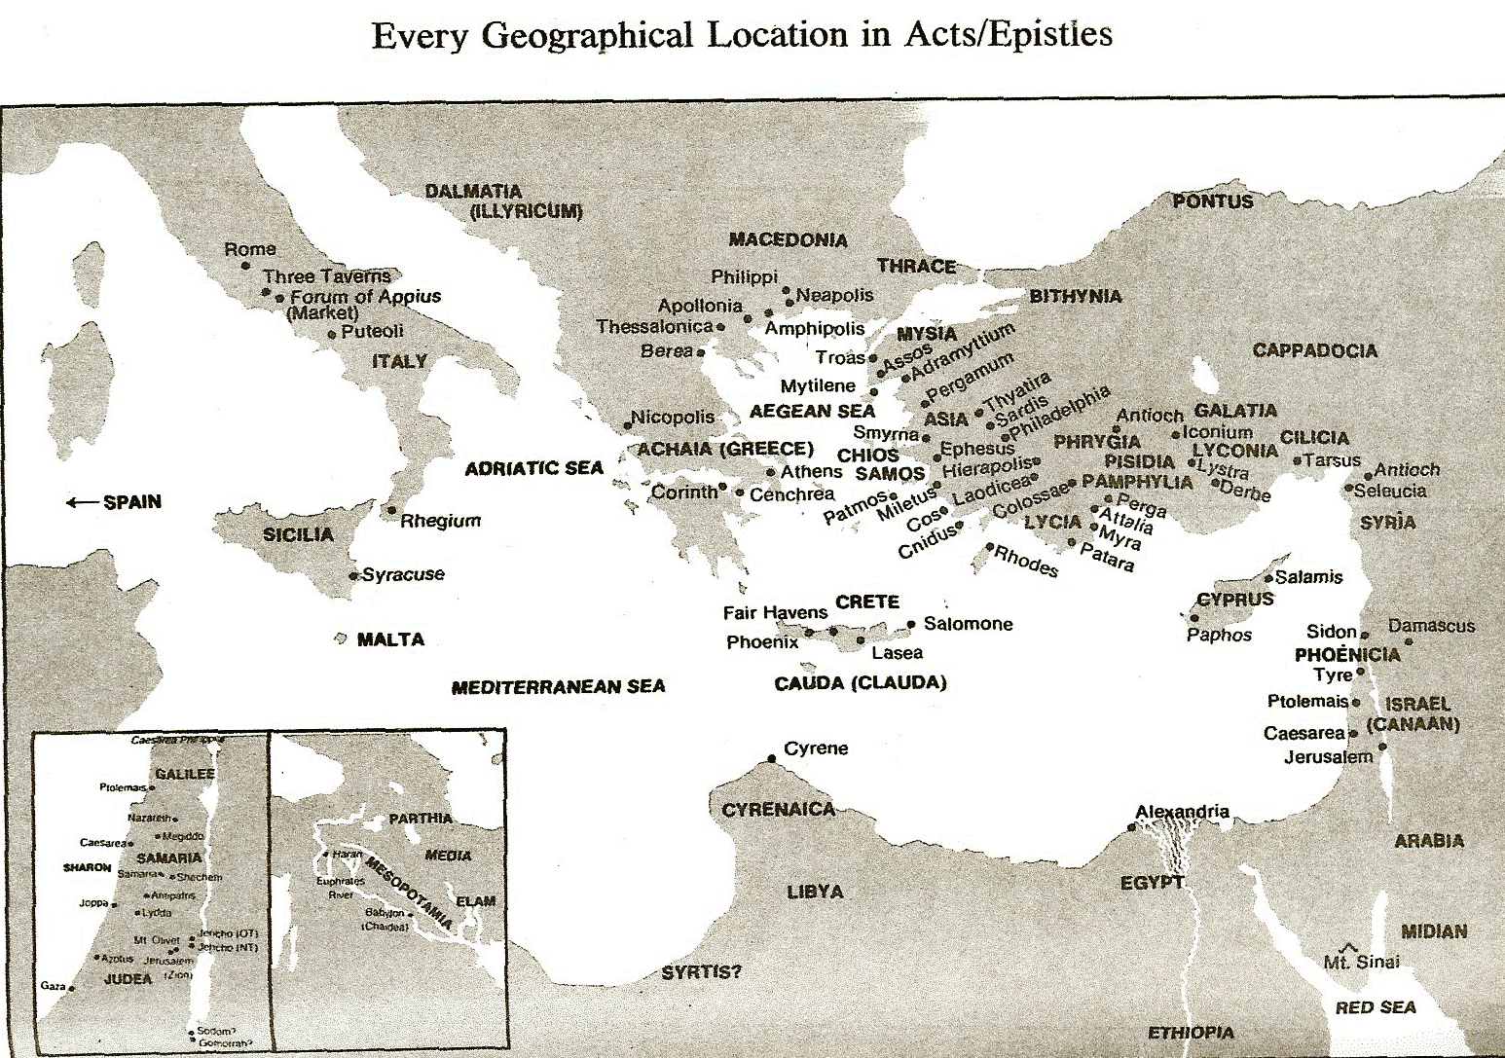

Slide 55
Dr. Arnold G. Fruchtenbaum
The Book of Acts, 374-75
“Freedom from the Mosaic Law means two things: First, it means believers are free from the obligation to obey any of the 613 commandments; but second, freedom from the law also means that they are free to observe those things that they choose to observe as long as they do not contradict the laws of Messiah. Paul saw no contradiction between keeping Jewish customs and living his new faith…The difference between Paul and the Judaizers was that the Judaizers tried to impose these things upon the Gentile believers. While choosing to practice many Jewish customs, Paul refused to impose them on the Gentiles.”

Slide 56
Conclusion

Slide 57
VIII. Corinthian Ministry Acts 18:1-18
Arrival (1-4)
Ministry (5-11)
Paul Before Gallio (12-17)
Paul’s Departure (18)

Slide 58
Acts 15:36‒18:22 2nd Missionary Journey
Schism between Paul & Barnabas (15:36-41)
Syria & Cilicia ministry (16:1-5)
Macedonian call (16:6-10)
Philippian ministry (16:11-40)
Thessalonica ministry (17:1-9)
Berean ministry (17:10-15)
Athens’ ministry (17:16-34)
Corinthian ministry (18:1-18)
Ephesus’ ministry (18:19-21)
Return to Antioch (18:22)

