Slide 1

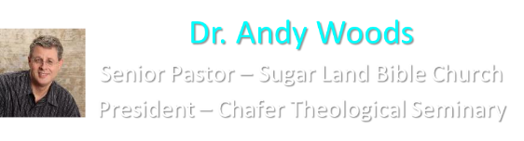

Slide 2

EXODUS STRUCTURE/OUTLINE
Redemption (1–18)
  Redemption (1:1–12:30)
  Liberation (12:31–15:21)
  Preservation (15:22–18:27)
Mosaic Covenant (19–40)
  Law (19–24)
  Tabernacle instructions (25–31)
  Apostasy (32–34)
  Tabernacle building (35–40)

Slide 3
REDEMPTION
(1:1–12:30)
Why redemption is necessary (Exod 1)
Development of the deliverer (Exod 2–4)
First confrontation with Pharaoh (Exod 5)
God reassures Moses (Exod 6:1–7:7)
Second confrontation with Pharaoh (Exod 7:8-13)
Plagues (Exod 7:14–12:30)

Slide 4
The Plagues of Egypt
NO. | DESCRIPTION | SCRIPTURE | Egyptian Deity
1. | Water to Blood | Exod. 7:14-25 | Hapi, Khnum
2. | Frogs | Exod. 8:1-15 | Heqt
3. | Gnats | Exod. 8:16-19 | Set
4. | Flies | Exod. 8:20-32 | Uatchit
5. | Disease on Cattle | Exod. 9:1-7 | Hathor, Apis
6. | Boils | Exod. 9:8-12 | Sekhmet, Serapis
7. | Hail | Exod. 9:13-35 | Seth, Nut
8. | Locusts | Exod. 10:1-20 | Seth, Nut, Osiris
9. | Darkness | Exod. 10:21-29 | Re, Horus, Atum
10. | Death of the First Born | Exod. 12:29-36 | Min, Osiris, Heqt, Isis

Slide 5
TEN PLAGUES REDEMPTION (7:14–12:30)
Nile to blood
Frogs
Gnats
Flies
Death of livestock
Boils
Hail
Locusts
Darkness
Death of 1st born

Slide 6
DEATH OF FIRST BORN
Exodus 11:1-10
  Conversation Interrupted (1-3)
  Conversation Continued (4-8)
  Conversation Aftermath (9-10)

Slide 7
DEATH OF FIRST BORN
Exodus 11:1-10
  Conversation Interrupted (1-3)
  Conversation Continued (4-8)
  Conversation Aftermath (9-10)

Slide 8
I. Exodus 11:1-3
Conversation Interrupted
    Plague (1)
    Plundering (2)
    Favor (3)

Slide 9
I. Exodus 11:1-3
Conversation Interrupted
    Plague (1)
    Plundering (2)
    Favor (3)

Slide 10
Exodus 11:1
Plague
      Liberation (1a)
      Permanence (1b)

Slide 11
Exodus 11:1
Plague
      Liberation (1a)
      Permanence (1b)

Slide 12
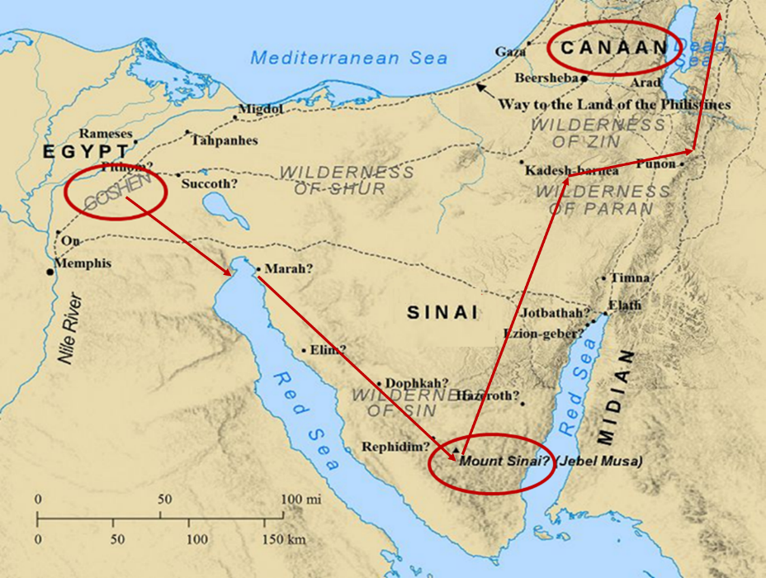

Slide 13
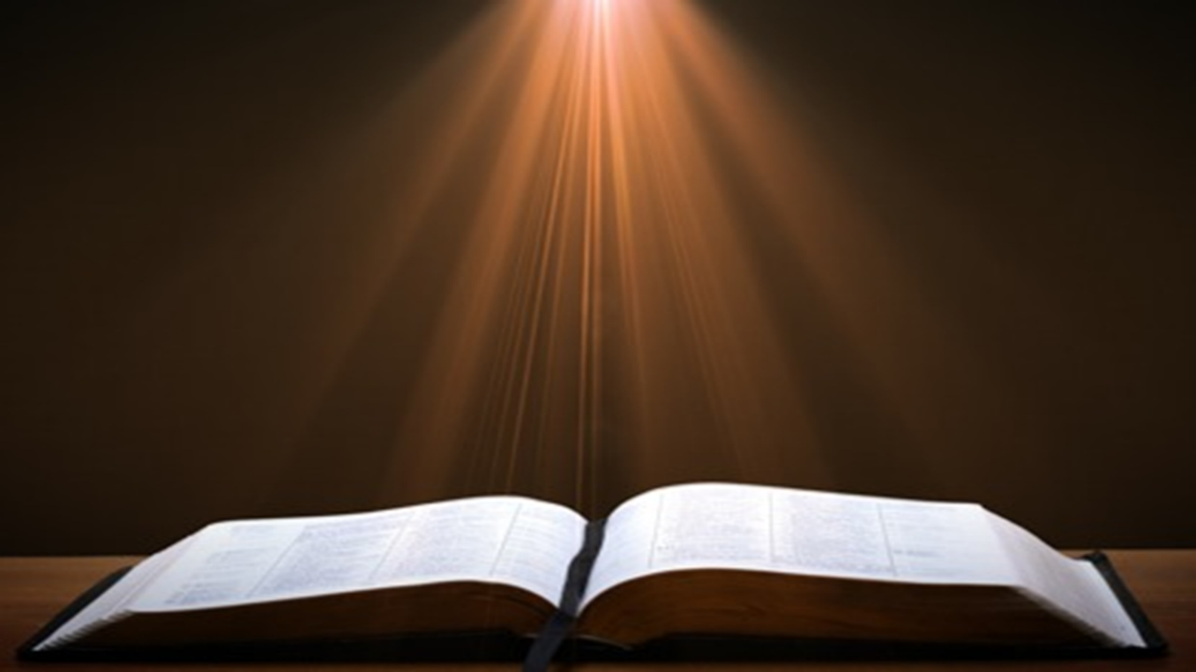
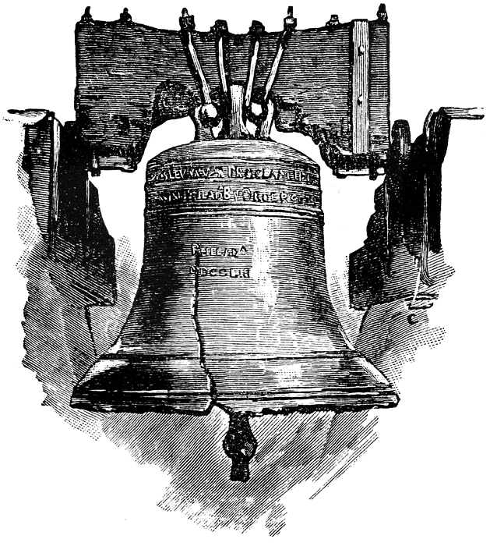
Leviticus 25:10
“And you shall consecrate the fiftieth year, and proclaim liberty throughout [all] the land to all its inhabitants. It shall be a Jubilee for you; and each of you shall return to his possession, and each of you shall return to his family.”

Slide 14
Exodus 11:1
Plague
      Liberation (1a)
      Permanence (1b)

Slide 15
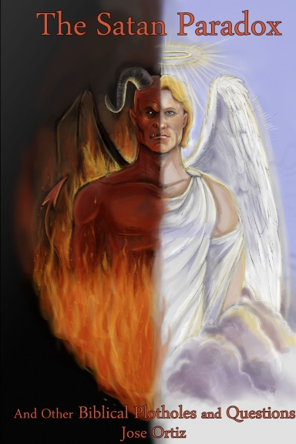
Names & Titles Demonstrating Satan’s Post-Fall, Earthly Authority
(Job 1:7; 2:2; Luke 4:5-8; Rom. 8:19-22)
Prince of this world (John 12:31; 14:30; 16:11)
God of this world (2 Cor. 4:4)
Prince and power of the air (Eph. 2:2)
Who the believer wrestles with (Eph. 6:12)
Roaring lion (1 Pet. 5:8)
Whole world lies in his power (1 John 5:19)

Slide 16
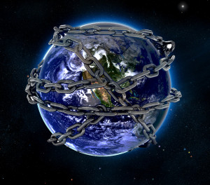

Slide 17
Ultimate Exodus
(Rev 11:15)
Sores: 6th plague (Ex 9:8-12), 1st bowl (Rev 16:1-2)
Rivers to blood: 1st plague (Ex 7:19-21), 3rd bowl (Rev 16:4-7)
Darkness: 9th plague (Ex 10:21-23), 5th bowl (Rev 16:10-11)
Frogs: 2nd plague (Ex 7:25‒8:15), 6th bowl (Rev 16:13)
Hail: 7th plague (Ex 9:22-26), 7th bowl (Rev 16:17-21)

Slide 18
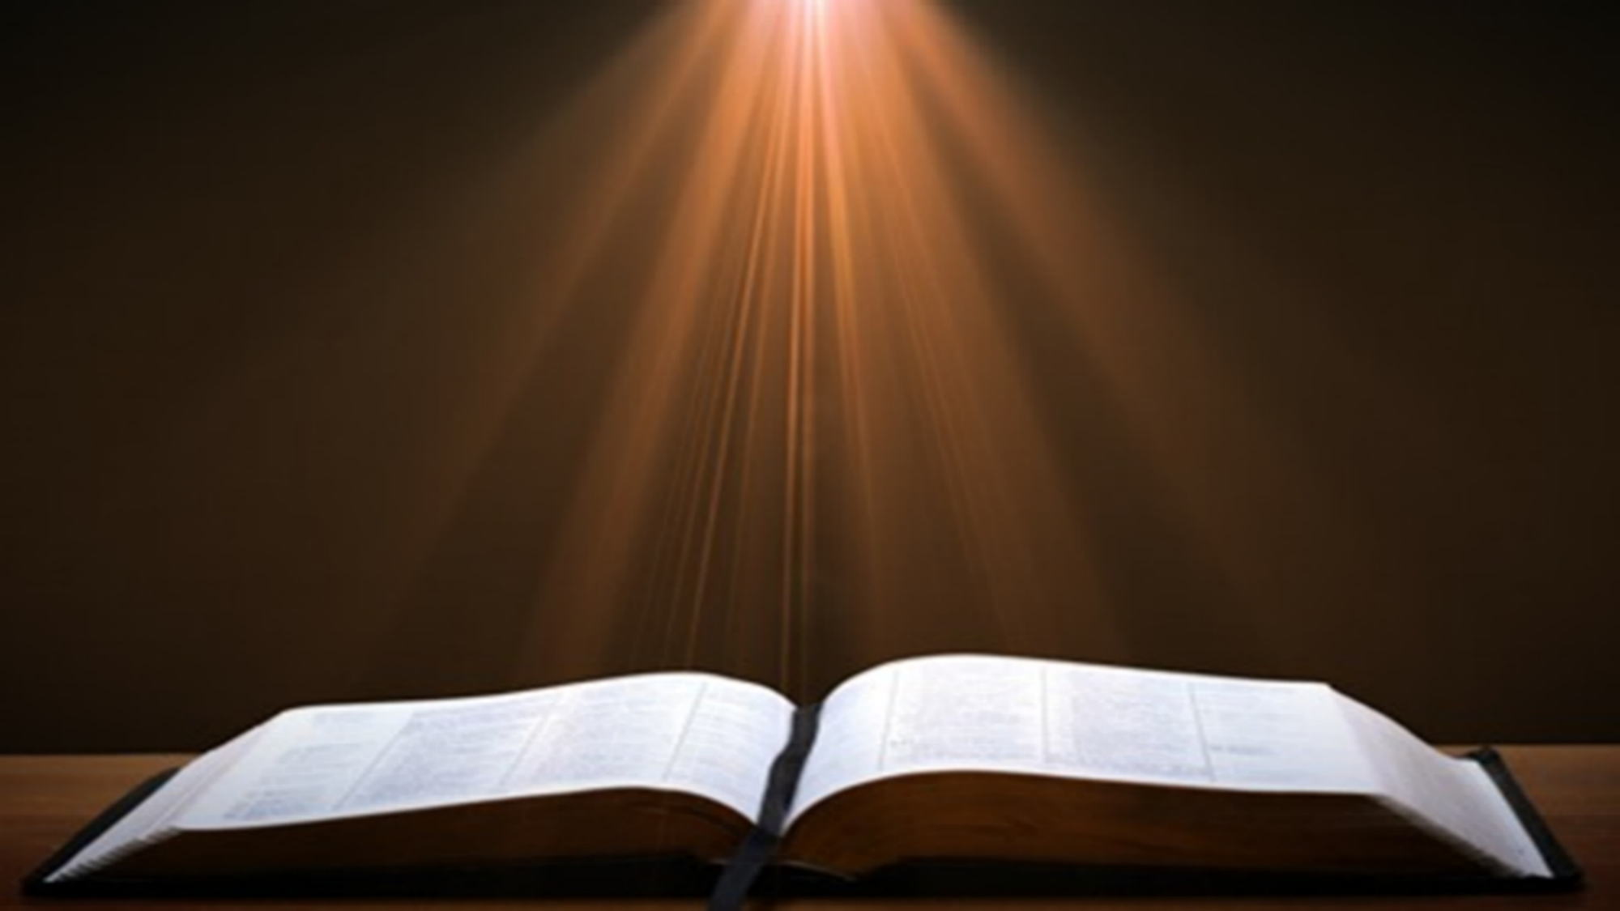
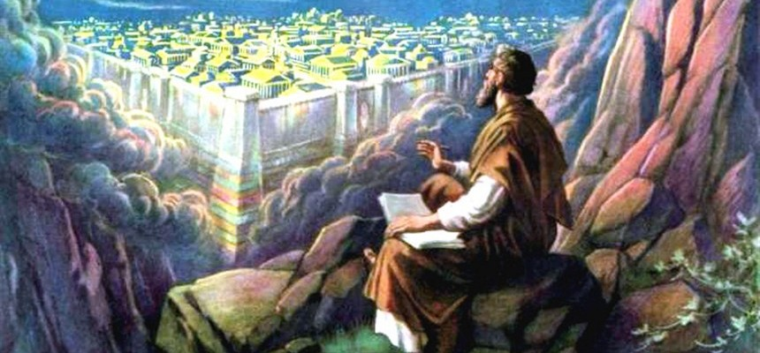
Revelation 11:15
¹⁵ “Then the seventh angel sounded; and there were loud voices in heaven, saying, ‘The kingdom of the world has become the kingdom of our Lord and of His Christ; and He will reign forever and ever.’”

Slide 19
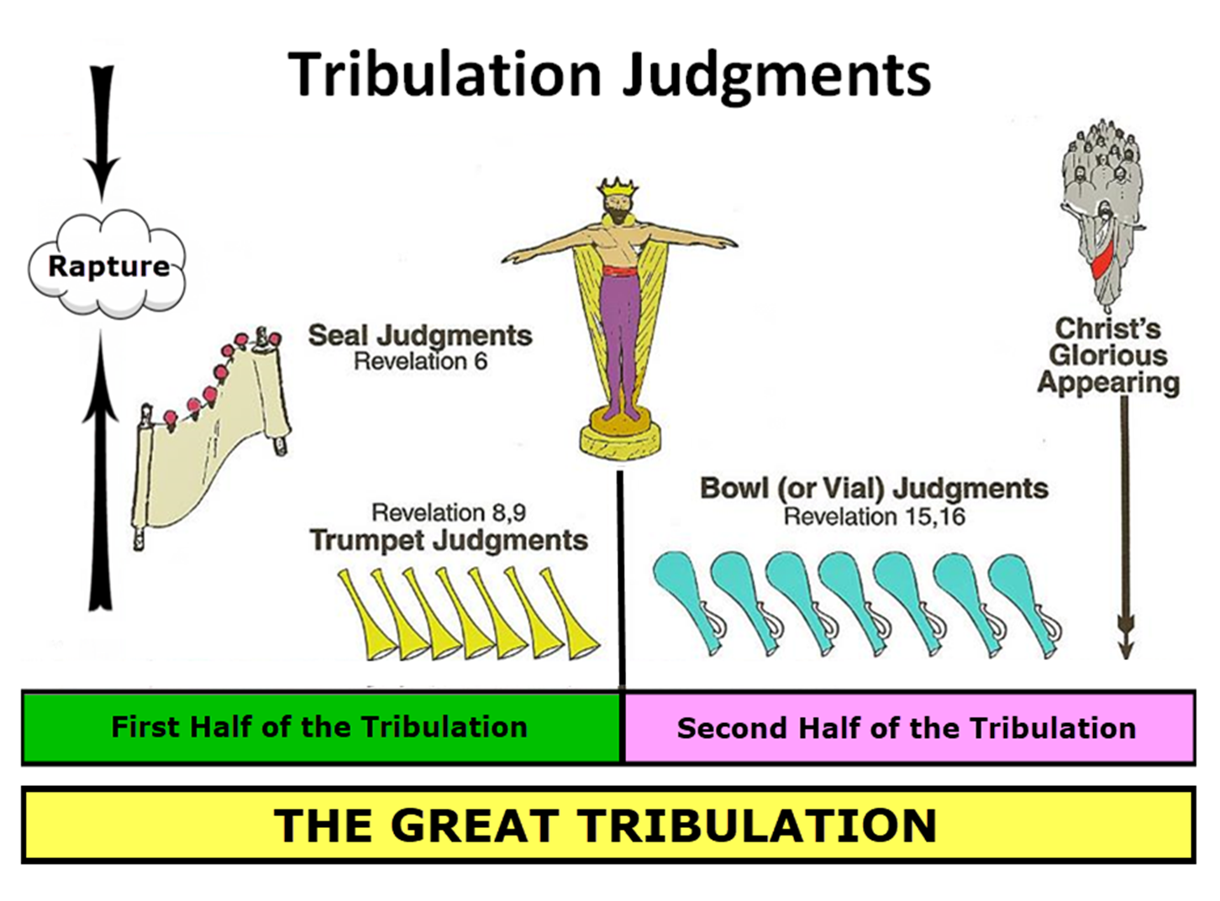

Slide 20
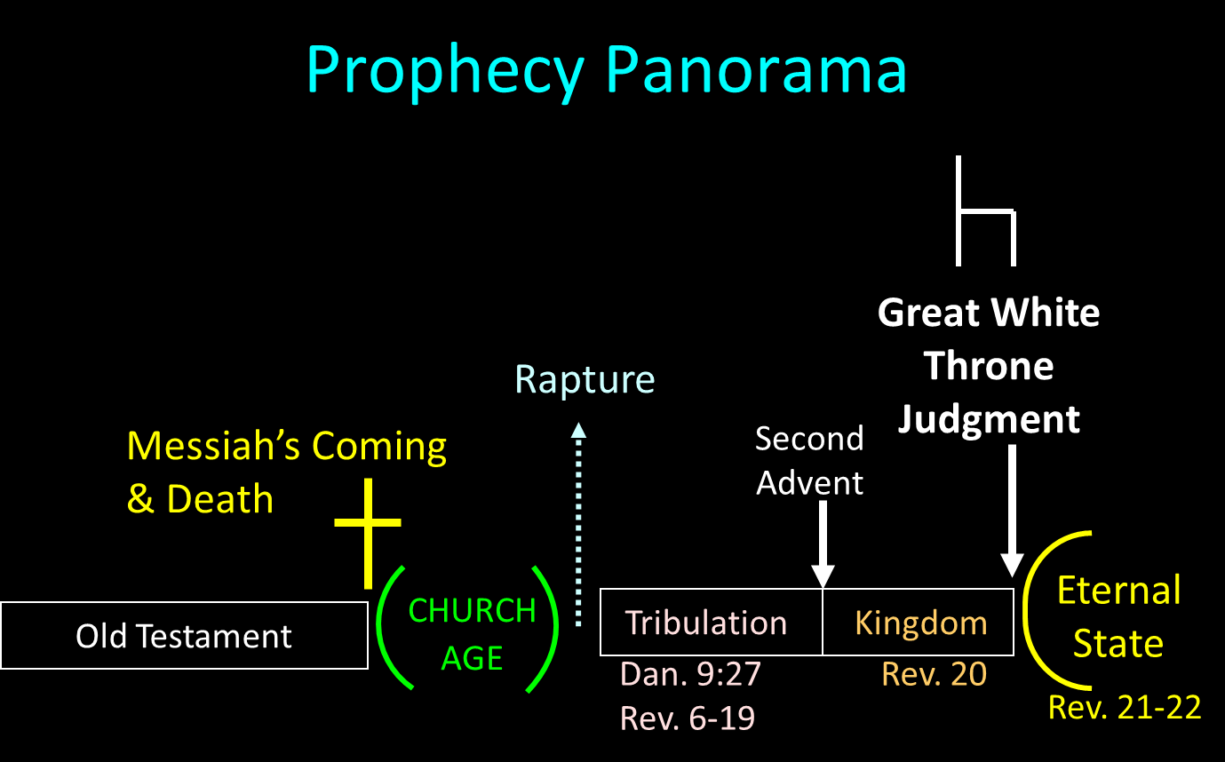

Slide 21
I. Exodus 11:1-3
Conversation Interrupted
    Plague (1)
    Plundering (2)
    Favor (3)

Slide 22
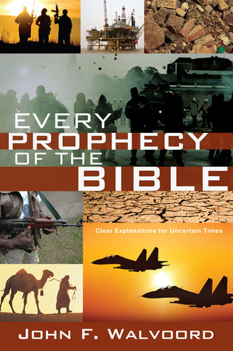

Slide 23


John 13:19; 14:29
“¹⁹ From now on I am telling you before it comes to pass, so that when it does occur, you may believe that I am He… ^{14:29} Now I have told you before it happens, so that when it happens, you may believe.”

Slide 24
I. Exodus 11:1-3
Conversation Interrupted
    Plague (1)
    Plundering (2)
    Favor (3)

Slide 25
Exodus 11:3
Favor
      For Israel (3a)
      For Moses (3b)

Slide 26
Exodus 11:3
Favor
      For Israel (3a)
      For Moses (3b)

Slide 27
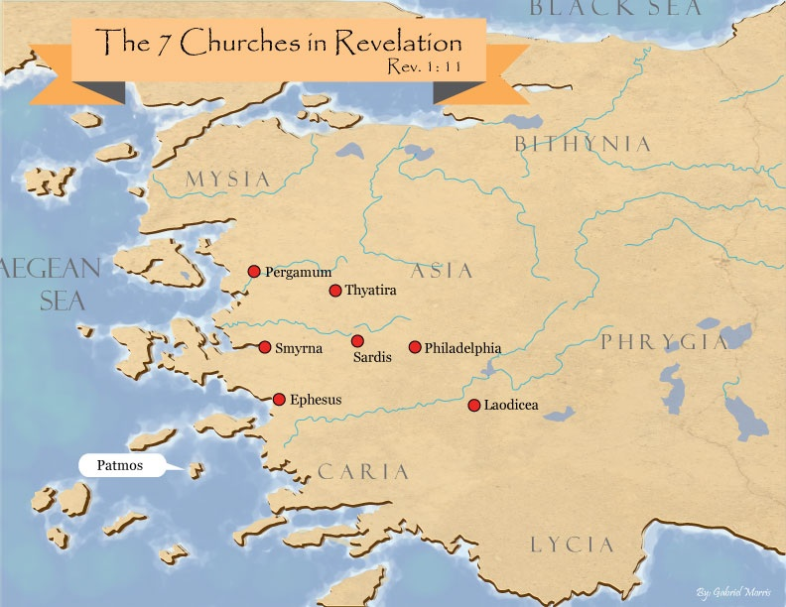
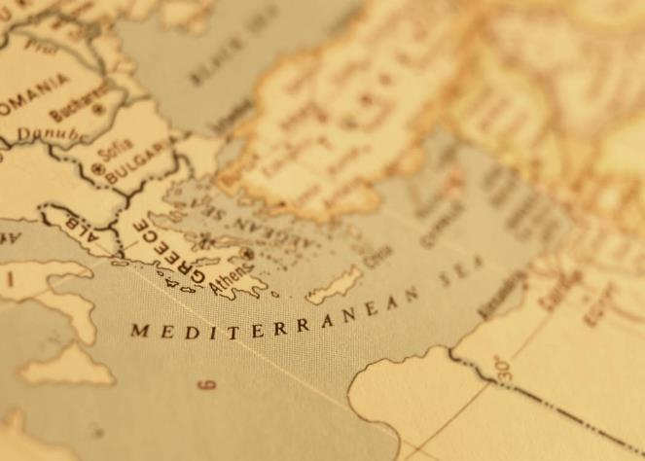

Slide 28
Exodus 11:3
Favor
      For Israel (3a)
      For Moses (3b)

Slide 29
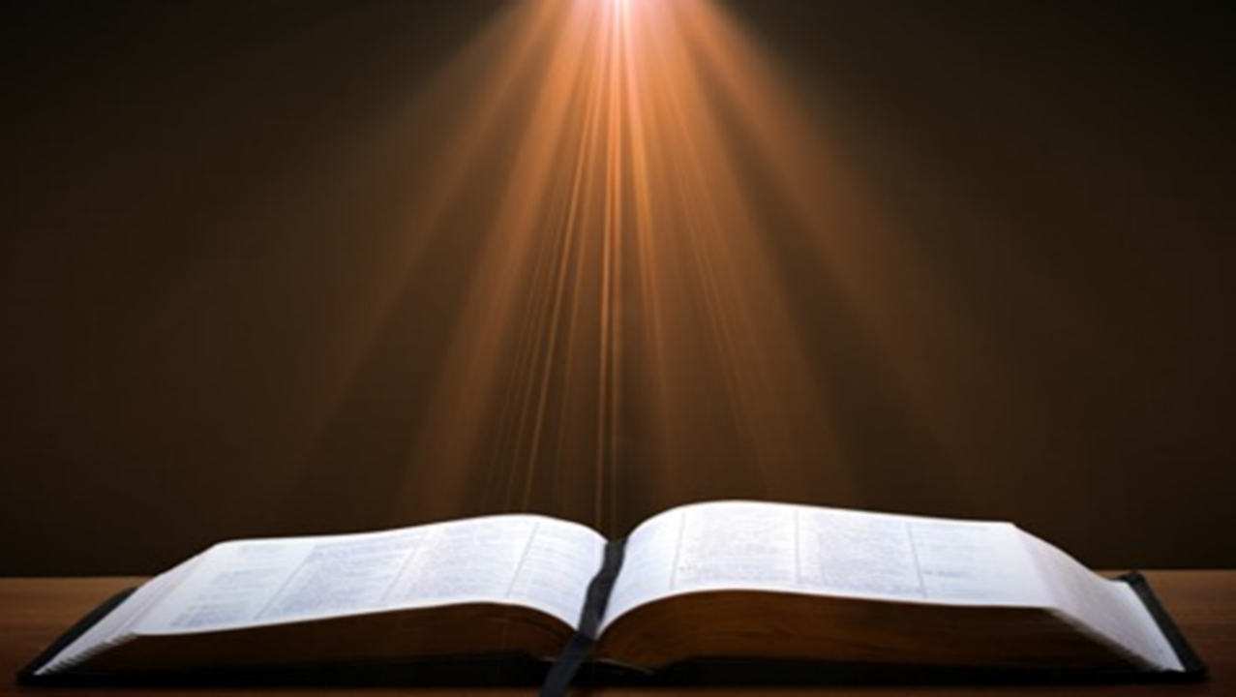
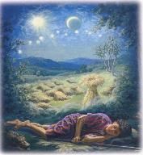
Genesis 37:9
“Now he had still another dream, and related it to his brothers, and said, ‘Lo, I have had still another dream; and behold, the sun and the moon and eleven stars were bowing down to me.’”

Slide 30
Genesis 37:10
“He related it to his father and to his brothers; and his father rebuked him and said to him, ‘What is this dream that you have had? Shall I and your mother and your brothers actually come to bow ourselves down before you to the ground?’”

Slide 31
DEATH OF FIRST BORN
Exodus 11:1-10
  Conversation Interrupted (1-3)
  Conversation Continued (4-8)
  Conversation Aftermath (9-10)

Slide 32
II. Exodus 11:4-8
Conversation Continued
    Plague predicted (4-8c)
    Conversation terminated (8d)

Slide 33
II. Exodus 11:4-8
Conversation Continued
    Plague predicted (4-8c)
    Conversation terminated (8d)

Slide 34
Exodus 11:4-8c
Plague Predicted
      God’s direct involvement (4)
      Comprehensive death of first born (5)
      Emotional anguish (6)
      Israel exempted (7)
      Servants’ reaction (8a-b)
      Moses’ exit (8c)

Slide 35
Exodus 11:4-8c
Plague Predicted
      God’s direct involvement (4)
      Comprehensive death of first born (5)
      Emotional anguish (6)
      Israel exempted (7)
      Servants’ reaction (8a-b)
      Moses’ exit (8c)

Slide 36
Strabo, Geography, 16.1.5?
“Strabo, who died in A.D. 25, is cited in proof that by this time no city was left. . . . This is an instance of how easily lax quotation or assertion may falsify both an author and an issue, which being once done, other writers too easily follow suit. What Strabo says is: ‘And now indeed [Selucia] has become greater than Babylon, which for the most part has become deserted’ (ἡ δʼ ἔρημοs ἡ πολλή).”
G. H. Lang, The Revelation of Jesus Christ: Select Studies (London: Paternoster, 1948), 302.

Slide 37
Exodus 11:4-8c
Plague Predicted
      God’s direct involvement (4)
      Comprehensive death of first born (5)
      Emotional anguish (6)
      Israel exempted (7)
      Servants’ reaction (8a-b)
      Moses’ exit (8c)

Slide 38
The Plagues of Egypt
NO. | DESCRIPTION | SCRIPTURE | Egyptian Deity
1. | Water to Blood | Exod. 7:14-25 | Hapi, Khnum
2. | Frogs | Exod. 8:1-15 | Heqt
3. | Gnats | Exod. 8:16-19 | Set
4. | Flies | Exod. 8:20-32 | Uatchit
5. | Disease on Cattle | Exod. 9:1-7 | Hathor, Apis
6. | Boils | Exod. 9:8-12 | Sekhmet, Serapis
7. | Hail | Exod. 9:13-35 | Seth, Nut
8. | Locusts | Exod. 10:1-20 | Seth, Nut, Osiris
9. | Darkness | Exod. 10:21-29 | Re, Horus, Atum
10. | Death of the First Born | Exod. 12:29-36 | Min, Osiris, Heqt, Isis

Slide 39
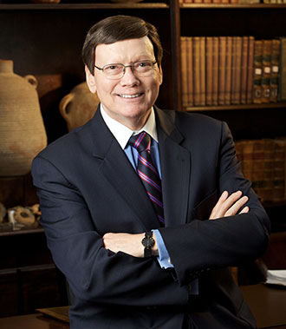
Dr. Ed Hindson
Hindson, E. E., & Mitchell, D. R., eds. (2010). KJV Bible Commentary for Today: The Most Up-to-Date Commentary on the Time-Honored Text of the KJV (p. 98). Thomas Nelson.
Exodus 11:5 - “Egyptian deities challenged by this concluding plague were Isis, the goddess of reproduction and the ostensible protector of Egyptian children; Min, the reproduction god; Ra, the divine father of every past, present, and future pharaoh; and Pharaoh himself, who was considered the divine incarnation of the falcon-headed god, Horus. With this plague, the pretense of the king’s divinity would be forever shattered. The Egyptian king would definitively be shown powerless before YHWH.”

Slide 41
Scripture’s Four Judgments
NAME | SHEEP AND GOAT | JUDGMENT OF THE JEWS | BEMA SEAT | GREAT WHITE THRONE
SCRIPTURE | Matt 25:31-46 | Ezek 20:33-44 | 1 Cor 3:10-15 | Rev 20:11-15
PLACE | Earth, Jerusalem | Earth, wilderness | Heaven | Earth
AUDIENCE | Gentile Tribulation survivors | Jewish Tribulation survivors | Church Age believers | All unsaved
WHEN | After Tribulation | After Tribulation | After rapture | After Millennium
PURPOSE | Saved Gentiles enter kingdom | Saved Jews enter kingdom | Reward believers | Degree of punishment in hell
EVALUATION | Treatment of Christ’s brethren | Passing under shepherd’s rod | Works taken through fire | Not in the book; judged by books

Slide 42
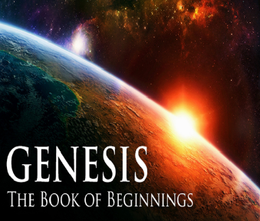
8 New Promises
Genesis 12:1-3
    Land (Gen. 12:1b)
    Great nation (Gen. 12:2a)
    Personal blessing (Gen. 12:2b)
    Great name (Gen. 12:2c)
    Blessing to others (Gen. 12:2d)
    Blessing to blessers (Gen. 12:3a)
    Cursing to cursers (Gen. 12:3b)
    Blessing to the world (Gen. 12:3c)

Slide 43

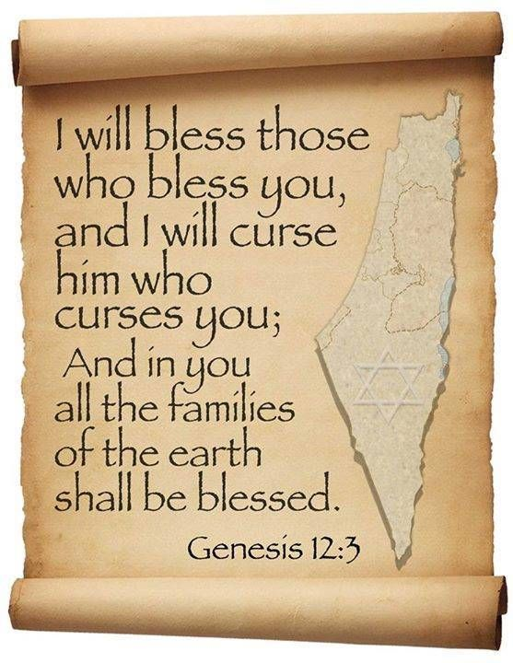
Genesis 12:3
“And I will bless those who bless you, And the one who curses you I will curse. And in you all the families of the earth will be blessed.”

Slide 44
Exodus 11:4-8c
Plague Predicted
      God’s direct involvement (4)
      Comprehensive death of first born (5)
      Emotional anguish (6)
      Israel exempted (7)
      Servants’ reaction (8a-b)
      Moses’ exit (8c)

Slide 45

1 Thessalonians 4:13-18
¹³ "But we do not want you to be uninformed, brethren, about those who are asleep, so that you will not grieve as do the rest who have no hope. ¹⁴ For if we believe that Jesus died and rose again, even so God will bring with Him those who have fallen asleep in Jesus. ¹⁵ For this we say to you by the word of the Lord, that we who are alive and remain until the coming of the Lord, will not precede. . .

Slide 46
1 Thessalonians 4:13-18
. . . those who have fallen asleep. ¹⁶ For the Lord Himself descend from heaven with a shout, with the voice of the archangel and with the trumpet of God, and the dead in Christ will rise first. ¹⁷ Then we who are alive and remain will be caught up together with them in the clouds to meet the Lord in the air, and so we shall always be with the Lord. ¹⁸ Therefore comfort one another with these words."

Slide 47


Slide 48

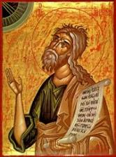
Jeremiah 30:7
“Alas! for that day is great, There is none like it; And it is the time of Jacob’s distress (Gen. 32:8; 35:10), But he will be saved from it.”

Slide 49
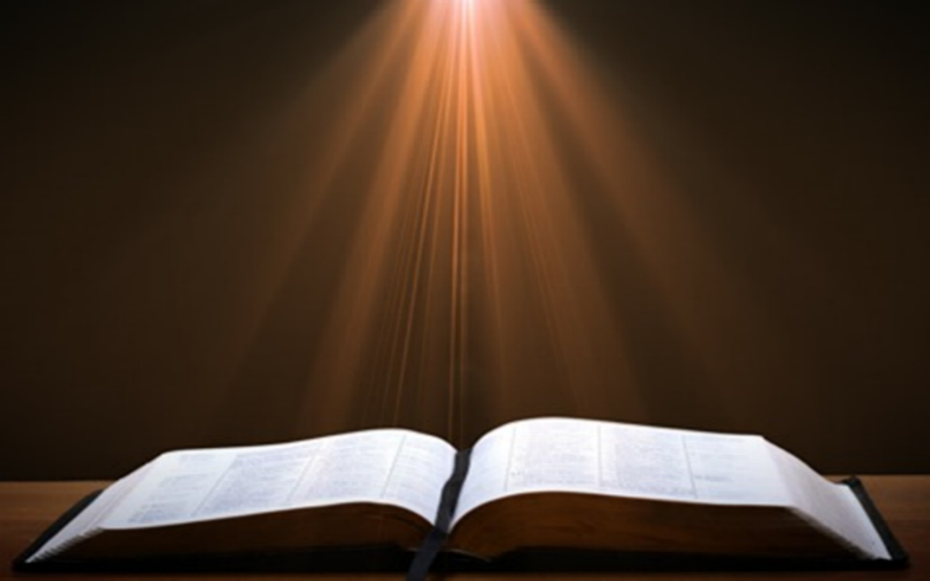
Matthew 24:21-22
“²¹ For then there will be a great tribulation, such as has not occurred since the beginning of the world until now, nor ever will. ²² Unless those days had been cut short, no life would have been saved; but for the sake of the elect those days will be cut short.”

Slide 50
Exodus 11:4-8c
Plague Predicted
      God’s direct involvement (4)
      Comprehensive death of first born (5)
      Emotional anguish (6)
      Israel exempted (7)
      Servants’ reaction (8a-b)
      Moses’ exit (8c)

Slide 51

Protection Through the Tribulation?
(Revelation 3:10)
Like the protection in Goshen (Exod. 8:22, 24; 9:4, 6; 11:4-7; Rev. 9:4; 16:2)
Effective? Rev. 6:9-11; 7:13-14; 13:10, 15; 20:4
Comfort? John 14:1; 1 Thess. 4:18; Titus 2:13

Slide 52

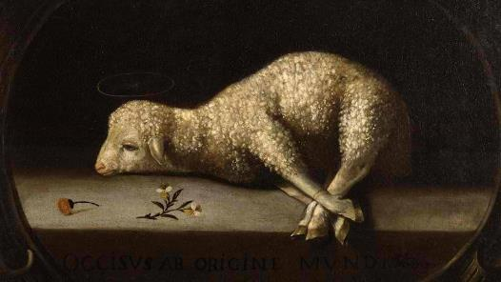
Exodus 12:5, 46
“Your lamb shall be an unblemished male a year old; you may take it from the sheep or from the goats…nor are you to break any bone of it.”

Slide 53

PLAGUES’ MIRACULOUS NATURE
Moses knew about them beforehand (8:10; 9:5, 29)
Instantaneous appearance and termination
Description as “signs and wonders” (7:3)
Intensification
Timing
Accomplishment of a moral purpose (11:1)
Response they invoked from the Egyptian sorcerers (7:22; 8:18-19)
Last seven plagues did not effect the Jews living in Goshen (9:6)
Nile into blood affected all rivers, streams, pools, reservoirs, and vessels holding waters
Hill and Walton, A Survey of the Old Testament, 114-15

Slide 54
Exodus 11:4-8c
Plague Predicted
      God’s direct involvement (4)
      Comprehensive death of first born (5)
      Emotional anguish (6)
      Israel exempted (7)
      Servants’ reaction (8a-b)
      Moses’ exit (8c)

Slide 55
Exodus 11:8a-b
Servants’ Reaction
      What they will do (8a)
      What they will say (8b)

Slide 56
Exodus 11:8a-b
Servants’ Reaction
      What they will do (8a)
      What they will say (8b)

Slide 58
Genesis 37:9
“Now he had still another dream, and related it to his brothers, and said, ‘Lo, I have had still another dream; and behold, the sun and the moon and eleven stars were bowing down to me.’”

Slide 59
Genesis 37:10
“He related it to his father and to his brothers; and his father rebuked him and said to him, ‘What is this dream that you have had? Shall I and your mother and your brothers actually come to bow ourselves down before you to the ground?’”

Slide 60
Exodus 11:8a-b
Servants’ Reaction
      What they will do (8a)
      What they will say (8b)

Slide 61
Exodus 11:4-8c
Plague Predicted
      God’s direct involvement (4)
      Comprehensive death of first born (5)
      Emotional anguish (6)
      Israel exempted (7)
      Servants’ reaction (8a-b)
      Moses’ exit (8c)

Slide 62
II. Exodus 11:4-8
Conversation Continued
    Plague predicted (4-8c)
    Conversation terminated (8d)

Slide 63
DEATH OF FIRST BORN
Exodus 11:1-10
  Conversation Interrupted (1-3)
  Conversation Continued (4-8)
  Conversation Aftermath (9-10)

Slide 64
III. Exodus 11:9-10
Conversation Aftermath
    God’s prediction (9a)
    God’s purpose (9b)
    Summary (10a)
    Pharaoh’s hardening (10b)

Slide 65
III. Exodus 11:9-10
Conversation Aftermath
    God’s prediction (9a)
    God’s purpose (9b)
    Summary (10a)
    Pharaoh’s hardening (10b)

Slide 67
John 13:19; 14:29
“¹⁹ From now on I am telling you before it comes to pass, so that when it does occur, you may believe that I am He… ^{14:29} Now I have told you before it happens, so that when it happens, you may believe.”

Slide 68
III. Exodus 11:9-10
Conversation Aftermath
    God’s prediction (9a)
    God’s purpose (9b)
    Summary (10a)
    Pharaoh’s hardening (10b)

Slide 69
Dispensational Theology is a System of Theology
Traditional-normative dispensational theology is a system that embodies three essential, fundamental concepts called the sine qua non (lit. “without which is not”):
The consistent use of a plain, normal, literal, grammatical-historical method of interpretation;
Which reveals that the Church is distinct from Israel;
God’s overall purpose is to bring glory to Himself (Eph. 1:6, 12, 14).
Dr. Charles Ryrie, Dispensationalism, pp. 38-41

Slide 70
Doxological Purpose
God’s ultimate purpose for the ages is to glorify Himself. Scripture is not human-centered, as though salvation were the principle point, but God-centered, because His glory is at the center.
The glory of God is the primary principle that unifies all dispensations, the program of salvation being just one of the means by which God glorifies Himself. Each successive revelation of God’s plan for the ages, as well as His dealing with the elect, non-elect, angels, and nations all manifest His glory.
Dictionary of Premillennial Theology, Charles Ryrie, p. 94

Slide 71
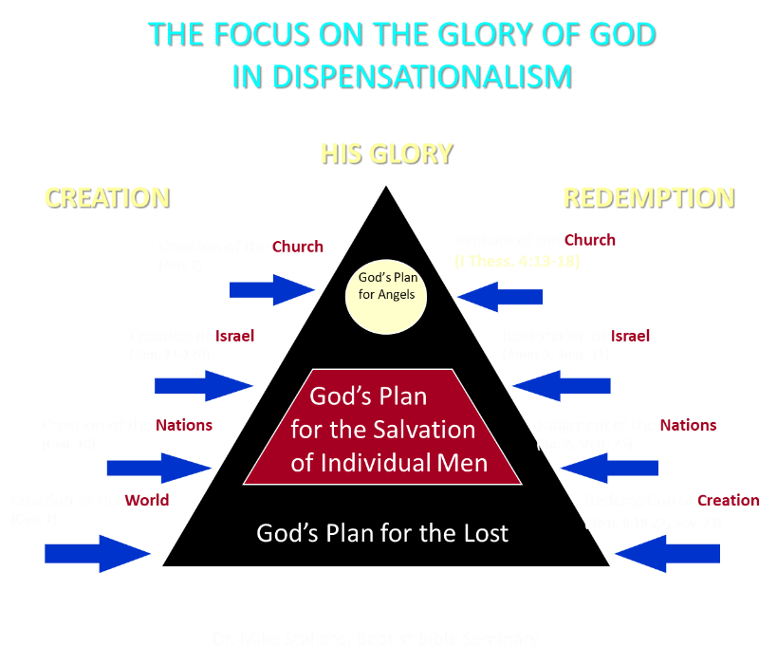

Slide 72
III. Exodus 11:9-10
Conversation Aftermath
    God’s prediction (9a)
    God’s purpose (9b)
    Summary (10a)
    Pharaoh’s hardening (10b)

Slide 73
TEN PLAGUES REDEMPTION (7:14–12:30)
Nile to blood
Frogs
Gnats
Flies
Death of livestock
Boils
Hail
Locusts
Darkness
Death of 1st born

Slide 74
The Plagues of Egypt
NO. | DESCRIPTION | SCRIPTURE | Egyptian Deity
1. | Water to Blood | Exod. 7:14-25 | Hapi, Khnum
2. | Frogs | Exod. 8:1-15 | Heqt
3. | Gnats | Exod. 8:16-19 | Set
4. | Flies | Exod. 8:20-32 | Uatchit
5. | Disease on Cattle | Exod. 9:1-7 | Hathor, Apis
6. | Boils | Exod. 9:8-12 | Sekhmet, Serapis
7. | Hail | Exod. 9:13-35 | Seth, Nut
8. | Locusts | Exod. 10:1-20 | Seth, Nut, Osiris
9. | Darkness | Exod. 10:21-29 | Re, Horus, Atum
10. | Death of the First Born | Exod. 12:29-36 | Min, Osiris, Heqt, Isis

Slide 75
III. Exodus 11:9-10
Conversation Aftermath
    God’s prediction (9a)
    God’s purpose (9b)
    Summary (10a)
    Pharaoh’s hardening (10b)

Slide 76
Dr. Ed Hindson
Hindson, E. E., & Mitchell, D. R., eds. (2010). KJV Bible Commentary for Today: The Most Up-to-Date Commentary on the Time-Honored Text of the KJV (p. 86). Thomas Nelson.
“4:21. I will harden his heart. An expression meaning ‘to strengthen his will.’ The text identifies the heart as the location of the volition, man’s decision-making ability. On seven occasions in the narrative, God hardens Pharaoh’s heart (9:12; 10:1, 20, 27; 11:10; 14:4, 8) or foretells that He will harden Pharaoh’s heart (4:21; 7:3), and nine times in the text, Pharaoh hardens his own heart (7:13, 14, 22; 8:15, 19, 32; 9:7, 34–35). For the initial five plagues, the text registers Pharaoh as the agent of hardening. Not until the sixth plague does God participate in the confirmation of Pharaoh’s own volitional choices.”

Slide 77

Charles Ryrie
Ryrie Study Bible, page 96
Exodus 4:21 - “harden his heart. Ten times it is said that Pharaoh hardened his own heart (7:13, 14, 22; 8:15, 19, 32; 9:7, 34, 35; 13:15), and 10 times that God hardened Pharaoh’s heart (4:21; 7:3; 9:12; 10:1, 20, 27; 11:10; 14:4, 8, 17). Paul uses this as an example of the inscrutable will of God and of His mercy toward men (Rom. 9:14–18). Seven times Pharaoh hardened his own heart before God first hardened it, though the prediction that God would do it preceded all.”

Slide 78
GOD HARDENING PHARAOH'S HEART
The prediction of God hardening of Pharaoh (4:21)
Pharaoh repeatedly hardening his own heart (7:13, 22; 8:15, 19, 32; 9:7)
Not until the sixth plague did God harden Pharaoh’s heart (Exod 9:12)

Slide 79
Conclusion

Slide 80
DEATH OF FIRST BORN
Exodus 11:1-10
  Conversation Interrupted (1-3)
  Conversation Continued (4-8)
  Conversation Aftermath (9-10)

Slide 81
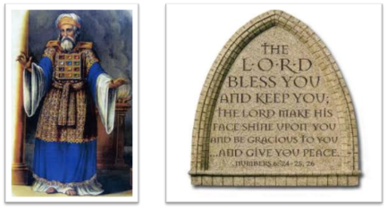
²⁴ The Lord bless you, and keep you; ²⁵ The Lord make His face shine on you, And be gracious to you; ²⁶ The Lord lift up His countenance on you, And give you peace.
Numbers 6:24–26 (NASB95)

