Slide 1
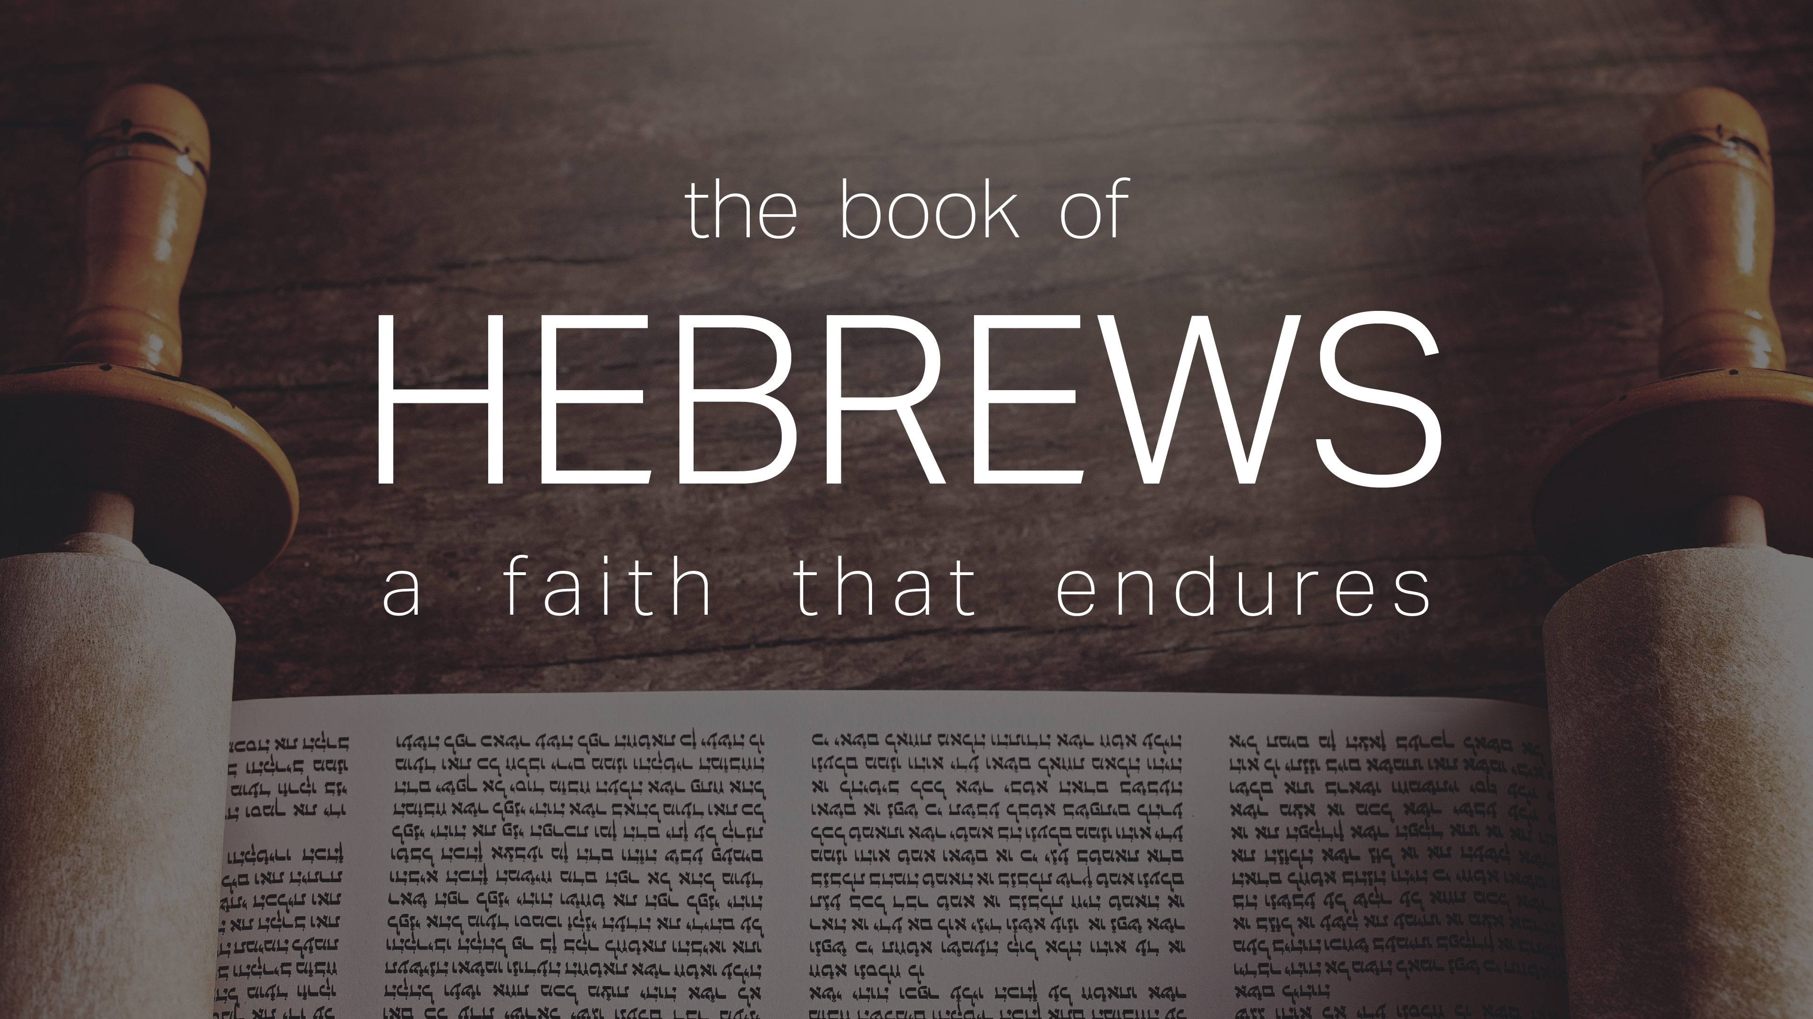
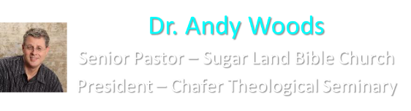

Slide 2
INTRODUCTORY MATTERS
Authorship
Audience
Date
Occasion
Purpose
Message
Outline

Slide 3
AUTHORSHIP
Apollos?
Barnabas?
Paul?

Slide 4
INTRODUCTORY MATTERS
Authorship
Audience
Date
Occasion
Purpose
Message
Outline

Slide 5
AUDIENCE
Believers (1:3)
2nd generation (2:2-3)
Jews
Located in the Land of Israel

Slide 6
INTRODUCTORY MATTERS
Authorship
Audience
Date
Occasion
Purpose
Message
Outline

Slide 7
DATE (A.D. 62–64)
Before
  A.D. 95 (Clement of Rome)
  A.D. 70 (Heb 8:4, 13; 9:6; 10:1-2; 13:10)
  A.D. 64 (Heb 12:4)
After apostolic generation (2:2-3)

Slide 8
INTRODUCTORY MATTERS
Authorship
Audience
Date
Occasion
Purpose
Message
Outline

Slide 9
OCCASION
A.D. 70
Heb 3:1 (Christian confession)
Unbelieving Jews placing audience under duress to return to Judaism
Audience being worn down
Temple still standing
Notes:
Crisis Literature / Sitz im Leben

Slide 10
INTRODUCTORY MATTERS
Authorship
Audience
Date
Occasion
Purpose
Message
Outline

Slide 11
PURPOSE
Encouragement/motivation to not lapse back into Judaism
  What believers already have in Christ is superior to every vestige of Judaism (Angels, Moses, and the Aaronic priesthood)
  Warnings

Slide 12
5 WARNINGS
2:1-4 – Warning against drifting
3:7–4:13 – Warning against disobedience
5:10–6:20 – Warning against immaturity
10:26-39 – Warning against despising the truth
12:25-29 – Warning against denying the truth

Slide 13
4 VIEWS ON WARNING PASSAGES
Hypothetical
Arminianism
Calvinism/Reformed
Loss of blessings

Slide 14
INTRODUCTORY MATTERS
Authorship
Audience
Date
Occasion
Purpose
Message
Outline

Slide 15
MESSAGE
The superiority of the full revelation of Christ in comparison to OT Judaism is shown through Christ’s superiority to every major vestige of Judaism, and the author wrote Hebrews so that his audience would not lapse back into Judaism.

Slide 16
INTRODUCTORY MATTERS
Authorship
Audience
Date
Occasion
Purpose
Message
Outline

Slide 17
OUTLINE
Doctrinal section (1:1–10:18)
  Christ’s attributes (1:1-3)
  Christ is superior to the angels (1:4–2:18)
  Christ is superior to Moses (3:1–4:13)
  Christ is superior to Aaron (4:14–10:18)
Practical section (10:19–13:25)
  Exhortations and pastoral reminders (10, 12, 13)
  Hall of faith (11)
  Benediction (13:20-25)

Slide 18
OUTLINE
Doctrinal section (1:1–10:18)
  Christ’s attributes (1:1-3)
  Christ is superior to the angels (1:4–2:18)
  Christ is superior to Moses (3:1–4:13)
  Christ is superior to Aaron (4:14–10:18)
Practical section (10:19–13:25)
  Exhortations and pastoral reminders (10, 12, 13)
  Hall of faith (11)
  Benediction (13:20-25)

Slide 19
CHRIST IS SUPERIOR TO PREVIOUS REVELATION (1:1-2A)
OT – Indirect, incomplete, temporary
Christ – Direct, complete, permanent

Slide 20
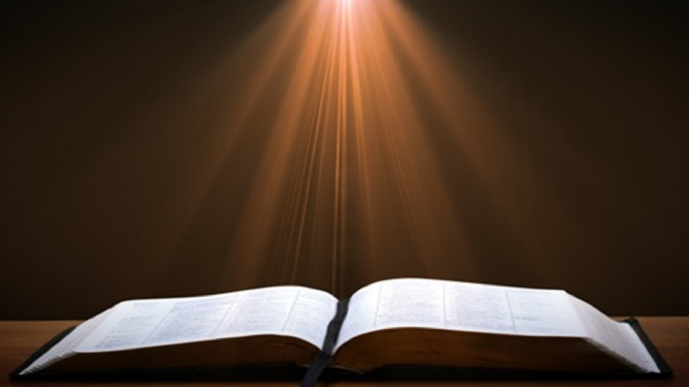
Hebrews 1:2-3
“² in these last days has spoken to us in His Son, whom He appointed heir of all things, through whom also He made the world. ³ And He is the radiance of His glory and the exact representation of His nature, and upholds all things by the word of His power. When He had made purification of sins, He sat down at the right hand of the Majesty on high.”

Slide 21
Hebrews 1:2-3
“² in these last days has spoken to us in His Son, whom He appointed heir of all things, through whom also He made the world. ³ And He is the radiance of His glory and the exact representation of His nature, and upholds all things by the word of His power. When He had made purification of sins, He sat down at the right hand of the Majesty on high.”

Slide 22
CHRIST’S 7 ATTRIBUTES SHOWING HIS FINALITY (1:2B-3)
Heir of all things
Maker of all things
Brightness of the Father’s glory
Express image of the Father
Upholds all things
Made complete purification for sins
Sat down at the Father’s right hand

Slide 23
CHRIST’S 7 ATTRIBUTES SHOWING HIS FINALITY (1:2B-3)
Heir of all things
Maker of all things
Brightness of the Father’s glory
Express image of the Father
Upholds all things
Made complete purification for sins
Sat down at the Father’s right hand

Slide 24
Hebrews 1:2-3
“² in these last days has spoken to us in His Son, whom He appointed heir of all things, through whom also He made the world. ³ And He is the radiance of His glory and the exact representation of His nature, and upholds all things by the word of His power. When He had made purification of sins, He sat down at the right hand of the Majesty on high.”

Slide 25
CHRIST’S 7 ATTRIBUTES SHOWING HIS FINALITY (1:2B-3)
Heir of all things
Maker of all things
Brightness of the Father’s glory
Express image of the Father
Upholds all things
Made complete purification for sins
Sat down at the Father’s right hand

Slide 26
Hebrews 1:2-3
“² in these last days has spoken to us in His Son, whom He appointed heir of all things, through whom also He made the world. ³ And He is the radiance of His glory and the exact representation of His nature, and upholds all things by the word of His power. When He had made purification of sins, He sat down at the right hand of the Majesty on high.”

Slide 27
CHRIST’S 7 ATTRIBUTES SHOWING HIS FINALITY (1:2B-3)
Heir of all things
Maker of all things
Brightness of the Father’s glory
Express image of the Father
Upholds all things
Made complete purification for sins
Sat down at the Father’s right hand

Slide 28
Hebrews 1:2-3
“² in these last days has spoken to us in His Son, whom He appointed heir of all things, through whom also He made the world. ³ And He is the radiance of His glory and the exact representation of His nature, and upholds all things by the word of His power. When He had made purification of sins, He sat down at the right hand of the Majesty on high.”

Slide 29
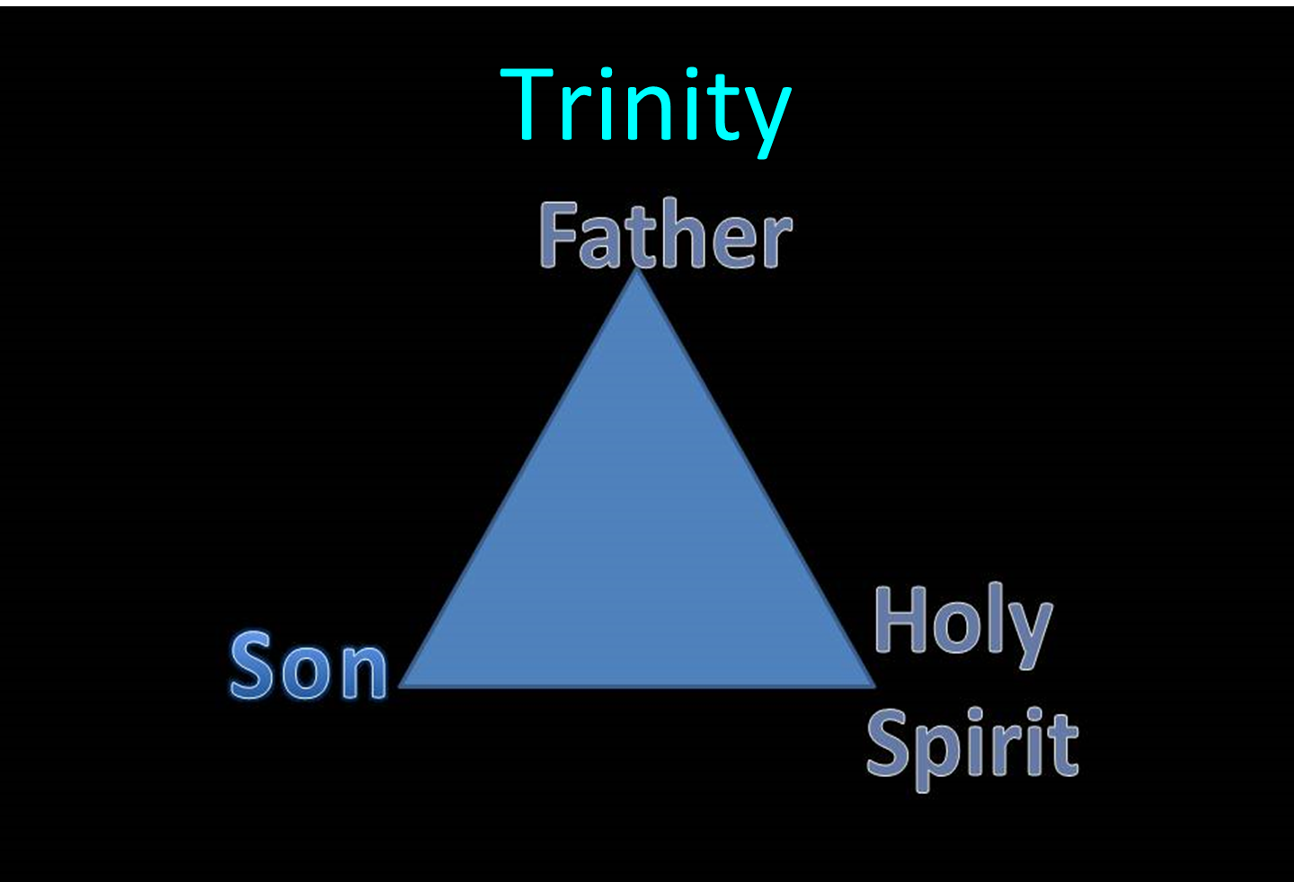

Slide 30
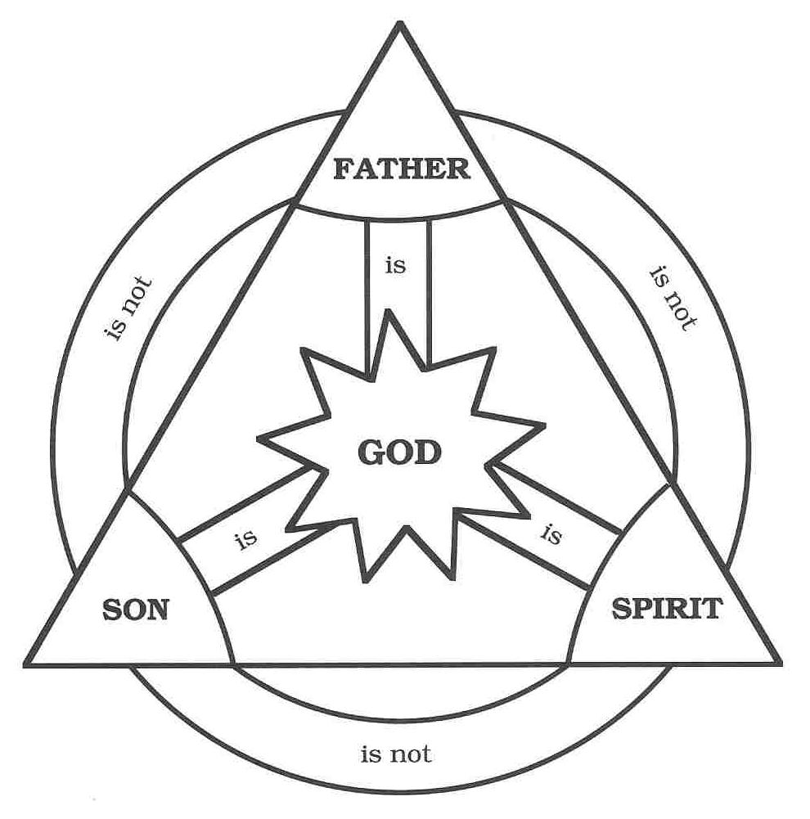

Slide 31
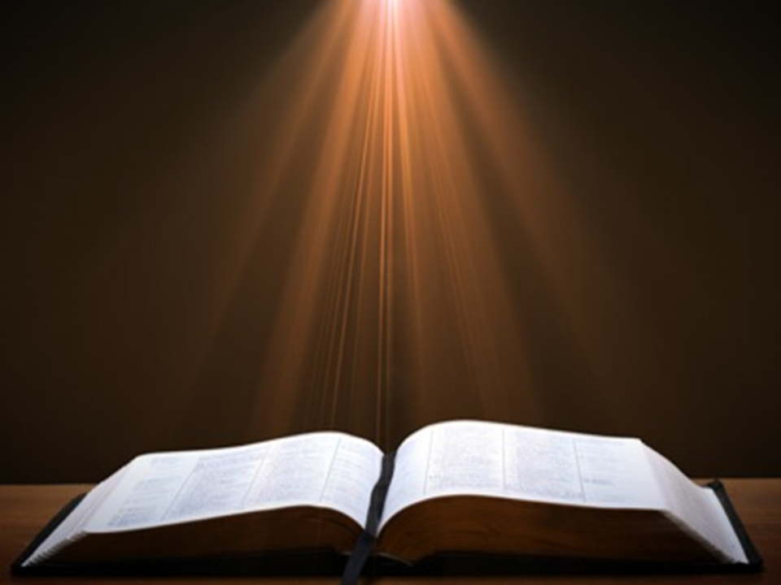
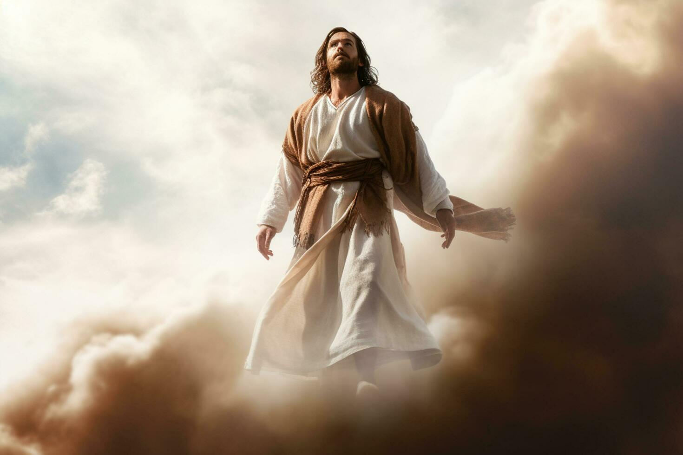
John 17:5
“Now, Father, glorify Me together with Yourself, with the glory which I had with You before the world was.”

Slide 32
CHRIST’S 7 ATTRIBUTES SHOWING HIS FINALITY (1:2B-3)
Heir of all things
Maker of all things
Brightness of the Father’s glory
Express image of the Father
Upholds all things
Made complete purification for sins
Sat down at the Father’s right hand

Slide 33
Hebrews 1:2-3
“² in these last days has spoken to us in His Son, whom He appointed heir of all things, through whom also He made the world. ³ And He is the radiance of His glory and the exact representation of His nature, and upholds all things by the word of His power. When He had made purification of sins, He sat down at the right hand of the Majesty on high.”

Slide 34

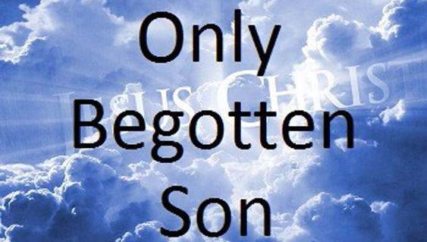
John 1:14
“And the Word became flesh, and dwelt among us, and we saw His glory, glory as of the only begotten [monogenēs] from the Father, full of grace and truth.”

Slide 35
John 1:18
“No one has seen God at any time; the only begotten [monogenēs] God who is in the bosom of the Father, He has explained [exēgeomai] Him.”

Slide 36

J. Dwight Pentecost
Pentecost, J. D., & Durham, K. (2000). Faith that endures : a practical commentary on the book of Hebrews (Rev. ed., p. 47). Kregel Publications.
“The fourth statement is that the Son is ‘the express image of His person’ (1:3b). This emphasizes that the Son in Himself is a full and perfect revelation of what is in the Father. Even though we have not seen the Father, we know the Father because all that is in the Father is in the Son. In the Greco-Roman world, coins bore the image of the emperor. Because the image of the emperor had been impressed on the coin by a die, by looking at a coin one could recognize the emperor.”

Slide 37
J. Dwight Pentecost
Pentecost, J. D., & Durham, K. (2000). Faith that endures : a practical commentary on the book of Hebrews (Rev. ed., p. 47). Kregel Publications.
“And though the likeness of the emperor on the coin was only a representative likeness, if the die were cast away, one could determine exactly what was in the die by studying the coin. Why? Because the die reproduced itself in every detail on the coin. This is the essence of the word the author chose here to show the relationship between the Son and the Father. While we do not see the Father, all that is in the Father is in the Son. By studying the Son we learn of the Father. Just as an impression on a coin becomes an expression of the die, so what was in Christ is a revelation of the Father.”

Slide 38
CHRIST’S 7 ATTRIBUTES SHOWING HIS FINALITY (1:2B-3)
Heir of all things
Maker of all things
Brightness of the Father’s glory
Express image of the Father
Upholds all things
Made complete purification for sins
Sat down at the Father’s right hand

Slide 39
Hebrews 1:2-3
“² in these last days has spoken to us in His Son, whom He appointed heir of all things, through whom also He made the world. ³ And He is the radiance of His glory and the exact representation of His nature, and upholds all things by the word of His power. When He had made purification of sins, He sat down at the right hand of the Majesty on high.”

Slide 40
CHRIST’S 7 ATTRIBUTES SHOWING HIS FINALITY (1:2B-3)
Heir of all things
Maker of all things
Brightness of the Father’s glory
Express image of the Father
Upholds all things
Made complete purification for sins
Sat down at the Father’s right hand

Slide 41
Hebrews 1:2-3
“² in these last days has spoken to us in His Son, whom He appointed heir of all things, through whom also He made the world. ³ And He is the radiance of His glory and the exact representation of His nature, and upholds all things by the word of His power. When He had made purification of sins, He sat down at the right hand of the Majesty on high.”

Slide 42
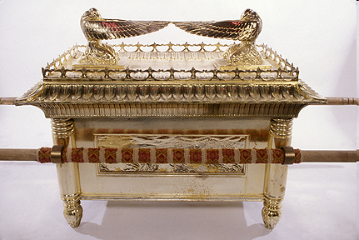
ARK OF THE COVENANT

Slide 43
Chart courtesy of Thomas Stegall

Slide 44
CHRIST’S 7 ATTRIBUTES SHOWING HIS FINALITY (1:2B-3)
Heir of all things
Maker of all things
Brightness of the Father’s glory
Express image of the Father
Upholds all things
Made complete purification for sins
Sat down at the Father’s right hand

Slide 45
Hebrews 1:2-3
“² in these last days has spoken to us in His Son, whom He appointed heir of all things, through whom also He made the world. ³ And He is the radiance of His glory and the exact representation of His nature, and upholds all things by the word of His power. When He had made purification of sins, He sat down at the right hand of the Majesty on high.”

Slide 46
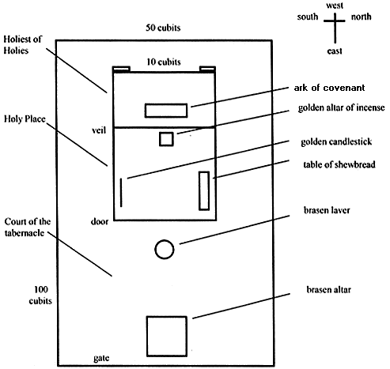
Tabernacle Diagram

Slide 47
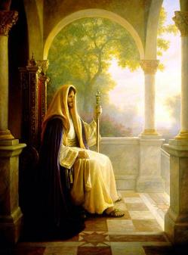
Christ’s Three Offices
Prophet – 1st Coming (Matt. 4:17)
Priest – Present Session (Heb. 4:15)
King – 2nd Coming (Isa. 9:6-7; Matt. 25:31)

Slide 48
Christ’s Three Offices
Prophet – 1st Coming (Matt. 4:17)
Priest – Present Session (Heb. 4:15)
King – 2nd Coming (Isa. 9:6-7; Matt. 25:31)

Slide 49
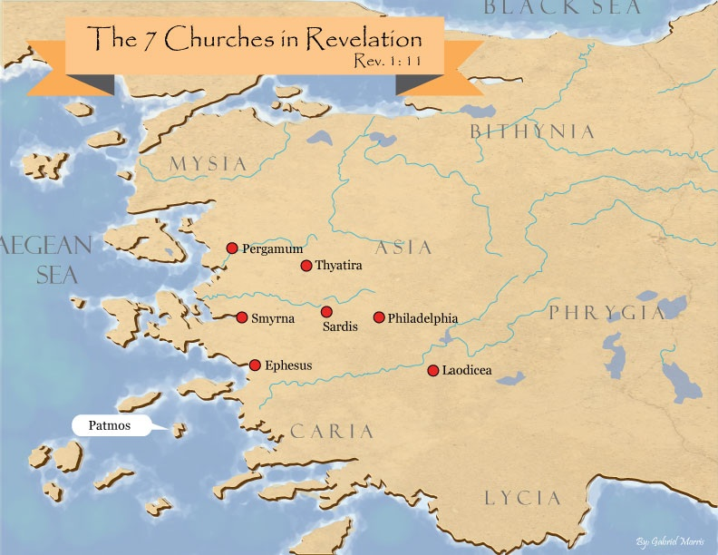
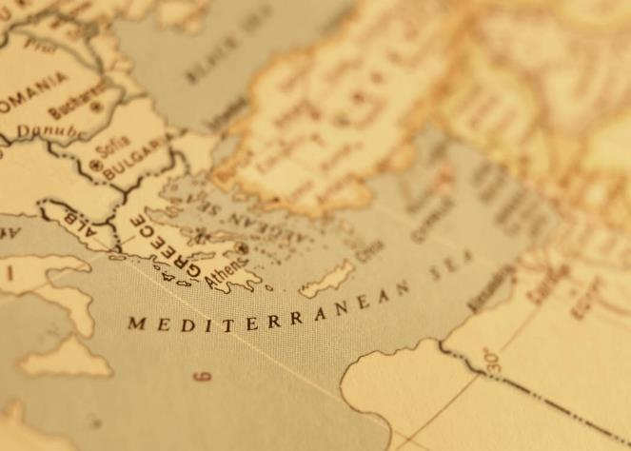

Slide 50

Revelation 3:21
PROMISE TO THE OVERCOMERS
“He who overcomes, I will grant [future tense of didōmi] to him to sit down with Me on My throne, as I also overcame and sat down [aorist tense of kathizō] with My Father on His throne.”

Slide 51
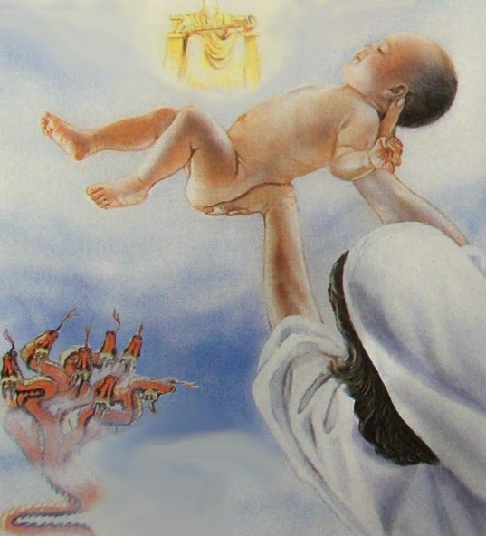
Revelation 12:5
“And she gave birth to a son, a male child, who is to rule all the nations with a rod of iron; and her child was caught up to God and to His throne.”

Slide 52
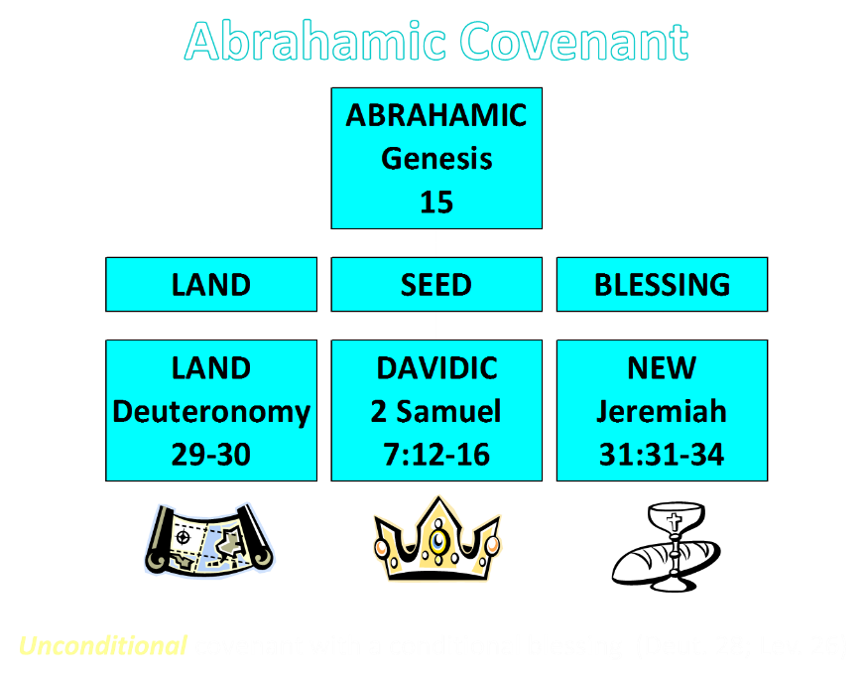

Slide 53
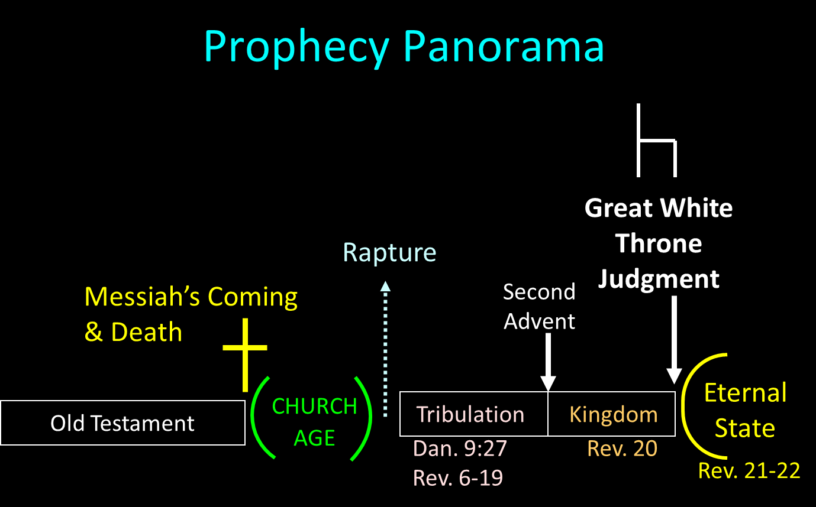

Slide 54
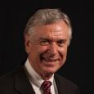
Dave Anderson
The King-Priest of Psalm 110 in Hebrews (New York: Lang, 2001), 2.
“But clearly Jesus did not set up a natural theocratic kingdom with Himself as the king ruling from Jerusalem on earth before His resurrection. So, what happened to the kingdom He promised? It was postponed, many NT interpreters suggest. . . . But if the premillennial view just espoused is true, that leaves the question concerning the present ministry of Christ. What is He doing right now?”

Slide 55
Dave Anderson
The King-Priest of Psalm 110 in Hebrews (New York: Lang, 2001), 296.
“But classical or revised dispensationalists should also recognize the already eschatology of Hebrews. Christ is not passive on the throne. He is reigning. He has subjects. And because He is the forerunner, there are many present blessings which belong to the eschatological age which can be enjoyed now because the Davidic Covenant with some of its blessings has been inaugurated.”

Slide 56


Slide 57

Lewis Sperry Chafer
vol. 5, Systematic Theology (Grand Rapids, MI: Kregel Publications, 1993), 273-74.
“The present ministry of Christ in heaven, known as His session, is far-reaching both in consequence and import. It too, has not been treated even with a passing consideration by Covenant theologians, doubtless due to their inability—because of being confronted with their one covenant theory—to introduce features and ministries which indicate a new divine purpose in the Church and by so much tend to disrupt the unity of a supposed immutable purpose and covenant of God’s. Since, as will be seen, certain vital ministries of Christ in heaven provide completely for the believer’s security, the present session of Christ has been eschewed by Arminians in a manner equally unpardonable. This neglect accounts very well . . .

Slide 58
Lewis Sperry Chafer
vol. 5, Systematic Theology (Grand Rapids, MI: Kregel Publications, 1993), 273-74.
…for the emphasis of their pulpit ministrations. The Christian public, because deprived of the knowledge of Christ’s present ministry, are unaware of its vast realities, though they are able from childhood itself to relate the mere historical facts and activities of Christ during His three and one-half years of service on earth. That Christ is doing anything now is not recognized by Christians generally and for this part-truth kind of preaching is wholly responsible. It yet remains true, whether neglected by one or the other kind of theologian, that Christ is now engaged in ministry which determines the service and destiny of all those who have put their trust in Him.”

Slide 59
CHRIST’S HIGH PRIESTLY ACTIVITIES IN HIS PRESENT SESSION
Sustains creation (Col. 1:16-17) | Keeps the Saints (John 10:27-29; 1 Pet. 1:5)
Head over the Church (Eph. 1:22-23) | Intercedes for the Saints (Rom. 8:34; Heb. 7:25)
Groom of the Church (Eph. 5:22-33) | Advocate for the Saints (Heb. 9:24; 1 John 2:1)
Building the Church (Matt. 16:18; Acts 2:41; 4:4) | Restores broken fellowship (1 John 1:9)
Bestowal of Spiritual Gifts (Eph. 4:7-12) | Disciplines His children (Heb. 12:5-13)
Melchizedekian High Priestly role (Heb. 6:20) | 12. Indwells His people (John 14:23)

Slide 60
Conclusion

Slide 61
Hebrews 1:2-3
“² in these last days has spoken to us in His Son, whom He appointed heir of all things, through whom also He made the world. ³ And He is the radiance of His glory and the exact representation of His nature, and upholds all things by the word of His power. When He had made purification of sins, He sat down at the right hand of the Majesty on high.”

Slide 62
CHRIST’S 7 ATTRIBUTES SHOWING HIS FINALITY (1:2B-3)
Heir of all things
Maker of all things
Brightness of the Father’s glory
Express image of the Father
Upholds all things
Made complete purification for sins
Sat down at the Father’s right hand

