Slide 1
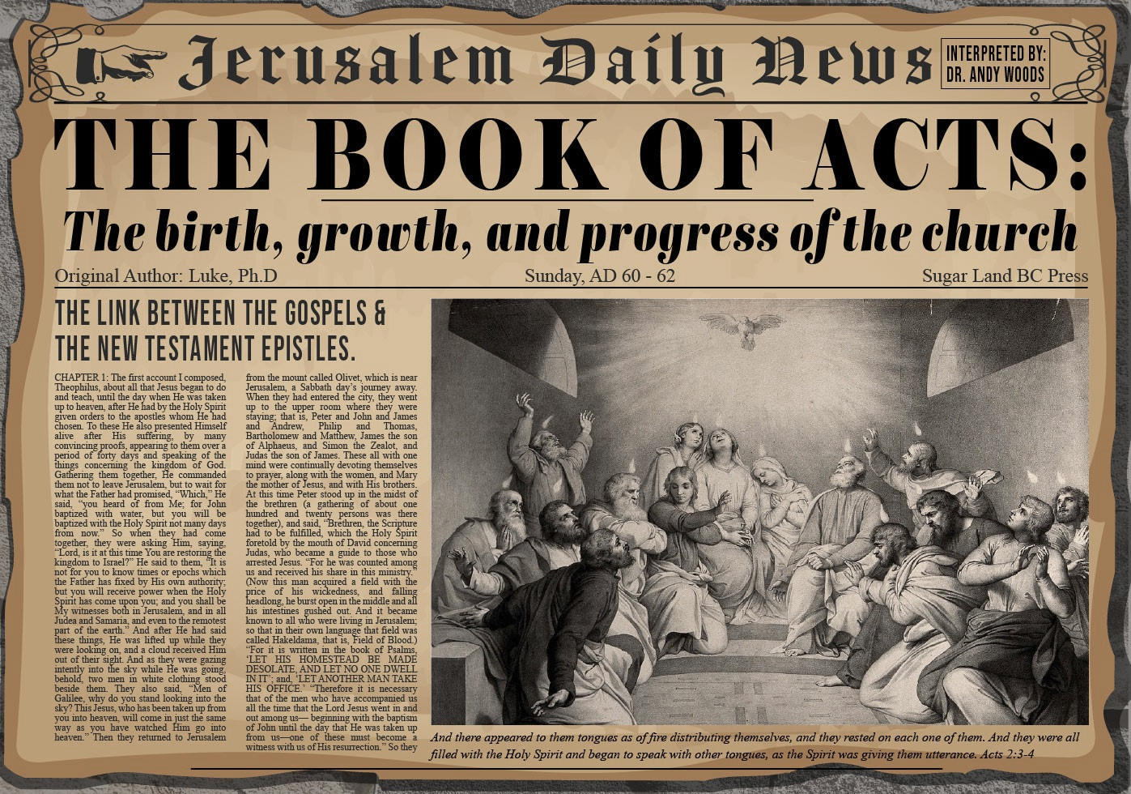


Slide 2
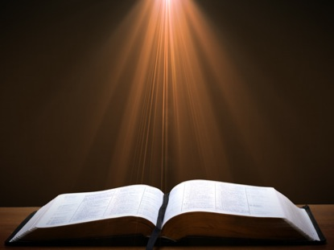
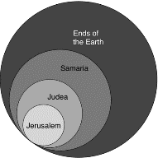
Acts 1:8
“but you will receive power when the Holy Spirit has come upon you; and you shall be My witnesses both in Jerusalem (Acts 1-7), and in all Judea and Samaria (Acts 8-12), and even to the remotest part of the earth (Acts 13-28).”

Slide 3
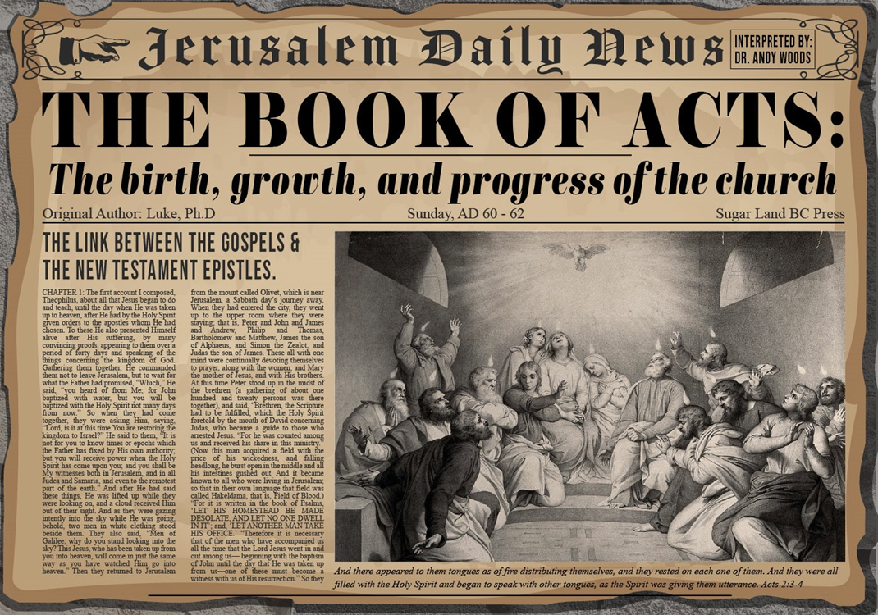
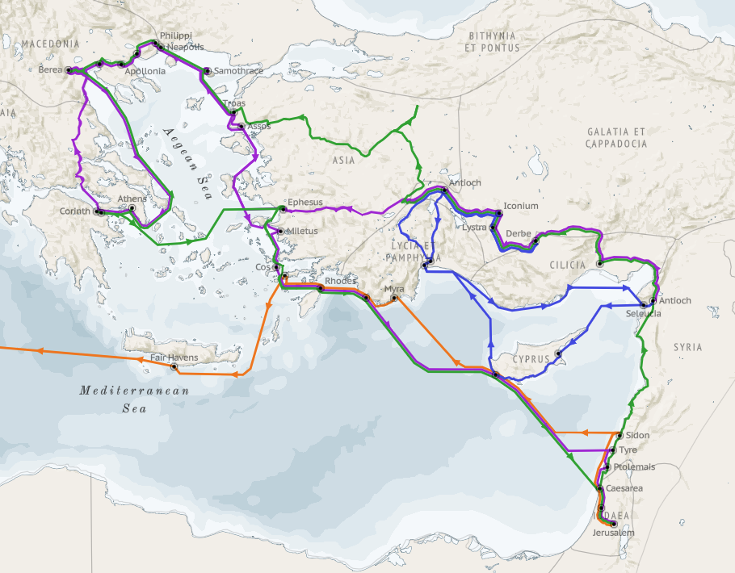
Structure (Acts 1:8)
Jerusalem (Acts 1–7)
Judea and Samaria (Acts 8–12)
Remotest part of the earth (Acts 13–28)
1st missionary journey (Acts 13–14)
Jerusalem council (Acts 15:1-35)
2nd missionary journey (Acts 15:36 –18:22)
3rd missionary journey (Acts 18:23–21:17)
Trip to Rome (Acts 21:18–28:31)

Slide 4
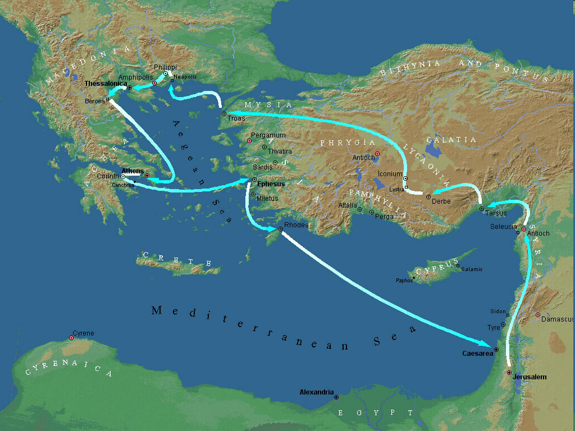
Second Missionary Journey

Slide 5
Acts 15:36‒18:22 2nd Missionary Journey
Schism between Paul & Barnabas (15:36-41)
Syria & Cilicia ministry (16:1-5)
Macedonian call (16:6-10)
Philippian ministry (16:11-40)
Thessalonica ministry (17:1-9)
Berean ministry (17:10-15)
Athens’ ministry (17:16-34)
Corinthian ministry (18:1-18)
Ephesus’ ministry (18:19-21)
Return to Antioch (18:22)

Slide 6
VIII. Corinthian Ministry Acts 18:1-18
Arrival (1-4)
Ministry (5-11)
Paul Before Gallio (12-17)
Paul’s Departure (18)

Slide 7
VIII. Corinthian Ministry Acts 18:1-18
Arrival (1-4)
Ministry (5-11)
Paul Before Gallio (12-17)
Paul’s Departure (18)

Slide 8
Acts 18:1-4 Arrival
Journey (1)
Meeting with Priscilla & Aquila (2-3)
Ministry Pattern (4)

Slide 9
Acts 18:1-4 Arrival
Journey (1)
Meeting with Priscilla & Aquila (2-3)
Ministry Pattern (4)

Slide 10
Second Missionary Journey

Slide 11
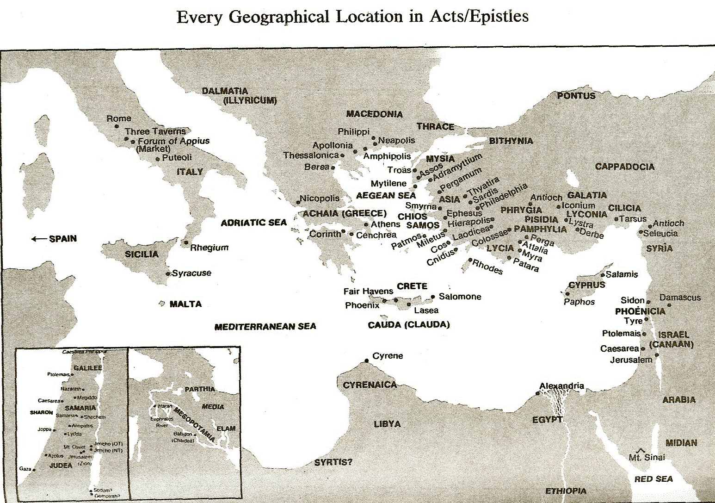

Slide 12
Acts 18:1-4 Arrival
Journey (1)
Meeting with Priscilla & Aquila (2-3)
Ministry Pattern (4)

Slide 13
Acts 18:2-3 Meeting with Priscilla and Aquila
Expulsion (2)
Vocation (3)

Slide 14
Acts 18:2-3 Meeting with Priscilla and Aquila
Expulsion (2)
Vocation (3)

Slide 15

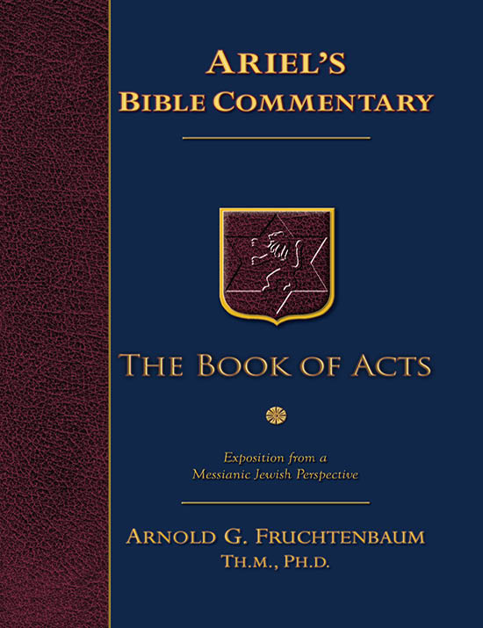
Dr. Arnold G. Fruchtenbaum
The Book of Acts, 374-75
“Aquila and Priscilla were now in Corinth because Claudius had commanded all the Jews to depart from Rome. This edict of the Jews’ expulsion from Rome was issued in A.D. 49. According to the Roman historian Suetonius, Emperor Claudius had issued the edict because ‘Jews constantly made disturbances at the instigation of Chrestus,’ which was probably a misreading of the term Christos, meaning ‘Christ.’ Apparently, a riot broke out within the Jewish community in Rome over the Messiah. The Romans, not knowing what the issues were, expelled the entire Jewish community from the city. Later, however, the Jews did return to Rome (Rom. 16:3).”

Slide 16
Acts 18:2-3 Meeting with Priscilla and Aquila
Expulsion (2)
Vocation (3)

Slide 17

Genesis 3:17-19a
¹⁷ Then to Adam He said, “Because you have listened to the voice of your wife, and have eaten from the tree about which I commanded you, saying, ‘You shall not eat from it’; Cursed is the ground because of you; In toil you will eat of it All the days of your life. ¹⁸ “Both thorns and thistles it shall grow for you; And you will eat the plants of the field; ¹⁹ By the sweat of your face You will eat bread...”

Slide 18
Acts 18:1-4 Arrival
Journey (1)
Meeting with Priscilla & Aquila (2-3)
Ministry Pattern (4)

Slide 19
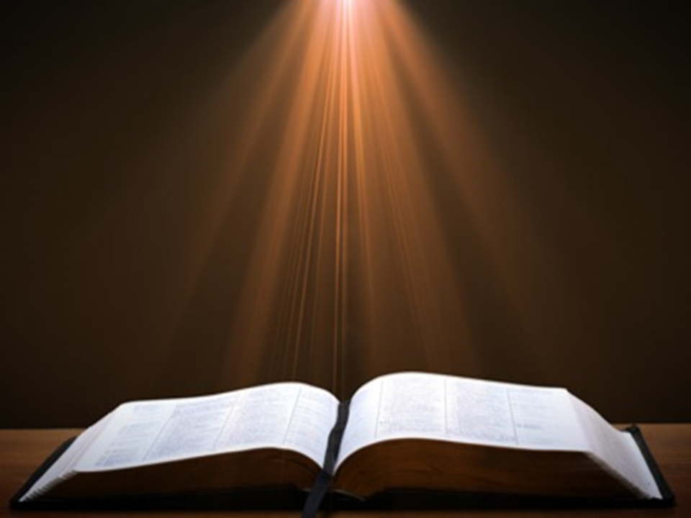
Acts 17:1-3
“¹ Now when they had traveled through Amphipolis and Apollonia, they came to Thessalonica, where there was a synagogue of the Jews. ² And according to Paul’s custom, he visited them, and for three Sabbaths reasoned with them from the Scriptures, ³ explaining and giving evidence that the Christ had to suffer and rise from the dead, and saying, “This Jesus whom I am proclaiming to you is the Christ.”

Slide 20
VIII. Corinthian Ministry Acts 18:1-18
Arrival (1-4)
Ministry (5-11)
Paul Before Gallio (12-17)
Paul’s Departure (18)

Slide 21
Acts 18:5-11 Ministry
Silas & Timothy’s report (5a)
Jewish evangelism (5b)
Jewish opposition (6)
Ministry results (7-8)
Divine revelation (9-10)
Ministry duration (11)

Slide 22
Acts 18:5-11 Ministry
Silas & Timothy’s report (5a)
Jewish evangelism (5b)
Jewish opposition (6)
Ministry results (7-8)
Divine revelation (9-10)
Ministry duration (11)

Slide 23
Second Missionary Journey

Slide 25
ORDER OF PAUL’S LETTERS | ORDER OF PAUL’S LETTERS
1. | Galatians | A.D. 49
2. | 1‒2 Thessalonians | A.D. 51
3. | 1‒2 Corinthians | A.D. 56
4. | Romans | A.D. 57
5. | Ephesians, Colossians, Philemon, Philippians | A.D. 60‒62
6. | 1 Timothy, Titus | A.D. 62‒66
7. | 2 Timothy | A.D. 67

Slide 26
Paul’s Ministry Chronology
# OF BOOKS | JOURNEY | ACTS | DATE | BOOKS
1 | 1 | 13–14 | 48–49 | Gal
2 | 2 | 15:36–18:22 | 50–52 | 1–2 Thess
3 | 3 | 18:23–21:17 | 53–57 | 1–2 Cor, Rom
4 | 4 | 28:16-31 | 60–62 | Eph, Col, Phlm, Phlp
2 | Between Imprisonments | Post Acts | 62–66 | 1 Tim, Titus
1 | 2nd Imprisonment | Post Acts | 67 | 2 Tim

Slide 27
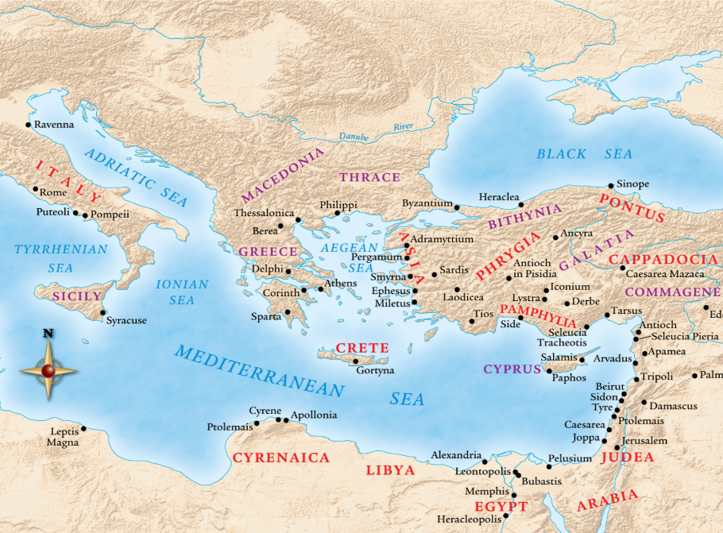

Slide 28

1 Thessalonians 4:13-18
¹³ "But we do not want you to be uninformed, brethren, about those who are asleep, so that you will not grieve as do the rest who have no hope. ¹⁴ For if we believe that Jesus died and rose again, even so God will bring with Him those who have fallen asleep in Jesus. ¹⁵ For this we say to you by the word of the Lord, that we who are alive and remain until the coming of the Lord, will not precede. . .

Slide 29
1 Thessalonians 4:13-18
. . . those who have fallen asleep. ¹⁶ For the Lord Himself descend from heaven with a shout, with the voice of the archangel and with the trumpet of God, and the dead in Christ will rise first. ¹⁷ Then we who are alive and remain will be caught up together with them in the clouds to meet the Lord in the air, and so we shall always be with the Lord. ¹⁸ Therefore comfort one another with these words."

Slide 30
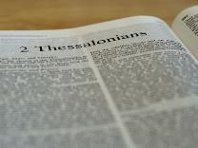
2 Thessalonians 2:1-12
Problem (2:1-2)
Prerequisites for the Day of the Lord (2:3-12)
The apostasy (2:3a)
Advent of the lawless one (2:3b-4)
Removal of the restrainer (2:5-7)
Destruction of the lawless one (2:8-9)
Destruction of lawless one’s followers (2:10-12)

Slide 31
Acts 18:5-11 Ministry
Silas & Timothy’s report (5a)
Jewish evangelism (5b)
Jewish opposition (6)
Ministry results (7-8)
Divine revelation (9-10)
Ministry duration (11)

Slide 32
Acts 18:5-11 Ministry
Silas & Timothy’s report (5a)
Jewish evangelism (5b)
Jewish opposition (6)
Ministry results (7-8)
Divine revelation (9-10)
Ministry duration (11)

Slide 33
Acts 18:5-11 Ministry
Silas & Timothy’s report (5a)
Jewish evangelism (5b)
Jewish opposition (6)
Ministry results (7-8)
Divine revelation (9-10)
Ministry duration (11)

Slide 34
Acts 18:7-8 Ministry Results
Titus Justus (7)
Crispus (8a)
Other Corinthians (8b)

Slide 35
Acts 18:7-8 Ministry Results
Titus Justus (7)
Crispus (8a)
Other Corinthians (8b)

Slide 36
Acts 18:7-8 Ministry Results
Titus Justus (7)
Crispus (8a)
Other Corinthians (8b)

Slide 37
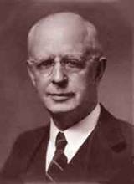
Lewis Sperry Chafer, vol. 7, Systematic Theology (Grand Rapids, MI: Kregel Publications, 1993), 265-66.
Belief – God’s One Condition for Justification
“…because upwards of 150 passages of Scripture condition salvation upon believing only (cf. John 3:16; Acts 16:31).”

Slide 38
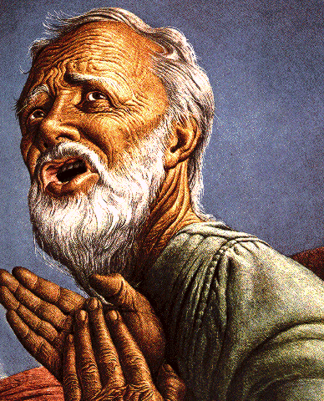
Belief – God’s One Condition for Justification
Gen 15:6
Then he believed in the LORD; and He reckoned it to him as righteousness.
John 3:16
For God so loved the world, that He gave His only begotten Son, that whoever believes in Him shall not perish, but have eternal life.
Acts 16:30-31
"Sirs, what must I do to be saved?" They said, "Believe in the Lord Jesus, and you will be saved..."

Slide 39
Acts 18:7-8 Ministry Results
Titus Justus (7)
Crispus (8a)
Other Corinthians (8b)

Slide 40
Acts 18:5-11 Ministry
Silas & Timothy’s report (5a)
Jewish evangelism (5b)
Jewish opposition (6)
Ministry results (7-8)
Divine revelation (9-10)
Ministry duration (11)

Slide 41
Acts 18:9-10 Divine Revelation
Timing (9a)
Content (9b)
Reason (10)

Slide 42
Acts 18:9-10 Divine Revelation
Timing (9a)
Content (9b)
Reason (10)

Slide 43
Acts 18:9-10 Divine Revelation
Timing (9a)
Content (9b)
Reason (10)

Slide 44
Acts 18:9-10 Divine Revelation
Timing (9a)
Content (9b)
Reason (10)

Slide 45


2 Peter 3:9
“The Lord is not slow about His promise, as some count slowness, but is patient toward you, not wishing for any to perish but for all to come to repentance.”

Slide 46
Acts 18:5-11 Ministry
Silas & Timothy’s report (5a)
Jewish evangelism (5b)
Jewish opposition (6)
Ministry results (7-8)
Divine revelation (9-10)
Ministry duration (11)

Slide 47


Acts 2:42
“They were continually devoting themselves to the apostles’ teaching and to fellowship, to the breaking of bread and to prayer.”

Slide 48

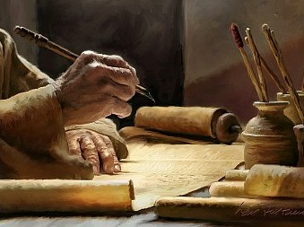
1 Timothy 4:13
“Until I come, give your attention to the public reading, to exhortation, and teaching.”

Slide 49
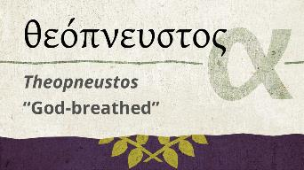
2 Timothy 3:16-17
“All Scripture is inspired by God [theopneustos] and profitable for teaching, for reproof, for correction, for training in righteousness; so that the man of God may be adequate, equipped for every good work.”
Notes:
hapaxlegomena

Slide 50

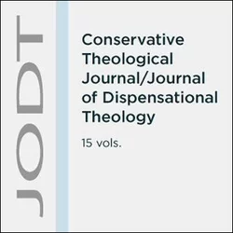
Emphasis of 2 Timothy
“By my count, there are twenty-seven explicit commands given in the body of this letter. In 27 words Paul tells pastors what to focus on. You have to be blind to miss the thrust of Paul's instructions here, because eighteen of those commands--fully two-thirds--have to do with the ministry of the Word.”
Daniel Wallace, “Crisis of the Word: A Message to Pastors or Would-be Pastors,”
Conservative Theological Journal 1, no. 2 (August 1997): 108.

Slide 51
VIII. Corinthian Ministry Acts 18:1-18
Arrival (1-4)
Ministry (5-11)
Paul Before Gallio (12-17)
Paul’s Departure (18)

Slide 52
Acts 18:12-17 Paul Before Gallio
Opposition (12-13)
Gallio’s decision (14-15)
Judgment’s results (16-17)

Slide 53
Acts 18:12-17 Paul Before Gallio
Opposition (12-13)
Gallio’s decision (14-15)
Judgment’s results (16-17)

Slide 54
Acts 18:12-13 Opposition
Circumstances (12)
Charge (13)

Slide 55
Acts 18:12-13 Opposition
Circumstances (12)
Charge (13)

Slide 56
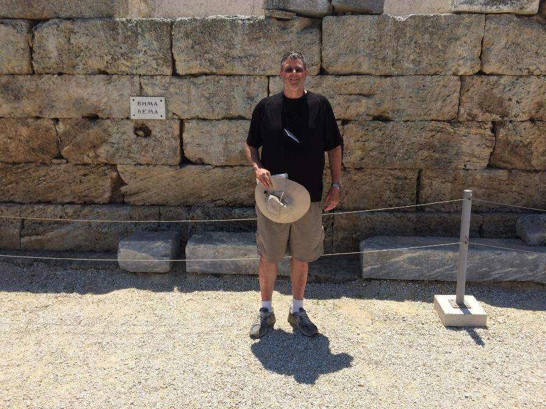

Slide 57
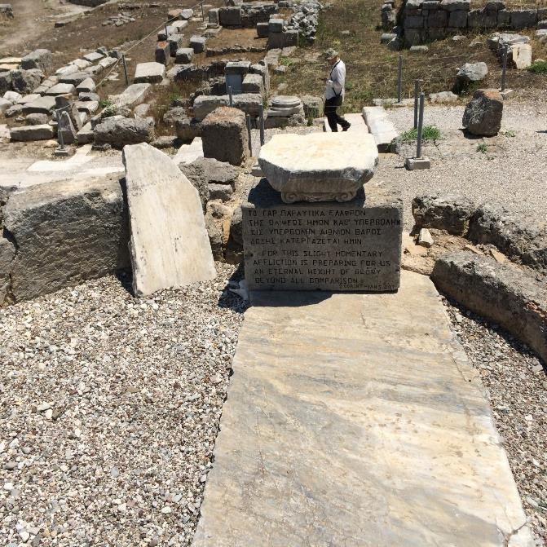

Slide 58

1 Corinthians 3:10-15
“¹⁰ According to the grace of God which was given to me, like a wise master builder I laid a foundation, and another is building on it. But each person must be careful how he builds on it. ¹¹ For no one can lay a foundation other than the one which is laid, which is Jesus Christ. ¹² Now if anyone builds on the foundation with gold, silver, precious stones, wood, hay, or straw. ¹³ each one’s work will become evident; for the day will show it because it is to be revealed with fire, and the fire itself will test the . . .

Slide 59
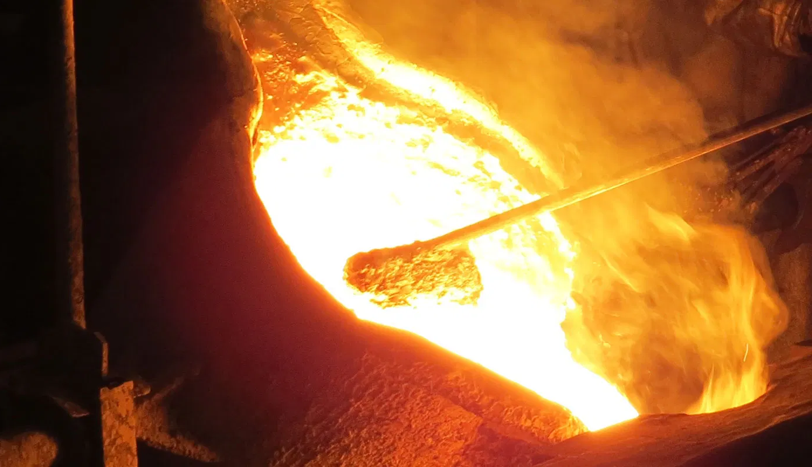
1 Corinthians 3:10-15
…quality of each one’s work. ¹⁴ If anyone’s work which he has built on it remains, he will receive a reward. ¹⁵ If anyone’s work is burned up, he will suffer loss; but he himself will be saved, yet only so as through fire.”

Slide 60
1 Corinthians 4:5
“Therefore do not go on passing judgment before the time, but wait until the Lord comes who will both bring to light the things hidden in the darkness and disclose the motives of men’s hearts; and then each man’s praise will come to him from God.”

Slide 61

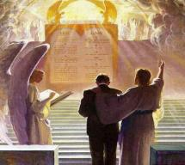
2 Corinthians 5:10
“For we must all appear before the judgment seat of Christ, so that each one may be recompensed for his deeds in the body, according to what he has done, whether good or bad.”

Slide 62

1 Corinthians 9:24-27
“²⁴ Do you not know that those who run in a race all run, but only one receives the prize? Run in such a way that you may win. ²⁵ Everyone who competes in the games exercises self-control in all things. They then do it to receive a perishable wreath, but we an imperishable. ²⁶ Therefore I run in such a way, as not without aim; I box in such a way, as not beating the air; ²⁷ but I discipline my body and make it my slave, so that, after I have preached to others, I myself will not be disqualified.”

Slide 63
Scripture’s Five Crowns (Rev 4:10: 3:11; 2 John 8)
SCRIPTURE | CROWN | PURPOSE
1 Cor. 9:24-27 | Incorruptible | Gaining mastery over the flesh
1 Thess. 2:19-20 | Rejoicing | Soul winning
Jas. 1:12; Rev. 2:10 | Life | Enduring trials
1 Pet. 5:2-4 | Glory | Shepherding God’s people
2 Tim. 4:8 | Righteousness | Longing for His appearing

Slide 64
SCRIPTURE’S FOUR JUDGMENTS
NAME | SHEEP AND GOAT | JUDGMENT OF THE JEWS | BEMA SEAT | GREAT WHITE THRONE
SCRIPTURE | Matt 25:31-46 | Ezek 20:33-44 | 1 Cor 3:10-15 | Rev 20:11-15
PLACE | Earth, Jerusalem | Earth, wilderness | Heaven | Earth
AUDIENCE | Gentile Tribulation survivors | Jewish Tribulation survivors | Church Age believers | All unsaved
WHEN | After Tribulation | After Tribulation | After rapture | After Millennium
PURPOSE | Saved Gentiles enter kingdom | Saved Jews enter kingdom | Reward believers | Degree of punishment in hell
EVALUATION | Treatment of Christ’s brethren | Passing under shepherd’s rod | Works taken through fire | Not in the book; judged by books

Slide 65
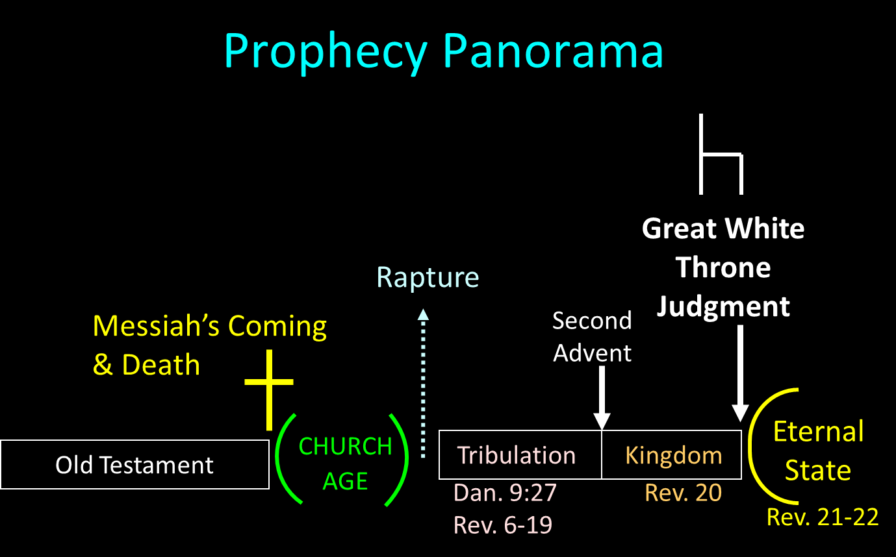

Slide 66
Acts 18:12-13 Opposition
Circumstances (12)
Charge (13)

Slide 67
Acts 18:12-17 Paul Before Gallio
Opposition (12-13)
Gallio’s decision (14-15)
Judgment’s results (16-17)

Slide 68
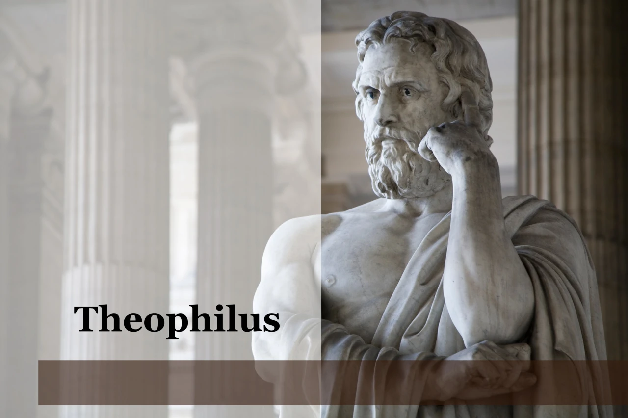
Purpose
To present Theophilus with an orderly account of the birth and growth of the church so as to affirm him in what he has believed.

Slide 69

Message
Birth and growth of the church numerically, geographically, ethnically.
Components
Numerically (progress reports)
Geographically (From Jerusalem to Rome)
Ethnically (From Judaism to Gentile domination)

Slide 70
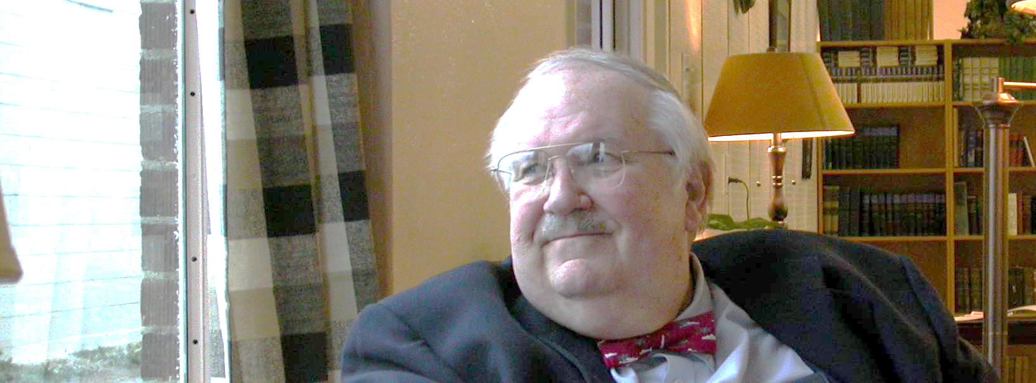
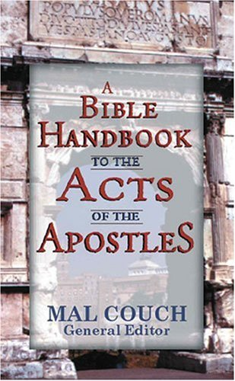
Dr. Mal Couch
Couch, A Bible Handbook to the Acts of the Apostles, 348
“Gallio’s actions in the book of Acts will have profound effect on the growth of Christianity in the Roman world by postponing official persecution... [His] refusal to indict Paul has ramifications throughout the Empire. Had he sided with the Jewish leaders and proclaimed Christianity a new religion, it would be illegal under Roman law. A precedent would have been set that could outlaw the church at a time it is still weak and vulnerable. His refusal to indict Paul protects the preaching of Christianity for a time.”

Slide 71
Acts 18:12-17 Paul Before Gallio
Opposition (12-13)
Gallio’s decision (14-15)
Judgment’s results (16-17)

Slide 72
Acts 18:16-17 Judgment’s Results
Case dismissed (16)
Attack on the Jews (17a)
Gallio’s indifference (17b)

Slide 73
Acts 18:16-17 Judgment’s Results
Case dismissed (16)
Attack on the Jews (17a)
Gallio’s indifference (17b)

Slide 74
Acts 18:16-17 Judgment’s Results
Case dismissed (16)
Attack on the Jews (17a)
Gallio’s indifference (17b)

Slide 75
Acts 18:16-17 Judgment’s Results
Case dismissed (16)
Attack on the Jews (17a)
Gallio’s indifference (17b)

Slide 76
VIII. Corinthian Ministry Acts 18:1-18
Arrival (1-4)
Ministry (5-11)
Paul Before Gallio (12-17)
Paul’s Departure (18)

Slide 77
Acts 18:18 Paul’s Departure
Additional ministry (18a)
Return to Jerusalem (18b)
Nazirite vow (18c)

Slide 78
Acts 18:18 Paul’s Departure
Additional ministry (18a)
Return to Jerusalem (18b)
Nazirite vow (18c)

Slide 79
Acts 18:18 Paul’s Departure
Additional ministry (18a)
Return to Jerusalem (18b)
Nazirite vow (18c)

Slide 80
Second Missionary Journey

Slide 81
Acts 18:18 Paul’s Departure
Additional ministry (18a)
Return to Jerusalem (18b)
Nazirite vow (18c)

Slide 82
Second Missionary Journey

Slide 84
Dr. Arnold G. Fruchtenbaum
The Book of Acts, 374-75
“Freedom from the Mosaic Law means two things: First, it means believers are free from the obligation to obey any of the 613 commandments; but second, freedom from the law also means that they are free to observe those things that they choose to observe as long as they do not contradict the laws of Messiah. Paul saw no contradiction between keeping Jewish customs and living his new faith…The difference between Paul and the Judaizers was that the Judaizers tried to impose these things upon the Gentile believers. While choosing to practice many Jewish customs, Paul refused to impose them on the Gentiles.”

Slide 85
Conclusion

Slide 86
VIII. Corinthian Ministry Acts 18:1-18
Arrival (1-4)
Ministry (5-11)
Paul Before Gallio (12-17)
Paul’s Departure (18)

Slide 87
Acts 15:36‒18:22 2nd Missionary Journey
Schism between Paul & Barnabas (15:36-41)
Syria & Cilicia ministry (16:1-5)
Macedonian call (16:6-10)
Philippian ministry (16:11-40)
Thessalonica ministry (17:1-9)
Berean ministry (17:10-15)
Athens’ ministry (17:16-34)
Corinthian ministry (18:1-18)
Ephesus’ ministry (18:19-21)
Return to Antioch (18:22)

