Slide 1



Slide 2

EXODUS STRUCTURE/OUTLINE
Redemption (1–18)
  Redemption (1:1–12:30)
  Liberation (12:31–15:21)
  Preservation (15:22–18:27)
Mosaic Covenant (19–40)
  Law (19–24)
  Tabernacle instructions (25–31)
  Apostasy (32–34)
  Tabernacle building (35–40)

Slide 3
REDEMPTION
(1:1–12:30)
Why redemption is necessary (Exod 1)
Development of the deliverer (Exod 2–4)
First confrontation with Pharaoh (Exod 5)
God reassures Moses (Exod 6:1–7:7)
Second confrontation with Pharaoh (Exod 7:8-13)
Plagues (Exod 7:14–12:30)

Slide 4
The Plagues of Egypt
NO. | DESCRIPTION | SCRIPTURE | Egyptian Deity
1. | Water to Blood | Exod. 7:14-25 | Hapi, Khnum
2. | Frogs | Exod. 8:1-15 | Heqt
3. | Gnats | Exod. 8:16-19 | Set
4. | Flies | Exod. 8:20-32 | Uatchit
5. | Disease on Cattle | Exod. 9:1-7 | Hathor, Apis
6. | Boils | Exod. 9:8-12 | Sekhmet, Serapis
7. | Hail | Exod. 9:13-35 | Seth, Nut
8. | Locusts | Exod. 10:1-20 | Seth, Nut, Osiris
9. | Darkness | Exod. 10:21-29 | Re, Horus, Atum
10. | Death of the First Born | Exod. 12:29-36 | Min, Osiris, Heqt, Isis

Slide 5
TEN PLAGUES REDEMPTION (7:14–12:30)
Nile to blood
Frogs
Gnats
Flies
Death of livestock
Boils
Hail
Locusts
Darkness
Death of 1st born

Slide 6
DARKNESS
Exodus 10:21-29
  Plague’s Manifestation (21-23)
  Pharaoh Speaks to Moses (24-29)

Slide 7
II. Exodus 10:24-29
Pharaoh Speaks to Moses
    Entrance (24a)
    Pharaoh’s command (24b)
    Pharaoh’s qualification (24c)
    Moses’ rebuttal (25-26)
    God’s hardening (27)
    Pharaoh’s command (28)
    Moses’ affirmation (29)

Slide 8
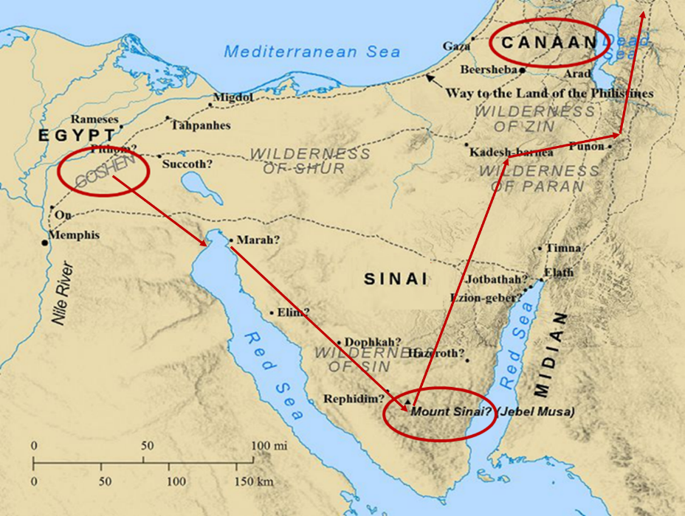

Slide 9
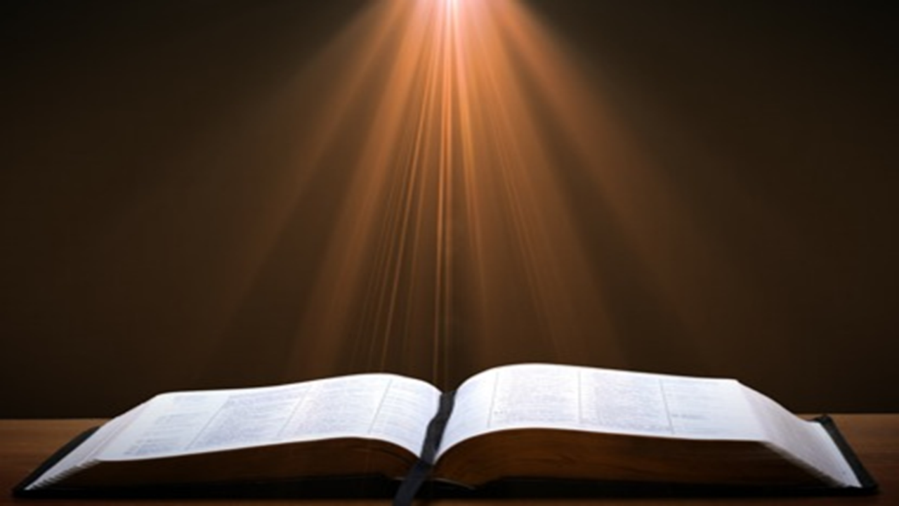
Ephesians 2:8-10
“⁸ For by grace you have been saved through faith; and that not of yourselves, it is the gift of God; ⁹ not as a result of works, so that no one may boast. ¹⁰ For we are His workmanship, created in Christ Jesus for good works, which God prepared beforehand so that we would walk [peripateō, subjunctive mood] in them.”

Slide 10
Galatians 5:1
Therefore…
1-4
5-6

Slide 11
Romans 12:1
Therefore…
1-11
12-16

Slide 12
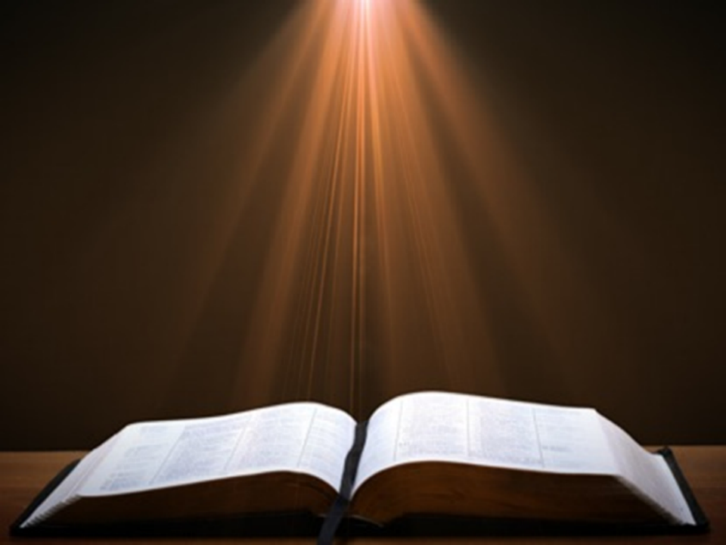

Romans 12:1
“Therefore I urge you, brethren, by the mercies of God, to present your bodies a living and holy sacrifice, acceptable to God, which is your spiritual service of worship.”

Slide 13
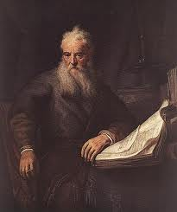
Romans Outline
Salutation (1:1-17)
Sin (1:18–3:20)
Salvation (3:21–5:21)
Sanctification (6–8)
Sovereignty (9–11)
SERVICE (12:1–15:13)
Summation (15:14–16:27)

Slide 14

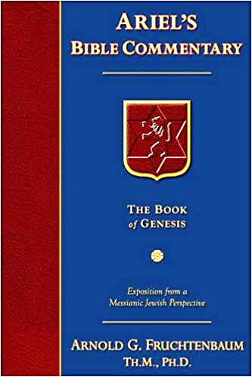
Dr. Arnold G. Fruchtenbaum
The Book of Genesis, 299
“It is the same principle in salvation. Salvation is by grace through faith, not based on works. Once saved, believers retain salvation unconditionally; but in response to God’s love for them, believers are expected to keep His commandments. However, whether believers keep them or do not keep them, their salvation is secure.”

Slide 15

John 10:27-29
“My sheep hear My voice, and I know them, and they follow Me; ²⁸ and I give eternal life to them, and they will never perish [ou mē; aiōnia]; and no one will snatch them out of My hand. ²⁹ My Father, who has given them to Me, is greater than all; and no one is able to snatch them out of the Father’s hand.”

Slide 16
Ephesians 4:1
Therefore…
1-3
4-6

Slide 17
EPHESIANS: WHAT IS INSIDE?
1–3 | 4–6
Relationship | Responsibility
Doctrine | Deed
Orthodoxy | Orthopraxy
Knowledge | Wisdom
Belief | Behavior
Position | Practice
Privileges | Responsibility

Slide 18
HEBREWS OUTLINE
Doctrinal section (1:1–10:18)
  Christ’s attributes (1:1-3)
  Christ is superior to the angels (1:4–2:18)
  Christ is superior to Moses (3:1–4:13)
  Christ is superior to Aaron (4:14–10:18)
Practical section (10:19–13:25)
  Exhortations and pastoral reminders (10, 12, 13)
  Hall of faith (11)
  Benediction (13:20-25)

Slide 19
II. Exodus 10:24-29
Pharaoh Speaks to Moses
    Entrance (24a)
    Pharaoh’s command (24b)
    Pharaoh’s qualification (24c)
    Moses’ rebuttal (25-26)
    God’s hardening (27)
    Pharaoh’s command (28)
    Moses’ affirmation (29)

Slide 20
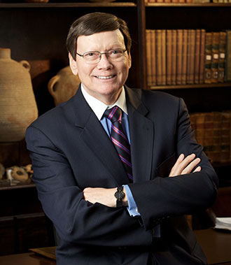
Dr. Ed Hindson
Hindson, E. E., & Mitchell, D. R., eds. (2010). KJV Bible Commentary for Today: The Most Up-to-Date Commentary on the Time-Honored Text of the KJV (p. 86). Thomas Nelson.
“4:21. I will harden his heart. An expression meaning ‘to strengthen his will.’ The text identifies the heart as the location of the volition, man’s decision-making ability. On seven occasions in the narrative, God hardens Pharaoh’s heart (9:12; 10:1, 20, 27; 11:10; 14:4, 8) or foretells that He will harden Pharaoh’s heart (4:21; 7:3), and nine times in the text, Pharaoh hardens his own heart (7:13, 14, 22; 8:15, 19, 32; 9:7, 34–35). For the initial five plagues, the text registers Pharaoh as the agent of hardening. Not until the sixth plague does God participate in the confirmation of Pharaoh’s own volitional choices.”

Slide 21

Charles Ryrie
Ryrie Study Bible, page 96
Exodus 4:21 - “harden his heart. Ten times it is said that Pharaoh hardened his own heart (7:13, 14, 22; 8:15, 19, 32; 9:7, 34, 35; 13:15), and 10 times that God hardened Pharaoh’s heart (4:21; 7:3; 9:12; 10:1, 20, 27; 11:10; 14:4, 8, 17). Paul uses this as an example of the inscrutable will of God and of His mercy toward men (Rom. 9:14–18). Seven times Pharaoh hardened his own heart before God first hardened it, though the prediction that God would do it preceded all.”

Slide 22
GOD HARDENING PHARAOH'S HEART
The prediction of God hardening of Pharaoh (4:21)
Pharaoh repeatedly hardening his own heart (7:13, 22; 8:15, 19, 32; 9:7)
Not until the sixth plague did God harden Pharaoh’s heart (Exod 9:12)

Slide 23

Genesis 1:26-28
²⁶ Then God said, “Let Us make man in Our image, according to Our likeness; and let them rule over the fish of the sea and over the birds of the sky and over the cattle and over all the earth, and over every creeping thing that creeps on the earth.” ²⁷ God created man in His own image, in the image of God He created him; male and female He created them. ²⁸ God blessed them; and God said to them, “Be fruitful and multiply, and fill the earth, and subdue it; and rule over the fish of the sea and over the birds of the sky and over every living thing that moves on the earth.”

Slide 24

Genesis 9:6
“Whoever sheds man’s blood, By man his blood shall be shed, For in the image of God He made man.”

Slide 25

Romans 1:18–20
¹⁸ For the wrath of God is revealed from heaven against all ungodliness and unrighteousness of men who suppress the truth in unrighteousness, ¹⁹ because that which is known about God is evident within them; for God made it evident to them. ²⁰ For since the creation of the world His invisible attributes, His eternal power and divine nature, have been clearly seen, being understood through what has been made, so that they are without excuse.

Slide 26
Romans 1:18–20
¹⁸ For the wrath of God is revealed from heaven against all ungodliness and unrighteousness of men who suppress the truth in unrighteousness, ¹⁹ because that which is known about God is evident within them; for God made it evident to them. ²⁰ For since the creation of the world His invisible attributes, His eternal power and divine nature, have been clearly seen, being understood through what has been made, so that they are without excuse.

Slide 27
II. Exodus 10:24-29
Pharaoh Speaks to Moses
    Entrance (24a)
    Pharaoh’s command (24b)
    Pharaoh’s qualification (24c)
    Moses’ rebuttal (25-26)
    God’s hardening (27)
    Pharaoh’s command (28)
    Moses’ affirmation (29)

Slide 28
Dr. Ed Hindson
Hindson, E. E., & Mitchell, D. R., eds. (2010). KJV Bible Commentary for Today: The Most Up-to-Date Commentary on the Time-Honored Text of the KJV (p. 98). Thomas Nelson.
Exodus 10:28-29 - “The king expelled Moses and Aaron from his presence, forbidding any future return, with the promise of capital consequence for any infraction. While they would indeed shortly see each other once again, it would be for the sole purpose of Pharaoh’s humiliating admission of defeat before YHWH.”

Slide 29
II. Exodus 10:24-29
Pharaoh Speaks to Moses
    Entrance (24a)
    Pharaoh’s command (24b)
    Pharaoh’s qualification (24c)
    Moses’ rebuttal (25-26)
    God’s hardening (27)
    Pharaoh’s command (28)
    Moses’ affirmation (29)

Slide 30
Dr. Ed Hindson
Hindson, E. E., & Mitchell, D. R., eds. (2010). KJV Bible Commentary for Today: The Most Up-to-Date Commentary on the Time-Honored Text of the KJV (p. 98). Thomas Nelson.
Exodus 10:28-29 - “The king expelled Moses and Aaron from his presence, forbidding any future return, with the promise of capital consequence for any infraction. While they would indeed shortly see each other once again, it would be for the sole purpose of Pharaoh’s humiliating admission of defeat before YHWH.”

Slide 31
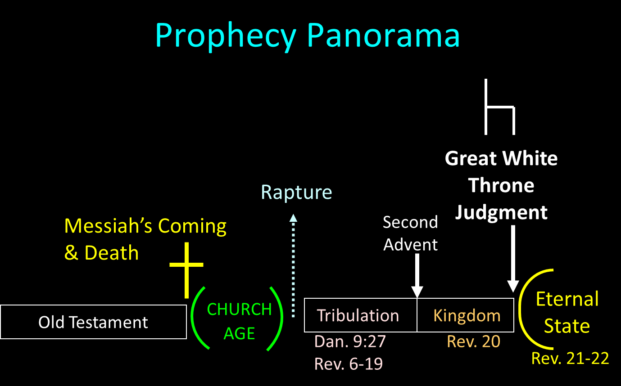

Slide 32

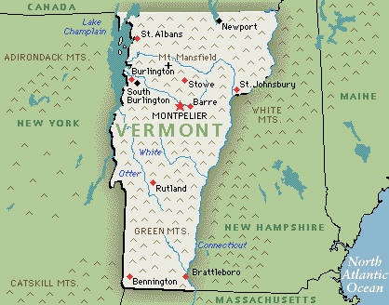
Vermont Constitution (1777)
Brewer, United States A Christian Nation, 25
“The Vermont Constitution of 1777 required of every member of the House of Representatives that he take this oath: ‘I do believe in one God, the creator and governor of the universe, the rewarder of the good and punisher of the wicked, and I do acknowledge the scriptures of the Old and New Testaments to be given by divine inspiration, and own and profess that Protestant religion.’ A similar requirement was provided by the Constitution of 1786.”

Slide 33
Scripture’s Four Judgments
NAME | SHEEP AND GOAT | JUDGMENT OF THE JEWS | BEMA SEAT | GREAT WHITE THRONE
SCRIPTURE | Matt 25:31-46 | Ezek 20:33-44 | 1 Cor 3:10-15 | Rev 20:11-15
PLACE | Earth, Jerusalem | Earth, wilderness | Heaven | Earth
AUDIENCE | Gentile Tribulation survivors | Jewish Tribulation survivors | Church Age believers | All unsaved
WHEN | After Tribulation | After Tribulation | After rapture | After Millennium
PURPOSE | Saved Gentiles enter kingdom | Saved Jews enter kingdom | Reward believers | Degree of punishment in hell
EVALUATION | Treatment of Christ’s brethren | Passing under shepherd’s rod | Works taken through fire | Not in the book; judged by books

Slide 34

Acts 17:30-31
“³⁰ Therefore having overlooked the times of ignorance, God is now declaring to men that all people everywhere should repent [metanoeō], ³¹ because He has fixed a day in which He will judge the world in righteousness through a Man whom He has appointed, having furnished proof to all men by raising Him from the dead.”

Slide 35

1 Corinthians 4:5
“ Therefore do not go on passing judgment before the time, but wait until the Lord comes who will both bring to light the things hidden in the darkness and disclose the motives of men’s hearts; and then each man’s praise will come to him from God.”

Slide 36
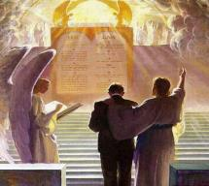
2 Corinthians 5:10
“For we must all appear before the judgment seat of Christ, so that each one may be recompensed for his deeds in the body, according to what he has done, whether good or bad.”

Slide 37
Conclusion

Slide 38
DARKNESS
Exodus 10:21-29
  Plague’s Manifestation (21-23)
  Pharaoh Speaks to Moses (24-29)

Slide 39
II. Exodus 10:24-29
Pharaoh Speaks to Moses
    Entrance (24a)
    Pharaoh’s command (24b)
    Pharaoh’s qualification (24c)
    Moses’ rebuttal (25-26)
    God’s hardening (27)
    Pharaoh’s command (28)
    Moses’ affirmation (29)

Slide 40
TEN PLAGUES REDEMPTION (7:14–12:30)
Nile to blood
Frogs
Gnats
Flies
Death of livestock
Boils
Hail
Locusts
Darkness
Death of 1st born

Slide 41
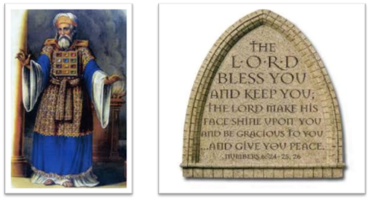
²⁴ The Lord bless you, and keep you; ²⁵ The Lord make His face shine on you, And be gracious to you; ²⁶ The Lord lift up His countenance on you, And give you peace.
Numbers 6:24–26 (NASB95)

