Slide 1



Slide 2
INTRODUCTORY MATTERS
Authorship
Audience
Date
Occasion
Purpose
Message
Outline

Slide 3
AUTHORSHIP
Apollos?
Barnabas?
Paul?

Slide 4
INTRODUCTORY MATTERS
Authorship
Audience
Date
Occasion
Purpose
Message
Outline

Slide 5
AUDIENCE
Believers (1:3)
2nd generation (2:2-3)
Jews
Located in the Land of Israel

Slide 6
AUDIENCE
Believers (1:3)
2nd generation (2:2-3)
Jews
Located in the Land of Israel

Slide 7

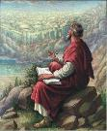
John 20:30-31
“Therefore many other signs Jesus also performed in the presence of the disciples, which are not written in this book; but these have been written so that you may believe that Jesus is the Christ, the Son of God; and that believing you may have life in His name.”

Slide 8
AUDIENCE
Believers (1:3)
2nd generation (2:2-3)
Jews
Located in the Land of Israel

Slide 9
AUDIENCE
Believers (1:3)
2nd generation (2:2-3)
Jews
Located in the Land of Israel

Slide 10
AUDIENCE
Believers (1:3)
2nd generation (2:2-3)
Jews
Located in the Land of Israel

Slide 11

Acts 8:3-4; 11:19
“³ But Saul began ravaging the church, entering house after house, and dragging off men and women, he would put them in prison. ⁴ Therefore, those who had been scattered went about preaching the word…¹⁹ So then those who were scattered because of the persecution that occurred in connection with Stephen made their way to Phoenicia and Cyprus and Antioch, speaking the word to no one except to Jews alone.”

Slide 12

James 1:1
“James, a bond-servant of God and of the Lord Jesus Christ, To the twelve tribes who are dispersed abroad: Greetings.”

Slide 13
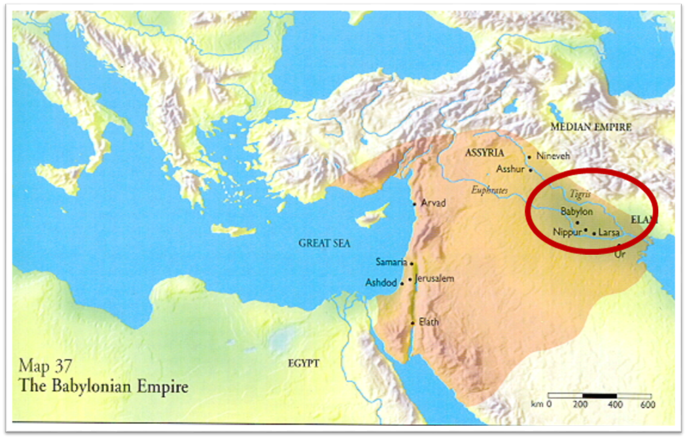

Slide 14

1 Peter 1:1
“To those who reside as aliens, scattered [diaspora] throughout Pontus, Galatia, Cappadocia, Asia, and Bithynia, who are chosen.”

Slide 15
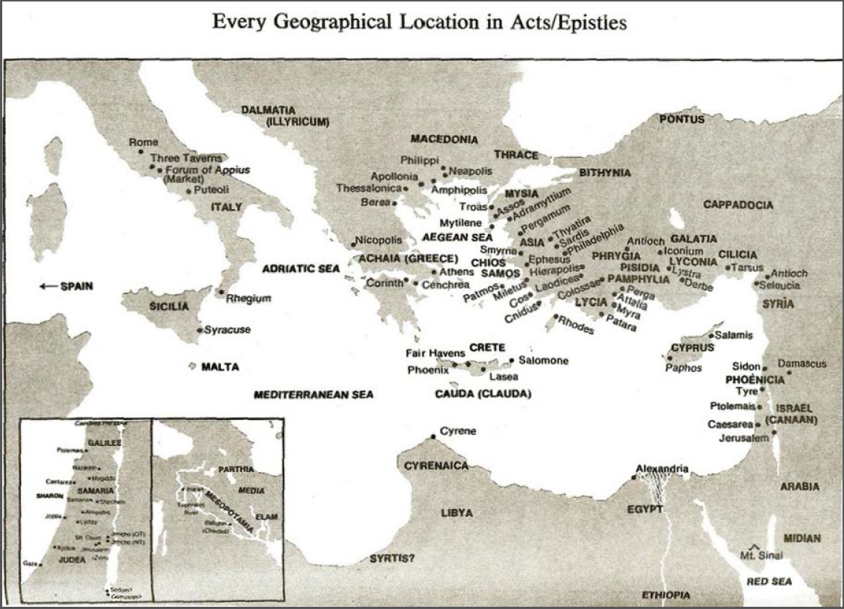

Slide 16
INTRODUCTORY MATTERS
Authorship
Audience
Date
Occasion
Purpose
Message
Outline

Slide 17
DATE (A.D. 62–64)
Before
A.D. 95 (Clement of Rome)
A.D. 70 (Heb 8:4, 13; 9:6; 10:1-2; 13:10)
A.D. 64 (Heb 12:4)
After apostolic generation (2:2-3)

Slide 18
INTRODUCTORY MATTERS
Authorship
Audience
Date
Occasion
Purpose
Message
Outline

Slide 19
OCCASION
A.D. 70
Heb 3:1 (Christian confession)
Unbelieving Jews placing audience under duress to return to Judaism
Audience being worn down
Temple still standing

Slide 20
OCCASION
A.D. 70
Heb 3:1 (Christian confession)
Unbelieving Jews placing audience under duress to return to Judaism
Audience being worn down
Temple still standing

Slide 21

Daniel 9:26
“Then after the sixty-two weeks the Messiah will be cut off and have nothing, and the people of the prince who is to come will destroy the city and the sanctuary. And its end will come with a flood; even to the end there will be war; desolations are determined.”

Slide 22
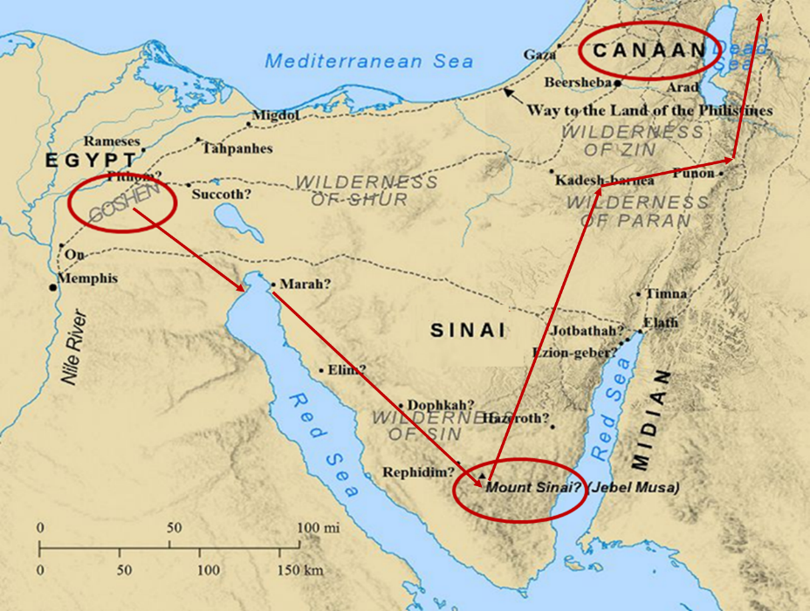

Slide 23
Six Parts of a Suzerain-Vassal Treaty in Deuteronomy
Preamble (1:1-5)
Prologue (1:6–4:40)
Covenant obligations (5–26)
Storage and reading instructions (27:2-3; 31:9, 24, 26)
Witnesses (32:1)
Blessings and curses (28)

Slide 24


Deuteronomy 28:49-50
⁴⁹ “The Lord will bring a nation against you from afar, from the end of the earth, as the eagle swoops down, a nation whose language you shall not understand, ⁵⁰ a nation of fierce countenance who will have no respect for the old, nor show favor to the young.”

Slide 25
ISRAEL'S JUDGMENTS
Division of the kingdom in 931 B.C. (1 Kgs. 12)
Assyrian judgment in 722 B.C. (2 Kgs. 17)
Babylonian captivity in 586 B.C. (2 Kgs. 25)
Rome Diaspora in A.D. 70 (Luke 19:41-44)

Slide 26
OCCASION
A.D. 70
Heb 3:1 (Christian confession)
Unbelieving Jews placing audience under duress to return to Judaism
Audience being worn down
Temple still standing

Slide 27
OCCASION
A.D. 70
Heb 3:1 (Christian confession)
Unbelieving Jews placing audience under duress to return to Judaism
Audience being worn down
Temple still standing

Slide 28
OCCASION
A.D. 70
Heb 3:1 (Christian confession)
Unbelieving Jews placing audience under duress to return to Judaism
Audience being worn down
Temple still standing

Slide 29
OCCASION
A.D. 70
Heb 3:1 (Christian confession)
Unbelieving Jews placing audience under duress to return to Judaism
Audience being worn down
Temple still standing

Slide 30
INTRODUCTORY MATTERS
Authorship
Audience
Date
Occasion
Purpose
Message
Outline

Slide 31
PURPOSE
Encouragement/motivation to not lapse back into Judaism
What believers already have in Christ is superior to every vestige of Judaism (Angels, Moses, and the Aaronic priesthood)
Warnings

Slide 32
PURPOSE
Encouragement/motivation to not lapse back into Judaism
What believers already have in Christ is superior to every vestige of Judaism (Angels, Moses, and the Aaronic priesthood)
Warnings

Slide 33
PURPOSE
Encouragement/motivation to not lapse back into Judaism
What believers already have in Christ is superior to every vestige of Judaism (Angels, Moses, and the Aaronic priesthood)
Warnings

Slide 34
PURPOSE
Encouragement/motivation to not lapse back into Judaism
What believers already have in Christ is superior to every vestige of Judaism (Angels, Moses, and the Aaronic priesthood)
Warnings

Slide 35
WARNINGS
2:1-4 – Warning against drifting
3:7–4:13 – Warning against disobedience
5:10–6:20 – Warning against immaturity
10:26-39 – Warning against despising the truth
12:25-29 – Warning against denying the truth

Slide 36
4 VIEWS ON WARNING PASSAGES
Hypothetical
Arminianism
Calvinism/Reformed
Loss of blessings

Slide 37
4 VIEWS ON WARNING PASSAGES
Hypothetical
Arminianism
Calvinism/Reformed
Loss of blessings

Slide 38
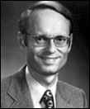
Charles Ryrie. – Threat View Ryrie Study Bible, Page 1521
“Others understand the passage to be a warning to genuine believers to urge them on in Christian growth and maturity. To ‘fall away’ is impossible (since, according to this view, true believers are eternally secure), but the phrase is placed in the sentence to strengthen the warning. It is similar to saying something like this to a class of students: ‘It is impossible for a student, once enrolled in this course, if he turns the clock back [which cannot be done], to start the course over. Therefore, let all students go on to deeper knowledge.’ In this view the phrases in verses 4-5 are understood to refer to the conversion experience.”

Slide 39
4 VIEWS ON WARNING PASSAGES
Hypothetical
Arminianism
Calvinism/Reformed
Loss of blessings

Slide 40


John 10:27-29
“²⁷ My sheep hear My voice, and I know them, and they follow Me; ²⁸ and I give eternal life to them, and they will never perish [ou mē; aiōnia]; and no one will snatch them out of My hand. ²⁹ My Father, who has given them to Me, is greater than all; and no one is able to snatch them out of the Father’s hand.”

Slide 41
4 VIEWS ON WARNING PASSAGES
Hypothetical
Arminianism
Calvinism/Reformed
Loss of blessings

Slide 42
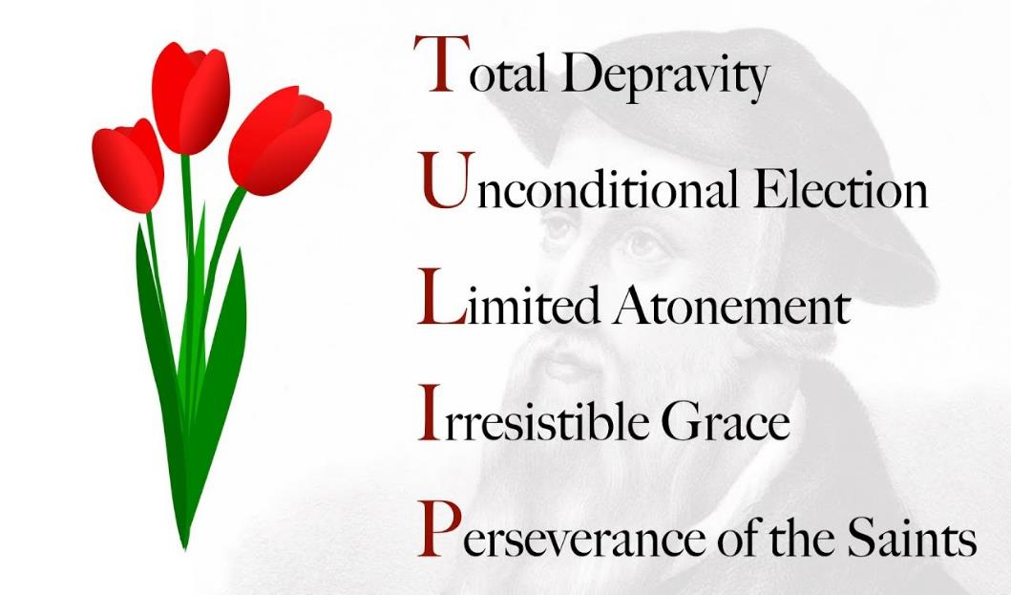

Slide 43
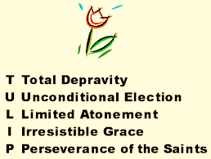
IV. Running TULIP Through the Grid of Scripture
Total Depravity
Unconditional Election
Limited Atonement
Irresistible Grace
Perseverance of the Saints

Slide 44
Perseverance of the Saints = Perseverance in Good Works to the End of One’s Life to Prove that He is One of the Elect
“P” stands for “Perseverance of the Saints.” This is what Calvinists say gives them the assurance of eternal security, but in actuality “the emphasis is upon the believer’s faithfulness in persevering—not upon God’s keeping power … uncertainty as to one’s ultimate salvation is, in fact, built into the very fabric of Calvinism itself.”
Bob Kirkland, Calvinism: None Dare Call It Heresy; Spotlight on the Life and Teachings of John Calvin (Eureka, MT: Lighthouse Trails, 2018), 34.

Slide 45
4 VIEWS ON WARNING PASSAGES
Hypothetical
Arminianism
Calvinism/Reformed
Loss of blessings

Slide 46
INTRODUCTORY MATTERS
Authorship
Audience
Date
Occasion
Purpose
Message
Outline

Slide 47
MESSAGE
The superiority of the full revelation of Christ in comparison to OT Judaism is shown through Christ’s superiority to every major vestige of Judaism, and the author wrote Hebrews so that his audience would not lapse back into Judaism.

Slide 48
INTRODUCTORY MATTERS
Authorship
Audience
Date
Occasion
Purpose
Message
Outline

Slide 49
OUTLINE
Doctrinal section (1:1–10:18)
Christ’s attributes (1:1-3)
Christ is superior to the angels (1:4–2:18)
Christ is superior to Moses (3:1–4:13)
Christ is superior to Aaron (4:14–10:18)
Practical section (10:19–13:25)
Exhortations and pastoral reminders (10, 12, 13)
Hall of faith (11)
Benediction (13:20-25)

Slide 50
Conclusion

Slide 51
INTRODUCTORY MATTERS
Authorship
Audience
Date
Occasion
Purpose
Message
Outline

Slide 52
OUTLINE
Doctrinal section (1:1–10:18)
Christ’s attributes (1:1-3)
Christ is superior to the angels (1:4–2:18)
Christ is superior to Moses (3:1–4:13)
Christ is superior to Aaron (4:14–10:18)
Practical section (10:19–13:25)
Exhortations and pastoral reminders (10, 12, 13)
Hall of faith (11)
Benediction (13:20-25)

Slide 53
CHRIST IS SUPERIOR TO PREVIOUS REVELATION (1:1-2A)
OT – Indirect, incomplete, temporary
Christ – Direct, complete, permanent

Slide 54
Hebrews 1:2-3
“² in these last days has spoken to us in His Son, whom He appointed heir of all things, through whom also He made the world. ³ And He is the radiance of His glory and the exact representation of His nature, and upholds all things by the word of His power. When He had made purification of sins, He sat down at the right hand of the Majesty on high.”

Slide 55
Hebrews 1:2-3
“² in these last days has spoken to us in His Son, whom He appointed heir of all things, through whom also He made the world. ³ And He is the radiance of His glory and the exact representation of His nature, and upholds all things by the word of His power. When He had made purification of sins, He sat down at the right hand of the Majesty on high.”

Slide 56
CHRIST’S 7 ATTRIBUTES SHOWING HIS FINALITY (1:2B-3)
Heir of all things
Maker of all things
Brightness of the Father’s glory
Express image of the Father
Upholds all things
Made complete purification for sins
Sat down at the Father’s right hand

Slide 57
CHRIST’S 7 ATTRIBUTES SHOWING HIS FINALITY (1:2B-3)
Heir of all things
Maker of all things
Brightness of the Father’s glory
Express image of the Father
Upholds all things
Made complete purification for sins
Sat down at the Father’s right hand

Slide 58
Hebrews 1:2-3
“² in these last days has spoken to us in His Son, whom He appointed heir of all things, through whom also He made the world. ³ And He is the radiance of His glory and the exact representation of His nature, and upholds all things by the word of His power. When He had made purification of sins, He sat down at the right hand of the Majesty on high.”

Slide 59
CHRIST’S 7 ATTRIBUTES SHOWING HIS FINALITY (1:2B-3)
Heir of all things
Maker of all things
Brightness of the Father’s glory
Express image of the Father
Upholds all things
Made complete purification for sins
Sat down at the Father’s right hand

Slide 60
Hebrews 1:2-3
“² in these last days has spoken to us in His Son, whom He appointed heir of all things, through whom also He made the world. ³ And He is the radiance of His glory and the exact representation of His nature, and upholds all things by the word of His power. When He had made purification of sins, He sat down at the right hand of the Majesty on high.”

Slide 61
CHRIST’S 7 ATTRIBUTES SHOWING HIS FINALITY (1:2B-3)
Heir of all things
Maker of all things
Brightness of the Father’s glory
Express image of the Father
Upholds all things
Made complete purification for sins
Sat down at the Father’s right hand

Slide 62
Hebrews 1:2-3
“² in these last days has spoken to us in His Son, whom He appointed heir of all things, through whom also He made the world. ³ And He is the radiance of His glory and the exact representation of His nature, and upholds all things by the word of His power. When He had made purification of sins, He sat down at the right hand of the Majesty on high.”

Slide 63
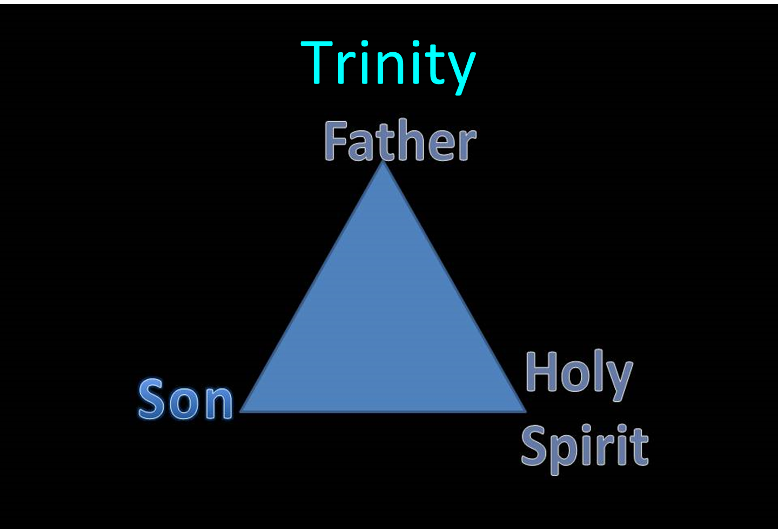

Slide 64
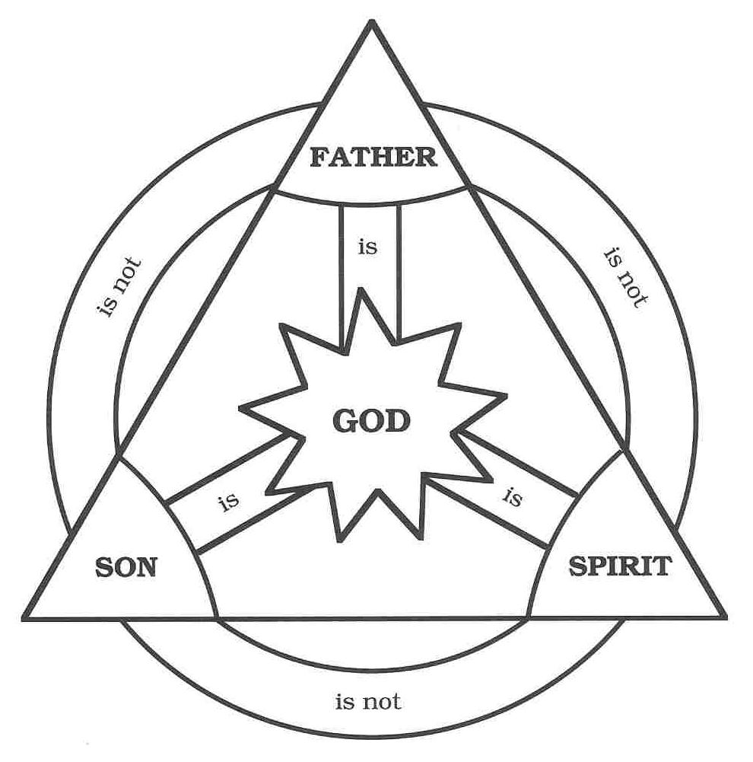

Slide 65

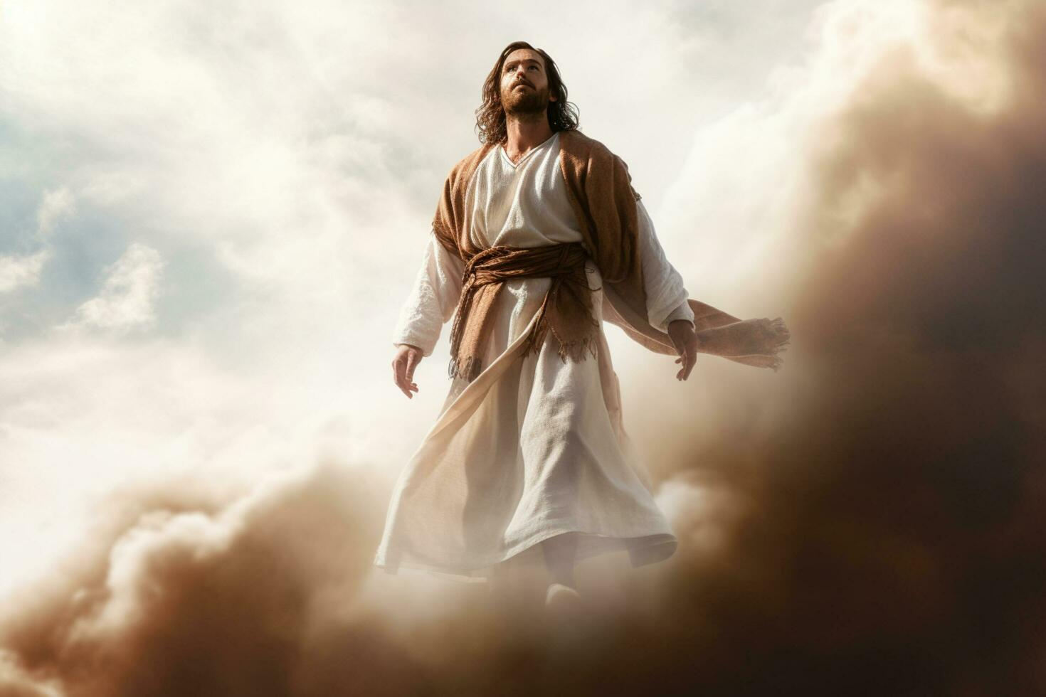
John 17:5
“Now, Father, glorify Me together with Yourself, with the glory which I had with You before the world was.”

Slide 66
CHRIST’S 7 ATTRIBUTES SHOWING HIS FINALITY (1:2B-3)
Heir of all things
Maker of all things
Brightness of the Father’s glory
Express image of the Father
Upholds all things
Made complete purification for sins
Sat down at the Father’s right hand

Slide 67
Hebrews 1:2-3
“² in these last days has spoken to us in His Son, whom He appointed heir of all things, through whom also He made the world. ³ And He is the radiance of His glory and the exact representation of His nature, and upholds all things by the word of His power. When He had made purification of sins, He sat down at the right hand of the Majesty on high.”

Slide 68
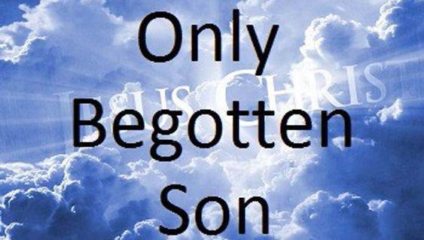
John 1:14
“And the Word became flesh, and dwelt among us, and we saw His glory, glory as of the only begotten [monogenēs] from the Father, full of grace and truth.”

Slide 69
John 1:18
“No one has seen God at any time; the only begotten God who is in the bosom of the Father, He has explained [exēgeomai] Him.”

Slide 70

J. Dwight Pentecost
Pentecost, J. D., & Durham, K. (2000). Faith that endures : a practical commentary on the book of Hebrews (Rev. ed., p. 47). Kregel Publications.
“The fourth statement is that the Son is ‘the express image of His person’ (1:3b). This emphasizes that the Son in Himself is a full and perfect revelation of what is in the Father. Even though we have not seen the Father, we know the Father because all that is in the Father is in the Son. In the Greco-Roman world, coins bore the image of the emperor. Because the image of the emperor had been impressed on the coin by a die, by looking at a coin one could recognize the emperor.”

Slide 71
J. Dwight Pentecost
Pentecost, J. D., & Durham, K. (2000). Faith that endures : a practical commentary on the book of Hebrews (Rev. ed., p. 47). Kregel Publications.
“And though the likeness of the emperor on the coin was only a representative likeness, if the die were cast away, one could determine exactly what was in the die by studying the coin. Why? Because the die reproduced itself in every detail on the coin. This is the essence of the word the author chose here to show the relationship between the Son and the Father. While we do not see the Father, all that is in the Father is in the Son. By studying the Son we learn of the Father. Just as an impression on a coin becomes an expression of the die, so what was in Christ is a revelation of the Father.”

Slide 72
CHRIST’S 7 ATTRIBUTES SHOWING HIS FINALITY (1:2B-3)
Heir of all things
Maker of all things
Brightness of the Father’s glory
Express image of the Father
Upholds all things
Made complete purification for sins
Sat down at the Father’s right hand

Slide 73
Hebrews 1:2-3
“² in these last days has spoken to us in His Son, whom He appointed heir of all things, through whom also He made the world. ³ And He is the radiance of His glory and the exact representation of His nature, and upholds all things by the word of His power. When He had made purification of sins, He sat down at the right hand of the Majesty on high.”

Slide 74
CHRIST’S 7 ATTRIBUTES SHOWING HIS FINALITY (1:2B-3)
Heir of all things
Maker of all things
Brightness of the Father’s glory
Express image of the Father
Upholds all things
Made complete purification for sins
Sat down at the Father’s right hand

Slide 75
Hebrews 1:2-3
“² in these last days has spoken to us in His Son, whom He appointed heir of all things, through whom also He made the world. ³ And He is the radiance of His glory and the exact representation of His nature, and upholds all things by the word of His power. When He had made purification of sins, He sat down at the right hand of the Majesty on high.”

Slide 76
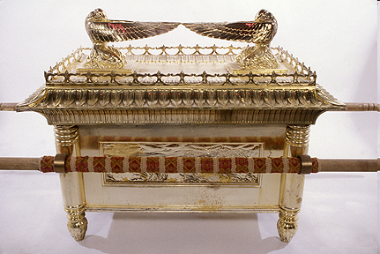
ARK OF THE COVENANT

Slide 77
Chart courtesy of Thomas Stegall

Slide 78
CHRIST’S 7 ATTRIBUTES SHOWING HIS FINALITY (1:2B-3)
Heir of all things
Maker of all things
Brightness of the Father’s glory
Express image of the Father
Upholds all things
Made complete purification for sins
Sat down at the Father’s right hand

Slide 79
Hebrews 1:2-3
“² in these last days has spoken to us in His Son, whom He appointed heir of all things, through whom also He made the world. ³ And He is the radiance of His glory and the exact representation of His nature, and upholds all things by the word of His power. When He had made purification of sins, He sat down at the right hand of the Majesty on high.”

Slide 80
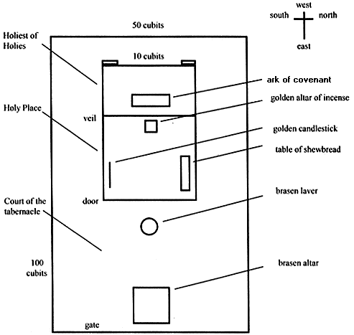
Tabernacle Diagram

Slide 81
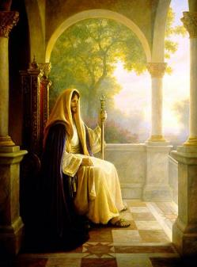
Christ’s Three Offices
Prophet – 1st Coming (Matt. 4:17)
Priest – Present Session (Heb. 4:15)
King – 2nd Coming (Isa. 9:6-7; Matt. 25:31)

Slide 82
Christ’s Three Offices
Prophet – 1st Coming (Matt. 4:17)
Priest – Present Session (Heb. 4:15)
King – 2nd Coming (Isa. 9:6-7; Matt. 25:31)

Slide 83
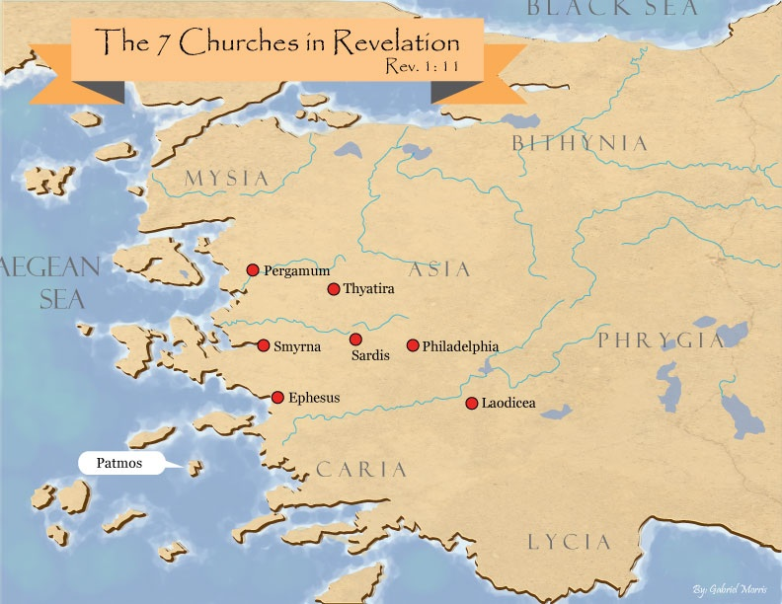
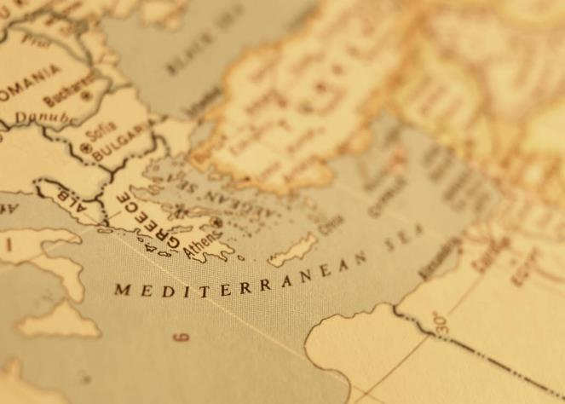

Slide 84

Revelation 3:21
PROMISE TO THE OVERCOMERS
“He who overcomes, I will grant [future tense of didōmi] to him to sit down with Me on My throne, as I also overcame and sat down [aorist tense of kathizō] with My Father on His throne.”

Slide 85
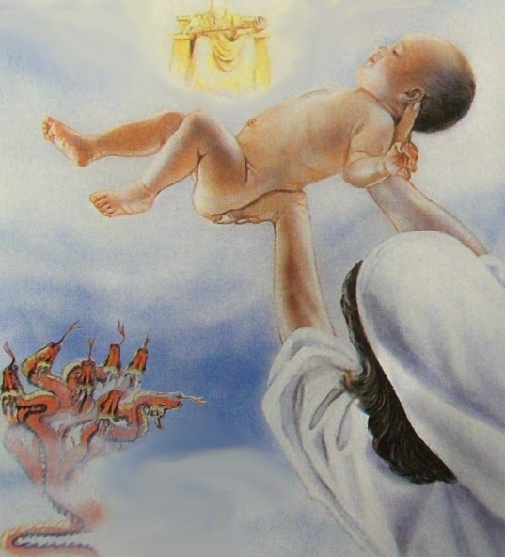
Revelation 12:5
“And she gave birth to a son, a male child, who is to rule all the nations with a rod of iron; and her child was caught up to God and to His throne.”

Slide 86
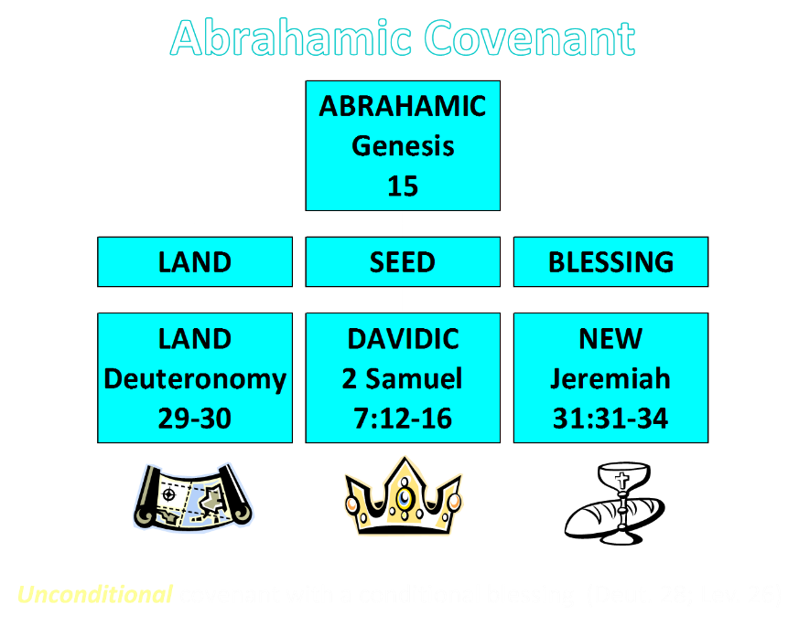

Slide 87
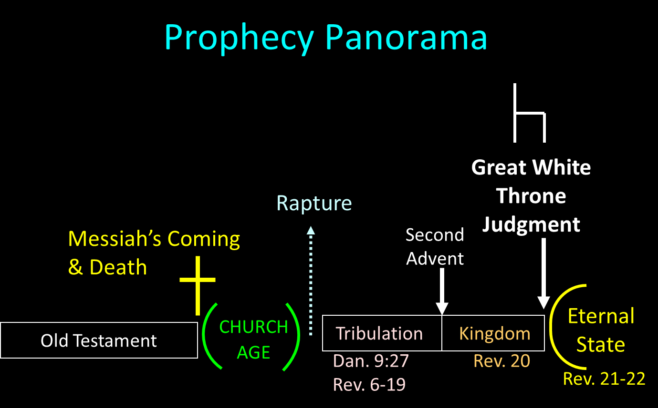

Slide 88
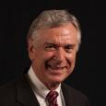
Dave Anderson
The King-Priest of Psalm 110 in Hebrews (New York: Lang, 2001), 2.
“But clearly Jesus did not set up a natural theocratic kingdom with Himself as the king ruling from Jerusalem on earth before His resurrection. So, what happened to the kingdom He promised? It was postponed, many NT interpreters suggest. . . . But if the premillennial view just espoused is true, that leaves the question concerning the present ministry of Christ. What is He doing right now?”

Slide 89
Dave Anderson
The King-Priest of Psalm 110 in Hebrews (New York: Lang, 2001), 296.
“But classical or revised dispensationalists should also recognize the already eschatology of Hebrews. Christ is not passive on the throne. He is reigning. He has subjects. And because He is the forerunner, there are many present blessings which belong to the eschatological age which can be enjoyed now because the Davidic Covenant with some of its blessings has been inaugurated.”

Slide 90


Slide 91

Lewis Sperry Chafer
vol. 5, Systematic Theology (Grand Rapids, MI: Kregel Publications, 1993), 273-74.
“The present ministry of Christ in heaven, known as His session, is far-reaching both in consequence and import. It too, has not been treated even with a passing consideration by Covenant theologians, doubtless due to their inability—because of being confronted with their one covenant theory—to introduce features and ministries which indicate a new divine purpose in the Church and by so much tend to disrupt the unity of a supposed immutable purpose and covenant of God’s. Since, as will be seen, certain vital ministries of Christ in heaven provide completely for the believer’s security, the present session of Christ has been eschewed by Arminians in a manner equally unpardonable. This neglect accounts very well . . .

Slide 92
Lewis Sperry Chafer
vol. 5, Systematic Theology (Grand Rapids, MI: Kregel Publications, 1993), 273-74.
…for the emphasis of their pulpit ministrations. The Christian public, because deprived of the knowledge of Christ’s present ministry, are unaware of its vast realities, though they are able from childhood itself to relate the mere historical facts and activities of Christ during His three and one-half years of service on earth. That Christ is doing anything now is not recognized by Christians generally and for this part-truth kind of preaching is wholly responsible. It yet remains true, whether neglected by one or the other kind of theologian, that Christ is now engaged in ministry which determines the service and destiny of all those who have put their trust in Him.”

Slide 93
CHRIST’S HIGH PRIESTLY ACTIVITIES IN HIS PRESENT SESSION
Sustains creation (Col. 1:16-17) | Keeps the Saints (John 10:27-29; 1 Pet. 1:5)
Head over the Church (Eph. 1:22-23) | Intercedes for the Saints (Rom. 8:34; Heb. 7:25)
Groom of the Church (Eph. 5:22-33) | Advocate for the Saints (Heb. 9:24; 1 John 2:1)
Building the Church (Matt. 16:18; Acts 2:41; 4:4) | Restores broken fellowship (1 John 1:9)
Bestowal of Spiritual Gifts (Eph. 4:7-12) | Disciplines His children (Heb. 12:5-13)
Melchizedekian High Priestly role (Heb. 6:20) | 12. Indwells His people (John 14:23)

Slide 94
Conclusion

Slide 95
Hebrews 1:2-3
“² in these last days has spoken to us in His Son, whom He appointed heir of all things, through whom also He made the world. ³ And He is the radiance of His glory and the exact representation of His nature, and upholds all things by the word of His power. When He had made purification of sins, He sat down at the right hand of the Majesty on high.”

Slide 96
CHRIST’S 7 ATTRIBUTES SHOWING HIS FINALITY (1:2B-3)
Heir of all things
Maker of all things
Brightness of the Father’s glory
Express image of the Father
Upholds all things
Made complete purification for sins
Sat down at the Father’s right hand

