Slide 1
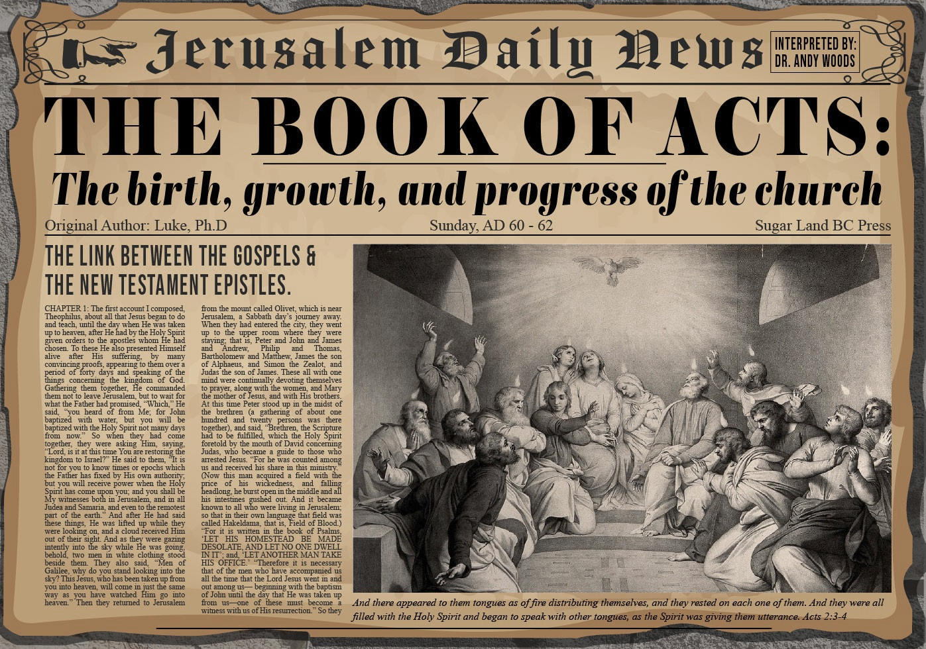


Slide 2
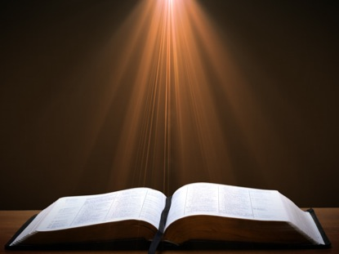
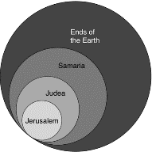
Acts 1:8
“but you will receive power when the Holy Spirit has come upon you; and you shall be My witnesses both in Jerusalem (Acts 1-7), and in all Judea and Samaria (Acts 8-12), and even to the remotest part of the earth (Acts 13-28).”

Slide 3
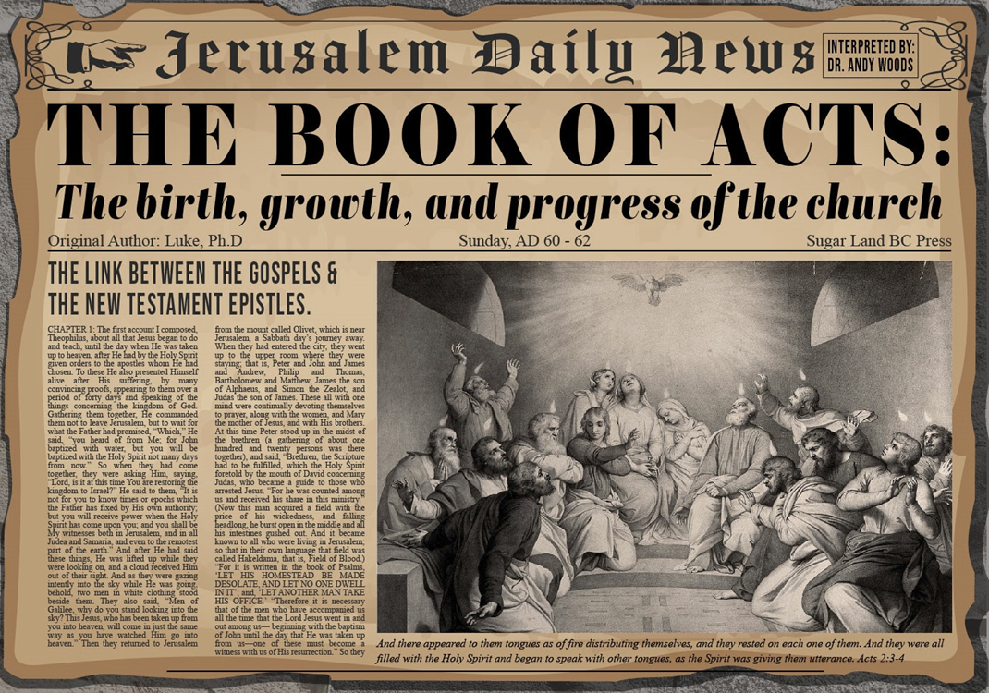
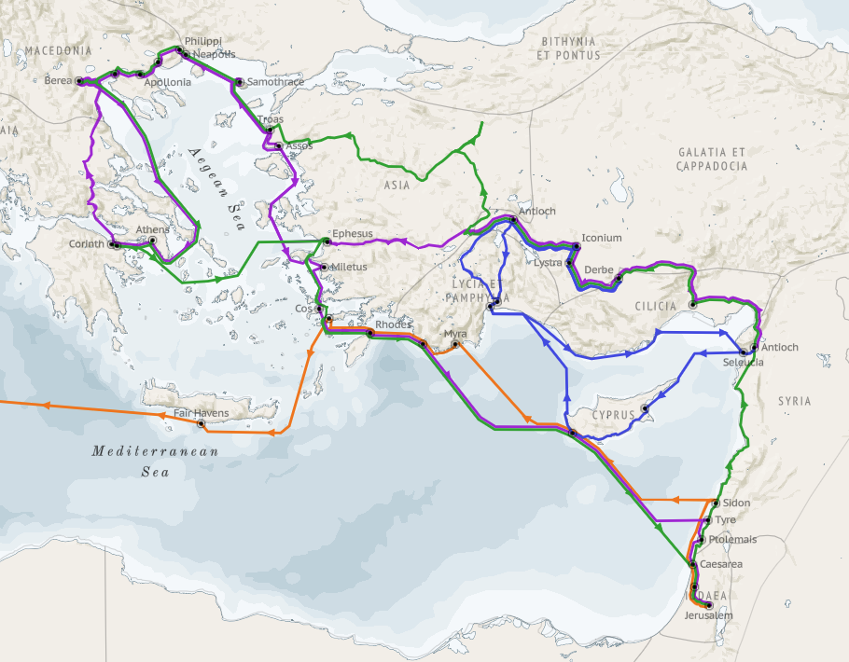
Structure (Acts 1:8)
  Jerusalem (Acts 1–7)
  Judea and Samaria (Acts 8–12)
  Remotest part of the earth (Acts 13–28)
  1st missionary journey (Acts 13–14)
  Jerusalem council (Acts 15:1-35)
  2nd missionary journey (Acts 15:36 –18:22)
  3rd missionary journey (Acts 18:23–21:17)
  Trip to Rome (Acts 21:18–28:31)

Slide 4
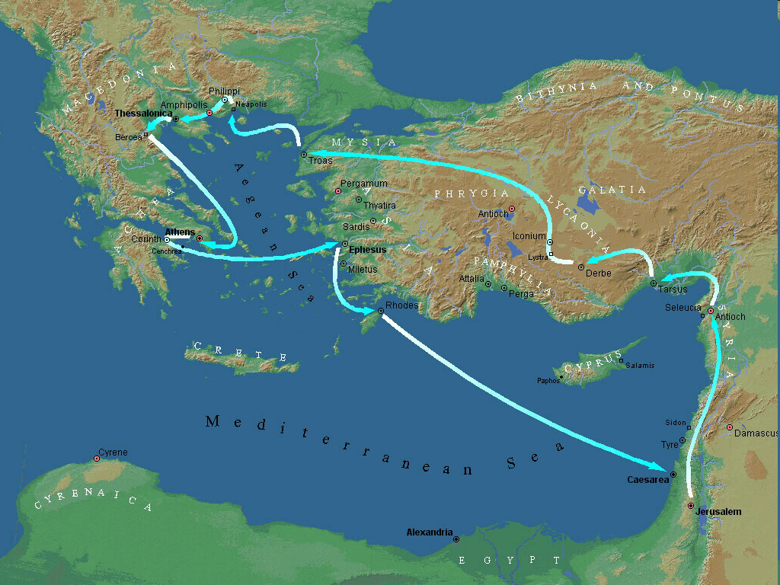
Second Missionary Journey

Slide 5
Acts 15:36‒18:22
2nd Missionary Journey
  Schism between Paul & Barnabas (15:36-41)
  Syria & Cilicia ministry (16:1-5)
  Macedonian call (16:6-10)
  Philippian ministry (16:11-40)
  Thessalonica ministry (17:1-9)
  Berean ministry (17:10-15)
  Athens’ ministry (17:16-34)
  Corinthian ministry (18:1-18)
  Ephesus’ ministry (18:19-21)
  Return to Antioch (18:22)

Slide 6
VII. Athens Ministry
Acts 17:16-34
  Paul’s witness (16-21)
  Paul’s speech (22-31)
  Athenians’ response (32-34)

Slide 7
Acts 17:22-31
Paul’s Speech
      Location (22a)
      Introduction (22b-23a)
      Unknown God described (23b-28)
      Man’s responsibility (29-31)

Slide 8
Acts 17:23b-28
Unknown God Described
      Introduction (23b)
      Characteristics (24-28)

Slide 9
Acts 17:24-28
Characteristics
      Creator (24)
      Sufficient (25)
      Humanity’s creator (26)
      Purpose: that men might seek Him (27)
      Man’s preserver (28)

Slide 10
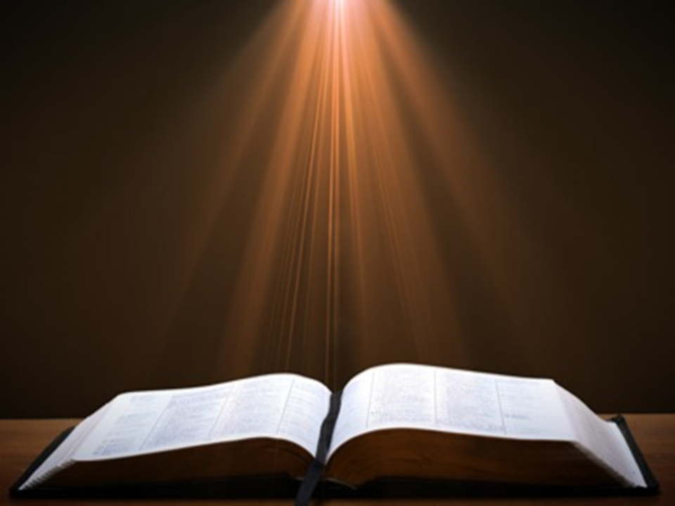
Acts 17:1-3
“¹ Now when they had traveled through Amphipolis and Apollonia, they came to Thessalonica, where there was a synagogue of the Jews. ² And according to Paul’s custom, he visited them, and for three Sabbaths reasoned with them from the Scriptures, ³ explaining and giving evidence that the Christ had to suffer and rise from the dead, and saying, “This Jesus whom I am proclaiming to you is the Christ.”

Slide 11

GENERAL VS. SPECIAL REVELATION
 | GENERAL | SPECIAL
EXAMPLES | Nature, conscience (Rom 1–2) | Incarnation, Scripture, miracles
AVAILABILITY | All | Some
ACCOMPLISHMENT | Accountability (Rom 1) | Salvation (Acts 4:12; 2 Tim 3:15)
FORM | Non-written / non-verbal | Written
QUALITY | Natural | Supernatural, miraculous

Slide 12

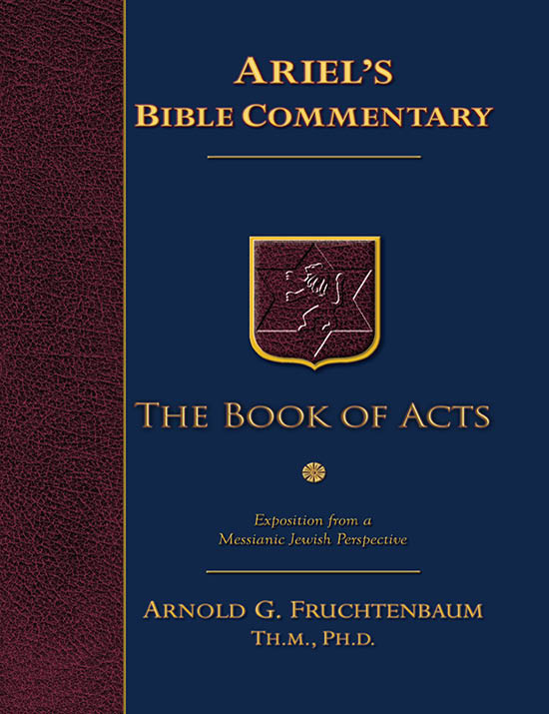
Dr. Arnold G. Fruchtenbaum
The Book of Acts, 372-73
“The fifth characteristic is that God is the Preserver of man (v. 28). Paul pointed to the fact that in him we live, and move, and have our being. This was the proof of God’s nearness. Instead of Stoic pantheism, there is real immanence with God. Paul provided an ascending scale, reaching a climax in God:
  We live; therefore, we have life.
  We move; therefore, there is movement.
  We have our being; therefore, there is existence.”

Slide 13
Dr. Arnold G. Fruchtenbaum
The Book of Acts, 372-73
“Then Paul reminded his listeners that some of their own poets have said the same things, among them Aratus of Soli (315-240 B.C.) and the already mentioned Cretan poet Epimenides, who had this to say to the god Zeus:
  They fashioned a tomb for thee, O holy and high one—
  The Cretans, always liars, evil beasts, idle bellies!
  But thou art not dead: though livest and abidest for ever,
  For in thee we live and move and have our being.”

Slide 14
Dr. Arnold G. Fruchtenbaum
The Book of Acts, 372-73
“Paul quoted the same poet in Titus 1:12. Another poet would have been Cleanthes, the son of Phanius of Assos and head of the Stoic School in Athens from 263 to 232 B.C. The Zondervan Illustrated Bible Dictionary notes: ‘His Hymn to Zeus, a surviving poem, contains the words quoted by Paul in his address before the Areopagus Court (Acts 17:28).’ Regarding Zeus, Cleanthes wrote: ‘For we are your offspring.’”

Slide 15
Acts 17:22-31
Paul’s Speech
      Location (22a)
      Introduction (22b-23a)
      Unknown God described (23b-28)
      Man’s responsibility (29-31)

Slide 16
Acts 17:29-31
Man’s Responsibility
      Reject idolatry (29)
      Repent (30)
      Reason: coming judgment (31)

Slide 17
Acts 17:29-31
Man’s Responsibility
      Reject idolatry (29)
      Repent (30)
      Reason: coming judgment (31)

Slide 18
Acts 17:29-31
Man’s Responsibility
      Reject idolatry (29)
      Repent (30)
      Reason: coming judgment (31)

Slide 19

Acts 17:30-31
“³⁰ Therefore having overlooked the times of ignorance, God is now declaring to men that all people everywhere should repent [metanoeō], ³¹ because He has fixed a day in which He will judge the world in righteousness through a Man whom He has appointed, having furnished proof to all men by raising Him from the dead.”

Slide 20
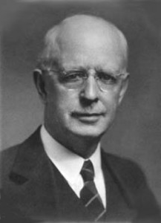
Lewis Sperry Chafer
vol. 7, Systematic Theology (Grand Rapids, MI: Kregel Publications, 1993), 265-66.
“This vital newness of mind is a part of believing, after all, and therefore it may be and is used as a synonym for believing at times (cf. Acts 17:30; 20:21; 26:20; Rom. 2:4; 2Tim. 2:25; 2 Pet. 3:9). Repentance nevertheless cannot be added to believing as a condition of salvation, because upwards of 150 passages of Scripture condition salvation upon believing only (cf. John 3:16; Acts 16:31).”

Slide 21
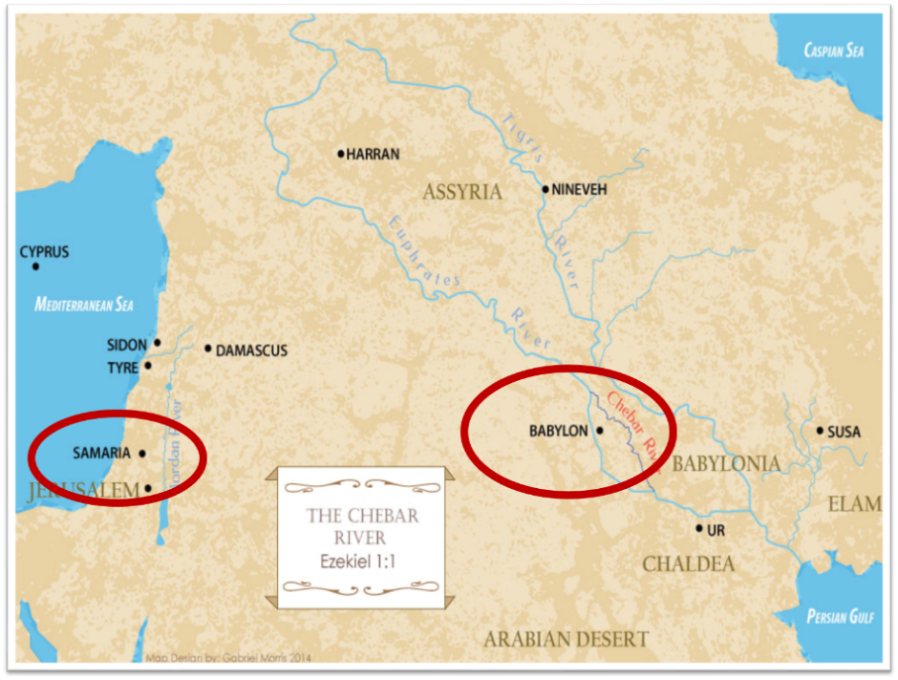

Slide 22
Acts 14:15d-17
God’s Attributes
      Living (15d)
      Creator (15e)
      Patient (16)
      Revealer (17a)
      Good (17b)

Slide 23
Acts 17:29-31
Man’s Responsibility
      Reject idolatry (29)
      Repent (30)
      Reason: coming judgment (31)

Slide 24
Acts 17:30-31
“³⁰ Therefore having overlooked the times of ignorance, God is now declaring to men that all people everywhere should repent [metanoeō], ³¹ because He has fixed a day in which He will judge the world in righteousness through a Man whom He has appointed, having furnished proof to all men by raising Him from the dead.”

Slide 25
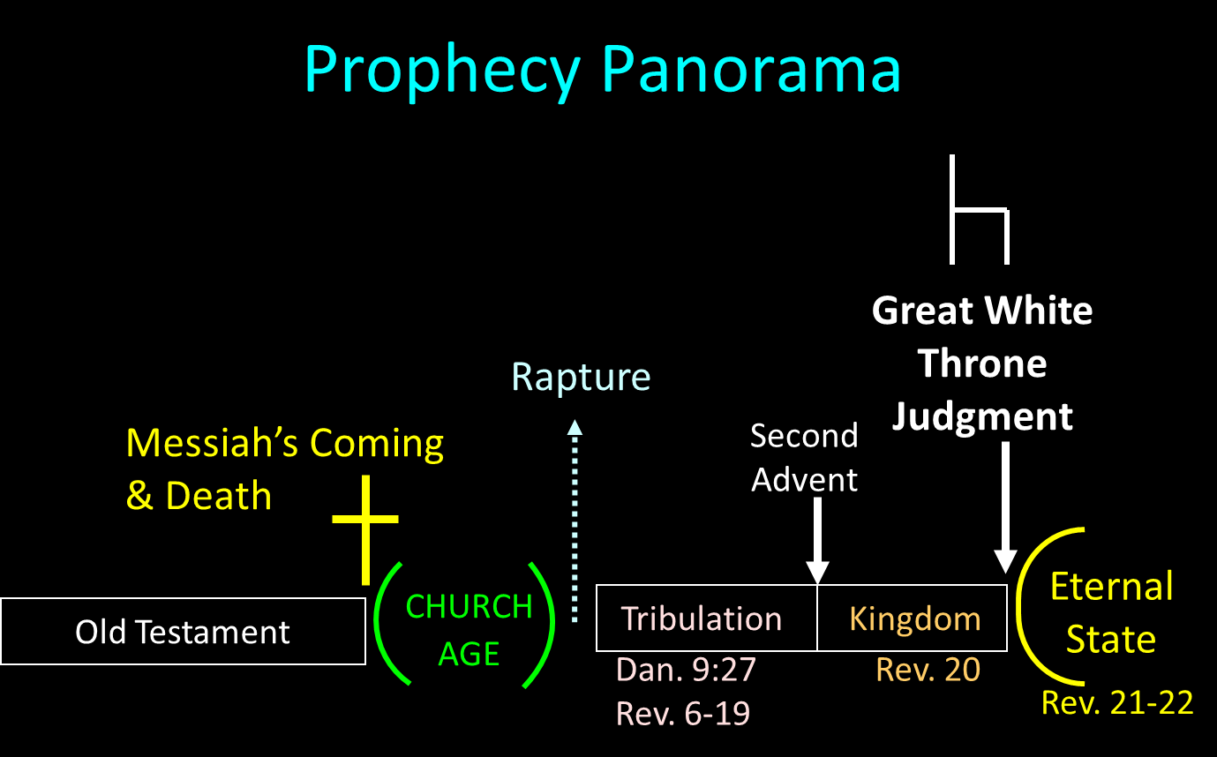

Slide 26
SCRIPTURE’S FOUR JUDGMENTS
NAME | SHEEP AND GOAT | JUDGMENT OF THE JEWS | BEMA SEAT | GREAT WHITE THRONE
SCRIPTURE | Matt 25:31-46 | Ezek 20:33-44 | 1 Cor 3:10-15 | Rev 20:11-15
PLACE | Earth, Jerusalem | Earth, wilderness | Heaven | Earth
AUDIENCE | Gentile Tribulation survivors | Jewish Tribulation survivors | Church Age believers | All unsaved
WHEN | After Tribulation | After Tribulation | After rapture | After Millennium
PURPOSE | Saved Gentiles enter kingdom | Saved Jews enter kingdom | Reward believers | Degree of punishment in hell
EVALUATION | Treatment of Christ’s brethren | Passing under shepherd’s rod | Works taken through fire | Not in the book; judged by books

Slide 27
VII. Athens Ministry
Acts 17:16-34
  Paul’s witness (16-21)
  Paul’s speech (22-31)
  Athenians’ response (32-34)

Slide 28
Acts 17:32-34
Athenians’ Response
      Two negative responses (32)
      Paul’s departure (33)
      Positive response (34)

Slide 29
Acts 17:32-34
Athenians’ Response
      Two negative responses (32)
      Paul’s departure (33)
      Positive response (34)

Slide 30
Acts 17:32
Two Negative Responses
      Mocking (32a)
      Postponement (32b)

Slide 31
Acts 17:32
Two Negative Responses
      Mocking (32a)
      Postponement (32b)

Slide 32
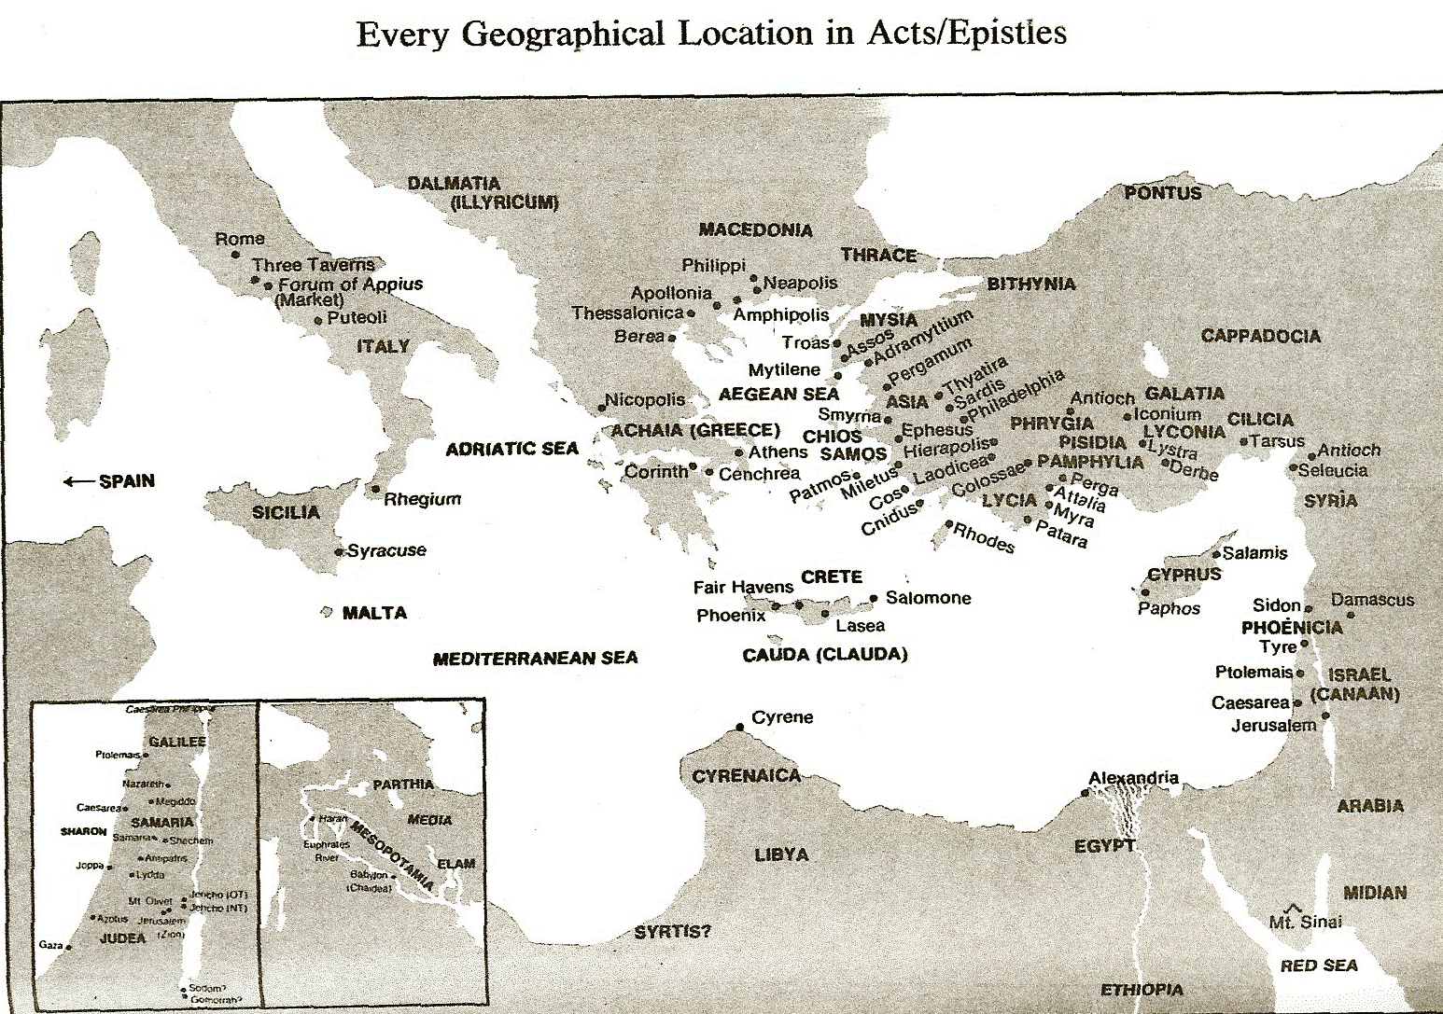

Slide 33
Second Missionary Journey

Slide 34
Acts 17:32
Two Negative Responses
      Mocking (32a)
      Postponement (32b)

Slide 35
Acts 17:32-34
Athenians’ Response
      Two negative responses (32)
      Paul’s departure (33)
      Positive response (34)

Slide 36
Acts 17:32-34
Athenians’ Response
      Two negative responses (32)
      Paul’s departure (33)
      Positive response (34)

Slide 37
Dr. Arnold G. Fruchtenbaum
The Book of Acts, 374-75
“While no church was planted at this time, some did believe: Dionysius the Areopagite, and a woman named Damaris, and others with them. The fact that Dionysius was described as an Areopagite shows that he was a member of the Council of Areopagus. He was convinced and became a believer. According to the fourth-century historian Eusebius, Dionysius became the bishop of the church of Athens and died as a martyr. Also mentioned is Damaris. She was probably an aristocrat, as was Dionysius. There were others, though unnamed, who also believed.”

Slide 38
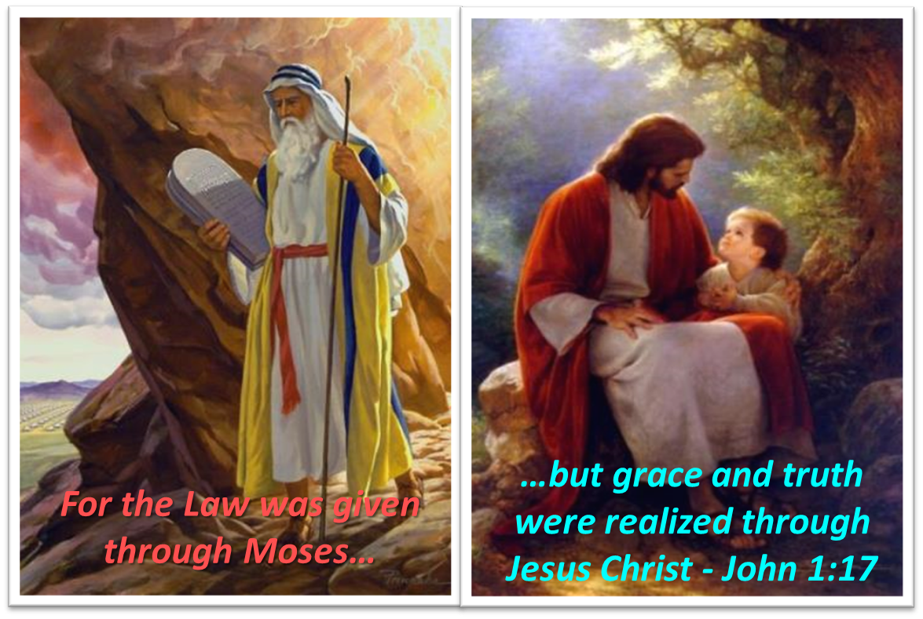
Themes
  From Peter to Paul (Gal 2:7-8)
  Universality of the Gospel
  Transitions
  Sovereignty of God (Acts 2:23; 13:48)
  Soteriology (Acts 16:31)

Slide 39
Acts 16:11-15
Lydia’s Conversion
      Journey to Neapolis (11)
      Arrival at Philippi (12)
      Jewish Sabbath meeting (13)
      Lydia’s conversion (14)
      Results of conversion (15)

Slide 40
Conclusion

Slide 41
VII. Athens Ministry
Acts 17:16-34
  Paul’s witness (16-21)
  Paul’s speech (22-31)
  Athenians’ response (32-34)

Slide 42
Acts 15:36‒18:22
2nd Missionary Journey
  Schism between Paul & Barnabas (15:36-41)
  Syria & Cilicia ministry (16:1-5)
  Macedonian call (16:6-10)
  Philippian ministry (16:11-40)
  Thessalonica ministry (17:1-9)
  Berean ministry (17:10-15)
  Athens’ ministry (17:16-34)
  Corinthian ministry (18:1-18)
  Ephesus’ ministry (18:19-21)
  Return to Antioch (18:22)

