Slide 1



Slide 2
INTRODUCTORY MATTERS
Authorship
Audience
Date
Occasion
Purpose
Message
Outline

Slide 3
INTRODUCTORY MATTERS
Authorship
Audience
Date
Occasion
Purpose
Message
Outline

Slide 4
AUTHORSHIP
Apollos?
Barnabas?
Paul?

Slide 5
AUTHORSHIP
Apollos?
Barnabas?
Paul?

Slide 6
OUTLINE
Doctrinal section (1:1–10:18)
  Christ’s attributes (1:1-3)
  Christ is superior to the angels (1:4–2:18)
  Christ is superior to Moses (3:1–4:13)
  Christ is superior to Aaron (4:14–10:18)
Practical section (10:19–13:25)
  Exhortations and pastoral reminders (10, 12, 13)
  Hall of faith (11)
  Benediction (13:20-25)

Slide 7
Galatians 5:1
Therefore…
1-4
5-6

Slide 8
Romans 12:1
Therefore…
1-11
12-16

Slide 9
Ephesians 4:1
Therefore…
1-3
4-6

Slide 10

Galatians 2:7-8
“⁷ But on the contrary, seeing that I had been entrusted with the gospel to the uncircumcised, just as Peter had been to the circumcised ⁸ (for He who effectually worked for Peter in his apostleship to the circumcised effectually worked for me also to the Gentiles).”

Slide 11
INTRODUCTORY MATTERS
Authorship
Audience
Date
Occasion
Purpose
Message
Outline

Slide 12
AUDIENCE
Believers (1:3)
2nd generation (2:2-3)
Jews
Located in the Land of Israel

Slide 13
AUDIENCE
Believers (1:3)
2nd generation (2:2-3)
Jews
Located in the Land of Israel

Slide 14

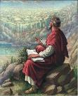
John 20:30-31
“Therefore many other signs Jesus also performed in the presence of the disciples, which are not written in this book; but these have been written so that you may believe that Jesus is the Christ, the Son of God; and that believing you may have life in His name.”

Slide 15
AUDIENCE
Believers (1:3)
2nd generation (2:2-3)
Jews
Located in the Land of Israel

Slide 16
AUDIENCE
Believers (1:3)
2nd generation (2:2-3)
Jews
Located in the Land of Israel

Slide 17
AUDIENCE
Believers (1:3)
2nd generation (2:2-3)
Jews
Located in the Land of Israel

Slide 18

Acts 8:3-4; 11:19
“³ But Saul began ravaging the church, entering house after house, and dragging off men and women, he would put them in prison. ⁴ Therefore, those who had been scattered went about preaching the word…¹⁹ So then those who were scattered because of the persecution that occurred in connection with Stephen made their way to Phoenicia and Cyprus and Antioch, speaking the word to no one except to Jews alone.”

Slide 19

James 1:1
“James, a bond-servant of God and of the Lord Jesus Christ, To the twelve tribes who are dispersed abroad: Greetings.”

Slide 20

1 Peter 1:1
“To those who reside as aliens, scattered [diaspora] throughout Pontus, Galatia, Cappadocia, Asia, and Bithynia, who are chosen.”

Slide 21
INTRODUCTORY MATTERS
Authorship
Audience
Date
Occasion
Purpose
Message
Outline

Slide 22
DATE (A.D. 62–64)
Before
  A.D. 95 (Clement of Rome)
  A.D. 70 (Heb 8:4, 13; 9:6; 10:1-2; 13:10)
  A.D. 64 (Heb 12:4)
After apostolic generation (2:2-3)

Slide 23
INTRODUCTORY MATTERS
Authorship
Audience
Date
Occasion
Purpose
Message
Outline

Slide 24
OCCASION
A.D. 70
Heb 3:1 (Christian confession)
Unbelieving Jews placing audience under duress to return to Judaism
Audience being worn down
Temple still standing

Slide 25
OCCASION
A.D. 70
Heb 3:1 (Christian confession)
Unbelieving Jews placing audience under duress to return to Judaism
Audience being worn down
Temple still standing

Slide 26

Daniel 9:26
“Then after the sixty-two weeks the Messiah will be cut off and have nothing, and the people of the prince who is to come will destroy the city and the sanctuary. And its end will come with a flood; even to the end there will be war; desolations are determined.”

Slide 27
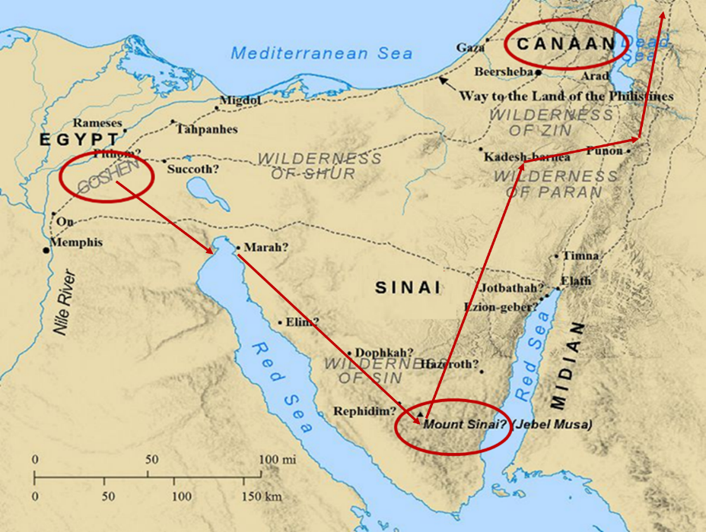

Slide 28
Six Parts of a Suzerain-Vassal Treaty in Deuteronomy
Preamble (1:1-5)
Prologue (1:6–4:40)
Covenant obligations (5–26)
Storage and reading instructions (27:2-3; 31:9, 24, 26)
Witnesses (32:1)
Blessings and curses (28)

Slide 29


Deuteronomy 28:49-50
⁴⁹ “The Lord will bring a nation against you from afar, from the end of the earth, as the eagle swoops down, a nation whose language you shall not understand, ⁵⁰ a nation of fierce countenance who will have no respect for the old, nor show favor to the young.”

Slide 30
ISRAEL'S JUDGMENTS
Division of the kingdom in 931 B.C. (1 Kgs. 12)
Assyrian judgment in 722 B.C. (2 Kgs. 17)
Babylonian captivity in 586 B.C. (2 Kgs. 25)
Rome Diaspora in A.D. 70 (Luke 19:41-44)

Slide 31
OCCASION
A.D. 70
Heb 3:1 (Christian confession)
Unbelieving Jews placing audience under duress to return to Judaism
Audience being worn down
Temple still standing

Slide 32
OCCASION
A.D. 70
Heb 3:1 (Christian confession)
Unbelieving Jews placing audience under duress to return to Judaism
Audience being worn down
Temple still standing

Slide 33
OCCASION
A.D. 70
Heb 3:1 (Christian confession)
Unbelieving Jews placing audience under duress to return to Judaism
Audience being worn down
Temple still standing

Slide 34
OCCASION
A.D. 70
Heb 3:1 (Christian confession)
Unbelieving Jews placing audience under duress to return to Judaism
Audience being worn down
Temple still standing

Slide 35
INTRODUCTORY MATTERS
Authorship
Audience
Date
Occasion
Purpose
Message
Outline

Slide 36
PURPOSE
Encouragement/motivation to not lapse back into Judaism
  What believers already have in Christ is superior to every vestige of Judaism (Angels, Moses, and the Aaronic priesthood)
  Warnings

Slide 37
PURPOSE
Encouragement/motivation to not lapse back into Judaism
  What believers already have in Christ is superior to every vestige of Judaism (Angels, Moses, and the Aaronic priesthood)
  Warnings

Slide 38
PURPOSE
Encouragement/motivation to not lapse back into Judaism
  What believers already have in Christ is superior to every vestige of Judaism (Angels, Moses, and the Aaronic priesthood)
  Warnings

Slide 39
PURPOSE
Encouragement/motivation to not lapse back into Judaism
  What believers already have in Christ is superior to every vestige of Judaism (Angels, Moses, and the Aaronic priesthood)
  Warnings

Slide 40
WARNINGS
2:1-4 – Warning against drifting
3:7–4:13 – Warning against disobedience
5:10–6:20 – Warning against immaturity
10:26-39 – Warning against despising the truth
12:25-29 – Warning against denying the truth

Slide 41
4 VIEWS ON WARNING PASSAGES
Hypothetical
Arminianism
Calvinism/Reformed
Loss of blessings

Slide 42
4 VIEWS ON WARNING PASSAGES
Hypothetical
Arminianism
Calvinism/Reformed
Loss of blessings

Slide 43
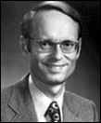
Charles Ryrie. – Threat View
Ryrie Study Bible, Page 1521
“Others understand the passage to be a warning to genuine believers to urge them on in Christian growth and maturity. To ‘fall away’ is impossible (since, according to this view, true believers are eternally secure), but the phrase is placed in the sentence to strengthen the warning. It is similar to saying something like this to a class of students: ‘It is impossible for a student, once enrolled in this course, if he turns the clock back [which cannot be done], to start the course over. Therefore, let all students go on to deeper knowledge.’ In this view the phrases in verses 4-5 are understood to refer to the conversion experience.”

Slide 44
4 VIEWS ON WARNING PASSAGES
Hypothetical
Arminianism
Calvinism/Reformed
Loss of blessings

Slide 45


John 10:27-29
“²⁷ My sheep hear My voice, and I know them, and they follow Me; ²⁸ and I give eternal life to them, and they will never perish [ou mē; aiōnia]; and no one will snatch them out of My hand. ²⁹ My Father, who has given them to Me, is greater than all; and no one is able to snatch them out of the Father’s hand.”

Slide 46
4 VIEWS ON WARNING PASSAGES
Hypothetical
Arminianism
Calvinism/Reformed
Loss of blessings

Slide 47


Slide 48

IV. Running TULIP Through the Grid of Scripture
Total Depravity
Unconditional Election
Limited Atonement
Irresistible Grace
Perseverance of the Saints

Slide 49
Perseverance of the Saints = Perseverance in Good Works to the End of One’s Life to Prove that He is One of the Elect
“P” stands for “Perseverance of the Saints.” This is what Calvinists say gives them the assurance of eternal security, but in actuality “the emphasis is upon the believer’s faithfulness in persevering—not upon God’s keeping power … uncertainty as to one’s ultimate salvation is, in fact, built into the very fabric of Calvinism itself.”
Bob Kirkland, Calvinism: None Dare Call It Heresy; Spotlight on the Life and Teachings of John Calvin (Eureka, MT: Lighthouse Trails, 2018), 34.

Slide 50
4 VIEWS ON WARNING PASSAGES
Hypothetical
Arminianism
Calvinism/Reformed
Loss of blessings

Slide 51
INTRODUCTORY MATTERS
Authorship
Audience
Date
Occasion
Purpose
Message
Outline

Slide 52
MESSAGE
The superiority of the full revelation of Christ in comparison to OT Judaism is shown through Christ’s superiority to every major vestige of Judaism, and the author wrote Hebrews so that his audience would not lapse back into Judaism.

Slide 53
INTRODUCTORY MATTERS
Authorship
Audience
Date
Occasion
Purpose
Message
Outline

Slide 54
OUTLINE
Doctrinal section (1:1–10:18)
  Christ’s attributes (1:1-3)
  Christ is superior to the angels (1:4–2:18)
  Christ is superior to Moses (3:1–4:13)
  Christ is superior to Aaron (4:14–10:18)
Practical section (10:19–13:25)
  Exhortations and pastoral reminders (10, 12, 13)
  Hall of faith (11)
  Benediction (13:20-25)

Slide 55
Conclusion

Slide 56
INTRODUCTORY MATTERS
Authorship
Audience
Date
Occasion
Purpose
Message
Outline

