Slide 1



Slide 2

EXODUS STRUCTURE/OUTLINE
Redemption (1–18)
  Redemption (1:1–12:30)
  Liberation (12:31–15:21)
  Preservation (15:22–18:27)
Mosaic Covenant (19–40)
  Law (19–24)
  Tabernacle instructions (25–31)
  Apostasy (32–34)
  Tabernacle building (35–40)

Slide 3
REDEMPTION
(1:1–12:30)
Why redemption is necessary (Exod 1)
Development of the deliverer (Exod 2–4)
First confrontation with Pharaoh (Exod 5)
God reassures Moses (Exod 6:1–7:7)
Second confrontation with Pharaoh (Exod 7:8-13)
Plagues (Exod 7:14–12:30)

Slide 4
The Plagues of Egypt
NO. | DESCRIPTION | SCRIPTURE | Egyptian Deity
1. | Water to Blood | Exod. 7:14-25 | Hapi, Khnum
2. | Frogs | Exod. 8:1-15 | Heqt
3. | Gnats | Exod. 8:16-19 | Set
4. | Flies | Exod. 8:20-32 | Uatchit
5. | Disease on Cattle | Exod. 9:1-7 | Hathor, Apis
6. | Boils | Exod. 9:8-12 | Sekhmet, Serapis
7. | Hail | Exod. 9:13-35 | Seth, Nut
8. | Locusts | Exod. 10:1-20 | Seth, Nut, Osiris
9. | Darkness | Exod. 10:21-29 | Re, Horus, Atum
10. | Death of the First Born | Exod. 12:29-36 | Min, Osiris, Heqt, Isis

Slide 5
TEN PLAGUES REDEMPTION (7:14–12:30)
Nile to blood
Frogs
Gnats
Flies
Death of livestock
Boils
Hail
Locusts
Darkness
Death of 1st born

Slide 6
DARKNESS
Exodus 10:21-29
  Plague’s Manifestation (21-23)
  Pharaoh Speaks to Moses (24-29)

Slide 7
DARKNESS
Exodus 10:21-29
  Plague’s Manifestation (21-23)
  Pharaoh Speaks to Moses (24-29)

Slide 8
I. Exodus 10:21-23
Plague’s Manifestation
    God’s command (21)
    Moses’ obedience (22a)
    Plague’s severity (22b-23a)
    Israel’s exemption (23b)

Slide 9
I. Exodus 10:21-23
Plague’s Manifestation
    God’s command (21)
    Moses’ obedience (22a)
    Plague’s severity (22b-23a)
    Israel’s exemption (23b)

Slide 10
Ultimate Exodus
(Rev 11:15)
Sores: 6th plague (Ex 9:8-12), 1st bowl (Rev 16:1-2)
Rivers to blood: 1st plague (Ex 7:19-21), 3rd bowl (Rev 16:4-7)
Darkness: 9th plague (Ex 10:21-23), 5th bowl (Rev 16:10-11)
Frogs: 2nd plague (Ex 7:25‒8:15), 6th bowl (Rev 16:13)
Hail: 7th plague (Ex 9:22-26), 7th bowl (Rev 16:17-21)

Slide 11
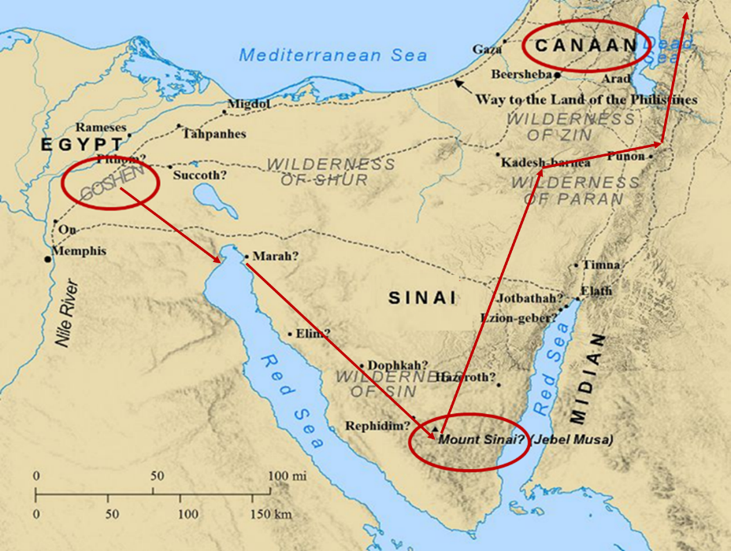

Slide 12

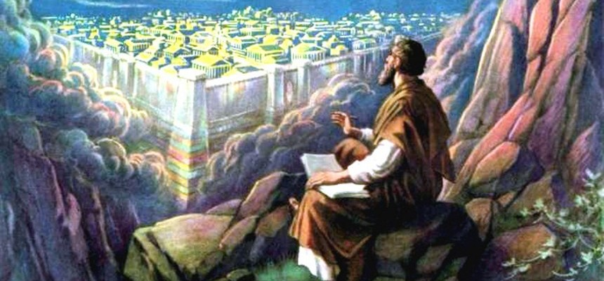
Revelation 11:15
¹⁵ “Then the seventh angel sounded; and there were loud voices in heaven, saying, ‘The kingdom of the world has become the kingdom of our Lord and of His Christ; and He will reign forever and ever.’”

Slide 13
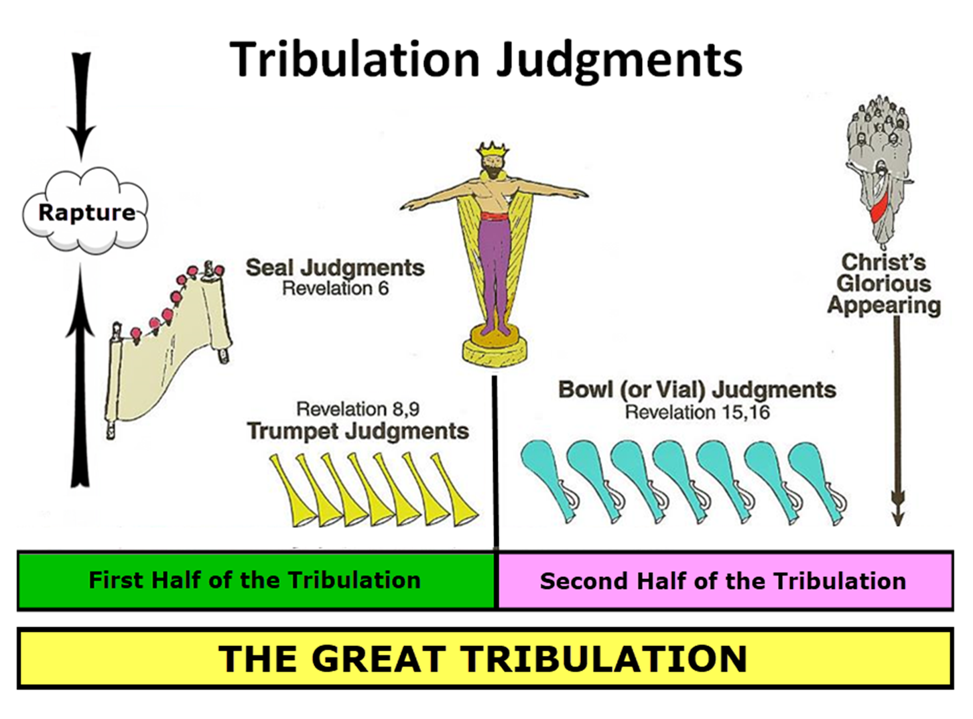

Slide 14
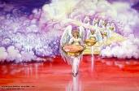

Seven Bowls
(Revelation 16)
1st Bowl (16:1-2) – Boils
2nd Bowl (16:3) – Sea becomes blood
3rd Bowl (16:4-7) – Freshwater destroyed
4th Bowl (16:8-9) – Sun scorches man
5th Bowl (16:10-11) – Darkness
6th Bowl (16:12-16) – Euphrates dried
7th Bowl (16:17-21) – Greatest earthquake

Slide 15

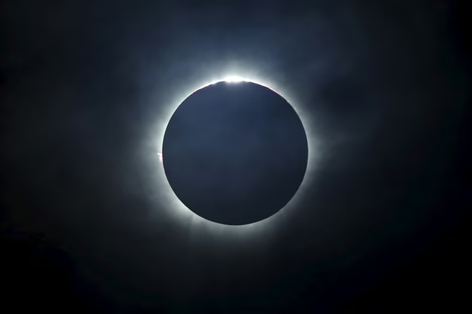
Charles Ryrie
Ryrie Study Bible, page 106
Exodus 10:21 - “darkness which may be felt. Possibly a combination of a violent sandstorm and supernatural darkness.”

Slide 16
The Plagues of Egypt
NO. | DESCRIPTION | SCRIPTURE | Egyptian Deity
1. | Water to Blood | Exod. 7:14-25 | Hapi, Khnum
2. | Frogs | Exod. 8:1-15 | Heqt
3. | Gnats | Exod. 8:16-19 | Set
4. | Flies | Exod. 8:20-32 | Uatchit
5. | Disease on Cattle | Exod. 9:1-7 | Hathor, Apis
6. | Boils | Exod. 9:8-12 | Sekhmet, Serapis
7. | Hail | Exod. 9:13-35 | Seth, Nut
8. | Locusts | Exod. 10:1-20 | Seth, Nut, Osiris
9. | Darkness | Exod. 10:21-29 | Re, Horus, Atum
10. | Death of the First Born | Exod. 12:29-36 | Min, Osiris, Heqt, Isis

Slide 17
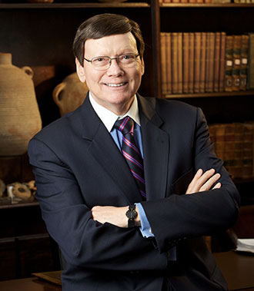
Dr. Ed Hindson
Hindson, E. E., & Mitchell, D. R., eds. (2010). KJV Bible Commentary for Today: The Most Up-to-Date Commentary on the Time-Honored Text of the KJV (p. 97). Thomas Nelson.
Exodus 10:21 - “The chief Egyptian deity challenged by this plague was Pharaoh’s own divine father, Ra, the sun god and high god of the pantheon. This is surely a response to Pharaoh’s previous equation of YHWH’s power with that of Ra (10:10). Shu and Nut, the respective sky god and goddess, would also have been (yet again) shown impotent before the Lord.”

Slide 18
Dr. Ed Hindson
Hindson, E. E., & Mitchell, D. R., eds. (2010). KJV Bible Commentary for Today: The Most Up-to-Date Commentary on the Time-Honored Text of the KJV (p. 96-97). Thomas Nelson.
“10:10. Evil is before you. “Many interpreters have stumbled over the explanation of this phrase. Pharaoh seems to be uncharacteristically warning Moses to beware of approaching evil. The difficulty of ascertaining Pharaoh’s intent disappears, however, when one takes into account that the Hebrew word ra, usually translated as ‘evil,’ is also the name of the Egyptian sun god, Ra. Each pharaoh was considered to be Ra’s divine son. The intent of Pharaoh may be conveyed as ‘My god Ra is before you; your god YHWH may be strong, but do not forget that Ra is just as strong.’”

Slide 20
I. Exodus 10:21-23
Plague’s Manifestation
    God’s command (21)
    Moses’ obedience (22a)
    Plague’s severity (22b-23a)
    Israel’s exemption (23b)

Slide 21
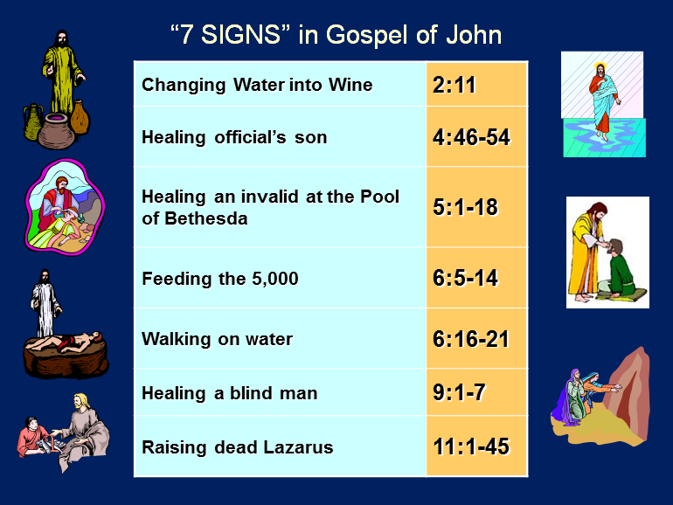

Slide 22
THREE PHASES OF MOSES’ 120 YEAR LIFE
LIFE PHASE | SCRIPTURE | YEARS | AGE | ACTIVITY
Natural Training | Acts 7:23 | 1526–1486 B.C. | 1-40 | Egyptian Education
Spiritual Training | Exod. 7:7 | 1486–1446 B.C. | 40-80 | Midian Shepherding
Ministry | Deut. 31:2; 34:7; Acts 7:36 | 1446–1406 B.C. | 80-120 | Exodus, Law, Wilderness Preservation, Pentateuch Authorship

Slide 23
I. Exodus 10:21-23
Plague’s Manifestation
    God’s command (21)
    Moses’ obedience (22a)
    Plague’s severity (22b-23a)
    Israel’s exemption (23b)

Slide 24
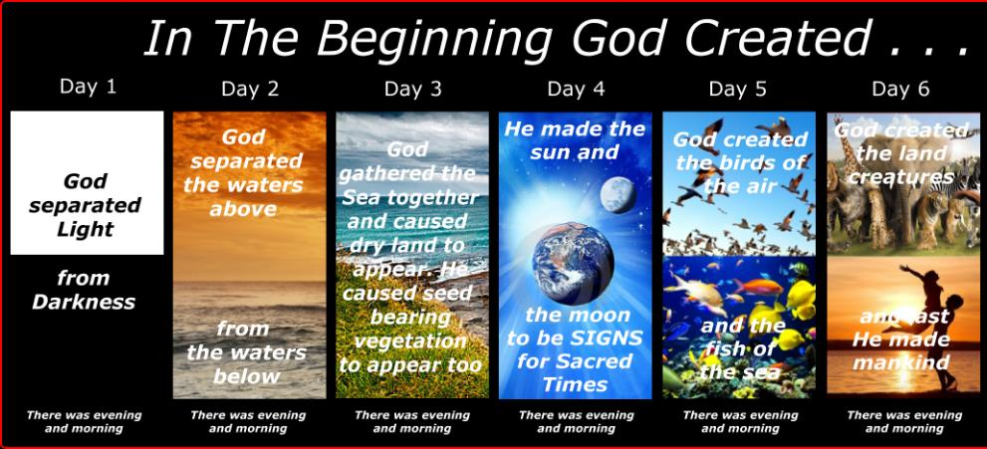
SHAPING AND POPULATING (GEN 1:1)
Day 1: | Light | Day 4: | Luminaries
Day 2: | Water, sky | Day 5: | Sea animals, birds
Day 3: | Land, vegetation | Day 6: | Land animals, man

Slide 25
I. Exodus 10:21-23
Plague’s Manifestation
    God’s command (21)
    Moses’ obedience (22a)
    Plague’s severity (22b-23a)
    Israel’s exemption (23b)

Slide 26


Slide 27

Protection Through the Tribulation?
(Revelation 3:10)
Like the protection in Goshen (Exod. 8:22, 24; 9:4, 6; 11:4-7; Rev. 9:4; 16:2)
Effective? Rev. 6:9-11; 7:13-14; 13:10, 15; 20:4
Comfort? John 14:1; 1 Thess. 4:18; Titus 2:13

Slide 28
Dr. Ed Hindson
Hindson, E. E., & Mitchell, D. R., eds. (2010). KJV Bible Commentary for Today: The Most Up-to-Date Commentary on the Time-Honored Text of the KJV (p. 97). Thomas Nelson.
Exodus 10:21 - “Proponents of the miraculous intensification of natural events theory propose that the darkness resulted from the arrival of a blinding sandstorm. This does not take into consideration, however, that the darkness began at the discretion of Moses or the continued distinction the Lord made between Goshen and the remainder of Egypt. Although the entire nation suffered in suffocating, pitch-black darkness, the Hebrews in Goshen had retained the sunlight.”

Slide 29
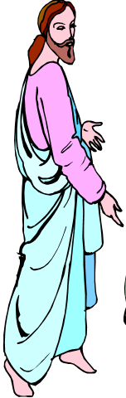
7 “I AM” statements in John
I am the Bread of Life | 6:35
I am the Light of the world | 8:12
I am the Gate for the sheep | 10:7; cf. v.9
I am the Good Shepherd | 10:11,14
I am the Resurrection and the Life | 11:25
I am the Way and the Truth and the Life | 14:6
I am the true Vine | 15:1; cf. v.5

Slide 30
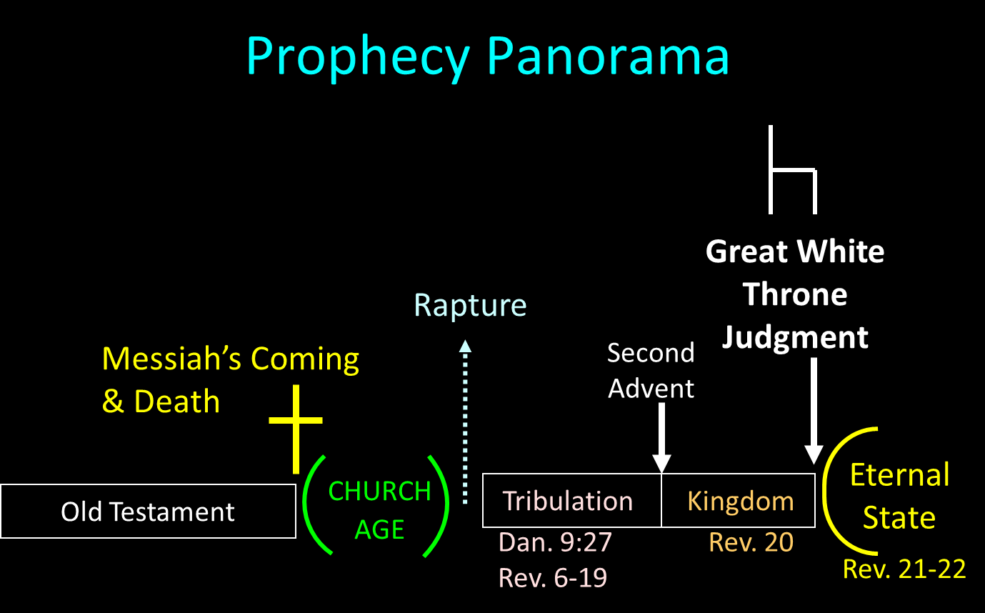

Slide 31
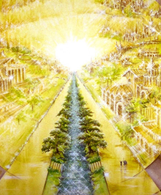
Eternal State is Future
No Satan (Rev 20:10)
No sea (Rev 21:1)
No death, crying, or pain (Rev 21:4)
No Sun (Rev 22:5)
No Moon (Rev 21:23)
No temple (Rev. 21:22)
No night (Rev 21:25)
No evil (Rev 21:27)
No curse (Rev 22:3)

Slide 32
Eternal State is Future
No Satan (Rev 20:10)
No sea (Rev 21:1)
No death, crying, or pain (Rev 21:4)
No Sun (Rev 22:5)
No Moon (Rev 21:23)
No temple (Rev. 21:22)
No night (Rev 21:25)
No evil (Rev 21:27)
No curse (Rev 22:3)

Slide 33
DARKNESS
Exodus 10:21-29
  Plague’s Manifestation (21-23)
  Pharaoh Speaks to Moses (24-29)

Slide 34
II. Exodus 10:24-29
Pharaoh Speaks to Moses
    Entrance (24a)
    Pharaoh’s command (24b)
    Pharaoh’s qualification (24c)
    Moses’ rebuttal (25-26)
    God’s hardening (27)
    Pharaoh’s command (28)
    Moses’ affirmation (29)

Slide 35
II. Exodus 10:24-29
Pharaoh Speaks to Moses
    Entrance (24a)
    Pharaoh’s command (24b)
    Pharaoh’s qualification (24c)
    Moses’ rebuttal (25-26)
    God’s hardening (27)
    Pharaoh’s command (28)
    Moses’ affirmation (29)

Slide 36
II. Exodus 10:24-29
Pharaoh Speaks to Moses
    Entrance (24a)
    Pharaoh’s command (24b)
    Pharaoh’s qualification (24c)
    Moses’ rebuttal (25-26)
    God’s hardening (27)
    Pharaoh’s command (28)
    Moses’ affirmation (29)

Slide 38

Ephesians 2:8-10
“⁸ For by grace you have been saved through faith; and that not of yourselves, it is the gift of God; ⁹ not as a result of works, so that no one may boast. ¹⁰ For we are His workmanship, created in Christ Jesus for good works, which God prepared beforehand so that we would walk [peripateō, subjunctive mood] in them.”

Slide 39
II. Exodus 10:24-29
Pharaoh Speaks to Moses
    Entrance (24a)
    Pharaoh’s command (24b)
    Pharaoh’s qualification (24c)
    Moses’ rebuttal (25-26)
    God’s hardening (27)
    Pharaoh’s command (28)
    Moses’ affirmation (29)

Slide 40
Ultimate Exodus
(Rev 11:15)
Sores: 6th plague (Ex 9:8-12), 1st bowl (Rev 16:1-2)
Rivers to blood: 1st plague (Ex 7:19-21), 3rd bowl (Rev 16:4-7)
Darkness: 9th plague (Ex 10:21-23), 5th bowl (Rev 16:10-11)
Frogs: 2nd plague (Ex 7:25‒8:15), 6th bowl (Rev 16:13)
Hail: 7th plague (Ex 9:22-26), 7th bowl (Rev 16:17-21)

Slide 42
Revelation 11:15
¹⁵ “Then the seventh angel sounded; and there were loud voices in heaven, saying, ‘The kingdom of the world has become the kingdom of our Lord and of His Christ; and He will reign forever and ever.’”

Slide 44
II. Exodus 10:24-29
Pharaoh Speaks to Moses
    Entrance (24a)
    Pharaoh’s command (24b)
    Pharaoh’s qualification (24c)
    Moses’ rebuttal (25-26)
    God’s hardening (27)
    Pharaoh’s command (28)
    Moses’ affirmation (29)

Slide 46
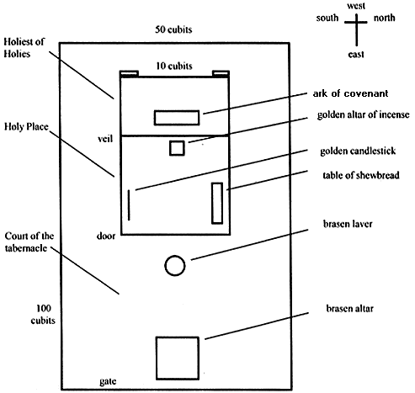
Tabernacle Diagram

Slide 47
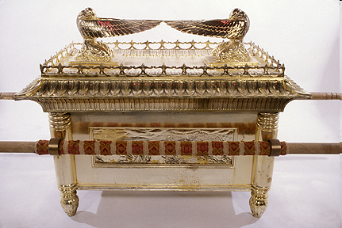
Ark of the Covenant

Slide 48
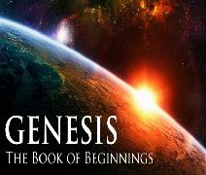
God’s Provision
(3:20-24)
  Continuation of the race (3:20)
  Forgiveness (3:21, 7)
  Expulsion of Adam and Eve from Eden (3:22-24)

Slide 49

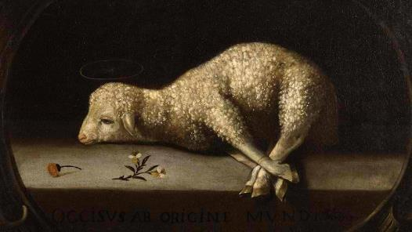
Exodus 12:5, 46
“Your lamb shall be an unblemished male a year old; you may take it from the sheep or from the goats…nor are you to break any bone of it.”

Slide 51
Ephesians 2:8-10
“⁸ For by grace you have been saved through faith; and that not of yourselves, it is the gift of God; ⁹ not as a result of works, so that no one may boast. ¹⁰ For we are His workmanship, created in Christ Jesus for good works, which God prepared beforehand so that we would walk [peripateō, subjunctive mood] in them.”

Slide 52
II. Exodus 10:24-29
Pharaoh Speaks to Moses
    Entrance (24a)
    Pharaoh’s command (24b)
    Pharaoh’s qualification (24c)
    Moses’ rebuttal (25-26)
    God’s hardening (27)
    Pharaoh’s command (28)
    Moses’ affirmation (29)

Slide 53
Dr. Ed Hindson
Hindson, E. E., & Mitchell, D. R., eds. (2010). KJV Bible Commentary for Today: The Most Up-to-Date Commentary on the Time-Honored Text of the KJV (p. 86). Thomas Nelson.
“4:21. I will harden his heart. An expression meaning ‘to strengthen his will.’ The text identifies the heart as the location of the volition, man’s decision-making ability. On seven occasions in the narrative, God hardens Pharaoh’s heart (9:12; 10:1, 20, 27; 11:10; 14:4, 8) or foretells that He will harden Pharaoh’s heart (4:21; 7:3), and nine times in the text, Pharaoh hardens his own heart (7:13, 14, 22; 8:15, 19, 32; 9:7, 34–35). For the initial five plagues, the text registers Pharaoh as the agent of hardening. Not until the sixth plague does God participate in the confirmation of Pharaoh’s own volitional choices.”

Slide 54
Charles Ryrie
Ryrie Study Bible, page 96
Exodus 4:21 - “harden his heart. Ten times it is said that Pharaoh hardened his own heart (7:13, 14, 22; 8:15, 19, 32; 9:7, 34, 35; 13:15), and 10 times that God hardened Pharaoh’s heart (4:21; 7:3; 9:12; 10:1, 20, 27; 11:10; 14:4, 8, 17). Paul uses this as an example of the inscrutable will of God and of His mercy toward men (Rom. 9:14–18). Seven times Pharaoh hardened his own heart before God first hardened it, though the prediction that God would do it preceded all.”

Slide 55
GOD HARDENING PHARAOH'S HEART
The prediction of God hardening of Pharaoh (4:21)
Pharaoh repeatedly hardening his own heart (7:13, 22; 8:15, 19, 32; 9:7)
Not until the sixth plague did God harden Pharaoh’s heart (Exod 9:12)

Slide 56

Genesis 1:26-28
²⁶ Then God said, “Let Us make man in Our image, according to Our likeness; and let them rule over the fish of the sea and over the birds of the sky and over the cattle and over all the earth, and over every creeping thing that creeps on the earth.” ²⁷ God created man in His own image, in the image of God He created him; male and female He created them. ²⁸ God blessed them; and God said to them, “Be fruitful and multiply, and fill the earth, and subdue it; and rule over the fish of the sea and over the birds of the sky and over every living thing that moves on the earth.”

Slide 57

Genesis 9:6
“Whoever sheds man’s blood, By man his blood shall be shed, For in the image of God He made man.”

Slide 58
II. Exodus 10:24-29
Pharaoh Speaks to Moses
    Entrance (24a)
    Pharaoh’s command (24b)
    Pharaoh’s qualification (24c)
    Moses’ rebuttal (25-26)
    God’s hardening (27)
    Pharaoh’s command (28)
    Moses’ affirmation (29)

Slide 59
II. Exodus 10:24-29
Pharaoh Speaks to Moses
    Entrance (24a)
    Pharaoh’s command (24b)
    Pharaoh’s qualification (24c)
    Moses’ rebuttal (25-26)
    God’s hardening (27)
    Pharaoh’s command (28)
    Moses’ affirmation (29)

Slide 60
Dr. Ed Hindson
Hindson, E. E., & Mitchell, D. R., eds. (2010). KJV Bible Commentary for Today: The Most Up-to-Date Commentary on the Time-Honored Text of the KJV (p. 98). Thomas Nelson.
Exodus 10:28-29 - “The king expelled Moses and Aaron from his presence, forbidding any future return, with the promise of capital consequence for any infraction. While they would indeed shortly see each other once again, it would be for the sole purpose of Pharaoh’s humiliating admission of defeat before YHWH.”

Slide 61
Conclusion

Slide 62
DARKNESS
Exodus 10:21-29
  Plague’s Manifestation (21-23)
  Pharaoh Speaks to Moses (24-29)

Slide 63
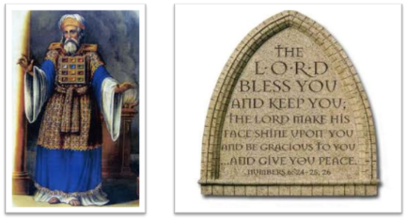
²⁴ The Lord bless you, and keep you; ²⁵ The Lord make His face shine on you, And be gracious to you; ²⁶ The Lord lift up His countenance on you, And give you peace.
Numbers 6:24–26 (NASB95)

