Slide 1



Slide 2

EXODUS STRUCTURE/OUTLINE
Redemption (1–18)
  Redemption (1:1–12:30)
  Liberation (12:31–15:21)
  Preservation (15:22–18:27)
Mosaic Covenant (19–40)
  Law (19–24)
  Tabernacle instructions (25–31)
  Apostasy (32–34)
  Tabernacle building (35–40)

Slide 3
REDEMPTION
(1:1–12:30)
Why redemption is necessary (Exod 1)
Development of the deliverer (Exod 2–4)
First confrontation with Pharaoh (Exod 5)
God reassures Moses (Exod 6:1–7:7)
Second confrontation with Pharaoh (Exod 7:8-13)
Plagues (Exod 7:14–12:30)

Slide 4
The Plagues of Egypt
NO. | DESCRIPTION | SCRIPTURE | Egyptian Deity
1. | Water to Blood | Exod. 7:14-25 | Hapi, Khnum
2. | Frogs | Exod. 8:1-15 | Heqt
3. | Gnats | Exod. 8:16-19 | Set
4. | Flies | Exod. 8:20-32 | Uatchit
5. | Disease on Cattle | Exod. 9:1-7 | Hathor, Apis
6. | Boils | Exod. 9:8-12 | Sekhmet, Serapis
7. | Hail | Exod. 9:13-35 | Seth, Nut
8. | Locusts | Exod. 10:1-20 | Seth, Nut, Osiris
9. | Darkness | Exod. 10:21-29 | Re, Horus, Atum
10. | Death of the First Born | Exod. 12:29-36 | Min, Osiris, Heqt, Isis

Slide 5
TEN PLAGUES REDEMPTION (7:14–12:30)
Nile to blood
Frogs
Gnats
Flies
Death of livestock
Boils
Hail
Locusts
Darkness
Death of 1st born

Slide 6
IV. Exodus 10:12-15
Plague’s Manifestation
    God’s command (12)
    Moses’ obedience (13a)
    Locusts’ manifestation (13b-14a)
    Locusts’ severity (14b-15)

Slide 7
LOCUSTS
Exodus 10:1-20
  God’s Instructions (1-2)
  Moses & Aaron Speak to Pharaoh (3-6)
  Moses & Aaron Speak to Pharaoh Again (7-11)
  Plague’s Manifestation (12-15)
  Pharaoh Speaks to Moses & Aaron (16-17)
  God Answers (18-20)

Slide 8
V. Exodus 10:16-17
Pharaoh Speaks to Moses & Aaron
    Summoning (16a)
    Repentance (16b)
    Request (17)

Slide 9
V. Exodus 10:16-17
Pharaoh Speaks to Moses & Aaron
    Summoning (16a)
    Repentance (16b)
    Request (17)

Slide 10
V. Exodus 10:16-17
Pharaoh Speaks to Moses & Aaron
    Summoning (16a)
    Repentance (16b)
    Request (17)

Slide 11
V. Exodus 10:16-17
Pharaoh Speaks to Moses & Aaron
    Summoning (16a)
    Repentance (16b)
    Request (17)

Slide 12

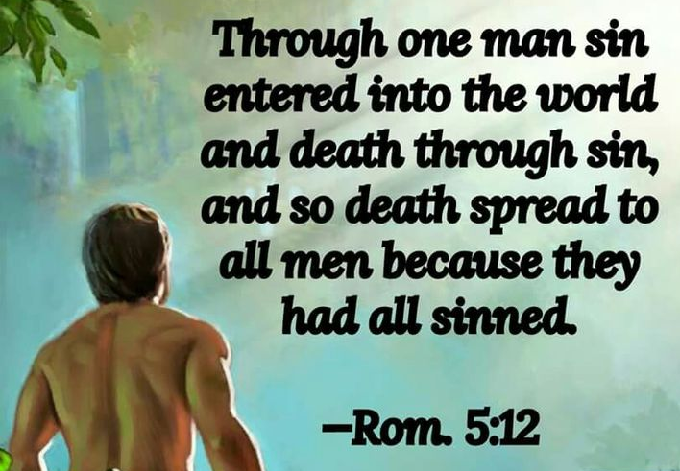
Genesis 2:16-17
“¹⁶ The Lord God commanded the man, saying, ‘From any tree of the garden you may eat freely; ¹⁷ but from the tree of the knowledge of good and evil you shall not eat, for in the day that you eat from it you will surely die (muwth).’”

Slide 13

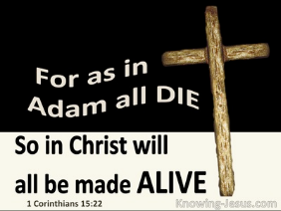
1 Corinthians 15:21-22
“²¹ For since by a man came death, by a man also came the resurrection of the dead. ²² For as in Adam all die, so also in Christ all will be made alive.”

Slide 14
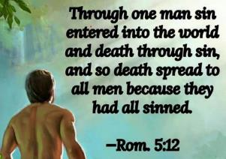
Romans 5:12
“Therefore, just as through one man sin entered into the world, and death through sin, and so death spread to all men, because all sinned—.”

Slide 15
Romans 6:23
“For the wages of sin is death, but the free gift of God is eternal life in Christ Jesus our Lord.”

Slide 16

Ephesians 2:1-5
¹ “And you were dead in your trespasses and sins, ² in which you formerly walked according to the course of this world, according to the prince of the power of the air, of the spirit that is now working in the sons of disobedience. ³ Among them we too all formerly lived in the lusts of our flesh, indulging the desires of the flesh and of the mind, and were by nature children of wrath, even as the rest. ⁴ But God, being rich in mercy, because of His great love with which He loved us, ⁵ even when we were dead in our transgressions, made us alive together with Christ (by grace you have been saved)”

Slide 17
LOCUSTS
Exodus 10:1-20
  God’s Instructions (1-2)
  Moses & Aaron Speak to Pharaoh (3-6)
  Moses & Aaron Speak to Pharaoh Again (7-11)
  Plague’s Manifestation (12-15)
  Pharaoh Speaks to Moses & Aaron (16-17)
  God Answers (18-20)

Slide 18
VI. Exodus 10:18-20
God Answers
    Exit (18a)
    Supplication (18b)
    God’s answers (19)
    God’s hardening (20)

Slide 19
VI. Exodus 10:18-20
God Answers
    Exit (18a)
    Supplication (18b)
    God’s answers (19)
    God’s hardening (20)

Slide 20
VI. Exodus 10:18-20
God Answers
    Exit (18a)
    Supplication (18b)
    God’s answers (19)
    God’s hardening (20)

Slide 21
VI. Exodus 10:18-20
God Answers
    Exit (18a)
    Supplication (18b)
    God’s answers (19)
    God’s hardening (20)

Slide 22
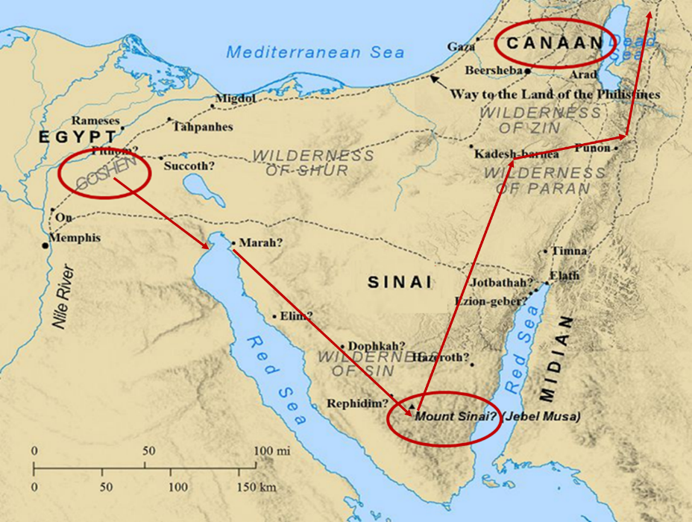

Slide 23
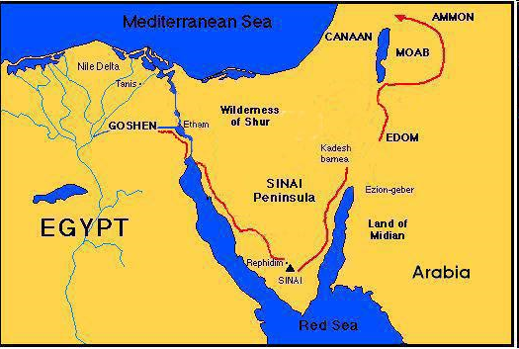

Slide 24
VI. Exodus 10:18-20
God Answers
    Exit (18a)
    Supplication (18b)
    God’s answers (19)
    God’s hardening (20)

Slide 25
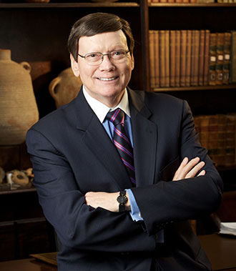
Dr. Ed Hindson
Hindson, E. E., & Mitchell, D. R., eds. (2010). KJV Bible Commentary for Today: The Most Up-to-Date Commentary on the Time-Honored Text of the KJV (p. 86). Thomas Nelson.
“4:21. I will harden his heart. An expression meaning ‘to strengthen his will.’ The text identifies the heart as the location of the volition, man’s decision-making ability. On seven occasions in the narrative, God hardens Pharaoh’s heart (9:12; 10:1, 20, 27; 11:10; 14:4, 8) or foretells that He will harden Pharaoh’s heart (4:21; 7:3), and nine times in the text, Pharaoh hardens his own heart (7:13, 14, 22; 8:15, 19, 32; 9:7, 34–35). For the initial five plagues, the text registers Pharaoh as the agent of hardening. Not until the sixth plague does God participate in the confirmation of Pharaoh’s own volitional choices.”

Slide 26

Charles Ryrie
Ryrie Study Bible, page 96
Exodus 4:21 - “harden his heart. Ten times it is said that Pharaoh hardened his own heart (7:13, 14, 22; 8:15, 19, 32; 9:7, 34, 35; 13:15), and 10 times that God hardened Pharaoh’s heart (4:21; 7:3; 9:12; 10:1, 20, 27; 11:10; 14:4, 8, 17). Paul uses this as an example of the inscrutable will of God and of His mercy toward men (Rom. 9:14–18). Seven times Pharaoh hardened his own heart before God first hardened it, though the prediction that God would do it preceded all.”

Slide 27
GOD HARDENING PHARAOH'S HEART
The prediction of God hardening of Pharaoh (4:21)
Pharaoh repeatedly hardening his own heart (7:13, 22; 8:15, 19, 32; 9:7)
Not until the sixth plague did God harden Pharaoh’s heart (Exod 9:12)

Slide 28

Romans 1:18–20
¹⁸ “For the wrath of God is revealed from heaven against all ungodliness and unrighteousness of men who suppress the truth in unrighteousness, ¹⁹ because that which is known about God is evident within them; for God made it evident to them. ²⁰ For since the creation of the world His invisible attributes, His eternal power and divine nature, have been clearly seen, being understood through what has been made, so that they are without excuse.”

Slide 29
Conclusion

Slide 30
LOCUSTS
Exodus 10:1-20
  God’s Instructions (1-2)
  Moses & Aaron Speak to Pharaoh (3-6)
  Moses & Aaron Speak to Pharaoh Again (7-11)
  Plague’s Manifestation (12-15)
  Pharaoh Speaks to Moses & Aaron (16-17)
  God Answers (18-20)

Slide 31
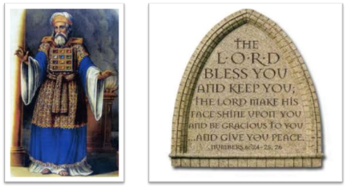
²⁴ The Lord bless you, and keep you; ²⁵ The Lord make His face shine on you, And be gracious to you; ²⁶ The Lord lift up His countenance on you, And give you peace.
Numbers 6:24–26 (NASB95)

Slide 32
TEN PLAGUES REDEMPTION (7:14–12:30)
Nile to blood
Frogs
Gnats
Flies
Death of livestock
Boils
Hail
Locusts
Darkness
Death of 1st born

Slide 33
DARKNESS
Exodus 10:21-29
  Plague’s Manifestation (21-23)
  Pharaoh Speaks to Moses (24-29)

Slide 34
DARKNESS
Exodus 10:21-29
  Plague’s Manifestation (21-23)
  Pharaoh Speaks to Moses (24-29)

Slide 35
I. Exodus 10:21-23
Plague’s Manifestation
    God’s command (21)
    Moses’ obedience (22a)
    Plague’s severity (22b-23a)
    Israel’s exemption (23b)

Slide 36
I. Exodus 10:21-23
Plague’s Manifestation
    God’s command (21)
    Moses’ obedience (22a)
    Plague’s severity (22b-23a)
    Israel’s exemption (23b)

Slide 37
Ultimate Exodus
(Rev 11:15)
Sores: 6th plague (Ex 9:8-12), 1st bowl (Rev 16:1-2)
Rivers to blood: 1st plague (Ex 7:19-21), 3rd bowl (Rev 16:4-7)
Darkness: 9th plague (Ex 10:21-23), 5th bowl (Rev 16:10-11)
Frogs: 2nd plague (Ex 7:25‒8:15), 6th bowl (Rev 16:13)
Hail: 7th plague (Ex 9:22-26), 7th bowl (Rev 16:17-21)

Slide 39

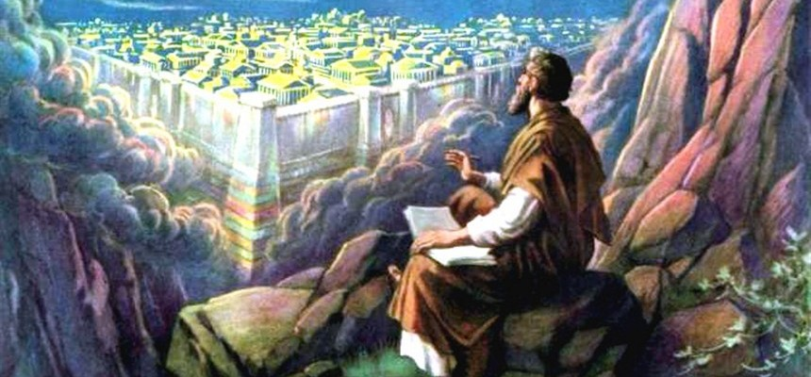
Revelation 11:15
¹⁵ “Then the seventh angel sounded; and there were loud voices in heaven, saying, ‘The kingdom of the world has become the kingdom of our Lord and of His Christ; and He will reign forever and ever.’”

Slide 40
The Plagues of Egypt
NO. | DESCRIPTION | SCRIPTURE | Egyptian Deity
1. | Water to Blood | Exod. 7:14-25 | Hapi, Khnum
2. | Frogs | Exod. 8:1-15 | Heqt
3. | Gnats | Exod. 8:16-19 | Set
4. | Flies | Exod. 8:20-32 | Uatchit
5. | Disease on Cattle | Exod. 9:1-7 | Hathor, Apis
6. | Boils | Exod. 9:8-12 | Sekhmet, Serapis
7. | Hail | Exod. 9:13-35 | Seth, Nut
8. | Locusts | Exod. 10:1-20 | Seth, Nut, Osiris
9. | Darkness | Exod. 10:21-29 | Re, Horus, Atum
10. | Death of the First Born | Exod. 12:29-36 | Min, Osiris, Heqt, Isis

Slide 41
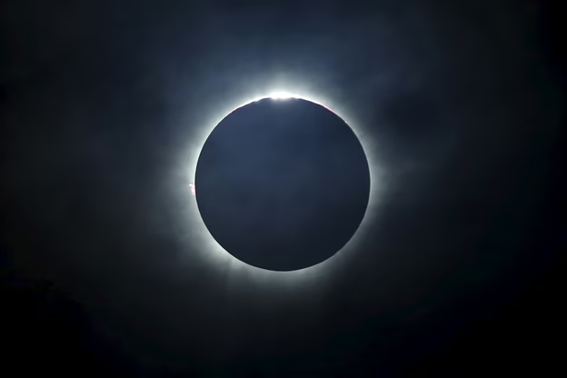
Charles Ryrie
Ryrie Study Bible, page 106
Exodus 10:21 - “darkness which may be felt. Possibly a combination of a violent sandstorm and supernatural darkness.”

Slide 42
The Plagues of Egypt
NO. | DESCRIPTION | SCRIPTURE | Egyptian Deity
1. | Water to Blood | Exod. 7:14-25 | Hapi, Khnum
2. | Frogs | Exod. 8:1-15 | Heqt
3. | Gnats | Exod. 8:16-19 | Set
4. | Flies | Exod. 8:20-32 | Uatchit
5. | Disease on Cattle | Exod. 9:1-7 | Hathor, Apis
6. | Boils | Exod. 9:8-12 | Sekhmet, Serapis
7. | Hail | Exod. 9:13-35 | Seth, Nut
8. | Locusts | Exod. 10:1-20 | Seth, Nut, Osiris
9. | Darkness | Exod. 10:21-29 | Re, Horus, Atum
10. | Death of the First Born | Exod. 12:29-36 | Min, Osiris, Heqt, Isis

Slide 43
Dr. Ed Hindson
Hindson, E. E., & Mitchell, D. R., eds. (2010). KJV Bible Commentary for Today: The Most Up-to-Date Commentary on the Time-Honored Text of the KJV (p. 97). Thomas Nelson.
Exodus 10:21 - “The chief Egyptian deity challenged by this plague was Pharaoh’s own divine father, Ra, the sun god and high god of the pantheon. This is surely a response to Pharaoh’s previous equation of YHWH’s power with that of Ra (10:10). Shu and Nut, the respective sky god and goddess, would also have been (yet again) shown impotent before the Lord.”

Slide 45
I. Exodus 10:21-23
Plague’s Manifestation
    God’s command (21)
    Moses’ obedience (22a)
    Plague’s severity (22b-23a)
    Israel’s exemption (23b)

Slide 46
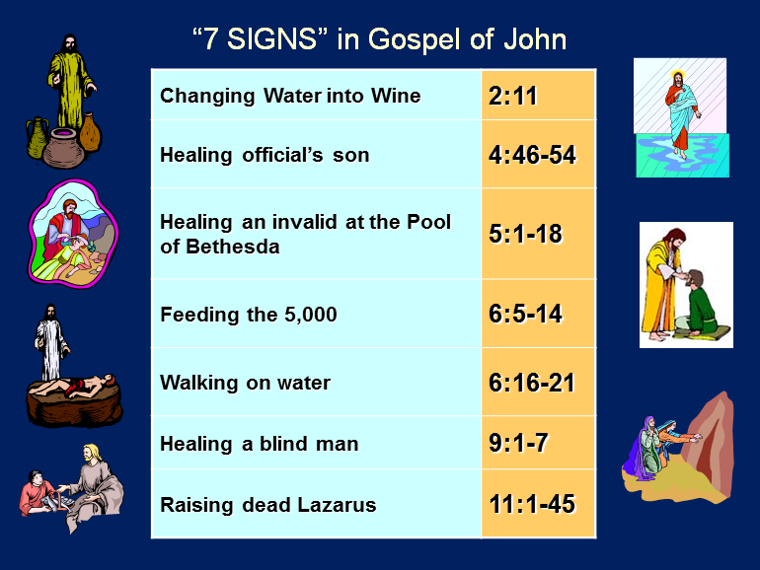

Slide 47
I. Exodus 10:21-23
Plague’s Manifestation
    God’s command (21)
    Moses’ obedience (22a)
    Plague’s severity (22b-23a)
    Israel’s exemption (23b)

Slide 48
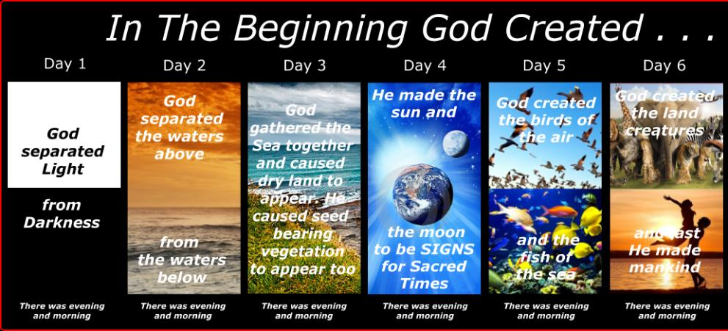
SHAPING AND POPULATING (GEN 1:1)
Day 1: | Light | Day 4: | Luminaries
Day 2: | Water, sky | Day 5: | Sea animals, birds
Day 3: | Land, vegetation | Day 6: | Land animals, man

Slide 49
I. Exodus 10:21-23
Plague’s Manifestation
    God’s command (21)
    Moses’ obedience (22a)
    Plague’s severity (22b-23a)
    Israel’s exemption (23b)

Slide 50
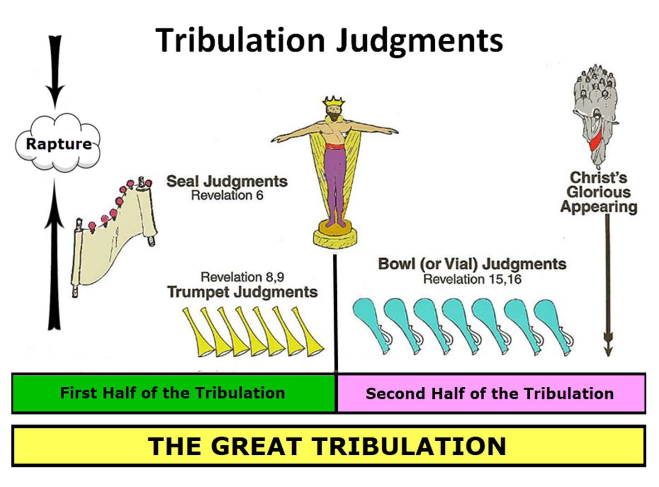

Slide 51

Protection Through the Tribulation?
(Revelation 3:10)
Like the protection in Goshen (Exod. 8:22, 24; 9:4, 6; 11:4-7; Rev. 9:4; 16:2)
Effective? Rev. 6:9-11; 7:13-14; 13:10, 15; 20:4
Comfort? John 14:1; 1 Thess. 4:18; Titus 2:13

Slide 52
Dr. Ed Hindson
Hindson, E. E., & Mitchell, D. R., eds. (2010). KJV Bible Commentary for Today: The Most Up-to-Date Commentary on the Time-Honored Text of the KJV (p. 97). Thomas Nelson.
Exodus 10:21 - “Proponents of the miraculous intensification of natural events theory propose that the darkness resulted from the arrival of a blinding sandstorm. This does not take into consideration, however, that the darkness began at the discretion of Moses or the continued distinction the Lord made between Goshen and the remainder of Egypt. Although the entire nation suffered in suffocating, pitch-black darkness, the Hebrews in Goshen had retained the sunlight.”

Slide 53
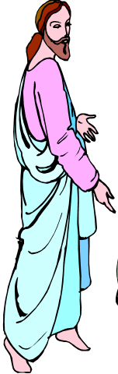
7 “I AM” statements in John
I am the Bread of Life | 6:35
I am the Light of the world | 8:12
I am the Gate for the sheep | 10:7; cf. v.9
I am the Good Shepherd | 10:11,14
I am the Resurrection and the Life | 11:25
I am the Way and the Truth and the Life | 14:6
I am the true Vine | 15:1; cf. v.5

Slide 54
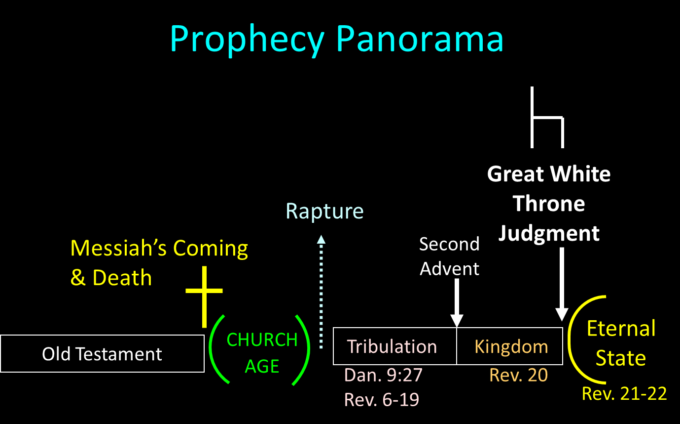

Slide 55
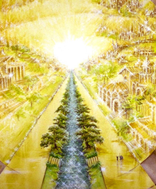
Eternal State is Future
No Satan (Rev 20:10)
No sea (Rev 21:1)
No death, crying, or pain (Rev 21:4)
No Sun (Rev 22:5)
No Moon (Rev 21:23)
No temple (Rev. 21:22)
No night (Rev 21:25)
No evil (Rev 21:27)
No curse (Rev 22:3)

Slide 56
DARKNESS
Exodus 10:21-29
  Plague’s Manifestation (21-23)
  Pharaoh Speaks to Moses (24-29)

Slide 57
II. Exodus 10:24-29
Pharaoh Speaks to Moses
    Entrance (24a)
    Pharaoh’s command (24b)
    Pharaoh’s qualification (24c)
    Moses’ rebuttal (25-26)
    God’s hardening (27)
    Pharaoh’s command (28)
    Moses’ affirmation (29)

Slide 58
II. Exodus 10:24-29
Pharaoh Speaks to Moses
    Entrance (24a)
    Pharaoh’s command (24b)
    Pharaoh’s qualification (24c)
    Moses’ rebuttal (25-26)
    God’s hardening (27)
    Pharaoh’s command (28)
    Moses’ affirmation (29)

Slide 59
II. Exodus 10:24-29
Pharaoh Speaks to Moses
    Entrance (24a)
    Pharaoh’s command (24b)
    Pharaoh’s qualification (24c)
    Moses’ rebuttal (25-26)
    God’s hardening (27)
    Pharaoh’s command (28)
    Moses’ affirmation (29)

Slide 61

Ephesians 2:8-10
“⁸ For by grace you have been saved through faith; and that not of yourselves, it is the gift of God; ⁹ not as a result of works, so that no one may boast. ¹⁰ For we are His workmanship, created in Christ Jesus for good works, which God prepared beforehand so that we would walk [peripateō, subjunctive mood] in them.”

Slide 62
II. Exodus 10:24-29
Pharaoh Speaks to Moses
    Entrance (24a)
    Pharaoh’s command (24b)
    Pharaoh’s qualification (24c)
    Moses’ rebuttal (25-26)
    God’s hardening (27)
    Pharaoh’s command (28)
    Moses’ affirmation (29)

Slide 63
II. Exodus 10:24-29
Pharaoh Speaks to Moses
    Entrance (24a)
    Pharaoh’s command (24b)
    Pharaoh’s qualification (24c)
    Moses’ rebuttal (25-26)
    God’s hardening (27)
    Pharaoh’s command (28)
    Moses’ affirmation (29)

Slide 65
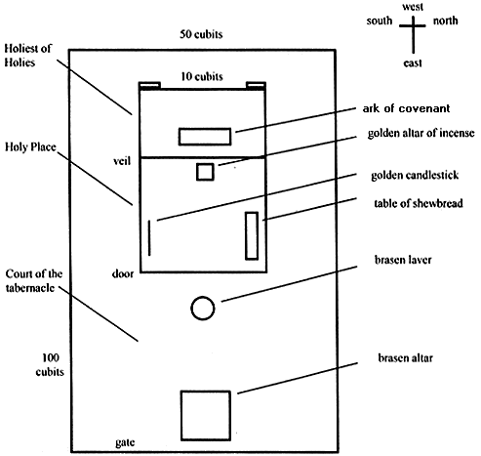
Tabernacle Diagram

Slide 66
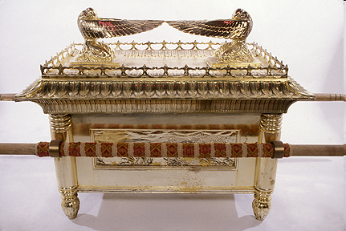
Ark of the Covenant

Slide 67
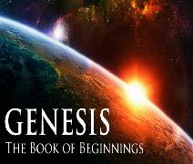
God’s Provision
(3:20-24)
  Continuation of the race (3:20)
  Forgiveness (3:21, 7)
  Expulsion of Adam and Eve from Eden (3:22-24)

Slide 69
Ephesians 2:8-10
“⁸ For by grace you have been saved through faith; and that not of yourselves, it is the gift of God; ⁹ not as a result of works, so that no one may boast. ¹⁰ For we are His workmanship, created in Christ Jesus for good works, which God prepared beforehand so that we would walk [peripateō, subjunctive mood] in them.”

Slide 70
II. Exodus 10:24-29
Pharaoh Speaks to Moses
    Entrance (24a)
    Pharaoh’s command (24b)
    Pharaoh’s qualification (24c)
    Moses’ rebuttal (25-26)
    God’s hardening (27)
    Pharaoh’s command (28)
    Moses’ affirmation (29)

Slide 71
Dr. Ed Hindson
Hindson, E. E., & Mitchell, D. R., eds. (2010). KJV Bible Commentary for Today: The Most Up-to-Date Commentary on the Time-Honored Text of the KJV (p. 86). Thomas Nelson.
“4:21. I will harden his heart. An expression meaning ‘to strengthen his will.’ The text identifies the heart as the location of the volition, man’s decision-making ability. On seven occasions in the narrative, God hardens Pharaoh’s heart (9:12; 10:1, 20, 27; 11:10; 14:4, 8) or foretells that He will harden Pharaoh’s heart (4:21; 7:3), and nine times in the text, Pharaoh hardens his own heart (7:13, 14, 22; 8:15, 19, 32; 9:7, 34–35). For the initial five plagues, the text registers Pharaoh as the agent of hardening. Not until the sixth plague does God participate in the confirmation of Pharaoh’s own volitional choices.”

Slide 72
Charles Ryrie
Ryrie Study Bible, page 96
Exodus 4:21 - “harden his heart. Ten times it is said that Pharaoh hardened his own heart (7:13, 14, 22; 8:15, 19, 32; 9:7, 34, 35; 13:15), and 10 times that God hardened Pharaoh’s heart (4:21; 7:3; 9:12; 10:1, 20, 27; 11:10; 14:4, 8, 17). Paul uses this as an example of the inscrutable will of God and of His mercy toward men (Rom. 9:14–18). Seven times Pharaoh hardened his own heart before God first hardened it, though the prediction that God would do it preceded all.”

Slide 73
GOD HARDENING PHARAOH'S HEART
The prediction of God hardening of Pharaoh (4:21)
Pharaoh repeatedly hardening his own heart (7:13, 22; 8:15, 19, 32; 9:7)
Not until the sixth plague did God harden Pharaoh’s heart (Exod 9:12)

Slide 74
II. Exodus 10:24-29
Pharaoh Speaks to Moses
    Entrance (24a)
    Pharaoh’s command (24b)
    Pharaoh’s qualification (24c)
    Moses’ rebuttal (25-26)
    God’s hardening (27)
    Pharaoh’s command (28)
    Moses’ affirmation (29)

Slide 75
II. Exodus 10:24-29
Pharaoh Speaks to Moses
    Entrance (24a)
    Pharaoh’s command (24b)
    Pharaoh’s qualification (24c)
    Moses’ rebuttal (25-26)
    God’s hardening (27)
    Pharaoh’s command (28)
    Moses’ affirmation (29)

Slide 76
Conclusion

Slide 77
DARKNESS
Exodus 10:21-29
  Plague’s Manifestation (21-23)
  Pharaoh Speaks to Moses (24-29)

Slide 78
²⁴ The Lord bless you, and keep you; ²⁵ The Lord make His face shine on you, And be gracious to you; ²⁶ The Lord lift up His countenance on you, And give you peace.
Numbers 6:24–26 (NASB95)

