Slide 1
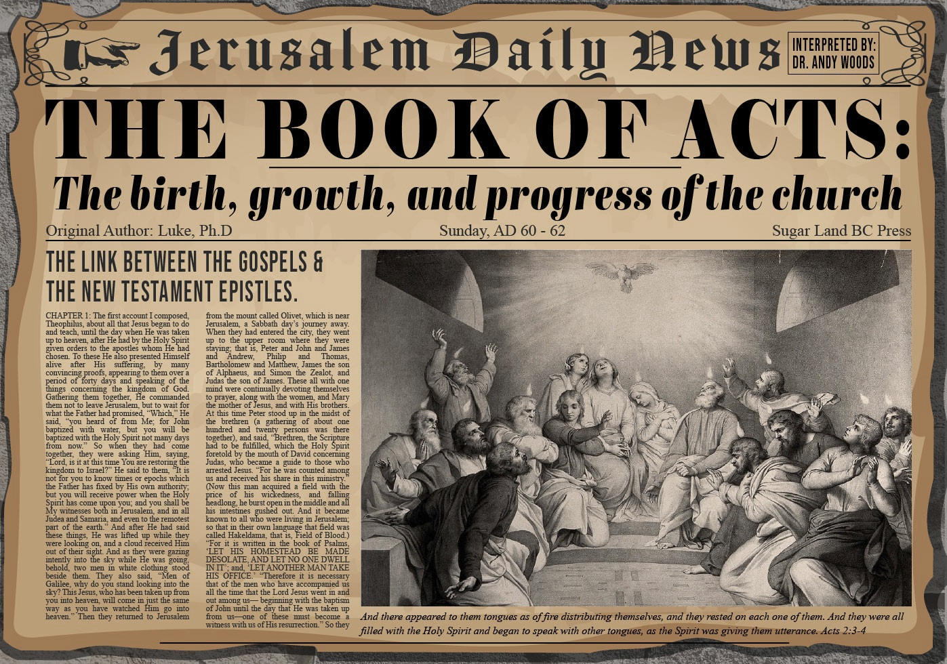


Slide 2
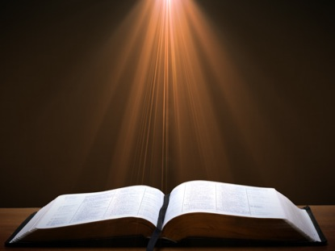
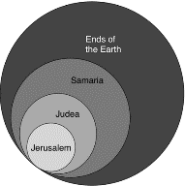
Acts 1:8
“but you will receive power when the Holy Spirit has come upon you; and you shall be My witnesses both in Jerusalem (Acts 1-7), and in all Judea and Samaria (Acts 8-12), and even to the remotest part of the earth (Acts 13-28).”

Slide 3
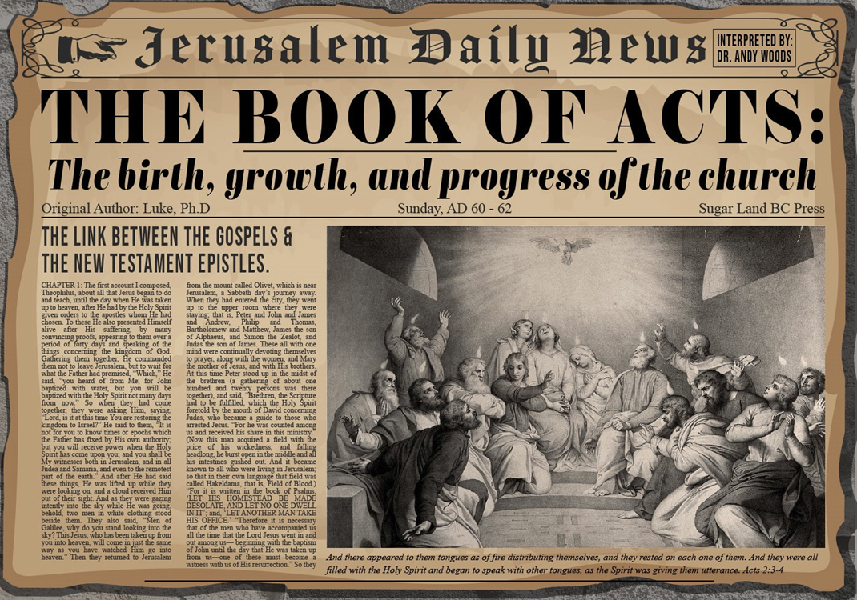
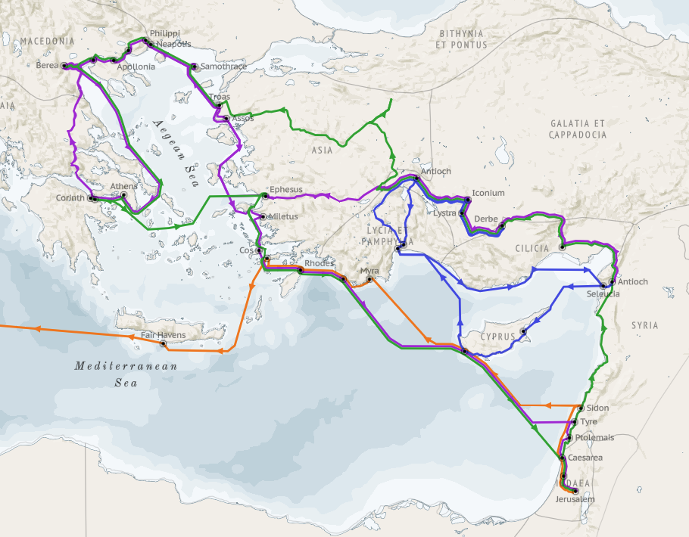
Structure (Acts 1:8)
  Jerusalem (Acts 1–7)
  Judea and Samaria (Acts 8–12)
  Remotest part of the earth (Acts 13–28)
  1st missionary journey (Acts 13–14)
  Jerusalem council (Acts 15:1-35)
  2nd missionary journey (Acts 15:36 –18:22)
  3rd missionary journey (Acts 18:23–21:17)
  Trip to Rome (Acts 21:18–28:31)

Slide 4
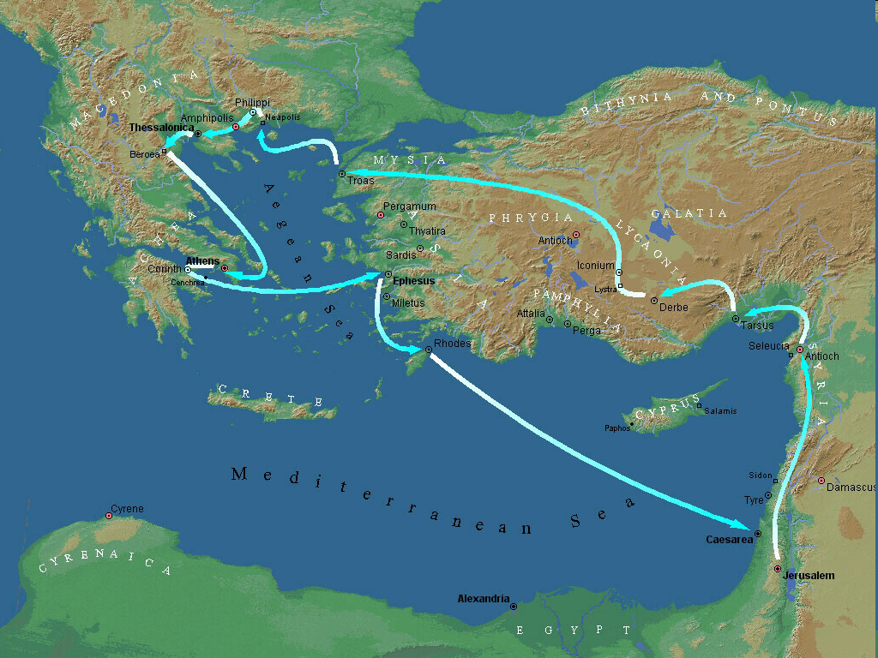
Second Missionary Journey

Slide 5
Acts 15:36‒18:22
2nd Missionary Journey
  Schism between Paul & Barnabas (15:36-41)
  Syria & Cilicia ministry (16:1-5)
  Macedonian call (16:6-10)
  Philippian ministry (16:11-40)
  Thessalonica ministry (17:1-9)
  Berean ministry (17:10-15)
  Athens’ ministry (17:16-34)
  Corinthian ministry (18:1-18)
  Ephesus’ ministry (18:19-21)
  Return to Antioch (18:22)

Slide 6
VI. Berean Ministry
Acts 17:10-15
  Journey to Berea (10a)
  Synagogue ministry (10b)
  Berean Discernment (11)
  1st Berean Believers (12)
  Opposition (13-15)

Slide 7
Acts 17:13-15
Opposition
      Source (13)
      Paul leaves Athens (14)
      Paul in Athens (15)

Slide 8
Acts 17:13-15
Opposition
      Source (13)
      Paul leaves Athens (14)
      Paul in Athens (15)

Slide 9
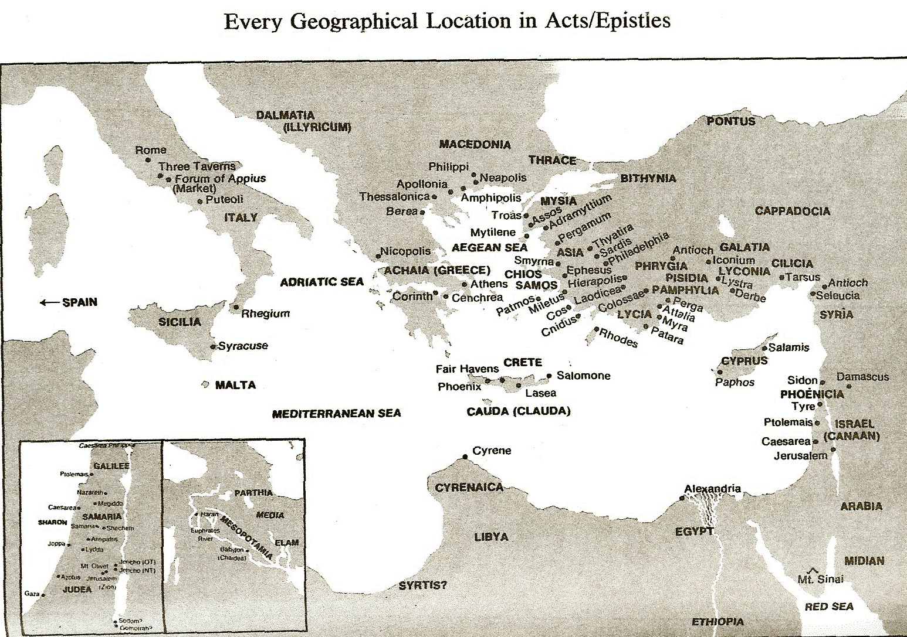

Slide 10
Second Missionary Journey

Slide 11
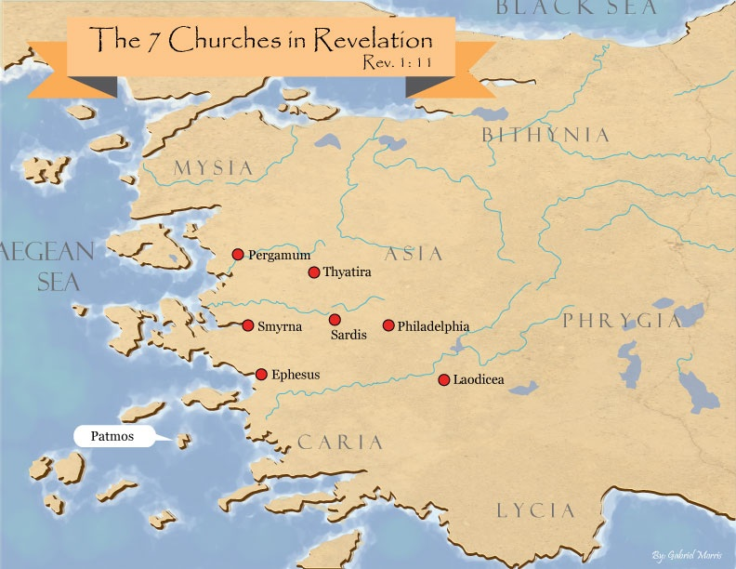
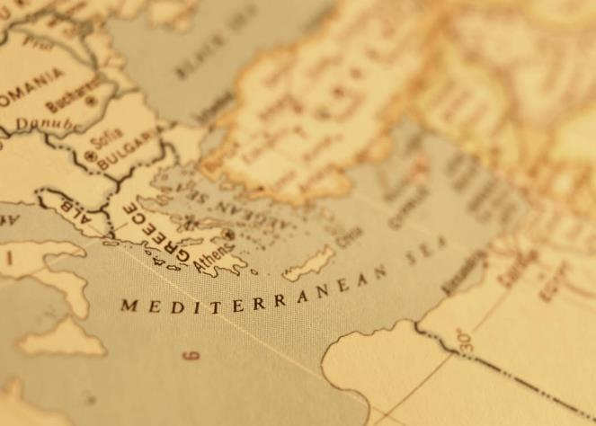

Slide 12
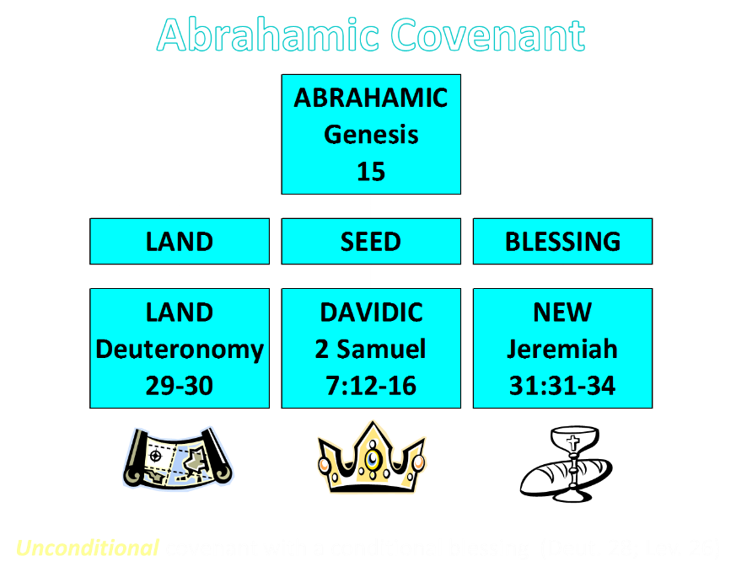

Slide 13
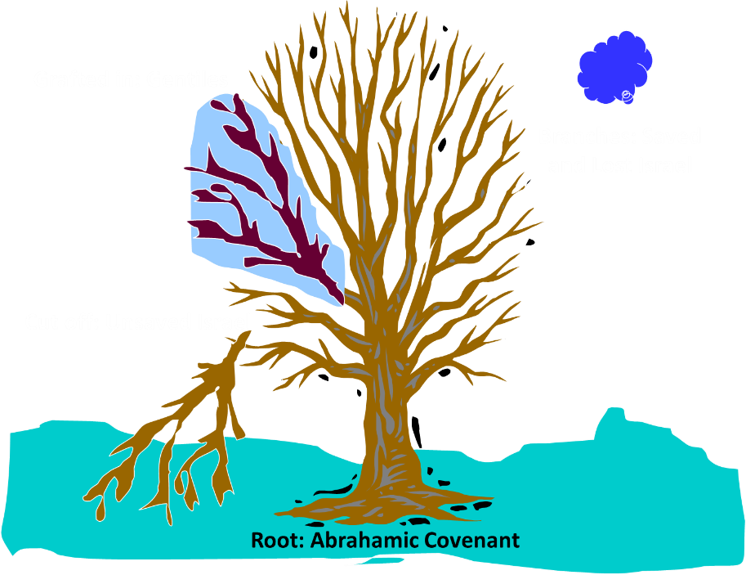
Notes:
13

Slide 14
Acts 17:13-15
Opposition
      Source (13)
      Paul leaves Athens (14)
      Paul in Athens (15)

Slide 16
Second Missionary Journey

Slide 17
Acts 17:13-15
Opposition
      Source (13)
      Paul leaves Athens (14)
      Paul in Athens (15)

Slide 19
Second Missionary Journey

Slide 20
Acts 15:36‒18:22
2nd Missionary Journey
  Schism between Paul & Barnabas (15:36-41)
  Syria & Cilicia ministry (16:1-5)
  Macedonian call (16:6-10)
  Philippian ministry (16:11-40)
  Thessalonica ministry (17:1-9)
  Berean ministry (17:10-15)
  Athens’ ministry (17:16-34)
  Corinthian ministry (18:1-18)
  Ephesus’ ministry (18:19-21)
  Return to Antioch (18:22)

Slide 21
VII. Athens Ministry
Acts 17:16-34
  Paul’s witness (16-21)
  Paul’s speech (22-31)
  Athenians’ response (32-34)

Slide 22
VII. Athens Ministry
Acts 17:16-34
  Paul’s witness (16-21)
  Paul’s speech (22-31)
  Athenians’ response (32-34)

Slide 23
Acts 17:16-21
Paul’s Witness
      Paul’s provocation (16a)
      Athens’ idolatry (16b)
      Athenian ministry (17)
      Philosophical opposition (18-21)

Slide 24
Acts 17:16-21
Paul’s Witness
      Paul’s provocation (16a)
      Athens’ idolatry (16b)
      Athenian ministry (17)
      Philosophical opposition (18-21)

Slide 25

2 Peter 2:7-9
“⁷ and if He rescued righteous Lot, oppressed by the sensual conduct of unprincipled men ⁸ (for by what he saw and heard that righteous man, while living among them, felt his righteous soul tormented day after day by their lawless deeds), ⁹ then the Lord knows how to rescue the godly from temptation, and to keep the unrighteous under punishment for the day of judgment.”

Slide 26
Acts 17:16-21
Paul’s Witness
      Paul’s provocation (16a)
      Athens’ idolatry (16b)
      Athenian ministry (17)
      Philosophical opposition (18-21)

Slide 27
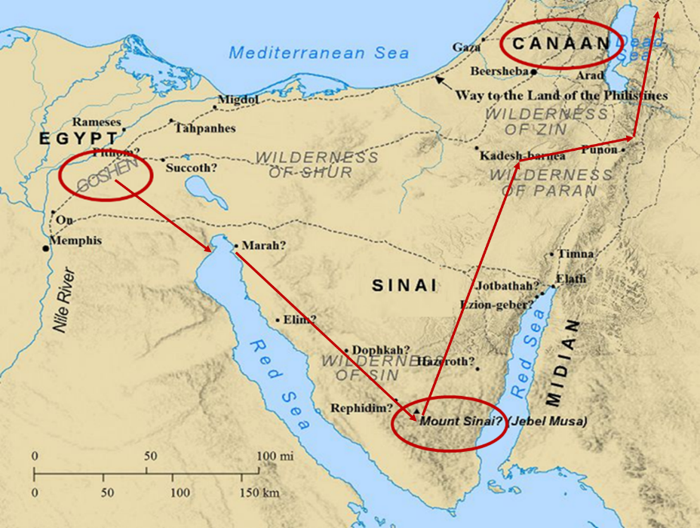

Slide 28
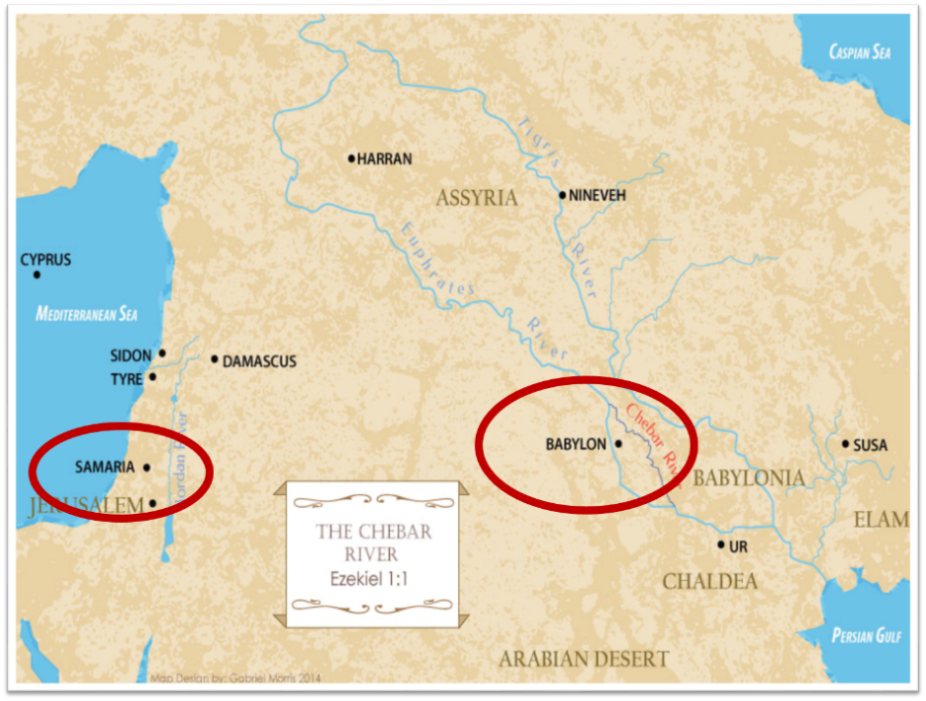

Slide 29
Acts 17:16-21
Paul’s Witness
      Paul’s provocation (16a)
      Athens’ idolatry (16b)
      Athenian ministry (17)
      Philosophical opposition (18-21)

Slide 30
Acts 17:17
Athenian Ministry
      Synagogue (17a)
      Proselytes (17b)
      Market place (17c)

Slide 31
Acts 17:17
Athenian Ministry
      Synagogue (17a)
      Proselytes (17b)
      Market place (17c)

Slide 32
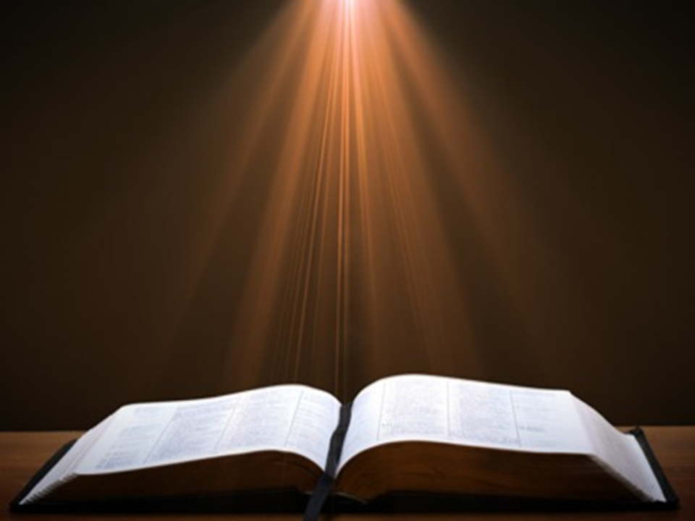
Acts 17:1-3
“¹ Now when they had traveled through Amphipolis and Apollonia, they came to Thessalonica, where there was a synagogue of the Jews. ² And according to Paul’s custom, he visited them, and for three Sabbaths reasoned with them from the Scriptures, ³ explaining and giving evidence that the Christ had to suffer and rise from the dead, and saying, “This Jesus whom I am proclaiming to you is the Christ.”

Slide 33
Acts 17:17
Athenian Ministry
      Synagogue (17a)
      Proselytes (17b)
      Market place (17c)

Slide 34
Acts 17:17
Athenian Ministry
      Synagogue (17a)
      Proselytes (17b)
      Market place (17c)

Slide 35
Acts 17:16-21
Paul’s Witness
      Paul’s provocation (16a)
      Athens’ idolatry (16b)
      Athenian ministry (17)
      Philosophical opposition (18-21)

Slide 36
Acts 17:18-21
Philosophical Opposition
      Opponents (18a-b)
      Mockery (18c-d)
      Before the Aeropagus (19-21)

Slide 37
Acts 17:18-21
Philosophical Opposition
      Opponents (18a-b)
      Mockery (18c-d)
      Before the Aeropagus (19-21)

Slide 38
Acts 17:18a-b
Opponents
      Epicureans (18a)
      Stoics (18b)

Slide 39
Acts 17:18a-b
Opponents
      Epicureans (18a)
      Stoics (18b)

Slide 40

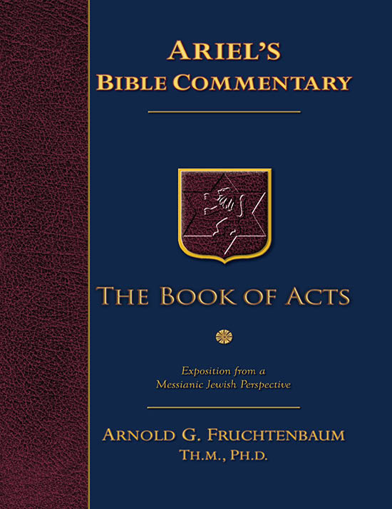
Dr. Arnold G. Fruchtenbaum
The Book of Acts, 366
“The first group followed the teachings of Epicurus, a Greek philosopher who lived between the years 341-270 B.C. Epicureanism began with the search for pure truth by reason. However, since this search was considered to be hopeless, the chief end of man was to try to find happiness. Pleasure, not knowledge, should be the goal of life. Epicureans believed that the gods live in eternal calm but away from the lives of man and that, unlike the gods, man has no afterlife either to fear or to hope for. Because there is no afterlife for either the good or the bad, they believed that man should make the best of his life here. While Epicureans were not theological atheists, they were practical atheists. Eventually, this philosophical movement degenerated into a life of sensualism. Among the more famous Epicurean poets were Lucretius and Horace.”

Slide 41
Acts 17:18a-b
Opponents
      Epicureans (18a)
      Stoics (18b)

Slide 42
Dr. Arnold G. Fruchtenbaum
The Book of Acts, 366-67
“The second type of Greek philosophers Paul encountered were the Stoics. They were followers of Zeno (ca. 334-262 B.C.) and Chrysippus (ca. 279-206 B.C.). Zeno taught in the Stoa Poikile (‘Painted Porchm’). Therefore, his philosophy became known as ‘Stoicism.’ According to the Stoics, wisdom lay in being free from intense emotionalism. Therefore, man had to submit to natural law and learn to live comfortably with nature. The highest expression of this life was reason. To be virtuous was to live in harmony with reason, and this was the only good. Not to be virtuous was the only evil. All other things, such as death or pleasure or pain, were indifferent. Theologically, Stoics were pantheists.”

Slide 43
Dr. Arnold G. Fruchtenbaum
The Book of Acts, 366-67
“In their view, the purpose of the gods was in directing history, and man had only to align himself with the gods in this purpose. They viewed the gods as the ‘world soul.’ The Stoic ideal was to be absolutely brave in the face of pain and death because pain and death were not evils. Man was also to be unmoved by either joy or grief. There was a stern self-repression on the basis of human self-sufficiency. The goal was absolute contentment because pleasure was not good. Absolute justice was not to be influenced by pleasures or favor. Stoics stressed the rational over the emotional in man. They stressed, individual self-sufficiency, including the right to commit suicide. The ideal was a stern and unending endurance. This philosophy was especially attractive to the Roman mind. Seneca was one of the famous Roman Stoics, as were Epictetus and Marcus Aurelius.”

Slide 44
Acts 17:18-21
Philosophical Opposition
      Opponents (18a-b)
      Mockery (18c-d)
      Before the Aeropagus (19-21)

Slide 45
Acts 17:18c-d
Mockery
      Babbler (18c)
      Resurrection (18d)

Slide 46
Acts 17:18c-d
Mockery
      Babbler (18c)
      Resurrection (18d)

Slide 47
Dr. Arnold G. Fruchtenbaum
The Book of Acts, 367
“The Epicureans and the Stoics mocked Paul, calling him a babbler (v. 18b). The Greek word for ‘babbler’ is spermologos. Aristotle and Aristophanes used the term of crows or daws picking up grain in the fields. Plutarch used it of small carnivorous birds. Hence, the term often means ‘seed picker,’ ‘scavenger,’ or ‘scrapmonger.’ Paul was seen as one who took learning here and there and passed it on as his own. He was considered a loquacious person with nothing to say, and so they mocked, ‘Let us see what this little seed picker is going to say.’ This would have been an Epicurean question.”

Slide 48
Acts 17:18c-d
Mockery
      Babbler (18c)
      Resurrection (18d)

Slide 50
Second Missionary Journey

Slide 51
Acts 17:18-21
Philosophical Opposition
      Opponents (18a-b)
      Mockery (18c-d)
      Before the Aeropagus (19-21)

Slide 52
Acts 17:19-21
Before the Aeropagus
      Transfer (19a)
      Need to explain strange teachings (19b-21)

Slide 53
Acts 17:19-21
Before the Aeropagus
      Transfer (19a)
      Need to explain strange teachings (19b-21)

Slide 54
Acts 17:19-21
Before the Aeropagus
      Transfer (19a)
      Need to explain strange teachings (19b-21)

Slide 55


2 Timothy 4:3-4
“For the time will come when they will not endure sound doctrine; but wanting to have their ears tickled, they will accumulate for themselves teachers in accordance to their own desires, ⁴ and will turn away their ears from the truth and will turn aside to myths.”

Slide 56
VII. Athens Ministry
Acts 17:16-34
  Paul’s witness (16-21)
  Paul’s speech (22-31)
  Athenians’ response (32-34)

Slide 57
Acts 17:22-31
Paul’s Speech
      Location (22a)
      Introduction (22b-23a)
      Unknown God described (23b-28)
      Man’s responsibility (29-31)

Slide 58
Acts 17:22-31
Paul’s Speech
      Location (22a)
      Introduction (22b-23a)
      Unknown God described (23b-28)
      Man’s responsibility (29-31)

Slide 59

GENERAL VS. SPECIAL REVELATION
 | GENERAL | SPECIAL
EXAMPLES | Nature, conscience (Rom 1–2) | Incarnation, Scripture, miracles
AVAILABILITY | All | Some
ACCOMPLISHMENT | Accountability (Rom 1) | Salvation (Acts 4:12; 2 Tim 3:15)
FORM | Non-written / non-verbal | Written
QUALITY | Natural | Supernatural, miraculous

Slide 60
Romans 1:18–20
¹⁸ For the wrath of God is revealed from heaven against all ungodliness and unrighteousness of men who suppress the truth in unrighteousness, ¹⁹ because that which is known about God is evident within them; for God made it evident to them. ²⁰ For since the creation of the world His invisible attributes, His eternal power and divine nature, have been clearly seen, being understood through what has been made, so that they are without excuse.

Slide 61
Acts 14:15d-17
God’s Attributes
      Living (15d)
      Creator (15e)
      Patient (16)
      Revealer (17a)
      Good (17b)

Slide 62
Acts 17:22-31
Paul’s Speech
      Location (22a)
      Introduction (22b-23a)
      Unknown God described (23b-28)
      Man’s responsibility (29-31)

Slide 63
Acts 17:22b-23a
Introduction
      Audience described (22b)
      Evidence of description (23a)

Slide 64
Acts 17:22b-23a
Introduction
      Audience described (22b)
      Evidence of description (23a)

Slide 65
Acts 17:22b-23a
Introduction
      Audience described (22b)
      Evidence of description (23a)

Slide 66
Acts 17:22-31
Paul’s Speech
      Location (22a)
      Introduction (22b-23a)
      Unknown God described (23b-28)
      Man’s responsibility (29-31)

Slide 67
Acts 17:23b-28
Unknown God Described
      Introduction (23b)
      Characteristics (24-28)

Slide 68
Acts 17:23b-28
Unknown God Described
      Introduction (23b)
      Characteristics (24-28)

Slide 69
Acts 17:23b-28
Unknown God Described
      Introduction (23b)
      Characteristics (24-28)

Slide 70
Acts 17:24-28
Characteristics
      Creator (24)
      Sufficient (25)
      Humanity’s creator (26)
      Purpose: that men might seek Him (27)
      Man’s preserver (28)

Slide 71
Acts 17:24-28
Characteristics
      Creator (24)
      Sufficient (25)
      Humanity’s creator (26)
      Purpose: that men might seek Him (27)
      Man’s preserver (28)

Slide 72
Dr. Arnold G. Fruchtenbaum
The Book of Acts, 371
“The first characteristic is that God is the Creator and the source of all life (v. 24). When Paul stated, The God that made the world and all things therein, he used Stoic language because this argument was aimed toward the Stoics. He challenged certain Greek ideas, such as that the demiurge created the universe. Furthermore, the fact that the Creator brought all things into being proved that matter did not exist eternally, as they believed. Paul declared that one God made everything, which contradicted the idea of a pantheon with a god for this and a god for that. Then, Paul said that this God is not only the Creator of the universe, but also Lord of heaven and earth. God is the Owner and absolute Possessor of both heaven and earth, not just parts of them. He does not dwell in temples made with hands, like the Parthenon in Athens.”

Slide 73
Acts 17:24-28
Characteristics
      Creator (24)
      Sufficient (25)
      Humanity’s creator (26)
      Purpose: that men might seek Him (27)
      Man’s preserver (28)

Slide 74
Acts 17:24-28
Characteristics
      Creator (24)
      Sufficient (25)
      Humanity’s creator (26)
      Purpose: that men might seek Him (27)
      Man’s preserver (28)

Slide 75
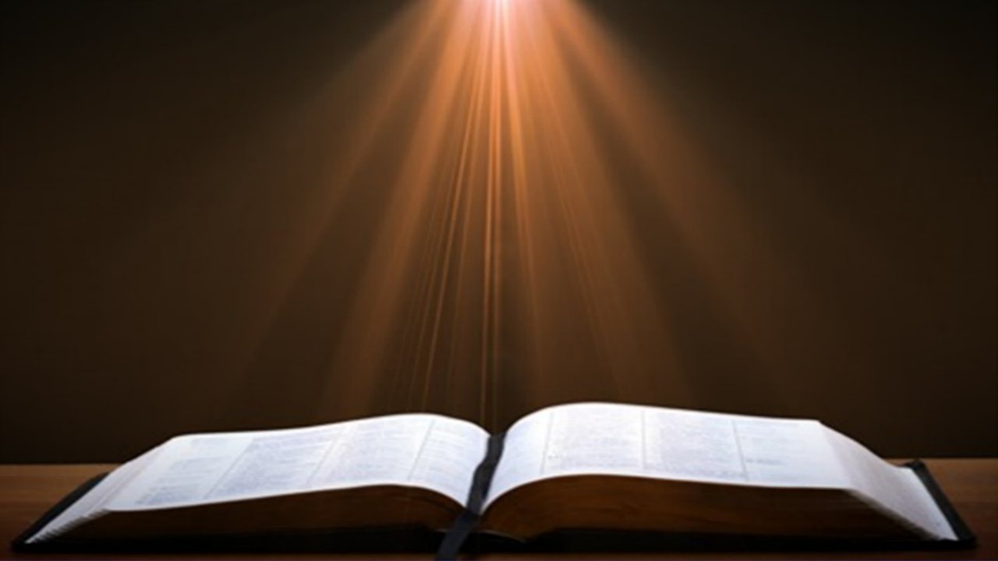
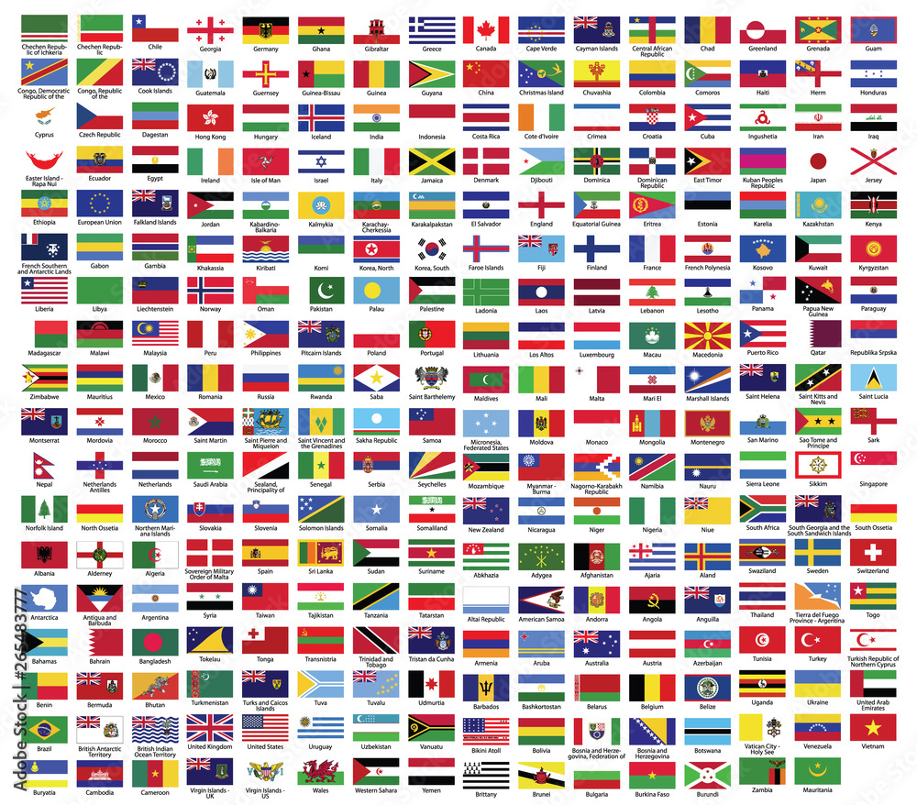
Acts 17:26
“and He made from one man every nation of mankind to live on all the face of the earth, having determined their appointed times and the boundaries of their habitation.”

Slide 76

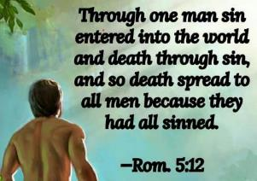
Romans 5:12
“Therefore, just as through one man sin entered into the world, and death through sin, and so death spread to all men, because all sinned—.”

Slide 77
Acts 17:26
“and He made from one man every nation of mankind to live on all the face of the earth, having determined their appointed times and the boundaries of their habitation.”

Slide 78
Genesis 11:1-9
¹ Now the whole earth used the same language and the same words. ² It came about as they journeyed east, that they found a plain in the land of Shinar and settled there. ³ They said to one another, “Come, let us make bricks and burn them thoroughly.” And they used brick for stone, and they used tar for mortar. ⁴ They said, “Come, let us build for ourselves a city, and a tower whose top will reach into heaven, and let us make for ourselves a name, otherwise…

Slide 79
Genesis 11:1-9 (cont’d)
…we will be scattered abroad over the face of the whole earth.” ⁵ The Lord came down to see the city and the tower which the sons of men had built. ⁶ The Lord said, “Behold, they are one people, and they all have the same language. And this is what they began to do, and now nothing which they purpose to do will be impossible for them. ⁷ “Come, let Us go down and there confuse their language, so that they will not understand one another’s speech.” ⁸ So the Lord . . .

Slide 80
Genesis 11:1-9 (cont’d)
…scattered them abroad from there over the face of the whole earth; and they stopped building the city. ⁹ Therefore its name was called Babel, because there the Lord confused the language of the whole earth; and from there the Lord scattered them abroad over the face of the whole earth.

Slide 81
Genesis 10:32
“These are the families of the sons of Noah, according to their genealogies, by their nations; and out of these the nations were separated on the earth after the flood.”

Slide 82
Deuteronomy 32:8
“When the Most High gave the nations their inheritance, When He separated the sons of man, He set the boundaries of the peoples According to the number of the sons of Israel.”

Slide 83

Megan Basham
Shepherds for Sale, 50.
“Scripture does not require us to sacrifice national sovereignty. In fact, Acts 17:26 tells us that God ‘marked out [our] appointed times in history and the boundaries of [our] lands.’ The Lord is not opposed to borders; He invented them. Nor does this command require us to abandon good sense and prudence when setting limits for how many immigrants we admit and what qualifications we use for doing so.”
Megan Basham, Shepherds for Sale: How Evangelical Leaders Traded the Truth for a Leftist Agenda (NY: Broadside Books, 2024), 50.

Slide 84
Acts 17:24-28
Characteristics
      Creator (24)
      Sufficient (25)
      Humanity’s creator (26)
      Purpose: that men might seek Him (27)
      Man’s preserver (28)

Slide 85

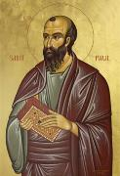
Romans 3:11
“There is none who understands, There is none who seeks for God.”

Slide 86

John MacArthur
John F. MacArthur Jr., Faith Works: The Gospel According to the Apostles (Dallas: Word, 1993), 64-65
“Because we were dead to God, we were dead to truth, righteousness, peace, happiness, and every other good thing, no more capable to respond to God than a cadaver” and are “spiritual zombies, death-walkers, unable even to understand the gravity of their situation. They are lifeless.”

Slide 87
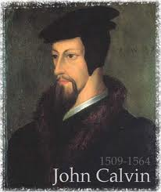
GOD’S GRACE TO THE UNSAVED
Holy Spirit’s conviction
God’s Word
Gospel
Creation
Conscience
Conclusion

Slide 88

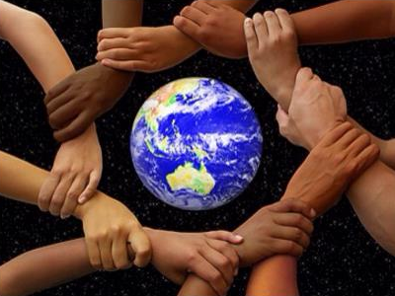
Acts 17:26-27
²⁶ and He made from one man every nation of mankind to live on all the face of the earth, having determined their appointed times and the boundaries of their habitation, ²⁷ that they would seek God, if perhaps they might grope for Him and find Him, though He is not far from each one of us (Italics added)

Slide 89
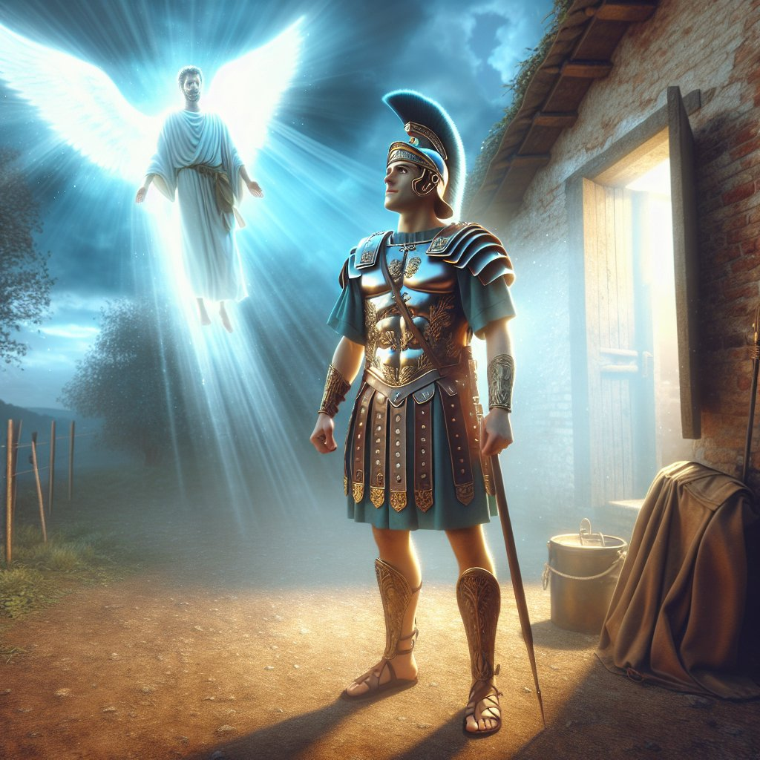
Acts 10:2
“Now there was a man at Caesarea named Cornelius, a centurion of what was called the Italian cohort, ² a devout man and one who feared God with all his household, and gave many alms to the Jewish people and prayed to God continually.”

Slide 90
Acts 11:14
“and he will speak words to you by which you [Cornelius] will be saved, you and all your household.”

Slide 91
Acts 17:24-28
Characteristics
      Creator (24)
      Sufficient (25)
      Humanity’s creator (26)
      Purpose: that men might seek Him (27)
      Man’s preserver (28)

Slide 92
Dr. Arnold G. Fruchtenbaum
The Book of Acts, 372-73
“The fifth characteristic is that God is the Preserver of man (v. 28). Paul pointed to the fact that in him we live, and move, and have our being. This was the proof of God’s nearness. Instead of Stoic pantheism, there is real immanence with God. Paul provided an ascending scale, reaching a climax in God:
  We live; therefore, we have life.
  We move; therefore, there is movement.
  We have our being; therefore, there is existence.”

Slide 93
Dr. Arnold G. Fruchtenbaum
The Book of Acts, 372-73
“Then Paul reminded his listeners that some of their own poets have said the same things, among them Aratus of Soli (315-240 B.C.) and the already mentioned Cretan poet Epimenides, who had this to say to the god Zeus:
  They fashioned a tomb for thee, O holy and high one—
  The Cretans, always liars, evil beasts, idle bellies!
  But thou art not dead: though livest and abidest for ever,
  For in thee we live and move and have our being.”

Slide 94
Dr. Arnold G. Fruchtenbaum
The Book of Acts, 372-73
“Paul quoted the same poet in Titus 1:12. Another poet would have been Cleanthes, the son of Phanius of Assos and head of the Stoic School in Athens from 263 to 232 B.C. The Zondervan Illustrated Bible Dictionary notes: ‘His Hymn to Zeus, a surviving poem, contains the words quoted by Paul in his address before the Areopagus Court (Acts 17:28).’ Regarding Zeus, Cleanthes wrote: ‘For we are your offspring.’”

Slide 95
Acts 17:22-31
Paul’s Speech
      Location (22a)
      Introduction (22b-23a)
      Unknown God described (23b-28)
      Man’s responsibility (29-31)

Slide 96
Acts 17:29-31
Man’s Responsibility
      Reject idolatry (29)
      Repent (30)
      Reason: coming judgment (31)

Slide 97
Acts 17:29-31
Man’s Responsibility
      Reject idolatry (29)
      Repent (30)
      Reason: coming judgment (31)

Slide 98
Acts 17:29-31
Man’s Responsibility
      Reject idolatry (29)
      Repent (30)
      Reason: coming judgment (31)

Slide 99

Acts 17:30-31
“³⁰ Therefore having overlooked the times of ignorance, God is now declaring to men that all people everywhere should repent [metanoeō], ³¹ because He has fixed a day in which He will judge the world in righteousness through a Man whom He has appointed, having furnished proof to all men by raising Him from the dead.”

Slide 100
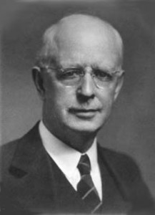
Lewis Sperry Chafer
vol. 7, Systematic Theology (Grand Rapids, MI: Kregel Publications, 1993), 265-66.
“This vital newness of mind is a part of believing, after all, and therefore it may be and is used as a synonym for believing at times (cf. Acts 17:30; 20:21; 26:20; Rom. 2:4; 2Tim. 2:25; 2 Pet. 3:9). Repentance nevertheless cannot be added to believing as a condition of salvation, because upwards of 150 passages of Scripture condition salvation upon believing only (cf. John 3:16; Acts 16:31).”

Slide 101
Acts 17:29-31
Man’s Responsibility
      Reject idolatry (29)
      Repent (30)
      Reason: coming judgment (31)

Slide 102
Acts 17:30-31
“³⁰ Therefore having overlooked the times of ignorance, God is now declaring to men that all people everywhere should repent [metanoeō], ³¹ because He has fixed a day in which He will judge the world in righteousness through a Man whom He has appointed, having furnished proof to all men by raising Him from the dead.”

Slide 103
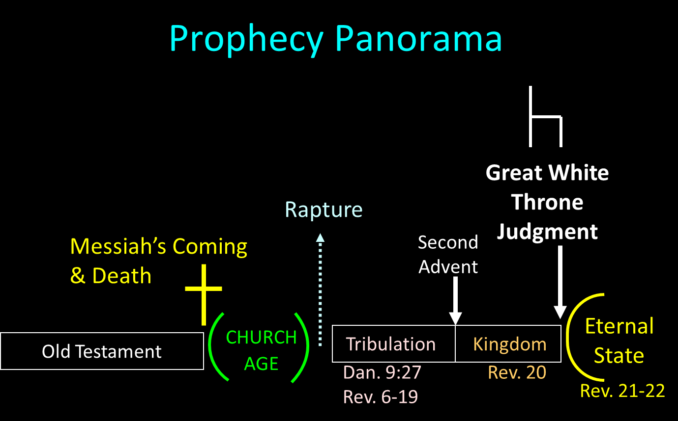

Slide 104
SCRIPTURE’S FOUR JUDGMENTS
NAME | SHEEP AND GOAT | JUDGMENT OF THE JEWS | BEMA SEAT | GREAT WHITE THRONE
SCRIPTURE | Matt 25:31-46 | Ezek 20:33-44 | 1 Cor 3:10-15 | Rev 20:11-15
PLACE | Earth, Jerusalem | Earth, wilderness | Heaven | Earth
AUDIENCE | Gentile Tribulation survivors | Jewish Tribulation survivors | Church Age believers | All unsaved
WHEN | After Tribulation | After Tribulation | After rapture | After Millennium
PURPOSE | Saved Gentiles enter kingdom | Saved Jews enter kingdom | Reward believers | Degree of punishment in hell
EVALUATION | Treatment of Christ’s brethren | Passing under shepherd’s rod | Works taken through fire | Not in the book; judged by books

Slide 105
VII. Athens Ministry
Acts 17:16-34
  Paul’s witness (16-21)
  Paul’s speech (22-31)
  Athenians’ response (32-34)

Slide 106
Acts 17:32-34
Athenians’ Response
      Two negative responses (32)
      Paul’s departure (33)
      Positive response (34)

Slide 107
Acts 17:32-34
Athenians’ Response
      Two negative responses (32)
      Paul’s departure (33)
      Positive response (34)

Slide 108
Acts 17:32
Two Negative Responses
      Mocking (32a)
      Postponement (32b)

Slide 109
Acts 17:32
Two Negative Responses
      Mocking (32a)
      Postponement (32b)

Slide 111
Second Missionary Journey

Slide 112
Acts 17:32
Two Negative Responses
      Mocking (32a)
      Postponement (32b)

Slide 113
Acts 17:32-34
Athenians’ Response
      Two negative responses (32)
      Paul’s departure (33)
      Positive response (34)

Slide 114
Acts 17:32-34
Athenians’ Response
      Two negative responses (32)
      Paul’s departure (33)
      Positive response (34)

Slide 115
Dr. Arnold G. Fruchtenbaum
The Book of Acts, 374-75
“While no church was planted at this time, some did believe: Dionysius the Areopagite, and a woman named Damaris, and others with them. The fact that Dionysius was described as an Areopagite shows that he was a member of the Council of Areopagus. He was convinced and became a believer. According to the fourth-century historian Eusebius, Dionysius became the bishop of the church of Athens and died as a martyr. Also mentioned is Damaris. She was probably an aristocrat, as was Dionysius. There were others, though unnamed, who also believed.”

Slide 116
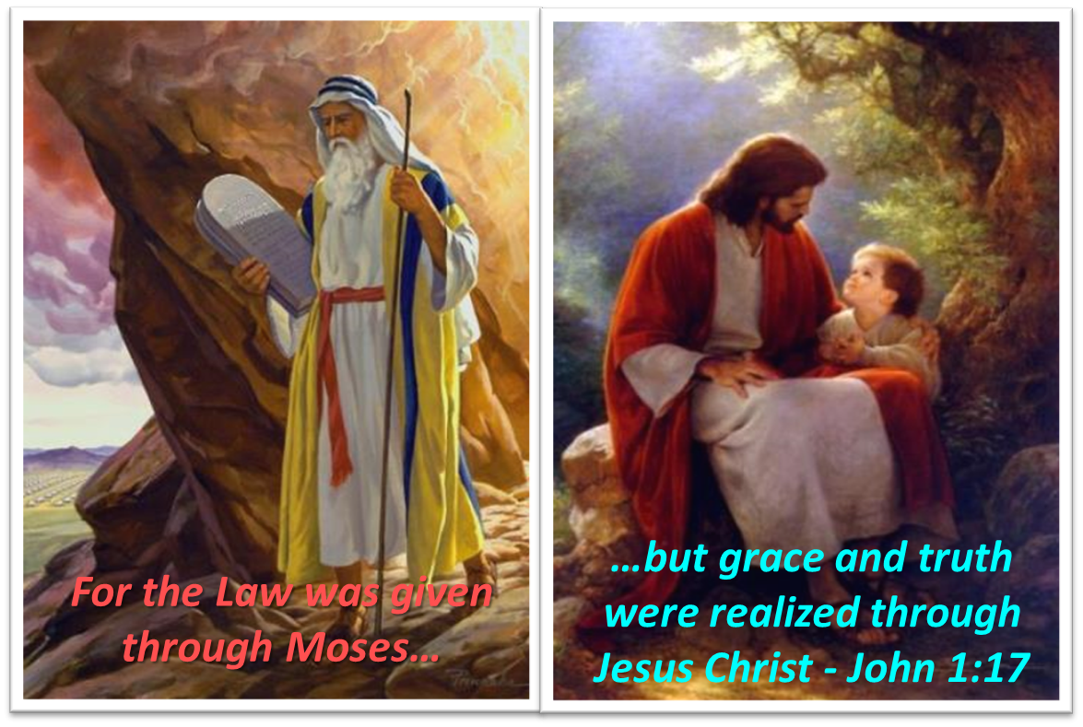
Themes
  From Peter to Paul (Gal 2:7-8)
  Universality of the Gospel
  Transitions
  Sovereignty of God (Acts 2:23; 13:48)
  Soteriology (Acts 16:31)

Slide 117
Acts 16:11-15
Lydia’s Conversion
      Journey to Neapolis (11)
      Arrival at Philippi (12)
      Jewish Sabbath meeting (13)
      Lydia’s conversion (14)
      Results of conversion (15)

Slide 118
Conclusion

Slide 119
Acts 15:36‒18:22
2nd Missionary Journey
  Schism between Paul & Barnabas (15:36-41)
  Syria & Cilicia ministry (16:1-5)
  Macedonian call (16:6-10)
  Philippian ministry (16:11-40)
  Thessalonica ministry (17:1-9)
  Berean ministry (17:10-15)
  Athens’ ministry (17:16-34)
  Corinthian ministry (18:1-18)
  Ephesus’ ministry (18:19-21)
  Return to Antioch (18:22)

