Slide 1
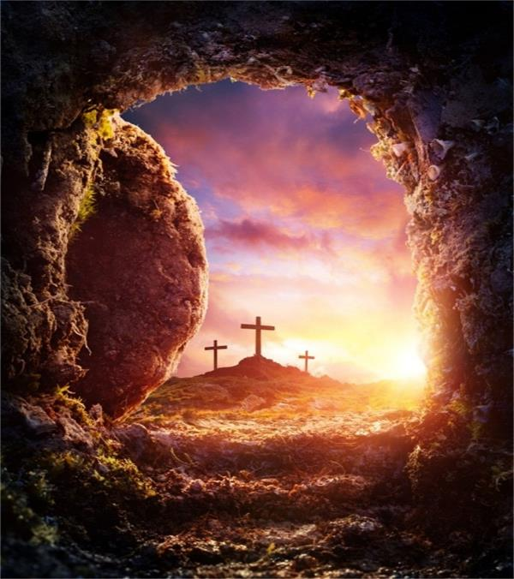
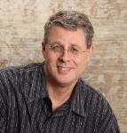
The Believer's Future Resurrection Body
Dr. Andy Woods
Senior Pastor – Sugar Land Bible Church
President – Chafer Theological Seminary

Slide 2
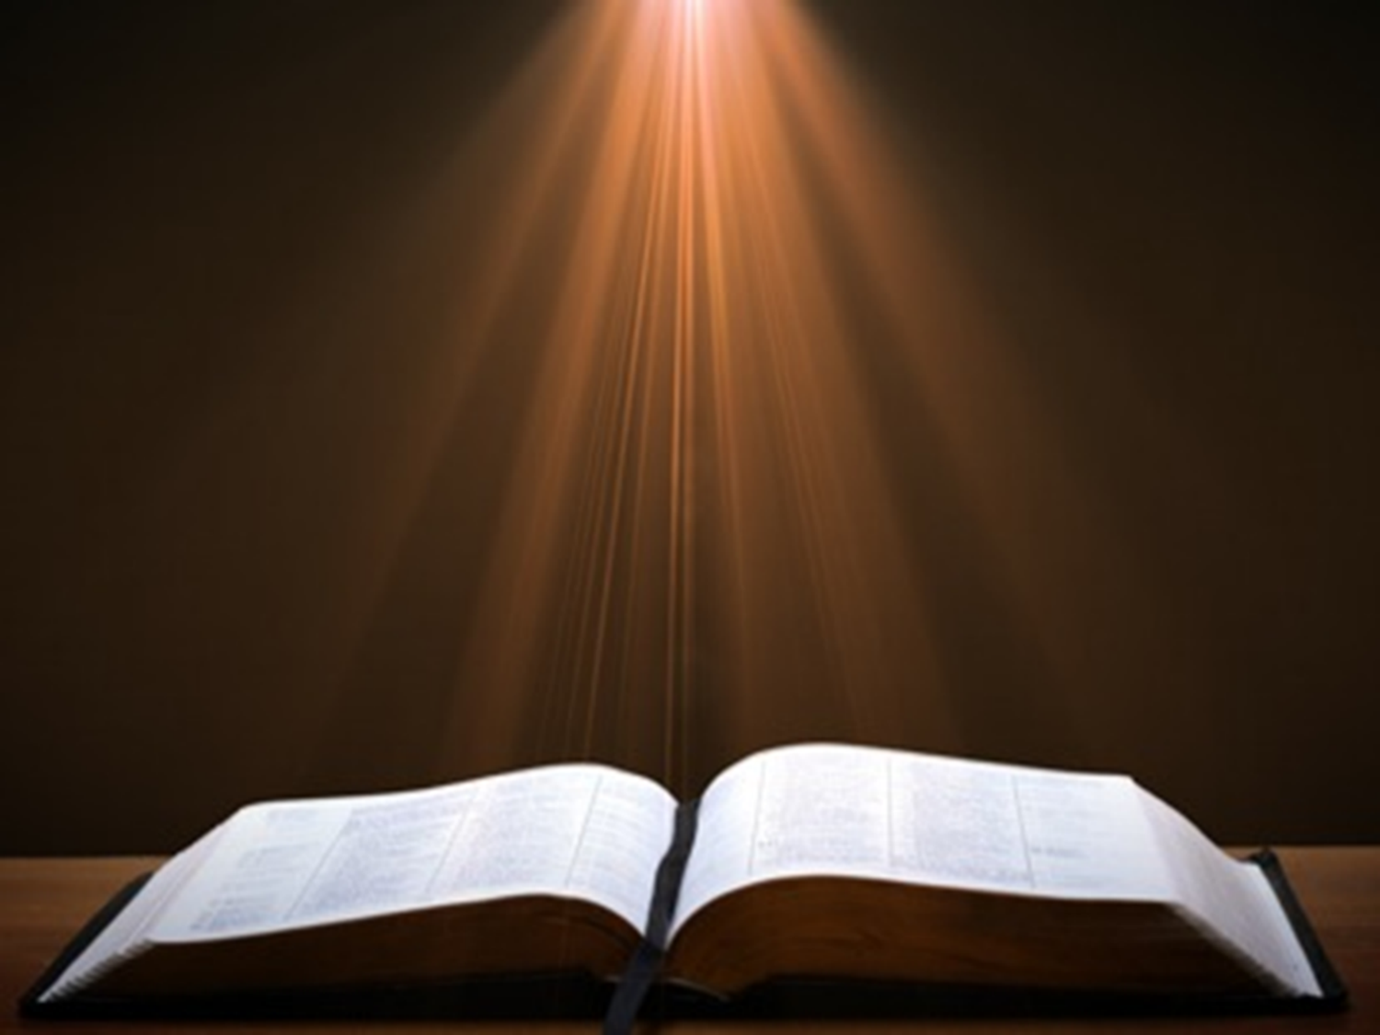
1 Corinthians 15:20-23
“²⁰ But now Christ has been raised from the dead, the first fruits of those who are asleep. ²¹ For since by a man came death, by a man also came the resurrection of the dead. ²² For as in Adam all die, so also in Christ all will be made alive. ²³ But each in his own order: Christ the first fruits, after that those who are Christ’s at His coming.”

Slide 3
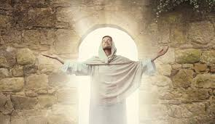
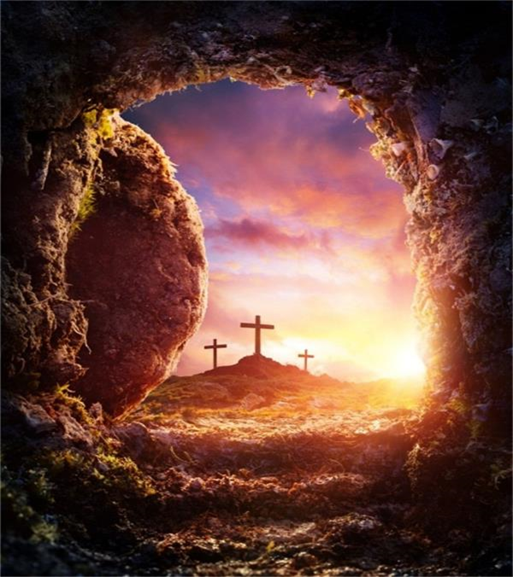
The Believer's Coming Resurrection Body
The Problem
The Power
The Permanency
The Physicality
The Picnic
The Postponement
The Pedigree

Slide 4
The Believer's Coming Resurrection Body
The Problem
The Power
The Permanency
The Physicality
The Picnic
The Postponement
The Pedigree

Slide 5
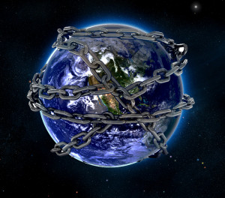

Slide 6
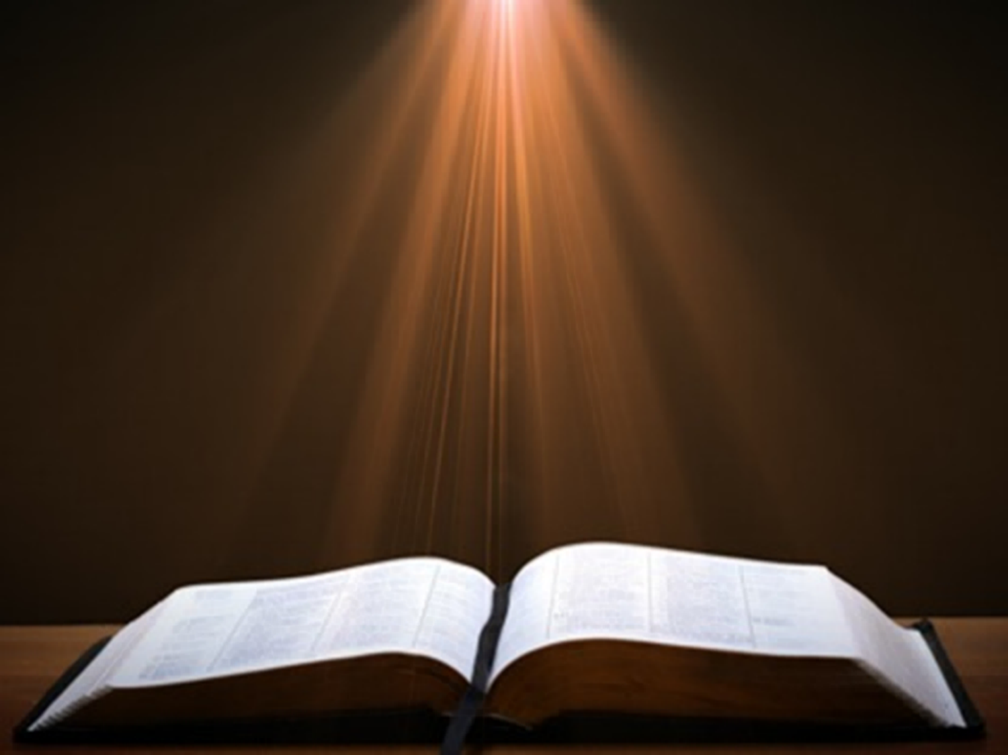
Romans 8:19–23
¹⁸ “For I consider that the sufferings of this present time are not worthy to be compared with the glory that is to be revealed to us. ¹⁹ For the anxious longing of the creation waits eagerly for the revealing of the sons of God. ²⁰ For the creation was subjected to futility, not willingly, but because of Him who subjected it, in hope ²¹ that the creation itself also will be set free from its slavery to corruption into the freedom of the glory of the children of God. ²² For we know…

Slide 7
Romans 8:19–23
…that the whole creation groans and suffers the pains of childbirth together until now. ²³ And not only this, but also, we ourselves, having the first fruits of the Spirit, even we ourselves groan within ourselves, waiting eagerly for our adoption as sons, the redemption of our body.”

Slide 8
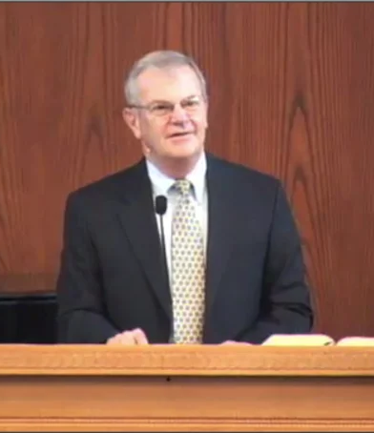
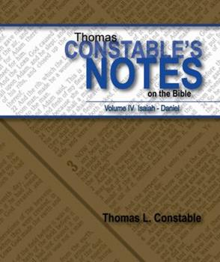
Thomas L. Constable
Constable’s online notes on 2 Corinthians, p. 80-82.
“We groan because we feel the pains associated with mortality, namely, our physical limitations, sickness, and the increasing disability that accompanies advancing age…We groan because we long to enter into whatever God has for us in the future: an intermediate body, a resurrection body, or a heavenly home. We want ‘to be clothed.’ God's promises of something better make us dissatisfied with what we have now. We long for the time when immortal life will, in a sense, consume what is mortal and dies.”

Slide 9

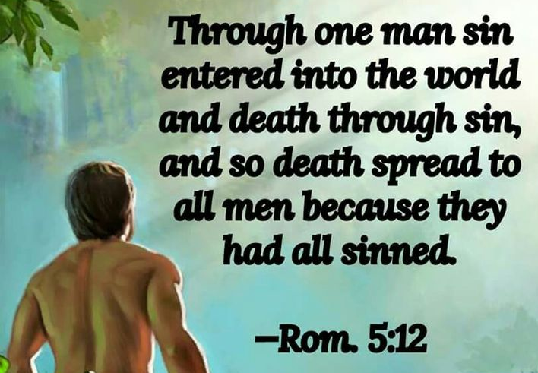
Genesis 3:19
“By the sweat of your face You will eat bread, Till you return to the ground, Because from it you were taken; For you are dust, And to dust you shall return.”

Slide 10

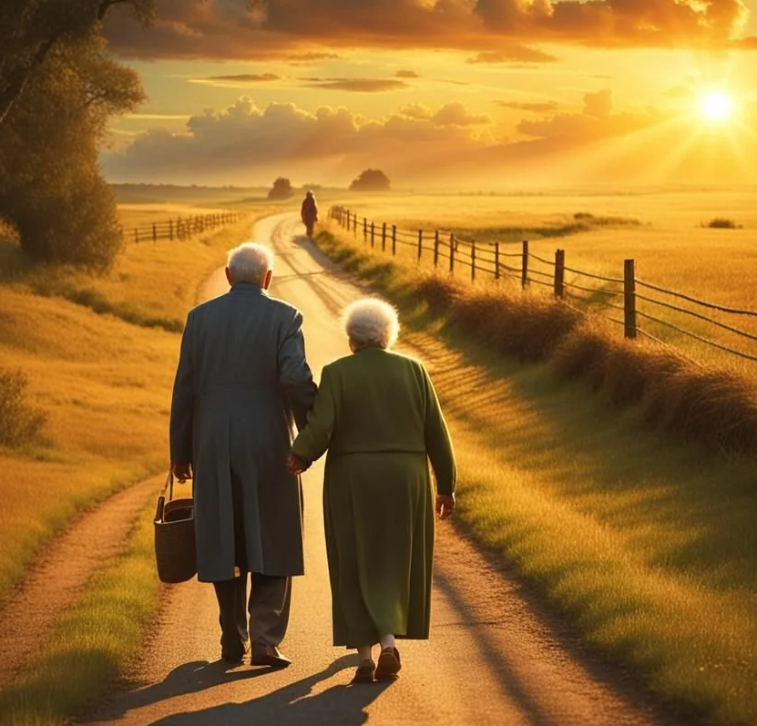
2 Corinthians 4:16
“Therefore we do not lose heart, but though our outer man is decaying, yet our inner man is being renewed day by day.”

Slide 11
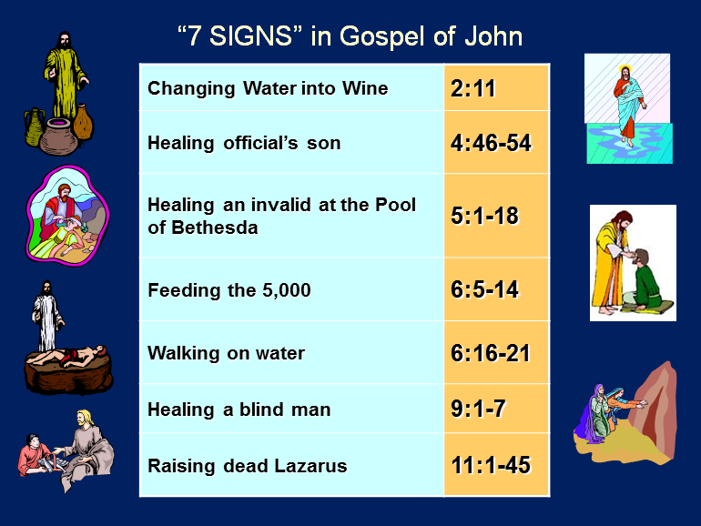

Slide 12
The Believer's Coming Resurrection Body
The Problem
The Power
The Permanency
The Physicality
The Picnic
The Postponement
The Pedigree

Slide 13
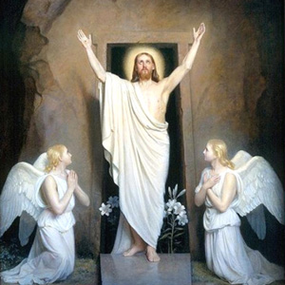
Differences Between the Earthly and Heavenly Bodies (1 Corinthians 15:42-44)
Earthly Body
Perishable
Lowly
Weak
Natural
Heavenly Body
Imperishable
Honorable
Powerful
Spiritual

Slide 14
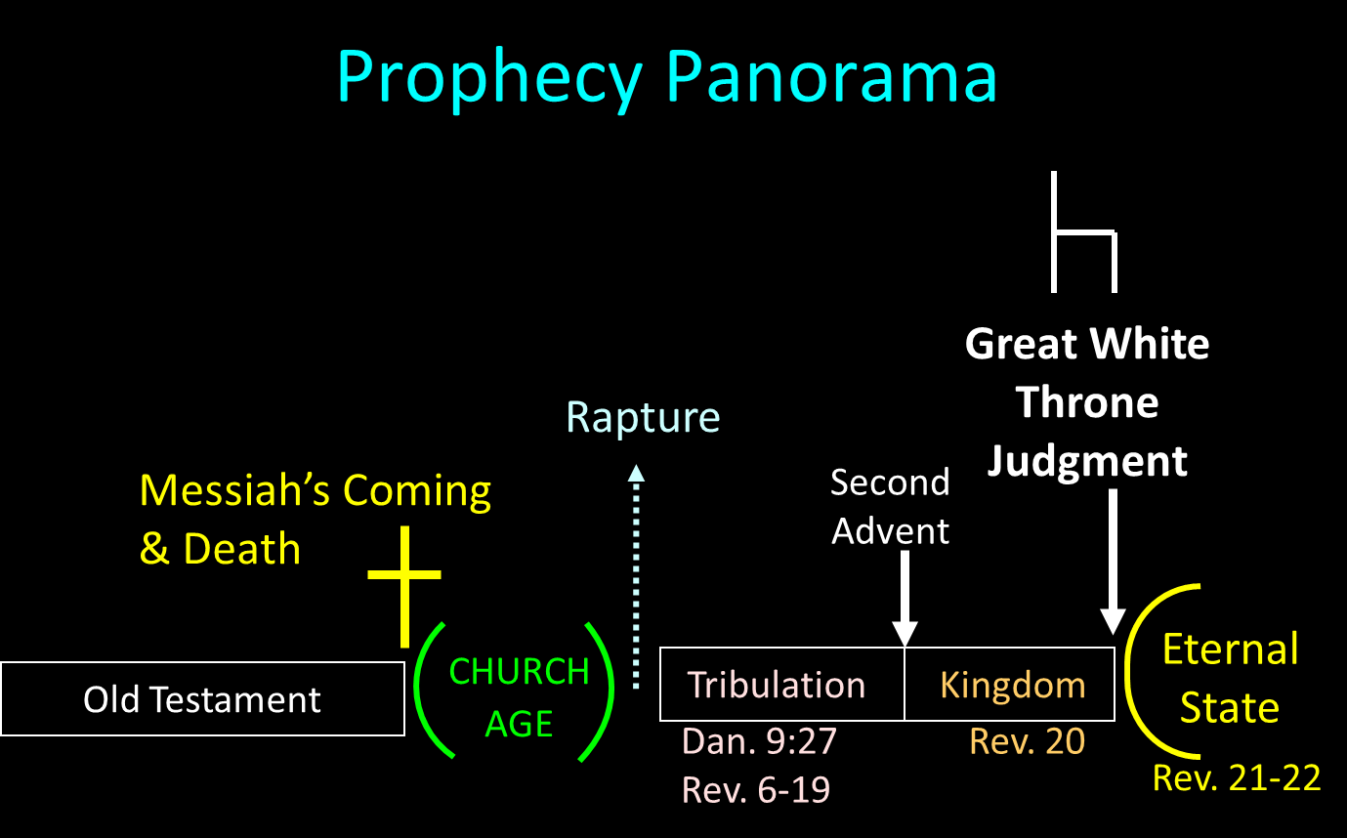

Slide 15
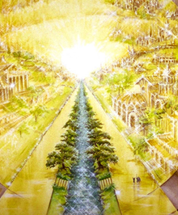
ETERNAL STATE IS FUTURE
No Satan (Rev 20:10)
No sea (Rev 21:1)
No death, crying, or pain (Rev 21:4)
No Sun (Rev 22:5)
No Moon (Rev 21:23)
No temple (Rev. 21:22)
No night (Rev 21:25)
No evil (Rev 21:27)
No curse (Rev 22:3)

Slide 16
ETERNAL STATE IS FUTURE
No Satan (Rev 20:10)
No sea (Rev 21:1)
No death, crying, or pain (Rev 21:4)
No Sun (Rev 22:5)
No Moon (Rev 21:23)
No temple (Rev. 21:22)
No night (Rev 21:25)
No evil (Rev 21:27)
No curse (Rev 22:3)

Slide 17
Genesis 1:1-3
“¹ In the beginning God created the heavens and the earth. ² The earth was formless and void, and darkness was over the surface of the deep, and the Spirit of God was moving over the surface of the waters. ³ Then God said, ‘Let there be light’; and there was light.”

Slide 18
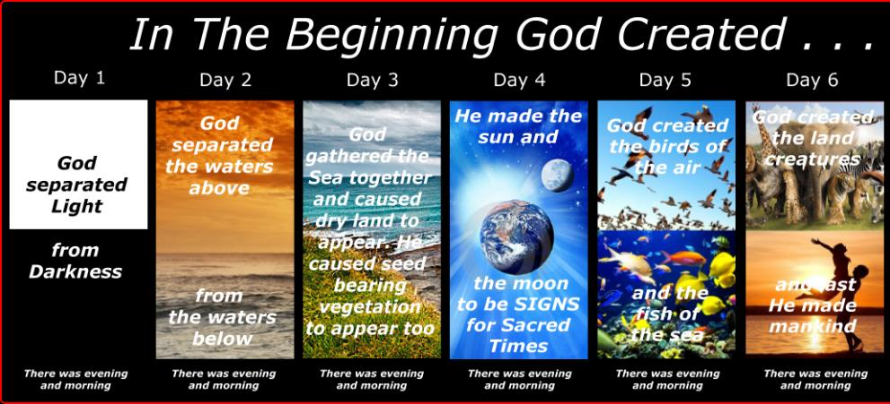
SHAPING AND POPULATING (GEN 1:1)
Day 1: | Light | Day 4: | Luminaries
Day 2: | Water, sky | Day 5: | Sea animals, birds
Day 3: | Land, vegetation | Day 6: | Land animals, man

Slide 19
The Believer's Coming Resurrection Body
The Problem
The Power
The Permanency
The Physicality
The Picnic
The Postponement
The Pedigree

Slide 20
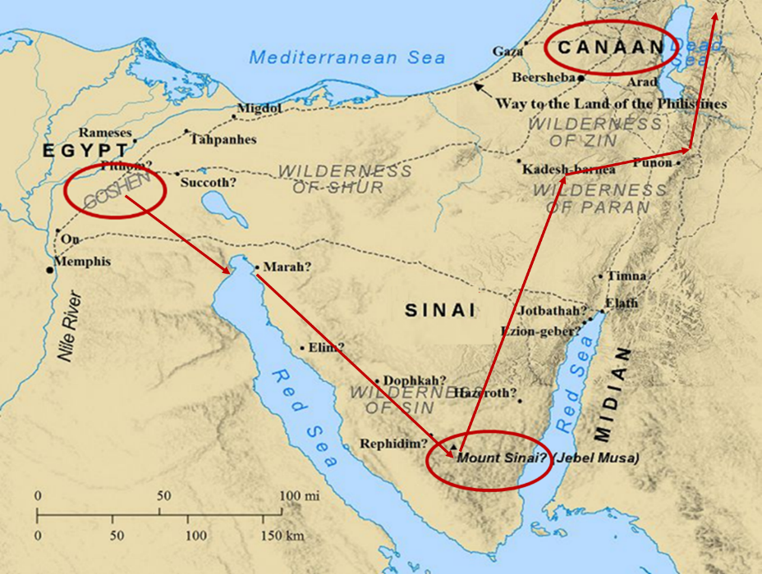

Slide 21
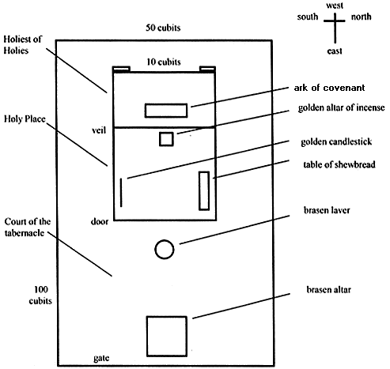
Tabernacle Diagram

Slide 22
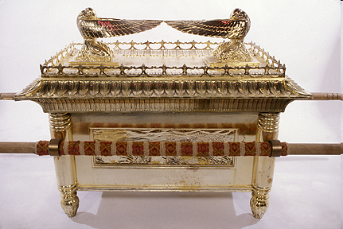
Ark of the Covenant

Slide 23
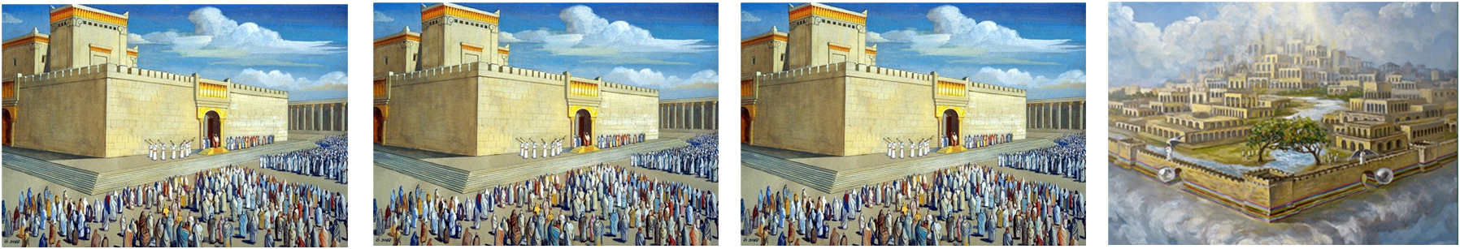
ISRAEL’S FOUR TEMPLES
Solomon’s pre-exilic temple (Kings and Chronicles)
Zerubbabel’s post exilic temple (Ezra 1-6; John 2:20)
Antichrist's temple (Dan. 9:27; Matt. 24:15; 2 Thess. 2:4; Rev. 11:1-2)
Millennial temple (Ezek. 40-48)

Slide 24
ISRAEL’S FOUR TEMPLES
Solomon’s pre-exilic temple (Kings and Chronicles)
Zerubbabel’s post exilic temple (Ezra 1-6; John 2:20)
Antichrist's temple (Dan. 9:27; Matt. 24:15; 2 Thess. 2:4; Rev. 11:1-2)
Millennial temple (Ezek. 40-48)

Slide 25
William McDonald
William MacDonald and Arthur L. Farstad, Believer’s Bible Commentary (Nashville: Thomas Nelson, 2016), in the Bible Study App, Olive Tree Bible Software, 2022.
“A tent is not a permanent dwelling, but a portable one for pilgrims and travelers…The temporary tent is taken down, but a new, permanent house awaits the believer in the land beyond the skies. This is a building from God, in the sense that God is the One who gives it to us…The believer’s future body is also described as eternal in the heavens. It is a body that will no longer be subject to disease, decay, and death, but one that will endure forever in our heavenly home.”

Slide 26
The Believer's Coming Resurrection Body
The Problem
The Power
The Permanency
The Physicality
The Picnic
The Postponement
The Pedigree

Slide 27
Christ's Resurrection Attested to by Eyewitnesses (1 Corinthians 15:5-11)
Cephas (5a)
The twelve (5b)
The five hundred (6)
James (7a)
The rest of the apostles (7b)
Paul (8-11)

Slide 28

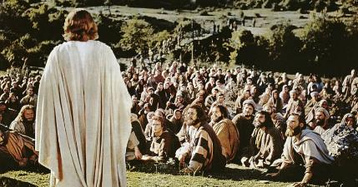
1 Corinthians 15:6-7
“⁶ After that He appeared to more than five hundred brethren at one time, most of whom remain until now, but some have fallen asleep; ⁷ then He appeared to James, then to all the apostles…”

Slide 29
Naturalistic Theories
Swoon theory
Theft theory
Hallucination theory
Wrong tomb theory

Slide 30
Naturalistic Theories
Swoon theory
Theft theory
Hallucination theory
Wrong tomb theory

Slide 31
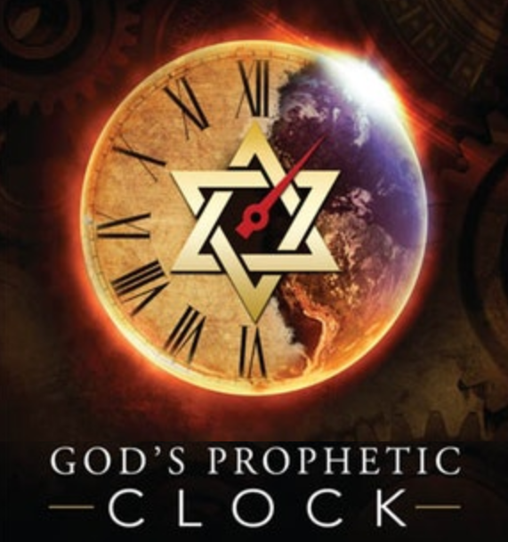
Acts 1:6-7
“⁶ So when they had come together, they were asking Him, saying, ‘Lord, is it at this time You are restoring the kingdom to Israel?’ ⁷ He said to them, ‘It is not for you to know times or epochs which the Father has fixed by His own authority.’”

Slide 32
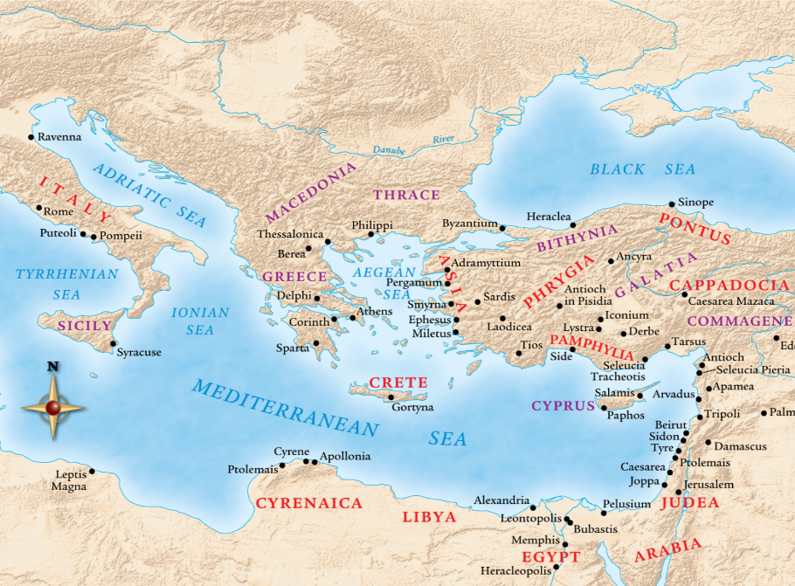

Slide 33
The Believer's Coming Resurrection Body
The Problem
The Power
The Permanency
The Physicality
The Picnic
The Postponement
The Pedigree

Slide 34

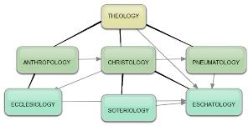
Areas of Systematic Theology
Prolegomena – Introduction
Theology – Study of God
Christology – Study of Christ
Pneumatology – Study of the Holy Spirit
Anthropology – Study of Man
Hamartiology – Study of sin
Soteriology – Study of salvation
Angelology – Study of angels
Ecclesiology – Study of the Church
Eschatology – Study of the end
Israelology – Study of Israel

Slide 36
Genesis 2:16-17
“¹⁶ The Lord God commanded the man, saying, ‘From any tree of the garden you may eat freely; ¹⁷ but from the tree of the knowledge of good and evil you shall not eat, for in the day that you eat from it you will surely die (muwth).’”

Slide 37
The Believer's Coming Resurrection Body
The Problem
The Power
The Permanency
The Physicality
The Picnic
The Postponement
The Pedigree

Slide 38
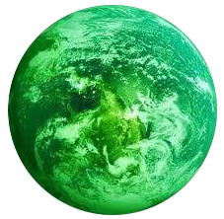
Jerusalem Descending
Notes:
The descending city is described as being like a stone called Jasper, only unlike the earthly stone, this one is clear as crystal. The ultimate state of heaven sounds more like a diamond, doesn’t it?

Slide 39
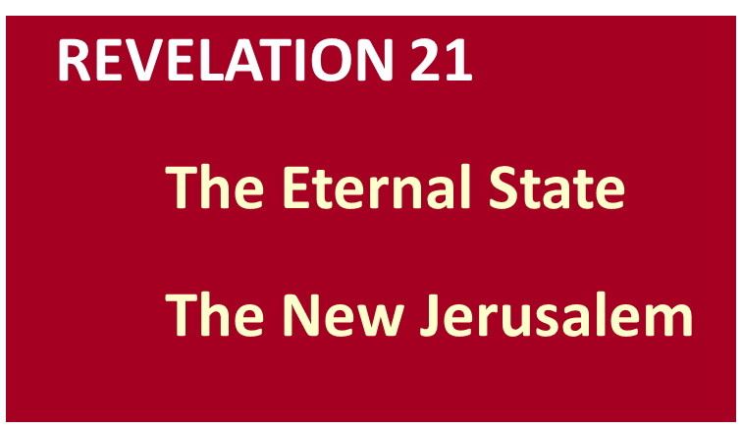
Galatians 4:26
“But the Jerusalem above is free; she is our mother.”

Slide 41
The Believer's Coming Resurrection Body
The Problem
The Power
The Permanency
The Physicality
The Picnic
The Postponement
The Pedigree

Slide 42

Genesis 11:1-9
¹ Now the whole earth used the same language and the same words. ² It came about as they journeyed east, that they found a plain in the land of Shinar and settled there. ³ They said to one another, “Come, let us make bricks and burn them thoroughly.” And they used brick for stone, and they used tar for mortar. ⁴ They said, “Come, let us build for ourselves a city, and a tower whose top will reach into . . .

Slide 43
Genesis 11:1-9 (cont’d)
…heaven, and let us make for ourselves a name, otherwise we will be scattered abroad over the face of the whole earth.” ⁵ The Lord came down to see the city and the tower which the sons of men had built. ⁶ The Lord said, “Behold, they are one people, and they all have the same language. And this is what they began to do, and now nothing which they purpose to do will be impossible for them. ⁷ “Come, let…

Slide 44
Genesis 11:1-9 (cont’d)
… Us go down and there confuse their language, so that they will not understand one another’s speech.” ⁸ So the Lord scattered them abroad from there over the face of the whole earth; and they stopped building the city. ⁹ Therefore its name was called Babel, because there the Lord confused the language of the whole earth; and from there the Lord scattered them abroad over the face of the whole earth.

Slide 45
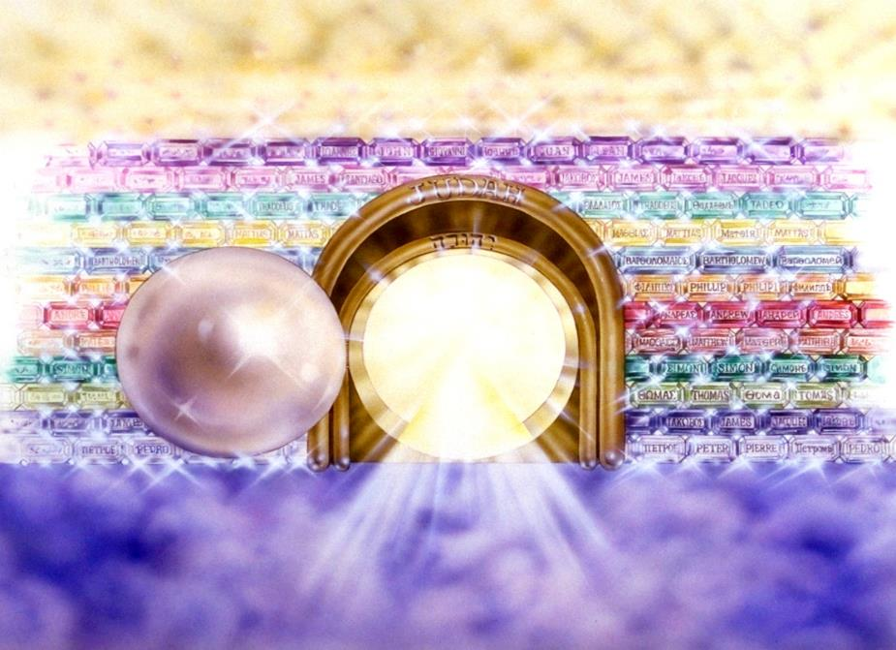
Notes:
Here you see an artist’s ideas of…
12 Gates = 12 Tribes of Israel
12 Foundation Stones = 12 Apostles of the Church

Slide 46
The Believer's Coming Resurrection Body
The Problem
The Power
The Permanency
The Physicality
The Picnic
The Postponement
The Pedigree

Slide 47
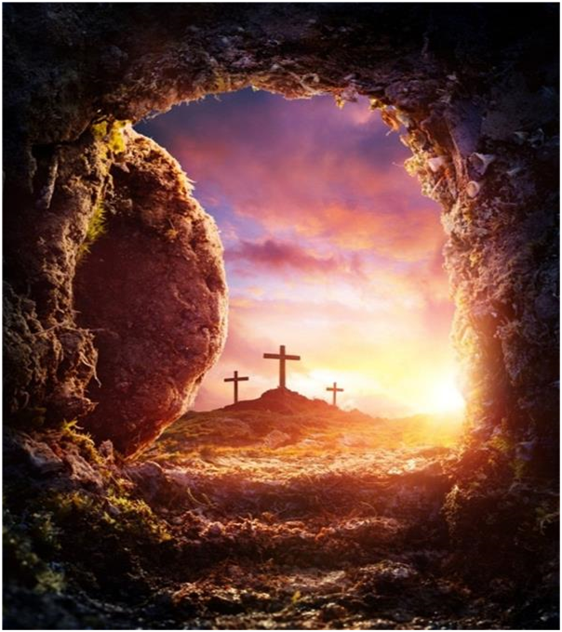
Conclusion THE PROVISION

Slide 48
Seven “I AM” statements in John
1. I am the Bread of Life | 6:35
2. I am the Light of the world | 8:12
3. I am the Gate for the sheep | 10:7; cf. v.9
4. I am the Good Shepherd | 10:11,14
5. I am the Resurrection and the Life | 11:25
6. I am the Way and the Truth and the Life | 14:6
7. I am the true Vine | 15:1; cf. v.5

Slide 49
John 11:25-27
“²⁵ Jesus said to her, ‘I am the resurrection and the life; he who believes in Me will live even if he dies, ²⁶ and everyone who lives and believes in Me will never die. Do you believe this?’ ²⁷ She said to Him, ‘Yes, Lord; I have believed that You are the Christ, the Son of God, even He who comes into the world.’”

Slide 50
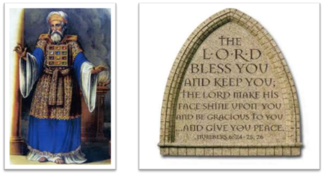
²⁴ The Lord bless you, and keep you; ²⁵ The Lord make His face shine on you, And be gracious to you; ²⁶ The Lord lift up His countenance on you, And give you peace.
Numbers 6:24–26 (NASB95)

