Slide 1
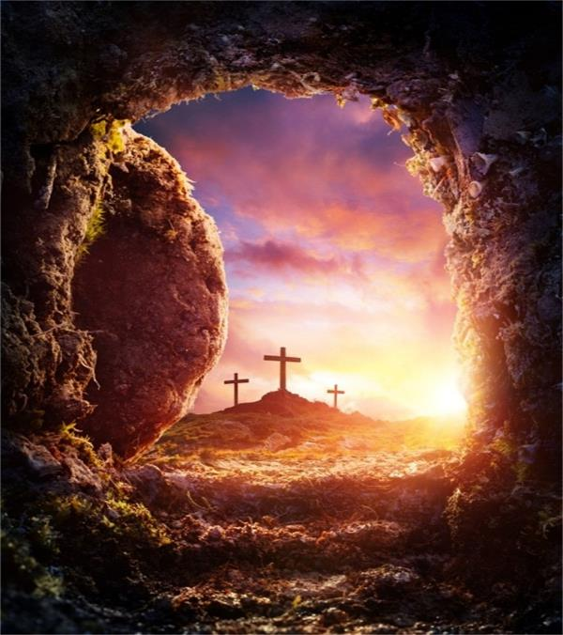
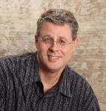
The Centrality of Christ’s Resurrection
Dr. Andy Woods
Senior Pastor – Sugar Land Bible Church
President – Chafer Theological Seminary

Slide 2
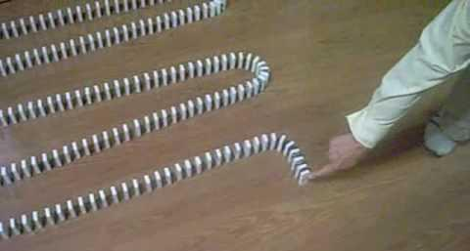
Dominoes in a Row

Slide 3
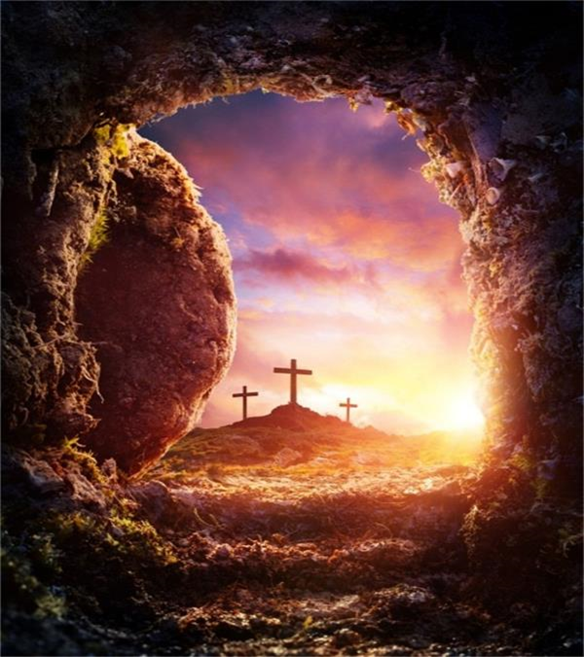
WHY CHRIST’S RESURRECTION?
To Fulfill OT Prophecy (1 Cor. 15:3-4)
To Fulfill Christ’s Prophecies (John 2:19-22)
To Solidify Israel’s Unbelief (Matt. 12:38-40)
To Vindicate Christ’s Deity (John 10:17-18)
To Foster Christianity‘s Growth (John 20:19)
To Furnish Christianity’s Message (Acts 3:15)
To Guarantee Future Resurrections (1 Cor. 15:20-23)
Notes:
Outline

Slide 4
WHY CHRIST’S RESURRECTION?
To Fulfill OT Prophecy (1 Cor. 15:3-4)
To Fulfill Christ’s Prophecies (John 2:19-22)
To Solidify Israel’s Unbelief (Matt. 12:38-40)
To Vindicate Christ’s Deity (John 10:17-18)
To Foster Christianity‘s Growth (John 20:19)
To Furnish Christianity’s Message (Acts 3:15)
To Guarantee Future Resurrections (1 Cor. 15:20-23)
Notes:
Outline

Slide 5
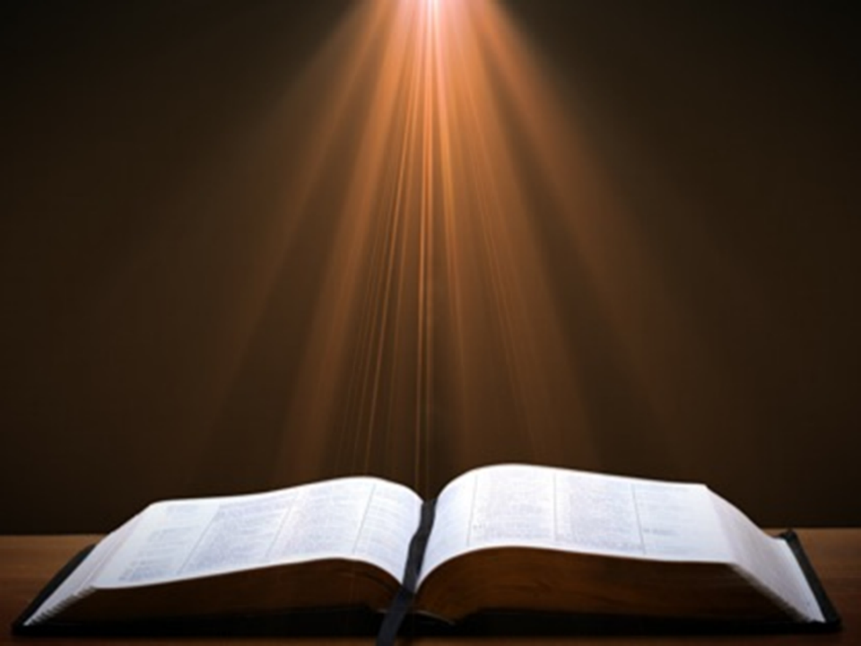
Luke 24:27, 44
“²⁷ Then beginning with Moses and with all the prophets, He explained to them the things concerning Himself in all the Scriptures…⁴⁴ Now He said to them, ‘These are My words which I spoke to you while I was still with you, that all things which are written about Me in the Law of Moses and the Prophets and the Psalms must be fulfilled.’”

Slide 6
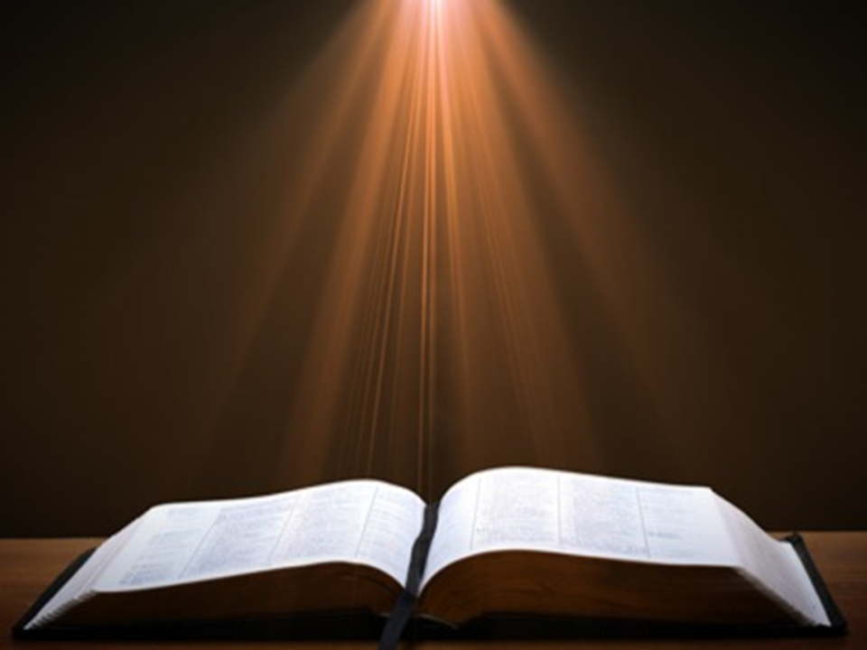
Acts 17:1-3
“¹ Now when they had traveled through Amphipolis and Apollonia, they came to Thessalonica, where there was a synagogue of the Jews. ² And according to Paul’s custom, he visited them, and for three Sabbaths reasoned with them from the Scriptures, ³ explaining and giving evidence that the Christ had to suffer and rise from the dead, and saying, “This Jesus whom I am proclaiming to you is the Christ.”

Slide 7

1 Corinthians 15:3-4
“³ For I handed down to you as of first importance what I also received, that Christ died for our sins according to the Scriptures, ⁴ and that He was buried, and that He was raised on the third day according to the Scriptures.”

Slide 8
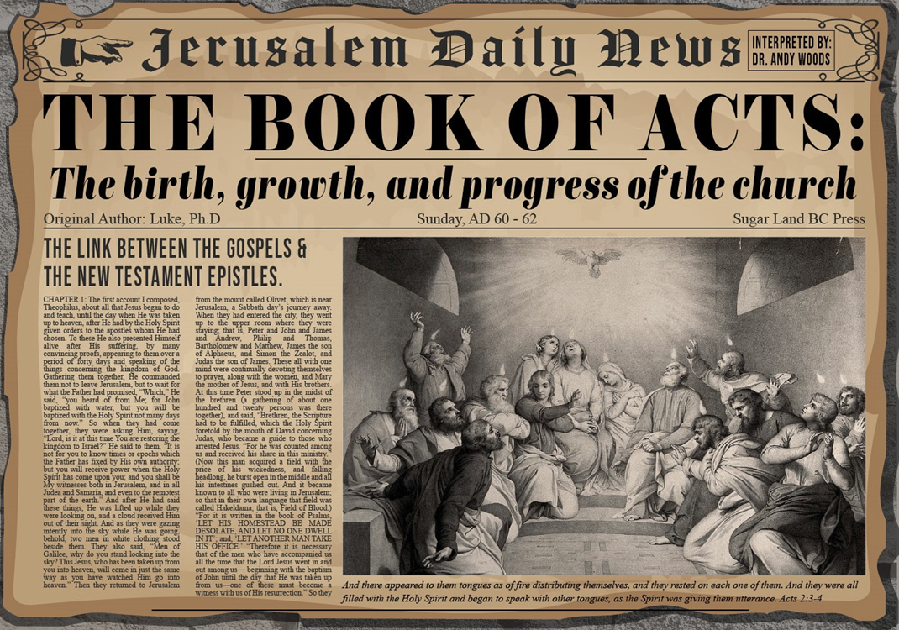
Acts 2:15-35 Refutation of the Charge of Drunkenness
Too early (15)
Use of Joel 2:28-32 (16-21)
Christ’s miracles (22)
Crucifixion (23)
Resurrection (24)
Use of Psalm 16:8-11 (25-29)
Use of Psalm 132:11 (30-32)
High priestly ministry (33)
Use of Psalm 110:1 (34-35)

Slide 9
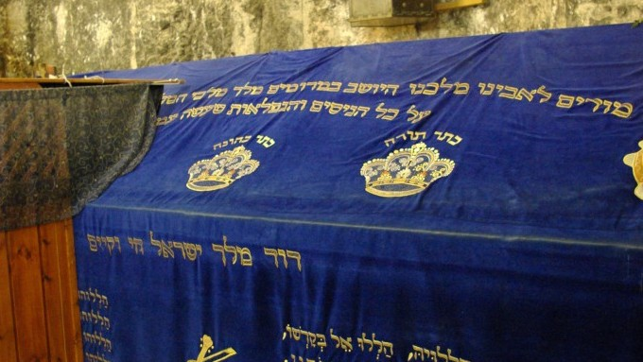

Slide 10

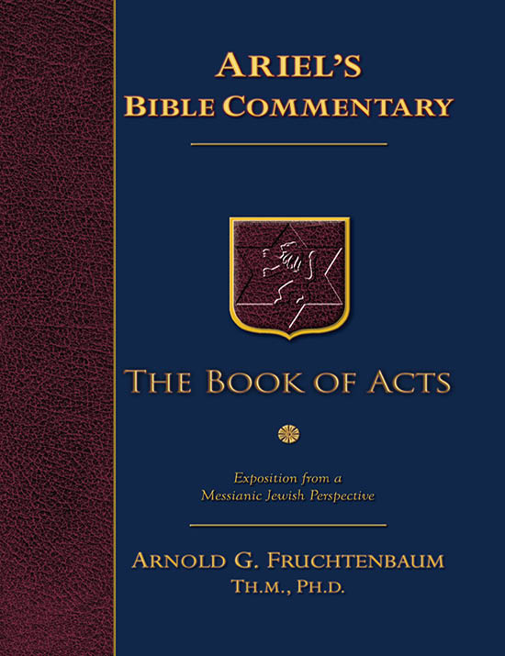
Dr. Arnold G. Fruchtenbaum
The Book of Acts, 74
“Either way, this type of quotation would be considered as ‘literal prophecy plus literal fulfillment,’ because in the context of Psalm 16, the psalmist was clearly speaking of the resurrection of the Messiah. Even some rabbis understood this passage to be Messianic. For example, the Midrash Tehillim on this verse states, ‘My glory rejoices over King Messiah, who shall rise up out of me (i.e., from David).’”
m. Tehillim on Psalm 16:9 as quoted by F. F. Bruce in The Acts of the Apostles: Greek Text with Introduction and Commentary (Grand Rapids, MI: Eerdmans, 1990), p. 124.

Slide 11
WHY CHRIST’S RESURRECTION?
To Fulfill OT Prophecy (1 Cor. 15:3-4)
To Fulfill Christ’s Prophecies (John 2:19-22)
To Solidify Israel’s Unbelief (Matt. 12:38-40)
To Vindicate Christ’s Deity (John 10:17-18)
To Foster Christianity‘s Growth (John 20:19)
To Furnish Christianity’s Message (Acts 3:15)
To Guarantee Future Resurrections (1 Cor. 15:20-23)
Notes:
Outline

Slide 12


John 13:19; 14:29
“^{13:19} From now on I am telling you before it comes to pass, so that when it does occur, you may believe that I am He… ^{14:29} Now I have told you before it happens, so that when it happens, you may believe.”

Slide 13
WHY CHRIST’S RESURRECTION?
To Fulfill OT Prophecy (1 Cor. 15:3-4)
To Fulfill Christ’s Prophecies (John 2:19-22)
To Solidify Israel’s Unbelief (Matt. 12:38-40)
To Vindicate Christ’s Deity (John 10:17-18)
To Foster Christianity‘s Growth (John 20:19)
To Furnish Christianity’s Message (Acts 3:15)
To Guarantee Future Resurrections (1 Cor. 15:20-23)
Notes:
Outline

Slide 14

Dr. John Walvoord
Walvoord, J. F. (2007). Matthew: Thy Kingdom Come (p. 90).
“Having thus been challenged to face the evidence that Jesus was indeed what He claimed to be, the Pharisees, in their unbelief, asked for a spectacular sign. Jesus answered them in an unsparing indictment. He declared ‘An evil and adulterous generation seeketh after a sign; and there shall no sign be given to it, but the sign of the prophet Jonas’ (v. 39). He then recited the facts of the experience of Jonah, how he was three days and three nights in the great fish, and He described this as a prophetic incident, anticipating that the Son of Man will be three days and three nights in the heart of the earth. In other words,…

Slide 15
Dr. John Walvoord
Walvoord, J. F. (2007). Matthew: Thy Kingdom Come (p. 90).
…He was predicting His death and resurrection as the supreme sign for those seeking evidence of His claims. In the incident of Jonah, the men of Nineveh repented, even though they were unbelieving Gentiles. Here Jesus, who was far greater than Jonah, was before His own people, and they would not believe.”

Slide 16
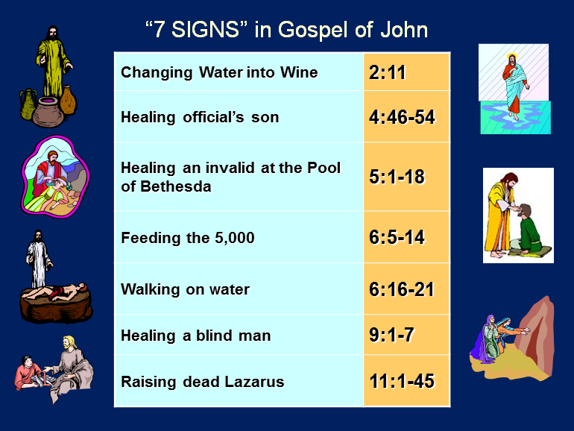

Slide 17
WHY CHRIST’S RESURRECTION?
To Fulfill OT Prophecy (1 Cor. 15:3-4)
To Fulfill Christ’s Prophecies (John 2:19-22)
To Solidify Israel’s Unbelief (Matt. 12:38-40)
To Vindicate Christ’s Deity (John 10:17-18)
To Foster Christianity‘s Growth (John 20:19)
To Furnish Christianity’s Message (Acts 3:15)
To Guarantee Future Resurrections (1 Cor. 15:20-23)
Notes:
Outline

Slide 18
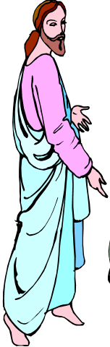
7 “I AM” statements in John
I am the Bread of Life | 6:35
I am the Light of the world | 8:12
I am the Gate for the sheep | 10:7; cf. v.9
I am the Good Shepherd | 10:11,14
I am the Resurrection and the Life | 11:25
I am the Way and the Truth and the Life | 14:6
I am the true Vine | 15:1; cf. v.5

Slide 19
WHY CHRIST’S RESURRECTION?
To Fulfill OT Prophecy (1 Cor. 15:3-4)
To Fulfill Christ’s Prophecies (John 2:19-22)
To Solidify Israel’s Unbelief (Matt. 12:38-40)
To Vindicate Christ’s Deity (John 10:17-18)
To Foster Christianity‘s Growth (John 20:19)
To Furnish Christianity’s Message (Acts 3:15)
To Guarantee Future Resurrections (1 Cor. 15:20-23)
Notes:
Outline

Slide 20

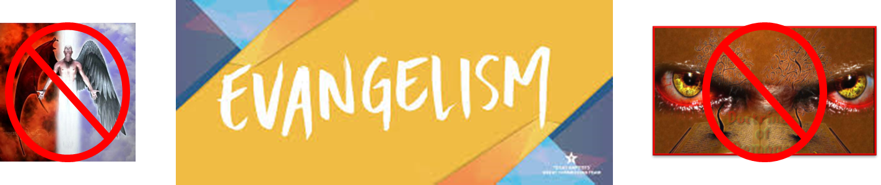
Matthew 16:18
“I also say to you that you are Peter, and upon this rock I will build [oikodomeō] My church; and the gates of Hades WILL NOT overpower it.”

Slide 21

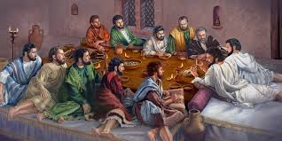
Ephesians 2:20
“having been built on the foundation of the apostles and prophets, Christ Jesus Himself being the corner stone.”

Slide 22
What Happened to Christ’s Disciples?
Disciple | Place | Martyrdom
James the Son of Alpheus | Jerusalem | Clubbed to death
Simon the Zealot | Jerusalem | Martyred
James the Son of Zebedee | Judea (Acts 12:2) | Executed
Thaddeus | Mesopotamia | Beaten to death
Peter | Babylon, Rome | Crucified upside down
Matthew | Parthia (Tehran) | Beheaded
Notes:
109 prophecies…
Peter Stoner – SCIENCE SPEAKS, An Evaluation of Certain Christian Evidences
To fulfill just 8 prophecies =1 X 10 to the twenty-eighth power!
Can we visualize this with an illustration? Suppose we took an atheistic professor, blindfolded him and covered the state of Texas two feet deep with silver dollars. Then we put a check on one of those silver dollars and mixed them up. The odds of one person fulfilling just these eight prophecies would be the same as this atheistic professor selecting the silver dollar upon which we have placed a check, in his first try.
https://www.bereanpublishers.com/the-odds-of-eight-messianic-prophecies-coming-true/

Slide 23
What Happened to Christ’s Disciples?
Disciple | Place | Martyrdom
John | Asia Minor, Patmos, Ephesus | Fried in boiling oil
Philip | E. Turkey | Tortured & crucified
Thomas | India | Speared
Bartholomew | India | Flayed & crucified
Andrew | Ukraine, Russia, Greece | Hanged
Notes:
109 prophecies…
Peter Stoner – SCIENCE SPEAKS, An Evaluation of Certain Christian Evidences
To fulfill just 8 prophecies =1 X 10 to the twenty-eighth power!
Can we visualize this with an illustration? Suppose we took an atheistic professor, blindfolded him and covered the state of Texas two feet deep with silver dollars. Then we put a check on one of those silver dollars and mixed them up. The odds of one person fulfilling just these eight prophecies would be the same as this atheistic professor selecting the silver dollar upon which we have placed a check, in his first try.
https://www.bereanpublishers.com/the-odds-of-eight-messianic-prophecies-coming-true/

Slide 24
WHY CHRIST’S RESURRECTION?
To Fulfill OT Prophecy (1 Cor. 15:3-4)
To Fulfill Christ’s Prophecies (John 2:19-22)
To Solidify Israel’s Unbelief (Matt. 12:38-40)
To Vindicate Christ’s Deity (John 10:17-18)
To Foster Christianity‘s Growth (John 20:19)
To Furnish Christianity’s Message (Acts 3:15)
To Guarantee Future Resurrections (1 Cor. 15:20-23)
Notes:
Outline

Slide 25
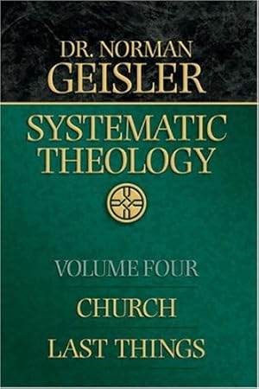
Dr. Norman Geisler
Geisler, N. L. (2005). Systematic theology, volume two: church, last things (p. 624). Bethany House Publishers.
“Of all the wonderful things Jesus taught them about love (Matt. 22:36–37), non-retaliation (Matt. 5), and the kingdom of God (cf. Matt. 13), the prevailing theme of apostolic preaching was none of these: It was the resurrection of Christ.”

Slide 26
Acts 2:15-35 Refutation of the Charge of Drunkenness
Too early (15)
Use of Joel 2:28-32 (16-21)
Christ’s miracles (22)
Crucifixion (23)
Resurrection (24)
Use of Psalm 16:8-11 (25-29)
Use of Psalm 132:11 (30-32)
High priestly ministry (33)
Use of Psalm 110:1 (34-35)

Slide 27
Acts 3:13-15 Israel’s Rejection of Her Messiah
God sent His Son (13a)
Delivered to Pilate (13b)
Rejection of the Holy & Righteous One (14)
Killed the Prince of Life (15a)
Messiah was Resurrected (15b)

Slide 28
WHY CHRIST’S RESURRECTION?
To Fulfill OT Prophecy (1 Cor. 15:3-4)
To Fulfill Christ’s Prophecies (John 2:19-22)
To Solidify Israel’s Unbelief (Matt. 12:38-40)
To Vindicate Christ’s Deity (John 10:17-18)
To Foster Christianity‘s Growth (John 20:19)
To Furnish Christianity’s Message (Acts 3:15)
To Guarantee Future Resurrections (1 Cor. 15:20-23)
Notes:
Outline

Slide 29

1 Corinthians 15:20-23
“²⁰ But now Christ has been raised from the dead, the first fruits of those who are asleep. ²¹ For since by a man came death, by a man also came the resurrection of the dead. ²² For as in Adam all die, so also in Christ all will be made alive. ²³ But each in his own order: Christ the first fruits, after that those who are Christ’s at His coming.”

Slide 30

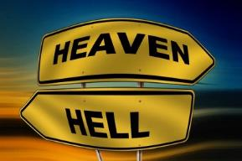
Daniel 12:2
“Many of those who sleep in the dust of the ground will awake, these to everlasting (olam) life, but the others to disgrace and everlasting (olam) contempt.”

Slide 31
John 5:28-29
“²⁸ Do not marvel at this; for an hour is coming, in which all who are in the tombs will hear His voice, ²⁹ and will come forth; those who did the good deeds to a resurrection of life, those who committed the evil deeds to a resurrection of judgment.”

Slide 32
Acts 24:14-15
“¹⁴ But this I admit to you, that according to the Way which they call a sect I do serve the God of our fathers, believing everything that is in accordance with the Law and that is written in the Prophets; ¹⁵ having a hope in God, which these men cherish themselves, that there shall certainly be a resurrection of both the righteous and the wicked.”

Slide 33
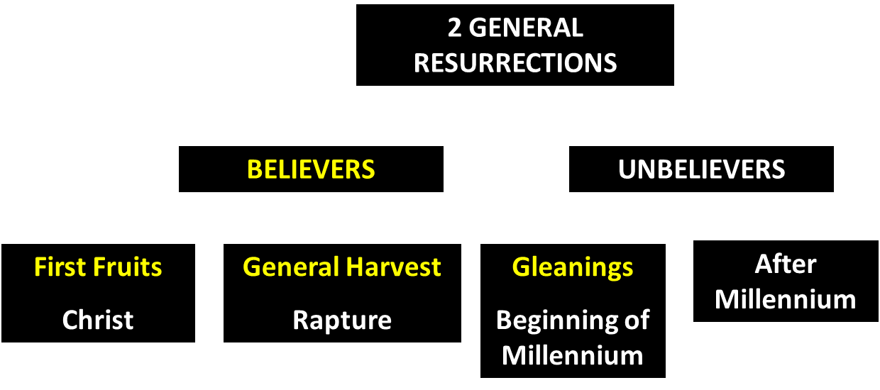
God’s Resurrection Program

Slide 34
Revelation 20:4-6
“⁴ Then I saw thrones, and they sat on them, and judgment was given to them. And I saw the souls of those who had been beheaded because of their testimony of Jesus and because of the word of God, and those who had not worshiped the beast or his image, and had not received the mark on their forehead and on their hand; and they came to life [zaō] and reigned with Christ for a thousand years….

Slide 35
Revelation 20:4-6
…⁵ The rest of the dead did not come to life [zaō] until the thousand years were completed. This is the first resurrection [anastasis]. ⁶ Blessed and holy is the one who has a part in the first resurrection [anastasis]; over these the second death has no power, but they will be priests of God and of Christ and will reign with Him for a thousand years.”

Slide 36
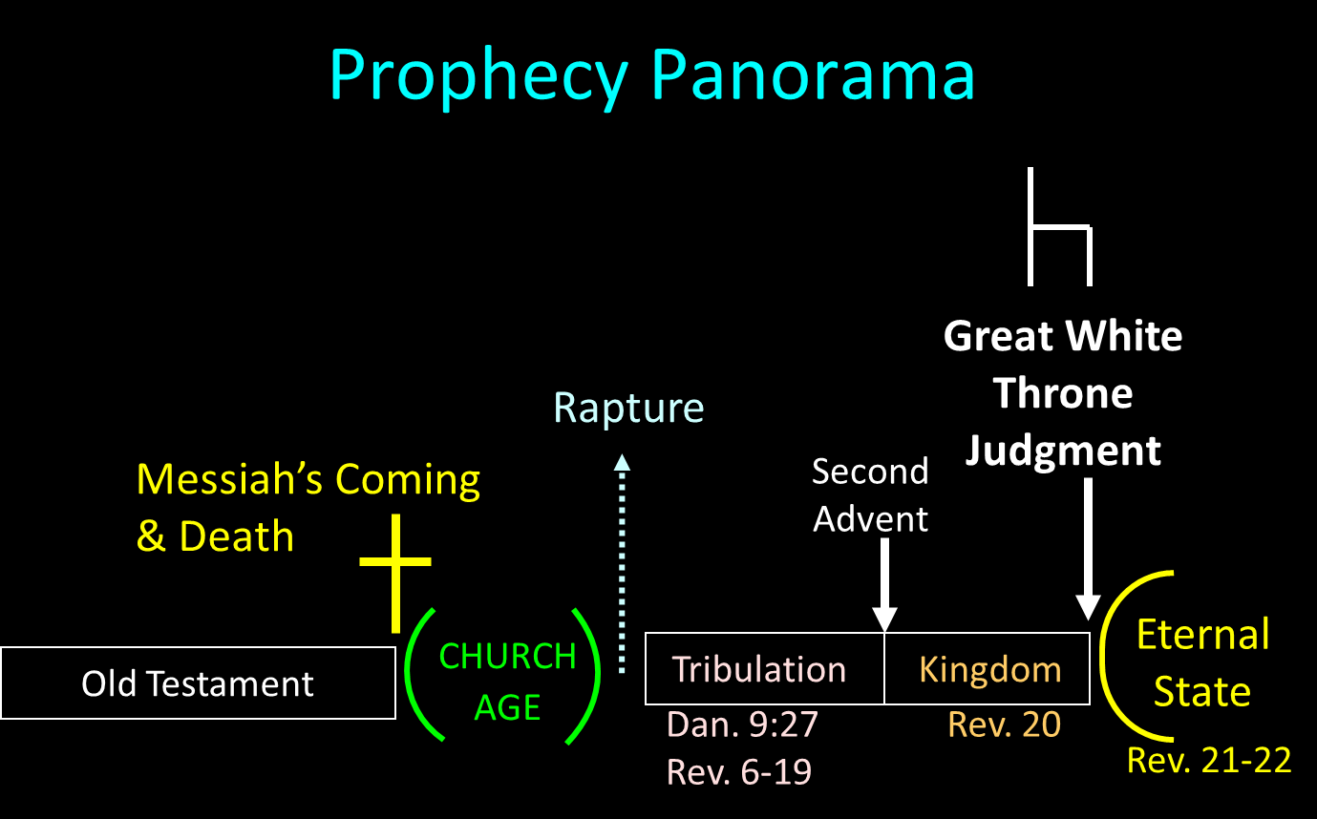

Slide 37
Conclusion

Slide 38
WHY CHRIST’S RESURRECTION?
To Fulfill OT Prophecy (1 Cor. 15:3-4)
To Fulfill Christ’s Prophecies (John 2:19-22)
To Solidify Israel’s Unbelief (Matt. 12:38-40)
To Vindicate Christ’s Deity (John 10:17-18)
To Foster Christianity‘s Growth (John 20:19)
To Furnish Christianity’s Message (Acts 3:15)
To Guarantee Future Resurrections (1 Cor. 15:20-23)
Notes:
Outline

Slide 39
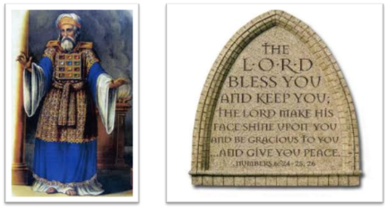
²⁴ The Lord bless you, and keep you; ²⁵ The Lord make His face shine on you, And be gracious to you; ²⁶ The Lord lift up His countenance on you, And give you peace.
Numbers 6:24–26 (NASB95)

