Slide 1



Slide 2

EXODUS STRUCTURE/OUTLINE
Redemption (1–18)
Redemption (1:1–12:30)
Liberation (12:31–15:21)
Preservation (15:22–18:27)
Mosaic Covenant (19–40)
Law (19–24)
Tabernacle instructions (25–31)
Apostasy (32–34)
Tabernacle building (35–40)

Slide 3
REDEMPTION (1:1–12:30)
Why redemption is necessary (Exod 1)
Development of the deliverer (Exod 2–4)
First confrontation with Pharaoh (Exod 5)
God reassures Moses (Exod 6:1–7:7)
Second confrontation with Pharaoh (Exod 7:8-13)
Plagues (Exod 7:14–12:30)

Slide 4
The Plagues of Egypt
NO. | DESCRIPTION | SCRIPTURE | Egyptian Deity
1. | Water to Blood | Exod. 7:14-25 | Hapi, Khnum
2. | Frogs | Exod. 8:1-15 | Heqt
3. | Gnats | Exod. 8:16-19 | Set
4. | Flies | Exod. 8:20-32 | Uatchit
5. | Disease on Cattle | Exod. 9:1-7 | Hathor, Apis
6. | Boils | Exod. 9:8-12 | Sekhmet, Serapis
7. | Hail | Exod. 9:13-35 | Seth, Nut
8. | Locusts | Exod. 10:1-20 | Seth, Nut, Osiris
9. | Darkness | Exod. 10:21-29 | Re, Horus, Atum
10. | Death of the First Born | Exod. 12:29-36 | Min, Osiris, Heqt, Isis

Slide 5
TEN PLAGUES REDEMPTION (7:14–12:30)
Nile to blood
Frogs
Gnats
Flies
Death of livestock
Boils
Hail
Locusts
Darkness
Death of 1st born

Slide 6
LOCUSTS Exodus 10:1-20
God’s Instructions (1-2)
Moses & Aaron Speak to Pharaoh (3-6)
Moses & Aaron Speak to Pharaoh Again (7-11)
Plague’s Manifestation (12-15)
Pharaoh Speaks to Moses & Aaron (16-17)
God Answers (18-20)

Slide 7
III. Exodus 10:7-11 Moses & Aaron Speak to Pharaoh Again
Pharaoh’s servants’ question (7)
Entrance (8a)
Pharaoh’s command (8b)
Pharaoh’s question (8c)
Moses’ answer (9)
Pharaoh’s command (10-11a)
Exit (11b)

Slide 8
III. Exodus 10:7-11 Moses & Aaron Speak to Pharaoh Again
Pharaoh’s servants’ question (7)
Entrance (8a)
Pharaoh’s command (8b)
Pharaoh’s question (8c)
Moses’ answer (9)
Pharaoh’s command (10-11a)
Exit (11b)

Slide 9
THREE PHASES OF MOSES’ 120 YEAR LIFE
LIFE PHASE | SCRIPTURE | YEARS | AGE | ACTIVITY
Natural Training | Acts 7:23 | 1526–1486 B.C. | 1-40 | Egyptian Education
Spiritual Training | Exod. 7:7 | 1486–1446 B.C. | 40-80 | Midian Shepherding
Ministry | Deut. 31:2; 34:7; Acts 7:36 | 1446–1406 B.C. | 80-120 | Exodus, Law, Wilderness Preservation, Pentateuch Authorship

Slide 10

Ephesians 2:8-10
“⁸ For by grace you have been saved through faith; and that not of yourselves, it is the gift of God; ⁹ not as a result of works, so that no one may boast. ¹⁰ For we are His workmanship, created in Christ Jesus for good works, which God prepared beforehand so that we would walk [peripateō, subjunctive mood] in them.”

Slide 11
The Plagues of Egypt
NO. | DESCRIPTION | SCRIPTURE | Egyptian Deity
1. | Water to Blood | Exod. 7:14-25 | Hapi, Khnum
2. | Frogs | Exod. 8:1-15 | Heqt
3. | Gnats | Exod. 8:16-19 | Set
4. | Flies | Exod. 8:20-32 | Uatchit
5. | Disease on Cattle | Exod. 9:1-7 | Hathor, Apis
6. | Boils | Exod. 9:8-12 | Sekhmet, Serapis
7. | Hail | Exod. 9:13-35 | Seth, Nut
8. | Locusts | Exod. 10:1-20 | Seth, Nut, Osiris
9. | Darkness | Exod. 10:21-29 | Re, Horus, Atum
10. | Death of the First Born | Exod. 12:29-36 | Min, Osiris, Heqt, Isis

Slide 12
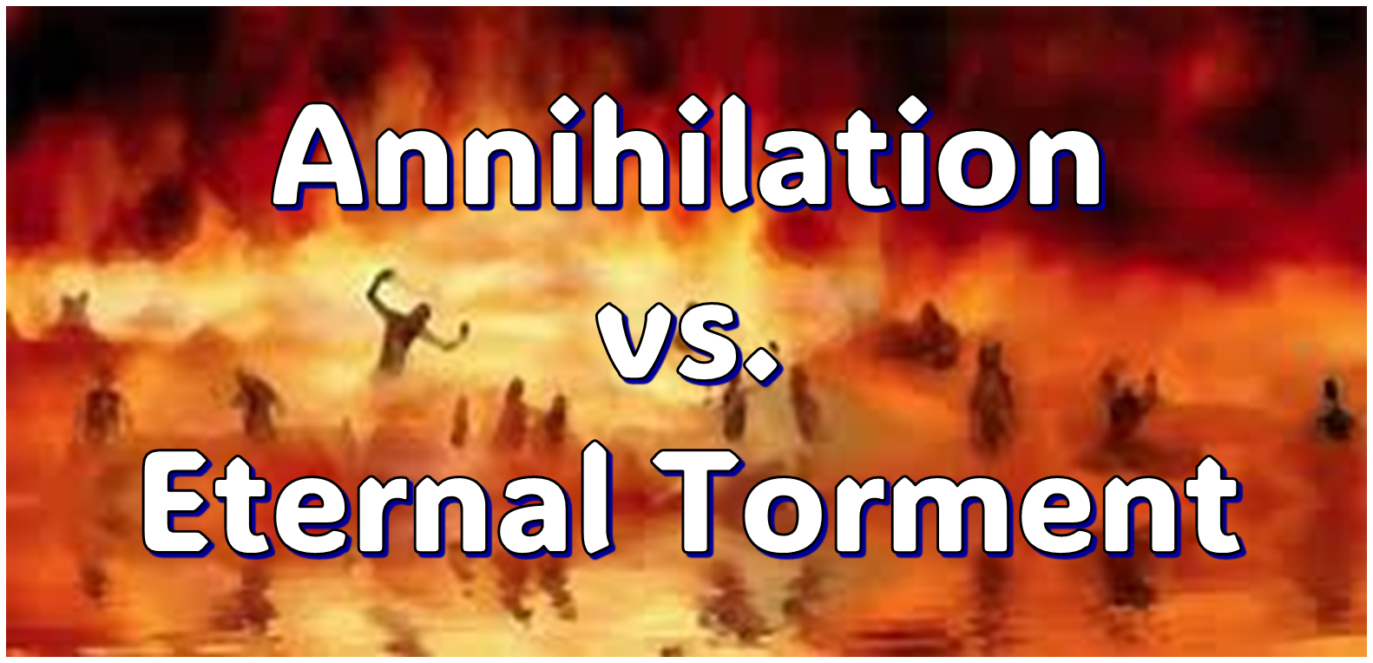
IV. Answering Annihilationist Biblical Arguments
2nd death (Rev. 20:14)
Destroy (Rev. 11:18)
Destruction (2 Thess. 1:9)
Burning up (Matt. 3:12)
Eternal results (Rev. 14:11)

Slide 13
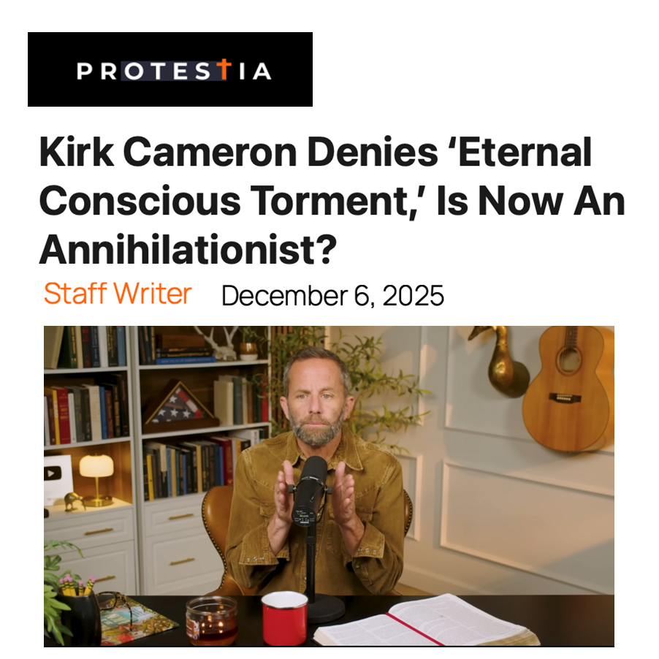

Slide 14
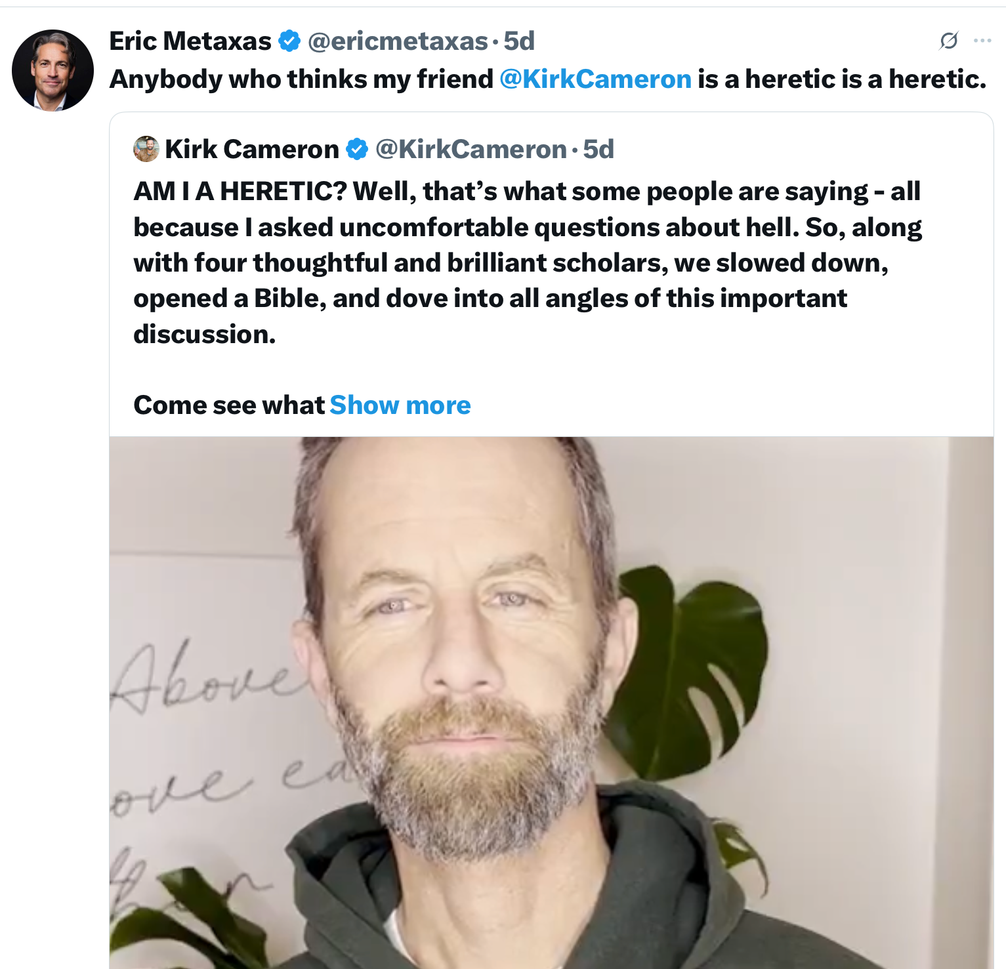

Slide 15

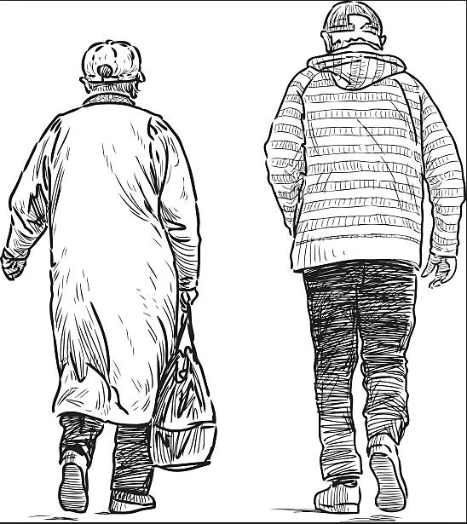
2 Corintians 4:16
“Therefore we do not lose heart, but though our outer man is decaying [diaphtheirô], yet our inner man is being renewed day by day.”

Slide 16
III. Exodus 10:7-11 Moses & Aaron Speak to Pharaoh Again
Pharaoh’s servants’ question (7)
Entrance (8a)
Pharaoh’s command (8b)
Pharaoh’s question (8c)
Moses’ answer (9)
Pharaoh’s command (10-11a)
Exit (11b)

Slide 17
III. Exodus 10:7-11 Moses & Aaron Speak to Pharaoh Again
Pharaoh’s servants’ question (7)
Entrance (8a)
Pharaoh’s command (8b)
Pharaoh’s question (8c)
Moses’ answer (9)
Pharaoh’s command (10-11a)
Exit (11b)

Slide 18
Ephesians 2:8-10
“⁸ For by grace you have been saved through faith; and that not of yourselves, it is the gift of God; ⁹ not as a result of works, so that no one may boast. ¹⁰ For we are His workmanship, created in Christ Jesus for good works, which God prepared beforehand so that we would walk [peripateō, subjunctive mood] in them.”

Slide 19
III. Exodus 10:7-11 Moses & Aaron Speak to Pharaoh Again
Pharaoh’s servants’ question (7)
Entrance (8a)
Pharaoh’s command (8b)
Pharaoh’s question (8c)
Moses’ answer (9)
Pharaoh’s command (10-11a)
Exit (11b)

Slide 20
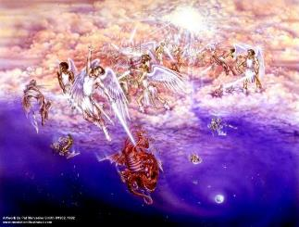
Satan as Ruler of this World
Job 1:7; 2:2
Luke 4:5-7
John 12:31; 14:30; 16:11
2 Corinthians 4:4
Ephesians 2:2
1 John 4:4; 5:19

Slide 21
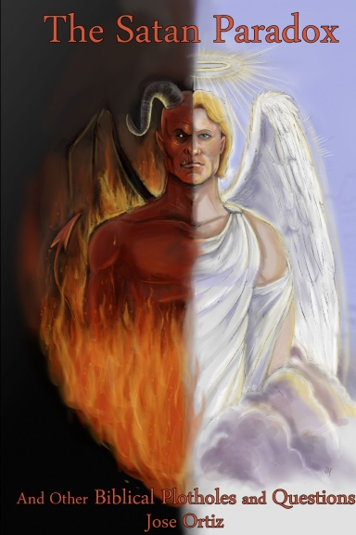
Names & Titles Demonstrating Satan’s Post-Fall, Earthly Authority (Job 1:7; 2:2; Luke 4:5-8; Rom. 8:19-22)
Prince of this world (John 12:31; 14:30; 16:11)
God of this world (2 Cor. 4:4)
Prince and power of the air (Eph. 2:2)
Who the believer wrestles with (Eph. 6:12)
Roaring lion (1 Pet. 5:8)
Whole world lies in his power (1 John 5:19)

Slide 22

Romans 8:19-23
¹⁹ “For the anxious longing of the creation waits eagerly for the revealing of the sons of God. ²⁰ For the creation was subjected to futility, not willingly, but because of Him who subjected it, in hope ²¹ that the creation itself also will be set free from its slavery to corruption into the freedom of the glory of the children of God. ²² For we know that the whole creation groans and suffers the pains of childbirth together until now. ²³ And not only this, but also we ourselves, having the first fruits of the Spirit, even we ourselves groan within ourselves, waiting eagerly for our adoption as sons, the redemption of our body.”

Slide 23
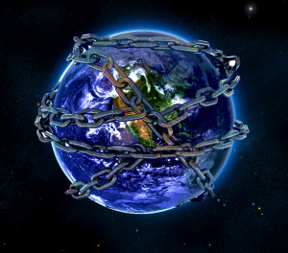

Slide 24

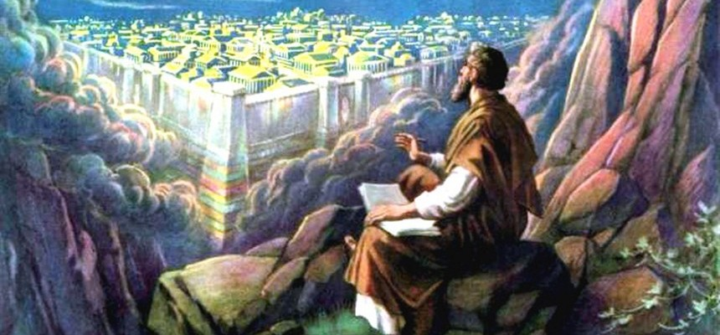
Revelation 11:15
¹⁵ “Then the seventh angel sounded; and there were loud voices in heaven, saying, ‘The kingdom of the world has become the kingdom of our Lord and of His Christ; and He will reign forever and ever.’”

Slide 25
Ultimate Exodus (Rev 11:15)
Sores: 6th plague (Ex 9:8-12), 1st bowl (Rev 16:1-2)
Rivers to blood: 1st plague (Ex 7:19-21), 3rd bowl (Rev 16:4-7)
Darkness: 9th plague (Ex 10:21-23), 5th bowl (Rev 16:10-11)
Frogs: 2nd plague (Ex 7:25‒8:15), 6th bowl (Rev 16:13)
Hail: 7th plague (Ex 9:22-26), 7th bowl (Rev 16:17-21)

Slide 26
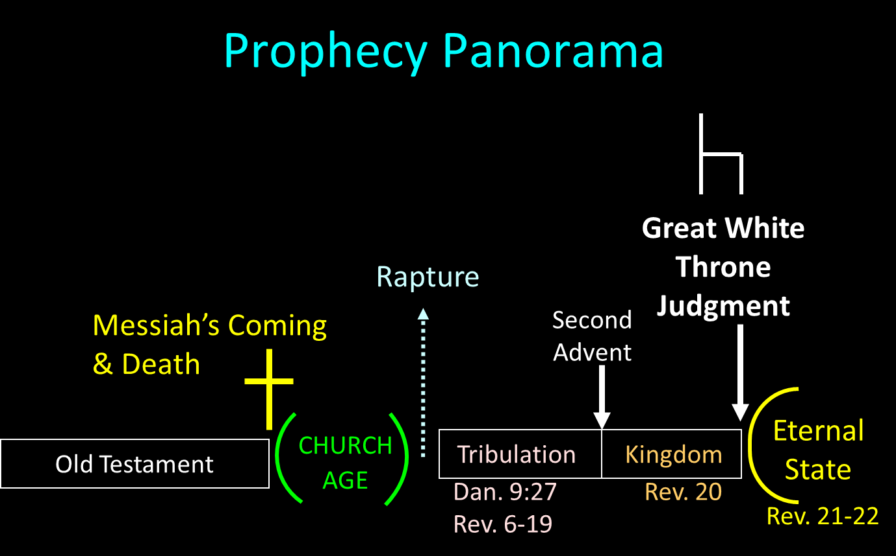

Slide 27
III. Exodus 10:7-11 Moses & Aaron Speak to Pharaoh Again
Pharaoh’s servants’ question (7)
Entrance (8a)
Pharaoh’s command (8b)
Pharaoh’s question (8c)
Moses’ answer (9)
Pharaoh’s command (10-11a)
Exit (11b)

Slide 28
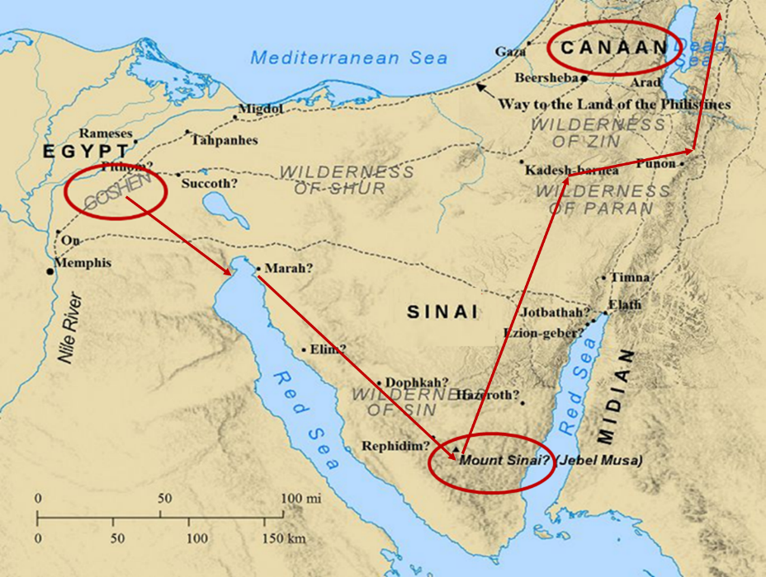

Slide 29
7 Levitical Feasts (Leviticus 23)
Feast | Season | Purpose | Type
Passover | Spring | Redemption | 1 Cor 5:7
Unleavened Bread | Spring | Separation | John 6:35
1st fruits | Spring | Praise for initial crop | 1 Cor. 15:20
Pentecost | Spring | Praise for full crop | Acts 2:1-4
Trumpets | Fall | New Year | Matt. 24:31
Atonement | Fall | Lev. 16 | Zech. 12:10
Booths | Fall | Wilderness provision | Zech. 14:16-18

Slide 30
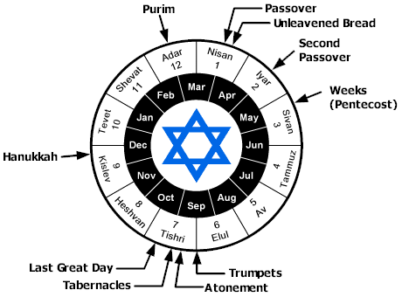

Slide 31
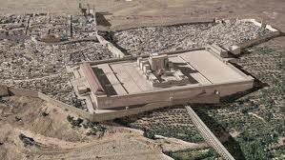
Christ’s Five Trips to Jerusalem
Feast | Verse
Passover | 2:23
Unnamed | 5:1
Tabernacles | 7:2
Dedication | 10:22
Passover | 13:1

Slide 32
Levitical Feasts (Lev. 23)
FEAST | SEASON | PURPOSE | TYPE
1. Passover | Spring | Redemption | 1 Cor. 5:7
2. Unleavened Bread | Spring | Separation | John 6:35
3. 1st fruits | Spring | Praise | 1 Cor. 15:20
4. Pentecost | Spring | Praise | Acts 2:1-4
INTER-ADVENT AGE (CHURCH AGE)
5. Trumpets | Fall | New Year | Matt. 24:31
6. Atonement (Eze. 39) | Fall | Lev 16 | Zech. 12:10
7. Booths | Fall | Wilderness provision | Zech. 14:16-18

Slide 33
III. Exodus 10:7-11 Moses & Aaron Speak to Pharaoh Again
Pharaoh’s servants’ question (7)
Entrance (8a)
Pharaoh’s command (8b)
Pharaoh’s question (8c)
Moses’ answer (9)
Pharaoh’s command (10-11a)
Exit (11b)

Slide 34

Charles Ryrie Ryrie Study Bible, page 105
Exodus 10:7–10 “In response to the pleas of his servants, Pharaoh offered Moses another compromise. He would let the men go, but not their families or children, charging Moses with wanting to do evil by depriving him of such a large number of workers.”

Slide 35
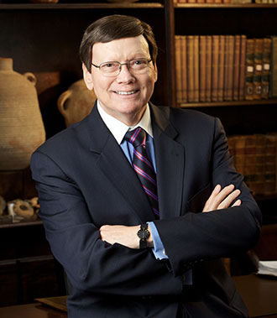
Dr. Ed Hindson
Hindson, E. E., & Mitchell, D. R., eds. (2010). KJV Bible Commentary for Today: The Most Up-to-Date Commentary on the Time-Honored Text of the KJV (p. 96-97). Thomas Nelson.
“10:10. Evil is before you. “Many interpreters have stumbled over the explanation of this phrase. Pharaoh seems to be uncharacteristically warning Moses to beware of approaching evil. The difficulty of ascertaining Pharaoh’s intent disappears, however, when one takes into account that the Hebrew word ra, usually translated as ‘evil,’ is also the name of the Egyptian sun god, Ra. Each pharaoh was considered to be Ra’s divine son. The intent of Pharaoh may be conveyed as ‘My god Ra is before you; your god YHWH may be strong, but do not forget that Ra is just as strong.’”

Slide 36
The Plagues of Egypt
NO. | DESCRIPTION | SCRIPTURE | Egyptian Deity
1. | Water to Blood | Exod. 7:14-25 | Hapi, Khnum
2. | Frogs | Exod. 8:1-15 | Heqt
3. | Gnats | Exod. 8:16-19 | Set
4. | Flies | Exod. 8:20-32 | Uatchit
5. | Disease on Cattle | Exod. 9:1-7 | Hathor, Apis
6. | Boils | Exod. 9:8-12 | Sekhmet, Serapis
7. | Hail | Exod. 9:13-35 | Seth, Nut
8. | Locusts | Exod. 10:1-20 | Seth, Nut, Osiris
9. | Darkness | Exod. 10:21-29 | Re, Horus, Atum
10. | Death of the First Born | Exod. 12:29-36 | Min, Osiris, Heqt, Isis

Slide 37
III. Exodus 10:7-11 Moses & Aaron Speak to Pharaoh Again
Pharaoh’s servants’ question (7)
Entrance (8a)
Pharaoh’s command (8b)
Pharaoh’s question (8c)
Moses’ answer (9)
Pharaoh’s command (10-11a)
Exit (11b)

Slide 38
LOCUSTS Exodus 10:1-20
God’s Instructions (1-2)
Moses & Aaron Speak to Pharaoh (3-6)
Moses & Aaron Speak to Pharaoh Again (7-11)
Plague’s Manifestation (12-15)
Pharaoh Speaks to Moses & Aaron (16-17)
God Answers (18-20)

Slide 39
IV. Exodus 10:12-15 Plague’s Manifestation
God’s command (12)
Moses’ obedience (13a)
Locusts’ manifestation (13b-14a)
Locusts’ severity (14b-15)

Slide 40
IV. Exodus 10:12-15 Plague’s Manifestation
God’s command (12)
Moses’ obedience (13a)
Locusts’ manifestation (13b-14a)
Locusts’ severity (14b-15)

Slide 41
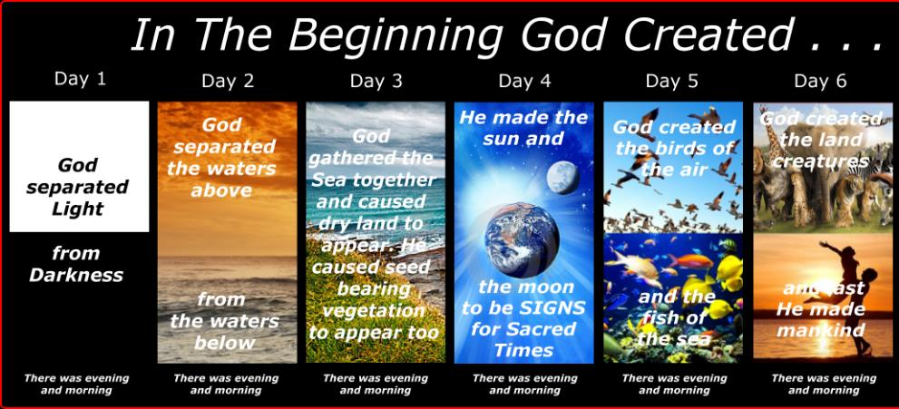
SHAPING AND POPULATING (GEN 1:1)
Day 1: | Light | Day 4: | Luminaries
Day 2: | Water, sky | Day 5: | Sea animals, birds
Day 3: | Land, vegetation | Day 6: | Land animals, man

Slide 42
IV. Exodus 10:12-15 Plague’s Manifestation
God’s command (12)
Moses’ obedience (13a)
Locusts’ manifestation (13b-14a)
Locusts’ severity (14b-15)

Slide 43
THREE PHASES OF MOSES’ 120 YEAR LIFE
LIFE PHASE | SCRIPTURE | YEARS | AGE | ACTIVITY
Natural Training | Acts 7:23 | 1526–1486 B.C. | 1-40 | Egyptian Education
Spiritual Training | Exod. 7:7 | 1486–1446 B.C. | 40-80 | Midian Shepherding
Ministry | Deut. 31:2; 34:7; Acts 7:36 | 1446–1406 B.C. | 80-120 | Exodus, Law, Wilderness Preservation, Pentateuch Authorship

Slide 44
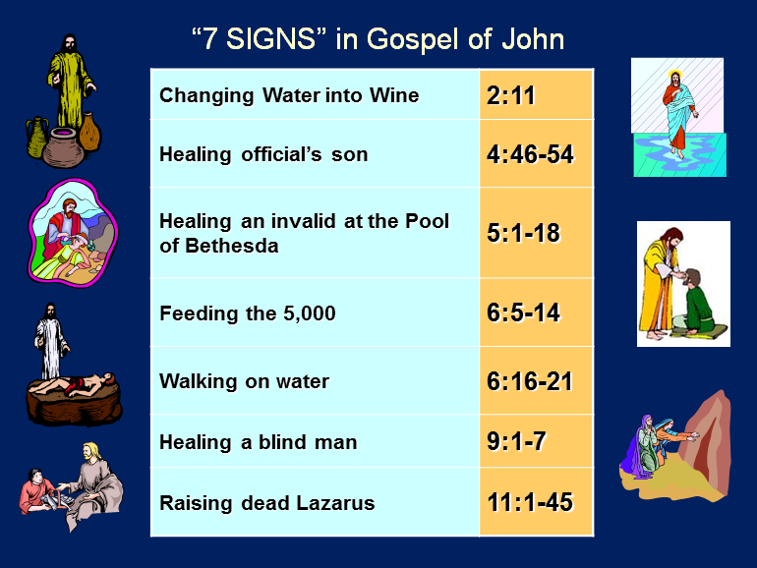

Slide 45
IV. Exodus 10:12-15 Plague’s Manifestation
God’s command (12)
Moses’ obedience (13a)
Locusts’ manifestation (13b-14a)
Locusts’ severity (14b-15)

Slide 46
IV. Exodus 10:12-15 Plague’s Manifestation
God’s command (12)
Moses’ obedience (13a)
Locusts’ manifestation (13b-14a)
Locusts’ severity (14b-15)

Slide 47
Exodus 10:14b-15 Locusts’ Severity
Number (14b)
Darkness (15a)
Consumption (15b)

Slide 48
Exodus 10:14b-15 Locusts’ Severity
Number (14b)
Darkness (15a)
Consumption (15b)

Slide 49
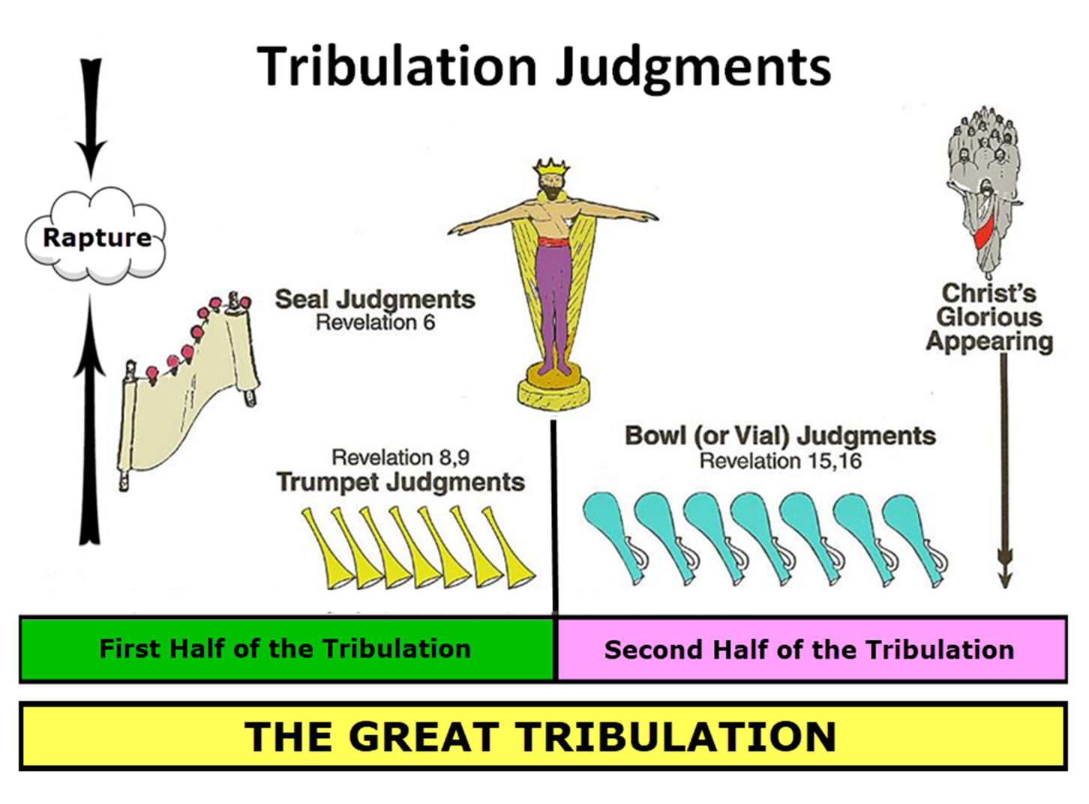

Slide 50

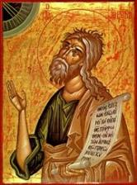
Jeremiah 30:7
“Alas! for that day is great, There is none like it; And it is the time of Jacob’s distress (Gen. 32:8; 35:10), But he will be saved from it.”

Slide 51

Matthew 24:21-22
“²¹ For then there will be a great tribulation, such as has not occurred since the beginning of the world until now, nor ever will. ²² Unless those days had been cut short, no life would have been saved; but for the sake of the elect those days will be cut short.”

Slide 52
Exodus 10:14b-15 Locusts’ Severity
Number (14b)
Darkness (15a)
Consumption (15b)

Slide 53
Ultimate Exodus (Rev 11:15)
Sores: 6th plague (Ex 9:8-12), 1st bowl (Rev 16:1-2)
Rivers to blood: 1st plague (Ex 7:19-21), 3rd bowl (Rev 16:4-7)
Darkness: 9th plague (Ex 10:21-23), 5th bowl (Rev 16:10-11)
Frogs: 2nd plague (Ex 7:25‒8:15), 6th bowl (Rev 16:13)
Hail: 7th plague (Ex 9:22-26), 7th bowl (Rev 16:17-21)

Slide 55
Revelation 11:15
¹⁵ “Then the seventh angel sounded; and there were loud voices in heaven, saying, ‘The kingdom of the world has become the kingdom of our Lord and of His Christ; and He will reign forever and ever.’”

Slide 56
Exodus 10:14b-15 Locusts’ Severity
Number (14b)
Darkness (15a)
Consumption (15b)

Slide 57
SHAPING AND POPULATING (GEN 1:1)
Day 1: | Light | Day 4: | Luminaries
Day 2: | Water, sky | Day 5: | Sea animals, birds
Day 3: | Land, vegetation | Day 6: | Land animals, man

Slide 58
Charles Ryrie Ryrie Study Bible, page 106
Exodus 10:14–15 locusts. “One of the most destructive of creatures. A swarm may have an average density of 130,000,000 locusts per square mile. They can denude hundreds of square miles quickly, bringing horror, despair, and terrible economic consequences to the inhabitants.”

Slide 59
LOCUSTS Exodus 10:1-20
God’s Instructions (1-2)
Moses & Aaron Speak to Pharaoh (3-6)
Moses & Aaron Speak to Pharaoh Again (7-11)
Plague’s Manifestation (12-15)
Pharaoh Speaks to Moses & Aaron (16-17)
God Answers (18-20)

Slide 60
V. Exodus 10:16-17 Pharaoh Speaks to Moses & Aaron
Summoning (16a)
Repentance (16b)
Request (17)

Slide 61
V. Exodus 10:16-17 Pharaoh Speaks to Moses & Aaron
Summoning (16a)
Repentance (16b)
Request (17)

Slide 62
V. Exodus 10:16-17 Pharaoh Speaks to Moses & Aaron
Summoning (16a)
Repentance (16b)
Request (17)

Slide 63
V. Exodus 10:16-17 Pharaoh Speaks to Moses & Aaron
Summoning (16a)
Repentance (16b)
Request (17)

Slide 64
LOCUSTS Exodus 10:1-20
God’s Instructions (1-2)
Moses & Aaron Speak to Pharaoh (3-6)
Moses & Aaron Speak to Pharaoh Again (7-11)
Plague’s Manifestation (12-15)
Pharaoh Speaks to Moses & Aaron (16-17)
God Answers (18-20)

Slide 65
VI. Exodus 10:18-20 God Answers
Exit (18a)
Supplication (18b)
God’s answers (19)
God’s hardening (20)

Slide 66
VI. Exodus 10:18-20 God Answers
Exit (18a)
Supplication (18b)
God’s answers (19)
God’s hardening (20)

Slide 67
VI. Exodus 10:18-20 God Answers
Exit (18a)
Supplication (18b)
God’s answers (19)
God’s hardening (20)

Slide 68
VI. Exodus 10:18-20 God Answers
Exit (18a)
Supplication (18b)
God’s answers (19)
God’s hardening (20)

Slide 70
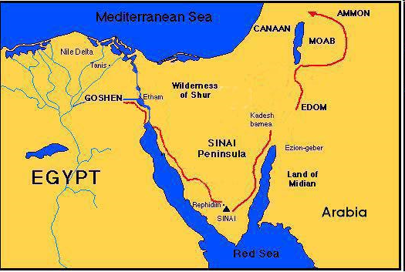

Slide 71
VI. Exodus 10:18-20 God Answers
Exit (18a)
Supplication (18b)
God’s answers (19)
God’s hardening (20)

Slide 72
Dr. Ed Hindson
Hindson, E. E., & Mitchell, D. R., eds. (2010). KJV Bible Commentary for Today: The Most Up-to-Date Commentary on the Time-Honored Text of the KJV (p. 86). Thomas Nelson.
“4:21. I will harden his heart. An expression meaning ‘to strengthen his will.’ The text identifies the heart as the location of the volition, man’s decision-making ability. On seven occasions in the narrative, God hardens Pharaoh’s heart (9:12; 10:1, 20, 27; 11:10; 14:4, 8) or foretells that He will harden Pharaoh’s heart (4:21; 7:3), and nine times in the text, Pharaoh hardens his own heart (7:13, 14, 22; 8:15, 19, 32; 9:7, 34–35). For the initial five plagues, the text registers Pharaoh as the agent of hardening. Not until the sixth plague does God participate in the confirmation of Pharaoh’s own volitional choices.”

Slide 73
Charles Ryrie Ryrie Study Bible, page 96
Exodus 4:21 - “harden his heart. Ten times it is said that Pharaoh hardened his own heart (7:13, 14, 22; 8:15, 19, 32; 9:7, 34, 35; 13:15), and 10 times that God hardened Pharaoh’s heart (4:21; 7:3; 9:12; 10:1, 20, 27; 11:10; 14:4, 8, 17). Paul uses this as an example of the inscrutable will of God and of His mercy toward men (Rom. 9:14–18). Seven times Pharaoh hardened his own heart before God first hardened it, though the prediction that God would do it preceded all.”

Slide 74
GOD HARDENING PHARAOH'S HEART
The prediction of God hardening of Pharaoh (4:21)
Pharaoh repeatedly hardening his own heart (7:13, 22; 8:15, 19, 32; 9:7)
Not until the sixth plague did God harden Pharaoh’s heart (Exod 9:12)

Slide 75
Conclusion

Slide 76
LOCUSTS Exodus 10:1-20
God’s Instructions (1-2)
Moses & Aaron Speak to Pharaoh (3-6)
Moses & Aaron Speak to Pharaoh Again (7-11)
Plague’s Manifestation (12-15)
Pharaoh Speaks to Moses & Aaron (16-17)
God Answers (18-20)

Slide 77
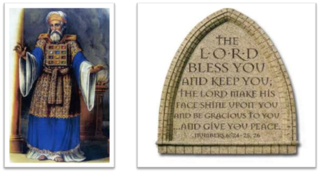
²⁴ The Lord bless you, and keep you; ²⁵ The Lord make His face shine on you, And be gracious to you; ²⁶ The Lord lift up His countenance on you, And give you peace.
Numbers 6:24–26 (NASB95)

Slide 78
TEN PLAGUES REDEMPTION (7:14–12:30)
Nile to blood
Frogs
Gnats
Flies
Death of livestock
Boils
Hail
Locusts
Darkness
Death of 1st born

Slide 79
DARKNESS Exodus 10:21-29
Plague’s Manifestation (21-23)
Pharaoh Speaks to Moses (24-29)

Slide 80
DARKNESS Exodus 10:21-29
Plague’s Manifestation (21-23)
Pharaoh Speaks to Moses (24-29)

Slide 81
I. Exodus 10:21-23 Plague’s Manifestation
God’s command (21)
Moses’ obedience (22a)
Plague’s severity (22b-23a)
Israel’s exemption (23b)

Slide 82
I. Exodus 10:21-23 Plague’s Manifestation
God’s command (21)
Moses’ obedience (22a)
Plague’s severity (22b-23a)
Israel’s exemption (23b)

Slide 83
Ultimate Exodus (Rev 11:15)
Sores: 6th plague (Ex 9:8-12), 1st bowl (Rev 16:1-2)
Rivers to blood: 1st plague (Ex 7:19-21), 3rd bowl (Rev 16:4-7)
Darkness: 9th plague (Ex 10:21-23), 5th bowl (Rev 16:10-11)
Frogs: 2nd plague (Ex 7:25‒8:15), 6th bowl (Rev 16:13)
Hail: 7th plague (Ex 9:22-26), 7th bowl (Rev 16:17-21)

Slide 85
Revelation 11:15
¹⁵ “Then the seventh angel sounded; and there were loud voices in heaven, saying, ‘The kingdom of the world has become the kingdom of our Lord and of His Christ; and He will reign forever and ever.’”

Slide 86
The Plagues of Egypt
NO. | DESCRIPTION | SCRIPTURE | Egyptian Deity
1. | Water to Blood | Exod. 7:14-25 | Hapi, Khnum
2. | Frogs | Exod. 8:1-15 | Heqt
3. | Gnats | Exod. 8:16-19 | Set
4. | Flies | Exod. 8:20-32 | Uatchit
5. | Disease on Cattle | Exod. 9:1-7 | Hathor, Apis
6. | Boils | Exod. 9:8-12 | Sekhmet, Serapis
7. | Hail | Exod. 9:13-35 | Seth, Nut
8. | Locusts | Exod. 10:1-20 | Seth, Nut, Osiris
9. | Darkness | Exod. 10:21-29 | Re, Horus, Atum
10. | Death of the First Born | Exod. 12:29-36 | Min, Osiris, Heqt, Isis

Slide 87
Charles Ryrie Ryrie Study Bible, page 106
Exodus 10:21 - “darkness which may be felt. Possibly a combination of a violent sandstorm and supernatural darkness.”

Slide 88
The Plagues of Egypt
NO. | DESCRIPTION | SCRIPTURE | Egyptian Deity
1. | Water to Blood | Exod. 7:14-25 | Hapi, Khnum
2. | Frogs | Exod. 8:1-15 | Heqt
3. | Gnats | Exod. 8:16-19 | Set
4. | Flies | Exod. 8:20-32 | Uatchit
5. | Disease on Cattle | Exod. 9:1-7 | Hathor, Apis
6. | Boils | Exod. 9:8-12 | Sekhmet, Serapis
7. | Hail | Exod. 9:13-35 | Seth, Nut
8. | Locusts | Exod. 10:1-20 | Seth, Nut, Osiris
9. | Darkness | Exod. 10:21-29 | Re, Horus, Atum
10. | Death of the First Born | Exod. 12:29-36 | Min, Osiris, Heqt, Isis

Slide 89
Dr. Ed Hindson
Hindson, E. E., & Mitchell, D. R., eds. (2010). KJV Bible Commentary for Today: The Most Up-to-Date Commentary on the Time-Honored Text of the KJV (p. 97). Thomas Nelson.
Exodus 10:21 - “The chief Egyptian deity challenged by this plague was Pharaoh’s own divine father, Ra, the sun god and high god of the pantheon. This is surely a response to Pharaoh’s previous equation of YHWH’s power with that of Ra (10:10). Shu and Nut, the respective sky god and goddess, would also have been (yet again) shown impotent before the Lord.”

Slide 91
I. Exodus 10:21-23 Plague’s Manifestation
God’s command (21)
Moses’ obedience (22a)
Plague’s severity (22b-23a)
Israel’s exemption (23b)

Slide 93
I. Exodus 10:21-23 Plague’s Manifestation
God’s command (21)
Moses’ obedience (22a)
Plague’s severity (22b-23a)
Israel’s exemption (23b)

Slide 94
SHAPING AND POPULATING (GEN 1:1)
Day 1: | Light | Day 4: | Luminaries
Day 2: | Water, sky | Day 5: | Sea animals, birds
Day 3: | Land, vegetation | Day 6: | Land animals, man

Slide 95
I. Exodus 10:21-23 Plague’s Manifestation
God’s command (21)
Moses’ obedience (22a)
Plague’s severity (22b-23a)
Israel’s exemption (23b)

Slide 97

Protection Through the Tribulation?
(Revelation 3:10)
Like the protection in Goshen (Exod. 8:22, 24; 9:4, 6; 11:4-7; Rev. 9:4; 16:2)
Effective? Rev. 6:9-11; 7:13-14; 13:10, 15; 20:4
Comfort? John 14:1; 1 Thess. 4:18; Titus 2:13

Slide 98
Dr. Ed Hindson
Hindson, E. E., & Mitchell, D. R., eds. (2010). KJV Bible Commentary for Today: The Most Up-to-Date Commentary on the Time-Honored Text of the KJV (p. 97). Thomas Nelson.
Exodus 10:21 - “Proponents of the miraculous intensification of natural events theory propose that the darkness resulted from the arrival of a blinding sandstorm. This does not take into consideration, however, that the darkness began at the discretion of Moses or the continued distinction the Lord made between Goshen and the remainder of Egypt. Although the entire nation suffered in suffocating, pitch-black darkness, the Hebrews in Goshen had retained the sunlight.”

Slide 99

7 “I AM” statements in John
I am the Bread of Life | 6:35
I am the Light of the world | 8:12
I am the Gate for the sheep | 10:7; cf. v.9
I am the Good Shepherd | 10:11,14
I am the Resurrection and the Life | 11:25
I am the Way and the Truth and the Life | 14:6
I am the true Vine | 15:1; cf. v.5

Slide 101
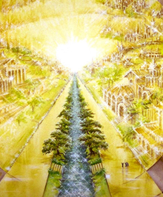
Eternal State is Future
No Satan (Rev 20:10)
No sea (Rev 21:1)
No death, crying, or pain (Rev 21:4)
No Sun (Rev 22:5)
No Moon (Rev 21:23)
No temple (Rev. 21:22)
No night (Rev 21:25)
No evil (Rev 21:27)
No curse (Rev 22:3)

Slide 102
DARKNESS Exodus 10:21-29
Plague’s Manifestation (21-23)
Pharaoh Speaks to Moses (24-29)

Slide 103
II. Exodus 10:24-29 Pharaoh Speaks to Moses
Entrance (24a)
Pharaoh’s command (24b)
Pharaoh’s qualification (24c)
Moses’ rebuttal (25-26)
God’s hardening (27)
Pharaoh’s command (28)
Moses’ affirmation (29)

Slide 104
II. Exodus 10:24-29 Pharaoh Speaks to Moses
Entrance (24a)
Pharaoh’s command (24b)
Pharaoh’s qualification (24c)
Moses’ rebuttal (25-26)
God’s hardening (27)
Pharaoh’s command (28)
Moses’ affirmation (29)

Slide 105
II. Exodus 10:24-29 Pharaoh Speaks to Moses
Entrance (24a)
Pharaoh’s command (24b)
Pharaoh’s qualification (24c)
Moses’ rebuttal (25-26)
God’s hardening (27)
Pharaoh’s command (28)
Moses’ affirmation (29)

Slide 107
Ephesians 2:8-10
“⁸ For by grace you have been saved through faith; and that not of yourselves, it is the gift of God; ⁹ not as a result of works, so that no one may boast. ¹⁰ For we are His workmanship, created in Christ Jesus for good works, which God prepared beforehand so that we would walk [peripateō, subjunctive mood] in them.”

Slide 108
II. Exodus 10:24-29 Pharaoh Speaks to Moses
Entrance (24a)
Pharaoh’s command (24b)
Pharaoh’s qualification (24c)
Moses’ rebuttal (25-26)
God’s hardening (27)
Pharaoh’s command (28)
Moses’ affirmation (29)

Slide 109
II. Exodus 10:24-29 Pharaoh Speaks to Moses
Entrance (24a)
Pharaoh’s command (24b)
Pharaoh’s qualification (24c)
Moses’ rebuttal (25-26)
God’s hardening (27)
Pharaoh’s command (28)
Moses’ affirmation (29)

Slide 111
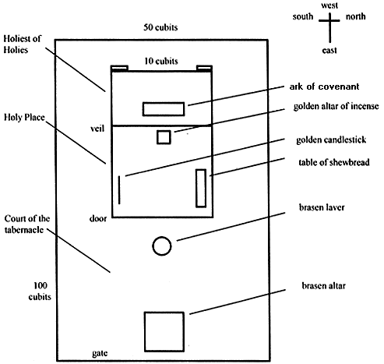
Tabernacle Diagram

Slide 112
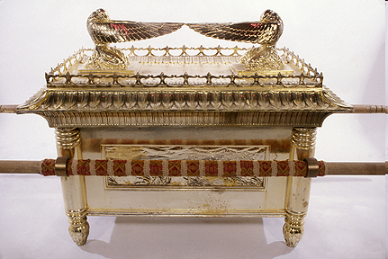
Ark of the Covenant

Slide 113
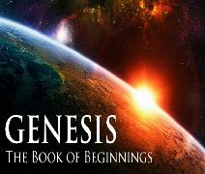
God’s Provision (3:20-24)
Continuation of the race (3:20)
Forgiveness (3:21, 7)
Expulsion of Adam and Eve from Eden (3:22-24)

Slide 115
Ephesians 2:8-10
“⁸ For by grace you have been saved through faith; and that not of yourselves, it is the gift of God; ⁹ not as a result of works, so that no one may boast. ¹⁰ For we are His workmanship, created in Christ Jesus for good works, which God prepared beforehand so that we would walk [peripateō, subjunctive mood] in them.”

Slide 116
II. Exodus 10:24-29 Pharaoh Speaks to Moses
Entrance (24a)
Pharaoh’s command (24b)
Pharaoh’s qualification (24c)
Moses’ rebuttal (25-26)
God’s hardening (27)
Pharaoh’s command (28)
Moses’ affirmation (29)

Slide 117
Dr. Ed Hindson
Hindson, E. E., & Mitchell, D. R., eds. (2010). KJV Bible Commentary for Today: The Most Up-to-Date Commentary on the Time-Honored Text of the KJV (p. 86). Thomas Nelson.
“4:21. I will harden his heart. An expression meaning ‘to strengthen his will.’ The text identifies the heart as the location of the volition, man’s decision-making ability. On seven occasions in the narrative, God hardens Pharaoh’s heart (9:12; 10:1, 20, 27; 11:10; 14:4, 8) or foretells that He will harden Pharaoh’s heart (4:21; 7:3), and nine times in the text, Pharaoh hardens his own heart (7:13, 14, 22; 8:15, 19, 32; 9:7, 34–35). For the initial five plagues, the text registers Pharaoh as the agent of hardening. Not until the sixth plague does God participate in the confirmation of Pharaoh’s own volitional choices.”

Slide 118
Charles Ryrie Ryrie Study Bible, page 96
Exodus 4:21 - “harden his heart. Ten times it is said that Pharaoh hardened his own heart (7:13, 14, 22; 8:15, 19, 32; 9:7, 34, 35; 13:15), and 10 times that God hardened Pharaoh’s heart (4:21; 7:3; 9:12; 10:1, 20, 27; 11:10; 14:4, 8, 17). Paul uses this as an example of the inscrutable will of God and of His mercy toward men (Rom. 9:14–18). Seven times Pharaoh hardened his own heart before God first hardened it, though the prediction that God would do it preceded all.”

Slide 119
GOD HARDENING PHARAOH'S HEART
The prediction of God hardening of Pharaoh (4:21)
Pharaoh repeatedly hardening his own heart (7:13, 22; 8:15, 19, 32; 9:7)
Not until the sixth plague did God harden Pharaoh’s heart (Exod 9:12)

Slide 120
II. Exodus 10:24-29 Pharaoh Speaks to Moses
Entrance (24a)
Pharaoh’s command (24b)
Pharaoh’s qualification (24c)
Moses’ rebuttal (25-26)
God’s hardening (27)
Pharaoh’s command (28)
Moses’ affirmation (29)

Slide 121
II. Exodus 10:24-29 Pharaoh Speaks to Moses
Entrance (24a)
Pharaoh’s command (24b)
Pharaoh’s qualification (24c)
Moses’ rebuttal (25-26)
God’s hardening (27)
Pharaoh’s command (28)
Moses’ affirmation (29)

Slide 122
Conclusion

Slide 123
DARKNESS Exodus 10:21-29
Plague’s Manifestation (21-23)
Pharaoh Speaks to Moses (24-29)

Slide 124
²⁴ The Lord bless you, and keep you; ²⁵ The Lord make His face shine on you, And be gracious to you; ²⁶ The Lord lift up His countenance on you, And give you peace.
Numbers 6:24–26 (NASB95)

