Slide 1
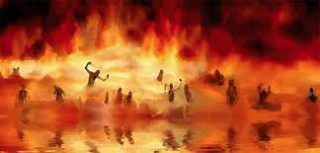

Annihilation
vs.
Eternal Torment

Slide 2
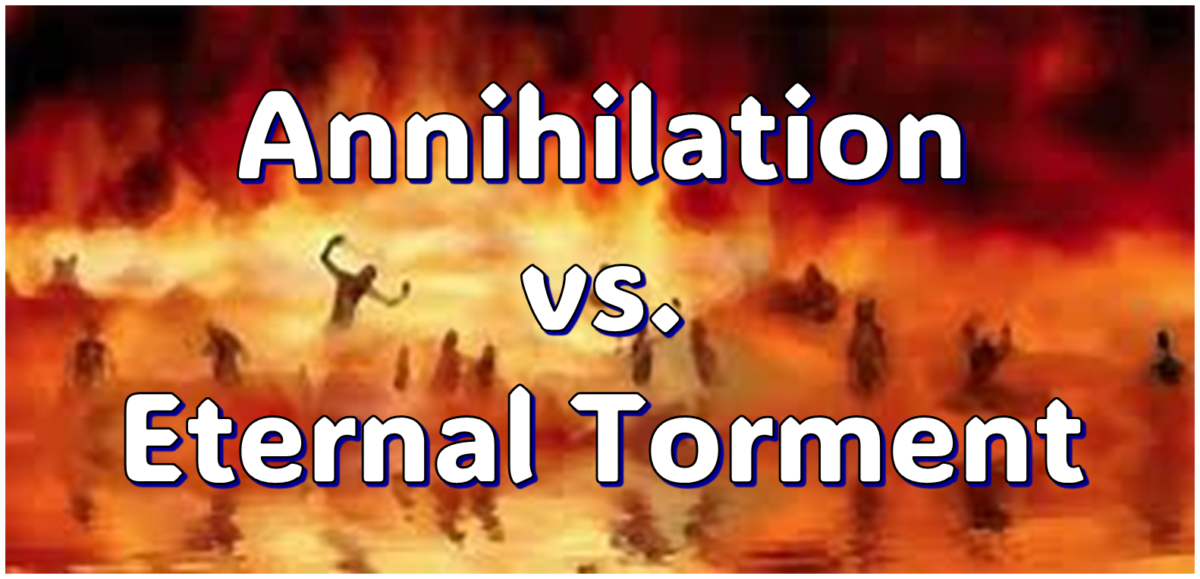
ANNIHILATION VS. ETERNAL CONSCIOUS TORMENT
Introduction to the Controversy
Biblical Arguments Against Annihilation
Theological Arguments Against Annihilation
Answering Annihilationist Biblical Arguments
Answering Annihilationist Theological Arguments
Examining Church History
Conclusion

Slide 3

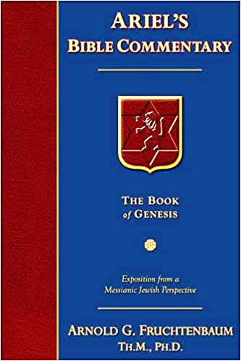
Dr. Arnold G. Fruchtenbaum
Footsteps of the Messiah, 707-8
“Conditional immortality means the soul is not inherently immortal; immortality is not part of the make-up of the soul. Rather, immortality is a gift for the saved only. So at death, the unbeliever simply becomes non-existent, and only the believer continues to exist…What annihilationism says is this: the unsaved soul is annihilated after a temporary period of punishment. These people do believe that the unsaved soul goes to Hell, but not for eternity, only temporarily. Eventually the unsaved soul is annihilated after suffering a duration of punishment.”

Slide 4
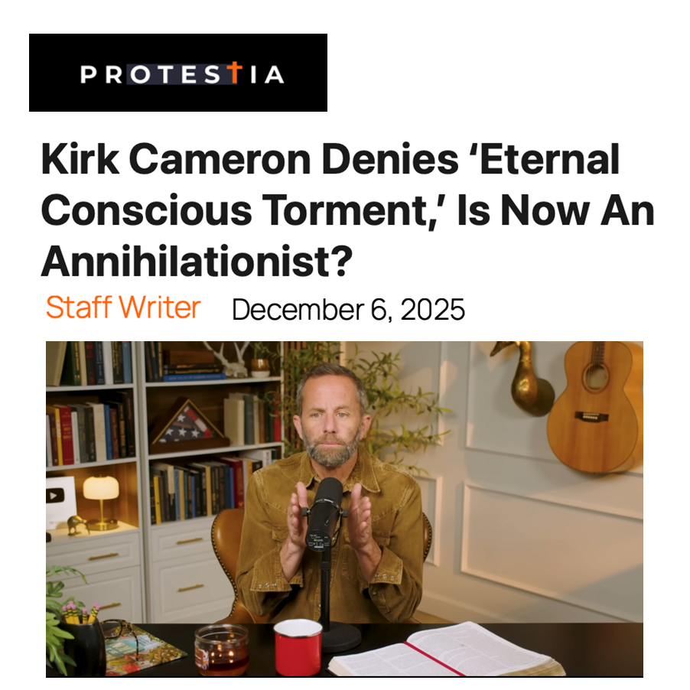

Slide 5


Slide 6
ANNIHILATION VS. ETERNAL CONSCIOUS TORMENT
Introduction to the Controversy
Biblical Arguments Against Annihilation
Theological Arguments Against Annihilation
Answering Annihilationist Biblical Arguments
Answering Annihilationist Theological Arguments
Examining Church History
Conclusion

Slide 7
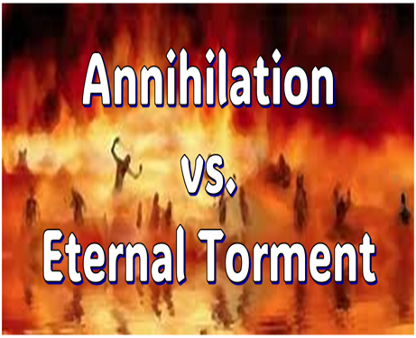
II. Anti-Annihilationist Texts
Dan. 12:2 Matt. 25:46 Mark 9:47-48 Matt. 8:12 Luke 16:19-31 |  | 2 Thess. 1:9 Heb. 6:2 Rev. 14:11 Rev. 20:10 Rev. 19:20

Slide 8
ANNIHILATION VS. ETERNAL CONSCIOUS TORMENT
Introduction to the Controversy
Biblical Arguments Against Annihilation
Theological Arguments Against Annihilation
Answering Annihilationist Biblical Arguments
Answering Annihilationist Theological Arguments
Examining Church History
Conclusion

Slide 9
III. Theological Arguments Against Annihilation
Underestimates sin’s severity
Contradicts humanity’s nature
Denies degrees of punishment
Seeks to escape sin’s consequences

Slide 10
ANNIHILATION VS. ETERNAL CONSCIOUS TORMENT
Introduction to the Controversy
Biblical Arguments Against Annihilation
Theological Arguments Against Annihilation
Answering Annihilationist Biblical Arguments
Answering Annihilationist Theological Arguments
Examining Church History
Conclusion

Slide 11
IV. Answering Annihilationist Biblical Arguments
2nd death (Rev. 20:14)
Destroy (Rev. 11:18)
Destruction (2 Thess. 1:9)
Burning up (Matt. 3:12)
Eternal results (Rev. 14:11)

Slide 12
IV. Answering Annihilationist Biblical Arguments
Perdition (2 Pet. 3:7)
Better to have never been born (Mark 14:21)
Wicked perishing (2 Pet. 3:9)
Blotted out of existence (Hebrews 9:25–26)
Life activity suspended in death (Eccles. 9:10)

Slide 13
ANNIHILATION VS. ETERNAL CONSCIOUS TORMENT
Introduction to the Controversy
Biblical Arguments Against Annihilation
Theological Arguments Against Annihilation
Answering Annihilationist Biblical Arguments
Answering Annihilationist Theological Arguments
Examining Church History
Conclusion

Slide 14
V. Answering Annihilationist Theological Arguments
Immortality: a gift only for the believer (1 Tim. 6:16)
Temporal nature of the soul (Gen. 3:22)
Finite nature of Christ’s death (John 19:30)
God’s justice (Ps. 90:2)
God’s mercy (1 John 4:8)
All things reconciled to God (Col. 1:20)
Universal nature of God’s victory (Philip. 2:10)
Burden of heaven’s citizens (Rev. 21:4)

Slide 15
Dr. Arnold G. Fruchtenbaum
Footsteps of the Messiah, 710, 714-16
“Colossians 1:20, where it states that ‘all things are reconciled.’ If there is a continuous existence of the unsaved in eternal punishment, it would mean that ‘all things’ were not reconciled; but if all things are reconciled, it means there is an elimination and annihilation of the unbelieving element…they also use Colossians 1:20, which speaks about ‘all things being reconciled.’ But in that context, the ‘all things’ does not mean ‘all things without exception;’ rather, it means ‘all things without distinction.’ All kinds of things will be reconciled, but not all things as such...”

Slide 16
Dr. Arnold G. Fruchtenbaum
Footsteps of the Messiah, 710, 714-16
“The…additional argument is found in Hebrews 2:16, which points out that God did not provide salvation for fallen angels. How is that relevant? Part of the teaching of the annihilationists is based upon the theological argument and the scriptural argument that the Bible promises that ‘all things are to be reconciled to God’ (Col. 1:20). But the fact is that the ‘all things’ here does not mean ‘all things without exception;’ rather, all kinds of things will be reconciled, but not every one of every kind.”

Slide 17
Dr. Arnold G. Fruchtenbaum
Footsteps of the Messiah, 710, 714-16
“According to Hebrews 2:16, salvation was not provided for fallen angels, so fallen angels will never be reconciled to God, and yet they continue to be eternal beings. The fact that there is no reconciliation for fallen angels shows that the Colossians passage cannot be used to teach that all things without exception are going to be reconciled by means of the annihilation of the evil ones. It simply cannot mean that.”

Slide 18
V. Answering Annihilationist Theological Arguments
Immortality: a gift only for the believer (1 Tim. 6:16)
Temporal nature of the soul (Gen. 3:22)
Finite nature of Christ’s death (John 19:30)
God’s justice (Ps. 90:2)
God’s mercy (1 John 4:8)
All things reconciled to God (Col. 1:20)
Universal nature of God’s victory (Philip. 2:10)
Burden of heaven’s citizens (Rev. 21:4)

Slide 19
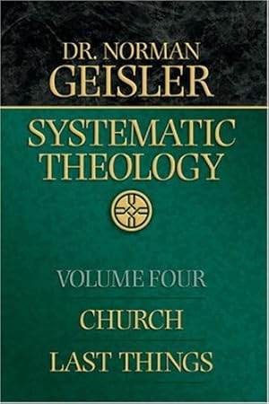
Dr. Norman Geisler
Geisler, N. L. (2005). Systematic theology, volume four: church, last things (p. 406-07). Bethany House Publishers.
“While the annihilationist disagrees with the universalist contention that all will be saved; nonetheless, he concurs that the passages describing God’s universal victory over evil demand that there be no evil left in the universe. For example, in the end everyone will bow the knee to Christ (Phil. 2:10); the world will be reconciled to Christ (2 Cor. 5:19); all will be ‘in Christ’ (Eph. 1:10 nkjv); death and sin will be destroyed (1 Cor. 15:26); and everyone will be subject to Christ (v. 15:28). Even though universalism’s interpretation of these texts is incorrect, they do indicate that sin will be completely defeated, which conditionalists insist cannot occur unless all sinners are destroyed.”

Slide 20
Dr. Norman Geisler
Geisler, N. L. (2005). Systematic theology, volume four: church, last things (p. 406-07). Bethany House Publishers.
“The annihilationist conclusion does not follow from these ‘universal victory passages.’ Some only refer to the fact that salvation is universally possible (e.g., Rom. 5:18–19; 2 Cor. 5:19); Christ’s death for all means salvation is universal in extent but limited in application, since not all will believe. Other passages do not refer to the salvation of all but the subjugation of all (e.g., Phil. 2:10), while others apply to believers and not unbelievers (e.g., Eph. 1:10).”

Slide 21
Dr. Norman Geisler
Geisler, N. L. (2005). Systematic theology, volume four: church, last things (p. 406-07). Bethany House Publishers.
“Some texts do speak of the unilateral defeat of all death (e.g., 1 Cor. 15:26); this is fulfilled in the resurrection of all persons, saved and unsaved (cf. John 5:29; Rev. 20:4–5). The other verses that speak of God’s triumph over all evil teach the separation, not the annihilation, of all evil (e.g., Matt. 13:41–42; 25:31–41). As has been repeatedly demonstrated, no passage speaks of the annihilation of evil beings: Evil is defeated by everlasting imprisonment and quarantine. Once again, for God to annihilate His image in fallen beings would not be a victory but a defeat, an attack of God upon Himself.”

Slide 22

John 5:28-29
“²⁸ Do not marvel at this; for an hour is coming, in which all who are in the tombs will hear His voice, ²⁹ and will come forth; those who did the good deeds to a resurrection of life, those who committed the evil deeds to a resurrection of judgment.”

Slide 23
Acts 24:14-15
“¹⁴ But this I admit to you, that according to the Way which they call a sect I do serve the God of our fathers, believing everything that is in accordance with the Law and that is written in the Prophets; ¹⁵ having a hope in God, which these men cherish themselves, that there shall certainly be a resurrection of both the righteous and the wicked.”

Slide 24


Daniel 12:2
“Many of those who sleep in the dust of the ground will awake, these to everlasting (olam) life, but the others to disgrace and everlasting (olam) contempt.”

Slide 25
Revelation 20:4-6
“⁴ Then I saw thrones, and they sat on them, and judgment was given to them. And I saw the souls of those who had been beheaded because of their testimony of Jesus and because of the word of God, and those who had not worshiped the beast or his image, and had not received the mark on their forehead and on their hand; and they came to life [zaō] and reigned with Christ for a thousand years….

Slide 26
Revelation 20:4-6
…⁵ The rest of the dead did not come to life [zaō] until the thousand years were completed. This is the first resurrection [anastasis]. ⁶ Blessed and holy is the one who has a part in the first resurrection [anastasis]; over these the second death has no power, but they will be priests of God and of Christ and will reign with Him for a thousand years.”

Slide 27
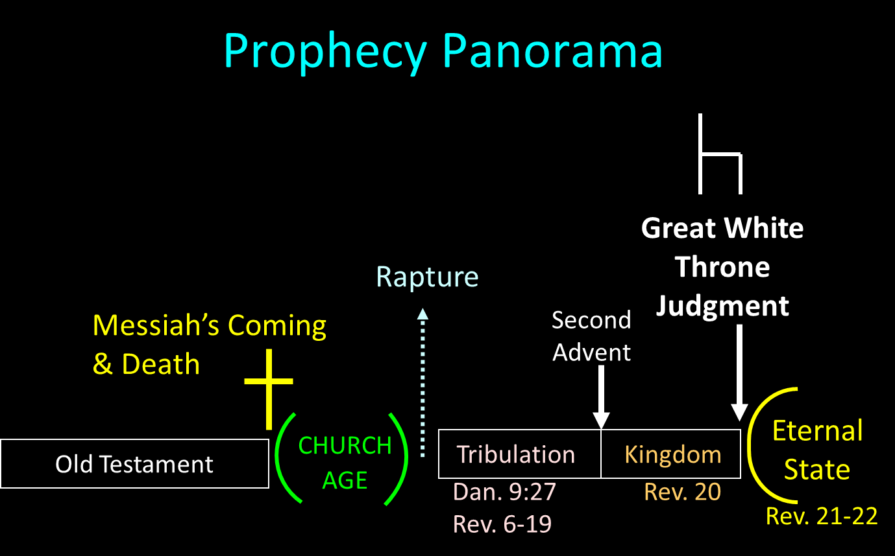

Slide 28
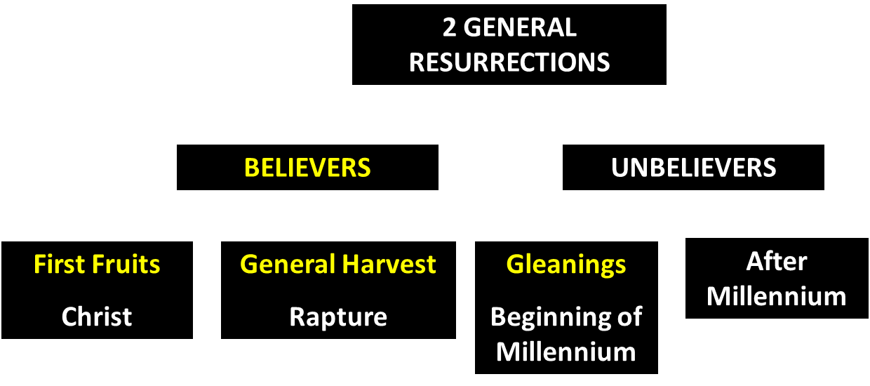
God’s Resurrection Program

Slide 29
V. Answering Annihilationist Theological Arguments
Immortality: a gift only for the believer (1 Tim. 6:16)
Temporal nature of the soul (Gen. 3:22)
Finite nature of Christ’s death (John 19:30)
God’s justice (Ps. 90:2)
God’s mercy (1 John 4:8)
All things reconciled to God (Col. 1:20)
Universal nature of God’s victory (Philip. 2:10)
Burden of heaven’s citizens (Rev. 21:4)

Slide 30
Dr. Arnold G. Fruchtenbaum
Footsteps of the Messiah, 709, 711-12
“The eighth theological argument is that the righteous ones could not enjoy bliss knowing that others are continually in Hell. Those in Heaven will simply not be able to enjoy it if they know that there are others suffering continuously in Hell…the righteous could enjoy bliss only if they know that others are not suffering eternally; the righteous could not enjoy bliss knowing that others are continually suffering in Hell. But the answer here is that the righteous will enjoy the bliss of God’s presence and will not be encumbered with the present perspective regarding what is inappropriate to Heaven’s bliss.”

Slide 32

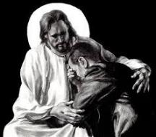
Revelation 21:4
“and He will wipe away every tear from their eyes; and there will no longer be any death; there will no longer be any mourning, or crying, or pain; the first things have passed away.”

Slide 33
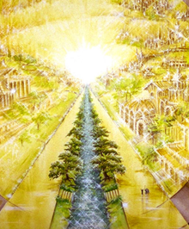
Eternal State is Future
No Satan (Rev 20:10)
No sea (Rev 21:1)
No death, crying, or pain (Rev 21:4)
No Sun (Rev 22:5)
No Moon (Rev 21:23)
No temple (Rev. 21:22)
No night (Rev 21:25)
No evil (Rev 21:27)
No curse (Rev 22:3)

Slide 34
V. Answering Annihilationist Theological Arguments
Immortality: a gift only for the believer (1 Tim. 6:16)
Temporal nature of the soul (Gen. 3:22)
Finite nature of Christ’s death (John 19:30)
God’s justice (Ps. 90:2)
God’s mercy (1 John 4:8)
All things reconciled to God (Col. 1:20)
Universal nature of God’s victory (Philip. 2:10)
Burden of heaven’s citizens (Rev. 21:4)

Slide 35
ANNIHILATION VS. ETERNAL CONSCIOUS TORMENT
Introduction to the Controversy
Biblical Arguments Against Annihilation
Theological Arguments Against Annihilation
Answering Annihilationist Biblical Arguments
Answering Annihilationist Theological Arguments
Examining Church History
Conclusion

Slide 36
ANNIHILATION VS. ETERNAL CONSCIOUS TORMENT
Introduction to the Controversy
Biblical Arguments Against Annihilation
Theological Arguments Against Annihilation
Answering Annihilationist Biblical Arguments
Answering Annihilationist Theological Arguments
Examining Church History
Conclusion

Slide 37

Dominoes in a Row

Slide 38
ANNIHILATION VS. ETERNAL CONSCIOUS TORMENT
Introduction to the Controversy
Biblical Arguments Against Annihilation
Theological Arguments Against Annihilation
Answering Annihilationist Biblical Arguments
Answering Annihilationist Theological Arguments
Examining Church History
Conclusion

