Slide 1
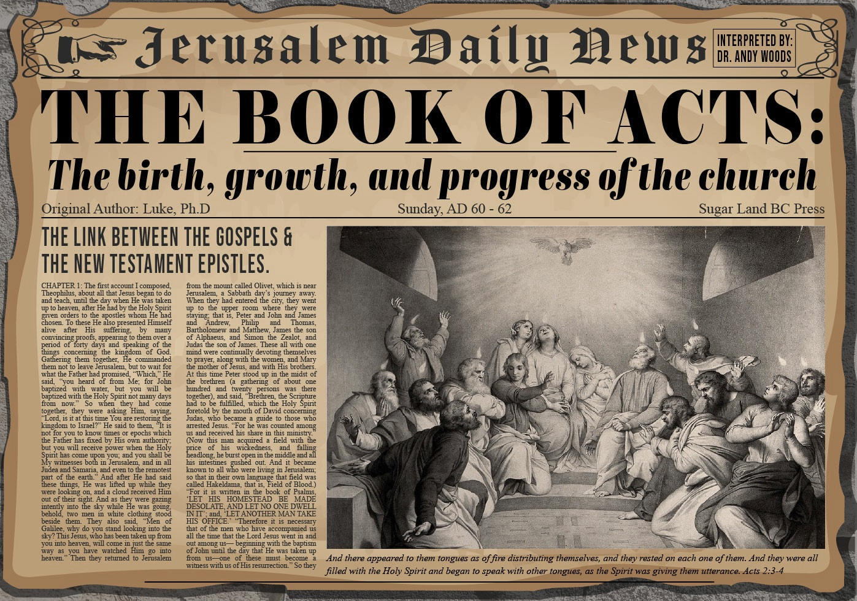


Slide 2
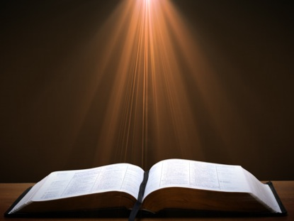
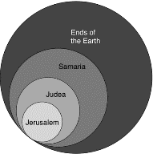
Acts 1:8
“but you will receive power when the Holy Spirit has come upon you; and you shall be My witnesses both in Jerusalem (Acts 1-7), and in all Judea and Samaria (Acts 8-12), and even to the remotest part of the earth (Acts 13-28).”

Slide 3
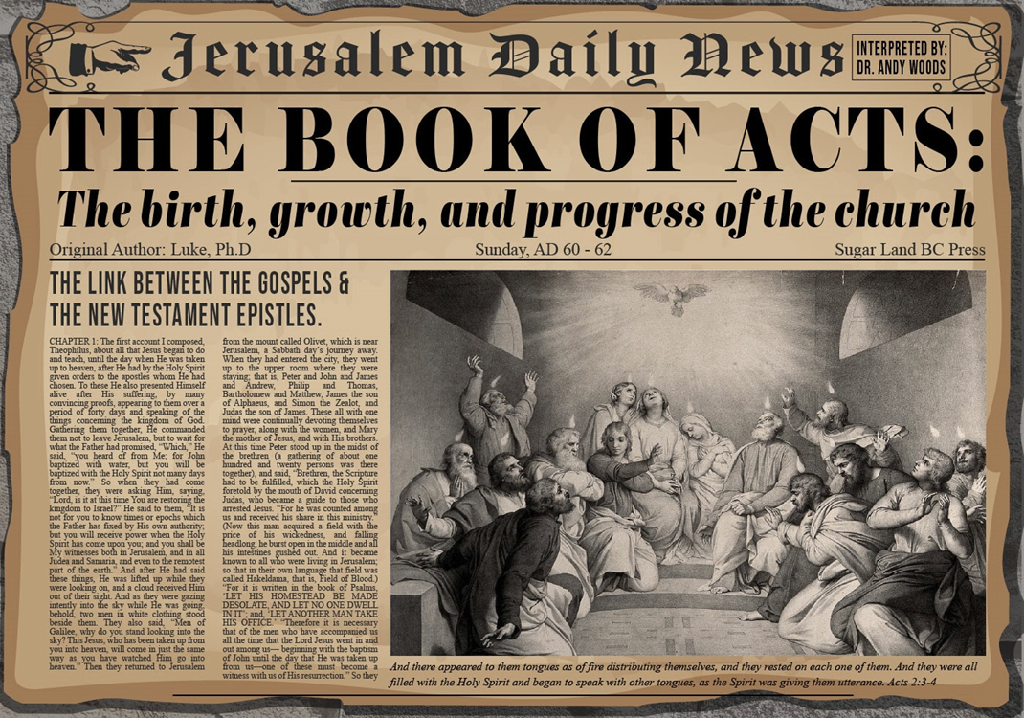
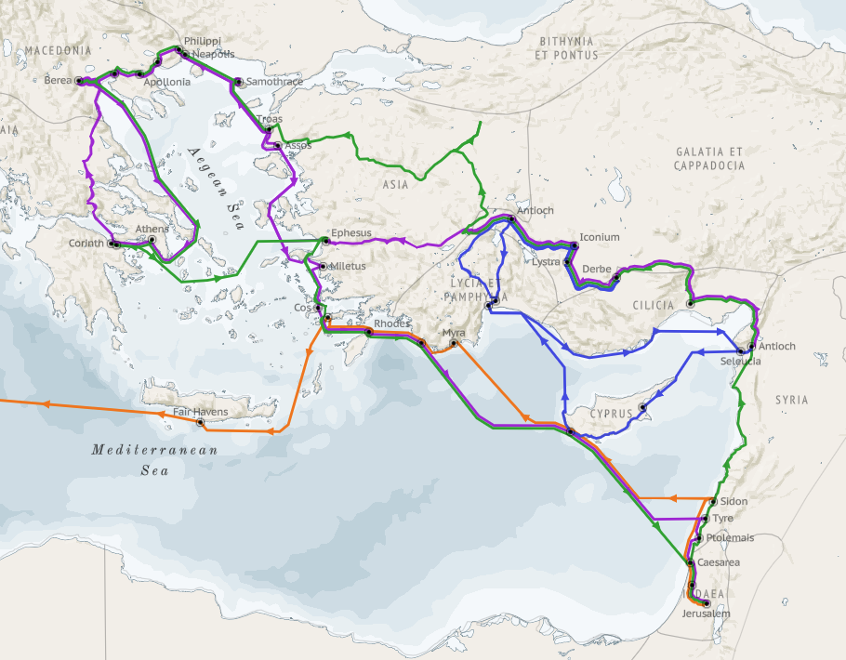
Structure (Acts 1:8)
Jerusalem (Acts 1–7)
Judea and Samaria (Acts 8–12)
Remotest part of the earth (Acts 13–28)
1st missionary journey (Acts 13–14)
Jerusalem council (Acts 15:1-35)
2nd missionary journey (Acts 15:36 –18:22)
3rd missionary journey (Acts 18:23–21:17)
Trip to Rome (Acts 21:18–28:31)

Slide 4
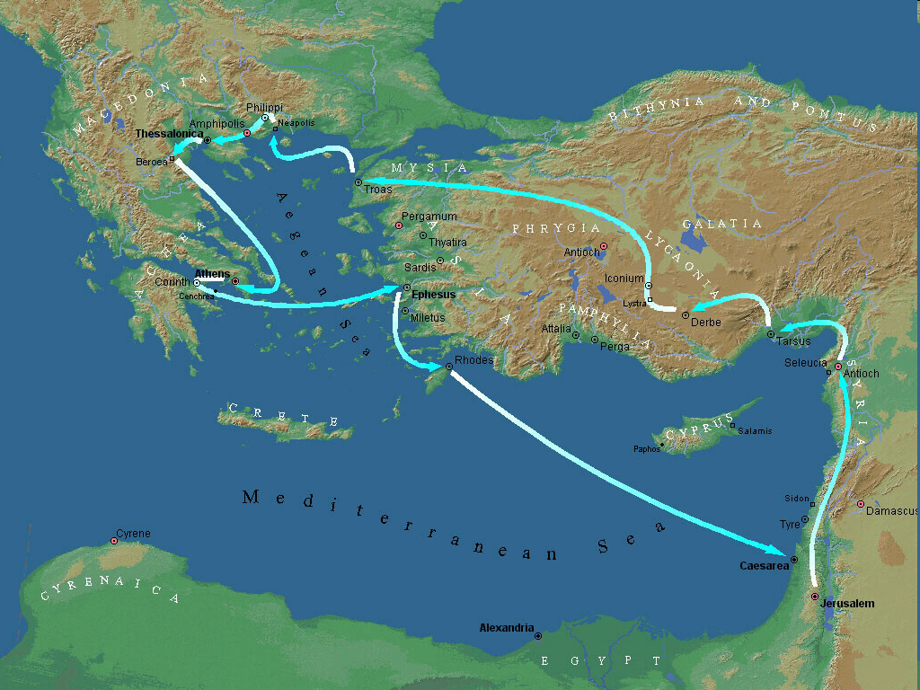
Second Missionary Journey

Slide 5
Acts 15:36‒18:22 2nd Missionary Journey
Schism between Paul & Barnabas (15:36-41)
Syria & Cilicia ministry (16:1-5)
Macedonian call (16:6-10)
Philippian ministry (16:11-40)
Thessalonica ministry (17:1-9)
Berean ministry (17:10-15)
Athens’ ministry (17:16-34)
Corinthian ministry (18:1-18)
Ephesus’ ministry (18:19-21)
Return to Antioch (18:22)

Slide 6
V. Thessalonica Ministry Acts 17:1-9
Paul’s journey (1)
Paul’s preaching (2-3)
Results of Paul’s preaching (4)
Opposition to Paul’s preaching (5-9)

Slide 7
V. Thessalonica Ministry Acts 17:1-9
Paul’s journey (1)
Paul’s preaching (2-3)
Results of Paul’s preaching (4)
Opposition to Paul’s preaching (5-9)

Slide 8
Acts 17:1 Paul’s Journey
Amphipolis (1a)
Apollonia (1b)
Thessalonica (1c)

Slide 9
Acts 17:1 Paul’s Journey
Amphipolis (1a)
Apollonia (1b)
Thessalonica (1c)

Slide 10
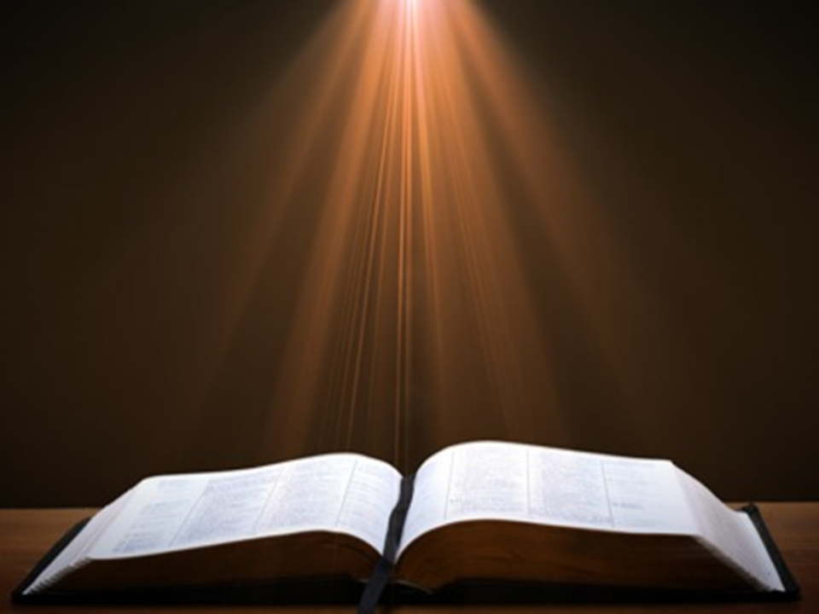
Acts 17:1-3
“¹ Now when they had traveled through Amphipolis and Apollonia, they came to Thessalonica, where there was a synagogue of the Jews. ² And according to Paul’s custom, he visited them, and for three Sabbaths reasoned with them from the Scriptures, ³ explaining and giving evidence that the Christ had to suffer and rise from the dead, and saying, “This Jesus whom I am proclaiming to you is the Christ.”

Slide 11
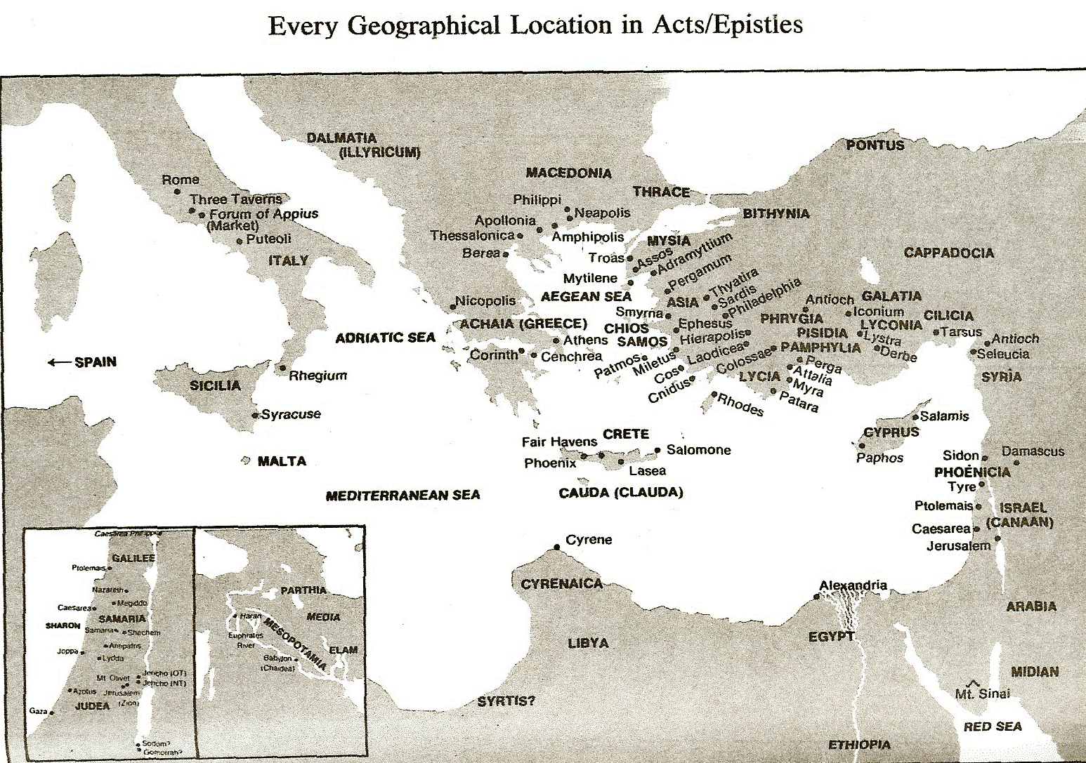

Slide 12
Second Missionary Journey

Slide 13
Acts 17:1 Paul’s Journey
Amphipolis (1b)
Apollina (1a)
Thessalonica (1c)

Slide 14
Acts 17:1-3
“¹ Now when they had traveled through Amphipolis and Apollonia, they came to Thessalonica, where there was a synagogue of the Jews. ² And according to Paul’s custom, he visited them, and for three Sabbaths reasoned with them from the Scriptures, ³ explaining and giving evidence that the Christ had to suffer and rise from the dead, and saying, “This Jesus whom I am proclaiming to you is the Christ.”

Slide 16
Acts 17:1 Paul’s Journey
Apollonia (1a)
Amphipolis (1b)
Thessalonica (1c)

Slide 17
Acts 17:1-3
“¹ Now when they had traveled through Amphipolis and Apollonia, they came to Thessalonica, where there was a synagogue of the Jews. ² And according to Paul’s custom, he visited them, and for three Sabbaths reasoned with them from the Scriptures, ³ explaining and giving evidence that the Christ had to suffer and rise from the dead, and saying, “This Jesus whom I am proclaiming to you is the Christ.”

Slide 19
Second Missionary Journey

Slide 20
V. Thessalonica Ministry Acts 17:1-9
Paul’s journey (1)
Paul’s preaching (2-3)
Results of Paul’s preaching (4)
Opposition to Paul’s preaching (5-9)

Slide 21
Acts 17:2-3 Paul’s Preaching
Custom (2)
Content (3)

Slide 22
Acts 17:2-3 Paul’s Preaching
Custom (2)
Content (3)

Slide 23
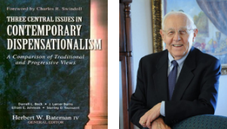
Stanley D. Toussaint
The Bible Knowledge Commentary, p. 401.
“The reference to three Sabbath days does not mean the missionary band stayed only three weeks in Thessalonica. Paul carried on the work with a Jewish emphasis for three Sabbaths and then turned to Gentiles and ministered to them for some weeks after that. This was the situation for three reasons: (1) The Philippian church sent money to Paul at least twice during this visit (Phil. 4:15-16), implying a longer lapse of time than three weeks. (2) In addition, Paul supported himself by manual labor (I Thes. 2:9; 2 Thes. 3:7-10). This may indicate that considerable time elapsed before the aid from Philippi arrived. (3) Most of the converts at Thessalonica were not from the synagogue but were Gentiles steeped in idolatry (cf. 1 Thes. 1:9).”

Slide 24
Presumed Knowledge
Trinity | 1:1, 5-6
Holy Spirit | 1:5-6; 4:8; 5:19
Second Advent | 1:10; 2:19; 3:13; 4:14-17; 5:23
Day of the Lord | 5:1-3
Eschatology | 2 Thess 2:5
Assurance | 1:5
Conversion | 1:9
Election | 1:4
Resurrection | 4:14-18
Sanctification | 4:3; 5:23
Christian behavior | 2:12; 4:1
Adapted from Scofield Study Bible, 1640

Slide 25
Acts 17:2-3 Paul’s Preaching
Custom (2)
Content (3)

Slide 26
Acts 17:1-3
“¹ Now when they had traveled through Amphipolis and Apollonia, they came to Thessalonica, where there was a synagogue of the Jews. ² And according to Paul’s custom, he visited them, and for three Sabbaths reasoned with them from the Scriptures, ³ explaining and giving evidence that the Christ had to suffer and rise from the dead, and saying, “This Jesus whom I am proclaiming to you is the Christ.”

Slide 27

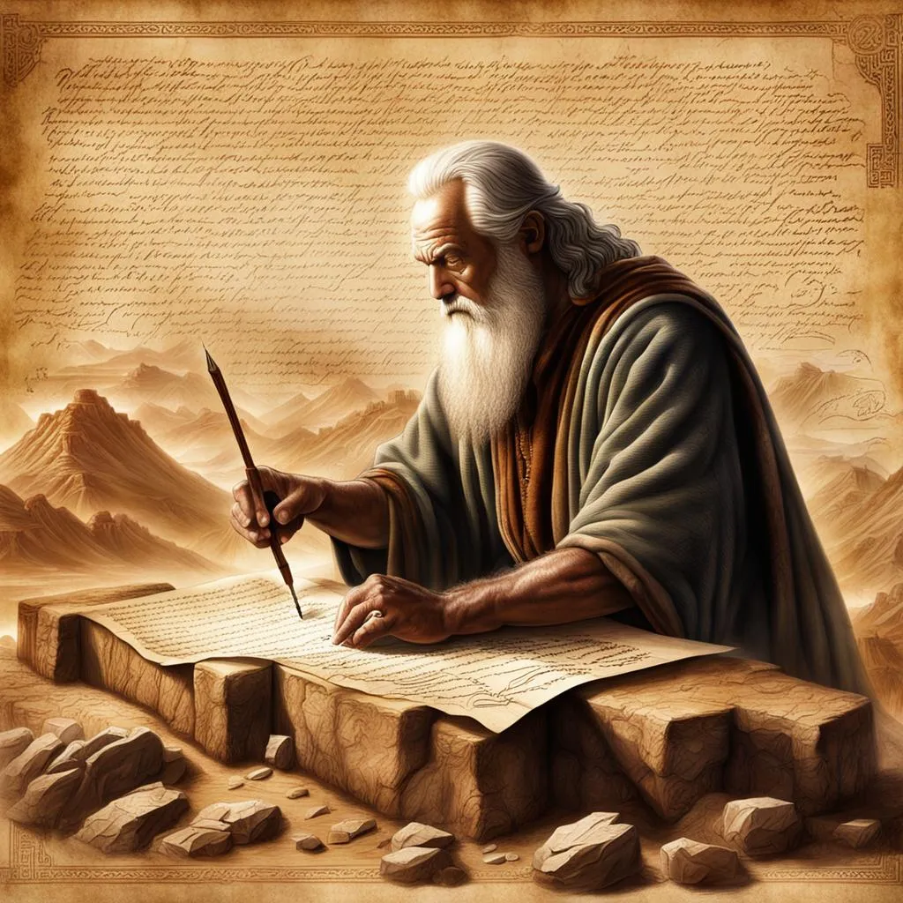
John 5:39, 46
“³⁹ You search the Scriptures because you think that in them you have eternal life; it is these that testify about Me…⁴⁶ For if you believed Moses, you would believe Me, for he wrote about Me.”

Slide 28
Luke 24:27, 44
“²⁷ Then beginning with Moses and with all the prophets, He explained to them the things concerning Himself in all the Scriptures…⁴⁴ Now He said to them, ‘These are My words which I spoke to you while I was still with you, that all things which are written about Me in the Law of Moses and the Prophets and the Psalms must be fulfilled.’”

Slide 29

1 Corinthians 15:3-4
“³ For I handed down to you as of first importance what I also received, that Christ died for our sins according to the Scriptures, ⁴ and that He was buried, and that He was raised on the third day according to the Scriptures.”

Slide 30
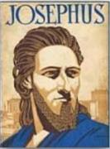
Josephus
Antiquities 18.3.3
“About this time there lived Jesus, a wise man, if indeed one ought to call him a man. For he was one who performed surprising deeds and was a teacher of such people as accept the truth gladly. He won over many Jews and many of the Greeks. He was the Christ. And when, upon the accusation of the principal men among us, Pilate had condemned him to a cross, those who had first come to love him did not cease. He appeared to them spending a third day restored to life, for the prophets of God had foretold these things and a thousand other marvels about him. And the tribe of the Christians, so called after him, has still to this day not disappeared.”

Slide 31
OT Prophecies About Christ
Prophecy | Scripture | Years in Advance
Manner of Birth | Isaiah 7:14 | 700 years
Place of Birth | Micah 5:2 | 700 years
Nationality | Numbers 24:17 | 1400 years
Tribe | Genesis 49:10 | 1800 years
Time of and Response to His Messiahship | Dan. 9:25-26 | 600 years

Slide 32
OT Prophecies About Christ
Prophecy | Scripture | Years in Advance
Crucified Between Thieves | Isaiah 53:9 | 700 years
Pierced | Isaiah 53:5 | 700 years
No Broken Bones | Psalm 22:17 | 1000 years
Gamble for His Clothing | Psalm 22:18 | 1000 years
Buried in Rich Man’s Tomb | Isaiah 53:9 | 700 years
Notes:
109 prophecies…
Peter Stoner – SCIENCE SPEAKS, An Evaluation of Certain Christian Evidences
To fulfill just 8 prophecies =1 X 10 to the twenty-eighth power!
Can we visualize this with an illustration? Suppose we took an atheistic professor, blindfolded him and covered the state of Texas two feet deep with silver dollars. Then we put a check on one of those silver dollars and mixed them up. The odds of one person fulfilling just these eight prophecies would be the same as this atheistic professor selecting the silver dollar upon which we have placed a check, in his first try.
https://www.bereanpublishers.com/the-odds-of-eight-messianic-prophecies-coming-true/

Slide 33
V. Thessalonica Ministry Acts 17:1-9
Paul’s journey (1)
Paul’s preaching (2-3)
Results of Paul’s preaching (4)
Opposition to Paul’s preaching (5-9)

Slide 34
Acts 17:4 Results of Paul’s Preaching
Jews (4a)
Greeks (4b)
Women (4c)

Slide 35
Acts 17:4 Results of Paul’s Preaching
Jews (4a)
Greeks (4b)
Women (4c)

Slide 36
Acts 17:4 Results of Paul’s Preaching
Jews (4a)
Greeks (4b)
Women (4c)

Slide 37
Acts 17:4 Results of Paul’s Preaching
Jews (4a)
Greeks (4b)
Women (4c)

Slide 38
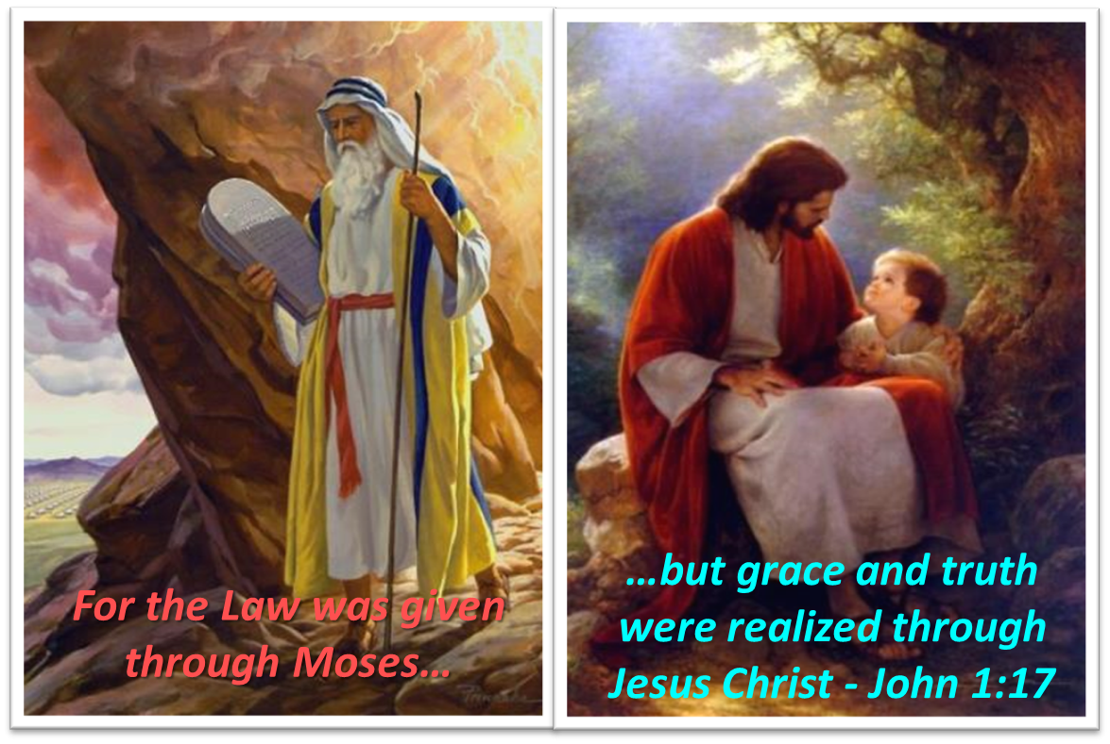
Themes
From Peter to Paul (Gal 2:7-8)
Universality of the Gospel
Transitions
Sovereignty of God (Acts 2:23; 13:48)
Soteriology (Acts 16:31)

Slide 39
IV. Philippian Ministry Acts 16:11-40
Lydia’s conversion (11-15)
Demonized slave girl (16-18)
Paul & Silas’ imprisonment (19-34)
Departure from Philippi (35-40)

Slide 40
V. Thessalonica Ministry Acts 17:1-9
Paul’s journey (1)
Paul’s preaching (2-3)
Results of Paul’s preaching (4)
Opposition to Paul’s preaching (5-9)

Slide 41
Acts 17:5-9 Opposition to Paul’s Preaching
Mob described (5a)
Attack on Jason (5b-6a)
Accusations (6b-7)
Results of mob action (8)
City’s decision (9)

Slide 42
Acts 17:5-9 Opposition to Paul’s Preaching
Mob described (5a)
Attack on Jason (5b-6a)
Accusations (6b-7)
Results of mob action (8)
City’s decision (9)

Slide 43
Acts 17:5-9 Opposition to Paul’s Preaching
Mob described (5a)
Attack on Jason (5b-6a)
Accusations (6b-7)
Results of mob action (8)
City’s decision (9)

Slide 44
Acts 17:5-9 Opposition to Paul’s Preaching
Mob described (5a)
Attack on Jason (5b-6a)
Accusations (6b-7)
Results of mob action (8)
City’s decision (9)

Slide 45
Acts 17:6b-7 Accusations
Disturbance (6b)
Proselytizing (7a)
Insurrection (7b)

Slide 46
Acts 17:6b-7 Accusations
Disturbance (6b)
Proselytizing (7a)
Insurrection (7b)

Slide 47

The Whole World? (Revelation 3:10)
Oikouménē – known world? (Luke 2:1; Acts 11:28)
Oikouménē – entire world (Luke 4:5; Acts 17:31; Rev. 12:9)
Context favors the global definition
Adjective “whole” (holos)
Rev. 6‒18

Slide 48
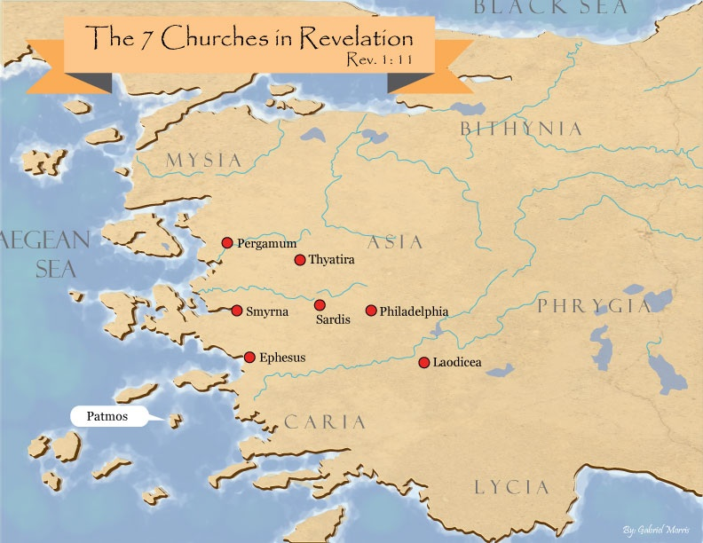
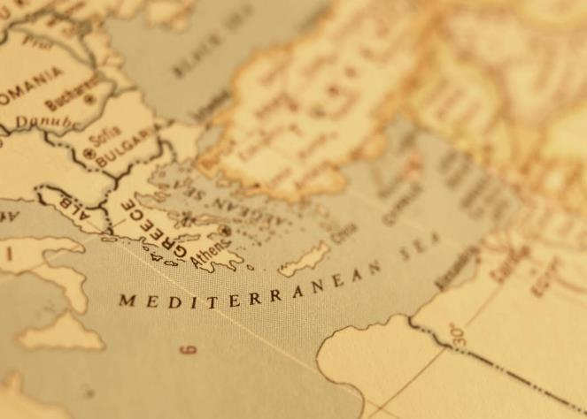

Slide 49
Acts 17:6b-7 Accusations
Disturbance (6b)
Proselytizing (7a)
Insurrection (7b)

Slide 50
Acts 17:6b-7 Accusations
Disturbance (6b)
Proselytizing (7a)
Insurrection (7b)

Slide 51
Acts 17:5-9 Opposition to Paul’s Preaching
Mob described (5a)
Attack on Jason (5b-6a)
Accusations (6b-7)
Results of mob action (8)
City’s decision (9)

Slide 52
Acts 17:8 Results of Mob Action
Troubled the multitudes (8a)
Troubled city officials (8b)

Slide 53
Acts 17:8 Results of Mob Action
Troubled the multitudes (8a)
Troubled city officials (8b)

Slide 54
Acts 17:8 Results of Mob Action
Troubled the multitudes (8a)
Troubled city officials (8b)

Slide 55
Acts 17:5-9 Opposition to Paul’s Preaching
Mob described (5a)
Attack on Jason (5b-6a)
Accusations (6b-7)
Results of mob action (8)
City’s decision (9)

Slide 56
Acts 17:9 City’s Decision
Took security (9a)
Released Jason & the others (9b)

Slide 57
Acts 17:9 City’s Decision
Took security (9a)
Released Jason & the others (9b)

Slide 58
Acts 17:9 City’s Decision
Took security (9a)
Released Jason & the others (9b)

Slide 59
Acts 15:36‒18:22 2nd Missionary Journey
Schism between Paul & Barnabas (15:36-41)
Syria & Cilicia ministry (16:1-5)
Macedonian call (16:6-10)
Philippian ministry (16:11-40)
Thessalonica ministry (17:1-9)
Berean ministry (17:10-15)
Athens’ ministry (17:16-34)
Corinthian ministry (18:1-18)
Ephesus’ ministry (18:19-21)
Return to Antioch (18:22)

Slide 60
VI. Berean Ministry Acts 17:10-15
Journey to Berea (10a)
Synagogue ministry (10b)
Berean Discernment (11)
1st Berean Believers (12)
Opposition (13-15)

Slide 61
VI. Berean Ministry Acts 17:10-15
Journey to Berea (10a)
Synagogue ministry (10b)
Berean Discernment (11)
1st Berean Believers (12)
Opposition (13-15)

Slide 62
Second Missionary Journey

Slide 64
VI. Berean Ministry Acts 17:10-15
Journey to Berea (10a)
Synagogue ministry (10b)
Berean Discernment (11)
1st Berean Believers (12)
Opposition (13-15)

Slide 65
Acts 17:1-3
“¹ Now when they had traveled through Amphipolis and Apollonia, they came to Thessalonica, where there was a synagogue of the Jews. ² And according to Paul’s custom, he visited them, and for three Sabbaths reasoned with them from the Scriptures, ³ explaining and giving evidence that the Christ had to suffer and rise from the dead, and saying, “This Jesus whom I am proclaiming to you is the Christ.”

Slide 66
VI. Berean Ministry Acts 17:10-15
Journey to Berea (10a)
Synagogue ministry (10b)
Berean Discernment (11)
1st Berean Believers (12)
Opposition (13-15)

Slide 67

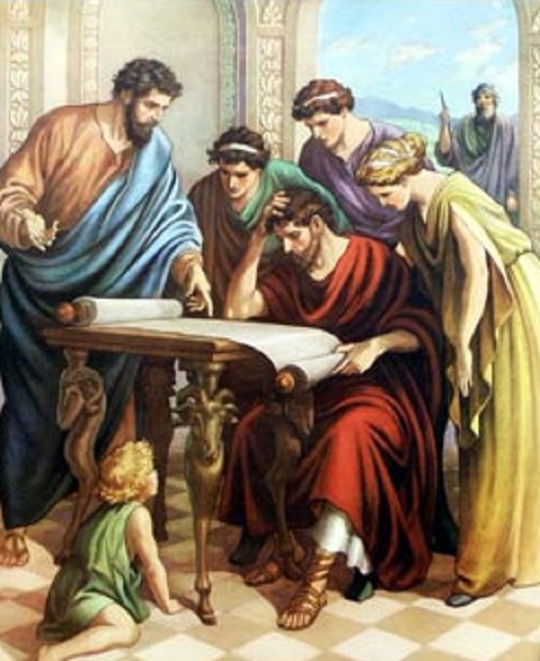
Acts 17:11
“Now these were more noble-minded than those in Thessalonica, for they received the word with great eagerness, examining the Scriptures daily to see whether these things were so.”

Slide 68
Acts 17:1-3
“¹ Now when they had traveled through Amphipolis and Apollonia, they came to Thessalonica, where there was a synagogue of the Jews. ² And according to Paul’s custom, he visited them, and for three Sabbaths reasoned with them from the Scriptures, ³ explaining and giving evidence that the Christ had to suffer and rise from the dead, and saying, “This Jesus whom I am proclaiming to you is the Christ.”

Slide 69

Galatians 1:6–9
⁶ I am amazed that you are so quickly deserting Him who called you by the grace of Christ, for a different gospel; ⁷ which is really not another; only there are some who are disturbing you and want to distort the gospel of Christ. ⁸ But even if we, or an angel from heaven, should preach to you a gospel contrary to what we have preached to you, he is to be accursed! ⁹ As we have said before, so I say again now, if any man is preaching to you a gospel contrary to what you received, he is to be accursed!

Slide 70
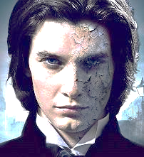
1 John 4:1
“Beloved, do not believe every spirit, but test the spirits to see whether they are from God, because many false prophets have gone out into the world.”

Slide 72

Revelation 2:2
“I know your deeds and your toil and perseverance, and that you cannot tolerate evil men, and you put to the test [peirázō] those who call themselves apostles, and they are not, and you found them to be false.”

Slide 73
VI. Berean Ministry Acts 17:10-15
Journey to Berea (10a)
Synagogue ministry (10b)
Berean Discernment (11)
1st Berean Believers (12)
Opposition (13-15)

Slide 74
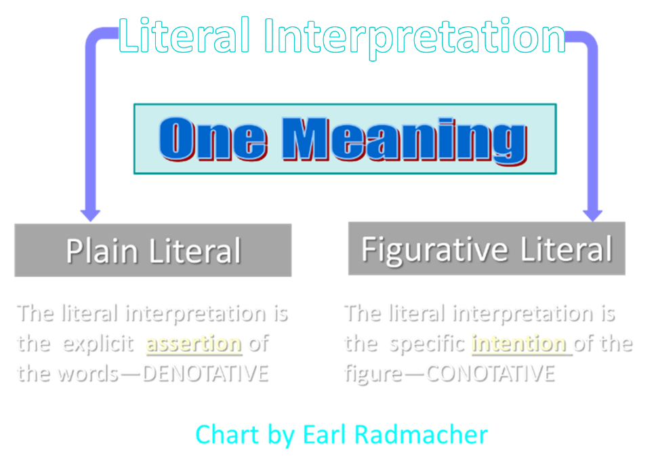

Slide 75
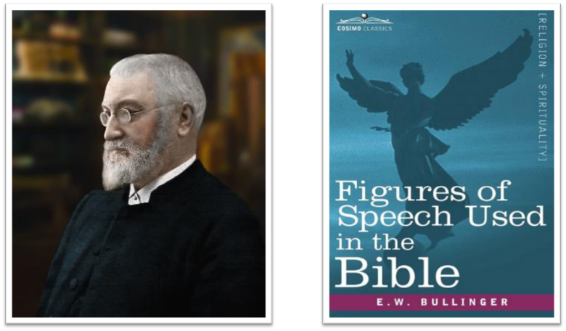
E.W. Bullinger (1837‒1913)

Slide 76
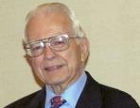

Dr. Roy B. Zuck
Basic Bible Interpretation, p. 156-57.
“﻿Litotes. A litotes is an understatement or a negative statement to express an affirmation. This is the opposite of hyperbole. When we say, ‘He is not a bad preacher,’ we mean he is a very good preacher. The understatement is made for emphasis. When Paul wrote, ‘I am a Jew … a citizen of no insignificant city’ (Acts 21:39, nasb), he meant that Tarsus was in fact a rather significant city. A litotes is at times a belittling statement, as in Numbers 13:33, ‘We seemed like grasshoppers in our own eyes, and we looked the same to them.’ Luke used a number of litotes.”

Slide 77
Dr. Roy B. Zuck
Basic Bible Interpretation, p. 156-57.
“﻿He spoke of ‘no small disturbance among the soldiers’ (Acts 12:18, nasb), ‘no little business’ (19:24), and ‘no small storm’ (27:20, nasb). When Luke wrote that Paul and Barnabas stayed in Antioch ‘a long time’ (14:28), the Greek has a litotes. It is literally, ‘they stayed there not a little time.’ Paul belittled himself with a litotes in 1 Corinthians 15:9, ‘For I am the least of the apostles.’ This statement of genuine humility was written to highlight God’s grace in his life as an undeserving sinner (see v. 10).”

Slide 78
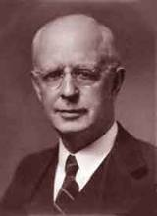
Lewis Sperry Chafer, vol. 7, Systematic Theology (Grand Rapids, MI: Kregel Publications, 1993), 265-66.
Belief – God’s One Condition for Justification
“…because upwards of 150 passages of Scripture condition salvation upon believing only (cf. John 3:16; Acts 16:31).”

Slide 79
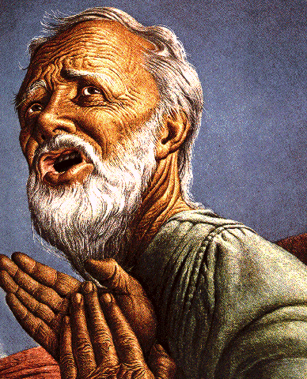
Belief – God’s One Condition for Justification
Gen 15:6
Then he believed in the LORD; and He reckoned it to him as righteousness.
John 3:16
For God so loved the world, that He gave His only begotten Son, that whoever believes in Him shall not perish, but have eternal life.
Acts 16:30-31
"Sirs, what must I do to be saved?" They said, "Believe in the Lord Jesus, and you will be saved..."

Slide 80
Themes
From Peter to Paul (Gal 2:7-8)
Universality of the Gospel
Transitions
Sovereignty of God (Acts 2:23; 13:48)
Soteriology (Acts 16:31)

Slide 81
VI. Berean Ministry Acts 17:10-15
Journey to Berea (10a)
Synagogue ministry (10b)
Berean Discernment (11)
1st Berean Believers (12)
Opposition (13-15)

Slide 82
Acts 17:13-15 Opposition
Source (13)
Paul leaves Athens (14)
Paul in Athens (15)

Slide 83
Acts 17:13-15 Opposition
Source (13)
Paul leaves Athens (14)
Paul in Athens (15)

Slide 85
Second Missionary Journey

Slide 86
Acts 17:13-15 Opposition
Source (13)
Paul leaves Athens (14)
Paul in Athens (15)

Slide 88
Second Missionary Journey

Slide 89
Acts 17:13-15 Opposition
Source (13)
Paul leaves Athens (14)
Paul in Athens (15)

Slide 91
Second Missionary Journey

Slide 92
Acts 15:36‒18:22 2nd Missionary Journey
Schism between Paul & Barnabas (15:36-41)
Syria & Cilicia ministry (16:1-5)
Macedonian call (16:6-10)
Philippian ministry (16:11-40)
Thessalonica ministry (17:1-9)
Berean ministry (17:10-15)
Athens’ ministry (17:16-34)
Corinthian ministry (18:1-18)
Ephesus’ ministry (18:19-21)
Return to Antioch (18:22)

Slide 93
VII. Athens Ministry Acts 17:16-34
Paul’s witness (16-21)
Paul’s speech (22-31)
Athenians’ response (32-34)

Slide 94
VII. Athens Ministry Acts 17:16-34
Paul’s witness (16-21)
Paul’s speech (22-31)
Athenians’ response (32-34)

Slide 95
Acts 17:16-21 Paul’s Witness
Paul’s witness (16a)
Athens’ idolatry (16b)
Athenian ministry (17)
Philosophical opposition (18-21)

Slide 96
Acts 17:16-21 Paul’s Witness
Paul’s witness (16a)
Athens’ idolatry (16b)
Athenian ministry (17)
Philosophical opposition (18-21)

Slide 97
Acts 17:16-21 Paul’s Witness
Paul’s witness (16a)
Athens’ idolatry (16b)
Athenian ministry (17)
Philosophical opposition (18-21)

Slide 98
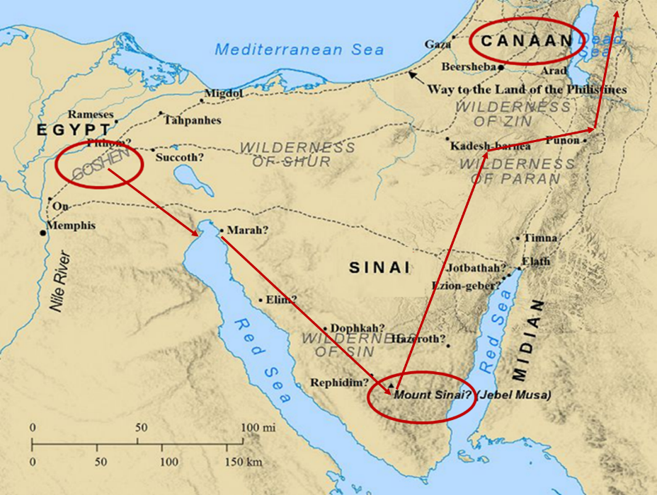

Slide 99
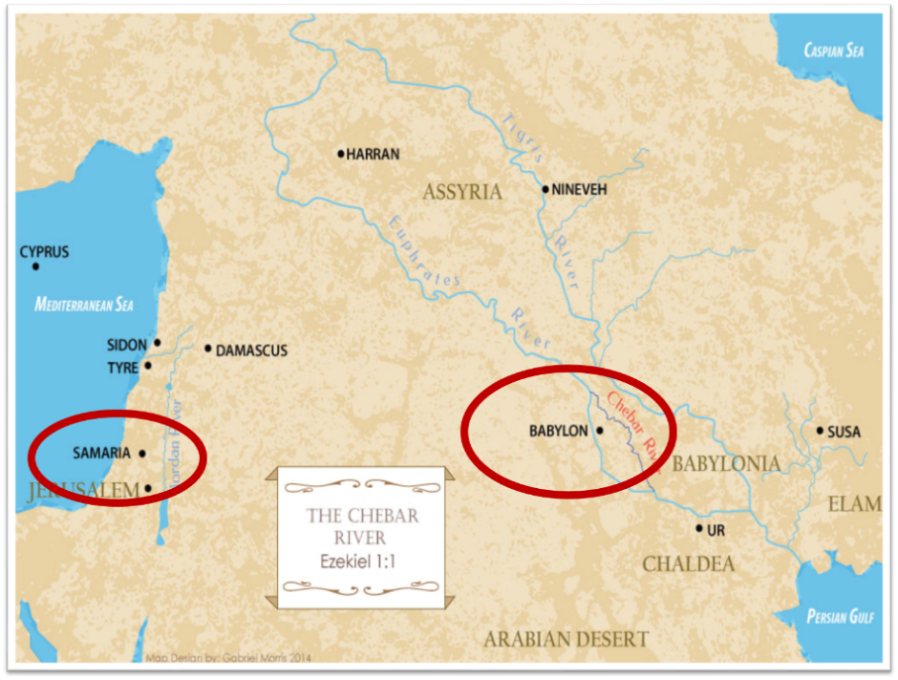

Slide 100
Acts 17:16-21 Paul’s Witness
Paul’s witness (16a)
Athens’ idolatry (16b)
Athenian ministry (17)
Philosophical opposition (18-21)

Slide 101
Acts 17:17 Athenian Ministry
Synagogue (17a)
Proselytes (17b)
Market place (17c)

Slide 102
Acts 17:17 Athenian Ministry
Synagogue (17a)
Proselytes (17b)
Market place (17c)

Slide 103
Acts 17:1-3
“¹ Now when they had traveled through Amphipolis and Apollonia, they came to Thessalonica, where there was a synagogue of the Jews. ² And according to Paul’s custom, he visited them, and for three Sabbaths reasoned with them from the Scriptures, ³ explaining and giving evidence that the Christ had to suffer and rise from the dead, and saying, “This Jesus whom I am proclaiming to you is the Christ.”

Slide 104
Acts 17:17 Athenian Ministry
Synagogue (17a)
Proselytes (17b)
Market place (17c)

Slide 105
Acts 17:17 Athenian Ministry
Synagogue (17a)
Proselytes (17b)
Market place (17c)

Slide 106
Acts 17:16-21 Paul’s Witness
Paul’s witness (16a)
Athens’ idolatry (16b)
Athenian ministry (17)
Philosophical opposition (18-21)

Slide 107
Acts 17:18-21 Philosophical Opposition
Opponents (18a-b)
Mockery (18c-d)
Before the Aeropagus (19-21)

Slide 108
Acts 17:18-21 Philosophical Opposition
Opponents (18a-b)
Mockery (18c-d)
Before the Aeropagus (19-21)

Slide 109
Acts 17:18a-b Opponents
Epicureans (18a)
Stoics (18b)

Slide 110
Acts 17:18a-b Opponents
Epicureans (18a)
Stoics (18b)

Slide 111

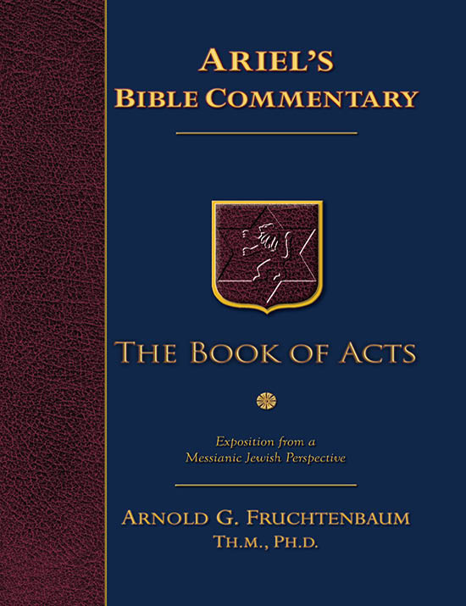
Dr. Arnold G. Fruchtenbaum
The Book of Acts, 366
“The first group followed the teachings of Epicurus, a Greek philosopher who lived between the years 341-270 B.C. Epicureanism began with the search for pure truth by reason. However, since this search was considered to be hopeless, the chief end of man was to try to find happiness. Pleasure, not knowledge, should be the goal of life. Epicureans believed that the gods live in eternal calm but away from the lives of man and that, unlike the gods, man has no afterlife either to fear or to hope for. Because there is no afterlife for either the good or the bad, they believed that man should make the best of his life here. While Epicureans were not theological atheists, they were practical atheists. Eventually, this philosophical movement degenerated into a life of sensualism. Among the more famous Epicurean poets were Lucretius and Horace.”

Slide 112
Acts 17:18a-b Opponents
Epicureans (18a)
Stoics (18b)

Slide 113
Dr. Arnold G. Fruchtenbaum
The Book of Acts, 366-67
“The second type of Greek philosophers Paul encountered were the Stoics. They were followers of Zeno (ca. 334-262 B.C.) and Chrysippus (ca. 279-206 B.C.). Zeno taught in the Stoa Poikile (‘Painted Porchm’). Therefore, his philosophy became known as ‘Stoicism.’ According to the Stoics, wisdom lay in being free from intense emotionalism. Therefore, man had to submit to natural law and learn to live comfortably with nature. The highest expression of this life was reason. To be virtuous was to live in harmony with reason, and this was the only good. Not to be virtuous was the only evil. All other things, such as death or pleasure or pain, were indifferent. Theologically, Stoics were pantheists.”

Slide 114
Dr. Arnold G. Fruchtenbaum
The Book of Acts, 366-67
“In their view, the purpose of the gods was in directing history, and man had only to align himself with the gods in this purpose. They viewed the gods as the ‘world soul.’ The Stoic ideal was to be absolutely brave in the face of pain and death because pain and death were not evils. Man was also to be unmoved by either joy or grief. There was a stern self-repression on the basis of human self-sufficiency. The goal was absolute contentment because pleasure was not good. Absolute justice was not to be influenced by pleasures or favor. Stoics stressed the rational over the emotional in man. They stressed, individual self-sufficiency, including the right to commit suicide. The ideal was a stern and unending endurance. This philosophy was especially attractive to the Roman mind. Seneca was one of the famous Roman Stoics, as were Epictetus and Marcus Aurelius.”

Slide 115
Acts 17:18-21 Philosophical Opposition
Opponents (18a-b)
Mockery (18c-d)
Before the Aeropagus (19-21)

Slide 116
Acts 17:18c-d Mockery
Babbler (18c)
Resurrection (18d)

Slide 117
Acts 17:18c-d Mockery
Babbler (18c)
Resurrection (18d)

Slide 118
Dr. Arnold G. Fruchtenbaum
The Book of Acts, 367
“The Epicureans and the Stoics mocked Paul, calling him a babbler (v. 18b). The Greek word for ‘babbler’ is spermologos. Aristotle and Aristophanes used the term of crows or daws picking up grain in the fields. Plutarch used it of small carnivorous birds. Hence, the term often means ‘seed picker,’ ‘scavenger,’ or ‘scrapmonger.’ Paul was seen as one who took learning here and there and passed it on as his own. He was considered a loquacious person with nothing to say, and so they mocked, ‘Let us see what this little seed picker is going to say.’ This would have been an Epicurean question.”

Slide 119
Acts 17:18c-d Mockery
Babbler (18c)
Resurrection (18d)

Slide 121
Second Missionary Journey

Slide 122
Acts 17:18-21 Philosophical Opposition
Opponents (18a-b)
Mockery (18c-d)
Before the Aeropagus (19-21)

Slide 123
Acts 17:19-21 Before the Aeropagus
Transfer (19a)
Need to explain strange teachings (19b-21)

Slide 124
Acts 17:19-21 Before the Aeropagus
Transfer (19a)
Need to explain strange teachings (19b-21)

Slide 125
Acts 17:19-21 Before the Aeropagus
Transfer (19a)
Need to explain strange teachings (19b-21)

Slide 126
VII. Athens Ministry Acts 17:16-34
Paul’s witness (16-21)
Paul’s speech (22-31)
Athenians’ response (32-34)

Slide 127
Acts 17:22-31 Paul’s Speech
Location (22a)
Introduction (22b-23a)
Unknown God described (23b-28)
Man’s responsibility (29-31)

Slide 128
Acts 17:22-31 Paul’s Speech
Location (22a)
Introduction (22b-23a)
Unknown God described (23b-28)
Man’s responsibility (29-31)

Slide 129

GENERAL VS. SPECIAL REVELATION
 | GENERAL | SPECIAL
EXAMPLES | Nature, conscience (Rom 1–2) | Incarnation, Scripture, miracles
AVAILABILITY | All | Some
ACCOMPLISHMENT | Accountability (Rom 1) | Salvation (Acts 4:12; 2 Tim 3:15)
FORM | Non-written / non-verbal | Written
QUALITY | Natural | Supernatural, miraculous

Slide 130
Romans 1:18–20
¹⁸ For the wrath of God is revealed from heaven against all ungodliness and unrighteousness of men who suppress the truth in unrighteousness, ¹⁹ because that which is known about God is evident within them; for God made it evident to them. ²⁰ For since the creation of the world His invisible attributes, His eternal power and divine nature, have been clearly seen, being understood through what has been made, so that they are without excuse.

Slide 131
Acts 14:15d-17 God’s Attributes
Living (15d)
Creator (15e)
Patient (16)
Revealer (17a)
Good (17b)

Slide 132
Acts 17:22-31 Paul’s Speech
Location (22a)
Introduction (22b-23a)
Unknown God described (23b-28)
Man’s responsibility (29-31)

Slide 133
Acts 17:22b-23a Introduction
Audience described (22b)
Evidence of description (23a)

Slide 134
Acts 17:22b-23a Introduction
Audience described (22b)
Evidence of description (23a)

Slide 135
Acts 17:22b-23a Introduction
Audience described (22b)
Evidence of description (23a)

Slide 136
Acts 17:22-31 Paul’s Speech
Location (22a)
Introduction (22b-23a)
Unknown God described (23b-28)
Man’s responsibility (29-31)

Slide 137
Acts 17:23b-28 Unknown God Described
Introduction (23b)
Characteristics (24-28)

Slide 138
Acts 17:23b-28 Unknown God Described
Introduction (23b)
Characteristics (24-28)

Slide 139
Acts 17:23b-28 Unknown God Described
Introduction (23b)
Characteristics (24-28)

Slide 140
Acts 17:24-28 Characteristics
Creator (24)
Sufficient (25)
Humanity’s creator (26)
Purpose: that men might seek Him (27)
Man’s preserver (28)

Slide 141
Acts 17:24-28 Characteristics
Creator (24)
Sufficient (25)
Humanity’s creator (26)
Purpose: that men might seek Him (27)
Man’s preserver (28)

Slide 142
Dr. Arnold G. Fruchtenbaum
The Book of Acts, 371
“The first characteristic is that God is the Creator and the source of all life (v. 24). When Paul stated, The God that made the world and all things therein, he used Stoic language because this argument was aimed toward the Stoics. He challenged certain Greek ideas, such as that the demiurge created the universe. Furthermore, the fact that the Creator brought all things into being proved that matter did not exist eternally, as they believed. Paul declared that one God made everything, which contradicted the idea of a pantheon with a god for this and a god for that. Then, Paul said that this God is not only the Creator of the universe, but also Lord of heaven and earth. God is the Owner and absolute Possessor of both heaven and earth, not just parts of them. He does not dwell in temples made with hands, like the Parthenon in Athens.”

Slide 143
Acts 17:24-28 Characteristics
Creator (24)
Sufficient (25)
Humanity’s creator (26)
Purpose: that men might seek Him (27)
Man’s preserver (28)

Slide 144
Acts 17:24-28 Characteristics
Creator (24)
Sufficient (25)
Humanity’s creator (26)
Purpose: that men might seek Him (27)
Man’s preserver (28)

Slide 145
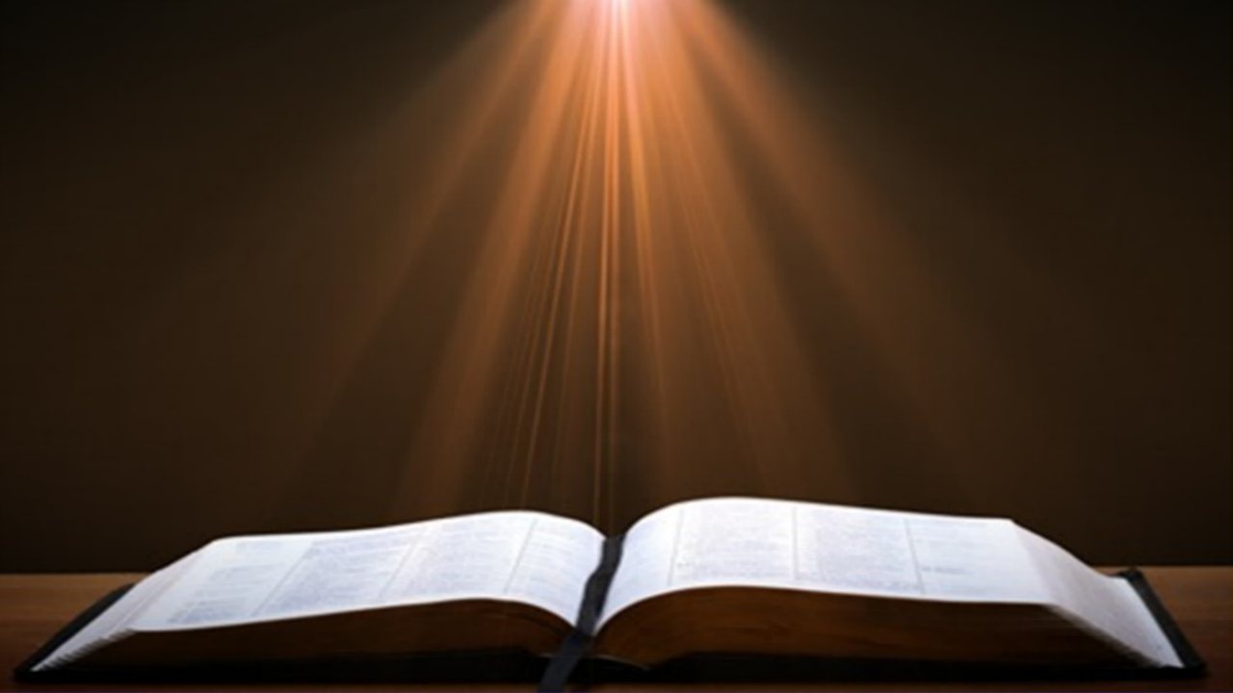
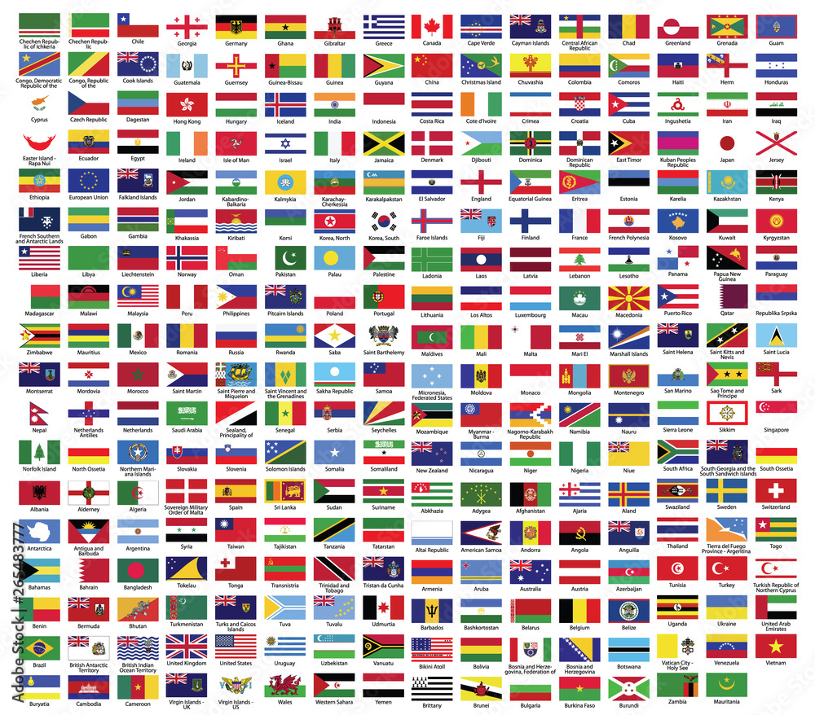
Acts 17:26
“and He made from one man every nation of mankind to live on all the face of the earth, having determined their appointed times and the boundaries of their habitation.”

Slide 146

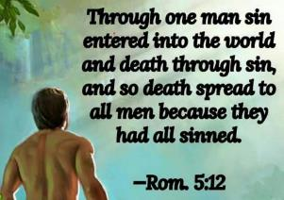
Romans 5:12
“Therefore, just as through one man sin entered into the world, and death through sin, and so death spread to all men, because all sinned—.”

Slide 147
Acts 17:26
“and He made from one man every nation of mankind to live on all the face of the earth, having determined their appointed times and the boundaries of their habitation.”

Slide 148
Genesis 11:1-9
¹ Now the whole earth used the same language and the same words. ² It came about as they journeyed east, that they found a plain in the land of Shinar and settled there. ³ They said to one another, “Come, let us make bricks and burn them thoroughly.” And they used brick for stone, and they used tar for mortar. ⁴ They said, “Come, let us build for ourselves a city, and a tower whose top will . . .

Slide 149
Genesis 11:1-9 (cont’d)
…reach into heaven, and let us make for ourselves a name, otherwise we will be scattered abroad over the face of the whole earth.” ⁵ The Lord came down to see the city and the tower which the sons of men had built. ⁶ The Lord said, “Behold, they are one people, and they all have the same language. And this is what they began to do, and now nothing which they purpose to do will be …

Slide 150
Genesis 11:1-9 (cont’d)
…impossible for them. ⁷ “Come, let Us go down and there confuse their language, so that they will not understand one another’s speech.” ⁸ So the Lord scattered them abroad from there over the face of the whole earth; and they stopped building the city. ⁹ Therefore its name was called Babel, because there the Lord confused the language of the whole earth; and from there the Lord scattered them abroad over the face of the whole earth.

Slide 151
Genesis 10:32
“These are the families of the sons of Noah, according to their genealogies, by their nations; and out of these the nations were separated on the earth after the flood.”

Slide 152
Deuteronomy 32:8
“When the Most High gave the nations their inheritance, When He separated the sons of man, He set the boundaries of the peoples According to the number of the sons of Israel.”

Slide 153

Megan Basham
Shepherds for Sale, 50.
“Scripture does not require us to sacrifice national sovereignty. In fact, Acts 17:26 tells us that God ‘marked out [our] appointed times in history and the boundaries of [our] lands.’ The Lord is not opposed to borders; He invented them. Nor does this command require us to abandon good sense and prudence when setting limits for how many immigrants we admit and what qualifications we use for doing so.”
Megan Basham, Shepherds for Sale: How Evangelical Leaders Traded the Truth for a Leftist Agenda (NY: Broadside Books, 2024), 50.

Slide 154
Acts 17:24-28 Characteristics
Creator (24)
Sufficient (25)
Humanity’s creator (26)
Purpose: that men might seek Him (27)
Man’s preserver (28)

Slide 155

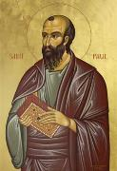
Romans 3:11
“There is none who understands, There is none who seeks for God.”

Slide 156

John MacArthur
John F. MacArthur Jr., Faith Works: The Gospel According to the Apostles (Dallas: Word, 1993), 64-65
“Because we were dead to God, we were dead to truth, righteousness, peace, happiness, and every other good thing, no more capable to respond to God than a cadaver” and are “spiritual zombies, death-walkers, unable even to understand the gravity of their situation. They are lifeless.”

Slide 157
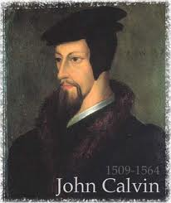
GOD’S GRACE TO THE UNSAVED
Holy Spirit’s conviction
God’s Word
Gospel
Creation
Conscience
Conclusion

Slide 158

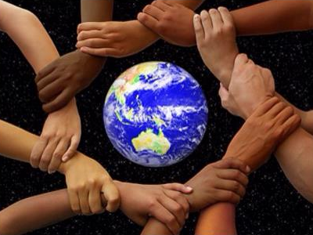
Acts 17:26-27
²⁶ and He made from one man every nation of mankind to live on all the face of the earth, having determined their appointed times and the boundaries of their habitation, ²⁷ that they would seek God, if perhaps they might grope for Him and find Him, though He is not far from each one of us (Italics added)

Slide 159
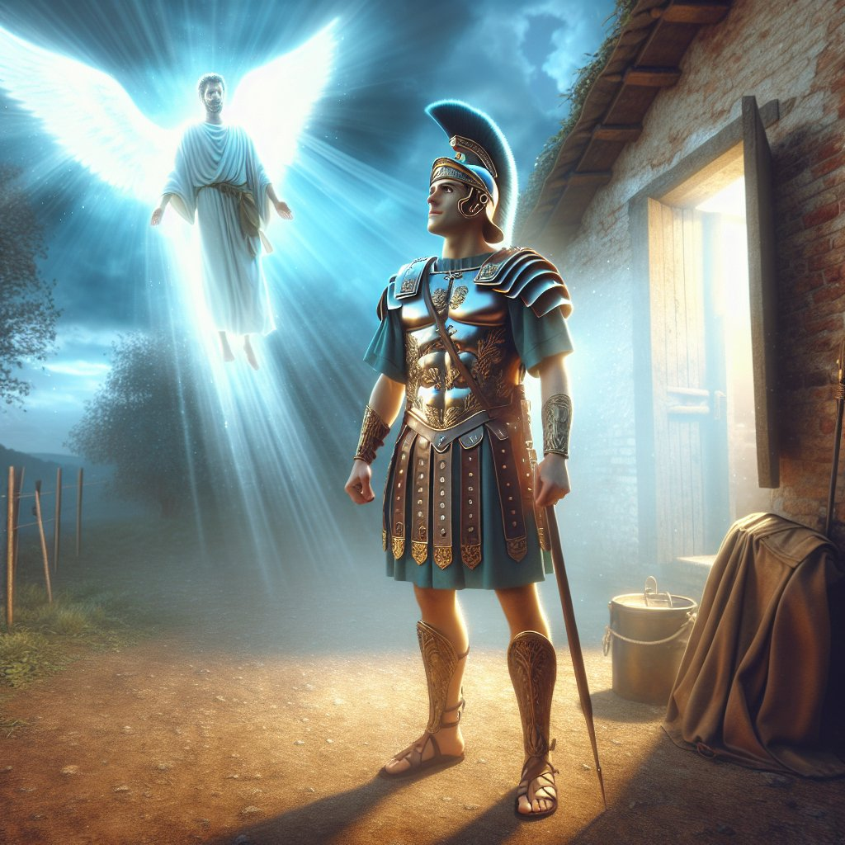
Acts 10:2
“Now there was a man at Caesarea named Cornelius, a centurion of what was called the Italian cohort, ² a devout man and one who feared God with all his household, and gave many alms to the Jewish people and prayed to God continually.”

Slide 160
Acts 11:14
“and he will speak words to you by which you [Cornelius] will be saved, you and all your household.”

Slide 161
Acts 17:24-28 Characteristics
Creator (24)
Sufficient (25)
Humanity’s creator (26)
Purpose: that men might seek Him (27)
Man’s preserver (28)

Slide 162
Dr. Arnold G. Fruchtenbaum
The Book of Acts, 372-73
“The fifth characteristic is that God is the Preserver of man (v. 28). Paul pointed to the fact that in him we live, and move, and have our being. This was the proof of God’s nearness. Instead of Stoic pantheism, there is real immanence with God. Paul provided an ascending scale, reaching a climax in God:
We live; therefore, we have life.
We move; therefore, there is movement.
We have our being; therefore, there is existence.”

Slide 163
Dr. Arnold G. Fruchtenbaum
The Book of Acts, 372-73
“Then Paul reminded his listeners that some of their own poets have said the same things, among them Aratus of Soli (315-240 B.C.) and the already mentioned Cretan poet Epimenides, who had this to say to the god Zeus:
They fashioned a tomb for thee, O holy and high one—
The Cretans, always liars, evil beasts, idle bellies!
But thou art not dead: though livest and abidest for ever,
For in thee we live and move and have our being.”

Slide 164
Dr. Arnold G. Fruchtenbaum
The Book of Acts, 372-73
“Paul quoted the same poet in Titus 1:12. Another poet would have been Cleanthes, the son of Phanius of Assos and head of the Stoic School in Athens from 263 to 232 B.C. The Zondervan Illustrated Bible Dictionary notes: ‘His Hymn to Zeus, a surviving poem, contains the words quoted by Paul in his address before the Areopagus Court (Acts 17:28).’ Regarding Zeus, Cleanthes wrote: ‘For we are your offspring.’”

Slide 165
Acts 17:22-31 Paul’s Speech
Location (22a)
Introduction (22b-23a)
Unknown God described (23b-28)
Man’s responsibility (29-31)

Slide 166
Acts 17:29-31 Man’s Responsibility
Reject idolatry (29)
Repent (30)
Reason: coming judgment (31)

Slide 167
Acts 17:29-31 Man’s Responsibility
Reject idolatry (29)
Repent (30)
Reason: coming judgment (31)

Slide 168
Acts 17:29-31 Man’s Responsibility
Reject idolatry (29)
Repent (30)
Reason: coming judgment (31)

Slide 169

Acts 17:30-31
“³⁰ Therefore having overlooked the times of ignorance, God is now declaring to men that all people everywhere should repent [metanoeō], ³¹ because He has fixed a day in which He will judge the world in righteousness through a Man whom He has appointed, having furnished proof to all men by raising Him from the dead.”

Slide 170
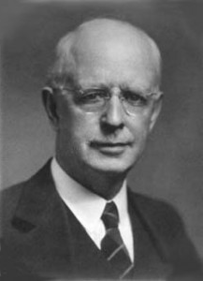
Lewis Sperry Chafer
vol. 7, Systematic Theology (Grand Rapids, MI: Kregel Publications, 1993), 265-66.
“This vital newness of mind is a part of believing, after all, and therefore it may be and is used as a synonym for believing at times (cf. Acts 17:30; 20:21; 26:20; Rom. 2:4; 2Tim. 2:25; 2 Pet. 3:9). Repentance nevertheless cannot be added to believing as a condition of salvation, because upwards of 150 passages of Scripture condition salvation upon believing only (cf. John 3:16; Acts 16:31).”

Slide 171
Acts 17:29-31 Man’s Responsibility
Reject idolatry (29)
Repent (30)
Reason: coming judgment (31)

Slide 172
Acts 17:30-31
“³⁰ Therefore having overlooked the times of ignorance, God is now declaring to men that all people everywhere should repent [metanoeō], ³¹ because He has fixed a day in which He will judge the world in righteousness through a Man whom He has appointed, having furnished proof to all men by raising Him from the dead.”

Slide 173
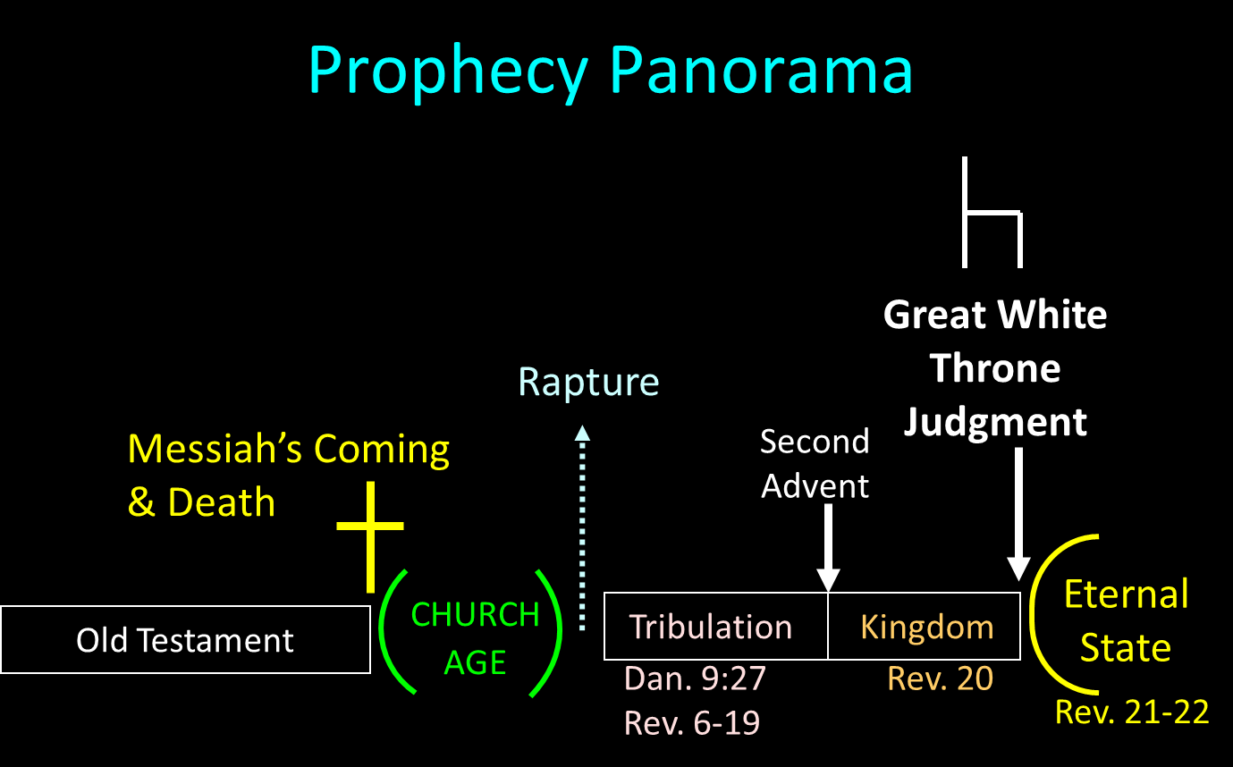

Slide 174
SCRIPTURE’S FOUR JUDGMENTS
NAME | SHEEP AND GOAT | JUDGMENT OF THE JEWS | BEMA SEAT | GREAT WHITE THRONE
SCRIPTURE | Matt 25:31-46 | Ezek 20:33-44 | 1 Cor 3:10-15 | Rev 20:11-15
PLACE | Earth, Jerusalem | Earth, wilderness | Heaven | Earth
AUDIENCE | Gentile Tribulation survivors | Jewish Tribulation survivors | Church Age believers | All unsaved
WHEN | After Tribulation | After Tribulation | After rapture | After Millennium
PURPOSE | Saved Gentiles enter kingdom | Saved Jews enter kingdom | Reward believers | Degree of punishment in hell
EVALUATION | Treatment of Christ’s brethren | Passing under shepherd’s rod | Works taken through fire | Not in the book; judged by books

Slide 175
VII. Athens Ministry Acts 17:16-34
Paul’s witness (16-21)
Paul’s speech (22-31)
Athenians’ response (32-34)

Slide 176
Acts 17:32-34 Athenians’ Response
Two negative responses (32)
Paul’s departure (33)
Positive response (34)

Slide 177
Acts 17:32-34 Athenians’ Response
Two negative responses (32)
Paul’s departure (33)
Positive response (34)

Slide 178
Acts 17:32 Two Negative Responses
Mocking (32a)
Postponement (32b)

Slide 179
Acts 17:32 Two Negative Responses
Mocking (32a)
Postponement (32b)

Slide 181
Second Missionary Journey

Slide 182
Acts 17:32 Two Negative Responses
Mocking (32a)
Postponement (32b)

Slide 183
Acts 17:32-34 Athenians’ Response
Two negative responses (32)
Paul’s departure (33)
Positive response (34)

Slide 184
Acts 17:32-34 Athenians’ Response
Two negative responses (32)
Paul’s departure (33)
Positive response (34)

Slide 185
Dr. Arnold G. Fruchtenbaum
The Book of Acts, 374-75
“While no church was planted at this time, some did believe: Dionysius the Areopagite, and a woman named Damaris, and others with them. The fact that Dionysius was described as an Areopagite shows that he was a member of the Council of Areopagus. He was convinced and became a believer. According to the fourth-century historian Eusebius, Dionysius became the bishop of the church of Athens and died as a martyr. Also mentioned is Damaris. She was probably an aristocrat, as was Dionysius. There were others, though unnamed, who also believed.”

Slide 186
Themes
From Peter to Paul (Gal 2:7-8)
Universality of the Gospel
Transitions
Sovereignty of God (Acts 2:23; 13:48)
Soteriology (Acts 16:31)

Slide 187
Acts 16:11-15 Lydia’s Conversion
Journey to Neapolis (11)
Arrival at Philippi (12)
Jewish Sabbath meeting (13)
Lydia’s conversion (14)
Results of conversion (15)

Slide 188
Conclusion

Slide 189
Acts 15:36‒18:22 2nd Missionary Journey
Schism between Paul & Barnabas (15:36-41)
Syria & Cilicia ministry (16:1-5)
Macedonian call (16:6-10)
Philippian ministry (16:11-40)
Thessalonica ministry (17:1-9)
Berean ministry (17:10-15)
Athens’ ministry (17:16-34)
Corinthian ministry (18:1-18)
Ephesus’ ministry (18:19-21)
Return to Antioch (18:22)

