Slide 1



Slide 2

EXODUS STRUCTURE/OUTLINE
Redemption (1–18)
Redemption (1:1–12:30)
Liberation (12:31–15:21)
Preservation (15:22–18:27)
Mosaic Covenant (19–40)
Law (19–24)
Tabernacle instructions (25–31)
Apostasy (32–34)
Tabernacle building (35–40)

Slide 3
REDEMPTION (1:1–12:30)
Why redemption is necessary (Exod 1)
Development of the deliverer (Exod 2–4)
First confrontation with Pharaoh (Exod 5)
God reassures Moses (Exod 6:1–7:7)
Second confrontation with Pharaoh (Exod 7:8-13)
Plagues (Exod 7:14–12:30)

Slide 4
The Plagues of Egypt
NO. | DESCRIPTION | SCRIPTURE | Egyptian Deity
1. | Water to Blood | Exod. 7:14-25 | Hapi, Khnum
2. | Frogs | Exod. 8:1-15 | Heqt
3. | Gnats | Exod. 8:16-19 | Set
4. | Flies | Exod. 8:20-32 | Uatchit
5. | Disease on Cattle | Exod. 9:1-7 | Hathor, Apis
6. | Boils | Exod. 9:8-12 | Sekhmet, Serapis
7. | Hail | Exod. 9:13-35 | Seth, Nut
8. | Locusts | Exod. 10:1-20 | Seth, Nut, Osiris
9. | Darkness | Exod. 10:21-29 | Re, Horus, Atum
10. | Death of the First Born | Exod. 12:29-36 | Min, Osiris, Heqt, Isis

Slide 5
TEN PLAGUES REDEMPTION (7:14–12:30)
Nile to blood
Frogs
Gnats
Flies
Death of livestock
Boils
Hail
Locusts
Darkness
Death of 1st born

Slide 6
LOCUSTS Exodus 10:1-20
God’s Instructions (1-2)
Moses & Aaron Speak to Pharaoh (3-6)
Moses & Aaron Speak to Pharaoh Again (7-11)
Plague’s Manifestation (12-15)
Pharaoh Speaks to Moses & Aaron (16-17)
God Answers (18-20)

Slide 7
LOCUSTS Exodus 10:1-20
God’s Instructions (1-2)
Moses & Aaron Speak to Pharaoh (3-6)
Moses & Aaron Speak to Pharaoh Again (7-11)
Plague’s Manifestation (12-15)
Pharaoh Speaks to Moses & Aaron (16-17)
God Answers (18-20)

Slide 8
I. Exodus 10:1-2 God’s Instructions
God hardens Pharaoh (1)
God’s purpose (2)

Slide 9
I. Exodus 10:1-2 God’s Instructions
God hardens Pharaoh (1)
God’s purpose (2)

Slide 10
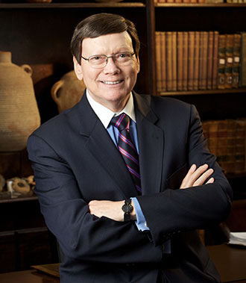
Dr. Ed Hindson
Hindson, E. E., & Mitchell, D. R., eds. (2010). KJV Bible Commentary for Today: The Most Up-to-Date Commentary on the Time-Honored Text of the KJV (p. 86). Thomas Nelson.
“4:21. I will harden his heart. An expression meaning ‘to strengthen his will.’ The text identifies the heart as the location of the volition, man’s decision-making ability. On seven occasions in the narrative, God hardens Pharaoh’s heart (9:12; 10:1, 20, 27; 11:10; 14:4, 8) or foretells that He will harden Pharaoh’s heart (4:21; 7:3), and nine times in the text, Pharaoh hardens his own heart (7:13, 14, 22; 8:15, 19, 32; 9:7, 34–35). For the initial five plagues, the text registers Pharaoh as the agent of hardening. Not until the sixth plague does God participate in the confirmation of Pharaoh’s own volitional choices.”

Slide 11

Charles Ryrie Ryrie Study Bible, page 96
Exodus 4:21 - “harden his heart. Ten times it is said that Pharaoh hardened his own heart (7:13, 14, 22; 8:15, 19, 32; 9:7, 34, 35; 13:15), and 10 times that God hardened Pharaoh’s heart (4:21; 7:3; 9:12; 10:1, 20, 27; 11:10; 14:4, 8, 17). Paul uses this as an example of the inscrutable will of God and of His mercy toward men (Rom. 9:14–18). Seven times Pharaoh hardened his own heart before God first hardened it, though the prediction that God would do it preceded all.”

Slide 12
GOD HARDENING PHARAOH'S HEART
The prediction of God hardening of Pharaoh (4:21)
Pharaoh repeatedly hardening his own heart (7:13, 22; 8:15, 19, 32; 9:7)
Not until the sixth plague did God harden Pharaoh’s heart (Exod 9:12)

Slide 13
Dispensational Theology is a System of Theology
Traditional-normative dispensational theology is a system that embodies three essential, fundamental concepts called the sine qua non (lit. “without which is not”):
The consistent use of a plain, normal, literal, grammatical-historical method of interpretation;
Which reveals that the Church is distinct from Israel;
God’s overall purpose is to bring glory to Himself (Eph. 1:6, 12, 14).
Dr. Charles Ryrie, Dispensationalism, pp. 38-41

Slide 14
Doxological Purpose
God’s ultimate purpose for the ages is to glorify Himself. Scripture is not human-centered, as though salvation were the principle point, but God-centered, because His glory is at the center.
The glory of God is the primary principle that unifies all dispensations, the program of salvation being just one of the means by which God glorifies Himself. Each successive revelation of God’s plan for the ages, as well as His dealing with the elect, non-elect, angels, and nations all manifest His glory.
Dictionary of Premillennial Theology, Charles Ryrie, p. 94

Slide 15
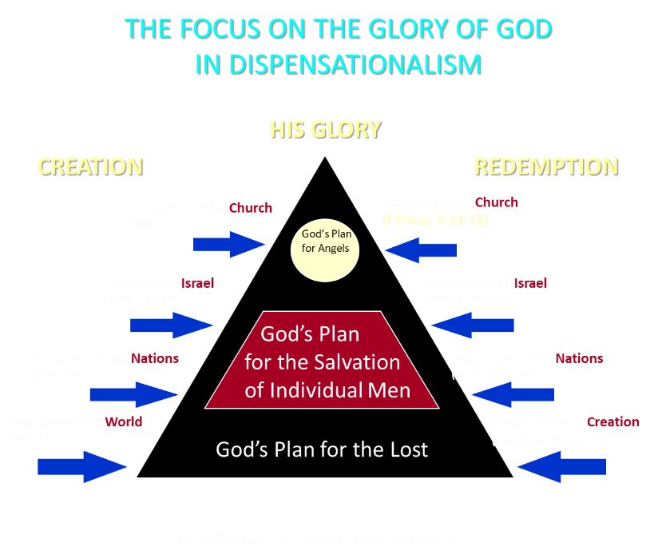

Slide 16
I. Exodus 10:1-2 God’s Instructions
God hardens Pharaoh (1)
God’s purpose (2)

Slide 17

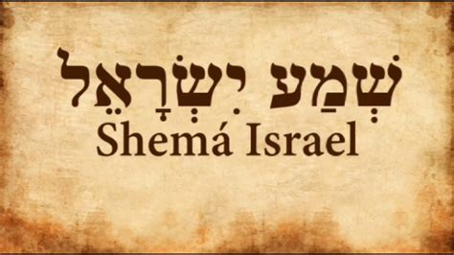
Deuteronomy 6:4-7
“⁴ Hear, Israel! The Lord is our God, the Lord is one!... ⁶ These words, which I am commanding you today, shall be on your heart. ⁷ You shall teach them diligently to your sons and shall talk of them when you sit in your house and when you walk by the way and when you lie down and when you rise up.”

Slide 18
LOCUSTS Exodus 10:1-20
God’s Instructions (1-2)
Moses & Aaron Speak to Pharaoh (3-6)
Moses & Aaron Speak to Pharaoh Again (7-11)
Plague’s Manifestation (12-15)
Pharaoh Speaks to Moses & Aaron (16-17)
God Answers (18-20)

Slide 19
II. Exodus 10:3-6 Moses & Aaron Speak to Pharaoh
Entrance (3a)
Question (3b)
Consequence (4)
Severity (5-6a)
Exit (6b)

Slide 20
II. Exodus 10:3-6 Moses & Aaron Speak to Pharaoh
Entrance (3a)
Question (3b)
Consequence (4)
Severity (5-6a)
Exit (6b)

Slide 21
II. Exodus 10:3-6 Moses & Aaron Speak to Pharaoh
Entrance (3a)
Question (3b)
Consequence (4)
Severity (5-6a)
Exit (6b)

Slide 22
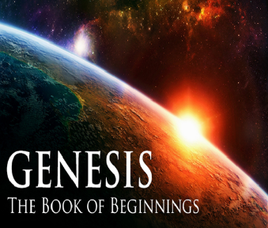
Names for God in Genesis
Elohim (1:1) - Power
Yahweh (2:4) - Relational
El Roi (Gen. 16:13) – Aware
El Olam (21:33) – Eternal
Jehovah Jireh (22:14) - Provision
God Isaac Feared (31:42, 53) - Reverenced
God, the God of Israel (33:20) - National

Slide 23

Ephesians 2:8-10
“⁸ For by grace you have been saved through faith; and that not of yourselves, it is the gift of God; ⁹ not as a result of works, so that no one may boast. ¹⁰ For we are His workmanship, created in Christ Jesus for good works, which God prepared beforehand so that we would walk [peripateō, subjunctive mood] in them.”

Slide 24
II. Exodus 10:3-6 Moses & Aaron Speak to Pharaoh
Entrance (3a)
Question (3b)
Consequence (4)
Severity (5-6a)
Exit (6b)

Slide 25
The Plagues of Egypt
NO. | DESCRIPTION | SCRIPTURE | Egyptian Deity
1. | Water to Blood | Exod. 7:14-25 | Hapi, Khnum
2. | Frogs | Exod. 8:1-15 | Heqt
3. | Gnats | Exod. 8:16-19 | Set
4. | Flies | Exod. 8:20-32 | Uatchit
5. | Disease on Cattle | Exod. 9:1-7 | Hathor, Apis
6. | Boils | Exod. 9:8-12 | Sekhmet, Serapis
7. | Hail | Exod. 9:13-35 | Seth, Nut
8. | Locusts | Exod. 10:1-20 | Seth, Nut, Osiris
9. | Darkness | Exod. 10:21-29 | Re, Horus, Atum
10. | Death of the First Born | Exod. 12:29-36 | Min, Osiris, Heqt, Isis

Slide 26
Dr. Ed Hindson
Hindson, E. E., & Mitchell, D. R., eds. (2010). KJV Bible Commentary for Today: The Most Up-to-Date Commentary on the Time-Honored Text of the KJV (p. 96). Thomas Nelson.
“The Egyptian deities challenged by this plague would have been Serapia, whose specialty was protecting the Egyptians from locust infestations; as well as the same gods challenged by the previous plague, Shu and Nut, the respective sky god and goddess; Set and Isis, the respective god and goddess charged with providing weather conditions conducive to agriculture; and Osirus, the god charged with crop production.”

Slide 27
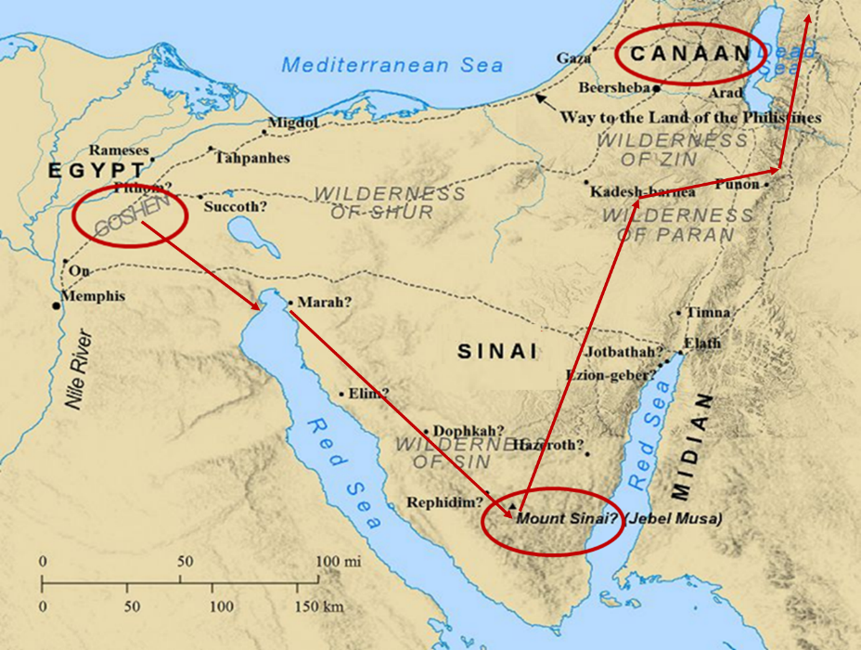

Slide 28
II. Exodus 10:3-6 Moses & Aaron Speak to Pharaoh
Entrance (3a)
Question (3b)
Consequence (4)
Severity (5-6a)
Exit (6b)

Slide 29
Charles Ryrie Ryrie Study Bible, page 106
Exodus 10:14–15 locusts. “One of the most destructive of creatures. A swarm may have an average density of 130,000,000 locusts per square mile. They can denude hundreds of square miles quickly, bringing horror, despair, and terrible economic consequences to the inhabitants.”

Slide 30
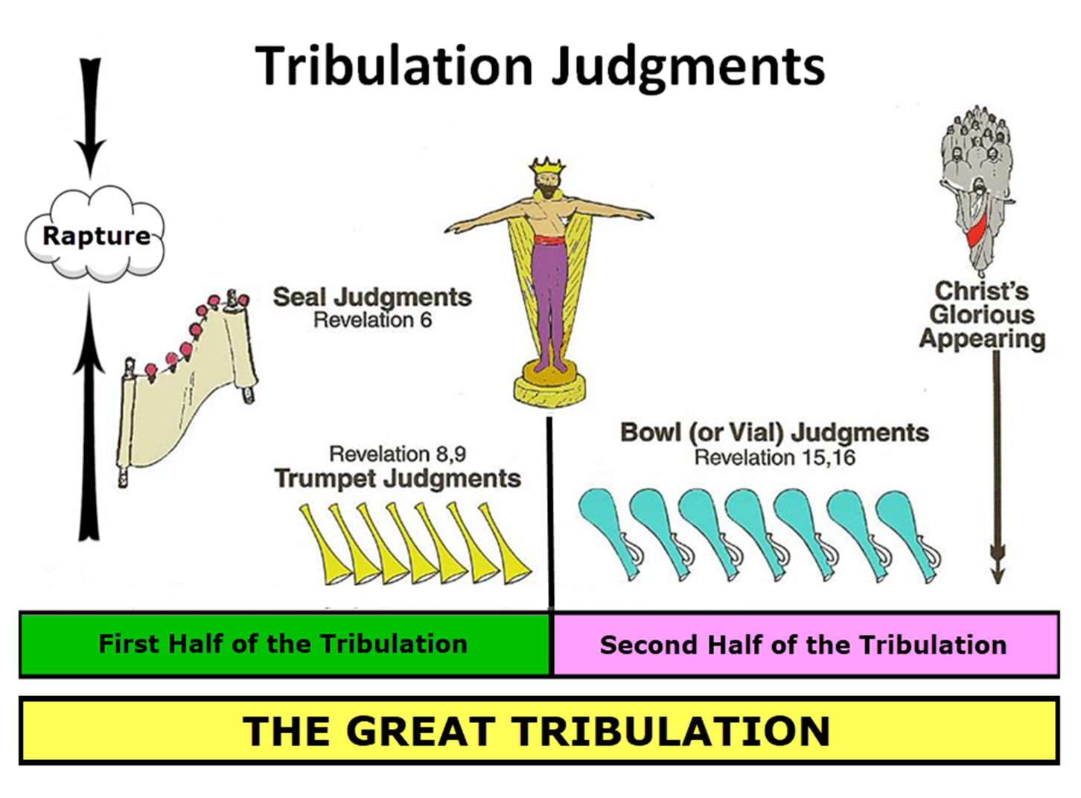

Slide 31

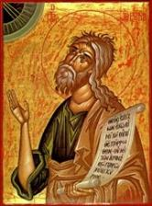
Jeremiah 30:7
“Alas! for that day is great, There is none like it; And it is the time of Jacob’s distress (Gen. 32:8; 35:10), But he will be saved from it.”

Slide 32

Matthew 24:21-22
“²¹ For then there will be a great tribulation, such as has not occurred since the beginning of the world until now, nor ever will. ²² Unless those days had been cut short, no life would have been saved; but for the sake of the elect those days will be cut short.”

Slide 33
II. Exodus 10:3-6 Moses & Aaron Speak to Pharaoh
Entrance (3a)
Question (3b)
Consequence (4)
Severity (5-6a)
Exit (6b)

Slide 34
LOCUSTS Exodus 10:1-20
God’s Instructions (1-2)
Moses & Aaron Speak to Pharaoh (3-6)
Moses & Aaron Speak to Pharaoh Again (7-11)
Plague’s Manifestation (12-15)
Pharaoh Speaks to Moses & Aaron (16-17)
God Answers (18-20)

Slide 35
III. Exodus 10:7-11 Moses & Aaron Speak to Pharaoh Again
Pharaoh’s servants’ question (7)
Entrance (8a)
Pharaoh’s command (8b)
Pharaoh’s question (8c)
Moses’ answer (9)
Pharaoh’s command (10-11a)
Exit (11b)

Slide 36
III. Exodus 10:7-11 Moses & Aaron Speak to Pharaoh Again
Pharaoh’s servants’ question (7)
Entrance (8a)
Pharaoh’s command (8b)
Pharaoh’s question (8c)
Moses’ answer (9)
Pharaoh’s command (10-11a)
Exit (11b)

Slide 37
THREE PHASES OF MOSES’ 120 YEAR LIFE
LIFE PHASE | SCRIPTURE | YEARS | AGE | ACTIVITY
Natural Training | Acts 7:23 | 1526–1486 B.C. | 1-40 | Egyptian Education
Spiritual Training | Exod. 7:7 | 1486–1446 B.C. | 40-80 | Midian Shepherding
Ministry | Deut. 31:2; 34:7; Acts 7:36 | 1446–1406 B.C. | 80-120 | Exodus, Law, Wilderness Preservation, Pentateuch Authorship

Slide 38
Ephesians 2:8-10
“⁸ For by grace you have been saved through faith; and that not of yourselves, it is the gift of God; ⁹ not as a result of works, so that no one may boast. ¹⁰ For we are His workmanship, created in Christ Jesus for good works, which God prepared beforehand so that we would walk [peripateō, subjunctive mood] in them.”

Slide 39
The Plagues of Egypt
NO. | DESCRIPTION | SCRIPTURE | Egyptian Deity
1. | Water to Blood | Exod. 7:14-25 | Hapi, Khnum
2. | Frogs | Exod. 8:1-15 | Heqt
3. | Gnats | Exod. 8:16-19 | Set
4. | Flies | Exod. 8:20-32 | Uatchit
5. | Disease on Cattle | Exod. 9:1-7 | Hathor, Apis
6. | Boils | Exod. 9:8-12 | Sekhmet, Serapis
7. | Hail | Exod. 9:13-35 | Seth, Nut
8. | Locusts | Exod. 10:1-20 | Seth, Nut, Osiris
9. | Darkness | Exod. 10:21-29 | Re, Horus, Atum
10. | Death of the First Born | Exod. 12:29-36 | Min, Osiris, Heqt, Isis

Slide 40
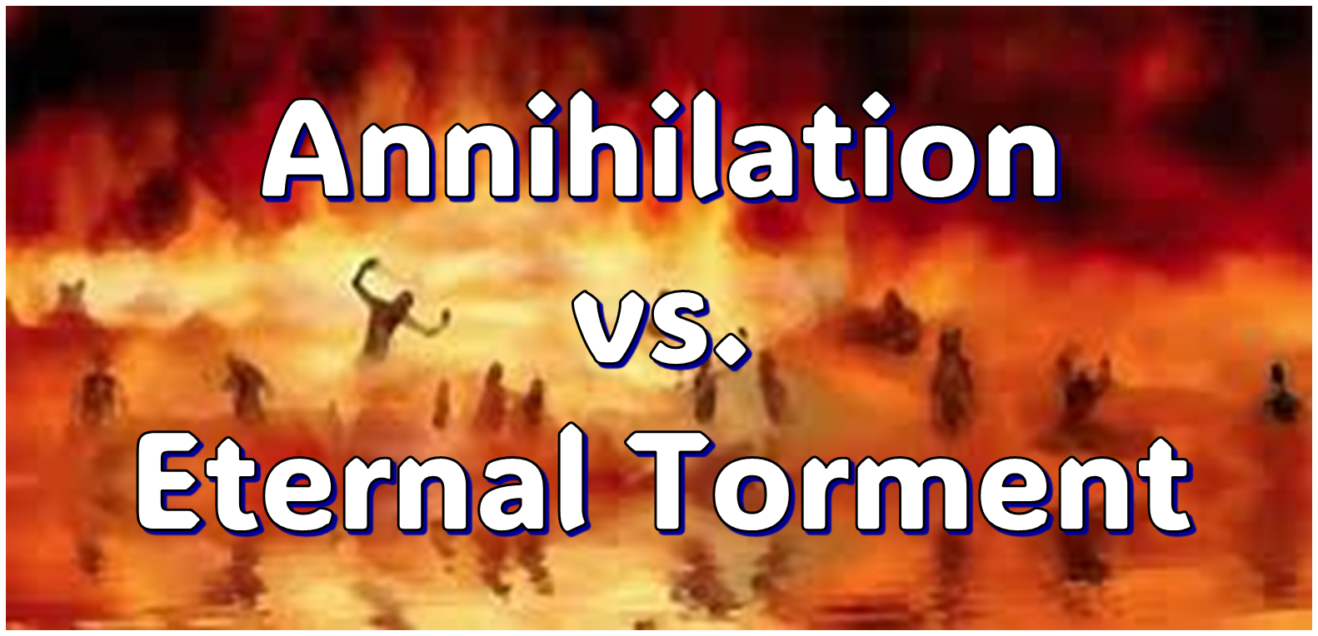
IV. Answering Annihilationist Biblical Arguments
2nd death (Rev. 20:14)
Destroy (Rev. 11:18)
Destruction (2 Thess. 1:9)
Burning up (Matt. 3:12)
Eternal results (Rev. 14:11)

Slide 41

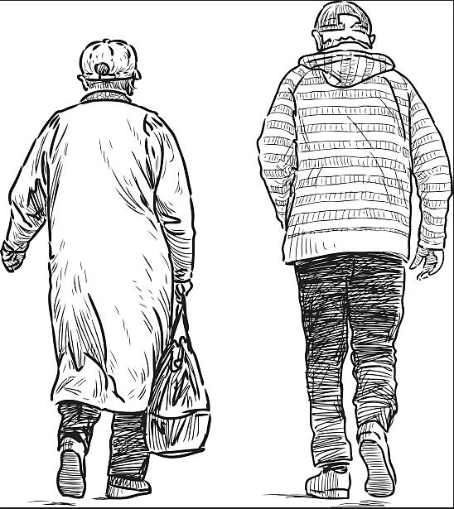
2 Corintians 4:16
“Therefore we do not lose heart, but though our outer man is decaying, yet our inner man is being renewed day by day.”

Slide 42
III. Exodus 10:7-11 Moses & Aaron Speak to Pharaoh Again
Pharaoh’s servants’ question (7)
Entrance (8a)
Pharaoh’s command (8b)
Pharaoh’s question (8c)
Moses’ answer (9)
Pharaoh’s command (10-11a)
Exit (11b)

Slide 43
III. Exodus 10:7-11 Moses & Aaron Speak to Pharaoh Again
Pharaoh’s servants’ question (7)
Entrance (8a)
Pharaoh’s command (8b)
Pharaoh’s question (8c)
Moses’ answer (9)
Pharaoh’s command (10-11a)
Exit (11b)

Slide 44
Ephesians 2:8-10
“⁸ For by grace you have been saved through faith; and that not of yourselves, it is the gift of God; ⁹ not as a result of works, so that no one may boast. ¹⁰ For we are His workmanship, created in Christ Jesus for good works, which God prepared beforehand so that we would walk [peripateō, subjunctive mood] in them.”

Slide 45
III. Exodus 10:7-11 Moses & Aaron Speak to Pharaoh Again
Pharaoh’s servants’ question (7)
Entrance (8a)
Pharaoh’s command (8b)
Pharaoh’s question (8c)
Moses’ answer (9)
Pharaoh’s command (10-11a)
Exit (11b)

Slide 46
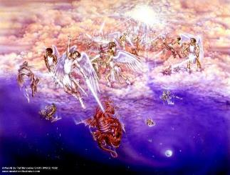
Satan as Ruler of this World
Job 1:7; 2:2
Luke 4:5-7
John 12:31; 14:30; 16:11
2 Corinthians 4:4
Ephesians 2:2
1 John 4:4; 5:19

Slide 47
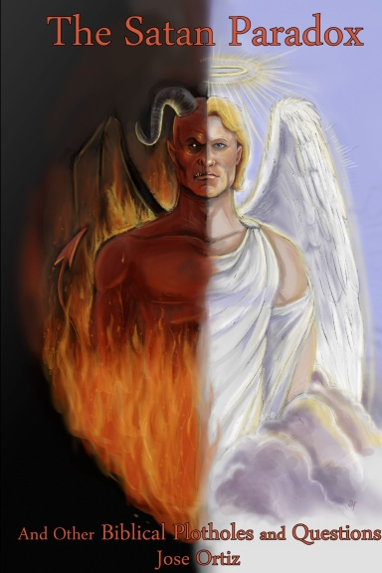
Names & Titles Demonstrating Satan’s Post-Fall, Earthly Authority (Job 1:7; 2:2; Luke 4:5-8; Rom. 8:19-22)
Prince of this world (John 12:31; 14:30; 16:11)
God of this world (2 Cor. 4:4)
Prince and power of the air (Eph. 2:2)
Who the believer wrestles with (Eph. 6:12)
Roaring lion (1 Pet. 5:8)
Whole world lies in his power (1 John 5:19)

Slide 48

Romans 8:19-23
¹⁹ “For the anxious longing of the creation waits eagerly for the revealing of the sons of God. ²⁰ For the creation was subjected to futility, not willingly, but because of Him who subjected it, in hope ²¹ that the creation itself also will be set free from its slavery to corruption into the freedom of the glory of the children of God. ²² For we know that the whole creation groans and suffers the pains of childbirth together until now. ²³ And not only this, but also we ourselves, having the first fruits of the Spirit, even we ourselves groan within ourselves, waiting eagerly for our adoption as sons, the redemption of our body.”

Slide 49


Slide 50

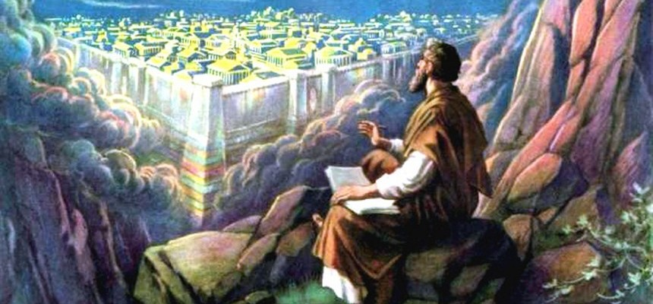
Revelation 11:15
¹⁵ “Then the seventh angel sounded; and there were loud voices in heaven, saying, ‘The kingdom of the world has become the kingdom of our Lord and of His Christ; and He will reign forever and ever.’”

Slide 51
Ultimate Exodus (Rev 11:15)
Sores: 6th plague (Ex 9:8-12), 1st bowl (Rev 16:1-2)
Rivers to blood: 1st plague (Ex 7:19-21), 3rd bowl (Rev 16:4-7)
Darkness: 9th plague (Ex 10:21-23), 5th bowl (Rev 16:10-11)
Frogs: 2nd plague (Ex 7:25‒8:15), 6th bowl (Rev 16:13)
Hail: 7th plague (Ex 9:22-26), 7th bowl (Rev 16:17-21)

Slide 52
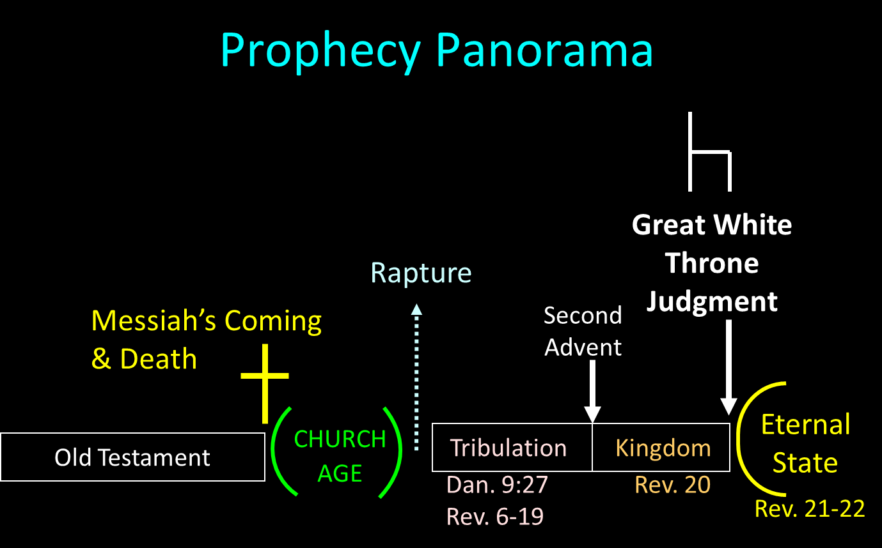

Slide 53
III. Exodus 10:7-11 Moses & Aaron Speak to Pharaoh Again
Pharaoh’s servants’ question (7)
Entrance (8a)
Pharaoh’s command (8b)
Pharaoh’s question (8c)
Moses’ answer (9)
Pharaoh’s command (10-11a)
Exit (11b)

Slide 55
7 Levitical Feasts (Leviticus 23)
Feast | Season | Purpose | Type
Passover | Spring | Redemption | 1 Cor 5:7
Unleavened Bread | Spring | Separation | John 6:35
1st fruits | Spring | Praise for initial crop | 1 Cor. 15:20
Pentecost | Spring | Praise for full crop | Acts 2:1-4
Trumpets | Fall | New Year | Matt. 24:31
Atonement | Fall | Lev. 16 | Zech. 12:10
Booths | Fall | Wilderness provision | Zech. 14:16-18

Slide 56
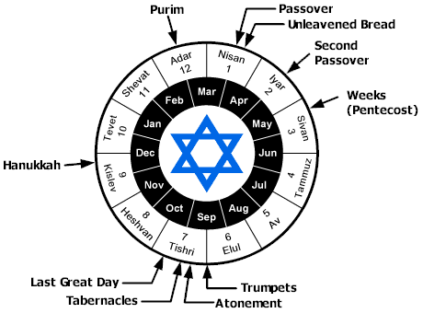

Slide 57
Levitical Feasts (Lev. 23)
FEAST | SEASON | PURPOSE | TYPE
1. Passover | Spring | Redemption | 1 Cor. 5:7
2. Unleavened Bread | Spring | Separation | John 6:35
3. 1st fruits | Spring | Praise | 1 Cor. 15:20
4. Pentecost | Spring | Praise | Acts 2:1-4
INTER-ADVENT AGE (CHURCH AGE)
5. Trumpets | Fall | New Year | Matt. 24:31
6. Atonement (Eze. 39) | Fall | Lev 16 | Zech. 12:10
7. Booths | Fall | Wilderness provision | Zech. 14:16-18

Slide 58
III. Exodus 10:7-11 Moses & Aaron Speak to Pharaoh Again
Pharaoh’s servants’ question (7)
Entrance (8a)
Pharaoh’s command (8b)
Pharaoh’s question (8c)
Moses’ answer (9)
Pharaoh’s command (10-11a)
Exit (11b)

Slide 59
Charles Ryrie Ryrie Study Bible, page 105
Exodus 10:7–10 “In response to the pleas of his servants, Pharaoh offered Moses another compromise. He would let the men go, but not their families or children, charging Moses with wanting to do evil by depriving him of such a large number of workers.”

Slide 60
Dr. Ed Hindson
Hindson, E. E., & Mitchell, D. R., eds. (2010). KJV Bible Commentary for Today: The Most Up-to-Date Commentary on the Time-Honored Text of the KJV (p. 96-97). Thomas Nelson.
“10:10. Evil is before you. “Many interpreters have stumbled over the explanation of this phrase. Pharaoh seems to be uncharacteristically warning Moses to beware of approaching evil. The difficulty of ascertaining Pharaoh’s intent disappears, however, when one takes into account that the Hebrew word ra, usually translated as ‘evil,’ is also the name of the Egyptian sun god, Ra. Each pharaoh was considered to be Ra’s divine son. The intent of Pharaoh may be conveyed as ‘My god Ra is before you; your god YHWH may be strong, but do not forget that Ra is just as strong.’”

Slide 61
III. Exodus 10:7-11 Moses & Aaron Speak to Pharaoh Again
Pharaoh’s servants’ question (7)
Entrance (8a)
Pharaoh’s command (8b)
Pharaoh’s question (8c)
Moses’ answer (9)
Pharaoh’s command (10-11a)
Exit (11b)

Slide 62
LOCUSTS Exodus 10:1-20
God’s Instructions (1-2)
Moses & Aaron Speak to Pharaoh (3-6)
Moses & Aaron Speak to Pharaoh Again (7-11)
Plague’s Manifestation (12-15)
Pharaoh Speaks to Moses & Aaron (16-17)
God Answers (18-20)

Slide 63
IV. Exodus 10:12-15 Plague’s Manifestation
God’s command (12)
Moses’ obedience (13a)
Locusts’ manifestation (13b-14a)
Locusts’ severity (14b-15)

Slide 64
IV. Exodus 10:12-15 Plague’s Manifestation
God’s command (12)
Moses’ obedience (13a)
Locusts’ manifestation (13b-14a)
Locusts’ severity (14b-15)

Slide 65
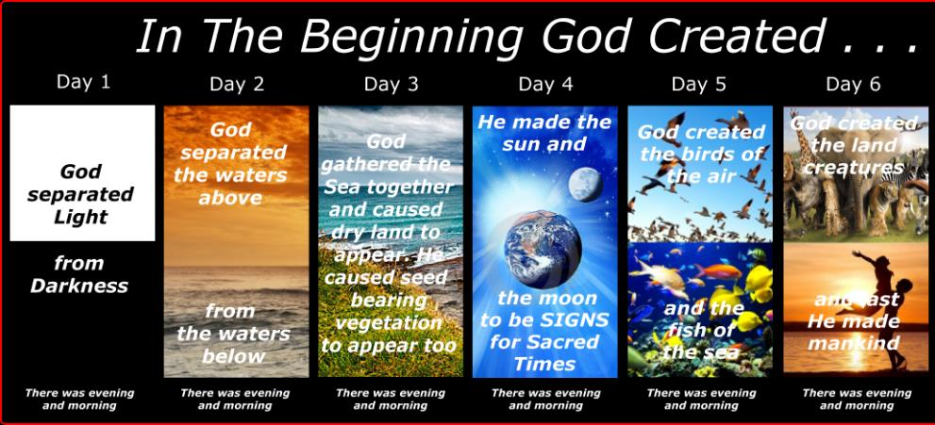
SHAPING AND POPULATING (GEN 1:1)
Day 1: | Light | Day 4: | Luminaries
Day 2: | Water, sky | Day 5: | Sea animals, birds
Day 3: | Land, vegetation | Day 6: | Land animals, man

Slide 66
IV. Exodus 10:12-15 Plague’s Manifestation
God’s command (12)
Moses’ obedience (13a)
Locusts’ manifestation (13b-14a)
Locusts’ severity (14b-15)

Slide 67
THREE PHASES OF MOSES’ 120 YEAR LIFE
LIFE PHASE | SCRIPTURE | YEARS | AGE | ACTIVITY
Natural Training | Acts 7:23 | 1526–1486 B.C. | 1-40 | Egyptian Education
Spiritual Training | Exod. 7:7 | 1486–1446 B.C. | 40-80 | Midian Shepherding
Ministry | Deut. 31:2; 34:7; Acts 7:36 | 1446–1406 B.C. | 80-120 | Exodus, Law, Wilderness Preservation, Pentateuch Authorship

Slide 68
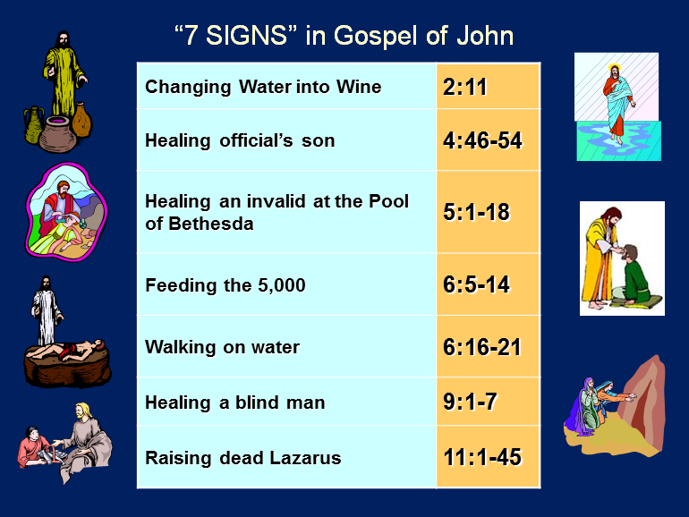

Slide 69
IV. Exodus 10:12-15 Plague’s Manifestation
God’s command (12)
Moses’ obedience (13a)
Locusts’ manifestation (13b-14a)
Locusts’ severity (14b-15)

Slide 70
IV. Exodus 10:12-15 Plague’s Manifestation
God’s command (12)
Moses’ obedience (13a)
Locusts’ manifestation (13b-14a)
Locusts’ severity (14b-15)

Slide 71
Exodus 10:14b-15 Locusts’ Severity
Number (14b)
Darkness (15a)
Consumption (15b)

Slide 72
Exodus 10:14b-15 Locusts’ Severity
Number (14b)
Darkness (15a)
Consumption (15b)

Slide 74
Jeremiah 30:7
“Alas! for that day is great, There is none like it; And it is the time of Jacob’s distress (Gen. 32:8; 35:10), But he will be saved from it.”

Slide 75
Matthew 24:21-22
“²¹ For then there will be a great tribulation, such as has not occurred since the beginning of the world until now, nor ever will. ²² Unless those days had been cut short, no life would have been saved; but for the sake of the elect those days will be cut short.”

Slide 76
Exodus 10:14b-15 Locusts’ Severity
Number (14b)
Darkness (15a)
Consumption (15b)

Slide 77
Ultimate Exodus (Rev 11:15)
Sores: 6th plague (Ex 9:8-12), 1st bowl (Rev 16:1-2)
Rivers to blood: 1st plague (Ex 7:19-21), 3rd bowl (Rev 16:4-7)
Darkness: 9th plague (Ex 10:21-23), 5th bowl (Rev 16:10-11)
Frogs: 2nd plague (Ex 7:25‒8:15), 6th bowl (Rev 16:13)
Hail: 7th plague (Ex 9:22-26), 7th bowl (Rev 16:17-21)

Slide 79
Revelation 11:15
¹⁵ “Then the seventh angel sounded; and there were loud voices in heaven, saying, ‘The kingdom of the world has become the kingdom of our Lord and of His Christ; and He will reign forever and ever.’”

Slide 80
Exodus 10:14b-15 Locusts’ Severity
Number (14b)
Darkness (15a)
Consumption (15b)

Slide 81
SHAPING AND POPULATING (GEN 1:1)
Day 1: | Light | Day 4: | Luminaries
Day 2: | Water, sky | Day 5: | Sea animals, birds
Day 3: | Land, vegetation | Day 6: | Land animals, man

Slide 82
LOCUSTS Exodus 10:1-20
God’s Instructions (1-2)
Moses & Aaron Speak to Pharaoh (3-6)
Moses & Aaron Speak to Pharaoh Again (7-11)
Plague’s Manifestation (12-15)
Pharaoh Speaks to Moses & Aaron (16-17)
God Answers (18-20)

Slide 83
V. Exodus 10:16-17 Pharaoh Speaks to Moses & Aaron
Summoning (16a)
Repentance (16b)
Request (17)

Slide 84
V. Exodus 10:16-17 Pharaoh Speaks to Moses & Aaron
Summoning (16a)
Repentance (16b)
Request (17)

Slide 85
V. Exodus 10:16-17 Pharaoh Speaks to Moses & Aaron
Summoning (16a)
Repentance (16b)
Request (17)

Slide 86
V. Exodus 10:16-17 Pharaoh Speaks to Moses & Aaron
Summoning (16a)
Repentance (16b)
Request (17)

Slide 87
LOCUSTS Exodus 10:1-20
God’s Instructions (1-2)
Moses & Aaron Speak to Pharaoh (3-6)
Moses & Aaron Speak to Pharaoh Again (7-11)
Plague’s Manifestation (12-15)
Pharaoh Speaks to Moses & Aaron (16-17)
God Answers (18-20)

Slide 88
VI. Exodus 10:18-20 God Answers
Exit (18a)
Supplication (18b)
God’s answers (19)
God’s hardening (20)

Slide 89
VI. Exodus 10:18-20 God Answers
Exit (18a)
Supplication (18b)
God’s answers (19)
God’s hardening (20)

Slide 90
VI. Exodus 10:18-20 God Answers
Exit (18a)
Supplication (18b)
God’s answers (19)
God’s hardening (20)

Slide 91
VI. Exodus 10:18-20 God Answers
Exit (18a)
Supplication (18b)
God’s answers (19)
God’s hardening (20)

Slide 93
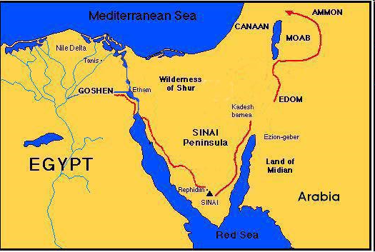

Slide 94
VI. Exodus 10:18-20 God Answers
Exit (18a)
Supplication (18b)
God’s answers (19)
God’s hardening (20)

Slide 95
Dr. Ed Hindson
Hindson, E. E., & Mitchell, D. R., eds. (2010). KJV Bible Commentary for Today: The Most Up-to-Date Commentary on the Time-Honored Text of the KJV (p. 86). Thomas Nelson.
“4:21. I will harden his heart. An expression meaning ‘to strengthen his will.’ The text identifies the heart as the location of the volition, man’s decision-making ability. On seven occasions in the narrative, God hardens Pharaoh’s heart (9:12; 10:1, 20, 27; 11:10; 14:4, 8) or foretells that He will harden Pharaoh’s heart (4:21; 7:3), and nine times in the text, Pharaoh hardens his own heart (7:13, 14, 22; 8:15, 19, 32; 9:7, 34–35). For the initial five plagues, the text registers Pharaoh as the agent of hardening. Not until the sixth plague does God participate in the confirmation of Pharaoh’s own volitional choices.”

Slide 96
Charles Ryrie Ryrie Study Bible, page 96
Exodus 4:21 - “harden his heart. Ten times it is said that Pharaoh hardened his own heart (7:13, 14, 22; 8:15, 19, 32; 9:7, 34, 35; 13:15), and 10 times that God hardened Pharaoh’s heart (4:21; 7:3; 9:12; 10:1, 20, 27; 11:10; 14:4, 8, 17). Paul uses this as an example of the inscrutable will of God and of His mercy toward men (Rom. 9:14–18). Seven times Pharaoh hardened his own heart before God first hardened it, though the prediction that God would do it preceded all.”

Slide 97
GOD HARDENING PHARAOH'S HEART
The prediction of God hardening of Pharaoh (4:21)
Pharaoh repeatedly hardening his own heart (7:13, 22; 8:15, 19, 32; 9:7)
Not until the sixth plague did God harden Pharaoh’s heart (Exod 9:12)

Slide 98
Conclusion

Slide 99
LOCUSTS Exodus 10:1-20
God’s Instructions (1-2)
Moses & Aaron Speak to Pharaoh (3-6)
Moses & Aaron Speak to Pharaoh Again (7-11)
Plague’s Manifestation (12-15)
Pharaoh Speaks to Moses & Aaron (16-17)
God Answers (18-20)

Slide 100
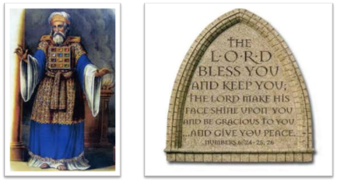
²⁴ The Lord bless you, and keep you; ²⁵ The Lord make His face shine on you, And be gracious to you; ²⁶ The Lord lift up His countenance on you, And give you peace.
Numbers 6:24–26 (NASB95)

