Slide 1
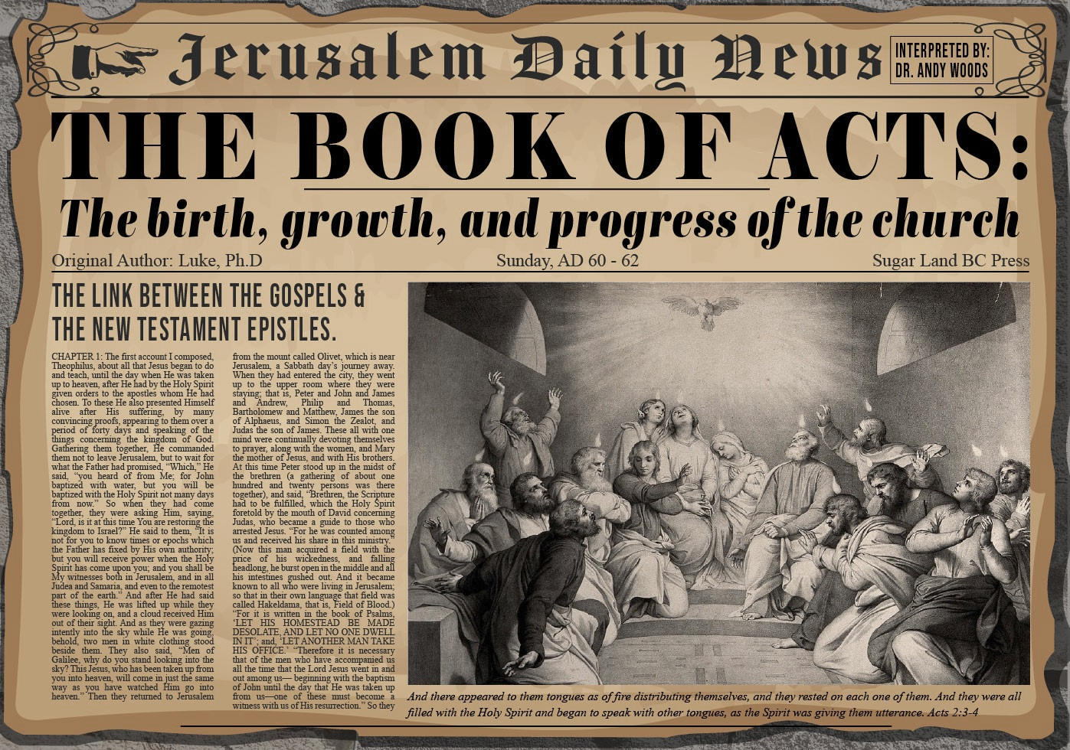


Slide 2

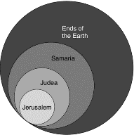
Acts 1:8
“but you will receive power when the Holy Spirit has come upon you; and you shall be My witnesses both in Jerusalem (Acts 1-7), and in all Judea and Samaria (Acts 8-12), and even to the remotest part of the earth (Acts 13-28).”

Slide 3
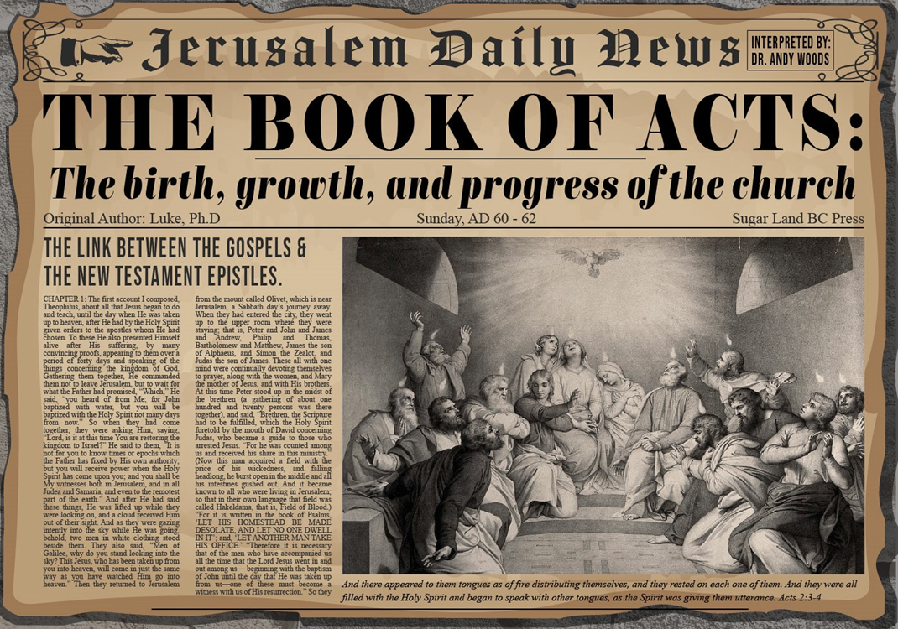
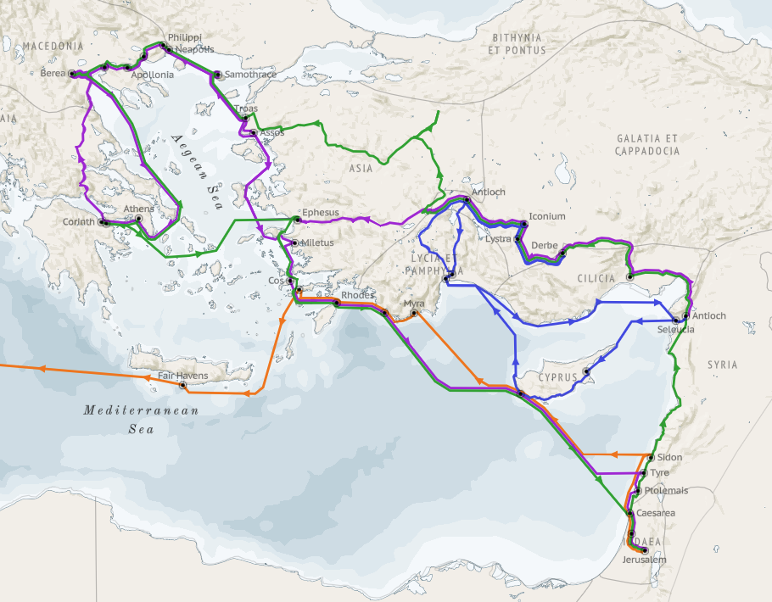
Structure (Acts 1:8)
Jerusalem (Acts 1–7)
Judea and Samaria (Acts 8–12)
Remotest part of the earth (Acts 13–28)
1st missionary journey (Acts 13–14)
Jerusalem council (Acts 15:1-35)
2nd missionary journey (Acts 15:36 –18:22)
3rd missionary journey (Acts 18:23–21:17)
Trip to Rome (Acts 21:18–28:31)

Slide 4
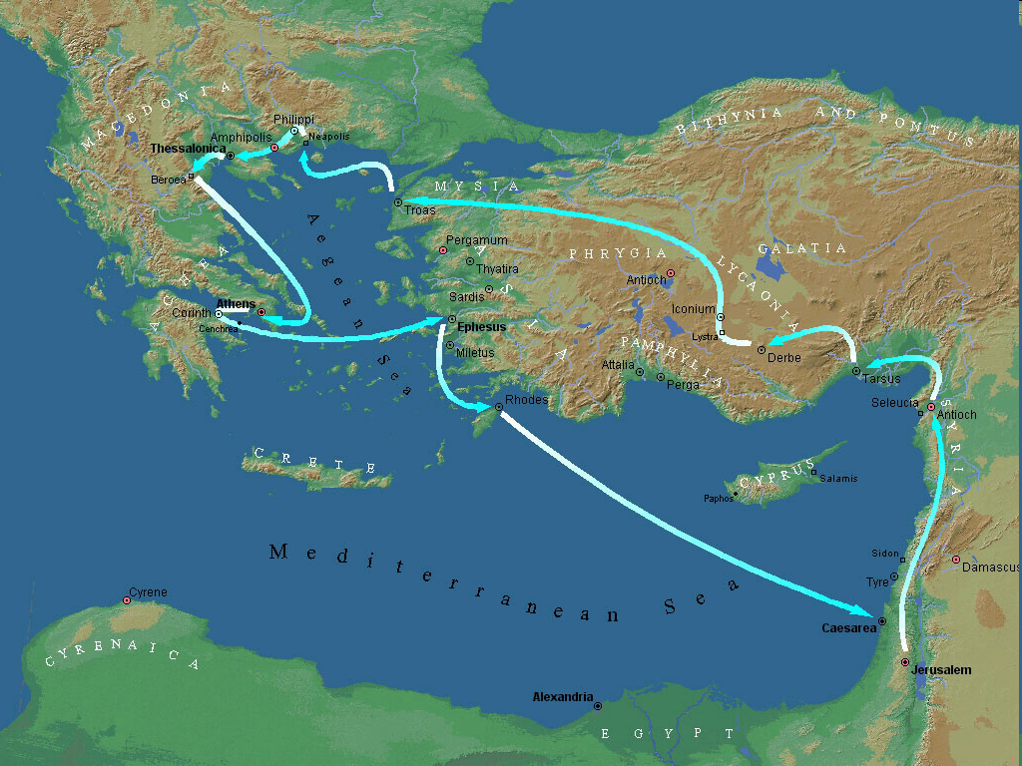
Second Missionary Journey

Slide 5
Acts 15:36‒18:22 2nd Missionary Journey
Schism between Paul & Barnabas (15:36-41)
Syria & Cilicia ministry (16:1-5)
Macedonian call (16:6-10)
Philippian ministry (16:11-40)
Thessalonica ministry (17:1-9)
Berean ministry (17:10-15)
Athens’ ministry (17:16-34)
Corinthian ministry (18:1-18)
Ephesus’ ministry (18:19-21)
Return to Antioch (18:22)

Slide 6
IV. Philippian Ministry Acts 16:11-40
Lydia’s conversion (11-15)
Demonized slave girl (16-18)
Paul & Silas’ imprisonment (19-34)
Departure from Philippi (35-40)

Slide 7
Acts 16:19-34 Paul & Silas’ Imprisonment
Imprisonment (19-24)
Jailer’s conversion (25-34)

Slide 8
Acts 16:25-34 Jailer’s Conversion
Timing (25)
Earthquake (26)
Jailer’s response (27)
Paul’s response (28)
Jailer’s reaction (29-30)
Gospel message (31)
Household evangelism (32)
Results of salvation (33-34)

Slide 9
Acts 16:25-34 Jailer’s Conversion
Timing (25)
Earthquake (26)
Jailer’s response (27)
Paul’s response (28)
Jailer’s reaction (29-30)
Gospel message (31)
Household evangelism (32)
Results of salvation (33-34)

Slide 10
Acts 16:33-34 Results of Salvation
Wounds treated (33a)
Baptism (33b)
Hospitality (34a)
Fellowship (34b)

Slide 11
Acts 16:33-34 Results of Salvation
Wounds treated (33a)
Baptism (33b)
Hospitality (34a)
Fellowship (34b)

Slide 12
Acts 16:33-34 Results of Salvation
Wounds treated (33a)
Baptism (33b)
Hospitality (34a)
Fellowship (34b)

Slide 13
Acts 16:33-34 Results of Salvation
Wounds treated (33a)
Baptism (33b)
Hospitality (34a)
Fellowship (34b)

Slide 14
Acts 16:33-34 Results of Salvation
Wounds treated (33a)
Baptism (33b)
Hospitality (34a)
Fellowship (34b)

Slide 15
IV. Philippian Ministry Acts 16:11-40
Lydia’s conversion (11-15)
Demonized slave girl (16-18)
Paul & Silas’ imprisonment (19-34)
Departure from Philippi (35-40)

Slide 16
Acts 16:35-40 Departure from Philippi
Ruler’s decision (35-36)
Paul’s defense (37)
Leader’s response (38-39)
Paul & Silas comfort & departure (40)

Slide 17
Acts 16:35-40 Departure from Philippi
Ruler’s decision (35-36)
Paul’s defense (37)
Leader’s response (38-39)
Paul & Silas comfort & departure (40)

Slide 18
Acts 16:35-36 Rulers’ Decision
Timing (35)
Jailer’s report (36)

Slide 19
Acts 16:35-36 Rulers’ Decision
Timing (35)
Jailer’s report (36)

Slide 20
Acts 16:35-36 Rulers’ Decision
Timing (35)
Jailer’s report (36)

Slide 21
Acts 16:35-40 Departure from Philippi
Ruler’s decision (35-36)
Paul’s defense (37)
Leader’s response (38-39)
Paul & Silas comfort & departure (40)

Slide 22


Dr. Arnold G. Fruchtenbaum
The Book of Acts, 355-56
﻿“What had been done to them was illegal by Roman law. In fact, it violated two specific sets of laws. The first one was called Lex Valeria, which was passed in the year 509 B.C. The second set of laws was called Leges Porciae. Issued between 248 B.C. and 195 B.C., these laws exempted Roman citizens from shameful forms of punishment, such as whipping, beating, or crucifixion. They also guaranteed that Roman citizens had the right to appeal to the tribunes of the plebs. In his speeches against the corrupt governor Gaius Verres, Cicero wrote: ‘To fetter a Roman citizen was a crime, to scourge him was a scandal, to slay him – parricide.’ It was a crime to inflict blows on a Roman citizen, and the law protected a Roman citizen from scourging for any reason whatsoever. At the same time, it was a capital offense to make a false claim of Roman citizenship.”

Slide 23

Romans 13:3-5
“For rulers are not a cause of fear for good behavior, but for evil. Do you want to have no fear of authority? Do what is good and you will have praise from the same; for it [government] is a minister of God to you for good. But if you do what is evil, be afraid; for it [government] does not bear the sword for nothing; for it [government] is a minister of God, an avenger who brings wrath on the one who practices evil.”

Slide 24
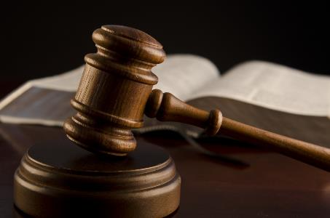
1 Peter 2:13-14
“Submit yourselves for the Lord’s sake to every human institution, whether to a king as the one in authority, or to governors as sent by him for the punishment of evildoers and the praise of those who do right.”

Slide 25

Principles of Civil Disobedience
“Crystal” clear conflict between the laws of man and God
Exhaustion of all creative legal remedies
A willingness to “pay the consequences”
Maintaining of respect for civil authorities

Slide 26
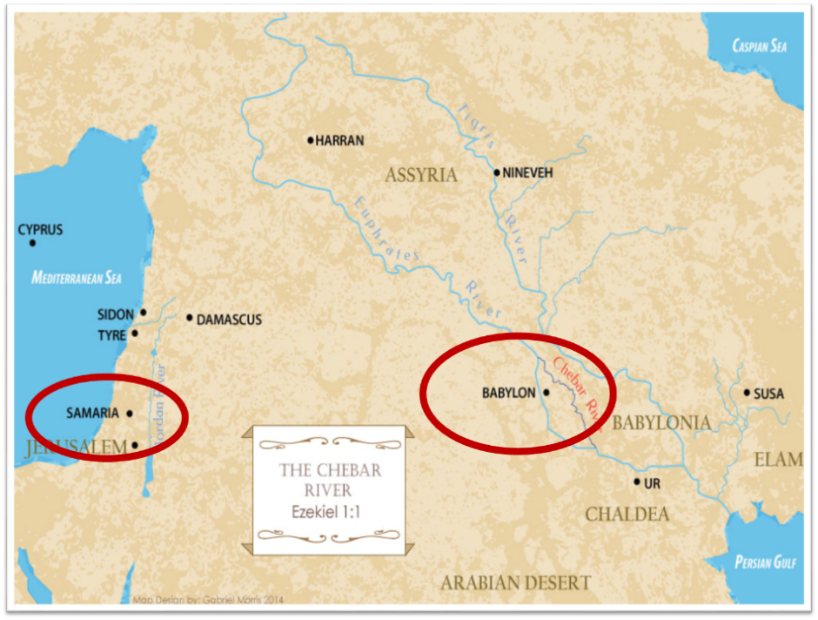

Slide 27

Synthetic Outline
Chiasm in “Aramaic” ( Dan. 2-7)
1. Gentile History (2)
2. Protection (3)
3. Revelation to a gentile king (4)
3'. Revelation to a gentile king (5)
2. Protection (6)
1. Gentile history (7)

Slide 28
Synthetic Outline
Chiasm in “Aramaic” ( Dan. 2-7)
1. Gentile History (2)
2. Protection (3)
3. Revelation to a gentile king (4)
3'. Revelation to a gentile king (5)
2. Protection (6)
1. Gentile history (7)

Slide 29
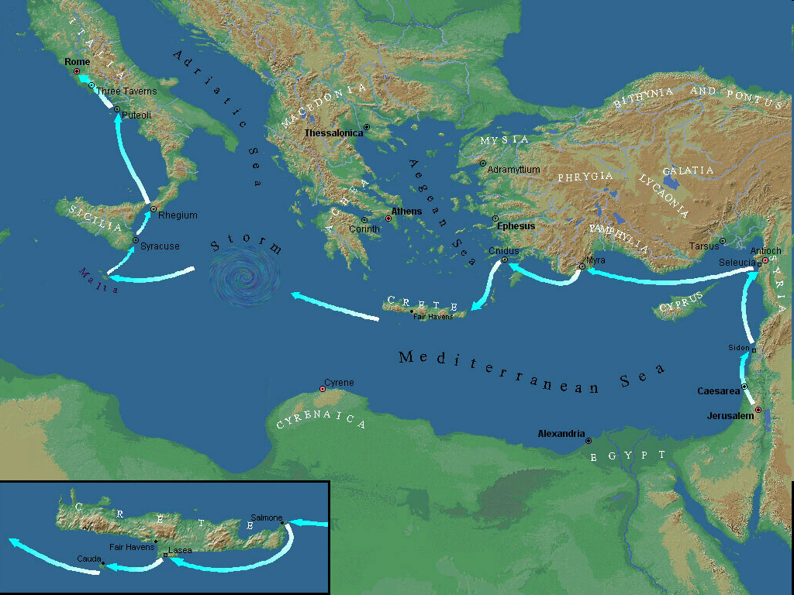

Slide 30
Acts 16:35-40 Departure from Philippi
Ruler’s decision (35-36)
Paul’s defense (37)
Leader’s response (38-39)
Paul & Silas comfort & departure (40)

Slide 31
Acts 16:38-39 Leaders’ Response
Fear (38)
Escort & beseeching (39)

Slide 32
Acts 16:38-39 Leaders’ Response
Fear (38)
Escort & beseeching (39)

Slide 33
Dr. Arnold G. Fruchtenbaum
The Book of Acts, 356
﻿“Verses 38-39 reveal the response of the leaders. The serjeants gave the report to the rulers with the result that the magistrates feared when they heard that they were Romans (v. 38). They became afraid, because now their own lives were at stake for what they had done to two Roman citizens. Apparently, Emperor Claudius once deprived the city of Rhodes of its freedom for having crucified a Roman citizen. So, the magistrates’ fear was indeed justified.”

Slide 34
Acts 16:38-39 Leaders’ Response
Fear (38)
Escort & beseeching (39)

Slide 35
Acts 16:35-40 Departure from Philippi
Ruler’s decision (35-36)
Paul’s defense (37)
Leader’s response (38-39)
Paul & Silas comfort & departure (40)

Slide 36

Place of Writing
“We” sections (Acts 16:10-40; 20:5–21:18; 27:1–28:16)
From Paul
Cesarean imprisonment (Acts 24:27)
Voyage to Rome (Acts 27)
First Roman imprisonment (Acts 28:16)
Combination

Slide 37
Conclusion

Slide 38
Acts 15:36‒18:22 2nd Missionary Journey
Schism between Paul & Barnabas (15:36-41)
Syria & Cilicia ministry (16:1-5)
Macedonian call (16:6-10)
Philippian ministry (16:11-40)
Thessalonica ministry (17:1-9)
Berean ministry (17:10-15)
Athens’ ministry (17:16-34)
Corinthian ministry (18:1-18)
Ephesus’ ministry (18:19-21)
Return to Antioch (18:22)

Slide 39
IV. Philippian Ministry Acts 16:11-40
Lydia’s conversion (11-15)
Demonized slave girl (16-18)
Paul & Silas’ imprisonment (19-34)
Departure from Philippi (35-40)

