Slide 1


Slide 2
INTRODUCTORY MATTERS OF JONAH
Who wrote it? Jonah
When was it written? 770-750 BC
Who was it written to? Israel
Historicity of the book? Fact!
Genre of the book? Historical Narrative
What is it all about? (Message) To showcase God’s universal love and plan of redemption which extends beyond Israel to include all nations

Slide 3
INTRODUCTORY MATTERS OF JONAH
Why was it written? (Purpose) Expose Israel’s ethnocentrism and encourage national repentance
What’s in it? (Survey) Defiance (1-2) Compliance (3-4)
Christ in Jonah? Yes, through Messianic typology
What makes this book unique? 5 unique things
Structure/outline of the book?

Slide 4
What makes this book unique?
Disobedience may bring turmoil in the believer’s life, but God will always pursue in faithfulness.
God’s relentless love, grace, and mercy towards man.
God’s sovereignty
God’s/Israel’s missionary purpose
Examples of appropriate responses to God

Slide 5
A. The Preaching Prophet (3:1-10)
Jonah’s re-commission (1-2)
  God’s attributes in action (1)
  God’s Instructions (2)
Jonah’s sermon to Nineveh (3-4)
  Jonah’s obedience (3)
  Jonah’s sermon (4)
Nineveh's response (5-9)
God’s response (10)

Slide 6
channun חַנּוּן – gracious, kind, merciful
  Root – hen חַן – grace, favor freely given
rachum רַחוּם – compassionate, merciful
  Root – rehem רחם – womb, bowels

Slide 7
Mercy - the undeserved kindness or forgiveness shown to someone who is guilty, suffering, or in need.
Compassion - the deep, heartfelt sympathy and willingness to relieve another’s distress—an active, emotional identification with the suffering of others which leads to action.
Graciousness - the undeserved kindness and or favor to men in need.

Slide 8
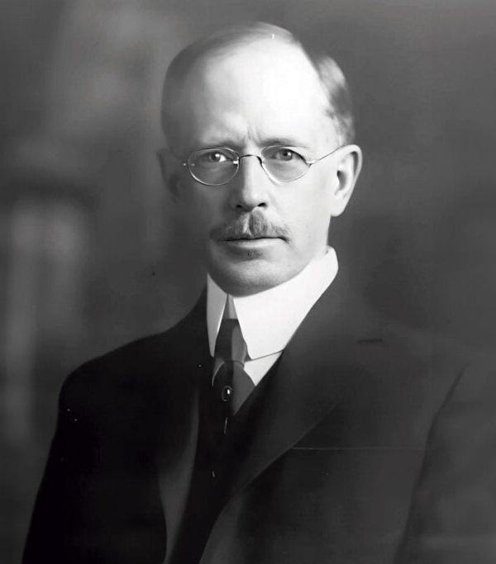

“Grace: An Exposition of God’s Marvelous Gift”
Grace is not withheld because of demerit
Grace cannot be lessened because of demerit
Grace cannot incur a debt
Grace is not exercised in the just payment of a debt
Grace is never the over-payment of a debt
Grace does not appear in the immediate divine dealings with the sins of the unsaved
Grace does not appear in the immediate divine dealings with the sins of the saved

Slide 9
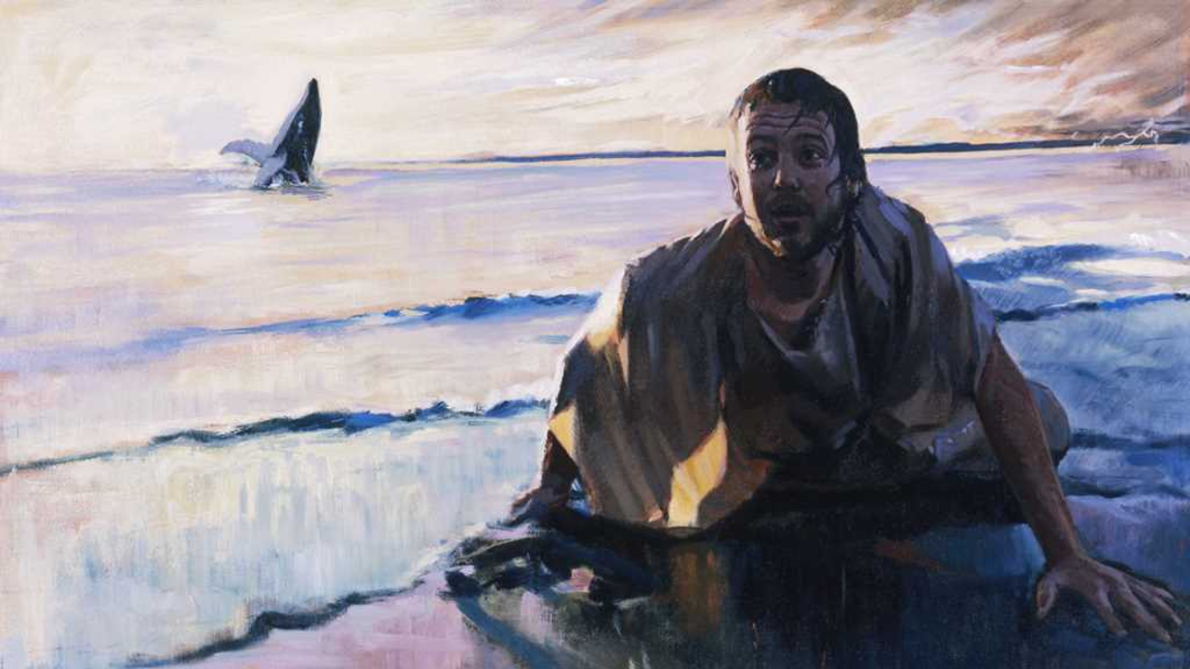
“Then the LORD commanded the fish, and it vomited Jonah up onto the dry land.”
Jonah 2:10

Slide 10
A. The Preaching Prophet (3:1-10)
Jonah’s re-commission (1-2)
  God’s attributes in action (1)
  God’s Instructions (2)
Jonah’s sermon to Nineveh (3-4)
  Jonah’s obedience (3)
  Jonah’s sermon (4)
Nineveh's response (5-9)
God’s response (10)

Slide 11
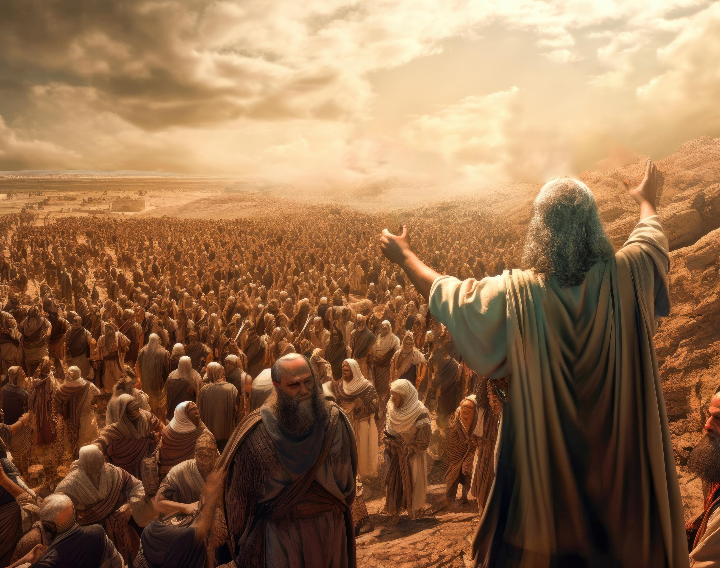
Exodus 24:2-3
Moses alone, however, shall come near to the Lord, but they shall not come near, nor shall the people come up with him.” Then Moses came and recounted to the people all the words of the Lord and all the ordinances; and all the people answered with one voice and said, “All the words which the Lord has spoken we will do!”

Slide 12
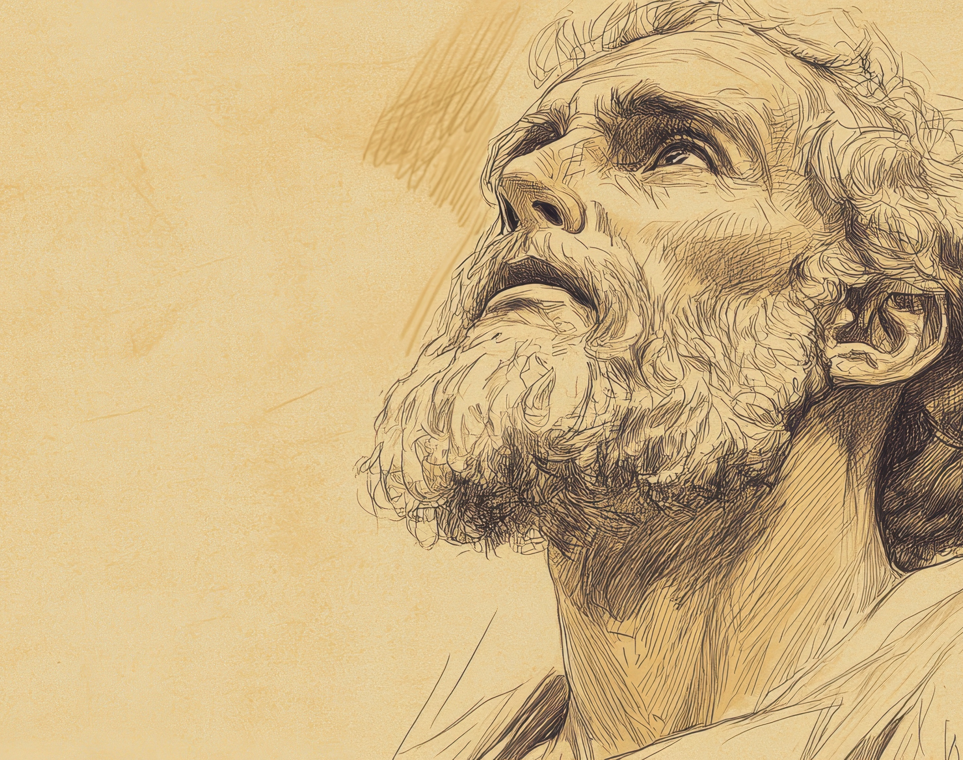
Jeremiah 1:17
“Now, gird up your loins and arise, and speak to them all which I command you.”

Slide 13
Jeremiah 1:17
“Now, gird up your loins and arise, and speak to them all which I command you.”
Ezekiel 2:7a, 3:17
“But you shall speak My words to them…”
“Son of man, I have appointed you a watchman to the house of Israel; whenever you hear a word from My mouth, warn them from Me.”

Slide 14
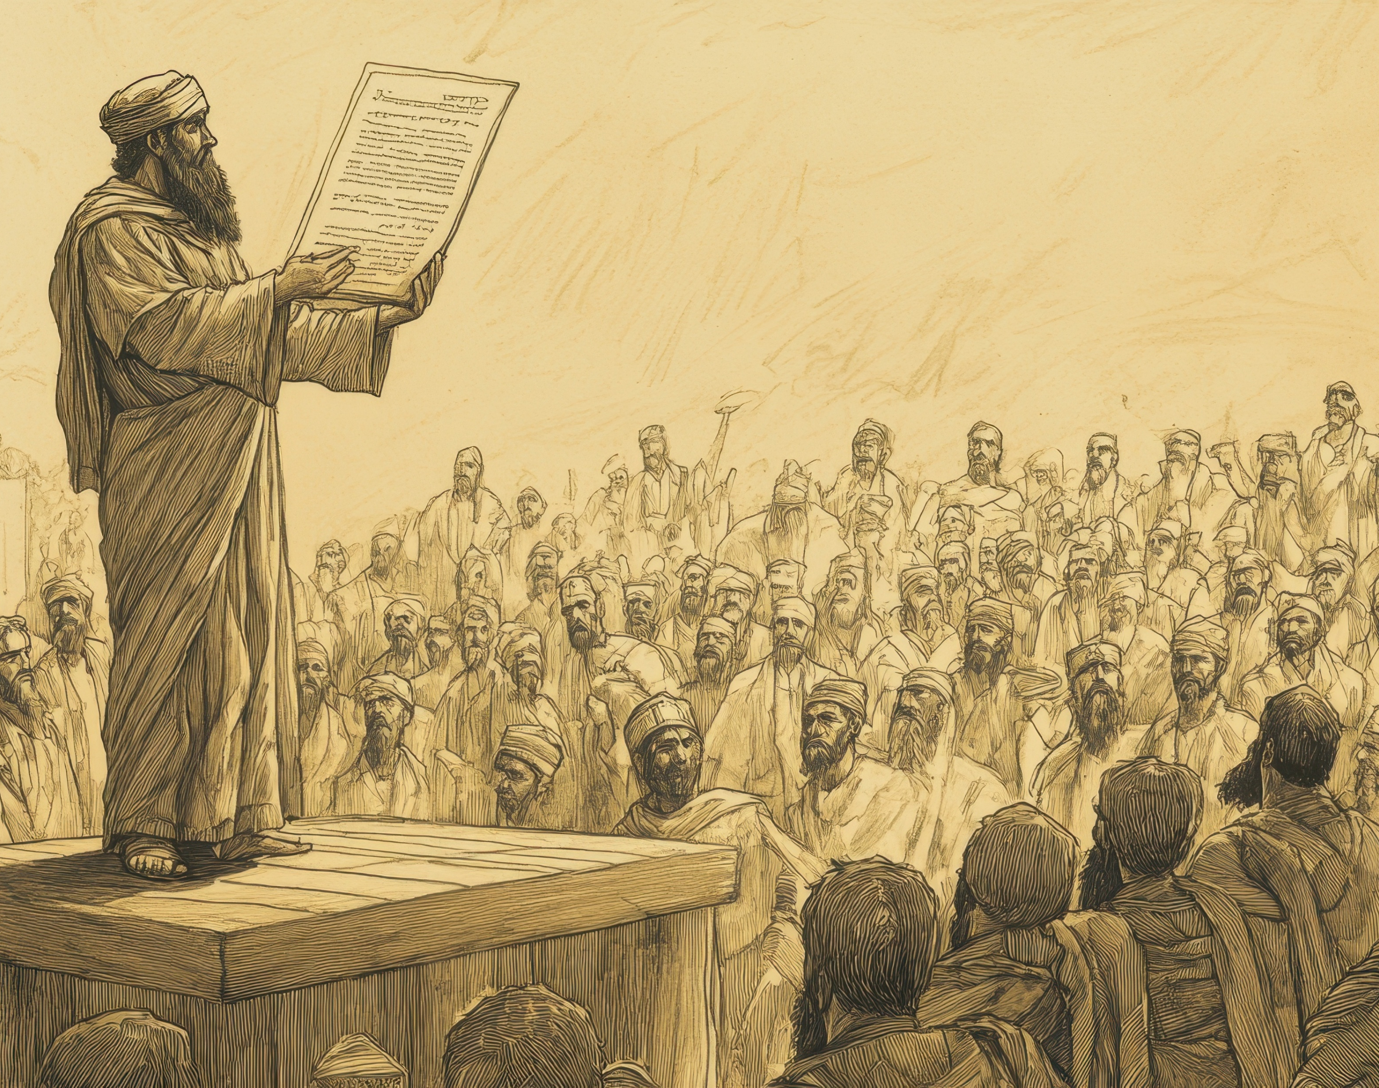
Ezra 2:7
“They read from the book, from the law of God, translating to give the sense so that they understood the reading.”

Slide 15
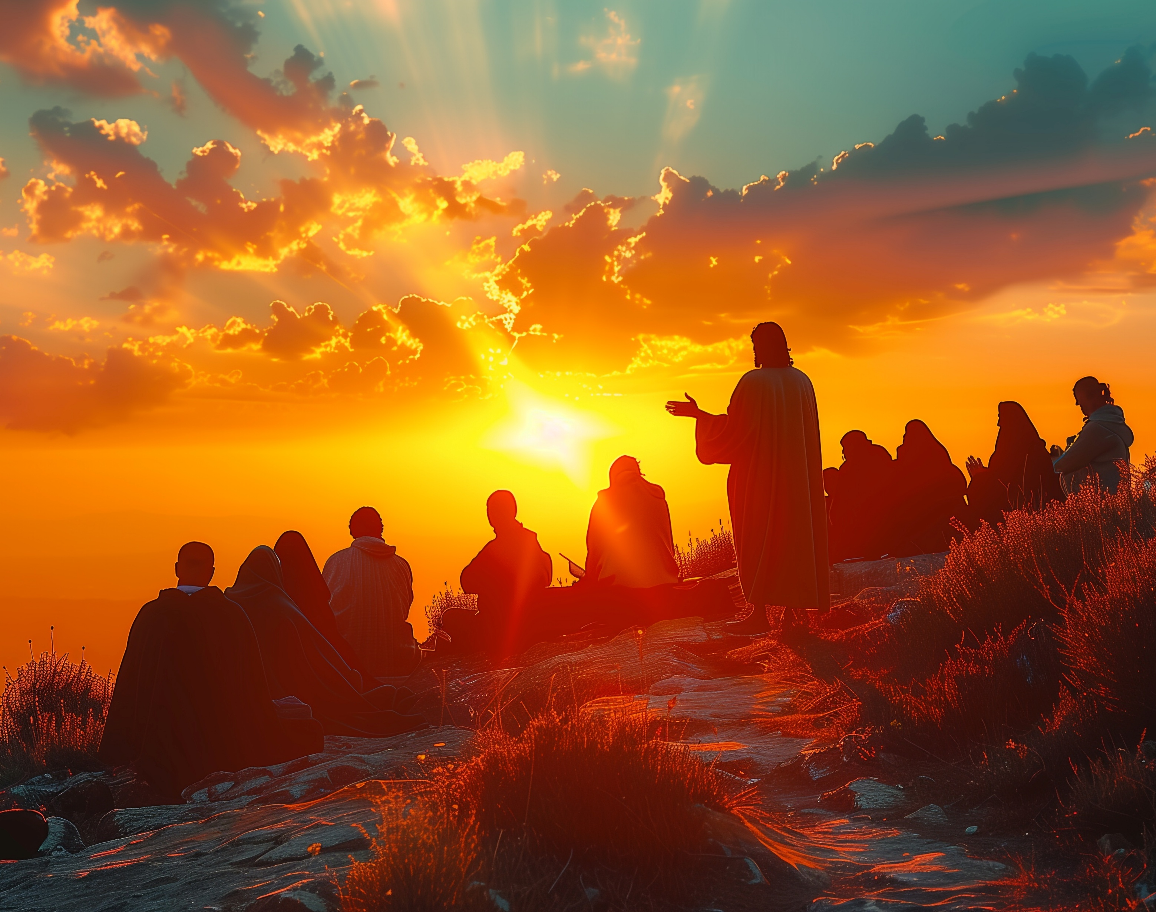
John 1:18
“No one has seen God at any time; the only begotten God who is in the bosom of the Father, He has explained Him.”

Slide 16
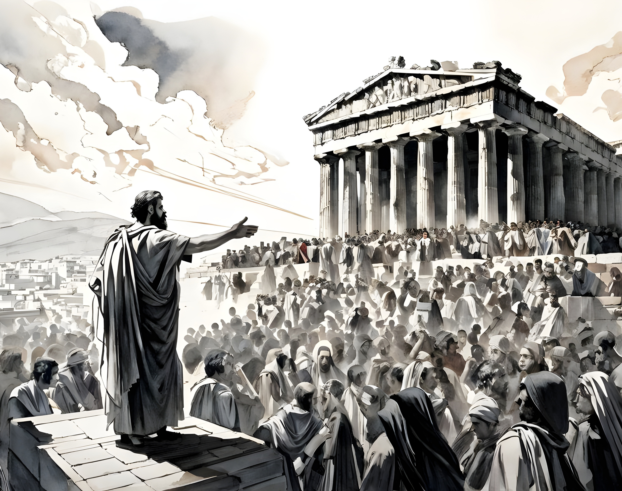
2 Tim 4:3-4
“For the time will come when they will not endure sound doctrine; but wanting to have their ears tickled, they will accumulate for themselves teachers in accordance to their own desires, and will turn away their ears from the truth and will turn aside to myths.”

Slide 17
2 Tim 4:3-4
“For the time will come when they will not endure sound doctrine; but wanting to have their ears tickled, they will accumulate for themselves teachers in accordance to their own desires, and will turn away their ears from the truth and will turn aside to myths.”

Slide 18
2 Tim 4:1-2
I solemnly charge you in the presence of God and of Christ Jesus, who is to judge the living and the dead, and by His appearing and His kingdom:
preach the word; be ready in season and out of season; reprove, rebuke, exhort, with great patience and instruction.

Slide 19
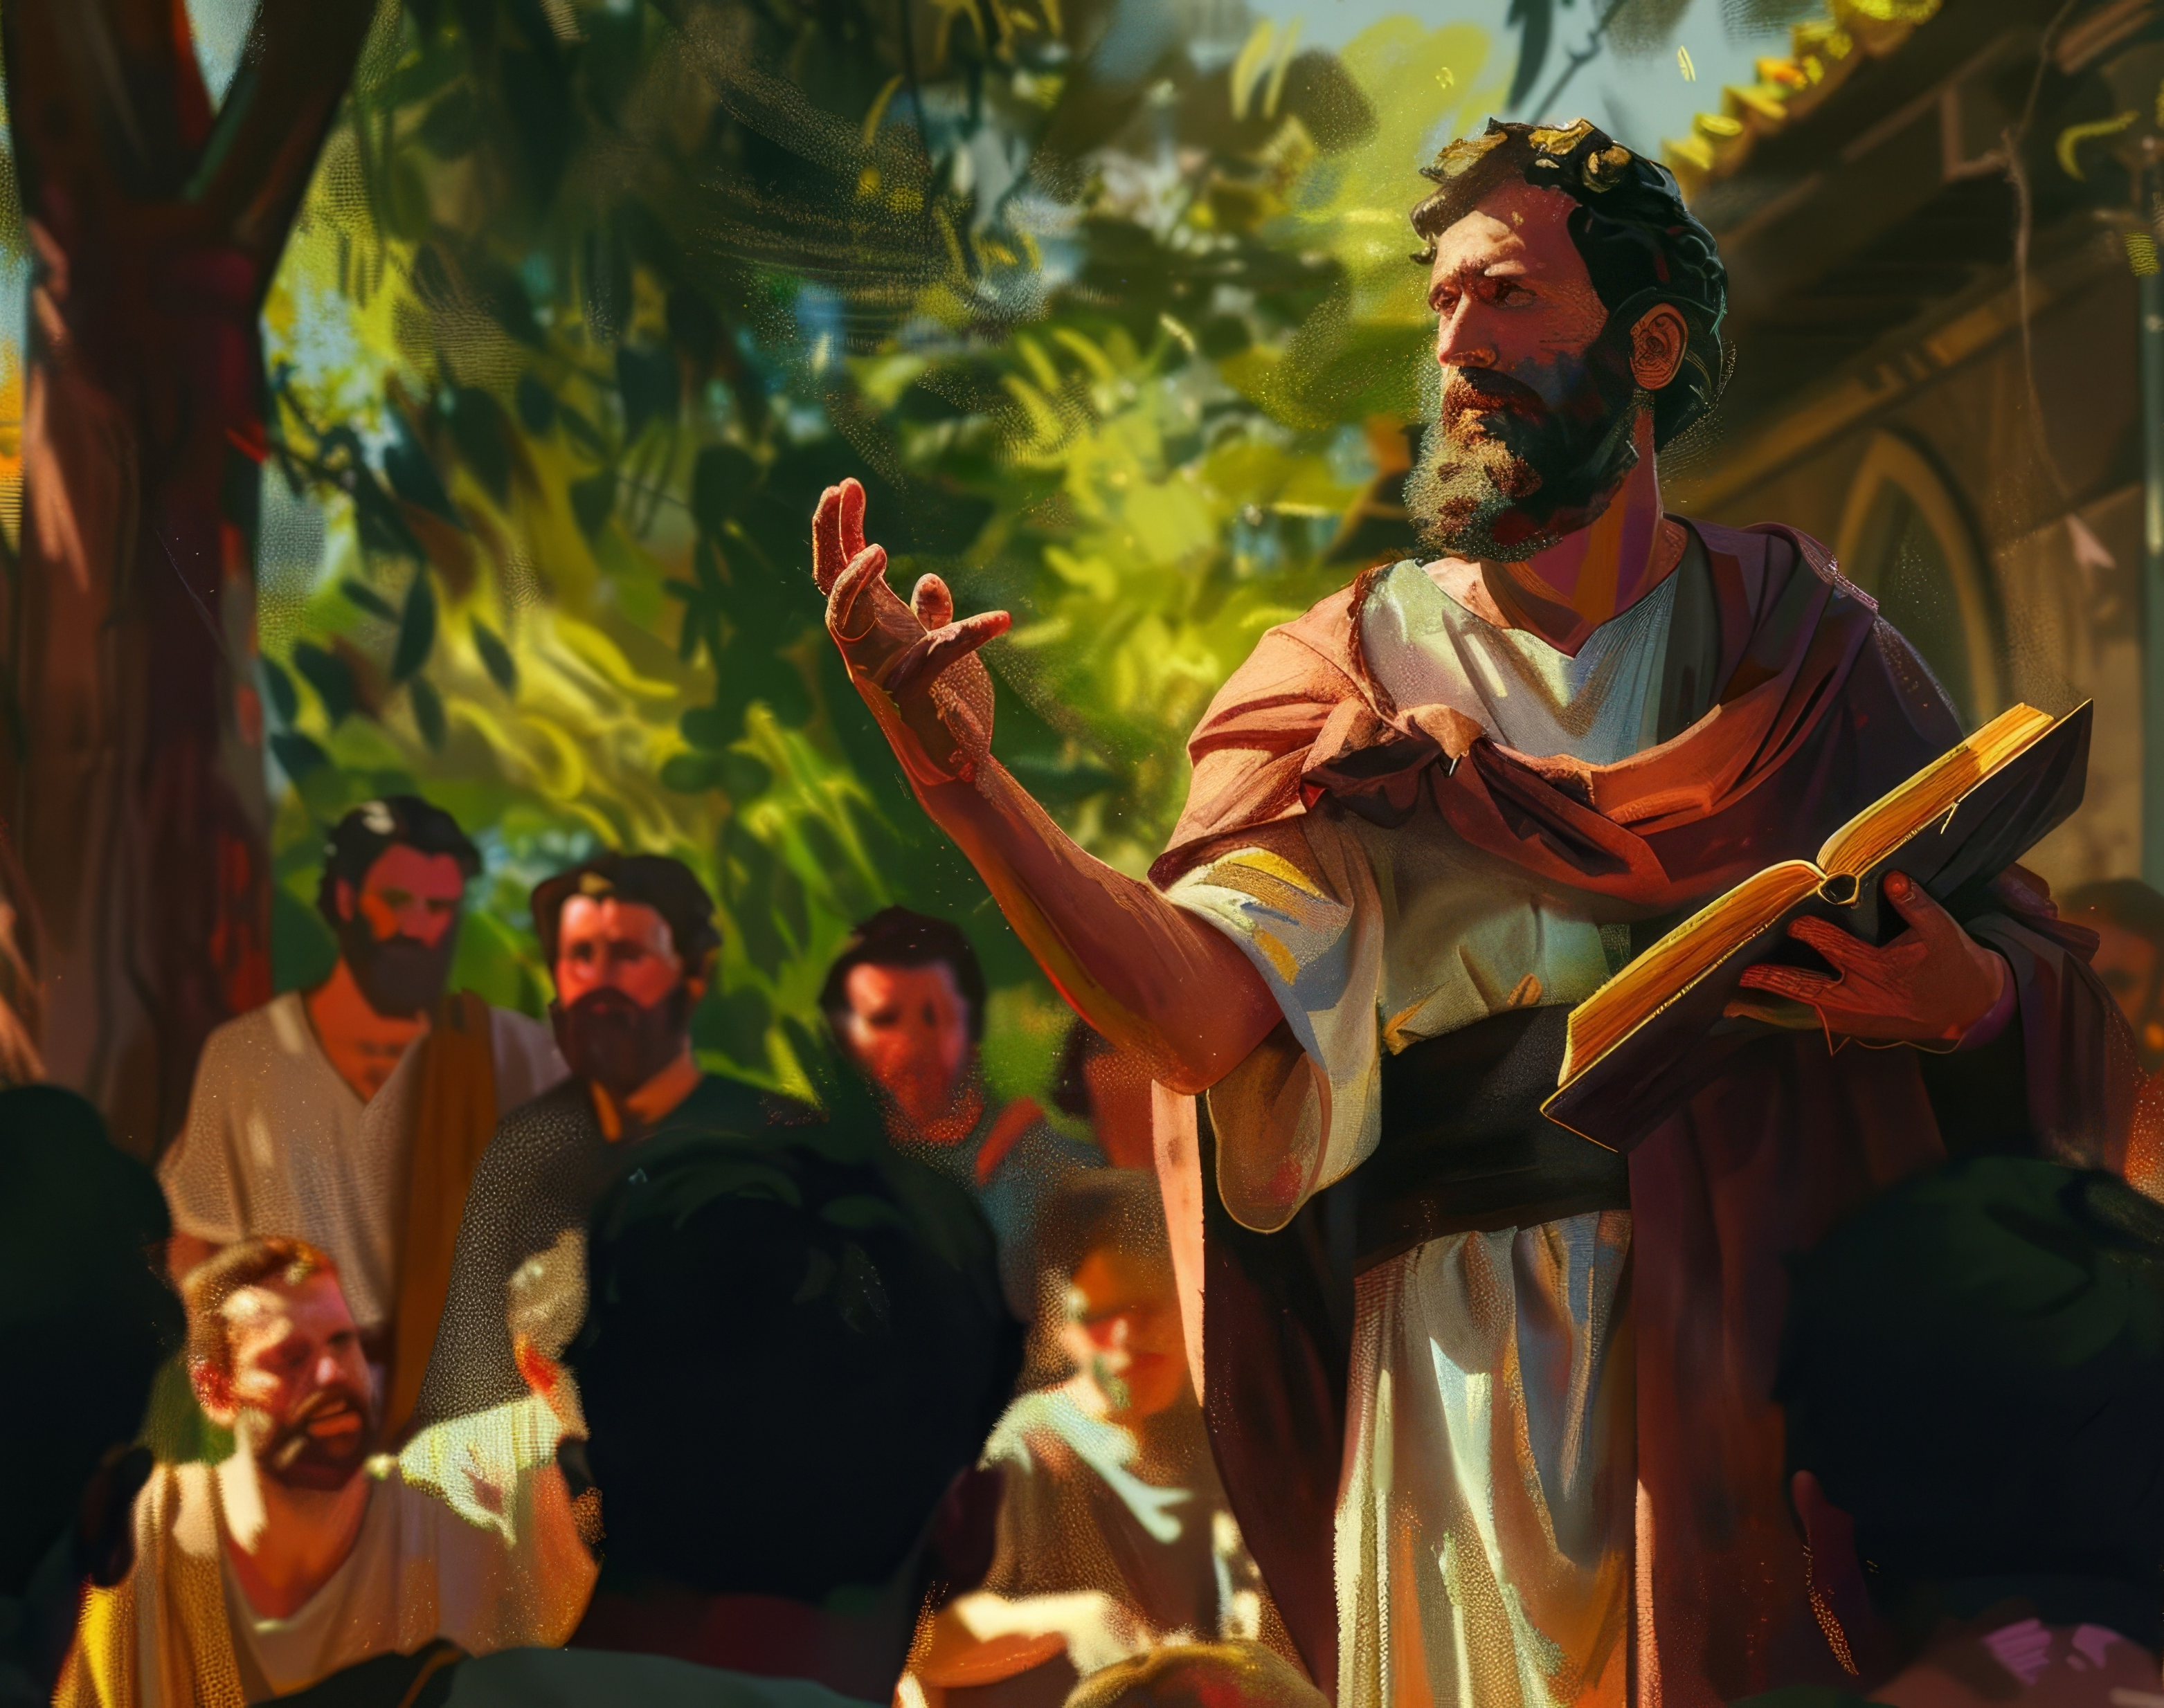
Acts 20:26-28
“Therefore, I testify to you this day that I am innocent of the blood of all men. “For I did not shrink from declaring to you the whole purpose of God. “Be on guard for yourselves and for all the flock, among which the Holy Spirit has made you overseers, to shepherd the church of God which He purchased with His own blood.

Slide 20
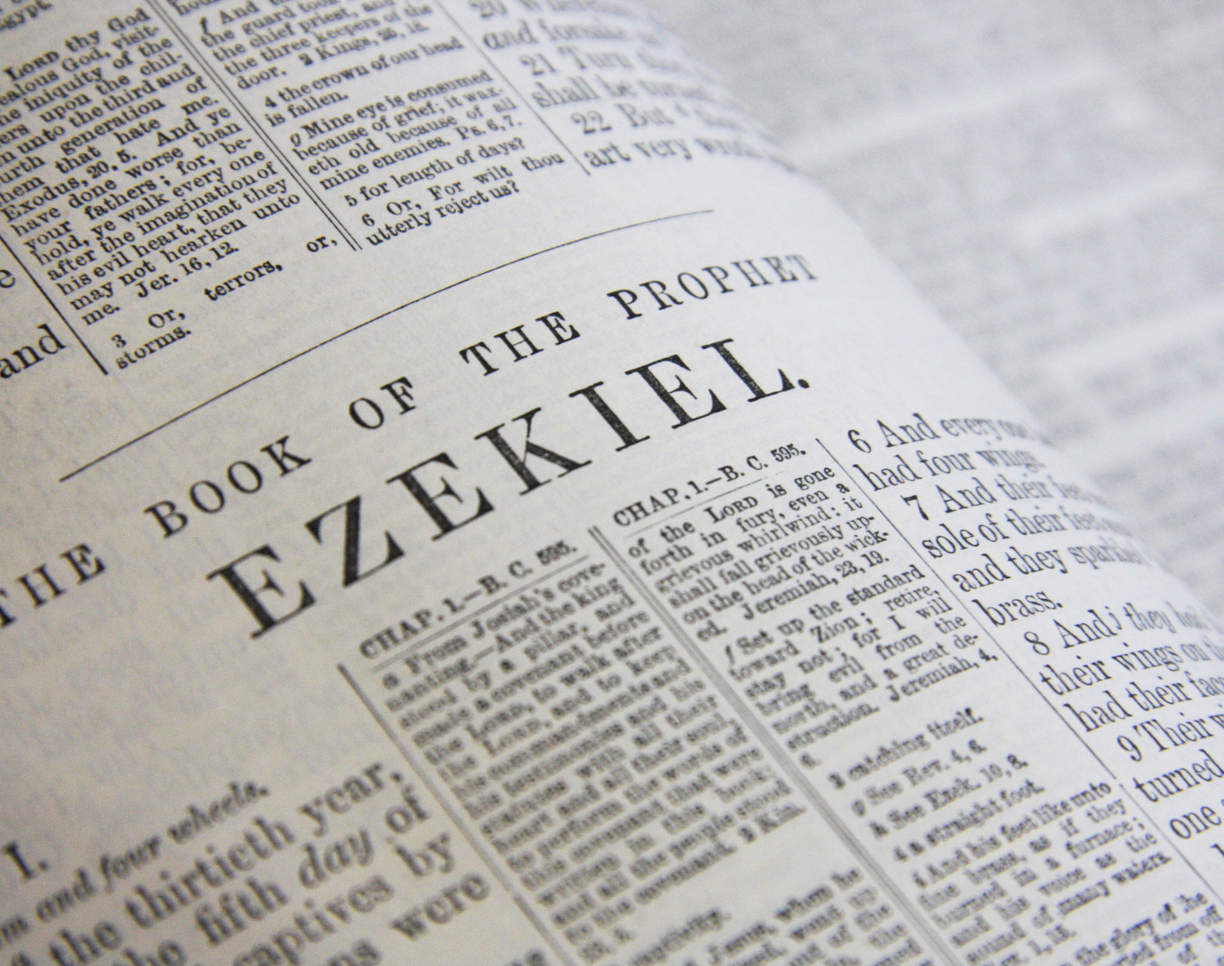
Ezekiel 33:7-9
“Now as for you, son of man, I have appointed you a watchman for the house of Israel; so you will hear a message from My mouth and give them warning from Me. “When I say to the wicked, ‘O wicked man, you will surely die,’ and you do not speak to warn the wicked from his way, that wicked man shall die in his iniquity, but his blood I will require from your hand. “But if you on your part warn a wicked man to turn from his way and he does not turn from his way, he will die in his iniquity, but you have delivered your life.

Slide 21
A. The Preaching Prophet (3:1-10)
Jonah’s re-commission (1-2)
  God’s attributes in action (1)
  God’s Instructions (2)
Jonah’s sermon to Nineveh (3-4)
  Jonah’s obedience (3)
  Jonah’s sermon (4)
Nineveh's response (5-9)
God’s response (10)

Slide 22
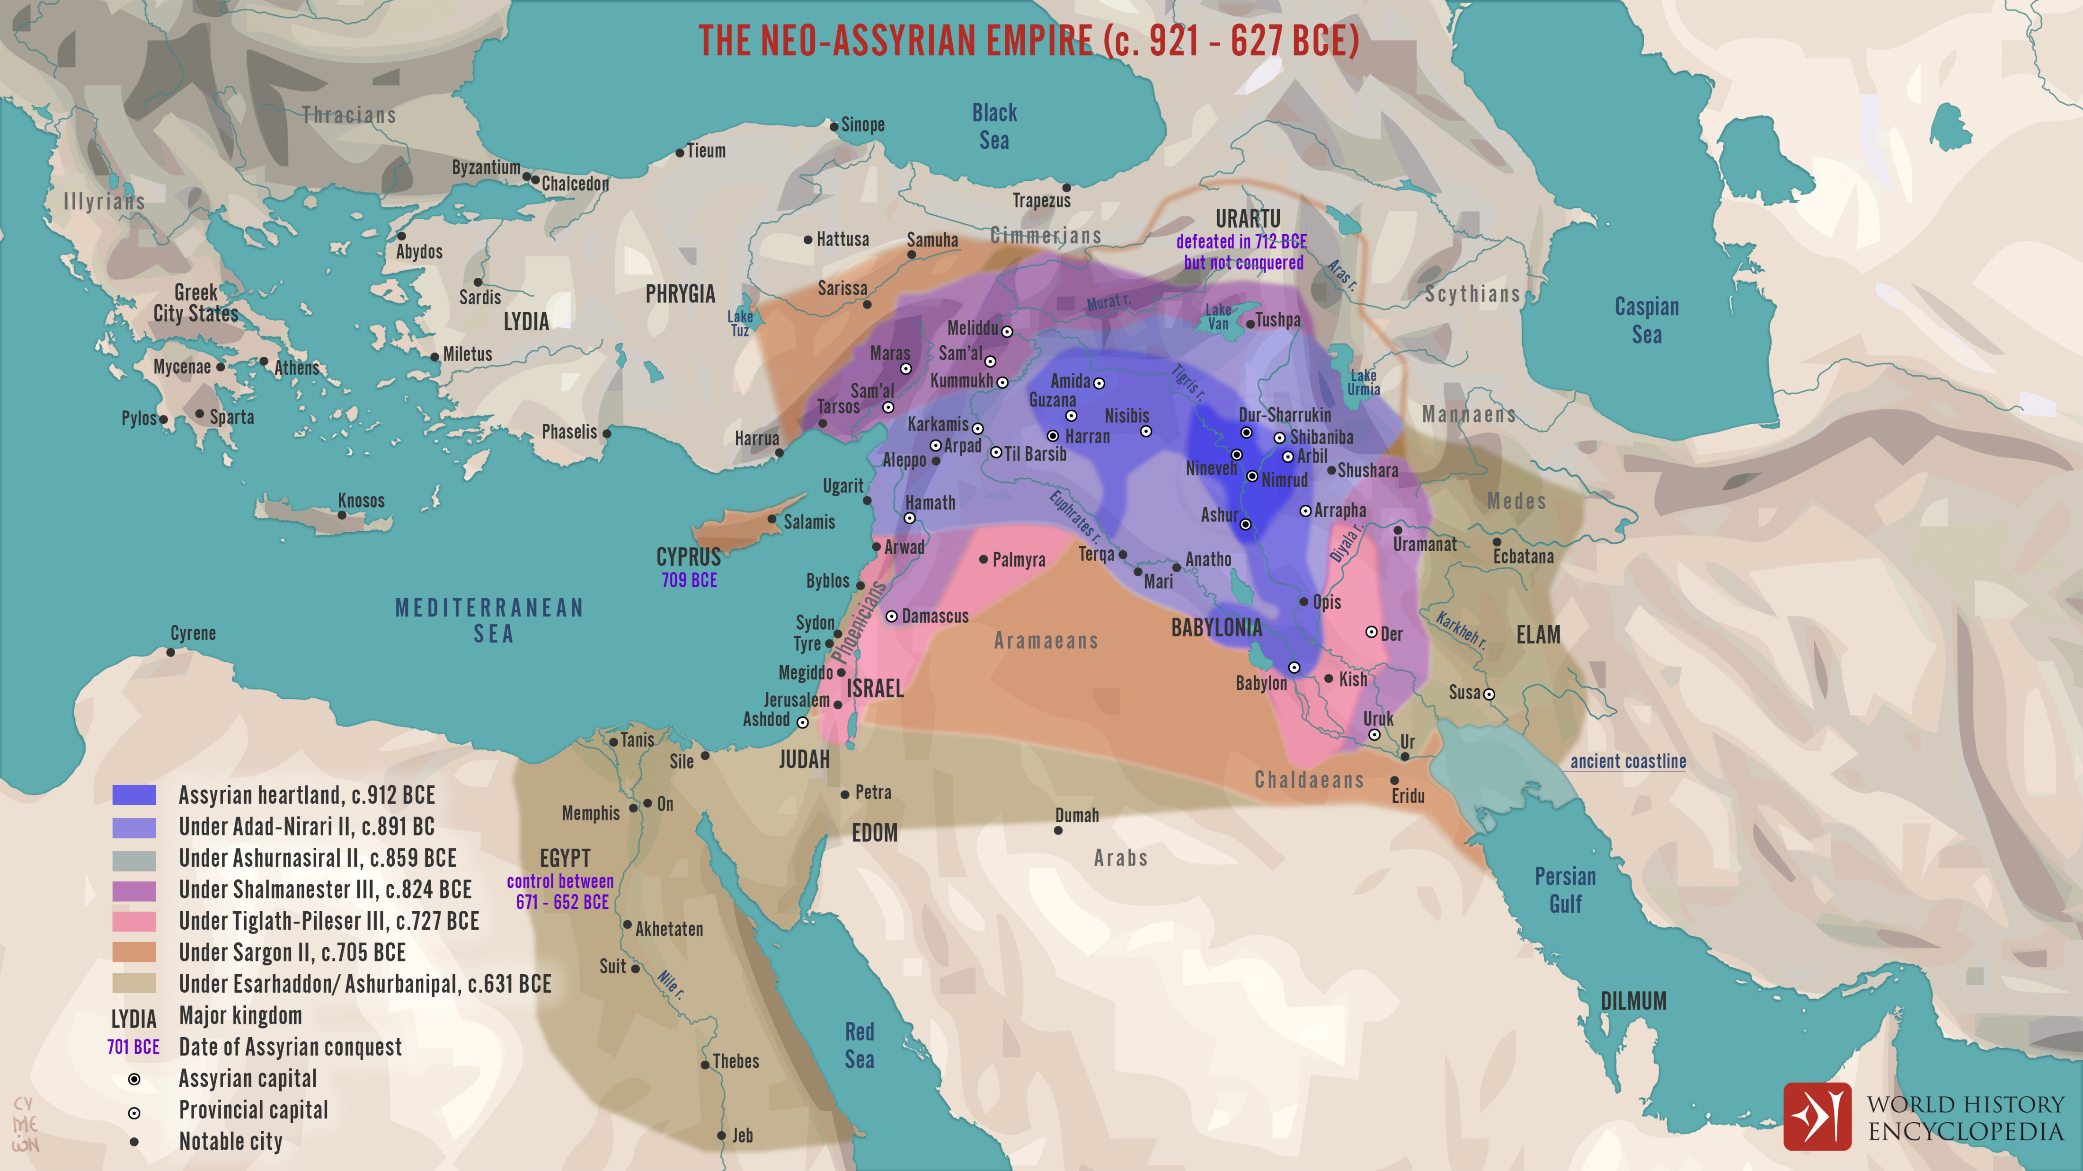

Slide 23
INTRODUCTORY MATTERS OF JONAH
Who wrote it? Jonah
When was it written? 770-750 BC
Who was it written to? Israel
Historicity of the book? Fact!
Genre of the book? Historical Narrative
What is it all about? (Message) To showcase God’s universal love and plan of redemption which extends beyond Israel to include all nations

Slide 24
A. The Preaching Prophet (3:1-10)
Jonah’s re-commission (1-2)
  God’s attributes in action (1)
  God’s Instructions (2)
Jonah’s sermon to Nineveh (3-4)
  Jonah’s obedience (3)
  Jonah’s sermon (4)
Nineveh's response (5-9)
God’s response (10)

Slide 25
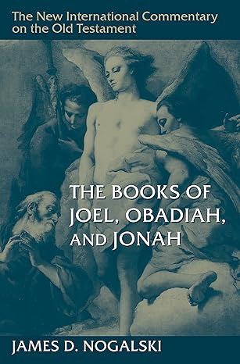
NICOT - “The Books of Joel, Obadiah, and Jonah”
“When one reads this sermon within the broader context of Jonah’s flight (ch. 1) and his chagrin at Yahweh’s mercy (ch. 4), especially in light of the statement indicating that Yahweh’s mercy was the reason Jonah fled in the first place (4:2), it becomes painfully obvious that Jonah’s lucid brevity should not be interpreted positively. Jonah is not acting out of a sense of conviction that the delivery of the message will cause the Ninevites to change their ways. Rather, Jonah’s actions should be understood as those of a child forced to do something the child does not want to do. Jonah does just enough to fulfill his commission. He was expected to deliver a message of impending judgment, and that is precisely what he does—that and nothing more. He did not want the Ninevites to change. He wants them to ignore his message so that Yahweh would be forced to follow through with the judgment as promised.”

Slide 26
A. The Preaching Prophet (3:1-10)
Jonah’s re-commission (1-2)
  God’s attributes in action (1)
  God’s Instructions (2)
Jonah’s sermon to Nineveh (3-4)
  Jonah’s obedience (3)
  Jonah’s sermon (4)
Nineveh's response (5-9)
God’s response (10)

Slide 27
INTRODUCTORY MATTERS OF JONAH
Why was it written? (Purpose) Expose Israel’s ethnocentrism and encourage national repentance
What’s in it? (Survey) Defiance (1-2) Compliance (3-4)
Christ in Jonah? Yes, through Messianic typology
What makes this book unique? 5 unique things
Structure/outline of the book?

Slide 28
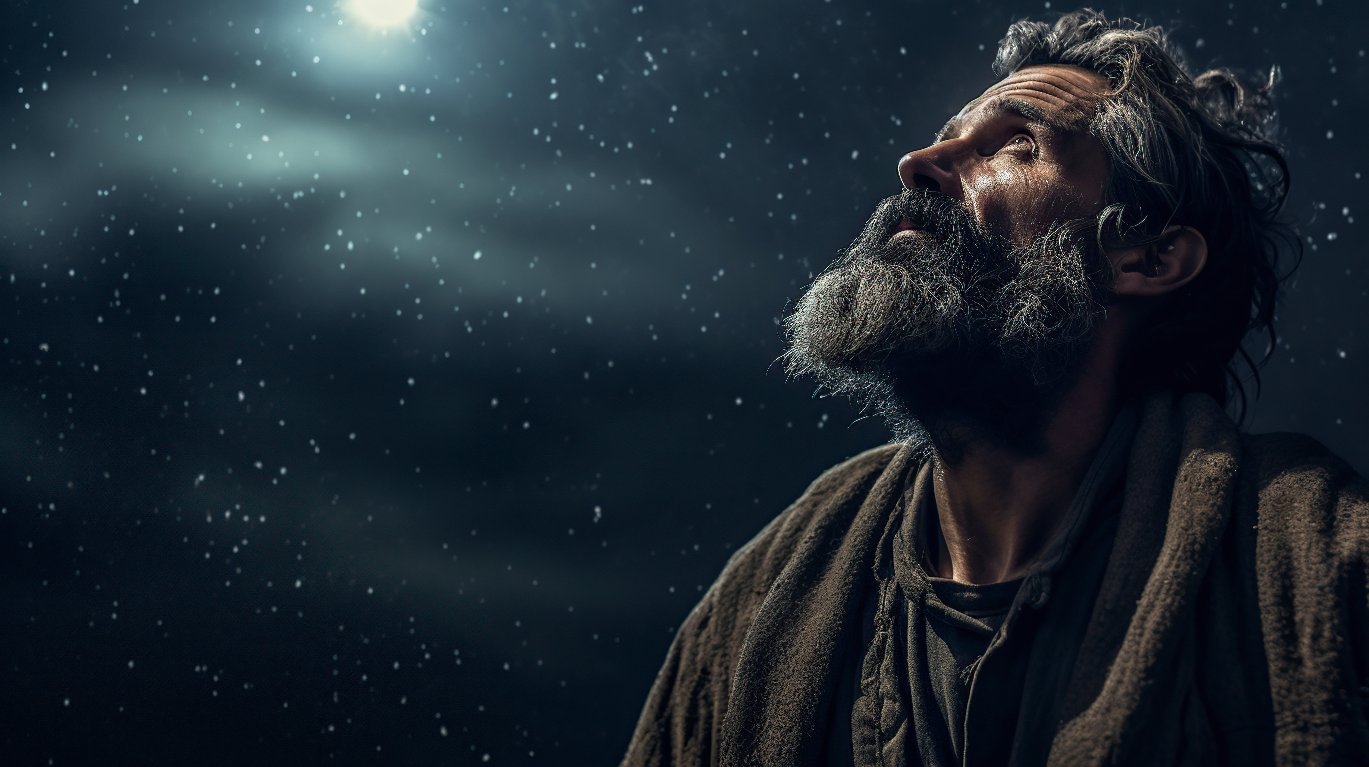
“Then he believed in the LORD; and He reckoned it to him as righteousness.”
Genesis 15:6
Cf. Then the people of Nineveh believed in God; and they called a fast and put on sackcloth from the greatest to the least of them.
Jonah 3:5

Slide 29
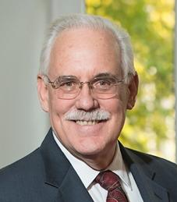

“How Were People Saved in the Old Testament”
“Faith was the necessary condition for salvation in the OT as well as in the New: “And the people of Nineveh believed God…And Abraham believed in the LORD and He counted it to him as righteousness” (Genesis 15:6). This is not a generic faith in the existence of God, but rather, a specific faith in the revelation of the true God who is the sole origin of salvation. “Salvation belongs to the Lord” (Jonah 2:9).

Slide 30

“Revival At Nineveh”
““They believed in God. The Hebrew term believe (יַּאֲמִ֛ינוּ) means to trust, believe, accept as true, or to rely upon. When used as a verb, believe indicates the response of belief or trust in regard to facts, words, or people (Gen 15:6; Isa 28:16)… Faith always requires an object, and the object of the Ninevites trust was in the God of the Bible, Yahweh, due to the message of his prophet. As a result, the Ninevites experienced deliverance in every sense of the word, physically and spiritually (Jon 4:10).”

Slide 31
“The men of Nineveh will stand up with this generation at the judgment, and will condemn it because they repented at the preaching of Jonah; and behold, something greater than Jonah is here.
Matthew 12:41c

Slide 32
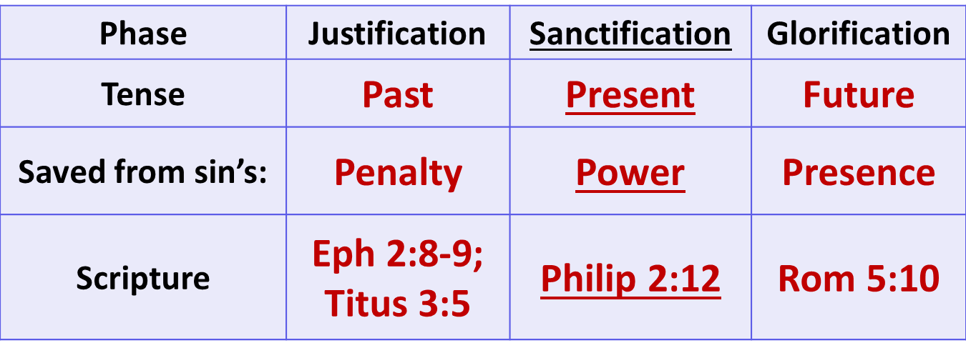
The 3 Phases of Salvation

Slide 33
Conclusion

