Slide 1
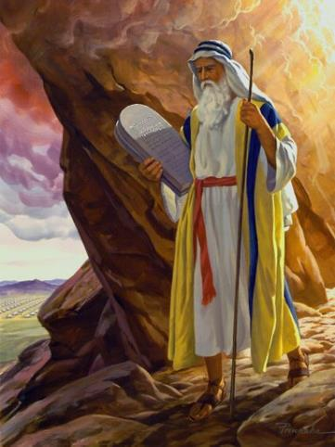
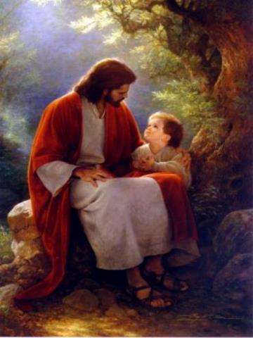
Law and Grace: An Overview Jim McGowan, Th.D. Sugar Land Bible Church 03-15-2026
…but grace and truth were realized through Jesus Christ - John 1:17
For the Law was given through Moses…
Special thanks to Dr. Vern Peterman for access to his insights and resources.

Slide 2
Session 48 Outline
Review
Purpose, Aim, and Objective
Session 47
Faith and Believing – Matthew 9:18-38
General Information
Matthew 9:18-38
Concluding Observations

Slide 3

OUR PURPOSE, AIM AND OBJECTIVE
Law and Grace
…is to Compare and Contrast Law and Grace so as to properly understand these two important themes and how they are related to the life of the New Testament Believer.

Slide 4
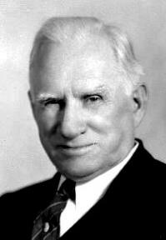
William R. Newell
Romans Verse-by-Verse (p. 274).
Grand Rapids, MI: Christian Classics Ethereal Library.
It is because Reformed theology has kept us Gentiles under the Law,—if not as a means of righteousness, then as “a rule of life,” that all the trouble has arisen. The Law is no more a rule of life than it is a means of righteousness. Walking in the Spirit has now taken the place of walking by ordinances. God has another principle under which He has put his saints: “Ye are not under law, but, under grace! (Rom. 6:14)” (italics mine)
PDF Download Here: https://archive.org/details/Romans_Verse_By_Verse-NewellWR

Slide 5

Henry Ironside
The Continual Burnt Offering: Daily Meditations on the Word of God (p. 265). Neptune, NJ: Loizeaux Brothers.
In Romans 7 we have a man renewed by the Spirit of God, but struggling under law, hoping thereby to subdue or find deliverance from the power of the old Adamic nature. In chapter 8 we have God’s way of deliverance through the death and resurrection of Christ with which the believer is identified before God. The chapter begins with “no condemnation” and ends with “no separation.”
All who are in Christ Jesus are accepted in the Beloved and as free from every charge of guilt as He is Himself. He paid our penalty on the cross. Now we are linked up with Him in resurrection, not under law but under grace.

Slide 6
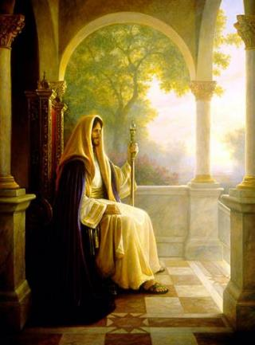
Matthew’s 3-Fold Purpose
Law and Grace: Review - Matthew
To explain to his believing Jewish brethren:
that Jesus was indeed the long-awaited Jewish Messiah;
why the kingdom had been postponed despite the fact that the king had arrived;
and, the interim program of God during the kingdom’s postponement.

Slide 7



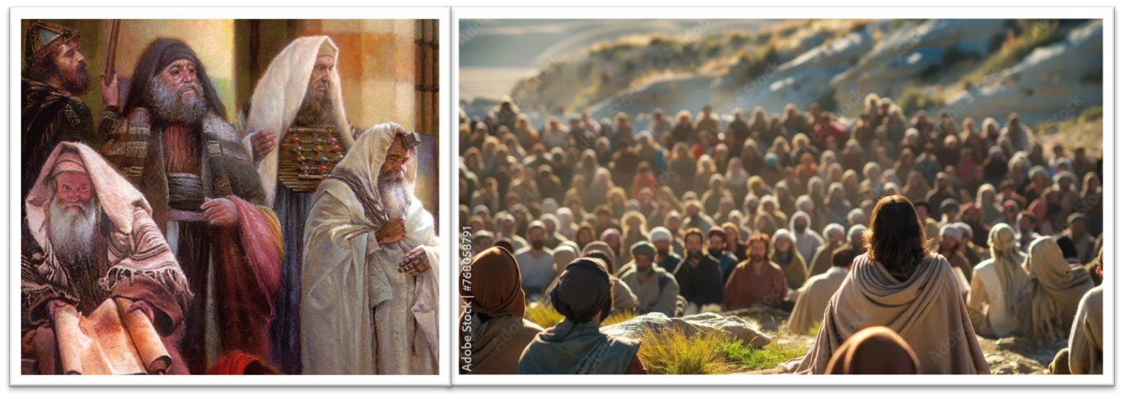
Matthew 5:20
“For I say to you that unless your righteousness surpasses that of the scribes and Pharisees, you will not enter the kingdom of heaven.”

Slide 8
THE MOSAIC (LAW) & NEW (GRACE) COVENANT CONTRASTS
1. Economy | (Old) | New | v. 6
2. Type | Letter | Spirit | v. 6
3. Result Manward | Death | Life | v. 6
4. Vehicle | Stone | Spirit | v. 7
5. Result Godward | Some Glory | Greater Glory | vv. 7, 8, 10
6. Purpose | Condemnation | Righteousness | v. 9
7. Duration | Temporary | Permanent | v. 11
8. Symbol | Veil | Mirror | vv. 13–18
9. Initiator | Moses | Christ | vv. 12–14
Constable, T. (2003). Tom Constable’s Expository Notes on the Bible (2 Co 3:10). Galaxie Software

Slide 9
Session 48 Outline
Review
Purpose, Aim, and Objective
Session 47
Faith and Believing – Matthew 9:18-38
General Information
Matthew 9:18-38
Concluding Observations

Slide 10
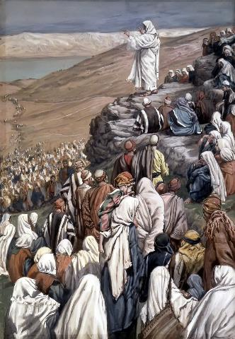

Law and Grace: Review Session 47: Forgiving Sins
TO WHOM IS JESUS SPEAKING?
Roses are red
And violets are bluish
Those to whom Jesus is speaking are Jewish!

Slide 11
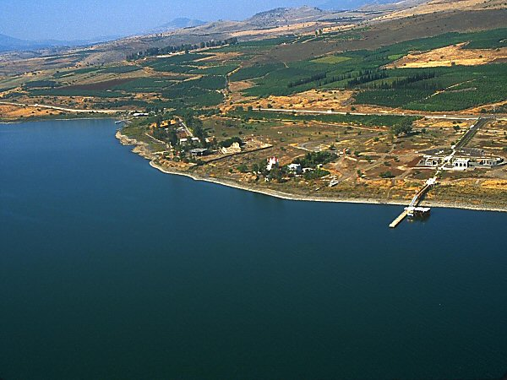
Law and Grace: Review Session 47: Forgiving Sins
JESUS RETURNED BY BOAT BACK TO - CAPERNAUM
Matthew 9:1

Slide 12
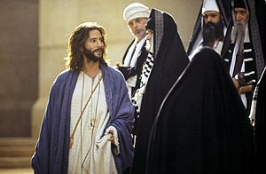
Law and Grace: Review Session 47: Forgiving Sins
AN UNSPOKEN ACCUSATION ARISING FROM A MIRACLE
Matthew 9:2-8
Jesus had not incurred religious opposition in chapter 8, but in chapter 9, we encountered the first of 3 instances of opposition to His ministry manifested when the Scribes and the Pharisees accused Jesus of blaspheming for ‘forgiving the sins’ of the paralytic (vv. 2-8).

Slide 13

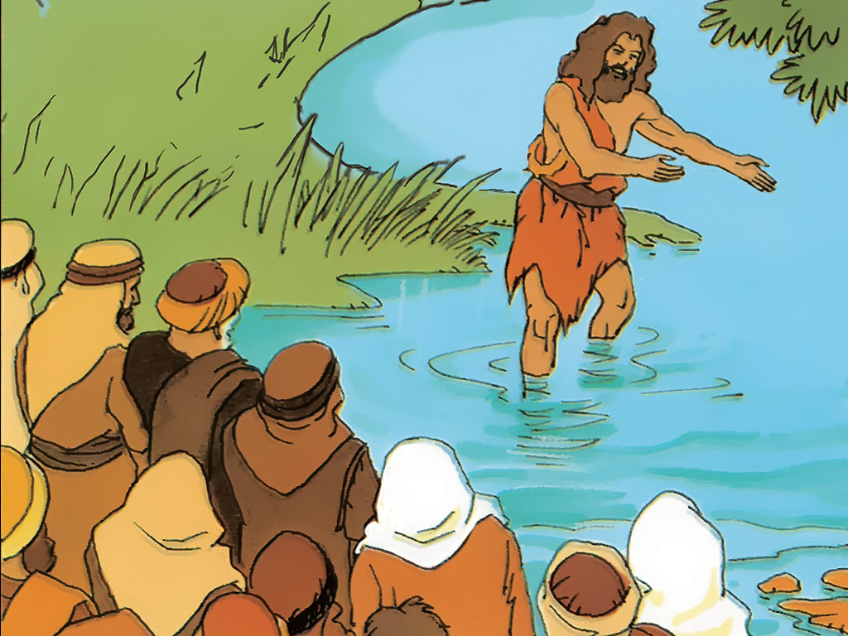
Law and Grace: Review Session 47: Forgiving Sins
TWO ISSUES NOT ARISING FROM MIRACLES
Matthew 9:9-17
Then in vv. 9-17, we noted 2 additional issues that arose:
Vs. 9-13: Jesus calls Matthew, the tax collector, and the Pharisees question His disciples about eating with the tax collectors and sinners.
Vs. 14-17: the disciples of both John the Baptist and the Pharisees ask Jesus why it is that they fast, but they don’t see Jesus disciples fasting according to Jewish tradition.

Slide 14
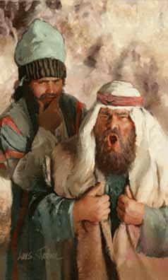
Law and Grace: Review Session 47: Forgiving Sins
DID THE PHARISEES RECOGNIZE THEIR SPIRITUAL NEED?
Matthew 9:1-17
The Pharisees did not recognize their need for a Savior because they believed their competence in the Law of Moses and the traditions was totally adequate to meet their needs, so they rejected Christ.

Slide 15
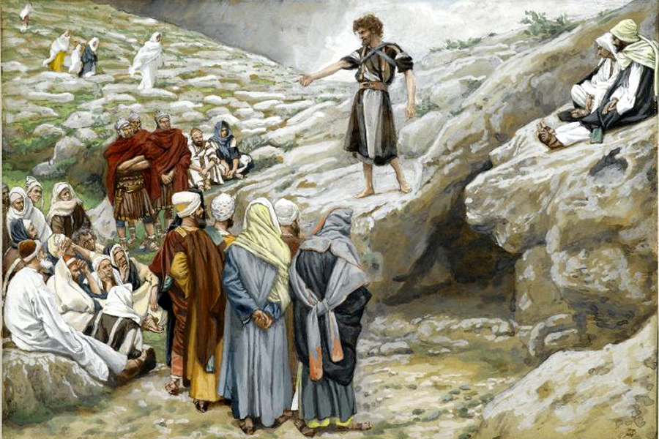
Law and Grace: Review Session 47: Forgiving Sins
DID JOHN’S DISCIPLES RECOGNIZE SPIRITUAL THEIR NEED?
Matthew 9:1-17
John the Baptist’s disciples recognized their need to the point of being John’s disciples.
But they didn’t see their greater need for the One to whom John had been pointing!
“Behold the Lamb of God!”
“He must increase and I must decrease!”

Slide 16
Session 48 Outline
Review
Purpose, Aim, and Objective
Session 47
Faith and Believing – Matthew 9:18-38
General Information
Matthew 9:18-38
Concluding Observations

Slide 17






Law and Grace: Session 48 – Faith and Believing
SIX THINGS JESUS DOES
Matthew 9:18-38

Slide 18
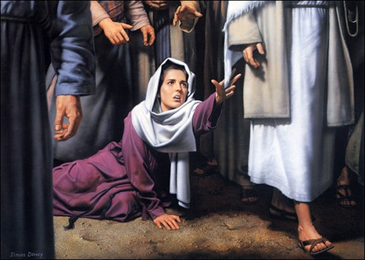
Law and Grace: Session 48 – Faith and Believing
SIX THINGS JESUS DOES
Matthew 9:18-38
Stops a woman’s chronic blood loss…

Slide 19
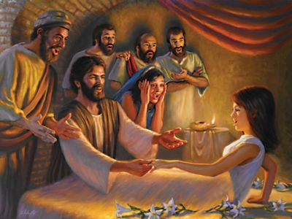
Law and Grace: Session 48 – Faith and Believing
SIX THINGS JESUS DOES
Matthew 9:18-38
Raises Jairus’ once dead daughter… (cf. Mark 5:22–43; Luke 8:41–56)

Slide 20
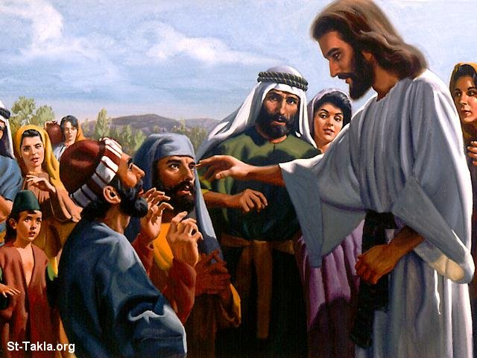
Law and Grace: Session 48 – Faith and Believing
SIX THINGS JESUS DOES
Matthew 9:18-38
Heals two blind men see…

Slide 21
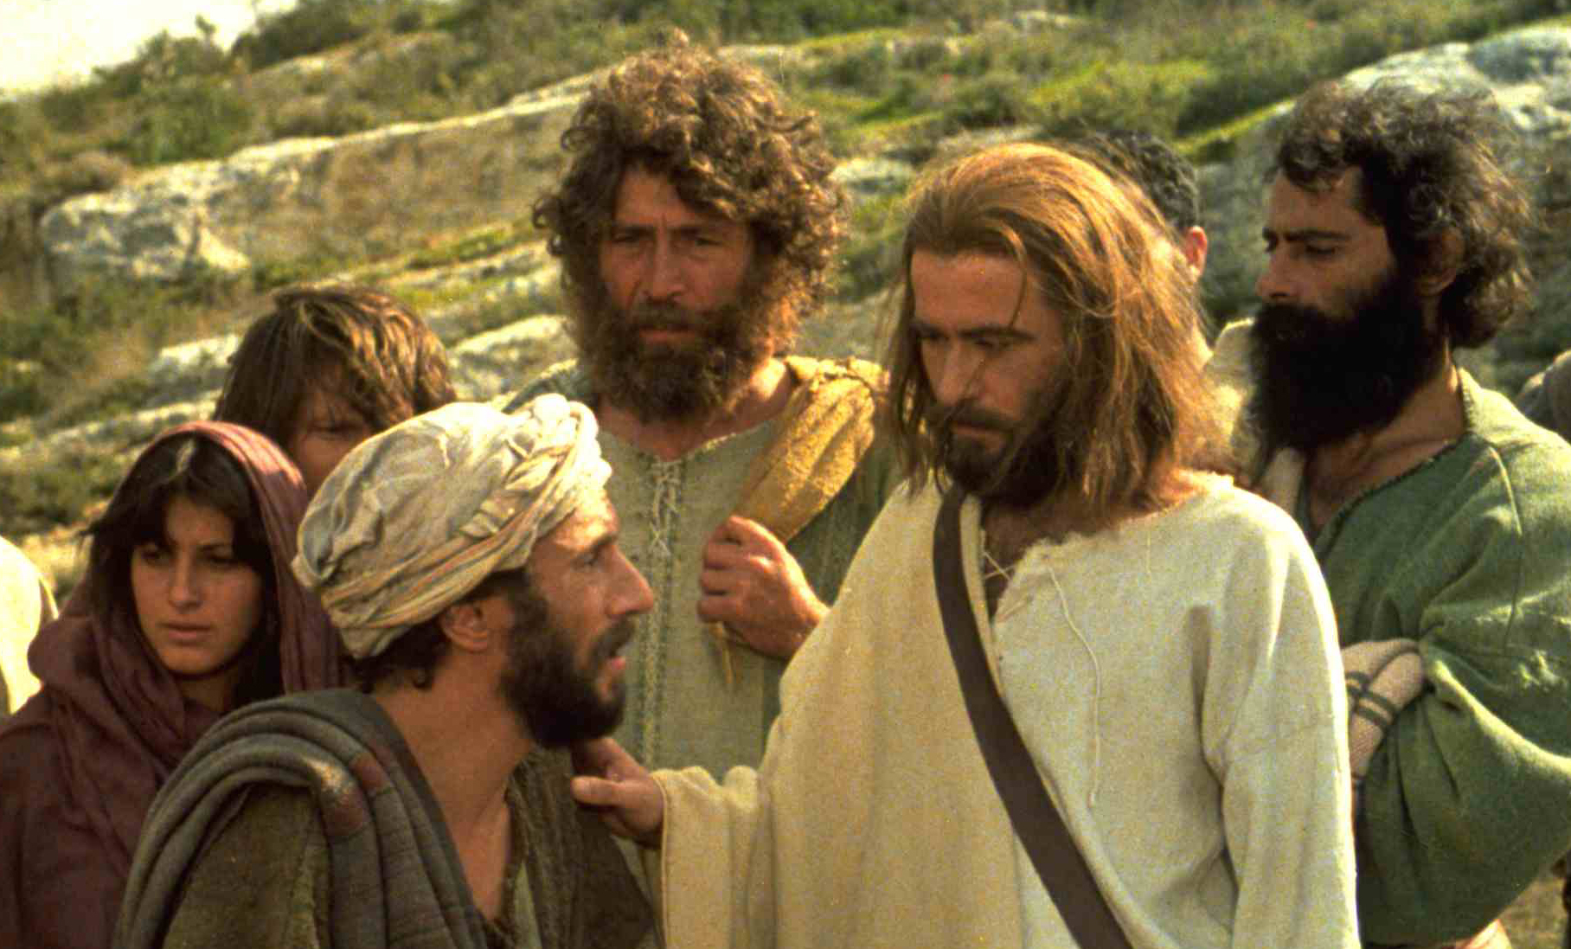
Law and Grace: Session 48 – Faith and Believing
SIX THINGS JESUS DOES
Matthew 9:18-38
Delivers a man, demon possessed and mute. . .

Slide 22
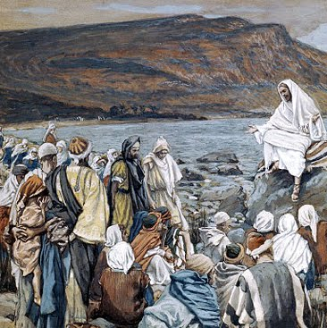
Law and Grace: Session 48 – Faith and Believing
SIX THINGS JESUS DOES
Matthew 9:18-38
Extensively teaches, proclaims the kingdom, and heals. . .

Slide 23
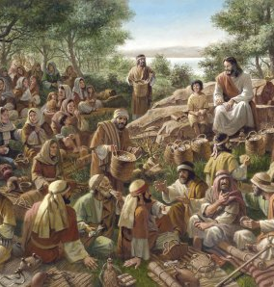
Law and Grace: Session 48 – Faith and Believing
SIX THINGS JESUS DOES
Matthew 9:18-38
Observes the crowds and tells the disciples: PRAY!

Slide 24
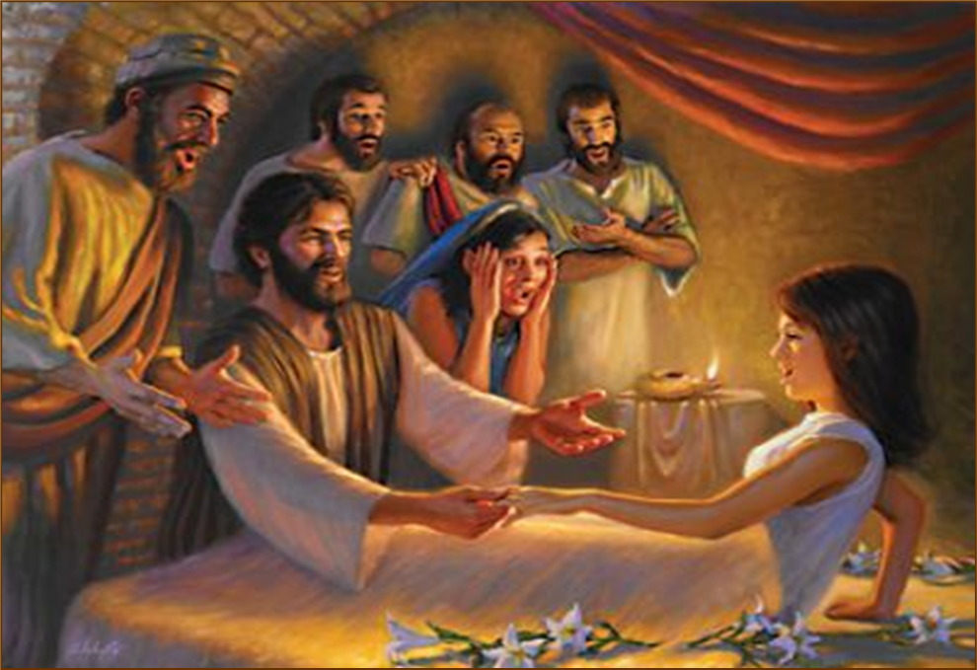
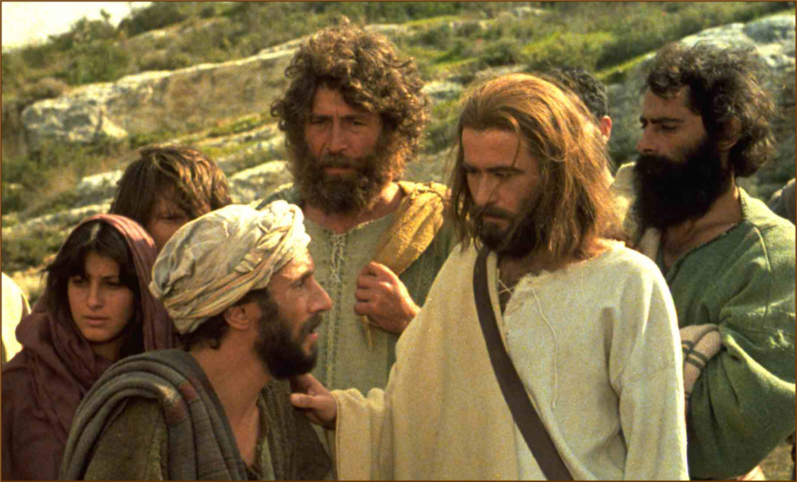
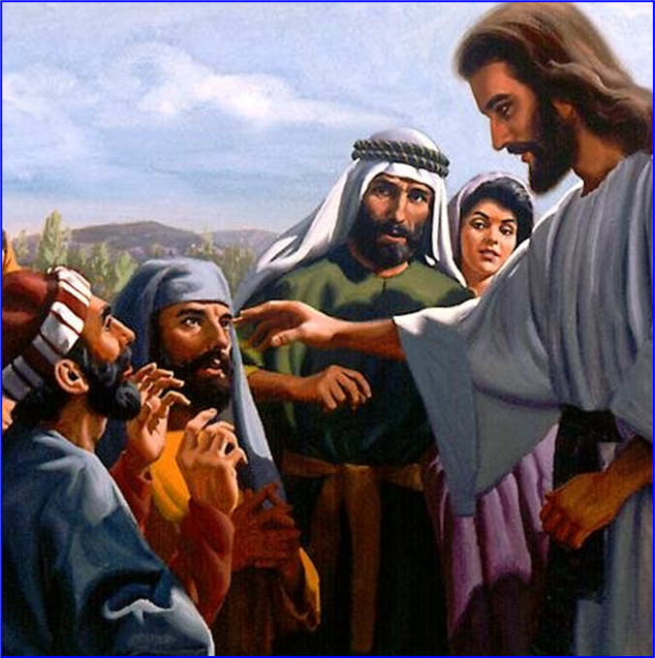
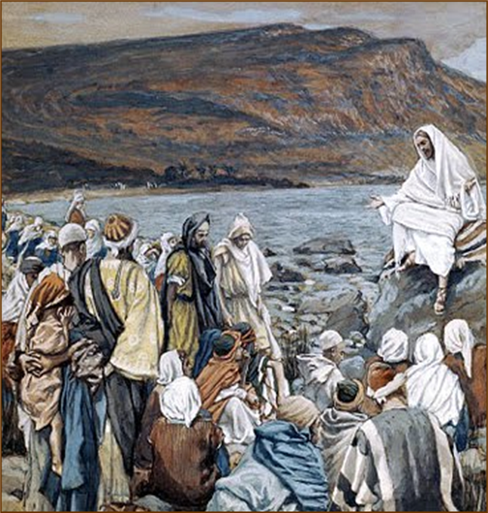
Law and Grace: Session 48 – Faith and Believing
SIX THINGS JESUS DOES
Matthew 9:18-38
His purpose: to proclaim and to validate that He, Jesus, is indeed Israel’s long-promised Messiah.

Slide 25
Session 48 Outline
Review
Purpose, Aim, and Objective
Session 47
Faith and Believing – Matthew 9:18-38
General Information
Matthew 9:18-38
Concluding Observations

Slide 26
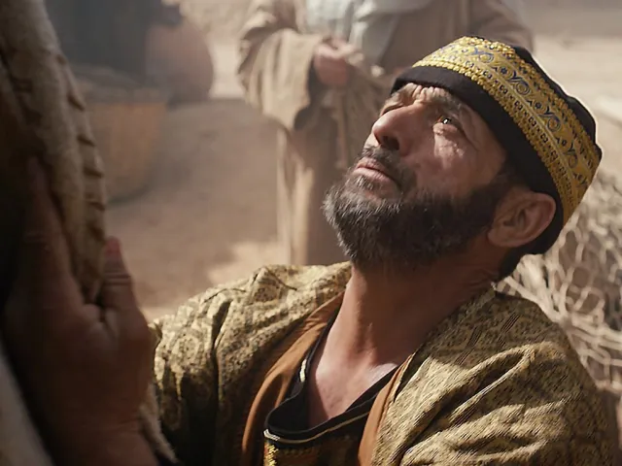
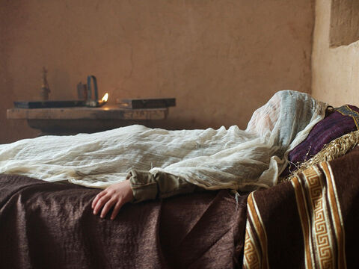
Matthew 9:18
¹⁸ While He was saying these things to them, (a reference to John’s disciples cf. vv.14-17) a synagogue official came and bowed down before Him, and said, “My daughter has just died; but come and lay Your hand on her, and she will live.”

Slide 27
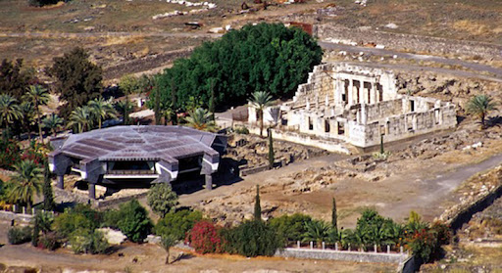
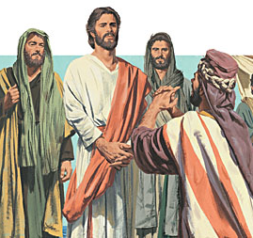
Law and Grace: Session 48 – Faith and Believing
FIRST, THE SYNAGOGUE LEADER COMES
Matthew 9:18
The synagogue official (ἄρχων árchōn), who is very likely the leader at the synagogue in Capernaum, comes to Jesus, bowing to Him and asking that Jesus come to raise his daughter from the dead!

Slide 28
Law and Grace: Session 48 – Faith and Believing
FIRST, THE SYNAGOGUE LEADER COMES
Matthew 9:18
This account is also found in Mark 5:22-42 and Luke 8:41-56, where we find that the synagogue official (ἄρχων árchōn), is named Jairus, and HE FIRST CAME TO JESUS ASKING FOR HEALING, only later to learn that his daughter had died.

Slide 29

Matthew 9:19-22
… ¹⁹ Jesus got up and began to follow him, and so did His disciples. ²⁰ And a woman who had been suffering from a hemorrhage for twelve years, came up behind Him and touched the fringe of His cloak; ²¹ for she was saying to herself, “If I only touch His garment, I will get well.” ²² But Jesus turning and seeing her said, “Daughter, take courage; your faith has made you well.” At once the woman was made well….

Slide 30
Law and Grace: Session 48 – Faith and Believing
AS JESUS AND THE DISCIPLES ARE GOING…
Matthew 9:19-22
As Jesus and His disciples are going to Jairus’ house, along with a great and pressing crowd, a woman who had a chronic flow of blood just touches Jesus’ garment – and Jesus knows it.

Slide 31
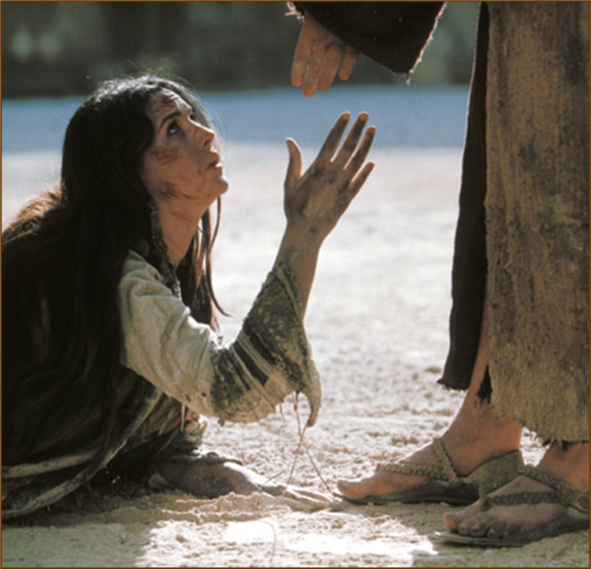
Law and Grace: Session 48 – Faith and Believing
AS JESUS AND THE DISCIPLES ARE GOING…
Matthew 9:19-22
She had suffered with this condition for 12 years, but Jesus encourages her, making note that her faith has made her well. (cf. Mark 5:25-34; Luke 8:43-48)

Slide 32

Law and Grace: Session 48 – Faith and Believing
JAIRUS, YOU’RE TOO LATE...
Matthew 9:23-26
During the delay caused by the woman and the crowd, Jairus’ only daughter has now died – so Jairus’ servants tell him not to bother Jesus. (cf. Mark 5:22-42; Luke 8:41-56)

Slide 33
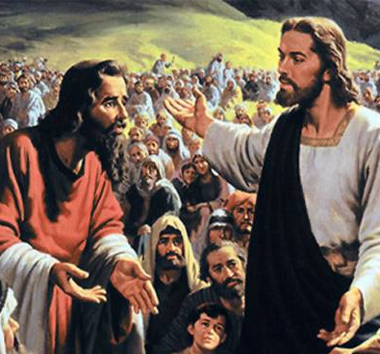
Law and Grace: Session 48 – Faith and Believing
JAIRUS, YOU’RE TOO LATE...
Matthew 9:23-26
Jesus, however, assures Jairus that he need not be afraid, but only believe, so they press on to the house.

Slide 34
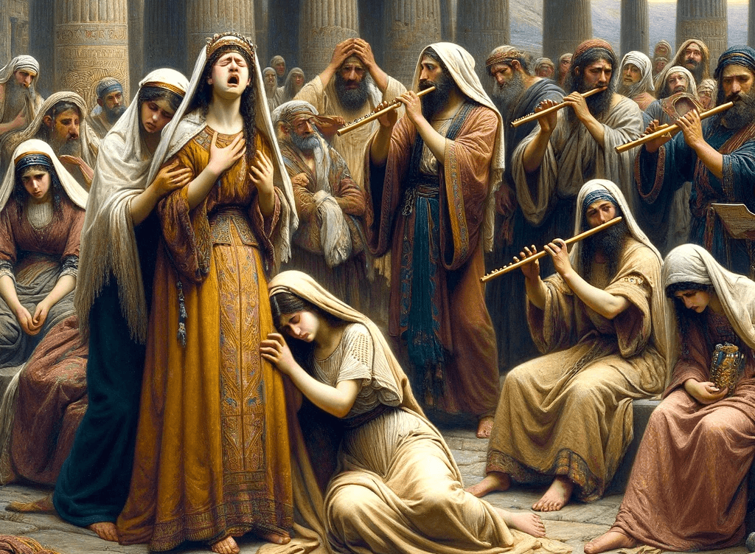
Matthew 9:23-26
… ²³ When Jesus came into the official’s house, and saw the flute-players and the crowd in noisy disorder, ²⁴ He said, “Leave; for the girl has not died, but is asleep.” And they began laughing at Him. ²⁵ But when the crowd had been sent out, He entered and took her by the hand, and the girl got up. ²⁶ This news spread throughout all that land….

Slide 35
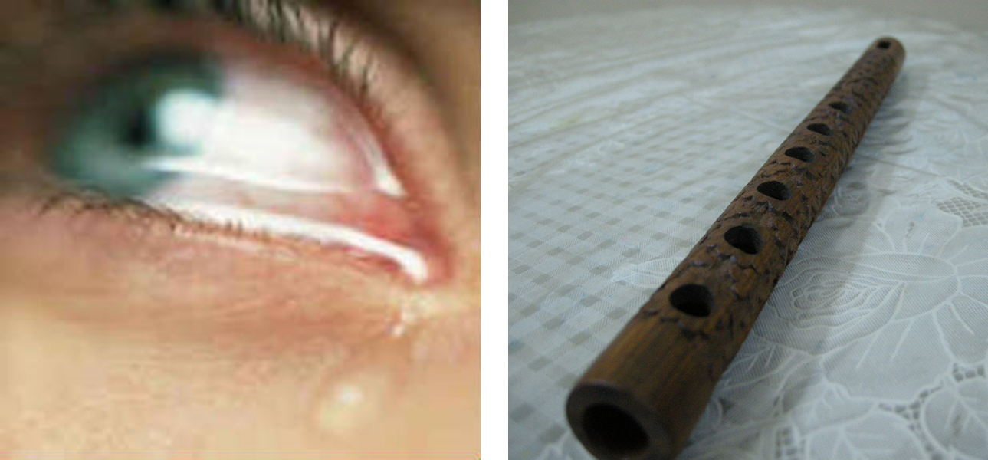
Law and Grace: Session 48 – Faith and Believing
BOO-HOO...
Matthew 9:23-26
The wailers and flute players for hire are already busy with their mournful noise, . . .

Slide 36
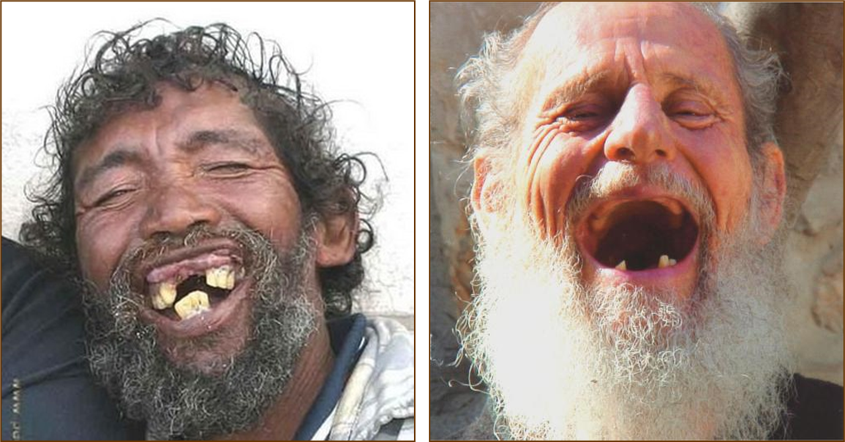
Law and Grace: Session 48 – Faith and Believing
...HA! HA! HA!
Matthew 9:23-26
. . .but when Jesus tells everyone that the girl is just sleeping, ‘Boo-hoo’ turns to ‘Ha! Ha! Ha!’.

Slide 37
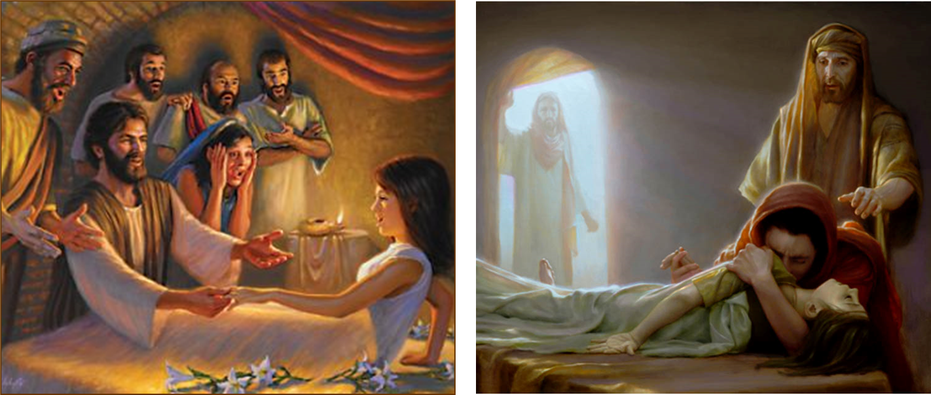
Law and Grace: Session 48 – Faith and Believing
A PRIVILEGED FEW
Matthew 9:23-26
Jesus brings only the girl’s parents, Peter, James, and John into the room, takes her hand, raises her from death, issues a command, and then a charge to get her something to eat.

Slide 38
Law and Grace: Session 48 – Faith and Believing
SAY NOTHING!
Matthew 9:23-26
Jesus says to tell no one what happened (cf. Mark 5:32; Luke 8:56).

Slide 39
Matthew 9:27-31
... ²⁷ As Jesus went on from there, two blind men followed Him, crying out, “Have mercy on us, Son of David!” ²⁸ When He entered the house, the blind men came up to Him, and Jesus said to them, “Do you believe that I am able to do this?” They said to Him, “Yes, Lord.” ²⁹ Then He touched their eyes, saying, “It shall be done to you according to your faith.” ³⁰ And their eyes were opened. And Jesus sternly warned them: “See that no one knows about this!” ³¹ But they went out and spread the news about Him throughout all that land.” . . .

Slide 40
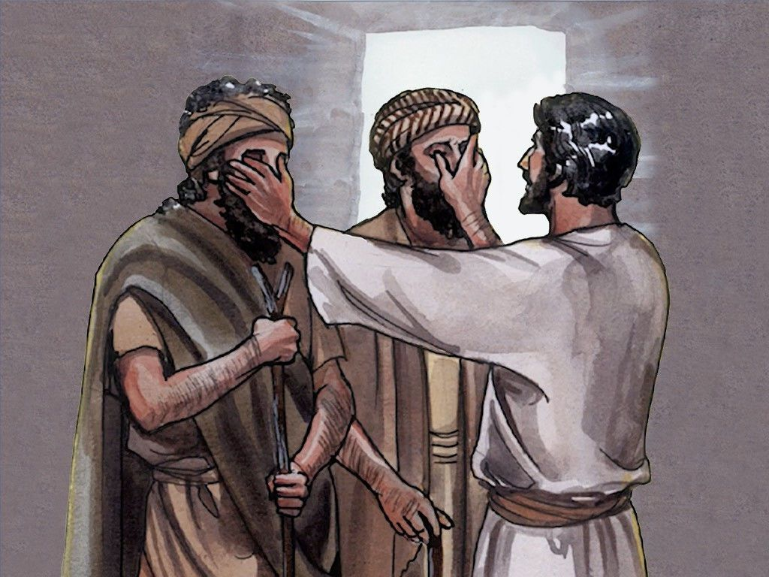
Law and Grace: Session 48 – Faith and Believing
TWO BLIND MEN SEE
Matthew 9:27-31
Two blind men approach Jesus, begging for him to have mercy, calling Him the ‘Son of David’, a term for the Messiah.

Slide 41
Law and Grace: Session 48 – Faith and Believing
TWO BLIND MEN SEE
Matthew 9:27-31
Jesus asks these two if they believe that He can restore their sight, and they responded, “Yes, Lord”, so for their faith He healed them.

Slide 42
Law and Grace: Session 48 – Faith and Believing
TWO BLIND MEN SEE
Matthew 9:27-31
Jesus orders them to tell no one what has happened, but they go about doing just the opposite, telling everyone they can.

Slide 43
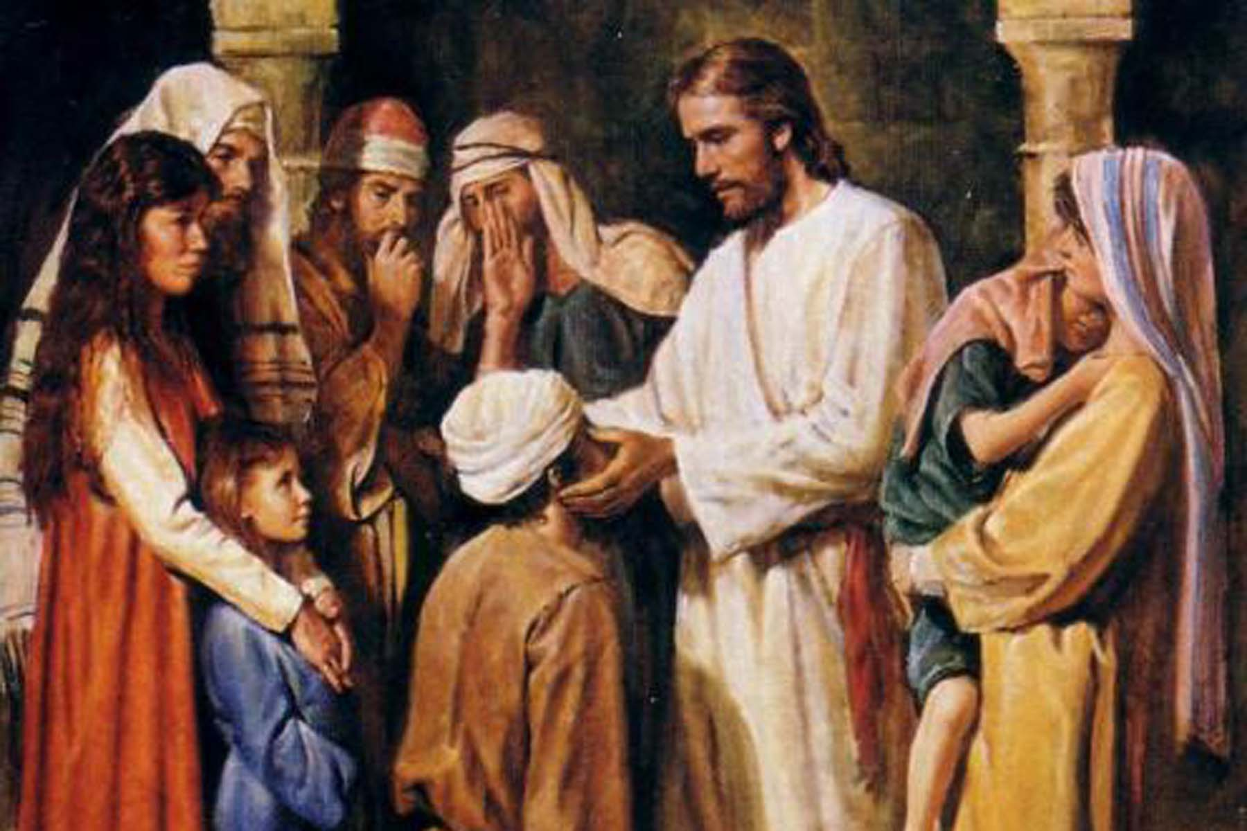
Matthew 9:32-34
³² As they were going out, a mute, demon-possessed man was brought to Him. ³³ After the demon was cast out, the mute man spoke; and the crowds were amazed, and were saying, “Nothing like this has ever been seen in Israel.” ³⁴ But the Pharisees were saying, “He casts out the demons by the ruler of the demons.”

Slide 44
Law and Grace: Session 48 – Faith and Believing
HELP! I’M DEMON-POSSESSED AND CAN’T TALK ABOUT IT!
Matthew 9:32-34
A man is brought to Jesus who is unable to speak, apparently from a demon that has possessed him.

Slide 45
Law and Grace: Session 48 – Faith and Believing
HELP! I’M DEMON-POSSESSED AND CAN’T TALK ABOUT IT!
Matthew 9:32-34
Jesus cast out the demon and the man is then able to speak and the crowds are astonished at this.

Slide 46
Law and Grace: Session 48 – Faith and Believing
HELP! I’M DEMON-POSSESSED AND CAN’T TALK ABOUT IT!
Matthew 9:32-34
The Pharisees, are not impressed by this and proclaim that Jesus casts out demons by the prince of demons (Satan).

Slide 47
Law and Grace: Session 48 – Faith and Believing
THE BEGINNING OF THE ACCUSATION – BUT NOT THE END OF IT!
Matthew 9:32-34
The Pharisees are just beginning to make this serious accusation, but it will not be the last.

Slide 48
Law and Grace: Session 48 – Faith and Believing
THE BEGINNING OF THE ACCUSATION – BUT NOT THE END OF IT!
Matthew 9:32-34
This same serious accusation will appear again when we get to Matthew 12:22-32 and encounter ‘the unforgivable sin’.

Slide 49
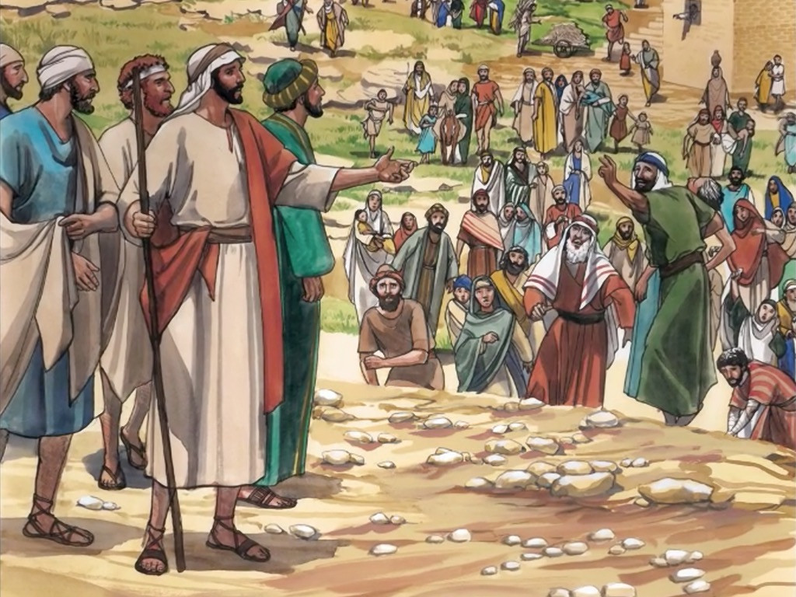
Matthew 9:35
³⁵ “Jesus was going through all the cities and villages, teaching in their synagogues and proclaiming the gospel of the kingdom, and healing every kind of disease and every kind of sickness.”…

Slide 50
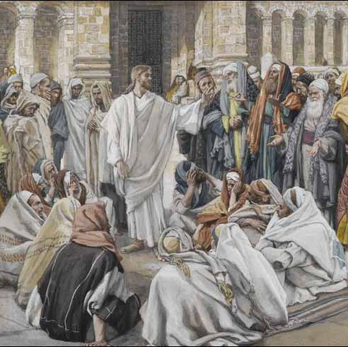
Law and Grace: Session 48 – Faith and Believing
WHAT IS HE DOING?!
Matthew 9:35
V. 35 sums up Jesus’ authoritative teaching ministry in all the towns and villages (in Israel) in contrast to that of the scribes and the Pharisees.

Slide 51

Law and Grace: Session 48 – Faith and Believing
WHAT IS HE DOING?!
Matthew 9:35
Jesus is proclaiming the Gospel of the Kingdom – that He is the King of Israel and the kingdom is being offered.
Jesus validated His kingship by healing, casting out demons, and other miracles. (cf. Isaiah 29:18-19; 30:26; 35:5-6; 42:7; 61:1-3; Jeremiah 30:17)

Slide 52
Matthew 9:36-37
...“³⁶ Seeing the people, He felt compassion for them, because they were distressed and dispirited like sheep without a shepherd. ³⁷ Then He said to His disciples, “The harvest is plentiful, but the workers are few. ³⁸ “Therefore beseech (δέομαι déomai; to plead) the Lord of the harvest to send out workers into His harvest.”

Slide 53
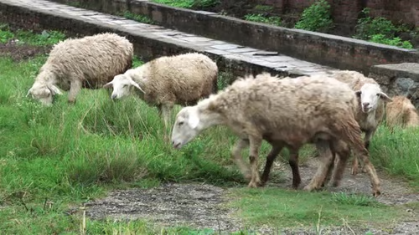
Law and Grace: Session 48 – Faith and Believing
WHAT IS HE THINKING?!
Matthew 9:36-37
Jesus saw all the people, and observed that they were very distressed and also dispirited (lacking a hopeful spirit).
He said that they were like sheep without a shepherd, a fairly common Old Testament theme for Israel’s people.

Slide 54

Zechariah 10:2
THE ‘SHEEP WITH NO SHEPHERD’ THEME IN THE OLD TESTAMENT
“Therefore the people wander like sheep, They are afflicted, because there is no shepherd.” (cf. Numbers 28:15-17, 1 Kings 22:17; 2 Chronicles 18:16; See also Mark 6:43)

Slide 55

Law and Grace: Session 48 – Faith and Believing
WHAT IS HE THINKING?!
Matthew 9:36-37
Jesus, did not see Israel’s present condition as one without remedy, but rather a spiritual opportunity and told His disciples to pray for harvest workers.

Slide 56
Session 48 Outline
Review
Purpose, Aim, and Objective
Session 47
Faith and Believing – Matthew 9:18-38
General Information
Matthew 9:18-38
Concluding Observations

Slide 57
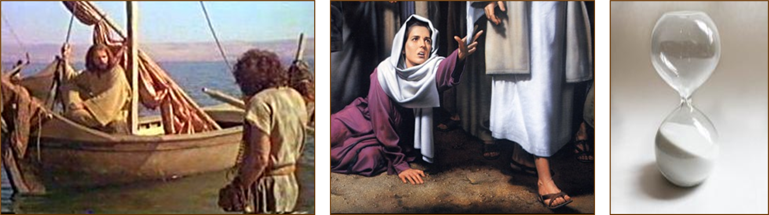
Law and Grace: Session 48 – Faith and Believing
EVER FRUSTRATED WHEN GOD ALLOWS DELAYS OR BAD NEWS?
Matthew 9:18-26
We can sympathize with the synagogue ruler, who after first waiting for Jesus to get back to the city of Capernaum, had to suffer also with the crowd, and the woman with a flow of blood, and skeptical servants.

Slide 58


Law and Grace: Session 48 – Faith and Believing
EVER FRUSTRATED WHEN GOD ALLOWS DELAYS OR BAD NEWS?
Matthew 9:18-26
Likely all of us have been through some circumstance that involved endless and countless delays and a cascade of more and more bad news.
It’s comforting to know that God has His purpose in it.
Blessed is a man who perseveres under trial; for once he has been approved, he will receive the crown of life which the Lord has promised to those who love Him. - James 1:12

Slide 59
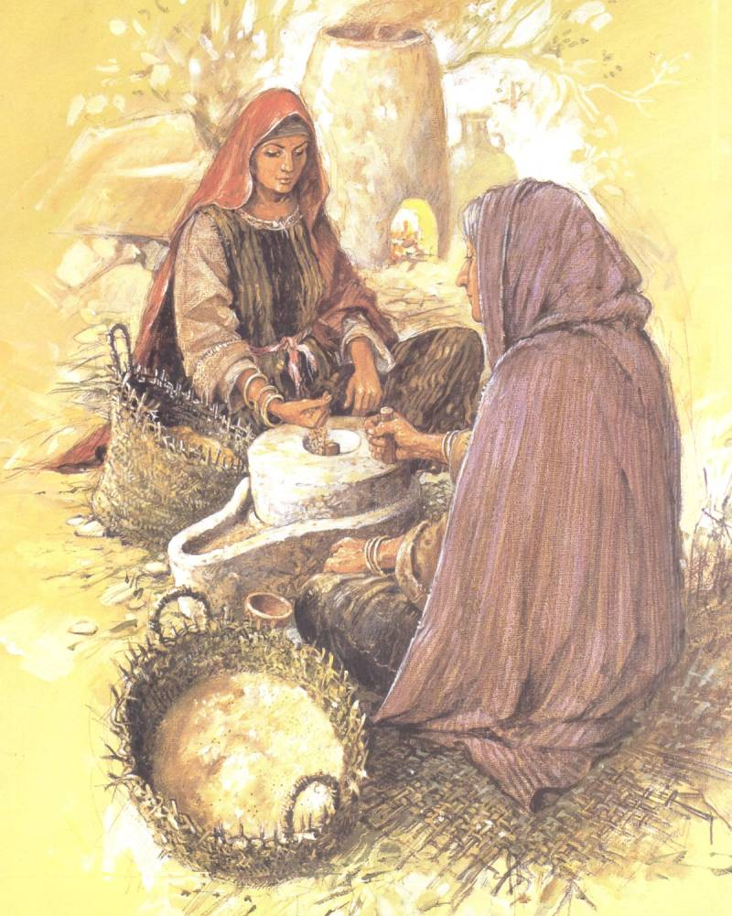
Law and Grace: Session 48 – Faith and Believing
IS GOD A CHAUVINIST; DOES GOD CARE ABOUT INDIVIDUALS?
Matthew 9:18-26
Some have claimed that the books of the Bible come from a culture that is male dominated and treats women like cattle.

Slide 60
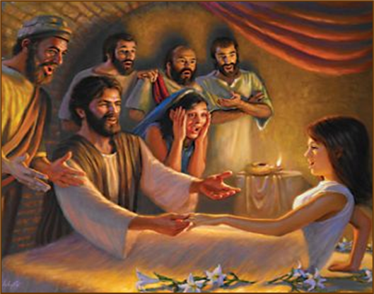
Law and Grace: Session 48 – Faith and Believing
IS GOD A CHAUVINIST; DOES GOD CARE ABOUT INDIVIDUALS?
Matthew 9:18-26
While accusation can be made of the culture, it cannot rightly be made of Christ and the God of the Bible!
In our passage today we see Jesus ministering to the family, the parents, an only child, and two individual females, a woman and a daughter.

Slide 61
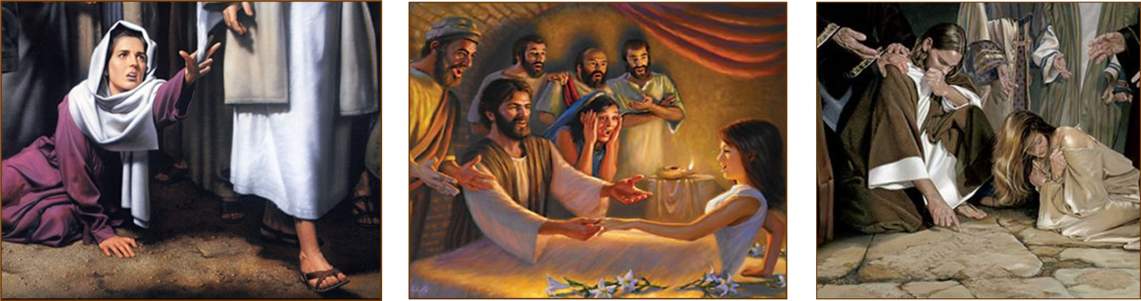
Law and Grace: Session 48 – Faith and Believing
CHRIST DOES NOT BOW TO CULTURE!
Matthew 9:18-26
Not only do we have Christ dealing with a woman and a girl with sensitivity in this passage, but the woman caught in adultery was brought to Christ for His condemnation in John 8:1-11.

Slide 62
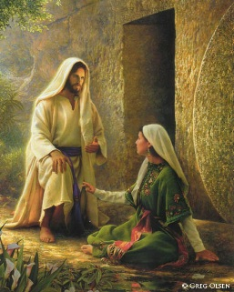
Law and Grace: Session 48 – Faith and Believing
CHRIST DOES NOT BOW TO CULTURE!
Matthew 9:18-26
The first witnesses of the resurrection of Christ were all ‘unreliable’ women!

Slide 63
Law and Grace: Session 48 – Faith and Believing
WHY DID JESUS SAY ‘DON’T TALK’
Matthew 9:18-38
Jesus was not campaigning for public office – He knew that the motives and intentions of the people were earthly-oriented and not God-oriented and they would attempt to compel Him to conform to their self-serving plans of a Conquering Messiah.
“Jesus answered them and said, “Truly, truly, I say to you, you seek Me, not because you saw signs, but because you ate of the loaves and were filled.” - John 6:26

Slide 64
Law and Grace: Session 48 – Faith and Believing
WHY DID JESUS SAY ‘DON’T TALK’
Matthew 9:18-38
Obviously, Jesus knew that these Israelites were going to go tell people anyway.
But out of His graciousness He never threatened them or reversed His miracles because as we have pointed out, His miracles were an undeniable confirmation of His prophetic claim to be the Messiah.

Slide 65
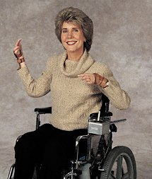
Law and Grace: Session 48 – Faith and Believing
DOES A LACK OF FAITH = NO HEALING?
Matthew 9:18-38
Some Christians have taken these kinds of passages as the basis to tell those with a chronic debilitation that the reason that there was no healing was due to lack of faith.

Slide 66
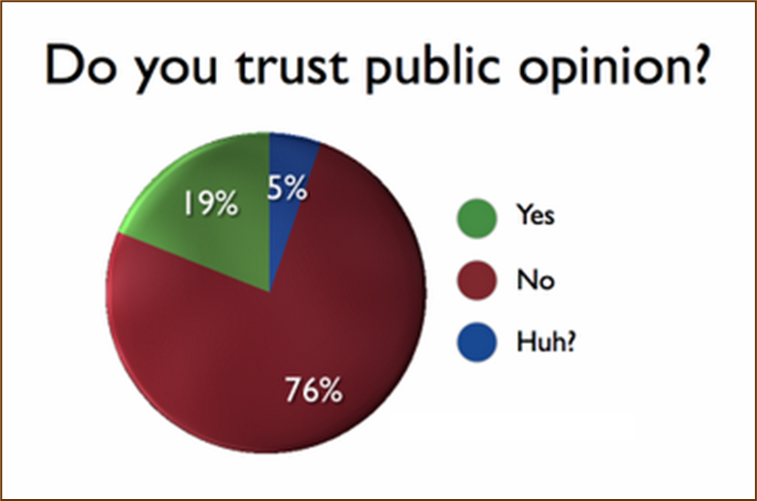
Law and Grace: Session 48 – Faith and Believing
HOW OFTEN DOES THE CROWD HAVE IT RIGHT?
Matthew 9:18-38

Slide 67
Law and Grace: Session 48 – Faith and Believing
HOW OFTEN DOES THE CROWD HAVE IT RIGHT?
Matthew 9:18-38
Jesus obviously dealt with crowds as well, often being deliberate in getting away from them!
But while Jesus sometimes interacts with the crowds, we see that the spiritual insight of the crowd was rarely ‘on target’.

Slide 68

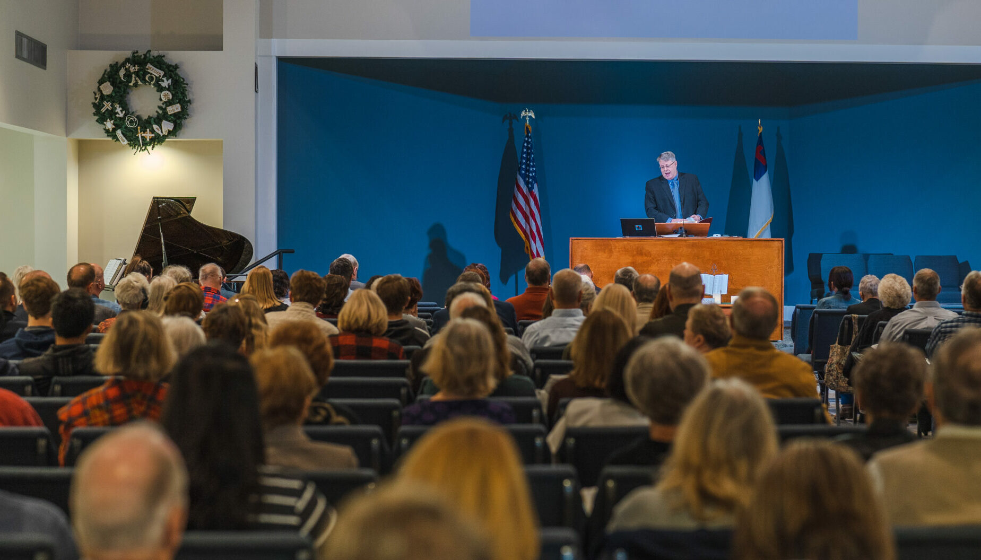
Law and Grace: Session 48 – Faith and Believing
CHRIST LOVES THE CHURCH AND EVERY INDIVIDUAL IN IT!
Matthew 9:18-38
Christ loves the church – the Body of Christ, another type of crowd!

Slide 69

Law and Grace: Session 48 – Faith and Believing
CHRIST LOVES THE CHURCH AND EVERY INDIVIDUAL IN IT!
Matthew 9:18-38
Christ’s death was the bride price, paid for us all corporately, individually, and joyfully!

Slide 70


Law and Grace: Session 48 – Faith and Believing
CHRIST LOVES THE CHURCH AND EVERY INDIVIDUAL IN IT!
Matthew 9:18-38
We are instantaneously added to the beloved the Body of Christ, ‘one at a time’ the moment we place our faith, trust, and confidence in Him for the safekeeping of our soul).
And now, our Savior desires fellowship with each one of us, individually. And He always has time for us. The question is…
DO WE HAVE TIME FOR JESUS?

Slide 71
Law and Grace: An Overview Jim McGowan, Th.D. Sugar Land Bible Church 03-15-2026
…but grace and truth were realized through Jesus Christ - John 1:17
For the Law was given through Moses…
Special thanks to Dr. Vern Peterman for access to his insights and resources.

