Slide 1
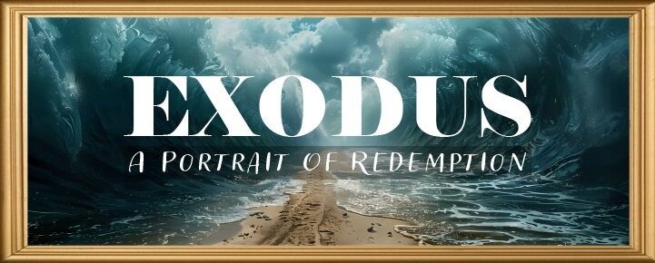


Slide 2
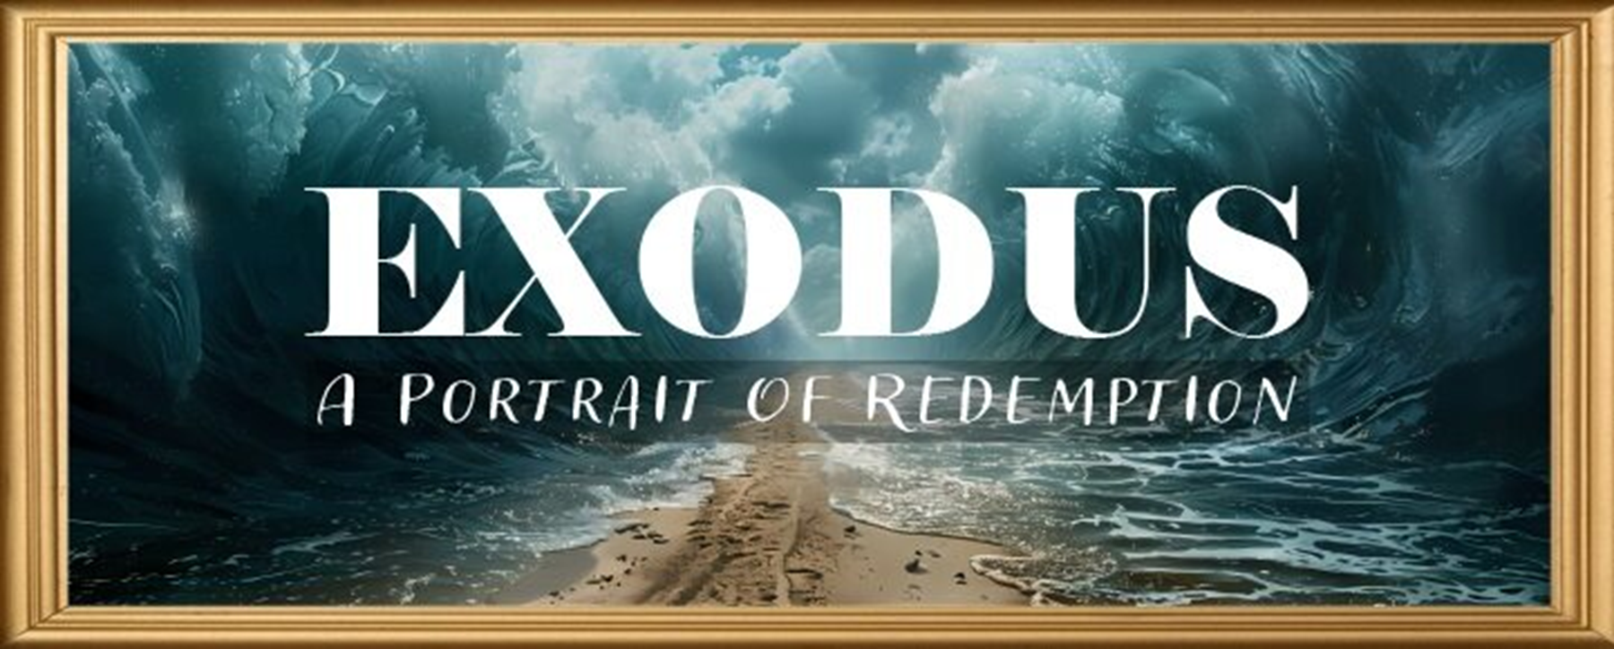
EXODUS STRUCTURE/OUTLINE
Redemption (1–18)
Redemption (1:1–12:30)
Liberation (12:31–15:21)
Preservation (15:22–18:27)
Mosaic Covenant (19–40)
Law (19–24)
Tabernacle instructions (25–31)
Apostasy (32–34)
Tabernacle building (35–40)

Slide 3
REDEMPTION (1:1–12:30)
Why redemption is necessary (Exod 1)
Development of the deliverer (Exod 2–4)
First confrontation with Pharaoh (Exod 5)
God reassures Moses (Exod 6:1–7:7)
Second confrontation with Pharaoh (Exod 7:8-13)
Plagues (Exod 7:14–12:30)

Slide 4
TEN PLAGUES REDEMPTION (7:14–12:30)
Nile to blood
Frogs
Gnats
Flies
Death of livestock
Boils
Hail
Locusts
Darkness
Death of 1st born

Slide 5
The Plagues of Egypt
NO. | DESCRIPTION | SCRIPTURE | Egyptian Deity
1. | Water to Blood | Exod. 7:14-25 | Hapi, Khnum
2. | Frogs | Exod. 8:1-15 | Heqt
3. | Gnats | Exod. 8:16-19 | Set
4. | Flies | Exod. 8:20-32 | Uatchit
5. | Disease on Cattle | Exod. 9:1-7 | Hathor, Apis
6. | Boils | Exod. 9:8-12 | Sekhmet, Serapis
7. | Hail | Exod. 9:13-35 | Seth, Nut
8. | Locusts | Exod. 10:1-20 | Seth, Nut, Osiris
9. | Darkness | Exod. 10:21-29 | Re, Horus, Atum
10. | Death of the First Born | Exod. 12:29-36 | Min, Osiris, Heqt, Isis

Slide 6
HAIL Exodus 9:13-35
God’s Instructions (13-16)
God’s Prediction (17-21)
Prophecy’s Fulfillment (22-26)
Pharaoh’s Reaction (27-32)
Moses’ Reversal (33-35)

Slide 7
V. Exodus 9:33-35 Moses’ Reversal
Plague Ceases (33)
Pharaoh’s Hardening (34)
Pharaoh’s Refusal (35)

Slide 8
V. Exodus 9:33-35 Moses’ Reversal
Plague Ceases (33)
Pharaoh’s Hardening (34)
Pharaoh’s Refusal (35)

Slide 9
The Plagues of Egypt
NO. | DESCRIPTION | SCRIPTURE | Egyptian Deity
1. | Water to Blood | Exod. 7:14-25 | Hapi, Khnum
2. | Frogs | Exod. 8:1-15 | Heqt
3. | Gnats | Exod. 8:16-19 | Set
4. | Flies | Exod. 8:20-32 | Uatchit
5. | Disease on Cattle | Exod. 9:1-7 | Hathor, Apis
6. | Boils | Exod. 9:8-12 | Sekhmet, Serapis
7. | Hail | Exod. 9:13-35 | Seth, Nut
8. | Locusts | Exod. 10:1-20 | Seth, Nut, Osiris
9. | Darkness | Exod. 10:21-29 | Re, Horus, Atum
10. | Death of the First Born | Exod. 12:29-36 | Min, Osiris, Heqt, Isis

Slide 10

Satanic/Demonic Miracles
Exod. 7–8
Deut. 13:1-3
Job 1:12-19; 2:7-8
1 Sam. 28?
Matt. 7:21-23; 24:24
Luke 4:5
Acts 8:9; 16:16
Gal. 1:6-9
2 Thess. 2:9
2 Cor. 11:14
Rev. 13:3, 13, 15; 16:13-14

Slide 11
V. Exodus 9:33-35 Moses’ Reversal
Plague Ceases (33)
Pharaoh’s Hardening (34)
Pharaoh’s Refusal (35)

Slide 12
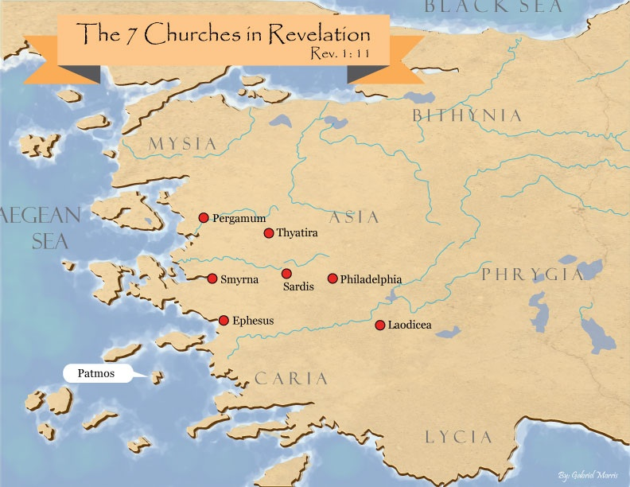
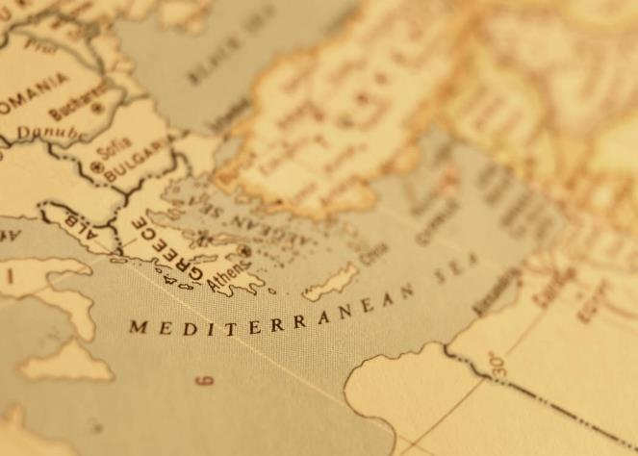

Slide 13
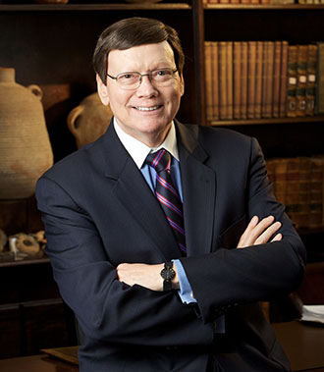
Dr. Ed Hindson
Hindson, E. E., & Mitchell, D. R., eds. (2010). KJV Bible Commentary for Today: The Most Up-to-Date Commentary on the Time-Honored Text of the KJV (p. 86). Thomas Nelson.
“4:21. I will harden his heart. An expression meaning ‘to strengthen his will.’ The text identifies the heart as the location of the volition, man’s decision-making ability. On seven occasions in the narrative, God hardens Pharaoh’s heart (9:12; 10:1, 20, 27; 11:10; 14:4, 8) or foretells that He will harden Pharaoh’s heart (4:21; 7:3), and nine times in the text, Pharaoh hardens his own heart (7:13, 14, 22; 8:15, 19, 32; 9:7, 34–35). For the initial five plagues, the text registers Pharaoh as the agent of hardening. Not until the sixth plague does God participate in the confirmation of Pharaoh’s own volitional choices.”

Slide 14

Charles Ryrie Ryrie Study Bible, page 96
Exodus 4:21 - “harden his heart. Ten times it is said that Pharaoh hardened his own heart (7:13, 14, 22; 8:15, 19, 32; 9:7, 34, 35; 13:15), and 10 times that God hardened Pharaoh’s heart (4:21; 7:3; 9:12; 10:1, 20, 27; 11:10; 14:4, 8, 17). Paul uses this as an example of the inscrutable will of God and of His mercy toward men (Rom. 9:14–18). Seven times Pharaoh hardened his own heart before God first hardened it, though the prediction that God would do it preceded all.”

Slide 15
GOD HARDENING PHARAOH'S HEART
The prediction of God hardening of Pharaoh (4:21)
Pharaoh repeatedly hardening his own heart (7:13, 22; 8:15, 19, 32; 9:7)
Not until the sixth plague did God harden Pharaoh’s heart (Exod 9:12)

Slide 16
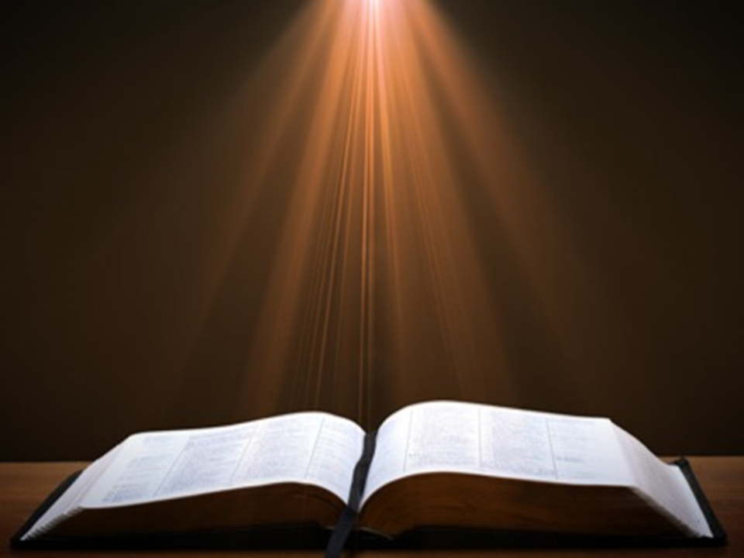
Romans 1:18–20
¹⁸ For the wrath of God is revealed from heaven against all ungodliness and unrighteousness of men who suppress the truth in unrighteousness, ¹⁹ because that which is known about God is evident within them; for God made it evident to them. ²⁰ For since the creation of the world His invisible attributes, His eternal power and divine nature, have been clearly seen, being understood through what has been made, so that they are without excuse.

Slide 17
V. Exodus 9:33-35 Moses’ Reversal
Plague Ceases (33)
Pharaoh’s Hardening (34)
Pharaoh’s Refusal (35)

Slide 18
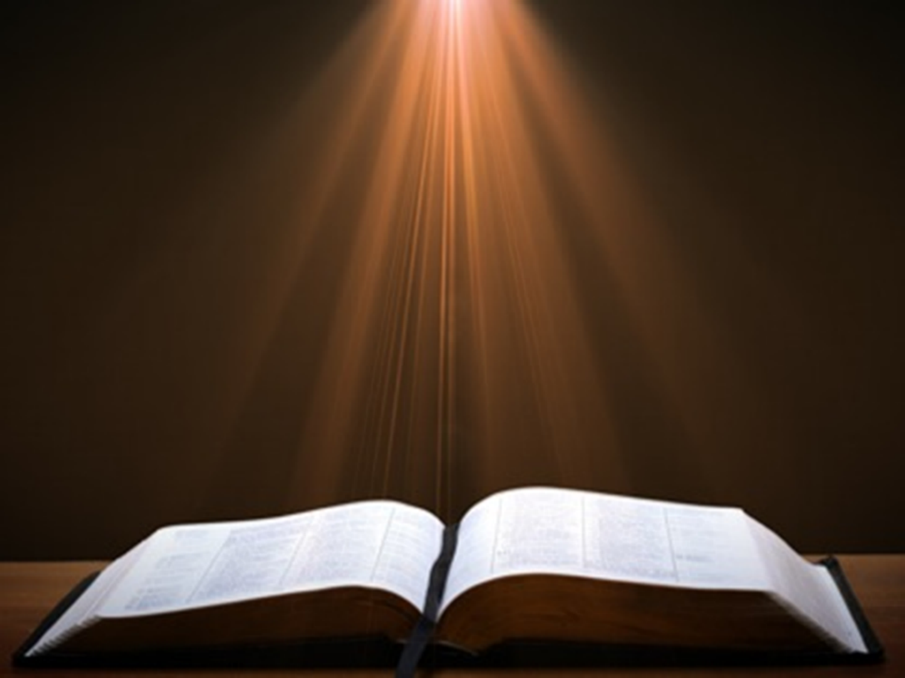
Exodus 2:24
“So God heard their groaning; and God remembered His covenant with Abraham, Isaac, and Jacob.”

Slide 19

2 Timothy 2:11-13 (NASB)
“It is a trustworthy statement: For if we died with Him, we will also live with Him; ¹² If we endure, we will also reign with Him; If we deny Him, He also will deny us; ¹³ If we are faithless, He remains faithful, for He cannot deny Himself.”

Slide 20
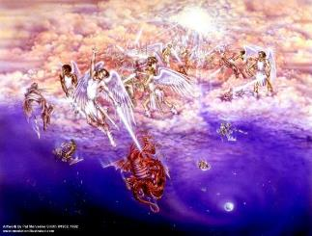
Satan as Ruler of this World
Job 1:7; 2:2
Luke 4:5-7
John 12:31; 14:30; 16:11
2 Corinthians 4:4
Ephesians 2:2
1 John 4:4; 5:19

Slide 21
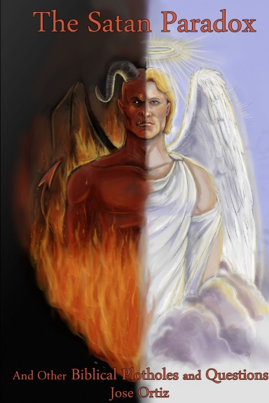
Names & Titles Demonstrating Satan’s Post-Fall, Earthly Authority (Job 1:7; 2:2; Luke 4:5-8; Rom. 8:19-22)
Prince of this world (John 12:31; 14:30; 16:11)
God of this world (2 Cor. 4:4)
Prince and power of the air (Eph. 2:2)
Who the believer wrestles with (Eph. 6:12)
Roaring lion (1 Pet. 5:8)
Whole world lies in his power (1 John 5:19)

Slide 22
Romans 8:19-23
¹⁹ “For the anxious longing of the creation waits eagerly for the revealing of the sons of God. ²⁰ For the creation was subjected to futility, not willingly, but because of Him who subjected it, in hope ²¹ that the creation itself also will be set free from its slavery to corruption into the freedom of the glory of the children of God. ²² For we know that the whole creation groans and suffers the pains of childbirth together until now. ²³ And not only this, but also we ourselves, having the first fruits of the Spirit, even we ourselves groan within ourselves, waiting eagerly for our adoption as sons, the redemption of our body.”

Slide 23
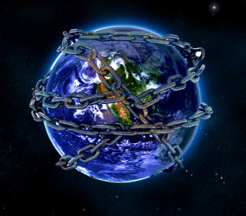

Slide 24
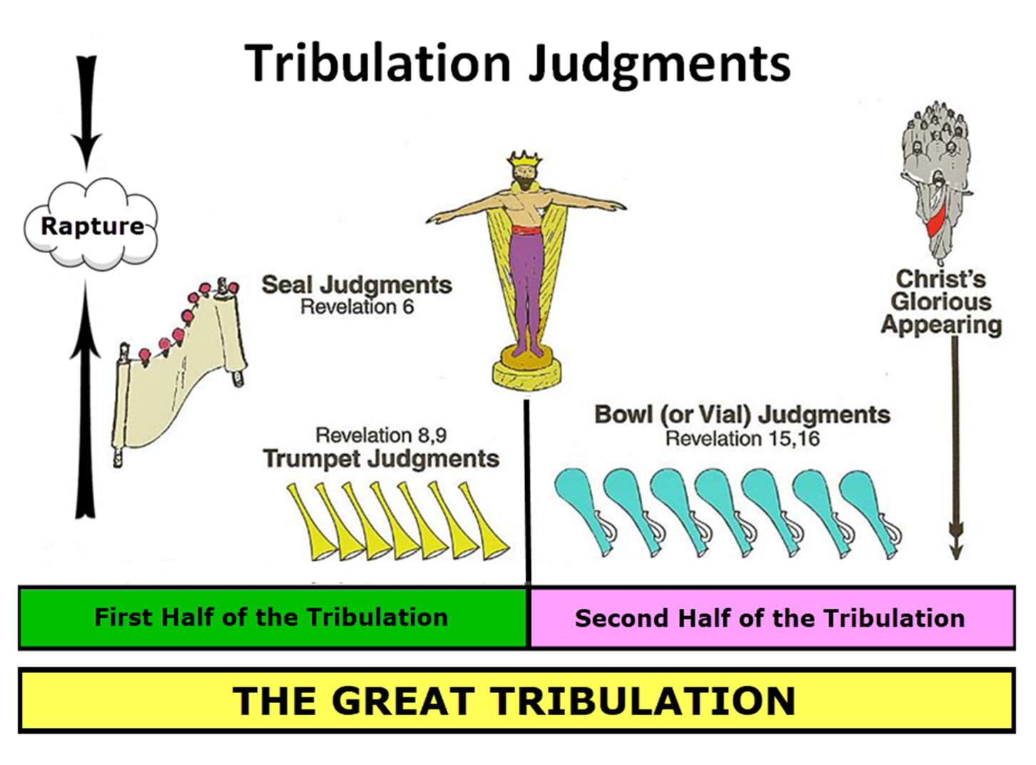

Slide 25

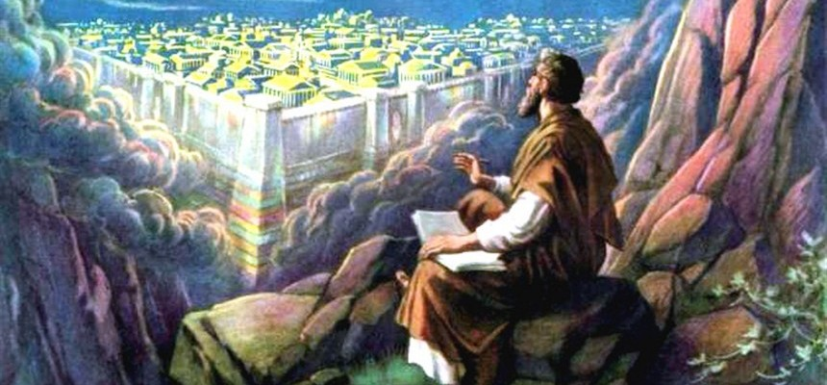
Revelation 11:15
¹⁵ “Then the seventh angel sounded; and there were loud voices in heaven, saying, ‘The kingdom of the world has become the kingdom of our Lord and of His Christ; and He will reign forever and ever.’”

Slide 26
Ultimate Exodus (Rev 11:15)
Sores: 6th plague (Ex 9:8-12), 1st bowl (Rev 16:1-2)
Rivers to blood: 1st plague (Ex 7:19-21), 3rd bowl (Rev 16:4-7)
Darkness: 9th plague (Ex 10:21-23), 5th bowl (Rev 16:10-11)
Frogs: 2nd plague (Ex 7:25‒8:15), 6th bowl (Rev 16:13)
Hail: 7th plague (Ex 9:22-26), 7th bowl (Rev 16:17-21)

Slide 27
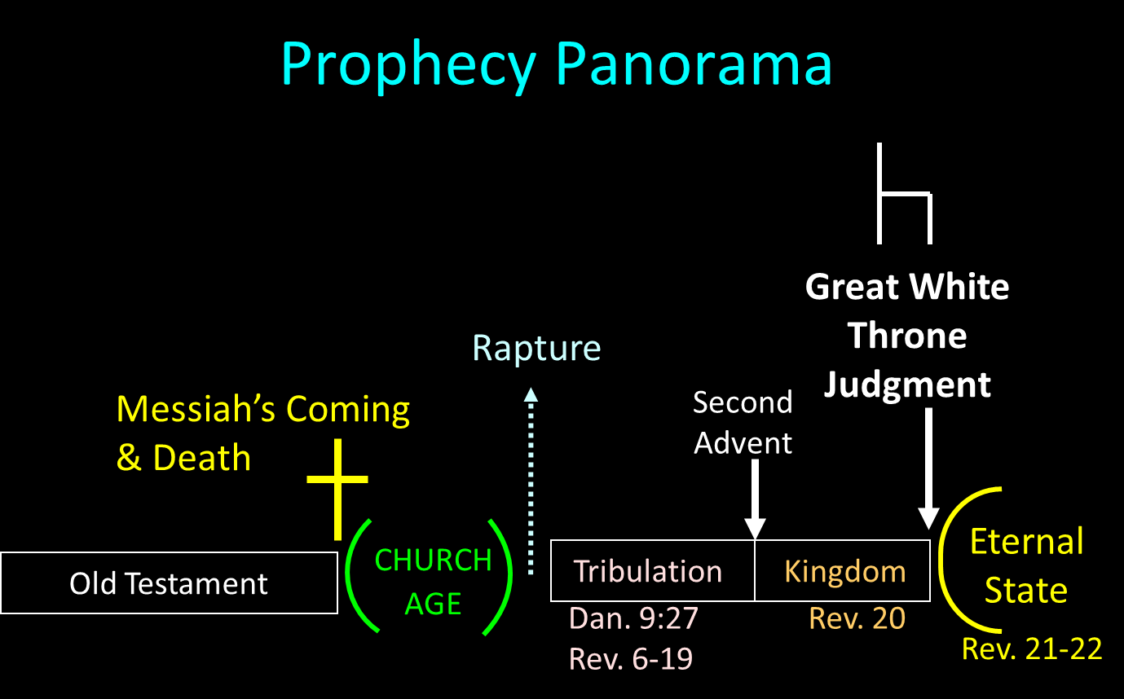

Slide 28
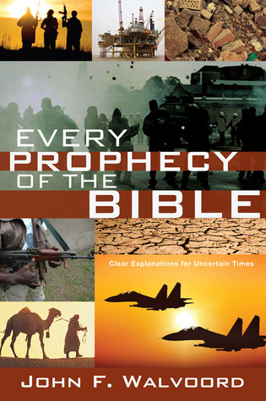

Slide 29


John 13:19; 14:29
“¹⁹ From now on I am telling you before it comes to pass, so that when it does occur, you may believe that I am He… ^{14:29} Now I have told you before it happens, so that when it happens, you may believe.”

Slide 30
What Happened to Christ’s Disciples?
Disciple | Place | Martyrdom
James the Son of Alpheus | Jerusalem | Clubbed to death
Simon the Zealot | Jerusalem | Martyred
James the Son of Zebedee | Judea (Acts 12:2) | Executed
Thaddeus | Mesopotamia | Beaten to death
Peter | Babylon, Rome | Crucified upside down
Matthew | Parthia (Tehran) | Beheaded
Notes:
109 prophecies…
Peter Stoner – SCIENCE SPEAKS, An Evaluation of Certain Christian Evidences
To fulfill just 8 prophecies =1 X 10 to the twenty-eighth power!
Can we visualize this with an illustration? Suppose we took an atheistic professor, blindfolded him and covered the state of Texas two feet deep with silver dollars. Then we put a check on one of those silver dollars and mixed them up. The odds of one person fulfilling just these eight prophecies would be the same as this atheistic professor selecting the silver dollar upon which we have placed a check, in his first try.
https://www.bereanpublishers.com/the-odds-of-eight-messianic-prophecies-coming-true/

Slide 31
What Happened to Christ’s Disciples?
Disciple | Place | Martyrdom
John | Asia Minor, Patmos, Ephesus | Fried in boiling oil
Philip | E. Turkey | Tortured & crucified
Thomas | India | Speared
Bartholomew | India | Flayed & crucified
Andrew | Ukraine, Russia, Greece | Hanged
Notes:
109 prophecies…
Peter Stoner – SCIENCE SPEAKS, An Evaluation of Certain Christian Evidences
To fulfill just 8 prophecies =1 X 10 to the twenty-eighth power!
Can we visualize this with an illustration? Suppose we took an atheistic professor, blindfolded him and covered the state of Texas two feet deep with silver dollars. Then we put a check on one of those silver dollars and mixed them up. The odds of one person fulfilling just these eight prophecies would be the same as this atheistic professor selecting the silver dollar upon which we have placed a check, in his first try.
https://www.bereanpublishers.com/the-odds-of-eight-messianic-prophecies-coming-true/

Slide 33

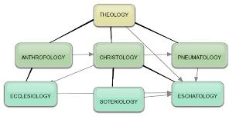
Areas of Systematic Theology
Prolegomena – Introduction
Theology – Study of God
Christology – Study of Christ
Pneumatology – Study of the Holy Spirit
Anthropology – Study of Man
Hamartiology – Study of sin
Soteriology – Study of salvation
Angelology – Study of angels
Ecclesiology – Study of the Church
Eschatology – Study of the end

Slide 34
Conclusion

Slide 35
HAIL Exodus 9:13-35
God’s Instructions (13-16)
God’s Prediction (17-21)
Prophecy’s Fulfillment (22-26)
Pharaoh’s Reaction (27-32)
Moses’ Reversal (33-35)

Slide 36
TEN PLAGUES REDEMPTION (7:14–12:30)
Nile to blood
Frogs
Gnats
Flies
Death of livestock
Boils
Hail
Locusts
Darkness
Death of 1st born

Slide 37
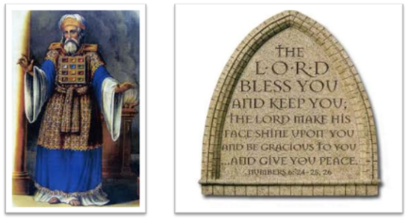
²⁴ The Lord bless you, and keep you; ²⁵ The Lord make His face shine on you, And be gracious to you; ²⁶ The Lord lift up His countenance on you, And give you peace.
Numbers 6:24–26 (NASB95)

