Slide 1
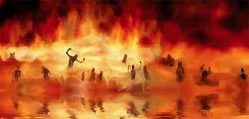

Annihilation
vs.
Eternal Torment

Slide 2
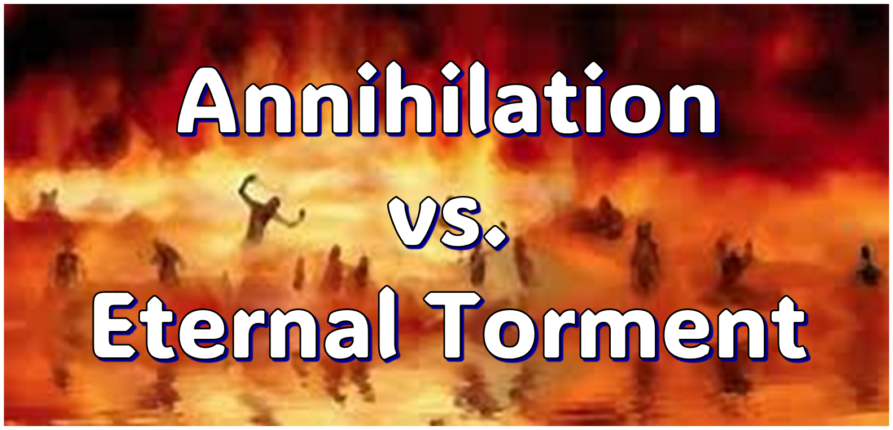
ANNIHILATION VS. ETERNAL CONSCIOUS TORMENT
Introduction to the Controversy
Biblical Arguments Against Annihilation
Theological Arguments Against Annihilation
Answering Annihilationist Biblical Arguments
Answering Annihilationist Theological Arguments
Examining Church History
Conclusion

Slide 3

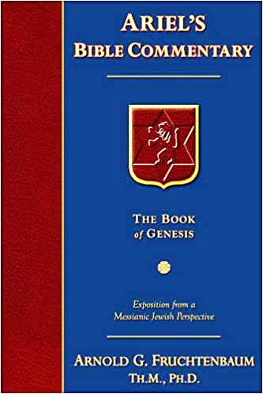
Dr. Arnold G. Fruchtenbaum
Footsteps of the Messiah, 707-8
“Conditional immortality means the soul is not inherently immortal; immortality is not part of the make-up of the soul. Rather, immortality is a gift for the saved only. So at death, the unbeliever simply becomes non-existent, and only the believer continues to exist…What annihilationism says is this: the unsaved soul is annihilated after a temporary period of punishment. These people do believe that the unsaved soul goes to Hell, but not for eternity, only temporarily. Eventually the unsaved soul is annihilated after suffering a duration of punishment.”

Slide 4
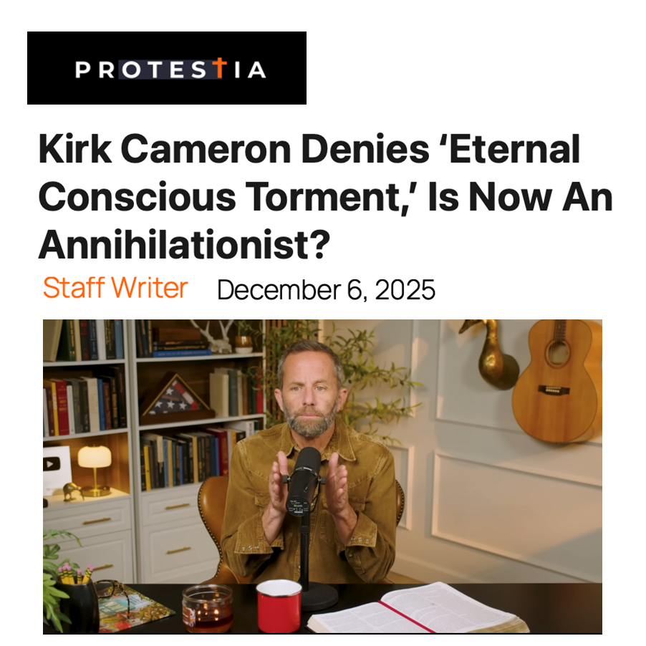

Slide 5
ANNIHILATION VS. ETERNAL CONSCIOUS TORMENT
Introduction to the Controversy
Biblical Arguments Against Annihilation
Theological Arguments Against Annihilation
Answering Annihilationist Biblical Arguments
Answering Annihilationist Theological Arguments
Examining Church History
Conclusion

Slide 6
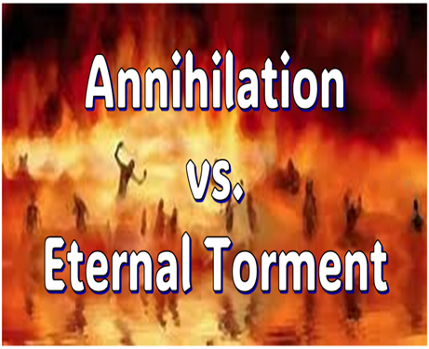
II. Anti-Annihilationist Texts
Dan. 12:2 Matt. 25:46 Mark 9:47-48 Matt. 8:12 Luke 16:19-31 |  | 2 Thess. 1:9 Heb. 6:2 Rev. 14:11 Rev. 20:10 Rev. 19:20

Slide 7
ANNIHILATION VS. ETERNAL CONSCIOUS TORMENT
Introduction to the Controversy
Biblical Arguments Against Annihilation
Theological Arguments Against Annihilation
Answering Annihilationist Biblical Arguments
Answering Annihilationist Theological Arguments
Examining Church History
Conclusion

Slide 8
III. Theological Arguments Against Annihilation
Underestimates sin’s severity
Contradicts humanity’s nature
Denies degrees of punishment
Seeks to escape sin’s consequences

Slide 9
ANNIHILATION VS. ETERNAL CONSCIOUS TORMENT
Introduction to the Controversy
Biblical Arguments Against Annihilation
Theological Arguments Against Annihilation
Answering Annihilationist Biblical Arguments
Answering Annihilationist Theological Arguments
Examining Church History
Conclusion

Slide 10
IV. Answering Annihilationist Biblical Arguments
2nd death (Rev. 20:14)
Destroy (Rev. 11:18)
Destruction (2 Thess. 1:9)
Burning up (Matt. 3:12)
Eternal results (Rev. 14:11)

Slide 11
IV. Answering Annihilationist Biblical Arguments
Perdition (2 Pet. 3:7)
Better to have never been born (Mark 14:21)
Wicked perishing (2 Pet. 3:9)
Blotted out of existence (Hebrews 9:25–26)
Life activity suspended in death (Eccles. 9:10)

Slide 12
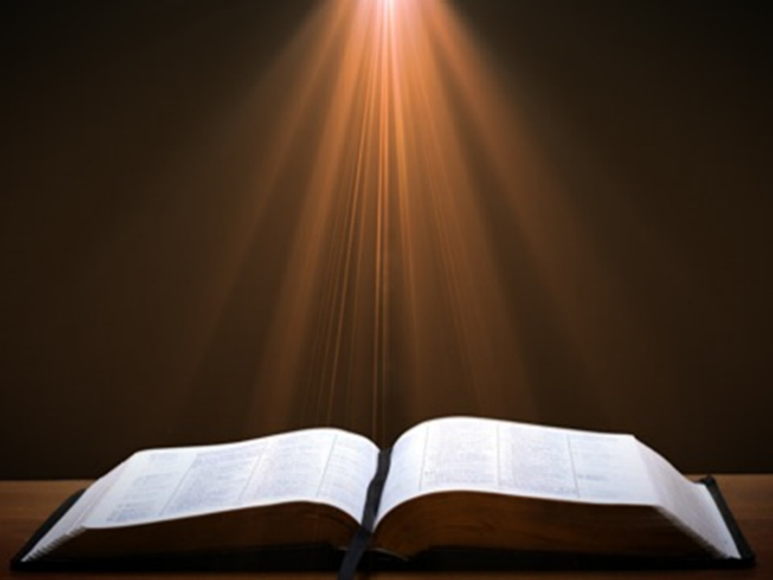

Ecclesiastes 9:10
“Whatever your hand finds to do, do it with all your might; for there is no activity or planning or knowledge or wisdom in Sheol where you are going.”

Slide 13
Dr. Arnold G. Fruchtenbaum
Footsteps of the Messiah, 713-14
“Ecclesiastes 9:5 does speak about the dead not knowing any thing, but the context of Ecclesiastes 9:5 is simply drawing the conclusion of human philosophy. Indeed, from the standpoint of human philosophy, under the sun, that is the way it looks (v. 6). But again, Ecclesiastes 9:5 simply spells out what human philosophy feels under the sun. It is not a divine decree; it is not a positive affirmation of the Word of God.”

Slide 14

Psalm 146:4
“His spirit departs, he returns to the earth; In that very day his thoughts perish.”

Slide 15
Dr. Arnold G. Fruchtenbaum
Footsteps of the Messiah, 713
“Another Old Testament passage that they use is Psalm 146:4, where it states that a man’s thoughts perish when he dies. But actually, verses 3 and 4 taken together and in context simply teach that a man’s devices, man’s plans, and man’s thoughts cannot be carried out on the earth after physical death. He has lost any opportunity to see his plans carried out; it does not teach a cessation of existence.”

Slide 16
ANNIHILATION VS. ETERNAL CONSCIOUS TORMENT
Introduction to the Controversy
Biblical Arguments Against Annihilation
Theological Arguments Against Annihilation
Answering Annihilationist Biblical Arguments
Answering Annihilationist Theological Arguments
Examining Church History
Conclusion

Slide 17
V. Answering Annihilationist Theological Arguments
Immortality: a gift only for the believer (1 Tim. 6:16)
Temporal nature of the soul (Gen. 3:22)
Finite nature of Christ’s death (John 19:30)
God’s justice (Ps. 90:2)
God’s mercy (1 John 4:8)
All things reconciled to God (Col. 1:20)
Universal nature of God’s victory (Philip. 2:10)
Burden of heaven’s citizens (Rev. 21:4)

Slide 18
V. Answering Annihilationist Theological Arguments
Immortality: a gift only for the believer (1 Tim. 6:16)
Temporal nature of the soul (Gen. 3:22)
Finite nature of Christ’s death (John 19:30)
God’s justice (Ps. 90:2)
God’s mercy (1 John 4:8)
All things reconciled to God (Col. 1:20)
Universal nature of God’s victory (Philip. 2:10)
Burden of heaven’s citizens (Rev. 21:4)

Slide 19
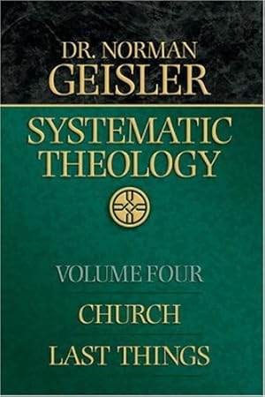
Dr. Norman Geisler
Geisler, N. L. (2005). Systematic theology, volume four: church, last things (p. 401-02). Bethany House Publishers.
“…the annihilationist fails to acknowledge that immortality and existing forever are not the same. As noted, angels will live forever but are never called immortal. The term immortality, like eternal life, has a positive quality that mere existence does not. Jesus defined eternal life as knowing God (John 17:3), and though unbelievers do not have this, by virtue of His image they will still exist forever...”

Slide 20
Dr. Norman Geisler
Geisler, N. L. (2005). Systematic theology, volume four: church, last things (p. 401-02). Bethany House Publishers.
“…Also, even though the term immortal is biblically used only of God and His gift to believers, nevertheless, terms like everlasting (Matt. 25:41 nkjv) and eternal (Mark 3:29) are used of unbelievers. While their quality of existence will be nothing like that of the saved, the duration will be the same.”

Slide 21
V. Answering Annihilationist Theological Arguments
Immortality: a gift only for the believer (1 Tim. 6:16)
Temporal nature of the soul (Gen. 3:22)
Finite nature of Christ’s death (John 19:30)
God’s justice (Ps. 90:2)
God’s mercy (1 John 4:8)
All things reconciled to God (Col. 1:20)
Universal nature of God’s victory (Philip. 2:10)
Burden of heaven’s citizens (Rev. 21:4)

Slide 22
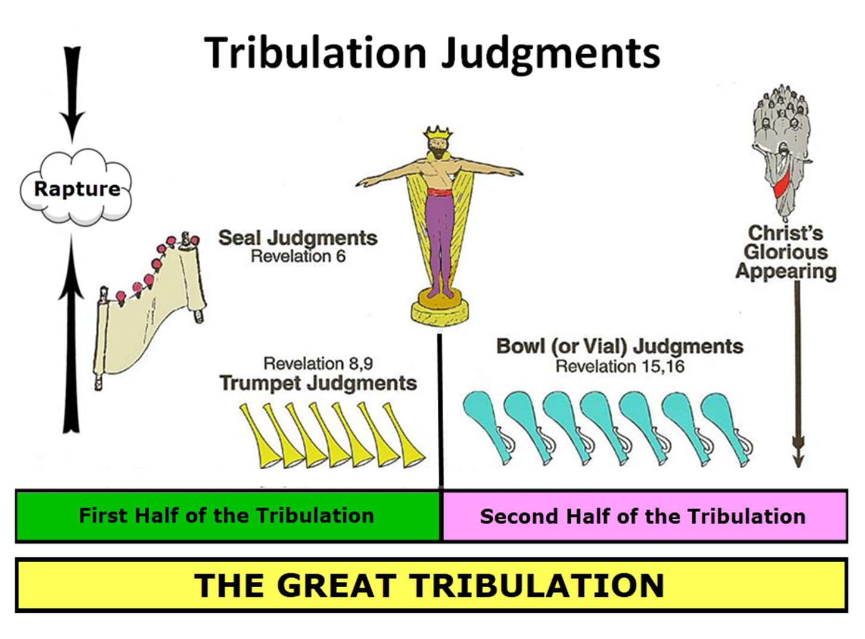

Slide 23
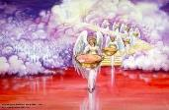

Seven Bowls
(Revelation 16)
1st Bowl (16:1-2) – Boils
2nd Bowl (16:3) – Sea becomes blood
3rd Bowl (16:4-7) – Freshwater destroyed
4th Bowl (16:8-9) – Sun scorches man
5th Bowl (16:10-11) – Darkness
6th Bowl (16:13-16) – Euphrates dried
7th Bowl (16:17-21) – Greatest earthquake

Slide 24
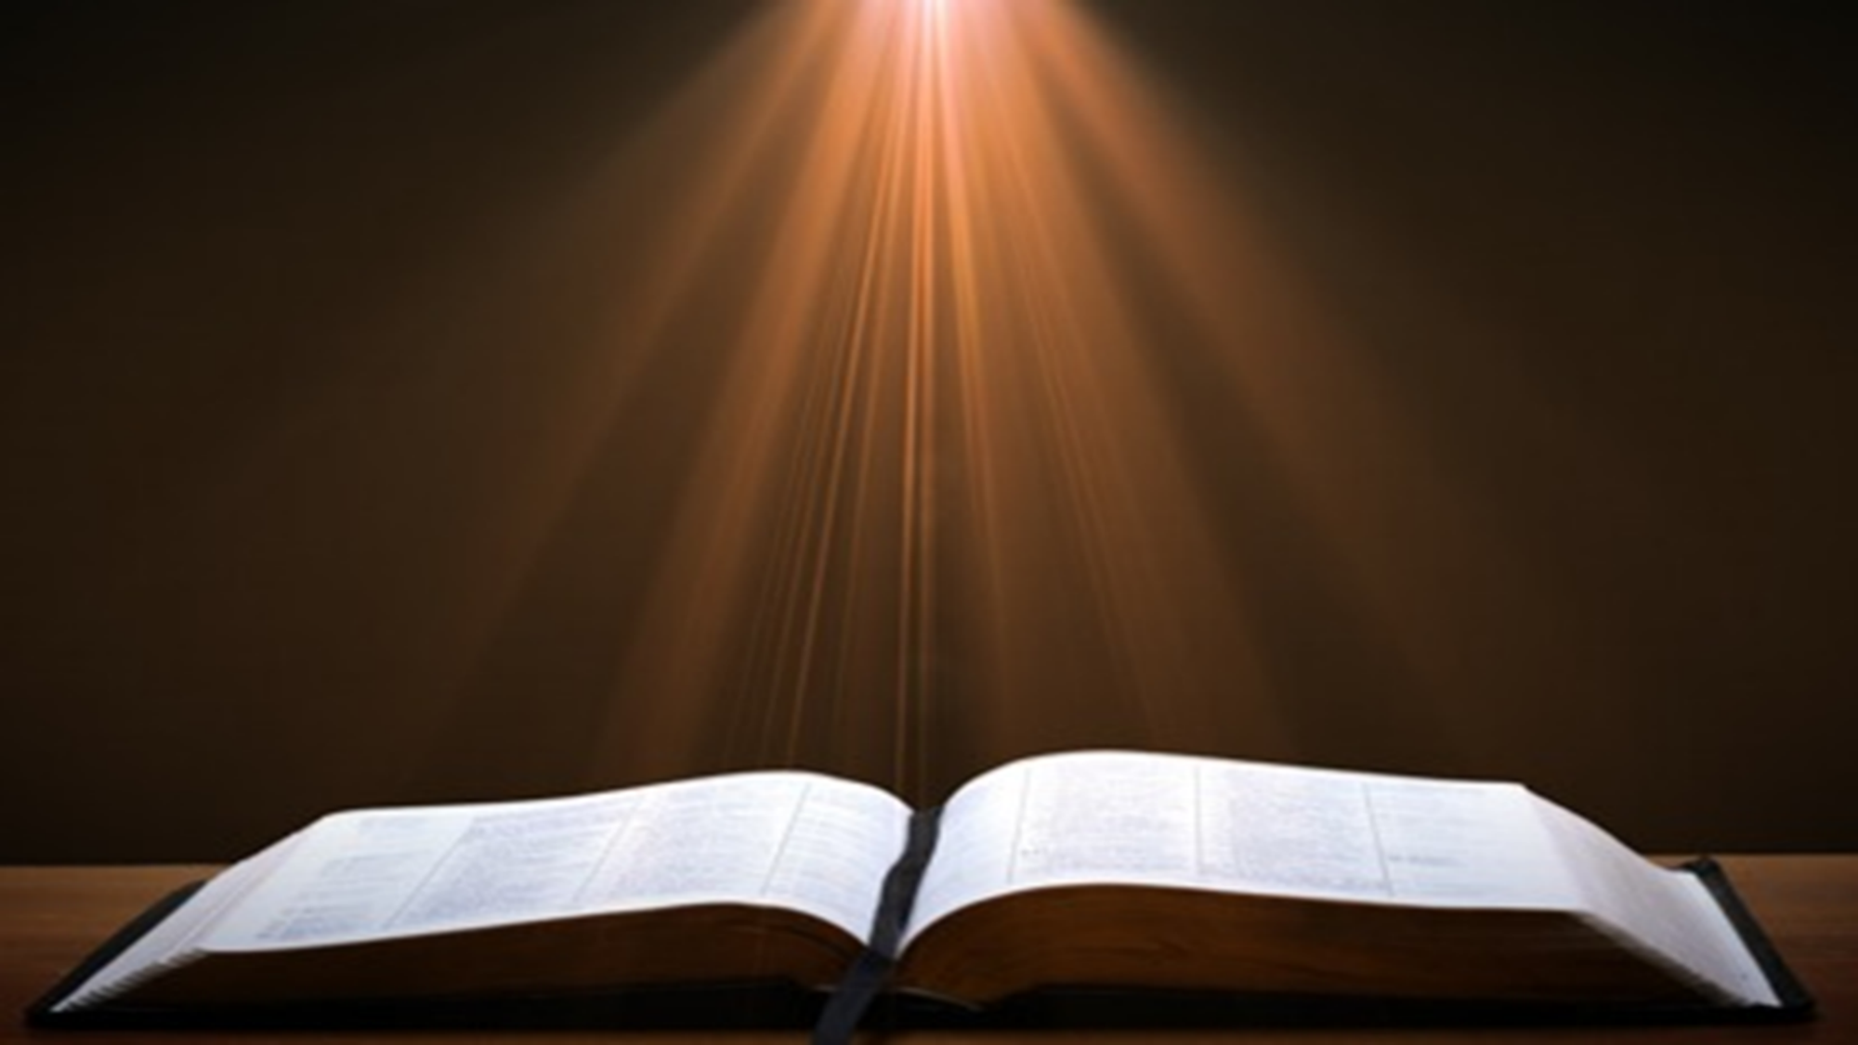
Genesis 1:26-28
²⁶ Then God said, “Let Us make man in Our image, according to Our likeness; and let them rule over the fish of the sea and over the birds of the sky and over the cattle and over all the earth, and over every creeping thing that creeps on the earth.” ²⁷ God created man in His own image, in the image of God He created him; male and female He created them. ²⁸ God blessed them; and God said to them, “Be fruitful and multiply, and fill the earth, and subdue it; and rule over the fish of the sea and over the birds of the sky and over every living thing that moves on the earth.”

Slide 25

Genesis 9:6
“Whoever sheds man’s blood, By man his blood shall be shed, For in the image of God He made man.”

Slide 26

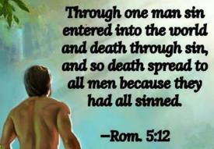
Genesis 3:19
“By the sweat of your face You will eat bread, Till you return to the ground, Because from it you were taken; For you are dust, And to dust you shall return.”

Slide 27
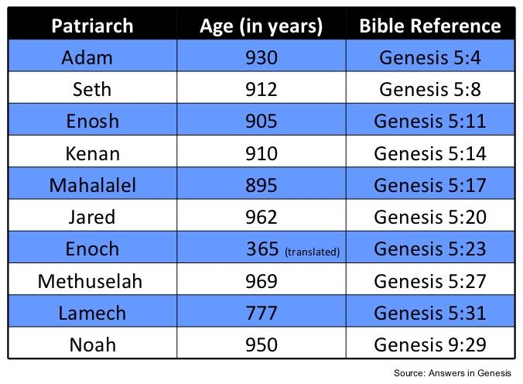

Slide 28
V. Answering Annihilationist Theological Arguments
Immortality: a gift only for the believer (1 Tim. 6:16)
Temporal nature of the soul (Gen. 3:22)
Finite nature of Christ’s death (John 19:30)
God’s justice (Ps. 90:2)
God’s mercy (1 John 4:8)
All things reconciled to God (Col. 1:20)
Universal nature of God’s victory (Philip. 2:10)
Burden of heaven’s citizens (Rev. 21:4)

Slide 29
Dr. Norman Geisler
Geisler, N. L. (2005). Systematic theology, volume four: church, last things (p. 402-03). Bethany House Publishers.
“[Death] means cessation of life, not eternal life in torment.… [It is a] strange contention of some that to perish is to live on forever! [For] if the death that threatened Adam were eternal torture, then it would have necessitated that our Savior, as man’s complete Substitute, must be tormented eternally in order to pay his designated debt. (CFF, 1.78).”

Slide 30
Dr. Norman Geisler
Geisler, N. L. (2005). Systematic theology, volume four: church, last things (p. 403). Bethany House Publishers.
“This contention confuses the value and the duration of Christ’s death. Being by nature the infinite God, Christ’s death had infinite value, even though His suffering and death occurred in a finite amount of time. Time is not a mandatory measure of worth—birth, for instance, happens over a relatively short span but produces something of extraordinary value. One death in limited time achieved something of limitless value for all eternity.”

Slide 31
Dr. Norman Geisler
Geisler, N. L. (2005). Systematic theology, volume four: church, last things (p. 403). Bethany House Publishers.
“The fallacy in this conditionalist argument is akin to the claim that punishing someone forever is overkill for sins he committed in a lifetime. This is not overkill because sin against the Infinite has infinite significance and endless ramification. In the same sense, Christ’s finite suffering has infinite significance because of the suffering’s infinite value.”

Slide 32
V. Answering Annihilationist Theological Arguments
Immortality: a gift only for the believer (1 Tim. 6:16)
Temporal nature of the soul (Gen. 3:22)
Finite nature of Christ’s death (John 19:30)
God’s justice (Ps. 90:2)
God’s mercy (1 John 4:8)
All things reconciled to God (Col. 1:20)
Universal nature of God’s victory (Philip. 2:10)
Burden of heaven’s citizens (Rev. 21:4)

Slide 33
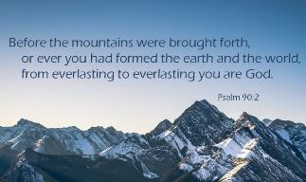
Psalm 90:2
“Before the mountains were born Or You gave birth to the earth and the world, Even from everlasting (olam) to everlasting (olam), You are God.”

Slide 34

Romans 16:26
“but now is manifested, and by the Scriptures of the prophets, according to the commandment of the eternal (aiōnios) God, has been made known to all the nations, leading to obedience of faith

Slide 35
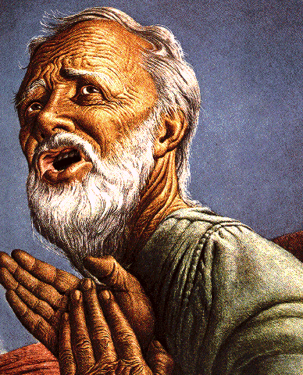
Belief – God’s One Condition for Justification
Gen 15:6
Then he believed in the LORD; and He reckoned it to him as righteousness.
John 3:16
For God so loved the world, that He gave His only begotten Son, that whoever believes in Him shall not perish, but have eternal life.
Acts 16:30-31
"Sirs, what must I do to be saved?" They said, "Believe in the Lord Jesus, and you will be saved..."

Slide 36
V. Answering Annihilationist Theological Arguments
Immortality: a gift only for the believer (1 Tim. 6:16)
Temporal nature of the soul (Gen. 3:22)
Finite nature of Christ’s death (John 19:30)
God’s justice (Ps. 90:2)
God’s mercy (1 John 4:8)
All things reconciled to God (Col. 1:20)
Universal nature of God’s victory (Philip. 2:10)
Burden of heaven’s citizens (Rev. 21:4)

Slide 37
Genesis 1:26-28
²⁶ Then God said, “Let Us make man in Our image, according to Our likeness; and let them rule over the fish of the sea and over the birds of the sky and over the cattle and over all the earth, and over every creeping thing that creeps on the earth.” ²⁷ God created man in His own image, in the image of God He created him; male and female He created them. ²⁸ God blessed them; and God said to them, “Be fruitful and multiply, and fill the earth, and subdue it; and rule over the fish of the sea and over the birds of the sky and over every living thing that moves on the earth.”

Slide 38
Genesis 9:6
“Whoever sheds man’s blood, By man his blood shall be shed, For in the image of God He made man.”

Slide 39
V. Answering Annihilationist Theological Arguments
Immortality: a gift only for the believer (1 Tim. 6:16)
Temporal nature of the soul (Gen. 3:22)
Finite nature of Christ’s death (John 19:30)
God’s justice (Ps. 90:2)
God’s mercy (1 John 4:8)
All things reconciled to God (Col. 1:20)
Universal nature of God’s victory (Philip. 2:10)
Burden of heaven’s citizens (Rev. 21:4)

Slide 40
Dr. Arnold G. Fruchtenbaum
Footsteps of the Messiah, 710, 714-16
“Colossians 1:20, where it states that ‘all things are reconciled.’ If there is a continuous existence of the unsaved in eternal punishment, it would mean that ‘all things’ were not reconciled; but if all things are reconciled, it means there is an elimination and annihilation of the unbelieving element…they also use Colossians 1:20, which speaks about ‘all things being reconciled.’ But in that context, the ‘all things’ does not mean ‘all things without exception;’ rather, it means ‘all things without distinction.’ All kinds of things will be reconciled, but not all things as such...”

Slide 41
Dr. Arnold G. Fruchtenbaum
Footsteps of the Messiah, 710, 714-16
“The…additional argument is found in Hebrews 2:16, which points out that God did not provide salvation for fallen angels. How is that relevant? Part of the teaching of the annihilationists is based upon the theological argument and the scriptural argument that the Bible promises that ‘all things are to be reconciled to God’ (Col. 1:20). But the fact is that the ‘all things’ here does not mean ‘all things without exception;’ rather, all kinds of things will be reconciled, but not every one of every kind.”

Slide 42
Dr. Arnold G. Fruchtenbaum
Footsteps of the Messiah, 710, 714-16
“According to Hebrews 2:16, salvation was not provided for fallen angels, so fallen angels will never be reconciled to God, and yet they continue to be eternal beings. The fact that there is no reconciliation for fallen angels shows that the Colossians passage cannot be used to teach that all things without exception are going to be reconciled by means of the annihilation of the evil ones. It simply cannot mean that.”

Slide 43
V. Answering Annihilationist Theological Arguments
Immortality: a gift only for the believer (1 Tim. 6:16)
Temporal nature of the soul (Gen. 3:22)
Finite nature of Christ’s death (John 19:30)
God’s justice (Ps. 90:2)
God’s mercy (1 John 4:8)
All things reconciled to God (Col. 1:20)
Universal nature of God’s victory (Philip. 2:10)
Burden of heaven’s citizens (Rev. 21:4)

Slide 44

John 5:28-29
“²⁸ Do not marvel at this; for an hour is coming, in which all who are in the tombs will hear His voice, ²⁹ and will come forth; those who did the good deeds to a resurrection of life, those who committed the evil deeds to a resurrection of judgment.”

Slide 45
Acts 24:14-15
“¹⁴ But this I admit to you, that according to the Way which they call a sect I do serve the God of our fathers, believing everything that is in accordance with the Law and that is written in the Prophets; ¹⁵ having a hope in God, which these men cherish themselves, that there shall certainly be a resurrection of both the righteous and the wicked.”

Slide 46
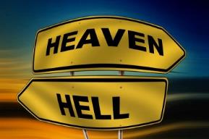
Daniel 12:2
“Many of those who sleep in the dust of the ground will awake, these to everlasting (olam) life, but the others to disgrace and everlasting (olam) contempt.”

Slide 47
Revelation 20:4-6
“⁴ Then I saw thrones, and they sat on them, and judgment was given to them. And I saw the souls of those who had been beheaded because of their testimony of Jesus and because of the word of God, and those who had not worshiped the beast or his image, and had not received the mark on their forehead and on their hand; and they came to life [zaō] and reigned with Christ for a thousand years….

Slide 48
Revelation 20:4-6
…⁵ The rest of the dead did not come to life [zaō] until the thousand years were completed. This is the first resurrection [anastasis]. ⁶ Blessed and holy is the one who has a part in the first resurrection [anastasis]; over these the second death has no power, but they will be priests of God and of Christ and will reign with Him for a thousand years.”

Slide 49
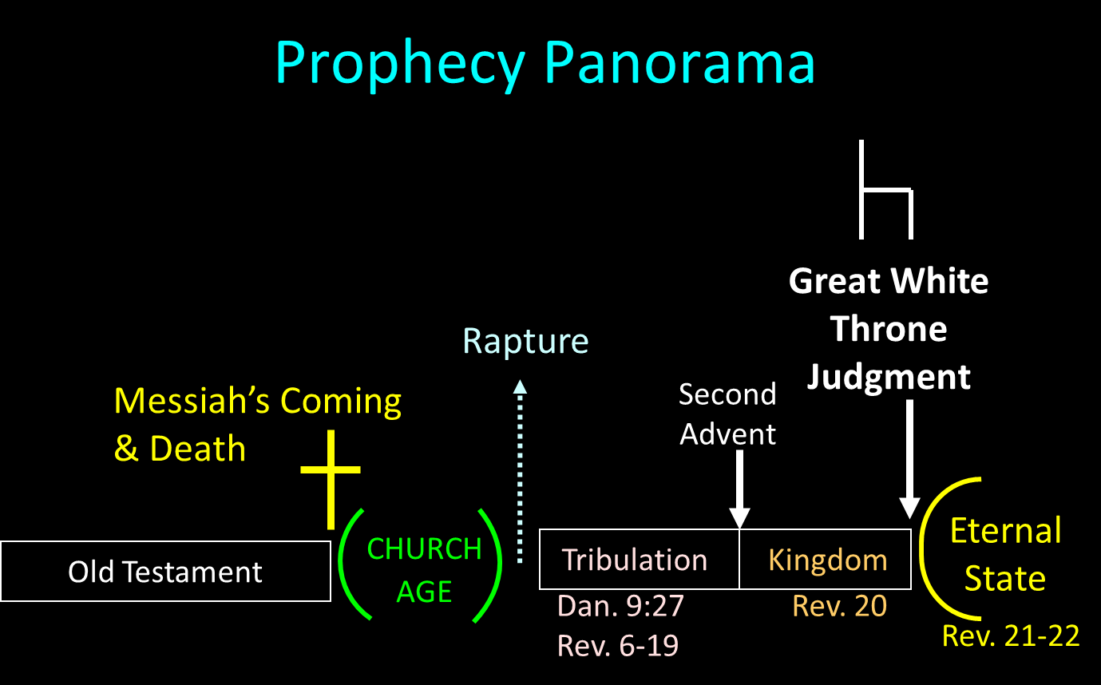

Slide 50
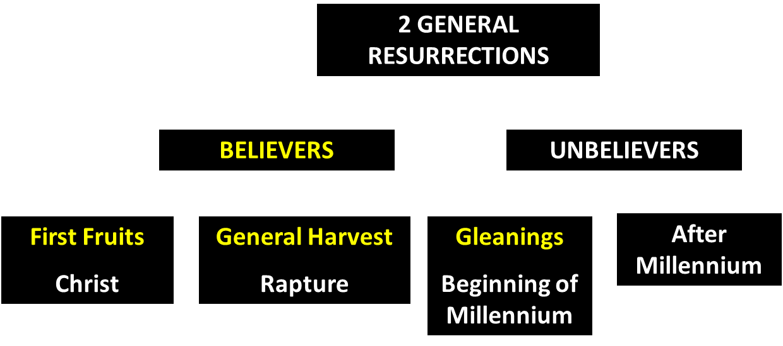
God’s Resurrection Program

Slide 51
V. Answering Annihilationist Theological Arguments
Immortality: a gift only for the believer (1 Tim. 6:16)
Temporal nature of the soul (Gen. 3:22)
Finite nature of Christ’s death (John 19:30)
God’s justice (Ps. 90:2)
God’s mercy (1 John 4:8)
All things reconciled to God (Col. 1:20)
Universal nature of God’s victory (Philip. 2:10)
Burden of heaven’s citizens (Rev. 21:4)

Slide 52
Dr. Arnold G. Fruchtenbaum
Footsteps of the Messiah, 709, 711-12
“The eighth theological argument is that the righteous ones could not enjoy bliss knowing that others are continually in Hell. Those in Heaven will simply not be able to enjoy it if they know that there are others suffering continuously in Hell…the righteous could enjoy bliss only if they know that others are not suffering eternally; the righteous could not enjoy bliss knowing that others are continually suffering in Hell. But the answer here is that the righteous will enjoy the bliss of God’s presence and will not be encumbered with the present perspective regarding what is inappropriate to Heaven’s bliss.”

Slide 53

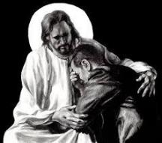
Revelation 21:4
“and He will wipe away every tear from their eyes; and there will no longer be any death; there will no longer be any mourning, or crying, or pain; the first things have passed away.”

Slide 54
V. Answering Annihilationist Theological Arguments
Immortality: a gift only for the believer (1 Tim. 6:16)
Temporal nature of the soul (Gen. 3:22)
Finite nature of Christ’s death (John 19:30)
God’s justice (Ps. 90:2)
God’s mercy (1 John 4:8)
All things reconciled to God (Col. 1:20)
Universal nature of God’s victory (Philip. 2:10)
Burden of heaven’s citizens (Rev. 21:4)

Slide 55
ANNIHILATION VS. ETERNAL CONSCIOUS TORMENT
Introduction to the Controversy
Biblical Arguments Against Annihilation
Theological Arguments Against Annihilation
Answering Annihilationist Biblical Arguments
Answering Annihilationist Theological Arguments
Examining Church History
Conclusion

Slide 56
ANNIHILATION VS. ETERNAL CONSCIOUS TORMENT
Introduction to the Controversy
Biblical Arguments Against Annihilation
Theological Arguments Against Annihilation
Answering Annihilationist Biblical Arguments
Answering Annihilationist Theological Arguments
Examining Church History
Conclusion

Slide 57

Dominoes in a Row

Slide 58
ANNIHILATION VS. ETERNAL CONSCIOUS TORMENT
Introduction to the Controversy
Biblical Arguments Against Annihilation
Theological Arguments Against Annihilation
Answering Annihilationist Biblical Arguments
Answering Annihilationist Theological Arguments
Examining Church History
Conclusion

