Slide 1
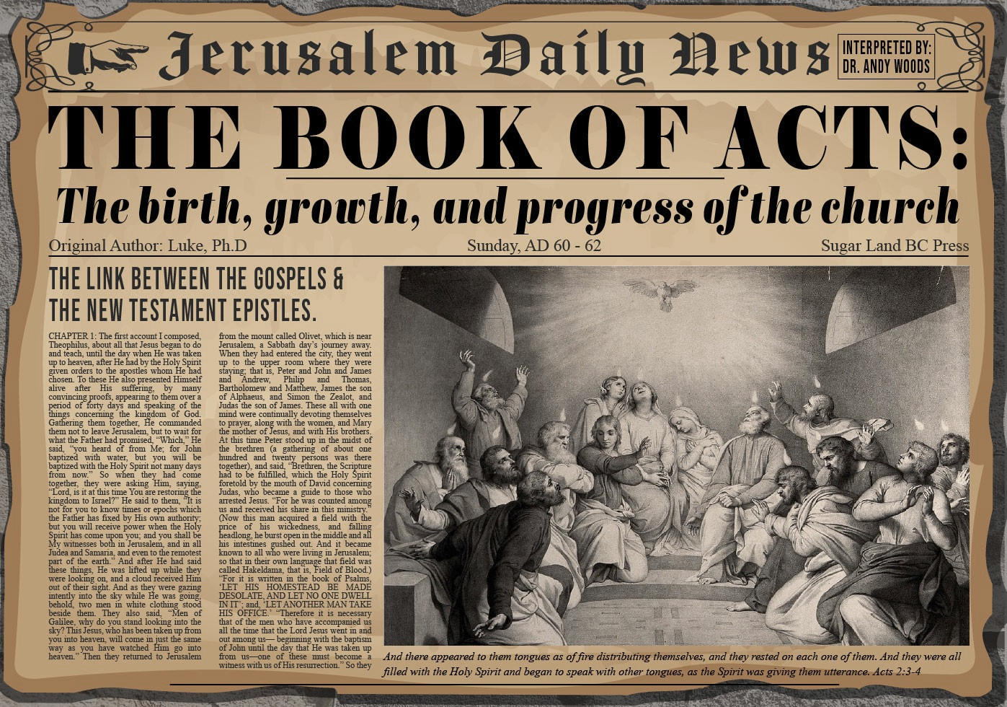


Slide 2

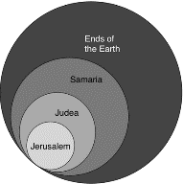
Acts 1:8
“but you will receive power when the Holy Spirit has come upon you; and you shall be My witnesses both in Jerusalem, and in all Judea and Samaria, and even to the remotest part of the earth.”

Slide 3
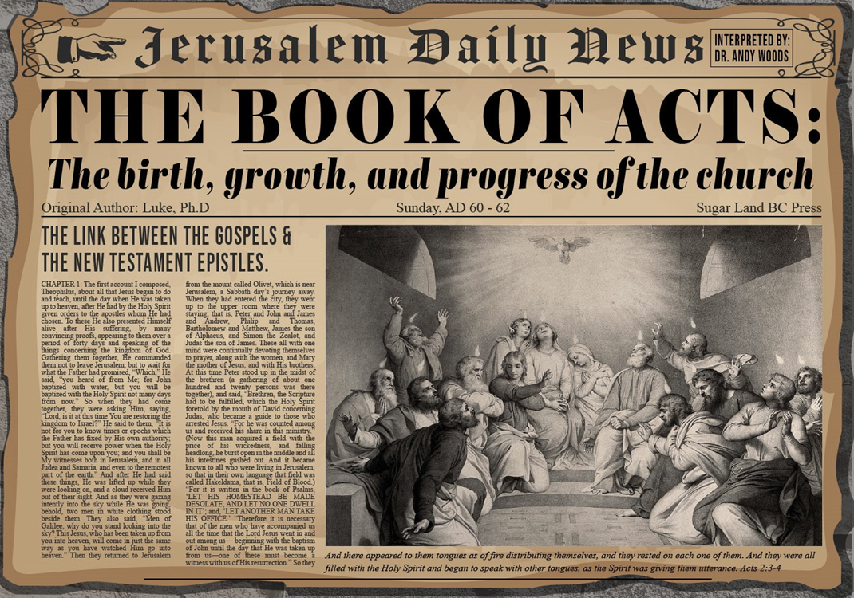
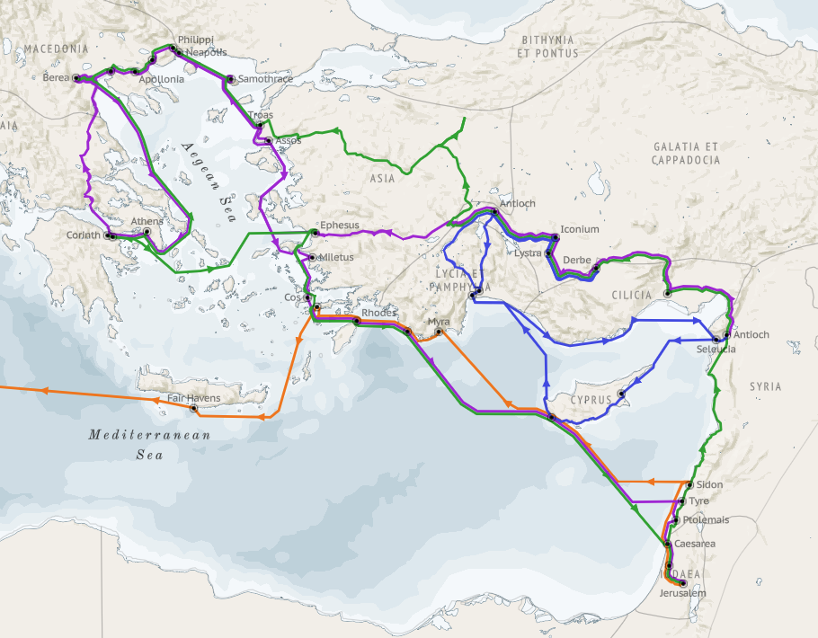
Structure (Acts 1:8)
  Jerusalem (Acts 1–7)
  Judea and Samaria (Acts 8–12)
  Remotest part of the earth (Acts 13–28)
  1st missionary journey (Acts 13–14)
  Jerusalem council (Acts 15:1-35)
  2nd missionary journey (Acts 15:36 –18:22)
  3rd missionary journey (Acts 18:23–21:17)
  Trip to Rome (Acts 21:18–28:31)

Slide 4
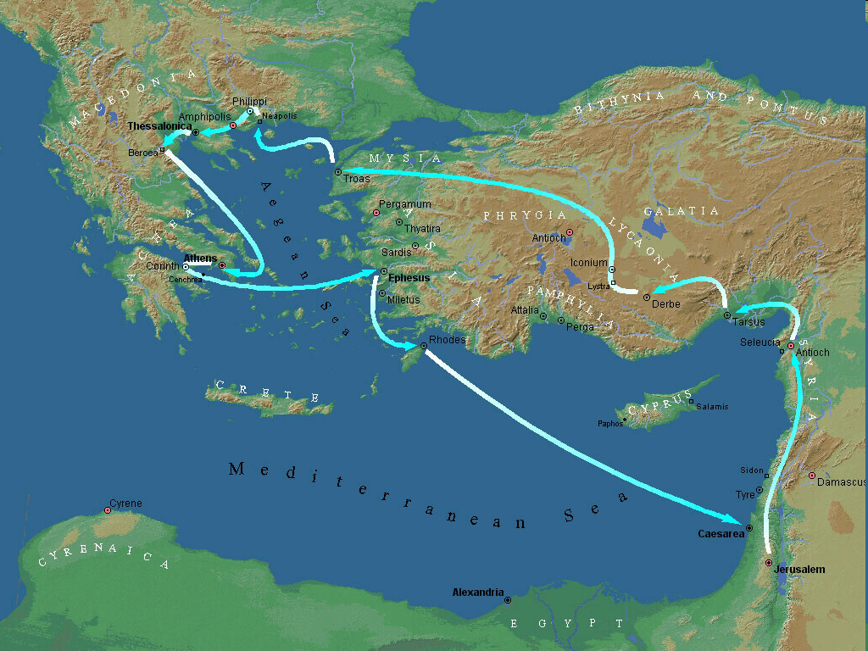
Second Missionary Journey

Slide 5
Acts 15:36‒18:22
2nd Missionary Journey
  Schism between Paul & Barnabas (15:36-41)
  Syria & Cilicia ministry (16:1-5)
  Macedonian call (16:6-10)
  Philippian ministry (16:11-40)
  Thessalonica ministry (17:1-9)
  Berean ministry (17:10-15)
  Athens’ ministry (17:16-34)
  Corinthian ministry (18:1-18)
  Ephesus’ ministry (18:19-21)
  Return to Antioch (18:22)

Slide 6
IV. Philippian Ministry
Acts 16:11-40
  Lydia’s conversion (11-15)
  Demonized slave girl (16-18)
  Paul & Silas’ imprisonment (19-34)
  Departure from Philippi (35-40)

Slide 7
Acts 16:16-18
Demonized Slave Girl
      Introductory encounter (16)
      Demonic recognition (17)
      Apostolic casting out (18)

Slide 8
Acts 16:16-18
Demonized Slave Girl
      Introductory encounter (16)
      Demonic recognition (17)
      Apostolic casting out (18)

Slide 9
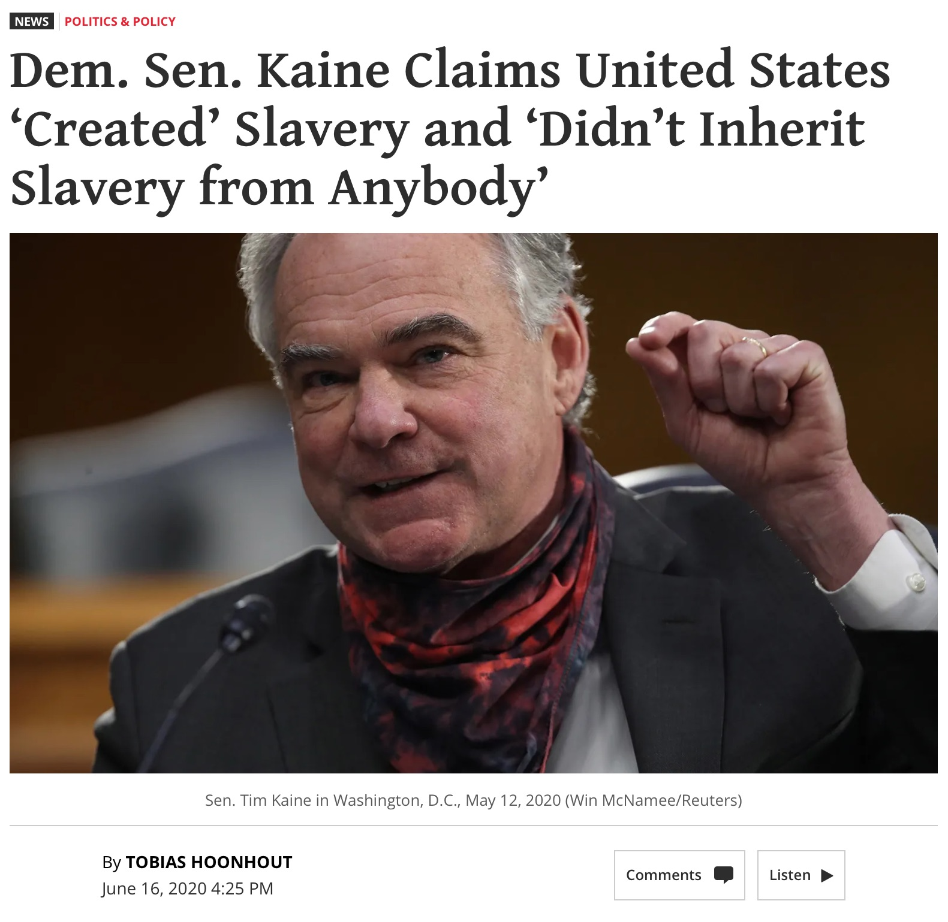

Slide 10

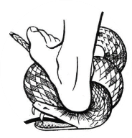
Genesis 3:15
“And I will put enmity Between you and the woman, And between your seed and her seed; He shall bruise you on the head, And you shall bruise him on the heel.”

Slide 11
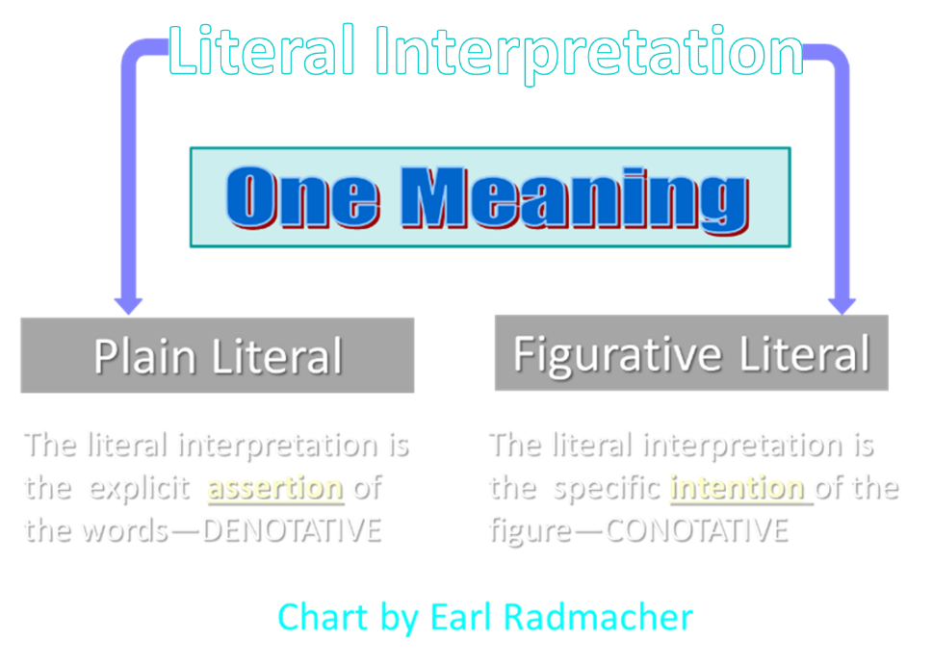

Slide 12
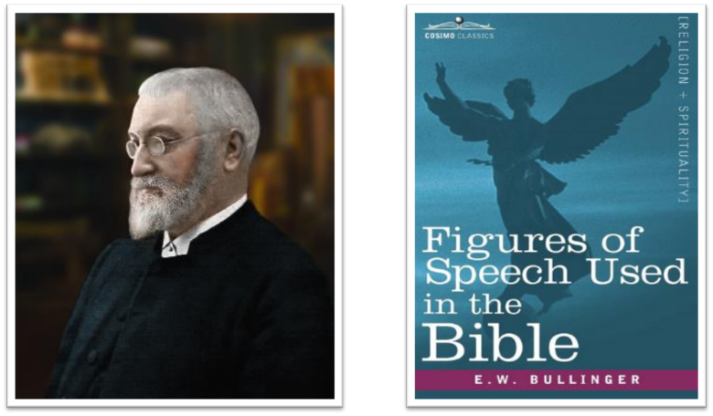
E.W. Bullinger (1837‒1913)

Slide 13
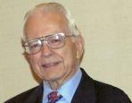

Dr. Roy B. Zuck
Basic Bible Interpretation, p. 156-57.
“﻿Litotes. A litotes is an understatement or a negative statement to express an affirmation. This is the opposite of hyperbole. When we say, ‘He is not a bad preacher,’ we mean he is a very good preacher. The understatement is made for emphasis. When Paul wrote, ‘I am a Jew … a citizen of no insignificant city’ (Acts 21:39, nasb), he meant that Tarsus was in fact a rather significant city. A litotes is at times a belittling statement, as in Numbers 13:33, ‘We seemed like grasshoppers in our own eyes, and we looked the same to them.’ Luke used a number of litotes.”

Slide 14
Dr. Roy B. Zuck
Basic Bible Interpretation, p. 156-57.
“﻿He spoke of ‘no small disturbance among the soldiers’ (Acts 12:18, nasb), ‘no little business’ (19:24), and ‘no small storm’ (27:20, nasb). When Luke wrote that Paul and Barnabas stayed in Antioch ‘a long time’ (14:28), the Greek has a litotes. It is literally, ‘they stayed there not a little time.’ Paul belittled himself with a litotes in 1 Corinthians 15:9, ‘For I am the least of the apostles.’ This statement of genuine humility was written to highlight God’s grace in his life as an undeserving sinner (see v. 10).”

Slide 15

Satanic/Demonic Miracles
Exod. 7–8
Deut. 13:1-3
Job 1:12-19; 2:7-8
1 Sam. 28?
Matt. 7:21-23; 24:24
Luke 4:5
Acts 8:9; 16:16
Gal. 1:6-9
2 Thess. 2:9
2 Cor. 11:14
Rev. 13:3, 13, 15; 16:13-14

Slide 16
Acts 16:16-18
Demonized Slave Girl
      Introductory encounter (16)
      Demonic recognition (17)
      Apostolic casting out (18)

Slide 17
Acts 16:16-18
Demonized Slave Girl
      Introductory encounter (16)
      Demonic recognition (17)
      Apostolic casting out (18)

Slide 18

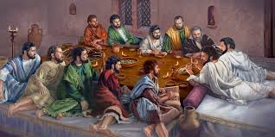
Ephesians 2:20
“having been built on the foundation of the apostles and prophets, Christ Jesus Himself being the corner stone.”

Slide 19
IV. Philippian Ministry
Acts 16:11-40
  Lydia’s conversion (11-15)
  Demonized slave girl (16-18)
  Paul & Silas’ imprisonment (19-34)
  Departure from Philippi (35-40)

Slide 20
Acts 16:19-34
Paul & Silas’ Imprisonment
      Imprisonment (19-24)
      Jailer’s conversion (25-34)

Slide 21
Acts 16:19-34
Paul & Silas’ Imprisonment
      Imprisonment (19-24)
      Jailer’s conversion (25-34)

Slide 22
Acts 16:19-24
Imprisonment
      Motive (19)
      Accusation (20-21)
      Mob beating (22)
      Imprisonment (23-24)

Slide 23
Acts 16:19-24
Imprisonment
      Motive (19)
      Accusation (20-21)
      Mob beating (22)
      Imprisonment (23-24)

Slide 24
Acts 16:19-24
Imprisonment
      Motive (19)
      Accusation (20-21)
      Mob beating (22)
      Imprisonment (23-24)

Slide 25


Slide 26
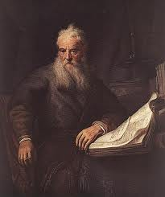
Romans Outline
Salutation (1:1-17)
Sin (1:18–3:20)
Salvation (3:21–5:21)
Sanctification (6–8)
Sovereignty (9–11)
Service (12:1–15:13)
Summation (15:14–16:27)

Slide 27
V. Sovereignty (Rom 9–11)
  Israel in the past: elected (Rom 9)
  Israel in the present: rejected (Rom 10)
  Israel in the future: accepted (Rom 11)

Slide 28

Notes:
28

Slide 29

Romans 11:13, 17-21
“But I am speaking to you who are Gentiles. Inasmuch then as I am an apostle of Gentiles, I magnify my ministry…But if some of the branches were broken off, and you, being a wild olive, were grafted in among them and became partaker with them of the rich root of the olive tree, ¹⁸ do not be arrogant toward the branches; but if you are arrogant, remember that it is not you who supports the root, but the root supports you. ¹⁹ You will say then, “Branches were broken off so that I might be grafted in.” ²⁰ Quite right, they were broken off for their unbelief, but you stand by your faith. Do not be conceited, but fear; ²¹ for if God did not spare the natural branches, He will not spare you, either.”

Slide 30
Acts 16:19-24
Imprisonment
      Motive (19)
      Accusation (20-21)
      Mob beating (22)
      Imprisonment (23-24)

Slide 31
Acts 16:19-24
Imprisonment
      Motive (19)
      Accusation (20-21)
      Mob beating (22)
      Imprisonment (23-24)

Slide 32
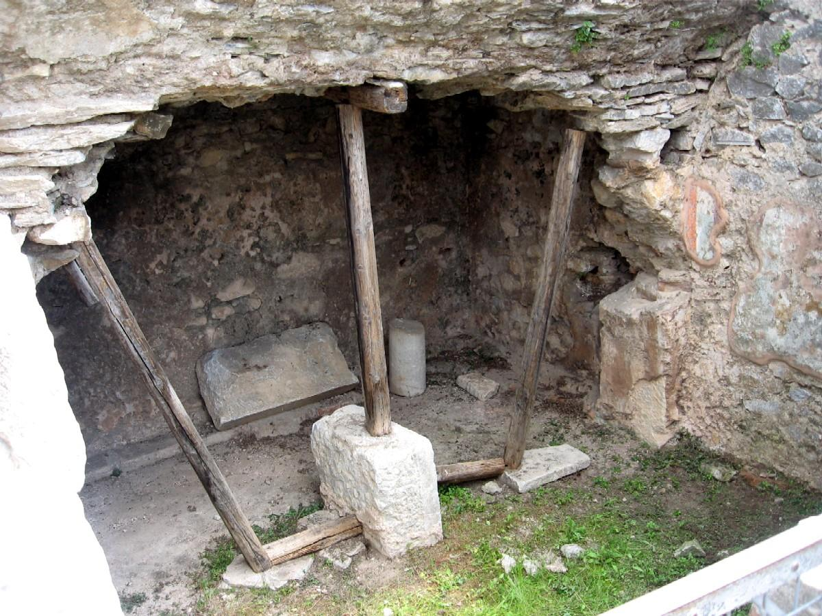

Slide 33

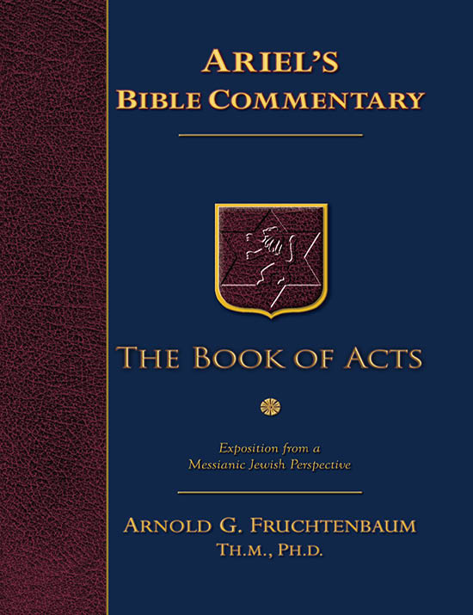
Dr. Arnold G. Fruchtenbaum
The Book of Acts, 351-52
﻿“After having received such a charge (v. 24) and because his life depended on it, the jailer threw Paul and Silas into the inner prison. The Roman public prison had a vestibule, followed by the outer prison. Then came the inner prison, which was a dungeon with no light or air except what came through when the door was opened. This confinement in the inner chamber would make escape virtually impossible.”

Slide 34
Dr. Arnold G. Fruchtenbaum
The Book of Acts, 352
﻿“But to make even more sure that Paul and Silas could not flee, the jailer made their feet fast in the stocks. This treatment was both unnecessary and cruel. The stocks were made from a piece of wood, such as a cross or a log or a large piece of timber, some of which had five holes: two for the wrists, two for the ankles, and one for the neck. Some had only two holes for the feet, which appears to be the case here. Paul’s and Silas’ feet were shackled after being stretched wide apart. All this shows that they underwent a very painful enclosure in the stocks and spent a very uncomfortable night, while their backs were still sore from being beaten with rods.”

Slide 35
Acts 16:19-34
Paul & Silas’ Imprisonment
      Imprisonment (19-24)
      Jailer’s conversion (25-34)

Slide 36
Acts 16:25-34
Jailer’s Conversion
      Timing (25)
      Earthquake (26)
      Jailer’s response (27)
      Paul’s response (28)
      Jailer’s reaction (29-30)
      Gospel message (31)
      Household evangelism (32)
      Results of salvation (33-34)

Slide 37
Acts 16:25-34
Jailer’s Conversion
      Timing (25)
      Earthquake (26)
      Jailer’s response (27)
      Paul’s response (28)
      Jailer’s reaction (29-30)
      Gospel message (31)
      Household evangelism (32)
      Results of salvation (33-34)

Slide 38
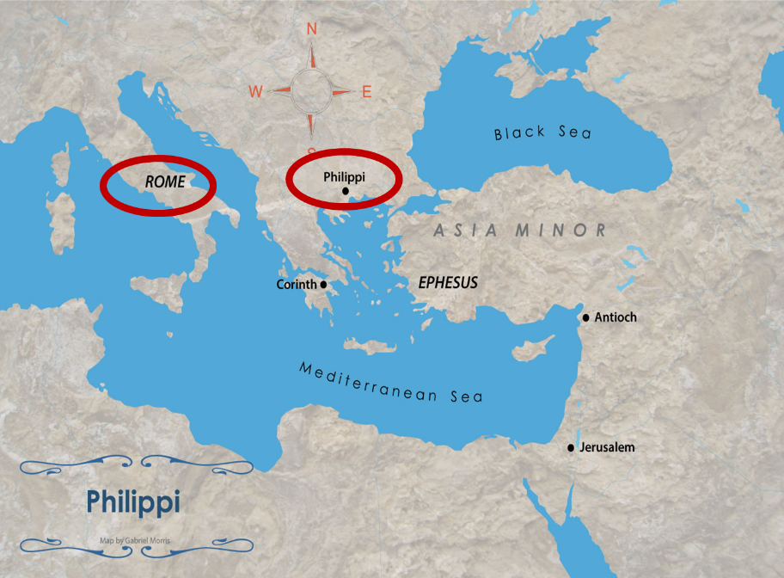

Slide 39
Acts 16:25-34
Jailer’s Conversion
      Timing (25)
      Earthquake (26)
      Jailer’s response (27)
      Paul’s response (28)
      Jailer’s reaction (29-30)
      Gospel message (31)
      Household evangelism (32)
      Results of salvation (33-34)

Slide 40
Acts 16:26
Earthquake
      Foundations shaken (26a)
      Doors opened (26b)
      Hands loosed (26c)

Slide 41
Acts 16:26
Earthquake
      Foundations shaken (26a)
      Doors opened (26b)
      Hands loosed (26c)

Slide 42


2 Thessalonians 2:2
“that you not be quickly shaken from your composure or be disturbed either by a spirit or a message or a letter as if from us, to the effect that the day of the Lord has come.”

Slide 43
Acts 16:26
Earthquake
      Foundations shaken (26a)
      Doors opened (26b)
      Hands loosed (26c)

Slide 44
Acts 16:26
Earthquake
      Foundations shaken (26a)
      Doors opened (26b)
      Hands loosed (26c)

Slide 45
Dr. Arnold G. Fruchtenbaum
The Book of Acts, 352
﻿“They were not necessarily loosened from the prisoners’ hands, but the inmates were no longer chained to the wall. They were free to flee, yet they did not do so, thanks to the influence of Paul and Silas.”

Slide 46
Acts 16:25-34
Jailer’s Conversion
      Timing (25)
      Earthquake (26)
      Jailer’s response (27)
      Paul’s response (28)
      Jailer’s reaction (29-30)
      Gospel message (31)
      Household evangelism (32)
      Results of salvation (33-34)

Slide 47
Naturalistic Theories
Swoon theory
Theft theory
Hallucination theory
Wrong tomb theory

Slide 48

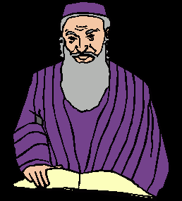
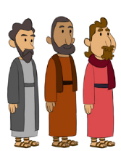
Theft Theories
Rome
Jews
Disciples

Slide 49
Acts 16:25-34
Jailer’s Conversion
      Timing (25)
      Earthquake (26)
      Jailer’s response (27)
      Paul’s response (28)
      Jailer’s reaction (29-30)
      Gospel message (31)
      Household evangelism (32)
      Results of salvation (33-34)

Slide 50
Acts 16:25-34
Jailer’s Conversion
      Timing (25)
      Earthquake (26)
      Jailer’s response (27)
      Paul’s response (28)
      Jailer’s reaction (29-30)
      Gospel message (31)
      Household evangelism (32)
      Results of salvation (33-34)

Slide 51
Acts 16:29-30
Jailer’s Reaction
      Fear (29)
      Question (30)

Slide 52
Acts 16:29-30
Jailer’s Reaction
      Fear (29)
      Question (30)

Slide 53
Acts 16:29-30
Jailer’s Reaction
      Fear (29)
      Question (30)

Slide 54
Acts 16:25-34
Jailer’s Conversion
      Timing (25)
      Earthquake (26)
      Jailer’s response (27)
      Paul’s response (28)
      Jailer’s reaction (29-30)
      Gospel message (31)
      Household evangelism (32)
      Results of salvation (33-34)

Slide 55
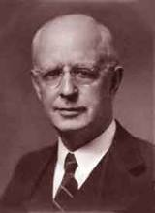
Lewis Sperry Chafer, vol. 7, Systematic Theology
(Grand Rapids, MI: Kregel Publications, 1993), 265-66.
Belief – God’s One Condition for Justification
“…because upwards of 150 passages of Scripture condition salvation upon believing only (cf. John 3:16; Acts 16:31).”

Slide 56
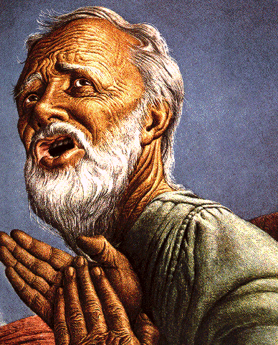
Belief – God’s One Condition for Justification
Gen 15:6
Then he believed in the LORD; and He reckoned it to him as righteousness.
John 3:16
For God so loved the world, that He gave His only begotten Son, that whoever believes in Him shall not perish, but have eternal life.
Acts 16:30-31
"Sirs, what must I do to be saved?" They said, "Believe in the Lord Jesus, and you will be saved..."

Slide 57
Dr. Arnold G. Fruchtenbaum
The Book of Acts, 353-54
﻿“The jailer had to believe the gospel, and the results would be spiritual salvation. Sometimes this verse is misinterpreted to mean that if one person in a family is saved, the others will be saved sooner or later as well, but too many believers have seen members of their families die without the Lord. Paul did not promise that the jailer’s family would be saved. The phrase “believe on the Lord Yeshua the Messiah” applied to both the jailer and his house. Both needed to believe in order to be saved. However, at the time, in strict Roman families the father was the paterfamilias, the head of the house, and was so authoritative that his decision to believe would free the others to believe as well, and believe they did.”

Slide 58
Acts 16:25-34
Jailer’s Conversion
      Timing (25)
      Earthquake (26)
      Jailer’s response (27)
      Paul’s response (28)
      Jailer’s reaction (29-30)
      Gospel message (31)
      Household evangelism (32)
      Results of salvation (33-34)

Slide 59
Acts 16:25-34
Jailer’s Conversion
      Timing (25)
      Earthquake (26)
      Jailer’s response (27)
      Paul’s response (28)
      Jailer’s reaction (29-30)
      Gospel message (31)
      Household evangelism (32)
      Results of salvation (33-34)

Slide 60
Acts 16:33-34
Results of Salvation
      Wounds treated (33a)
      Baptism (33b)
      Hospitality (34a)
      Fellowship (34b)

Slide 61
Acts 16:33-34
Results of Salvation
      Wounds treated (33a)
      Baptism (33b)
      Hospitality (34a)
      Fellowship (34b)

Slide 62
Acts 16:33-34
Results of Salvation
      Wounds treated (33a)
      Baptism (33b)
      Hospitality (34a)
      Fellowship (34b)

Slide 63
Acts 16:33-34
Results of Salvation
      Wounds treated (33a)
      Baptism (33b)
      Hospitality (34a)
      Fellowship (34b)

Slide 64
Acts 16:33-34
Results of Salvation
      Wounds treated (33a)
      Baptism (33b)
      Hospitality (34a)
      Fellowship (34b)

Slide 65
IV. Philippian Ministry
Acts 16:11-40
  Lydia’s conversion (11-15)
  Demonized slave girl (16-18)
  Paul & Silas’ imprisonment (19-34)
  Departure from Philippi (35-40)

Slide 66
Acts 16:35-40
Departure from Philippi
      Ruler’s decision (35-36)
      Paul’s defense (37)
      Leader’s response (38-39)
      Paul & Silas comfort & departure (40)

Slide 67
Acts 16:35-40
Departure from Philippi
      Ruler’s decision (35-36)
      Paul’s defense (37)
      Leader’s response (38-39)
      Paul & Silas comfort & departure (40)

Slide 68
Acts 16:35-36
Rulers’ Decision
      Timing (35)
      Jailer’s report (36)

Slide 69
Acts 16:35-36
Rulers’ Decision
      Timing (35)
      Jailer’s report (36)

Slide 70
Acts 16:35-36
Rulers’ Decision
      Timing (35)
      Jailer’s report (36)

Slide 71
Acts 16:35-40
Departure from Philippi
      Ruler’s decision (35-36)
      Paul’s defense (37)
      Leader’s response (38-39)
      Paul & Silas comfort & departure (40)

Slide 72
Dr. Arnold G. Fruchtenbaum
The Book of Acts, 355-56
﻿“What had been done to them was illegal by Roman law. In fact, it violated two specific sets of laws. The first one was called Lex Valeria, which was passed in the year 509 B.C. The second set of laws was called Leges Porciae. Issued between 248 B.C. and 195 B.C., these laws exempted Roman citizens from shameful forms of punishment, such as whipping, beating, or crucifixion. They also guaranteed that Roman citizens had the right to appeal to the tribunes of the plebs. In his speeches against the corrupt governor Gaius Verres, Cicero wrote: ‘To fetter a Roman citizen was a crime, to scourge him was a scandal, to slay him – parricide.’ It was a crime to inflict blows on a Roman citizen, and the law protected a Roman citizen from scourging for any reason whatsoever. At the same time, it was a capital offense to make a false claim of Roman citizenship.”

Slide 73

Romans 13:3-5
“For rulers are not a cause of fear for good behavior, but for evil. Do you want to have no fear of authority? Do what is good and you will have praise from the same; for it [government] is a minister of God to you for good. But if you do what is evil, be afraid; for it [government] does not bear the sword for nothing; for it [government] is a minister of God, an avenger who brings wrath on the one who practices evil.”

Slide 74
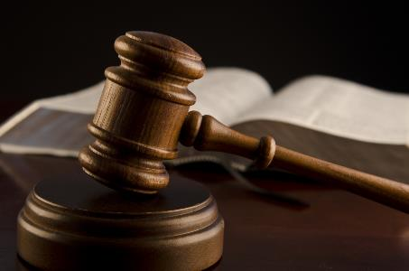
1 Peter 2:13-14
“Submit yourselves for the Lord’s sake to every human institution, whether to a king as the one in authority, or to governors as sent by him for the punishment of evildoers and the praise of those who do right.”

Slide 75
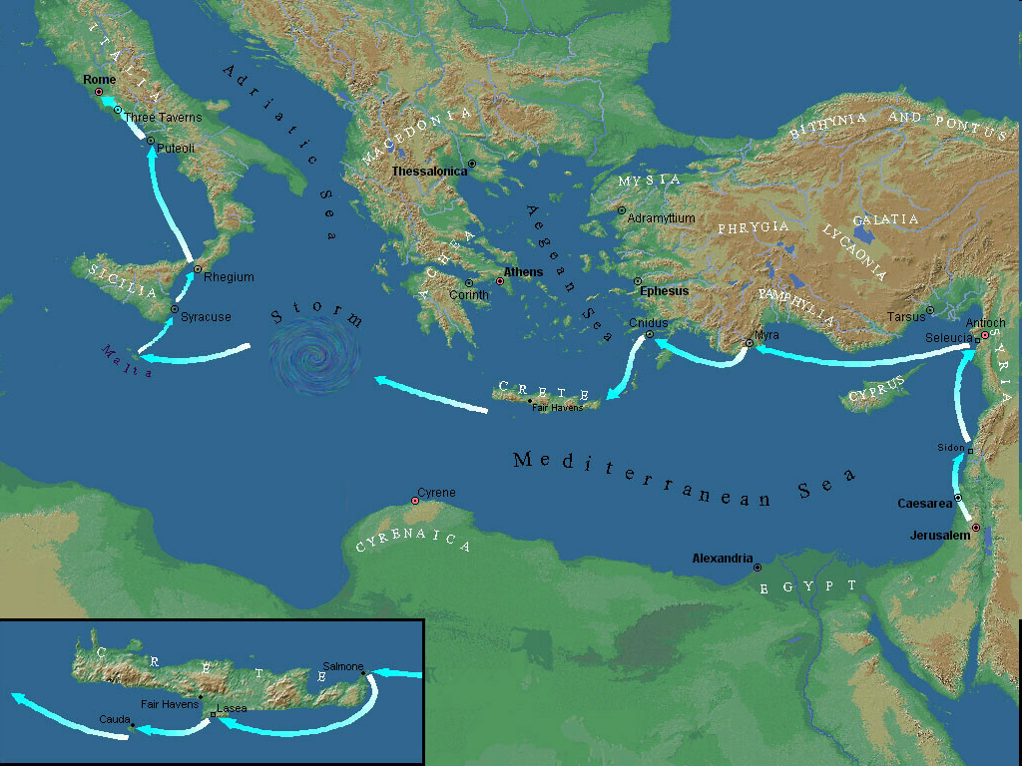

Slide 76
Acts 16:35-40
Departure from Philippi
      Ruler’s decision (35-36)
      Paul’s defense (37)
      Leader’s response (38-39)
      Paul & Silas comfort & departure (40)

Slide 77
Acts 16:38-39
Leaders’ Response
      Fear (38)
      Escort & beseeching (39)

Slide 78
Acts 16:38-39
Leaders’ Response
      Fear (38)
      Escort & beseeching (39)

Slide 79
Dr. Arnold G. Fruchtenbaum
The Book of Acts, 356
﻿“Verses 38-39 reveal the response of the leaders. The serjeants gave the report to the rulers with the result that the magistrates feared when they heard that they were Romans (v. 38). They became afraid, because now their own lives were at stake for what they had done to two Roman citizens. Apparently, Emperor Claudius once deprived the city of Rhodes of its freedom for having crucified a Roman citizen. So, the magistrates’ fear was indeed justified.”

Slide 80
Acts 16:38-39
Leaders’ Response
      Fear (38)
      Escort & beseeching (39)

Slide 81
Acts 16:35-40
Departure from Philippi
      Ruler’s decision (35-36)
      Paul’s defense (37)
      Leader’s response (38-39)
      Paul & Silas comfort & departure (40)

Slide 82

Place of Writing
  “We” sections (Acts 16:10-40; 20:5–21:18; 27:1–28:16)
  From Paul
  Cesarean imprisonment (Acts 24:27)
  Voyage to Rome (Acts 27)
  First Roman imprisonment (Acts 28:16)
  Combination

Slide 83
Conclusion

Slide 84
Acts 15:36‒18:22
2nd Missionary Journey
  Schism between Paul & Barnabas (15:36-41)
  Syria & Cilicia ministry (16:1-5)
  Macedonian call (16:6-10)
  Philippian ministry (16:11-40)
  Thessalonica ministry (17:1-9)
  Berean ministry (17:10-15)
  Athens’ ministry (17:16-34)
  Corinthian ministry (18:1-18)
  Ephesus’ ministry (18:19-21)
  Return to Antioch (18:22)

Slide 85
IV. Philippian Ministry
Acts 16:11-40
  Lydia’s conversion (11-15)
  Demonized slave girl (16-18)
  Paul & Silas’ imprisonment (19-34)
  Departure from Philippi (35-40)

