Slide 1
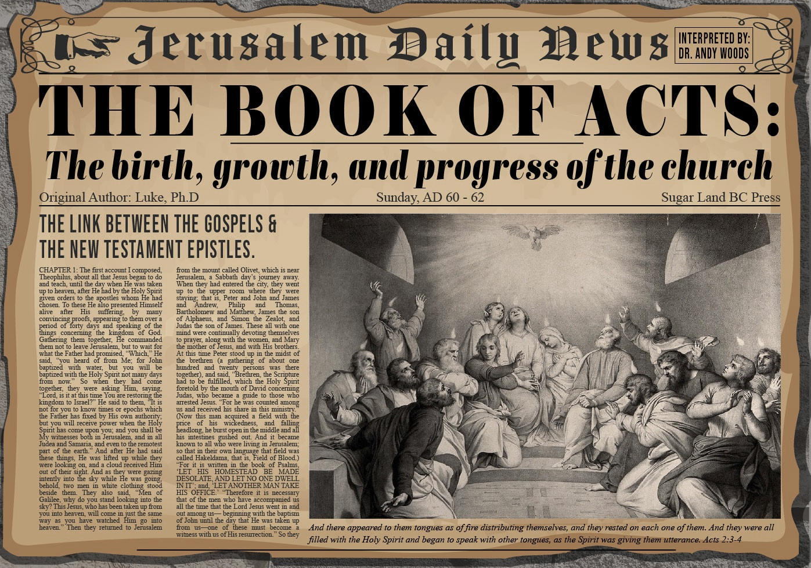


Slide 2

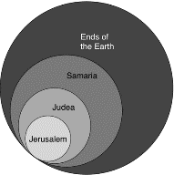
Acts 1:8
“but you will receive power when the Holy Spirit has come upon you; and you shall be My witnesses both in Jerusalem, and in all Judea and Samaria, and even to the remotest part of the earth.”

Slide 3
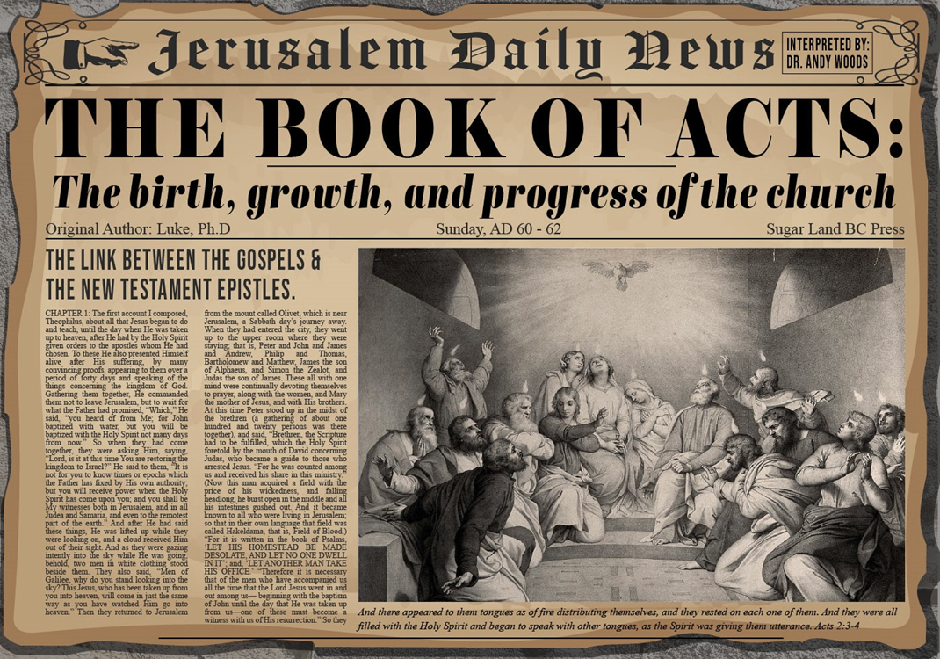
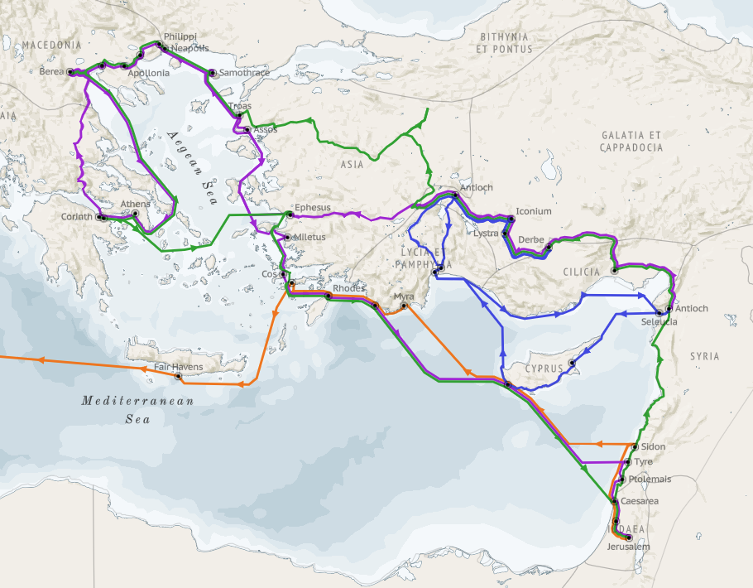
Structure (Acts 1:8)
Jerusalem (Acts 1–7)
Judea and Samaria (Acts 8–12)
Remotest part of the earth (Acts 13–28)
1st missionary journey (Acts 13–14)
Jerusalem council (Acts 15:1-35)
2nd missionary journey (Acts 15:36 –18:22)
3rd missionary journey (Acts 18:23–21:17)
Trip to Rome (Acts 21:18–28:31)

Slide 4
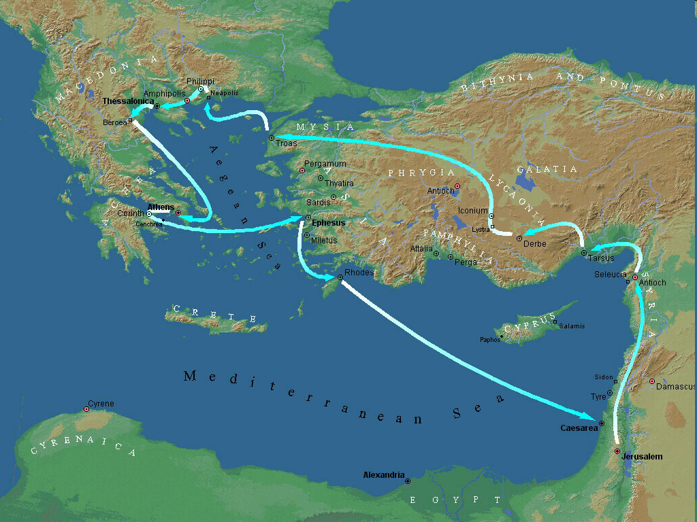
Second Missionary Journey

Slide 5
Acts 15:36‒18:22 2nd Missionary Journey
Schism between Paul & Barnabas (15:36-41)
Syria & Cilicia ministry (16:1-5)
Macedonian call (16:6-10)
Philippian ministry (16:11-40)
Thessalonica ministry (17:1-9)
Berean ministry (17:10-15)
Athens’ ministry (17:16-34)
Corinthian ministry (18:1-18)
Ephesus’ ministry (18:19-21)
Return to Antioch (18:22)

Slide 6
IV. Philippian Ministry Acts 16:11-40
Lydia’s conversion (11-15)
Demonized slave girl (16-18)
Paul & Silas’ imprisonment (19-34)
Departure from Philippi (35-40)

Slide 7
IV. Philippian Ministry Acts 16:11-40
Lydia’s conversion (11-15)
Demonized slave girl (16-18)
Paul & Silas’ imprisonment (19-34)
Departure from Philippi (35-40)

Slide 8
Acts 16:11-15 Lydia’s Conversion
Journey to Neapolis (11)
Arrival at Philippi (12)
Jewish Sabbath meeting (13)
Lydia’s conversion (14)
Results of conversion (15)

Slide 9
Acts 16:11-15 Lydia’s Conversion
Journey to Neapolis (11)
Arrival at Philippi (12)
Jewish Sabbath meeting (13)
Lydia’s conversion (14)
Results of conversion (15)

Slide 10
Second Missionary Journey

Slide 11
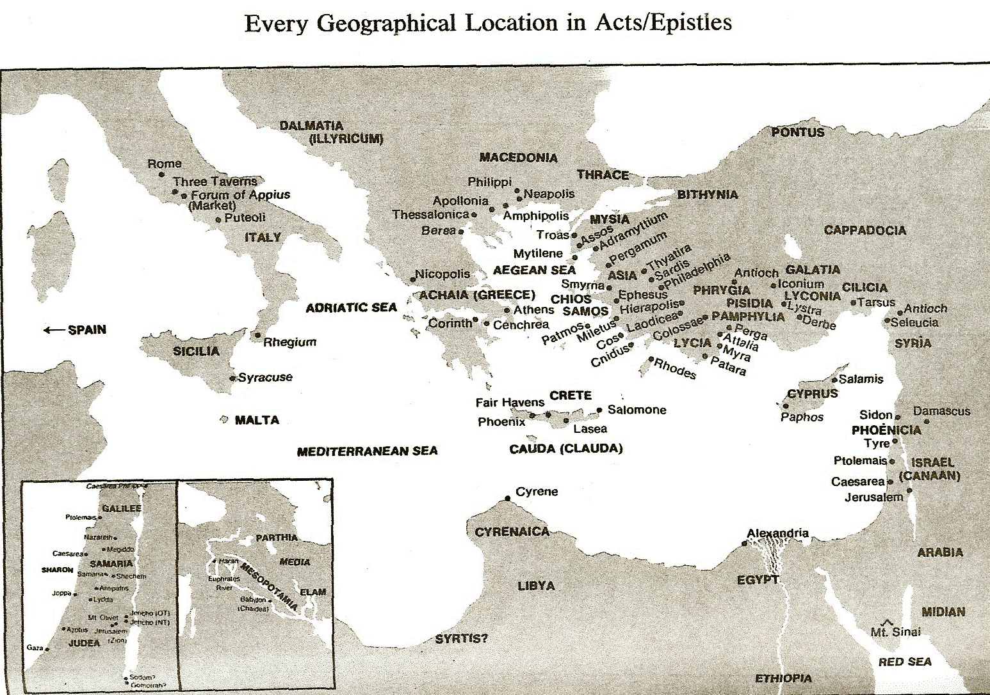

Slide 12
Acts 16:11-15 Lydia’s Conversion
Journey to Neapolis (11)
Arrival at Philippi (12)
Jewish Sabbath meeting (13)
Lydia’s conversion (14)
Results of conversion (15)

Slide 13
Second Missionary Journey

Slide 15


Dr. Arnold G. Fruchtenbaum
The Book of Acts, 345-46
﻿“Macedonia had been a Roman province since the year 146 B.C. In 167 B.C., the Romans divided the region into four administrative districts, and this was the first of the four districts. Philippi was merely a city of the first district of Macedonia. In 42 B.C., Antony and Octavian (Augustus) won an important battle over the assassins of Julius Caesar in the vicinity of Philippi. In honor of this victory, Philippi was made a Roman colony. At first, it was named Antoni Iussu Colonia Victrix Philippensium after the battle. About a decade later, it received the honorary title of Colonia Iulia Augusta Philippensis, indicating its status as a Roman colony.”

Slide 16
Dr. Arnold G. Fruchtenbaum
The Book of Acts, 345-46
﻿“People living in such a colony were automatically given Roman citizenship and therefore lived under the same laws and rights as the citizens of Rome. It was like a piece of Rome ‘transplanted’ abroad. Philippi was settled by Romans, mostly retired or active military men. Other Roman colonies mentioned in the New Testament include Antioch of Pisidia, Lystra, Troas, Ptolemais, and Corinth.”

Slide 17
Acts 16:11-15 Lydia’s Conversion
Journey to Neapolis (11)
Arrival at Philippi (12)
Jewish Sabbath meeting (13)
Lydia’s conversion (14)
Results of conversion (15)

Slide 18
Dr. Arnold G. Fruchtenbaum
The Book of Acts, 346
﻿“Verse 13 deals with the Jewish Sabbath meeting. On the sabbath day, Paul’s group went outside the gate, meaning they left the city, to go to a river side. This river was the Gangites, also known as Angites, and is about one-and-a-half miles outside of town. By Jewish law, a minyan of at least ten Jewish men from the age of thirteen are required to maintain a public synagogue and worship. If there were not enough adult men, then worship must take place outside, preferably by a river side. Knowing this Jewish custom and law, Paul supposed that if he went to the Gangites, he would find a Jewish prayer meeting. And indeed, he found a place of prayer, an open-air enclosure by the river. He and his men sat down, and spoke unto the women that were come together. Only women were present on this occasion.”

Slide 19
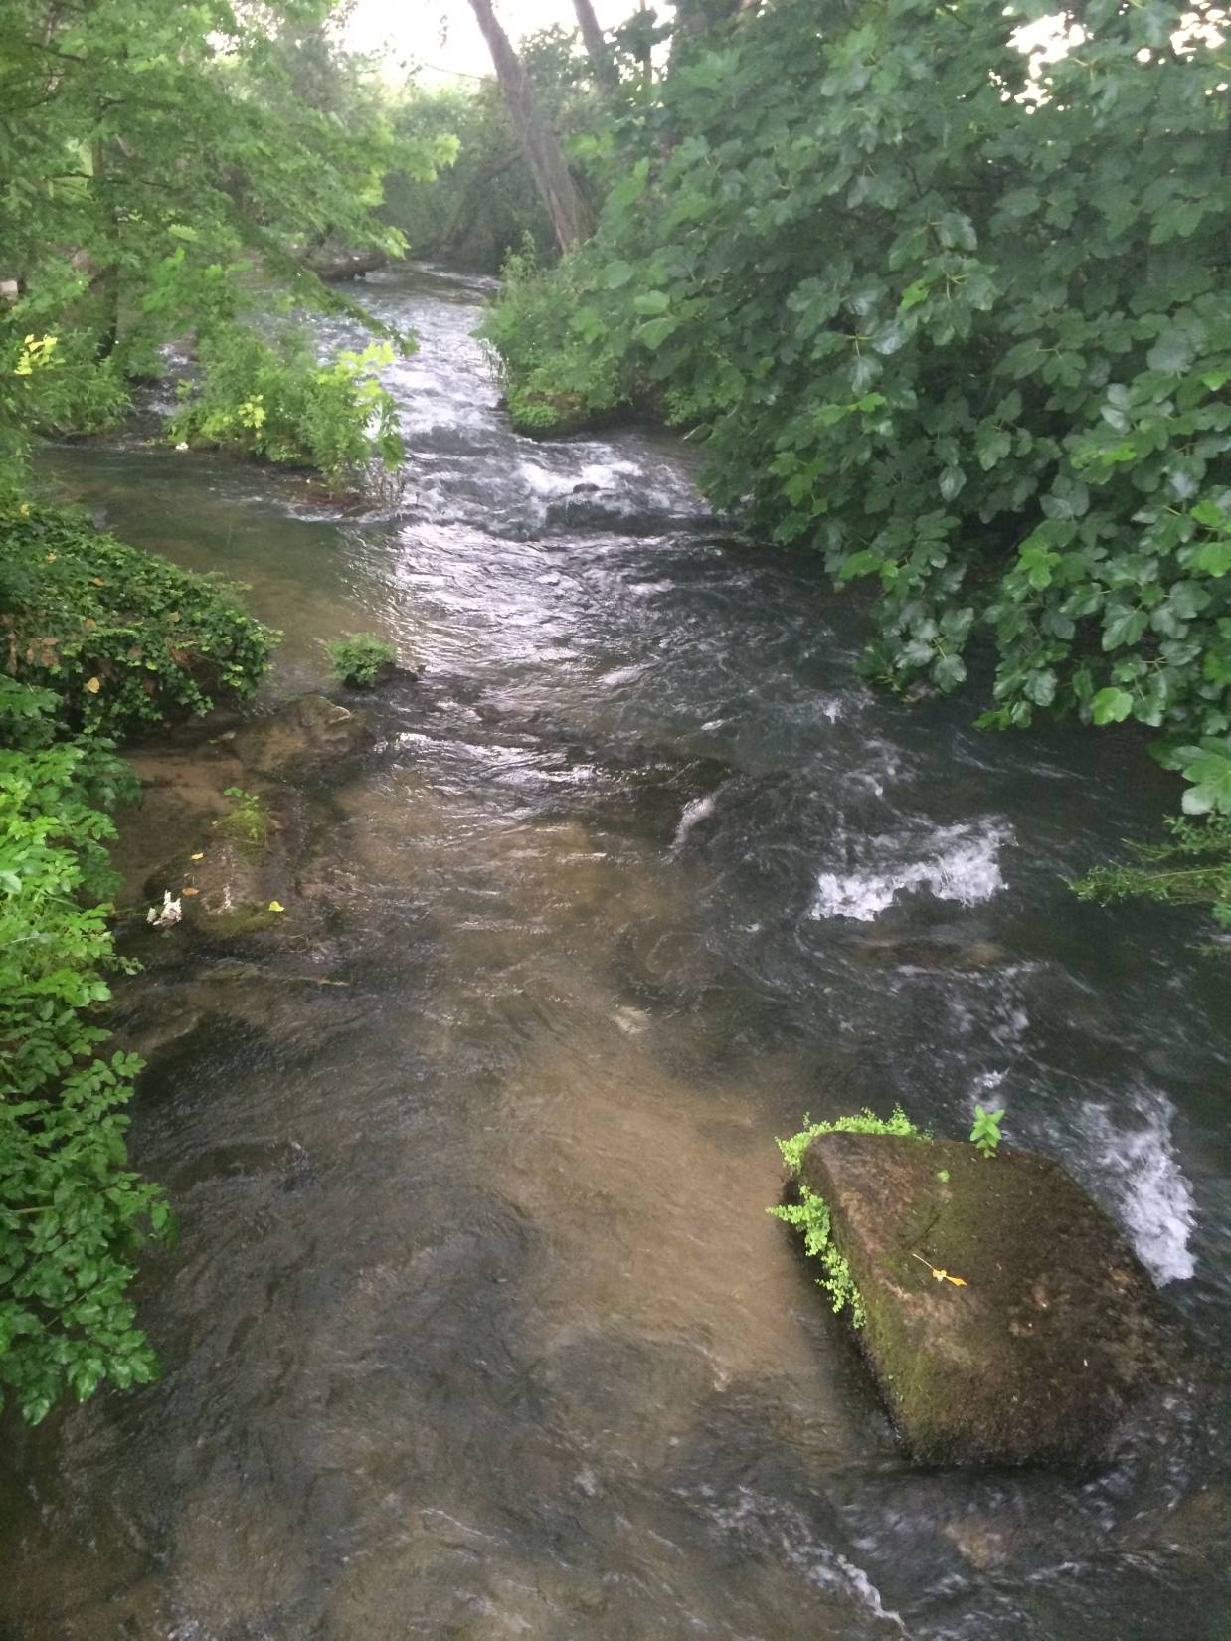

Slide 20
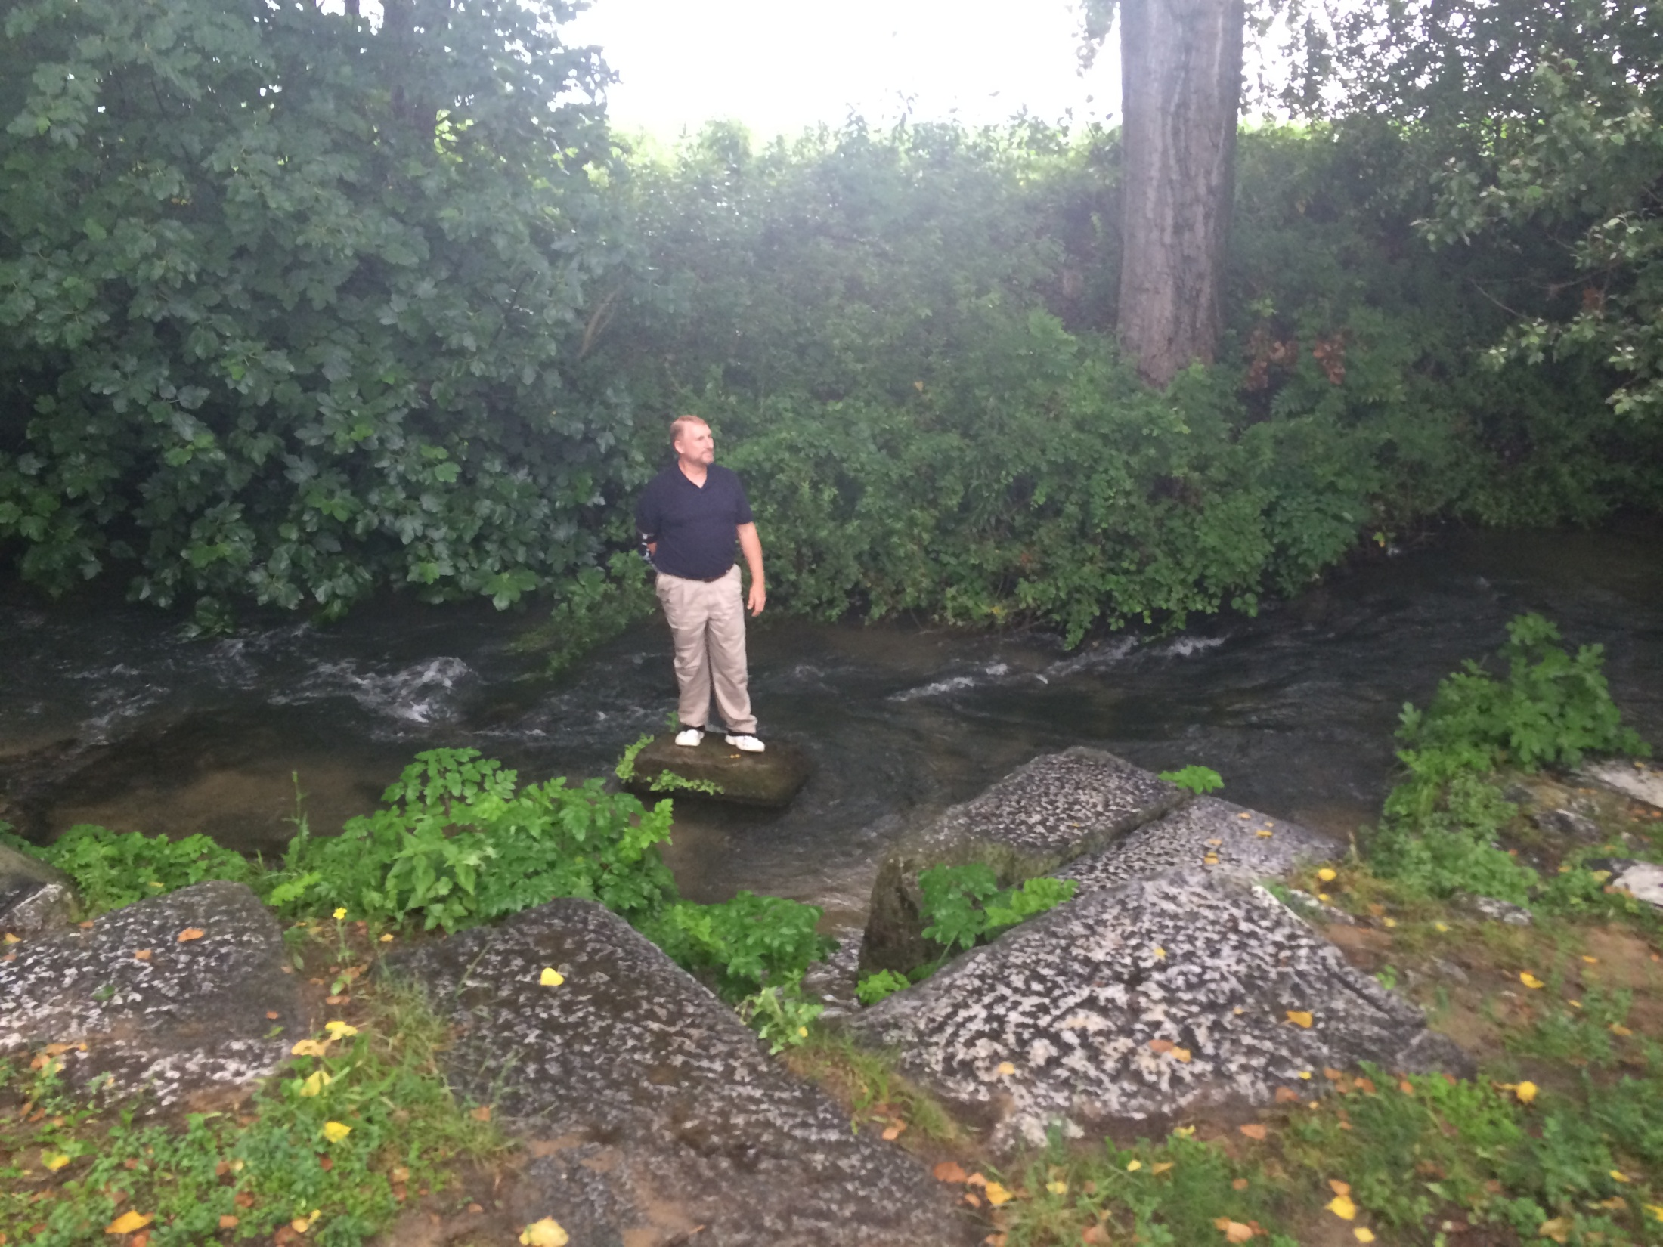

Slide 21
Acts 16:11-15 Lydia’s Conversion
Journey to Neapolis (11)
Arrival at Philippi (12)
Jewish Sabbath meeting (13)
Lydia’s conversion (14)
Results of conversion (15)

Slide 22
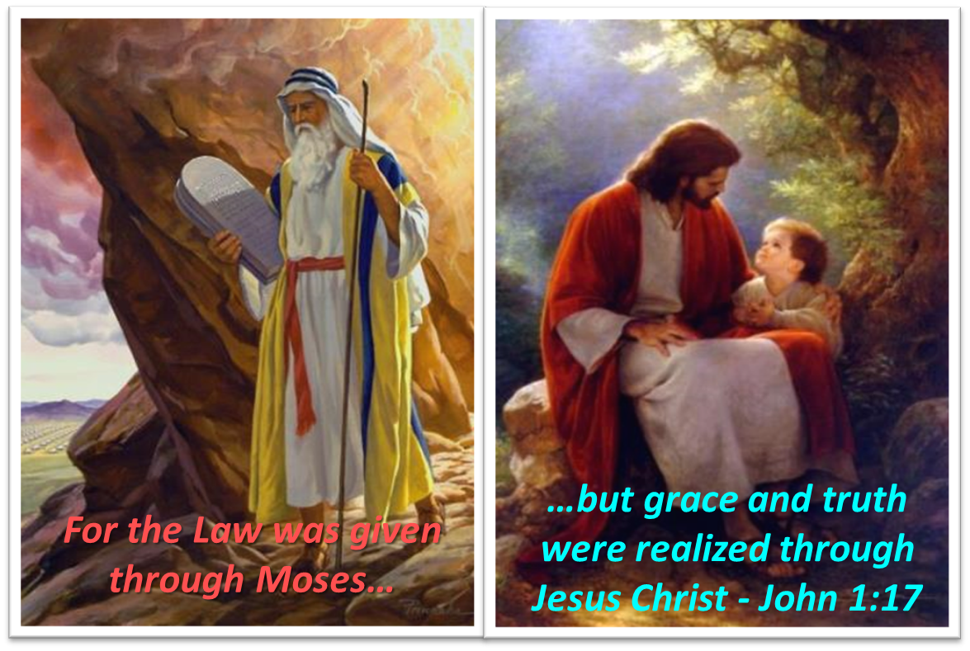
Themes
From Peter to Paul (Gal 2:7-8)
Universality of the Gospel
Transitions
Sovereignty of God (Acts 2:23; 13:48)
Soteriology (Acts 16:31)

Slide 23
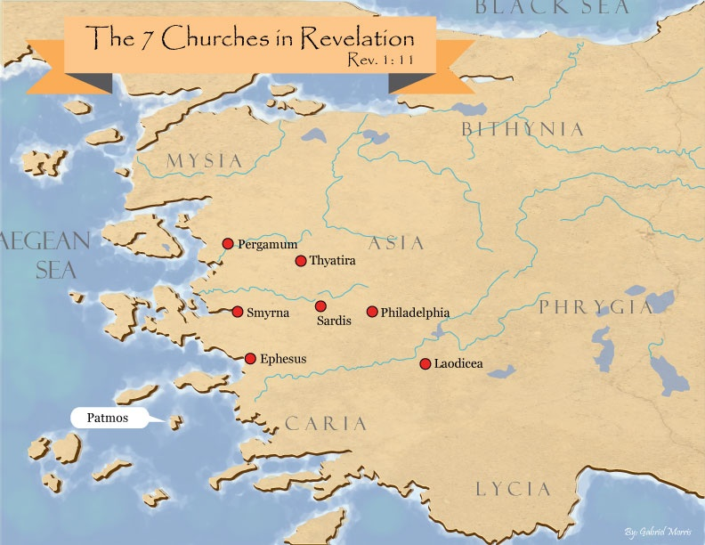
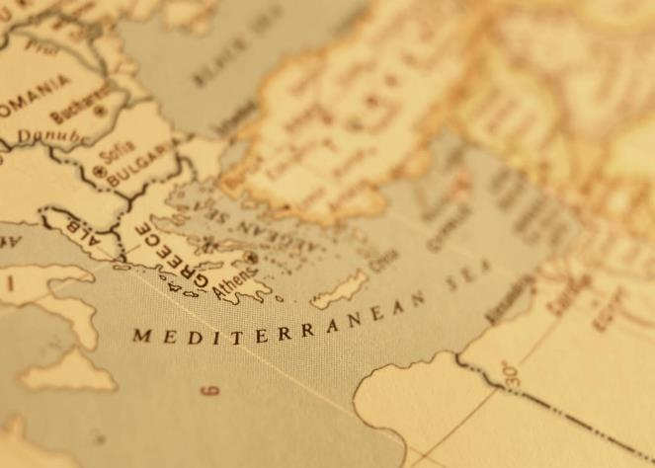

Slide 24

John 16:7-11
“⁷ But I tell you the truth, it is to your advantage that I go away; for if I do not go away, the Helper will not come to you; but if I go, I will send Him to you. ⁸ And He, when He comes, will convict the world concerning sin (hamartia, singular noun) and righteousness and judgment; ⁹ concerning sin, because they do not believe in Me; ¹⁰ and concerning righteousness, because I go to the Father and you no longer see Me; ¹¹ and concerning judgment, because the ruler of this world has been judged.”

Slide 25
René A. Lopez
“The Greek…(‘opened’) refers to ‘opening of the eyes to make understanding possible and enable perception.’ Many of the New Testament occurrences of…(‘heart’) refer to the mind, as it does here; God opened Lydia’s ‘eyes of the heart,’ as if removing a mental veil (2 Cor. 4:3–4), so that she would understand and respond. God enabled her to understand Paul’s message so that she could believe and be saved. But opening her heart (or understanding) is not the same as giving her faith. Acts 16 does not say God gave her faith. Instead He enabled her to understand so that she could exercise faith…Paul wrote in Romans 3:11, ‘There is none who understands, there is none who seeks for God.’ However, God was drawing (cf. John 6:44–45) Lydia to Himself before Paul arrived. Nevertheless giving a person the ability to understand differs from giving him or her faith to believe. God enlightened (a type of drawing) Lydia so that she could believe, but it was still her faith, not God’s gift of faith.”
“Is Faith a Gift From God or a Human Exercise?,” Bibliotheca Sacra 164 (July–September 2007): 264 and n. 20.

Slide 26
Acts 16:11-15 Lydia’s Conversion
Journey to Neapolis (11)
Arrival at Philippi (12)
Jewish Sabbath meeting (13)
Lydia’s conversion (14)
Results of conversion (15)

Slide 27
Acts 16:15 Results of Conversion
Baptism (15a)
Hospitality (15b)

Slide 28
Acts 16:15 Results of Conversion
Baptism (15a)
Hospitality (15b)

Slide 29
Acts 16:15 Results of Conversion
Baptism (15a)
Hospitality (15b)

Slide 30
IV. Philippian Ministry Acts 16:11-40
Lydia’s conversion (11-15)
Demonized slave girl (16-18)
Paul & Silas’ imprisonment (19-34)
Departure from Philippi (35-40)

Slide 31
Acts 16:16-18 Demonized Slave Girl
Introductory encounter (16)
Demonic recognition (17)
Apostolic casting out (18)

Slide 32
Acts 16:16-18 Demonized Slave Girl
Introductory encounter (16)
Demonic recognition (17)
Apostolic casting out (18)

Slide 33

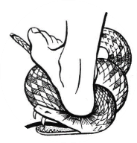
Genesis 3:15
“And I will put enmity Between you and the woman, And between your seed and her seed; He shall bruise you on the head, And you shall bruise him on the heel.”

Slide 34
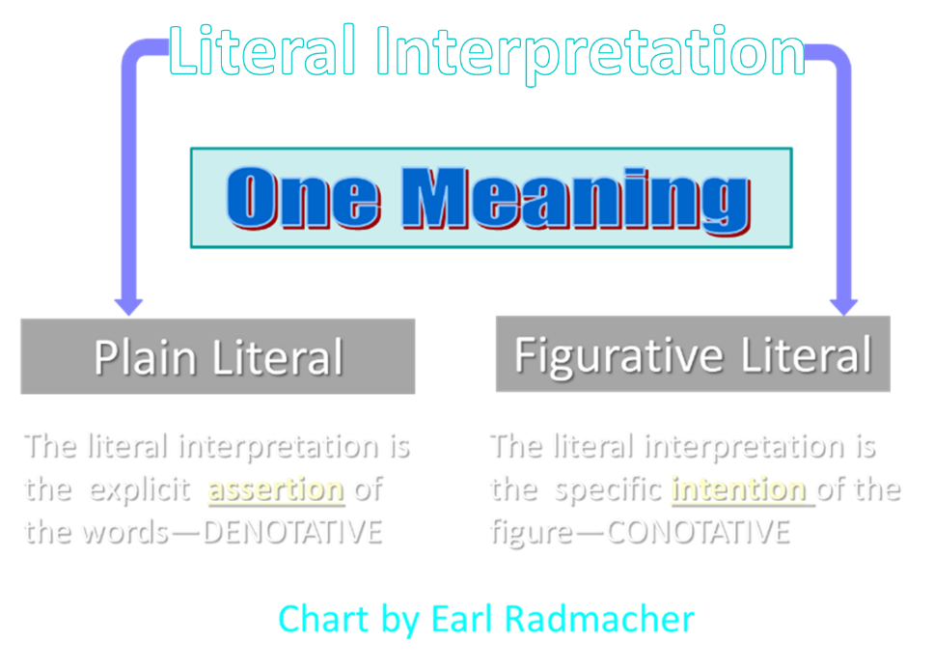

Slide 35
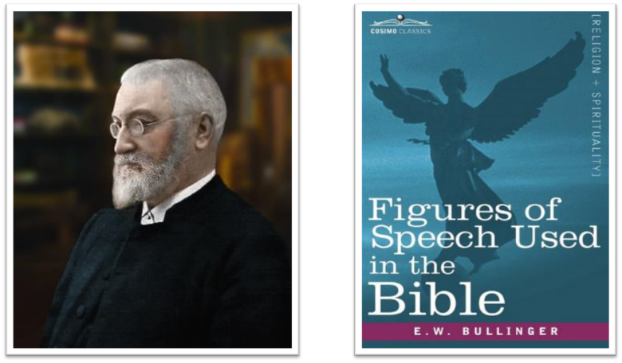
E.W. Bullinger (1837‒1913)

Slide 36
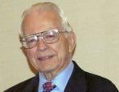

Dr. Roy B. Zuck
Basic Bible Interpretation, p. 156-57.
“﻿Litotes. A litotes is an understatement or a negative statement to express an affirmation. This is the opposite of hyperbole. When we say, ‘He is not a bad preacher,’ we mean he is a very good preacher. The understatement is made for emphasis. When Paul wrote, ‘I am a Jew … a citizen of no insignificant city’ (Acts 21:39, nasb), he meant that Tarsus was in fact a rather significant city. A litotes is at times a belittling statement, as in Numbers 13:33, ‘We seemed like grasshoppers in our own eyes, and we looked the same to them.’ Luke used a number of litotes.”

Slide 37
Dr. Roy B. Zuck
Basic Bible Interpretation, p. 156-57.
“﻿He spoke of ‘no small disturbance among the soldiers’ (Acts 12:18, nasb), ‘no little business’ (19:24), and ‘no small storm’ (27:20, nasb). When Luke wrote that Paul and Barnabas stayed in Antioch ‘a long time’ (14:28), the Greek has a litotes. It is literally, ‘they stayed there not a little time.’ Paul belittled himself with a litotes in 1 Corinthians 15:9, ‘For I am the least of the apostles.’ This statement of genuine humility was written to highlight God’s grace in his life as an undeserving sinner (see v. 10).”

Slide 38

Satanic/Demonic Miracles
Exod. 7–8
Deut. 13:1-3
Job 1:12-19; 2:7-8
1 Sam. 28?
Matt. 7:21-23; 24:24
Luke 4:5
Acts 8:9; 16:16
Gal. 1:6-9
2 Thess. 2:9
2 Cor. 11:14
Rev. 13:3, 13, 15; 16:13-14

Slide 39
Acts 16:16-18 Demonized Slave Girl
Introductory encounter (16)
Demonic recognition (17)
Apostolic casting out (18)

Slide 40
Acts 16:16-18 Demonized Slave Girl
Introductory encounter (16)
Demonic recognition (17)
Apostolic casting out (18)

Slide 41

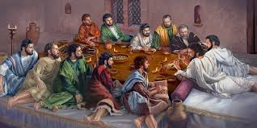
Ephesians 2:20
“having been built on the foundation of the apostles and prophets, Christ Jesus Himself being the corner stone.”

Slide 42
IV. Philippian Ministry Acts 16:11-40
Lydia’s conversion (11-15)
Demonized slave girl (16-18)
Paul & Silas’ imprisonment (19-34)
Departure from Philippi (35-40)

Slide 43
Acts 16:19-34 Paul & Silas’ Imprisonment
Imprisonment (19-24)
Jailer’s conversion (25-34)

Slide 44
Acts 16:19-34 Paul & Silas’ Imprisonment
Imprisonment (19-24)
Jailer’s conversion (25-34)

Slide 45
Acts 16:19-24 Imprisonment
Motive (19)
Accusation (20-21)
Mob beating (22)
Imprisonment (23-24)

Slide 46
Acts 16:19-24 Imprisonment
Motive (19)
Accusation (20-21)
Mob beating (22)
Imprisonment (23-24)

Slide 47
Acts 16:19-24 Imprisonment
Motive (19)
Accusation (20-21)
Mob beating (22)
Imprisonment (23-24)

Slide 48
Acts 16:19-24 Imprisonment
Motive (19)
Accusation (20-21)
Mob beating (22)
Imprisonment (23-24)

Slide 49
Acts 16:19-24 Imprisonment
Motive (19)
Accusation (20-21)
Mob beating (22)
Imprisonment (23-24)

Slide 50
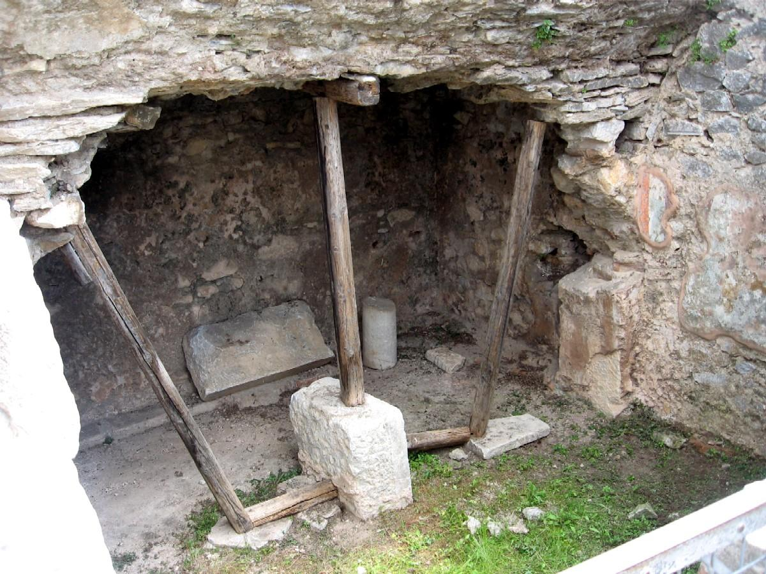

Slide 51
Dr. Arnold G. Fruchtenbaum
The Book of Acts, 351-52
﻿“After having received such a charge (v. 24) and because his life depended on it, the jailer threw Paul and Silas into the inner[429] prison. The Roman public prison had a vestibule, followed by the outer prison. Then came the inner prison, which was a dungeon with no light or air except what came through when the door was opened. This confinement in the inner chamber would make escape virtually impossible.”

Slide 52
Dr. Arnold G. Fruchtenbaum
The Book of Acts, 352
﻿“But to make even more sure that Paul and Silas could not flee, the jailer made their feet fast[430] in the stocks. This treatment was both unnecessary and cruel. The stocks were made from a piece of wood, such as a cross or a log or a large piece of timber, some of which had five holes: two for the wrists, two for the ankles, and one for the neck. Some had only two holes for the feet, which appears to be the case here. Paul’s and Silas’ feet were shackled after being stretched wide apart. All this shows that they underwent a very painful enclosure in the stocks and spent a very uncomfortable night, while their backs were still sore from being beaten with rods.”

Slide 53
Acts 16:19-34 Paul & Silas’ Imprisonment
Imprisonment (19-24)
Jailer’s conversion (25-34)

Slide 54
Acts 16:25-34 Jailer’s Conversion
Timing (25)
Earthquake (26)
Jailer’s response (27)
Paul’s response (28)
Jailer’s reaction (29-30)
Gospel message (31)
Household evangelism (32)
Results of salvation (33-34)

Slide 55
Acts 16:25-34 Jailer’s Conversion
Timing (25)
Earthquake (26)
Jailer’s response (27)
Paul’s response (28)
Jailer’s reaction (29-30)
Gospel message (31)
Household evangelism (32)
Results of salvation (33-34)

Slide 56
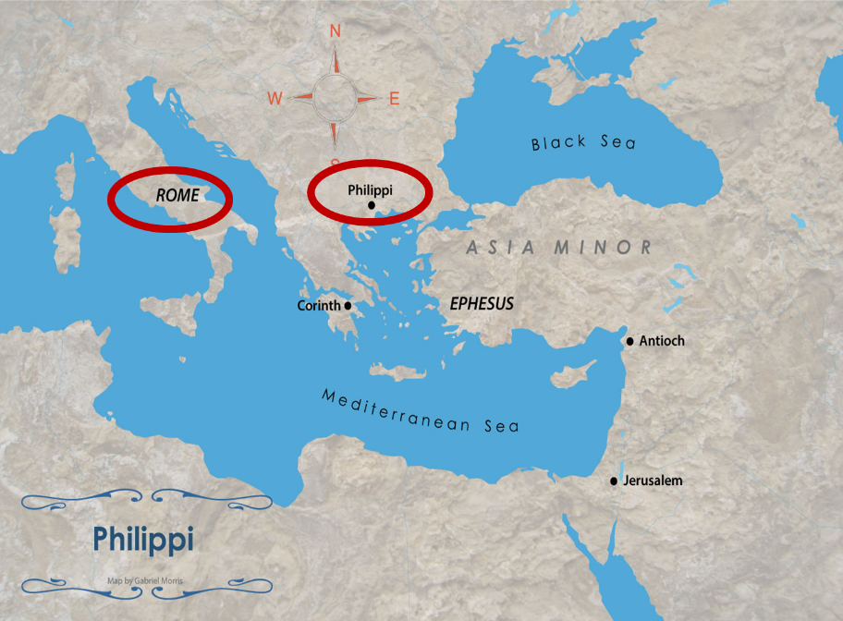

Slide 57
Acts 16:25-34 Jailer’s Conversion
Timing (25)
Earthquake (26)
Jailer’s response (27)
Paul’s response (28)
Jailer’s reaction (29-30)
Gospel message (31)
Household evangelism (32)
Results of salvation (33-34)

Slide 58
Acts 16:26 Earthquake
Foundations shaken (26a)
Doors opened (26b)
Hands loosed (26c)

Slide 59
Acts 16:26 Earthquake
Foundations shaken (26a)
Doors opened (26b)
Hands loosed (26c)

Slide 60


2 Thessalonians 2:2
“that you not be quickly shaken from your composure or be disturbed either by a spirit or a message or a letter as if from us, to the effect that the day of the Lord has come.”

Slide 61
Acts 16:26 Earthquake
Foundations shaken (26a)
Doors opened (26b)
Hands loosed (26c)

Slide 62
Acts 16:26 Earthquake
Foundations shaken (26a)
Doors opened (26b)
Hands loosed (26c)

Slide 63
Dr. Arnold G. Fruchtenbaum
The Book of Acts, 352
﻿“They were not necessarily loosened from the prisoners’ hands, but the inmates were no longer chained to the wall. They were free to flee, yet they did not do so, thanks to the influence of Paul and Silas.”

Slide 64
Acts 16:25-34 Jailer’s Conversion
Timing (25)
Earthquake (26)
Jailer’s response (27)
Paul’s response (28)
Jailer’s reaction (29-30)
Gospel message (31)
Household evangelism (32)
Results of salvation (33-34)

Slide 65
Naturalistic Theories
Swoon theory
Theft theory
Hallucination theory
Wrong tomb theory

Slide 66

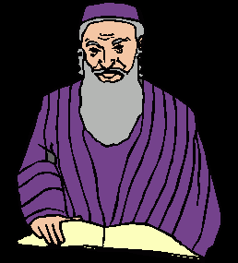
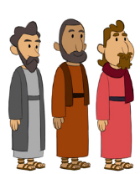
Theft Theories
Rome
Jews
Disciples

Slide 67
Acts 16:25-34 Jailer’s Conversion
Timing (25)
Earthquake (26)
Jailer’s response (27)
Paul’s response (28)
Jailer’s reaction (29-30)
Gospel message (31)
Household evangelism (32)
Results of salvation (33-34)

Slide 68
Acts 16:25-34 Jailer’s Conversion
Timing (25)
Earthquake (26)
Jailer’s response (27)
Paul’s response (28)
Jailer’s reaction (29-30)
Gospel message (31)
Household evangelism (32)
Results of salvation (33-34)

Slide 69
Acts 16:29-30 Jailer’s Reaction
Fear (29)
Question (30)

Slide 70
Acts 16:29-30 Jailer’s Reaction
Fear (29)
Question (30)

Slide 71
Acts 16:29-30 Jailer’s Reaction
Fear (29)
Question (30)

Slide 72
Acts 16:25-34 Jailer’s Conversion
Timing (25)
Earthquake (26)
Jailer’s response (27)
Paul’s response (28)
Jailer’s reaction (29-30)
Gospel message (31)
Household evangelism (32)
Results of salvation (33-34)

Slide 73
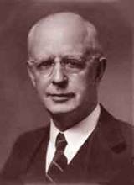
Lewis Sperry Chafer, vol. 7, Systematic Theology (Grand Rapids, MI: Kregel Publications, 1993), 265-66.
Belief – God’s One Condition for Justification
“…because upwards of 150 passages of Scripture condition salvation upon believing only (cf. John 3:16; Acts 16:31).”

Slide 74
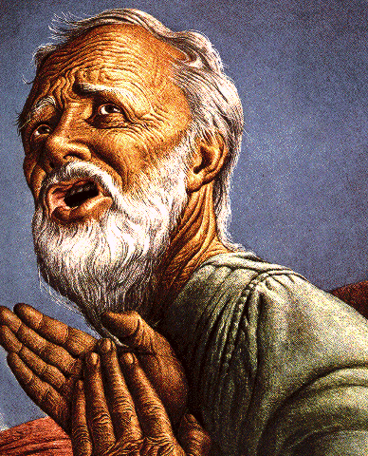
Belief – God’s One Condition for Justification
Gen 15:6
Then he believed in the LORD; and He reckoned it to him as righteousness.
John 3:16
For God so loved the world, that He gave His only begotten Son, that whoever believes in Him shall not perish, but have eternal life.
Acts 16:30-31
"Sirs, what must I do to be saved?" They said, "Believe in the Lord Jesus, and you will be saved..."

Slide 75
Dr. Arnold G. Fruchtenbaum
The Book of Acts, 353-54
﻿“The jailer had to believe the gospel, and the results would be spiritual salvation. Sometimes this verse is misinterpreted to mean that if one person in a family is saved, the others will be saved sooner or later as well, but too many believers have seen members of their families die without the Lord. Paul did not promise that the jailer’s family would be saved. The phrase “believe on the Lord Yeshua the Messiah” applied to both the jailer and his house. Both needed to believe in order to be saved. However, at the time, in strict Roman families the father was the paterfamilias, the head of the house, and was so authoritative that his decision to believe would free the others to believe as well, and believe they did.”

Slide 76
Acts 16:25-34 Jailer’s Conversion
Timing (25)
Earthquake (26)
Jailer’s response (27)
Paul’s response (28)
Jailer’s reaction (29-30)
Gospel message (31)
Household evangelism (32)
Results of salvation (33-34)

Slide 77
Acts 16:25-34 Jailer’s Conversion
Timing (25)
Earthquake (26)
Jailer’s response (27)
Paul’s response (28)
Jailer’s reaction (29-30)
Gospel message (31)
Household evangelism (32)
Results of salvation (33-34)

Slide 78
Acts 16:33-34 Results of Salvation
Wounds treated (33a)
Baptism (33b)
Hospitality (34a)
Fellowship (34b)

Slide 79
Acts 16:33-34 Results of Salvation
Wounds treated (33a)
Baptism (33b)
Hospitality (34a)
Fellowship (34b)

Slide 80
Acts 16:33-34 Results of Salvation
Wounds treated (33a)
Baptism (33b)
Hospitality (34a)
Fellowship (34b)

Slide 81
Acts 16:33-34 Results of Salvation
Wounds treated (33a)
Baptism (33b)
Hospitality (34a)
Fellowship (34b)

Slide 82
Acts 16:33-34 Results of Salvation
Wounds treated (33a)
Baptism (33b)
Hospitality (34a)
Fellowship (34b)

Slide 83
IV. Philippian Ministry Acts 16:11-40
Lydia’s conversion (11-15)
Demonized slave girl (16-18)
Paul & Silas’ imprisonment (19-34)
Departure from Philippi (35-40)

Slide 84
Acts 16:35-40 Departure from Philippi
Ruler’s decision (35-36)
Paul’s defense (37)
Leader’s response (38-39)
Paul & Silas comfort & departure (40)

Slide 85
Acts 16:35-40 Departure from Philippi
Ruler’s decision (35-36)
Paul’s defense (37)
Leader’s response (38-39)
Paul & Silas comfort & departure (40)

Slide 86
Acts 16:35-36 Rulers’ Decision
Timing (35)
Jailer’s report (36)

Slide 87
Acts 16:35-36 Rulers’ Decision
Timing (35)
Jailer’s report (36)

Slide 88
Acts 16:35-36 Rulers’ Decision
Timing (35)
Jailer’s report (36)

Slide 89
Acts 16:35-40 Departure from Philippi
Ruler’s decision (35-36)
Paul’s defense (37)
Leader’s response (38-39)
Paul & Silas comfort & departure (40)

Slide 90
Dr. Arnold G. Fruchtenbaum
The Book of Acts, 355-56
﻿“What had been done to them was illegal by Roman law. In fact, it violated two specific sets of laws. The first one was called Lex Valeria, which was passed in the year 509 B.C. The second set of laws was called Leges Porciae. Issued between 248 B.C. and 195 B.C., these laws exempted Roman citizens from shameful forms of punishment, such as whipping, beating, or crucifixion. They also guaranteed that Roman citizens had the right to appeal to the tribunes of the plebs. In his speeches against the corrupt governor Gaius Verres, Cicero wrote: ‘To fetter a Roman citizen was a crime, to scourge him was a scandal, to slay him – parricide.’ It was a crime to inflict blows on a Roman citizen, and the law protected a Roman citizen from scourging for any reason whatsoever. At the same time, it was a capital offense to make a false claim of Roman citizenship.”

Slide 91

Romans 13:3-5
“For rulers are not a cause of fear for good behavior, but for evil. Do you want to have no fear of authority? Do what is good and you will have praise from the same; for it [government] is a minister of God to you for good. But if you do what is evil, be afraid; for it [government] does not bear the sword for nothing; for it [government] is a minister of God, an avenger who brings wrath on the one who practices evil.”

Slide 92
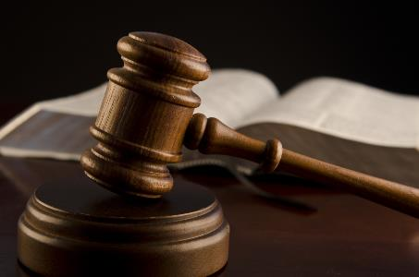
1 Peter 2:13-14
“Submit yourselves for the Lord’s sake to every human institution, whether to a king as the one in authority, or to governors as sent by him for the punishment of evildoers and the praise of those who do right.”

Slide 93
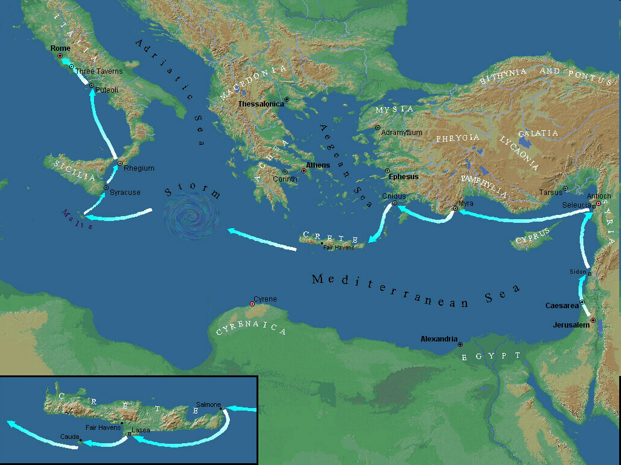

Slide 94
Acts 16:35-40 Departure from Philippi
Ruler’s decision (35-36)
Paul’s defense (37)
Leader’s response (38-39)
Paul & Silas comfort & departure (40)

Slide 95
Acts 16:38-39 Leaders’ Response
Fear (38)
Escort & beseeching (39)

Slide 96
Acts 16:38-39 Leaders’ Response
Fear (38)
Escort & beseeching (39)

Slide 97
Dr. Arnold G. Fruchtenbaum
The Book of Acts, 356
﻿“Verses 38-39 reveal the response of the leaders. The serjeants gave the report to the rulers with the result that the magistrates feared when they heard that they were Romans (v. 38). They became afraid, because now their own lives were at stake for what they had done to two Roman citizens. Apparently, Emperor Claudius once deprived the city of Rhodes of its freedom for having crucified a Roman citizen. So, the magistrates’ fear was indeed justified.”

Slide 98
Acts 16:38-39 Leaders’ Response
Fear (38)
Escort & beseeching (39)

Slide 99
Acts 16:35-40 Departure from Philippi
Ruler’s decision (35-36)
Paul’s defense (37)
Leader’s response (38-39)
Paul & Silas comfort & departure (40)

Slide 100

Place of Writing
“We” sections (Acts 16:10-40; 20:5–21:18; 27:1–28:16)
From Paul
Cesarean imprisonment (Acts 24:27)
Voyage to Rome (Acts 27)
First Roman imprisonment (Acts 28:16)
Combination

Slide 101
Conclusion

Slide 102
Acts 15:36‒18:22 2nd Missionary Journey
Schism between Paul & Barnabas (15:36-41)
Syria & Cilicia ministry (16:1-5)
Macedonian call (16:6-10)
Philippian ministry (16:11-40)
Thessalonica ministry (17:1-9)
Berean ministry (17:10-15)
Athens’ ministry (17:16-34)
Corinthian ministry (18:1-18)
Ephesus’ ministry (18:19-21)
Return to Antioch (18:22)

Slide 103
IV. Philippian Ministry Acts 16:11-40
Lydia’s conversion (11-15)
Demonized slave girl (16-18)
Paul & Silas’ imprisonment (19-34)
Departure from Philippi (35-40)

