Slide 1
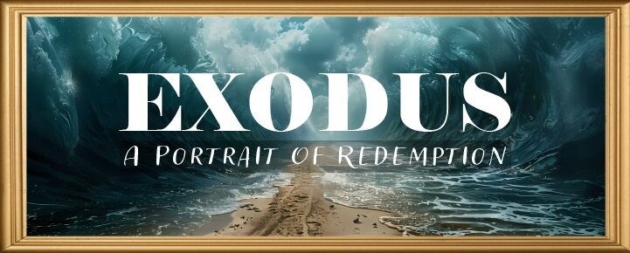


Slide 2

EXODUS STRUCTURE/OUTLINE
Redemption (1–18)
Redemption (1:1–12:30)
Liberation (12:31–15:21)
Preservation (15:22–18:27)
Mosaic Covenant (19–40)
Law (19–24)
Tabernacle instructions (25–31)
Apostasy (32–34)
Tabernacle building (35–40)

Slide 3
REDEMPTION (1:1–12:30)
Why redemption is necessary (Exod 1)
Development of the deliverer (Exod 2–4)
First confrontation with Pharaoh (Exod 5)
God reassures Moses (Exod 6:1–7:7)
Second confrontation with Pharaoh (Exod 7:8-13)
Plagues (Exod 7:14–12:30)

Slide 4
TEN PLAGUES REDEMPTION (7:14–12:30)
Nile to blood
Frogs
Gnats
Flies
Death of livestock
Boils
Hail
Locusts
Darkness
Death of 1st born

Slide 5
The Plagues of Egypt
NO. | DESCRIPTION | SCRIPTURE | Egyptian Deity
1. | Water to Blood | Exod. 7:14-25 | Hapi, Khnum
2. | Frogs | Exod. 8:1-15 | Heqt
3. | Gnats | Exod. 8:16-19 | Set
4. | Flies | Exod. 8:20-32 | Uatchit
5. | Disease on Cattle | Exod. 9:1-7 | Hathor, Apis
6. | Boils | Exod. 9:8-12 | Sekhmet, Serapis
7. | Hail | Exod. 9:13-35 | Seth, Nut
8. | Locusts | Exod. 10:1-20 | Seth, Nut, Osiris
9. | Darkness | Exod. 10:21-29 | Re, Horus, Atum
10. | Death of the First Born | Exod. 12:29-36 | Min, Osiris, Heqt, Isis

Slide 6
HAIL Exodus 9:13-35
God’s Instructions (13-16)
God’s Prediction (17-21)
Prophecy’s Fulfillment (22-26)
Pharaoh’s Reaction (27-32)
Moses’ Reversal (33-35)

Slide 7
III. Exodus 9:22–26 Prophecy’s Fulfillment
God’s Instructions (22)
Moses’ Obedience (23)
Plague’s Severity (24-25)
Plague’s Limitation (26)

Slide 8
III. Exodus 9:22–26 Prophecy’s Fulfillment
God’s Instructions (22)
Moses’ Obedience (23)
Plague’s Severity (24-25)
Plague’s Limitation (26)

Slide 9
THREE PHASES OF MOSES’ 120 YEAR LIFE
LIFE PHASE | SCRIPTURE | YEARS | AGE | ACTIVITY
Natural Training | Acts 7:23 | 1526–1486 B.C. | 1-40 | Egyptian Education
Spiritual Training | Exod. 7:7 | 1486–1446 B.C. | 40-80 | Midian Shepherding
Ministry | Deut. 31:2; 34:7; Acts 7:36 | 1446–1406 B.C. | 80-120 | Exodus, Law, Wilderness Preservation, Pentateuch Authorship

Slide 10
III. Exodus 9:22–26 Prophecy’s Fulfillment
God’s Instructions (22)
Moses’ Obedience (23)
Plague’s Severity (24-25)
Plague’s Limitation (26)

Slide 11
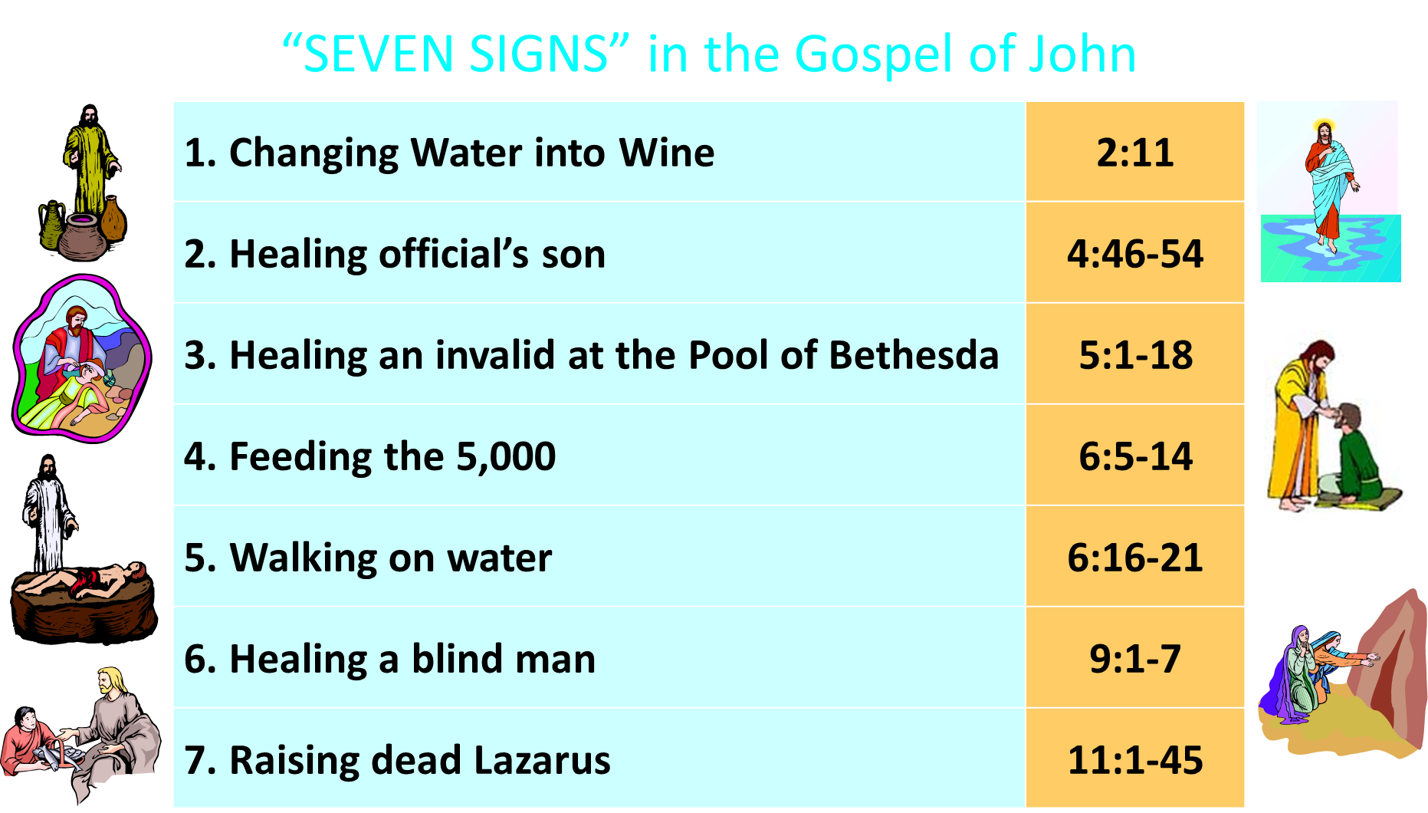

Slide 12
III. Exodus 9:22–26 Prophecy’s Fulfillment
God’s Instructions (22)
Moses’ Obedience (23)
Plague’s Severity (24-25)
Plague’s Limitation (26)

Slide 13
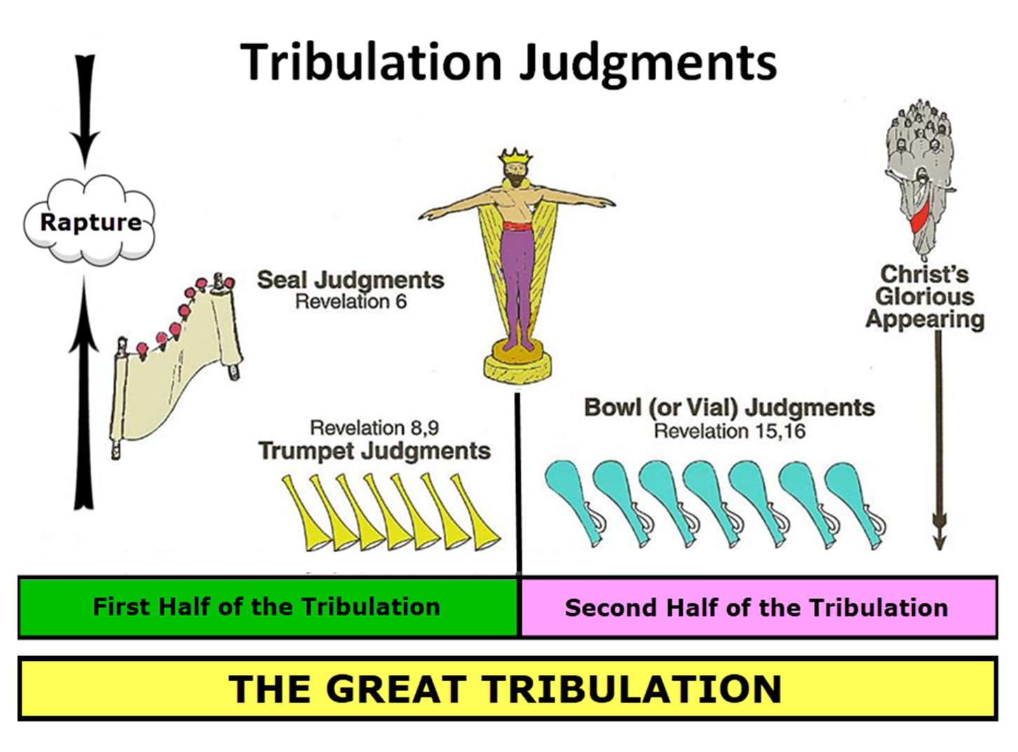

Slide 14

Matthew 24:21-22
“²¹ For then there will be a great tribulation, such as has not occurred since the beginning of the world until now, nor ever will. ²² Unless those days had been cut short, no life would have been saved; but for the sake of the elect those days will be cut short.”

Slide 15

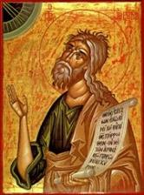
Jeremiah 30:7
“Alas! for that day is great, There is none like it; And it is the time of Jacob’s distress (Gen. 32:8; 35:10), But he will be saved from it.”

Slide 16
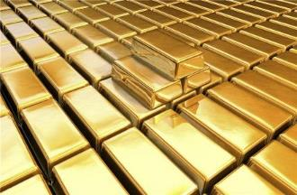
Isaiah 13:12
“I will make mortal man scarcer than pure gold and mankind than the gold of Ophir.”

Slide 17
III. Exodus 9:22–26 Prophecy’s Fulfillment
God’s Instructions (22)
Moses’ Obedience (23)
Plague’s Severity (24-25)
Plague’s Limitation (26)

Slide 18
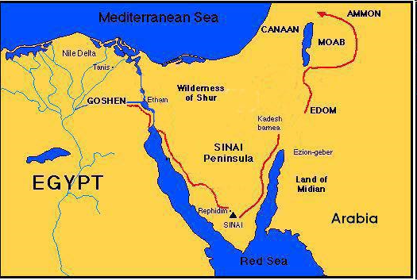

Slide 19

Protection Through the Tribulation?
(Revelation 3:10)
Like the protection in Goshen (Exod. 8:22, 24; 9:4, 6; 11:4-7; Rev. 9:4; 16:2)
Effective? Rev. 6:9-11; 7:13-14; 13:10, 15; 20:4
Comfort? John 14:1; 1 Thess. 4:18; Titus 2:13

Slide 20
HAIL Exodus 9:13-35
God’s Instructions (13-16)
God’s Prediction (17-21)
Prophecy’s Fulfillment (22-26)
Pharaoh’s Reaction (27-32)
Moses’ Reversal (33-35)

Slide 21
IV. Exodus 9:27-32 Pharaoh’s Reaction
Pharaoh’s Alleged Repentance (27)
Pharaoh’s Request (28)
Moses’ Promise (29)
Pharaoh’s Insincerity (30)
Plague’s Severity (31-32)

Slide 22
IV. Exodus 9:27-32 Pharaoh’s Reaction
Pharaoh’s Alleged Repentance (27)
Pharaoh’s Request (28)
Moses’ Promise (29)
Pharaoh’s Insincerity (30)
Plague’s Severity (31-32)

Slide 23

Romans 1:18–20
¹⁸ For the wrath of God is revealed from heaven against all ungodliness and unrighteousness of men who suppress the truth in unrighteousness, ¹⁹ because that which is known about God is evident within them; for God made it evident to them. ²⁰ For since the creation of the world His invisible attributes, His eternal power and divine nature, have been clearly seen, being understood through what has been made, so that they are without excuse.

Slide 24


Revelation 6:16-17
^{“16} and they said to the mountains and the rocks, ‘Fall on us and hide us from the sight of Him who sits on the throne, and from the wrath [orgḗ] of the Lamb; ¹⁷ for the great day of Their wrath [orgḗ] has come, and who is able to stand?’”

Slide 25
IV. Exodus 9:27-32 Pharaoh’s Reaction
Pharaoh’s Alleged Repentance (27)
Pharaoh’s Request (28)
Moses’ Promise (29)
Pharaoh’s Insincerity (30)
Plague’s Severity (31-32)

Slide 26
IV. Exodus 9:27-32 Pharaoh’s Reaction
Pharaoh’s Alleged Repentance (27)
Pharaoh’s Request (28)
Moses’ Promise (29)
Pharaoh’s Insincerity (30)
Plague’s Severity (31-32)

Slide 27

PLAGUES’ MIRACULOUS NATURE
Moses knew about them beforehand (8:10; 9:5, 29)
Instantaneous appearance and termination
Description as “signs and wonders” (7:3)
Intensification
Timing
Accomplishment of a moral purpose (11:1)
Response they invoked from the Egyptian sorcerers (7:22; 8:18-19)
Last seven plagues did not effect the jews living in Goshen (9:6)
Nile into blood affected all rivers, streams, pools, reservoirs, and vessels holding waters
Hill and Walton, A Survey of the Old Testament, 114-15

Slide 28
IV. Exodus 9:27-32 Pharaoh’s Reaction
Pharaoh’s Alleged Repentance (27)
Pharaoh’s Request (28)
Moses’ Promise (29)
Pharaoh’s Insincerity (30)
Plague’s Severity (31-32)

Slide 29
IV. Exodus 9:27-32 Pharaoh’s Reaction
Pharaoh’s Alleged Repentance (27)
Pharaoh’s Request (28)
Moses’ Promise (29)
Pharaoh’s Insincerity (30)
Plague’s Severity (31-32)

Slide 30
Exodus 9:31-32 Plague’s Severity
Early crop (31)
Late crop (32)

Slide 31
Exodus 9:31-32 Plague’s Severity
Early crop (31)
Late crop (32)

Slide 32

Charles Ryrie Ryrie Study Bible, page 105
Exodus 9:31-32 - “9:31 That barley was ripe and the flax in blossom indicates that the plague of hail was in January. Also, from January to April cattle were usually outdoors (cf. vv. 20–21). 9:32 The wheat and spelt (an inferior kind of wheat) were not harmed at this time because they ripen a month or so later (but see 10:5).

Slide 33
Exodus 9:31-32 Plague’s Severity
Early crop (31)
Late crop (32)

Slide 34
Charles Ryrie Ryrie Study Bible, page 105
Exodus 9:31-32 - “9:31 That barley was ripe and the flax in blossom indicates that the plague of hail was in January. Also, from January to April cattle were usually outdoors (cf. vv. 20–21). 9:32 The wheat and spelt (an inferior kind of wheat) were not harmed at this time because they ripen a month or so later (but see 10:5).

Slide 35


John 1:14
“And the Word became flesh, and dwelt among us, and we saw His glory, glory as of the only begotten [monogenēs] from the Father, full of grace and truth.”
35

Slide 36
HAIL Exodus 9:13-35
God’s Instructions (13-16)
God’s Prediction (17-21)
Prophecy’s Fulfillment (22-26)
Pharaoh’s Reaction (27-32)
Moses’ Reversal (33-35)

Slide 37
V. Exodus 9:33-35 Moses’ Reversal
Plague Ceases (33)
Pharaoh’s Hardening (34)
Pharaoh’s Refusal (35)

Slide 38
V. Exodus 9:33-35 Moses’ Reversal
Plague Ceases (33)
Pharaoh’s Hardening (34)
Pharaoh’s Refusal (35)

Slide 39
V. Exodus 9:33-35 Moses’ Reversal
Plague Ceases (33)
Pharaoh’s Hardening (34)
Pharaoh’s Refusal (35)

Slide 40
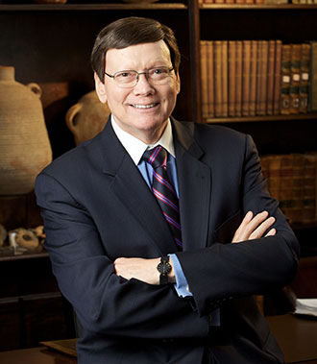
Dr. Ed Hindson
Hindson, E. E., & Mitchell, D. R., eds. (2010). KJV Bible Commentary for Today: The Most Up-to-Date Commentary on the Time-Honored Text of the KJV (p. 86). Thomas Nelson.
“4:21. I will harden his heart. An expression meaning ‘to strengthen his will.’ The text identifies the heart as the location of the volition, man’s decision-making ability. On seven occasions in the narrative, God hardens Pharaoh’s heart (9:12; 10:1, 20, 27; 11:10; 14:4, 8) or foretells that He will harden Pharaoh’s heart (4:21; 7:3), and nine times in the text, Pharaoh hardens his own heart (7:13, 14, 22; 8:15, 19, 32; 9:7, 34–35). For the initial five plagues, the text registers Pharaoh as the agent of hardening. Not until the sixth plague does God participate in the confirmation of Pharaoh’s own volitional choices.”

Slide 41
Charles Ryrie Ryrie Study Bible, page 96
Exodus 4:21 - “harden his heart. Ten times it is said that Pharaoh hardened his own heart (7:13, 14, 22; 8:15, 19, 32; 9:7, 34, 35; 13:15), and 10 times that God hardened Pharaoh’s heart (4:21; 7:3; 9:12; 10:1, 20, 27; 11:10; 14:4, 8, 17). Paul uses this as an example of the inscrutable will of God and of His mercy toward men (Rom. 9:14–18). Seven times Pharaoh hardened his own heart before God first hardened it, though the prediction that God would do it preceded all.”

Slide 42
GOD HARDENING PHARAOH'S HEART
The prediction of God hardening of Pharaoh (4:21)
Pharaoh repeatedly hardening his own heart (7:13, 22; 8:15, 19, 32; 9:7)
Not until the sixth plague did God harden Pharaoh’s heart (Exod 9:12)

Slide 43
V. Exodus 9:33-35 Moses’ Reversal
Plague Ceases (33)
Pharaoh’s Hardening (34)
Pharaoh’s Refusal (35)

Slide 44
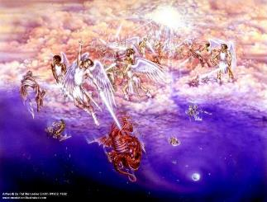
Satan as Ruler of this World
Job 1:7; 2:2
Luke 4:5-7
John 12:31; 14:30; 16:11
2 Corinthians 4:4
Ephesians 2:2
1 John 4:4; 5:19

Slide 45
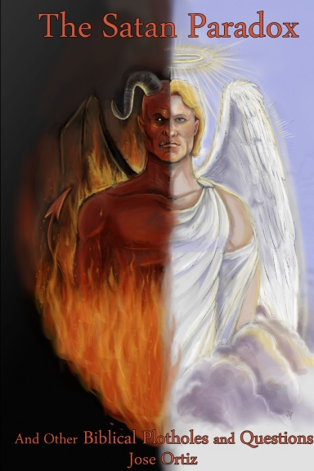
Names & Titles Demonstrating Satan’s Post-Fall, Earthly Authority (Job 1:7; 2:2; Luke 4:5-8; Rom. 8:19-22)
Prince of this world (John 12:31; 14:30; 16:11)
God of this world (2 Cor. 4:4)
Prince and power of the air (Eph. 2:2)
Who the believer wrestles with (Eph. 6:12)
Roaring lion (1 Pet. 5:8)
Whole world lies in his power (1 John 5:19)

Slide 46

Romans 8:19-23
¹⁹ “For the anxious longing of the creation waits eagerly for the revealing of the sons of God. ²⁰ For the creation was subjected to futility, not willingly, but because of Him who subjected it, in hope ²¹ that the creation itself also will be set free from its slavery to corruption into the freedom of the glory of the children of God. ²² For we know that the whole creation groans and suffers the pains of childbirth together until now. ²³ And not only this, but also we ourselves, having the first fruits of the Spirit, even we ourselves groan within ourselves, waiting eagerly for our adoption as sons, the redemption of our body.”

Slide 47
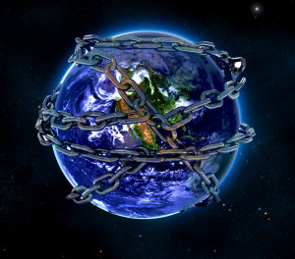

Slide 49

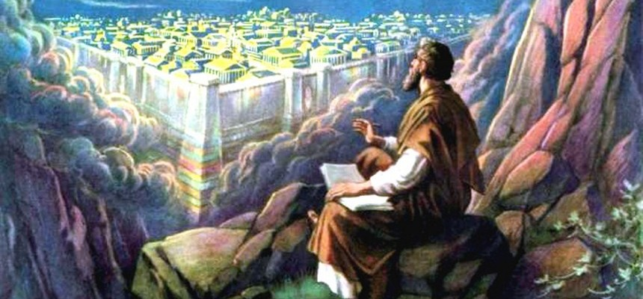
Revelation 11:15
¹⁵ “Then the seventh angel sounded; and there were loud voices in heaven, saying, ‘The kingdom of the world has become the kingdom of our Lord and of His Christ; and He will reign forever and ever.’”

Slide 50
Ultimate Exodus (Rev 11:15)
Sores: 6th plague (Ex 9:8-12), 1st bowl (Rev 16:1-2)
Rivers to blood: 1st plague (Ex 7:19-21), 3rd bowl (Rev 16:4-7)
Darkness: 9th plague (Ex 10:21-23), 5th bowl (Rev 16:10-11)
Frogs: 2nd plague (Ex 7:25‒8:15), 6th bowl (Rev 16:13)
Hail: 7th plague (Ex 9:22-26), 7th bowl (Rev 16:17-21)

Slide 51
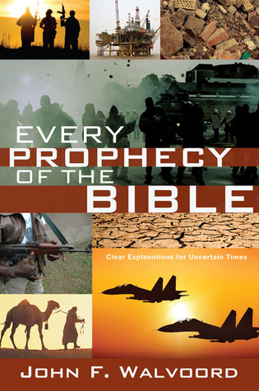

Slide 52

John 13:19; 14:29
“¹⁹ From now on I am telling you before it comes to pass, so that when it does occur, you may believe that I am He… ^{14:29} Now I have told you before it happens, so that when it happens, you may believe.”

Slide 53
What Happened to Christ’s Disciples?
Disciple | Place | Martyrdom
James the Son of Alpheus | Jerusalem | Clubbed to death
Simon the Zealot | Jerusalem | Martyred
James the Son of Zebedee | Judea (Acts 12:2) | Executed
Thaddeus | Mesopotamia | Beaten to death
Peter | Babylon, Rome | Crucified upside down
Matthew | Parthia (Tehran) | Beheaded
Notes:
109 prophecies…
Peter Stoner – SCIENCE SPEAKS, An Evaluation of Certain Christian Evidences
To fulfill just 8 prophecies =1 X 10 to the twenty-eighth power!
Can we visualize this with an illustration? Suppose we took an atheistic professor, blindfolded him and covered the state of Texas two feet deep with silver dollars. Then we put a check on one of those silver dollars and mixed them up. The odds of one person fulfilling just these eight prophecies would be the same as this atheistic professor selecting the silver dollar upon which we have placed a check, in his first try.
https://www.bereanpublishers.com/the-odds-of-eight-messianic-prophecies-coming-true/

Slide 54
What Happened to Christ’s Disciples?
Disciple | Place | Martyrdom
John | Asia Minor, Patmos, Ephesus | Fried in boiling oil
Philip | E. Turkey | Tortured & crucified
Thomas | India | Speared
Bartholomew | India | Flayed & crucified
Andrew | Ukraine, Russia, Greece | Hanged
Notes:
109 prophecies…
Peter Stoner – SCIENCE SPEAKS, An Evaluation of Certain Christian Evidences
To fulfill just 8 prophecies =1 X 10 to the twenty-eighth power!
Can we visualize this with an illustration? Suppose we took an atheistic professor, blindfolded him and covered the state of Texas two feet deep with silver dollars. Then we put a check on one of those silver dollars and mixed them up. The odds of one person fulfilling just these eight prophecies would be the same as this atheistic professor selecting the silver dollar upon which we have placed a check, in his first try.
https://www.bereanpublishers.com/the-odds-of-eight-messianic-prophecies-coming-true/

Slide 55
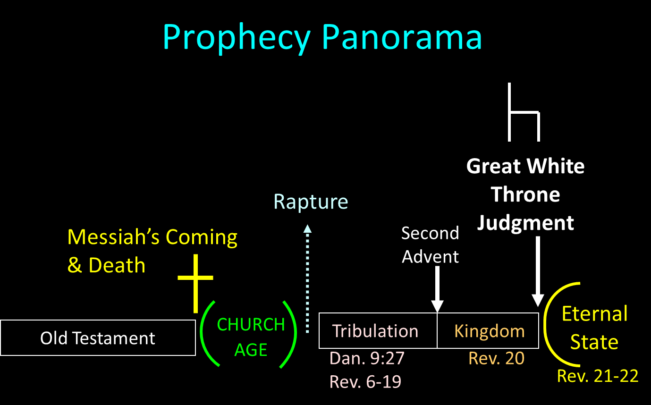

Slide 56

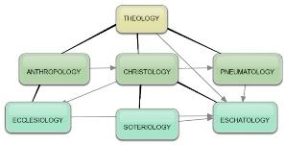
Areas of Systematic Theology
Prolegomena – Introduction
Theology – Study of God
Christology – Study of Christ
Pneumatology – Study of the Holy Spirit
Anthropology – Study of Man
Hamartiology – Study of sin
Soteriology – Study of salvation
Angelology – Study of angels
Ecclesiology – Study of the Church
Eschatology – Study of the end

Slide 57
Conclusion

Slide 58
HAIL Exodus 9:13-35
God’s Instructions (13-16)
God’s Prediction (17-21)
Prophecy’s Fulfillment (22-26)
Pharaoh’s Reaction (27-32)
Moses’ Reversal (33-35)

Slide 59
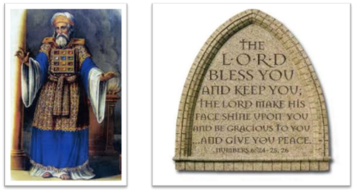
²⁴ The Lord bless you, and keep you; ²⁵ The Lord make His face shine on you, And be gracious to you; ²⁶ The Lord lift up His countenance on you, And give you peace.
Numbers 6:24–26 (NASB95)

