Slide 1
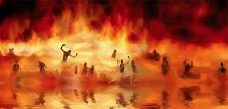

Annihilation
vs.
Eternal Torment

Slide 2
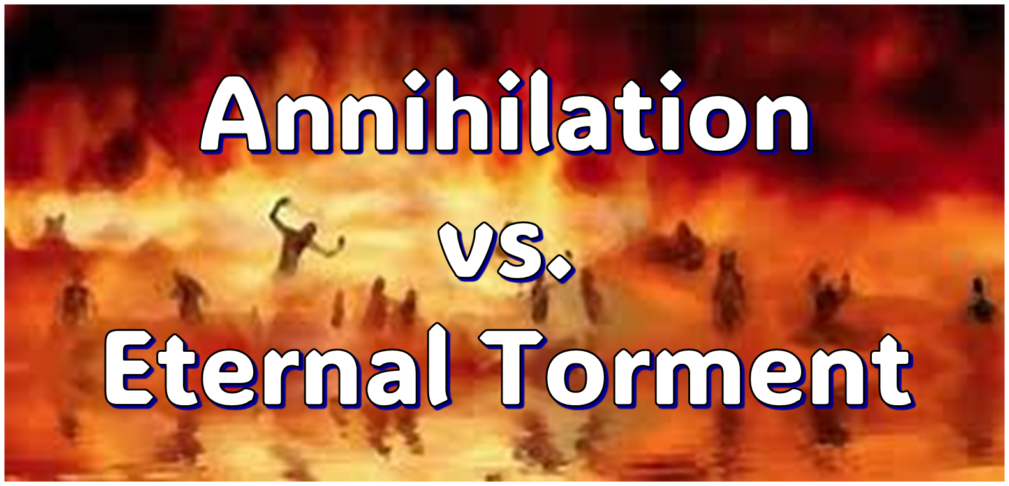
ANNIHILATION VS. ETERNAL CONSCIOUS TORMENT
Introduction to the Controversy
Biblical Arguments Against Annihilation
Theological Arguments Against Annihilation
Answering Annihilationist Biblical Arguments
Answering Annihilationist Theological Arguments
Examining Church History
Conclusion

Slide 3

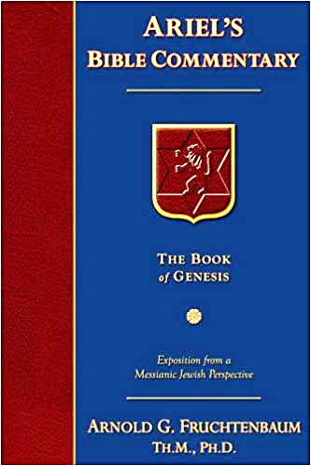
Dr. Arnold G. Fruchtenbaum
Footsteps of the Messiah, 707-8
“Conditional immortality means the soul is not inherently immortal; immortality is not part of the make-up of the soul. Rather, immortality is a gift for the saved only. So at death, the unbeliever simply becomes non-existent, and only the believer continues to exist…What annihilationism says is this: the unsaved soul is annihilated after a temporary period of punishment. These people do believe that the unsaved soul goes to Hell, but not for eternity, only temporarily. Eventually the unsaved soul is annihilated after suffering a duration of punishment.”

Slide 4
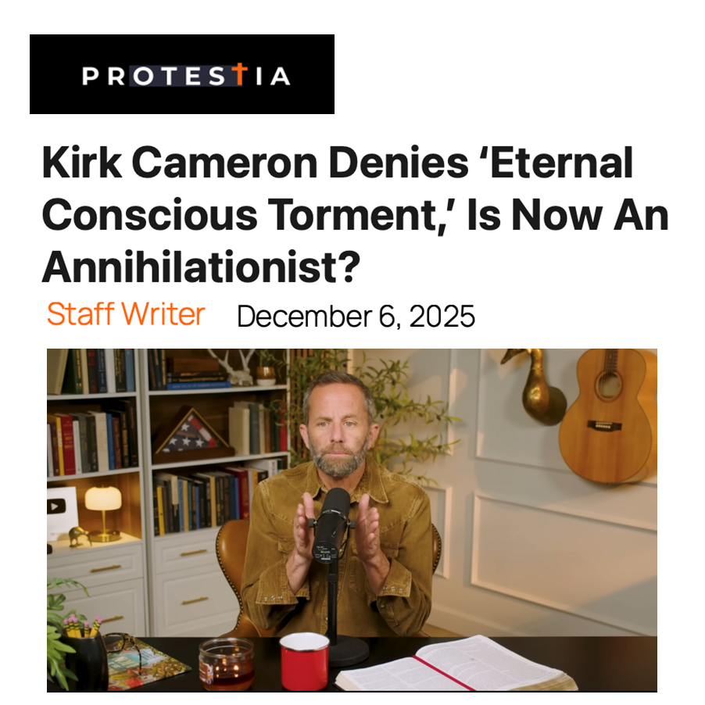

Slide 5
ANNIHILATION VS. ETERNAL CONSCIOUS TORMENT
Introduction to the Controversy
Biblical Arguments Against Annihilation
Theological Arguments Against Annihilation
Answering Annihilationist Biblical Arguments
Answering Annihilationist Theological Arguments
Examining Church History
Conclusion

Slide 6
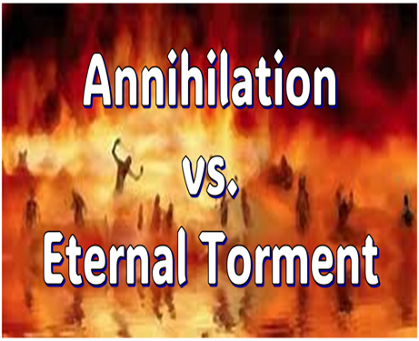
II. Anti-Annihilationist Texts
Dan. 12:2 Matt. 25:46 Mark 9:47-48 Matt. 8:12 Luke 16:19-31 |  | 2 Thess. 1:9 Heb. 6:2 Rev. 14:11 Rev. 20:10 Rev. 19:20

Slide 7
ANNIHILATION VS. ETERNAL CONSCIOUS TORMENT
Introduction to the Controversy
Biblical Arguments Against Annihilation
Theological Arguments Against Annihilation
Answering Annihilationist Biblical Arguments
Answering Annihilationist Theological Arguments
Examining Church History
Conclusion

Slide 8
III. Theological Arguments Against Annihilation
Underestimates sin’s severity
Contradicts humanity’s nature
Denies degrees of punishment
Seeks to escape sin’s consequences

Slide 9
ANNIHILATION VS. ETERNAL CONSCIOUS TORMENT
Introduction to the Controversy
Biblical Arguments Against Annihilation
Theological Arguments Against Annihilation
Answering Annihilationist Biblical Arguments
Answering Annihilationist Theological Arguments
Examining Church History
Conclusion

Slide 10
IV. Answering Annihilationist Biblical Arguments
2nd death (Rev. 20:14)
Destroy (Rev. 11:18)
Destruction (2 Thess. 1:9)
Burning up (Matt. 3:12)
Eternal results (Rev. 14:11)

Slide 11
IV. Answering Annihilationist Biblical Arguments
Perdition (2 Pet. 3:7)
Better to have never been born (Mark 14:21)
Wicked perishing (2 Pet. 3:9)
Blotted out of existence (Hebrews 9:25–26)
Life activity suspended in death (Eccles. 9:10)

Slide 12
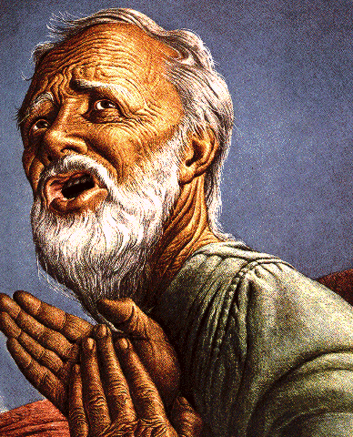
Belief – God’s One Condition for Justification
Gen 15:6
Then he believed in the LORD; and He reckoned it to him as righteousness.
John 3:16
For God so loved the world, that He gave His only begotten Son, that whoever believes in Him shall not perish, but have eternal life.
Acts 16:30-31
"Sirs, what must I do to be saved?" They said, "Believe in the Lord Jesus, and you will be saved..."

Slide 13


2 Peter 3:9
“The Lord is not slow about His promise, as some count slowness, but is patient toward you, not wishing for any to perish but for all to come to repentance.”

Slide 14


Matthew 10:5-7
“These twelve Jesus sent out after instructing them: “Do not go in the way of the Gentiles, and do not enter any city of the Samaritans; ⁶ but rather go to the lost sheep of the house of Israel. ⁷ And as you go, preach, saying, ‘The kingdom of heaven is at hand.’”

Slide 15
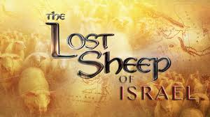
Matthew 15:24
“But He answered and said, ‘I was sent only to the lost sheep of the house of Israel.’”

Slide 16
IV. Answering Annihilationist Biblical Arguments
Perdition (2 Pet. 3:7)
Better to have never been born (Mark 14:21)
Wicked perishing (2 Pet. 3:9)
Blotted out of existence (Hebrews 9:25–26)
Life activity suspended in death (Eccles. 9:10)

Slide 17


Revelation 3:5
promise to the overcomers
“He who overcomes will thus be clothed in white garments; and I will not erase his name from the book of life, and I will confess his name before My Father and before His angels.”

Slide 18
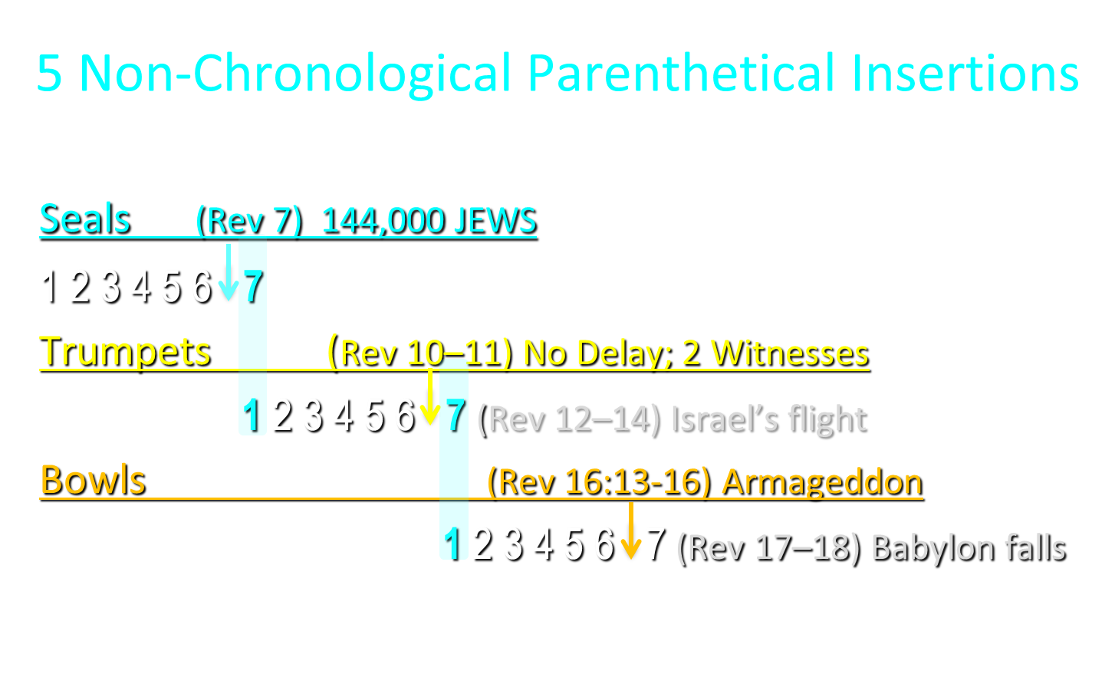

Slide 19
IV. Answering Annihilationist Biblical Arguments
Perdition (2 Pet. 3:7)
Better to have never been born (Mark 14:21)
Wicked perishing (2 Pet. 3:9)
Blotted out of existence (Hebrews 9:25–26)
Life activity suspended in death (Eccles. 9:10)

Slide 20


Ecclesiastes 9:10
“Whatever your hand finds to do, do it with all your might; for there is no activity or planning or knowledge or wisdom in Sheol where you are going.”

Slide 21
Dr. Arnold G. Fruchtenbaum
Footsteps of the Messiah, 713-14
“Ecclesiastes 9:5 does speak about the dead not knowing any thing, but the context of Ecclesiastes 9:5 is simply drawing the conclusion of human philosophy. Indeed, from the standpoint of human philosophy, under the sun, that is the way it looks (v. 6). But again, Ecclesiastes 9:5 simply spells out what human philosophy feels under the sun. It is not a divine decree; it is not a positive affirmation of the Word of God.”

Slide 22

Psalm 146:4
“His spirit departs, he returns to the earth; In that very day his thoughts perish.”

Slide 23
Dr. Arnold G. Fruchtenbaum
Footsteps of the Messiah, 713
“Another Old Testament passage that they use is Psalm 146:4, where it states that a man’s thoughts perish when he dies. But actually, verses 3 and 4 taken together and in context simply teach that a man’s devices, man’s plans, and man’s thoughts cannot be carried out on the earth after physical death. He has lost any opportunity to see his plans carried out; it does not teach a cessation of existence.”

Slide 24
ANNIHILATION VS. ETERNAL CONSCIOUS TORMENT
Introduction to the Controversy
Biblical Arguments Against Annihilation
Theological Arguments Against Annihilation
Answering Annihilationist Biblical Arguments
Answering Annihilationist Theological Arguments
Examining Church History
Conclusion

Slide 25
ANNIHILATION VS. ETERNAL CONSCIOUS TORMENT
Introduction to the Controversy
Biblical Arguments Against Annihilation
Theological Arguments Against Annihilation
Answering Annihilationist Biblical Arguments
Answering Annihilationist Theological Arguments
Examining Church History
Conclusion

Slide 26
ANNIHILATION VS. ETERNAL CONSCIOUS TORMENT
Introduction to the Controversy
Biblical Arguments Against Annihilation
Theological Arguments Against Annihilation
Answering Annihilationist Biblical Arguments
Answering Annihilationist Theological Arguments
Examining Church History
Conclusion

Slide 27
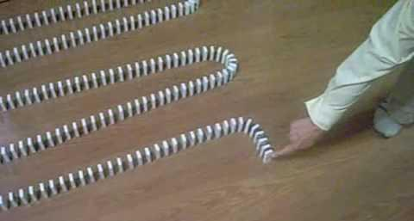
Dominoes in a Row

Slide 28
ANNIHILATION VS. ETERNAL CONSCIOUS TORMENT
Introduction to the Controversy
Biblical Arguments Against Annihilation
Theological Arguments Against Annihilation
Answering Annihilationist Biblical Arguments
Answering Annihilationist Theological Arguments
Examining Church History
Conclusion

