Slide 1
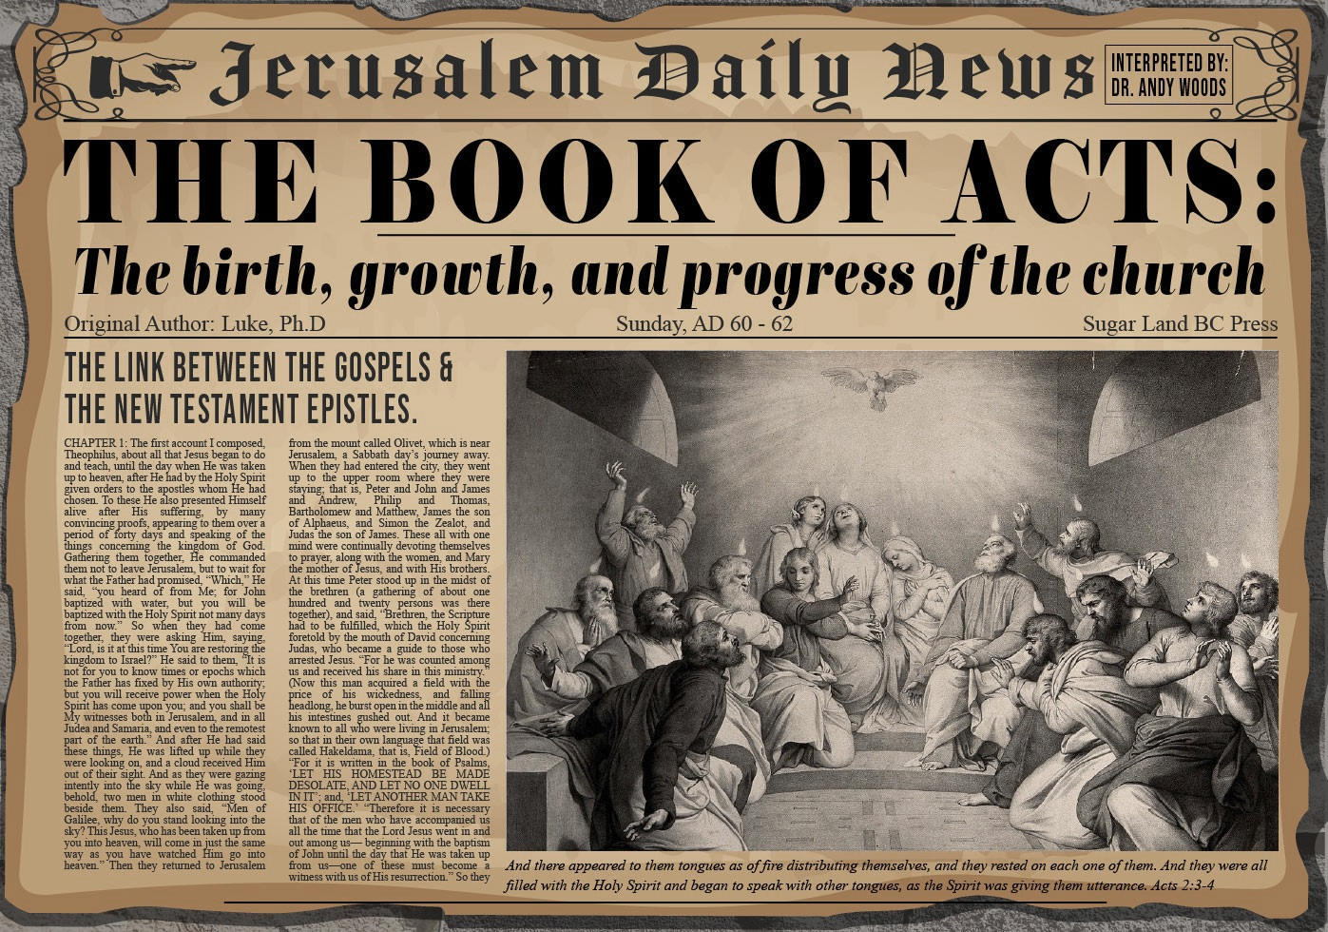


Slide 2

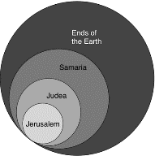
Acts 1:8
“but you will receive power when the Holy Spirit has come upon you; and you shall be My witnesses both in Jerusalem, and in all Judea and Samaria, and even to the remotest part of the earth.”

Slide 3
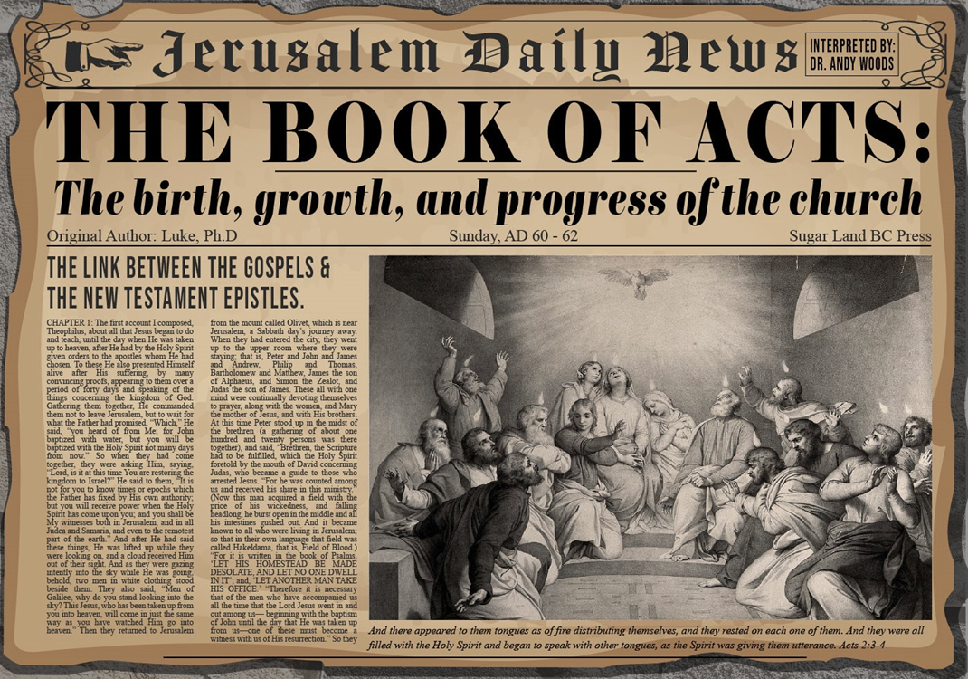
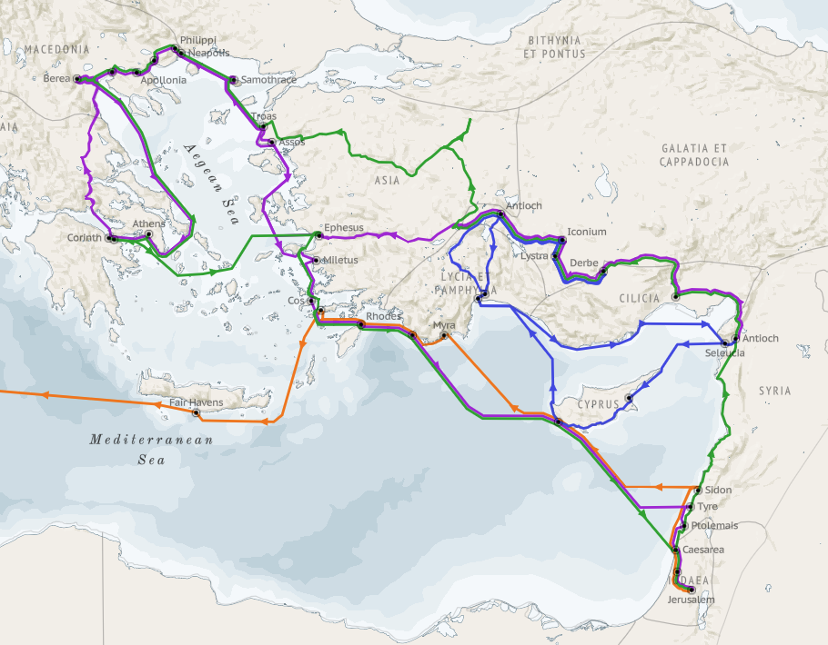
Structure (Acts 1:8)
  Jerusalem (Acts 1–7)
  Judea and Samaria (Acts 8–12)
  Remotest part of the earth (Acts 13–28)
  1st missionary journey (Acts 13–14)
  Jerusalem council (Acts 15:1-35)
  2nd missionary journey (Acts 15:36 –18:22)
  3rd missionary journey (Acts 18:23–21:17)
  Trip to Rome (Acts 21:18–28:31)

Slide 4
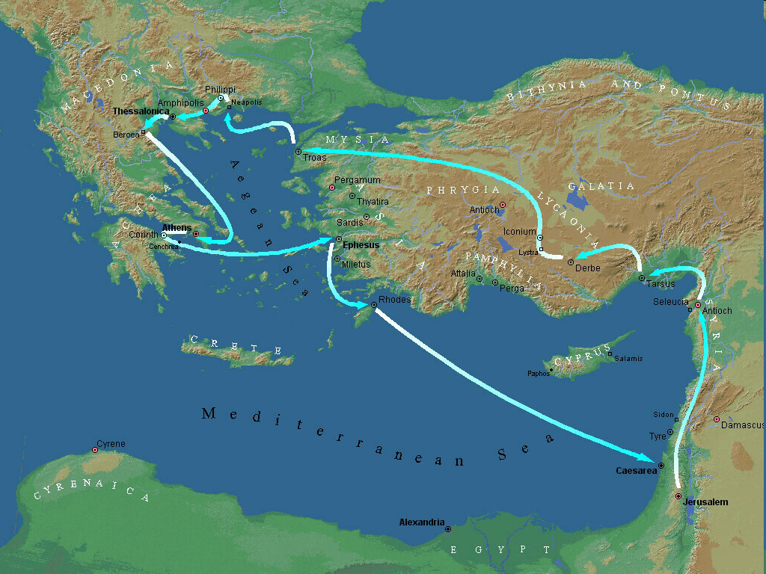
Second Missionary Journey

Slide 5
Acts 15:36‒18:22
2nd Missionary Journey
  Schism between Paul & Barnabas (15:36-41)
  Syria & Cilicia ministry (16:1-5)
  Macedonian call (16:6-10)
  Philippian ministry (16:11-40)
  Thessalonica ministry (17:1-9)
  Berean ministry (17:10-15)
  Athens’ ministry (17:16-34)
  Corinthian ministry (18:1-18)
  Ephesus’ ministry (18:19-21)
  Return to Antioch (18:22)

Slide 6
II. Syria and Cilicia
Acts 16:1-5
  Timothy’s circumcision (1-3)
  Decree delivered (4-5)

Slide 7
II. Syria and Cilicia
Acts 16:1-5
  Timothy’s circumcision (1-3)
  Decree delivered (4-5)

Slide 8
Acts 16:1-3
Timothy’s Circumcision
      Timothy the man (1-2)
      Circumcision (3)

Slide 9
Acts 16:1-3
Timothy’s Circumcision
      Timothy the man (1-2)
      Circumcision (3)

Slide 10
Acts 16:1-2
Timothy the Man
      Journey (1)
      Reputation (2)

Slide 11
Acts 16:1-2
Timothy the Man
      Journey (1)
      Reputation (2)

Slide 12
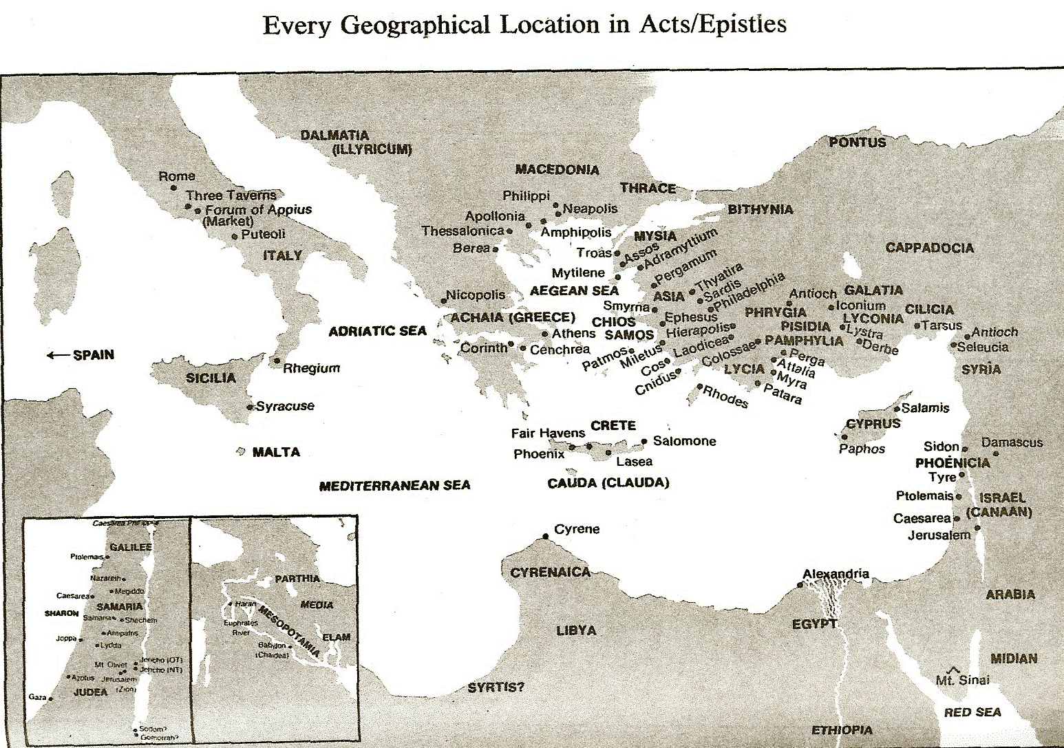

Slide 13
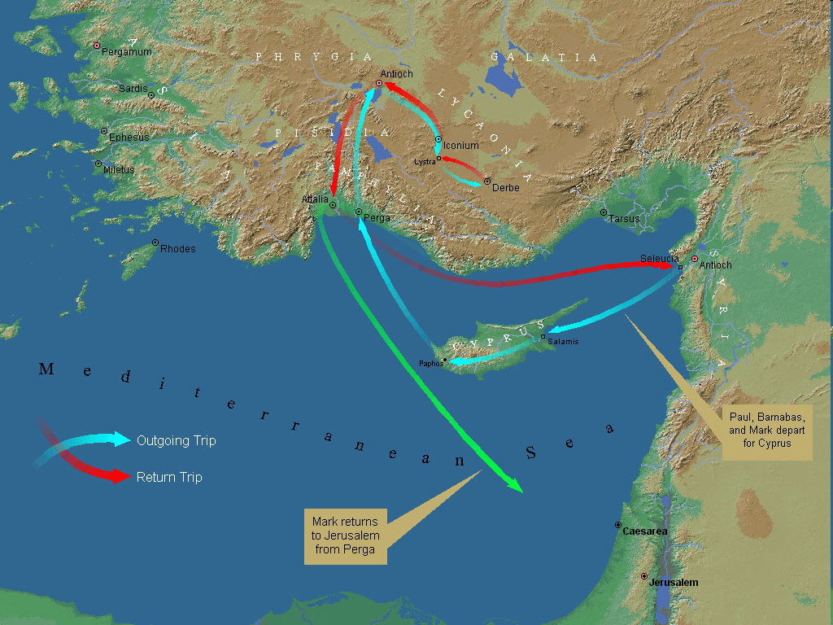
First Missionary Journey

Slide 14

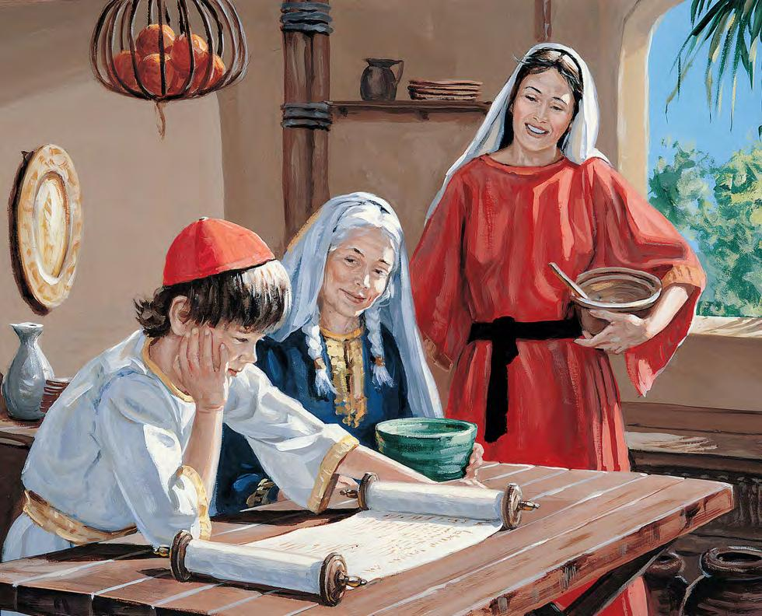
2 Timothy 3:15
“and that from childhood (brephos) you have known the sacred writings which are able to give you the wisdom that leads to salvation through faith which is in Christ Jesus.”

Slide 15

Genesis 12‒25
Abraham’s Early Journeys
Unconditional promises (Gen. 12:1-3) From Haran to Canaan (Gen. 12:4-5) In Canaan (Gen. 12:6-9) In Egypt (Gen. 12:10-20) Abram and Lot Separate (Gen. 13:1-13) Reaffirmation of Abram’s promises (Gen. 13:14-18) Abram Rescues Lot (14:1-24) Abrahamic Covenant (15:1-21) Hagar & Ishmael (16:1-16) Circumcision (Gen. 17:1-27) | Sodom & Gomorrah (Gen. 18‒19) Abraham & Abimelech (Gen. 20) Isaac’s birth (Gen. 21:1-7) Ishmael’s expulsion (21:8-21) Abraham & Abimelech’s covenant (21:22-34) Abraham sacrifices Isaac (22) Sarah’s death (23) Isaac’s marriage (24) Abraham & Keturah (25:1-6) Abraham’s death (25:7-11)

Slide 16
Acts 16:1-2
Timothy the Man
      Journey (1)
      Reputation (2)

Slide 18
Acts 16:1-3
Timothy’s Circumcision
      Timothy the man (1-2)
      Circumcision (3)

Slide 19
First Missionary Journey

Slide 20
II. Syria and Cilicia
Acts 16:1-5
  Timothy’s circumcision (1-3)
  Decree delivered (4-5)

Slide 21
Acts 16:4-5
Decree Delivered
      Process (4)
      Summary statement (5)

Slide 22
Acts 16:4-5
Decree Delivered
      Process (4)
      Summary statement (5)

Slide 23

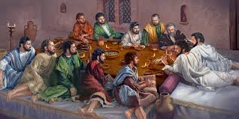
Ephesians 2:20
“having been built on the foundation of the apostles and prophets, Christ Jesus Himself being the corner stone.”

Slide 24
Acts 16:4-5
Decree Delivered
      Process (4)
      Summary statement (5)

Slide 25


Galatians 3:3
“Are you so foolish? Having begun by the Spirit, are you now being perfected by the flesh?”

Slide 26
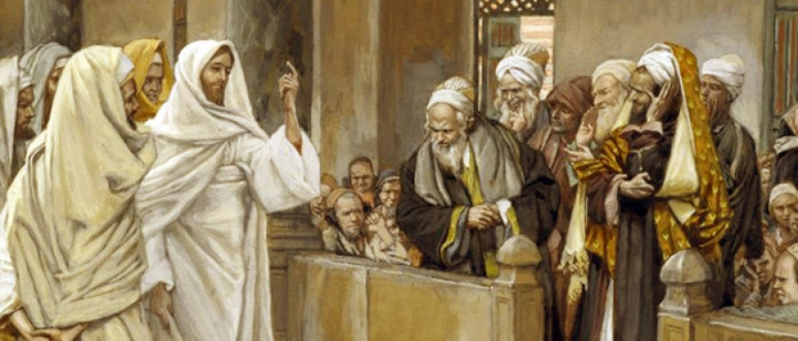
TYPES OF PHARISEES
TYPE | OVERTHROWN
Justification | Matthew 5:20
Sanctification | Galatians 3:3
Ecclesiology | Acts 15

Slide 27
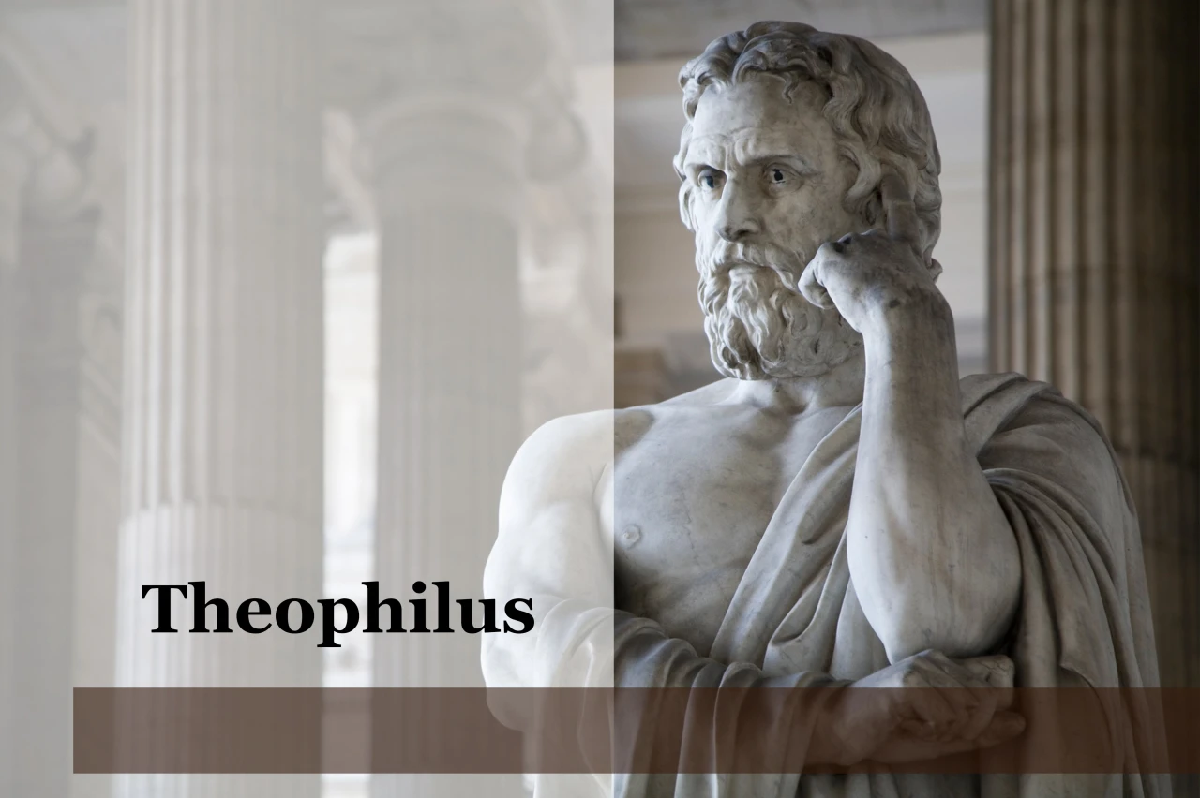
Purpose
  To present Theophilus with an orderly account of the birth and growth of the church so as to affirm him in what he has believed.

Slide 28

Message
  Birth and growth of the church numerically, geographically, ethnically.
  Components
  Numerically (progress reports)
  Geographically (From Jerusalem to Rome)
  Ethnically (From Judaism to Gentile domination)

Slide 29
Progress Reports
  Clearest:
    Acts 2:47; 4:4; 6:7; 9:31; 12:24; 16:5; 19:20; 28:30-31
  Less clear:
    Acts 1:13, 15; 2:41; 4:4:31; 5:14, 42; 8:25, 40; 11:21; 13:49; 17:6

Slide 30
Acts 15:36‒18:22
2nd Missionary Journey
  Schism between Paul & Barnabas (15:36-41)
  Syria & Cilicia ministry (16:1-5)
  Macedonian call (16:6-10)
  Philippian ministry (16:11-40)
  Thessalonica ministry (17:1-9)
  Berean ministry (17:10-15)
  Athens’ ministry (17:16-34)
  Corinthian ministry (18:1-18)
  Ephesus’ ministry (18:19-21)
  Return to Antioch (18:22)

Slide 31
III. Macedonian Call
Acts 16:6-10
  Prohibited territory (6-7)
  Arrival at Troas (8)
  Permitted territory (9-10)

Slide 32
III. Macedonian Call
Acts 16:6-10
  Prohibited territory (6-7)
  Arrival at Troas (8)
  Permitted territory (9-10)

Slide 33
Acts 16:6-7
Prohibited Territory
      Asia (6)
      Bithynia (7)

Slide 34
Acts 16:6-7
Prohibited Territory
      Asia (6)
      Bithynia (7)

Slide 36
Second Missionary Journey

Slide 37
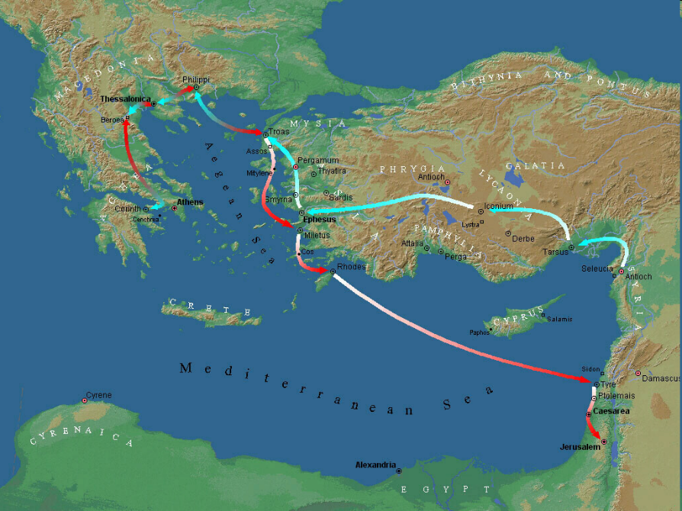

Slide 38
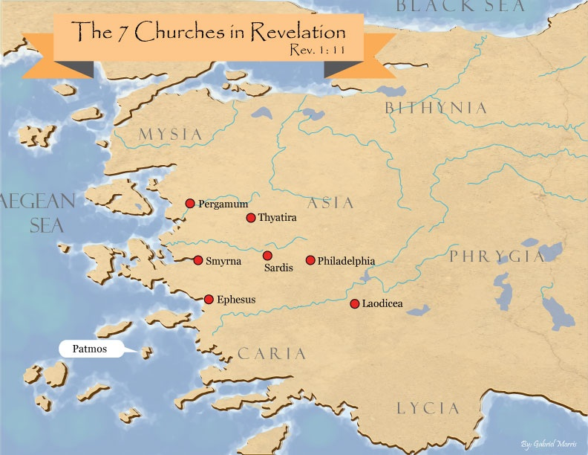
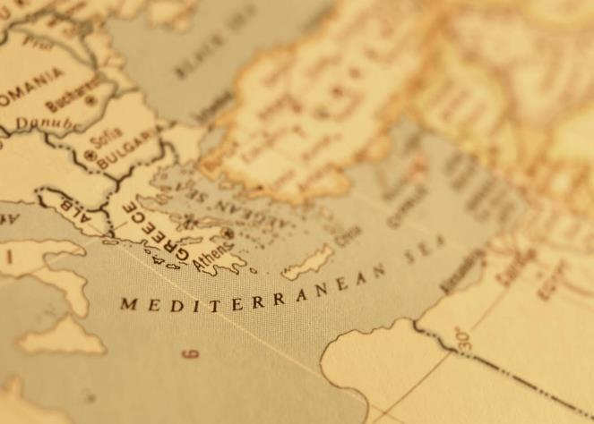

Slide 39
Acts 16:6-7
Prohibited Territory
      Asia (6)
      Bithynia (7)

Slide 41
Second Missionary Journey

Slide 42
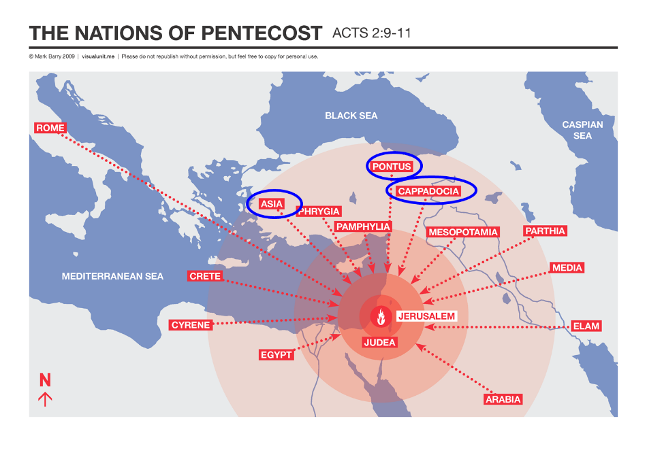

Slide 43

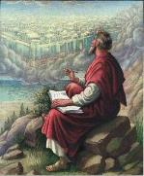
1 Peter 1:1
“To those who reside as aliens, scattered throughout Pontus, Galatia, Cappadocia, Asia, and Bithynia, who are chosen.”

Slide 44
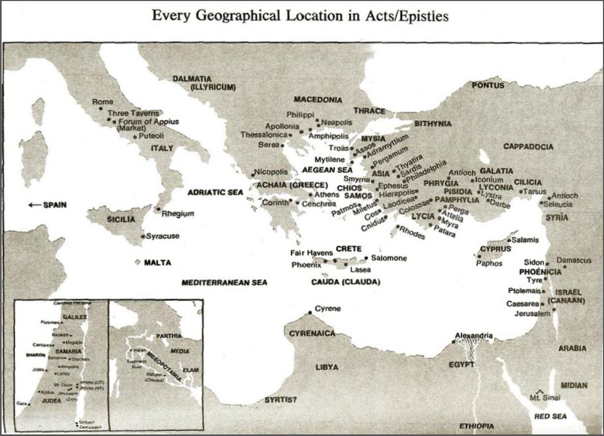

Slide 45
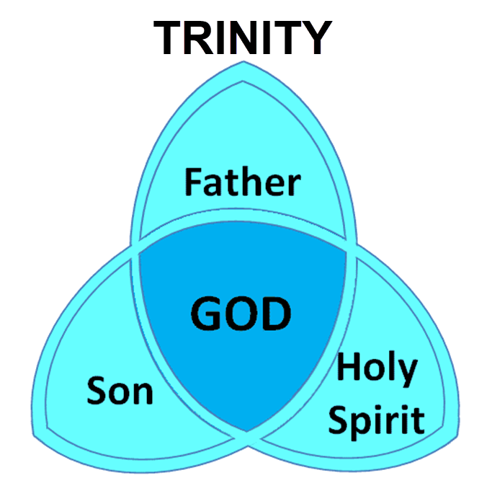

Slide 46
III. Macedonian Call
Acts 16:6-10
  Prohibited territory (6-7)
  Arrival at Troas (8)
  Permitted territory (9-10)

Slide 48
Second Missionary Journey

Slide 50
III. Macedonian Call
Acts 16:6-10
  Prohibited territory (6-7)
  Arrival at Troas (8)
  Permitted territory (9-10)

Slide 51
Acts 16:9-10
Permitted Territory
      Vision (9)
      Group’s conclusion (10)

Slide 52
Acts 16:9-10
Permitted Territory
      Vision (9)
      Group’s conclusion (10)

Slide 54
Second Missionary Journey

Slide 55
Acts 16:9-10
Permitted Territory
      Vision (9)
      Group’s conclusion (10)

Slide 56

Place of Writing
  “We” sections (Acts 16:10-40; 20:5–21:18; 27:1–28:16)
  From Paul
  Cesarean imprisonment (Acts 24:27)
  Voyage to Rome (Acts 27)
  First Roman imprisonment (Acts 28:16)
  Combination

Slide 57
Acts 15:36‒18:22
2nd Missionary Journey
  Schism between Paul & Barnabas (15:36-41)
  Syria & Cilicia ministry (16:1-5)
  Macedonian call (16:6-10)
  Philippian ministry (16:11-40)
  Thessalonica ministry (17:1-9)
  Berean ministry (17:10-15)
  Athens’ ministry (17:16-34)
  Corinthian ministry (18:1-18)
  Ephesus’ ministry (18:19-21)
  Return to Antioch (18:22)

Slide 58
III. Philippian Ministry
Acts 16:11-40
  Lydia’s conversion (11-15)
  Demonized slave girl (16-18)
  Paul & Silas’ imprisonment (19-34)
  Departure from Philippi (35-40)

Slide 59
III. Philippian Ministry
Acts 16:11-40
  Lydia’s conversion (11-15)
  Demonized slave girl (16-18)
  Paul & Silas’ imprisonment (19-34)
  Departure from Philippi (35-40)

Slide 60
Acts 16:11-15
Lydia’s Conversion
      Journey to Neapolis (11)
      Arrival at Philippi (12)
      Jewish Sabbath meeting (13)
      Lydia’s conversion (14)
      Results of conversion (15)

Slide 61
Acts 16:11-15
Lydia’s Conversion
      Journey to Neapolis (11)
      Arrival at Philippi (12)
      Jewish Sabbath meeting (13)
      Lydia’s conversion (14)
      Results of conversion (15)

Slide 62
Acts 16:11-15
Lydia’s Conversion
      Journey to Neapolis (11)
      Arrival at Philippi (12)
      Jewish Sabbath meeting (13)
      Lydia’s conversion (14)
      Results of conversion (15)

Slide 63
Acts 16:11-15
Lydia’s Conversion
      Journey to Neapolis (11)
      Arrival at Philippi (12)
      Jewish Sabbath meeting (13)
      Lydia’s conversion (14)
      Results of conversion (15)

Slide 64
Acts 16:11-15
Lydia’s Conversion
      Journey to Neapolis (11)
      Arrival at Philippi (12)
      Jewish Sabbath meeting (13)
      Lydia’s conversion (14)
      Results of conversion (15)

Slide 66
John 16:7-11
“⁷ But I tell you the truth, it is to your advantage that I go away; for if I do not go away, the Helper will not come to you; but if I go, I will send Him to you. ⁸ And He, when He comes, will convict the world concerning sin (hamartia, singular noun) and righteousness and judgment; ⁹ concerning sin, because they do not believe in Me; ¹⁰ and concerning righteousness, because I go to the Father and you no longer see Me; ¹¹ and concerning judgment, because the ruler of this world has been judged.”

Slide 67
Acts 16:11-15
Lydia’s Conversion
      Journey to Neapolis (11)
      Arrival at Philippi (12)
      Jewish Sabbath meeting (13)
      Lydia’s conversion (14)
      Results of conversion (15)

Slide 68
Acts 16:15
Results of Conversion
    Baptism (15a)
    Hospitality (15b)

Slide 69
Acts 16:15
Results of Conversion
    Baptism (15a)
    Hospitality (15b)

Slide 70
Acts 16:15
Results of Conversion
    Baptism (15a)
    Hospitality (15b)

Slide 71
III. Philippian Ministry
Acts 16:11-40
  Lydia’s conversion (11-15)
  Demonized slave girl (16-18)
  Paul & Silas’ imprisonment (19-34)
  Departure from Philippi (35-40)

Slide 72
Acts 16:16-18
Demonized Slave Girl
      Introductory encounter (16)
      Demonic recognition (17)
      Apostolic casting out (18)

Slide 73
Acts 16:16-18
Demonized Slave Girl
      Introductory encounter (16)
      Demonic recognition (17)
      Apostolic casting out (18)

Slide 74
Acts 16:16-18
Demonized Slave Girl
      Introductory encounter (16)
      Demonic recognition (17)
      Apostolic casting out (18)

Slide 75
Acts 16:16-18
Demonized Slave Girl
      Introductory encounter (16)
      Demonic recognition (17)
      Apostolic casting out (18)

Slide 76
III. Philippian Ministry
Acts 16:11-40
  Lydia’s conversion (11-15)
  Demonized slave girl (16-18)
  Paul & Silas’ imprisonment (19-34)
  Departure from Philippi (35-40)

Slide 77
Acts 16:19-34
Paul & Silas’ Imprisonment
      Imprisonment (19-24)
      Jailer’s conversion (25-34)

Slide 78
Acts 16:19-34
Paul & Silas’ Imprisonment
      Imprisonment (19-24)
      Jailer’s conversion (25-34)

Slide 79
Acts 16:19-24
Imprisonment
      Motive (19)
      Accusation (20-21)
      Mob beating (22)
      Imprisonment (23-24)

Slide 80
Acts 16:19-24
Imprisonment
      Motive (19)
      Accusation (20-21)
      Mob beating (22)
      Imprisonment (23-24)

Slide 81
Acts 16:19-24
Imprisonment
      Motive (19)
      Accusation (20-21)
      Mob beating (22)
      Imprisonment (23-24)

Slide 82
Acts 16:19-24
Imprisonment
      Motive (19)
      Accusation (20-21)
      Mob beating (22)
      Imprisonment (23-24)

Slide 83
Acts 16:19-24
Imprisonment
      Motive (19)
      Accusation (20-21)
      Mob beating (22)
      Imprisonment (23-24)

Slide 84
Acts 16:19-34
Paul & Silas’ Imprisonment
      Imprisonment (19-24)
      Jailer’s conversion (25-34)

Slide 85
Acts 16:25-34
Jailer’s Conversion
      Timing (25)
      Earthquake (26)
      Jailer’s response (27)
      Paul’s response (28)
      Jailer’s reaction (29-30)
      Gospel message (31)
      Household evangelism (32)
      Results of salvation (33-34)

Slide 86
Acts 16:25-34
Jailer’s Conversion
      Timing (25)
      Earthquake (26)
      Jailer’s response (27)
      Paul’s response (28)
      Jailer’s reaction (29-30)
      Gospel message (31)
      Household evangelism (32)
      Results of salvation (33-34)

Slide 87
Acts 16:25-34
Jailer’s Conversion
      Timing (25)
      Earthquake (26)
      Jailer’s response (27)
      Paul’s response (28)
      Jailer’s reaction (29-30)
      Gospel message (31)
      Household evangelism (32)
      Results of salvation (33-34)

Slide 88
Acts 16:26
Earthquake
      Foundations shaken (26a)
      Doors opened (26b)
      Hands loosed (26c)

Slide 89
Acts 16:26
Earthquake
      Foundations shaken (26a)
      Doors opened (26b)
      Hands loosed (26c)

Slide 90
Acts 16:26
Earthquake
      Foundations shaken (26a)
      Doors opened (26b)
      Hands loosed (26c)

Slide 91
Acts 16:25-34
Jailer’s Conversion
      Timing (25)
      Earthquake (26)
      Jailer’s response (27)
      Paul’s response (28)
      Jailer’s reaction (29-30)
      Gospel message (31)
      Household evangelism (32)
      Results of salvation (33-34)

Slide 92
Acts 16:25-34
Jailer’s Conversion
      Timing (25)
      Earthquake (26)
      Jailer’s response (27)
      Paul’s response (28)
      Jailer’s reaction (29-30)
      Gospel message (31)
      Household evangelism (32)
      Results of salvation (33-34)

Slide 93
Acts 16:25-34
Jailer’s Conversion
      Timing (25)
      Earthquake (26)
      Jailer’s response (27)
      Paul’s response (28)
      Jailer’s reaction (29-30)
      Gospel message (31)
      Household evangelism (32)
      Results of salvation (33-34)

Slide 94
Acts 16:29-30
Jailer’s Reaction
      Fear (29)
      Question (30)

Slide 95
Acts 16:29-30
Jailer’s Reaction
      Fear (29)
      Question (30)

Slide 96
Acts 16:29-30
Jailer’s Reaction
      Fear (29)
      Question (30)

Slide 97
Acts 16:25-34
Jailer’s Conversion
      Timing (25)
      Earthquake (26)
      Jailer’s response (27)
      Paul’s response (28)
      Jailer’s reaction (29-30)
      Gospel message (31)
      Household evangelism (32)
      Results of salvation (33-34)

Slide 98
Acts 16:25-34
Jailer’s Conversion
      Timing (25)
      Earthquake (26)
      Jailer’s response (27)
      Paul’s response (28)
      Jailer’s reaction (29-30)
      Gospel message (31)
      Household evangelism (32)
      Results of salvation (33-34)

Slide 99
Acts 16:25-34
Jailer’s Conversion
      Timing (25)
      Earthquake (26)
      Jailer’s response (27)
      Paul’s response (28)
      Jailer’s reaction (29-30)
      Gospel message (31)
      Household evangelism (32)
      Results of salvation (33-34)

Slide 100
Acts 16:25-34
Jailer’s Conversion
      Timing (25)
      Earthquake (26)
      Jailer’s response (27)
      Paul’s response (28)
      Jailer’s reaction (29-30)
      Gospel message (31)
      Household evangelism (32)
      Results of salvation (33-34)

Slide 101
Acts 16:33-34
Results of Salvation
      Wounds treated (33a)
      Baptism (33b)
      Hospitality (34a)
      Fellowship (34b)

Slide 102
Acts 16:33-34
Results of Salvation
      Wounds treated (33a)
      Baptism (33b)
      Hospitality (34a)
      Fellowship (34b)

Slide 103
Acts 16:33-34
Results of Salvation
      Wounds treated (33a)
      Baptism (33b)
      Hospitality (34a)
      Fellowship (34b)

Slide 104
Acts 16:33-34
Results of Salvation
      Wounds treated (33a)
      Baptism (33b)
      Hospitality (34a)
      Fellowship (34b)

Slide 105
Acts 16:33-34
Results of Salvation
      Wounds treated (33a)
      Baptism (33b)
      Hospitality (34a)
      Fellowship (34b)

Slide 106
III. Philippian Ministry
Acts 16:11-40
  Lydia’s conversion (11-15)
  Demonized slave girl (16-18)
  Paul & Silas’ imprisonment (19-34)
  Departure from Philippi (35-40)

Slide 107
Acts 16:35-40
Departure from Philippi
      Ruler’s decision (35-36)
      Paul’s defense (37)
      Leader’s response (38-39)
      Paul & Silas comfort & departure (40)

Slide 108
Acts 16:35-40
Departure from Philippi
      Ruler’s decision (35-36)
      Paul’s defense (37)
      Leader’s response (38-39)
      Paul & Silas comfort & departure (40)

Slide 109
Acts 16:35-36
Rulers’ Decision
      Timing (35)
      Jailer’s report (36)

Slide 110
Acts 16:35-36
Rulers’ Decision
      Timing (35)
      Jailer’s report (36)

Slide 111
Acts 16:35-36
Rulers’ Decision
      Timing (35)
      Jailer’s report (36)

Slide 112
Acts 16:35-40
Departure from Philippi
      Ruler’s decision (35-36)
      Paul’s defense (37)
      Leader’s response (38-39)
      Paul & Silas comfort & departure (40)

Slide 113
Acts 16:35-40
Departure from Philippi
      Ruler’s decision (35-36)
      Paul’s defense (37)
      Leader’s response (38-39)
      Paul & Silas comfort & departure (40)

Slide 114
Acts 16:38-39
Leaders’ Response
      Fear (38)
      Escort & beseeching (39)

Slide 115
Acts 16:38-39
Leaders’ Response
      Fear (38)
      Escort & beseeching (39)

Slide 116
Acts 16:38-39
Leaders’ Response
      Fear (38)
      Escort & beseeching (39)

Slide 117
Acts 16:35-40
Departure from Philippi
      Ruler’s decision (35-36)
      Paul’s defense (37)
      Leader’s response (38-39)
      Paul & Silas comfort & departure (40)

Slide 118


Dr. Arnold G. Fruchtenbaum
The Book of Acts, 334
﻿“This disagreement between Paul and Barnabas led to a schism (v. 39): And there arose a sharp contention, so that they parted asunder one from the other. The Greek word for ‘contention,’ paroxysmos, means ‘a very sharp disagreement.’ It seems that Barnabas, whose name means ‘son of consolation,’ lost his temper during the lengthy discussion. Barnabas stuck with his position to take Mark with him, and the dispute led to his departure. The Greek word for ‘parted asunder,’ apochōristhēnai, means ‘to separate,’ ‘to sever.’ There was no personal slander; they disagreed sharply only over the issue at hand. But it was an apocalyptic disaster.””

Slide 119
Purpose
  To present Theophilus with an orderly account of the birth and growth of the church so as to affirm him in what he has believed.

Slide 120
Message
  Birth and growth of the church numerically, geographically, ethnically.
  Components
  Numerically (progress reports)
  Geographically (From Jerusalem to Rome)
  Ethnically (From Judaism to Gentile domination)

Slide 121
Conclusion

Slide 122
Acts 15:36‒18:22
2nd Missionary Journey
  Schism between Paul & Barnabas (15:36-41)
  Syria & Cilicia ministry (16:1-5)
  Macedonian call (16:6-10)
  Philippian ministry (16:11-40)
  Thessalonica ministry (17:1-9)
  Berean ministry (17:10-15)
  Athens’ ministry (17:16-34)
  Corinthian ministry (18:1-18)
  Ephesus’ ministry (18:19-21)
  Return to Antioch (18:22)

