Slide 1
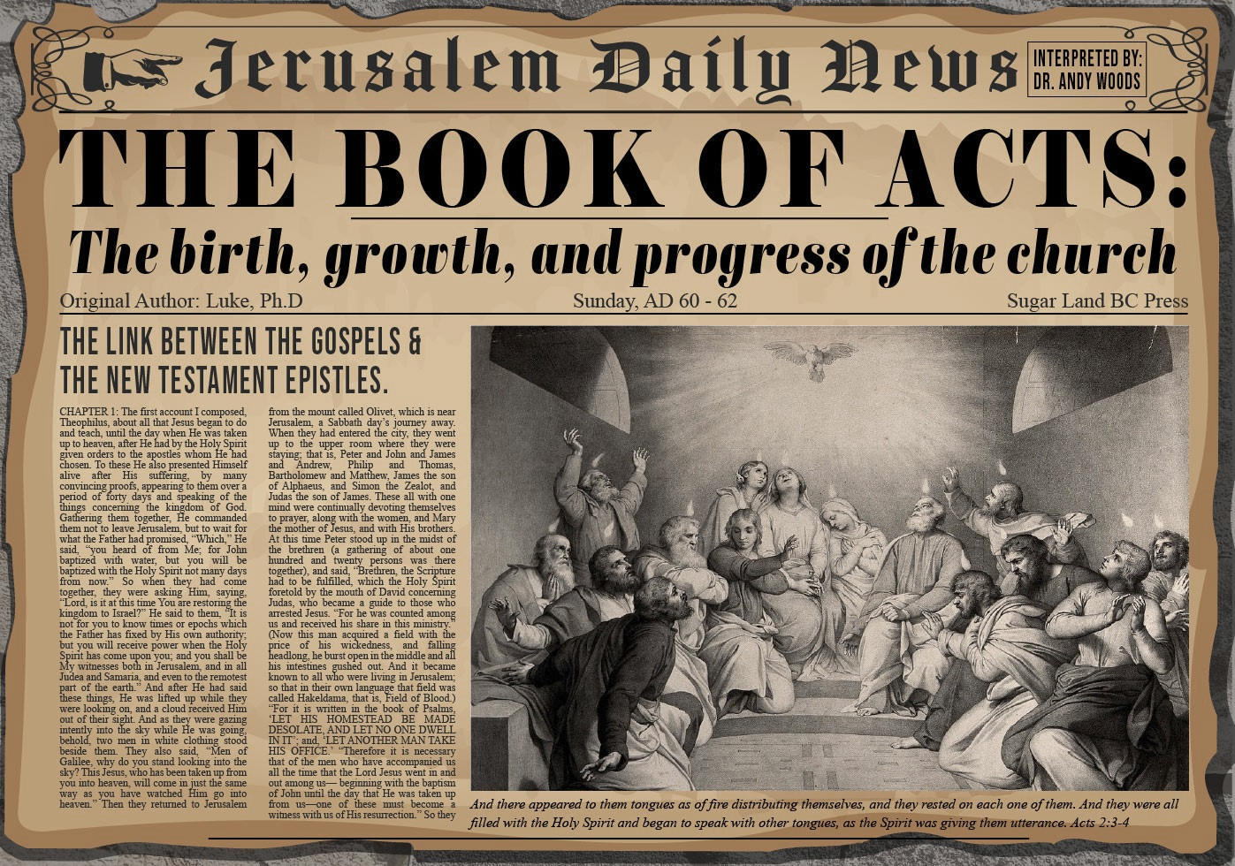


Slide 2

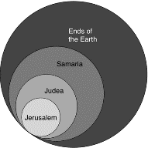
Acts 1:8
“but you will receive power when the Holy Spirit has come upon you; and you shall be My witnesses both in Jerusalem, and in all Judea and Samaria, and even to the remotest part of the earth.”

Slide 3
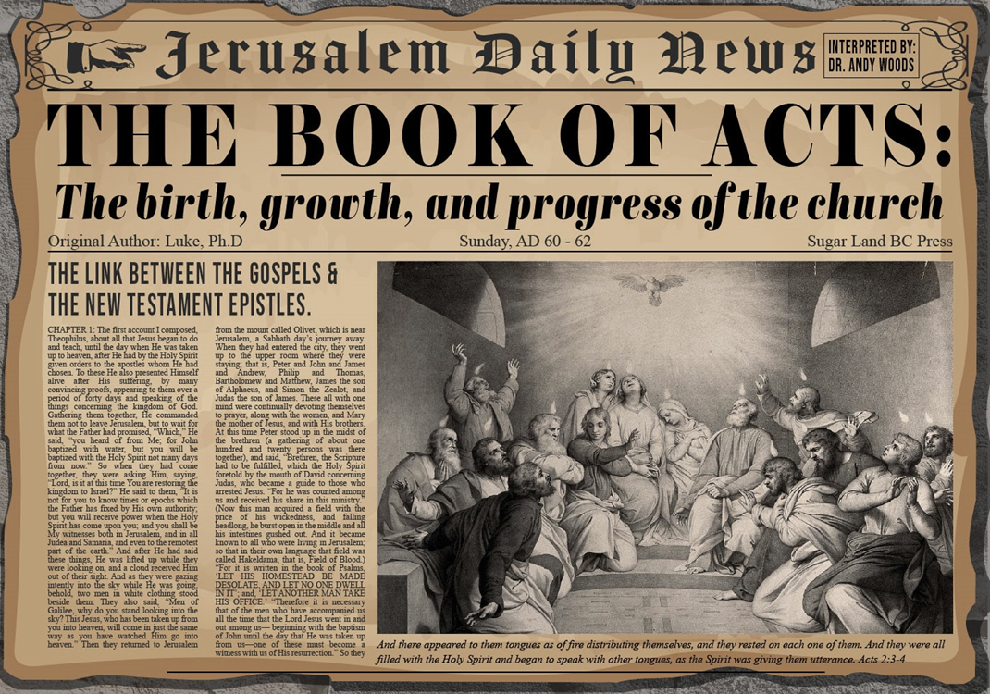
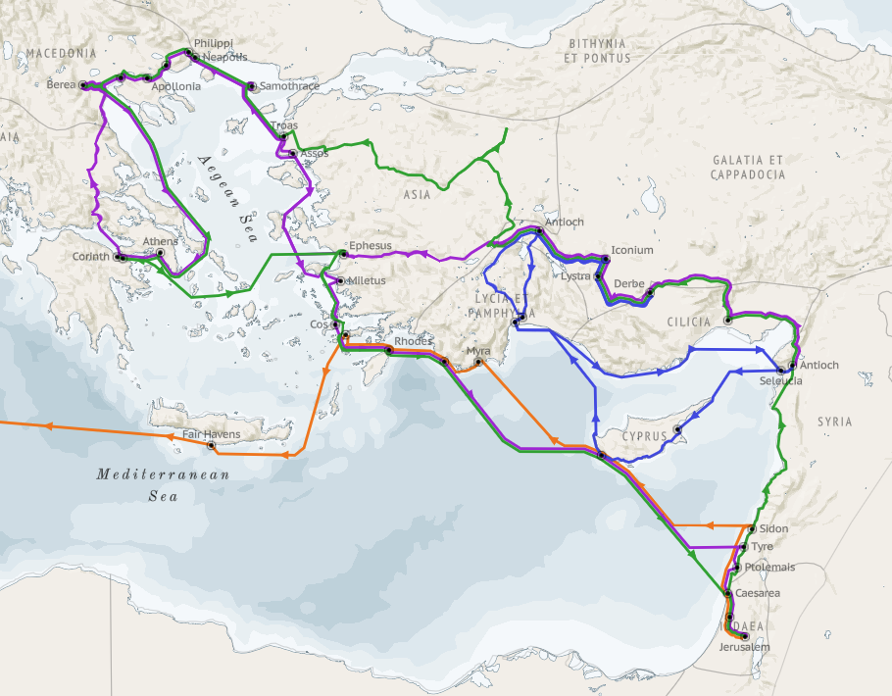
Structure (Acts 1:8)
Jerusalem (Acts 1–7)
Judea and Samaria (Acts 8–12)
Remotest part of the earth (Acts 13–28)
1st missionary journey (Acts 13–14)
Jerusalem council (Acts 15:1-35)
2nd missionary journey (Acts 15:36 –18:22)
3rd missionary journey (Acts 18:23–21:17)
Trip to Rome (Acts 21:18–28:31)

Slide 4
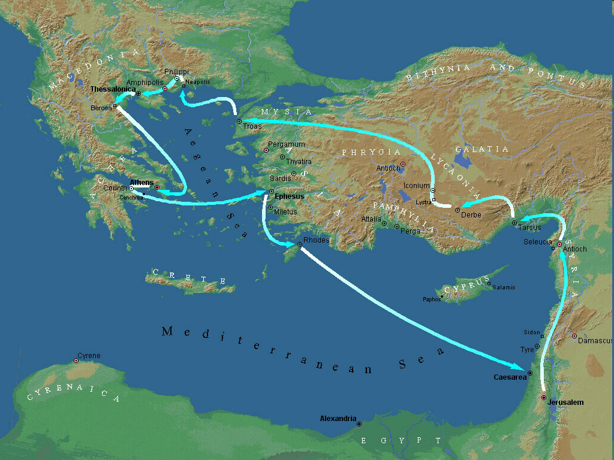
Second Missionary Journey

Slide 5
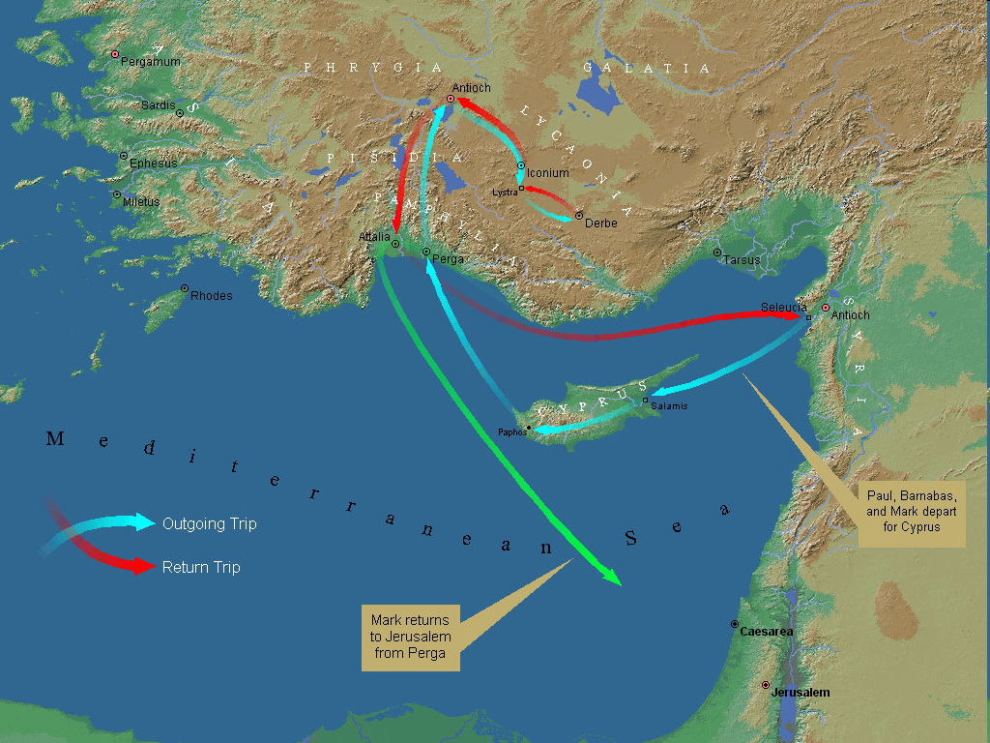
First Missionary Journey

Slide 6
Acts 15:36‒18:22 2nd Missionary Journey
Schism between Paul & Barnabas (15:36-41)
Syria & Cilicia ministry (16:1-5)
Macedonian call (16:6-10)
Philippian ministry (16:11-40)
Thessalonica ministry (17:1-9)
Berean ministry (17:10-15)
Athens’ ministry (17:16-34)
Corinthian ministry (18:1-18)
Ephesus’ ministry (18:19-21)
Return to Antioch (18:22)

Slide 7
Acts 15:36‒18:22 2nd Missionary Journey
Schism between Paul & Barnabas (15:36-41)
Syria & Cilicia ministry (16:1-5)
Macedonian call (16:6-10)
Philippian ministry (16:11-40)
Thessalonica ministry (17:1-9)
Berean ministry (17:10-15)
Athens’ ministry (17:16-34)
Corinthian ministry (18:1-18)
Ephesus’ ministry (18:19-21)
Return to Antioch (18:22)

Slide 8
I. Schism Between Paul & Barnabas Acts 15:36-41
Paul’s suggestion (36)
Barnabas’ suggestion (37)
Paul’s refusal (38)
Paul’s & Barnabas’ schism (39)
Barnabas’ replacement (40)
Paul travels through Syria to Cilicia (41)

Slide 9
I. Schism Between Paul & Barnabas Acts 15:36-41
Paul’s suggestion (36)
Barnabas’ suggestion (37)
Paul’s refusal (38)
Paul’s & Barnabas’ schism (39)
Barnabas’ replacement (40)
Paul travels through Syria to Cilicia (41)

Slide 10

Ephesians 4:11-16
“¹¹ And He gave some as apostles, and some as prophets, and some as evangelists, and some as pastors and teachers, ¹² for the equipping of the saints for the work of service, to the building up of the body of Christ; ¹³ until we all attain to the unity of the faith, and of the knowledge of the Son of God, to a mature man, to the measure of the stature which belongs to the fullness of Christ. ¹⁴ As a result, we are no longer to be children, tossed here and there by. . .

Slide 11
Ephesians 4:11-16
“. . . waves and carried about by every wind of doctrine, by the trickery of men, by craftiness in deceitful scheming; ¹⁵ but speaking the truth in love, we are to grow up in all aspects into Him who is the head, even Christ, ¹⁶ from whom the whole body, being fitted and held together by what every joint supplies, according to the proper working of each individual part, causes the growth of the body for the building up of itself in love.”

Slide 12
Second Missionary Journey

Slide 13
I. Schism Between Paul & Barnabas Acts 15:36-41
Paul’s suggestion (36)
Barnabas’ suggestion (37)
Paul’s refusal (38)
Paul’s & Barnabas’ schism (39)
Barnabas’ replacement (40)
Paul travels through Syria to Cilicia (41)

Slide 14
I. Schism Between Paul & Barnabas Acts 15:36-41
Paul’s suggestion (36)
Barnabas’ suggestion (37)
Paul’s refusal (38)
Paul’s & Barnabas’ schism (39)
Barnabas’ replacement (40)
Paul travels through Syria to Cilicia (41)

Slide 15
First Missionary Journey

Slide 16
I. Schism Between Paul & Barnabas Acts 15:36-41
Paul’s suggestion (36)
Barnabas’ suggestion (37)
Paul’s refusal (38)
Paul’s & Barnabas’ schism (39)
Barnabas’ replacement (40)
Paul travels through Syria to Cilicia (41)

Slide 17


Dr. Arnold G. Fruchtenbaum
The Book of Acts, 334
﻿“This disagreement between Paul and Barnabas led to a schism (v. 39): And there arose a sharp contention, so that they parted asunder one from the other. The Greek word for ‘contention,’ paroxysmos, means ‘a very sharp disagreement.’ It seems that Barnabas, whose name means ‘son of consolation,’ lost his temper during the lengthy discussion. Barnabas stuck with his position to take Mark with him, and the dispute led to his departure. The Greek word for ‘parted asunder,’ apochōristhēnai, means ‘to separate,’ ‘to sever.’ There was no personal slander; they disagreed sharply only over the issue at hand. But it was an apocalyptic disaster.””

Slide 18
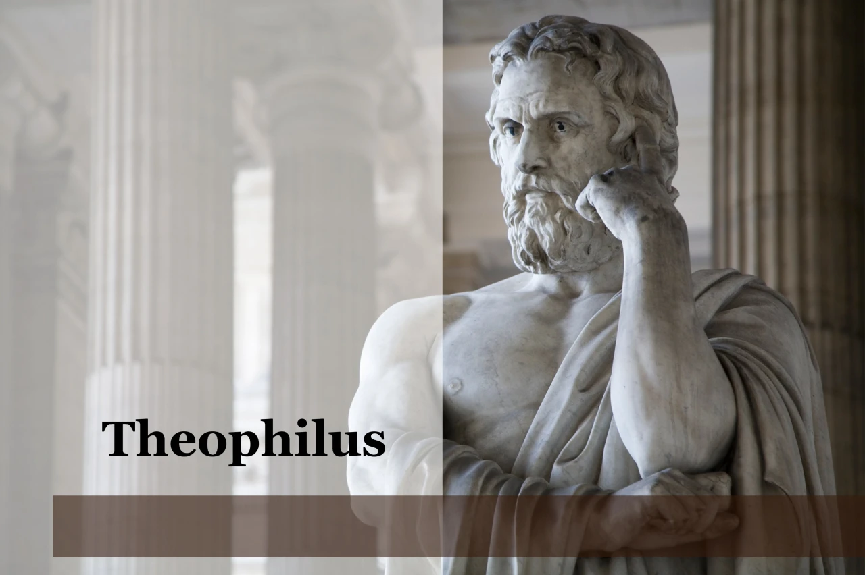
Purpose
To present Theophilus with an orderly account of the birth and growth of the church so as to affirm him in what he has believed.

Slide 19

Message
Birth and growth of the church numerically, geographically, ethnically.
Components
Numerically (progress reports)
Geographically (From Jerusalem to Rome)
Ethnically (From Judaism to Gentile domination)

Slide 20
Dr. Arnold G. Fruchtenbaum
The Book of Acts, 335
﻿“Some later developments of this dispute are known from other Scriptures. In spite of their disagreement over Mark, Paul and Barnabas maintained fellowship. This is evident from I Corinthians 9:6, which was written during the third missionary journey and shows that the schism had healed. Colossians 4:10 also shows that they maintained fellowship. Furthermore, Paul himself was reconciled to Mark later on (Col. 4:10; II Tim. 4:11; Philemon 24).”

Slide 21
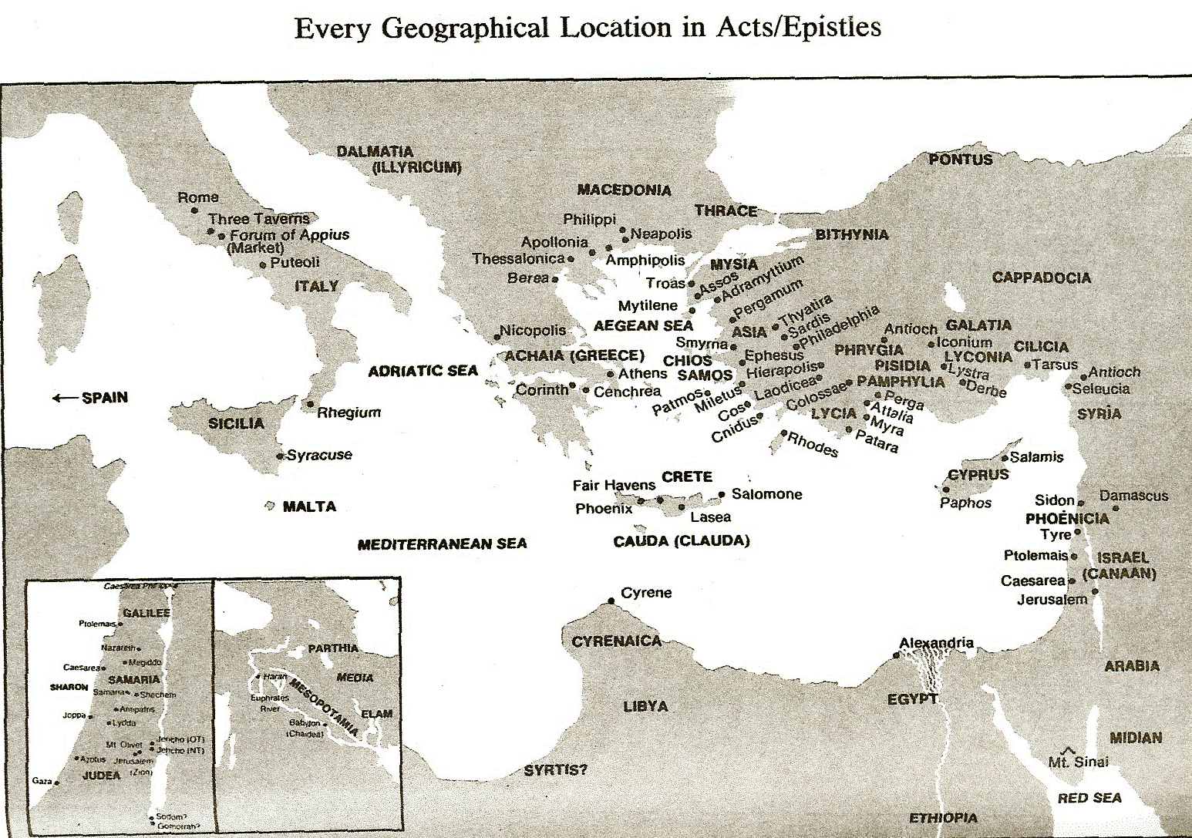

Slide 22
I. Schism Between Paul & Barnabas Acts 15:36-41
Paul’s suggestion (36)
Barnabas’ suggestion (37)
Paul’s refusal (38)
Paul’s & Barnabas’ schism (39)
Barnabas’ replacement (40)
Paul travels through Syria to Cilicia (41)

Slide 23
Dr. Arnold G. Fruchtenbaum
The Book of Acts, 326-27
﻿“The second man was Silas, which was his Hebrew name, about whom much more is known. His Roman name was Silvanus. He became Paul’s companion on his second missionary journey (Acts 15:40; 16:19, 25, 29; 17:4, 10, 14-15; 18:5). He is also mentioned in several of the Epistles (II Cor. 1:19; I Thess. 1:1; II Thess. 1:1; I Pet. 5:12). According to Acts 15:32, he had the gift of prophecy. Judas and Silas were chief men among the brethren. They were leaders of the church of Jerusalem. This gave them authoritative standing for what they had to say to the church of Antioch.”

Slide 24
Dr. Arnold G. Fruchtenbaum
The Book of Acts, 335
﻿“Silas was a key individual: He was a leading Jerusalemite believer (Acts 15:22, 27); he had the gift of prophecy, receiving direct revelation from God (Acts 15:32); he, like Paul, was a Roman citizen, which would help him later (Acts 16:37); and in the book of Acts, while Silas was associated with Paul, at times he was also associated with Peter (I Pet. 5:12).”

Slide 25

Galatians 3:3
“Are you so foolish? Having begun by the Spirit, are you now being perfected by the flesh?”

Slide 26
I. Schism Between Paul & Barnabas Acts 15:36-41
Paul’s suggestion (36)
Barnabas’ suggestion (37)
Paul’s refusal (38)
Paul’s & Barnabas’ schism (39)
Barnabas’ replacement (40)
Paul travels through Syria to Cilicia (41)

Slide 28


Matthew 4:4
“But He answered and said, “It is written, ‘Man shall not live on bread alone, but on every word that proceeds out of the mouth of God.’”

Slide 29


Acts 2:47
“They were continually devoting themselves to the apostles’ teaching and to fellowship, to the breaking of bread and to prayer…”

Slide 30
Activities of the Local Church (Acts 2:41-47)
Doctrine (Acts 2:42)
Ordinances (Acts 2:41-42, 46)
Prayer (Acts 2:42)
Evangelism (Acts 2:47)
Worship (Acts 2:47)
Benevolence (Acts 2:44-45)
Fellowship (Acts 2:42, 46-47)

Slide 31


Acts 20:26-27
“²⁶ Therefore, I testify to you this day that I am innocent of the blood of all men. ²⁷ For I did not shrink from declaring to you the whole purpose of God.”

Slide 32

1 Timothy 3:15
“but in case I am delayed, I write so that you will know how one ought to conduct himself in the household of God, which is the church of the living God, the pillar and support of the truth.”

Slide 33
2 Timothy 3:16-17
“¹⁶ All Scripture is inspired by God [theopneustos] and profitable for teaching, for reproof, for correction, for training in righteousness; ¹⁷ so that the man of God may be adequate, equipped for every good work.”

Slide 34
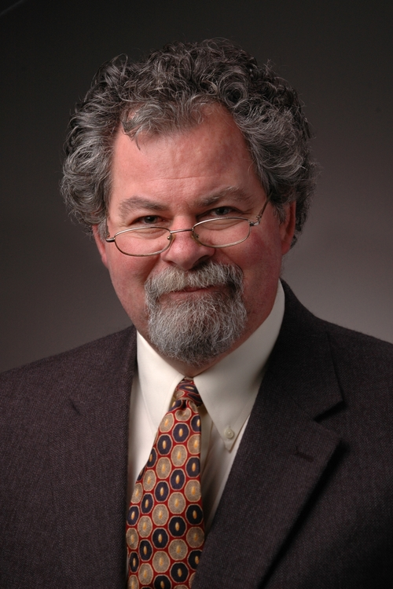
Emphasis of 2 Timothy
“By my count, there are twenty-seven explicit commands given in the body of this letter. In 27 words Paul tells pastors what to focus on. You have to be blind to miss the thrust of Paul's instructions here, because eighteen of those commands--fully two-thirds--have to do with the ministry of the Word.”
Daniel Wallace, “Crisis of the Word: A Message to Pastors or Would-be Pastors,”
Conservative Theological Journal 1, no. 2 (August 1997): 108.

Slide 35
Ephesians 4:11-16
“¹¹ And He gave some as apostles, and some as prophets, and some as evangelists, and some as pastors and teachers, ¹² for the equipping of the saints for the work of service, to the building up of the body of Christ; ¹³ until we all attain to the unity of the faith, and of the knowledge of the Son of God, to a mature man, to the measure of the stature which belongs to the fullness of Christ. ¹⁴ As a result, we are no longer to be children, tossed here and there by. . .

Slide 36
Ephesians 4:11-16
“. . . waves and carried about by every wind of doctrine, by the trickery of men, by craftiness in deceitful scheming; ¹⁵ but speaking the truth in love, we are to grow up in all aspects into Him who is the head, even Christ, ¹⁶ from whom the whole body, being fitted and held together by what every joint supplies, according to the proper working of each individual part, causes the growth of the body for the building up of itself in love.”

Slide 37
Conclusion

Slide 38
I. Schism Between Paul & Barnabas Acts 15:36-41
Paul’s suggestion (36)
Barnabas’ suggestion (37)
Paul’s refusal (38)
Paul’s & Barnabas’ schism (39)
Barnabas’ replacement (40)
Paul travels through Syria to Cilicia (41)

