Slide 1
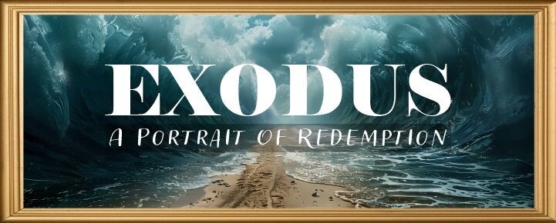


Slide 2
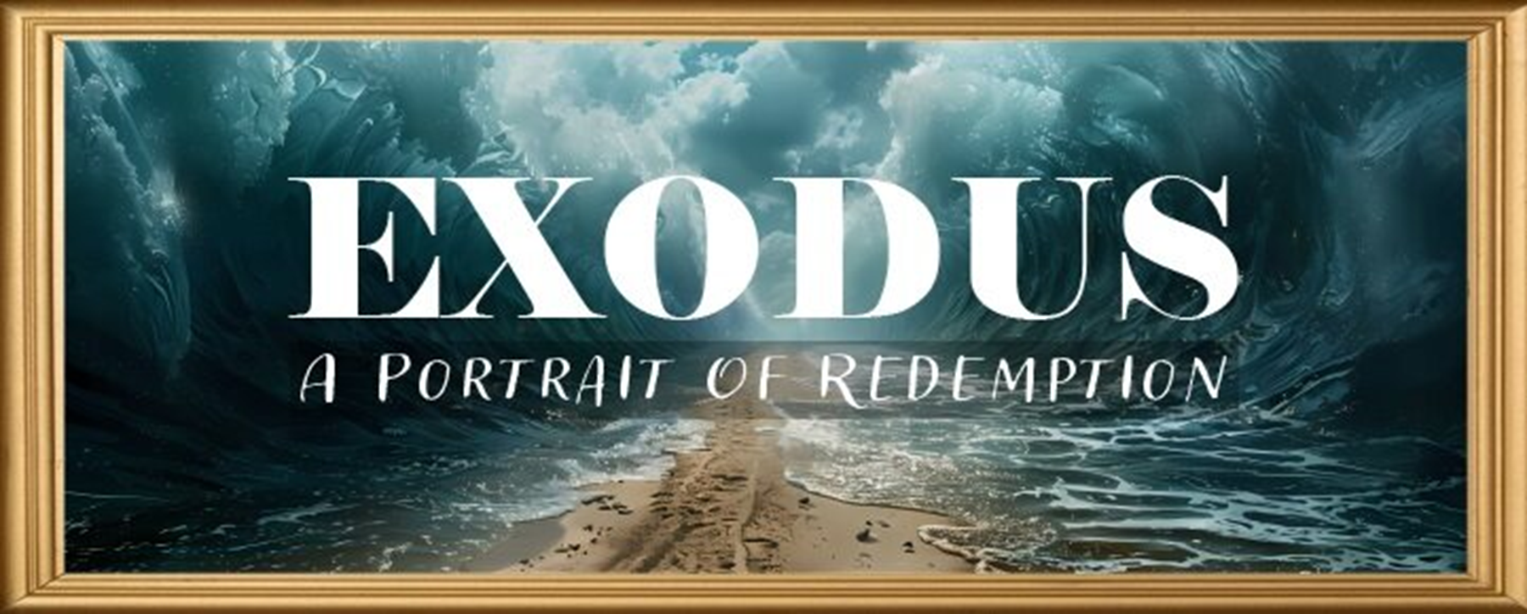
EXODUS STRUCTURE/OUTLINE
Redemption (1–18)
Redemption (1:1–12:30)
Liberation (12:31–15:21)
Preservation (15:22–18:27)
Mosaic Covenant (19–40)
Law (19–24)
Tabernacle instructions (25–31)
Apostasy (32–34)
Tabernacle building (35–40)

Slide 3
REDEMPTION (1:1–12:30)
Why redemption is necessary (Exod 1)
Development of the deliverer (Exod 2–4)
First confrontation with Pharaoh (Exod 5)
God reassures Moses (Exod 6:1–7:7)
Second confrontation with Pharaoh (Exod 7:8-13)
Plagues (Exod 7:14–12:30)

Slide 4
TEN PLAGUES REDEMPTION (7:14–12:30)
Nile to blood
Frogs
Gnats
Flies
Death of livestock
Boils
Hail
Locusts
Darkness
Death of 1st born

Slide 5
The Plagues of Egypt
NO. | DESCRIPTION | SCRIPTURE | Egyptian Deity
1. | Water to Blood | Exod. 7:14-25 | Hapi, Khnum
2. | Frogs | Exod. 8:1-15 | Heqt
3. | Gnats | Exod. 8:16-19 | Set
4. | Flies | Exod. 8:20-32 | Uatchit
5. | Disease on Cattle | Exod. 9:1-7 | Hathor, Apis
6. | Boils | Exod. 9:8-12 | Sekhmet, Serapis
7. | Hail | Exod. 9:13-35 | Seth, Nut
8. | Locusts | Exod. 10:1-20 | Seth, Nut, Osiris
9. | Darkness | Exod. 10:21-29 | Re, Horus, Atum
10. | Death of the First Born | Exod. 12:29-36 | Min, Osiris, Heqt, Isis

Slide 6
BOILS Exodus 9:8-12
God Instructs Moses & Aaron (8-9)
Moses & Aaron Obey (10-12)

Slide 7
BOILS Exodus 9:8-12
God Instructs Moses & Aaron (8-9)
Moses & Aaron Obey (10-12)

Slide 8
I. Exodus 9:8-9 God’s Instructions
Symbol (8)
Meaning (9)

Slide 9
I. Exodus 9:8-9 God’s Instructions
Symbol (8)
Meaning (9)

Slide 10
I. Exodus 9:8-9 God’s Instructions
Symbol (8)
Meaning (9)

Slide 11
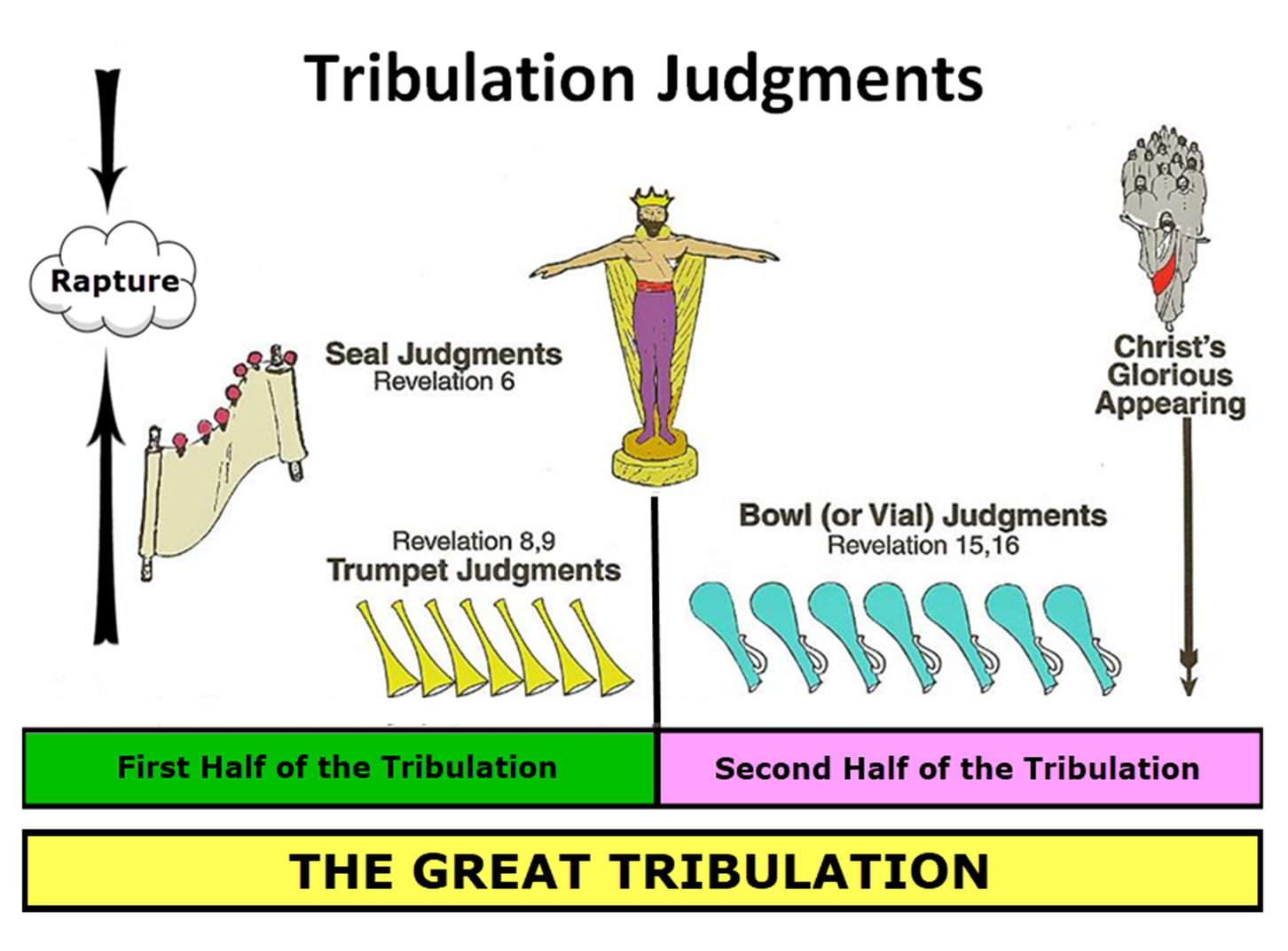

Slide 12
Ultimate Exodus (Rev 11:15)
Sores: 6th plague (Ex 9:8-12), 1st bowl (Rev 16:1-2)
Rivers to blood: 1st plague (Ex 7:19-21), 3rd bowl (Rev 16:4-7)
Darkness: 9th plague (Ex 10:21-23), 5th bowl (Rev 16:10-11)
Frogs: 2nd plague (Ex 7:25‒8:15), 6th bowl (Rev 16:13)
Hail: 7th plague (Ex 9:22-26), 7th bowl (Rev 16:17-21)

Slide 13
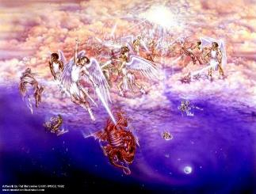
Satan as Ruler of this World
Job 1:7; 2:2
Luke 4:5-7
John 12:31; 14:30; 16:11
2 Corinthians 4:4
Ephesians 2:2
1 John 4:4; 5:19

Slide 14
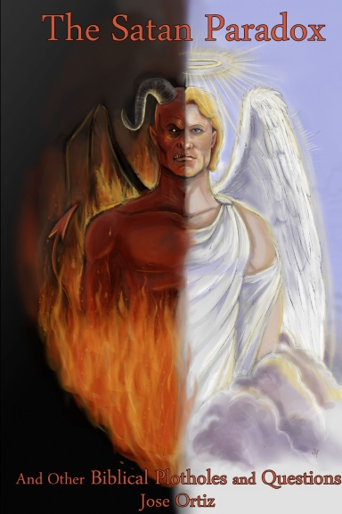
Names & Titles Demonstrating Satan’s Post-Fall, Earthly Authority (Job 1:7; 2:2; Luke 4:5-8; Rom. 8:19-22)
Prince of this world (John 12:31; 14:30; 16:11)
God of this world (2 Cor. 4:4)
Prince and power of the air (Eph. 2:2)
Who the believer wrestles with (Eph. 6:12)
Roaring lion (1 Pet. 5:8)
Whole world lies in his power (1 John 5:19)

Slide 15
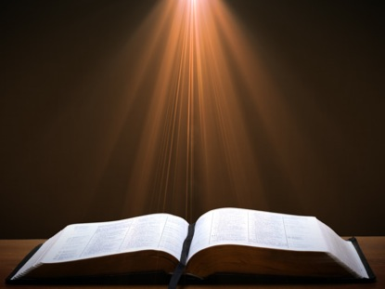
Romans 8:19-23
¹⁹ “For the anxious longing of the creation waits eagerly for the revealing of the sons of God. ²⁰ For the creation was subjected to futility, not willingly, but because of Him who subjected it, in hope ²¹ that the creation itself also will be set free from its slavery to corruption into the freedom of the glory of the children of God. ²² For we know that the whole creation groans and suffers the pains of childbirth together until now. ²³ And not only this, but also we ourselves, having the first fruits of the Spirit, even we ourselves groan within ourselves, waiting eagerly for our adoption as sons, the redemption of our body.”

Slide 16
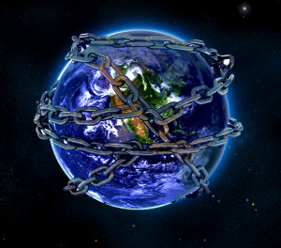

Slide 17

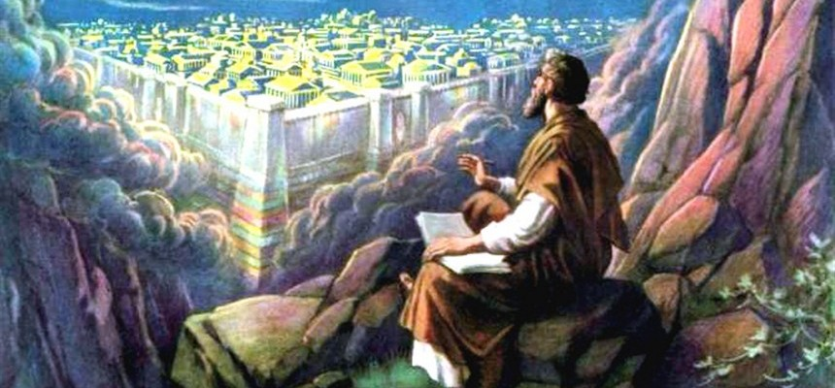
Revelation 11:15
¹⁵ “Then the seventh angel sounded; and there were loud voices in heaven, saying, ‘The kingdom of the world has become the kingdom of our Lord and of His Christ; and He will reign forever and ever.’”

Slide 18
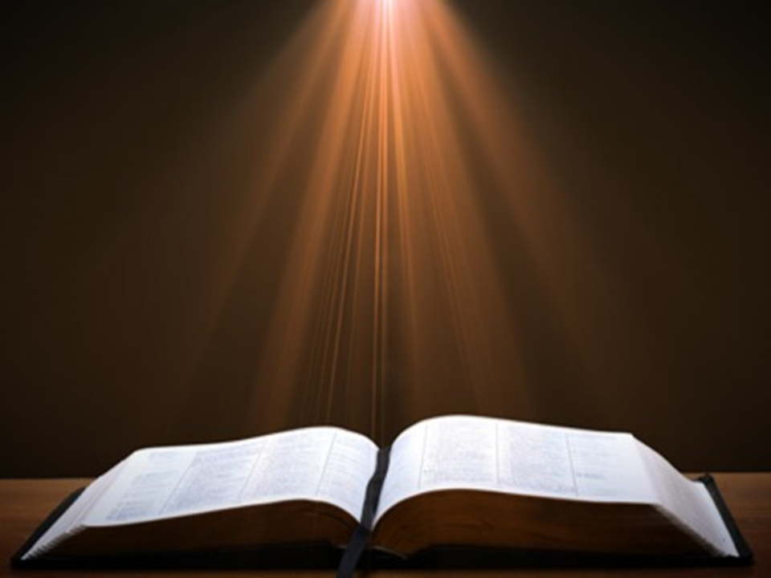
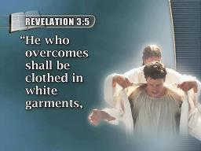
Revelation 5:5
“and one of the elders said to me, ‘Stop weeping; behold, the Lion that is from the tribe of Judah, the Root of David, has overcome [nikaō] so as to open the book and its seven seals.’”

Slide 19

John 16:33
“These things I have spoken to you, so that in Me you may have peace. In the world you have tribulation, but take courage; I have overcome [nikaō; perfect tense] the world.”

Slide 20
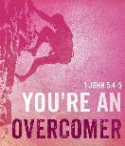
1 John 5:4-5
“For whatever is born of God overcomes [nikaō] the world; and this is the victory that has overcome [nikaō] the world—our faith.⁵ Who is the one who overcomes [nikaō] the world, but he who believes that Jesus is the Son of God?”

Slide 21
1 John 4:4
“You are from God, little children, and have overcome [nikaō; perfect tense] them; because greater is He who is in you than he who is in the world.”

Slide 22

Romans 8:37
“But in all these things we overwhelmingly conquer [hypernikaō, present tense] through Him who loved us.”

Slide 23
The Plagues of Egypt
NO. | DESCRIPTION | SCRIPTURE | Egyptian Deity
1. | Water to Blood | Exod. 7:14-25 | Hapi, Khnum
2. | Frogs | Exod. 8:1-15 | Heqt
3. | Gnats | Exod. 8:16-19 | Set
4. | Flies | Exod. 8:20-32 | Uatchit
5. | Disease on Cattle | Exod. 9:1-7 | Hathor, Apis
6. | Boils | Exod. 9:8-12 | Sekhmet, Serapis
7. | Hail | Exod. 9:13-35 | Seth, Nut
8. | Locusts | Exod. 10:1-20 | Seth, Nut, Osiris
9. | Darkness | Exod. 10:21-29 | Re, Horus, Atum
10. | Death of the First Born | Exod. 12:29-36 | Min, Osiris, Heqt, Isis

Slide 24
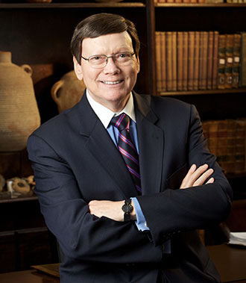
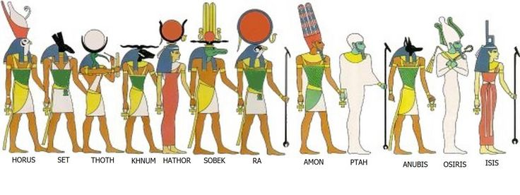
Dr. Ed Hindson
Hindson, E. E., & Mitchell, D. R., eds. (2010). KJV Bible Commentary for Today: The Most Up-to-Date Commentary on the Time-Honored Text of the KJV (p. 94). Thomas Nelson.
9:9. “Specific Egyptian deities challenged by this plague were a veritable pantheon: Typhon, the god of boil protection; Sekhmet, the lion-headed goddess of disease protection; Serapis and Isis, the god and goddess of healing; Imhotep, the medicine god; and Sunu, the pestilence god.”

Slide 25
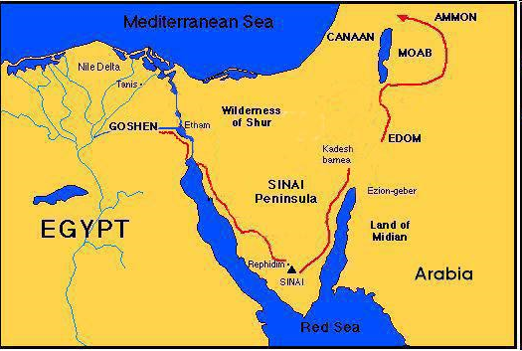

Slide 26
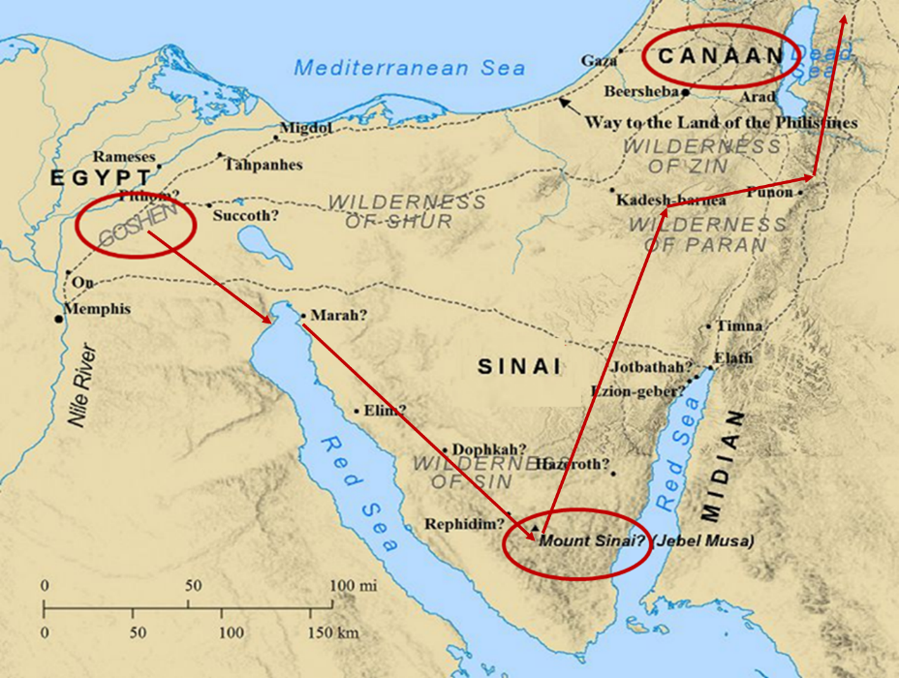

Slide 27
BOILS Exodus 9:8-12
God Instructs Moses & Aaron (8-9)
Moses & Aaron Obey (10-12)

Slide 28
II. Exodus 9:10-12 Moses’ & Aaron’s Obedience
Prophecy’s fulfillment (10)
Magicians’ defeat (11)
Pharaoh’s hardening (12)

Slide 29
II. Exodus 9:10-12 Moses’ & Aaron’s Obedience
Prophecy’s fulfillment (10)
Magicians’ defeat (11)
Pharaoh’s hardening (12)

Slide 30
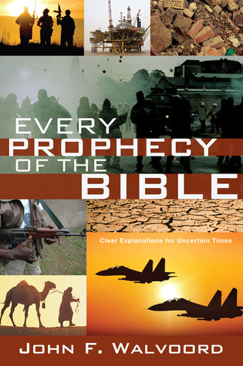

Slide 31


John 13:19; 14:29
“¹⁹ From now on I am telling you before it comes to pass, so that when it does occur, you may believe that I am He… ^{14:29} Now I have told you before it happens, so that when it happens, you may believe.”

Slide 32
What Happened to Christ’s Disciples?
Disciple | Place | Martyrdom
James the Son of Alpheus | Jerusalem | Clubbed to death
Simon the Zealot | Jerusalem | Martyred
James the Son of Zebedee | Judea (Acts 12:2) | Executed
Thaddeus | Mesopotamia | Beaten to death
Peter | Babylon, Rome | Crucified upside down
Matthew | Parthia (Tehran) | Beheaded
Notes:
109 prophecies…
Peter Stoner – SCIENCE SPEAKS, An Evaluation of Certain Christian Evidences
To fulfill just 8 prophecies =1 X 10 to the twenty-eighth power!
Can we visualize this with an illustration? Suppose we took an atheistic professor, blindfolded him and covered the state of Texas two feet deep with silver dollars. Then we put a check on one of those silver dollars and mixed them up. The odds of one person fulfilling just these eight prophecies would be the same as this atheistic professor selecting the silver dollar upon which we have placed a check, in his first try.
https://www.bereanpublishers.com/the-odds-of-eight-messianic-prophecies-coming-true/

Slide 33
What Happened to Christ’s Disciples?
Disciple | Place | Martyrdom
John | Asia Minor, Patmos, Ephesus | Fried in boiling oil
Philip | E. Turkey | Tortured & crucified
Thomas | India | Speared
Bartholomew | India | Flayed & crucified
Andrew | Ukraine, Russia, Greece | Hanged
Notes:
109 prophecies…
Peter Stoner – SCIENCE SPEAKS, An Evaluation of Certain Christian Evidences
To fulfill just 8 prophecies =1 X 10 to the twenty-eighth power!
Can we visualize this with an illustration? Suppose we took an atheistic professor, blindfolded him and covered the state of Texas two feet deep with silver dollars. Then we put a check on one of those silver dollars and mixed them up. The odds of one person fulfilling just these eight prophecies would be the same as this atheistic professor selecting the silver dollar upon which we have placed a check, in his first try.
https://www.bereanpublishers.com/the-odds-of-eight-messianic-prophecies-coming-true/

Slide 34
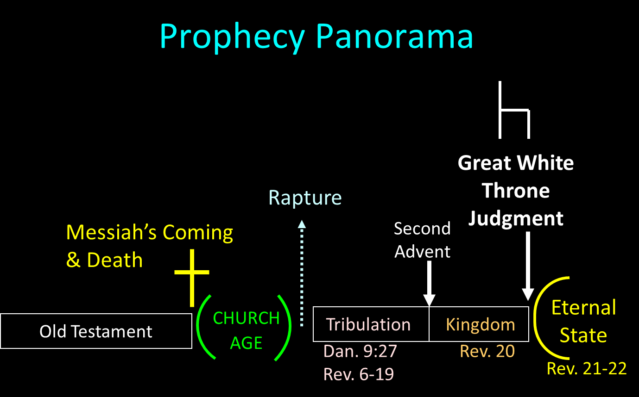

Slide 35

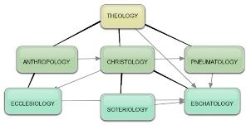
Areas of Systematic Theology
Prolegomena – Introduction
Theology – Study of God
Christology – Study of Christ
Pneumatology – Study of the Holy Spirit
Anthropology – Study of Man
Hamartiology – Study of sin
Soteriology – Study of salvation
Angelology – Study of angels
Ecclesiology – Study of the Church
Eschatology – Study of the end

Slide 36
II. Exodus 9:10-12 Moses’ & Aaron’s Obedience
Prophecy’s fulfillment (10)
Magicians’ defeat (11)
Pharaoh’s hardening (12)

Slide 37
TEN PLAGUES REDEMPTION (7:14–12:30)
Nile to blood
Frogs
Gnats
Flies
Death of livestock
Boils
Hail
Locusts
Darkness
Death of 1st born

Slide 38
The Plagues of Egypt
NO. | DESCRIPTION | SCRIPTURE | Egyptian Deity
1. | Water to Blood | Exod. 7:14-25 | Hapi, Khnum
2. | Frogs | Exod. 8:1-15 | Heqt
3. | Gnats | Exod. 8:16-19 | Set
4. | Flies | Exod. 8:20-32 | Uatchit
5. | Disease on Cattle | Exod. 9:1-7 | Hathor, Apis
6. | Boils | Exod. 9:8-12 | Sekhmet, Serapis
7. | Hail | Exod. 9:13-35 | Seth, Nut
8. | Locusts | Exod. 10:1-20 | Seth, Nut, Osiris
9. | Darkness | Exod. 10:21-29 | Re, Horus, Atum
10. | Death of the First Born | Exod. 12:29-36 | Min, Osiris, Heqt, Isis

Slide 39

Satanic/Demonic Miracles
Exod. 7–8
Deut. 13:1-3
Job 1:12-19; 2:7-8
1 Sam. 28?
Matt. 7:21-23; 24:24
Luke 4:5
Acts 8:9; 16:16
Gal. 1:6-9
2 Thess. 2:9
2 Cor. 11:14
Rev. 13:3, 13, 15; 16:13-14

Slide 40

Ezekiel 28:13, 15
¹³ “You were in Eden, the garden of God; Every precious stone was your covering: The ruby, the topaz and the diamond; The beryl, the onyx and the jasper; The lapis lazuli, the turquoise and the emerald; And the gold, the workmanship of your settings and sockets, Was in you. On the day that you were created They were prepared… ¹⁵ “You were blameless in your ways From the day you were created Until unrighteousness was found in you.

Slide 41
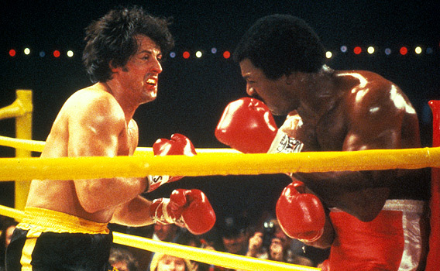

Slide 42
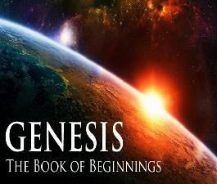
Refutation of Man’s Philosophies (Gen 1:1)
Atheism – God created (Ps. 14:1)
Pantheism – God is transcendent over creation
Polytheism – One God created (Deut. 6:4; Isa 43:11; 44:6; 45:5)
Materialism – Matter began
Dualism – God alone created (Ezek. 28:13, 15)
Humanism – God rather than man created
Naturalism – God created
Morris, Genesis Record, 38

Slide 43
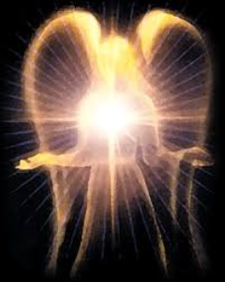
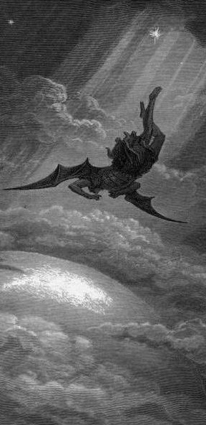
Satan’s Progressive Defeat
Initial eviction from heaven (Isa 14:12-15; Ezek 28:12-17)
Eden (Gen 3:15)
Pre-diluvian world (1 Pet 3:19-20)
Cross (John 12:31; 16:11; Col 2:15; Heb 2:14; 1 John 3:8)
Mid point of the Tribulation (Rev 12:9)
Beginning of millennium (Rev 20:2-3)
End of millennium (Rev 20:10)

Slide 44
II. Exodus 9:10-12 Moses’ & Aaron’s Obedience
Prophecy’s fulfillment (10)
Magicians’ defeat (11)
Pharaoh’s hardening (12)

Slide 45
Dr. Ed Hindson
Hindson, E. E., & Mitchell, D. R., eds. (2010). KJV Bible Commentary for Today: The Most Up-to-Date Commentary on the Time-Honored Text of the KJV (p. 86). Thomas Nelson.
“4:21. I will harden his heart. An expression meaning ‘to strengthen his will.’ The text identifies the heart as the location of the volition, man’s decision-making ability. On seven occasions in the narrative, God hardens Pharaoh’s heart (9:12; 10:1, 20, 27; 11:10; 14:4, 8) or foretells that He will harden Pharaoh’s heart (4:21; 7:3), and nine times in the text, Pharaoh hardens his own heart (7:13, 14, 22; 8:15, 19, 32; 9:7, 34–35). For the initial five plagues, the text registers Pharaoh as the agent of hardening. Not until the sixth plague does God participate in the confirmation of Pharaoh’s own volitional choices.”

Slide 46

Charles Ryrie Ryrie Study Bible, page 96
Exodus 4:21 - “harden his heart. Ten times it is said that Pharaoh hardened his own heart (7:13, 14, 22; 8:15, 19, 32; 9:7, 34, 35; 13:15), and 10 times that God hardened Pharaoh’s heart (4:21; 7:3; 9:12; 10:1, 20, 27; 11:10; 14:4, 8, 17). Paul uses this as an example of the inscrutable will of God and of His mercy toward men (Rom. 9:14–18). Seven times Pharaoh hardened his own heart before God first hardened it, though the prediction that God would do it preceded all.”

Slide 47
GOD HARDENING PHARAOH'S HEART
The prediction of God hardening of Pharaoh (4:21)
Pharaoh repeatedly hardening his own heart (7:13, 22; 8:15, 19, 32; 9:7)
Not until the sixth plague did God harden Pharaoh’s heart (Exod 9:12)

Slide 48

Genesis 6:1-3
“¹ Now it came about, when men began to multiply on the face of the land, and daughters were born to them, ² that the sons of God saw that the daughters of men were beautiful; and they took wives for themselves, whomever they chose. ³ Then the Lord said, “My Spirit shall not strive with man forever, because he also is flesh; nevertheless his days shall be one hundred and twenty years.”

Slide 49
Romans 1:18–20
¹⁸ For the wrath of God is revealed from heaven against all ungodliness and unrighteousness of men who suppress the truth in unrighteousness, ¹⁹ because that which is known about God is evident within them; for God made it evident to them. ²⁰ For since the creation of the world His invisible attributes, His eternal power and divine nature, have been clearly seen, being understood through what has been made, so that they are without excuse.

Slide 51
John 13:19; 14:29
“¹⁹ From now on I am telling you before it comes to pass, so that when it does occur, you may believe that I am He… ^{14:29} Now I have told you before it happens, so that when it happens, you may believe.”

Slide 52
What Happened to Christ’s Disciples?
Disciple | Place | Martyrdom
James the Son of Alpheus | Jerusalem | Clubbed to death
Simon the Zealot | Jerusalem | Martyred
James the Son of Zebedee | Judea (Acts 12:2) | Executed
Thaddeus | Mesopotamia | Beaten to death
Peter | Babylon, Rome | Crucified upside down
Matthew | Parthia (Tehran) | Beheaded
Notes:
109 prophecies…
Peter Stoner – SCIENCE SPEAKS, An Evaluation of Certain Christian Evidences
To fulfill just 8 prophecies =1 X 10 to the twenty-eighth power!
Can we visualize this with an illustration? Suppose we took an atheistic professor, blindfolded him and covered the state of Texas two feet deep with silver dollars. Then we put a check on one of those silver dollars and mixed them up. The odds of one person fulfilling just these eight prophecies would be the same as this atheistic professor selecting the silver dollar upon which we have placed a check, in his first try.
https://www.bereanpublishers.com/the-odds-of-eight-messianic-prophecies-coming-true/

Slide 53
What Happened to Christ’s Disciples?
Disciple | Place | Martyrdom
John | Asia Minor, Patmos, Ephesus | Fried in boiling oil
Philip | E. Turkey | Tortured & crucified
Thomas | India | Speared
Bartholomew | India | Flayed & crucified
Andrew | Ukraine, Russia, Greece | Hanged
Notes:
109 prophecies…
Peter Stoner – SCIENCE SPEAKS, An Evaluation of Certain Christian Evidences
To fulfill just 8 prophecies =1 X 10 to the twenty-eighth power!
Can we visualize this with an illustration? Suppose we took an atheistic professor, blindfolded him and covered the state of Texas two feet deep with silver dollars. Then we put a check on one of those silver dollars and mixed them up. The odds of one person fulfilling just these eight prophecies would be the same as this atheistic professor selecting the silver dollar upon which we have placed a check, in his first try.
https://www.bereanpublishers.com/the-odds-of-eight-messianic-prophecies-coming-true/

Slide 54
Conclusion

Slide 55
BOILS Exodus 9:8-12
God Instructs Moses & Aaron (8-9)
Moses & Aaron Obey (10-12)

Slide 56
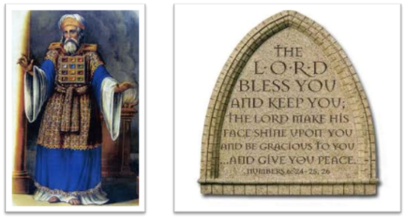
²⁴ The Lord bless you, and keep you; ²⁵ The Lord make His face shine on you, And be gracious to you; ²⁶ The Lord lift up His countenance on you, And give you peace.
Numbers 6:24–26 (NASB95)

