Slide 1
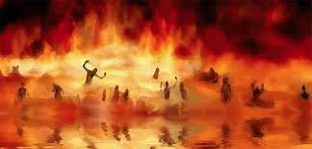

Annihilation
vs.
Eternal Torment

Slide 2
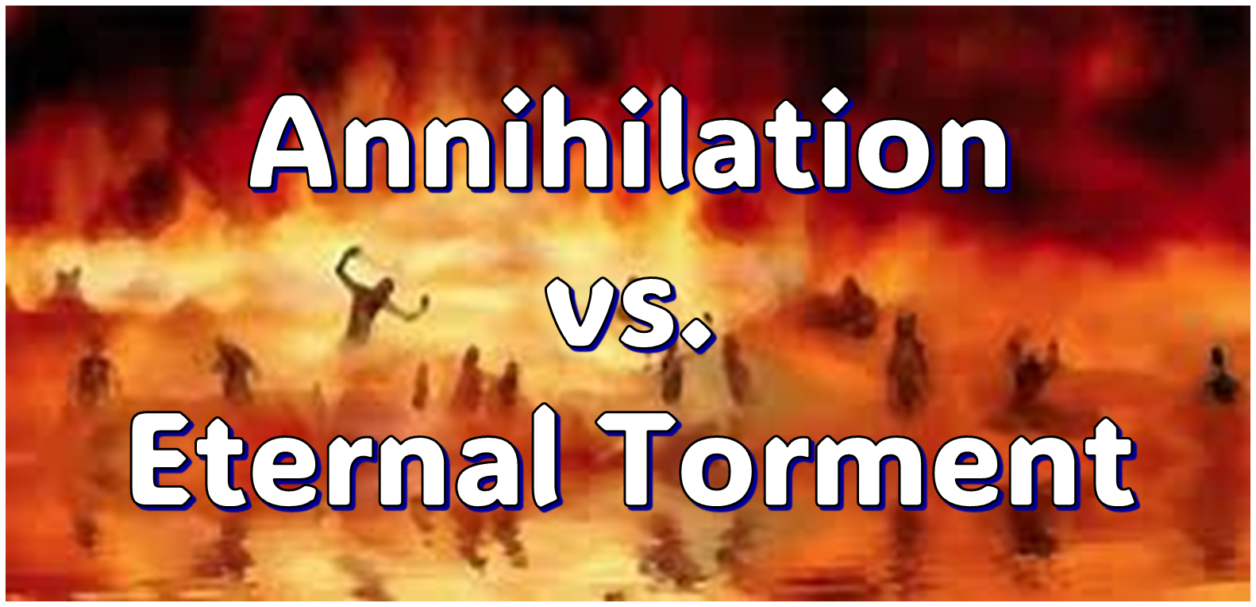
ANNIHILATION VS. ETERNAL CONSCIOUS TORMENT
Introduction to the Controversy
Biblical Arguments Against Annihilation
Theological Arguments Against Annihilation
Answering Annihilationist Biblical Arguments
Answering Annihilationist Theological Arguments
Examining Church History
Conclusion

Slide 3

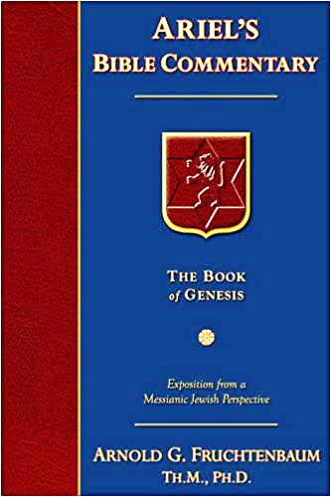
Dr. Arnold G. Fruchtenbaum
Footsteps of the Messiah, 707-8
“Conditional immortality means the soul is not inherently immortal; immortality is not part of the make-up of the soul. Rather, immortality is a gift for the saved only. So at death, the unbeliever simply becomes non-existent, and only the believer continues to exist…What annihilationism says is this: the unsaved soul is annihilated after a temporary period of punishment. These people do believe that the unsaved soul goes to Hell, but not for eternity, only temporarily. Eventually the unsaved soul is annihilated after suffering a duration of punishment.”

Slide 4
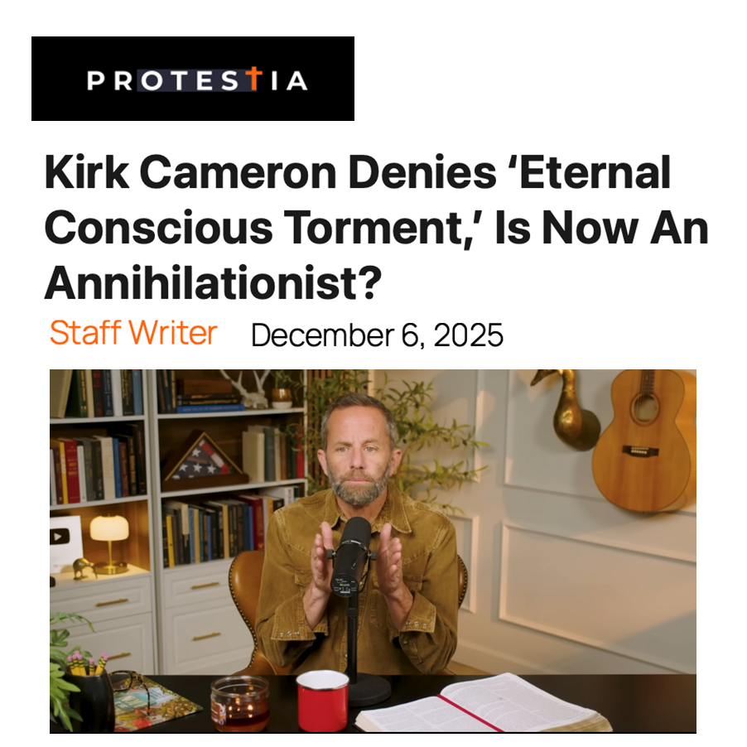

Slide 5
ANNIHILATION VS. ETERNAL CONSCIOUS TORMENT
Introduction to the Controversy
Biblical Arguments Against Annihilation
Theological Arguments Against Annihilation
Answering Annihilationist Biblical Arguments
Answering Annihilationist Theological Arguments
Examining Church History
Conclusion

Slide 6
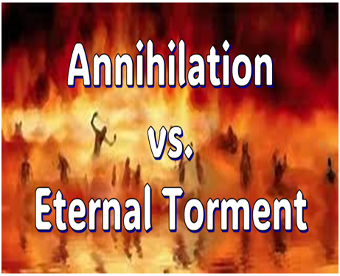
II. Anti-Annihilationist Texts
Dan. 12:2 Matt. 25:46 Mark 9:47-48 Matt. 8:12 Luke 16:19-31 |  | 2 Thess. 1:9 Heb. 6:2 Rev. 14:11 Rev. 20:10 Rev. 19:20

Slide 7
ANNIHILATION VS. ETERNAL CONSCIOUS TORMENT
Introduction to the Controversy
Biblical Arguments Against Annihilation
Theological Arguments Against Annihilation
Answering Annihilationist Biblical Arguments
Answering Annihilationist Theological Arguments
Examining Church History
Conclusion

Slide 8
III. Theological Arguments Against Annihilation
Underestimates sin’s severity
Contradicts humanity’s nature
Denies degrees of punishment
Seeks to escape sin’s consequences

Slide 9
ANNIHILATION VS. ETERNAL CONSCIOUS TORMENT
Introduction to the Controversy
Biblical Arguments Against Annihilation
Theological Arguments Against Annihilation
Answering Annihilationist Biblical Arguments
Answering Annihilationist Theological Arguments
Examining Church History
Conclusion

Slide 10
IV. Answering Annihilationist Biblical Arguments
2nd death (Rev. 20:14)
Destroy (Rev. 11:18)
Destruction (2 Thess. 1:9)
Burning up (Matt. 3:12)
Eternal results (Rev. 14:11)

Slide 11
IV. Answering Annihilationist Biblical Arguments
Perdition (2 Pet. 3:7)
Better to have never been born (Mark 14:21)
Wicked perishing (2 Pet. 3:9)
Blotted out of existence (Hebrews 9:25–26)
Life activity suspended in death (Eccles. 9:10)

Slide 12
IV. Answering Annihilationist Biblical Arguments
2nd death (Rev. 20:14)
Destroy (Rev. 11:18)
Destruction (2 Thess. 1:9)
Burning up (Matt. 3:12)
Eternal results (Rev. 14:11)

Slide 13
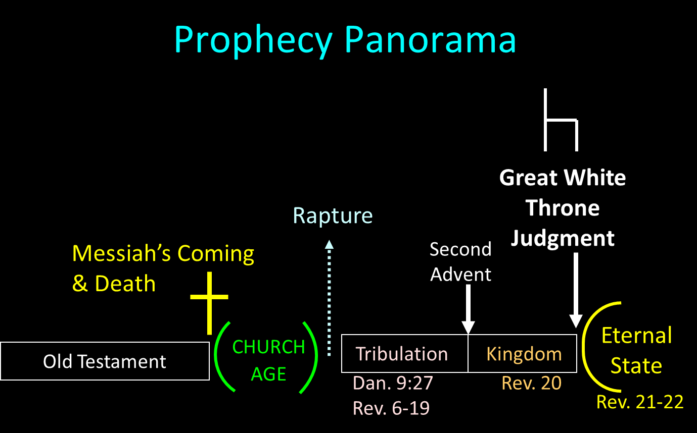

Slide 14
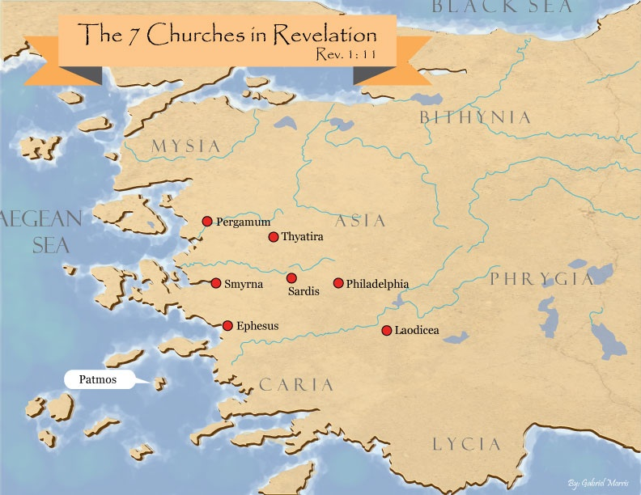
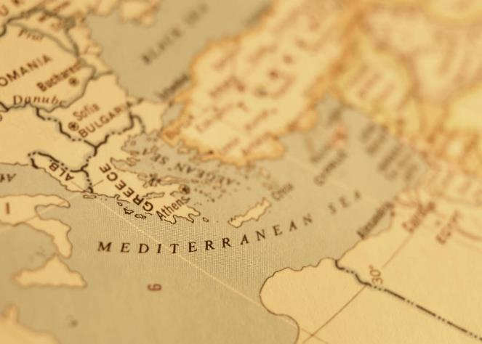

Slide 15
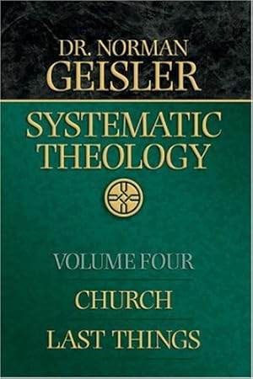
Dr. Norman Geisler
Geisler, N. L. (2005). Systematic theology, volume four: church, last things (p. 393). Bethany House Publishers.
“For one thing, the second death is no more annihilation than is the first death. The first death is the separation of the soul from the body for a short time (until the resurrection), not the soul’s annihilation; the second death is the separation of the body and soul from God forever.”

Slide 16

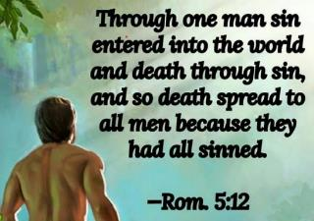
Genesis 2:16-17
“¹⁶ The Lord God commanded the man, saying, ‘From any tree of the garden you may eat freely; ¹⁷ but from the tree of the knowledge of good and evil you shall not eat, for in the day that you eat from it you will surely die (muwth).’”

Slide 17

Ephesians 2:1-5
¹ “And you were dead in your trespasses and sins, ² in which you formerly walked according to the course of this world, according to the prince of the power of the air, of the spirit that is now working in the sons of disobedience. ³ Among them we too all formerly lived in the lusts of our flesh, indulging the desires of the flesh and of the mind, and were by nature children of wrath, even as the rest. ⁴ But God, being rich in mercy, because of His great love with which He loved us, ⁵ even when we were dead in our transgressions, made us alive together with Christ (by grace you have been saved)”

Slide 18
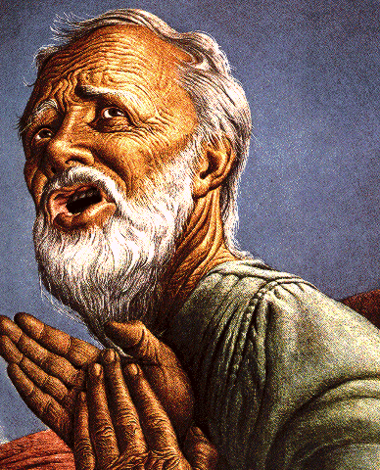
Belief – God’s One Condition for Justification
Gen 15:6
Then he believed in the LORD; and He reckoned it to him as righteousness.
John 3:16
For God so loved the world, that He gave His only begotten Son, that whoever believes in Him shall not perish, but have eternal life.
Acts 16:30-31
"Sirs, what must I do to be saved?" They said, "Believe in the Lord Jesus, and you will be saved..."

Slide 19
“Death” in the Old Testament
māwet: “Death is the consequences and the punishment of sin. It originated with sin. A grand theme of the Old Testament is God’s holiness, which separates Him from all that is in harmony with His character. Death, then, in the Old Testament means ultimate separation from God due to sin.”
Elmer B. Smick, “māwet," in Theological Wordbook of the Old Testament, ed. R. Laird Harris and Gleason L. Archer and Bruce K. Waltke(Chicago: Moody, 1980), 1:1169.

Slide 20
“Death” in the New Testament
thanatos: “that separation (whether natural or violent) of the soul from the body by which the life on earth is ended.”
Joseph Henry Thayer, Death - Thanatos, Greek-English Lexicon of the New Testament Being Grmm's Wilke's Clavis Novi Testamenti (Grand Rapids: Zondervan, 1977), 282.

Slide 21

Luke 16:24-26
“²⁴ And he cried out and said, ‘Father Abraham, have mercy on me, and send Lazarus so that he may dip the tip of his finger in water and cool off my tongue, for I am in agony in this flame.’ ²⁵ But Abraham said, ‘Child, remember that during your life you received your good things, and likewise Lazarus bad things; but now he is being comforted here, and you are in agony. ²⁶ And besides all this, between us and you there is a great chasm fixed, so that those who wish to come over from here to you will not be able, and that none may cross over from there to us.’”

Slide 22


Genesis 3:19
“By the sweat of your face You will eat bread, Till you return to the ground, Because from it you were taken; For you are dust, And to dust you shall return.”

Slide 23
IV. Answering Annihilationist Biblical Arguments
2nd death (Rev. 20:14)
Destroy (Rev. 11:18)
Destruction (2 Thess. 1:9)
Burning up (Matt. 3:12)
Eternal results (Rev. 14:11)

Slide 24

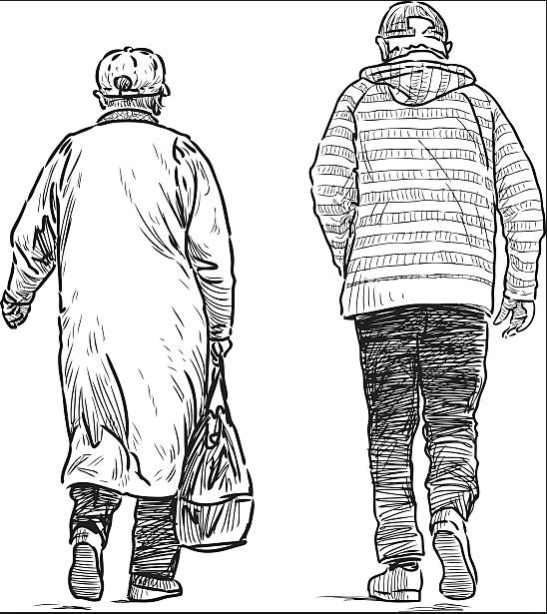
2 Corintians 4:16
“Therefore we do not lose heart, but though our outer man is decaying, yet our inner man is being renewed day by day.”

Slide 25
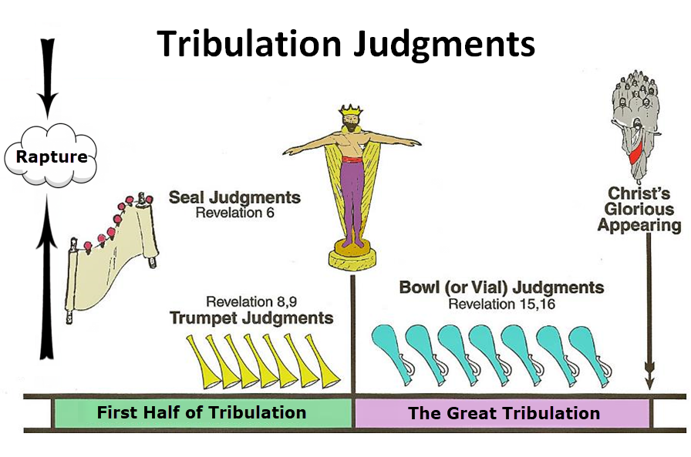

Slide 27

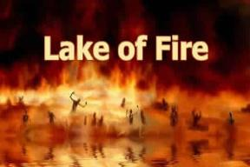
Revelation 20:10
“And the devil who deceived them was thrown into the lake of fire and brimstone, where the beast and the false prophet are also; and they will be tormented day and night forever (aiōn) and ever (aiōn).”

Slide 28
IV. Answering Annihilationist Biblical Arguments
2nd death (Rev. 20:14)
Destroy (Rev. 11:18)
Destruction (2 Thess. 1:9)
Burning up (Matt. 3:12)
Eternal results (Rev. 14:11)

Slide 30
Dr. Norman Geisler
Geisler, N. L. (2005). Systematic theology, volume four: church, last things (p. 396). Bethany House Publishers.
“…the Bible uses several main pictures to speak of hell: (1) darkness, (2) separation, (3) weeping, (4) gnashing of teeth, (5) punishment, (6) fire, (7) death, and (8) destruction. The first five in no sense coalesce with the idea of annihilation; and, when properly understood in context, neither do the last three. As applied to hell, then, destruction clearly does not mean annihilation but connotes the punishment of something still in existence. Punishment is precisely what Paul called the action taken on the excommunicated man (using the same word—cf. 2 Cor. 2:6; 1 Cor. 5:5).”

Slide 31
IV. Answering Annihilationist Biblical Arguments
2nd death (Rev. 20:14)
Destroy (Rev. 11:18)
Destruction (2 Thess. 1:9)
Burning up (Matt. 3:12)
Eternal results (Rev. 14:11)

Slide 32
Luke 16:24-26
“²⁴ And he cried out and said, ‘Father Abraham, have mercy on me, and send Lazarus so that he may dip the tip of his finger in water and cool off my tongue, for I am in agony in this flame.’ ²⁵ But Abraham said, ‘Child, remember that during your life you received your good things, and likewise Lazarus bad things; but now he is being comforted here, and you are in agony. ²⁶ And besides all this, between us and you there is a great chasm fixed, so that those who wish to come over from here to you will not be able, and that none may cross over from there to us.’”

Slide 34
Revelation 20:10
“And the devil who deceived them was thrown into the lake of fire and brimstone, where the beast and the false prophet are also; and they will be tormented day and night forever (aiōn) and ever (aiōn).”

Slide 35
Revelation 20:10
“And the devil who deceived them was thrown into the lake of fire and brimstone, where the beast and the false prophet are also; and they will be tormented day and night forever (aiōn) and ever (aiōn).”

Slide 37
IV. Answering Annihilationist Biblical Arguments
2nd death (Rev. 20:14)
Destroy (Rev. 11:18)
Destruction (2 Thess. 1:9)
Burning up (Matt. 3:12)
Eternal results (Rev. 14:11)

Slide 38

Revelation 14:11
“And the smoke of their torment goes up forever (aiōn) and ever (aiōn); they have no rest day and night, those who worship the beast and his image, and whoever receives the mark of his name.”

Slide 39
Revelation 14:11
“And the smoke of their torment goes up forever (aiōn) and ever (aiōn); they have no rest day and night, those who worship the beast and his image, and whoever receives the mark of his name.”

Slide 40
Revelation 20:10
“And the devil who deceived them was thrown into the lake of fire and brimstone, where the beast and the false prophet are also; and they will be tormented day and night forever (aiōn) and ever (aiōn).”

Slide 41
IV. Answering Annihilationist Biblical Arguments
Perdition (2 Pet. 3:7)
Better to have never been born (Mark 14:21)
Wicked perishing (2 Pet. 3:9)
Blotted out of existence (Hebrews 9:25–26)
Life activity suspended in death (Eccles. 9:10)

Slide 43
Revelation 20:10
“And the devil who deceived them was thrown into the lake of fire and brimstone, where the beast and the false prophet are also; and they will be tormented day and night forever (aiōn) and ever (aiōn).”

Slide 44
IV. Answering Annihilationist Biblical Arguments
Perdition (2 Pet. 3:7)
Better to have never been born (Mark 14:21)
Wicked perishing (2 Pet. 3:9)
Blotted out of existence (Hebrews 9:25–26)
Life activity suspended in death (Eccles. 9:10)

Slide 45
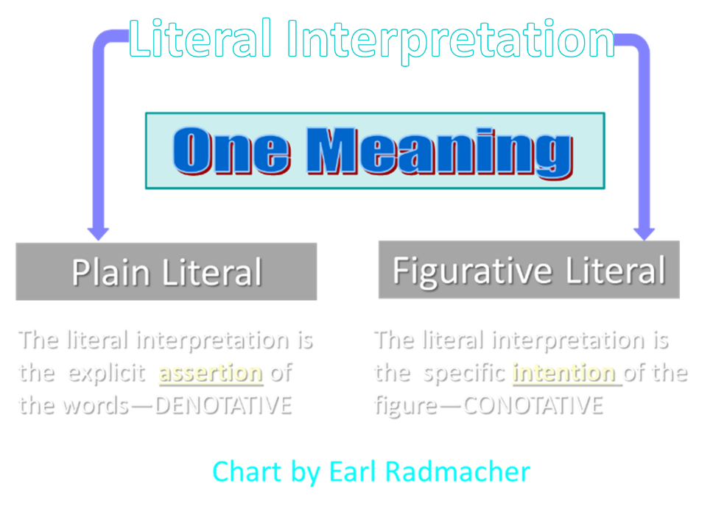

Slide 46
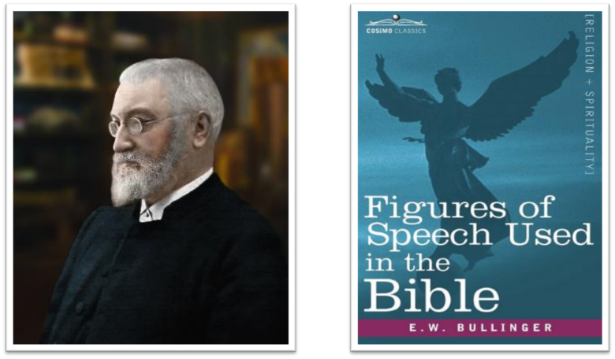
E.W. Bullinger (1837‒1913)

Slide 47
IV. Answering Annihilationist Biblical Arguments
Perdition (2 Pet. 3:7)
Better to have never been born (Mark 14:21)
Wicked perishing (2 Pet. 3:9)
Blotted out of existence (Hebrews 9:25–26)
Life activity suspended in death (Eccles. 9:10)

Slide 48
Belief – God’s One Condition for Justification
Gen 15:6
Then he believed in the LORD; and He reckoned it to him as righteousness.
John 3:16
For God so loved the world, that He gave His only begotten Son, that whoever believes in Him shall not perish, but have eternal life.
Acts 16:30-31
"Sirs, what must I do to be saved?" They said, "Believe in the Lord Jesus, and you will be saved..."

Slide 49


2 Peter 3:9
“The Lord is not slow about His promise, as some count slowness, but is patient toward you, not wishing for any to perish but for all to come to repentance.”

Slide 50


Matthew 10:5-7
“These twelve Jesus sent out after instructing them: “Do not go in the way of the Gentiles, and do not enter any city of the Samaritans; ⁶ but rather go to the lost sheep of the house of Israel. ⁷ And as you go, preach, saying, ‘The kingdom of heaven is at hand.’”

Slide 51
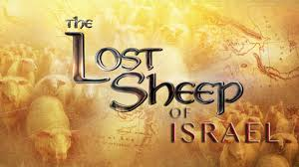
Matthew 15:24
“But He answered and said, ‘I was sent only to the lost sheep of the house of Israel.’”

Slide 52
IV. Answering Annihilationist Biblical Arguments
Perdition (2 Pet. 3:7)
Better to have never been born (Mark 14:21)
Wicked perishing (2 Pet. 3:9)
Blotted out of existence (Hebrews 9:25–26)
Life activity suspended in death (Eccles. 9:10)

Slide 53

Revelation 3:5
promise to the overcomers
“He who overcomes will thus be clothed in white garments; and I will not erase his name from the book of life, and I will confess his name before My Father and before His angels.”

Slide 54
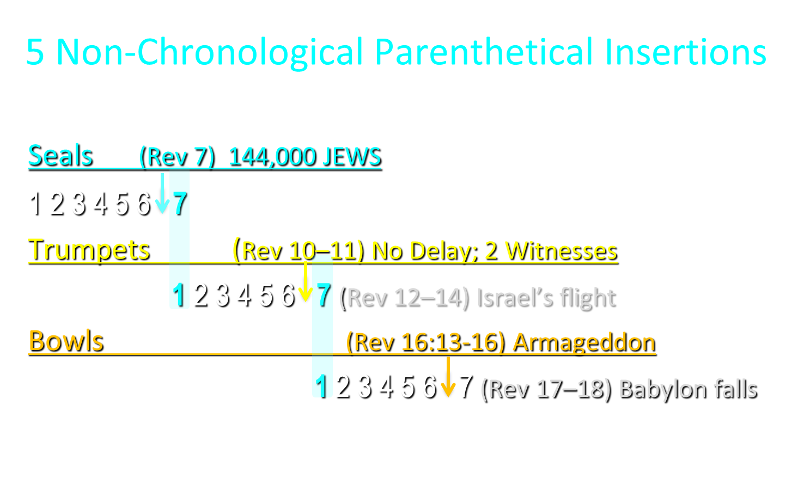

Slide 55
IV. Answering Annihilationist Biblical Arguments
Perdition (2 Pet. 3:7)
Better to have never been born (Mark 14:21)
Wicked perishing (2 Pet. 3:9)
Blotted out of existence (Hebrews 9:25–26)
Life activity suspended in death (Eccles. 9:10)

Slide 56


Ecclesiastes 9:10
“Whatever your hand finds to do, do it with all your might; for there is no activity or planning or knowledge or wisdom in Sheol where you are going.”

Slide 57
Psalm 146:4
“His spirit departs, he returns to the earth; In that very day his thoughts perish.”

Slide 58
ANNIHILATION VS. ETERNAL CONSCIOUS TORMENT
Introduction to the Controversy
Biblical Arguments Against Annihilation
Theological Arguments Against Annihilation
Answering Annihilationist Biblical Arguments
Answering Annihilationist Theological Arguments
Examining Church History
Conclusion

Slide 59
ANNIHILATION VS. ETERNAL CONSCIOUS TORMENT
Introduction to the Controversy
Biblical Arguments Against Annihilation
Theological Arguments Against Annihilation
Answering Annihilationist Biblical Arguments
Answering Annihilationist Theological Arguments
Examining Church History
Conclusion

Slide 60
ANNIHILATION VS. ETERNAL CONSCIOUS TORMENT
Introduction to the Controversy
Biblical Arguments Against Annihilation
Theological Arguments Against Annihilation
Answering Annihilationist Biblical Arguments
Answering Annihilationist Theological Arguments
Examining Church History
Conclusion

Slide 61
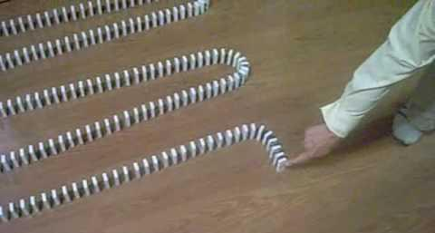
Dominoes in a Row

Slide 62
ANNIHILATION VS. ETERNAL CONSCIOUS TORMENT
Introduction to the Controversy
Biblical Arguments Against Annihilation
Theological Arguments Against Annihilation
Answering Annihilationist Biblical Arguments
Answering Annihilationist Theological Arguments
Examining Church History
Conclusion

