Slide 1
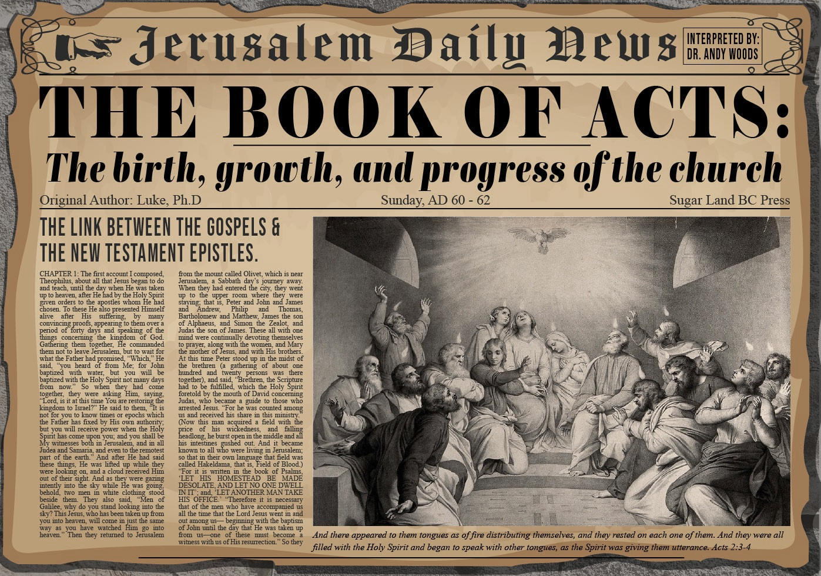


Slide 2

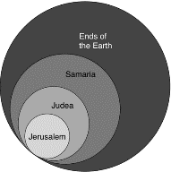
Acts 1:8
“but you will receive power when the Holy Spirit has come upon you; and you shall be My witnesses both in Jerusalem, and in all Judea and Samaria, and even to the remotest part of the earth.”

Slide 3
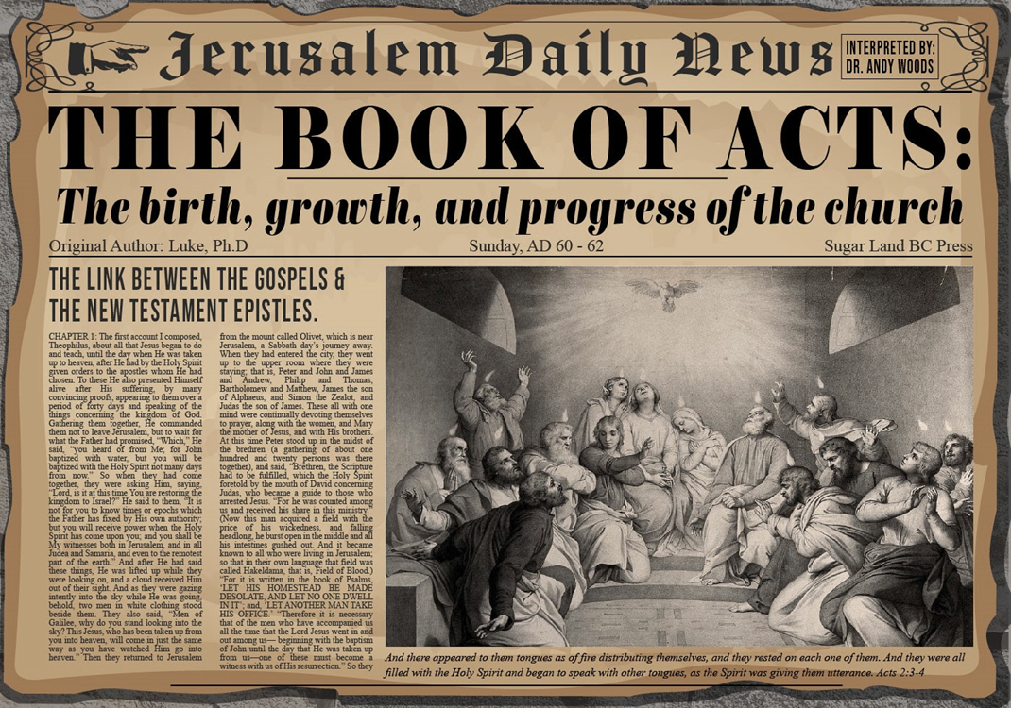
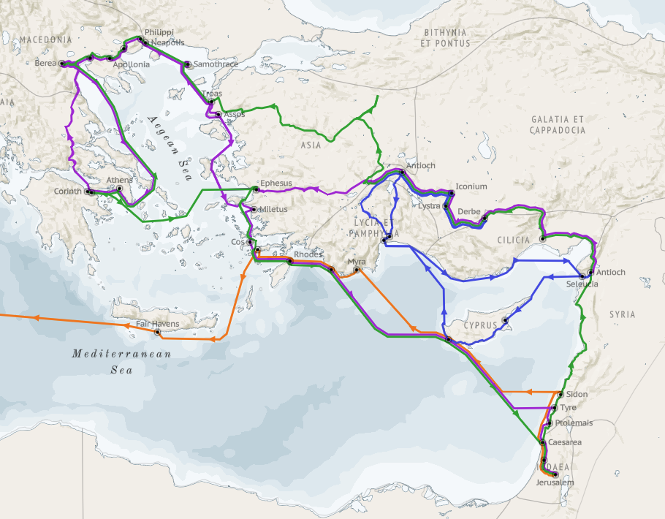
Structure (Acts 1:8)
Jerusalem (Acts 1–7)
Judea and Samaria (Acts 8–12)
Remotest part of the earth (Acts 13–28)
1st missionary journey (Acts 13–14)
Jerusalem council (Acts 15:1-35)
2nd missionary journey (Acts 15:36 –18:22)
3rd missionary journey (Acts 18:23–21:17)
Trip to Rome (Acts 21:18–28:31)

Slide 4
Acts 15:1-35 Jerusalem Council
Occasion (1-5)
Declarations (6-21)
Decision (22-29)
Delivery (30-35)

Slide 5
IV. Delivery Acts 15:30-35
Letter’s delivery to Antioch (30)
Letter’s result (31)
Judas’ & Silas’ ministry (32)
Judas’ & Silas’ departure (33)
Silas remains at Antioch (34)
Paul’s & Barnabas’ continuing ministry (35)

Slide 6
IV. Delivery Acts 15:30-35
Letter’s delivery to Antioch (30)
Letter’s result (31)
Judas’ & Silas’ ministry (32)
Judas’ & Silas’ departure (33)
Silas remains at Antioch (34)
Paul’s & Barnabas’ continuing ministry (35)

Slide 7
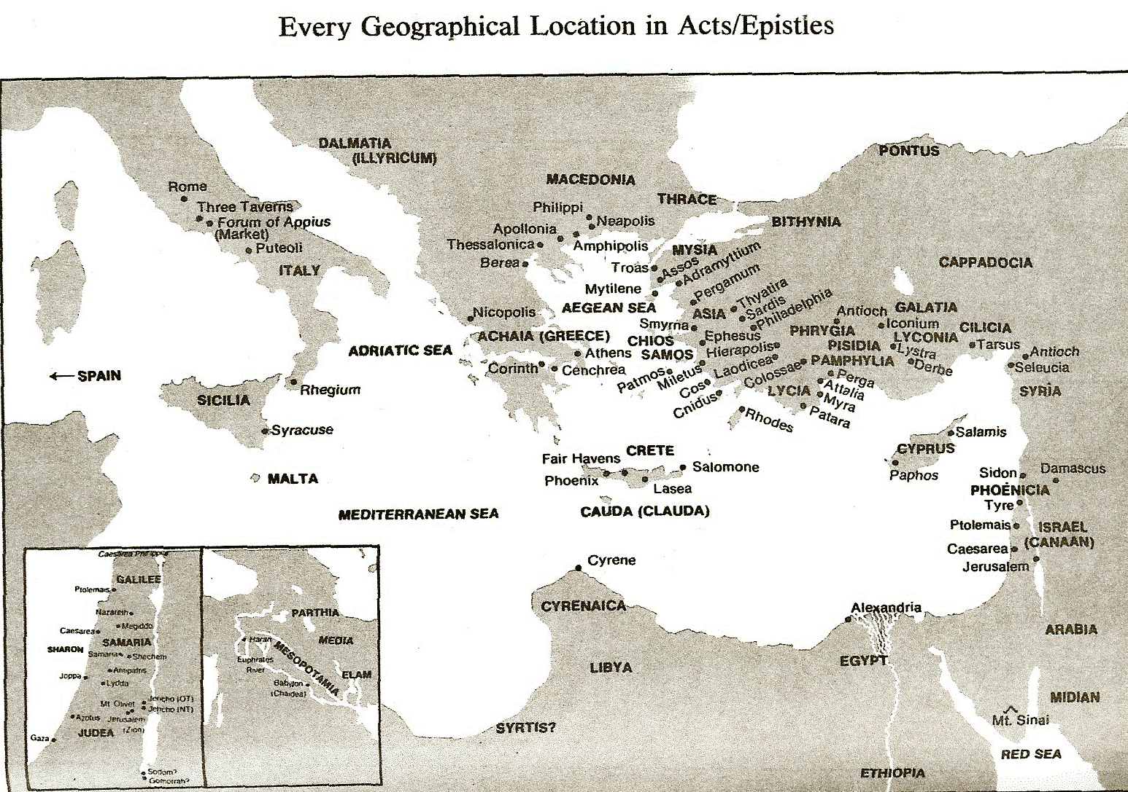

Slide 8
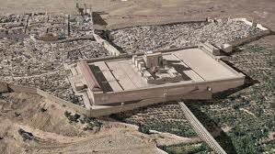
Christ’s Five Trips to Jerusalem
Feast | Verse
Passover | 2:23
Unnamed | 5:1
Tabernacles | 7:2
Dedication | 10:22
Passover | 13:1

Slide 9
IV. Delivery Acts 15:30-35
Letter’s delivery to Antioch (30)
Letter’s result (31)
Judas’ & Silas’ ministry (32)
Judas’ & Silas’ departure (33)
Silas remains at Antioch (34)
Paul’s & Barnabas’ continuing ministry (35)

Slide 10

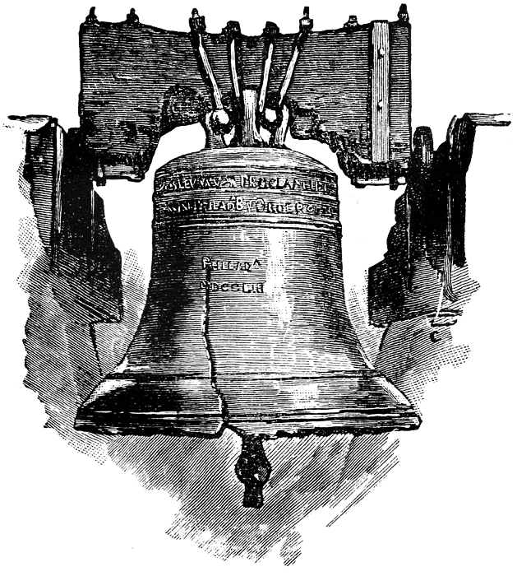
Leviticus 25:10
“And you shall consecrate the fiftieth year, and proclaim liberty throughout [all] the land to all its inhabitants. It shall be a Jubilee for you; and each of you shall return to his possession, and each of you shall return to his family.”

Slide 11
IV. Delivery Acts 15:30-35
Letter’s delivery to Antioch (30)
Letter’s result (31)
Judas’ & Silas’ ministry (32)
Judas’ & Silas’ departure (33)
Silas remains at Antioch (34)
Paul’s & Barnabas’ continuing ministry (35)

Slide 12

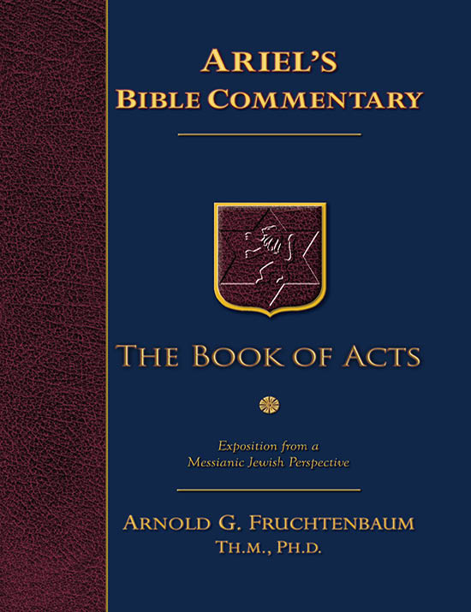
Dr. Arnold G. Fruchtenbaum
The Book of Acts, 327
﻿“The whole church made the decision to choose men out of their company, meaning members of the church of Jerusalem, to go with Paul and Barnabas to Antioch so that they could witness to the validity of their report. Two men were chosen. The first was Judas or Judah, who was also known as Barsabbas, which means ‘Son of the Sabbath.’ This is the only time he is mentioned in Scripture, and nothing else is known about him. He may have been the brother of Joseph Barsabbas of Acts 1:23.”

Slide 13
Dr. Arnold G. Fruchtenbaum
The Book of Acts, 326-27
﻿“The second man was Silas, which was his Hebrew name, about whom much more is known. His Roman name was Silvanus. He became Paul’s companion on his second missionary journey (Acts 15:40; 16:19, 25, 29; 17:4, 10, 14-15; 18:5). He is also mentioned in several of the Epistles (II Cor. 1:19; I Thess. 1:1; II Thess. 1:1; I Pet. 5:12). According to Acts 15:32, he had the gift of prophecy. Judas and Silas were chief men among the brethren. They were leaders of the church of Jerusalem. This gave them authoritative standing for what they had to say to the church of Antioch.”

Slide 14
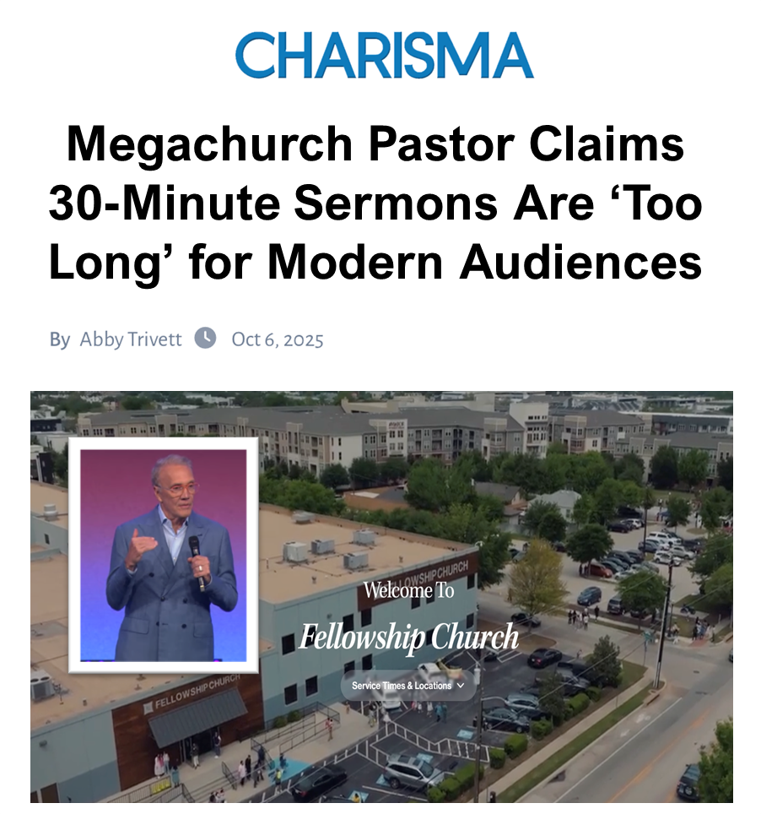

Slide 15
IV. Delivery Acts 15:30-35
Letter’s delivery to Antioch (30)
Letter’s result (31)
Judas’ & Silas’ ministry (32)
Judas’ & Silas’ departure (33)
Silas remains at Antioch (34)
Paul’s & Barnabas’ continuing ministry (35)

Slide 17
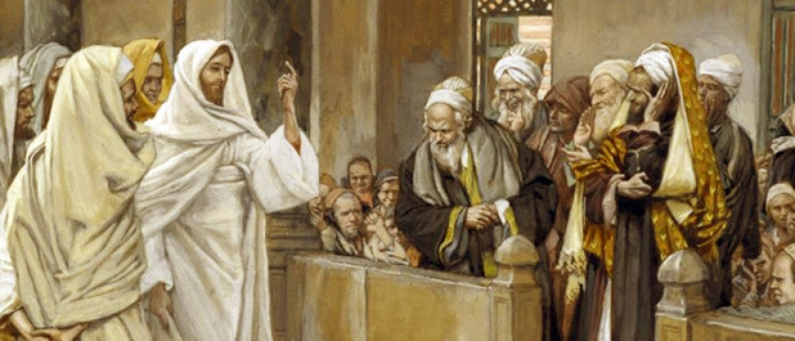
FREE FROM THE LAW
TYPE | OVERTHROWN
Justification | Matthew 5:20
Sanctification | Galatians 3:3
Ecclesiology | Acts 15

Slide 18
IV. Delivery Acts 15:30-35
Letter’s delivery to Antioch (30)
Letter’s result (31)
Judas’ & Silas’ ministry (32)
Judas’ & Silas’ departure (33)
Silas remains at Antioch (34)
Paul’s & Barnabas’ continuing ministry (35)

Slide 19
Author | Written | Earliest MSS | Time Span | No. MSS
Cesar | 100 to 44 b.c. | a.d. 900 | 1000 | 10
Plato | 427 to 347 b.c. | a.d. 900 | 1200 | 7
Thucydides | 460 to 400 b.c. | a.d. 900 | 1300 | 8
Tacitus | a.d. 100 | a.d. 1100 | 1000 | 20
Suetonius | a.d. 75 to 160 | a.d. 950 | 800 | 8
Homer (Illiad) | 900 b.c. | a.d. 400 | 500 | 643
New Testament | a.d. 40 to 100 | a.d. 125 | 25 to 50 | 24,000
Cesar | 100 to 44 b.c. | a.d. 900 | 1000 | 10
http://creationrevolution.com/2012/05/should-we-trust-the-bible/

Slide 20
Manuscript Evidence for Ancient Writings
Author | Written | Earliest Fragment/Copy | Time Span in Years | Number of Manuscripts
Cesar | 100 to 44 b.c. | a.d. 900 | 1000 | 10
Plato | 427 to 347 b.c. | a.d. 900 | 1200 | 7
Thucydides | 460 to 400 b.c. | a.d. 900 | 1300 | 8
Tacitus | a.d. 100 | a.d. 1100 | 1000 | 20
Suetonius | a.d. 75 to 160 | a.d. 950 | 800 | 8
Homer (Illiad) | 900 b.c. | a.d. 400 | 500 | 643
New Testament | a.d. 40 to 100 | a.d. 125 | 25 to 50 | 24,000
Information in this chart can be found in various sources. This chart was adapted from: Christian Apologetics, by Norman Geisler, 1976, p. 307; and Evidence That Demands a Verdict, by Josh McDowell, 1979, pp. 42, 43.

Slide 21

Acts 2:47
“praising God and having favor with all the people. And the Lord was adding to their number day by day those who were being saved.” (NASB)
“praising God and having favor with all the people. And the Lord added to the church daily those who were being saved.” (NKJV)

Slide 22
Dr. Arnold G. Fruchtenbaum
The Book of Acts, 330
﻿“Some ancient authorities insert, with variations, verse 34: But it seemed good unto Silas to abide there. Some Bibles may have the sentence in the main text, others in the margin. Either way, the verse was probably a scribal attempt to explain how Silas could leave with Paul from Antioch on the second missionary journey, in verse 40. Yet, most likely, the verse is not part of the original text, because verse 33 states that both Judas and Silas returned to Jerusalem. Apparently, Silas came back to Antioch later to accompany Paul.”

Slide 23
IV. Delivery Acts 15:30-35
Letter’s delivery to Antioch (30)
Letter’s result (31)
Judas’ & Silas’ ministry (32)
Judas’ & Silas’ departure (33)
Silas remains at Antioch (34)
Paul’s & Barnabas’ continuing ministry (35)

Slide 24


Matthew 4:4
“But He answered and said, “It is written, ‘Man shall not live on bread alone, but on every word that proceeds out of the mouth of God.’”

Slide 25


Acts 2:42
“…They were continually devoting themselves to the apostles’ teaching and to fellowship, to the breaking of bread and to prayer…”

Slide 26
Activities of the Local Church (Acts 2:41-47)
Doctrine (Acts 2:42)
Ordinances (Acts 2:41-42, 46)
Prayer (Acts 2:42)
Evangelism (Acts 2:47)
Worship (Acts 2:47)
Benevolence (Acts 2:44-45)
Fellowship (Acts 2:42, 46-47)

Slide 27


Acts 20:26-27
“²⁶ Therefore, I testify to you this day that I am innocent of the blood of all men. ²⁷ For I did not shrink from declaring to you the whole purpose of God.”

Slide 28

1 Timothy 3:15
“but in case I am delayed, I write so that you will know how one ought to conduct himself in the household of God, which is the church of the living God, the pillar and support of the truth.”

Slide 29
2 Timothy 3:16-17
“¹⁶ All Scripture is inspired by God [theopneustos] and profitable for teaching, for reproof, for correction, for training in righteousness; ¹⁷ so that the man of God may be adequate, equipped for every good work.”

Slide 30

Emphasis of 2 Timothy
“By my count, there are twenty-seven explicit commands given in the body of this letter. In 27 words Paul tells pastors what to focus on. You have to be blind to miss the thrust of Paul's instructions here, because eighteen of those commands--fully two-thirds--have to do with the ministry of the Word.”
Daniel Wallace, “Crisis of the Word: A Message to Pastors or Would-be Pastors,”
Conservative Theological Journal 1, no. 2 (August 1997): 108.

Slide 31
Ephesians 4:11-16
“¹¹ And He gave some as apostles, and some as prophets, and some as evangelists, and some as pastors and teachers, ¹² for the equipping of the saints for the work of service, to the building up of the body of Christ; ¹³ until we all attain to the unity of the faith, and of the knowledge of the Son of God, to a mature man, to the measure of the stature which belongs to the fullness of Christ. ¹⁴ As a result, we are no longer to be children, tossed here and there by. . .

Slide 32
Ephesians 4:11-16
“. . . waves and carried about by every wind of doctrine, by the trickery of men, by craftiness in deceitful scheming; ¹⁵ but speaking the truth in love, we are to grow up in all aspects into Him who is the head, even Christ, ¹⁶ from whom the whole body, being fitted and held together by what every joint supplies, according to the proper working of each individual part, causes the growth of the body for the building up of itself in love.”

Slide 33
Acts 15:1-35 Jerusalem Council
Occasion (1-5)
Declarations (6-21)
Decision (22-29)
Delivery (30-35)

Slide 34
Structure (Acts 1:8)
Jerusalem (Acts 1–7)
Judea and Samaria (Acts 8–12)
Remotest part of the earth (Acts 13–28)
1st missionary journey (Acts 13–14)
Jerusalem council (Acts 15:1-35)
2nd missionary journey (Acts 15:36 –18:22)
3rd missionary journey (Acts 18:23–21:17)
Trip to Rome (Acts 21:18–28:31)

