Slide 1
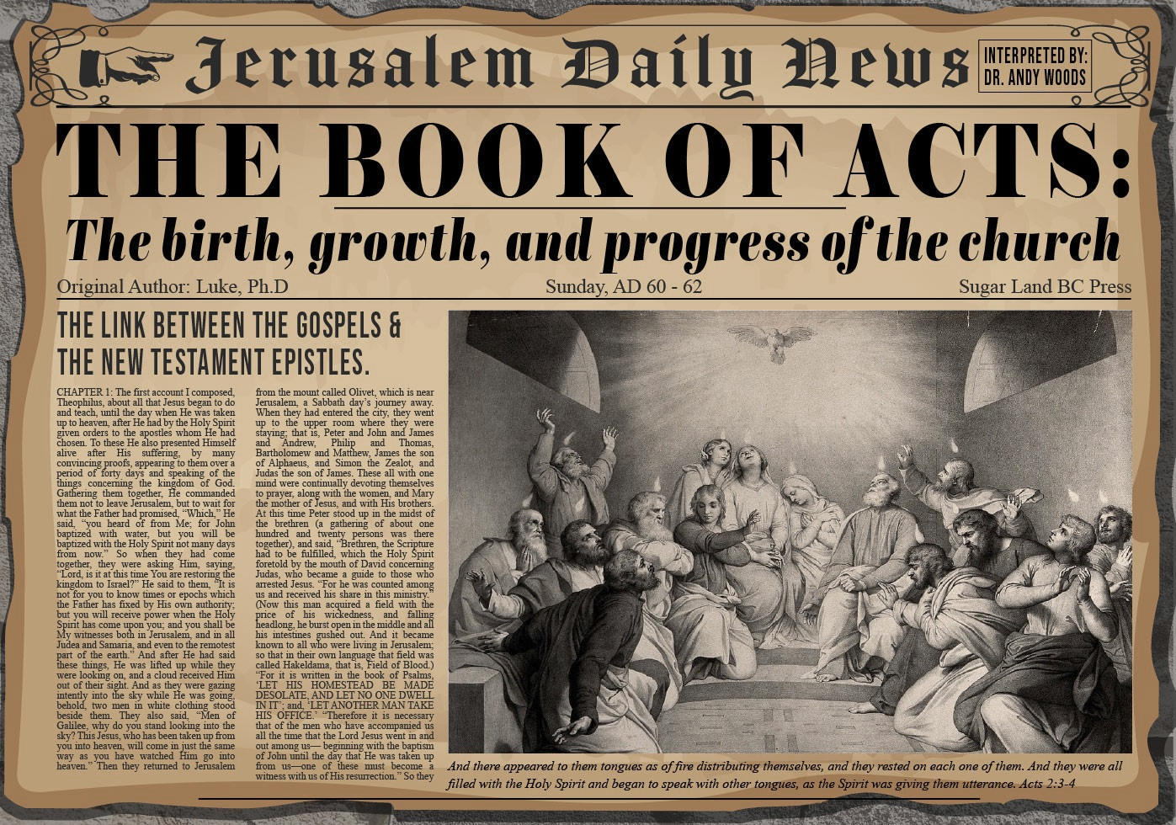


Slide 2

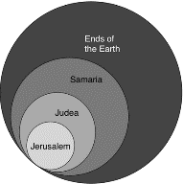
Acts 1:8
“but you will receive power when the Holy Spirit has come upon you; and you shall be My witnesses both in Jerusalem, and in all Judea and Samaria, and even to the remotest part of the earth.”

Slide 3
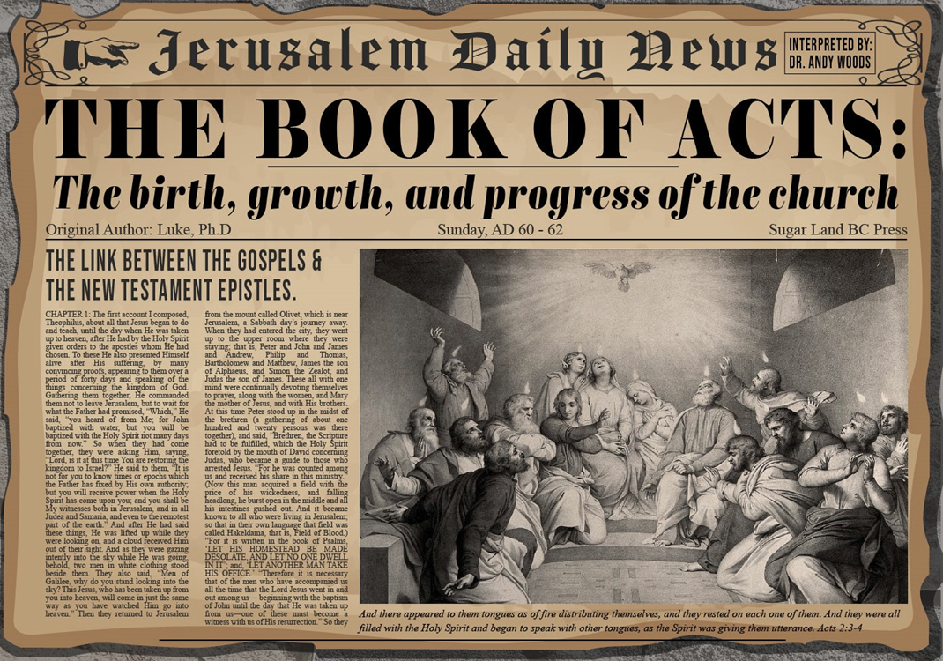
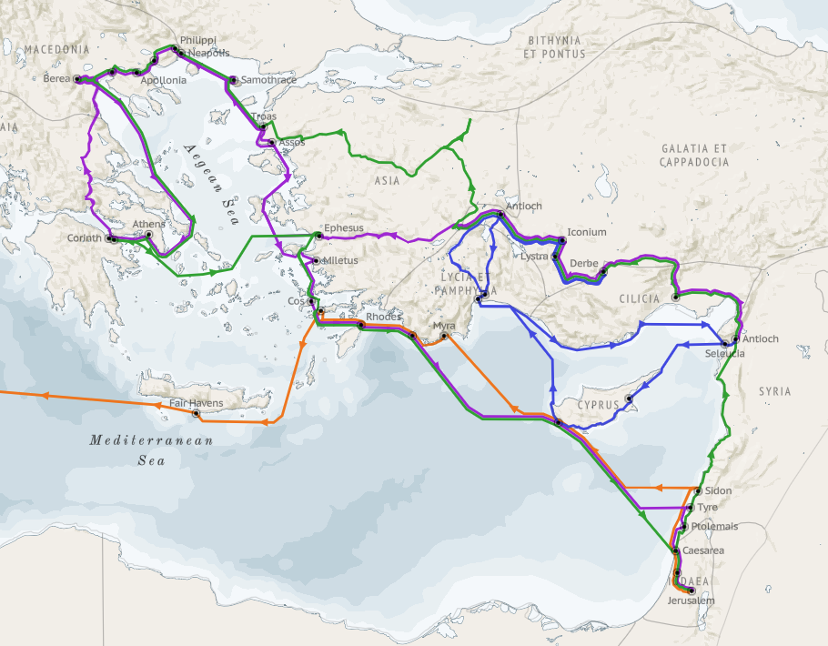
Structure (Acts 1:8)
Jerusalem (Acts 1–7)
Judea and Samaria (Acts 8–12)
Remotest part of the earth (Acts 13–28)
1st missionary journey (Acts 13–14)
Jerusalem council (Acts 15:1-35)
2nd missionary journey (Acts 15:36 –18:22)
3rd missionary journey (Acts 18:23–21:17)
Trip to Rome (Acts 21:18–28:31)

Slide 4
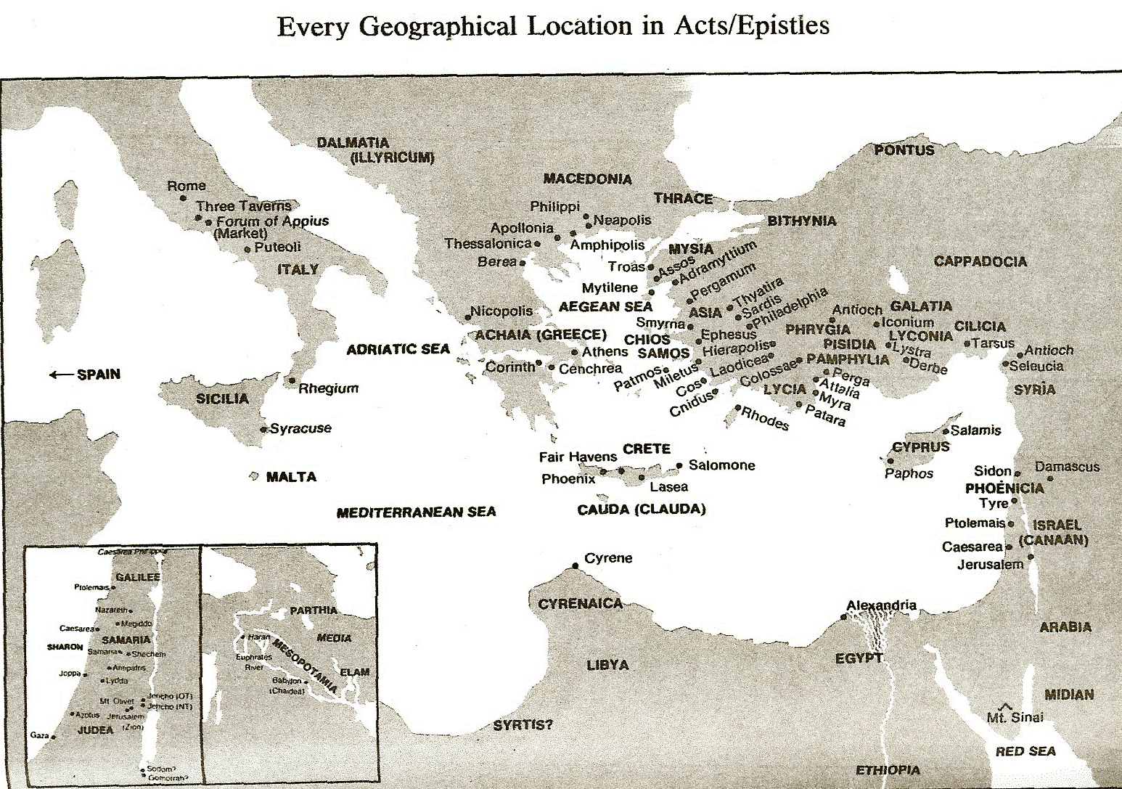

Slide 5
Acts 15:1-35 Jerusalem Council
Occasion (1-5)
Declarations (6-21)
Decision (22-29)
Delivery (30-35)

Slide 6
II. Declarations Acts 15:6-21
Meeting convened (6)
Peter’s address (7-11)
Barnabas’ & Paul’s testimony (12)
James’ address (13-21)

Slide 7
Acts 15:1-35 Jerusalem Council
Occasion (1-5)
Declarations (6-21)
Decision (22-29)
Delivery (30-35)

Slide 8
III. Decision Acts 15:22-29
Selection of emissaries (22)
Addressees (23)
Repudiation of Judaizers (24)
Approval of Paul & Barnabas (25-26)
Authorization of Judas & Silas (27)
Spirit’s role in the decision (28)
Abstentions reiterated (29a-d)
Farewell (29e)

Slide 10
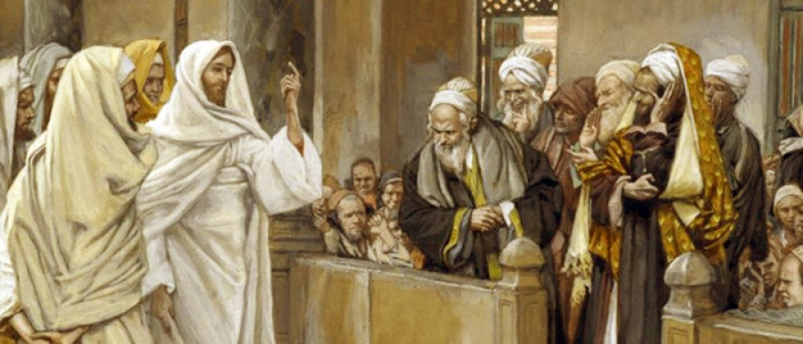
FREE FROM THE LAW
TYPE | OVERTHROWN
Justification | Matthew 5:20
Sanctification | Galatians 3:3
Ecclesiology | Acts 15

Slide 11
III. Decision Acts 15:22-29
Selection of emissaries (22)
Addressees (23)
Repudiation of Judaizers (24)
Approval of Paul & Barnabas (25-26)
Authorization of Judas & Silas (27)
Spirit’s role in the decision (28)
Abstentions reiterated (29a-d)
Farewell (29e)

Slide 12
III. Decision Acts 15:22-29
Selection of emissaries (22)
Addressees (23)
Repudiation of Judaizers (24)
Approval of Paul & Barnabas (25-26)
Authorization of Judas & Silas (27)
Spirit’s role in the decision (28)
Abstentions reiterated (29a-d)
Farewell (29e)

Slide 13
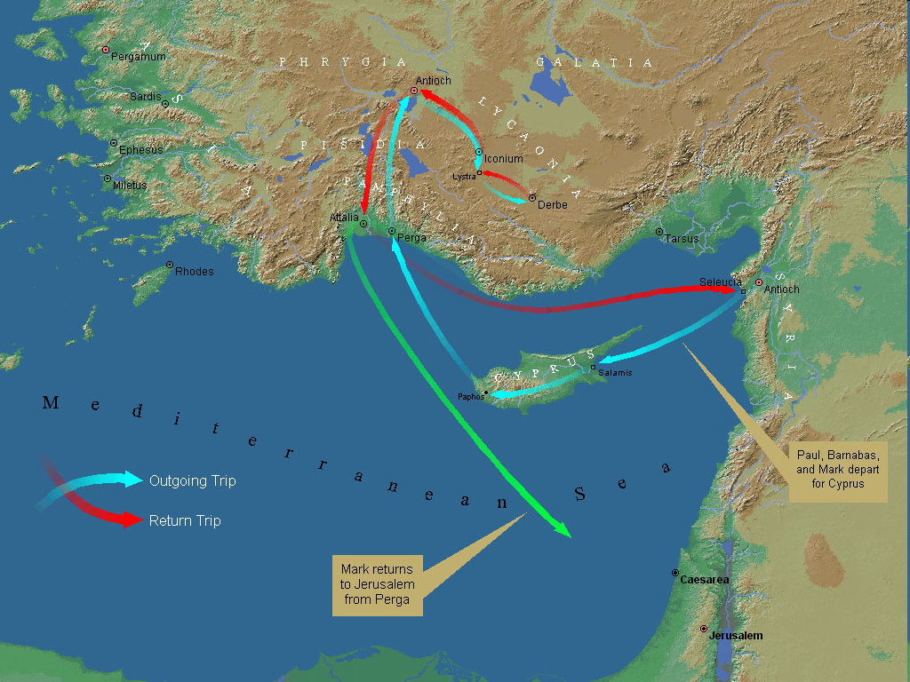
First Missionary Journey

Slide 14
III. Decision Acts 15:22-29
Selection of emissaries (22)
Addressees (23)
Repudiation of Judaizers (24)
Approval of Paul & Barnabas (25-26)
Authorization of Judas & Silas (27)
Spirit’s role in the decision (28)
Abstentions reiterated (29a-d)
Farewell (29e)

Slide 15

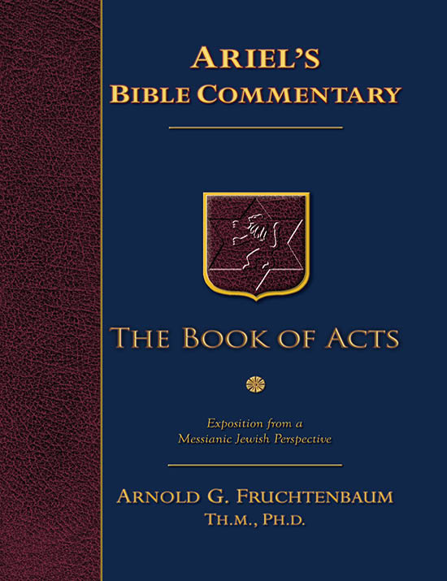
Dr. Arnold G. Fruchtenbaum
The Book of Acts, 327
﻿“The whole church made the decision to choose men out of their company, meaning members of the church of Jerusalem, to go with Paul and Barnabas to Antioch so that they could witness to the validity of their report. Two men were chosen. The first was Judas or Judah, who was also known as Barsabbas, which means ‘Son of the Sabbath.’ This is the only time he is mentioned in Scripture, and nothing else is known about him. He may have been the brother of Joseph Barsabbas of Acts 1:23.”

Slide 16
Dr. Arnold G. Fruchtenbaum
The Book of Acts, 326-27
﻿“The second man was Silas, which was his Hebrew name, about whom much more is known. His Roman name was Silvanus. He became Paul’s companion on his second missionary journey (Acts 15:40; 16:19, 25, 29; 17:4, 10, 14-15; 18:5). He is also mentioned in several of the Epistles (II Cor. 1:19; I Thess. 1:1; II Thess. 1:1; I Pet. 5:12). According to Acts 15:32, he had the gift of prophecy. Judas and Silas were chief men among the brethren. They were leaders of the church of Jerusalem. This gave them authoritative standing for what they had to say to the church of Antioch.”

Slide 17
III. Decision Acts 15:22-29
Selection of emissaries (22)
Addressees (23)
Repudiation of Judaizers (24)
Approval of Paul & Barnabas (25-26)
Authorization of Judas & Silas (27)
Spirit’s role in the decision (28)
Abstentions reiterated (29a-d)
Farewell (29e)

Slide 18
III. Decision Acts 15:22-29
Selection of emissaries (22)
Addressees (23)
Repudiation of Judaizers (24)
Approval of Paul & Barnabas (25-26)
Authorization of Judas & Silas (27)
Spirit’s role in the decision (28)
Abstentions reiterated (29a-d)
Farewell (29e)

Slide 19
Acts 15:29a-d Abstentions Reiterated
Food sacrificed to idols (29a)
Blood (29b)
Things strangled (29c)
Fornication (29d)

Slide 20
Acts 15:29a-d Abstentions Reiterated
Food sacrificed to idols (29a)
Blood (29b)
Things strangled (29c)
Fornication (29d)

Slide 21
FREE FROM THE LAW
TYPE | OVERTHROWN
Justification | Matthew 5:20
Sanctification | Galatians 3:3
Ecclesiology | Acts 15

Slide 22
Acts 15:29a-d Abstentions Reiterated
Food sacrificed to idols (29a)
Blood (29b)
Things strangled (29c)
Fornication (29d)

Slide 23
Acts 15:29a-d Abstentions Reiterated
Food sacrificed to idols (29a)
Blood (29b)
Things strangled (29c)
Fornication (29d)

Slide 24
Acts 15:29a-d Abstentions Reiterated
Food sacrificed to idols (29a)
Blood (29b)
Things strangled (29c)
Fornication (29d)

Slide 25
III. Decision Acts 15:22-29
Selection of emissaries (22)
Addressees (23)
Repudiation of Judaizers (24)
Approval of Paul & Barnabas (25-26)
Authorization of Judas & Silas (27)
Spirit’s role in the decision (28)
Abstentions reiterated (29a-d)
Farewell (29e)

Slide 26
Acts 15:1-35 Jerusalem Council
Occasion (1-5)
Declarations (6-21)
Decision (22-29)
Delivery (30-35)

