Slide 1
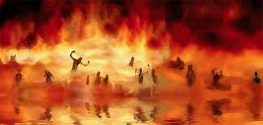

Annihilation
vs.
Eternal Torment

Slide 2
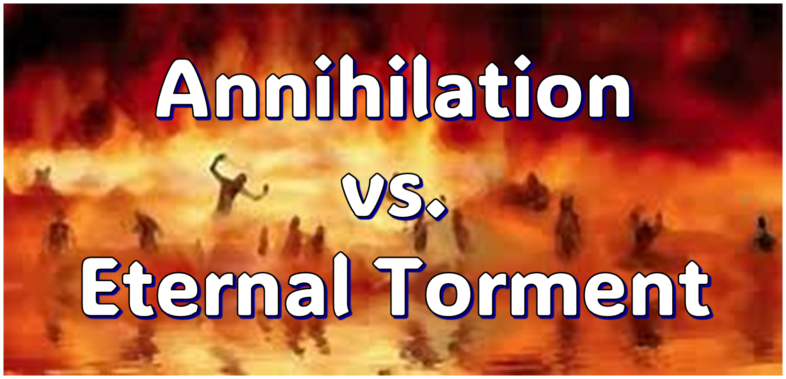
ANNIHILATION VS. ETERNAL CONSCIOUS TORMENT
Introduction to the Controversy
Biblical Arguments Against Annihilation
Theological Arguments Against Annihilation
Answering Annihilationist Biblical Arguments
Answering Annihilationist Theological Arguments
Examining Church History
Conclusion

Slide 3

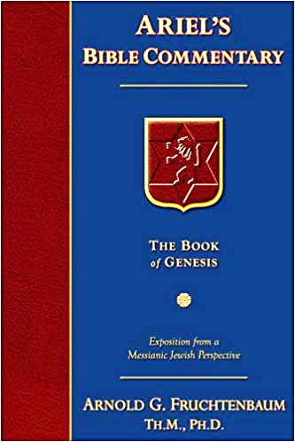
Dr. Arnold G. Fruchtenbaum
Footsteps of the Messiah, 707-8
“Conditional immortality means the soul is not inherently immortal; immortality is not part of the make-up of the soul. Rather, immortality is a gift for the saved only. So at death, the unbeliever simply becomes non-existent, and only the believer continues to exist…What annihilationism says is this: the unsaved soul is annihilated after a temporary period of punishment. These people do believe that the unsaved soul goes to Hell, but not for eternity, only temporarily. Eventually the unsaved soul is annihilated after suffering a duration of punishment.”

Slide 4
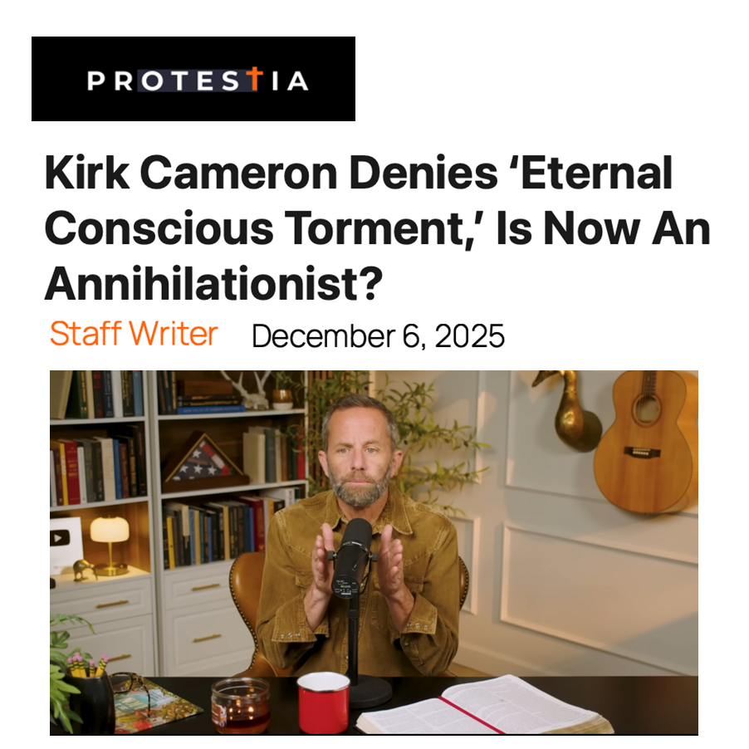

Slide 5
ANNIHILATION VS. ETERNAL CONSCIOUS TORMENT
Introduction to the Controversy
Biblical Arguments Against Annihilation
Theological Arguments Against Annihilation
Answering Annihilationist Biblical Arguments
Answering Annihilationist Theological Arguments
Examining Church History
Conclusion

Slide 6
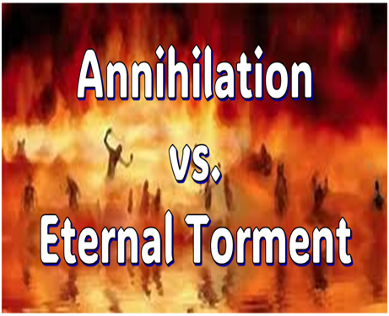
II. Anti-Annihilationist Texts
Dan. 12:2 Matt. 25:46 Mark 9:47-48 Matt. 8:12 Luke 16:19-31 |  | 2 Thess. 1:9 Heb. 6:2 Rev. 14:11 Rev. 20:10 Rev. 19:20

Slide 7
ANNIHILATION VS. ETERNAL CONSCIOUS TORMENT
Introduction to the Controversy
Biblical Arguments Against Annihilation
Theological Arguments Against Annihilation
Answering Annihilationist Biblical Arguments
Answering Annihilationist Theological Arguments
Examining Church History
Conclusion

Slide 8
III. Theological Arguments Against Annihilation
Underestimates sin’s severity
Contradicts humanity’s nature
Denies degrees of punishment
Seeks to escape sin’s consequences

Slide 9
III. Theological Arguments Against Annihilation
Underestimates sin’s severity
Contradicts humanity’s nature
Denies degrees of punishment
Seeks to escape sin’s consequences

Slide 10
III. Theological Arguments Against Annihilation
Underestimates sin’s severity
Contradicts humanity’s nature
Denies degrees of punishment
Seeks to escape sin’s consequences

Slide 11

Genesis 1:26-28
²⁶ Then God said, “Let Us make man in Our image, according to Our likeness; and let them rule over the fish of the sea and over the birds of the sky and over the cattle and over all the earth, and over every creeping thing that creeps on the earth.” ²⁷ God created man in His own image, in the image of God He created him; male and female He created them. ²⁸ God blessed them; and God said to them, “Be fruitful and multiply, and fill the earth, and subdue it; and rule over the fish of the sea and over the birds of the sky and over every living thing that moves on the earth.”

Slide 12

Genesis 9:6
“Whoever sheds man’s blood, By man his blood shall be shed, For in the image of God He made man.”

Slide 13

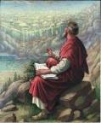
Ecclesiastes 3:11
“He has made everything appropriate in its time. He has also set eternity (olam) in their heart, yet so that man will not find out the work which God has done from the beginning even to the end.”

Slide 14

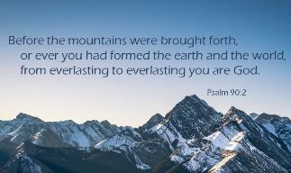
Psalm 90:2
“Before the mountains were born Or You gave birth to the earth and the world, Even from everlasting (olam) to everlasting (olam), You are God.”

Slide 15

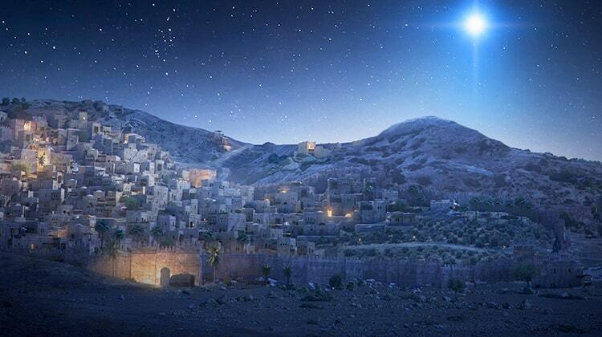
Micah 5:2
“But as for you, Bethlehem Ephrathah, Too little to be among the clans of Judah, From you One will go forth for Me to be ruler in Israel. His goings forth are from long ago, From the days of eternity (olam).”

Slide 16
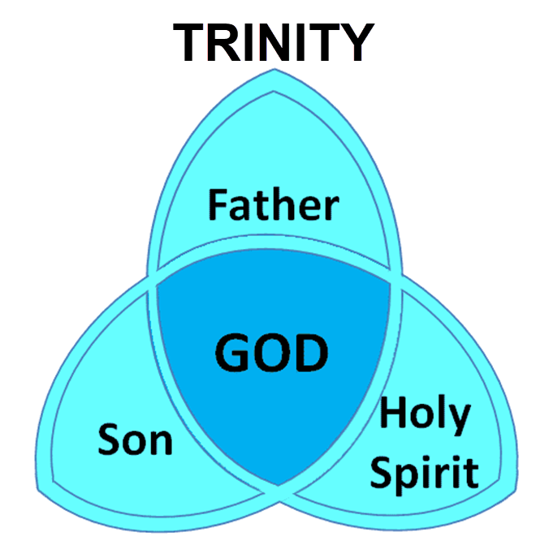

Slide 17
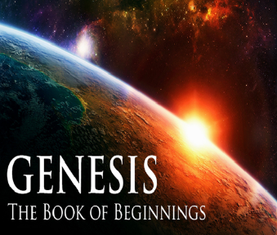
Names for God in Genesis
Elohim (1:1) – Power
Yahweh (2:4) – Relational
El Roi (Gen. 16:13) – Aware
El Olam (21:33) – Eternal
Jehovah Jireh (22:14) – Provision
God Isaac Feared (31:42, 53) – Reverenced
God, the God of Israel (33:20) – National

Slide 18
III. Theological Arguments Against Annihilation
Underestimates sin’s severity
Contradicts humanity’s nature
Denies degrees of punishment
Seeks to escape sin’s consequences

Slide 19
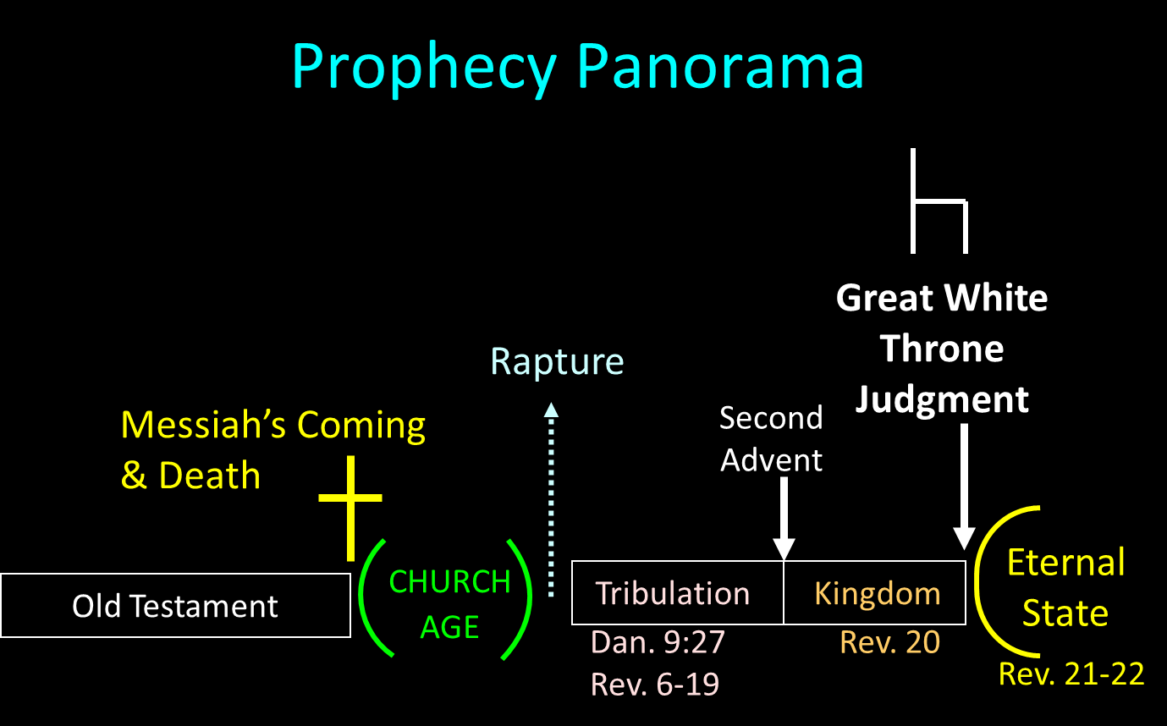

Slide 20
III. Theological Arguments Against Annihilation
Underestimates sin’s severity
Contradicts humanity’s nature
Denies degrees of punishment
Seeks to escape sin’s consequences

Slide 21

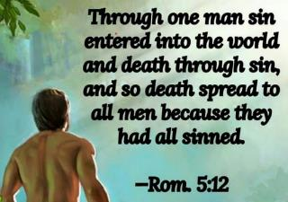
Genesis 2:16-17
“¹⁶ The Lord God commanded the man, saying, ‘From any tree of the garden you may eat freely; ¹⁷ but from the tree of the knowledge of good and evil you shall not eat, for in the day that you eat from it you will surely die (muwth).’”

Slide 22
Genesis 3:4-5
“⁴ The serpent said to the woman, ‘You surely will not die! ⁵ For God knows that in the day you eat from it your eyes will be opened, and you will be like God, knowing good and evil.’”

Slide 23
III. Theological Arguments Against Annihilation
Underestimates sin’s severity
Contradicts humanity’s nature
Denies degrees of punishment
Seeks to escape sin’s consequences

Slide 24
ANNIHILATION VS. ETERNAL CONSCIOUS TORMENT
Introduction to the Controversy
Biblical Arguments Against Annihilation
Theological Arguments Against Annihilation
Answering Annihilationist Biblical Arguments
Answering Annihilationist Theological Arguments
Examining Church History
Conclusion

Slide 25
ANNIHILATION VS. ETERNAL CONSCIOUS TORMENT
Introduction to the Controversy
Biblical Arguments Against Annihilation
Theological Arguments Against Annihilation
Answering Annihilationist Biblical Arguments
Answering Annihilationist Theological Arguments
Examining Church History
Conclusion

Slide 26
ANNIHILATION VS. ETERNAL CONSCIOUS TORMENT
Introduction to the Controversy
Biblical Arguments Against Annihilation
Theological Arguments Against Annihilation
Answering Annihilationist Biblical Arguments
Answering Annihilationist Theological Arguments
Examining Church History
Conclusion

Slide 27
ANNIHILATION VS. ETERNAL CONSCIOUS TORMENT
Introduction to the Controversy
Biblical Arguments Against Annihilation
Theological Arguments Against Annihilation
Answering Annihilationist Biblical Arguments
Answering Annihilationist Theological Arguments
Examining Church History
Conclusion

Slide 28

Dominoes in a Row

Slide 29
ANNIHILATION VS. ETERNAL CONSCIOUS TORMENT
Introduction to the Controversy
Biblical Arguments Against Annihilation
Theological Arguments Against Annihilation
Answering Annihilationist Biblical Arguments
Answering Annihilationist Theological Arguments
Examining Church History
Conclusion

