Slide 1
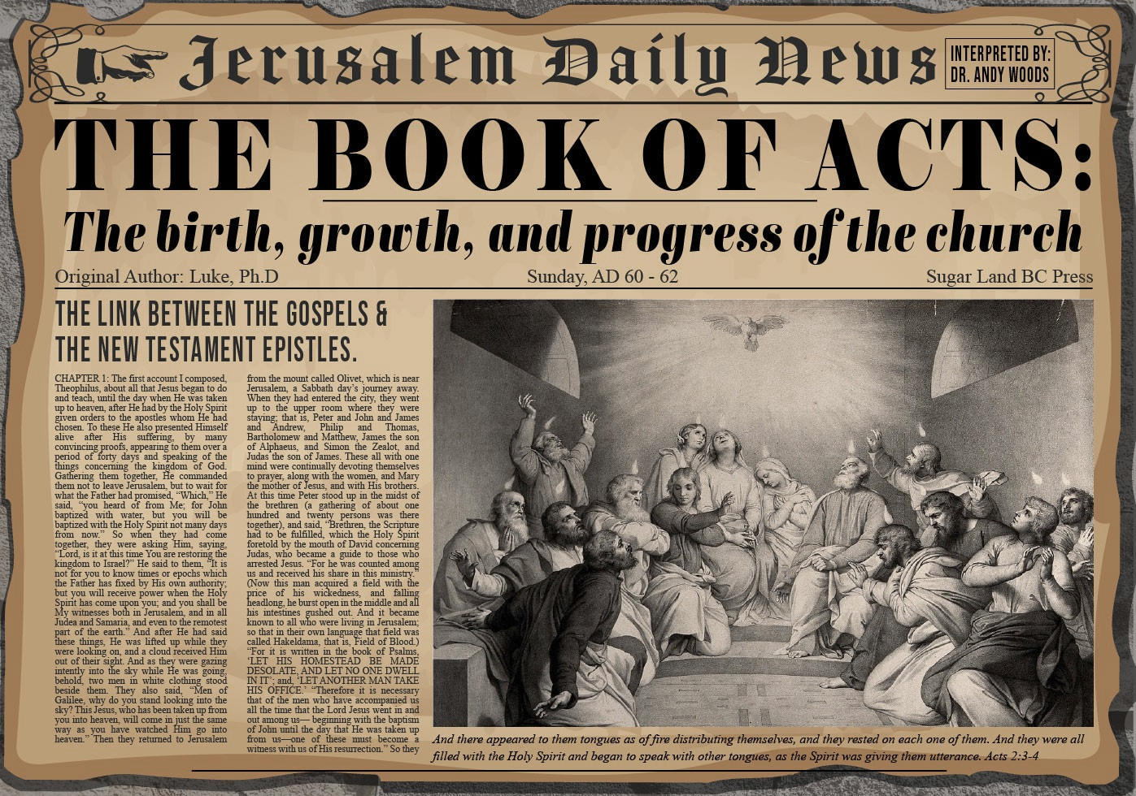


Slide 2

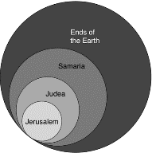
Acts 1:8
“but you will receive power when the Holy Spirit has come upon you; and you shall be My witnesses both in Jerusalem, and in all Judea and Samaria, and even to the remotest part of the earth.”

Slide 3
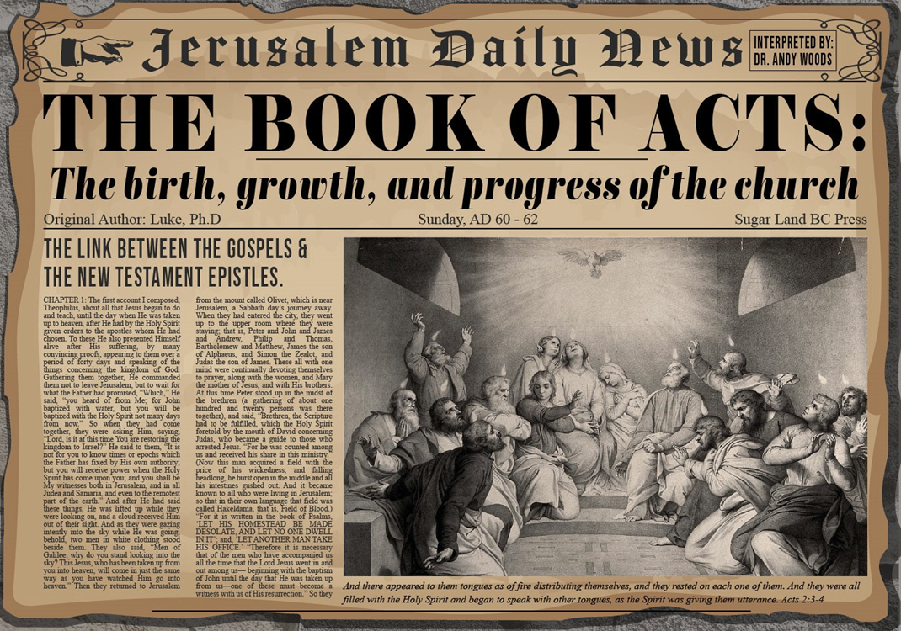
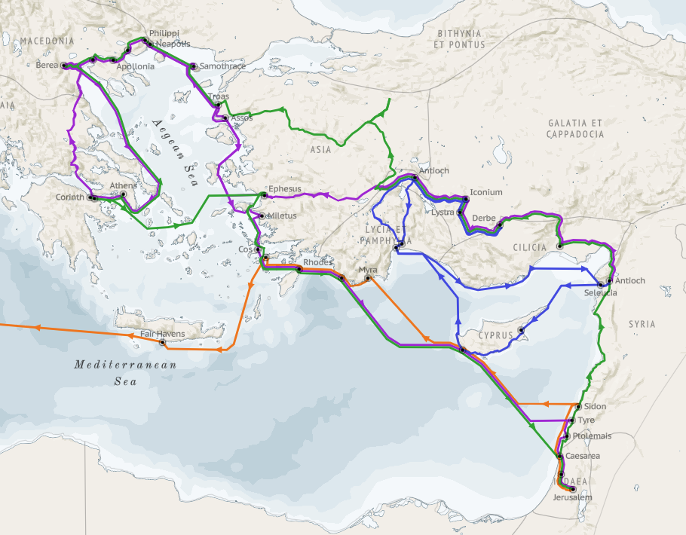
Structure (Acts 1:8)
Jerusalem (Acts 1–7)
Judea and Samaria (Acts 8–12)
Remotest part of the earth (Acts 13–28)
1st missionary journey (Acts 13–14)
Jerusalem council (Acts 15:1-35)
2nd missionary journey (Acts 15:36 –18:22)
3rd missionary journey (Acts 18:23–21:17)
Trip to Rome (Acts 21:18–28:31)

Slide 4
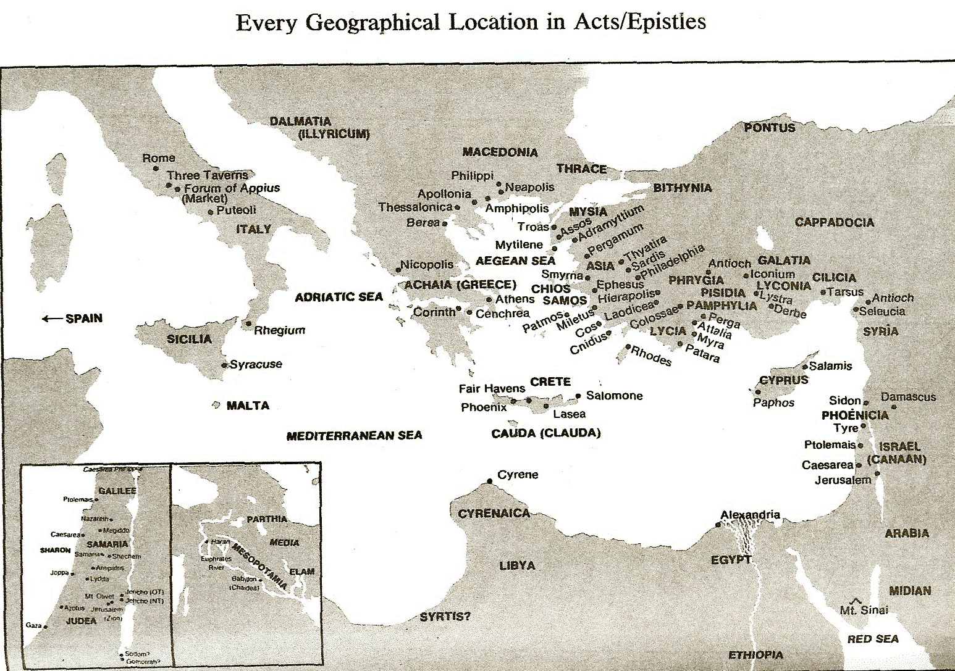

Slide 5
Acts 15:1-35 Jerusalem Council
Occasion (1-5)
Declarations (6-21)
Decision (22-29)
Delivery (30-35)

Slide 6
II. Declarations Acts 15:6-21
Meeting convened (6)
Peter’s address (7-11)
Barnabas’ & Paul’s testimony (12)
James’ address (13-21)

Slide 7
Acts 15:13-21 James’ Address
Introduction (13a)
Addressees (13b)
Peter’s address (14)
Old Testament citation (15-18)
Conclusions (19-21)

Slide 8
Acts 15:19-21 Conclusions
Concerning the Gentiles (19-20)
Concerning Moses (21)

Slide 9
Acts 15:19-21 Conclusions
Concerning the Gentiles (19-20)
Concerning Moses (21)

Slide 10
Acts 15:19-21 Concerning the Gentiles
Adherence to OT Law not required (19)
Abstentions to avoid offence (20)

Slide 11
Acts 15:19-21 Concerning the Gentiles
Adherence to OT Law not required (19)
Abstentions to avoid offence (20)

Slide 12

Acts 15:14-21
…“¹⁹ Therefore it is my judgment that we do not trouble those who are turning to God from among the Gentiles, ²⁰ but that we write to them that they abstain from things contaminated by idols and from fornication and from what is strangled and from blood. ²¹ For Moses from ancient generations has in every city those who preach him, since he is read in the synagogues every Sabbath.”

Slide 13
Acts 15:19-21 Concerning the Gentiles
Adherence to OT Law not required (19)
Abstentions to avoid offence (20)

Slide 14
Acts 15:20 Abstentions Reiterated
Food sacrificed to idols (20a)
Fornication (20b)
Things strangled (20c)
Blood (20d)

Slide 15
Acts 15:20 Abstentions Reiterated
Food sacrificed to idols (20a)
Fornication (20b)
Things strangled (20c)
Blood (20d)

Slide 16
Acts 15:14-21
…“¹⁹ Therefore it is my judgment that we do not trouble those who are turning to God from among the Gentiles, ²⁰ but that we write to them that they abstain from things contaminated by idols and from fornication and from what is strangled and from blood. ²¹ For Moses from ancient generations has in every city those who preach him, since he is read in the synagogues every Sabbath.”

Slide 17
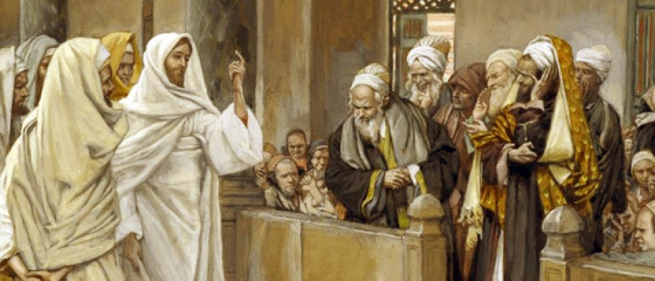
TYPES OF PHARISEES
TYPE | OVERTHROWN
Justification | Matthew 5:20
Sanctification | Galatians 3:3
Ecclesiology | Acts 15

Slide 18
Acts 15:20 Abstentions Reiterated
Food sacrificed to idols (20a)
Fornication (20b)
Things strangled (20c)
Blood (20d)

Slide 19
Acts 15:20 Abstentions Reiterated
Food sacrificed to idols (20a)
Fornication (20b)
Things strangled (20c)
Blood (20d)

Slide 20
Acts 15:20 Abstentions Reiterated
Food sacrificed to idols (20a)
Fornication (20b)
Things strangled (20c)
Blood (20d)

Slide 21
Acts 15:19-21 Conclusions
Concerning the Gentiles (19-20)
Concerning Moses (21)

Slide 22
Acts 15:14-21
…“¹⁹ Therefore it is my judgment that we do not trouble those who are turning to God from among the Gentiles, ²⁰ but that we write to them that they abstain from things contaminated by idols and from fornication and from what is strangled and from blood. ²¹ For Moses from ancient generations has in every city those who preach him, since he is read in the synagogues every Sabbath.”

Slide 23
Acts 15:1-35 Jerusalem Council
Occasion (1-5)
Declarations (6-21)
Decision (22-29)
Delivery (30-35)

Slide 24
III. Decision Acts 15:22-24
Selection of emissaries (22)
Addressees (23)
Repudiation of Judaizers (24)
Approval of Paul & Barnabas (25-26)
Authorization of Judas & Silas (27)
Spirit’s role in the decision (28)
Abstentions reiterated (29a-d)
Farewell (29e)

Slide 25
III. Decision Acts 15:22-24
Selection of emissaries (22)
Addressees (23)
Repudiation of Judaizers (24)
Approval of Paul & Barnabas (25-26)
Authorization of Judas & Silas (27)
Spirit’s role in the decision (28)
Abstentions reiterated (29a-d)
Farewell (29e)

Slide 26

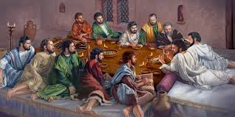
Ephesians 2:20
“having been built on the foundation of the apostles and prophets, Christ Jesus Himself being the corner stone.”

Slide 27


Dr. Arnold G. Fruchtenbaum
The Book of Acts, 327
﻿“The whole church made the decision to choose men out of their company, meaning members of the church of Jerusalem, to go with Paul and Barnabas to Antioch so that they could witness to the validity of their report. Two men were chosen. The first was Judas or Judah, who was also known as Barsabbas, which means ‘Son of the Sabbath.’ This is the only time he is mentioned in Scripture, and nothing else is known about him. He may have been the brother of Joseph Barsabbas of Acts 1:23.”

Slide 28
Dr. Arnold G. Fruchtenbaum
The Book of Acts, 326-27
﻿“The second man was Silas, which was his Hebrew name, about whom much more is known. His Roman name was Silvanus. He became Paul’s companion on his second missionary journey (Acts 15:40; 16:19, 25, 29; 17:4, 10, 14-15; 18:5). He is also mentioned in several of the Epistles (II Cor. 1:19; I Thess. 1:1; II Thess. 1:1; I Pet. 5:12). According to Acts 15:32, he had the gift of prophecy. Judas and Silas were chief men among the brethren. They were leaders of the church of Jerusalem. This gave them authoritative standing for what they had to say to the church of Antioch.”

Slide 29
III. Decision Acts 15:22-24
Selection of emissaries (22)
Addressees (23)
Repudiation of Judaizers (24)
Approval of Paul & Barnabas (25-26)
Authorization of Judas & Silas (27)
Spirit’s role in the decision (28)
Abstentions reiterated (29a-d)
Farewell (29e)

Slide 31
TYPES OF PHARISEES
TYPE | OVERTHROWN
Justification | Matthew 5:20
Sanctification | Galatians 3:3
Ecclesiology | Acts 15

Slide 32
III. Decision Acts 15:22-24
Selection of emissaries (22)
Addressees (23)
Repudiation of Judaizers (24)
Approval of Paul & Barnabas (25-26)
Authorization of Judas & Silas (27)
Spirit’s role in the decision (28)
Abstentions reiterated (29a-d)
Farewell (29e)

Slide 33
III. Decision Acts 15:22-24
Selection of emissaries (22)
Addressees (23)
Repudiation of Judaizers (24)
Approval of Paul & Barnabas (25-26)
Authorization of Judas & Silas (27)
Spirit’s role in the decision (28)
Abstentions reiterated (29a-d)
Farewell (29e)

Slide 34
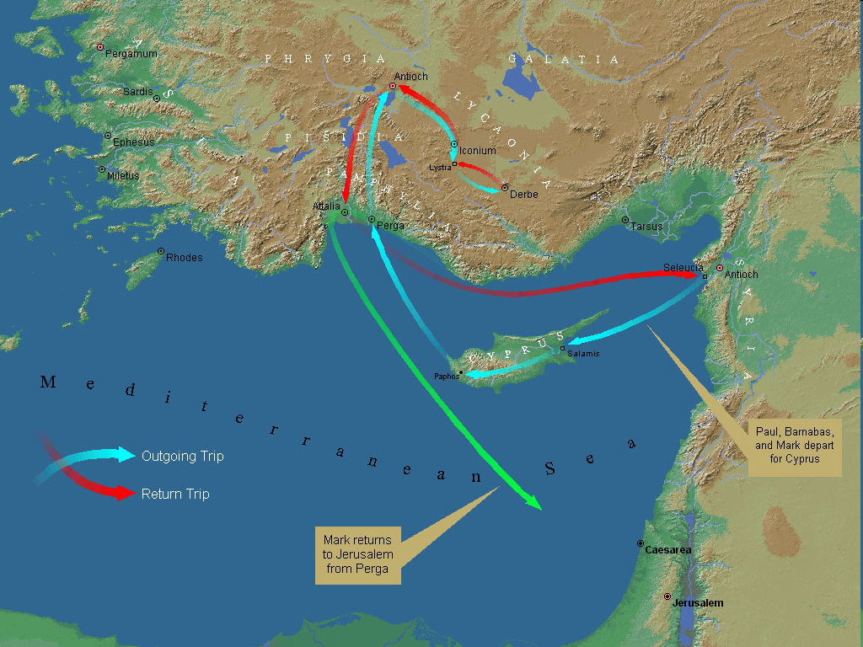
First Missionary Journey

Slide 35
III. Decision Acts 15:22-24
Selection of emissaries (22)
Addressees (23)
Repudiation of Judaizers (24)
Approval of Paul & Barnabas (25-26)
Authorization of Judas & Silas (27)
Spirit’s role in the decision (28)
Abstentions reiterated (29a-d)
Farewell (29e)

Slide 36
III. Decision Acts 15:22-24
Selection of emissaries (22)
Addressees (23)
Repudiation of Judaizers (24)
Approval of Paul & Barnabas (25-26)
Authorization of Judas & Silas (27)
Spirit’s role in the decision (28)
Abstentions reiterated (29a-d)
Farewell (29e)

Slide 37
III. Decision Acts 15:22-24
Selection of emissaries (22)
Addressees (23)
Repudiation of Judaizers (24)
Approval of Paul & Barnabas (25-26)
Authorization of Judas & Silas (27)
Spirit’s role in the decision (28)
Abstentions reiterated (29a-d)
Farewell (29e)

Slide 38
Acts 15:29a-d Abstentions Reiterated
Food sacrificed to idols (29a)
Blood (29b)
Things strangled (29c)
Fornication (29d)

Slide 39
Acts 15:29a-d Abstentions Reiterated
Food sacrificed to idols (29a)
Blood (29b)
Things strangled (29c)
Fornication (29d)

Slide 40
TYPES OF PHARISEES
TYPE | OVERTHROWN
Justification | Matthew 5:20
Sanctification | Galatians 3:3
Ecclesiology | Acts 15

Slide 41
Acts 15:29a-d Abstentions Reiterated
Food sacrificed to idols (29a)
Blood (29b)
Things strangled (29c)
Fornication (29d)

Slide 42
Acts 15:29a-d Abstentions Reiterated
Food sacrificed to idols (29a)
Blood (29b)
Things strangled (29c)
Fornication (29d)

Slide 43
Acts 15:29a-d Abstentions Reiterated
Food sacrificed to idols (29a)
Blood (29b)
Things strangled (29c)
Fornication (29d)

Slide 44
III. Decision Acts 15:22-24
Selection of emissaries (22)
Addressees (23)
Repudiation of Judaizers (24)
Approval of Paul & Barnabas (25-26)
Authorization of Judas & Silas (27)
Spirit’s role in the decision (28)
Abstentions reiterated (29a-d)
Farewell (29e)

Slide 45
III. Decision Acts 15:22-24
Selection of emissaries (22)
Addressees (23)
Repudiation of Judaizers (24)
Approval of Paul & Barnabas (25-26)
Authorization of Judas & Silas (27)
Spirit’s role in the decision (28)
Abstentions reiterated (29a-d)
Farewell (29e)

Slide 46
Acts 15:1-35 Jerusalem Council
Occasion (1-5)
Declarations (6-21)
Decision (22-29)
Delivery (30-35)

