Slide 1
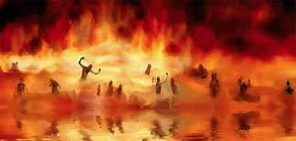

Annihilation
vs.
Eternal Torment

Slide 2
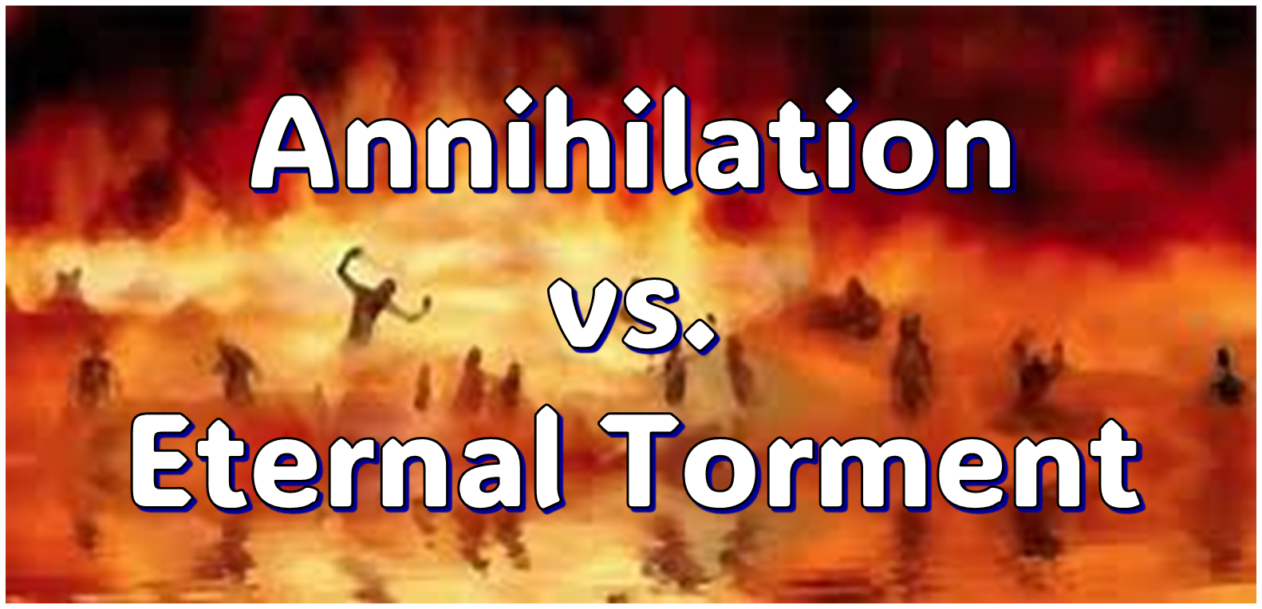
ANNIHILATION VS. ETERNAL CONSCIOUS TORMENT
Introduction to the Controversy
Biblical Arguments Against Annihilation
Theological Arguments Against Annihilation
Answering Annihilationist Biblical Arguments
Answering Annihilationist Theological Arguments
Examining Church History
Conclusion

Slide 3

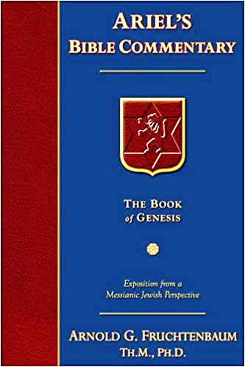
Dr. Arnold G. Fruchtenbaum
Footsteps of the Messiah, 707-8
“Conditional immortality means the soul is not inherently immortal; immortality is not part of the make-up of the soul. Rather, immortality is a gift for the saved only. So at death, the unbeliever simply becomes non-existent, and only the believer continues to exist…What annihilationism says is this: the unsaved soul is annihilated after a temporary period of punishment. These people do believe that the unsaved soul goes to Hell, but not for eternity, only temporarily. Eventually the unsaved soul is annihilated after suffering a duration of punishment.”

Slide 4
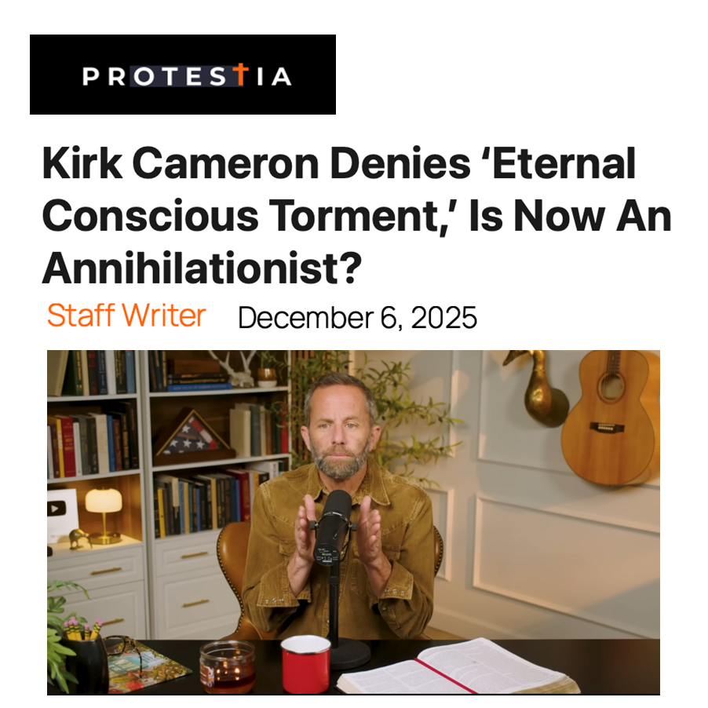

Slide 5
ANNIHILATION VS. ETERNAL CONSCIOUS TORMENT
Introduction to the Controversy
Biblical Arguments Against Annihilation
Theological Arguments Against Annihilation
Answering Annihilationist Biblical Arguments
Answering Annihilationist Theological Arguments
Examining Church History
Conclusion

Slide 6
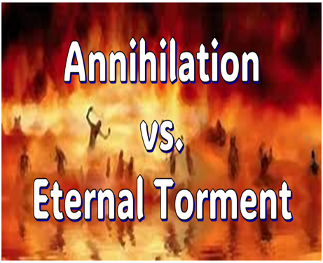
II. Anti-Annihilationist Texts
Dan. 12:2 Matt. 25:46 Mark 9:47-48 Matt. 8:12 Luke 16:19-31 |  | 2 Thess. 1:9 Heb. 6:2 Rev. 14:11 Rev. 20:10 Rev. 19:20

Slide 7

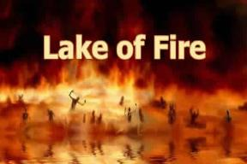
Revelation 14:11
“And the smoke of their torment goes up forever (aiōn) and ever (aiōn); they have no rest day and night, those who worship the beast and his image, and whoever receives the mark of his name.”

Slide 8
Dr. Arnold G. Fruchtenbaum
Footsteps of the Messiah, 717-18
“The…argument against annihilationism is also based on the expression ‘for ever and ever.’ This expression is used a total of thirteen times in the Book of Revelation. Nine of those thirteen times, it is used of God, and they all agree that when it is used of God, it emphasizes eternality and immortality. Once it is used of the saints in Heaven, and they certainly believe that in the case of the saints in Heaven, these are the eternal, immortal beings. Then it is used once of Satan in the Lake of Fire and twice of the unbeliever in the Lake of Fire. But in these last three cases, they want to make it only temporary. If ten times they agree that it…

Slide 9
Dr. Arnold G. Fruchtenbaum
Footsteps of the Messiah, 717-18
…means ‘eternal,’ they cannot then turn around and make these last three times mean something temporary. If it is true that it teaches the immortality of God and the saints in Heaven, it must also teach the immortality of Satan and the unbelievers in the Lake of Fire. Again, we must deduce our theology from the Scriptures, not interpret Scriptures by our preconceived theology or our emotional preferences.”

Slide 10
II. Anti-Annihilationist Texts
Dan. 12:2 Matt. 25:46 Mark 9:47-48 Matt. 8:12 Luke 16:19-31 |  | 2 Thess. 1:9 Heb. 6:2 Rev. 14:11 Rev. 20:10 Rev. 19:20

Slide 11
Revelation 20:10
“And the devil who deceived them was thrown into the lake of fire and brimstone, where the beast and the false prophet are also; and they will be tormented day and night forever (aiōn) and ever (aiōn).”

Slide 12
II. Anti-Annihilationist Texts
Dan. 12:2 Matt. 25:46 Mark 9:47-48 Matt. 8:12 Luke 16:19-31 |  | 2 Thess. 1:9 Heb. 6:2 Rev. 14:11 Rev. 20:10 Rev. 19:20

Slide 13

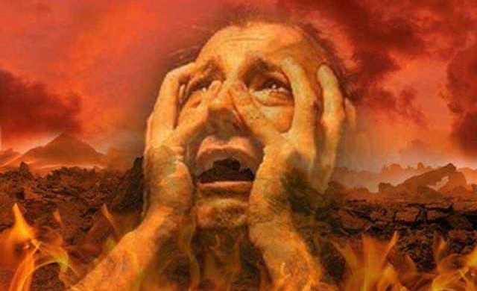
Revelation 19:20
“And the beast was seized, and with him the false prophet who performed the signs in his presence, by which he deceived those who had received the mark of the beast and those who worshiped his image; these two were thrown alive into the lake of fire which burns with brimstone.”

Slide 14

Revelation 13:16-18
¹⁶ “And he causes all, the small and the great, and the rich and the poor, and the free men and the slaves, to be given a mark on their right hand or on their forehead, ¹⁷ and he provides that no one will be able to buy or to sell, except the one who has the mark, either the name of the beast or the number of his name. ¹⁸ Here is wisdom. Let him who has understanding calculate the number of the beast, for the number is that of a man [anthrōpos]; and his number is six hundred and sixty-six.”

Slide 15


2 Thessalonians 2:3
“Let no one in any way deceive you, for it will not come unless the apostasy [apostasia] comes first, and the man [anthrōpos] of lawlessness is revealed, the son of destruction.”

Slide 16
Revelation 20:1-3
“¹Then I saw an angel coming down from heaven, holding the key of the abyss and a great chain in his hand. ² And he laid hold of the dragon, the serpent of old, who is the devil and Satan, and bound him for a thousand years; ³ and he threw him into the abyss, and shut it and sealed it over him, so that he would not deceive the nations any longer, until the thousand years were completed; after these things he must be released for a short time.”

Slide 17
Revelation 20:4-6
“⁴ Then I saw thrones, and they sat on them, and judgment was given to them. And I saw the souls of those who had been beheaded because of their testimony of Jesus and because of the word of God, and those who had not worshiped the beast or his image, and had not received the mark on their forehead and on their hand; and they came to life and reigned with Christ for a thousand years. ⁵ The rest of the dead did not come to life until the thousand years were completed. This. . .

Slide 18
Revelation 20:4-6
… is first resurrection. ⁶ Blessed and holy is the one who has a part in the first resurrection; over these the second death has no power, but they will be priests of God and of Christ and will reign with Him for a thousand years.”

Slide 19
Revelation 20:7-10
“⁷ When the thousand years are completed, Satan will be released from his prison, ⁸ and will come out to deceive the nations which are in the four corners of the earth, Gog and Magog, to gather them together for the war; the number of them is like the sand of the seashore. ⁹ And they came up on the broad plain of the earth and surrounded the camp of the saints and the beloved city, and fire came down…

Slide 20
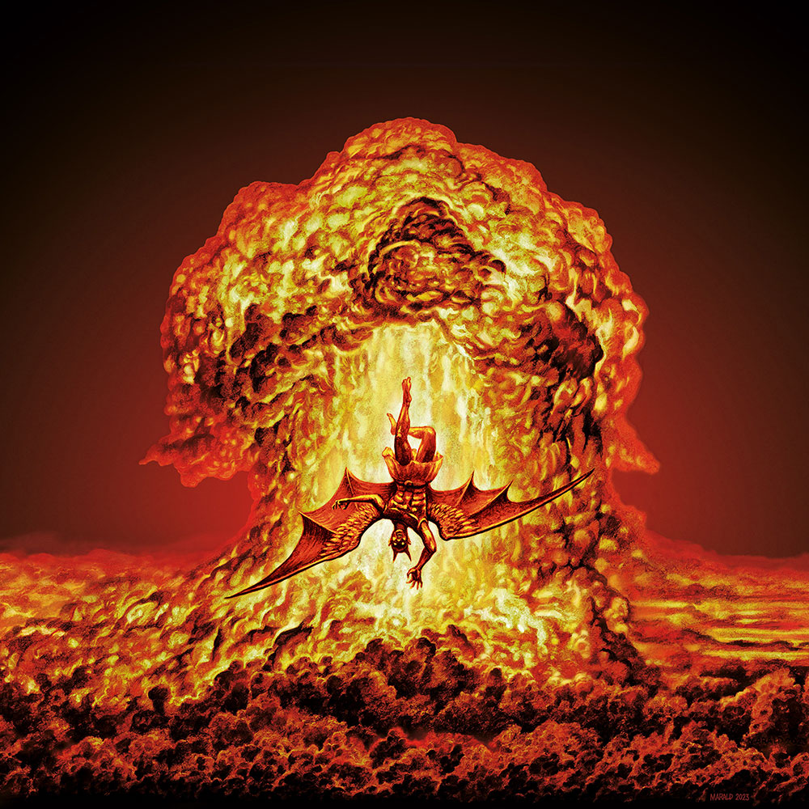
Revelation 20:7-10
…from heaven and devoured them. ¹⁰ And the devil who deceived them was thrown into the lake of fire and brimstone, where the beast and the false prophet are also; and they will be tormented day and night forever and ever.”

Slide 21

Robert Thomas
Revelation 8 to 22: An Exegetical Commentary (Chicago: Moody Press, 1992), 408.
Robert Thomas observes that, “no number in Revelation is verifiably a symbolic number.”

Slide 22
Reasons for Understanding 1000 Literally
John’s use of indefinite concepts elsewhere
  Revelation 20:8, 20:3
Exception to the “# of years” examples?
Other numbers are taken literally
  Two witnesses (11:3), 7000 people (11:13), 4 Angels (7:1) 7 Angels (8:6),144,000 Jews (7:4), 42 months (11:2), 1260 days (11:3)
Not always a symbolic interpretation
  (Rev. 17:18)

Slide 23
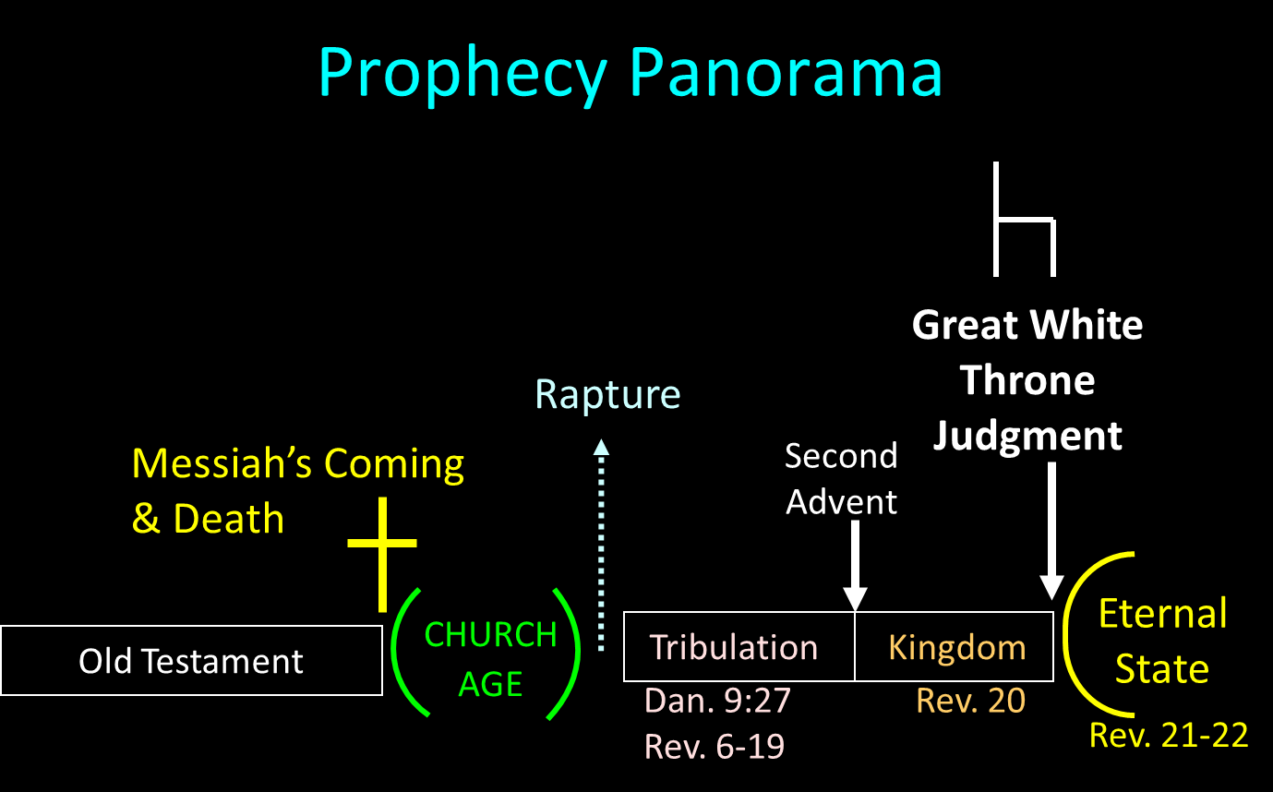

Slide 24
Revelation 20:10
“And the devil who deceived them was thrown into the lake of fire and brimstone, where the beast and the false prophet are also; and they will be tormented day and night forever (aiōn) and ever (aiōn).”

Slide 25

Dr. Norman Geisler
Geisler, N. L. (2005). Systematic theology, volume four: church, last things (p. 408). Bethany House Publishers.
“There is a clear biblical example of still-conscious beings who have endured a thousand years of hell’s torment. The beast and false prophet ‘were thrown alive into the fiery lake of burning sulfur’ (Rev. 19:20) before the ‘thousand years’ (20:2). Yet after this time the devil ‘was cast into the lake of fire and brimstone where the beast and the false prophet [still] are’ (v. 10 nkjv). Not only were they alive when they entered, but they were still alive after a thousand years of conscious torment. This alone is a definitive argument against annihilationism.”

Slide 26
II. Anti-Annihilationist Texts
Dan. 12:2 Matt. 25:46 Mark 9:47-48 Matt. 8:12 Luke 16:19-31 |  | 2 Thess. 1:9 Heb. 6:2 Rev. 14:11 Rev. 20:10 Rev. 19:20

Slide 27
ANNIHILATION VS. ETERNAL CONSCIOUS TORMENT
Introduction to the Controversy
Biblical Arguments Against Annihilation
Theological Arguments Against Annihilation
Answering Annihilationist Biblical Arguments
Answering Annihilationist Theological Arguments
Examining Church History
Conclusion

Slide 28
III. Theological Arguments Against Annihilation
Underestimates sin’s severity
Contradicts humanity’s nature
Denies degrees of punishment
Seeks to escape sin’s consequences

Slide 29
III. Theological Arguments Against Annihilation
Underestimates sin’s severity
Contradicts humanity’s nature
Denies degrees of punishment
Seeks to escape sin’s consequences

Slide 30
III. Theological Arguments Against Annihilation
Underestimates sin’s severity
Contradicts humanity’s nature
Denies degrees of punishment
Seeks to escape sin’s consequences

Slide 31

Genesis 1:26-28
²⁶ Then God said, “Let Us make man in Our image, according to Our likeness; and let them rule over the fish of the sea and over the birds of the sky and over the cattle and over all the earth, and over every creeping thing that creeps on the earth.” ²⁷ God created man in His own image, in the image of God He created him; male and female He created them. ²⁸ God blessed them; and God said to them, “Be fruitful and multiply, and fill the earth, and subdue it; and rule over the fish of the sea and over the birds of the sky and over every living thing that moves on the earth.”

Slide 32

Genesis 9:6
“Whoever sheds man’s blood, By man his blood shall be shed, For in the image of God He made man.”

Slide 33

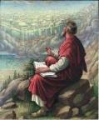
Ecclesiastes 3:11
“He has made everything appropriate in its time. He has also set eternity (olam) in their heart, yet so that man will not find out the work which God has done from the beginning even to the end.”

Slide 34
III. Theological Arguments Against Annihilation
Underestimates sin’s severity
Contradicts humanity’s nature
Denies degrees of punishment
Seeks to escape sin’s consequences

Slide 36
III. Theological Arguments Against Annihilation
Underestimates sin’s severity
Contradicts humanity’s nature
Denies degrees of punishment
Seeks to escape sin’s consequences

Slide 37

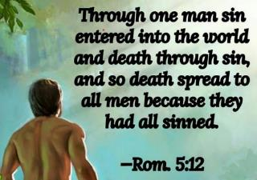
Genesis 2:16-17
“¹⁶ The Lord God commanded the man, saying, ‘From any tree of the garden you may eat freely; ¹⁷ but from the tree of the knowledge of good and evil you shall not eat, for in the day that you eat from it you will surely die (muwth).’”

Slide 38
Genesis 3:4-5
“⁴ The serpent said to the woman, ‘You surely will not die! ⁵ For God knows that in the day you eat from it your eyes will be opened, and you will be like God, knowing good and evil.’”

Slide 39
III. Theological Arguments Against Annihilation
Underestimates sin’s severity
Contradicts humanity’s nature
Denies degrees of punishment
Seeks to escape sin’s consequences

Slide 40
ANNIHILATION VS. ETERNAL CONSCIOUS TORMENT
Introduction to the Controversy
Biblical Arguments Against Annihilation
Theological Arguments Against Annihilation
Answering Annihilationist Biblical Arguments
Answering Annihilationist Theological Arguments
Examining Church History
Conclusion

Slide 41
ANNIHILATION VS. ETERNAL CONSCIOUS TORMENT
Introduction to the Controversy
Biblical Arguments Against Annihilation
Theological Arguments Against Annihilation
Answering Annihilationist Biblical Arguments
Answering Annihilationist Theological Arguments
Examining Church History
Conclusion

Slide 42
ANNIHILATION VS. ETERNAL CONSCIOUS TORMENT
Introduction to the Controversy
Biblical Arguments Against Annihilation
Theological Arguments Against Annihilation
Answering Annihilationist Biblical Arguments
Answering Annihilationist Theological Arguments
Examining Church History
Conclusion

Slide 43
ANNIHILATION VS. ETERNAL CONSCIOUS TORMENT
Introduction to the Controversy
Biblical Arguments Against Annihilation
Theological Arguments Against Annihilation
Answering Annihilationist Biblical Arguments
Answering Annihilationist Theological Arguments
Examining Church History
Conclusion

Slide 44

Dominoes in a Row

Slide 45
ANNIHILATION VS. ETERNAL CONSCIOUS TORMENT
Introduction to the Controversy
Biblical Arguments Against Annihilation
Theological Arguments Against Annihilation
Answering Annihilationist Biblical Arguments
Answering Annihilationist Theological Arguments
Examining Church History
Conclusion

