Slide 1
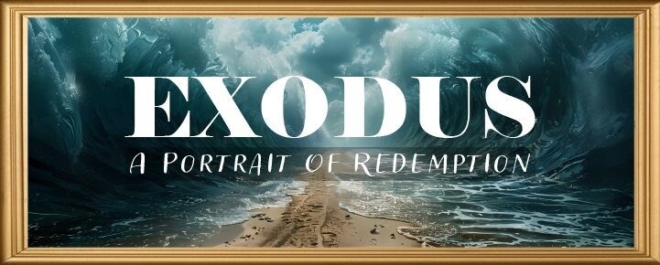


Slide 2
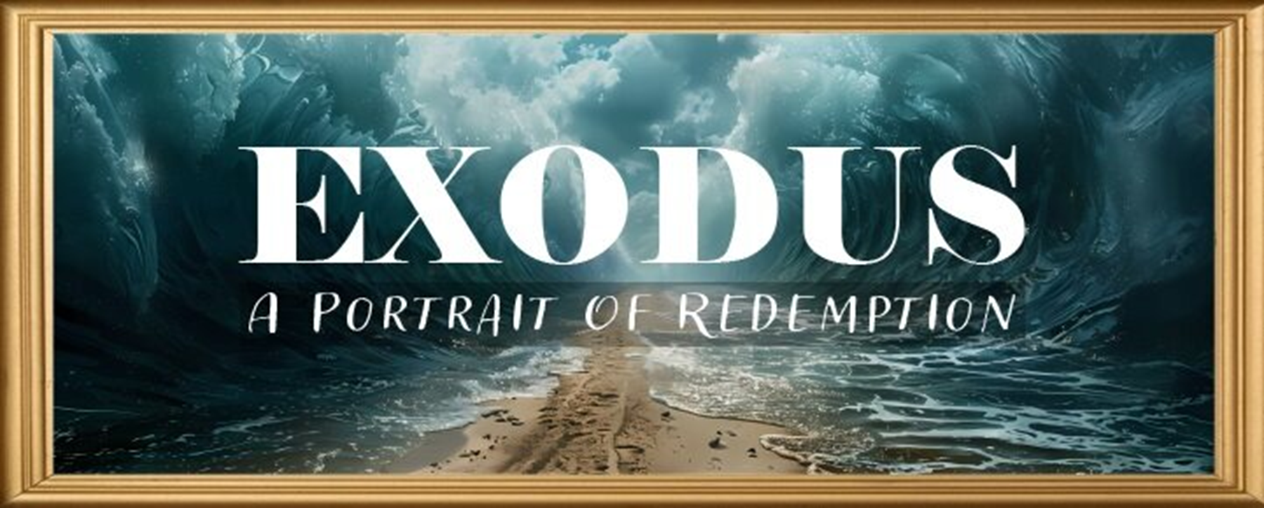
EXODUS STRUCTURE/OUTLINE
Redemption (1–18)
  Redemption (1:1–12:30)
  Liberation (12:31–15:21)
  Preservation (15:22–18:27)
Mosaic Covenant (19–40)
  Law (19–24)
  Tabernacle instructions (25–31)
  Apostasy (32–34)
  Tabernacle building (35–40)

Slide 3
REDEMPTION
(1:1–12:30)
Why redemption is necessary (Exod 1)
Development of the deliverer (Exod 2–4)
First confrontation with Pharaoh (Exod 5)
God reassures Moses (Exod 6:1–7:7)
Second confrontation with Pharaoh (Exod 7:8-13)
Plagues (Exod 7:14–12:30)

Slide 4
TEN PLAGUES REDEMPTION (7:14–12:30)
Nile to blood
Frogs
Gnats
Flies
Death of livestock
Boils
Hail
Locusts
Darkness
Death of 1st born

Slide 5
The Plagues of Egypt
NO. | DESCRIPTION | SCRIPTURE | Egyptian Deity
1. | Water to Blood | Exod. 7:14-25 | Hapi, Khnum
2. | Frogs | Exod. 8:1-15 | Heqt
3. | Gnats | Exod. 8:16-19 | Set
4. | Flies | Exod. 8:20-32 | Uatchit
5. | Disease on Cattle | Exod. 9:1-7 | Hathor, Apis
6. | Boils | Exod. 9:8-12 | Sekhmet, Serapis
7. | Hail | Exod. 9:13-35 | Seth, Nut
8. | Locusts | Exod. 10:1-20 | Seth, Nut, Osiris
9. | Darkness | Exod. 10:21-29 | Re, Horus, Atum
10. | Death of the First Born | Exod. 12:29-36 | Min, Osiris, Heqt, Isis

Slide 6
FLIES
Exodus 8:20-32
  God Instructs Moses (20-23)
  Prophetic Fulfillment (24)
  Pharaoh’s Concession (25-29)
  Moses’ Response (30-32)

Slide 7
IV. Exodus 8:30-32
Moses’ Response
    Exit (30a)
    Supplication (30b)
    God answers (31)
    Pharaoh’s response (32)

Slide 8
IV. Exodus 8:30-32
Moses’ Response
    Exit (30a)
    Supplication (30b)
    God answers (31)
    Pharaoh’s response (32)

Slide 9
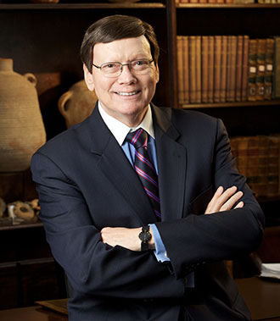
Dr. Ed Hindson
Hindson, E. E., & Mitchell, D. R., eds. (2010). KJV Bible Commentary for Today: The Most Up-to-Date Commentary on the Time-Honored Text of the KJV (p. 93). Thomas Nelson.
“8:26–27. Moses refused to accept this compromise, for the Hebrews’ worship would entail the sacrifice of either sheep or bulls or cows or all three, which he characterized as the abomination of the Egyptians (v. 26). The sacrifice of sheep was detestable to the Egyptians (Gen. 46:34). Bulls were considered the sacred representations of the Egyptian gods Apis and Mnevis. Cows were considered the sacred representations of their goddess Hathor. Will they not stone us? Moses was concerned that the Egyptians might consider the public sacrifice of these animals a blasphemous offense and be antagonized to a state of violence. For Moses, putting distance between the Egyptians and the Hebrews for their sacrifice was a nonnegotiable point.”

Slide 10
IV. Exodus 8:30-32
Moses’ Response
    Exit (30a)
    Supplication (30b)
    God answers (31)
    Pharaoh’s response (32)

Slide 11
IV. Exodus 8:30-32
Moses’ Response
    Exit (30a)
    Supplication (30b)
    God answers (31)
    Pharaoh’s response (32)

Slide 12
IV. Exodus 8:30-32
Moses’ Response
    Exit (30a)
    Supplication (30b)
    God answers (31)
    Pharaoh’s response (32)

Slide 13
Exodus 8:32
Pharaoh’s Response
      Self hardening (32a)
      Double cross (32b)

Slide 14
Exodus 8:32
Pharaoh’s Response
      Self hardening (32a)
      Double cross (32b)

Slide 15
Dr. Ed Hindson
Hindson, E. E., & Mitchell, D. R., eds. (2010). KJV Bible Commentary for Today: The Most Up-to-Date Commentary on the Time-Honored Text of the KJV (p. 86). Thomas Nelson.
“4:21. I will harden his heart. An expression meaning ‘to strengthen his will.’ The text identifies the heart as the location of the volition, man’s decision-making ability. On seven occasions in the narrative, God hardens Pharaoh’s heart (9:12; 10:1, 20, 27; 11:10; 14:4, 8) or foretells that He will harden Pharaoh’s heart (4:21; 7:3), and nine times in the text, Pharaoh hardens his own heart (7:13, 14, 22; 8:15, 19, 32; 9:7, 34–35). For the initial five plagues, the text registers Pharaoh as the agent of hardening. Not until the sixth plague does God participate in the confirmation of Pharaoh’s own volitional choices.”

Slide 16

Charles Ryrie
Ryrie Study Bible, page 96
Exodus 4:21 - “harden his heart. Ten times it is said that Pharaoh hardened his own heart (7:13, 14, 22; 8:15, 19, 32; 9:7, 34, 35; 13:15), and 10 times that God hardened Pharaoh’s heart (4:21; 7:3; 9:12; 10:1, 20, 27; 11:10; 14:4, 8, 17). Paul uses this as an example of the inscrutable will of God and of His mercy toward men (Rom. 9:14–18). Seven times Pharaoh hardened his own heart before God first hardened it, though the prediction that God would do it preceded all.”

Slide 17
GOD HARDENING PHARAOH'S HEART
The prediction of God hardening of Pharaoh (4:21)
Pharaoh repeatedly hardening his own heart (7:13, 22; 8:15, 19, 32; 9:7)
Not until the sixth plague did God harden Pharaoh’s heart (Exod 9:12)

Slide 18
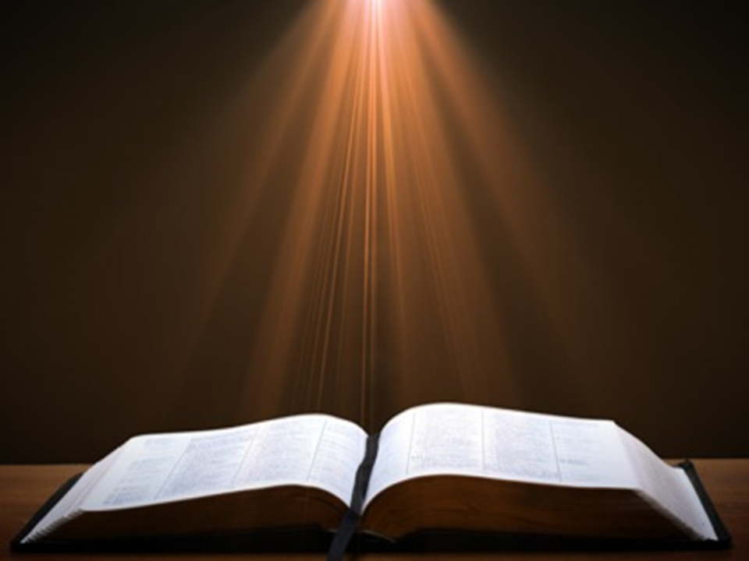
Romans 1:18–20
¹⁸ For the wrath of God is revealed from heaven against all ungodliness and unrighteousness of men who suppress the truth in unrighteousness, ¹⁹ because that which is known about God is evident within them; for God made it evident to them. ²⁰ For since the creation of the world His invisible attributes, His eternal power and divine nature, have been clearly seen, being understood through what has been made, so that they are without excuse.

Slide 19
Exodus 8:32
Pharaoh’s Response
      Self hardening (32a)
      Double cross (32b)

Slide 20
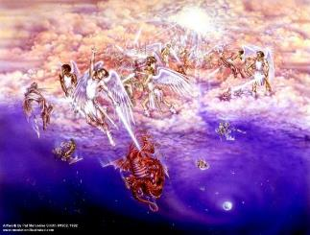
Satan as Ruler of this World
Job 1:7; 2:2
Luke 4:5-7
John 12:31; 14:30; 16:11
2 Corinthians 4:4
Ephesians 2:2
1 John 4:4; 5:19

Slide 21
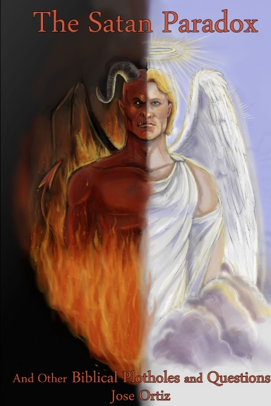
Names & Titles Demonstrating Satan’s Post-Fall, Earthly Authority
(Job 1:7; 2:2; Luke 4:5-8; Rom. 8:19-22)
Prince of this world (John 12:31; 14:30; 16:11)
God of this world (2 Cor. 4:4)
Prince and power of the air (Eph. 2:2)
Who the believer wrestles with (Eph. 6:12)
Roaring lion (1 Pet. 5:8)
Whole world lies in his power (1 John 5:19)

Slide 22
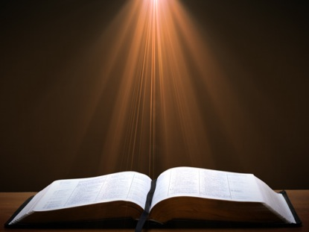
Romans 8:19-23
¹⁹ “For the anxious longing of the creation waits eagerly for the revealing of the sons of God. ²⁰ For the creation was subjected to futility, not willingly, but because of Him who subjected it, in hope ²¹ that the creation itself also will be set free from its slavery to corruption into the freedom of the glory of the children of God. ²² For we know that the whole creation groans and suffers the pains of childbirth together until now. ²³ And not only this, but also we ourselves, having the first fruits of the Spirit, even we ourselves groan within ourselves, waiting eagerly for our adoption as sons, the redemption of our body.”

Slide 23
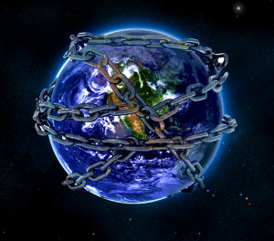

Slide 24
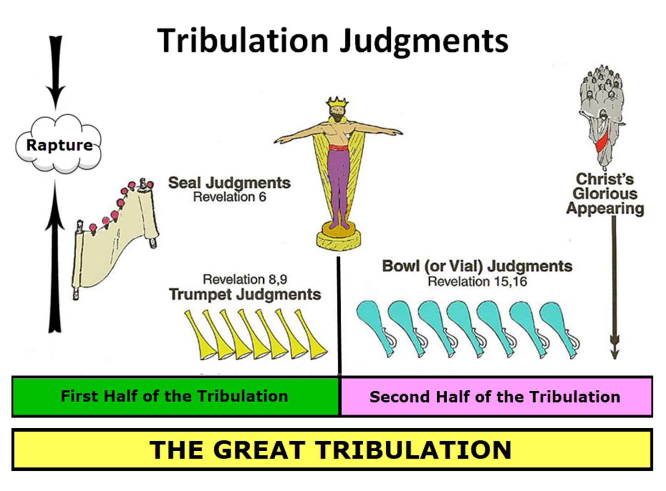

Slide 25
Ultimate Exodus
(Rev 11:15)
Sores: 6th plague (Ex 9:8-12), 1st bowl (Rev 16:1-2)
Rivers to blood: 1st plague (Ex 7:19-21), 3rd bowl (Rev 16:4-7)
Darkness: 9th plague (Ex 10:21-23), 5th bowl (Rev 16:10-11)
Frogs: 2nd plague (Ex 7:25‒8:15), 6th bowl (Rev 16:13)
Hail: 7th plague (Ex 9:22-26), 7th bowl (Rev 16:17-21)

Slide 26

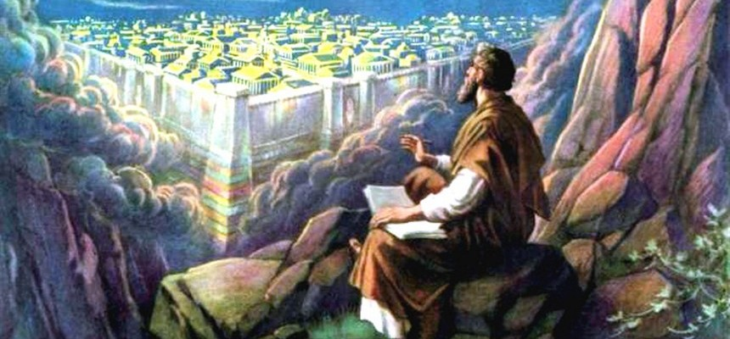
Revelation 11:15
¹⁵ “Then the seventh angel sounded; and there were loud voices in heaven, saying, ‘The kingdom of the world has become the kingdom of our Lord and of His Christ; and He will reign forever and ever.’”

Slide 27
Conclusion

Slide 28
FLIES
Exodus 8:20-32
  God Instructs Moses (20-23)
  Prophetic Fulfillment (24)
  Pharaoh’s Concession (25-29)
  Moses’ Response (30-32)

Slide 29
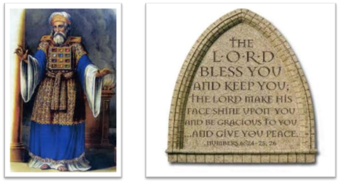
²⁴ The Lord bless you, and keep you; ²⁵ The Lord make His face shine on you, And be gracious to you; ²⁶ The Lord lift up His countenance on you, And give you peace.
Numbers 6:24–26 (NASB95)

