Slide 1
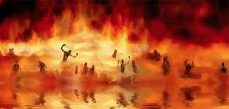

Annihilation
vs.
Eternal Torment

Slide 2
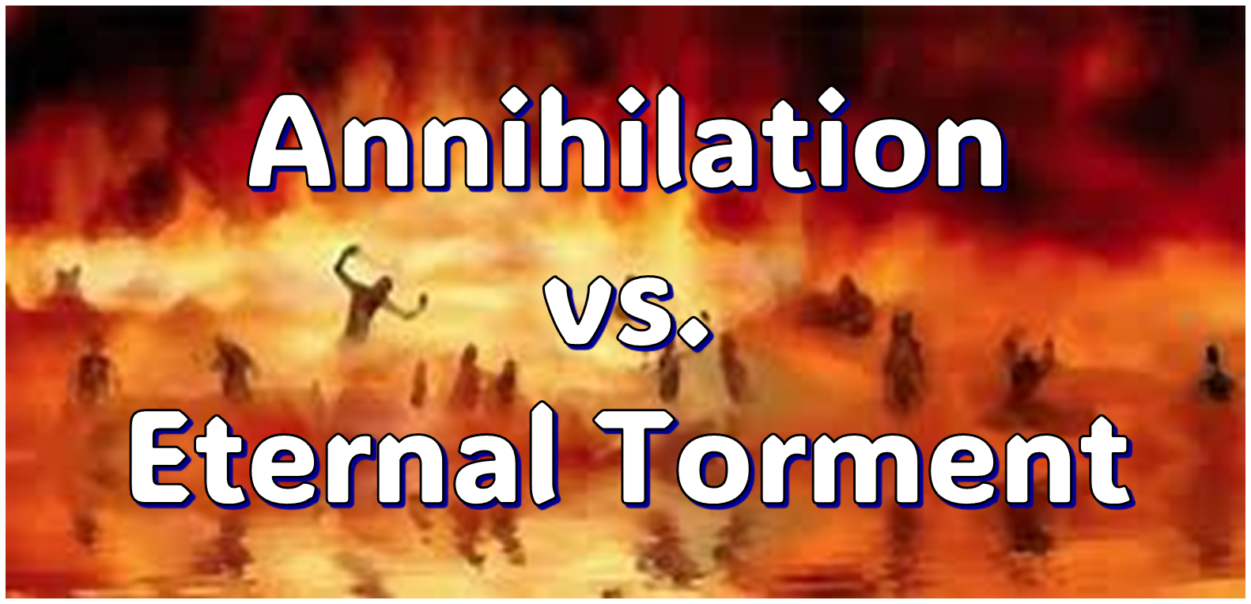
ANNIHILATION VS. ETERNAL CONSCIOUS TORMENT
Introduction to the Controversy
Biblical Arguments Against Annihilation
Theological Arguments Against Annihilation
Answering Annihilationist Biblical Arguments
Answering Annihilationist Theological Arguments
Examining Church History
Conclusion

Slide 3
ANNIHILATION VS. ETERNAL CONSCIOUS TORMENT
Introduction to the Controversy
Biblical Arguments Against Annihilation
Theological Arguments Against Annihilation
Answering Annihilationist Biblical Arguments
Answering Annihilationist Theological Arguments
Examining Church History
Conclusion

Slide 4
I. Introduction to the Controversy
Definition
Proponents

Slide 5
I. Introduction to the Controversy
Definition
Proponents

Slide 6

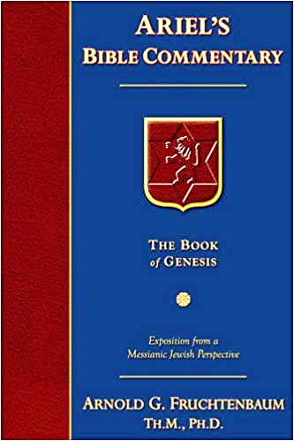
Dr. Arnold G. Fruchtenbaum
Footsteps of the Messiah, 707-8
“Conditional immortality means the soul is not inherently immortal; immortality is not part of the make-up of the soul. Rather, immortality is a gift for the saved only. So at death, the unbeliever simply becomes non-existent, and only the believer continues to exist…What annihilationism says is this: the unsaved soul is annihilated after a temporary period of punishment. These people do believe that the unsaved soul goes to Hell, but not for eternity, only temporarily. Eventually the unsaved soul is annihilated after suffering a duration of punishment.”

Slide 7
I. Introduction to the Controversy
Definition
Proponents

Slide 8
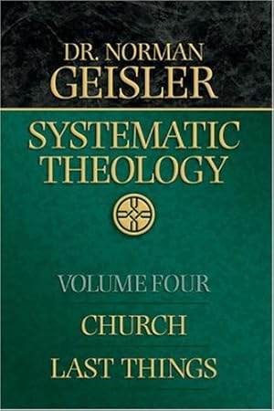
Dr. Norman Geisler
Geisler, N. L. (2005). Systematic theology, volume four: church, last things (pp. 390–391). Bethany House Publishers.
“Annihilationism was embraced by Arnobius (fl. fourth century) but did not become popular until the nineteenth century, when it was propagated by Congregationalist Edward White and then by Seventh-Day Adventist Le Roy Froom (1874–1970); Jehovah’s Witnesses are also annihilationists. In the mid-twentieth century, Harold Guillebaud (1882–1964) and Basil Atkinson (1895-?) defended conditionalism, and a few other evangelicals, such as John Wenham (b. 1913), John Stott, and Clark Pinnock (b. 1920) have embraced the view.”

Slide 9
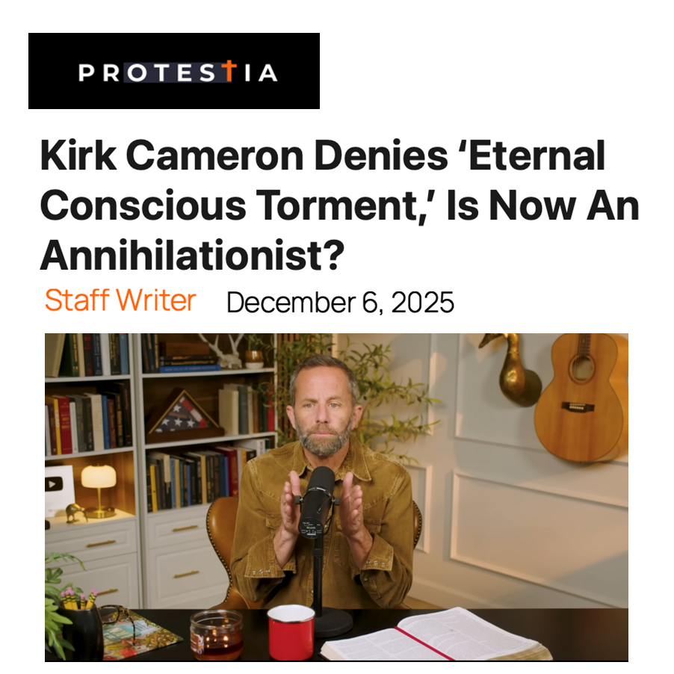

Slide 10
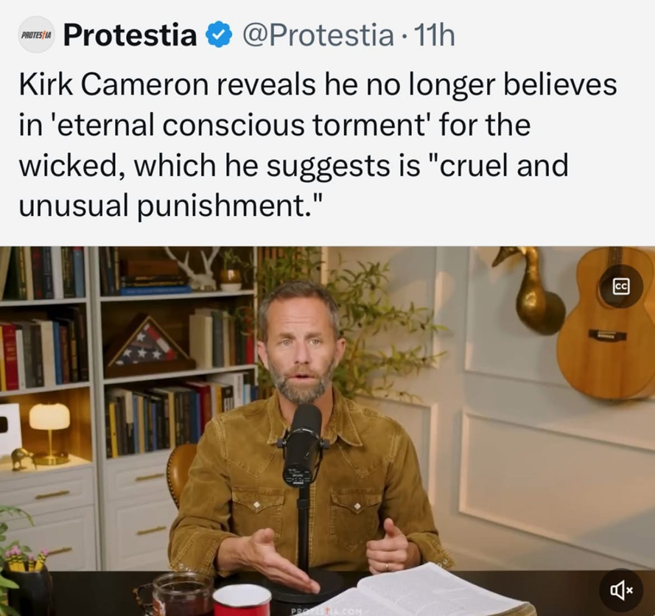

Slide 11
ANNIHILATION VS. ETERNAL CONSCIOUS TORMENT
Introduction to the Controversy
Biblical Arguments Against Annihilation
Theological Arguments Against Annihilation
Answering Annihilationist Biblical Arguments
Answering Annihilationist Theological Arguments
Examining Church History
Conclusion

Slide 12
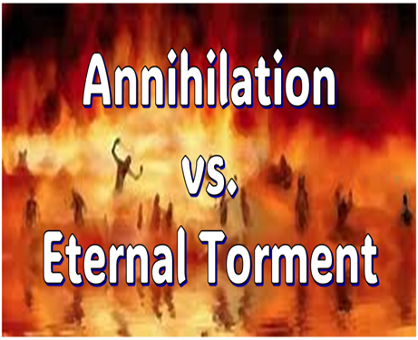
II. Anti-Annihilationist Texts
Dan. 12:2 Matt. 25:46 Mark 9:47-48 Matt. 8:12 Luke 16:19-31 |  | 2 Thess. 1:9 Heb. 6:2 Rev. 14:11 Rev. 20:10 Rev. 19:20

Slide 13
II. Anti-Annihilationist Texts
Dan. 12:2 Matt. 25:46 Mark 9:47-48 Matt. 8:12 Luke 16:19-31 |  | 2 Thess. 1:9 Heb. 6:2 Rev. 14:11 Rev. 20:10 Rev. 19:20

Slide 14


Daniel 12:2
“Many of those who sleep in the dust of the ground will awake, these to everlasting (olam) life, but the others to disgrace and everlasting (olam) contempt.”

Slide 15

Psalm 90:2
“Before the mountains were born Or You gave birth to the earth and the world, Even from everlasting (olam) to everlasting (olam), You are God.”

Slide 16

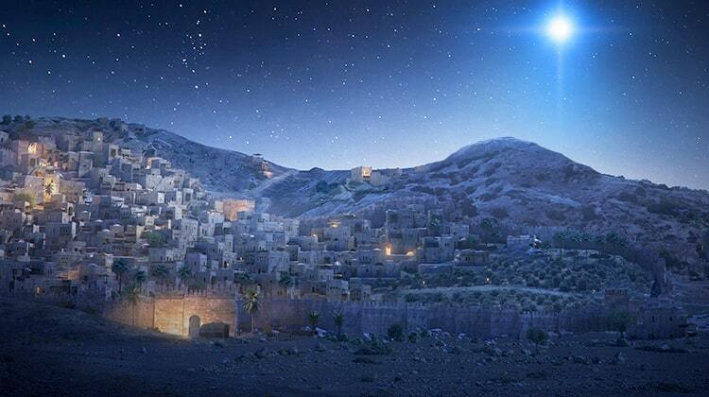
Micah 5:2
“But as for you, Bethlehem Ephrathah, Too little to be among the clans of Judah, From you One will go forth for Me to be ruler in Israel. His goings forth are from long ago, From the days of eternity (olam).”

Slide 17
II. Anti-Annihilationist Texts
Dan. 12:2 Matt. 25:46 Mark 9:47-48 Matt. 8:12 Luke 16:19-31 |  | 2 Thess. 1:9 Heb. 6:2 Rev. 14:11 Rev. 20:10 Rev. 19:20

Slide 18
Matthew 25:46
“These will go away into eternal (aiōnios) punishment, but the righteous into eternal (aiōnios) life.

Slide 19

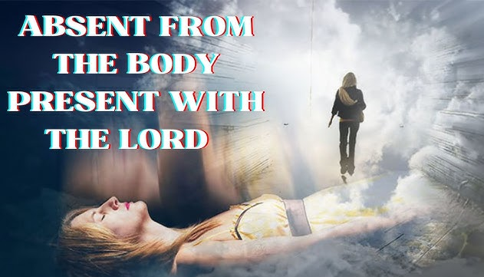
2 Corinthians 5:8
“we are of good courage, I say, and prefer rather to be absent from the body and to be at home with the Lord.”

Slide 20
Philippians 1:21-24
^{21 “}For to me, to live is Christ and to die is gain. ²² But if I am to live on in the flesh, this will mean fruitful labor for me; and I do not know which to choose. ²³ But I am hard-pressed from both directions, having the desire to depart and be with Christ, for that is very much better; ²⁴ yet to remain on in the flesh is more necessary for your sake.”

Slide 21

Romans 16:26
“but now is manifested, and by the Scriptures of the prophets, according to the commandment of the eternal (aiōnios) God, has been made known to all the nations, leading to obedience of faith

Slide 22
II. Anti-Annihilationist Texts
Dan. 12:2 Matt. 25:46 Mark 9:47-48 Matt. 8:12 Luke 16:19-31 |  | 2 Thess. 1:9 Heb. 6:2 Rev. 14:11 Rev. 20:10 Rev. 19:20

Slide 23
II. Anti-Annihilationist Texts
Dan. 12:2 Matt. 25:46 Mark 9:47-48 Matt. 8:12 Luke 16:19-31 |  | 2 Thess. 1:9 Heb. 6:2 Rev. 14:11 Rev. 20:10 Rev. 19:20

Slide 24
II. Anti-Annihilationist Texts
Dan. 12:2 Matt. 25:46 Mark 9:47-48 Matt. 8:12 Luke 16:19-31 |  | 2 Thess. 1:9 Heb. 6:2 Rev. 14:11 Rev. 20:10 Rev. 19:20

Slide 25

Luke 16:24-26
“²⁴ And he cried out and said, ‘Father Abraham, have mercy on me, and send Lazarus so that he may dip the tip of his finger in water and cool off my tongue, for I am in agony in this flame.’ ²⁵ But Abraham said, ‘Child, remember that during your life you received your good things, and likewise Lazarus bad things; but now he is being comforted here, and you are in agony. ²⁶ And besides all this, between us and you there is a great chasm fixed, so that those who wish to come over from here to you will not be able, and that none may cross over from there to us.’”

Slide 26
II. Anti-Annihilationist Texts
Dan. 12:2 Matt. 25:46 Mark 9:47-48 Matt. 8:12 Luke 16:19-31 |  | 2 Thess. 1:9 Heb. 6:2 Rev. 14:11 Rev. 20:10 Rev. 19:20

Slide 27

Dr. Alan W. Gomes
(Summer 1991). “Evangelicals and the Annihilation of Hell” (Part 2). In the Christian Research Journal. Page 11.
“A punishment [such as torment] that is not felt is not a punishment. It is an odd use of language to speak of an insensate state (i.e., unfeeling), an inanimate object receiving punishment. To say, ‘I punished my car for not starting by slowly plucking out it’s spark plug wires, one by one,’ would invoke laughter, not serious consideration.”

Slide 28
II. Anti-Annihilationist Texts
Dan. 12:2 Matt. 25:46 Mark 9:47-48 Matt. 8:12 Luke 16:19-31 |  | 2 Thess. 1:9 Heb. 6:2 Rev. 14:11 Rev. 20:10 Rev. 19:20

Slide 29
II. Anti-Annihilationist Texts
Dan. 12:2 Matt. 25:46 Mark 9:47-48 Matt. 8:12 Luke 16:19-31 |  | 2 Thess. 1:9 Heb. 6:2 Rev. 14:11 Rev. 20:10 Rev. 19:20

Slide 30
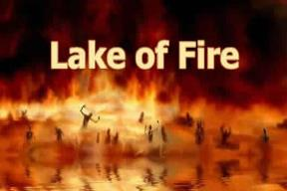
Revelation 14:11
“And the smoke of their torment goes up forever (aiōn) and ever (aiōn); they have no rest day and night, those who worship the beast and his image, and whoever receives the mark of his name.”

Slide 31
Dr. Arnold G. Fruchtenbaum
Footsteps of the Messiah, 717-18
“The…argument against annihilationism is also based on the expression ‘for ever and ever.’ This expression is used a total of thirteen times in the Book of Revelation. Nine of those thirteen times, it is used of God, and they all agree that when it is used of God, it emphasizes eternality and immortality. Once it is used of the saints in Heaven, and they certainly believe that in the case of the saints in Heaven, these are the eternal, immortal beings. Then it is used once of Satan in the Lake of Fire and twice of the unbeliever in the Lake of Fire.”

Slide 32
Dr. Arnold G. Fruchtenbaum
Footsteps of the Messiah, 717-18
“But in these last three cases, they want to make it only temporary. If ten times they agree that it means ‘eternal,’ they cannot then turn around and make these last three times mean something temporary. If it is true that it teaches the immortality of God and the saints in Heaven, it must also teach the immortality of Satan and the unbelievers in the Lake of Fire. Again, we must deduce our theology from the Scriptures, not interpret Scriptures by our preconceived theology or our emotional preferences.”

Slide 33
II. Anti-Annihilationist Texts
Dan. 12:2 Matt. 25:46 Mark 9:47-48 Matt. 8:12 Luke 16:19-31 |  | 2 Thess. 1:9 Heb. 6:2 Rev. 14:11 Rev. 20:10 Rev. 19:20

Slide 34
Revelation 20:10
“And the devil who deceived them was thrown into the lake of fire and brimstone, where the beast and the false prophet are also; and they will be tormented day and night forever (aiōn) and ever (aiōn).”

Slide 35
II. Anti-Annihilationist Texts
Dan. 12:2 Matt. 25:46 Mark 9:47-48 Matt. 8:12 Luke 16:19-31 |  | 2 Thess. 1:9 Heb. 6:2 Rev. 14:11 Rev. 20:10 Rev. 19:20

Slide 36

Revelation 13:16-18
¹⁶ “And he causes all, the small and the great, and the rich and the poor, and the free men and the slaves, to be given a mark on their right hand or on their forehead, ¹⁷ and he provides that no one will be able to buy or to sell, except the one who has the mark, either the name of the beast or the number of his name. ¹⁸ Here is wisdom. Let him who has understanding calculate the number of the beast, for the number is that of a man [anthrōpos]; and his number is six hundred and sixty-six.”

Slide 37

Revelation 20:1-3
“¹Then I saw an angel coming down from heaven, holding the key of the abyss and a great chain in his hand. ² And he laid hold of the dragon, the serpent of old, who is the devil and Satan, and bound him for a thousand years; ³ and he threw him into the abyss, and shut it and sealed it over him, so that he would not deceive the nations any longer, until the thousand years were completed; after these things he must be released for a short time.”

Slide 38
Revelation 20:4-6
“⁴ Then I saw thrones, and they sat on them, and judgment was given to them. And I saw the souls of those who had been beheaded because of their testimony of Jesus and because of the word of God, and those who had not worshiped the beast or his image, and had not received the mark on their forehead and on their hand; and they came to life and reigned with Christ for a thousand years. ⁵ The rest of the dead did not come to life until the thousand years were completed. This. . .

Slide 39
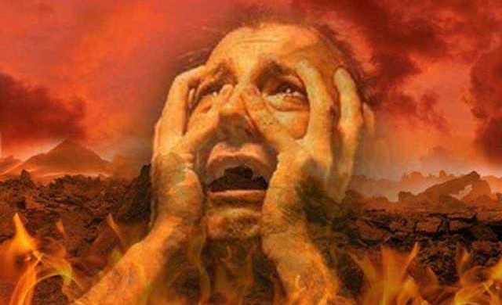
Revelation 20:4-6
… is first resurrection. ⁶ Blessed and holy is the one who has a part in the first resurrection; over these the second death has no power, but they will be priests of God and of Christ and will reign with Him for a thousand years.”

Slide 40
Revelation 20:7-10
“⁷ When the thousand years are completed, Satan will be released from his prison, ⁸ and will come out to deceive the nations which are in the four corners of the earth, Gog and Magog, to gather them together for the war; the number of them is like the sand of the seashore. ⁹ And they came up on the broad plain of the earth and surrounded the camp of the saints and the beloved city, and fire came down…

Slide 41
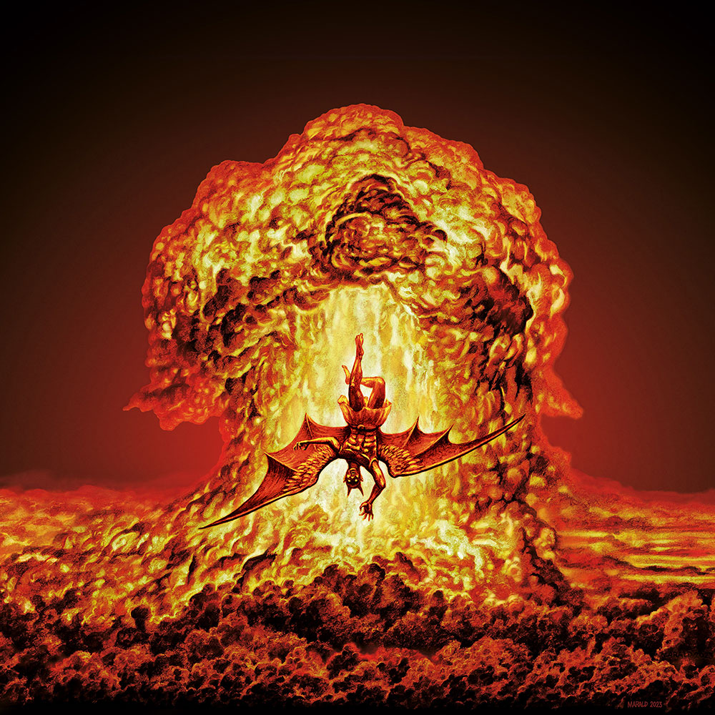
Revelation 20:7-10
…from heaven and devoured them. ¹⁰ And the devil who deceived them was thrown into the lake of fire and brimstone, where the beast and the false prophet are also; and they will be tormented day and night forever and ever.”

Slide 42
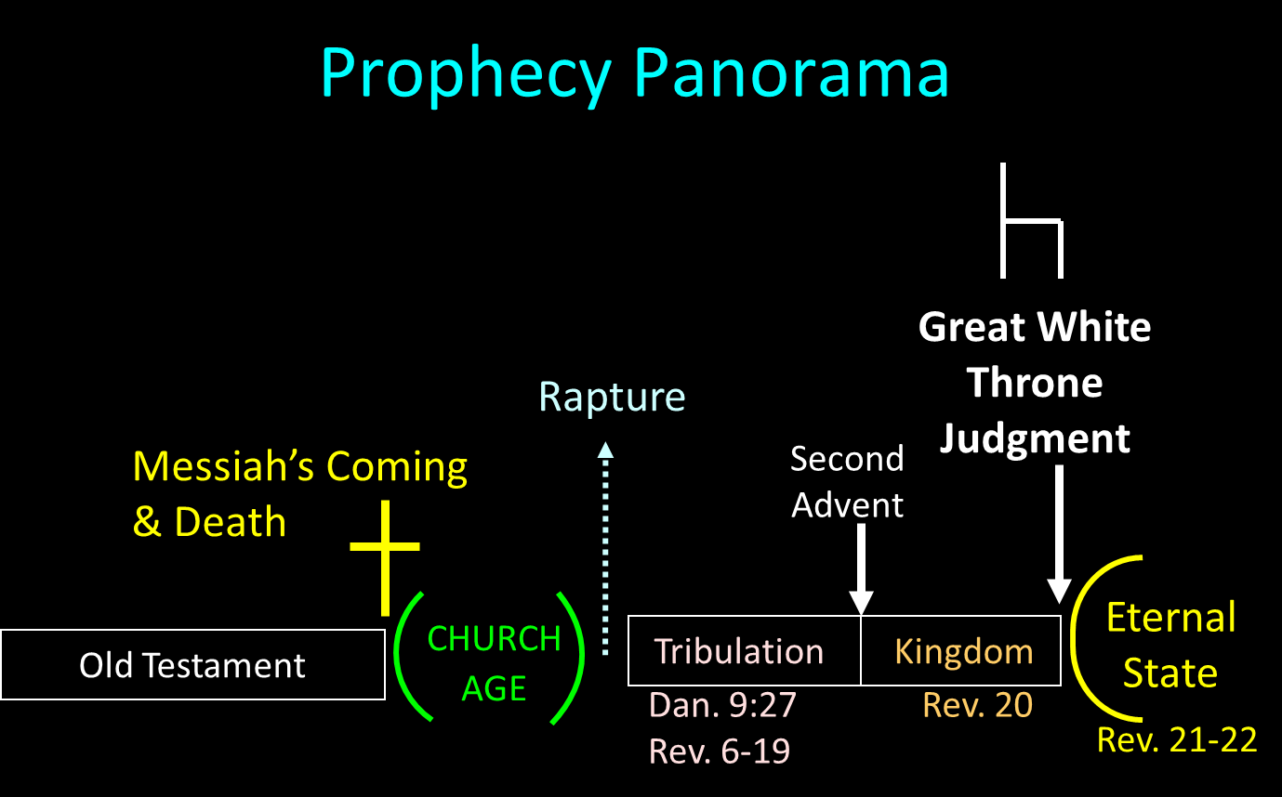

Slide 43
Revelation 20:10
“And the devil who deceived them was thrown into the lake of fire and brimstone, where the beast and the false prophet are also; and they will be tormented day and night forever (aiōn) and ever (aiōn).”

Slide 44
Dr. Norman Geisler
Geisler, N. L. (2005). Systematic theology, volume four: church, last things (p. 408). Bethany House Publishers.
“There is a clear biblical example of still-conscious beings who have endured a thousand years of hell’s torment. The beast and false prophet ‘were thrown alive into the fiery lake of burning sulfur’ (Rev. 19:20) before the ‘thousand years’ (20:2). Yet after this time the devil ‘was cast into the lake of fire and brimstone where the beast and the false prophet [still] are’ (v. 10 nkjv). Not only were they alive when they entered, but they were still alive after a thousand years of conscious torment. This alone is a definitive argument against annihilationism.”

Slide 45
ANNIHILATION VS. ETERNAL CONSCIOUS TORMENT
Introduction to the Controversy
Biblical Arguments Against Annihilation
Theological Arguments Against Annihilation
Answering Annihilationist Biblical Arguments
Answering Annihilationist Theological Arguments
Examining Church History
Conclusion

Slide 46
ANNIHILATION VS. ETERNAL CONSCIOUS TORMENT
Introduction to the Controversy
Biblical Arguments Against Annihilation
Theological Arguments Against Annihilation
Answering Annihilationist Biblical Arguments
Answering Annihilationist Theological Arguments
Examining Church History
Conclusion

Slide 47
ANNIHILATION VS. ETERNAL CONSCIOUS TORMENT
Introduction to the Controversy
Biblical Arguments Against Annihilation
Theological Arguments Against Annihilation
Answering Annihilationist Biblical Arguments
Answering Annihilationist Theological Arguments
Examining Church History
Conclusion

Slide 48
ANNIHILATION VS. ETERNAL CONSCIOUS TORMENT
Introduction to the Controversy
Biblical Arguments Against Annihilation
Theological Arguments Against Annihilation
Answering Annihilationist Biblical Arguments
Answering Annihilationist Theological Arguments
Examining Church History
Conclusion

Slide 49
ANNIHILATION VS. ETERNAL CONSCIOUS TORMENT
Introduction to the Controversy
Biblical Arguments Against Annihilation
Theological Arguments Against Annihilation
Answering Annihilationist Biblical Arguments
Answering Annihilationist Theological Arguments
Examining Church History
Conclusion

Slide 50

Dominoes in a Row

Slide 51
ANNIHILATION VS. ETERNAL CONSCIOUS TORMENT
Introduction to the Controversy
Biblical Arguments Against Annihilation
Theological Arguments Against Annihilation
Answering Annihilationist Biblical Arguments
Answering Annihilationist Theological Arguments
Examining Church History
Conclusion

