Slide 1
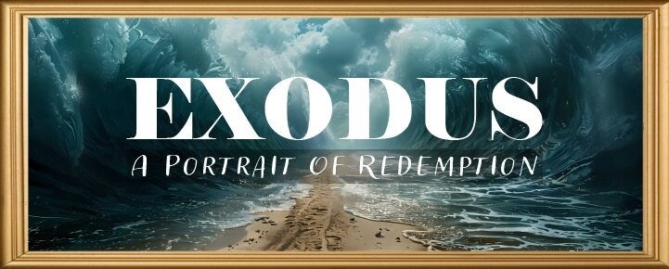


Slide 2

EXODUS STRUCTURE/OUTLINE
Redemption (1–18)
Redemption (1:1–12:30)
Liberation (12:31–15:21)
Preservation (15:22–18:27)
Mosaic Covenant (19–40)
Law (19–24)
Tabernacle instructions (25–31)
Apostasy (32–34)
Tabernacle building (35–40)

Slide 3
REDEMPTION (1:1–12:30)
Why redemption is necessary (Exod 1)
Development of the deliverer (Exod 2–4)
First confrontation with Pharaoh (Exod 5)
God reassures Moses (Exod 6:1–7:7)
Second confrontation with Pharaoh (Exod 7:8-13)
Plagues (Exod 7:14–12:30)

Slide 4
TEN PLAGUES REDEMPTION (7:14–12:30)
Nile to blood
Frogs
Gnats
Flies
Death of livestock
Boils
Hail
Locusts
Darkness
Death of 1st born

Slide 5
The Plagues of Egypt
NO. | DESCRIPTION | SCRIPTURE | Egyptian Deity
1. | Water to Blood | Exod. 7:14-25 | Hapi, Khnum
2. | Frogs | Exod. 8:1-15 | Heqt
3. | Gnats | Exod. 8:16-19 | Set
4. | Flies | Exod. 8:20-32 | Uatchit
5. | Disease on Cattle | Exod. 9:1-7 | Hathor, Apis
6. | Boils | Exod. 9:8-12 | Sekhmet, Serapis
7. | Hail | Exod. 9:13-35 | Seth, Nut
8. | Locusts | Exod. 10:1-20 | Seth, Nut, Osiris
9. | Darkness | Exod. 10:21-29 | Re, Horus, Atum
10. | Death of the First Born | Exod. 12:29-36 | Min, Osiris, Heqt, Isis

Slide 6
FLIES Exodus 8:20-32
God Instructs Moses (20-23)
Prophetic Fulfillment (24)
Pharaoh’s Concession (25-29)
Moses’ Response (30-32)

Slide 7
FLIES Exodus 8:20-32
God Instructs Moses (20-23)
Prophetic Fulfillment (24)
Pharaoh’s Concession (25-29)
Moses’ Response (30-32)

Slide 8
I. Exodus 8:20-23 Magicians’ Response
Command (20)
Consequence (21)
Protection (22-23)

Slide 9
I. Exodus 8:20-23 Magicians’ Response
Command (20)
Consequence (21)
Protection (22-23)

Slide 10

Ephesians 2:8-10
“⁸ For by grace you have been saved through faith; and that not of yourselves, it is the gift of God; ⁹ not as a result of works, so that no one may boast. ¹⁰ For we are His workmanship, created in Christ Jesus for good works, which God prepared beforehand so that we would walk [peripateō, subjunctive mood] in them.”

Slide 11
I. Exodus 8:20-23 Magicians’ Response
Command (20)
Consequence (21)
Protection (22-23)

Slide 12
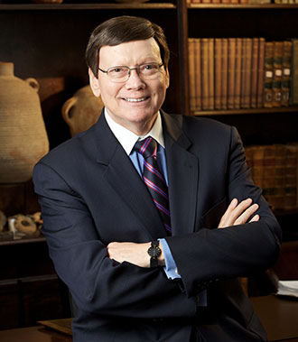
Dr. Ed Hindson
Hindson, E. E., & Mitchell, D. R., eds. (2010). King James Version Bible Commentary for Today: The Most Up-to-Date Commentary on the Time-Honored Text of the King James Version (p. 93). Thomas Nelson.
“The Egyptian deity challenged by this plague would have been Uatchit, who looked like a fly and whose function was to divinely protect Egypt from insect swarms.”

Slide 13
The Plagues of Egypt
NO. | DESCRIPTION | SCRIPTURE | Egyptian Deity
1. | Water to Blood | Exod. 7:14-25 | Hapi, Khnum
2. | Frogs | Exod. 8:1-15 | Heqt
3. | Gnats | Exod. 8:16-19 | Set
4. | Flies | Exod. 8:20-32 | Uatchit
5. | Disease on Cattle | Exod. 9:1-7 | Hathor, Apis
6. | Boils | Exod. 9:8-12 | Sekhmet, Serapis
7. | Hail | Exod. 9:13-35 | Seth, Nut
8. | Locusts | Exod. 10:1-20 | Seth, Nut, Osiris
9. | Darkness | Exod. 10:21-29 | Re, Horus, Atum
10. | Death of the First Born | Exod. 12:29-36 | Min, Osiris, Heqt, Isis

Slide 14
I. Exodus 8:20-23 Magicians’ Response
Command (20)
Consequence (21)
Protection (22-23)

Slide 15
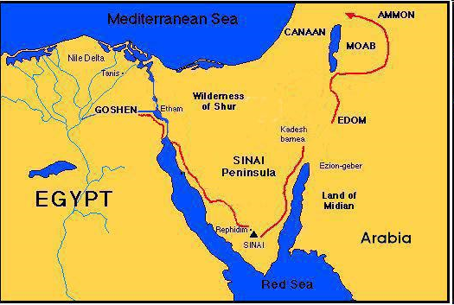

Slide 16
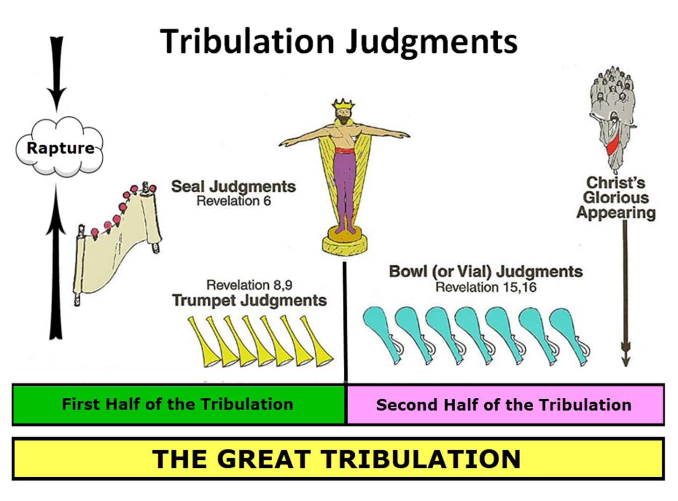

Slide 17

Protection Through the Tribulation?
(Revelation 3:10)
Like the protection in Goshen (Exod. 8:22, 24; 9:4, 6; 11:4-7; Rev. 9:4; 16:2)
Effective? Rev. 6:9-11; 7:13-14; 13:10, 15; 20:4
Comfort? John 14:1; 1 Thess. 4:18; Titus 2:13

Slide 18

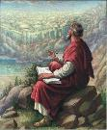
John 20:30-31
“Therefore many other signs Jesus also performed in the presence of the disciples, which are not written in this book; but these have been written so that you may believe that Jesus is the Christ, the Son of God; and that believing you may have life in His name.”

Slide 19
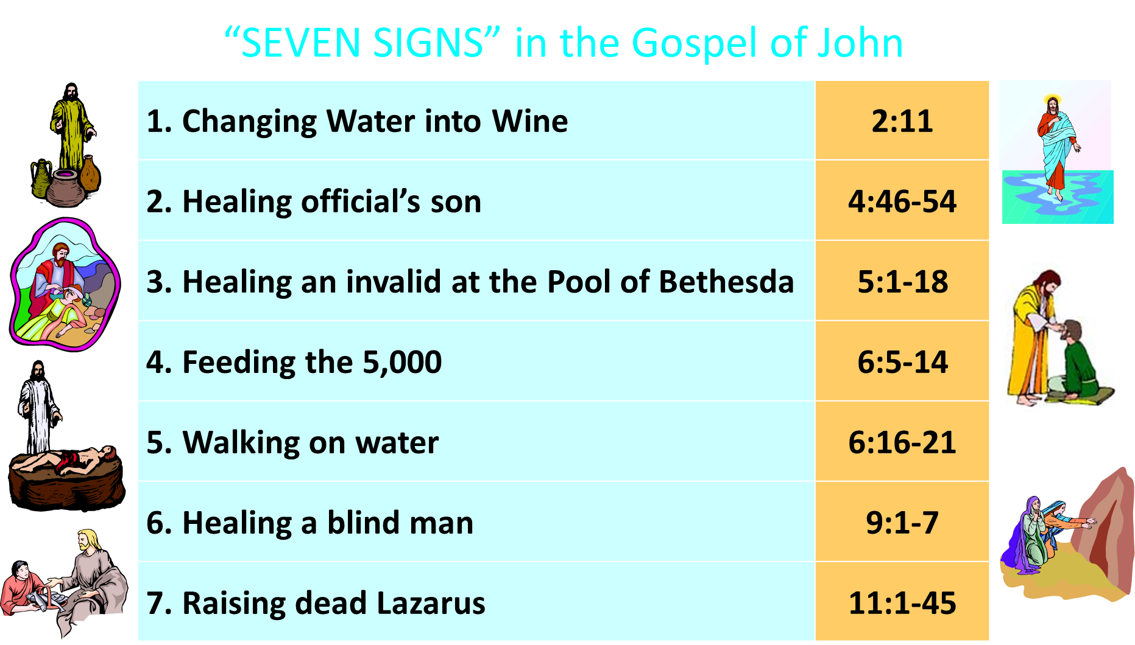

Slide 20
FLIES Exodus 8:20-32
God Instructs Moses (20-23)
Prophetic Fulfillment (24)
Pharaoh’s Concession (25-29)
Moses’ Response (30-32)

Slide 21
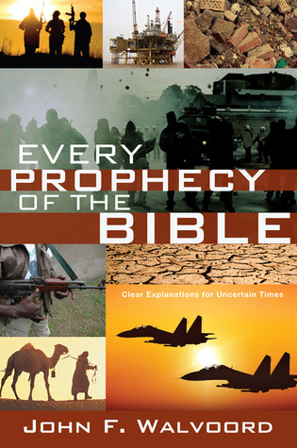

Slide 22
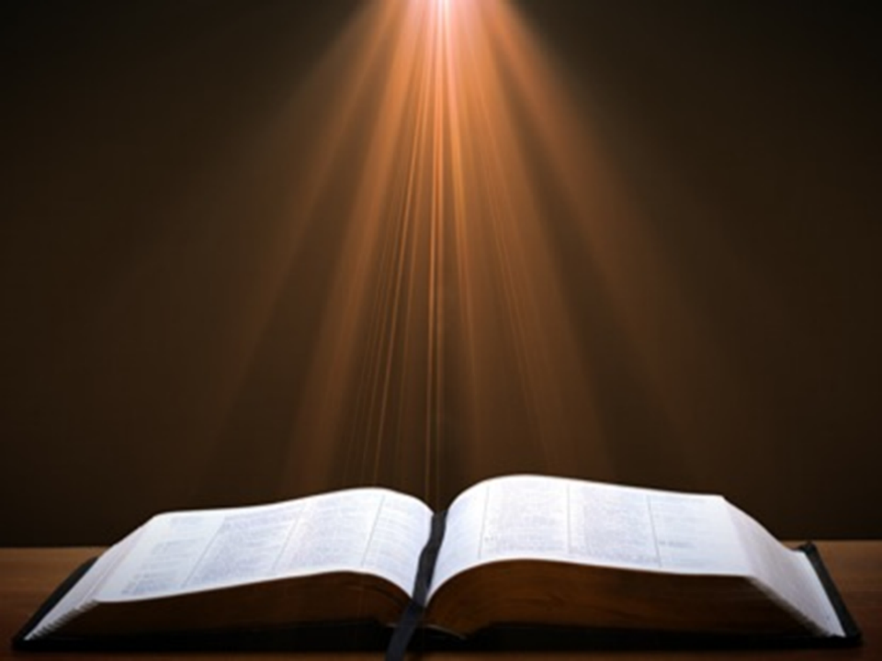

John 13:19; 14:29
“¹⁹ From now on I am telling you before it comes to pass, so that when it does occur, you may believe that I am He… ^{14:29} Now I have told you before it happens, so that when it happens, you may believe.”

Slide 23
What Happened to Christ’s Disciples?
Disciple | Place | Martyrdom
James the Son of Alpheus | Jerusalem | Clubbed to death
Simon the Zealot | Jerusalem | Martyred
James the Son of Zebedee | Judea (Acts 12:2) | Executed
Thaddeus | Mesopotamia | Beaten to death
Peter | Babylon, Rome | Crucified upside down
Matthew | Parthia (Tehran) | Beheaded
Notes:
109 prophecies…
Peter Stoner – SCIENCE SPEAKS, An Evaluation of Certain Christian Evidences
To fulfill just 8 prophecies =1 X 10 to the twenty-eighth power!
Can we visualize this with an illustration? Suppose we took an atheistic professor, blindfolded him and covered the state of Texas two feet deep with silver dollars. Then we put a check on one of those silver dollars and mixed them up. The odds of one person fulfilling just these eight prophecies would be the same as this atheistic professor selecting the silver dollar upon which we have placed a check, in his first try.
https://www.bereanpublishers.com/the-odds-of-eight-messianic-prophecies-coming-true/

Slide 24
What Happened to Christ’s Disciples?
Disciple | Place | Martyrdom
John | Asia Minor, Patmos, Ephesus | Fried in boiling oil
Philip | E. Turkey | Tortured & crucified
Thomas | India | Speared
Bartholomew | India | Flayed & crucified
Andrew | Ukraine, Russia, Greece | Hanged
Notes:
109 prophecies…
Peter Stoner – SCIENCE SPEAKS, An Evaluation of Certain Christian Evidences
To fulfill just 8 prophecies =1 X 10 to the twenty-eighth power!
Can we visualize this with an illustration? Suppose we took an atheistic professor, blindfolded him and covered the state of Texas two feet deep with silver dollars. Then we put a check on one of those silver dollars and mixed them up. The odds of one person fulfilling just these eight prophecies would be the same as this atheistic professor selecting the silver dollar upon which we have placed a check, in his first try.
https://www.bereanpublishers.com/the-odds-of-eight-messianic-prophecies-coming-true/

Slide 25
FLIES Exodus 8:20-32
God Instructs Moses (20-23)
Prophetic Fulfillment (24)
Pharaoh’s Concession (25-29)
Moses’ Response (30-32)

Slide 26
III. Exodus 8:25-29 Pharaoh’s Concession
Pharaoh’s proposal (25)
Moses’ counter proposal (26-27)
Pharaoh’s acceptance (28)
Moses’ intention (29)

Slide 27
III. Exodus 8:25-29 Pharaoh’s Concession
Pharaoh’s proposal (25)
Moses’ counter proposal (26-27)
Pharaoh’s acceptance (28)
Moses’ intention (29)

Slide 28

Names & Titles Demonstrating Satan’s Post-Fall, Earthly Authority (Job 1:7; 2:2; Luke 4:5-8; Rom. 8:19-22)
Prince of this world (John 12:31; 14:30; 16:11)
God of this world (2 Cor. 4:4)
Prince and power of the air (Eph. 2:2)
Who the believer wrestles with (Eph. 6:12)
Roaring lion (1 Pet. 5:8)
Whole world lies in his power (1 John 5:19)

Slide 29
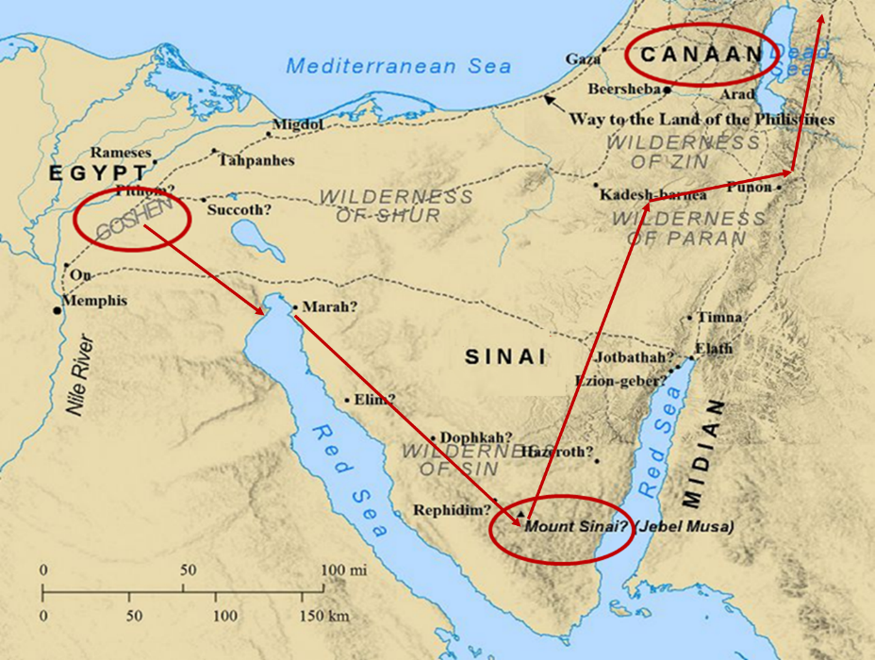

Slide 30
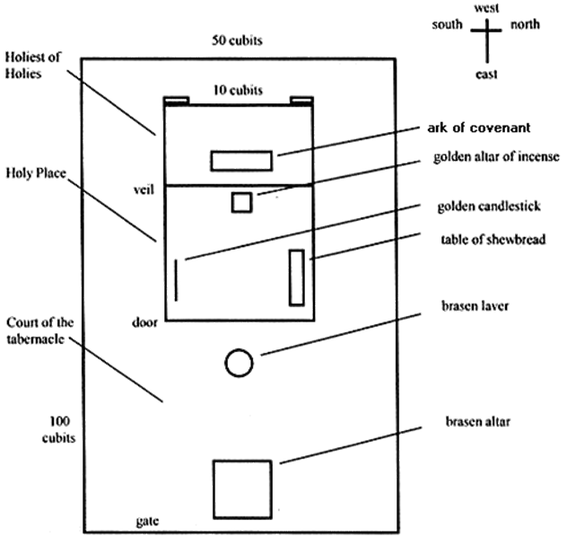
Tabernacle Diagram

Slide 31
III. Exodus 8:25-29 Pharaoh’s Concession
Pharaoh’s proposal (25)
Moses’ counter proposal (26-27)
Pharaoh’s acceptance (28)
Moses’ intention (29)

Slide 32
Exodus 8:26-27 Moses’ Counter Proposal
Reason (26)
3 days’ journey (27)

Slide 33
Exodus 8:26-27 Moses’ Counter Proposal
Reason (26)
3 days’ journey (27)

Slide 34
Dr. Ed Hindson
Hindson, E. E., & Mitchell, D. R., eds. (2010). KJV Bible Commentary for Today: The Most Up-to-Date Commentary on the Time-Honored Text of the KJV (p. 93). Thomas Nelson.
“8:26–27. Moses refused to accept this compromise, for the Hebrews’ worship would entail the sacrifice of either sheep or bulls or cows or all three, which he characterized as the abomination of the Egyptians (v. 26). The sacrifice of sheep was detestable to the Egyptians (Gen. 46:34). Bulls were considered the sacred representations of the Egyptian gods Apis and Mnevis. Cows were considered the sacred representations of their goddess Hathor. Will they not stone us? Moses was concerned that the Egyptians might consider the public sacrifice of these animals a blasphemous offense and be antagonized to a state of violence. For Moses, putting distance between the Egyptians and the Hebrews for their sacrifice was a nonnegotiable point.”

Slide 35

Daniel 9:27
“And he will make a firm covenant with the many for one week, but in the middle of the week he will put a stop to sacrifice and grain offering; and on the wing of abominations will come one who makes desolate, even until a complete destruction, one that is decreed, is poured out on the one who makes desolate.”
35

Slide 36
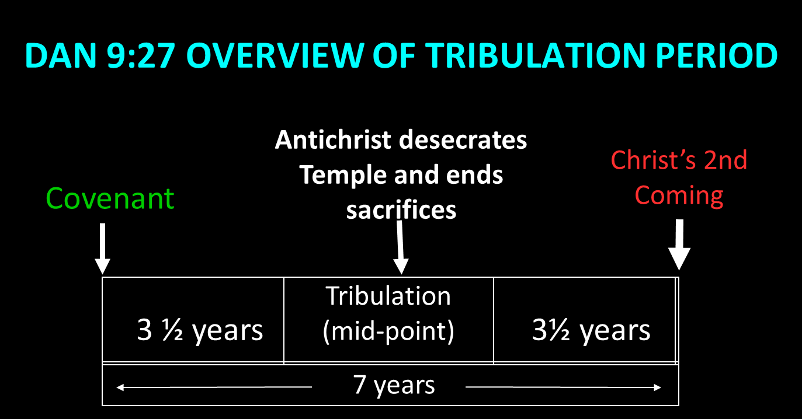

Slide 37
Exodus 8:26-27 Moses’ Counter Proposal
Reason (26)
3 days’ journey (27)

Slide 38
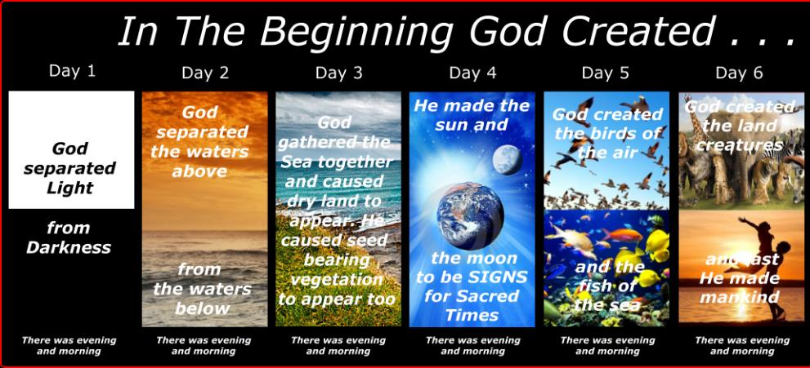
SHAPING AND POPULATING (GEN 1:1)
Day 1: | Light | Day 4: | Luminaries
Day 2: | Water, sky | Day 5: | Sea animals, birds
Day 3: | Land, vegetation | Day 6: | Land animals, man

Slide 39
III. Exodus 8:25-29 Pharaoh’s Concession
Pharaoh’s proposal (25)
Moses’ counter proposal (26-27)
Pharaoh’s acceptance (28)
Moses’ intention (29)

Slide 40
Exodus 8:28 Pharaoh’s Acceptance
Agreement (28a)
Condition (28b)

Slide 41
Exodus 8:28 Pharaoh’s Acceptance
Agreement (28a)
Condition (28b)

Slide 42
Names & Titles Demonstrating Satan’s Post-Fall, Earthly Authority (Job 1:7; 2:2; Luke 4:5-8; Rom. 8:19-22)
Prince of this world (John 12:31; 14:30; 16:11)
God of this world (2 Cor. 4:4)
Prince and power of the air (Eph. 2:2)
Who the believer wrestles with (Eph. 6:12)
Roaring lion (1 Pet. 5:8)
Whole world lies in his power (1 John 5:19)

Slide 43
Exodus 8:28 Pharaoh’s Acceptance
Agreement (28a)
Condition (28b)

Slide 44
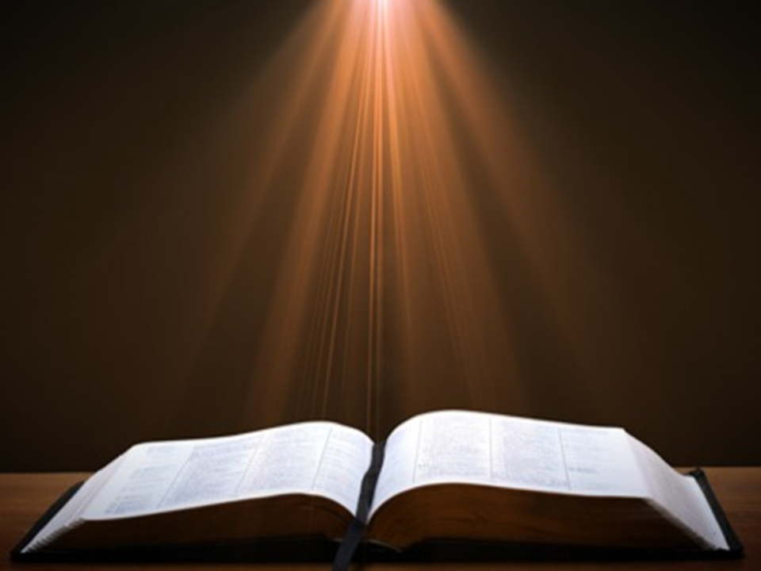
Romans 1:18–20
¹⁸ For the wrath of God is revealed from heaven against all ungodliness and unrighteousness of men who suppress the truth in unrighteousness, ¹⁹ because that which is known about God is evident within them; for God made it evident to them. ²⁰ For since the creation of the world His invisible attributes, His eternal power and divine nature, have been clearly seen, being understood through what has been made, so that they are without excuse.

Slide 45
III. Exodus 8:25-29 Pharaoh’s Concession
Pharaoh’s proposal (25)
Moses’ counter proposal (26-27)
Pharaoh’s acceptance (28)
Moses’ intention (29)

Slide 46
Exodus 8:29 Moses’ Intention
Exit (29a)
Supplication (29b)
Demand for integrity (29c)

Slide 47
Exodus 8:29 Moses’ Intention
Exit (29a)
Supplication (29b)
Demand for integrity (29c)

Slide 48
Exodus 8:29 Moses’ Intention
Exit (29a)
Supplication (29b)
Demand for integrity (29c)

Slide 49
PLAGUES’ MIRACULOUS NATURE
Moses knew about them beforehand (8:10; 9:5, 29)
Instantaneous appearance and termination
Description as “signs and wonders” (7:3)
Intensification
Timing
Accomplishment of a moral purpose (11:1)
Response they invoked from the Egyptian sorcerers (7:22; 8:18-19)
Last seven plagues did not effect the jews living in goshen (9:6)
Nile into blood affected all rivers, streams, pools, reservoirs, and vessels holding waters
Hill and Walton, A Survey of the Old Testament, 114-15

Slide 50
Exodus 8:29 Moses’ Intention
Exit (29a)
Supplication (29b)
Demand for integrity (29c)

Slide 53
Tabernacle Diagram

Slide 54
FLIES Exodus 8:20-32
God Instructs Moses (20-23)
Prophetic Fulfillment (24)
Pharaoh’s Concession (25-29)
Moses’ Response (30-32)

Slide 55
IV. Exodus 8:30-32 Moses’ Response
Exit (30a)
Supplication (30b)
God answers (31)
Pharaoh’s response (32)

Slide 56
IV. Exodus 8:30-32 Moses’ Response
Exit (30a)
Supplication (30b)
God answers (31)
Pharaoh’s response (32)

Slide 57
IV. Exodus 8:30-32 Moses’ Response
Exit (30a)
Supplication (30b)
God answers (31)
Pharaoh’s response (32)

Slide 58
IV. Exodus 8:30-32 Moses’ Response
Exit (30a)
Supplication (30b)
God answers (31)
Pharaoh’s response (32)

Slide 59
IV. Exodus 8:30-32 Moses’ Response
Exit (30a)
Supplication (30b)
God answers (31)
Pharaoh’s response (32)

Slide 60
Exodus 8:32 Pharaoh’s Response
Self hardening (32a)
Double cross (32b)

Slide 61
Exodus 8:32 Pharaoh’s Response
Self hardening (32a)
Double cross (32b)

Slide 62
Dr. Ed Hindson
Hindson, E. E., & Mitchell, D. R., eds. (2010). KJV Bible Commentary for Today: The Most Up-to-Date Commentary on the Time-Honored Text of the KJV (p. 86). Thomas Nelson.
“4:21. I will harden his heart. An expression meaning ‘to strengthen his will.’ The text identifies the heart as the location of the volition, man’s decision-making ability. On seven occasions in the narrative, God hardens Pharaoh’s heart (9:12; 10:1, 20, 27; 11:10; 14:4, 8) or foretells that He will harden Pharaoh’s heart (4:21; 7:3), and nine times in the text, Pharaoh hardens his own heart (7:13, 14, 22; 8:15, 19, 32; 9:7, 34–35). For the initial five plagues, the text registers Pharaoh as the agent of hardening. Not until the sixth plague does God participate in the confirmation of Pharaoh’s own volitional choices.”

Slide 63

Charles Ryrie Ryrie Study Bible, page 96
Exodus 4:21 - “harden his heart. Ten times it is said that Pharaoh hardened his own heart (7:13, 14, 22; 8:15, 19, 32; 9:7, 34, 35; 13:15), and 10 times that God hardened Pharaoh’s heart (4:21; 7:3; 9:12; 10:1, 20, 27; 11:10; 14:4, 8, 17). Paul uses this as an example of the inscrutable will of God and of His mercy toward men (Rom. 9:14–18). Seven times Pharaoh hardened his own heart before God first hardened it, though the prediction that God would do it preceded all.”

Slide 64
GOD HARDENING PHARAOH'S HEART
The prediction of God hardening of Pharaoh (4:21)
Pharaoh repeatedly hardening his own heart (7:13, 22; 8:15, 19, 32; 9:7)
Not until the sixth plague did God harden Pharaoh’s heart (Exod 9:12)

Slide 65
Exodus 8:32 Pharaoh’s Response
Self hardening (32a)
Double cross (32b)

Slide 66
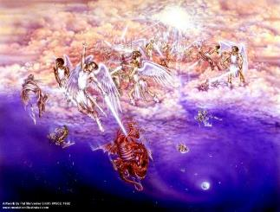
Satan as Ruler of this World
Job 1:7; 2:2
Luke 4:5-7
John 12:31; 14:30; 16:11
2 Corinthians 4:4
Ephesians 2:2
1 John 4:4; 5:19

Slide 67
Names & Titles Demonstrating Satan’s Post-Fall, Earthly Authority (Job 1:7; 2:2; Luke 4:5-8; Rom. 8:19-22)
Prince of this world (John 12:31; 14:30; 16:11)
God of this world (2 Cor. 4:4)
Prince and power of the air (Eph. 2:2)
Who the believer wrestles with (Eph. 6:12)
Roaring lion (1 Pet. 5:8)
Whole world lies in his power (1 John 5:19)

Slide 68

Romans 8:19-23
¹⁹ “For the anxious longing of the creation waits eagerly for the revealing of the sons of God. ²⁰ For the creation was subjected to futility, not willingly, but because of Him who subjected it, in hope ²¹ that the creation itself also will be set free from its slavery to corruption into the freedom of the glory of the children of God. ²² For we know that the whole creation groans and suffers the pains of childbirth together until now. ²³ And not only this, but also we ourselves, having the first fruits of the Spirit, even we ourselves groan within ourselves, waiting eagerly for our adoption as sons, the redemption of our body.”

Slide 69
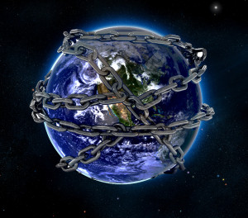

Slide 70
Conclusion

Slide 71
FLIES Exodus 8:20-32
God Instructs Moses (20-23)
Prophetic Fulfillment (24)
Pharaoh’s Concession (25-29)
Moses’ Response (30-32)

Slide 72
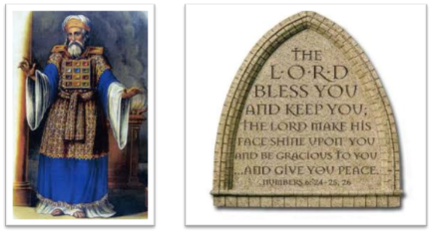
²⁴ The Lord bless you, and keep you; ²⁵ The Lord make His face shine on you, And be gracious to you; ²⁶ The Lord lift up His countenance on you, And give you peace.
Numbers 6:24–26 (NASB95)

