Slide 1
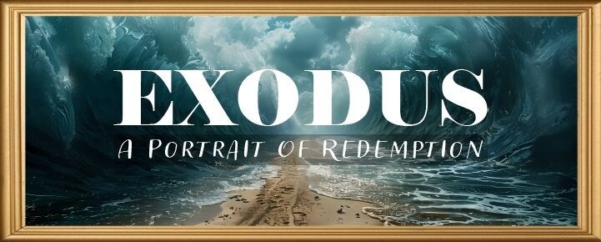


Slide 2
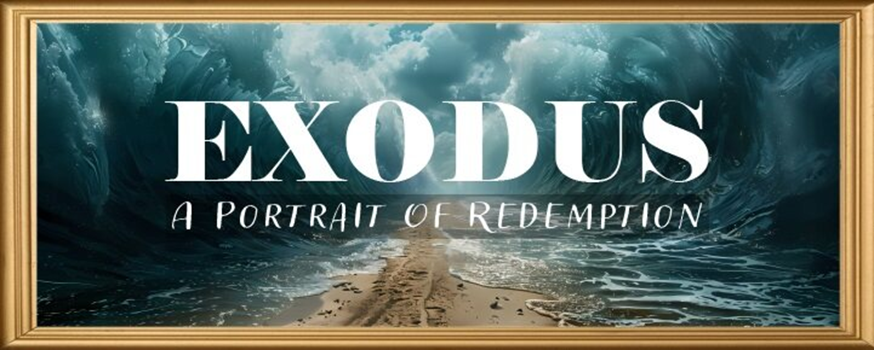
EXODUS STRUCTURE/OUTLINE
Redemption (1–18)
  Redemption (1:1–12:30)
  Liberation (12:31–15:21)
  Preservation (15:22–18:27)
Mosaic Covenant (19–40)
  Law (19–24)
  Tabernacle instructions (25–31)
  Apostasy (32–34)
  Tabernacle building (35–40)

Slide 3
REDEMPTION
(1:1–12:30)
Why redemption is necessary (Exod 1)
Development of the deliverer (Exod 2–4)
First confrontation with Pharaoh (Exod 5)
God reassures Moses (Exod 6:1–7:7)
Second confrontation with Pharaoh (Exod 7:8-13)
Plagues (Exod 7:14–12:30)

Slide 4
TEN PLAGUES REDEMPTION (7:14–12:30)
Nile to blood
Frogs
Gnats
Flies
Death of livestock
Boils
Hail
Locusts
Darkness
Death of 1st born

Slide 5
The Plagues of Egypt
NO. | DESCRIPTION | SCRIPTURE | Egyptian Deity
1. | Water to Blood | Exod. 7:14-25 | Hapi, Khnum
2. | Frogs | Exod. 8:1-15 | Heqt
3. | Gnats | Exod. 8:16-19 | Set
4. | Flies | Exod. 8:20-32 | Uatchit
5. | Disease on Cattle | Exod. 9:1-7 | Hathor, Apis
6. | Boils | Exod. 9:8-12 | Sekhmet, Serapis
7. | Hail | Exod. 9:13-35 | Seth, Nut
8. | Locusts | Exod. 10:1-20 | Seth, Nut, Osiris
9. | Darkness | Exod. 10:21-29 | Re, Horus, Atum
10. | Death of the First Born | Exod. 12:29-36 | Min, Osiris, Heqt, Isis

Slide 6
GNATS
Exodus 8:16-19
  God Instructs Moses (16)
  Moses’ & Aaron’s Obedience (17)
  Magicians’ Response (18-19a)
  Pharaoh’s Reaction (19b)

Slide 7
GNATS
Exodus 8:16-19
  God Instructs Moses (16)
  Moses’ & Aaron’s Obedience (17)
  Magicians’ Response (18-19a)
  Pharaoh’s Reaction (19b)

Slide 8
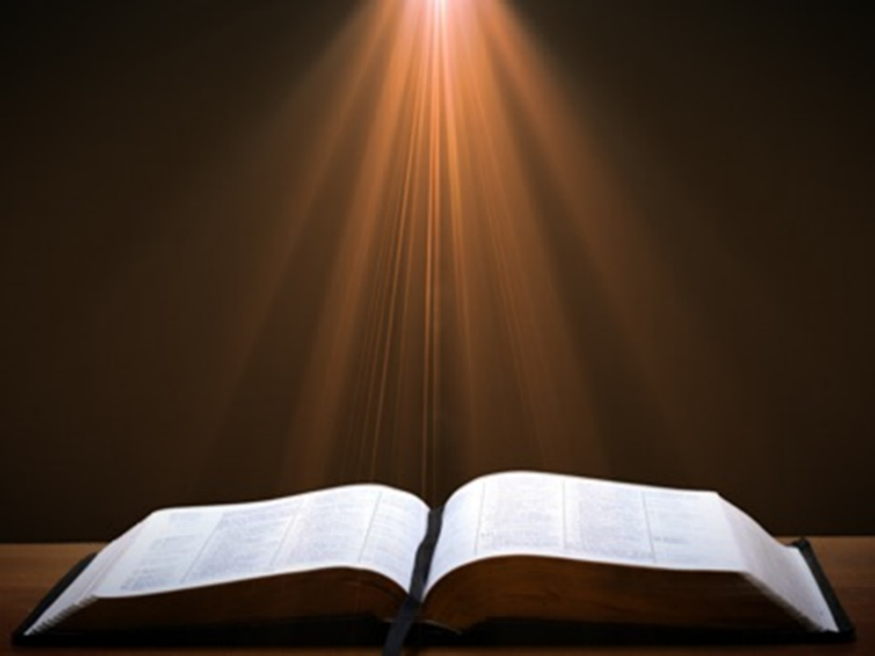
Genesis 1:1-3
“¹ In the beginning God created the heavens and the earth. ² The earth was formless and void, and darkness was over the surface of the deep, and the Spirit of God was moving over the surface of the waters. ³ Then God said, ‘Let there be light’; and there was light.”

Slide 9
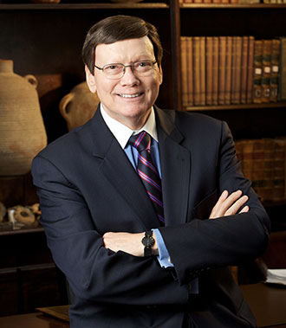
Dr. Ed Hindson
Hindson, E. E., & Mitchell, D. R., eds. (2010). King James Version Bible Commentary for Today: The Most Up-to-Date Commentary on the Time-Honored Text of the King James Version (p. 92). Thomas Nelson.
“Exactly which pesky flying insect is meant is unclear. Choices include lice, gnats, mosquitoes, or sand flies.”

Slide 10
The Plagues of Egypt
NO. | DESCRIPTION | SCRIPTURE | Egyptian Deity
1. | Water to Blood | Exod. 7:14-25 | Hapi, Khnum
2. | Frogs | Exod. 8:1-15 | Heqt
3. | Gnats | Exod. 8:16-19 | Set
4. | Flies | Exod. 8:20-32 | Uatchit
5. | Disease on Cattle | Exod. 9:1-7 | Hathor, Apis
6. | Boils | Exod. 9:8-12 | Sekhmet, Serapis
7. | Hail | Exod. 9:13-35 | Seth, Nut
8. | Locusts | Exod. 10:1-20 | Seth, Nut, Osiris
9. | Darkness | Exod. 10:21-29 | Re, Horus, Atum
10. | Death of the First Born | Exod. 12:29-36 | Min, Osiris, Heqt, Isis

Slide 11
Dr. Ed Hindson
Hindson, E. E., & Mitchell, D. R., eds. (2010). King James Version Bible Commentary for Today: The Most Up-to-Date Commentary on the Time-Honored Text of the King James Version (p. 92). Thomas Nelson.
“The Egyptian deities challenged by the third plague would have been Set, the desert god, and fly-like Uatchit, whose function was to divinely protect Egypt from insect swarms. It was also a successful swipe at the Egyptian priesthood who, concerned with maintaining ritual purity, frequently shaved themselves of all body hair to avoid lice.”

Slide 12
GNATS
Exodus 8:16-19
  God Instructs Moses (16)
  Moses’ & Aaron’s Obedience (17)
  Magicians’ Response (18-19a)
  Pharaoh’s Reaction (19b)

Slide 13
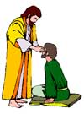
“SEVEN SIGNS” in Gospel of John
1. Changing Water into Wine | 2:11
2. Healing official’s son | 4:46-54
3. Healing an invalid at the Pool of Bethesda | 5:1-18
4. Feeding the 5,000 | 6:5-14
5. Walking on water | 6:16-21
6. Healing a blind man | 9:1-7
7. Raising dead Lazarus | 11:1-45

Slide 14
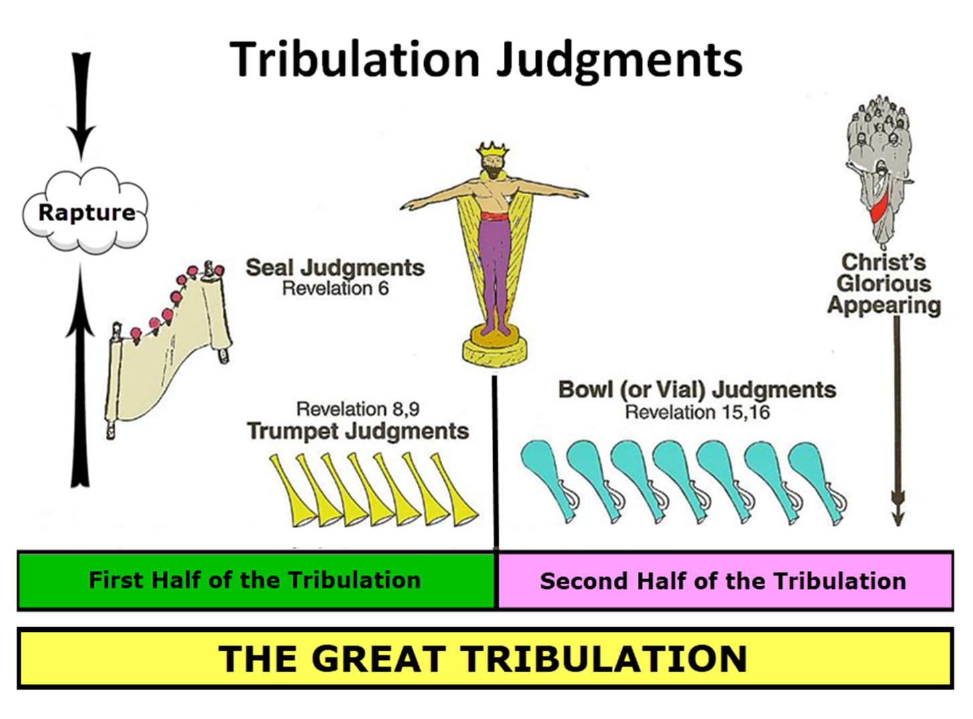

Slide 15
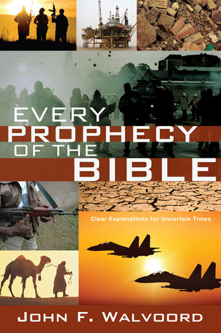

Slide 16


John 13:19; 14:29
“¹⁹ From now on I am telling you before it comes to pass, so that when it does occur, you may believe that I am He… ^{14:29} Now I have told you before it happens, so that when it happens, you may believe.”

Slide 17
What Happened to Christ’s Disciples?
Disciple | Place | Martyrdom
James the Son of Alpheus | Jerusalem | Clubbed to death
Simon the Zealot | Jerusalem | Martyred
James the Son of Zebedee | Judea (Acts 12:2) | Executed
Thaddeus | Mesopotamia | Beaten to death
Peter | Babylon, Rome | Crucified upside down
Matthew | Parthia (Tehran) | Beheaded
Notes:
109 prophecies…
Peter Stoner – SCIENCE SPEAKS, An Evaluation of Certain Christian Evidences
To fulfill just 8 prophecies =1 X 10 to the twenty-eighth power!
Can we visualize this with an illustration? Suppose we took an atheistic professor, blindfolded him and covered the state of Texas two feet deep with silver dollars. Then we put a check on one of those silver dollars and mixed them up. The odds of one person fulfilling just these eight prophecies would be the same as this atheistic professor selecting the silver dollar upon which we have placed a check, in his first try.
https://www.bereanpublishers.com/the-odds-of-eight-messianic-prophecies-coming-true/

Slide 18
What Happened to Christ’s Disciples?
Disciple | Place | Martyrdom
John | Asia Minor, Patmos, Ephesus | Fried in boiling oil
Philip | E. Turkey | Tortured & crucified
Thomas | India | Speared
Bartholomew | India | Flayed & crucified
Andrew | Ukraine, Russia, Greece | Hanged
Notes:
109 prophecies…
Peter Stoner – SCIENCE SPEAKS, An Evaluation of Certain Christian Evidences
To fulfill just 8 prophecies =1 X 10 to the twenty-eighth power!
Can we visualize this with an illustration? Suppose we took an atheistic professor, blindfolded him and covered the state of Texas two feet deep with silver dollars. Then we put a check on one of those silver dollars and mixed them up. The odds of one person fulfilling just these eight prophecies would be the same as this atheistic professor selecting the silver dollar upon which we have placed a check, in his first try.
https://www.bereanpublishers.com/the-odds-of-eight-messianic-prophecies-coming-true/

Slide 19
GNATS
Exodus 8:16-19
  God Instructs Moses (16)
  Moses’ & Aaron’s Obedience (17)
  Magicians’ Response (18-19a)
  Pharaoh’s Reaction (19b)

Slide 20
III. Exodus 8:16-19
Magicians’ Response
    Attempt (18)
    Conclusion (19a)

Slide 21
III. Exodus 8:16-19
Magicians’ Response
    Attempt (18)
    Conclusion (19a)

Slide 22
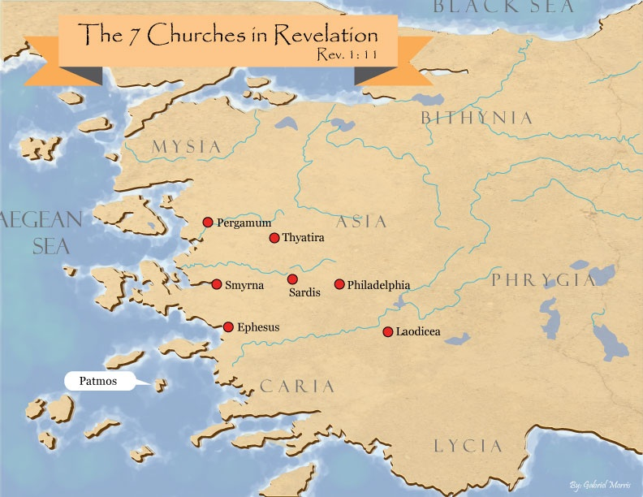
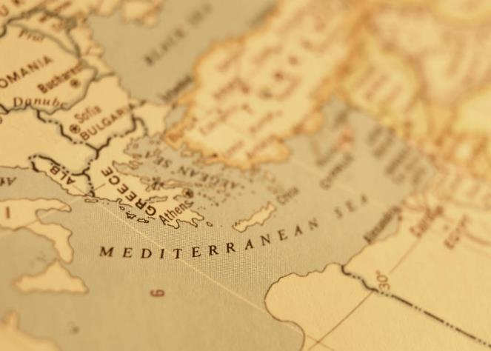

Slide 23

Satanic/Demonic Miracles
Exod. 7–8
Deut. 13:1-3
Job 1:12-19; 2:7-8
1 Sam. 28?
Matt. 7:21-23; 24:24
Luke 4:5
Acts 8:9; 16:16
Gal. 1:6-9
2 Thess. 2:9
2 Cor. 11:14
Rev. 13:3, 13, 15; 16:13-14

Slide 24
TEN PLAGUES REDEMPTION (7:14–12:30)
Nile to blood
Frogs
Gnats
Flies
Death of livestock
Boils
Hail
Locusts
Darkness
Death of 1st born

Slide 25
The Plagues of Egypt
NO. | DESCRIPTION | SCRIPTURE | Egyptian Deity
1. | Water to Blood | Exod. 7:14-25 | Hapi, Khnum
2. | Frogs | Exod. 8:1-15 | Heqt
3. | Gnats | Exod. 8:16-19 | Set
4. | Flies | Exod. 8:20-32 | Uatchit
5. | Disease on Cattle | Exod. 9:1-7 | Hathor, Apis
6. | Boils | Exod. 9:8-12 | Sekhmet, Serapis
7. | Hail | Exod. 9:13-35 | Seth, Nut
8. | Locusts | Exod. 10:1-20 | Seth, Nut, Osiris
9. | Darkness | Exod. 10:21-29 | Re, Horus, Atum
10. | Death of the First Born | Exod. 12:29-36 | Min, Osiris, Heqt, Isis

Slide 26
Dr. Ed Hindson
Hindson, E. E., & Mitchell, D. R., eds. (2010). King James Version Bible Commentary for Today: The Most Up-to-Date Commentary on the Time-Honored Text of the King James Version (p. 92). Thomas Nelson.
“Again, the question may be posed why they would attempt to create more lice (or gnats, etc.) instead of seeking to exercise some manner of divine fumigation power.”

Slide 27

Ezekiel 28:13, 15
¹³ “You were in Eden, the garden of God; Every precious stone was your covering: The ruby, the topaz and the diamond; The beryl, the onyx and the jasper; The lapis lazuli, the turquoise and the emerald; And the gold, the workmanship of your settings and sockets, Was in you. On the day that you were created They were prepared… ¹⁵ “You were blameless in your ways From the day you were created Until unrighteousness was found in you.

Slide 28
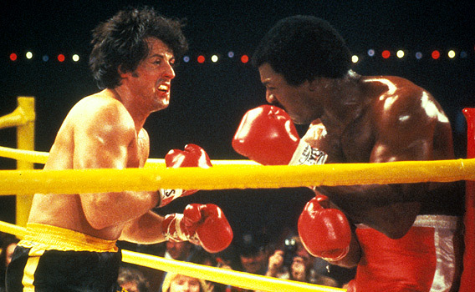

Slide 29
Genesis 1:1-3
“¹ In the beginning God created the heavens and the earth. ² The earth was formless and void, and darkness was over the surface of the deep, and the Spirit of God was moving over the surface of the waters. ³ Then God said, ‘Let there be light’; and there was light.”

Slide 30
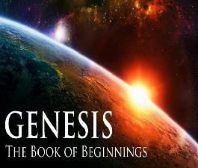
Refutation of Man’s Philosophies
(Gen 1:1)
Atheism – God created (Ps. 14:1)
Pantheism – God is transcendent over creation
Polytheism – One God created (Deut. 6:4; Isa 43:11; 44:6; 45:5)
Materialism – Matter began
Dualism – God alone created (Ezek. 28:13, 15)
Humanism – God rather than man created
Naturalism – God created
Morris, Genesis Record, 38

Slide 31
III. Exodus 8:16-19
Magicians’ Response
    Attempt (18)
    Conclusion (19a)

Slide 32
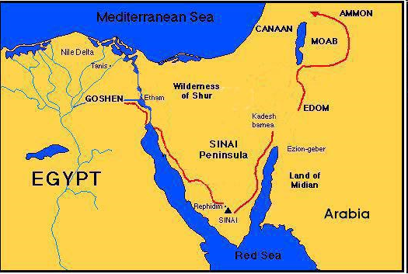

Slide 33
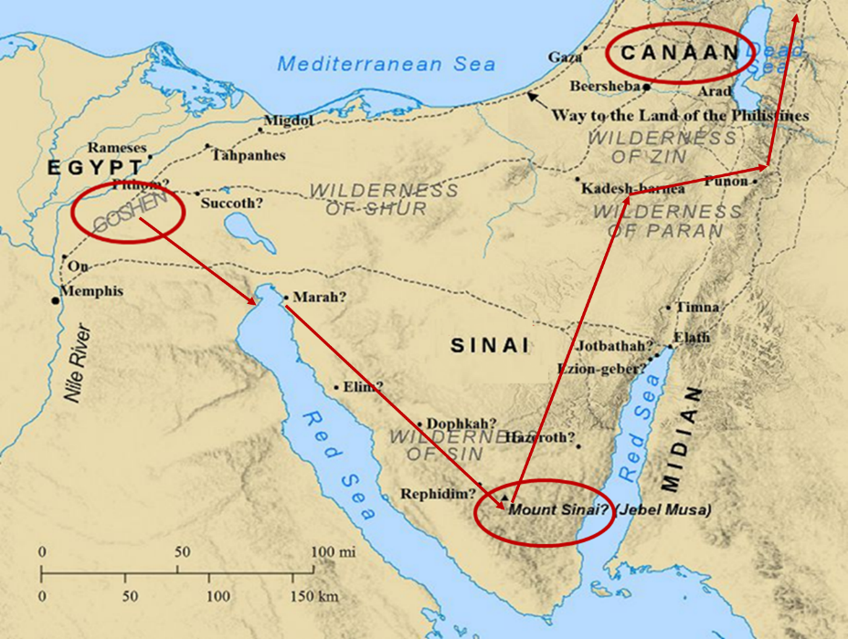

Slide 34

John 1:14
“And the Word became flesh, and dwelt among us, and we saw His glory, glory as of the only begotten [monogenēs] from the Father, full of grace and truth.”

Slide 35
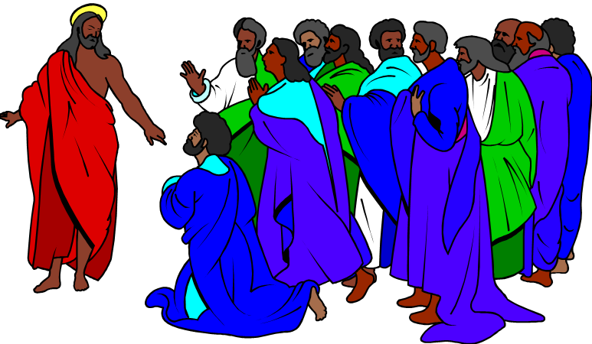
Christ's Resurrection Attested to by Eyewitnesses
(1 Corinthians 15:5-11)
Cephas (5a)
The twelve (5b)
The five hundred (6)
James (7a)
The rest of the apostles (7b)
Paul (8-11)

Slide 36
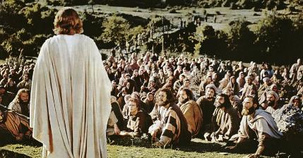
1 Corinthians 15:6-7
“⁶ After that He appeared to more than five hundred brethren at one time, most of whom remain until now, but some have fallen asleep; ⁷ then He appeared to James, then to all the apostles…”

Slide 37
GNATS
Exodus 8:16-19
  God Instructs Moses (16)
  Moses’ & Aaron’s Obedience (17)
  Magicians’ Response (18-19a)
  Pharaoh’s Reaction (19b)

Slide 38
Dr. Ed Hindson
Hindson, E. E., & Mitchell, D. R., eds. (2010). King James Version Bible Commentary for Today: The Most Up-to-Date Commentary on the Time-Honored Text of the King James Version (p. 86). Thomas Nelson.
“4:21. I will harden his heart. An expression meaning ‘to strengthen his will.’ The text identifies the heart as the location of the volition, man’s decision-making ability. On seven occasions in the narrative, God hardens Pharaoh’s heart (9:12; 10:1, 20, 27; 11:10; 14:4, 8) or foretells that He will harden Pharaoh’s heart (4:21; 7:3), and nine times in the text, Pharaoh hardens his own heart (7:13, 14, 22; 8:15, 19, 32; 9:7, 34–35). For the initial five plagues, the text registers Pharaoh as the agent of hardening. Not until the sixth plague does God participate in the confirmation of Pharaoh’s own volitional choices.”

Slide 39

Charles Ryrie
Ryrie Study Bible, page 96
Exodus 4:21 - “harden his heart. Ten times it is said that Pharaoh hardened his own heart (7:13, 14, 22; 8:15, 19, 32; 9:7, 34, 35; 13:15), and 10 times that God hardened Pharaoh’s heart (4:21; 7:3; 9:12; 10:1, 20, 27; 11:10; 14:4, 8, 17). Paul uses this as an example of the inscrutable will of God and of His mercy toward men (Rom. 9:14–18). Seven times Pharaoh hardened his own heart before God first hardened it, though the prediction that God would do it preceded all.”

Slide 40
GOD HARDENING PHARAOH'S HEART
The prediction of God hardening of Pharaoh (4:21)
Pharaoh repeatedly hardening his own heart (7:13, 22; 8:15, 19, 32; 9:7)
Not until the sixth plague did God harden Pharaoh’s heart (Exod 9:12)

Slide 41
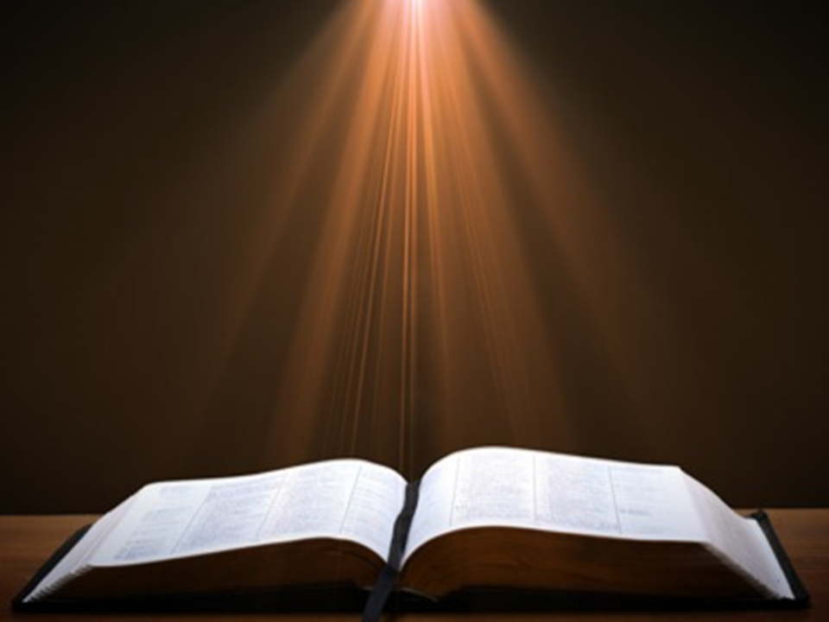
Romans 1:18–20
¹⁸ For the wrath of God is revealed from heaven against all ungodliness and unrighteousness of men who suppress the truth in unrighteousness, ¹⁹ because that which is known about God is evident within them; for God made it evident to them. ²⁰ For since the creation of the world His invisible attributes, His eternal power and divine nature, have been clearly seen, being understood through what has been made, so that they are without excuse.

Slide 42
Conclusion

Slide 43
GNATS
Exodus 8:16-19
  God Instructs Moses (16)
  Moses’ & Aaron’s Obedience (17)
  Magicians’ Response (18-19a)
  Pharaoh’s Reaction (19b)

Slide 44
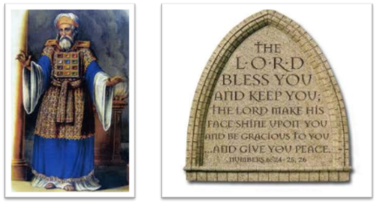
²⁴ The Lord bless you, and keep you; ²⁵ The Lord make His face shine on you, And be gracious to you; ²⁶ The Lord lift up His countenance on you, And give you peace.
Numbers 6:24–26 (NASB95)

